Slide 1


1st STFC_DAE WP1 virtual Meeting

Slide 2
Thin Film deposition and Characterization system in ASTeC

Slide 3
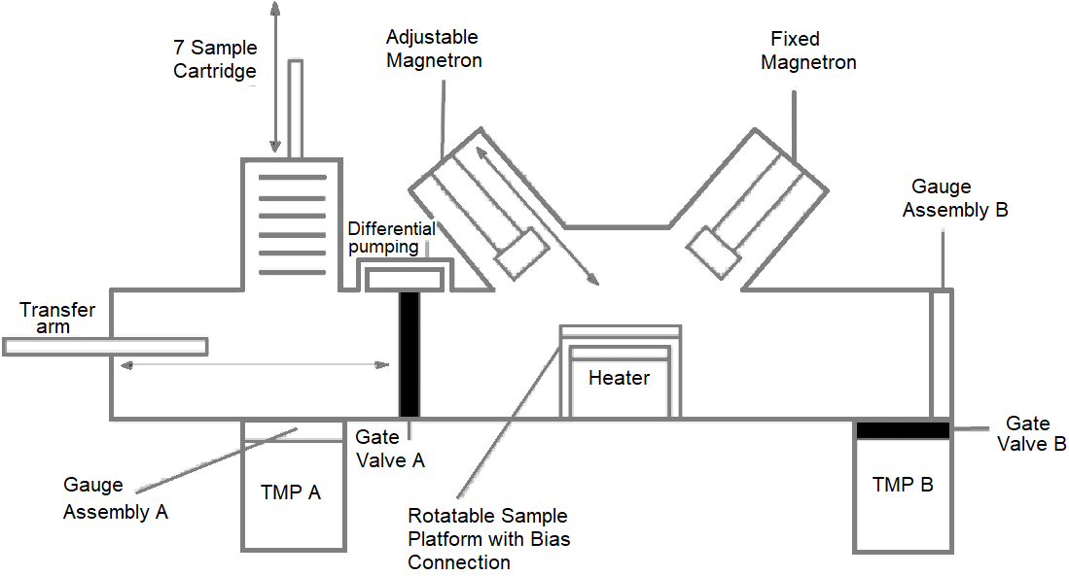
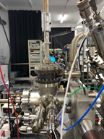
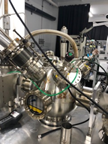
Co-deposition UHV deposition facility
It is UHV PVD deposition system
It has two chambers, load lock and deposition
The substrate can be heated up to 700 C
The substrate can be both DC and RF biased
It has three to four concentric magnetron
They can be arranged in balance and unbalanced
The deposition pressure is controlled by capacitance manometer gauge
It takes flat sample up to 12 cm diameter disk maximum
The load-lock can store up to seven samples.
Pumped by turbo pump and scroll pump for backing.
It is equipped with differential pumped RGA to measure residual gas analysis during deposition.

Slide 4
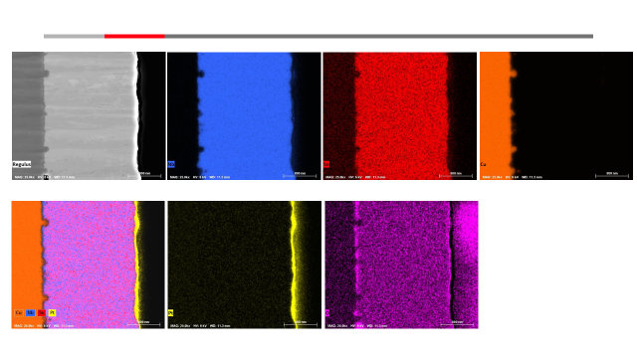
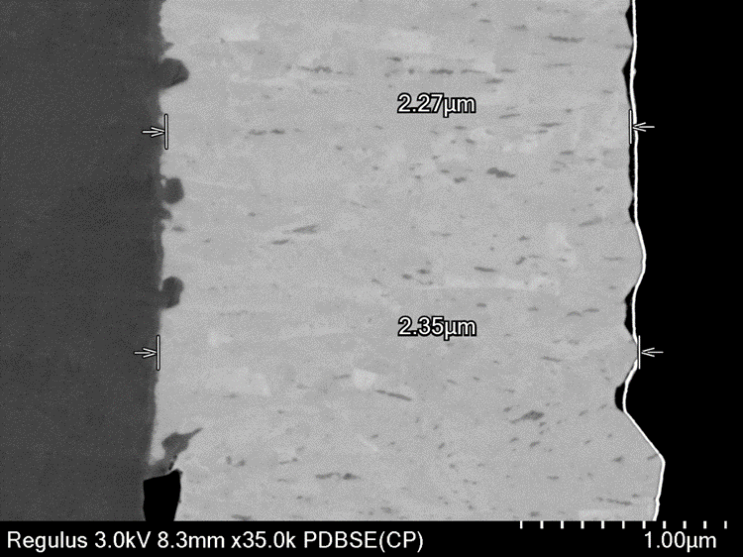
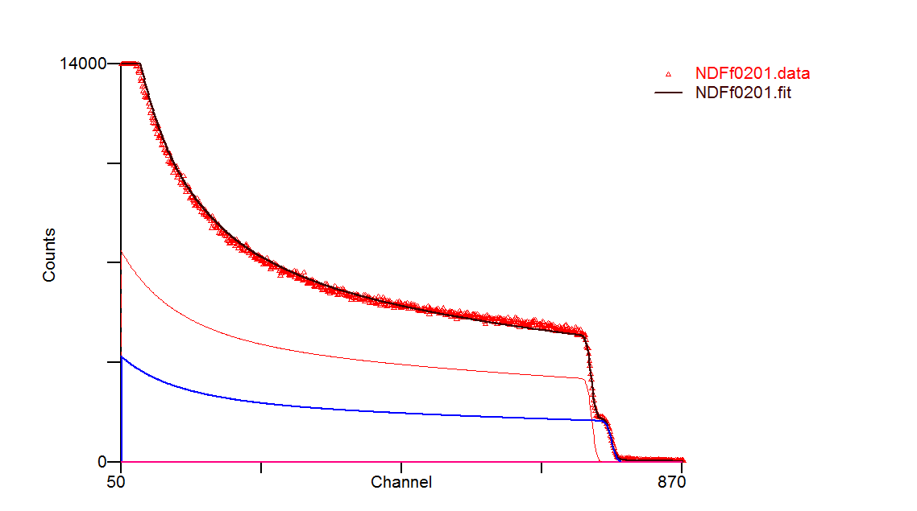
Cu (EP)LNL / Nb₃Sn (single layer) deposited at 650C
The Tc was determined to be between 17.75K (on sapphire) and 17.5 on copper
First Ben is estimated to be 50mT and 140mT deposited on Cu and Sapphire respectively, and H_{C2} above 16 T.
An interesting results which gives the opportunity of direct deposition of copper cavity rather than Niobium cavity.
Film thickness of 2.5 Microns
Layer t (1e15at/cm2) t (nm) r(1e22at/cm3) Nb Sn Al O
1 7606.631 1489.817 5.106 75.0000 25.0000 0.0000 0.0000
2 821647.625 69631.156 11.800 0.0000 0.0000 40.0000 60.0000
Notes:
There are area that seems to be Sn deficient where there are dark contrast spots.
The Tc was determined to be between 17.75K (on sapphire) and 17.5 on copper
the A15 stoichiometry was confirm by Rutherford Backscattering
First flux entry Ben is estimated to be 50mT and 140mT deposited on Cu and Sapphire respectively, and H_{C2} above 16 T.
An interesting results which gives the opportunity of direct deposition of copper cavity rather than Niobium cavity.

Slide 5
NbTi and NbTiN Single layer
For both system the superconducting phase only materialises at high Temperature.
The higher the temperature the higher Tc, ranging from 14 K to 17 K.
The best Tc and hysteresis was found to be on Cu substrate.
Can be synthesised quite easily with both alloy target and concurrent single elemental target.
Both RBS and EDS showed good compositional uniformity for all the film.
The XRD matched well with the published data with lattice parameter of 4.326 A and grain size of 29 nm.
Notes:
For both system the superconducting phase only materialises at high Temperature.
The higher the temperature the higher Tc, ranging from 14 K to 17 K.
The best Tc and hysteresis was found to be on Cu substrate.
Can be synthesised quite easily with both alloy target and concurrent single elemental target.
Both RBS and EDS showed good compositional uniformity for all the film.
The XRD matched well with the published data with lattice parameter of 4.326 A and grain size of 29 nm.

Slide 6
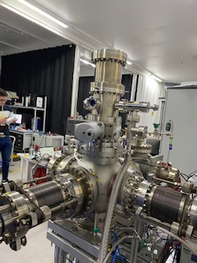
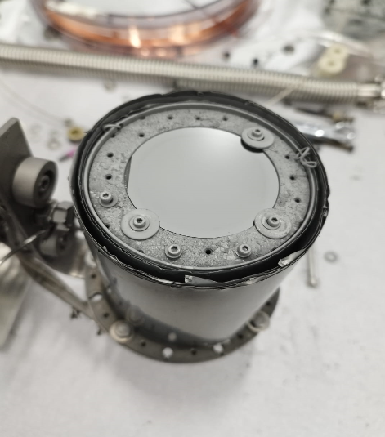
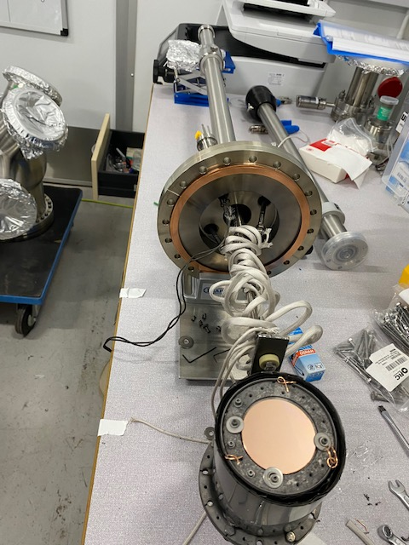
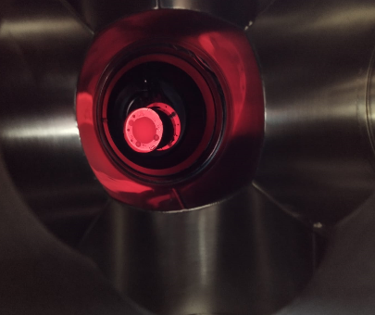
PVD deposition for QPR sample:
The deposition chamber comprises a 12 inch diameter spherical chamber with 6 ports and an adjoining six way cross piece which houses vacuum gauges and two turbo-molecular pumps (TMP).
Three 3 inch UHV magnetron is attached through a z drive to three of the port. The z drive determines the distance between the substrate and the magnetron.
. The substrate in this case is QPR sample that can be heated up to 800 C via five-240W halogen lamps
The QPR sample is attached to a magnetic coupled sample transfer drive that can rotate facing each magnetron at a time.
Pressure during deposition is typically 10⁻³ mbar and is set by adjusting the flow rate through the mass flow controller, with a constant pumping speed, until the desired pressure is read from the Pirani gauge

Slide 7
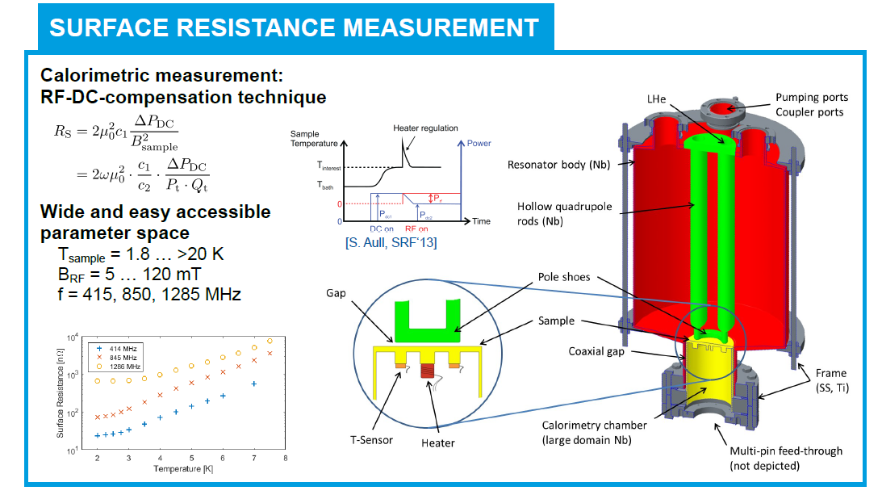

Slide 8
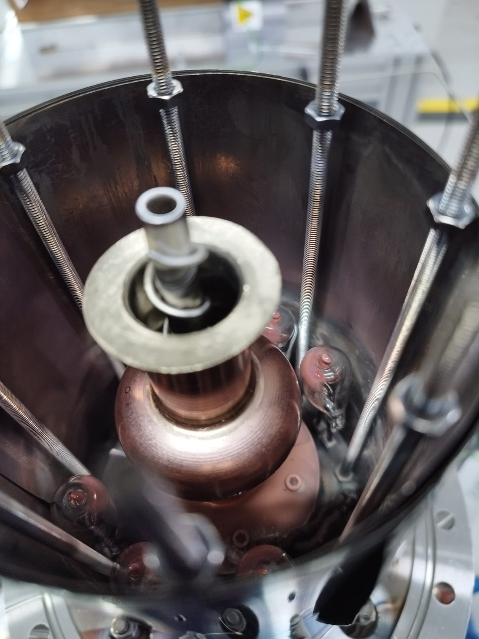
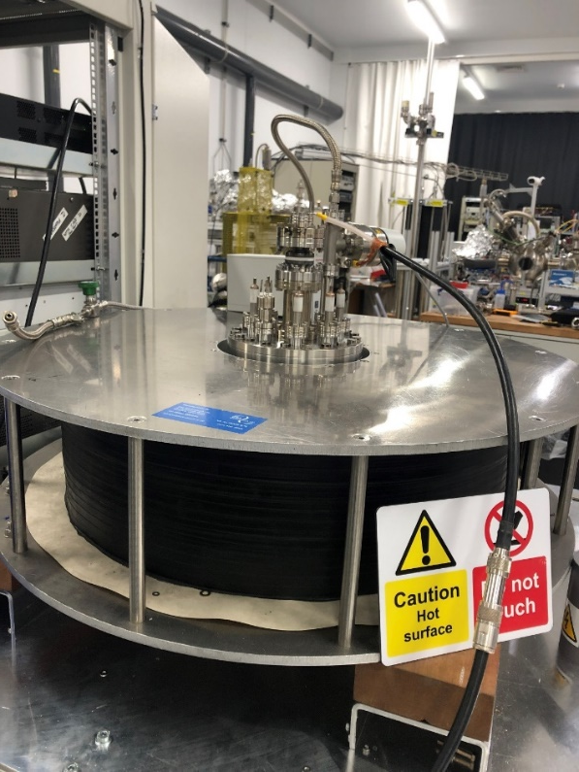
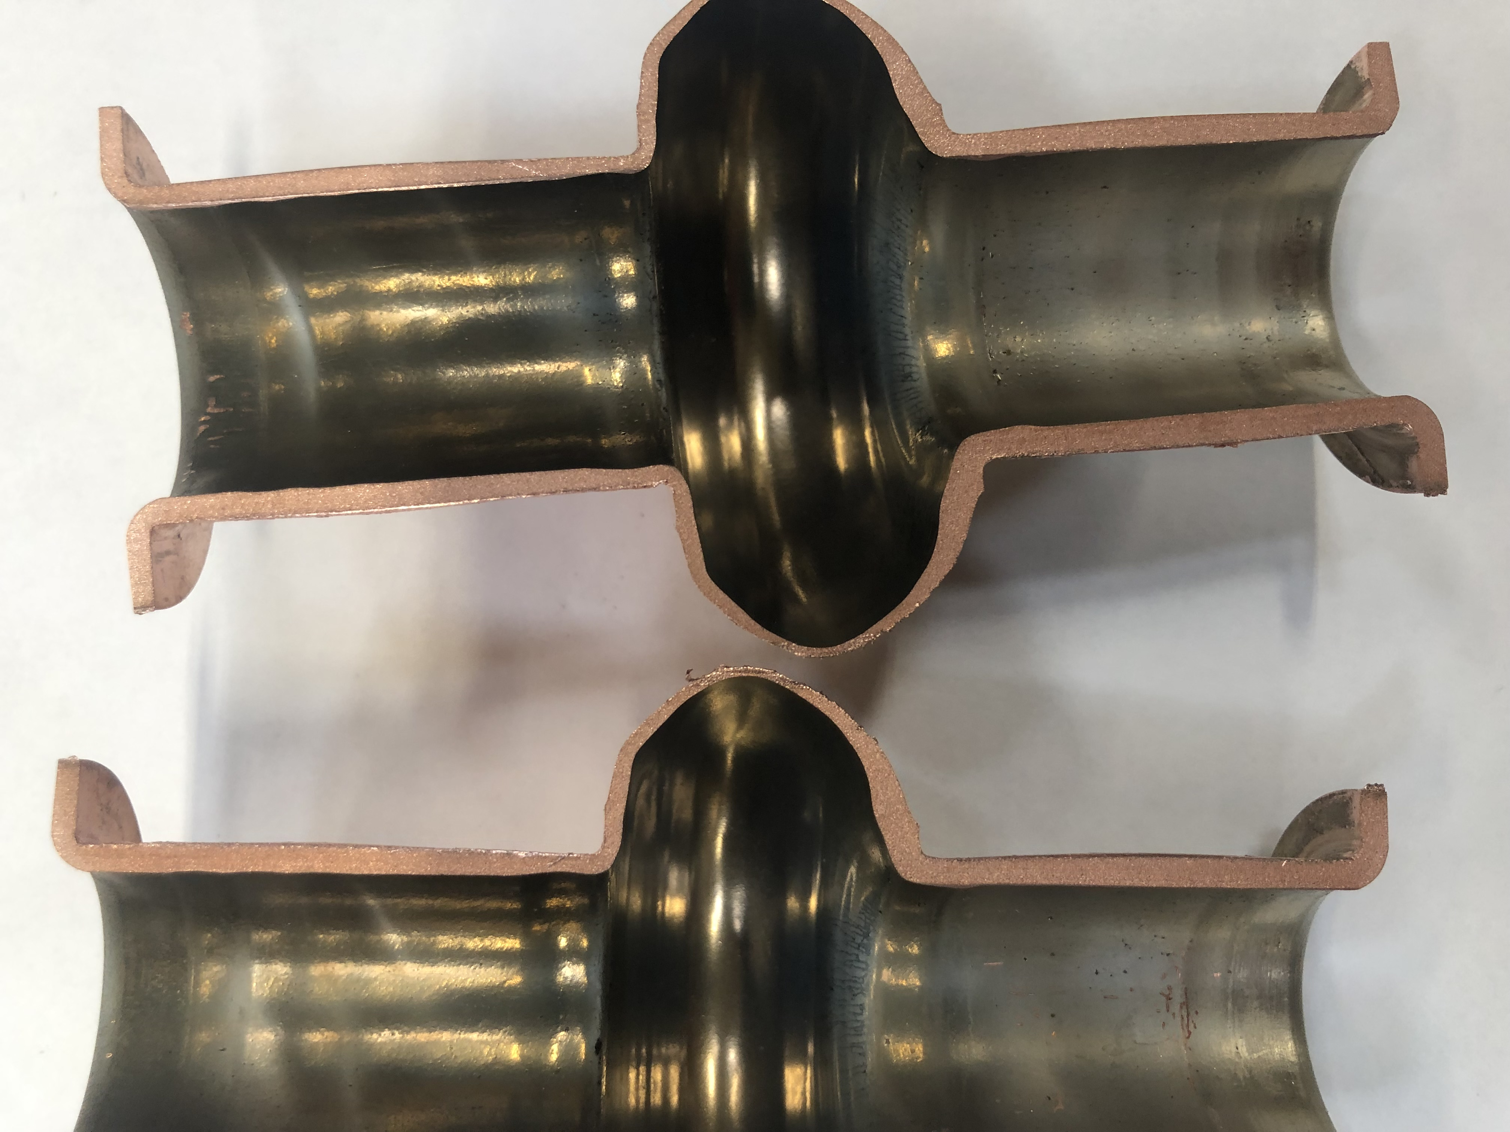
6 GHz cavity PVD deposition
The facility is comprised of 8 inch flange that supports target in form of a rod or tube placed in the centre.
The sample, which in this case is 6 GHz copper cavity, is placed over the target.
The latter is surrounded by six-240W halogen bulb that in turn is covered by a several layer of 0.5 mm thick SS foil as heat shield.
A temperture of 700 C can be achieved without any plasma, and during deposition, the temperature of the cavity can reach up to 900 C
An external coil capable of producing magnetic field of up 800 gauss, provides the magnetic field for the magnetron assembly. The double wall deposition chamber can be cooled by pumping water in the channel.

Slide 9
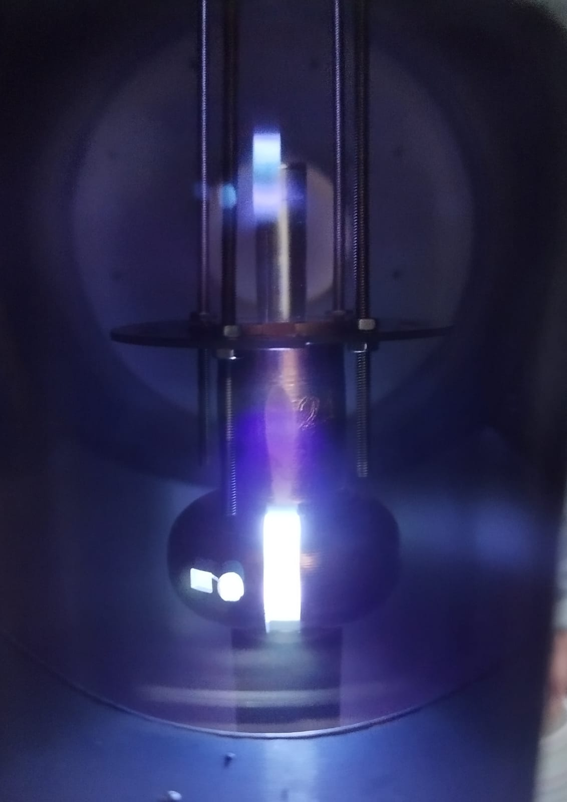
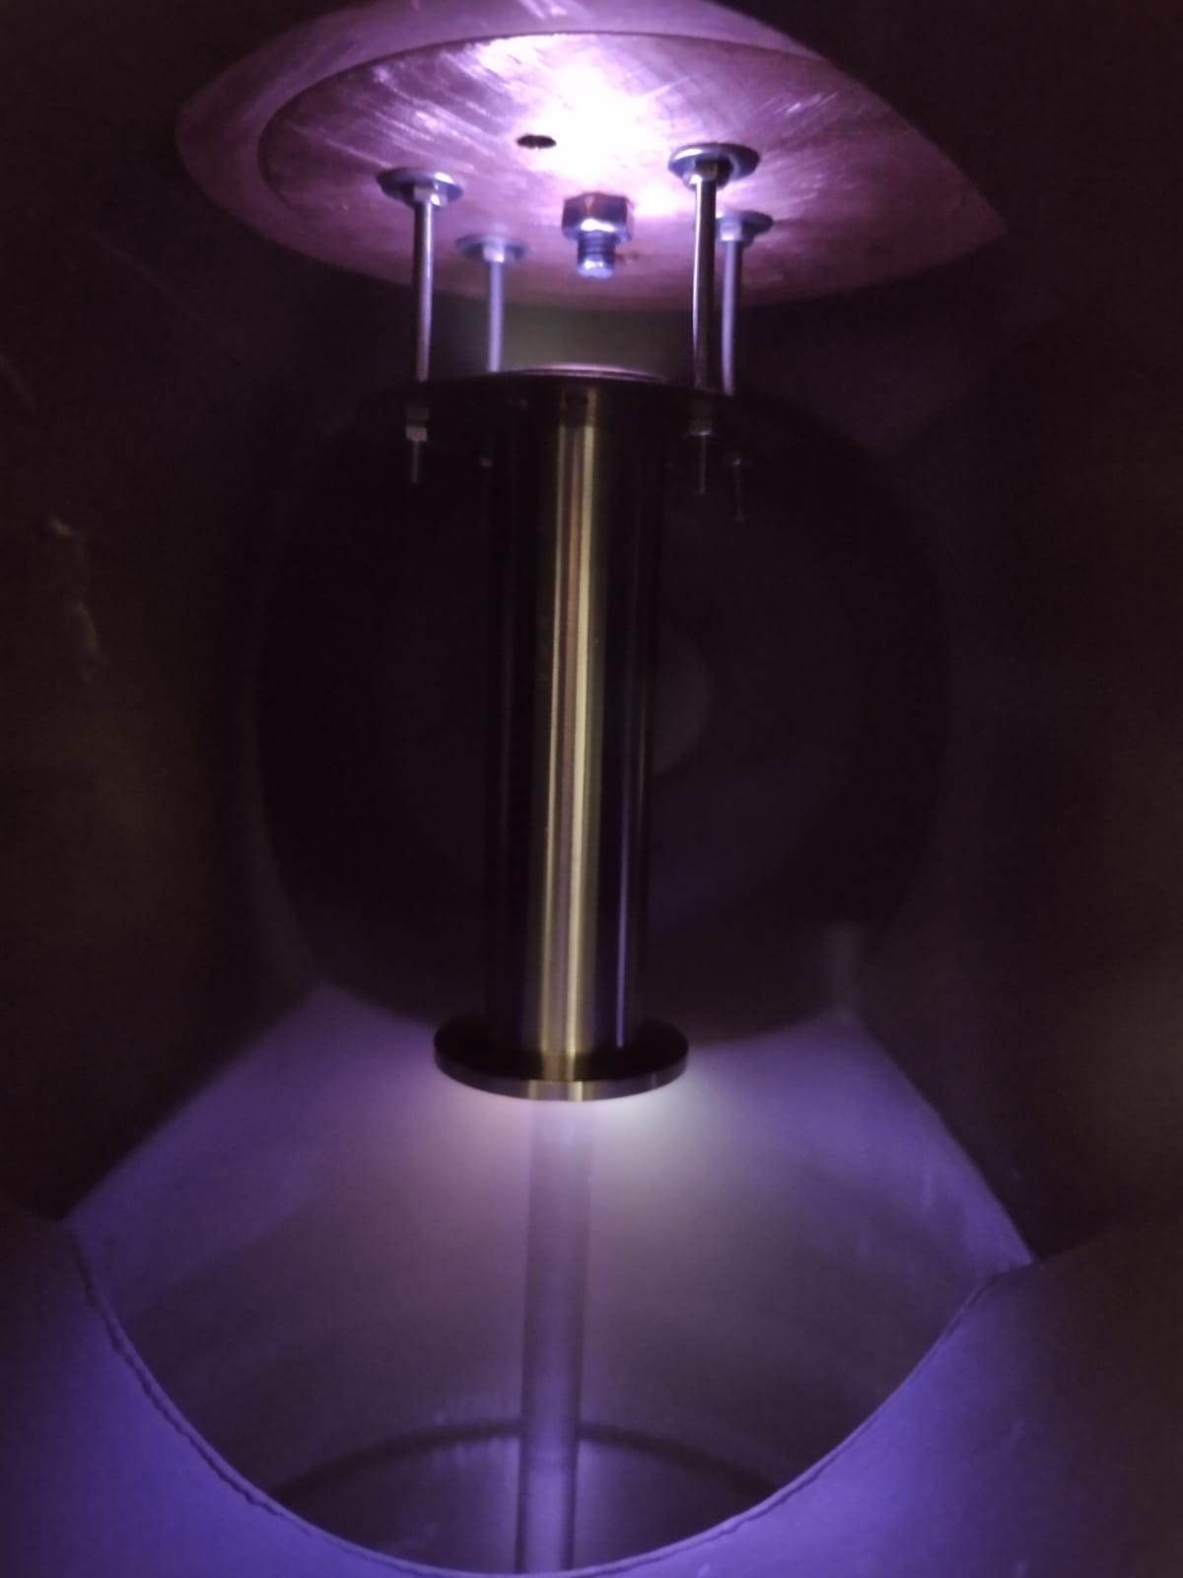
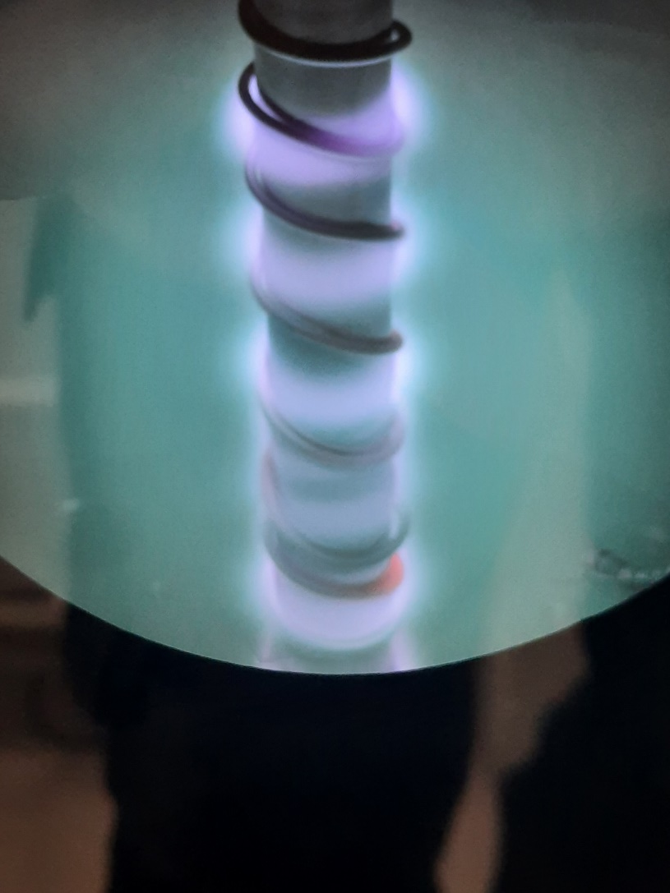
Nb/NbTiN Using Permanent Magnet Magnetron
Close cavity
For A15 and B1 superconducting deposition
Tube

Slide 10
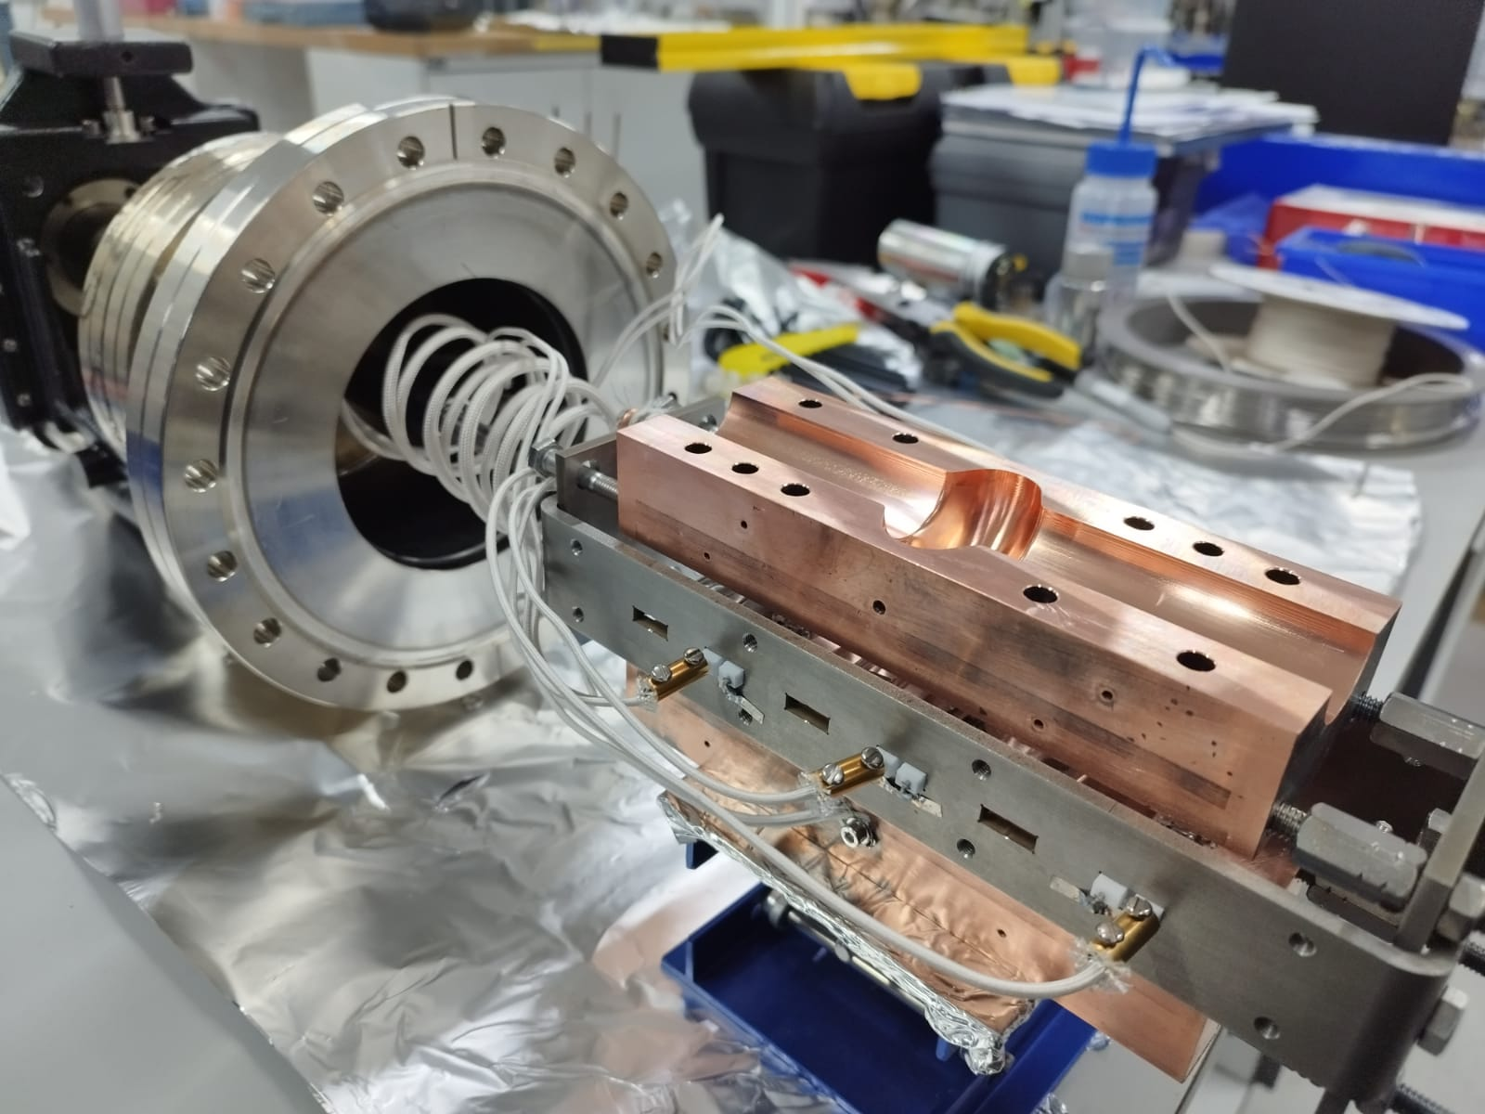
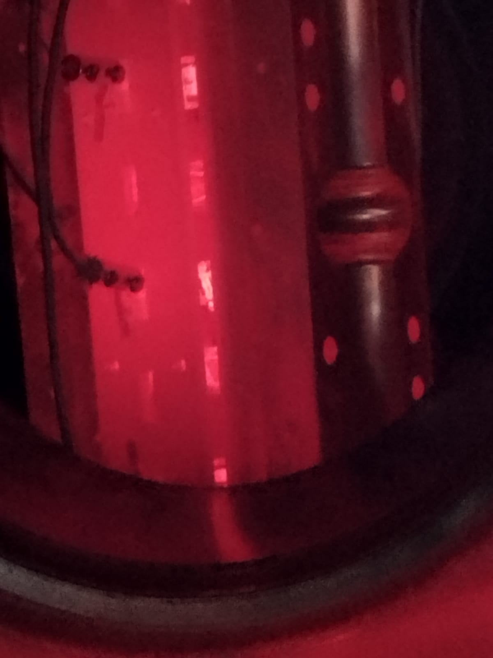
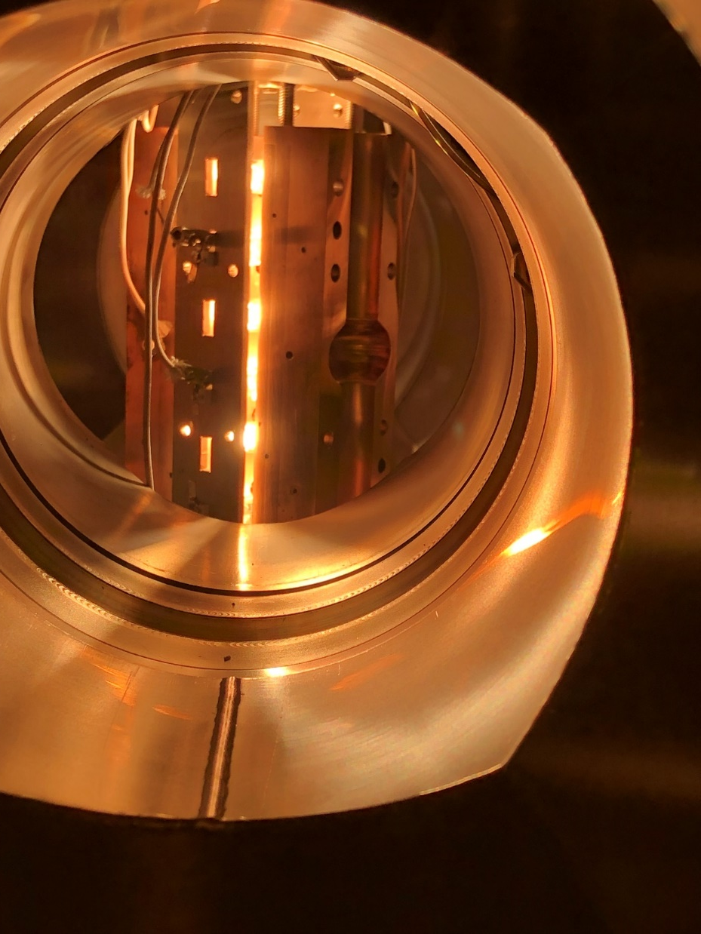
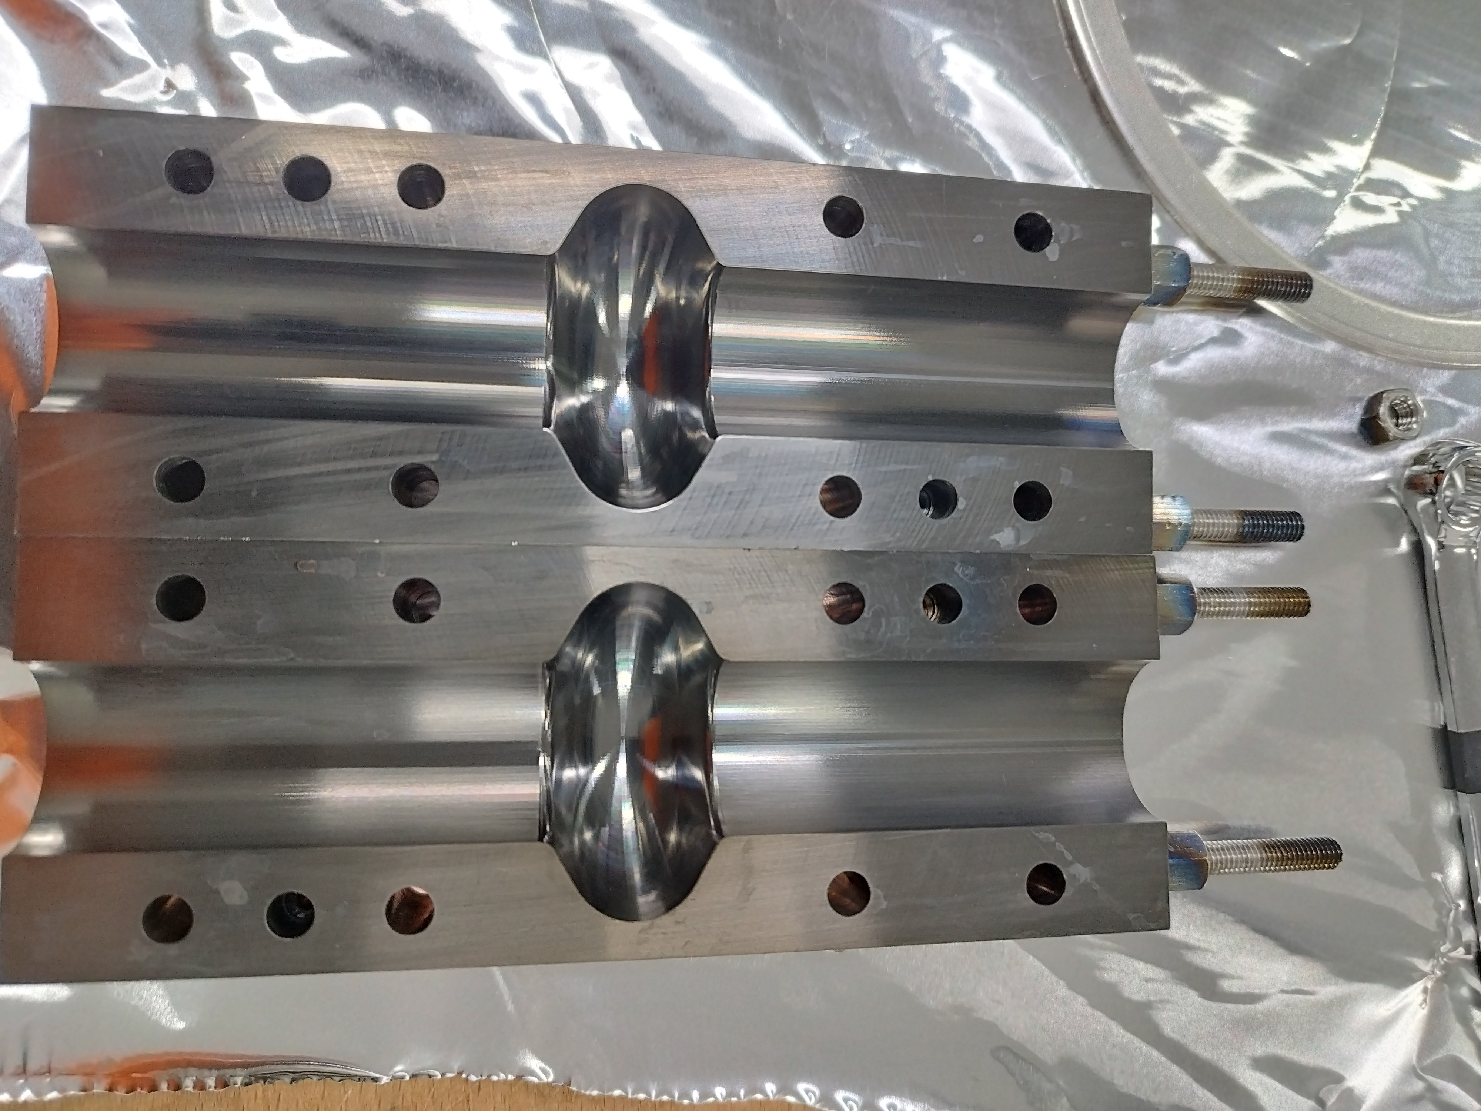
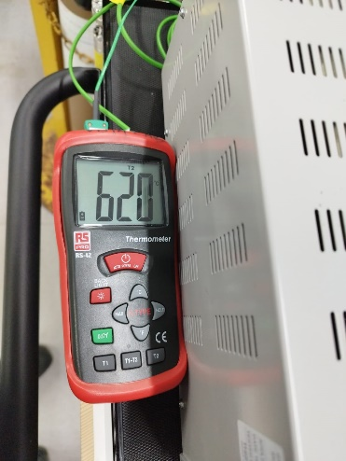
6 GHz Open Cavity Heating Stage
Without any heat shield the cavity temperature reaches to 600 C

Slide 11
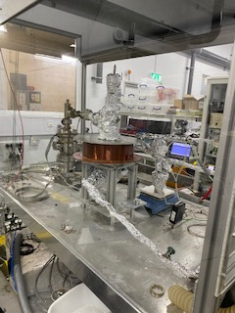
CVD/PECVD reactor development
The Mg sputtering target is confined within a stainless-steel metallic cylinder, which serves as the reaction chamber.
The metallic cylinder in turn is surrounded by a solenoid coil powered by a DC power supply to provide a uniform magnetic field.
One gas line is connected from the base of the substrate chamber to introduce H2 gas to initiate the precursor decomposition reaction within the chamber.
Another gas line is connected to bubbler containing a the precursor with Ar gas as carrier.
Both Ar and H2 are purified through SEAS purifier system.
Normally BBr₃ reacts with H₂ to liberate B and HBr at elevated temperatures.
In HPVCVD the Ar Plasma decomposes BBr₃ in presence of H atoms to liberate B atomic atoms
This is followed by chemical reaction between MG and B and ultimate deposition of MgB₂ on substrate.

Slide 12
Chemical Reaction
Images of Plasma plume and samples (i) purple colour of Ar plasma, (ii) whitish colour plasma after introduction of BBr3, (iii) Pristine Cu film, and (iv) Cu film after deposition of MgB2.
X-ray diffraction spectra of MgB2 film deposited on Cu film. Inset: X-ray diffraction spectra of commercial MgB2 powder.
Notes:
Once a stable plasma was established, BBr3 was introduced into the chamber by slowly opening the bubbler inlet and outlet
while closing the bypass line. The BBr3 flow into the chamber was controlled using the leak valve. Deposition was carried out for a total duration of 30 minutes wherein
the entire precursor was exhausted. At an Ar flow rate of 6 sccm, the precursor (BBr3) flow rate was estimated to be 60 sccm.
The deposited MgB2 films were subsequently annealed at 800 0C for 120 minutes, with the final temperature achieved gradually
at a heating rate of 100C/min. The annealing was carried out in a cylindrical heating furnace maintained at a pressure of 1.0 x 10-2 mbar.
Three MgB2 phase diffraction peaks were observed at 2θ=~25.6o, 43.9o and 53.0o corresponding to (001) (101) and (002) planes
In comparison, commercial MgB2 powder showed distinct diffraction peaks at 2θ = 33.6o, 42.6o, 52.1o, 60.1o, 62.7o and 76.40 corresponding to (100), (101), (002), (110) (102) and (201) planes, respectively

Slide 13
MgB2 results
N. Mizra, R.Valizadeh, V. Kumar Adv. Mater. Lett. 2020, 11(11), 20111574
Fig. 5. Zero-field-cooled (ZFC) magnetic moments vs. temperature curve
of MgB2 film deposited on Cu measured in 100 Oe DC magnetic field.
SEM micrographs (a) Pristine Cu film (Magnification=3200x), (b) Cu film after deposition of MgB2 (Magnification=3200x), (c) Cu film after deposition of MgB2 (Magnification=6400x) (d) EDX plot of MgB2 deposited on Cu film.
Magnetic moment vs. Magnetic field (M-H) hysteresis loop for MgB2 film deposited on Cu (3D) measured in a perpendicular field between +4000 Oe and -4000 Oe at 4.2 K.

Slide 14
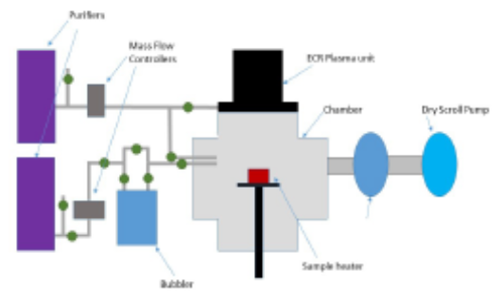
CVD/PECVD reactor development
The viewport is removed to introduce and remove samples.
A Pfeiﬀer TMH 260 C Fomblin turbo molecular pump, capable of pumping 260 l/s, makes the pumping array.
An an Edwards EM 18 sealed rotary vane oil pump, backs the turbo molecular pump.
A ﬁlter is placed between the turbo molecular pump and the backing pump to reduce malfunctioning and damaging the pump.
The outlet of the backing pump and the entire system is connected to an COSSH extraction system, to prevent any reactive gases to escape into the lab.
The gas lines, the chamber walls and the pumping bellows are all wrapped in heater tapes and kept at 10 ◦C above the bubbler temperature at all times.
This is to reduce the quantity of precursor condensing in the pipes, leading to clogs, and on the chamber walls.
The top DN160CF ﬂange has the ECR plasma unit connected to it. The carrier gas line (argon) and the co-reagent gas line (hydrogen) are connected to two separate SAES getter puriﬁers to reduce the level of impurities potentially present in the cylinders.

Slide 15
PECVD of NbN and NbTiN Thin Film
NbCl5 + NH3 + 3H2 + TiCl4 = NbTiN + 9HCl

Slide 16
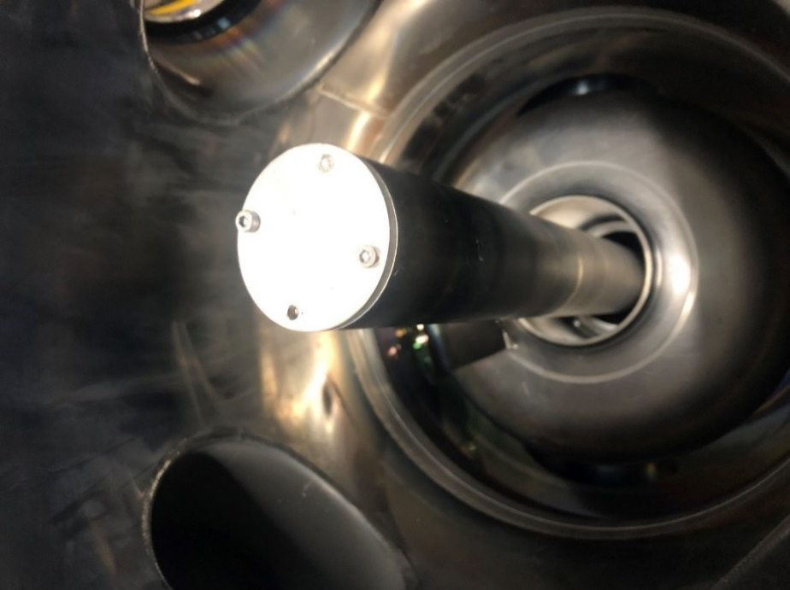
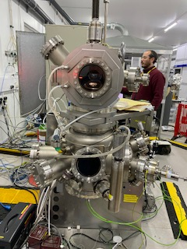
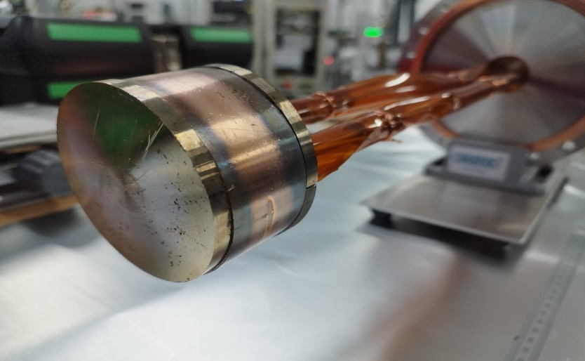
1.3 GHz Deposition Facility
The deposition facility comprises two chambers; a load-lock chamber and deposition chamber. The load lock is situated at the top and is separated by a 12 inch all metal valve. Both the load-lock and deposition chamber are pumped with turbo-molecular pump with pumping speed of 250 l/s and 500 l/s respectively. A dry scroll pump backs both turbo pump. A diaphragm valve controls the pumping speed in the deposition chamber, which is connected, to the Baratron to set the desire pressure during the deposition. During the deposition, the load-lock chamber becomes part of the deposition chamber. The cavity is attached to a magnetic coupled rotatable one-meter z-drive that can move up and down during deposition over the target to provide a uniform coating. The cavity is electrically isolated from the z drive so it be biased during the deposition. The deposition temperature is provided by halogen lamps surrounding the cavity.

Slide 17
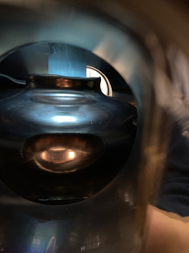
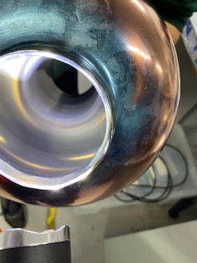
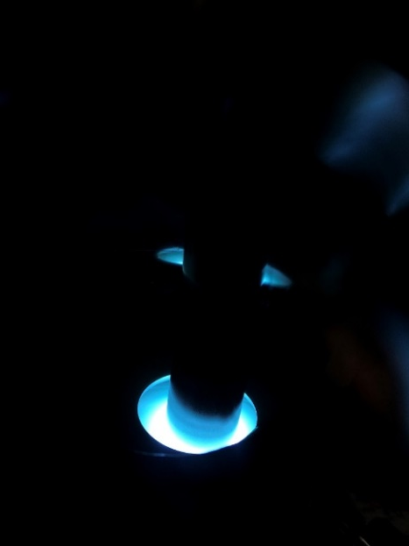

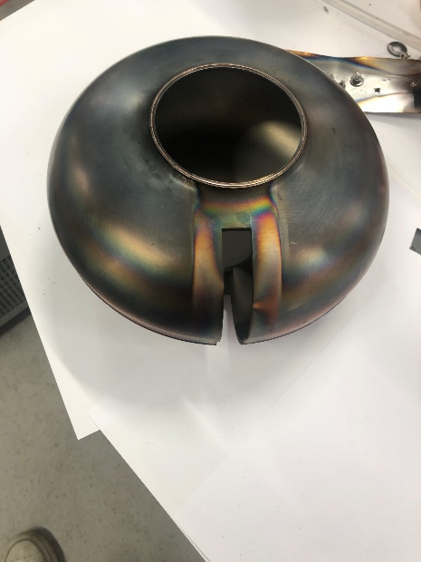
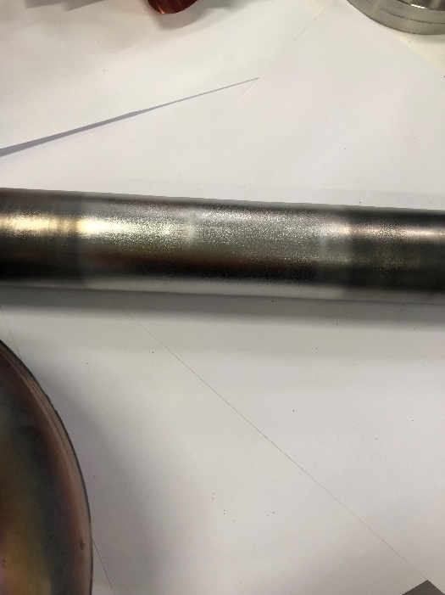
HIPIMS deposition On Half Cell copper Cavity
On copper foil
On copper plate
On Silicon
Nb Target race track

Slide 18
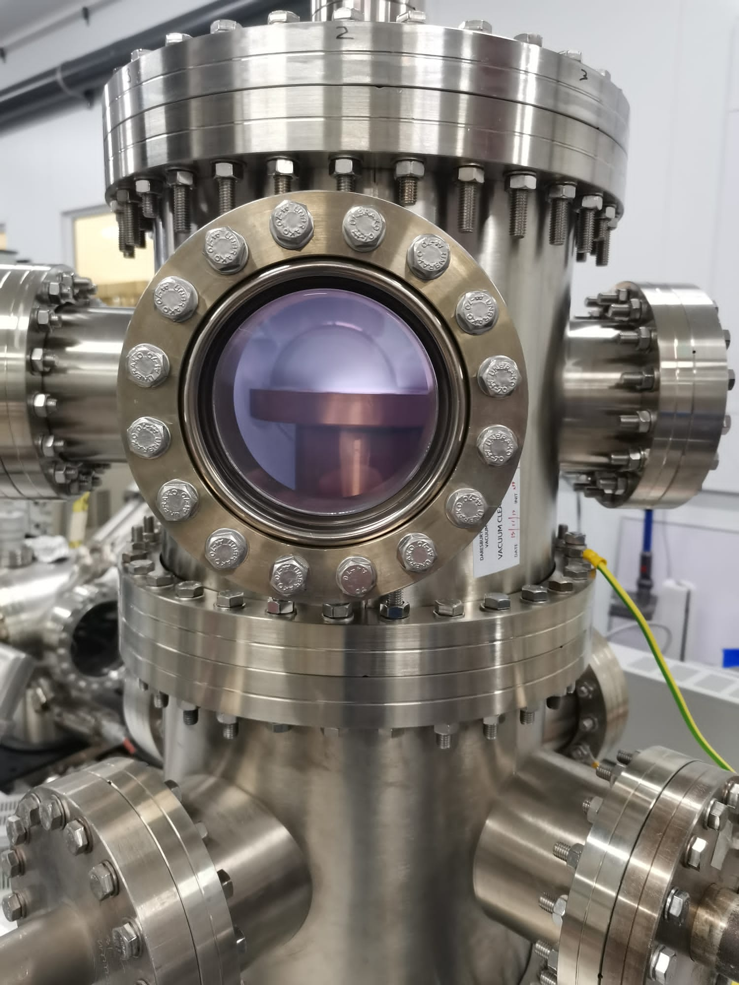
Plasma Diagnostic study

Slide 19
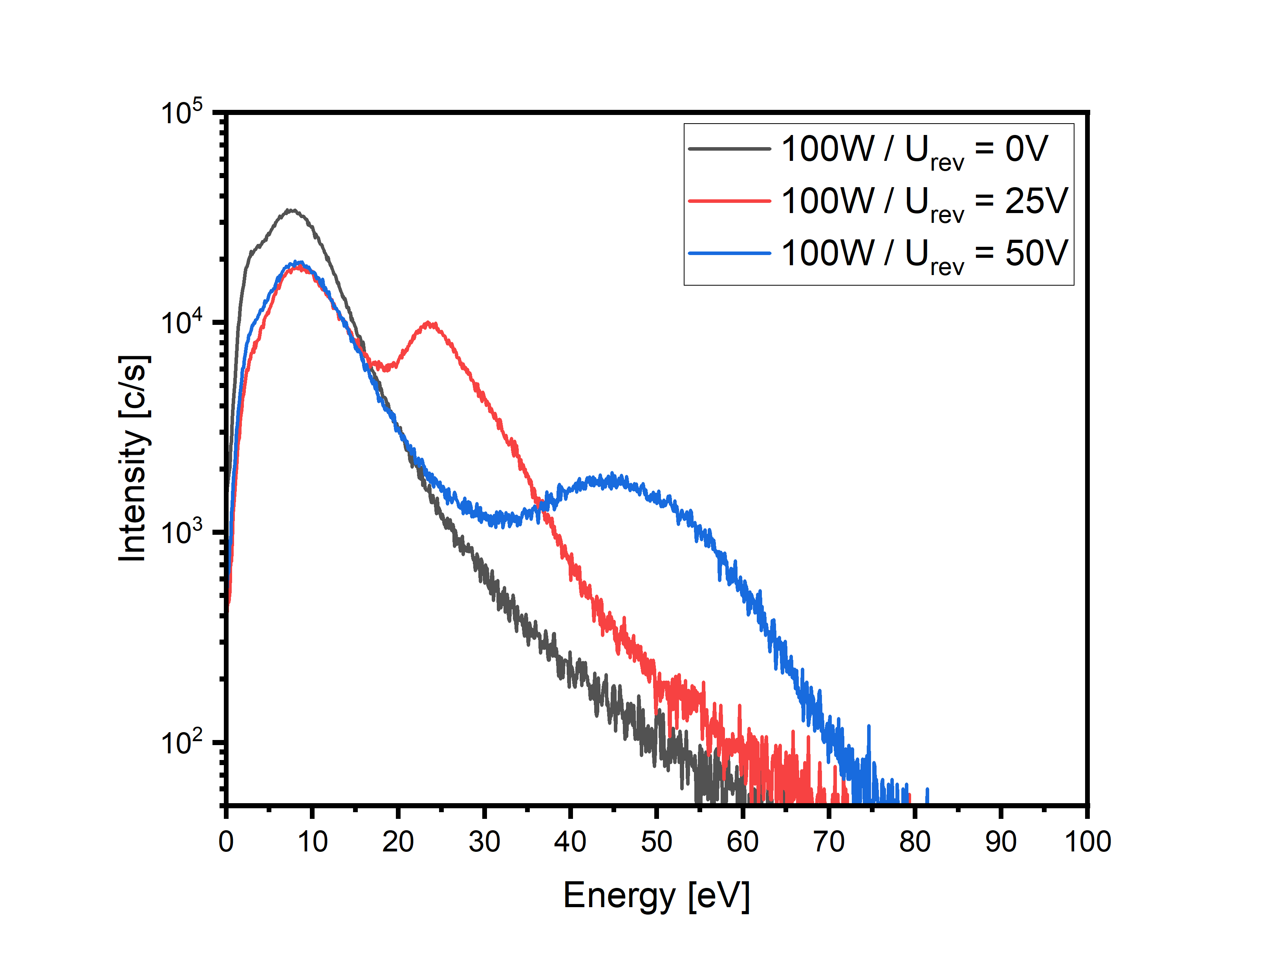
Energy scan - Nb positive ions
Pressure set at 5.5x10⁻³ mbar
PW_{neg}: 100 µs
PRR: 1000 Hz
Duty cycle: 10%
PW_{pos}: 250 µs
Pos. delay: 1.5 µs
E_{mean}: 9.6 eV / 16 eV / 16.16 eV

Slide 20
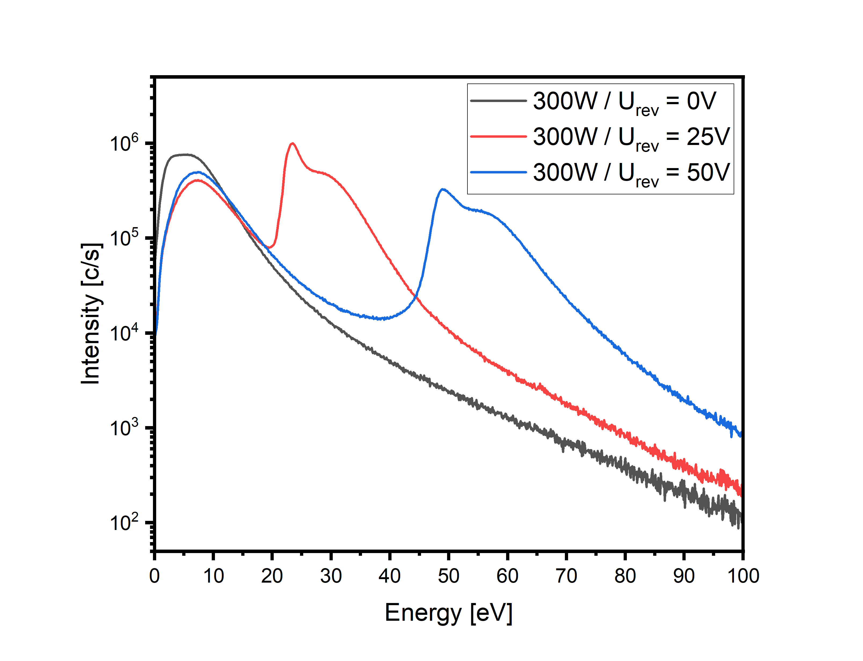
Energy scan - Nb positive ions
Pressure set at 5.5x10⁻³ mbar
PW_{neg}: 100 µs
PRR: 1000 Hz
Duty cycle: 10%
PW_{pos}: 250 µs
Pos. delay: 1.5 µs
E_{mean}: 8.4 eV / 21.6 eV / 28.6 eV

Slide 21
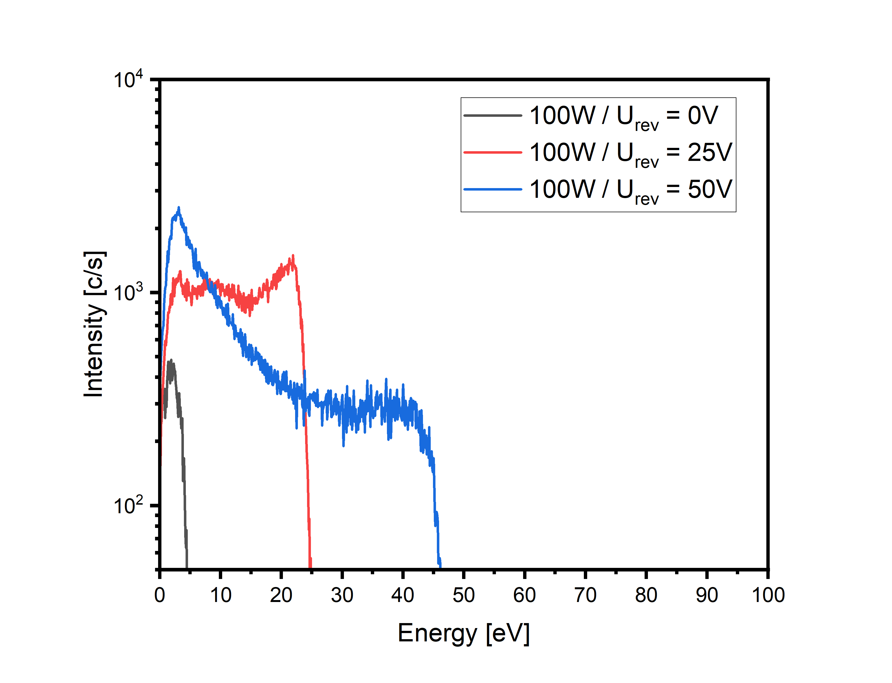
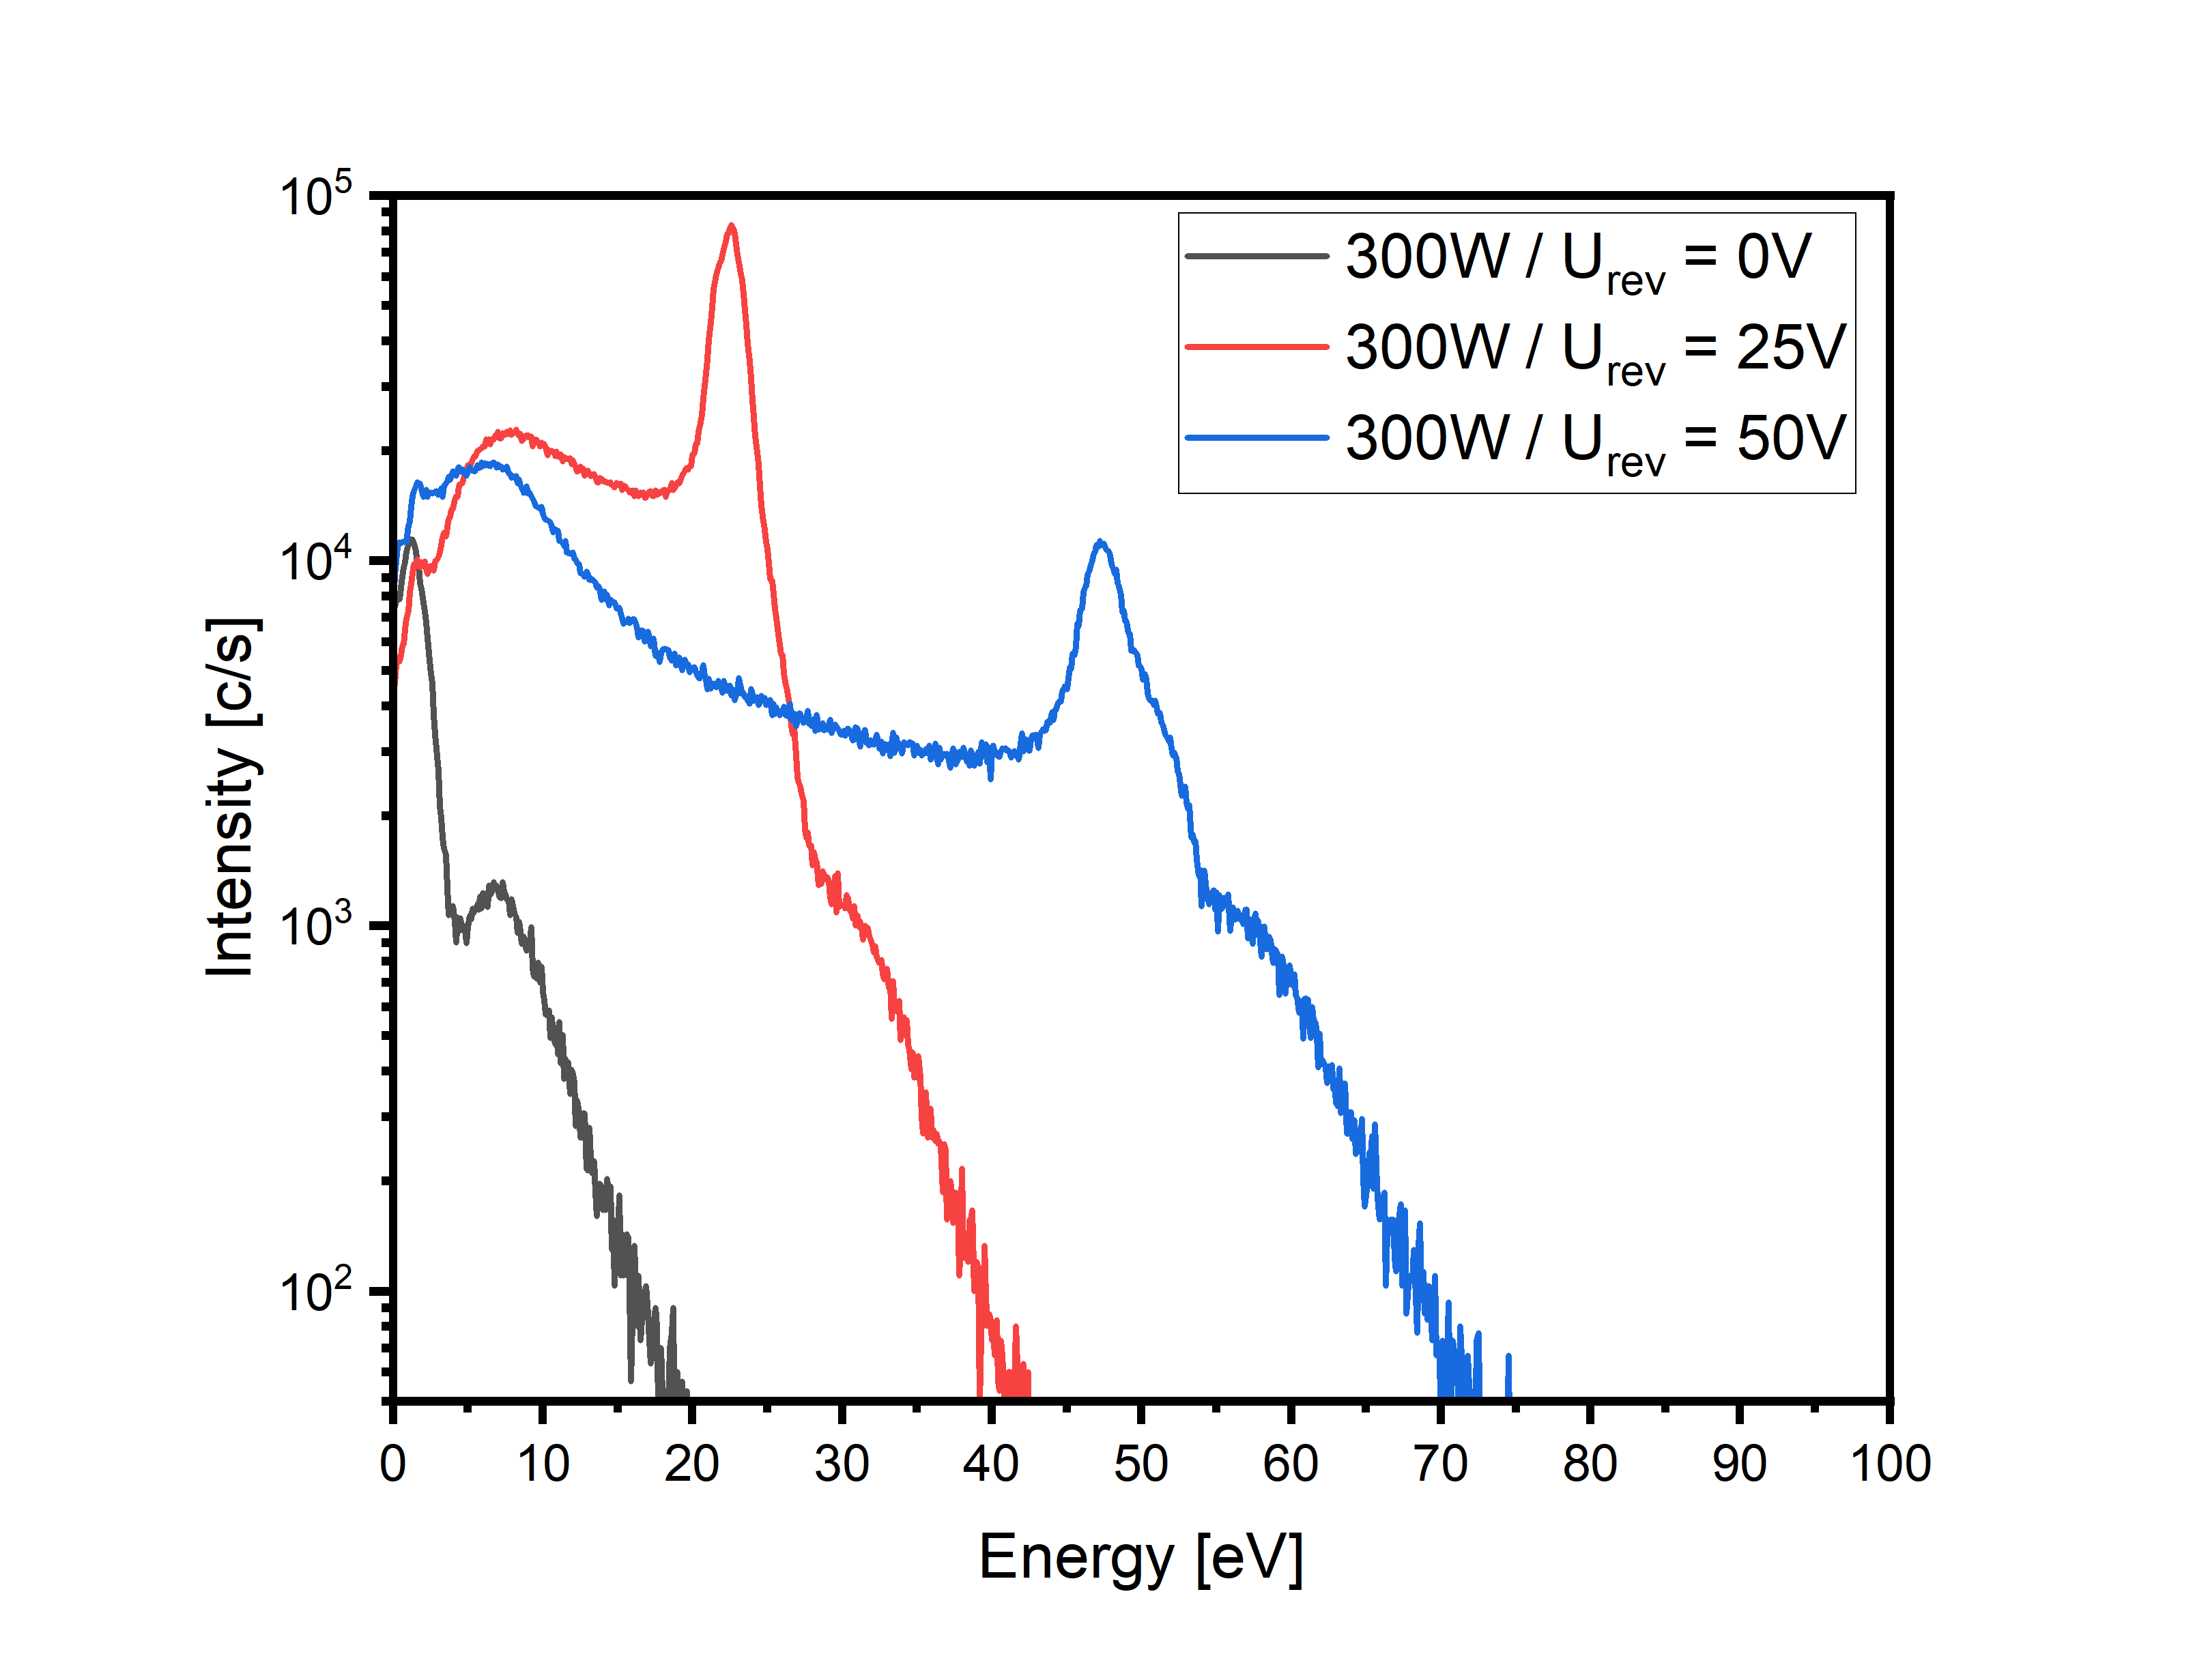
Energy scan - Kr positive ions
E_{mean}: 3.6 eV / 12.6 eV / 14.3 eV
E_{mean}: 3.3 eV / 15.8 eV / 20.1 eV

Slide 22
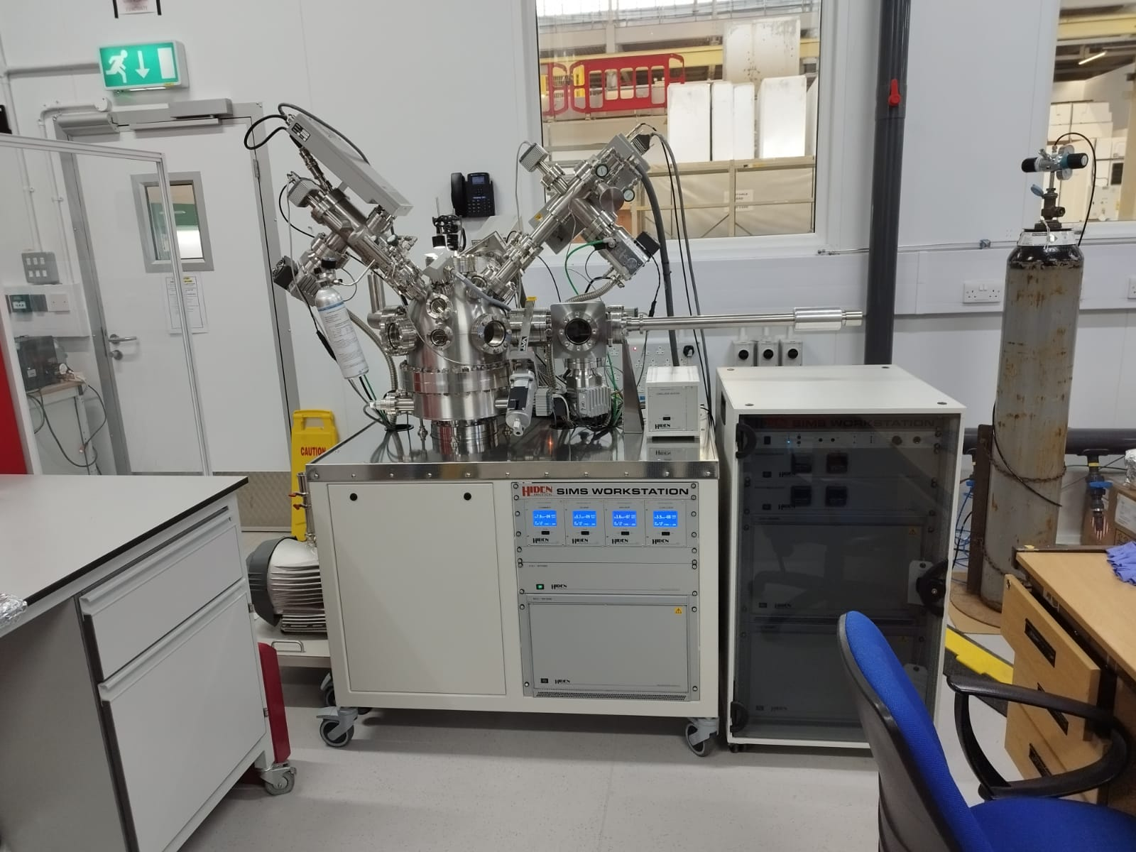
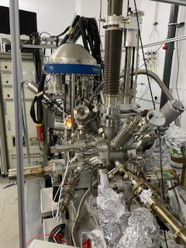
Additional Analytical Systems
Secondary Ion Mass spectrometry SIMS/SMNS:
Both static and dynamic SIMS
Cs for negative ions and Oxygen for positive ions
Detection limit ppm.
Chemical and Composition
XPS, AES, UPS

Slide 23
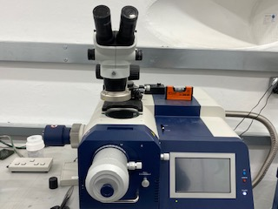
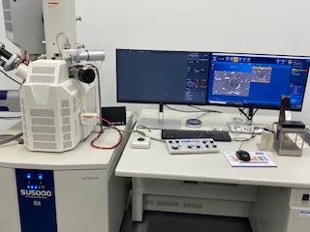
Additional Analytical Systems
FE SEM
Large sample
Compatible with ion beam milling
EDX mapping and 3D topography
EBSD
Ion Beam Milling system
Cross-section and planar sample prep for EBSD

Slide 24
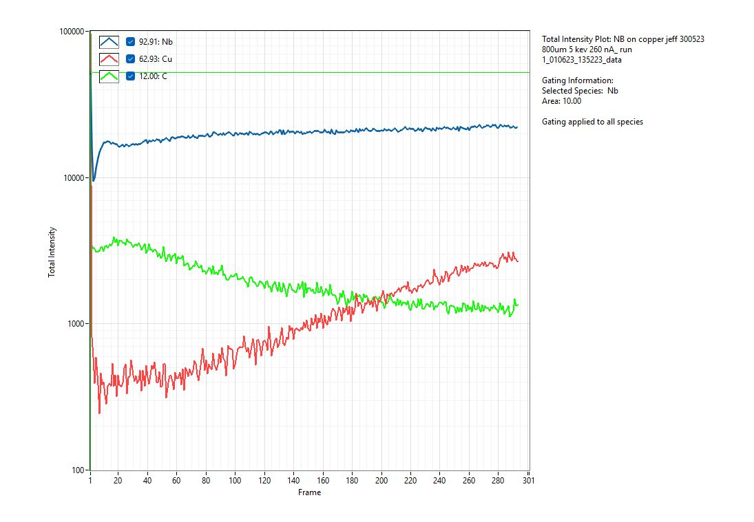
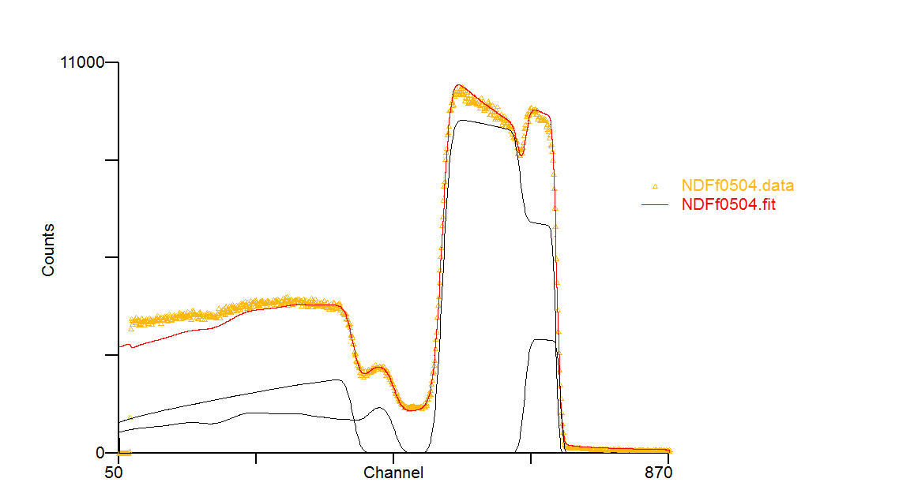
Film composition and Depth profile
Layer t (1e15at/cm2) t (nm) r(1e22at/cm3) Nb Sn O Al
1 7644.333 1497.201 5.106 75.0000 25.0000 0.0000 0.0000
2 15920.986 2855.270 5.576 100.0000 0.0000 0.0000 0.0000
3 898207.563 76119.281 11.800 0.0000 0.0000 60.0000 40.0000
RBS analysis of Nb3Sn on sapphire
SIMS depth profile of Nb on copper

Slide 25
Film composition and Depth profile
Layer t (1e15at/cm2) t (nm) r(1e22at/cm3) Nb Sn O Al
1 7644.333 1497.201 5.106 75.0000 25.0000 0.0000 0.0000
2 15920.986 2855.270 5.576 100.0000 0.0000 0.0000 0.0000
3 898207.563 76119.281 11.800 0.0000 0.0000 60.0000 40.0000
RBS analysis of Nb3Sn on sapphire
SIMS depth profile of Nb on copper

Slide 26
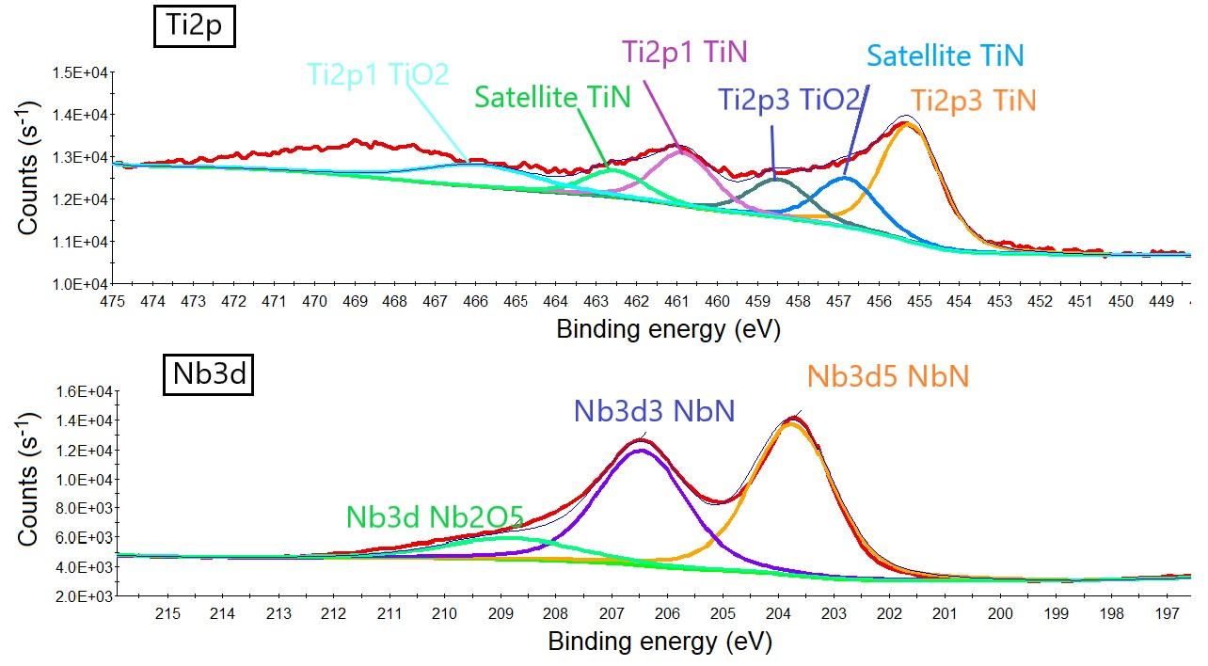
XPS: Composition and chemical analysis
XPS analysis of NbTiN representing Nb and Ti chemical state

