Slide 1



Thin film SRF perspectives in UK
Oleg B. Malyshev
ASTeC/CI
On behalf of a TF SRF team at STFC Daresbury Laboratory

Slide 2

Introduction
Present state

Slide 3
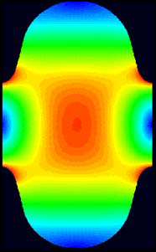
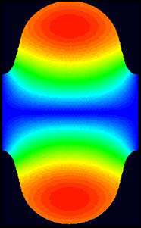
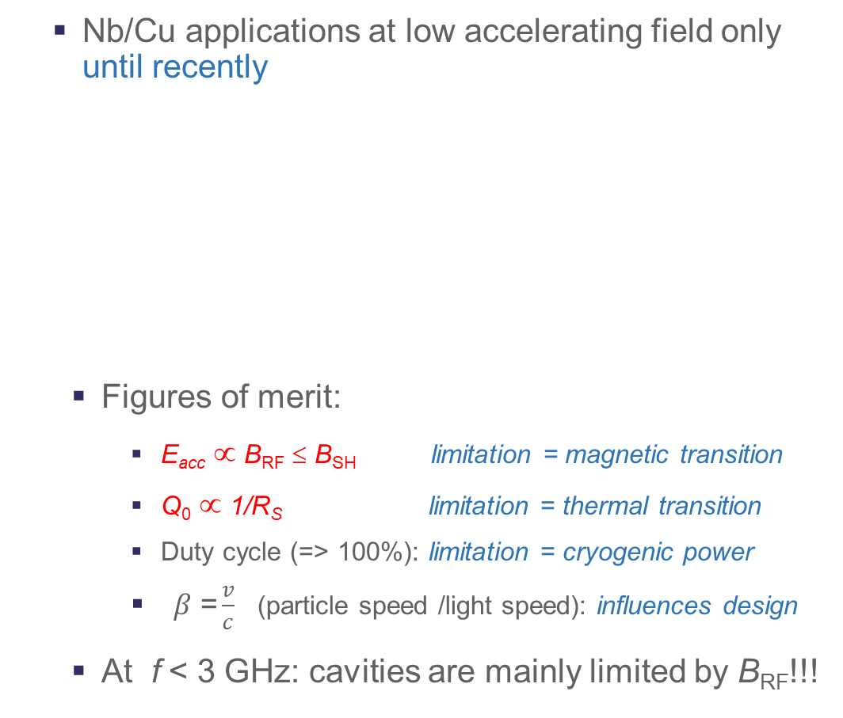
Bulk Nb: monopoly since > 50 years
Nb/Cu applications at low accelerating field only until recently
  Figures of merit:
    E_{acc} ∝ B_{RF} ≤ B_{SH} limitation = magnetic transition
    Q₀ ∝ 1/R_{S} limitation = thermal transition
    Duty cycle (=> 100%): limitation = cryogenic power
    $β\text{ =}\frac{v}{c}$ (particle speed /light speed): influences design
  At f < 3 GHz: cavities are mainly limited by B_{RF}!!!
Nb : Limits @ 2 K, 1.3 GHz :
E_{acc} ~ 55 MV/m (± 5 MV/m)
(Geometry : B/E_{acc} ~ 4.2 mT/(MV/m))
R_{s} = R_{BCS} + R_{rés}.
max.field
Q₀
Investment +
Power consumption
Q₀ ↑ Costs ↓
Aimed performance
Present state
B_{peak}
High field dissipations
E_{peak}
E Field
B Field
0
P = const, ↑
quench
E_{acc}
Investment
E_{acc} ↑ Costs ↓
Courtesy of C. Antoine (CEA, France)
Notes:
SC cavity are intensively used for accelerating charged particles, but bulk Nb cavities are ay their performance limit E_{acc} ∝ B_{RF} ≤ B_{SH} and Q₀ ∝ 1/R_{S} .
We aim to increase both E_{acc} and Q₀. for this we have to look for new solutions.

Slide 4
Superconductors considered for SRF
Material | T_{C} (K) | B_{SH} (mT)@ 0 K
Pb | 7.1 | 100
Nb | 9.2 | 219,0
NbTi | 9.2-10
NbTiN | 10.6-11.8
V₃Si | 17.0
NbN | 17.3 | 214,0
Nb₃Sn | 18.3 | 425,0
Nb₃Al | 18.5-19.1
MgB₂ | 39.0 | 170,0
Pnictides: Ba_{0.6}K_{0.4}Fe₂As₂ | 38.0 | 756,0
Cuprates: YBaCuO | 93.0 | 1050,0
High H_{SH} => High E_{acc} … in theory
High T_{C} => High Q₀
Courtesy of C. Antoine (CEA, France)
Notes:
We are looking for non-Nb SC materials with higher Tc to increase Q0 and higher B_{SH} to increase Eacc.
These materials are under considerations in present

Slide 5
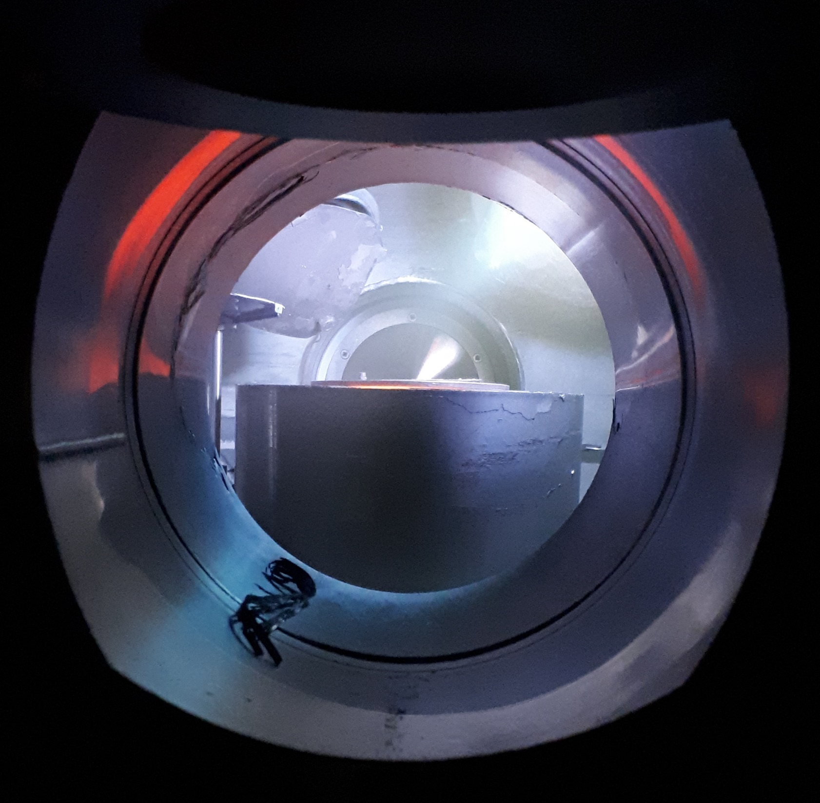
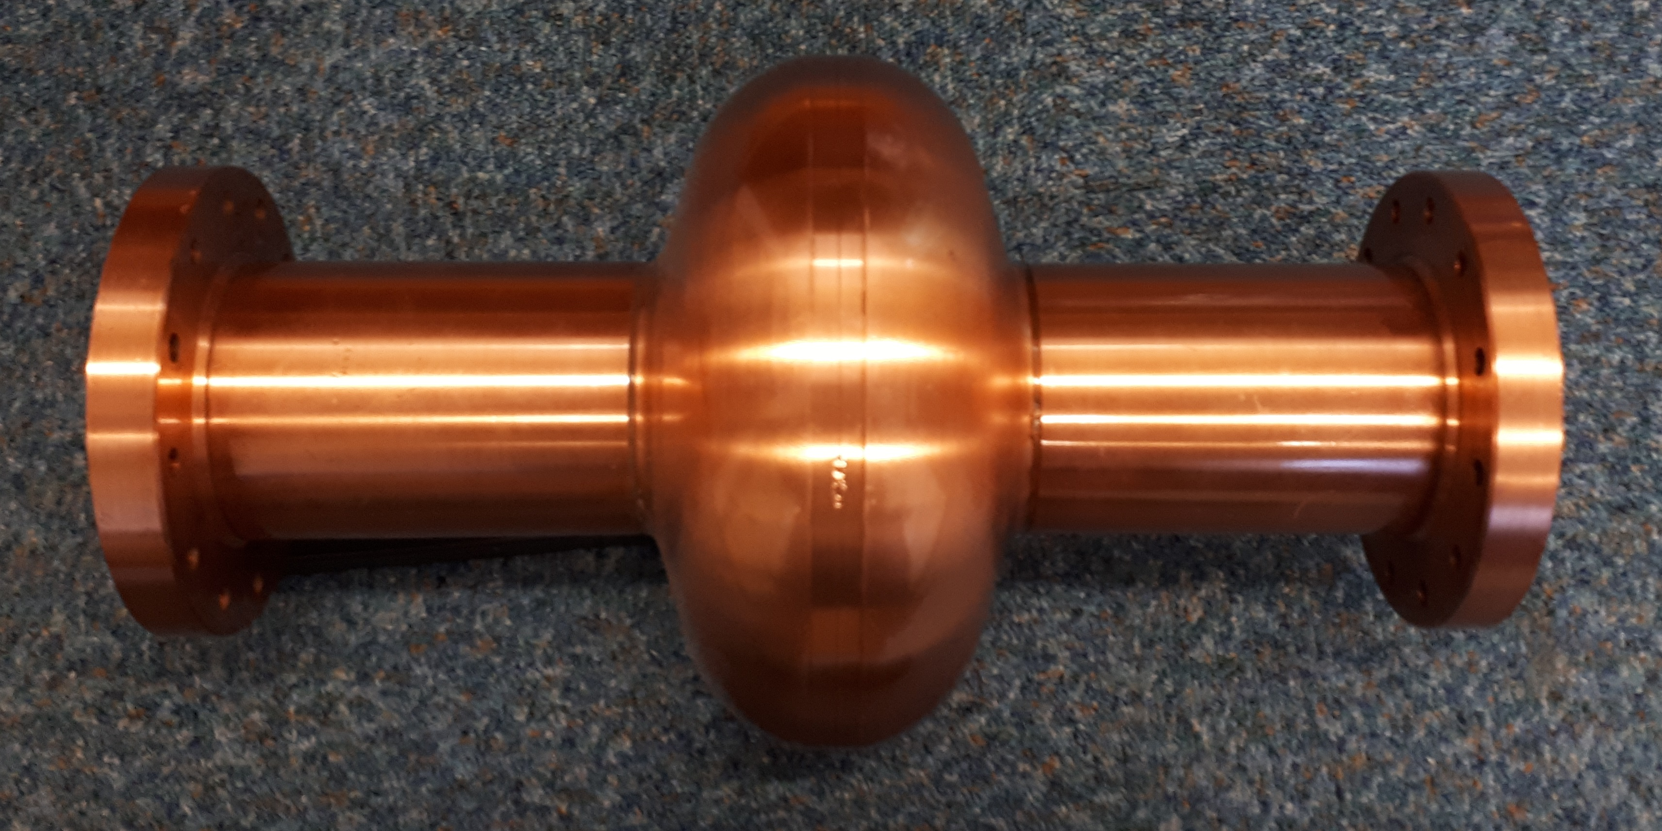
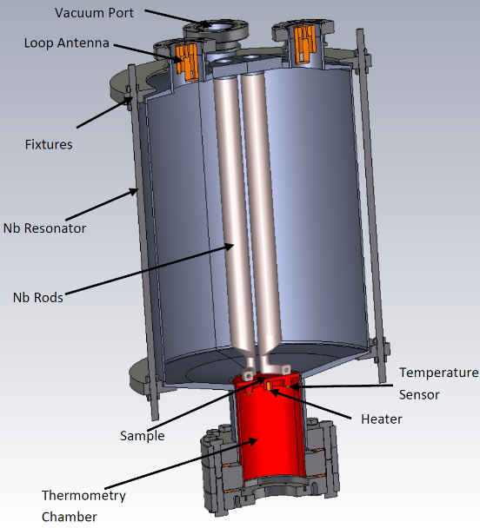
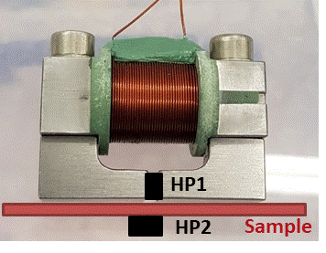
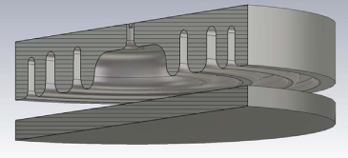
International collaborations
I.FAST WP9: Innovative superconducting cavities (01/05/2021-30/04/2025)
15 partners from 9 countries
The main emphasis is on applying the result of ARIES to RF cavity deposition with non-Nb STF and SRF testing
Thin film deposition
PVD: DC, pulsed, HIPIMS…
Film characterisation
SEM, FIB, AFM,
Real cavity measurement
Cavity deposition
(PE)CVD, (PE)ALD
XPS, XRD, RBS, TEM…
Superconducting RF properties evaluation
Superconducting properties measurement
RRR, H_{c}, H_{fp}, H_{sh}, …
QPR at CERN
QPR at HZF
HW choked cavity at ASTeC
Nb, NbN, Nb₃Sn, MgB₂, SIS, etc.
Surface preparation
Cleaning, etching,
Polishing, passivating
DC magnetic susceptibility,
Field penetration
Nb film laser treatment
Film deposition
ARIES WP15: (01/05/2017-30/04/2021)
9 partners from 6 countries
The main emphasis is on a systematic study of correlation between
1.3 GHz cavity for STF deposition
SEM image of a NbN thin film
QPR
DC magnetisation
Choked cavity
Notes:
Internationally the TF SRF community is quite small, organised with good working relations and collaborations,
For example, UK team was involved in ARIES… read
When the collaboration has expanded within IFAST project …. read

Slide 6
Superconducting Thin Film Coating for Radio Frequency Cavities (TF-SRF) at STFC/DL/CI
Main goal:
  To enable STFC for the superconducting thin film coated cavity production and testing
Main objectives:
  Developing coating technology for superconducting thin films (STF)
    Deposition of Nb, Nb₃Sn, NbTiN, V₃Si, Mg₂B, … and SIS structures
    Thin film characterisation
    AC/DC superconductivity evaluation
  Developing cavity deposition expertise
    Copper cavity production (incl. EB welding)
    Polishing and cleaning of copper cavities
    Building deposition facilities
    Developing deposition targets
    Optimising deposition parameters
  SRF testing at DL
    1.3 GHz (and 6 GHz) single cell cavity testing as a 1st step
    Scaling up to a routine cavity coating and testing
    Multicell cavities
Notes:
The UK team has the mail goal: read the slide
For this there 3 main objective:

Slide 7
A path towards the goal
(1) Superconducting thin film development

Slide 8
Copper surface preparation
Mechanical polishing
Fine mechanical polishing
  diamond turning (for flat samples) at STFC
  tumbling
Chemical polishing:
  SUBU5 solution
  Electropolishing (EP)
Laser polishing
  not proved yet
Combination of different techniques
In present, relying on IFAST partners: INFN/LNL and IJCLab
Needs to be developed at STFC
Notes:
In present, only small planar samples can be polished in-house, we have to rely on our collaborations.

Slide 9
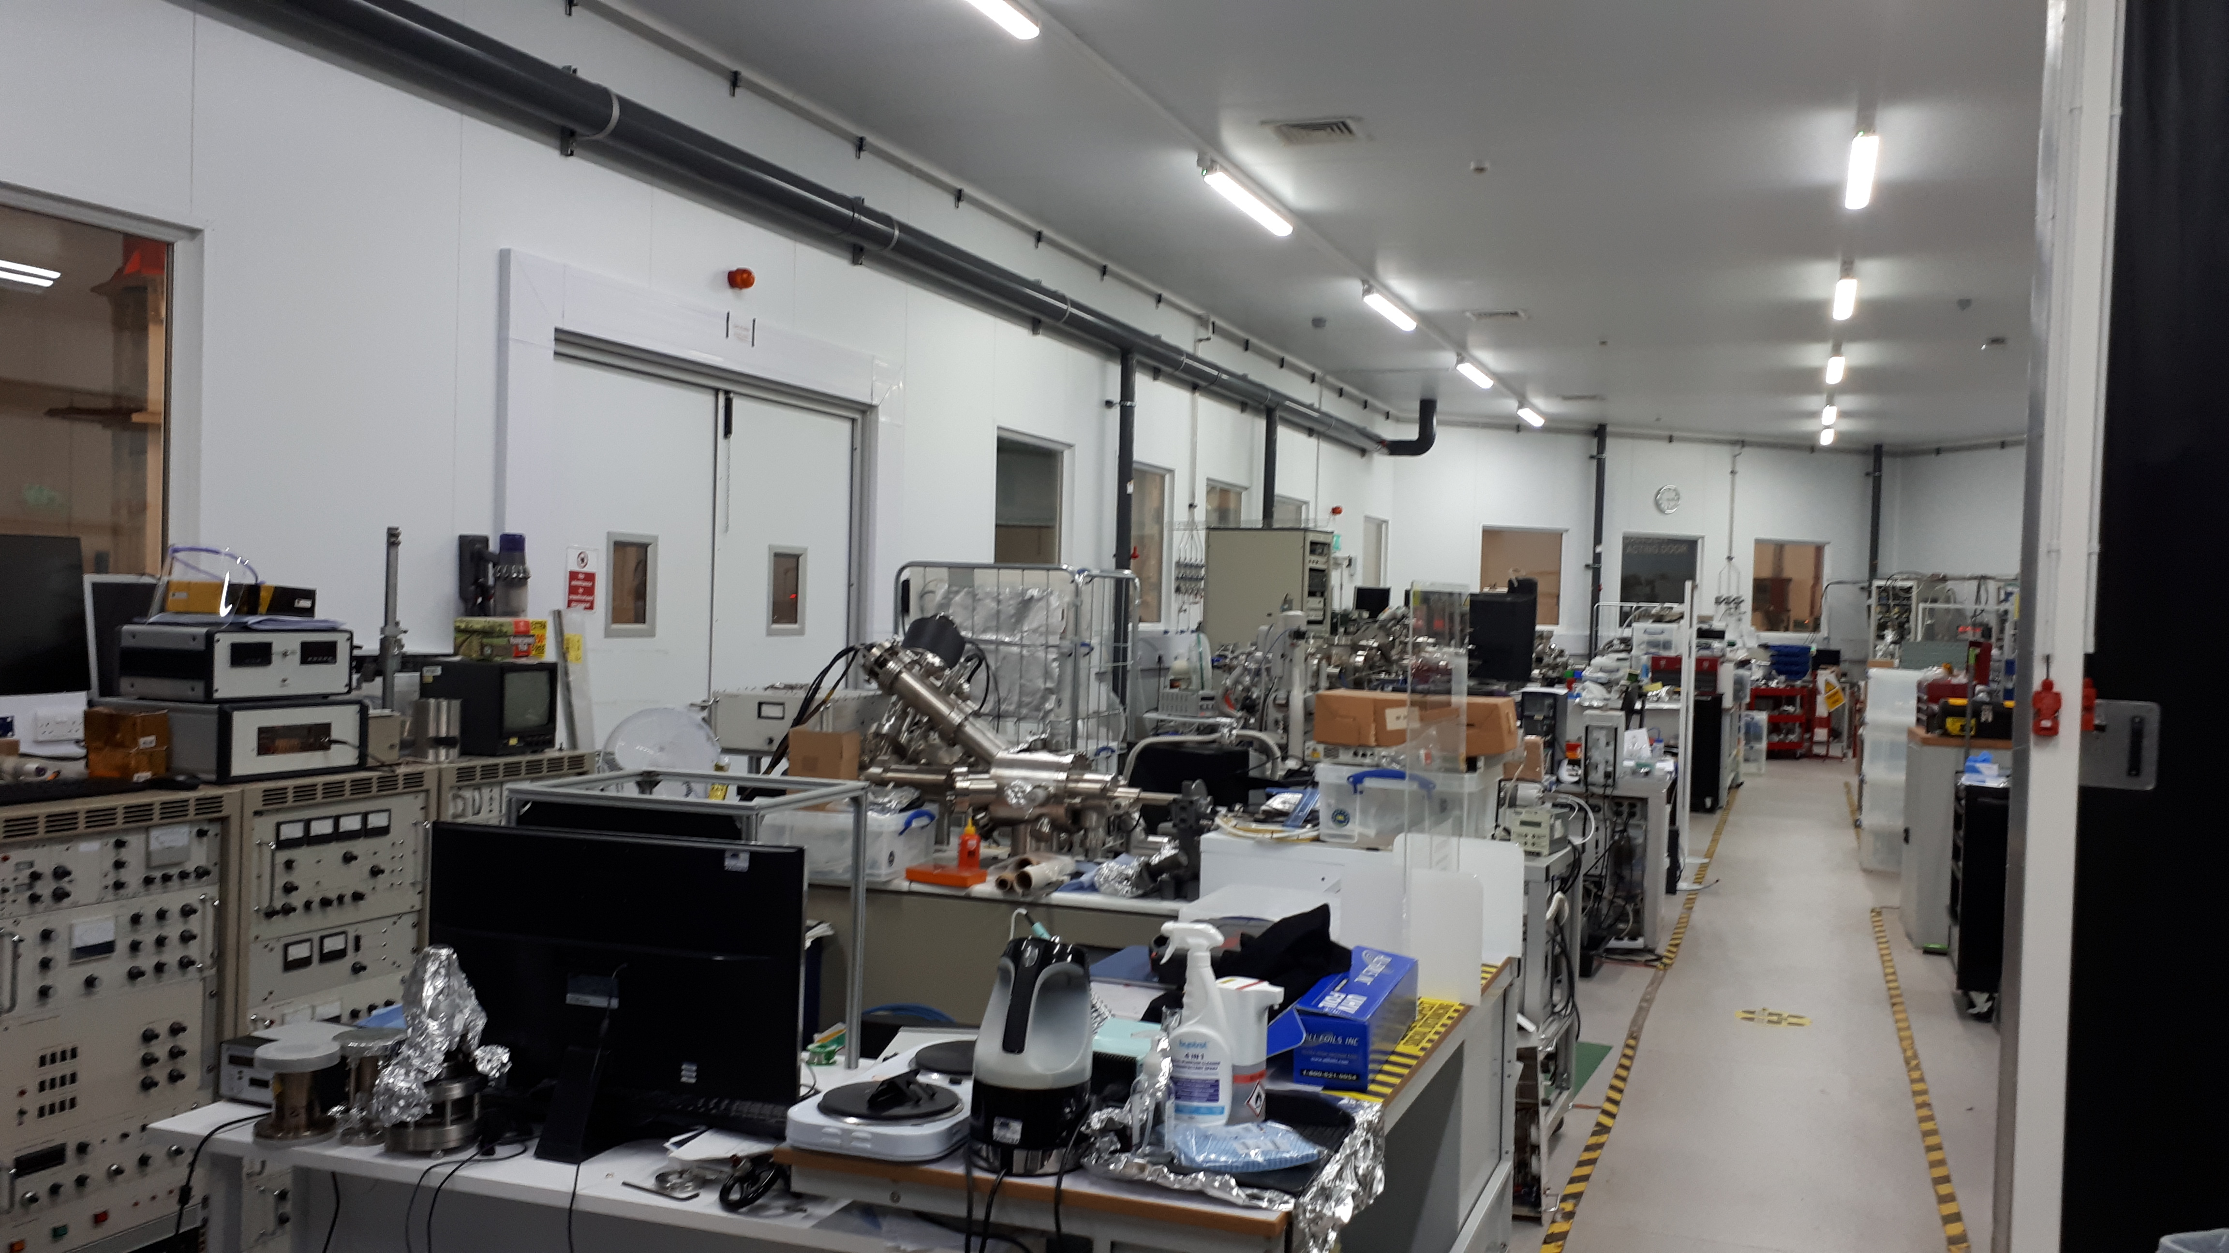
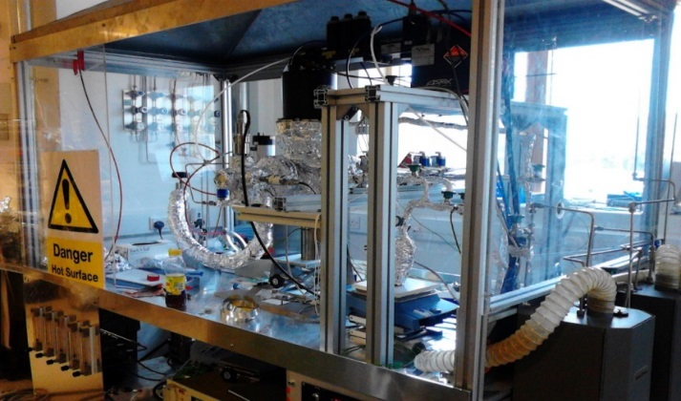
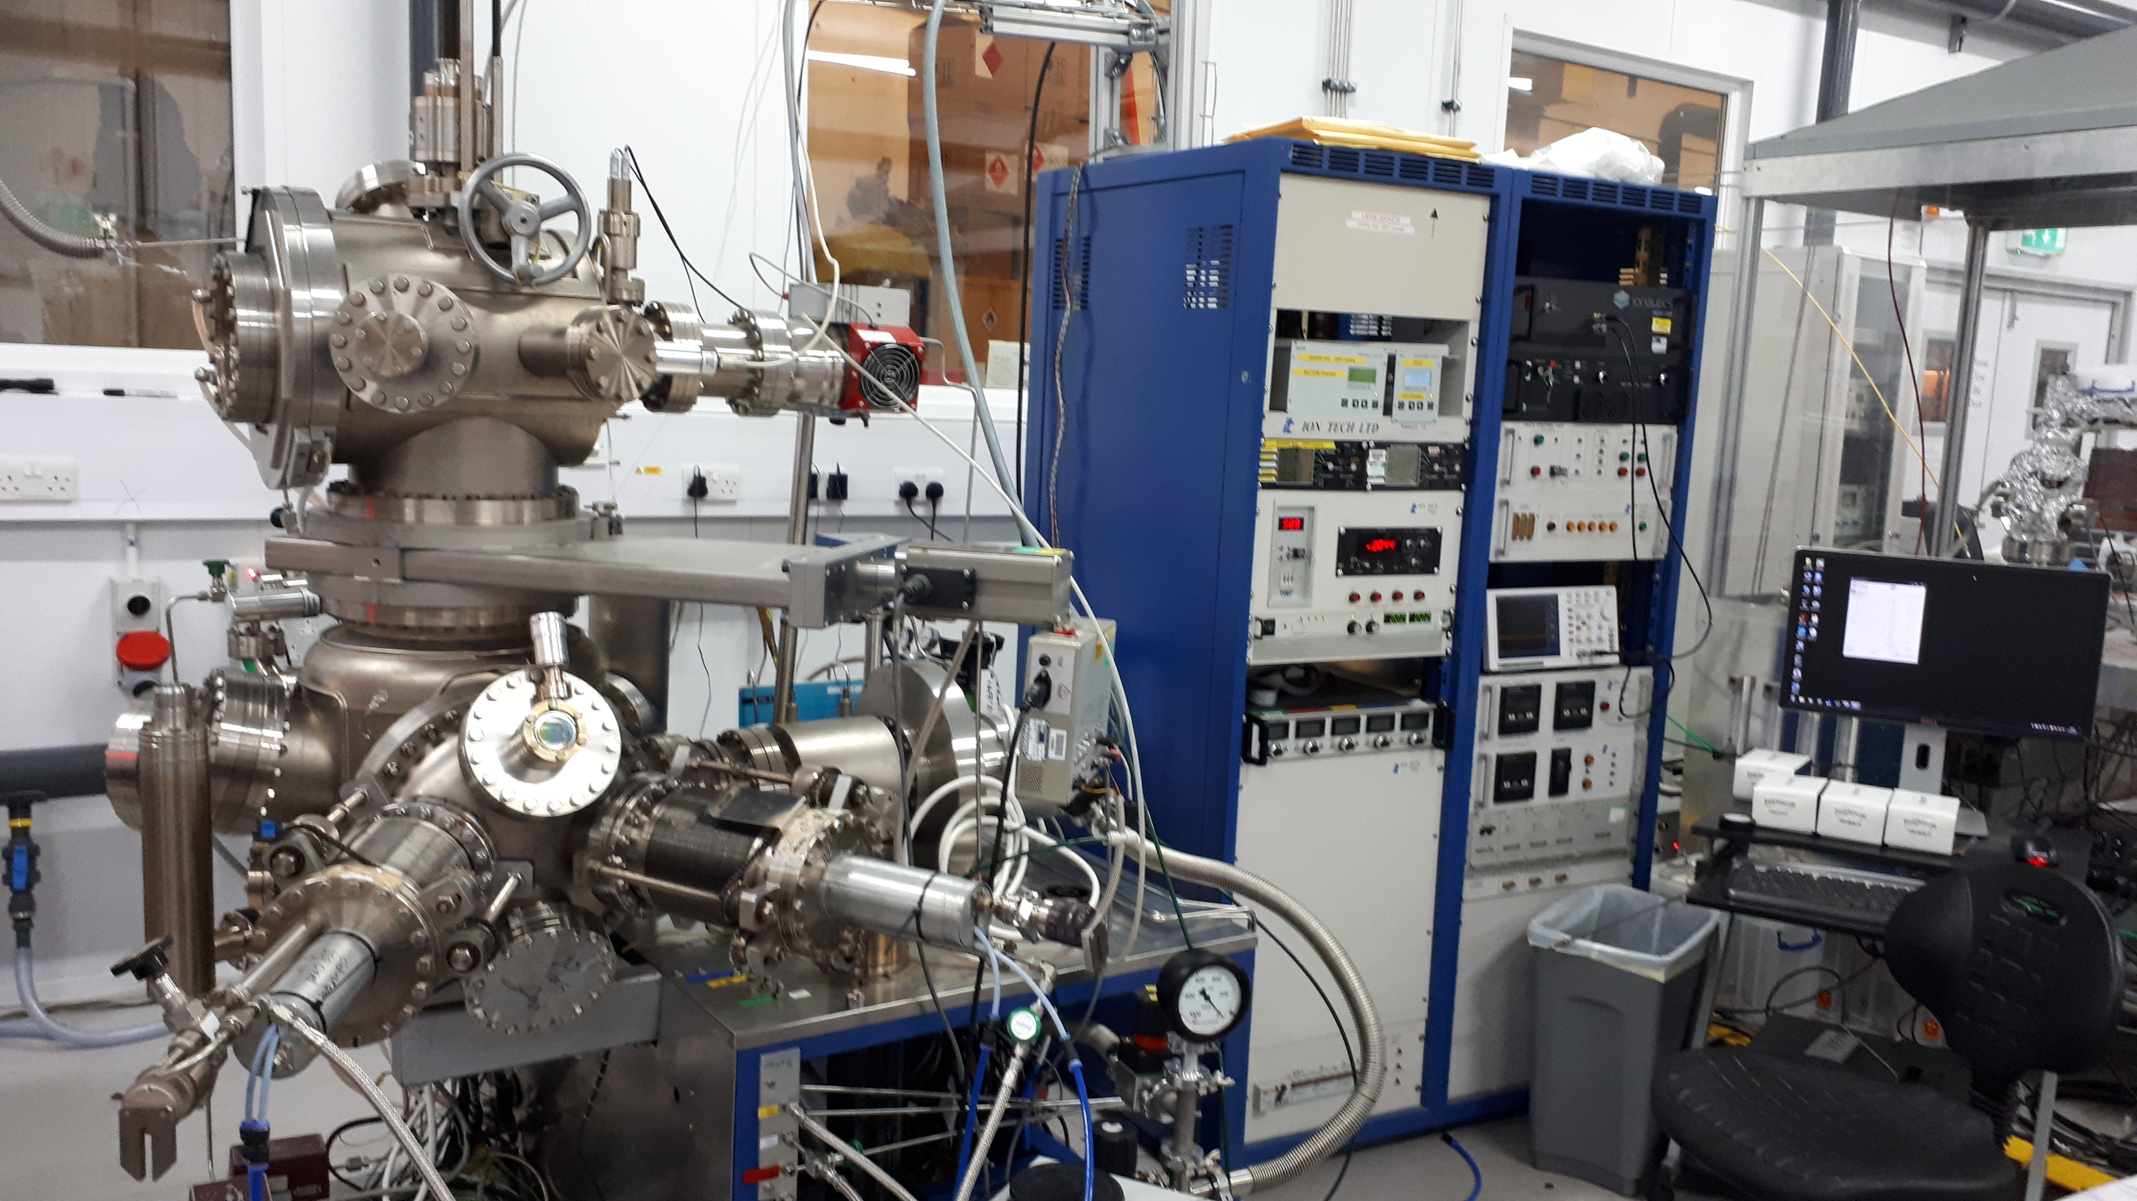
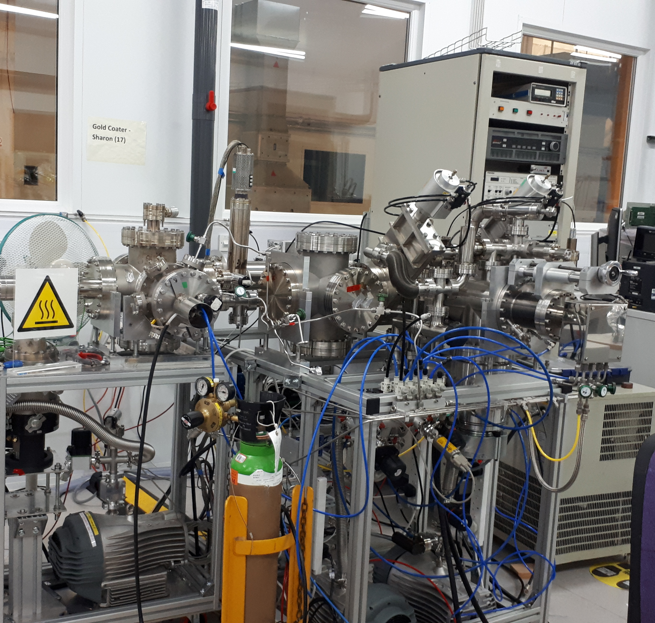
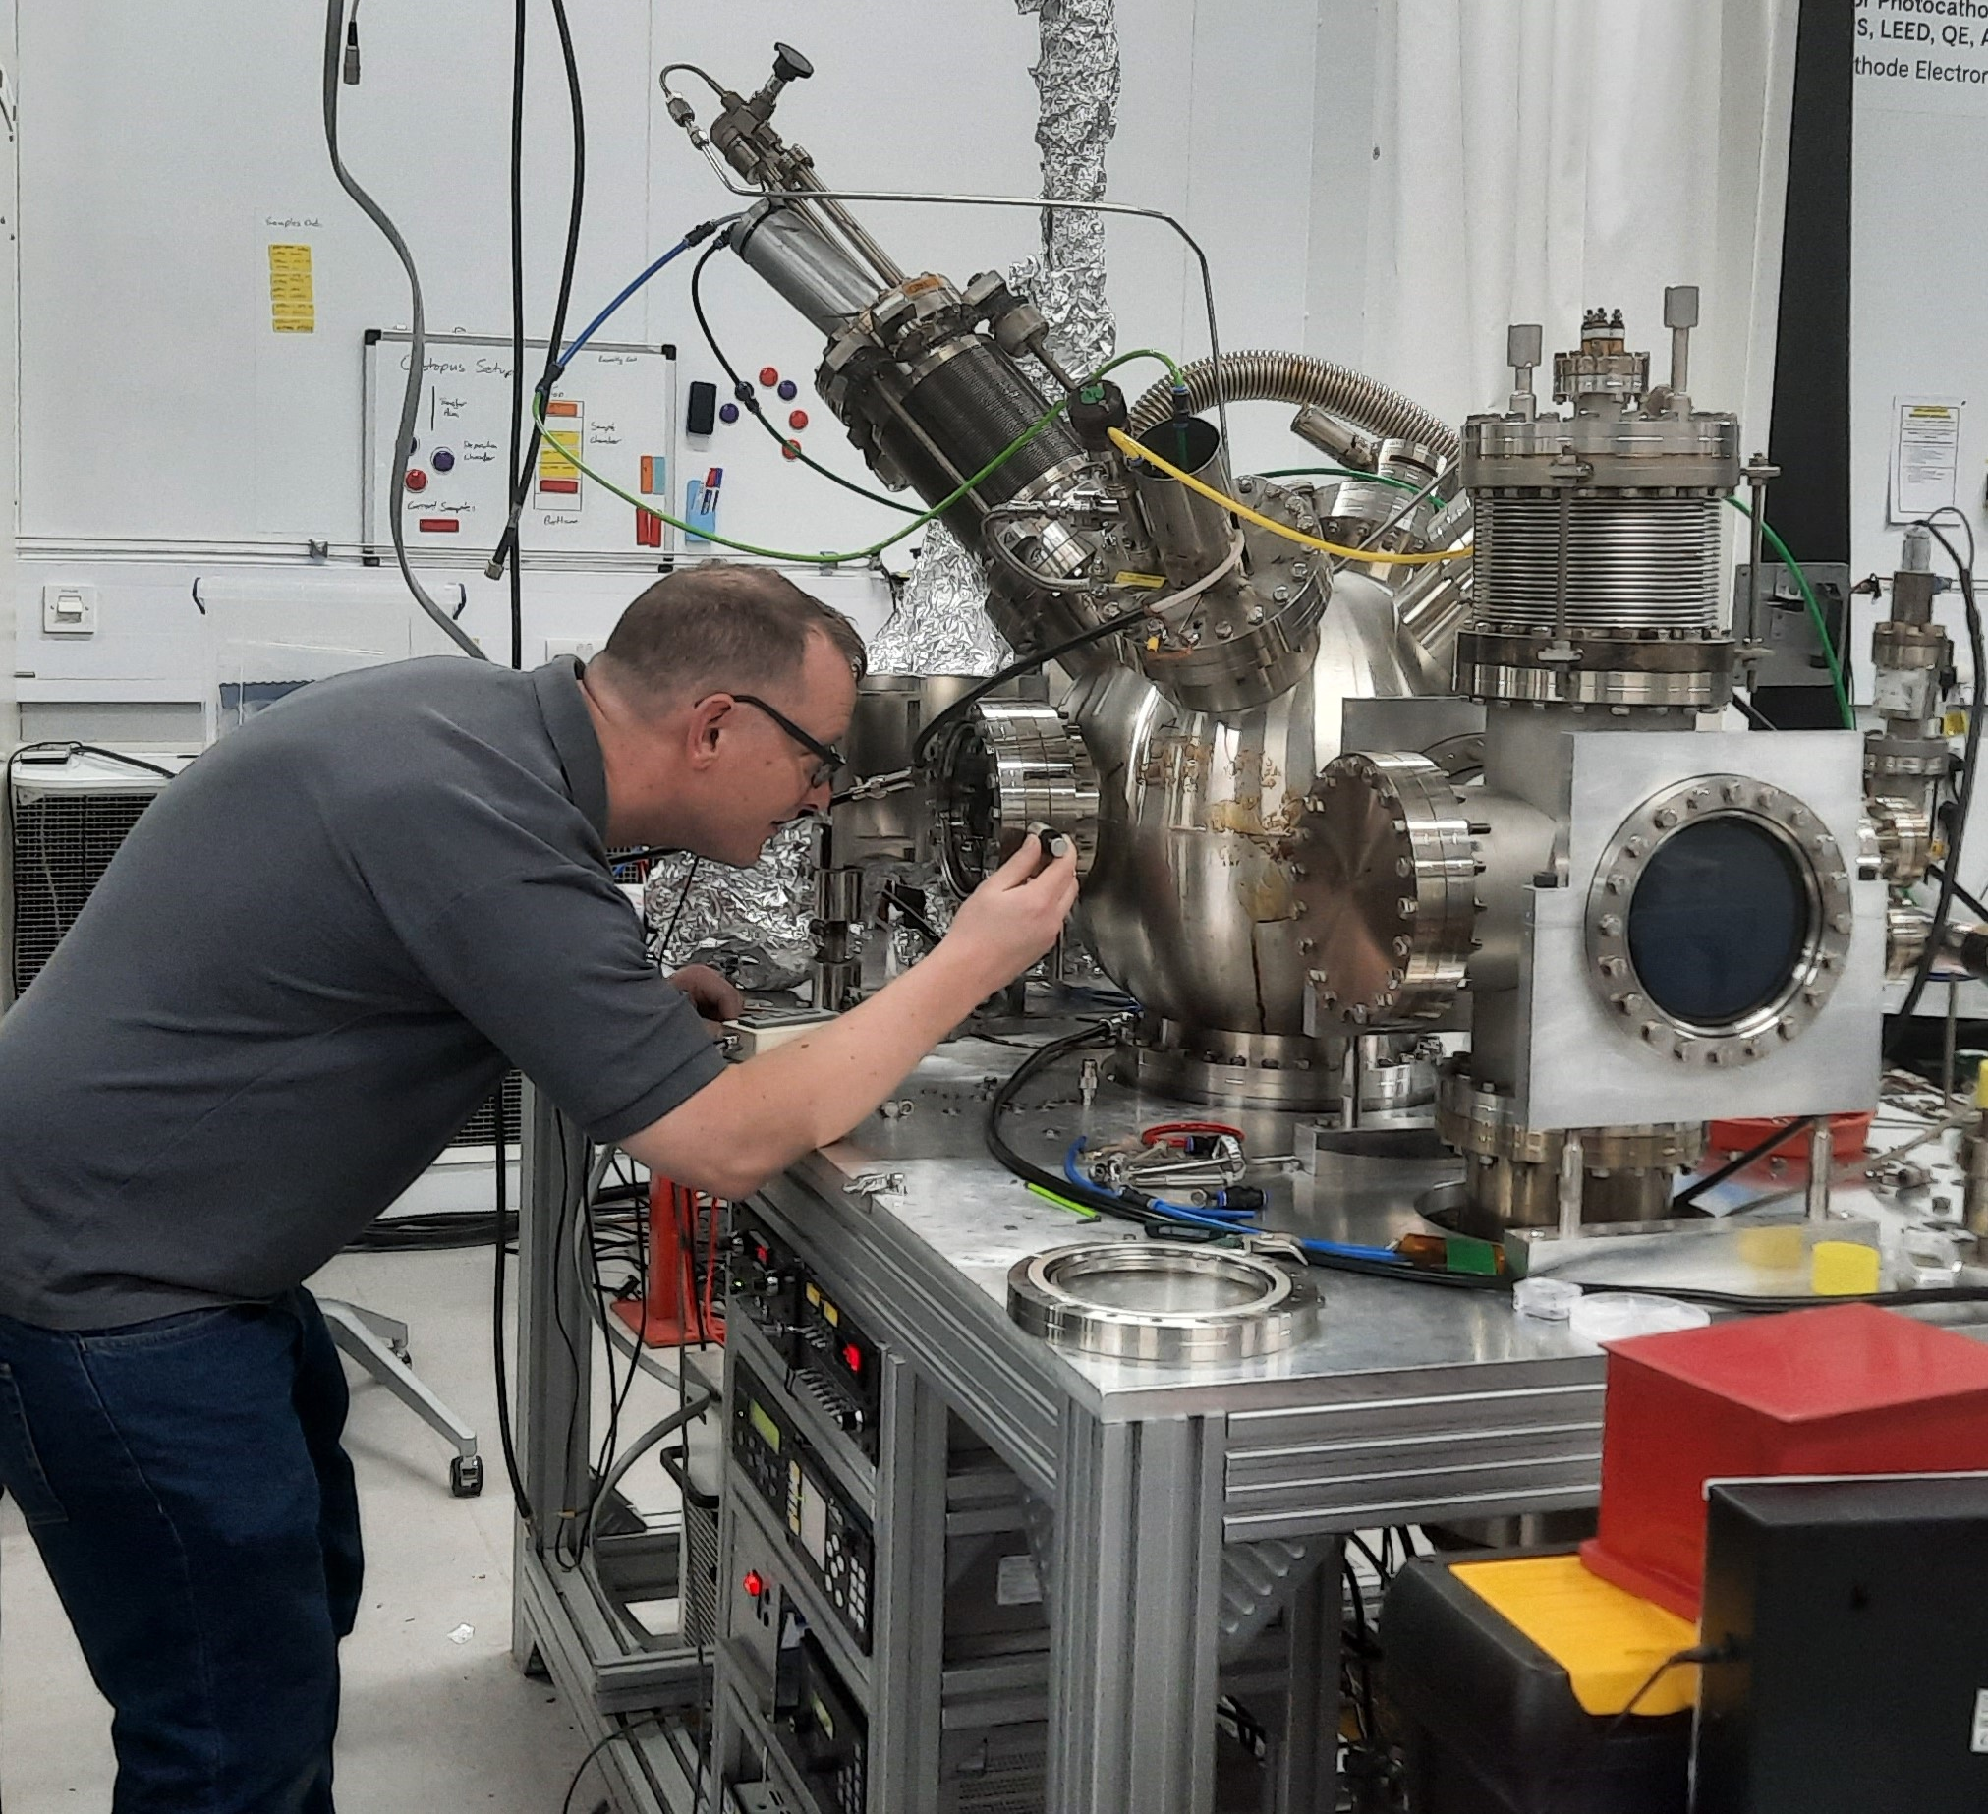
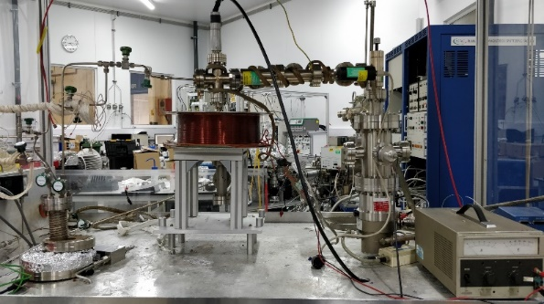
Thin Film Deposition in VISTA
Stablished and coordinated by R. Valizadeh (ASTeC)
CI collaborators: Prof J. Bradley and Dr V. Danak (Liverpool University)
Participants: : J. Conlon, C. Benjamin, S. Simon
Chemical Vapour Deposition (CVD)
VISTA laboratory
Physical Vapour Deposition (PVD)
PVD deposition
Hybrid Physical Chemical Vapour Deposition (HPCVD) Facility
PVD deposition
Notes:
To facilitate our aims we have VISTA laboratory where we built various deposition facilities based on a few types PVD, CVD and HPCVD

Slide 10
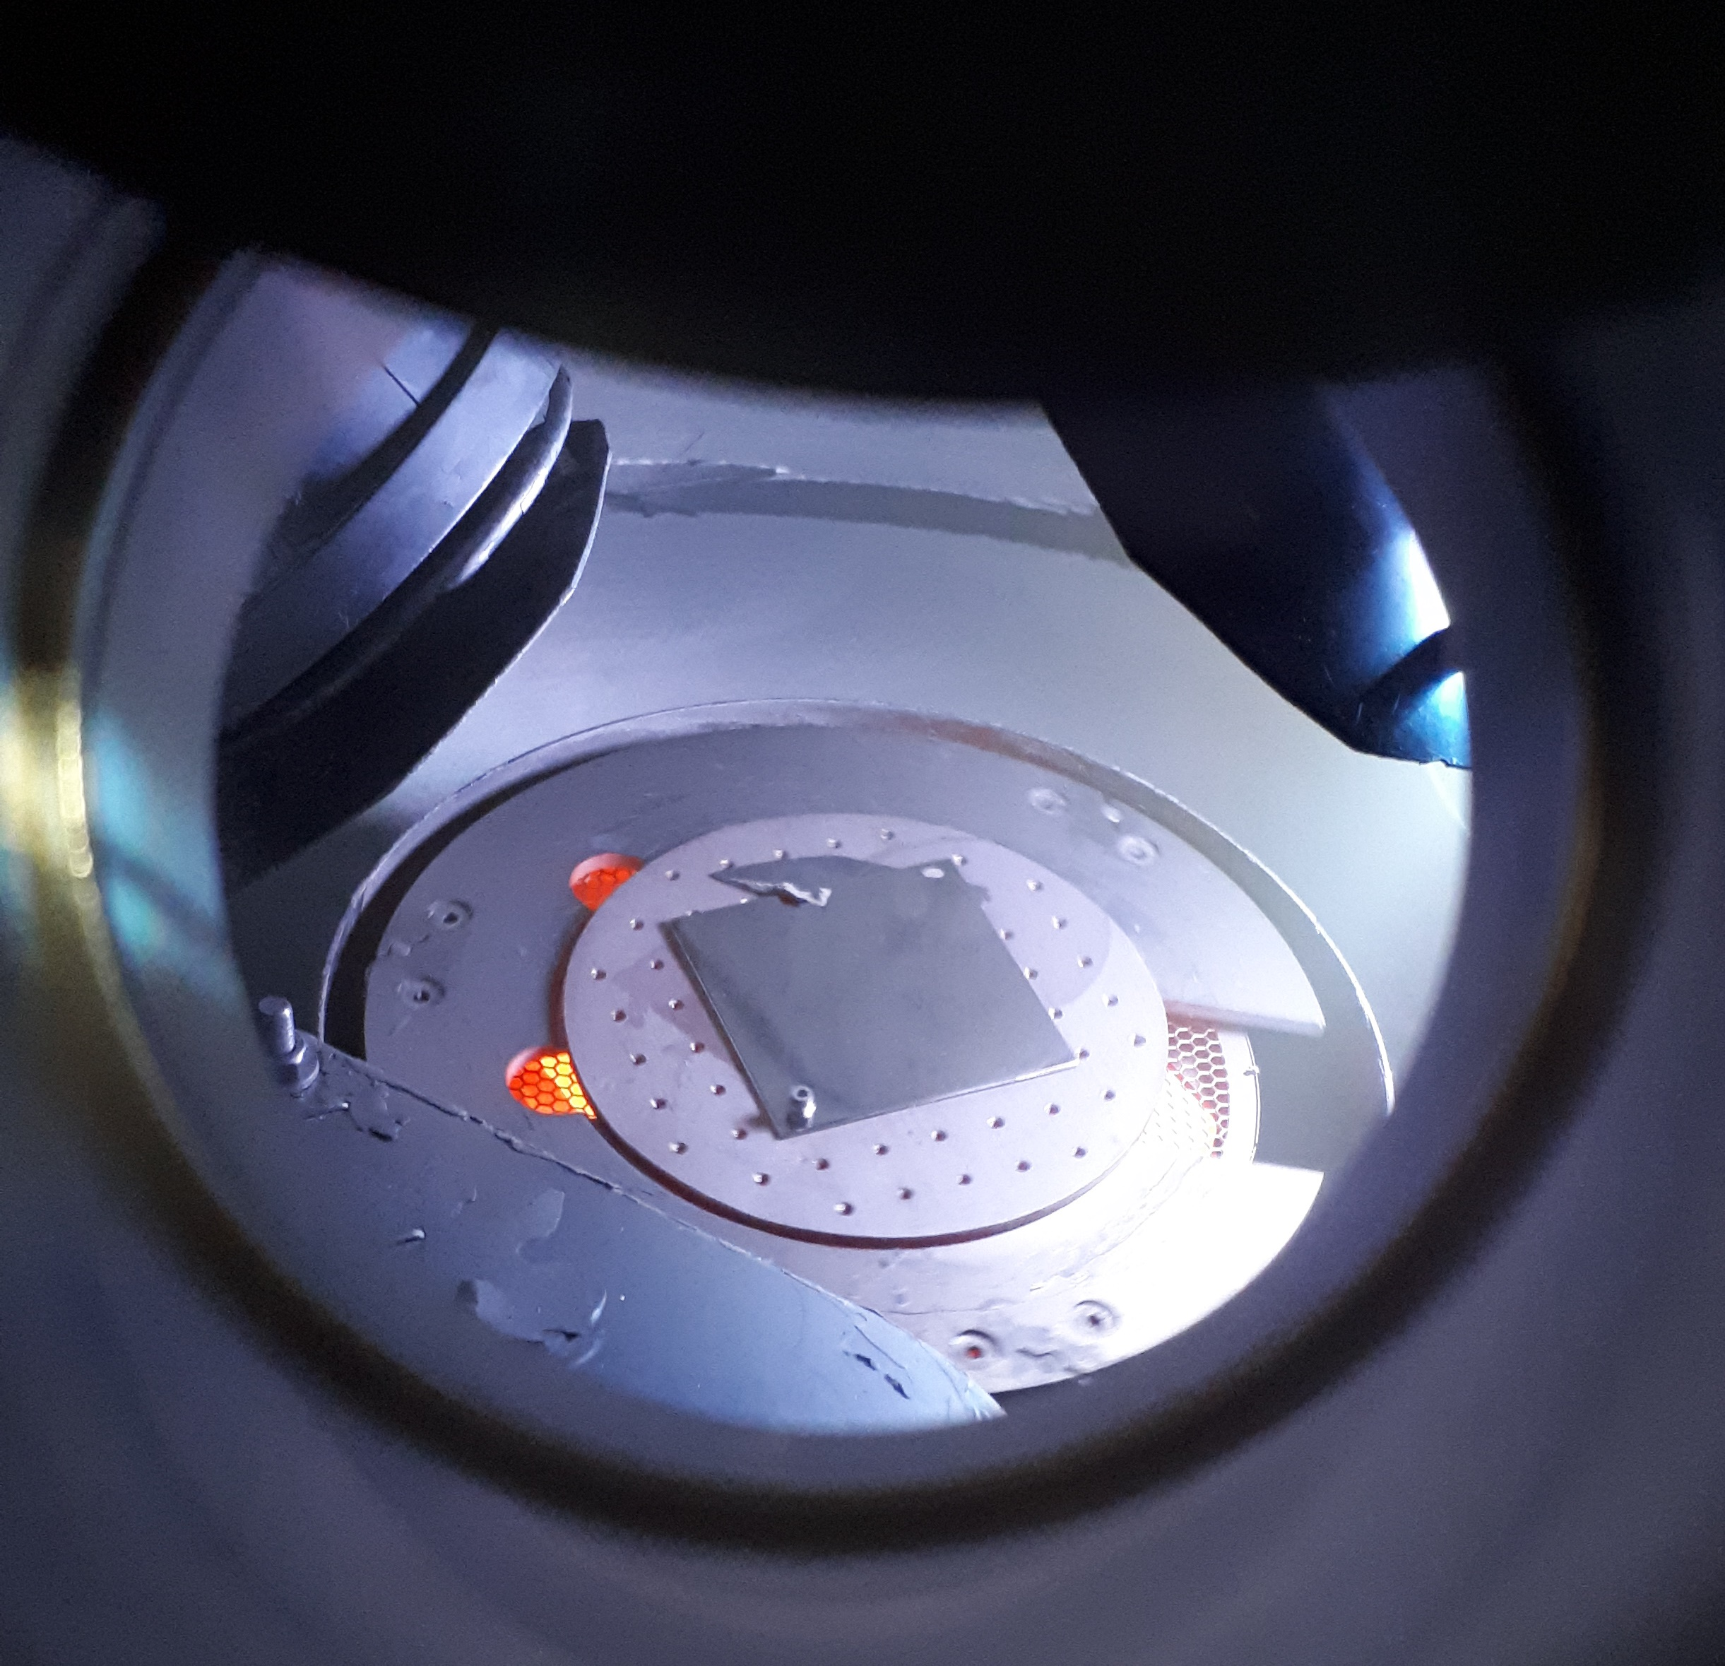
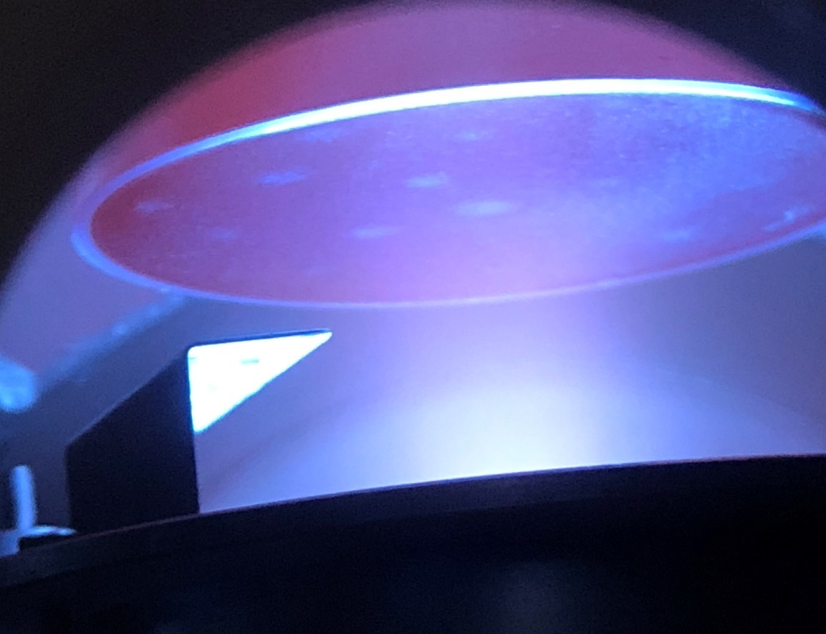
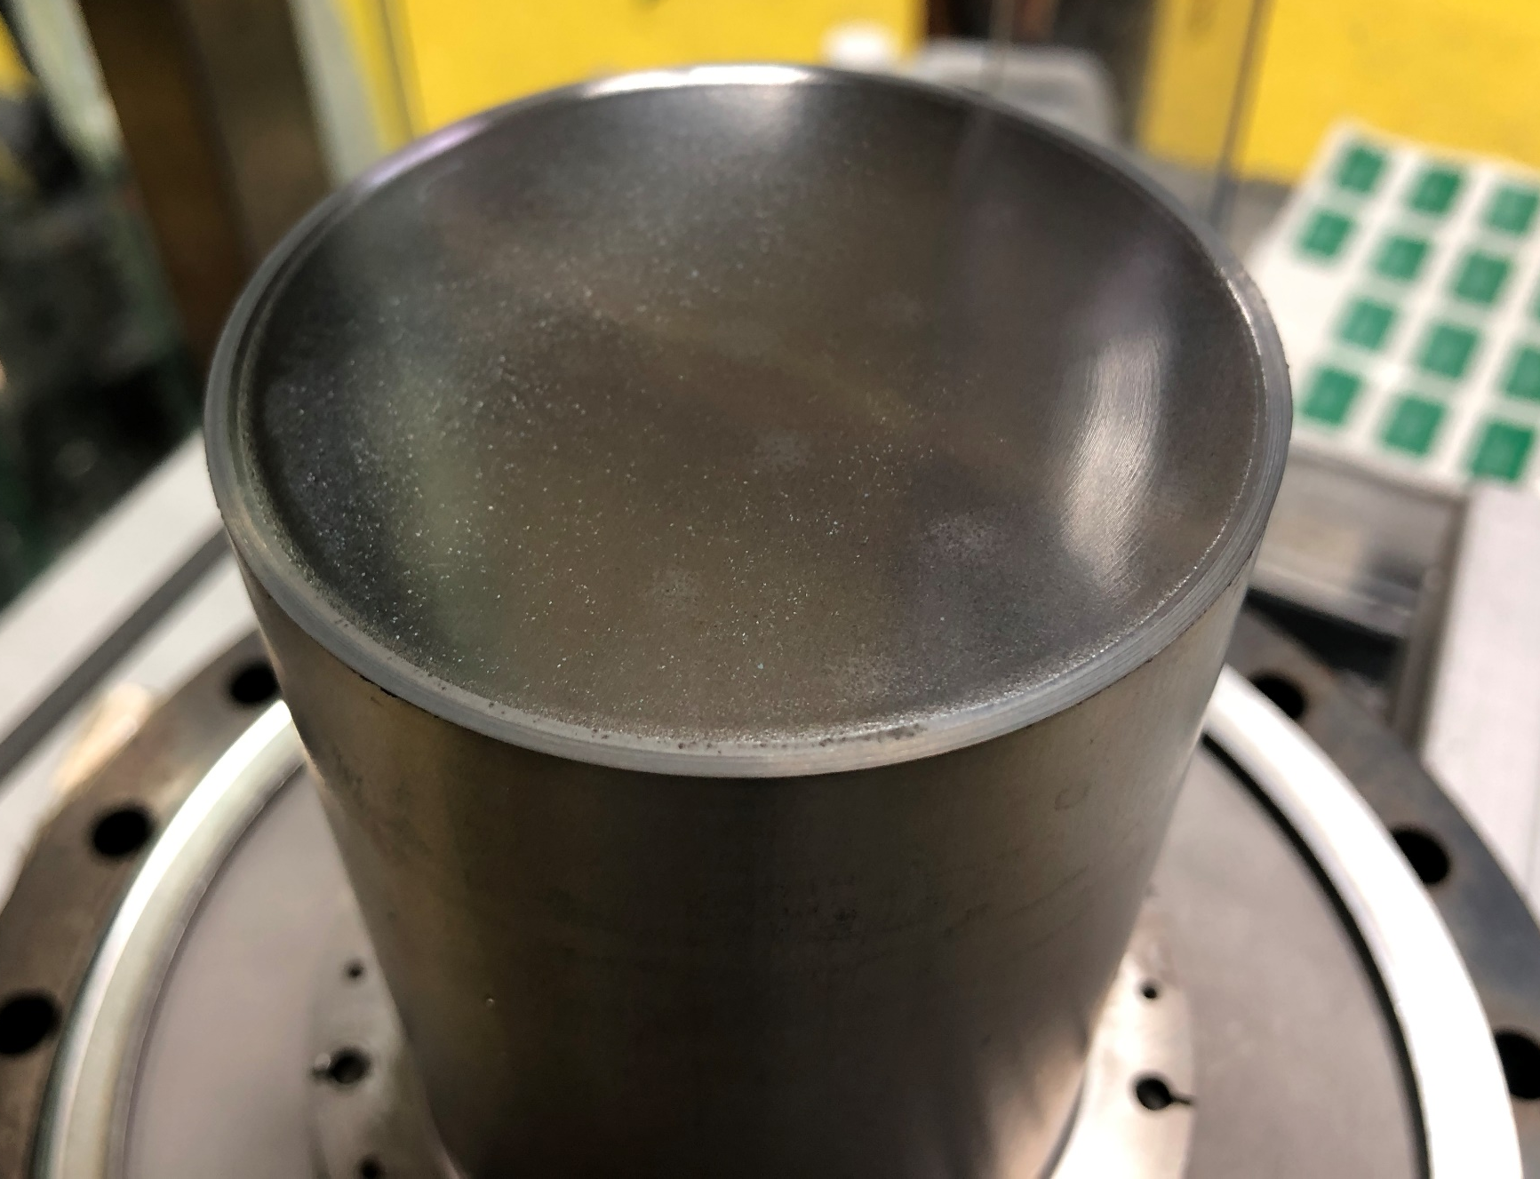
Thin film development
Techniques:
  PVD: DC, pulsed, HIPIMS…
  (PE)CVD, (PE)ALD – under development
  Combined: PCVD – under development
Materials:
  Nb
  Nb₃Sn, NbTiN, V₃Si, NbN, MgB₂, etc.
  SIS structures
Deposition facilities
  For planar samples
  For QPR samples
A sample during the Nb deposition
Courtesy of R. Valizadeh (STFC)
A QPR sample during and after the Nb TF deposition
Courtesy of R. Valizadeh (STFC)
Notes:
We have significant progress with thin film development:
read

Slide 11
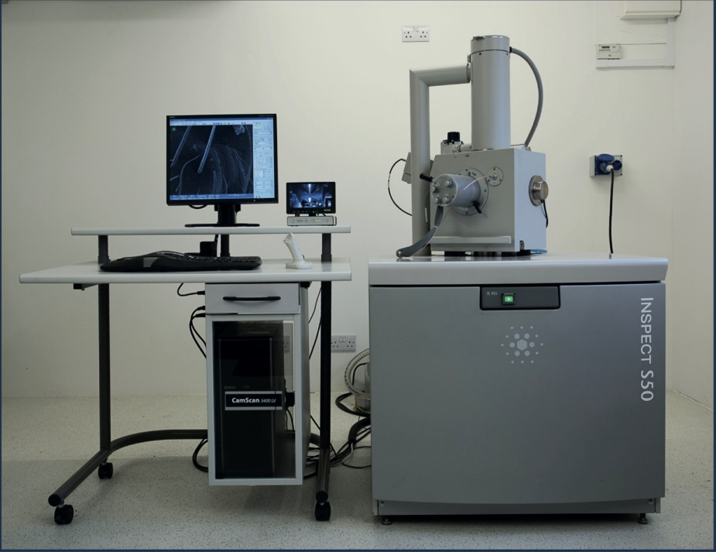
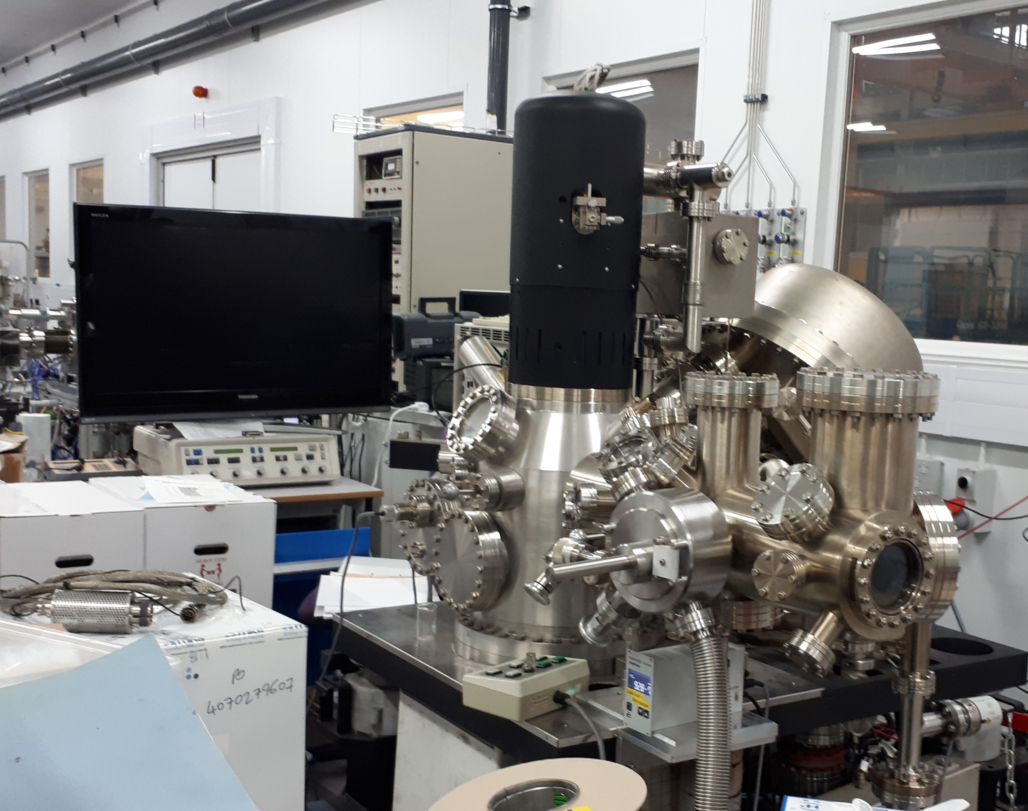
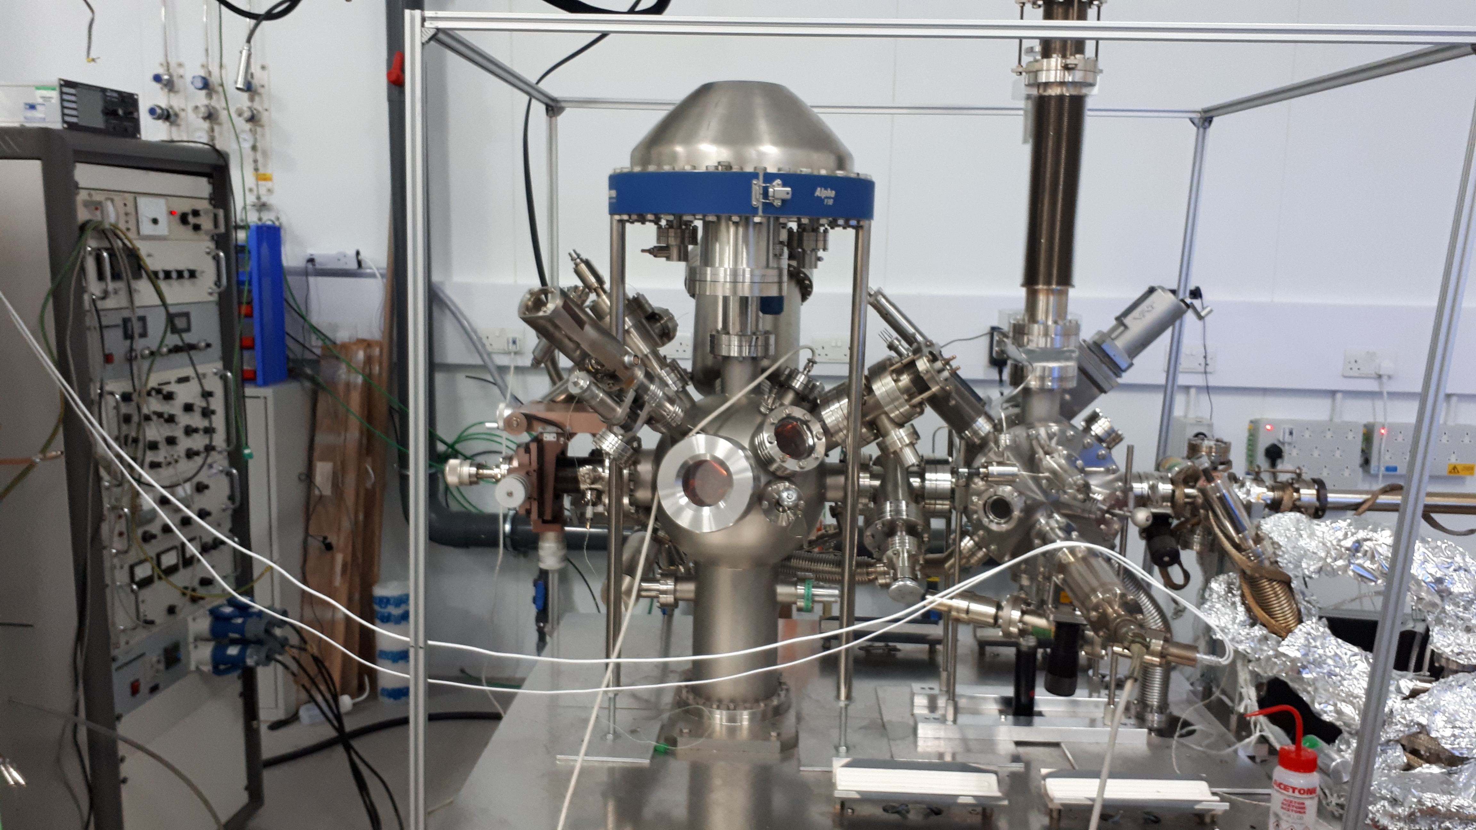
Thin Film Characterisation in VISTA
Stablished and coordinated by R. Valizadeh (ASTeC)
CI collaborators: Prof J. Bradley and Dr V. Danak (Liverpool University)
Participants: J. Conlon, C. Benjamin, S. Simon, A. Hannah, G. Stenning
Auger, XPS
FEI inspect S50 SEM
Auger
More characterisation facilities are available through collaborations with
The Materials Characterisation Laboratory at ISIS (RAL)
CI universities
Other UK universities
International collaborations
Courtesy of R. Valizadeh
Notes:
Various Thin Film Characterisation facilities for analysing TF composition, structure, morphology, etc. available in VISTA and in other labs through collaboration within UK and internationally.

Slide 12
Thin film characterisation - 1
X-section SEM of Nb₃Sn deposited on Cu
Film crystal structure with EBSD analysis of planar Nb on copper
X-section SEM of Nb₃Sn with a Nb underlayer as double structure on Cu
XRD analysis of NbTiN deposited on copper
Courtesy of R. Valizadeh (STFC)
Notes:
Various TF characterisation techniques are employed for this.
read

Slide 13
Thin film characterisation - 2
High resolution SEM of ion milled X-section of SIS multilayer structure (Nb/AlN/Nb₃Sn) deposited on Ta.
(b) EDX chemical mapping of the X-section. Courtesy of R. Valizadeh (STFC)

Slide 14
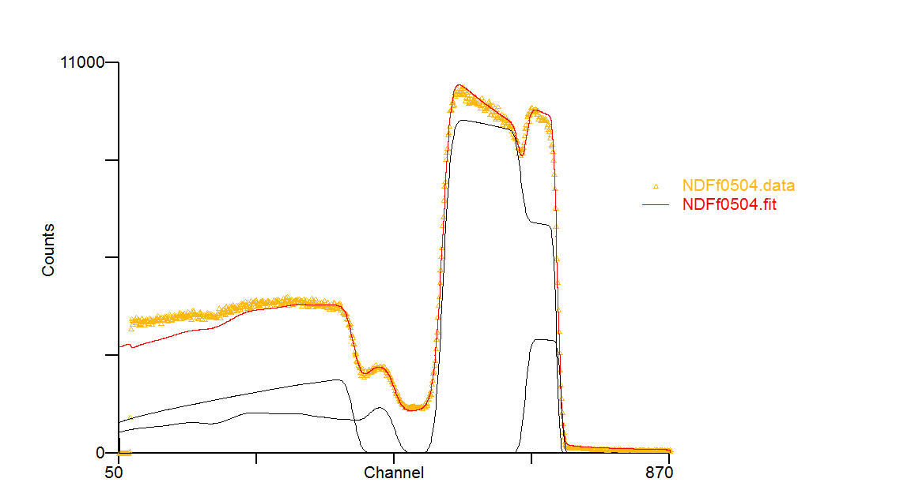
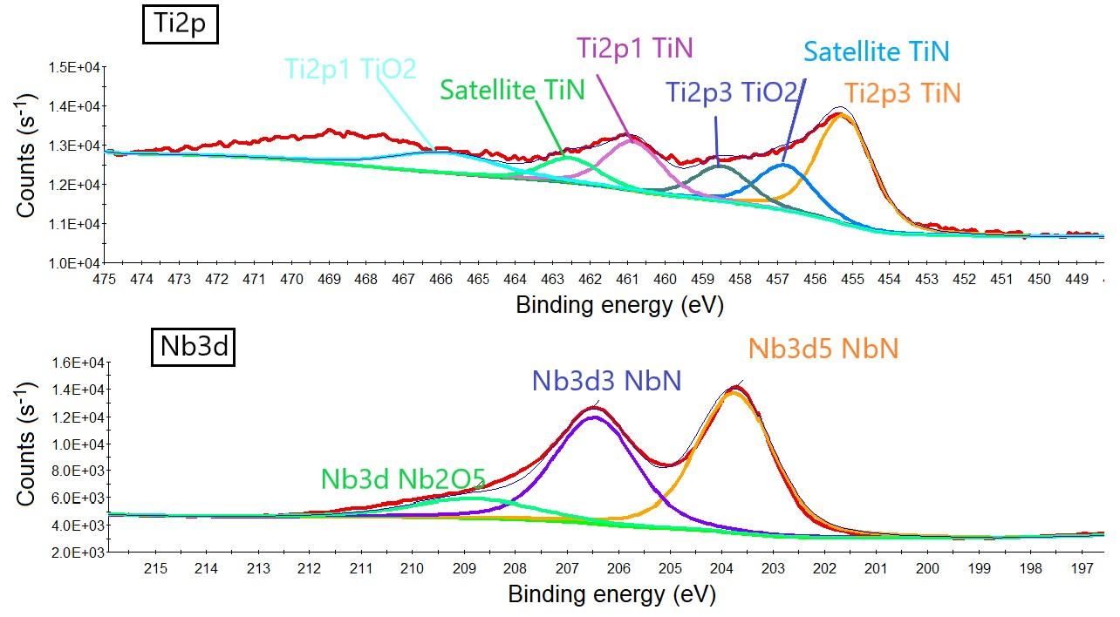
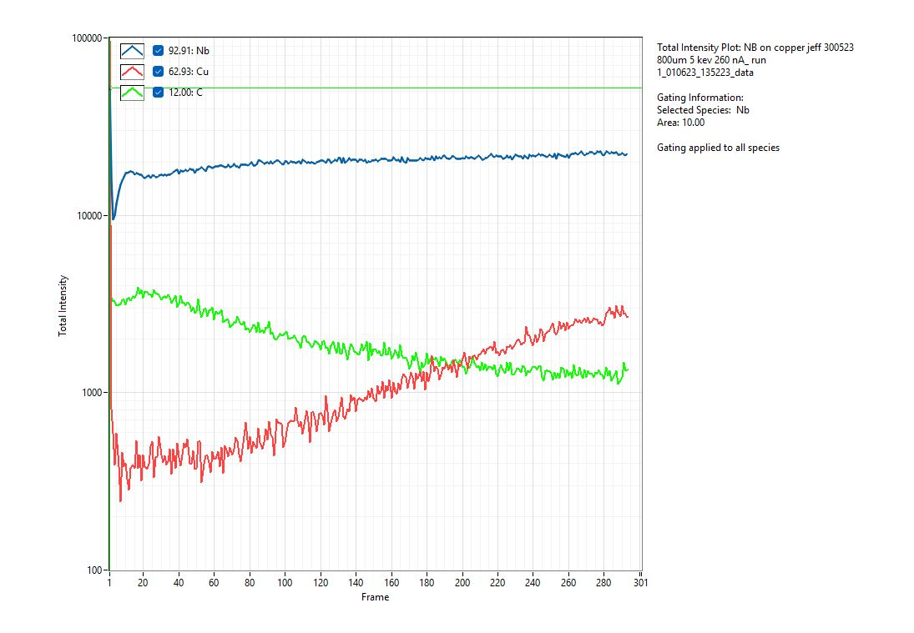
Thin film characterisation – 3
Film composition and Depth profile
XPS: Composition and chemical analysis
RBS analysis of Nb₃Sn on sapphire
Layer t (1e15at/cm2) t (nm) r(1e22at/cm3) Nb Sn O Al
1 7644.333 1497.201 5.106 75.0000 25.0000 0.0000 0.0000
2 15920.986 2855.270 5.576 100.0000 0.0000 0.0000 0.0000
3 898207.563 76119.281 11.800 0.0000 0.0000 60.0000 40.0000
SIMS depth profile of Nb on copper
XPS analysis of NbTiN representing Nb and Ti chemical state)

Slide 15
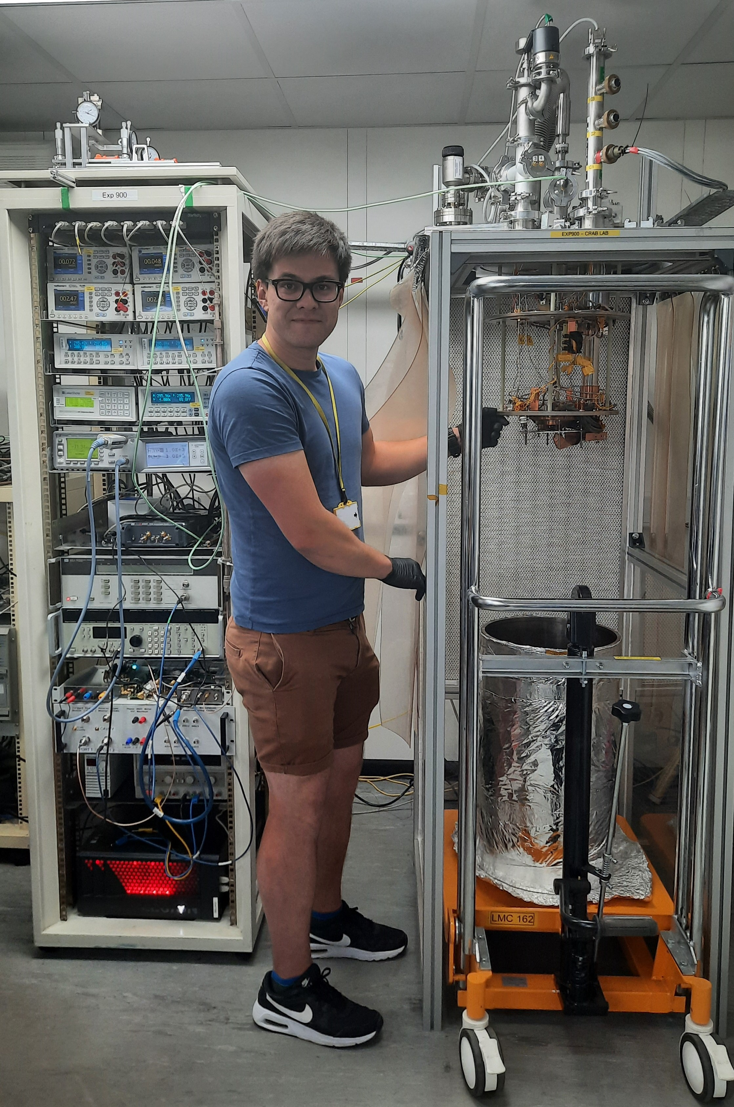
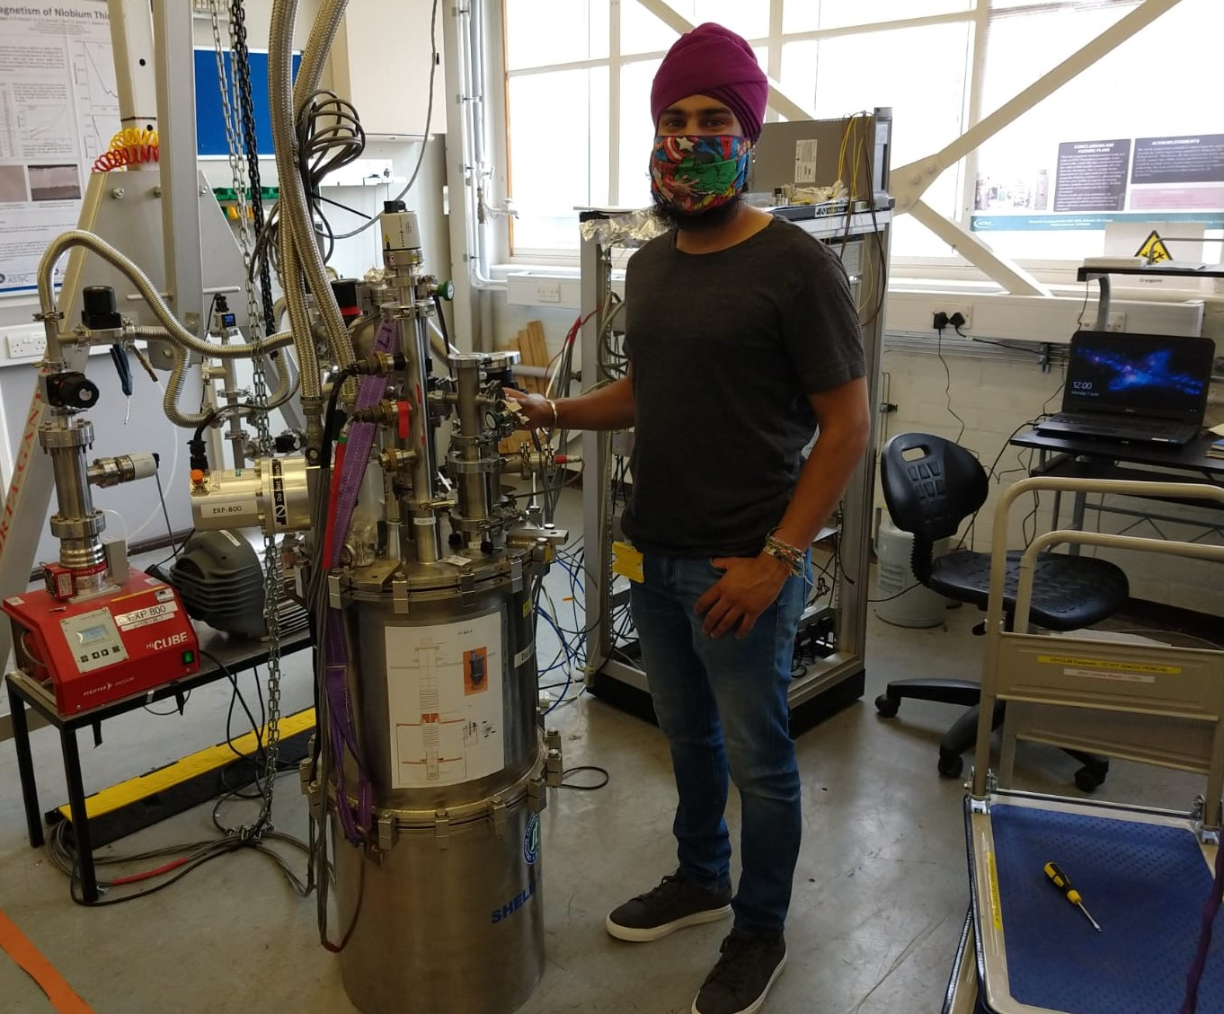
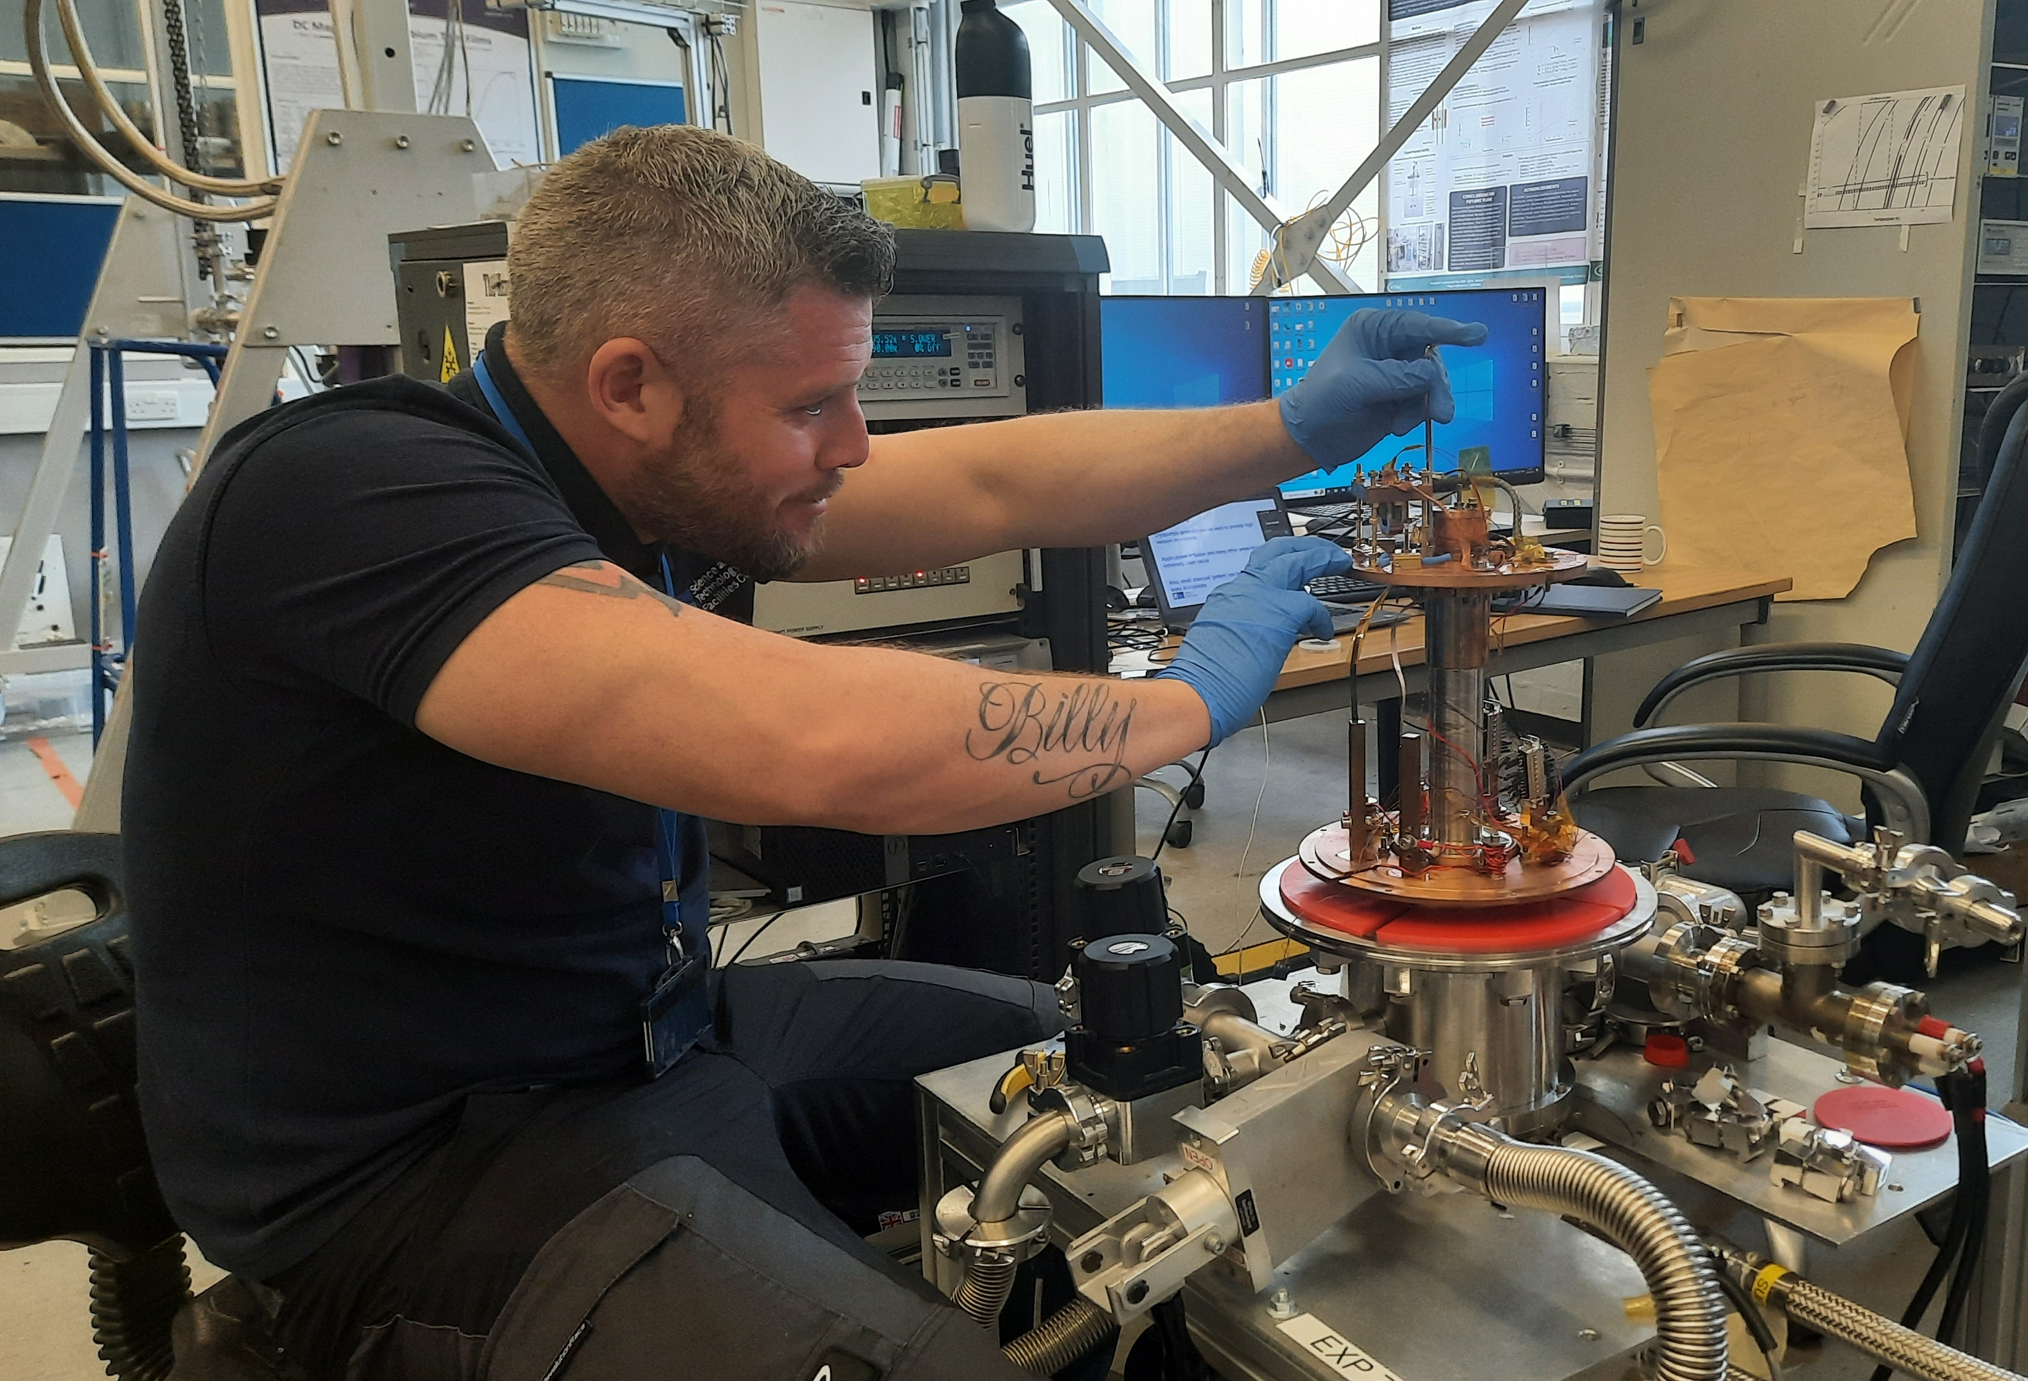
Superconducting Properties Evaluation
Coordinated by O.B. Malyshev (ASTeC)
CI collaborators: Prof G. Burt (Liverpool University)
Participants: D. Seal, L. Smith, T. Sian, D. Turner, N. Leicester, K. Marks, J. Conlon,
S. Pattalwar, A. May, K. Dumbel, J. Wilson, G. Stenning
CrabLab
CryoLab
RRR/T_{c}
+ 3 other experiments
Magnetic field penetration facility
R_{S} measurements with
a 7.8 GHz choked cavity and
a 6 GHz split cavity
Notes:
Superconducting Properties Evaluation are performed on 3 in-house designed and built facilities in Cryolab and Crablab

Slide 16
Thin film DC superconducting properties - 1
RRR and T_{c} measurements: (a) Cryostat, (b) insert, (c) sample holder
Resistance measurements for a V₃Si on sapphire
sample indicating the 10, 50 and 90 % transition points
Courtesy of L. Smith (STFC)
Notes:
First Superconducting property is whether the film is superconducting is performed by measuring RRR and Tc as shown in this slide

Slide 17
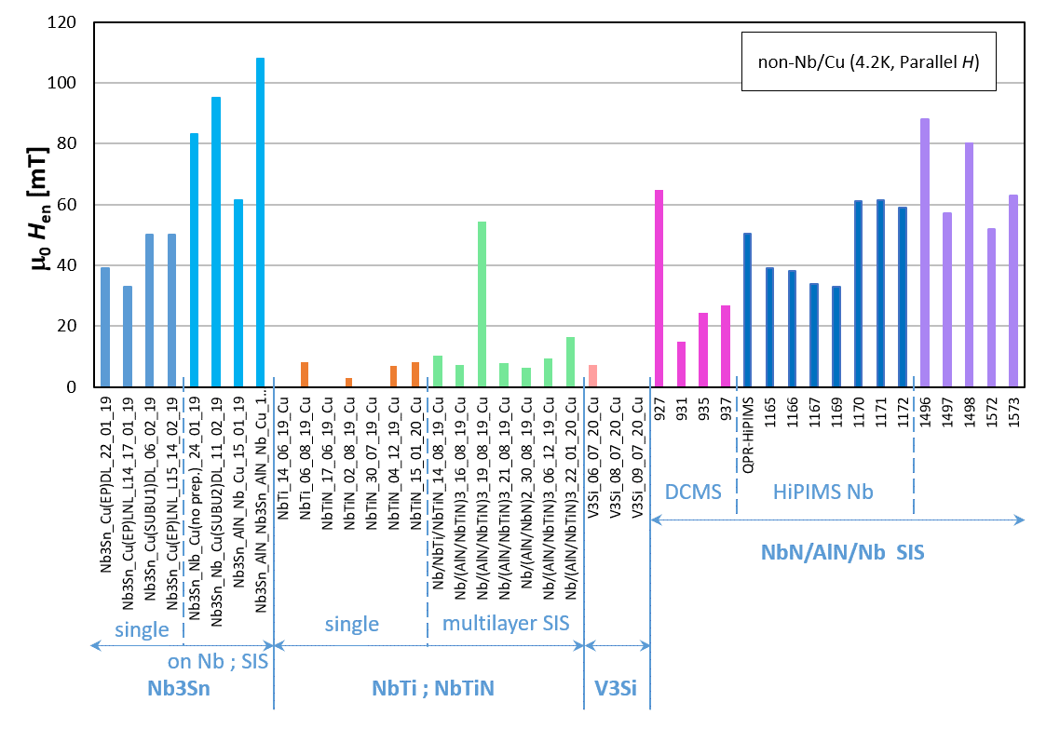
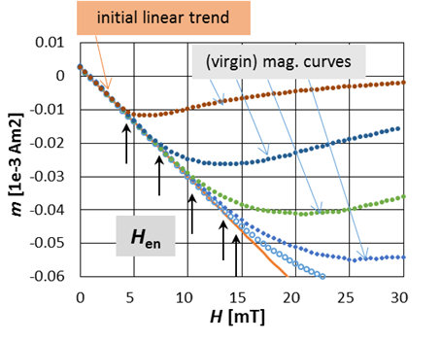
Thin film DC superconducting properties - 2
PPMS (Physical Property Measurement System)
  Virgin DC magnetisation curve: B_{en}(~B_{c1 perp}), [B_{p}, B_{c2}]
The Materials Characterisation Laboratory at ISIS (RAL)
IEE-SAS (Bratislava, Slovakia)
Nb/Cu
H_{en} for non-Nb STF produced within ARIES WP15
Courtesy of E. Seiler (IEE, Slovakia)
Determination of the characteristic field H_{en} from the virgin magnetization curves
Notes:
Physical Property Measurement Systems allow to study the characteristic field H_{en} from the virgin magnetization curves

Slide 18
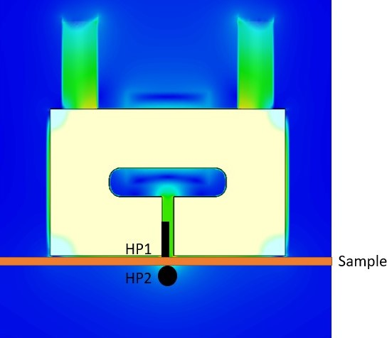
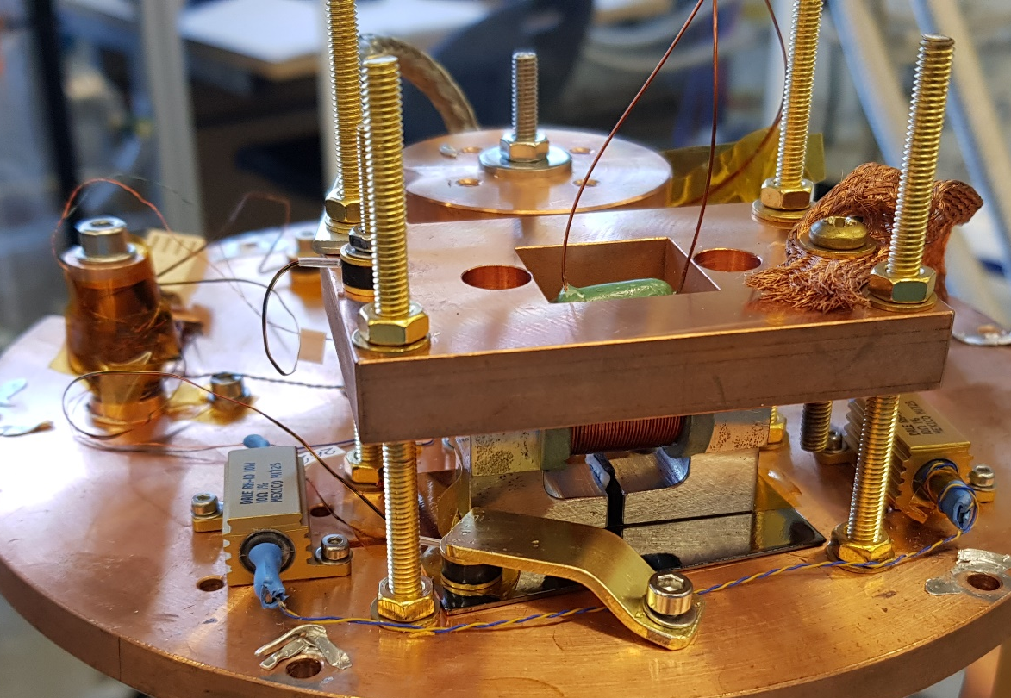
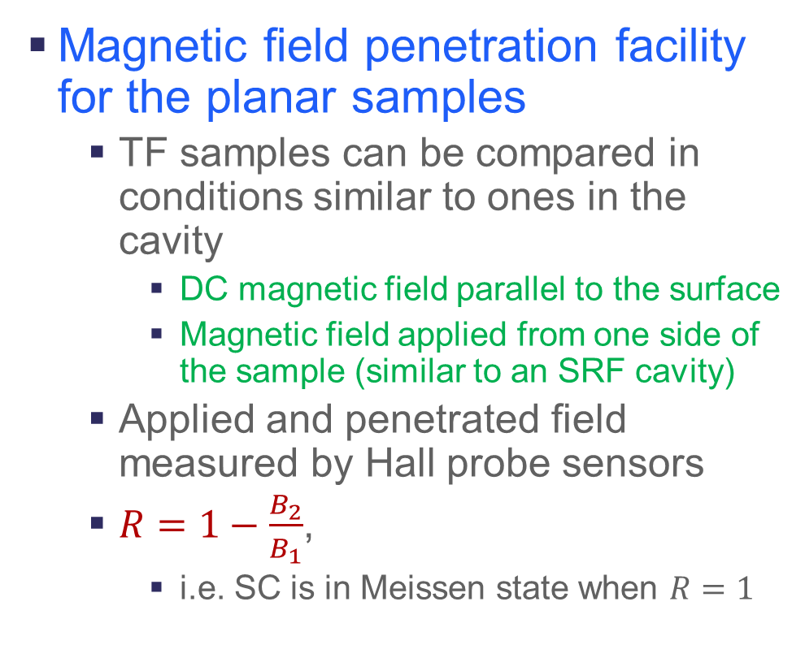
Thin film DC superconducting properties - 3
Magnetic field penetration facility for the planar samples
  TF samples can be compared in conditions similar to ones in the cavity
    DC magnetic field parallel to the surface
    Magnetic field applied from one side of the sample (similar to an SRF cavity)
  Applied and penetrated field measured by Hall probe sensors
  $R=1−\frac{B_{2}}{B_{1}}$,
    i.e. SC is in Meissen state when $R=1$
Courtesy of L. Smith (STFC)
Notes:
A unique Magnetic field penetration facility deigned and built at DL allows to TF samples be compared in conditions similar to ones in the cavity. Read green

Slide 19
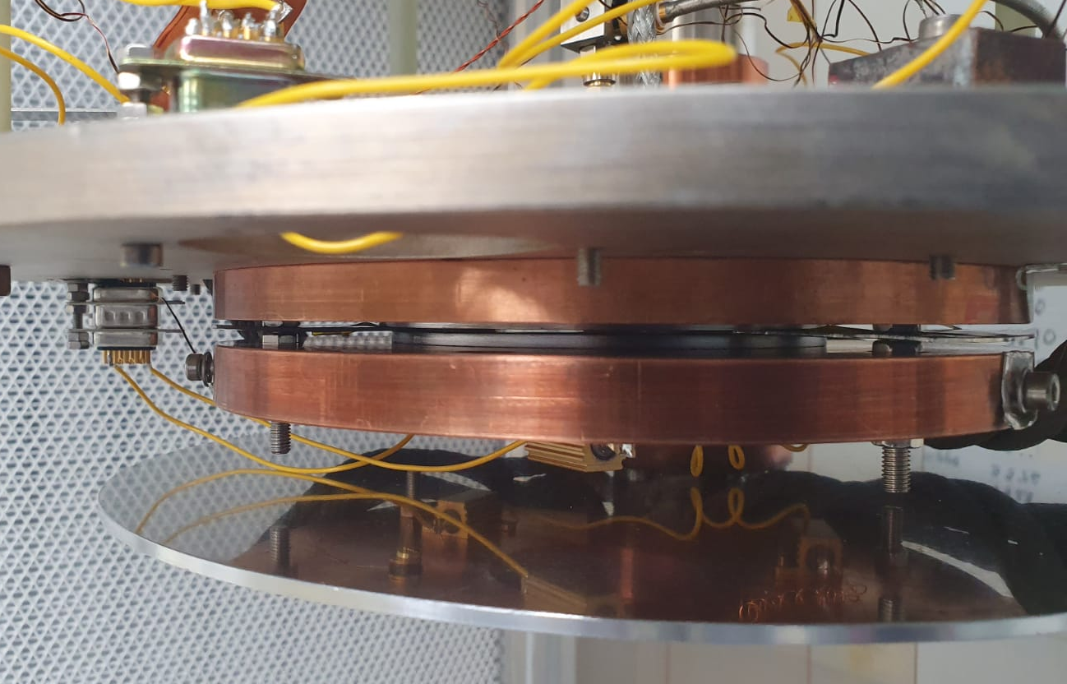
Thin film RF superconducting properties
A radiofrequency (RF) cavity and cryostat dedicated to the measurement of superconducting coatings at 7.8 GHz (CrabLab/DL/STFC)
  Operation with a closed-cycle refrigerator:
    T_{cavity} = 4.0 K and T_{sample} = 4.0 K
  Low power (≤1.0 W) measurements with an emphasis
  on fast turn-around time (~2 days for each sample).
  Flat Sample – a disk diam. 90 - 130 mm
An example of 𝑅_{s}(𝑇_{s}) measurements for Nb and Nb₃Sn TF planar samples with the choked cavity.
Cavity Plate
Sample
Sample Plate
Courtesy of D. Seal (STFC/LancU)
Notes:
Another unique facility allows to test planar samples at the RF conditions at 7.8 GHz.
The advantage of this system:
A simple sample – a disk of 100-mm diam
on fast turn-around time (~2 days for each sample).
An example of Rs(Ts) for Nb and Nb3Sn

Slide 20
A path towards the goal
(2) Superconducting thin film coated RF cavity
Notes:
All our finding must be finally lead to RF cavity deposition and testing

Slide 21
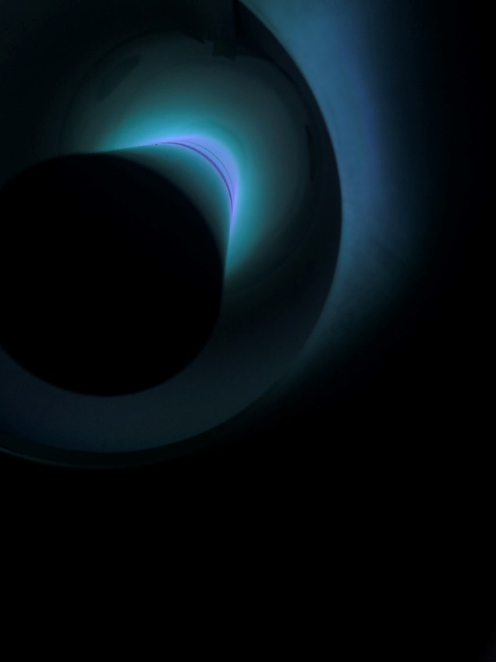
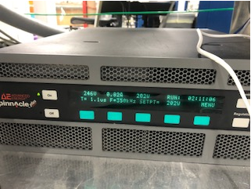
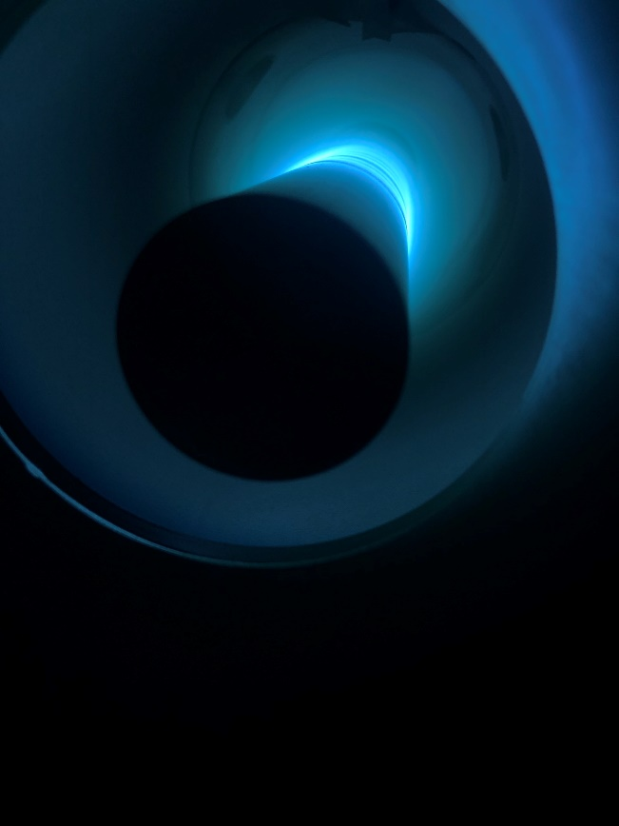
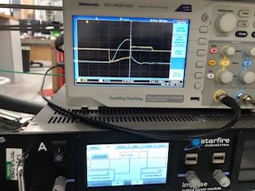

Development of 6 and 1.3 GHz cavity coating
Cylindrical Magnetron has been built
Nb thin film depositions on cylindrical and cavity shaped surfaces are ongoing
Cylindrical magnetron in low power (DC) sputtering mode
Plasma dominated by argon emission
Cylindrical magnetron in high power (HIPIMS) sputtering mode
Plasma dominated by niobium emission

Slide 22
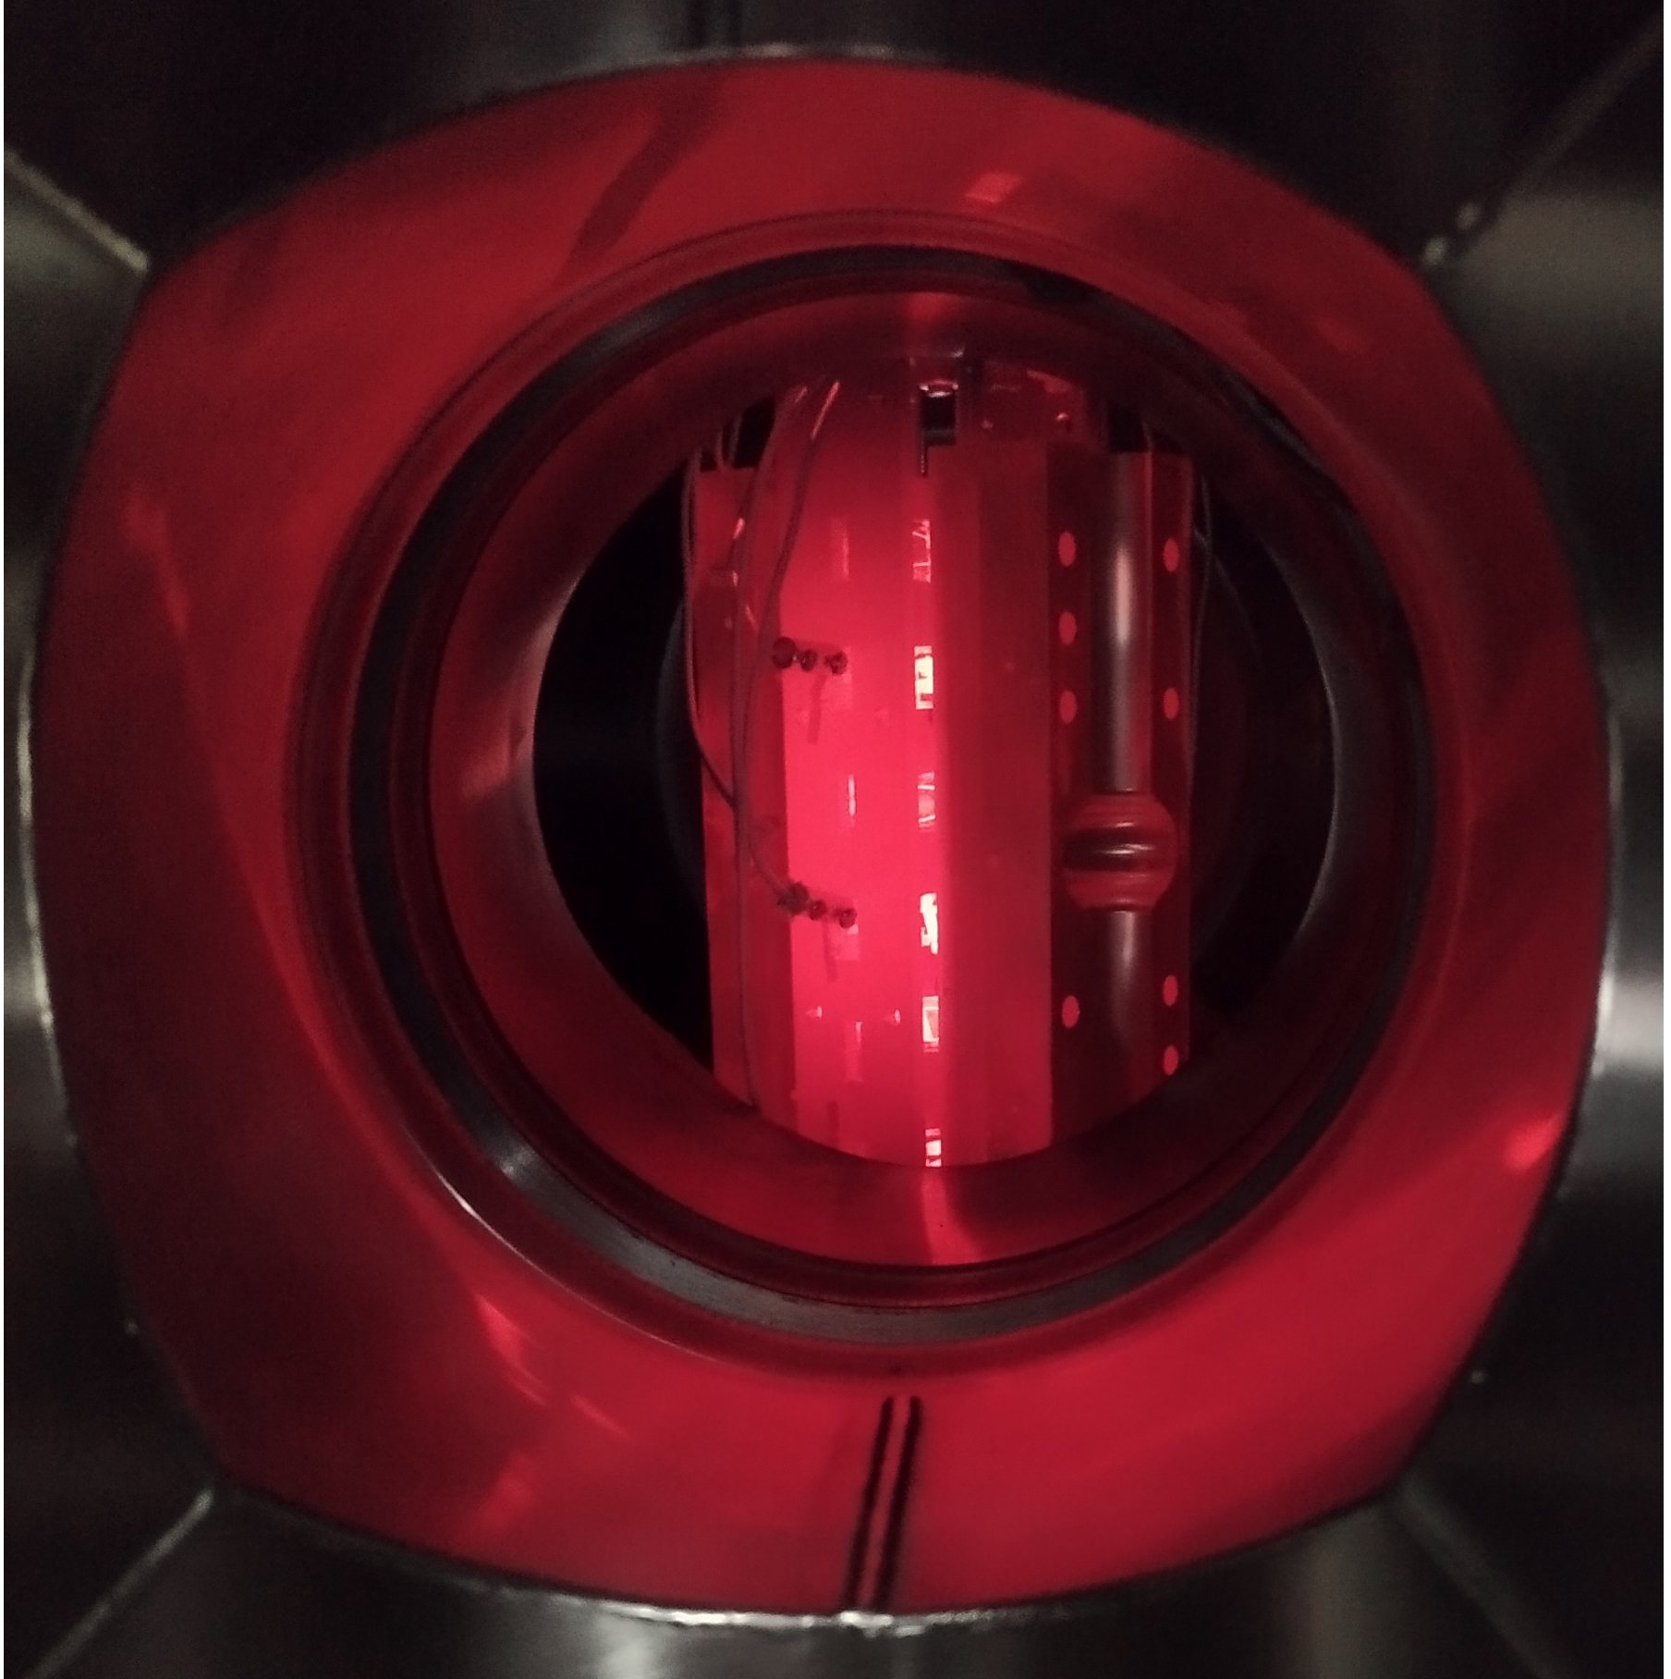
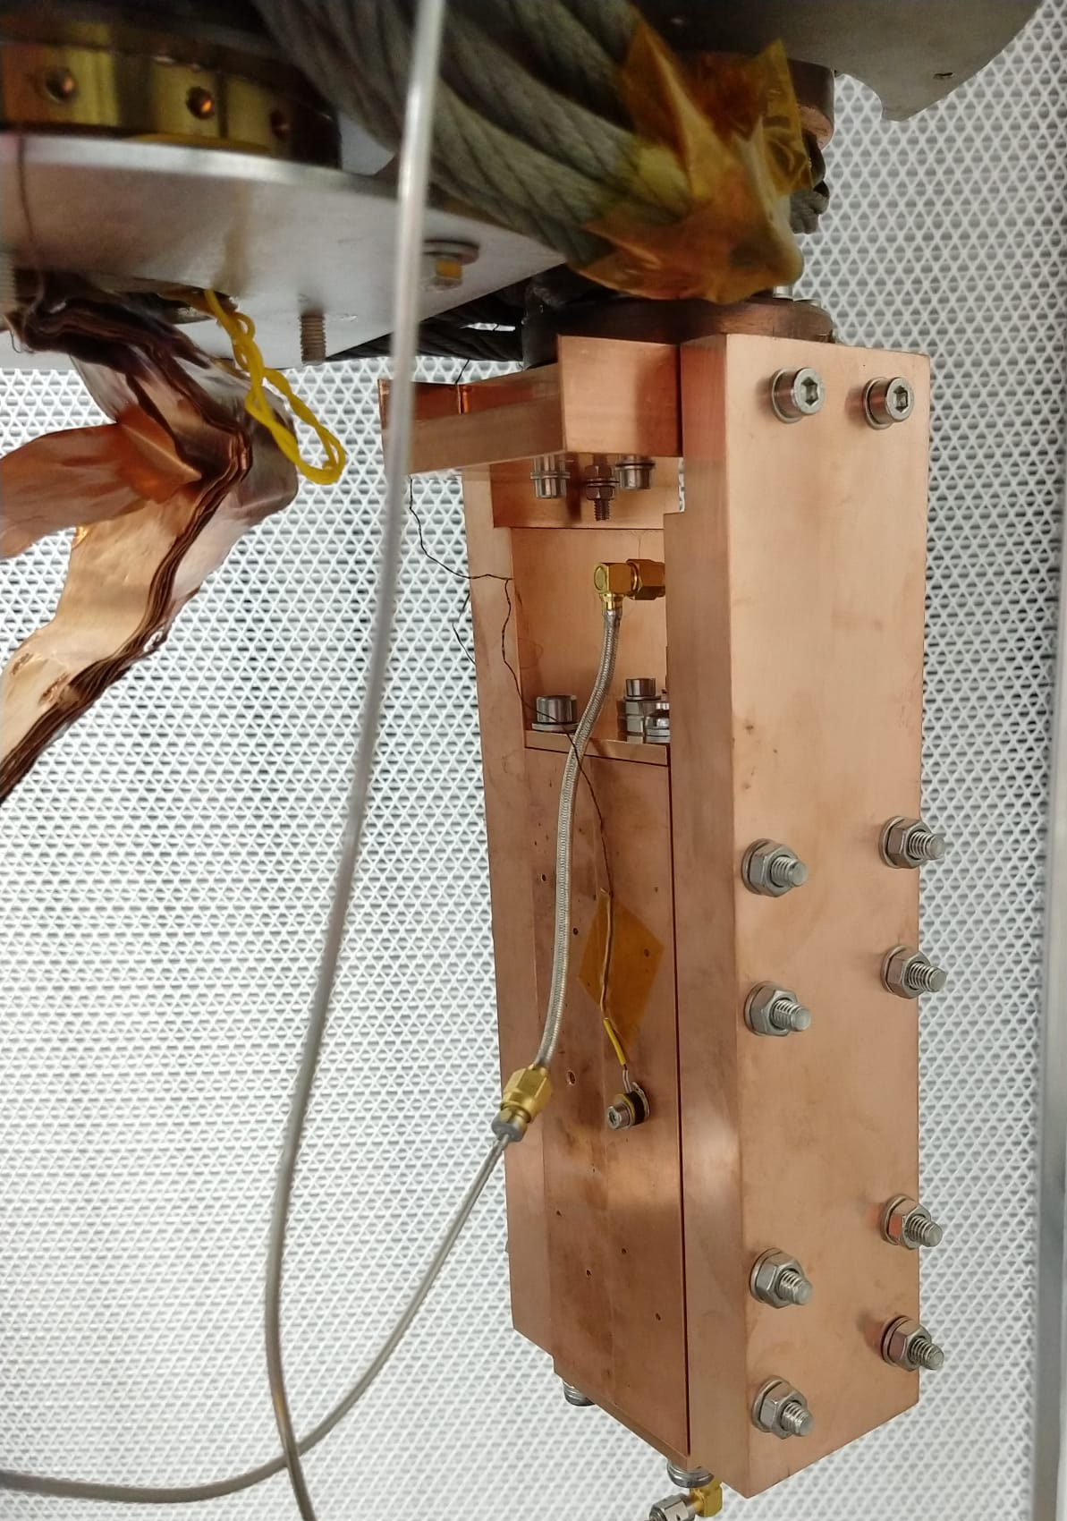
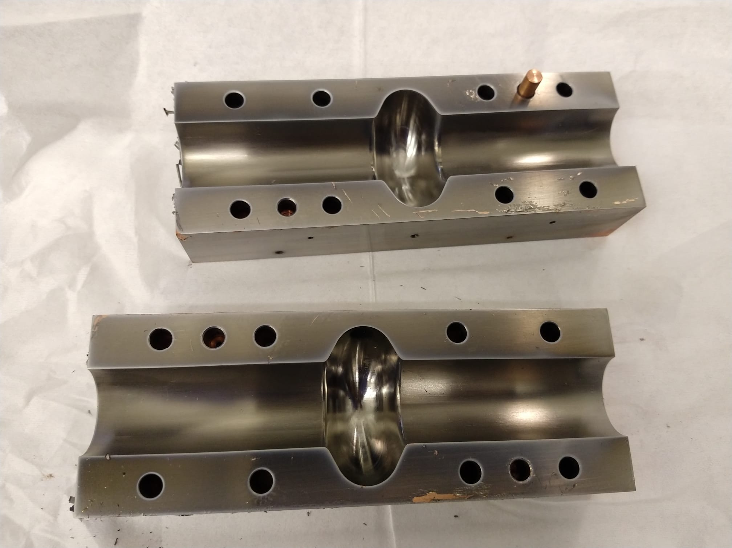
6 GHz split cavity
An idea suggested by G. Burt (CI)
The cavity cut is along the electric field lines, i.e. electric current is not crossing the cut
Easy to coat with either conventional planar magnetron or in tubular geometry used for RF cavities
Easy to inspect
Two 6 GHz cavities were Nb coated and tested at 4.2 K ≤ T ≤ 11 K
Surface resistance R_{s} as a function of temperature
for Nb thin films coated split cavity
Split cavity mounted on the cold head for cryogenic measurements
Nb thin films coated split cavity
A split cavity during thin film deposition
Courtesy of N. Leicester (STFC/LancU), T. Sian, and J. Conlon (STFC/LancU)
Notes:
Another unique project is exploring a longitudinally split cavity.
Read

Slide 23
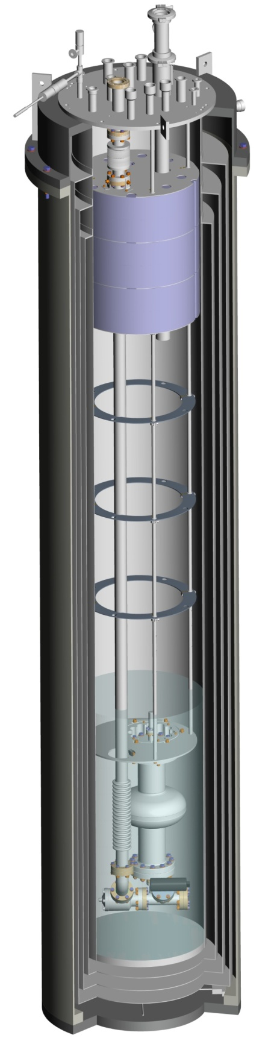
1.3 GHz cavity testing
Aiming a high power test
  Required fully operational by end of 2023
    Main Delivery for IFAST WP9: a non-Nb SC coated prototype testing (by March 2025)
  Cryostat and insert:
    Cryostat is available
    New insert is designed, parts manufactured, assembling in process
  Copper cavity:
    will be provided by I.FAST partners: Piccoli and LNL/INFN
    looking for UK industry as well
    Coating with STF at STFC/DL
  Clean room for assembling the cavity – TBD
  RF amplifier – under development
  Bunker and cryogenics:
    SuRF lab infrastructure is available
Notes:
Finally, the deposited cavity must be tested
Read

Slide 24
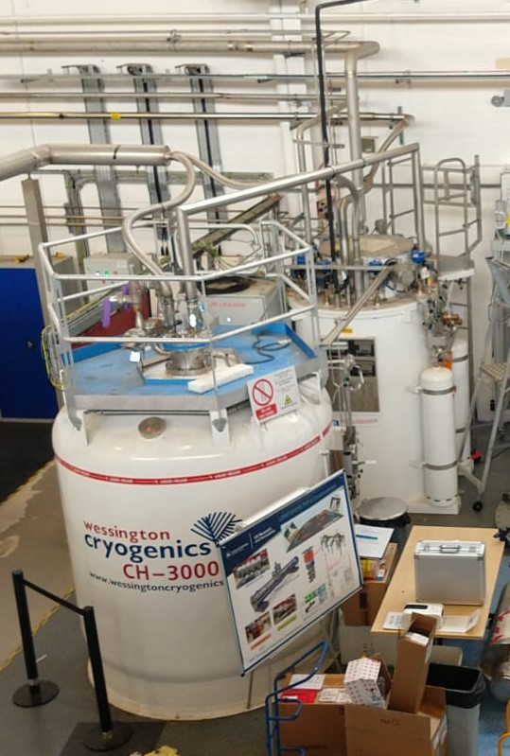
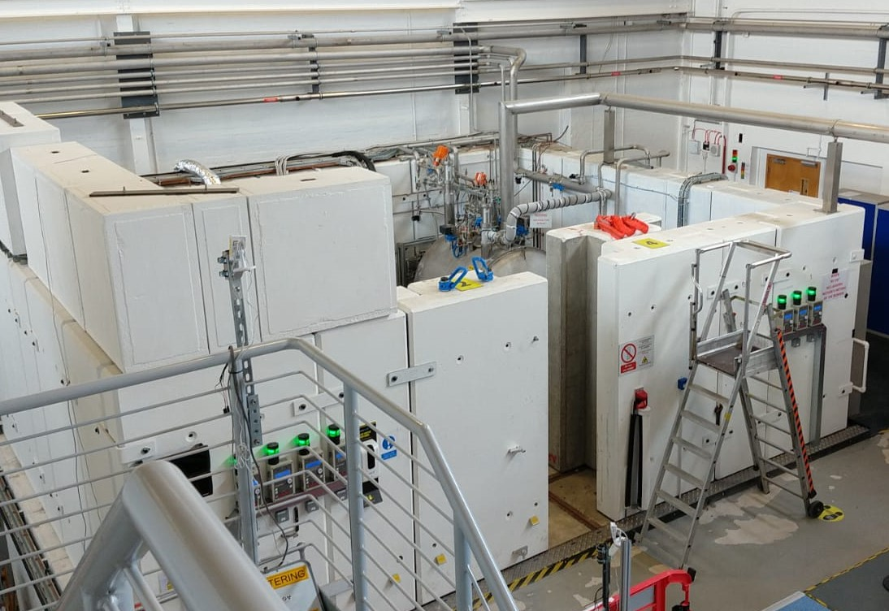
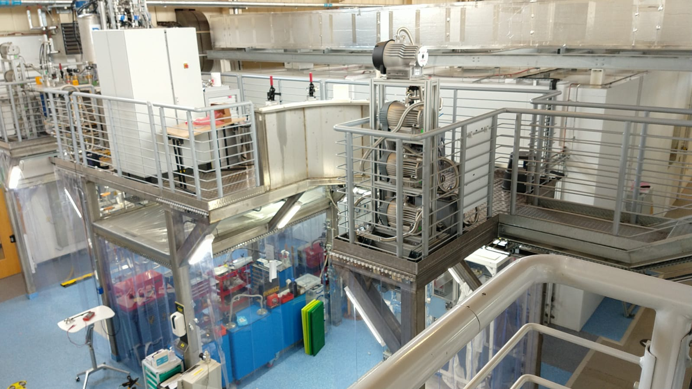
Superconducting Cavity Evaluation in SuRF lab
This STFC/DL infrastructure
is being used for the full power SRF testing of >160 cavity modules for ESS and
will be used for SRF testing of PEP-II cavities
He liquefier and
LHe storage Dewar
This infrastructure can be used in future for the full power SRF testing of superconducting thin film coated RF cavities
SRF bunker
Clean room and assembly area
Courtesy of T. Sian
Notes:
Large infrastructure already exist in STFC/DL for Superconducting Cavity Evaluation .
Read

Slide 25
Future for TF-SRF cavities in UK
Development
Possible applications
Single layer coating:
  Nb
  Nb₃Sn, NbTiN, V₃Si, Mg₂B
Multilayer coatings
  SS, SIS, SISIS…
Multicell cavity coating
Split cavity development
Low and high power RF testing at STFC/DL
RF loaded test in CLARA
  Multicell cavities
  Split cavity
  LHe-free cryo-cooling
UK-XFEL
ISIS-II
…
Possible involvement in international projects (e.g. ILC, FCC…)
Notes:
The future development will be following these stages: read
Ultimately, the RF civilities should be used for future machined : read

Slide 26
Conclusions
A significant progress since the programme started in 2014
Developing coating technology for superconducting thin films: an ongoing systematic study of correlation between deposition parameters and superconducting properties:
  Mastering Nb deposition
  Ongoing
  Development in non-Nb films: Nb₃Sn, NbTiN, V₃Si, Mg₂B…
  Ongoing
  Developing deposition targets for non-Nb films
  Ongoing
  Deposition of SIS structures (e.g. Nb₃Sn/AlN/Nb/Cu)
  Ongoing
  Thin film characterisation: SEM, FIB, XPS, XRD, AFM, RBS…
  Ongoing
  DC/AC superconductivity evaluation with in-house built and commercially available facilities
  Ongoing
  RF superconductivity evaluation with 7.8 GHz choked cavity test for planar samples
  Ongoing
Developing cavity deposition expertise
  Copper cavity production (incl. EB welding)
  Looking for industry partners
  Polishing and cleaning of copper cavities
  In plans (industry or in-house)
  Building and commissioning deposition facilities
  Ongoing
  Optimising deposition parameters for 1.3 and 6 GHz cavities
  Ongoing
  Plasma characterisation
  In progress
  Developing deposition targets
  In progress
SRF testing at DL
  6 GHz split cavity low power testing
  Ongoing
  Full power testing facility for 1.3 GHz cavity
  Nov. 2023
  Scaling up to a routine cavity coating and testing
  In plans - 2025
  Multicell cavities
  In plans - 2028
Applying TF-SRF cavities
  UK projects: UK-XFEL and ISIS-II
  In plans - 2025
  International projects, for example: FCC
  In plans – 20??
Notes:
In conclusion you cab see that UK team is progressing well in TF development with a number of ongoing activities.
We are in a progress towards a single cavity coating and testing
And we have a vision to the future development and applications

Slide 27
Acknowledgments
STFC/ASTeC:
  R. Valizadeh, C. Benjamin, L. Smith, A. Hannah, T. Sean, J. Conlon, F. Goudket, S. Wilde, S. Pattalwar, N. Pattalwar, A. May, P. Smith, J. Wilson, K. Dumbel, …
STFC/ISIS:
  G. Stenning
Liverpool University:
  J. Bradley, V. Danak, S. Simon, F. Lockwood Estrin, F. Walk
Lancaster University:
  G. Burt, H. Marks, D. Turner, D. Seal, N. Leicester
CEA:
  C. Antoine, …
CERN:
  A. Sublet, W. Venturini, G. Vandoni, M. Taborelli, …
IEE:
  E. Seiler, R. Ries and F. Gömöry
IJClab:
  D. Longuevergne and O. Hryhorenko
INFN
  C. Pira, E. Chyhyrynets, …
HZB:
  O. Kugeler, S. Keckert, D. Tikhonov, …
RTU
  A. Medvids, P. Onufriev …
Siegen University
  M. Vogel, A. Zubtsovskii …
…

