Slide 1
Superconducting Thin Film Coating for Radio Frequency Cavities (TF-SRF) at STFC/DL/CI
Main goal:
to enable STFC for the superconducting thin film coated cavity production and testing
Main objectives:
Developing coating technology for superconducting thin films (STF)
Deposition of Nb, Nb₃Sn, NbTiN, V₃Si, Mg₂B, … and SIS structures
Deposition targets for planar deposition (Nb₃Sn, NbTi, V₃Si, Mg₂B)
Thin film characterisation
AC/DC superconductivity evaluation
Developing cavity deposition expertise
Copper cavity production
Cavity polishing and cleaning
Building deposition facilities
Optimising deposition parameters
Deposition targets for cavity deposition in form of tubes or rods: Nb₃Sn, NbTi, V₃Si, Mg₂B
SRF testing at DL
1.3 GHz (and 6 GHz) cavity testing as 1st step
Scaling up to a routine cavity coating and testing
Multicell cavities
Possible topics
for STFC-DAE collaboration

Slide 2
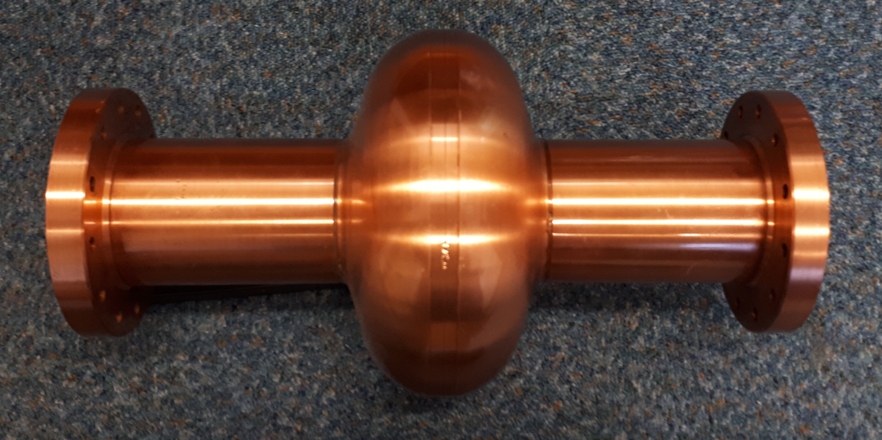
Copper cavity preparation
Copper cavity production:
Half-cell by machining or hydroforming, copper tubes and 316LN flanges,
Seamless cavity production
then EB welding
Chemical polishing:
SUBU5 solution,
Electropolishing (EP)
Cavity shipping:
With flanges, filed with N₂

Slide 3
Deposition targets
For planar deposition:
Materials: Nb₃Sn, NbTi, V₃Si, Mg₂B…
Diameter 50 mm and 100 mm
For cavity deposition:
Materials: Nb₃Sn, NbTi, V₃Si, Mg₂B…
A tube diam. 10-20 mm and length of 0.5-1 m
or a road diam. 2-5 mm and length of 0.5-1 m
For NEG deposition:
Materials: alloys of
Ti-Zr-V, Ti-Zr-Hf-V, Zr-Hf-V, with or w/o Cu or Ag,
Zr-Cu, Zr-Ag
or a road diam. 1-3 mm and length of 1-2 m

Slide 4
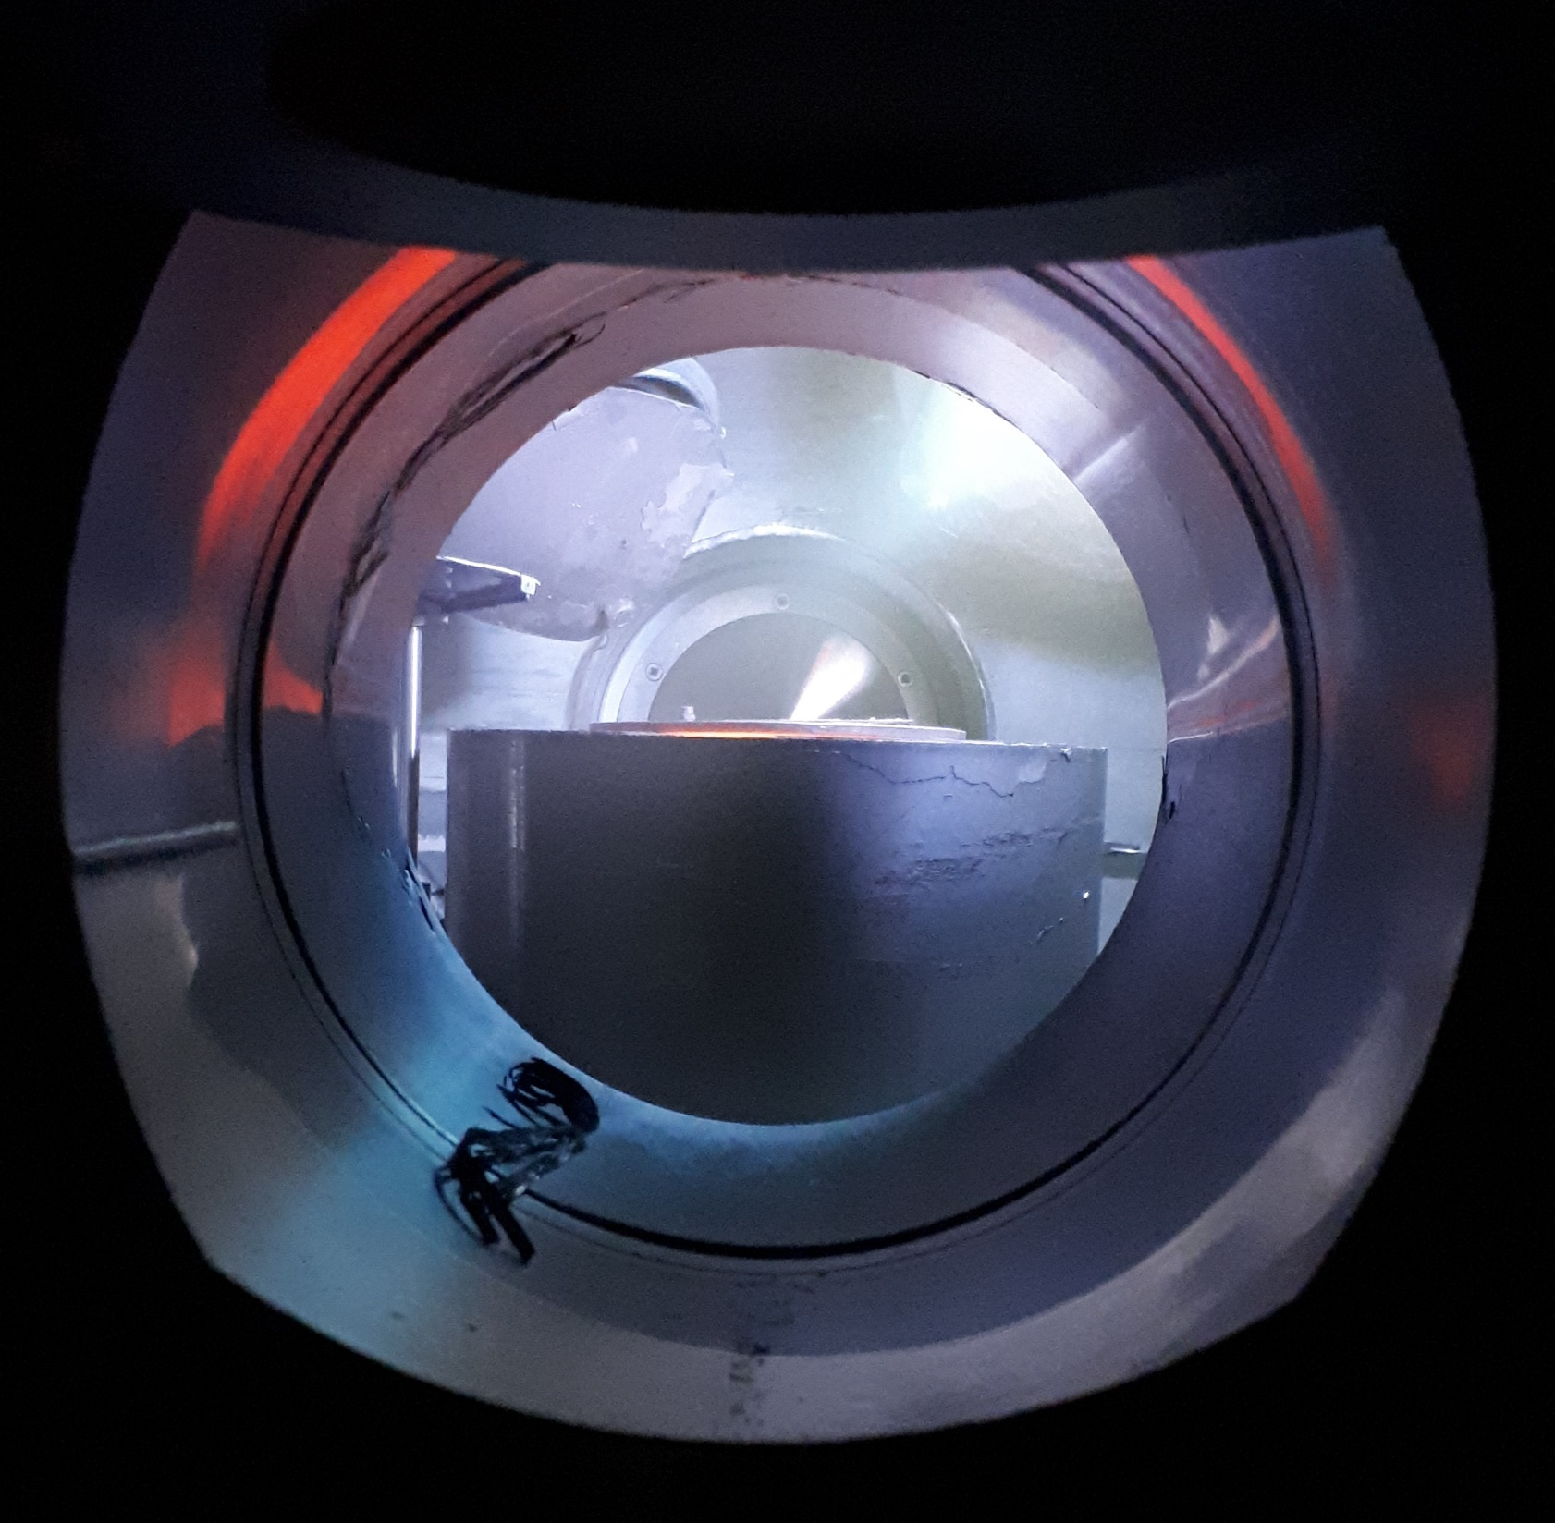
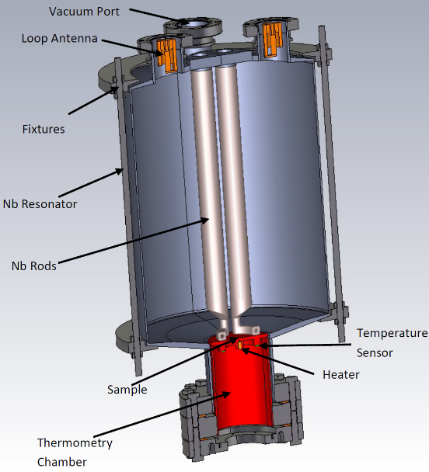
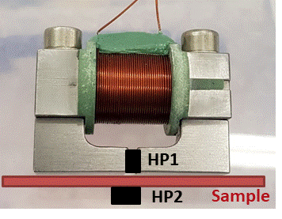
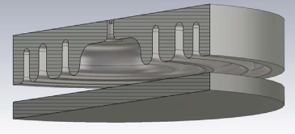
International collaborations
I.FAST WP9: Innovative superconducting cavities (01/05/2021-30/04/2025)
The main emphasis is on applying the result of ARIES to RF cavity deposition and testing
Thin film deposition
PVD: DC, pulsed, HIPIMS…
Film characterisation
SEM, FIB, AFM,
Real cavity measurement
Cavity deposition
(PE)CVD, (PE)ALD
XPS, XRD, RBS, TEM…
Superconducting RF properties evaluation
Superconducting properties measurement
RRR, H_{c}, H_{fp}, H_{sh}, …
QPR at CERN
QPR at HZF
HW cavity at ASTeC
Nb, NbN, Nb₃Sn, MgB₂, SIS, etc.
Surface preparation
Cleaning, etching,
Polishing, passivating
DC magnetic susceptibility,
Field penetration
Nb film laser treatment
Film deposition
1.3 GHz cavity for STF deposition
ARIES WP15: (01/05/2017-30/04/2021)
The main emphasis is on a systematic study of correlation between
SEM image of a NbN thin film
QPR
DC magnetisation
Test cavity

Slide 5
Other ways of collaboration
ASTeC vacuum solution group is well equipped and experienced to train:
a visiting scientist (postdoc) – recommended duration is 6 months or longer
PhD student (registered at any Indian University) – recommended duration is at least 12 months
Topics:
Vacuum system design and operation (for accelerators and in general)
Vacuum science
Non-evaporable getters
Low SEY
Thin film coatings and characterisation
Thin film SRF

