Slide 1
LBNF Target and Associated Equipment PI & PM Report
6th February 2024
Chris Densham (PI), Peter Loveridge (PM), Joe O’Dell, Eric Harvey-Fishenden, Dan Wilcox, Mike Fitton, Mike Parkin, Richard Cowan, Andrew Lintern, Angus Mackley, Joe Bennett (STFC Rutherford Appleton Laboratory)
John Back (University of Warwick)
Biao Cai (University of Birmingham)
Dong Liu (University of Bristol)
Jicheng Gong (University of Oxford)

Slide 2
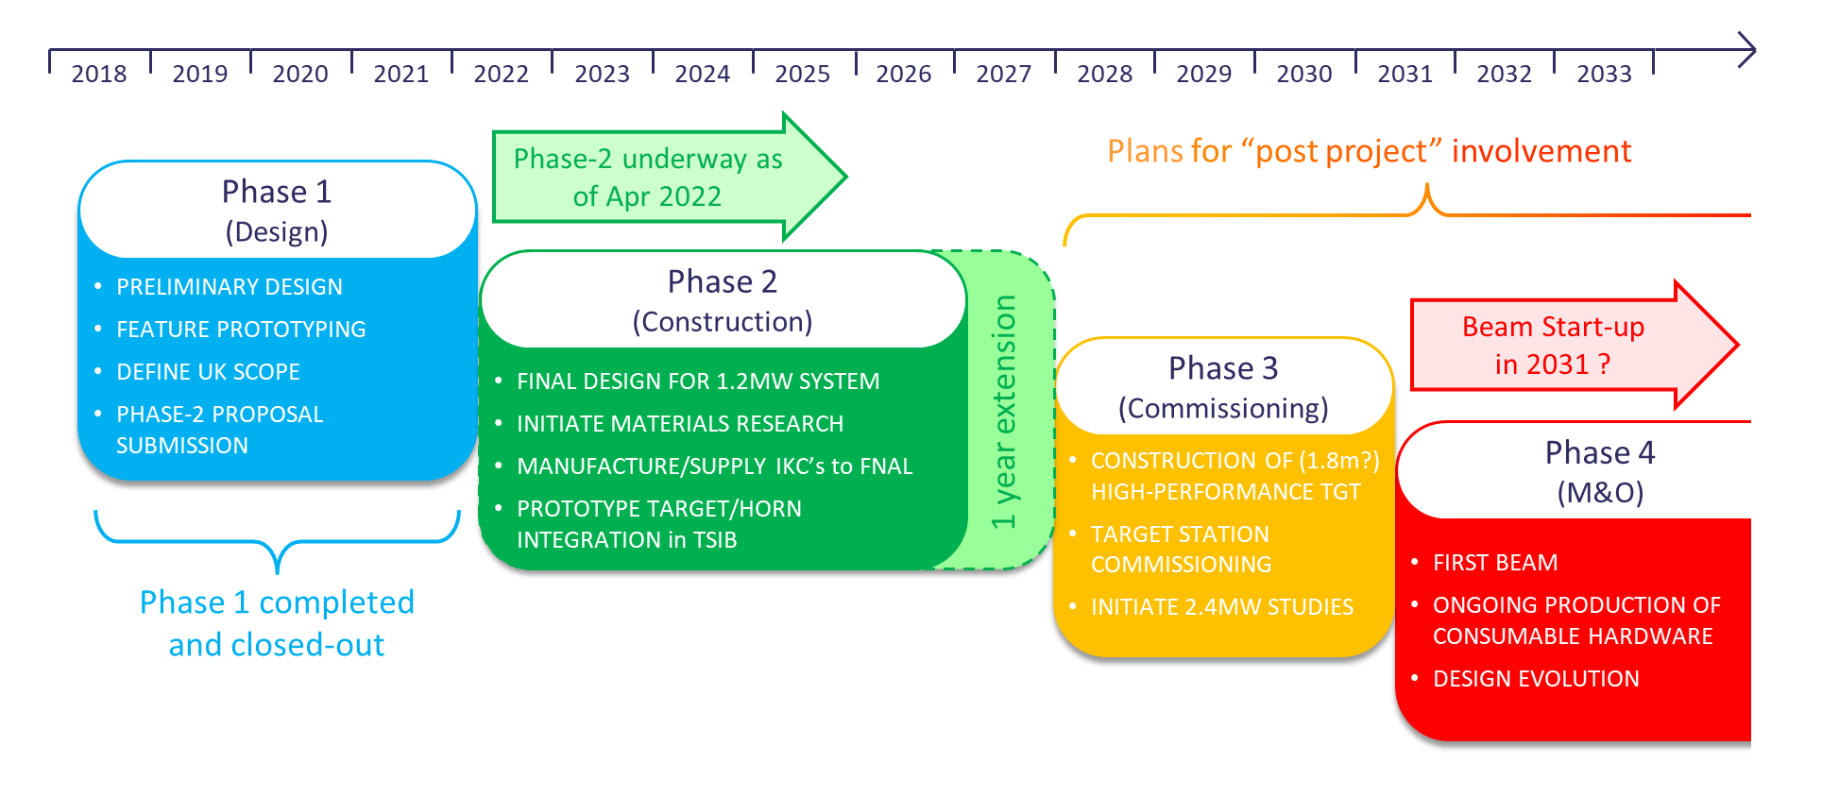
UK Project Timeline and Phases
CR005
CR004
CR006

Slide 3
Change Requests submitted to OsC
A technical change to the design of the helium flex-lines and a requested transfer of scope to Fermilab for manufacture (CR003 version 2)
A 1-year Phase-2 project extension to March 2028 needed to complete the present scope (CR005)
Includes deferring Birmingham University PDRA to 2027-2028
Presented to STFC Oversight Committee 6th Feb
Being considered for approval by LBNF/DUNE Project Board today
A 3-year Phase-3 commissioning and upgrade project, bridging from the end of the phase-2 project to beam start-up anticipated 2031 (CR004 version 2)
An Ongoing Maintenance & Operations phase to support LBNF beam operations (CR006)

Slide 4
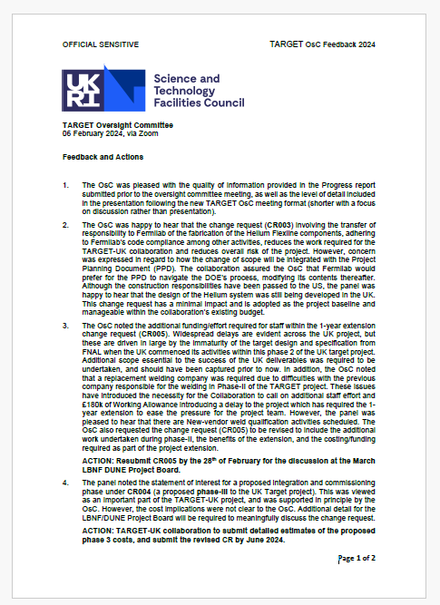
Feedback from OsC

Slide 5
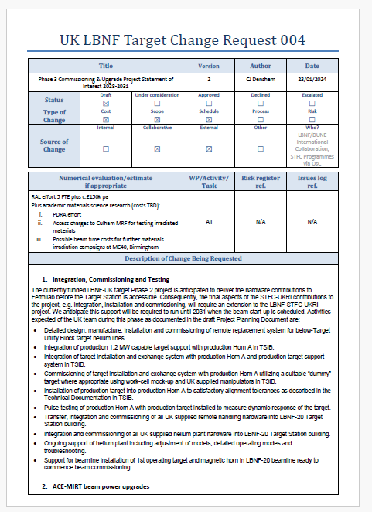
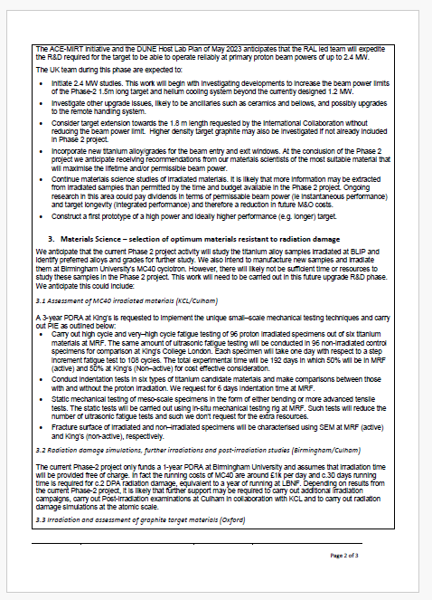
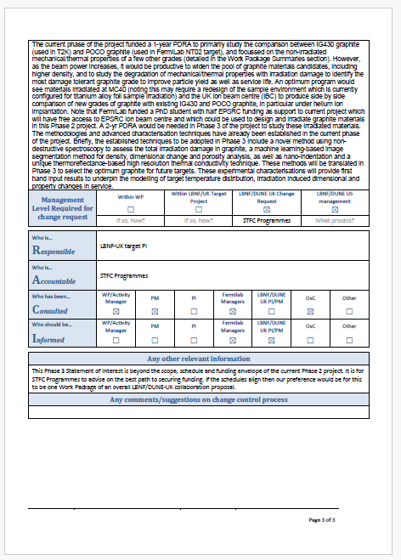
Change Request for Phase 3 Commissioning & Upgrade 2028-31

Slide 6
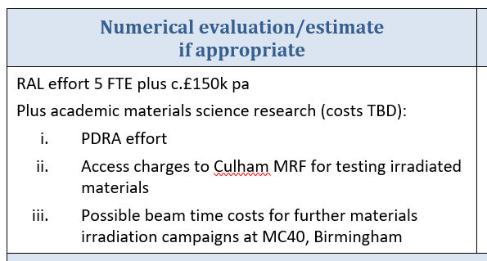
Change Request relating to Materials Science project
3. Materials Science – selection of optimum materials resistant to radiation damage
We anticipate that the current Phase 2 project activity will study the titanium alloy samples irradiated at BLIP and identify preferred alloys and grades for further study. We also intend to manufacture new samples and irradiate them at Birmingham University’s MC40 cyclotron. However, there will likely not be sufficient time or resources to study these samples in the Phase 2 project. This work will need to be carried out in this future upgrade R&D phase. We anticipate this could include:

Slide 7
Change Request relating to Materials project (i)
3.1 Assessment of MC40 irradiated materials (KCL/Culham)
A 3-year PDRA at King’s is requested to implement the unique small–scale mechanical testing techniques and carry out PIE as outlined below:
Carry out high cycle and very–high cycle fatigue testing of 96 proton irradiated specimens out of six titanium materials at MRF. The same amount of ultrasonic fatigue testing will be conducted in 96 non-irradiated control specimens for comparison at King’s College London. Each specimen will take one day with respect to a step increment fatigue test to 108 cycles. The total experimental time will be 192 days in which 50% will be in MRF (active) and 50% at King’s (Non–active) for cost effective consideration.
Conduct indentation tests in six types of titanium candidate materials and make comparisons between those with and without the proton irradiation. We request for 6 days indentation time at MRF.
Static mechanical testing of meso-scale specimens in the form of either bending or more advanced tensile tests. The static tests will be carried out using in-situ mechanical testing rig at MRF. Such tests will reduce the number of ultrasonic fatigue tests and such we don’t request for the extra resources.
Fracture surface of irradiated and non–irradiated specimens will be characterised using SEM at MRF (active) and King’s (non-active), respectively.

Slide 8
Change Request relating to Materials project (ii)
3.2 Radiation damage simulations, further irradiations and post-irradiation studies (Birmingham/Culham)
The current Phase-2 project only funds a 1-year PDRA at Birmingham University and assumes that irradiation time will be provided free of charge. In fact the running costs of MC40 are around £1k per day and c.30 days running time is required for c.2 DPA radiation damage, equivalent to a year of running at LBNF. Depending on results from the current Phase-2 project, it is likely that further support may be required to carry out additional irradiation campaigns, carry out Post-irradiation examinations at Culham in collaboration with KCL and to carry out radiation damage simulations at the atomic scale.

Slide 9
Change Request relating to Materials project (iii)
3.3 Irradiation and assessment of graphite target materials (Oxford)
The current phase of the project funded a 1-year PDRA to primarily study the comparison between IG430 graphite (used in T2K) and POCO graphite (used in FermiLab NT02 target), and focussed on the non-irradiated mechanical/thermal properties of a few other grades (detailed in the Work Package Summaries section). However, as the beam power increases, it would be productive to widen the pool of graphite materials candidates, including higher density, and to study the degradation of mechanical/thermal properties with irradiation damage to identify the most damage tolerant graphite grade to improve particle yield as well as service life. An optimum program would see materials irradiated at MC40 (noting this may require a redesign of the sample environment which is currently configured for titanium alloy foil sample irradiation) and the UK ion beam centre (IBC) to produce side by side comparison of new grades of graphite with existing IG430 and POCO graphite, in particular under helium ion implantation. Note that FermiLab funded a PhD student with half EPSRC funding as support to current project which will have free access to EPSRC ion beam centre and which could be used to design and irradiate graphite materials in this Phase 2 project. A 2-yr PDRA would be needed in Phase 3 of the project to study these irradiated materials. The methodologies and advanced characterisation techniques have already been established in the current phase of the project. Briefly, the established techniques to be adopted in Phase 3 include a novel method using non-destructive spectroscopy to assess the total irradiation damage in graphite, a machine learning-based image segmentation method for density, dimensional change and porosity analysis, as well as nano-indentation and a unique thermoreflectance-based high resolution thermal conductivity technique. These methods will be translated in Phase 3 to select the optimum graphite for future targets. These experimental characterisations will provide first hand input results to underpin the modelling of target temperature distribution, irradiation induced dimensional and property changes in service.

Slide 10
Next steps
Generate cost estimates suitable for budget request for 2028-2031:
3 year PDRA for Assessment of MC40 irradiated materials (Action KCL/Culham)
Generate budget request for radiation damage simulations, further irradiations and post-irradiation studies (Action Birmingham/Culham)
2 year PDRA for irradiation and assessment of graphite target materials (Action Oxford/Culham)
SoI in form of Change Request required by ‘June 2024’

Slide 11
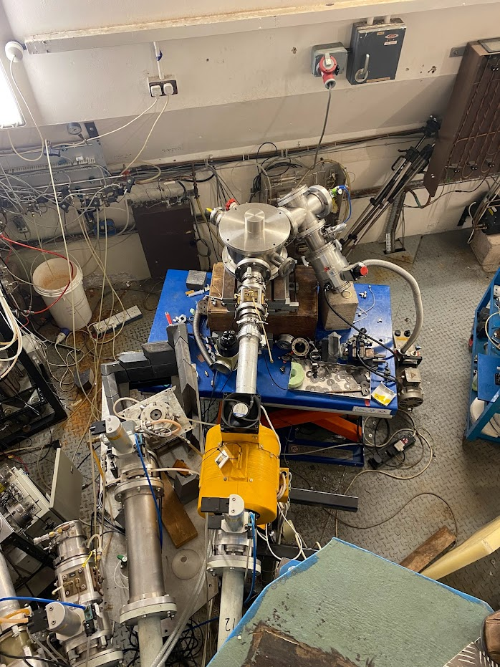
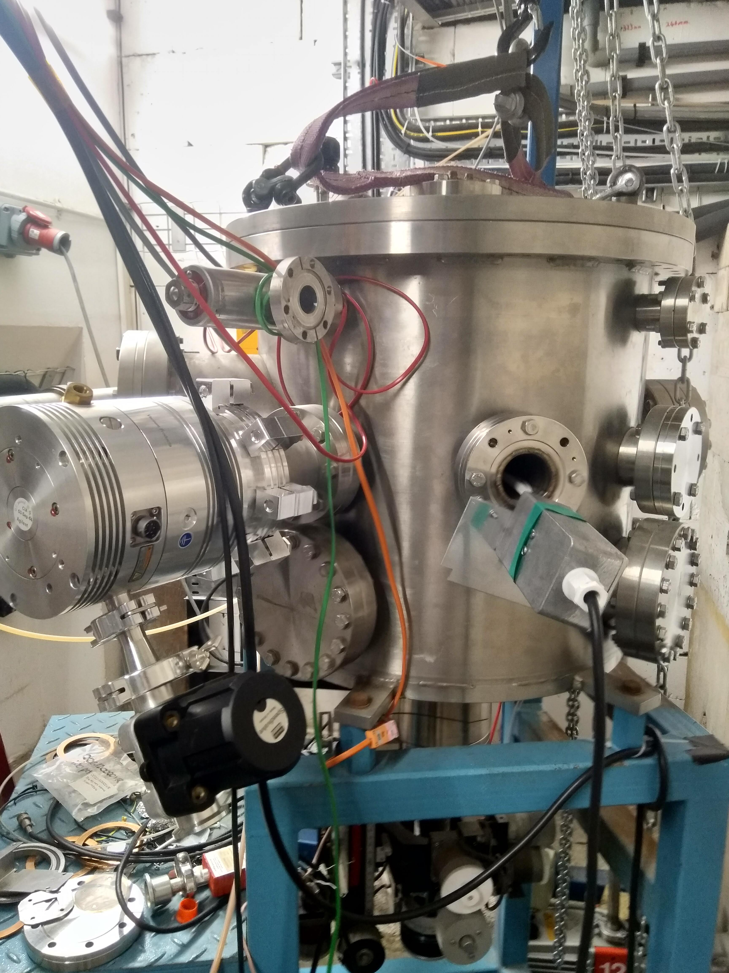
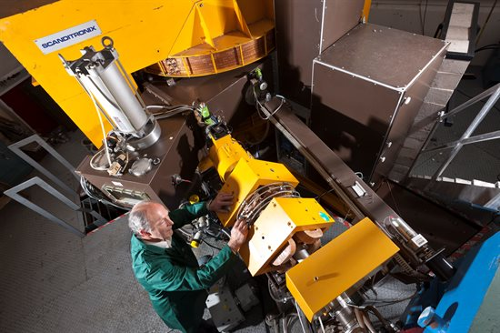
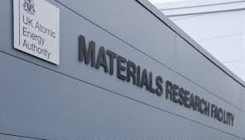
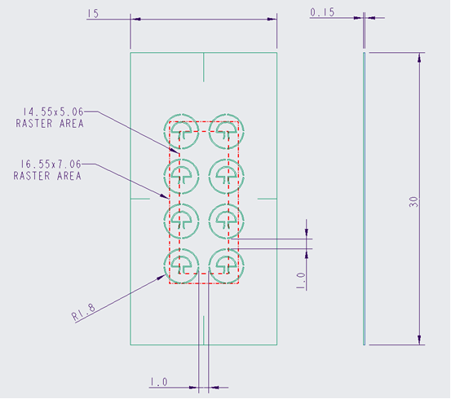
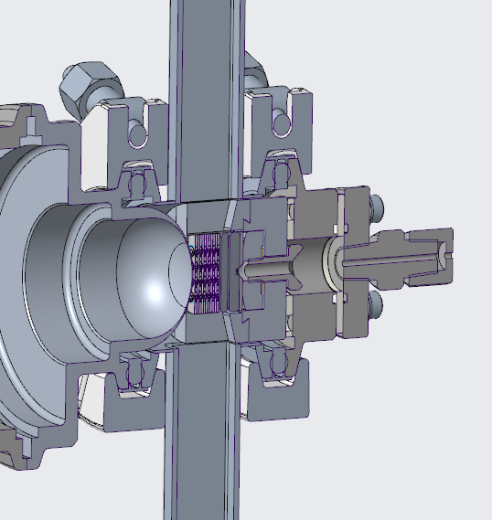
Birmingham MC40 Cyclotron for new materials irradiation studies:
Gas cooled meso-scale samples of candidate titanium alloy foils for future ultrasonic fatigue testing
MC40 Beamline
Sample & environment
(Birmingham)
PIE
Micro/nano indentation
High cycle fatigue testing
TEM/XRD
MC40 irradiation
Sample design (Oxford)
Sample environment
(RAL)
Proton and He irradiation at high energy
(Birmingham)
(Oxford, Birmingham @Culham)
Remotely handleable sample environment ready for manufacture

