Slide 1
Irradiation of Ti6Al4V Carried on 11/01/2024
Jatinder Singh
Supervisor: Dr. Biao Cai

Slide 2
Long Baseline Neutrino Facility
Figure 1. Schematic diagram of the LBNF/DUNE facilities [1]. (https://lbnf-dune.fnal.gov/how-it-works/introduction)
Ti alloys are good with dealing with thermal shocks and have excellent properties.
Ti and V have a very high dose rate decay.
However, there is little research on the irradiation hardening mechanisms. [2, 3]

Slide 3
Objectives
Irradiation hardening mechanisms and loss of thermal conductivity in irradiated Ti alloys
DFT simulations
Thermal conductivity of unirradiated Ti
Thermal conductivity of irradiated Ti
MD simulations
Propagation of irradiation induced defects in Ti
Post irradiation examination (PIE) of BLIP samples through NNUF
Experimental
Validating FISPACT-II, FLUKA, SRIM/TRIM and thermal simulations
PIE of newly generated samples at MC40

Slide 4
Objectives
Irradiation hardening mechanisms and loss of thermal conductivity in irradiated Ti alloys
DFT simulations
Thermal conductivity of unirradiated Ti
Thermal conductivity of irradiated Ti
MD simulations
Propagation of irradiation induced defects in Ti
Post irradiation examination (PIE) of BLIP samples through NNUF
Experimental
Validating FISPACT-II, FLUKA, SRIM/TRIM and thermal simulations
PIE of newly generated samples at MC40

Slide 5
Experimental Details
Table 1. Original and final experimental details.
Original | Experimental
17 MeV, current >3.5 μA, Total time = 10 mins | 17 MeV, 6 μA for 18 mins, 7.5 μA for 26 mins, Total time 44 mins.
No vacuum | Vacuum
Active water cooling (unknown flow rate) | Active water cooling (unknown flow rate)
Taking as many measurements as possible. | Temperature measurements were taken every minute for the whole duration of the experiment. The dose rate was measured frequently (every week), and when it became possible gamma-spectrums were also taken.

Slide 6
Equipment
Cyclotron, MC40, line 12.
Dose meter,
Temperature K-probe and datalogger thermometer.
Gamma spectrometer

Slide 7
Experimental Setup
Sample holder
Clamp to hold the sample down
Water cooling
Copper heat sink with active water-cooling
Ti6Al4V sample
Figure 2. Experimental setup. Left, the sample holder. Middle sample stage with copper heat sink and active water-cooling tubes. Right, Ti6Al4V sample inserted in the stage.

Slide 8
Copper heat sink with active water-cooling tubes
Beam direction
Figure 3. Experimental setup. Vacuum chamber where the sample stage is contained. There are cables for the water cooling, current monitoring, and temperature (with a K type thermocouple) monitoring.
Current and temperature cables.

Slide 9
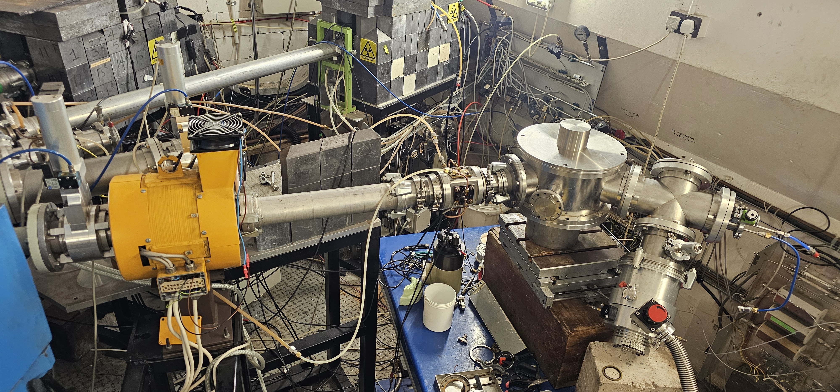
Vacuum Chamber
Beam direction
Figure 4. Experimental setup. MC40 line and the vacuum chamber.

Slide 10
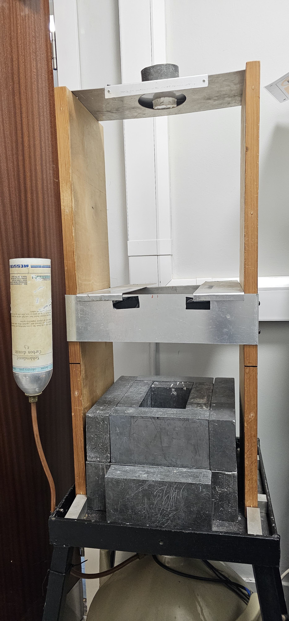
Sample holder
Lead bricks
Figure 5. Experimental setup. Left, datalogger used to measure temperature. Right, gem-28193 HPGe detector used for taking gamma-spectrums. Missing dosimetry detector, Tracerco T402.

Slide 11
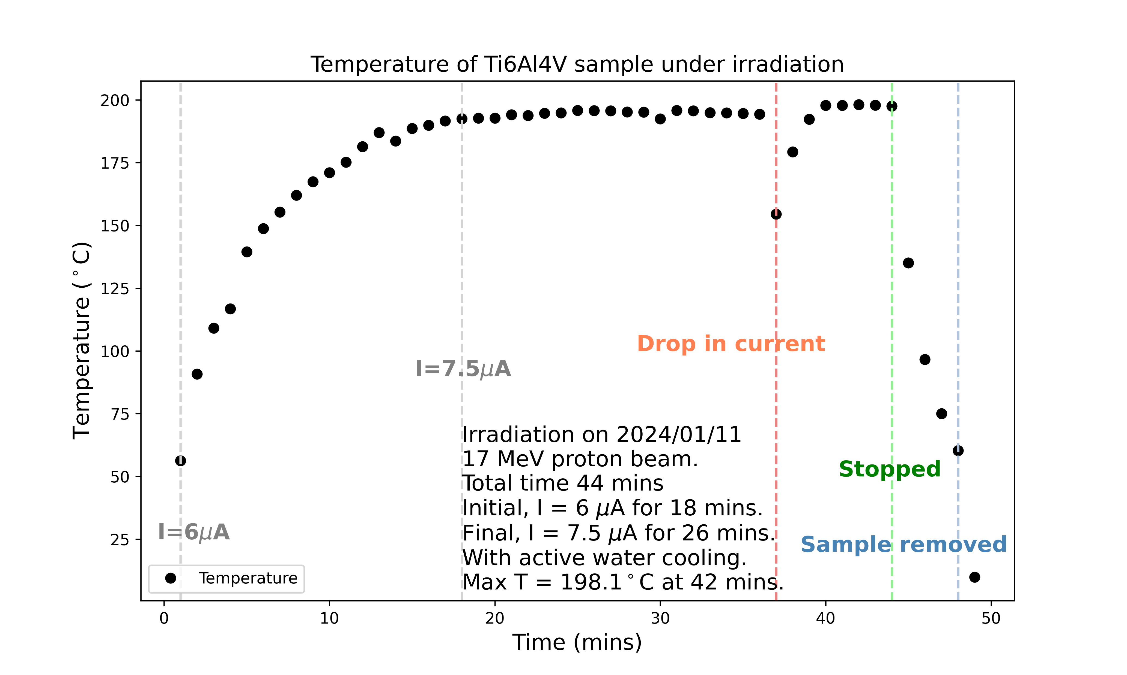
Results - Temperature
Figure 6. Temperature measurements. These were manually recorded every minute. The temperature did not go over 200 °C.

Slide 12
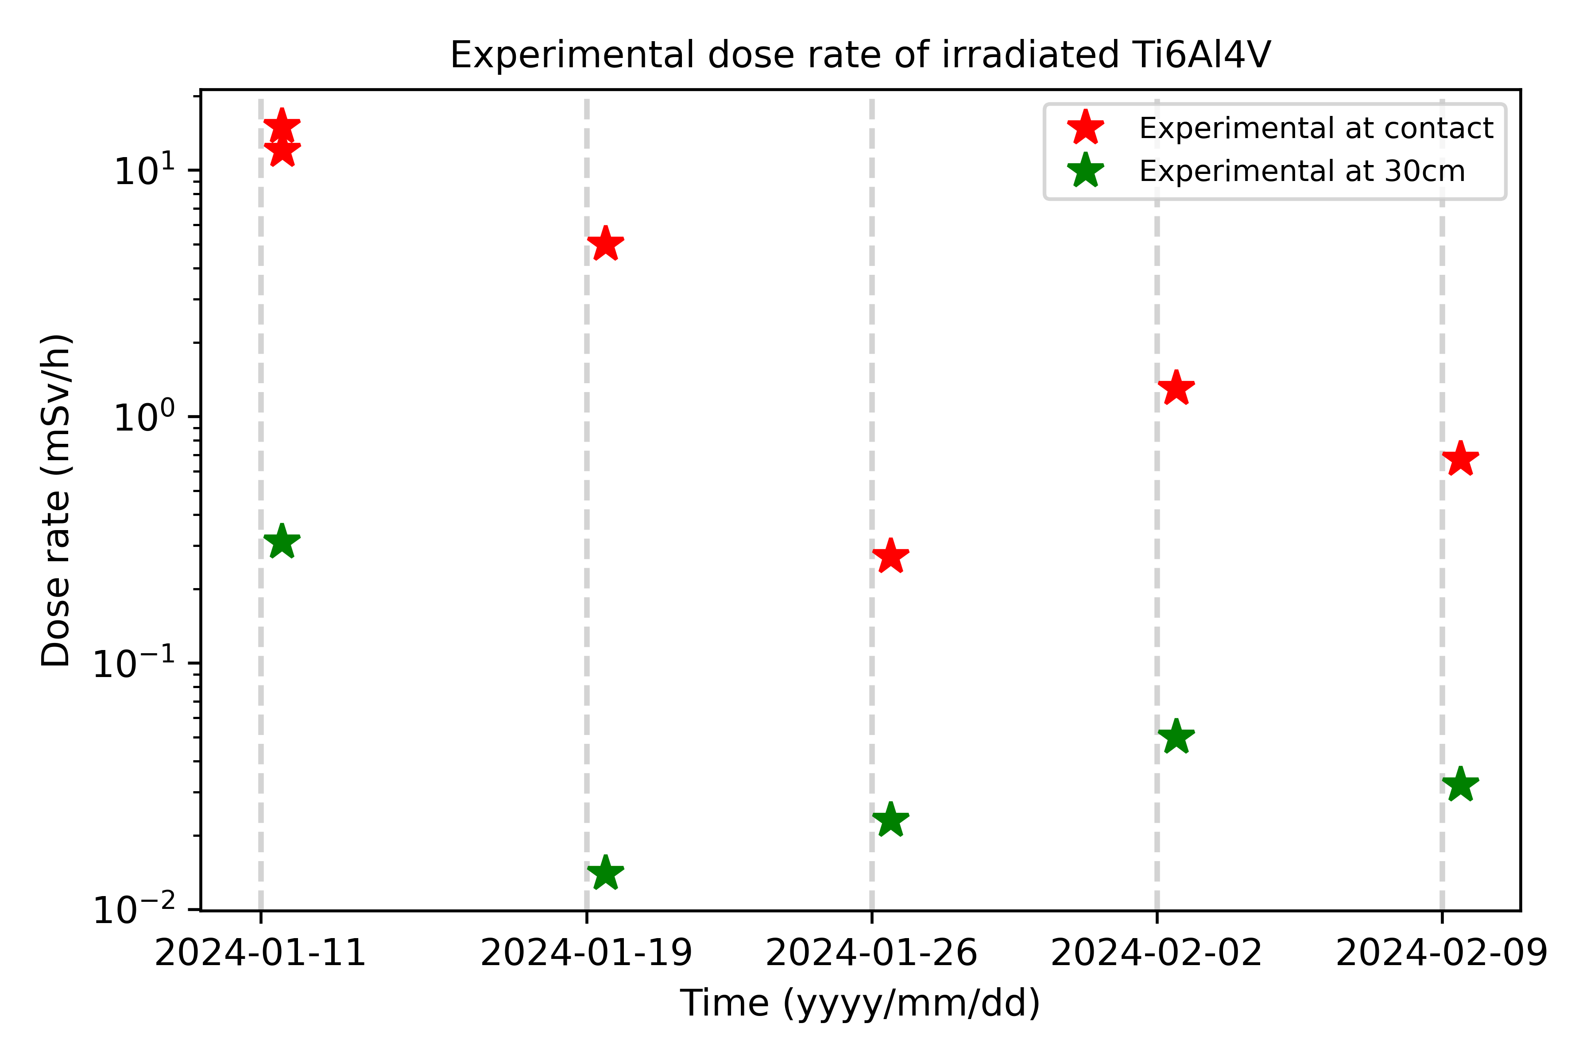
Results – Dose rate
Figure 7. Experimental measured dose as a function of time (years)
Table 2. Experimental values measured over time
Date | Time (hh.mm) | Contact Dose rate (mSv/h) | Dose rate at 30 cm (μSv/h) | Activity (counts/s)
2024/01/11 | 12.39 | 15.00 | 310 | >4000
2024/01/11 | 13.00 | 12.00 | / | /
2024/01/19 | 11.20 | 5.00 | 14 | >4000
2024/01/26 | 11.16 | 0.27 | 23 | 2600
2024/02/02 | 11.32 | 1.30 | 50 | >4000
2024/02/09 | 11.01 | 0.67 | 32 | >4000

Slide 13
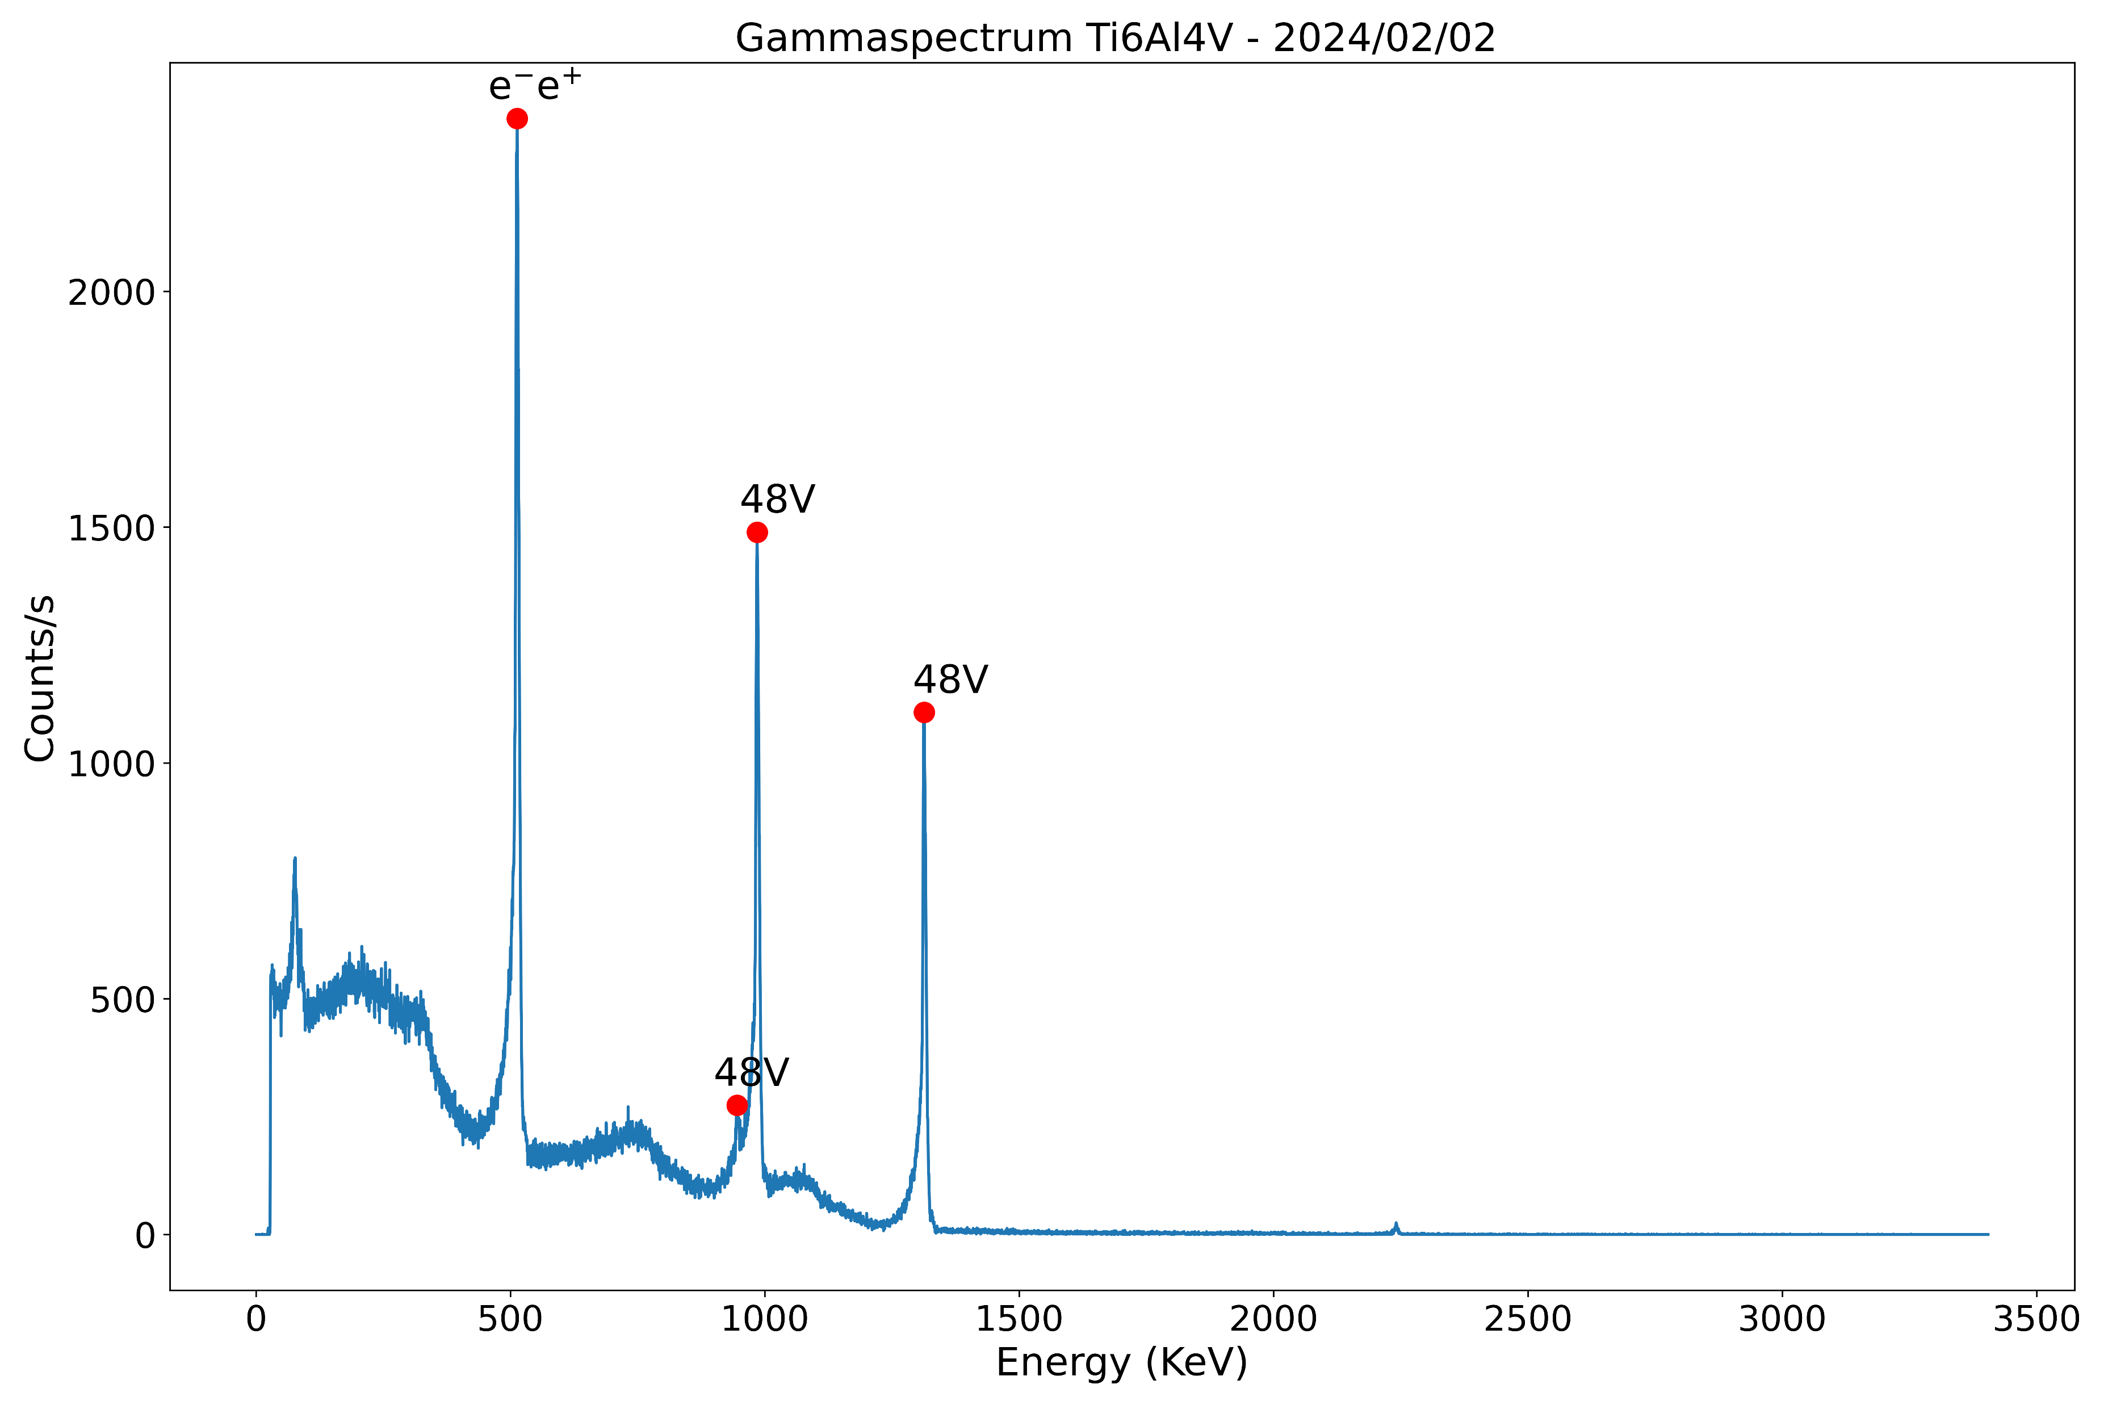
Results – Gamma spectrum (2024/02/02)
Figure 8. Ti6AlV gamma spectrum taken on 2024/02/02. A lead shield was used to isolate the sample and suppress background radiation.

Slide 14
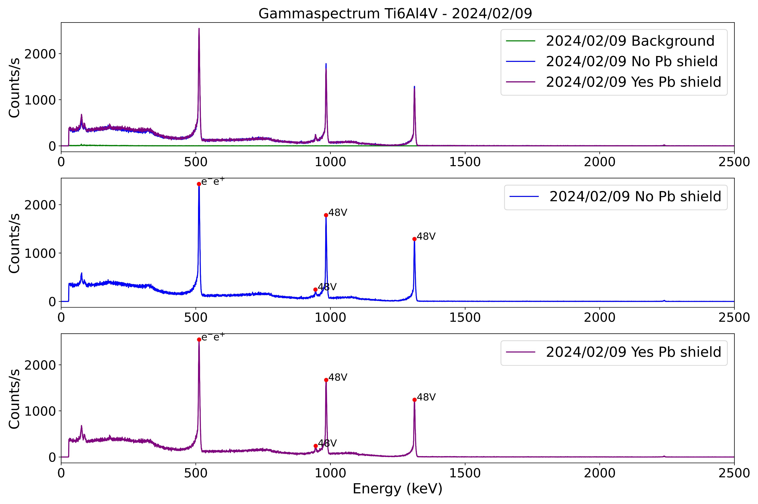
Results – Gamma spectrum (2024/02/09)
Figure 9. Ti6AlV gamma spectrum taken on 2024/02/09. Different measurements were taken, background radiation, sample with no lead shielding, and sample with lead shielding. Background is largely is suppressed, and the difference between shielded vs non-shielded is minimal.

Slide 15
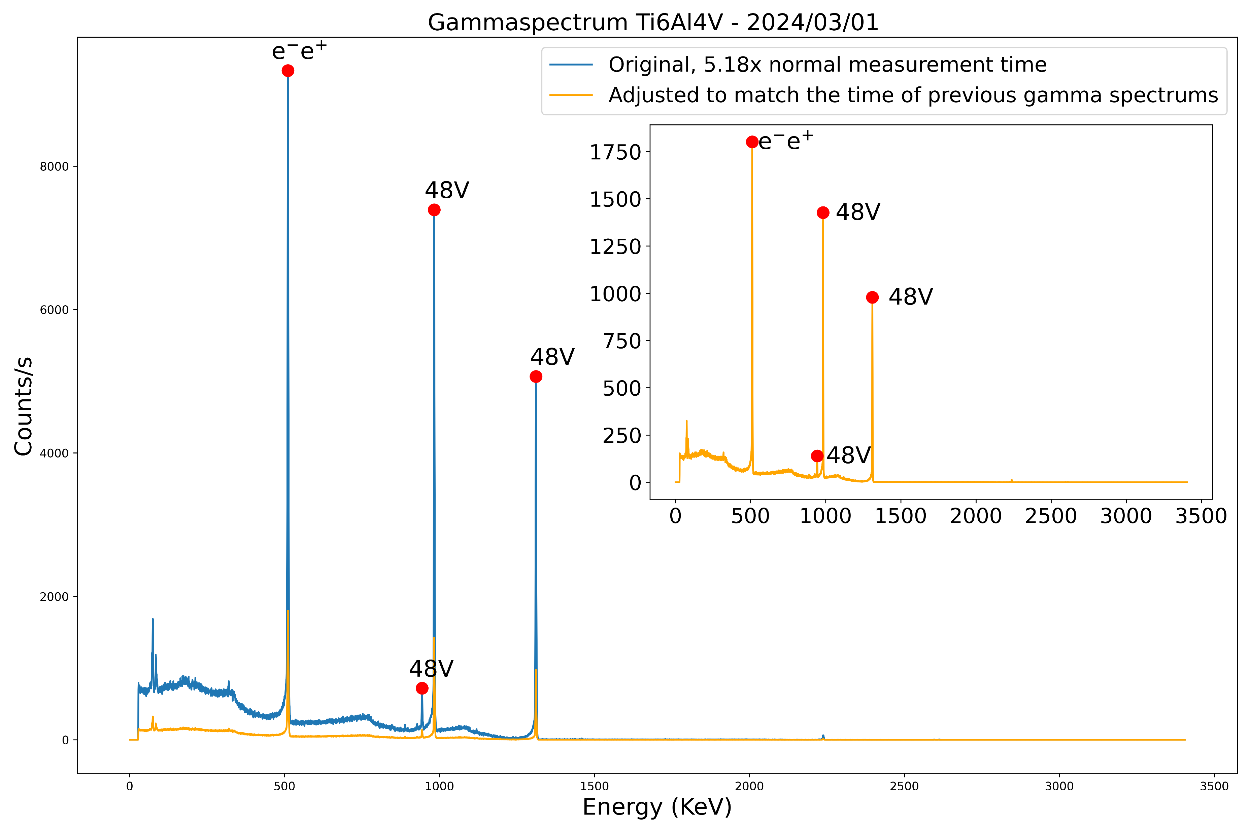
Results – Gamma spectrum (2024/03/01)
Figure 10. Ti6AlV gamma spectrum taken on 2024/03/01. A longer measurement was taken to verify that other peaks are not being suppressed. However, no new peaks were seen. The final counts were readjusted to match the measurements time

Slide 16
Results - Activities
Table 3. Peak fitting and corresponding detector efficiencies to calculate activities.
02/02/2024 | Energies | Isotope | Counts | Efficiencies (c/s/kBq) | Activity (Bq) | Activity (Bq/g) | Activity (MBq/g)
 | 513.50 | Annhil. | 2366 | 0.10 | 23660000 | 98531842 | 98.53
 | 945.57 | 48V | 274 | 0.06 | 4566667 | 19017839 | 19.02
 | 985.04 | 48V | 1489 | 0.06 | 24816667 | 103348769 | 103.35
 | 1313.67 | 48V | 1107 | 0.05 | 22140000 | 92201816 | 92.20
09/02/2024 - N Pb shield | Energies | Isotope | Counts | Efficiencies (c/s/kBq) | Activity (Bq) | Activity (Bq/g) | Activity (MBq/g)
 | 511.83 | Annhil. | 2427 | 0.10 | 24270000 | 101072181 | 101.07
 | 944.33 | 48V | 246 | 0.06 | 4100000 | 17074410 | 17.07
 | 983.79 | 48V | 1783 | 0.06 | 29716667 | 123754772 | 123.75
 | 1312.01 | 48V | 1290 | 0.05 | 25800000 | 107443851 | 107.44
09/02/2024 - Y Pb Shield | Energies | Isotope | Counts | Efficiencies (c/s/kBq) | Activity (Bq) | Activity (Bq/g) | Activity (MBq/g)
 | 512.25 | Annhil. | 2547 | 0.10 | 25470000 | 106069569 | 106.07
 | 945.16 | 48V | 242 | 0.06 | 4033333 | 16796778 | 16.80
 | 984.21 | 48V | 1671 | 0.06 | 27850000 | 115981056 | 115.98
 | 1312.42 | 48V | 1242 | 0.05 | 24840000 | 103445940 | 103.45
01/03/2024 | Energies | Isotope | Counts | Efficiencies (c/s/kBq) | Activity (Bq) | Activity (Bq/g) | Activity (MBq/g)
 | 511.00 | Annhil. | 1801 | 0.10 | 18013514 | 75017103 | 75.02
 | 943.91 | 48V | 139 | 0.06 | 2313385 | 9634069 | 9.63
 | 982.96 | 48V | 1427 | 0.06 | 23780566 | 99033939 | 99.03
 | 1311.18 | 48V | 978 | 0.05 | 19563707 | 81472867 | 81.47
Table 4. Total experimental activities
Date (dd/mm/yyyy) | Total Activity (MBq/g)
02/02/2024 – N Pb | 313.10
09/02/2024 - N Pb | 349.35
09/02/2024 - Y Pb | 342.29
01/03/2024 – N Pb | 265.16

Slide 17
Results – Activities comparison
Table 5. Comparing experimental activities to FISPACT-II and FLUKA
Date (dd/mm/yyyy) | Total Activity (MBq/g) | FISPACT-II (MBq/g) |  | FLUKA (MBq/g)
 |  | Single Bin | Multi Bin
02/02/2024 – N Pb | 313.10 | 90.98 | 12.79 | 36.61
09/02/2024 - N Pb | 349.35 | 67.92 | 9.60 | 27.26
09/02/2024 - Y Pb | 342.29
01/03/2024 – N Pb | 265.16 | 28.41 | 4.10 | 11.29

Slide 18
Results – Inventory comparison

Slide 19
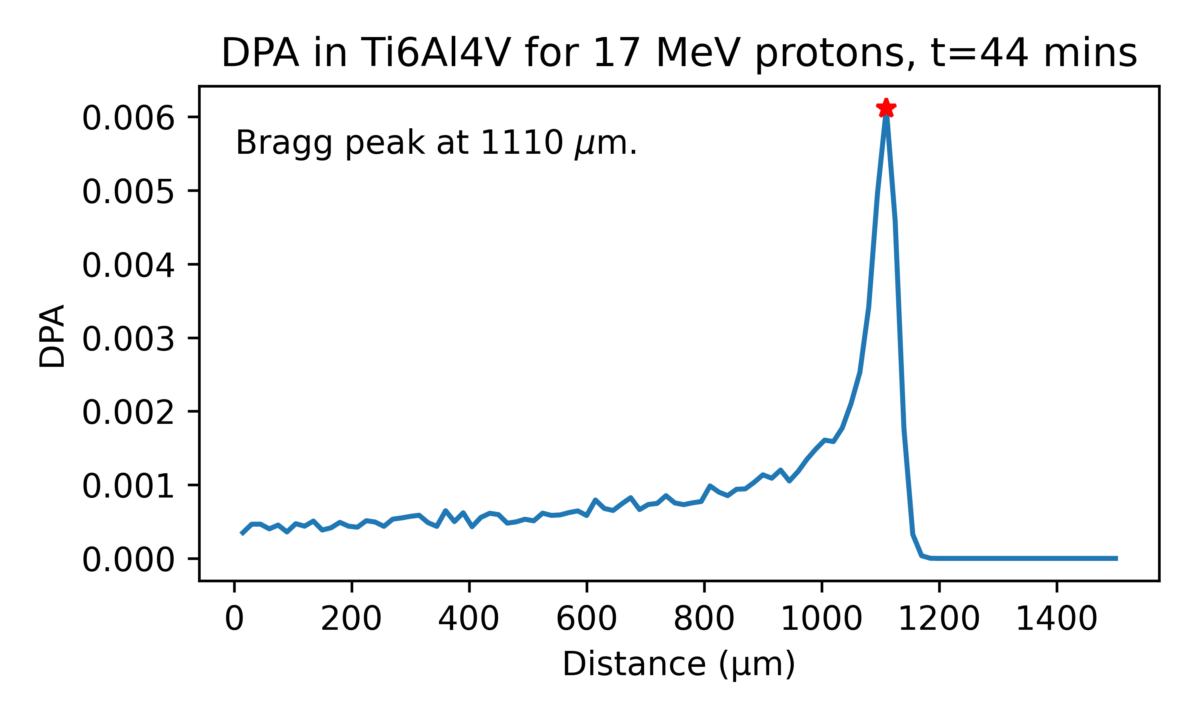
Results – DPA Bragg peak SRIM/TRIM
Figure 11. SRIM/TRIM simulation to find the Bragg peak from the experimental conditions.

Slide 20
Results – DPA Bragg peak FLUKA

Slide 21
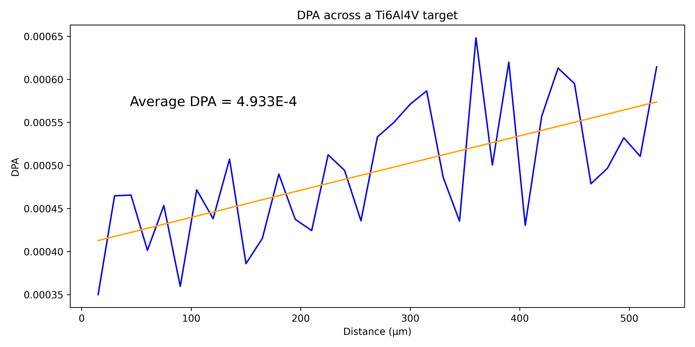
Results – Irradiation DPA SRIM/TRIM
Figure 12. Predicted DPA from SRIM/TRIM.

Slide 22
Results – Time for DPA SRIM/TRIM
Figure 13. SRIM/TRIM simulation to find the time needed to achieve 1 DPA with different currents.

Slide 23
Results – Time for DPA SRIM/TRIM
Figure 14. SRIM/TRIM simulation to find the time needed to achieve different DPAs with I = 7 μA.

Slide 24
Results – Predicted Dose rate for 0.1 DPA
Figure 15. FISPACT-II simulation to find the dose rate of 10x10x1mm Ti6Al4V sample irradiated with 17 MeV protons with I = 7 μA. This would be done to achieve 0.1 DPA on a tensile testing sample.

Slide 25
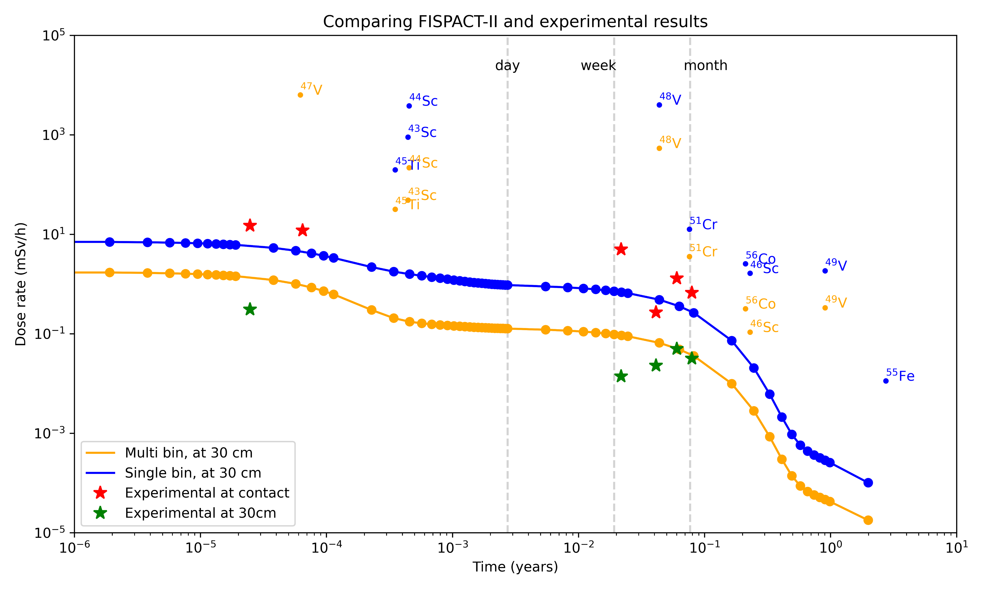
Results – FISPACT
Figure 16. FISPACT dose rate simulations vs experimental results.

Slide 26
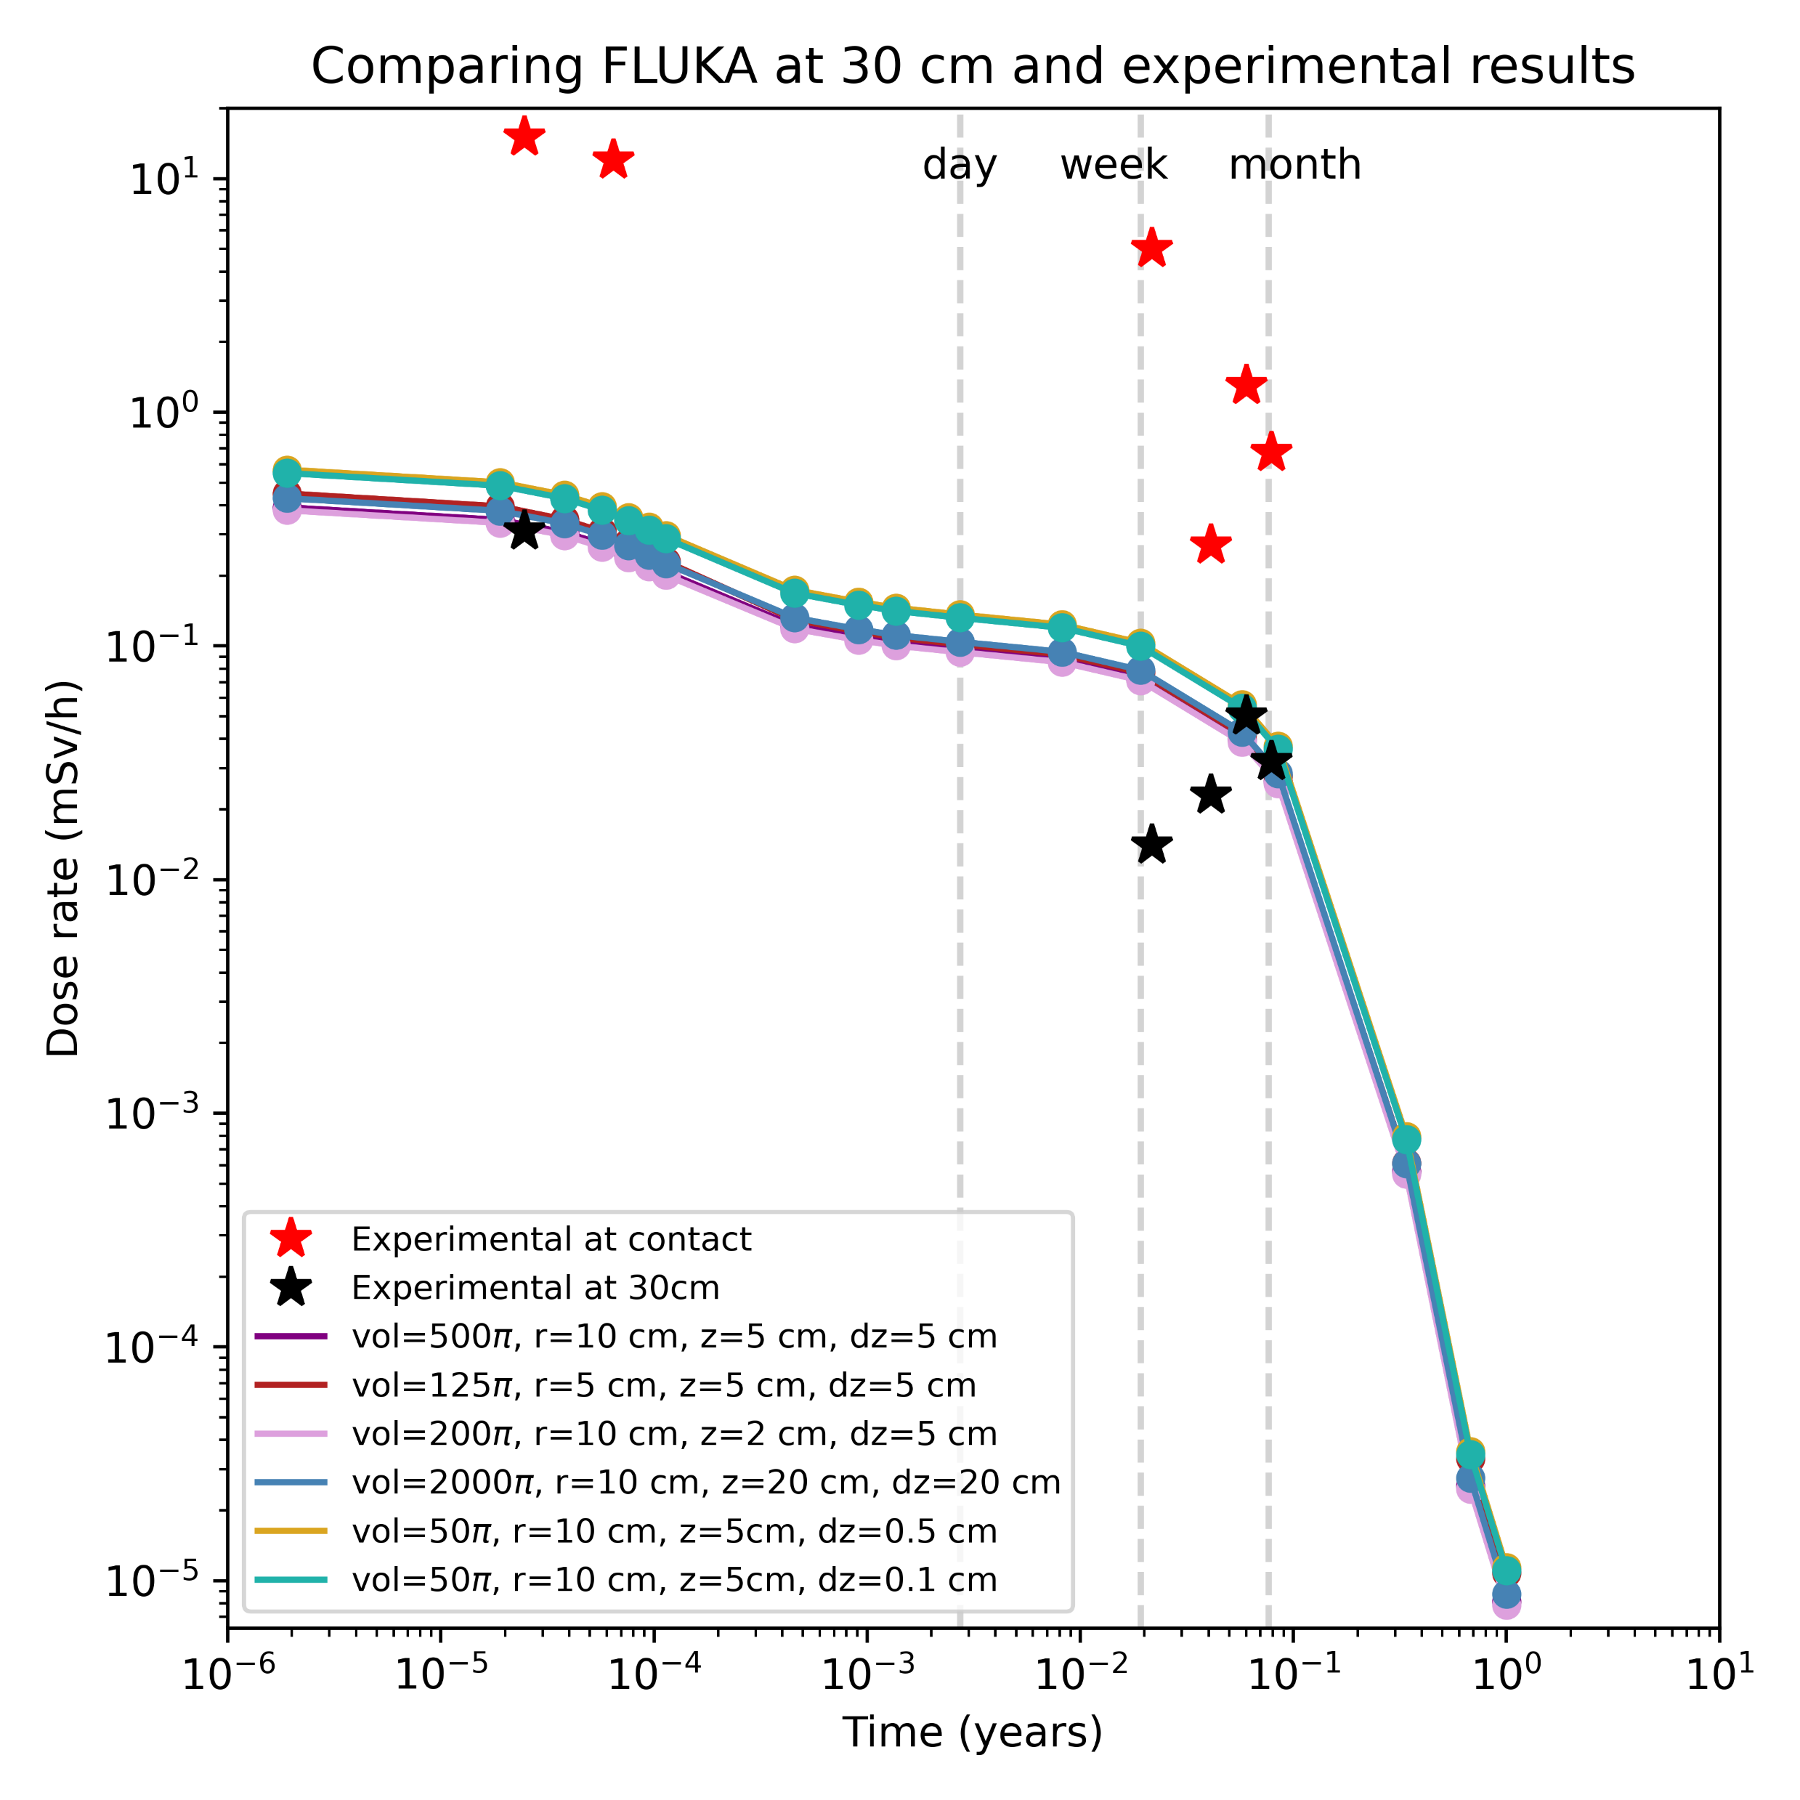
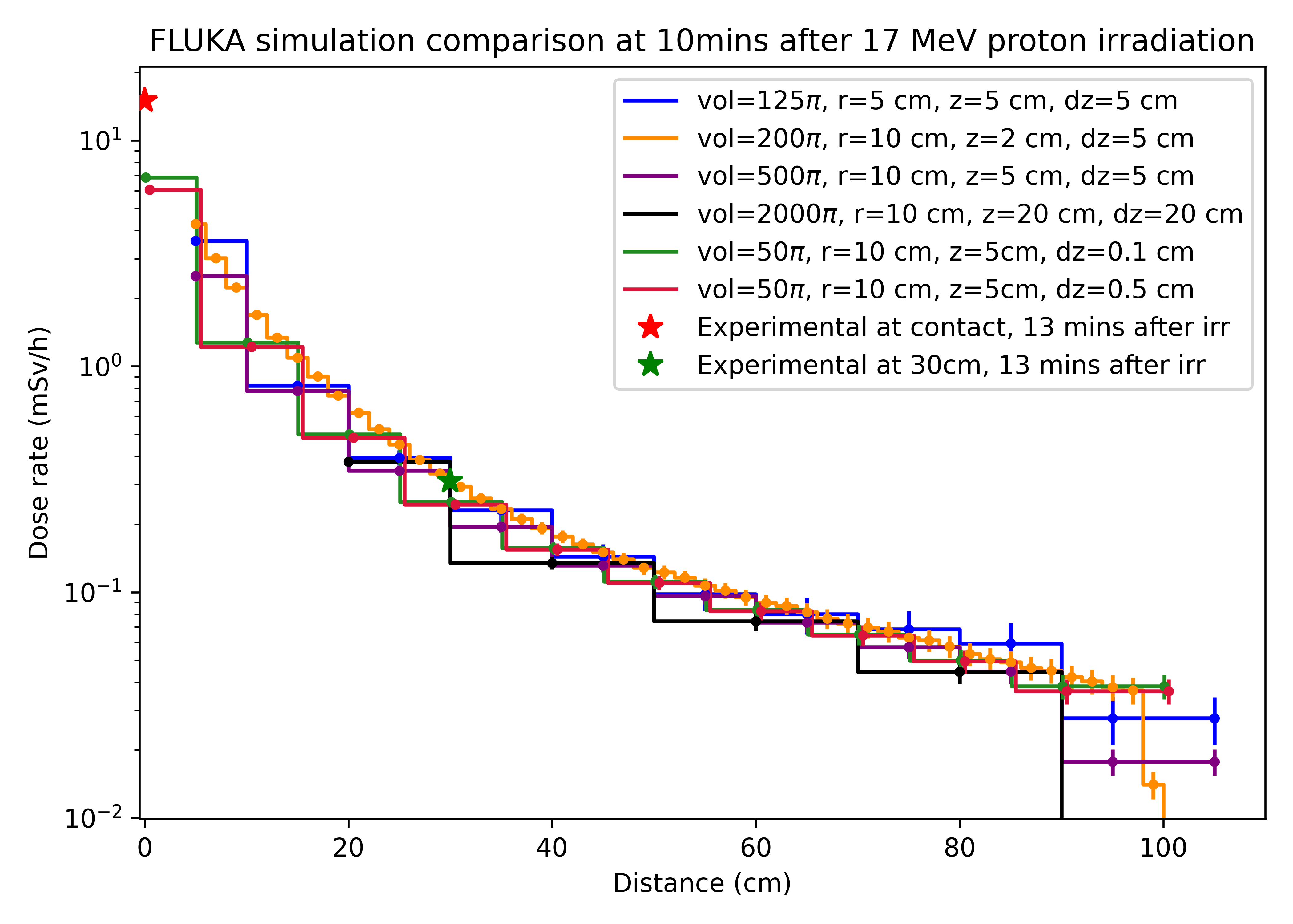
Results – FLUKA
Figure 17. FLUKA dose rate simulations vs experimental results. Left, FLUKA results as a function of distance after 10 mins irradiation. Right, FLUKA results at 30 cm as a function of time. Cylindrical bins were used, where z is the bin height, and dz indicates the distance of the bin from the sample.

Slide 27
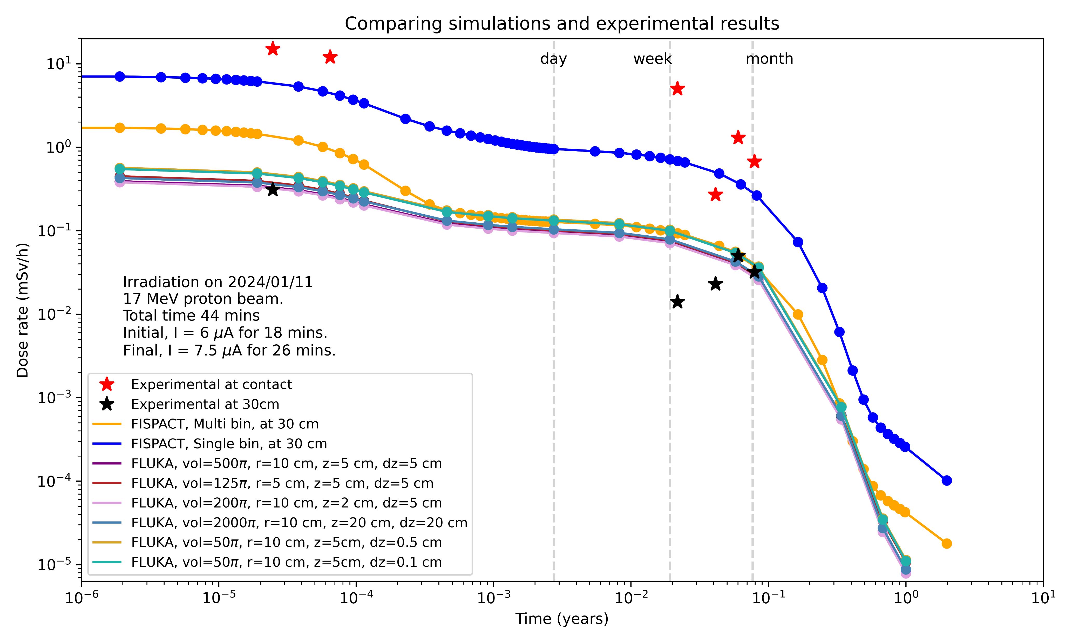
Results – Dose rate comparison
Figure 18. FISPACT vs FLUKA vs experimental results. Around after a day, the results of both FISPACT and FLUKA seems to agree, diverging at the one-year mark. Both fail to explain the secondary activation of the Ti6Al4V.

Slide 28
Results – H and He production

Slide 29
Problems
Measured an increase in dose rate after 26/01/2024
Possibly due to more radioactive daughter nuclei.

Slide 30
Possible future work
Tensile test sample (thickness ~ 0.8 - 1mm )
Temperature testing at 200 C.
0.1 DPA (~ 45h).
Temperature simulations with ANSYS.
TEM specimen of pure Ti for validating LAMMPS simulations.
Comparison of different results at different energies, (~7 MeV, and ~27 MeV).

Slide 31
Conclusion
Comparison of FISPACT-II and FLUKA results compared to experimental results.
To do,
Inventory comparison between FLUKA and FISPACT-II.
Hydrogen and Helium production between FLUKA and FISPACT-II.
FLUKA DPA with DPA-SCO and ARC-DPA.

Slide 32
References
[1] Unknown. DUNE at LBNF: Introduction;. Available from: https://lbnf-dune.fnal.gov/how-it-works/introduction.
[2] Ishida T, Wakai E, Makimura S, Hurh PG, Ammigan K, Casella AM, et al. Radiation Damage Studies on Titanium Alloys as High Intensity Proton Accelerator Beam Window Materials. In: Proceedings of the 14th International Workshop on Spallation Materials Technology. Fukushima, Japan: Journal of the Physical Society of Japan; 2020. Available from: https://journals.jps.jp/doi/10.7566/JPSCP.28.041001.
[3] Ishida T, Wakai E, Makimura S, Casella AM, Edwards DJ, Prabhakaran R, et al. Tensile behavior of dual-phase titanium alloys under high-intensity proton beam exposure: Radiation-induced omega phase transformation in Ti-6Al-4V. Journal of Nuclear Materials. 2020 Dec;541:152413.

Slide 33
Thank you for listening, any questions?

