Slide 1
Proposed Establishment of a Comprehensive Radionuclide Manufacturing Facility: Addressing the UK's Radionuclide Shortage and Advancing Applied Nuclear Physics
UK Radionuclide Manufacturing Facility
Mamad Eslami
University of York, York, UK
Nuclear Physics Forum Meeting (Spring 2024)
May 8, 2024, Liverpool, UK

Slide 2
Physics and Societal Drivers
Critical shortage of radionuclide supply due to lack of local production facilities
Role of radionuclides in advancing research, particularly in theranostic and targeted alpha therapy (TAT) for cancer diagnosis and treatment
Taken from: J. Nucl. Med. 62 (2021) 1495

Slide 3
Emerging Opportunities
Urgent need to enhance UK's production capacity for medical radioisotopes
Establishment of comprehensive radionuclide manufacturing facility requiring interdisciplinary collaboration from various fields
Incorporation of high-energy cyclotron and linear accelerator (LINAC) dedicated to the research and development of radioisotopes.

Slide 4
Project Scope
Features of the facility: 70–200 MeV cyclotron, 40 MeV LINAC, HPGe detectors, hot cells
Production capabilities: charged-particle-induced and photonuclear reactions
Advantages: filling knowledge gaps, encouraging collaboration, driving innovation
Encouraging interdisciplinary research: such as stable isotope targetry and radiochemistry

Slide 5
Benefits to UK Community
Advancement in nuclear applications
Investing in world-class science
Economic growth through enhanced healthcare outcomes, scientific expertise, and technological competence by enabling the large-scale production of emerging PET, SPECT and TAT isotopes.

Slide 6
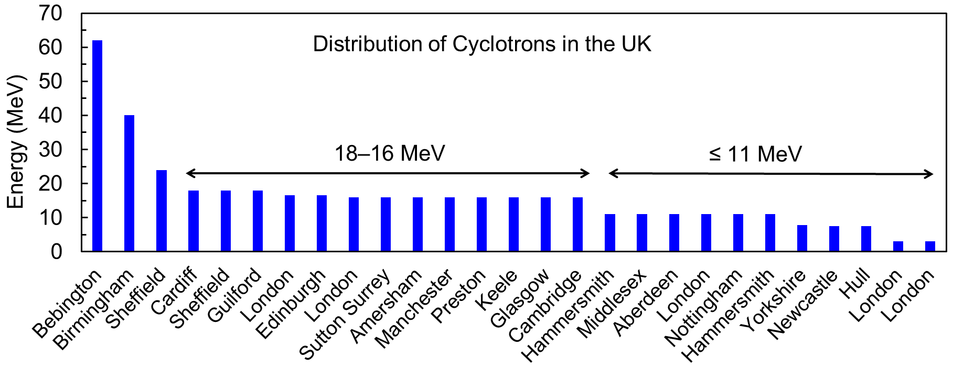
Distribution of Cyclotrons in the UK
City | Facility | Manufacturer | Model | Proton energy (MeV)
Bebington | Douglas Cyclotron Centre | Scanditronix | MC-62 | 62
Birmingham | unspecified | Scanditronix | MC-40 | 40
Sheffield | Alliance Medical | ACSI | TR-24 | 24
Cardiff | Wales Research and Diagnostic PET Imaging Centre | IBA | CYCLONE 18/9 | 18
Sheffield | unspecified | IBA | CYCLONE 18 | 18
Guilford | unspecified | IBA | CYCLONE 18 | 18
London | King's College London-1 | GE | PETtrace | 16.5
Edinburgh | Edinburgh Imaging / University of Edinburgh | GE | PETtrace8 | 16.5
London | St. Thomas Hospital, Pet Centre | GE | PETtrace | 16
Sutton Surrey | Royal Marsden NHS Foundation Trust | GE | PETtrace | 16
Amersham | AMERSHAM INTERNATIONAL PLC | GE | PETtrace | 16
Manchester | WOLFSON MOLECULAR IMAGING CENTRE | GE | PETtrace | 16
Preston | Royal Preston Hospital | GE | PETtrace | 16
Keele Staffordshire | Keele University Science Park | GE | PETtrace | 16
Glasgow | Gartnaval Hospital | GE | PETtrace | 16
Cambridge | WOLFSON BRAIN IMAGING CENTRE | GE | PETtrace | 16
Hammersmith | unspecified | Siemens | ECLIPSE | 11
Middlesex | unspecified | Siemens | ECLIPSE | 11
Aberdeen | John Mallard Scottish PET Centre | Siemens | RDS 111 | 11
London | King's College London-2 | Siemens | RDS 112 | 11
Nottingham | unspecified | Siemens | ECLIPSE | 11
Hammersmith | unspecified | Siemens | ECLIPSE | 11
Yorkshire | Castle Hill Hospital | GE | GENtrace | 7.8
Newcastle | unspecified | ABT | BG-75 | 7.5
Hull | University of Hull PET Research Centre | ABT | BG-75 | 7.5
London | unspecified | IBA | CYCLONE 3 | 3
London | unspecified | IBA | CYCLONE 3 | 3
IAEA Database of Cyclotrons for Radionuclide Production

Slide 7
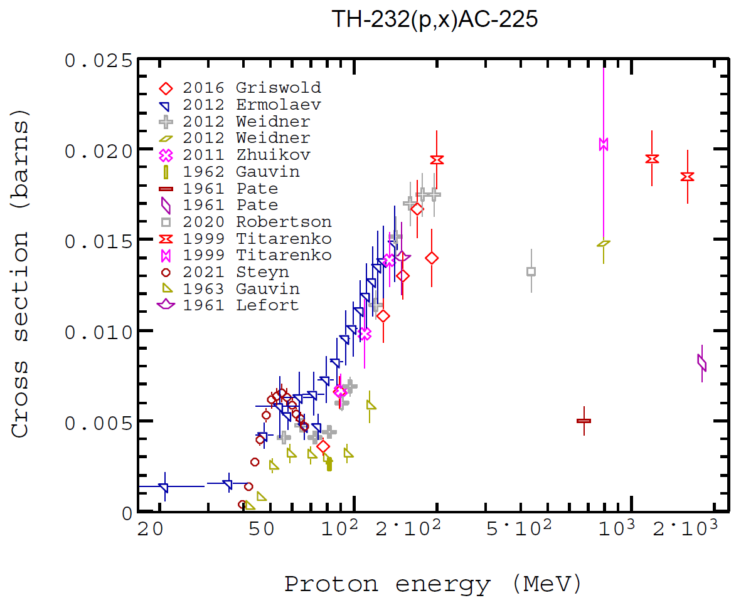
Proposed machines
Cyclone® 70
²²⁶Ra(γ,n)²²⁵Ra ²²⁵Ac 20 MeV
²³²Th(p,x)²²⁵Ac 200 MeV
Rhodotron®
Radionuclide production
Final product
Hospitals, clinics, etc.
Overnight shipment
Chelator production
Image from IBA RADIOPHARMA SOLUTIONS,
and IBA Industrial solutions
Notes:
maximum XS of ~20 mb at ~200 MeV, extending the machine's energy up to 200 MeV would accommodate the production of 225Ac.

Slide 8
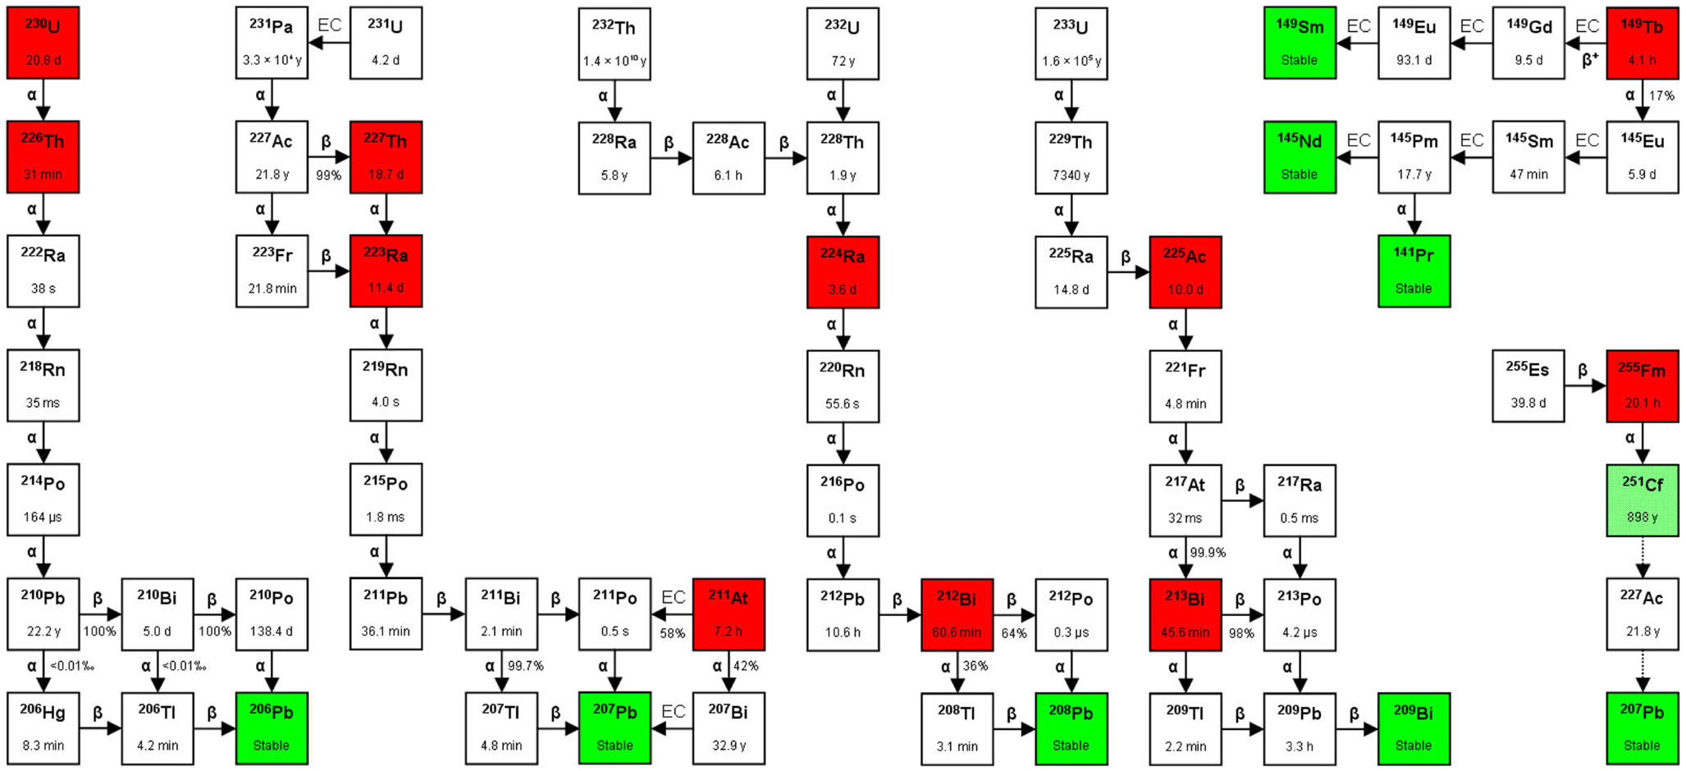
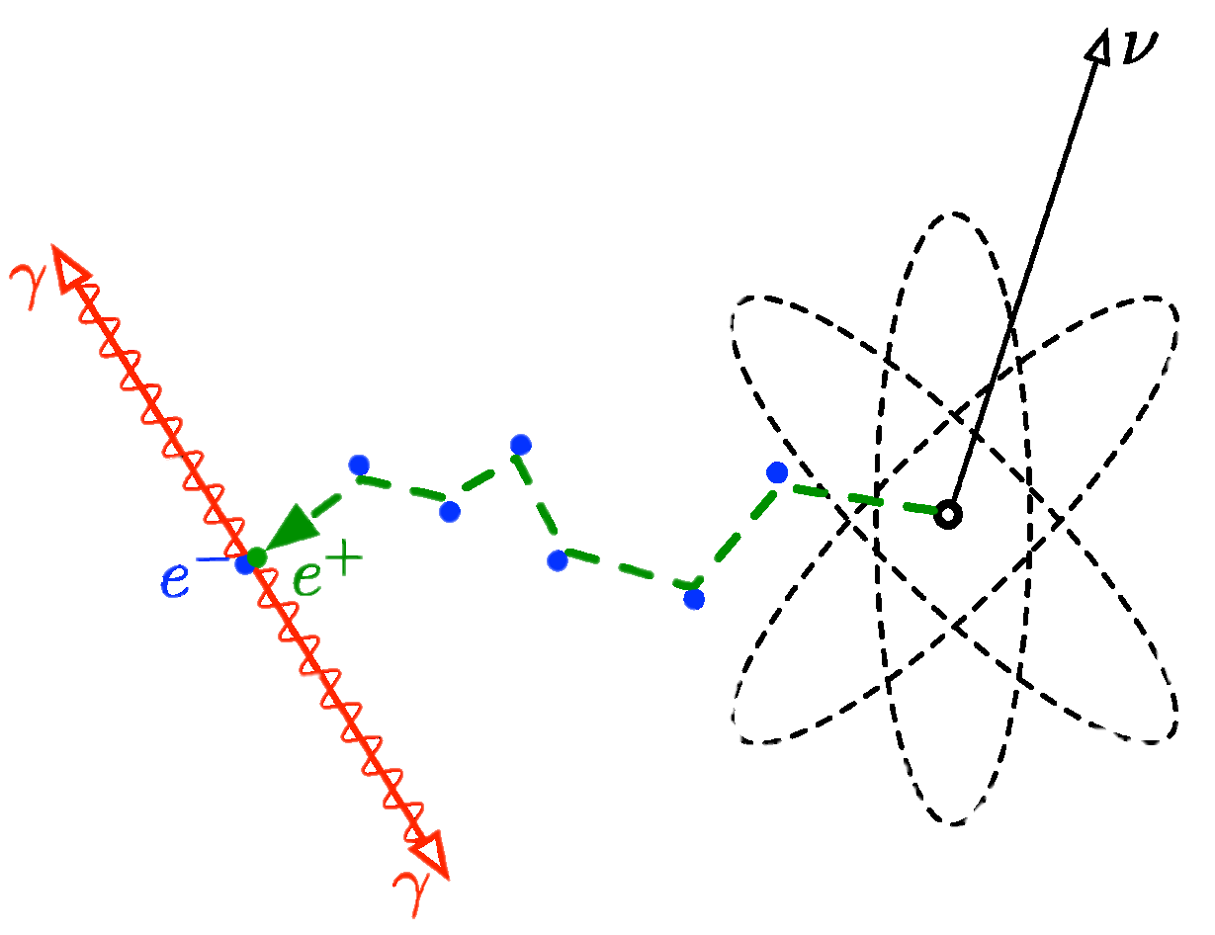
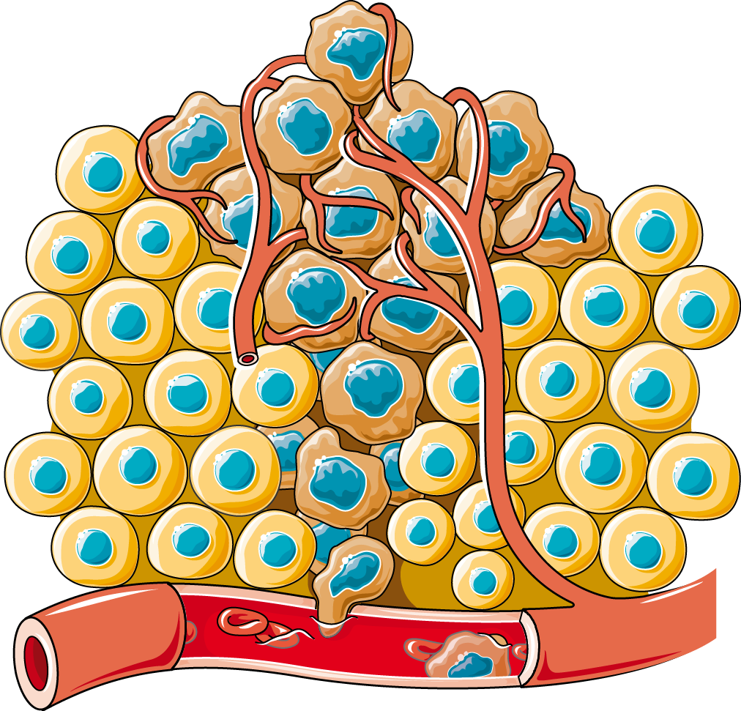
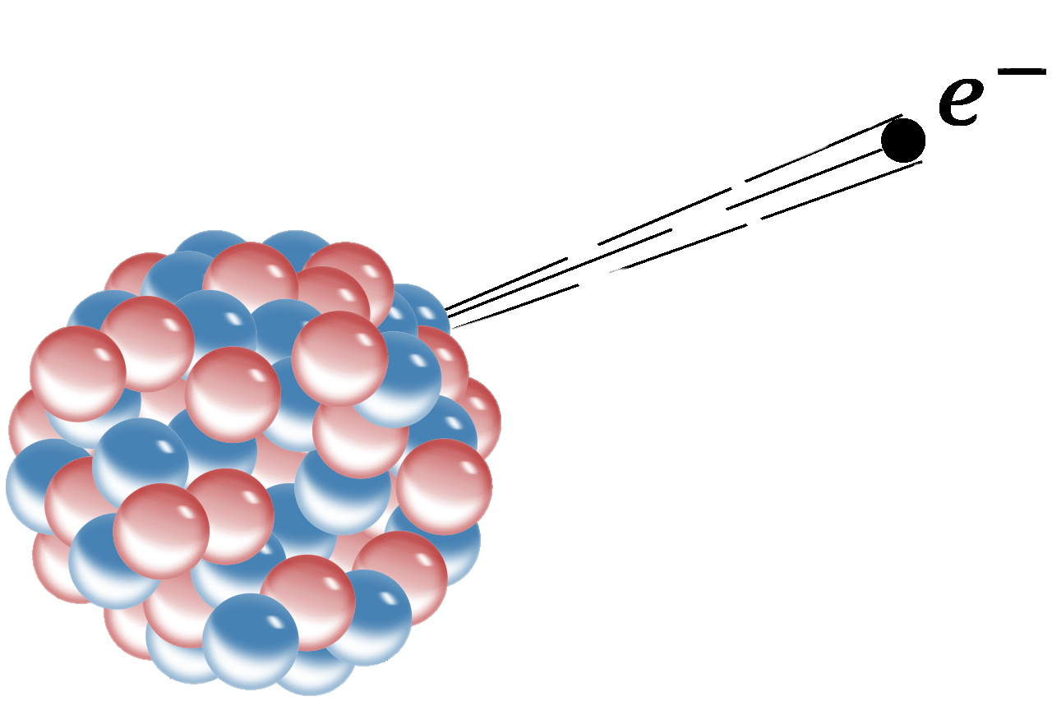
Radioisotopes Accessible with 70 MeV Proton and 40 MeV Bremsstrahlung Combo
PET
¹²⁸Ba/¹²⁸Cs
⁶²Zn/⁶²Cu
⁵²Fe/⁵²Mn
¹²²Xe/¹²²I
⁸²Sr/⁸²Rb
…
Therapy
⁶⁷Cu
²⁸Mg
SPECT
^{117m}Sn
⁹⁷Ru
…
Bremsstrahlung route significantly reduces the production costs
Higher production yields are achievable
Taken from: Front. Oncol. 3 (2014) 324

Slide 9
Summary and Cost estimation
Beam energy: Proton 70–200 MeV; electron 40 MeV
Beam current: Proton ~2 mA; electron ~100 mA
Establishment costs: ~ £100M
Annual operating cost: ~ £3M
Expected Returns: Enhanced healthcare outcomes, scientific expertise, technological competence, ...

Slide 10
Key Stakeholders
IF
ASTeC

