Slide 1
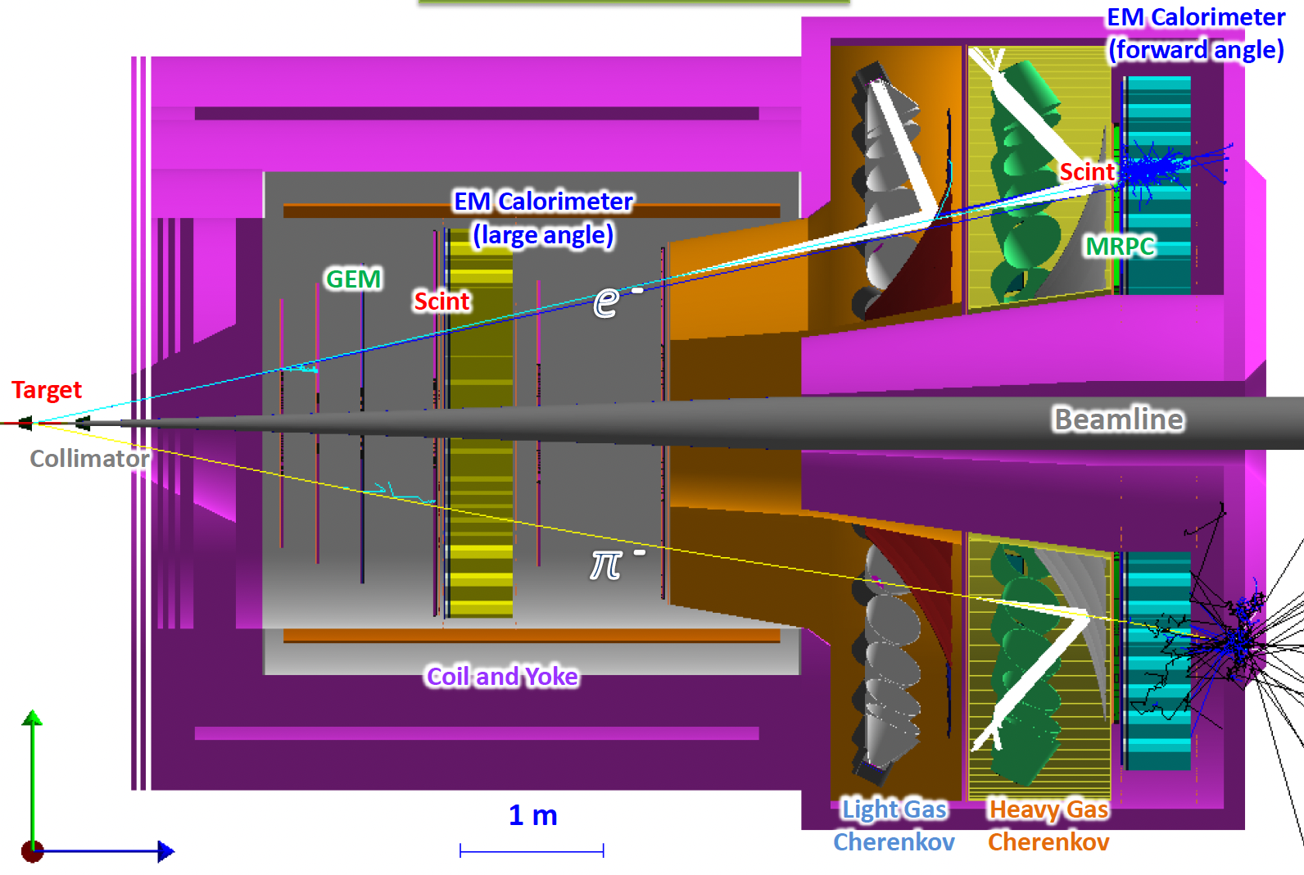
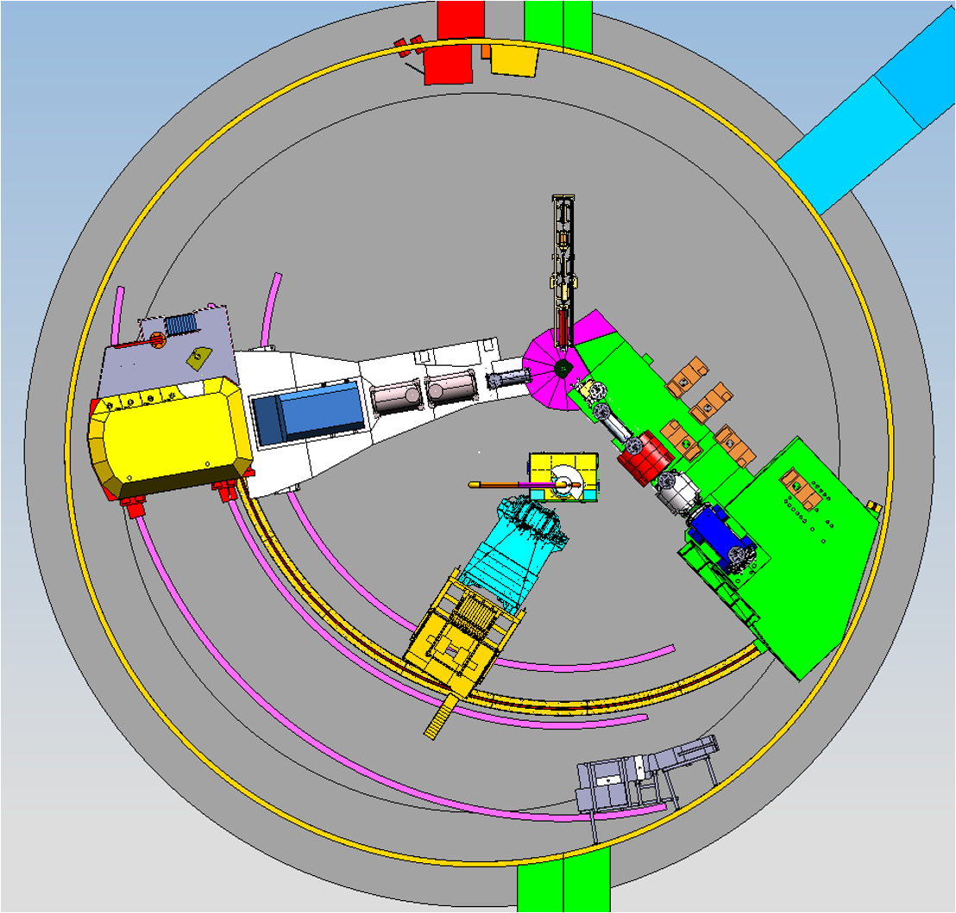
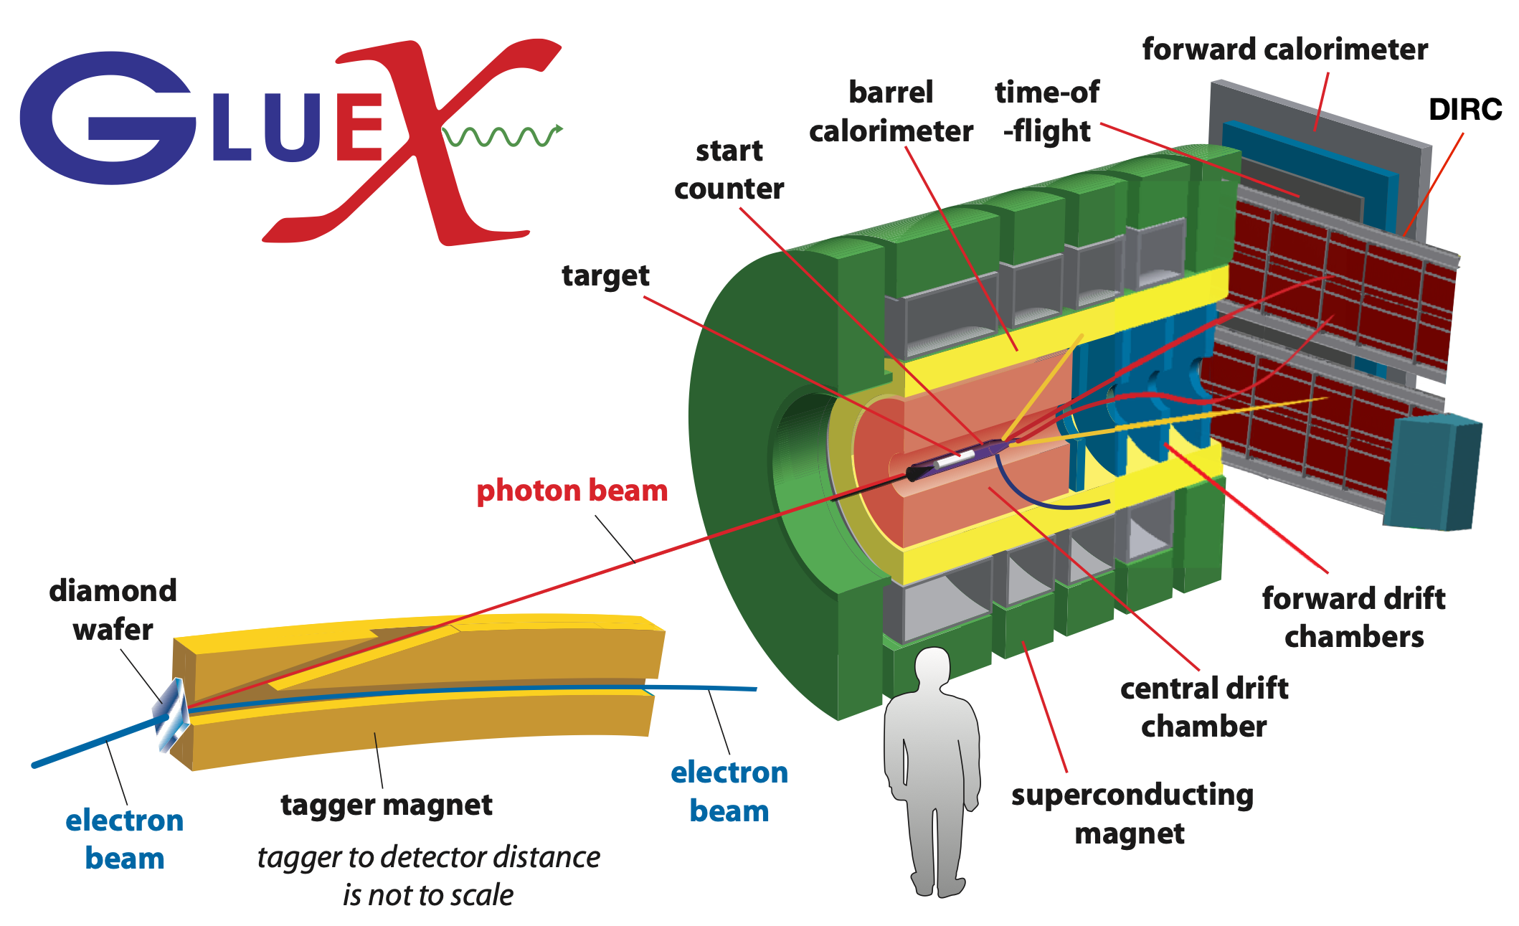
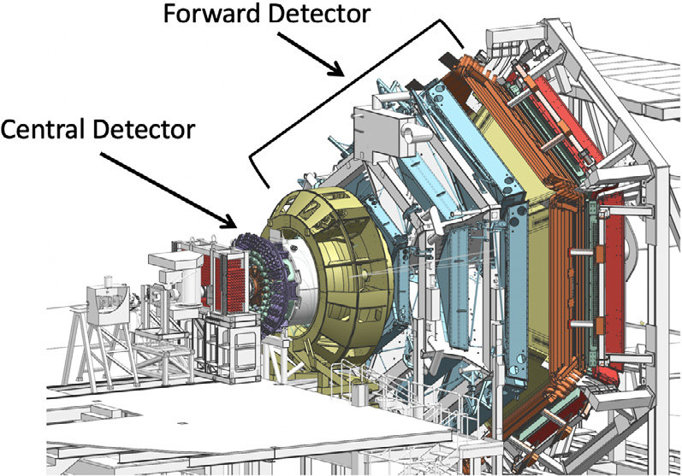
Next Frontier of High Luminosity Experiments in all Four Halls at JLab
Hall A
Proposed new DOE SoLID project
SIDIS, J/ψ
Mass enigma via J/ψ
Spin puzzle (TMDs)
Hall C
Future SBS and BB experiments in Hall C
TDIS, SIDIS, DVCS, Pion Photoproduction
Mass enigma via meson structure
High precision hadron structure (GPDs, TMDs)
SBS/BB in Hall C
Hall B
CLAS12 high luminosity upgrade (plus muon ID)
J/ψ, DDVCS, TCS
Mass enigma via J/ψ
High precision hadron
structure (eg GPDs,)
Hall D
Future GlueX-III proposal
Circularly polarised physics
Exotic hybrid mesons, while pushing into the charmonium mass regions
Gluonic and gravitational structure of proton (J/ψ photoproduction)
Does someone have a gluex 3 image

Slide 2
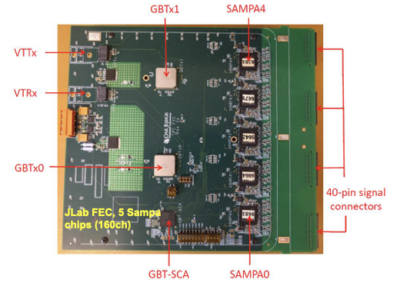
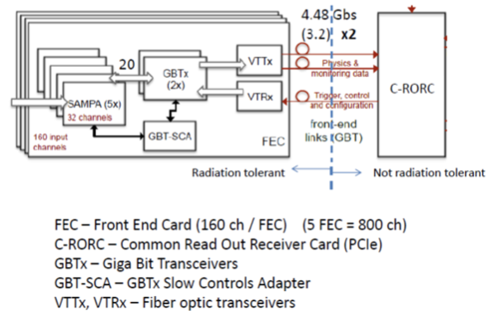
Triggerless Electronics Are Needed to Push High Luminosity Frontier
Unique science opportunities at JLab 12GeV due to new high luminosity frontier experiments
Proposed project: development of high-rate readout electronics, including streaming readout electronics
New opportunity for UK investment and leadership in new large-scale projects at JLab
12GeV developments could then be exploited to establish leadership for future JLab upgrades (22GeV, positron)
Timeline: present – 2031 (could start asap)
Critical Decision points: SoLID are awaiting DOE project approval; GlueX-III proposal at PAC July 2024
Shown – example prototype TDIS streaming readout electronics at JLab for high rate TPC

Slide 3
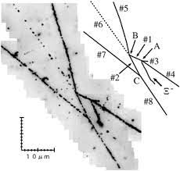
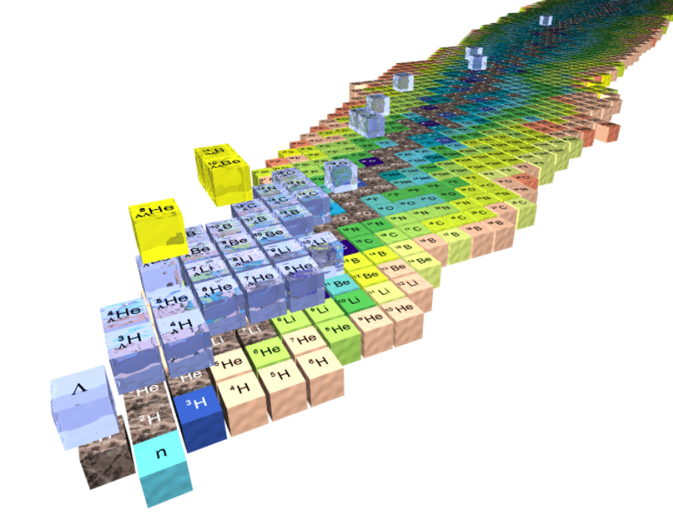
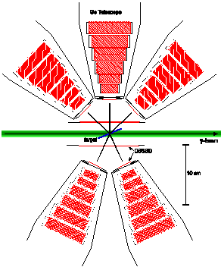
KLF2 - Strangeness facility
Lattice QCD predictions are more accurate for “strange” sector compare to “light”
Production rates are higher than charm/bottom
The early Universe cooling
Level splitting is optimal
Emulsions + HPG
No beam burning
Huge target/detector volume
Hypernuclei inside HPG detector
Hyperon-N interactions at threshold
ChPT
Hypernuclei
Charge symmetry restoration in excited hypernuclei
Complimentary nuclei to $K^{−}$ beams
Timescale ‘25/26
Cost: £2M
Probing hyperon puzzle in the lab
Up to $ΞN$ scattering
>3 OOM improvement
From ~0.7 GeV to 3 GeV
$$K^{+}$$
$$K_{L}$$
$$N$$
$$Ξ$$
$$N$$
$$Ξ$$
$$Λ$$
$$π$$

Slide 4
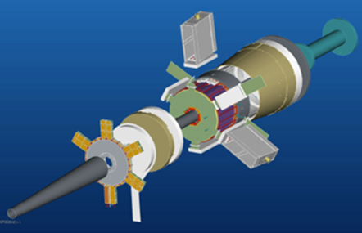
CLAS22
Polarization
To be decided in next 2-3 years
Bridging JLab12 and EIC
Upgrade of existing equipment to operate at high energies
Charm exotics – tetraquarks/pentaquarks
Internals structure of exotic particles
GlueX
KLF2 – complete experiment (only 2 single polarisation observables and 1 double polarisation)
Possible UK contribution – see D. Watts talk, chemical hyperpolarisation
CLAS12/22
Nucleon polarimeter (beam+target+recoil)
UK build existing Forward tagger
EIC pair spectrometer calorimeter
EIC based spaghetti design
Same technology, reduced cost
Better performance at high-E
Better at high intensities
Timescale ‘25/26
Cost £0.8M

Slide 5
JLab2 – High luminosity Frontier Experiments at Glasgow
Unique science opportunities will be provided at JLab by pushing the frontier of high luminosity experiments.
This demands electronics and data-aquisition that can operate in these challenging environments.
Crucial to invest in these experiments to expand existing hadron structure and spectroscopy programs in UK and avoid a gap in UK hadron physics until some years after EIC is running
JLab2 aligns with NSAC Long Range Plan for Nuclear Science and capitalises on investment made in consolidated grants and JLab1 project grant
Science Goal:
Hadron structure in valence regime with high precision and determining the role of gluons in the dynamic generation of the mass (>99%) of the visible Universe
Detailed structural imaging of protons, neutrons through Form Factors and Compton Scattering
J/ψ photoproduction and gluonic and gravitational structure of proton to shed more light in structure topics
Spectroscopy experiments to identify a nonet of exotic hybrid mesons, while pushing into the charmonium mass regions
Pion and kaon structure through Tagged Deep Inelastic and Semi-Inclusive Scattering which are practically unknown
Experiments: SoLID experiment; High-luminosity upgrade of CLAS12; Future Super Bigbite Spectrometer experiments ; GlueX-III
Activities:
Development of, and investment in, readout electronics for high-rate instrumentation, including developments of streaming readout/triggerless electronics
Development of new physics proposals for SoLID, CLAS12 and GlueX, realisation of experiments with existing leadership in Halls A/C

Slide 6
JLab2 – High luminosity Frontier Experiments at Glasgow
Size of project:
We expect the scale to be £1-2M
Timing of project:
The future running of the Jefferson Lab 12 GeV programme is expected to be: present - 2031. The high luminosity upgrades are planned to happen within the next decade. SoLID is expected to become operational in the 2020’s.
Critical decision points:
Currently SoLID are awaiting DOE project approval, although it is expected to receive it, especially given that the recent NSAC Long Range Plan recommends investing in SoLID as an additional project and a new strategic opportunity at JLab.
The Jefferson Lab Programme Advisory Committee will meet July 2024 to consider the GlueX-III proposal.
Scope for leadership:
Readout electronics will be a key part of the instrumentation for future high luminosity experiments at JLab, this would allow UK to take a leading role across several Halls at JLab to maintain an essential presence at JLab
The positron and energy upgrades at JLab will continue the programmme and run side-by-side with EIC operations. The experiments in this project will be expanded and complemented by new measurements at 22GeV and with positrons
- Funding of these activities would ensure UK leadership in the future JLab program beyond 10 years

