Slide 1
Studying nuclei at the extremes with FRIB Physics in the transactinide and lead region; GasDDSAM: a TPC for lifetimes in octupole deformed actinides; A Target Recoil Tracking device for FRIB400
Jack Henderson – University of Surrey
David O’Donnell – University of the West of Scotland
Stefanos Paschalis – University of York

Slide 2
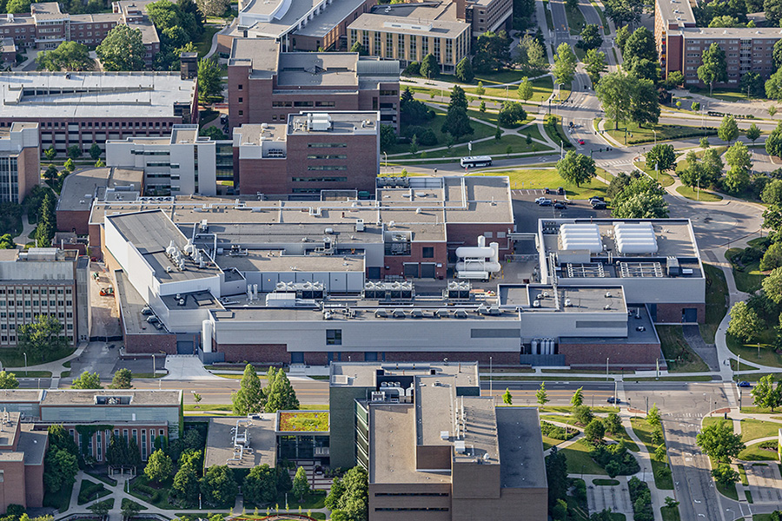
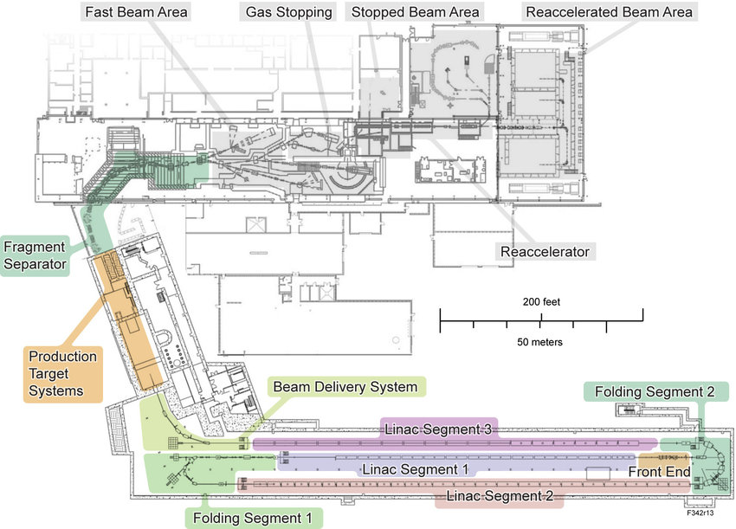
Facility for Rare Isotope Beams
LINAC driven rare-isotope beam facility
Beams produced by fragmentation
Fast, slow/stopped and reaccelerated experimental areas
Fast beams: “traditional” NSCL physics, i.e. GRETINA + S800, decay spec., etc.
Slow beams: mass, laser and decay spec.
Reaccelerated beams: transfer, Coulomb excitation, SECAR…

Slide 3
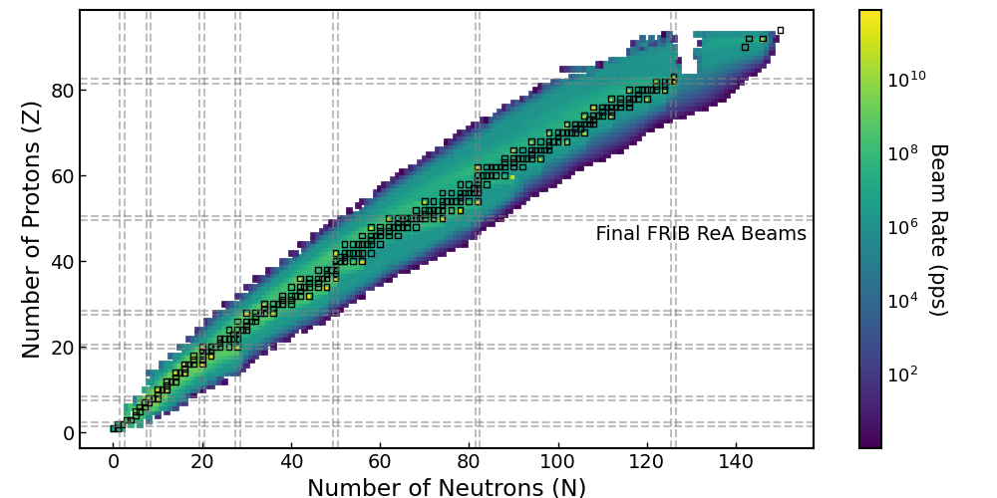
Facility for Rare Isotope Beams
LINAC driven rare-isotope beam facility
Beams produced by fragmentation
Fast, slow/stopped and reaccelerated experimental areas
Fast beams: “traditional” NSCL physics, i.e. GRETINA + S800, decay spec., etc.
Slow beams: mass, laser and decay spec.
Reaccelerated beams: transfer, Coulomb excitation, SECAR…

Slide 4
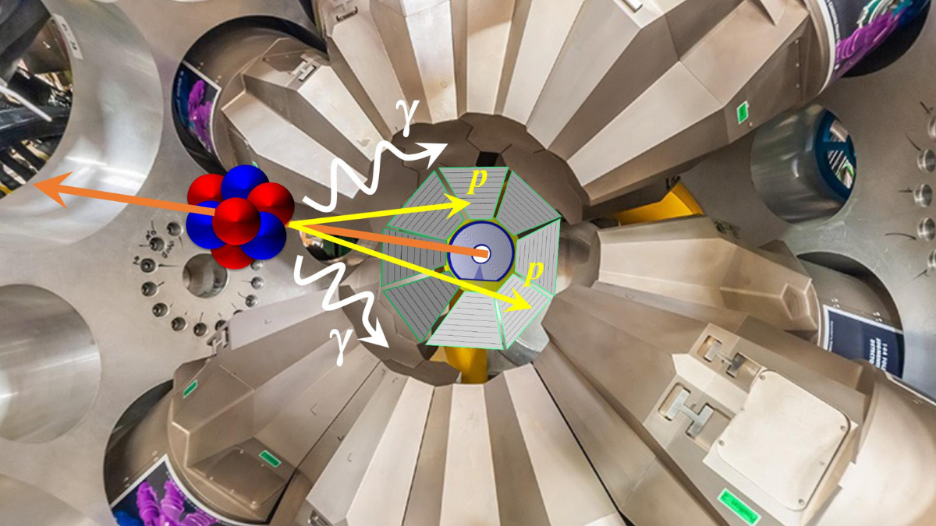
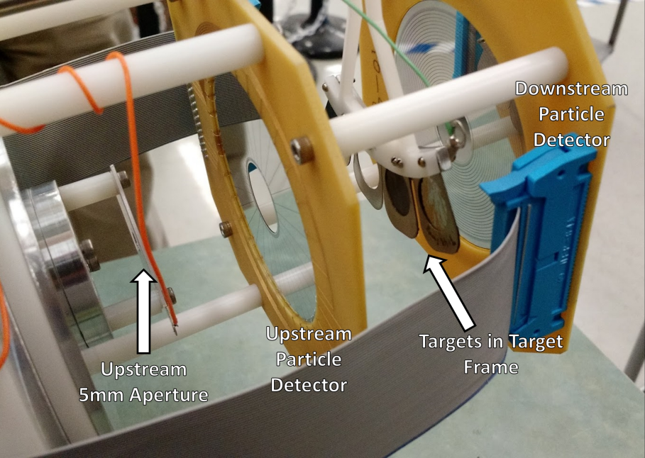
Facility for Rare Isotope Beams
Current UK involvement:
Exploring the p-process with SECAR (M. Williams, Surrey)
Shape coexistence in N=Z ⁴⁴Ti (LLNL, MSU, Surrey)
Collectivity and Shape North of Sn (MSU, LLNL, Surrey)
Shell evolution at N=28 studied through sub-barrier Coulomb excitation (MSU, LLNL, Surrey)
Evolution and isospin-dependence of quadrupole collectivity in the heaviest N=Z systems (M. Bentley, R. Wadsworth, York)
Constraining the Ni-Cu cycle in X-ray bursts and Core Collapse Supernovae: Spectroscopy of ⁶⁰Zn (G. Lotay, Surrey)
LoI for development of actinide beams (UWS, Liverpool)
FAUST (Surrey, Daresbury, York)
JANUS (MSU, LLNL, Surrey)

Slide 5
Facility for Rare Isotope Beams
Future developments:
High-Resolution Spectrometer (HRS): A replacement for the existing S800 spectrograph, optimized for high-rates and efficiencies up to the FRIB400 energies
Status: Funded ($115 million)
FRIB400: Upgrade of the FRIB LINAC to 400 MeV/u to increase production of exotic nuclei
Status: Whitepaper(s) submitted and endorsed in the 2023 Long Range Plan
Gamma-Ray Tracking Array (GRETA): Complete $4π$ tracking array with upgraded electronics
Status: Fully funded and nearing completion

Slide 6
Facility for Rare Isotope Beams
Intersections with UK interests:
Fast beams delivered to GRETA + S800/HRS for knockout followed by $γ$-ray spectroscopy (York) and transfer reactions (Surrey, York)
Reaccelerated beam (ReA) area can provide high-quality beams for Coulomb excitation (Liverpool, Surrey, UWS), direct measurements for nuclear astrophysics (Surrey, York) and transfer reactions with solenoidal spectrometers (Liverpool, Manchester)
Both fast and stopped beam areas allow for decay spectroscopy (silicon deposition or tape station) for isomeric and $β$-decay studies (Brighton, Surrey, York)
Stopped beam area for laser (Liverpool, Manchester) and mass spectroscopy (Edinburgh)
Active-target TPCs in use for low- and mid-mass beams (Birmingham, Sheffield Hallam)
FRIB Theory Alliance, bringing together nuclear theorists across the USA (Surrey, York)

Slide 7
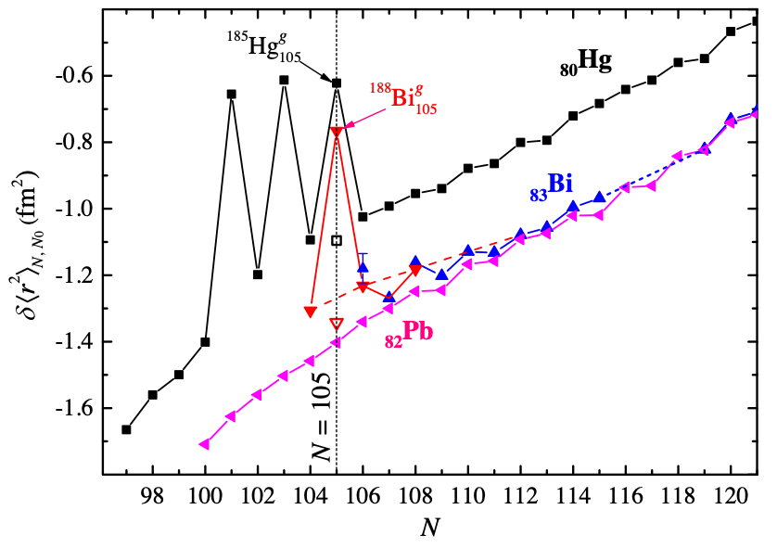
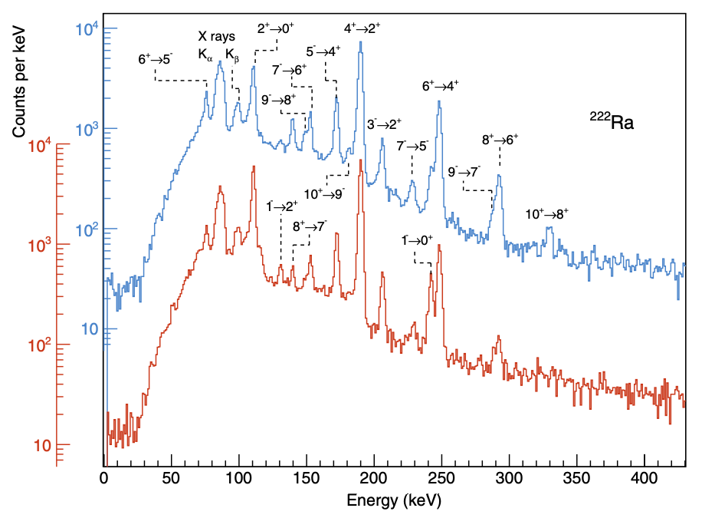
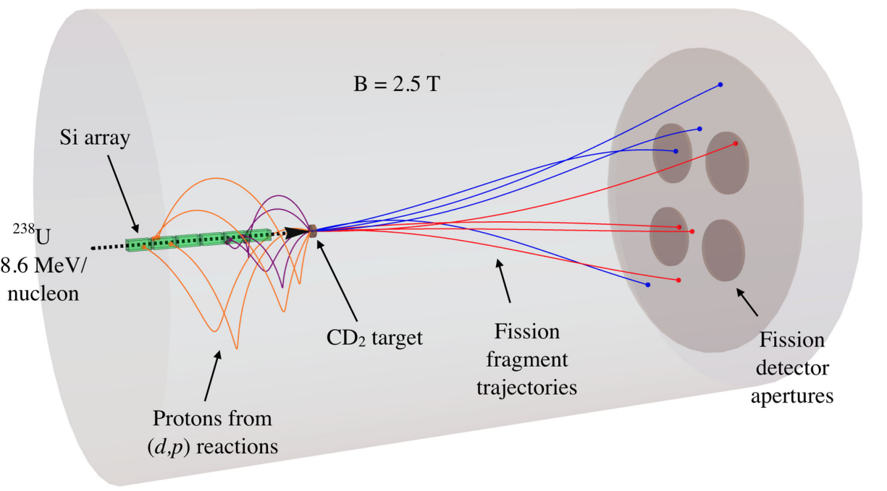
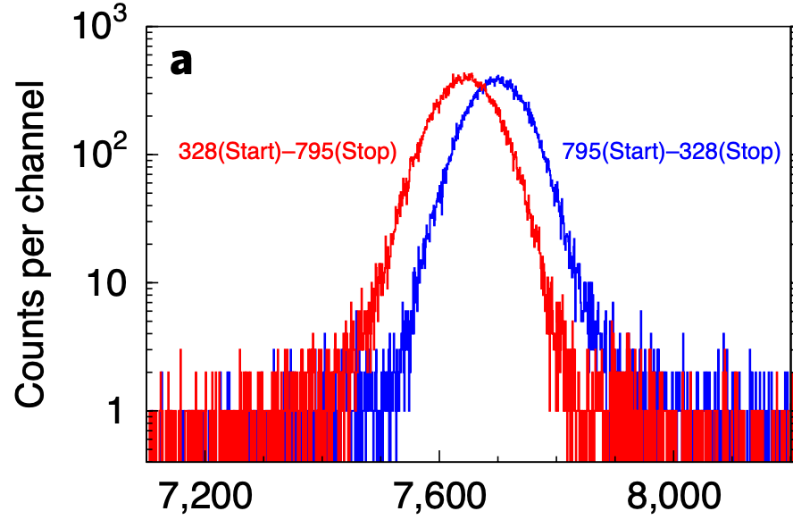
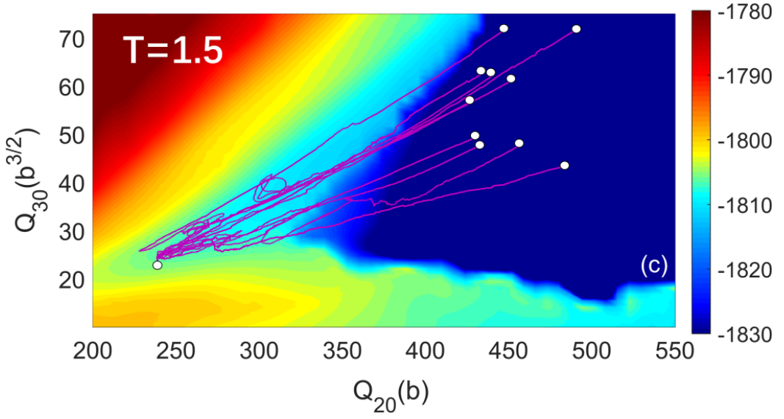
Physics in the trans-lead and actinide regions
(Liverpool, Manchester, Surrey, UWS, York)
UK has a wealth of experience and interest in the region
Challenges:
Low-energy $γ$-ray spectroscopy
Neutron detection
Charged-particle detection
Nuclear theory
Project:
BEGe detectors, neutron detectors, charged-particle R&D
Subdivisible and portable
Robust theoretical work-package to support and direct experimental work
ECR-led project

Slide 8
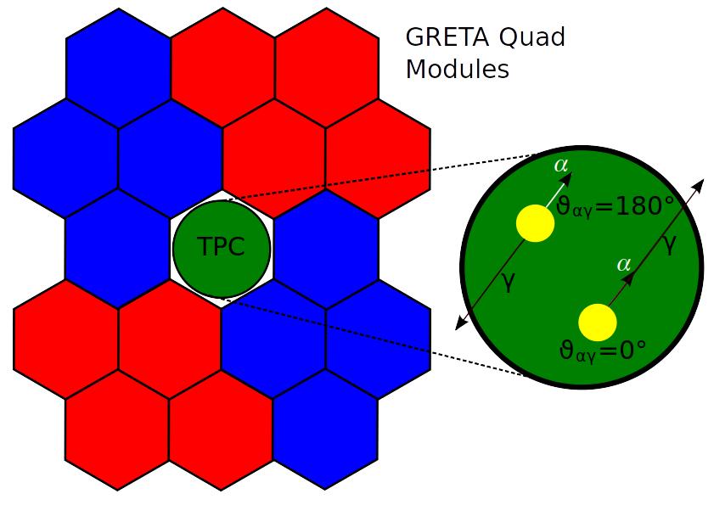
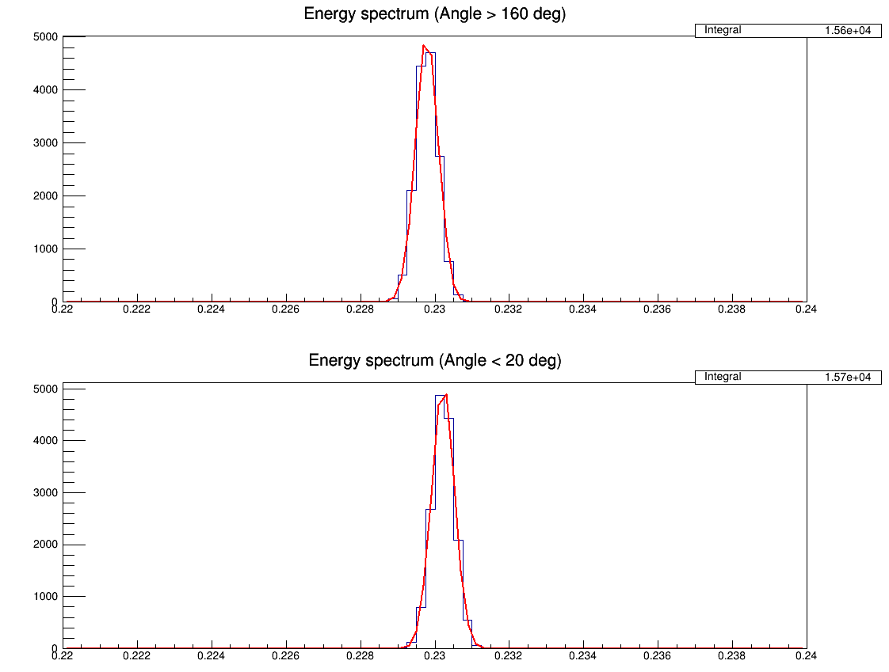
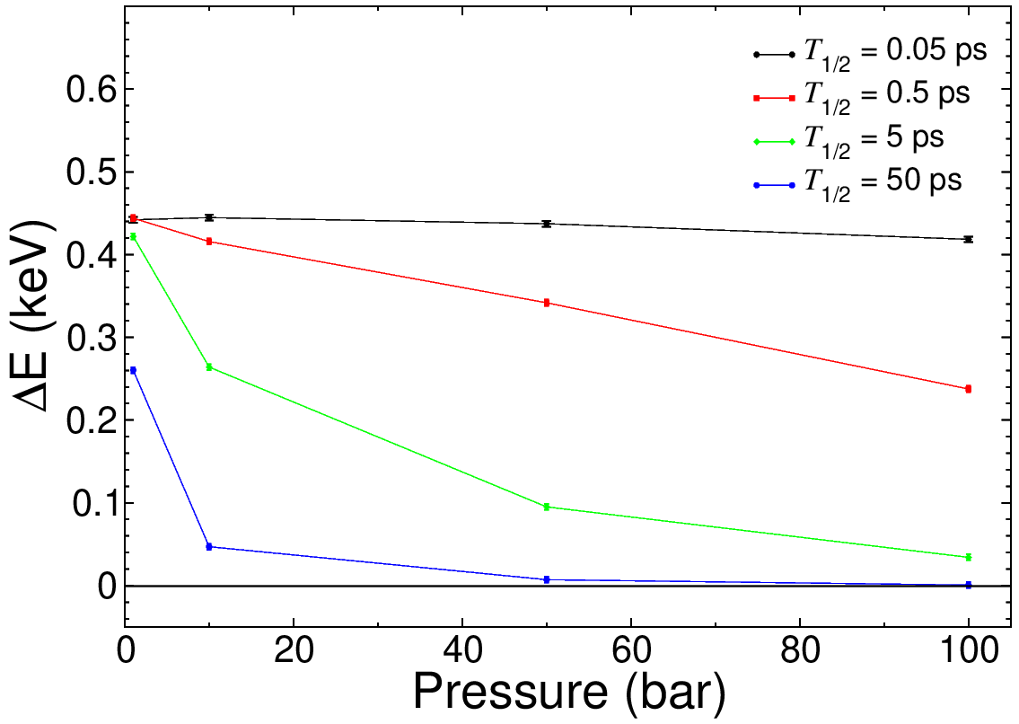
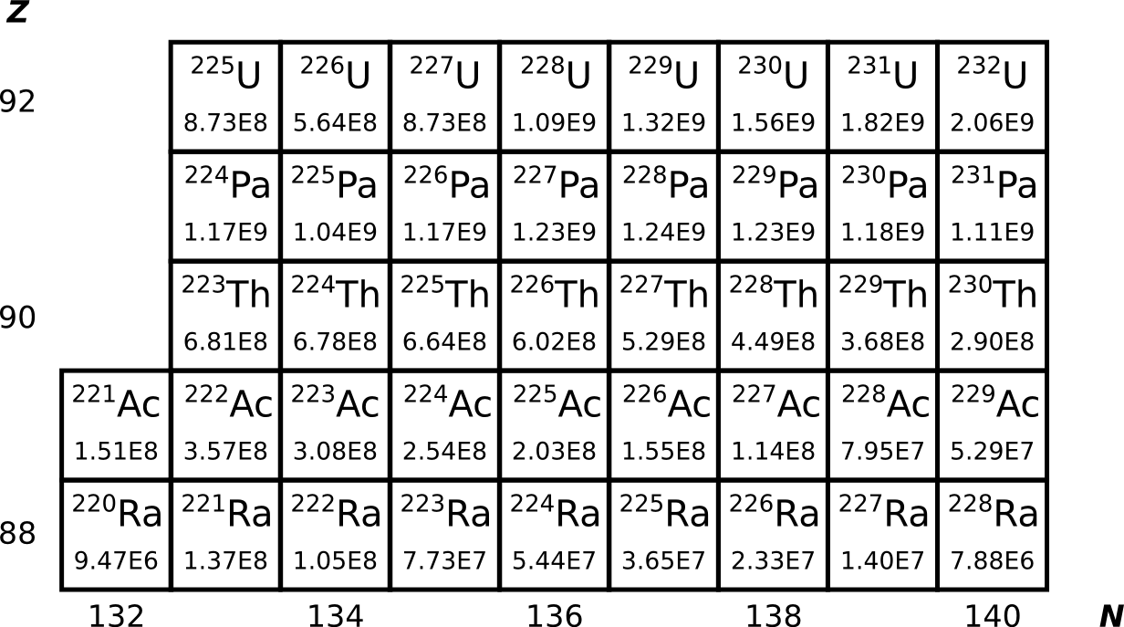
GasDDSAM: a TPC for the measurement of lifetimes in octupole-deformed actinide nuclei – David O’Donnell (UWS)
Motivation:
Solution:
Level lifetimes essential for quadrupole and octupole deformation
B(E1), B(E2) and B(E3)...
Identify candidate nuclei for future EDM searches
Test and refine theoretical models
High yields of actinide nuclei to be available at FRIB
Levels of interest are expected to be too short for fast-timing
Levels not populated as a result of fusion-evaporation
Levels are populated following alpha decay: use α-ɣ correlations
TPC with Xe gas held at high, variable pressure
Surround TPC with HPGe tracking detectors
Fast ions implanted into gas volume
Detect α particle in TPC volume and ɣ-ray in HPGe
7⁻
6⁺
5⁻
4⁺
3⁻
2⁺
1⁻
0⁺
3⁻
0⁺
1⁻
^{A}X
2⁺
0⁺
^{A-4}X’
Energy (MeV)

Slide 9
Target Recoil Tracker for FRIB400 (MeV/A) at HRS – Stefanos Paschalis (University of York)
Physics cases and the international landscape for FRIB400
Structure of the most exotic systems such as multi-neutron systems → see SAMURAI tetraneutron result
Structure studies through gamma-ray spectroscopy with thick LH2 target → See MINOS/SEASTAR campaign at RIKEN
Studies of clustering (through, e.g., (p,pα), (p,pd) QFS reactions) → New physics programme at R3B and at SAMURAI (ONOKORO/TOGAXSI)
Fission barrier heights determined through (p,2p) reactions → New physics programme at R3B and at SAMURAI
Short-range correlation (SRC) studies with exotic beams and hadronic probes → New programme at R3B
Apparatuses in fragmentation facilities share complementary physics goals and similar technological challenges:
HRS at FRIB400, R3B at FAIR, SAMURAI at RIBF
The regime of beam energies with a few hundred MeV/A:
Enables studies of dense asymmetric nuclear matter
Ideal for certain types of nuclear reactions (quasi-free scattering: p,2p p,pd ppa)
Optimal for increasing luminosity and the yield of exotic isotope production and in particular heavy ions

Slide 10
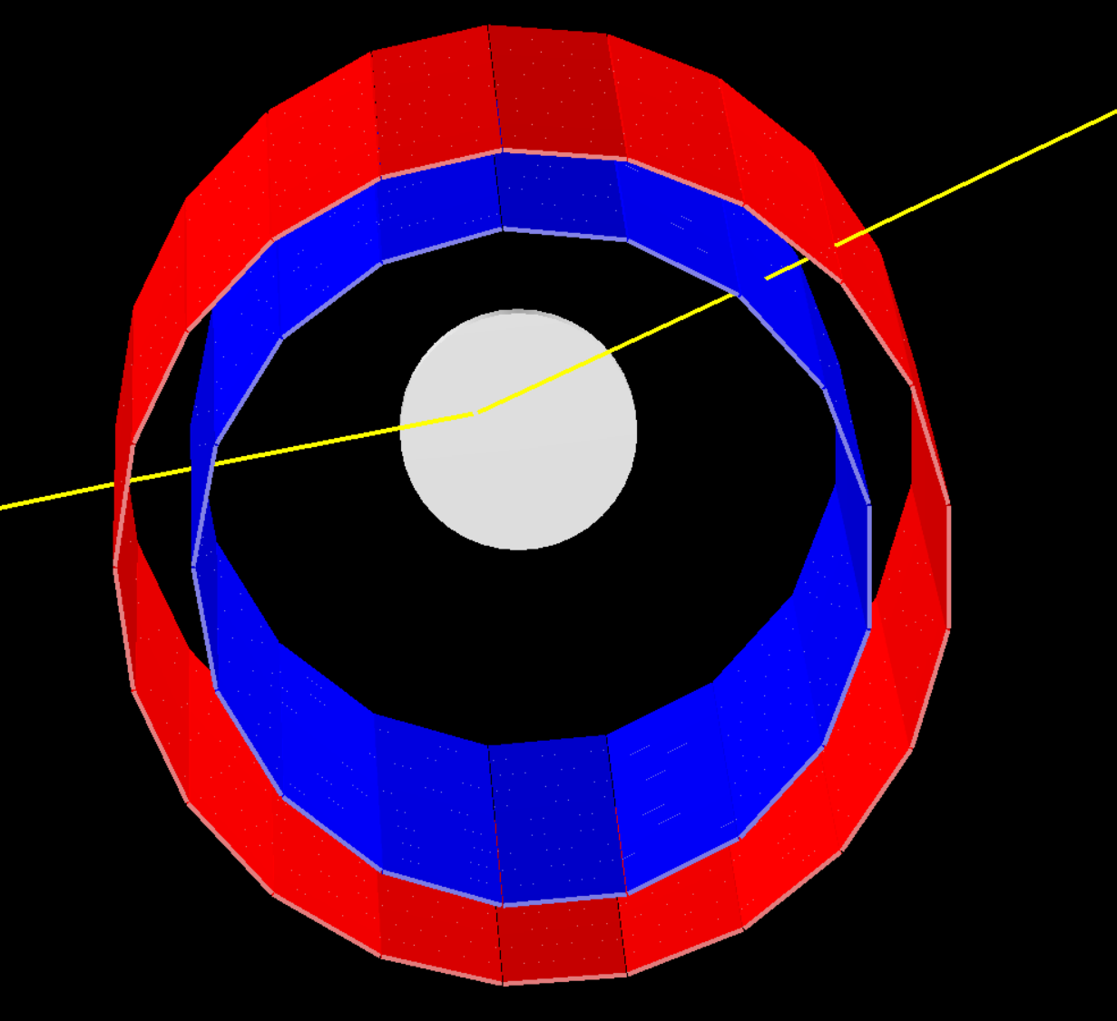
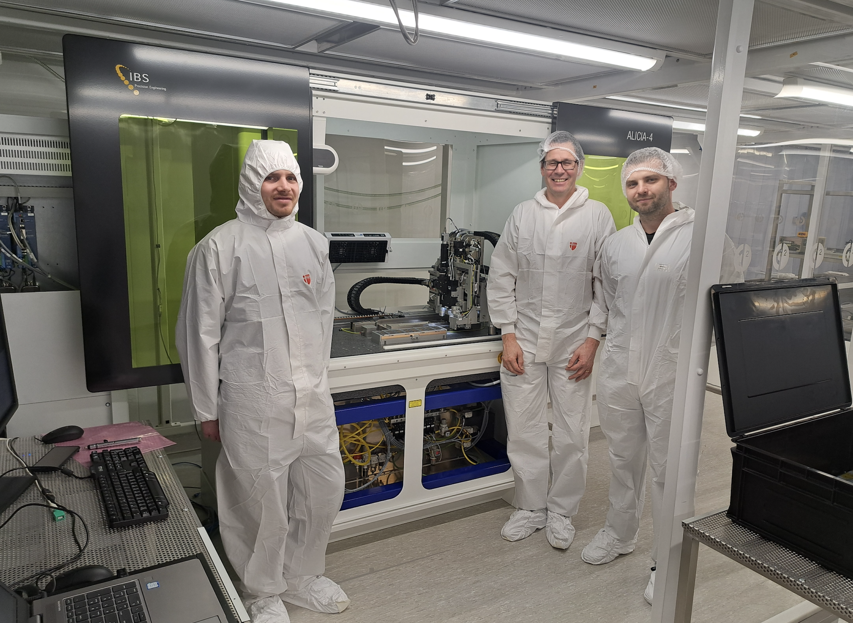
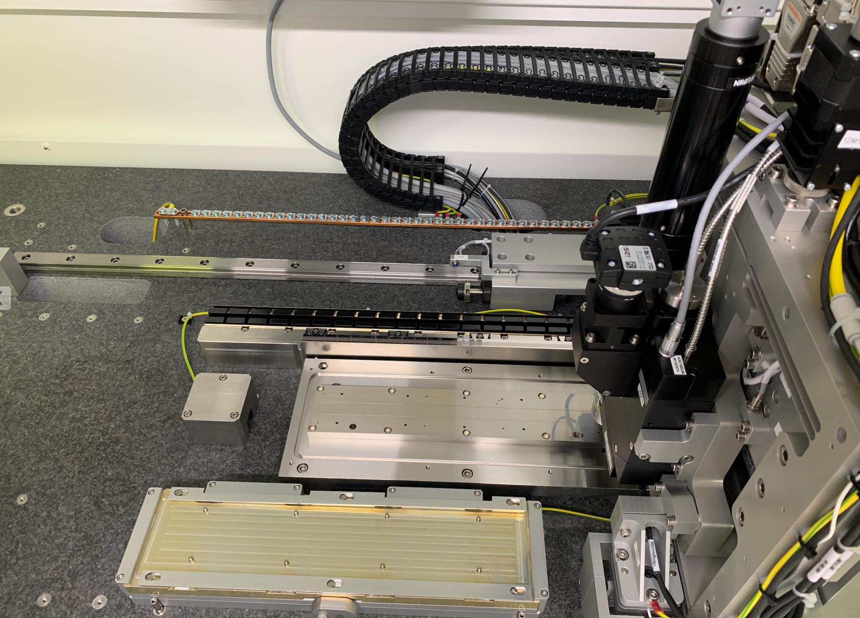
Target Recoil Tracker for FRIB400 (MeV/A) at HRS – Stefanos Paschalis (University of York)
High-precision Target Recoil Tracker is an essential instrument for reaction vertex reconstruction and missing-mass measurements with high energy beams
Capitalising on existing UK expertise → excellent value for money and low risk:
Currently leading the construction of the R3B TRT device at Daresbury
Leading relevant physics programmes at R3B (p,pd M. Petri ) and SAMURAI (ONOKRO)
ALICIA machine
installed at
Daresbury for R3B TRT

Slide 11
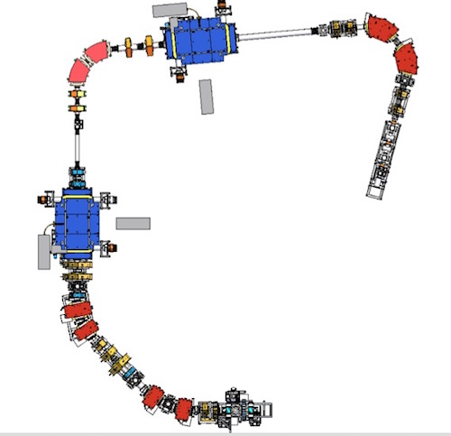
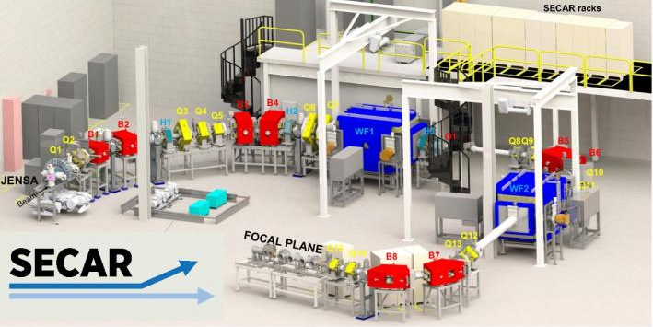
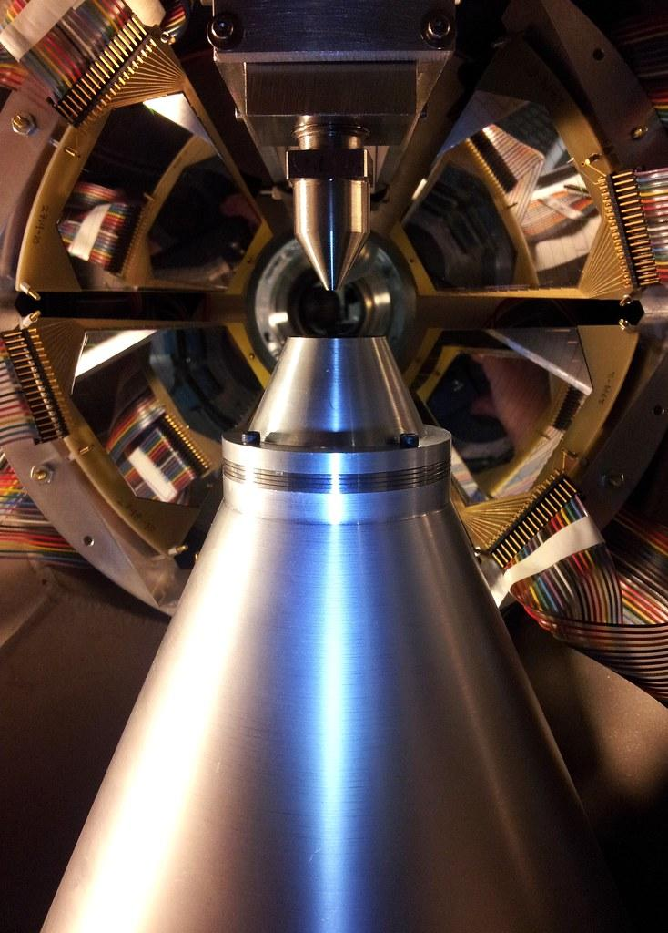
SECAR: Separator for Capture Reactions – Matthew Williams (University of Surrey)
New recoil separator in ReA3 Hall, optimised to measure (p,γ) and (α,γ) reactions for astrophysics.
Presently undergoing in-beam commissioning, expected to carry out first experiments by end of 2024/early 2025.
First approved radiative capture reaction to measure ⁷⁷Br(p,γ)⁷⁸Kr for p-process
- PI: Matt Williams (Surrey)

