Slide 1
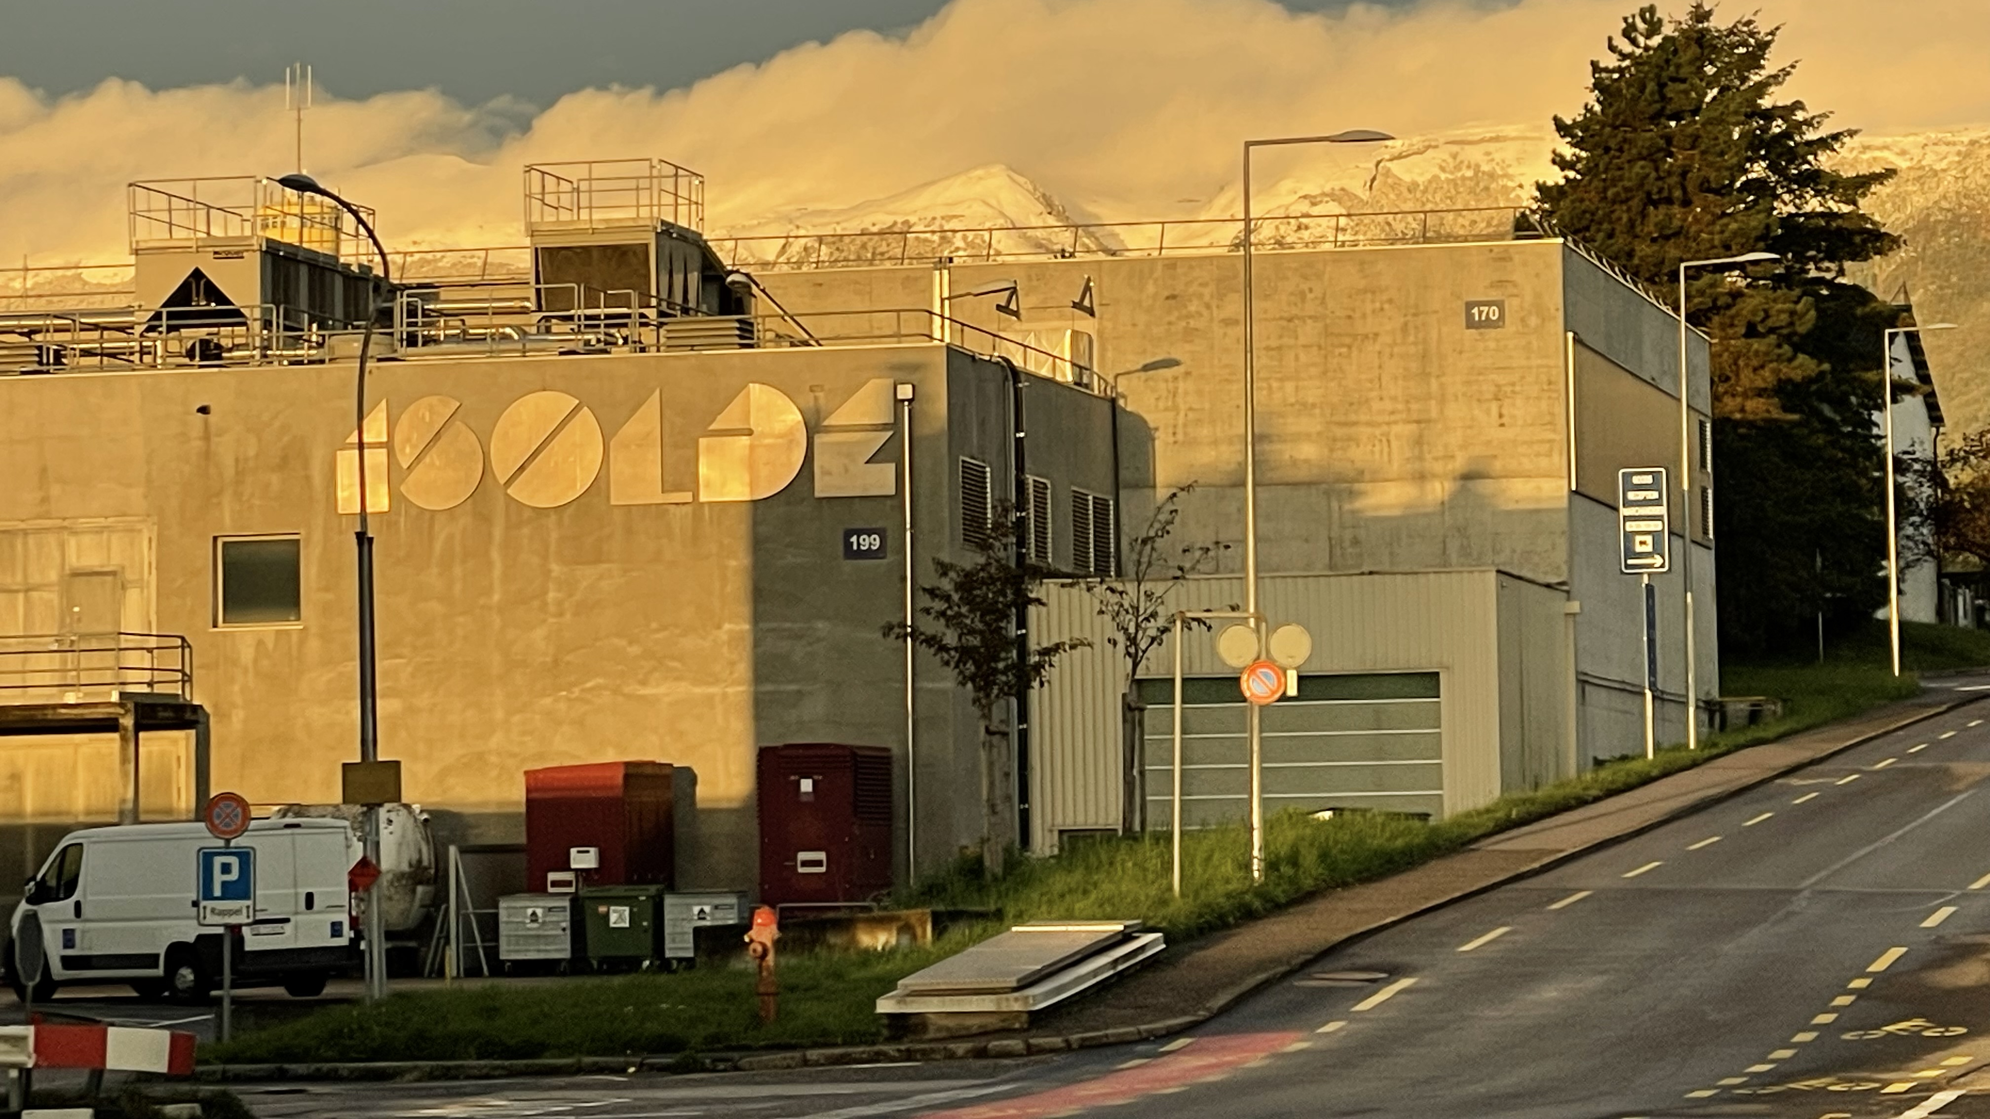
A Unique GeV-Driven
ISOL Radioactive Ion Beam Facility

Slide 2

UK at ISOLDE
“Punches above its weight”
11% of all registered users (96 individuals out of 873) – very close second to DE – from ten institutions.
In 2022 and 2023, 13% of researcher visits from UK institutions (165/1250).
INTC accepted proposals – 21% of active proposals, 35% of active LoI with UK spokesperson.
Currently 3 UK instrument spokespersons (IDS, CRIS, ISS) and, since 1999, 2 (out of 7) UK ISCC Chairs, 2 (out of 7) UK ISOLDE Spokespersons and 1 (out of 7) INTC Chair (cf 11-18 countries).
Past decade: five senior UK fellowships focussed on ISOLDE (AF, ERF, RS).
UK capital investment: cooler-buncher, CRIS, IDS, MINIBALL and ISS.
UK involvement in 8 instruments (COLLAPS, CRIS, VITO, IDS, TAS, MINIBALL, ISS and SEC) via STFC-CG (c.f. around 15 instruments in total).
UK science interests at ISOLDE:
nuclear physics (shapes, sizes, decay, reactions, structure, astrophysics), beyond the Standard Model (EDMs) and, beyond STFC remits, medical isotopes and condensed matter.
PARTICIPATION
BEAMTIME ACCESS
LEADERSHIP
INVESTMENT
SCIENCE
Improvements at ISOLDE benefit a wide section of the UK community.
Political lubrication: Helps max return from CERN Subscription.

Slide 3
Context and
Timelines
ISOLDE Improvements LS3
well-developed plan (e.g. higher yields)
~25 MCHF request to CERN budgets
OPPORTUNITY 1:
Improvements to instrumentation to take advantage of LS3 improvements in RUN 4 and beyond
CERN cycle of LHC Runs and Long Shutdowns (LS)
ISOLDE fed by proton injectors
OPPORTUNITY 2:
ISOLDE Improvements LS4
discussion just starting
OPPORTUNITY 3:
Longer term future of the proton complex 2041+

Slide 4
ISOLDE Improvements Programme LS3
Up and including LS3: user workshops (2019-2020) followed by ATS, ISCC, INTC/RB for MTP-2024. Several consolidation plus improvement items to ISOLDE infrastructure to assist both capacity and capability.
For example, need to improve aging proton beam dumps to modern RP standards gives opportunity to increase isotope yields via proton energy & intensity.
1.4-GeV to 2-GeV increases yields:
fragmentation products x2 to x5.
exotic spallation products >x6.
heavier nuclei x2 to x5.
minor increase for fission fragments.
See literature data, simulations, and recent tests at ISOLDE with “limited” 1.7-GeV delivery.
PSB could give x2 in intensity now, if beam dumps could take it, across all isotopes.
Require protons energies of 1.4, 1.7 & 2.0 GeV with modest intensity increase (used flexibly) for significant impact on scientific programme LS3+.
Factors of 2 or more in yield – capacity & capability for precision/detail.
Factors of 5 or more in yield – capability for new isotopes.
Also included: fire safety in primary areas, beam instrumentation, beam switching in central line, TRAP solenoid spare, initial phase of EBIS upgrade, REX RF consolidation – mainly building capacity.
Task force underway looking at improvements to HIE-ISOLDE cryo-maintenance – may add to LS3 plans next year.
So far so good - formal approval by CERN Council in June 2024.

Slide 5
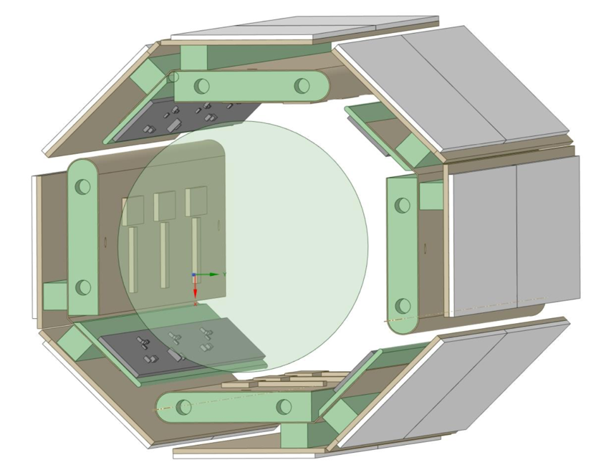
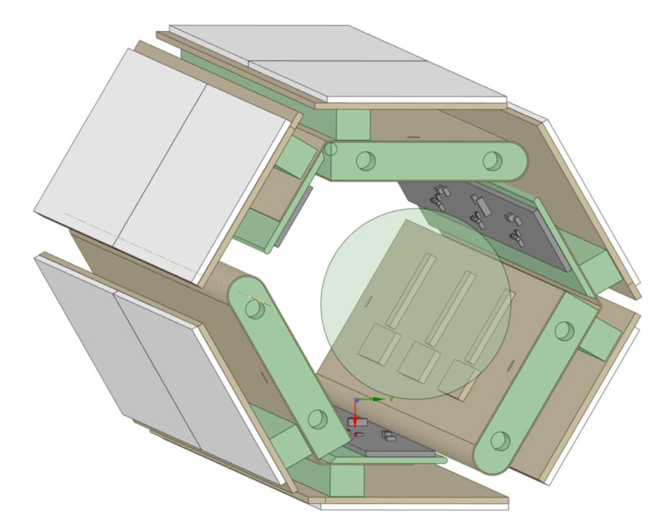
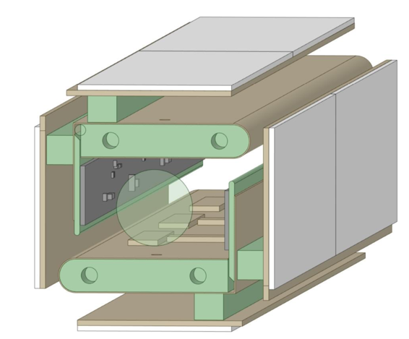
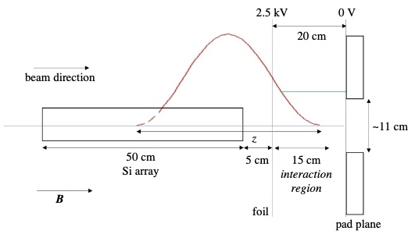
How to upgrade instruments to take advantage of LS3 improvements?
ISS Dual-array
Forward-going reactions: (d,d’), (p,d),(d,h),(α,t), (t,α), (p,t), (p,α)...
  Collective properties via inelastic scattering.
  Single-particle behaviour via transfer.
  Pairing, astrophysics….etc.
Breakup and clustering
  Breakup following transfer, e.g. ⁷Be(d,p)⁸Be → 2α or ⁷Li+p
  Large acceptance for 2α (fwds) and p (bkwds)
Surrogate (n,p) and (n,α) reactions for astrophysics
  Charge exchange with “extra” proton → (d,pp).
  Correlated protons in forward/backwards directions.
ISS Hybrid Silicon-TPC
(³He,d) reactions as surrogate for astrophysics (p,γ)
Single proton behaviour via (³He,d) and (α,t)
(α,p) for astrophysics etc..
  Gas target of similar effective thickness as CD₂ but without C and access to other gases – H_{2,} D_{2,} ^{3,4}He.
  TPC determines vertex with solenoid method minimising kinematic effects.
P.A. Butler, Proc. R. Soc. A, 479: 20230075 (2023)

Slide 6
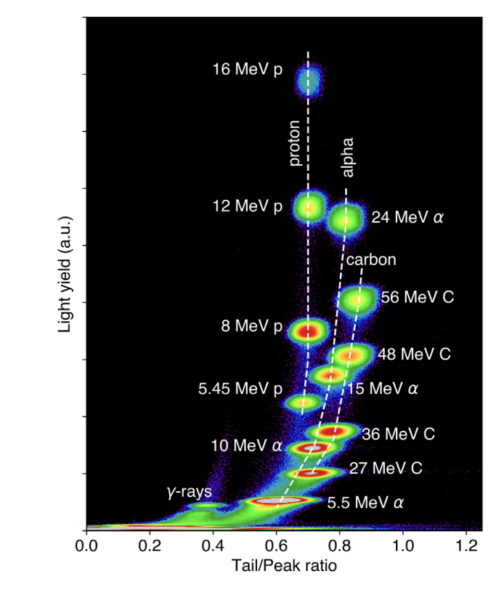
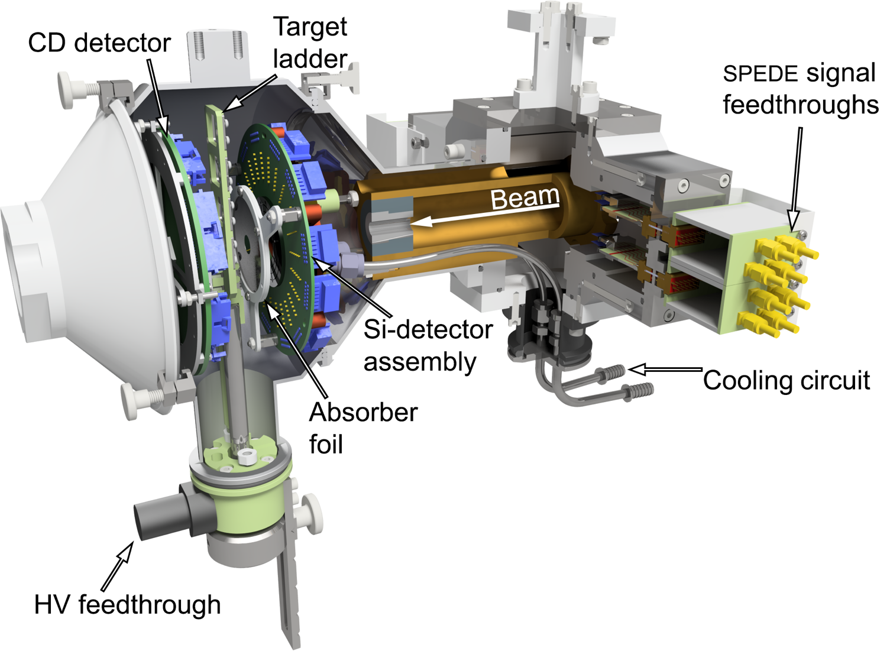
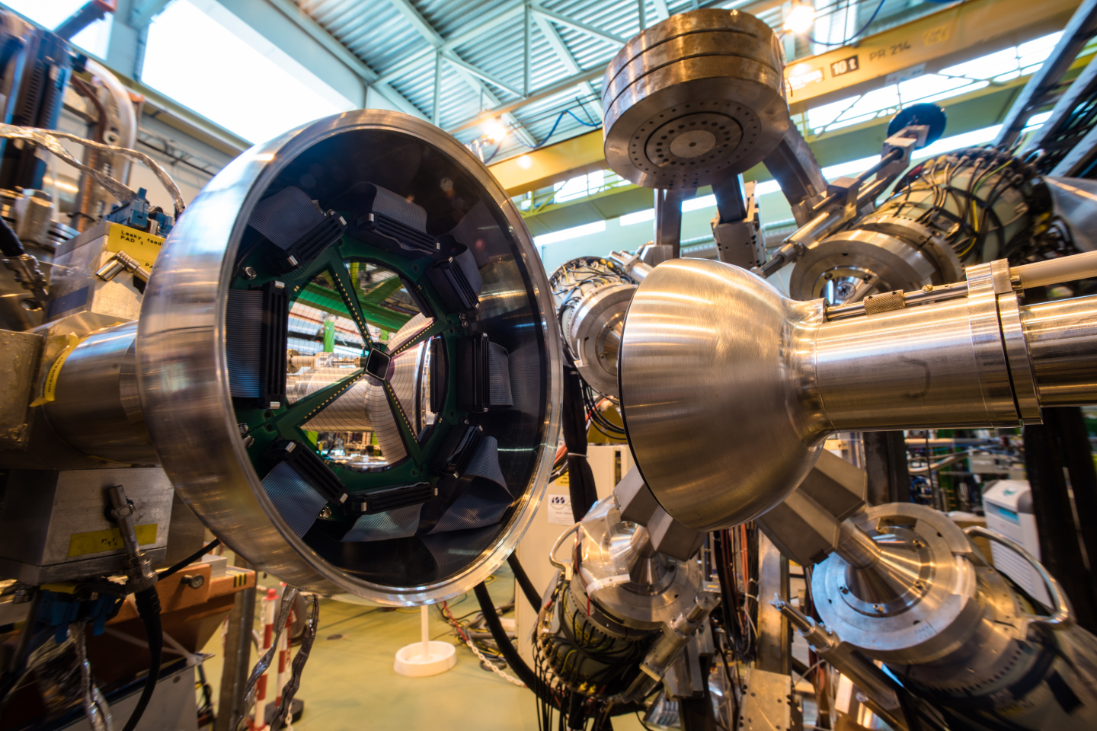
MINIBALL charged-particle arrays
T.J. Gray, et al. NIM A, 104, 167392 (2022)
Open possibility of γ-ray spectroscopy of exotic nuclei with new reactions using higher intensity beams: multi-nucleon transfer, fusion evaporation, cluster transfer,…
Address rate limitations of current silicon particle detectors with novel scintillator array. Example: TRINITY array of GAGG:Ce (ORNL).
Simultaneous upgrade to electron spectroscopy capabilities with SPEDE.

Slide 7
Summary Opportunity 1:
HIE-ISOLDE project (ISS + MINIBALL instrument upgrades) estimated of order £5-6M with submission within next 1-3 years – at least eight UK institutions involved with these instruments.
For low-energy instruments with UK involvement (CRIS, COLLAPS, IDS) – will benefit from LS3 improvements esp. yields, but evolution of instruments requires on-going support via CG/capital requests.

Slide 8
Opportunity 2: ISOLDE improvements and new initiatives LS4 (2033-4) and RUN 5 (2034 onwards).
Discussion at ISOLDE just beginning and plenty to think about.
Discussion points for facility improvements: beam purification, upgrades to EBIS/Trap system, increases in energy of post accelerated beams, upgrade of REX cavities, HIE-ISOLDE bunching/chopping, hall extension…
Possible point for new large instrument projects – separator, ring and/or others!

Slide 9
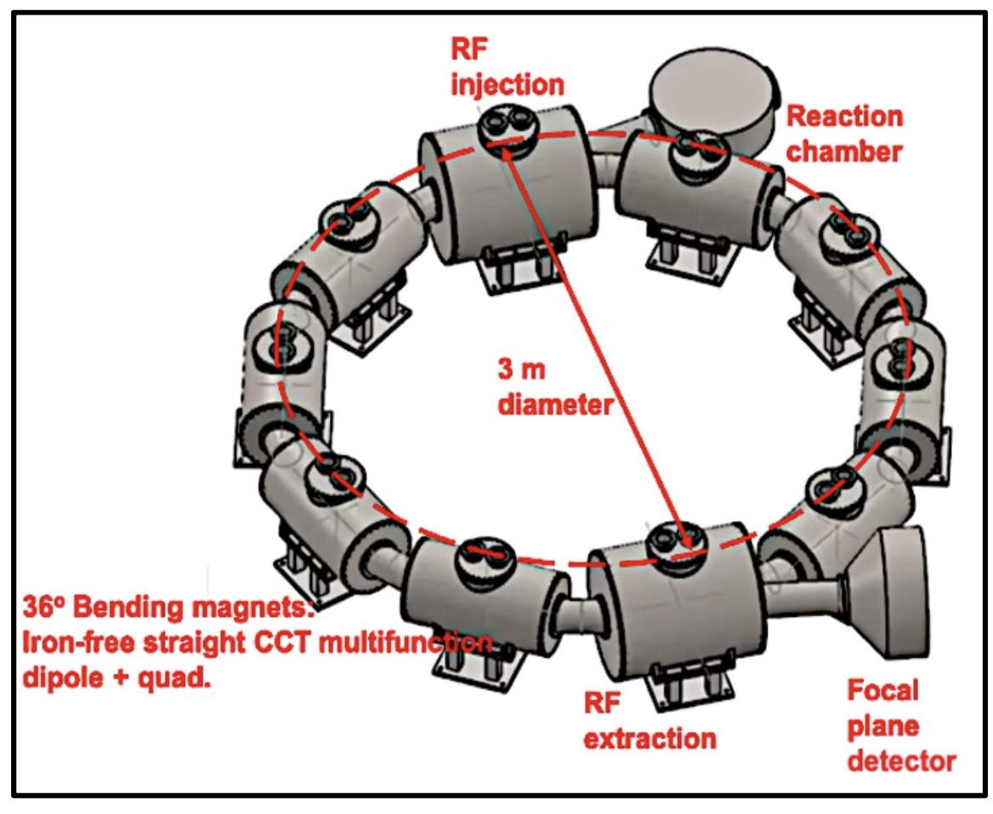
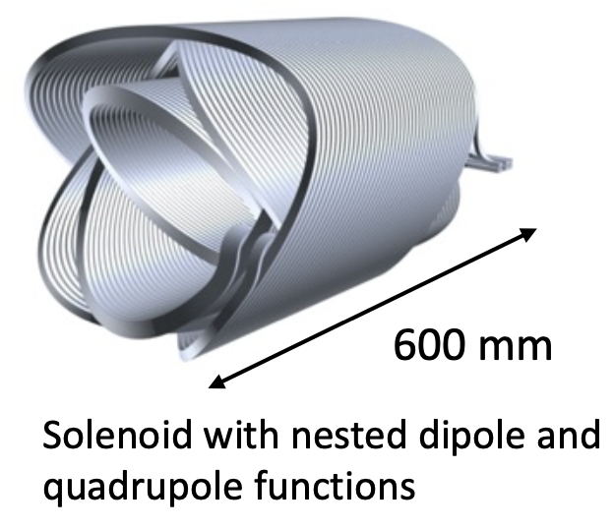
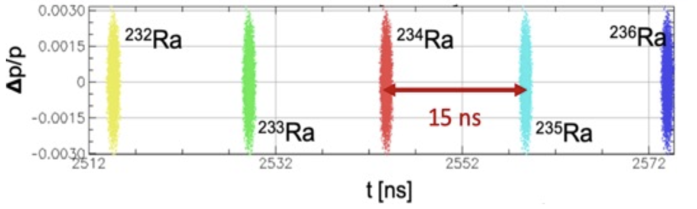
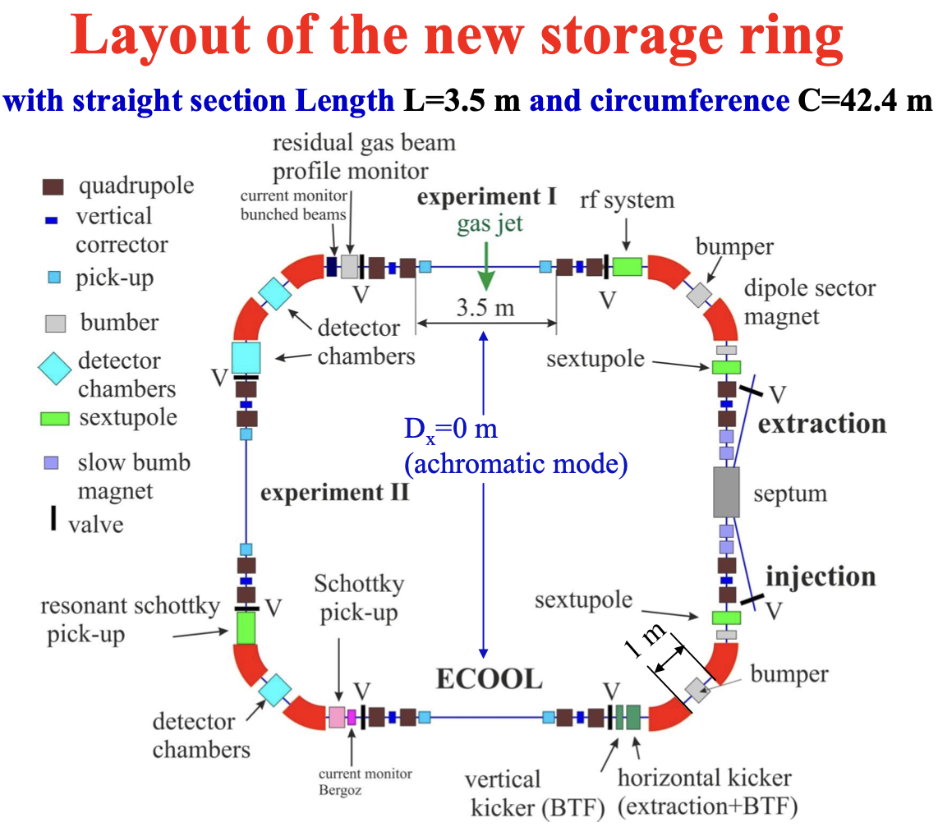
ISOLDE Superconducting Recoil Separator (ISRS).
Opportunity to enhance provision for the nuclear astrophysics and benefit to nuclear structure experiments.
R&D project underway (4M€ Spain) to validate designs for compact superconducting recoil separator- effectively a circular TOF device with new magnet technology with multifunction technology. Existing UK involvement in earlier stages to build on.
(b) Storage Ring.
Design study for a compact storage ring (2018) - new physics opportunities still emerging for ISOL+Ring, especially for astrophysics.
Would new magnet technology help?

Slide 10
Summary Opportunity 2:
Good overlap of opportunity with UK skills and interests to warrant developing a longer-term project for ISOLDE in terms of facility or new instruments – pencil in for later in decade, but with detail to be worked out. Larger projects clearly need a longer run up – but time to so it.
Could reach out to accelerator communities for separator and/or ring.
Common practice in previous Road Maps.

Slide 11
Opportunity 3: Longer term future 2040+
The non-LHC “NP” programmes (ISOLDE, AD, n_TOF) :
Interesting, world-leading science in a diversity of fields harnessing the unique capabilities available from protons at a few to tens of GeV.
Unique opportunities for 10+ years, with potential for much longer science programmes.
CERN organisational priorities are currently realisation of HI-LUMI-LHC and addressing whether FCC is feasible .
As that planning solidifies over the next five years, opportunities likely to arise for the proton injectors – e.g. enhanced performance, new injectors, higher power, higher energy, who knows?
In the NuPECC LRP headline recommendations:
Important that NPAP should articulate the UK’s ambition to be part of this strategy development. Despite the long-time scales, activity will begin soon.
Nuclear physics opportunities at CERN constitute a world-leading research programme that has successfully diversified CERN’s scientific reach. Construction of ALICE 3 as part of the HL-LHC plans is strongly supported. New initiatives should be sought to maximise the scientific exploitation of ISOLDE, n_TOF and AD. As the roadmap for the post-LHC future of CERN is developed, a strategy should be prepared to secure future opportunities for continuing world-leading nuclear-physics programmes that are unique to CERN.
P.S. Everything in this talk is consistent with NuPECC LRP – headline, infrastructure and physics recommendations

Slide 13
ISOLDE – FRIB/REA Comparison
RADIOACTIVE BEAM | NOW |  |  |  | LATER
 | HIGH ENERGY MEV/A |  | LOW ENERGY 10s KEV |  | HIGH ENERGY MEV/A |  | LOW ENERGY 10s KEV
 | HIE- ISOLDE RUN3 ACTUAL (pps) | FRIB PAC2 (pps) | ISOLDE low energy (pps) | FRIB PAC2 (pps) | HIE-ISOLDE RUN4 (pps) | FRIB Ultimate (pps) | ISOLDE low energy RUN4 (pps) | FRIB Ultimate 2033? (pps)
7Be | 3.00E+06 | 2.00E+04 | 6.00E+07 | 2.00E+04 | 6.78E+06 | 9.00E+05 | 1.36E+08 | 9.00E+05
11Be | 8.00E+05 | 2.40E+04 | 1.60E+07 | 2.40E+04 | 2.88E+06 | 9.60E+05 | 5.76E+07 | 9.60E+05
27Na | 8.00E+05 | 1.70E+05 | 1.60E+07 | 1.70E+05 | 2.88E+06 | 6.90E+06 | 5.76E+07 | 6.90E+06
30Mg | 5.00E+05 | 1.00E+05 | 1.00E+07 | 1.00E+05 | 1.70E+06 | 5.00E+05 | 3.40E+07 | 5.00E+05
49Ca | 3.00E+05 | 5.00E+06 | 6.00E+06 | 5.00E+06 | 8.10E+05 | 2.00E+08 | 1.62E+07 | 2.00E+08
50Ca | 6.00E+03 | 1.00E+04 | 1.20E+05 | 1.00E+04 | 1.36E+04 | 4.00E+05 | 2.71E+05 | 4.00E+05
61Zn | 4.00E+05 | 1.50E+06 | 8.00E+06 | 1.50E+06 | 8.00E+05 | 5.00E+07 | 1.60E+07 | 5.00E+07
68Ni | 3.00E+04 | 2.20E+06 | 6.00E+05 | 2.20E+06 | 6.00E+04 | 9.00E+07 | 1.20E+06 | 9.00E+07
94Kr | 1.00E+05 | 5.90E+02 | 2.00E+06 | 5.90E+02 | 2.40E+05 | 2.30E+04 | 4.80E+06 | 2.30E+04
110Sn | 1.00E+07 | 6.50E+06 | 2.00E+08 | 6.50E+06 | 3.40E+07 | 2.60E+08 | 6.80E+08 | 2.60E+08
206Hg | 8.00E+05 | 8.8 | 1.60E+07 | 8.8 | 1.60E+06 | 3.60E+02 | 3.20E+07 | 3.60E+02
212Rn | 5.00E+06 | 9.70E+04 | 1.00E+08 | 9.70E+04 | 1.00E+07 | 3.90E+06 | 2.00E+08 | 3.90E+06
Conclusion:
complementary facilities
Notes:
(i) ISOLDE Actual = measured rates at ISS during experiments 2021-23
(ii) FRIB PAC 2 = predicted FRIB rates with 5-10kW on target (FRIB Website 2023)
(iii) ISOLDE RUN 4 = predicted gain from 1.4 to 2 GeV with x2 proton intensity (N.B. Isotopes farthest from stability benefit most - not these ones!)
(iv) FRIB Ultimate = predicted rates with 400 kW on target in next decade? (FRIB Website 2023)
(v) assumed EBIS+LINAC efficiency is 5%
(vi) assumed same efficiency for FRIB stopping fragments and re-acceleration to tens keV and several MeV/A
(vii) if within a factor of two call it a draw

Slide 14
Examples of emerging science opportunities (10+ years):
Some examples of continuing and emerging themes for NuPECC Long Range Plan 2024
https://indico.ph.tum.de/event/7050/contributions/6297/attachments/4399/5621/NuPECC-LRP-Input-ISCC-v3.pdf
Radioisotopes with n_TOF (astrophysics/technology) and with AD (nucleon distributions etc).
Precision ground-state and decay properties of progressively exotic nuclei needed to test new theoretical approaches to nuclear structure through to probing astrophysically-important isotopes.
Radioactive molecules for fundamental physics searches, e.g. octupoles/EDM.
Programme of reaction studies at HIE-ISOLDE started in RUN 3: evolution of neutron shell structure, astrophysical reactions, fission process, …
Later, opportunities lie in new reactions at >10 MeV/u: proton shell structure, n-p pairing, clustering…
User-built superconducting recoil-separator for reaction studies at HIE-ISOLDE.
EXAMPLES FROM
CORE NP
Increase yields of most exotic species; isotope purity and yields; consistent running .
Underperformance of linac (7.5 MeV/u cf 10 MeV/u) is currently limiting physics / energy upgrade for >10 MeV/u.
Beam buncher and chopper / space in experimental hall.
β-NMR with polarised r/a ions is x10¹⁰ more sensitive than conventional NMR have huge potential e.g. nuclear magnetisation distributions, protein folding in biological fluids, diffusion in solid-state batteries… Offline polarisation of long-lived isotopes made at ISOLDE for novel medical imagining modalities.
Next generation instruments for in-situ probes of materials are becoming available – novel magnetic materials, multiferroics, quantum optical materials, topological insulators, low dimensional solids...
EXAMPLES FROM
OTHER AREAS
isotope purity / isotopes near stability / space in experimental hall .

Slide 15
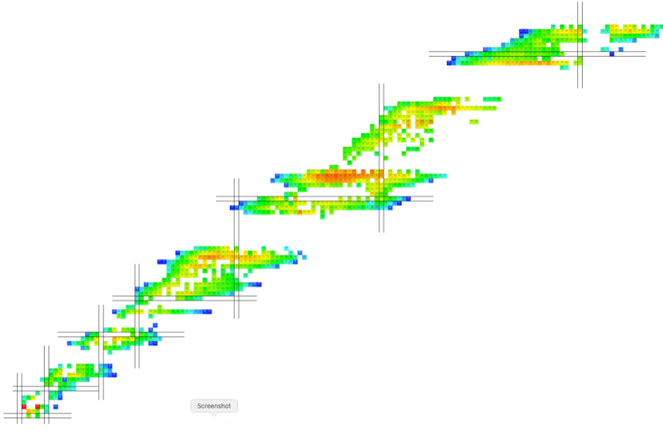

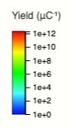
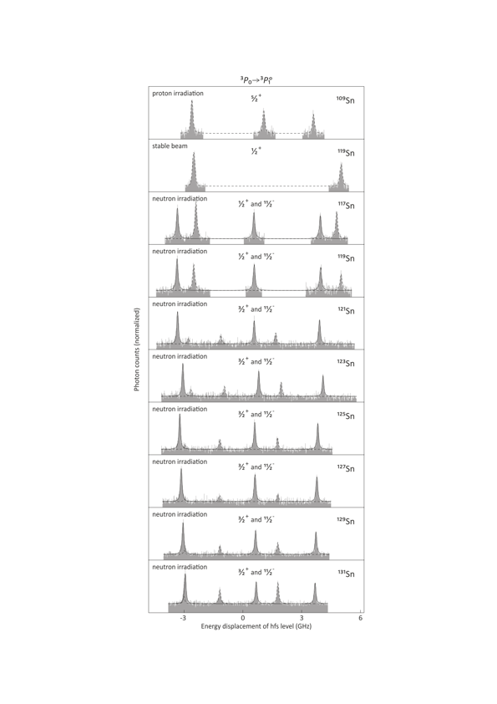
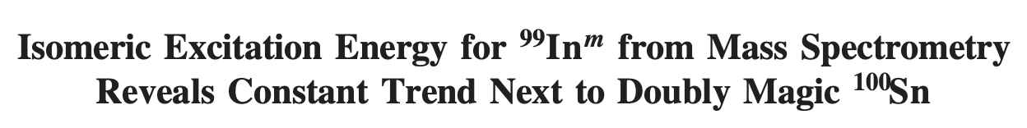
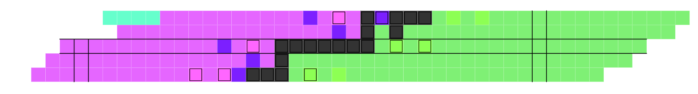
>1300 isotopes of >75 elements
Example – hyperfine structure of ten tin isotopes taken over days by the same instrument
The only radioactive ion beam facility using GeV protons - several processes (fission, spallation, fragmentation) all contribute to radioisotope production on a particular target gives wide range of isotopes with excellent yields.
Easy and quick delivery of different isotopes for precision studies across many isotopes with systematics under control.
>15 state-of-art instruments, cutting-edge in laser spectroscopy, mass traps, detector arrays, particle spectrometers…
spallation
fission
fragmentation
Very close collaboration between ATS groups and users is an important strength at CERN.
Example – back-to-back PRL’s on two extreme indium isotopes
＃ protons
Tin - Sn
Z=50
Indium - In
⁹⁹In
N=50
neutron deficient
stable
neutron rich
N=82
¹³³In
＃ neutrons

Slide 16
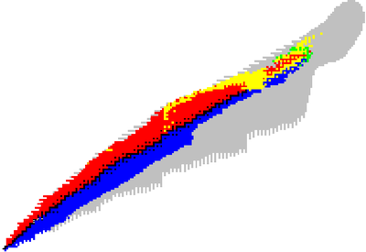
Research with radioactive beams at ISOLDE
Physics beyond the Standard model
Condensed-matter physics and material science
Nuclear astrophysics
Radioisotopes for medical applications
Nuclear physics: reactions and structure
Radioactive ion beams at < 60 keV or post-accelerated (HIE-ISOLDE).
Strong user demand (around 400 days approved by INTC c.f. 225 days running per year) especially for HIE-ISOLDE.
40-50 experiments/yr with 500-600 researcher-visits/yr.
Atomic and molecular physics
Life sciences and biophysics
CAPABILITY = what science the facility can do (isotope yields, beam and properties, and instrumentation).
CAPACITY = how much science the facility can do (operational efficiency, user demand, style of operation).

Slide 17
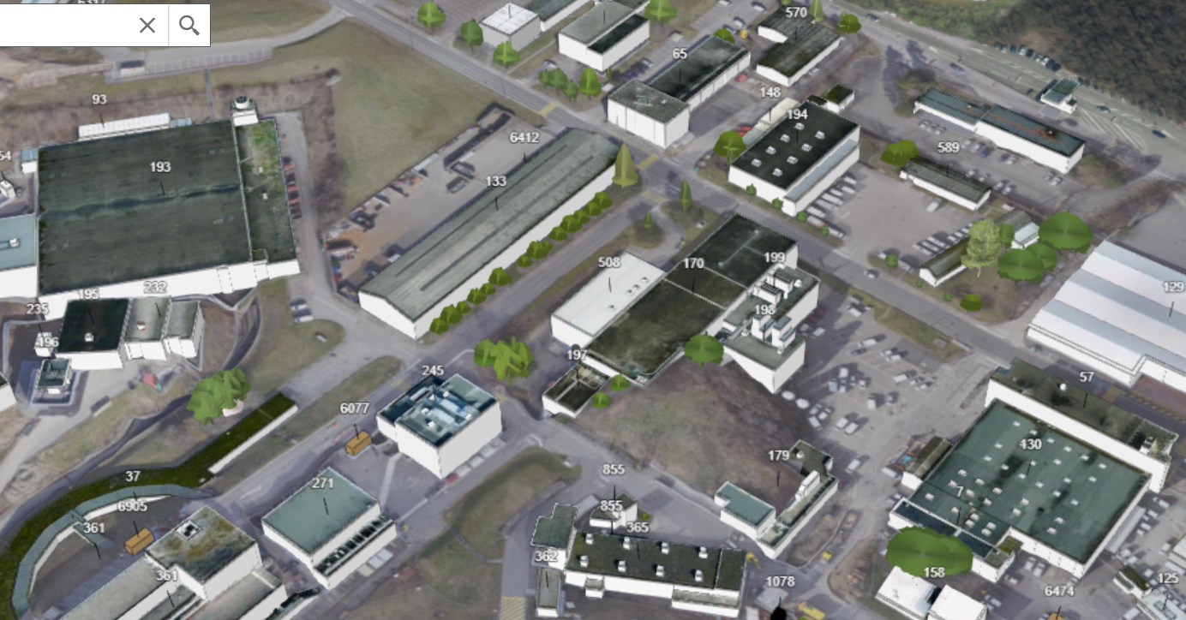
CONCLUSIONS/CODA:
Long-term future for “ISOLDE, n_TOF, AD and HI-fixed target” Science at CERN
ISOLDE Collaboration did some “unfettered dreaming” …
The non-LHC “NP” programmes show:
Interesting, world-leading science in a diversity of fields harnessing the unique capabilities available from protons at a few to 10s GeV.
Unique opportunities for 10+ years, with potential for much longer science programmes.
New Hall
Current Hall
New hall + target stations.
Dedicated space and facilities for new and current low-energy experiments.
Improved beam purity (mass resolution) and quality (time structure).
Parallel operation of high-energy experiments in current ISOLDE hall.
Liberates space for new large instruments: superconducting recoil separator and a compact storage ring.
At the appropriate time, availability of protons and heavy ions in the post-LHC era should be considered carefully.
…other programmes have long-term aspirations.
(Past facility developments have been opportunistic and benefit to reconsidering some features e.g. proton energies.)
…but begs the question of post-LHC future for unique non-LHC facilities at CERN that rely on proton delivery.

