Slide 1
UK Centre of Excellence for Nuclear Astrophysics
UK
CENA

Slide 2
experiment
observation
Astrophysics
Stellar evolution
nucleosynthesis calculations
astronomical observations
Nuclear Physics
Cosmology
nuclear reactions
nuclear properties
masses and decay lifetimes
standard model
cosmic microwave background
neutrinos and dark matter
Nuclear
Astrophysics
Atomic Physics
Plasma Physics
theory
radiation-matter interaction
energy losses, spectral lines
materials and detectors
degenerate matter
electron screening
equation of state
computation

Slide 3
Challenges
sectoral funding mechanisms
limited cross-community interaction
‘language barrier’ across domains

Slide 4
Our Vision
shape future of Nuclear Astrophysics worldwide
through sustained funding model to capitalize on:
breath-taking astronomical observations
ground-breaking advances in accelerator-based experiments
major breakthroughs in stellar modelling

Slide 5
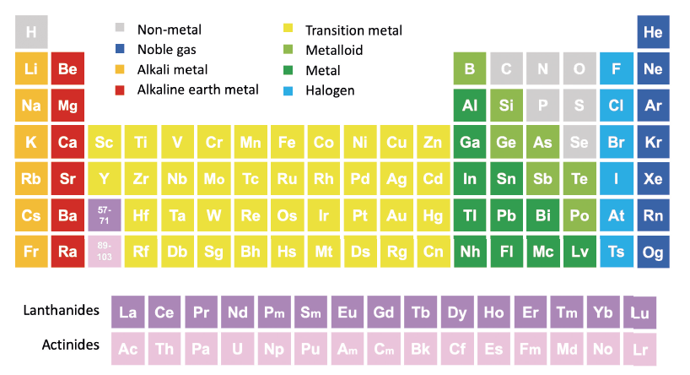
Physics Goals
chemical evolution of the universe
formation and evolution of stars and galaxies
origin of chemical elements, from Big Bang Nucleosynthesis to r-process
quiescent and explosive stellar phenomena

Slide 6
Centre’s Initiatives
cross-disciplinary research
sustained funding for PDRAs, PhD students, MSc scholarships
visiting programs
students, ECRs, staff, from UK, EU, overseas
tailored training activities
stellar simulations, reaction networks, nuclear reaction theory, R-matrix, detectors, accelerators, …
cross-community workshops
seed funds for collaborations
access to experimental facilities
UK (Birmingham cyclotron, neutron source)
overseas

Slide 7
Initial 5-Year Budget
UK Centre for Nuclear Astrophysics
item | subtotal [5y]
1x 2-year PDRA / year | £1,200,000
3x 4-year PhD studentship / year | £2,640,000
3x 1-year MSc scholarship / year | £450,000
10x Visiting Programme bursaries | £350,000
2x Workshops | £100,000
1x Summer Schools | £100,000
oversight committee costs | £50,000
program administrator | £150,000
 | £5,040,000
Mid-term Evaluation
quantifiable metrics
new collaborations, publications, other funding, …
soft indicators
personal impact, benefit, relevance, experience, …
→ Second period of 5-year funding

Slide 8
Statements of Support
Dr Umberto Battino
University of Hull
As one of the PI of the NuGrid collaboration, I am in full support of this proposal. Since 2007, NuGrid has developed a comprehensive nuclear astrophysics simulation capability. The two most significant factors contributing to the project's nearly two-decade-long success were the collaboration between nuclear physicists and astrophysicists and the availability of funding through participation in large scientific networks, such as JINA and IReNA. The Centre for Excellence in Nuclear Astrophysics will guarantee both these crucial factors and will hence be of great benefit for many scientists in the UK and attract the best overseas talents.
Prof Raphael Hirschi
Professor of Stellar Hydrodynamics and Nuclear Astrophysics, Keele University
BRIDGCE, ChETEC, ChETEC-INFRA, IReNA
I fully support the proposed Centre for excellence in Nuclear Astrophysics, which is key to maximise the return on STFC’s huge investments in both Astronomical observations and Nuclear experimental facilities. Indeed, chemical elements carry the fingerprints of the key processes taking place in the Universe and only by connecting Nuclear to Astrophysics can we tackle pressing open questions.
Prof Chiaki Kobayashi
Professor of Astrophysics, University of Hertfordshire
As the chair of the STFC-funded research network of nuclear astrophysics BRIDGCE, I fully support this proposal. 75 researchers across 20 UK universities are involved in the BRIDGCE network, yet unlike similar networks in other countries, it lacks secure, long-term funding which is fundamental to support students/ECRs and conduct breakthrough science. The Centre for Excellence in Nuclear Astrophysics will be beneficial to many researchers in the UK.

Slide 9
Initial 5-Year Budget
UK Centre for Nuclear Astrophysics
item / year | cost per item | international fees | travel allowance | years | items / year | subtotal/year | scheme duration [5y] | subtotal2
2-year PDRA | £120,000 |  |  | 2 | 1 | £240,000 | 5 | £1,200,000
4-year PhD studentship | £20,000 | £20,000 | £4,000 | 4 | 3 | £528,000 | 5 | £2,640,000
1-year MSc scholarship |  | £30,000 |  | 1 | 3 | £90,000 | 5 | £450,000
Visiting Programme bursaries | £7,000 |  |  | 1 | 10 | £70,000 | 5 | £350,000
Workshops | £10,000 |  |  | 1 | 2 | £20,000 | 5 | £100,000
Summer Schools | £20,000 |  |  | 1 | 1 | £20,000 | 5 | £100,000
oversight committee costs | £10,000 |  |  | 1 | 1 | £10,000 | 5 | £50,000
program administrator | £30,000 |  |  | 1 | 1 | £30,000 | 5 | £150,000
 |  |  |  |  |  |  |  | £5,040,000
Mid-term Evaluation → Second period of 5-year funding

