Slide 1
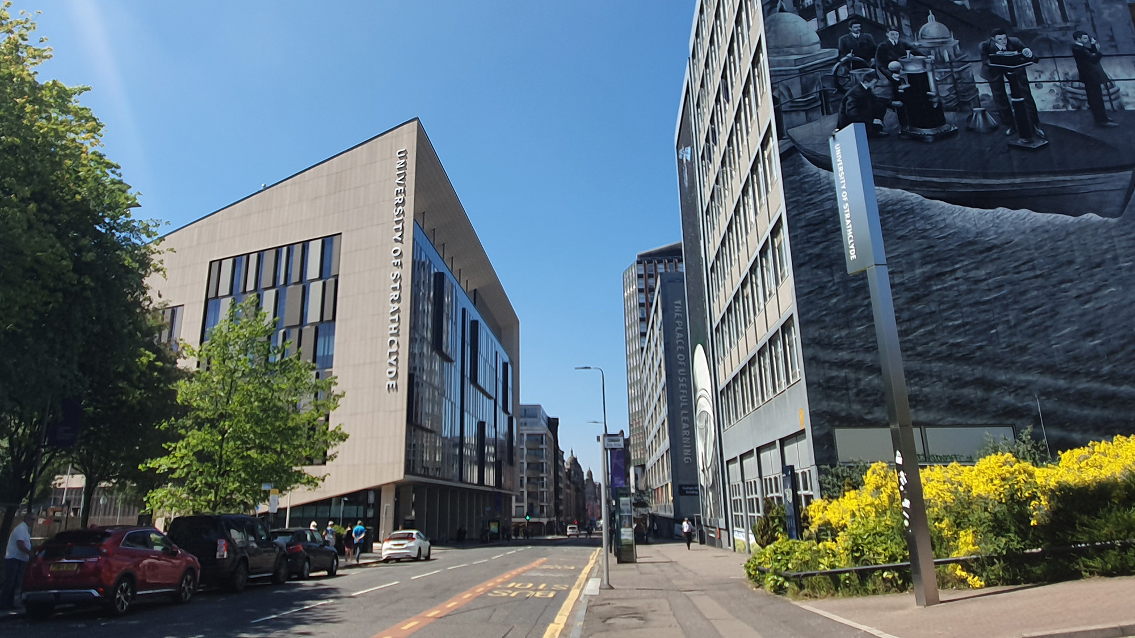
WP 2 Ion Detector Calibrations
Matthew Alderton
matthew.alderton@strath.ac.uk
X THE PLACE OF USEFUL LEARNING
ITRF/LhARA Collaboration Meeting #5 - 26/04/2024

Slide 2
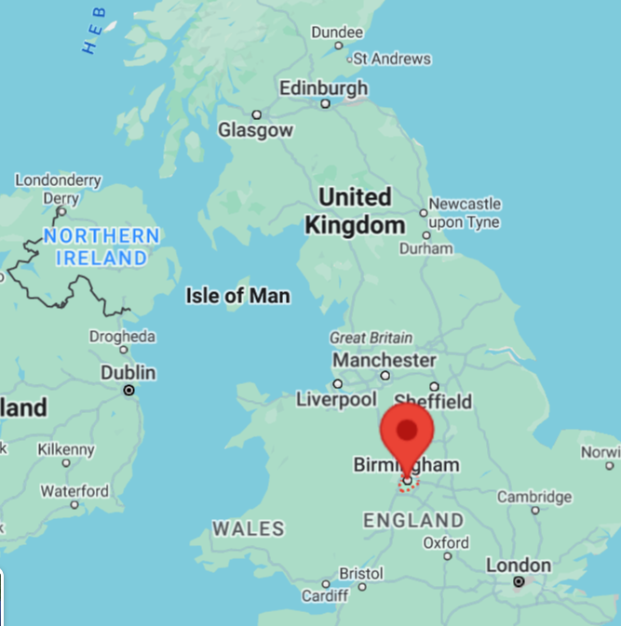
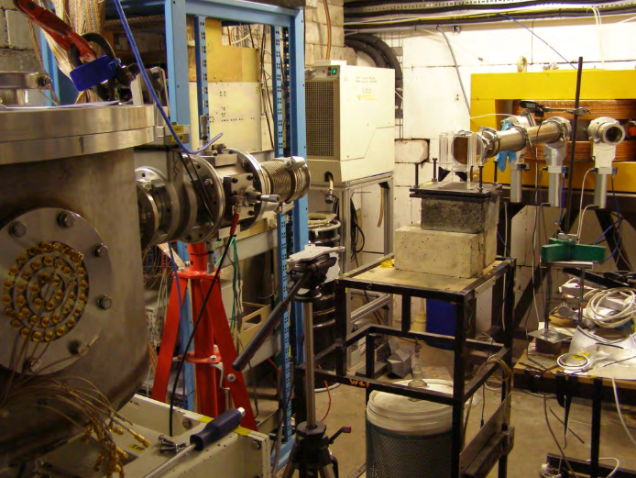
MC40 Calibration Team
University of Strathclyde
M. Alderton, T. P. Frazer and R. J. Gray
Imperial College London
N. P. Dover
Queen’s University Belfast
P. Parsons and C. A. J. Palmer
STFC, Central Laser Facility
H. Ahmed and J. S. Green

Slide 3
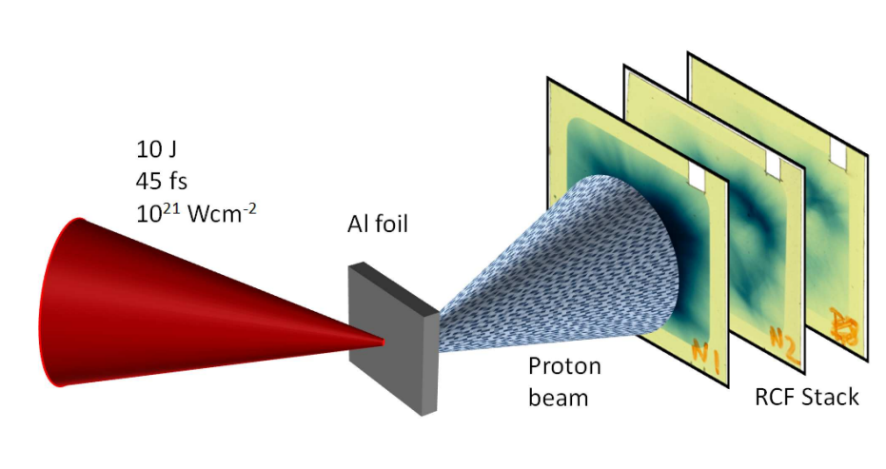
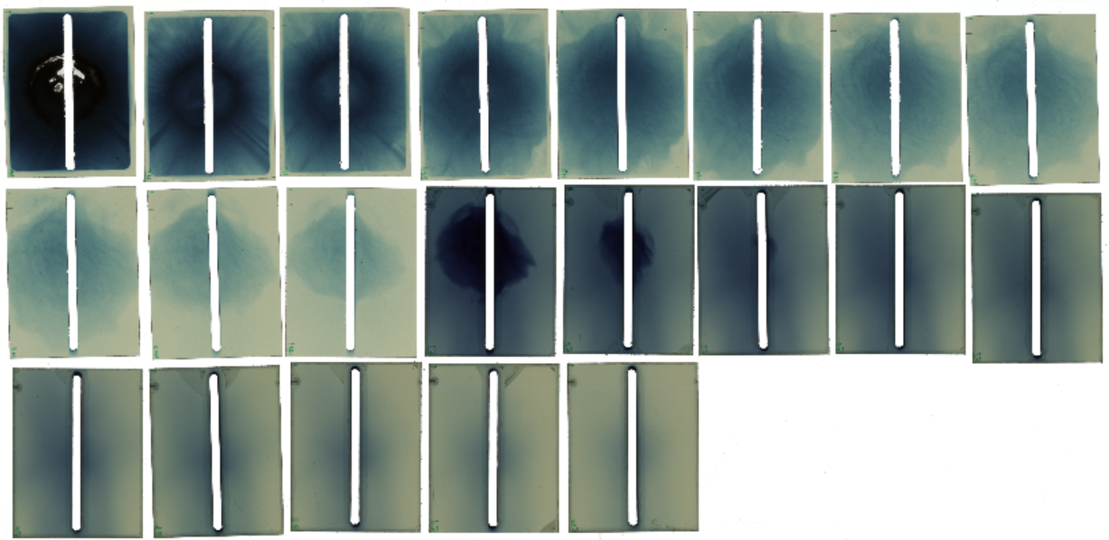
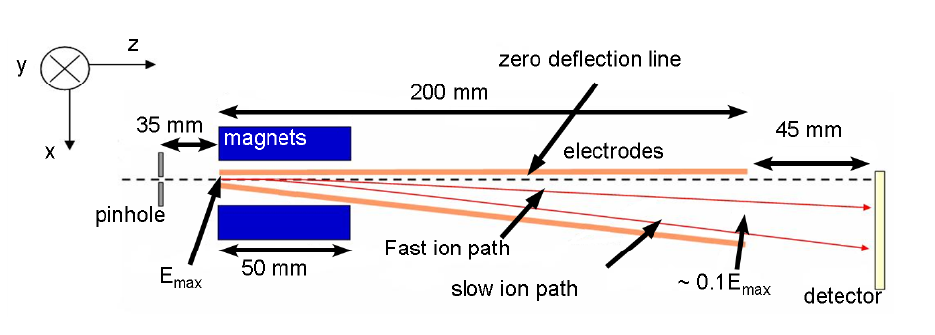
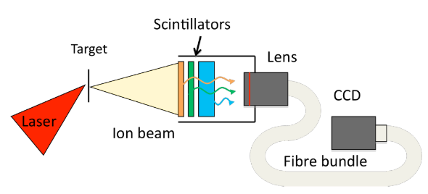
Ion Diagnostics at the Source
Aiming for 10⁹ 15 MeV protons generated from a laser-plasma accelerator (LPA) for radiobiological applications
LPAs have relied on radiochromic film-based diagnostics
Not compatible with the high repetition-rate operation of LhARA.
We need active spectro-spatial detectors
Thomson Parabola
Footprint Detectors

Slide 4
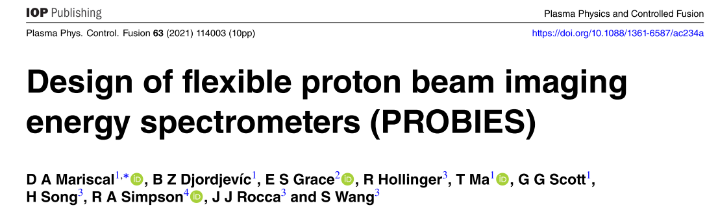
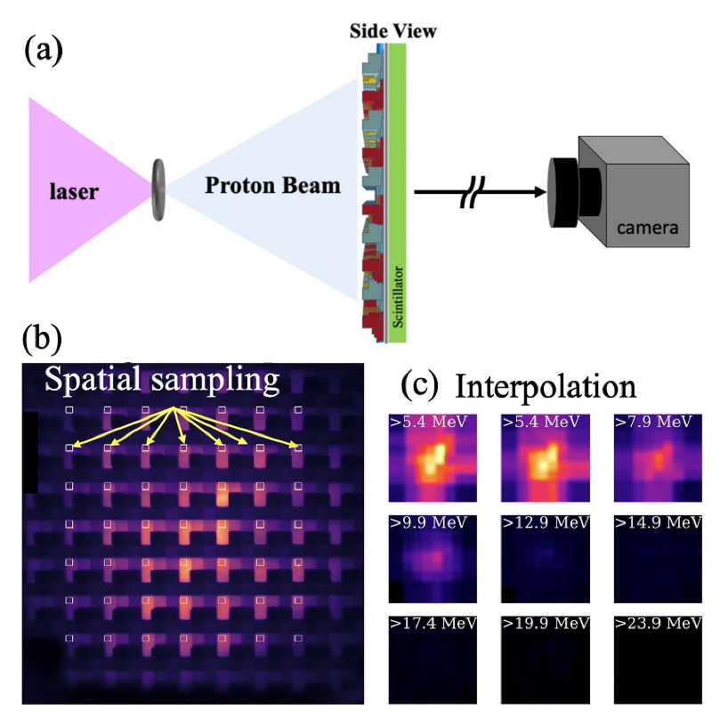
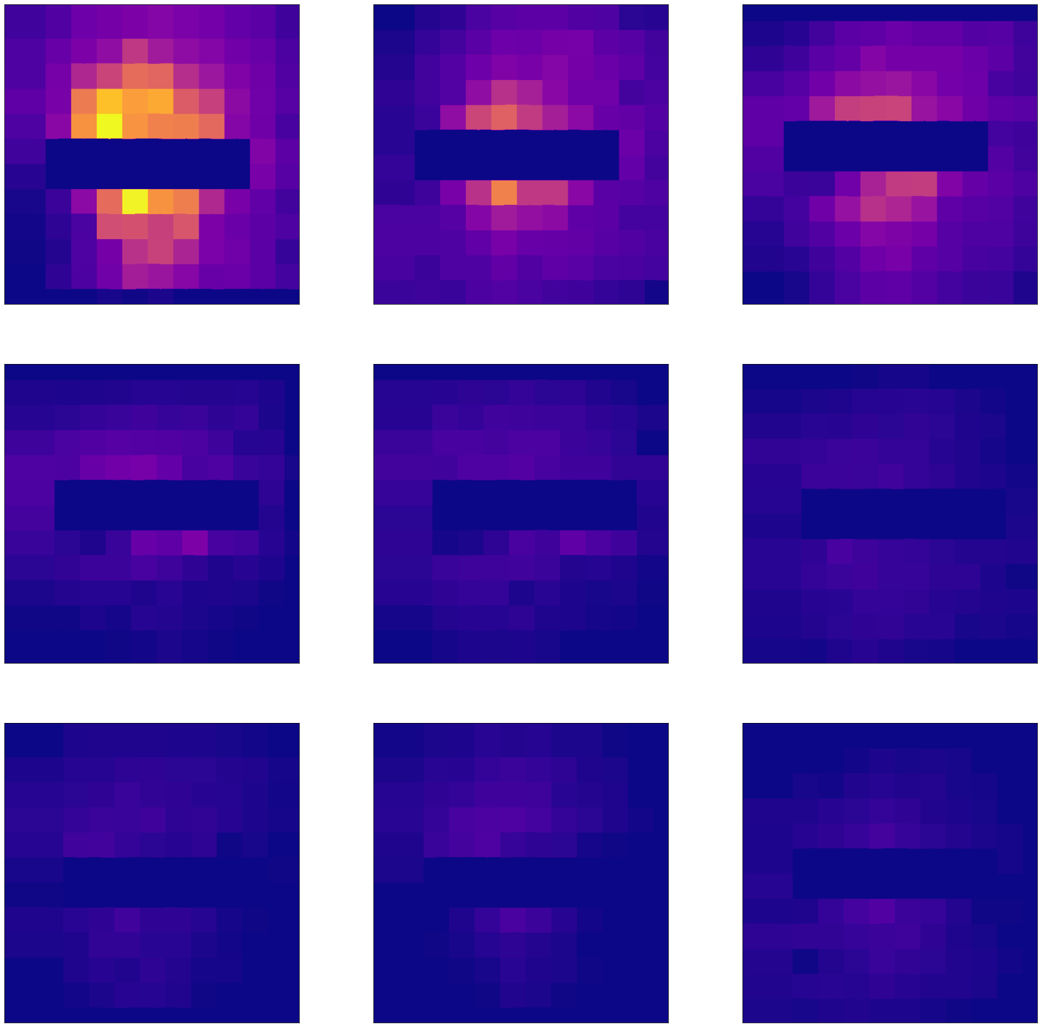
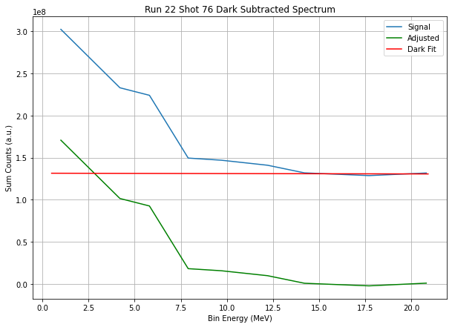
Active Ion Detection - PROBIES
Combined spectro-spatial proton detector
Attenuating grid used to sample different energy protons
Spatial profile interpolated
One of multiple detector technologies in SCAPA

Slide 5
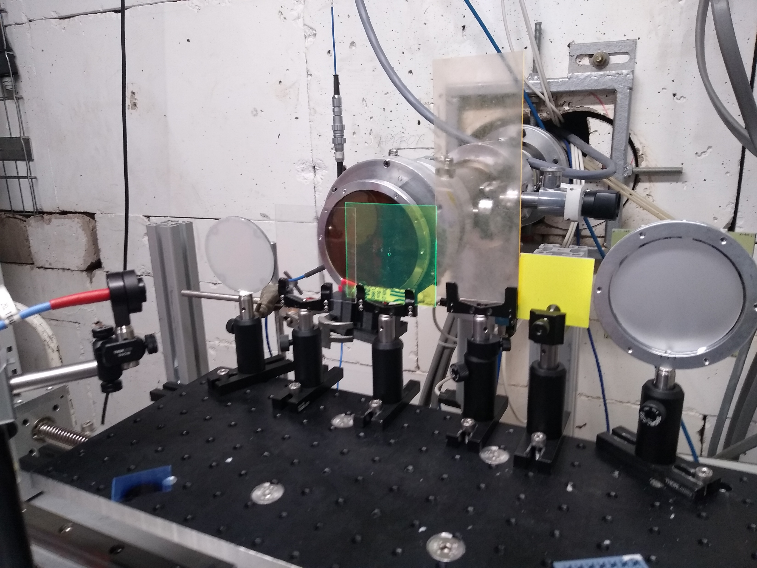
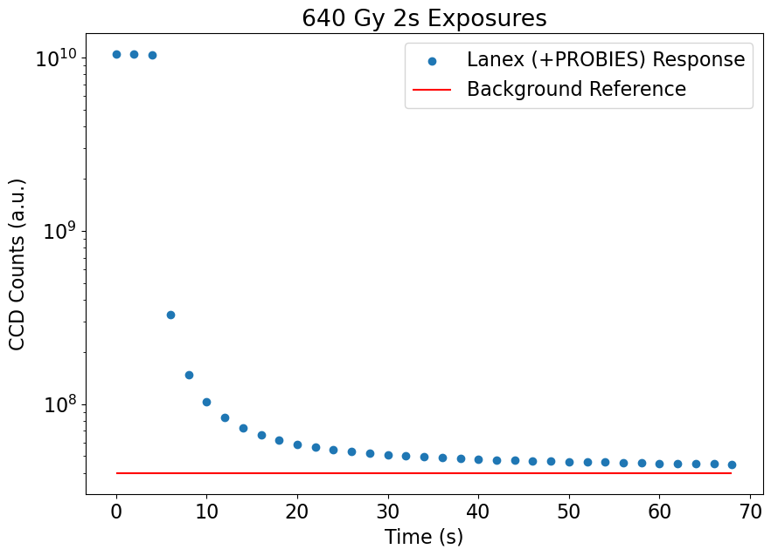
RCF Calibrations
Scintillator Dose Response
Scintillator Energy Response
Phosphor Afterglow

Slide 6
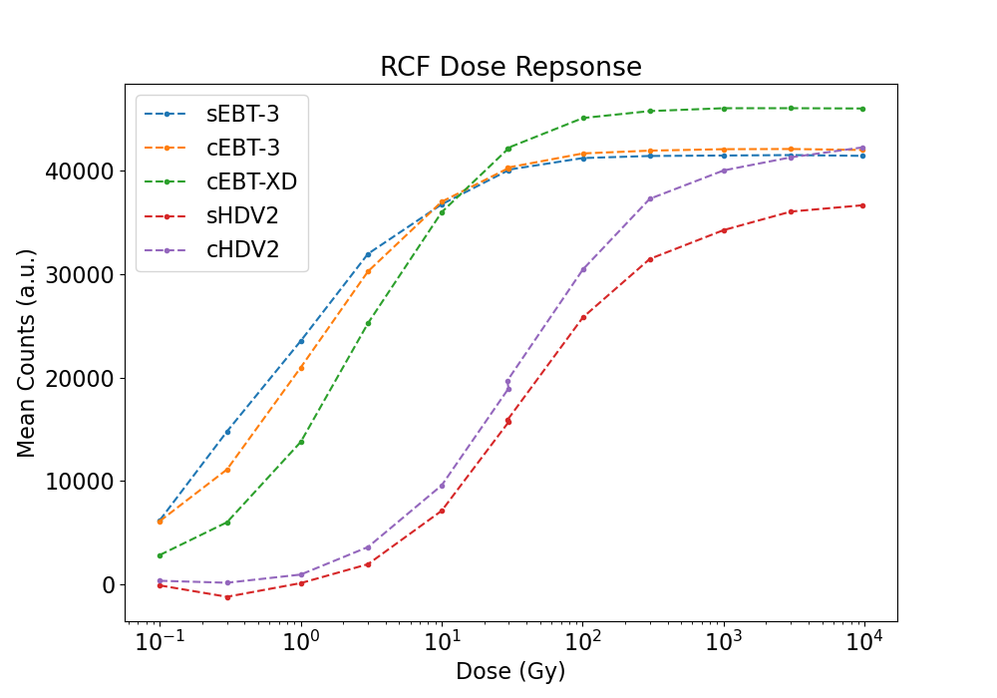
Updated RCF Calibration
Required for diagnostic cross-calibration
Well accepted standard
Maximum spatial resolution

Slide 7
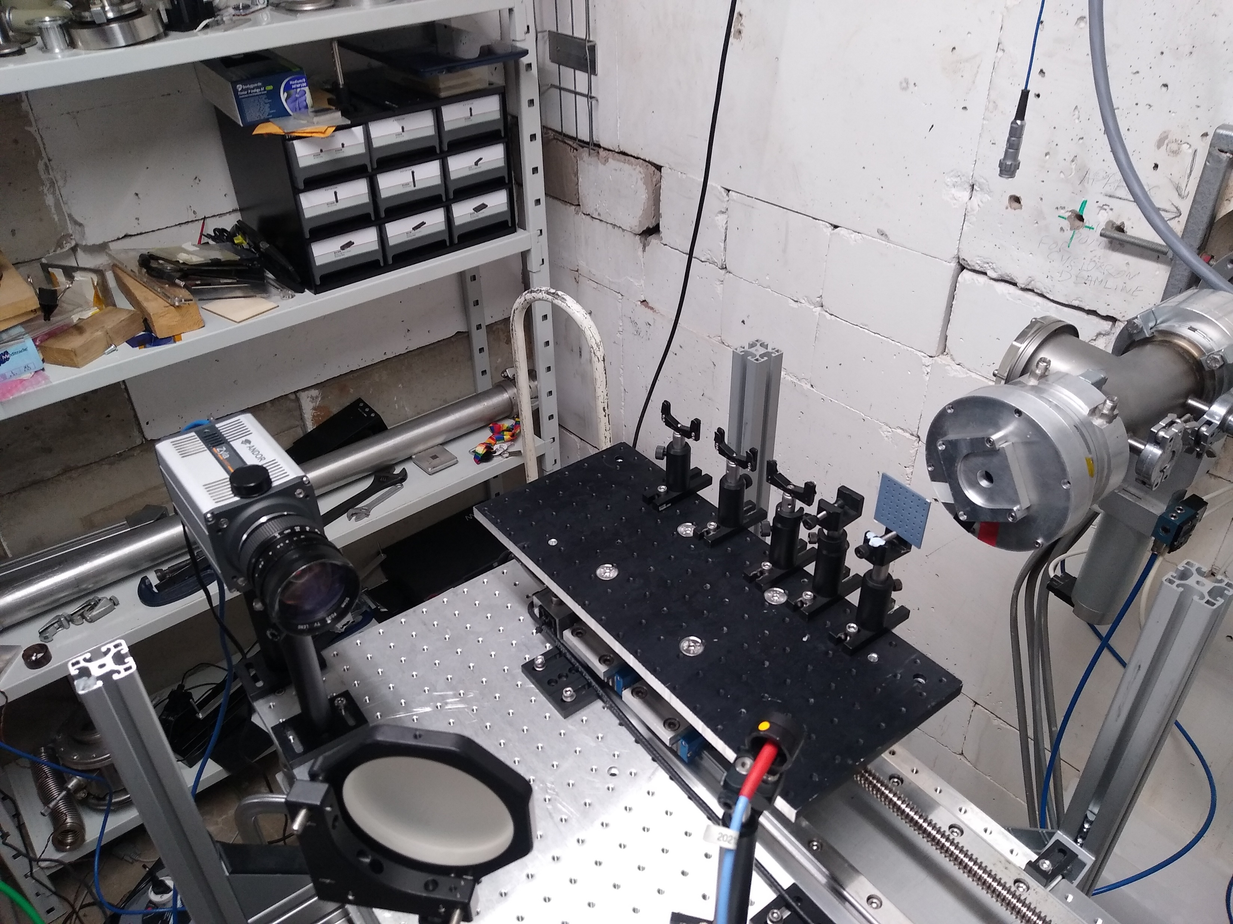
Scintillator Calibrations
Aimed for dose-light calibration and spectral response of each scintillator using a grid of variable thickness plastic to sample the emission at different dE/dx values
28 MeV beam for the dose calibrations and a 14 MeV beam for the energy response

Slide 8
Scintillator Dose Response
Calibrations acquired for a range of commonly available plastic scintillators and phosphors over LhARA relevant dose ranges
Detectors chosen with fast response times, high output and minimal phosphorescence

Slide 9
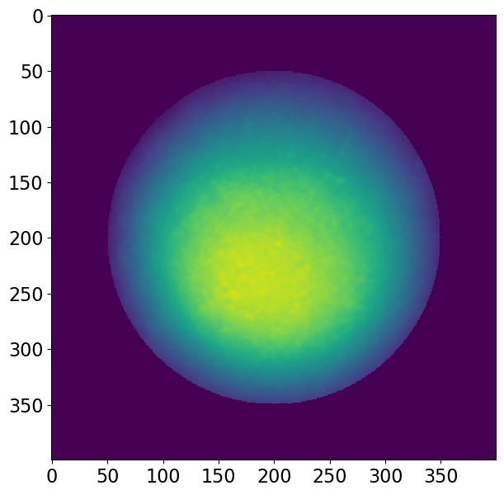
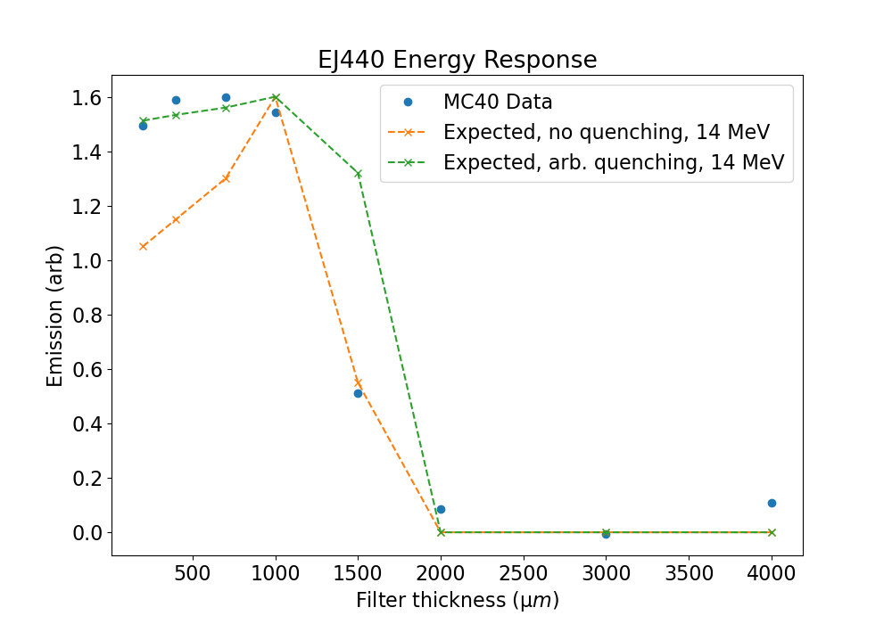
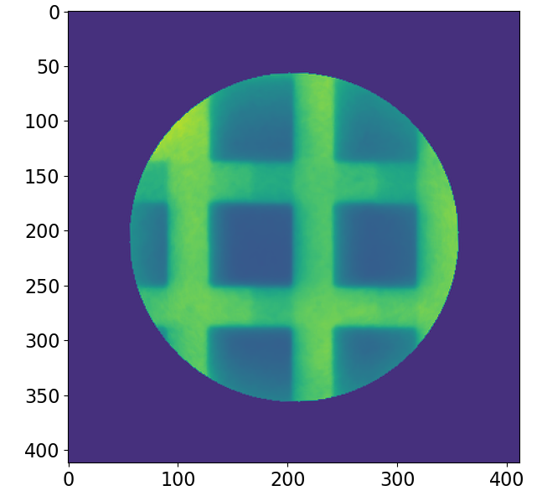
Scintillator Energy Response
14 MeV beam used in combination with PROBIES mask to sample the beam at different points of the Bragg peak and measure quenching parameters
Result was not quite as expected but analysis is ongoing with a second visit planned to improve our dataset
14 MeV

Slide 10
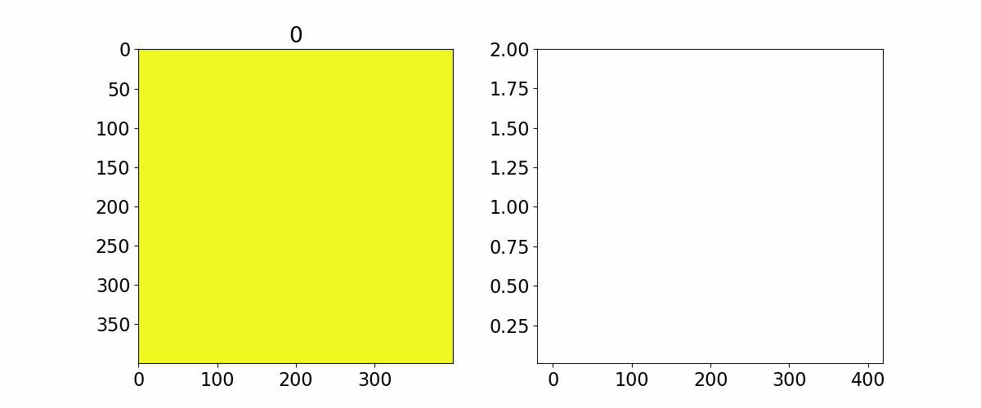
Scintillator Afterglow
Experimental work in SCAPA suggested detection of a long timescale phosphorescence present in Lanex
Irradiation at MC40 with 640 Gy of 28 MeV protons reveals a long timescale (tens-of-seconds) emission after irradiation ends when measured with a time-integrated CCD setup
This has clear implications for operation at 10 Hz in LhARA and further investigation is planned for our second visit to MC40

Slide 11
Summary
Fresh proton number calibrations acquired for RCF
Essential for diagnostic cross calibration and useful as a standard diagnostic
Scintillator responses measured for a variety of commonly used scintillators and phosphors, informing choice of detector for the laser-plasma source and allowing proton number measurement at high repetition-rate
Further work planned to improved measurements of the spectral response and afterglow
RCF Calibrations
Scintillator Energy Response
Scintillator Dose Response
Phosphor Afterglow

