Slide 1
ITRF/LhARA Timetable
18-month review
Hywel Owen (for collaboration)
25th April 2024
Notes:
The abstract pattern can be removed or repositioned if required. Be careful to ‘Send to Back’ so that it does not obscure any important information.

Slide 2
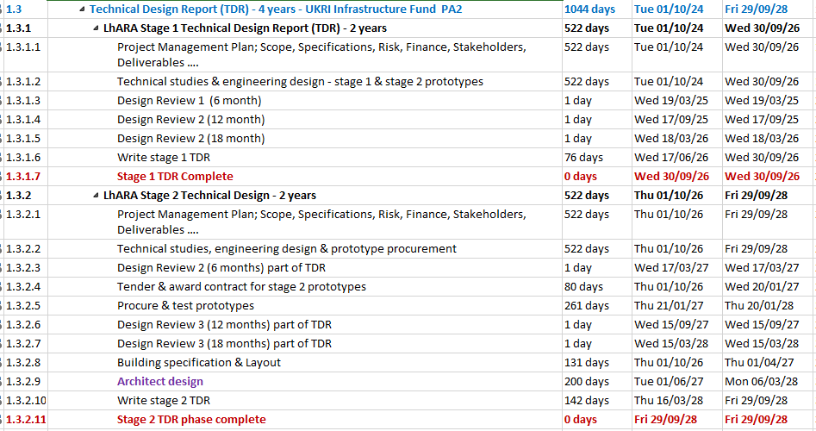
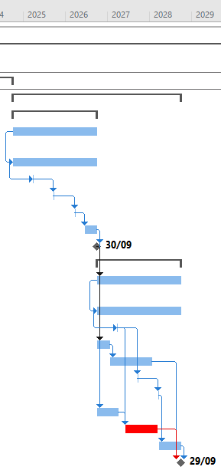
Original Schedule – over Full Construction Project
PA1 (CDR) > PA2 (TDR) > Build
Documents: 1272-pa1-pm-ppl-0001-v2.2 - ITRF schedule 2023-07-19 – summary
1272-pa1-pm-ppl-0001-v2.2 - ITRF schedule 2023-07-19 - full detail

Slide 3
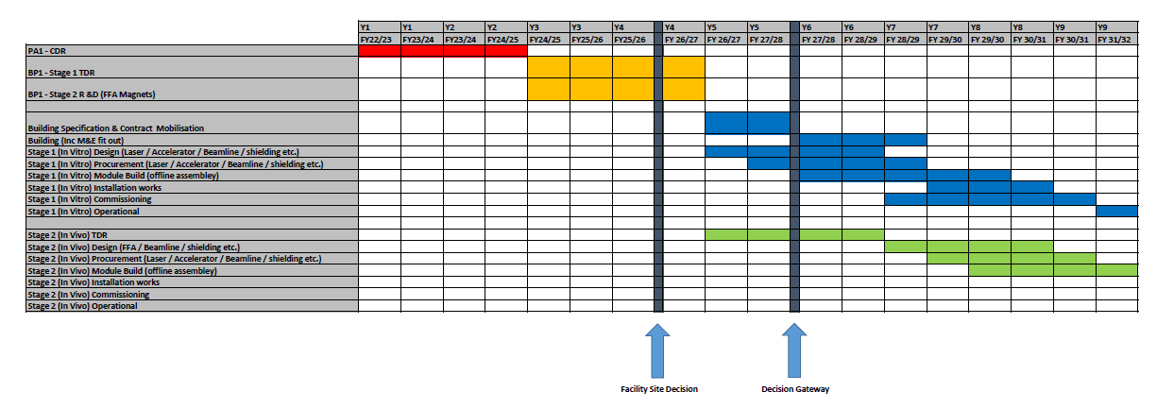
New TL Schedule – BP1 to Full Construction
Under discussion/bid
PA1
BP1
Staged Build
IF ‘rules of the game’ changed at half-time.
General funding pressures within UKRI.
Need to diversify our plan.
Documents: 1272-bp1-pm-ppl-0001-v1.0 - ITRF_LhARA_Top Level Schedule 2024-02-14.xlsx
2+1 BP1 → Bid for staged construction

Slide 4
Milestones and Deliverables, 1272-pa1-pm-ppl-0005-v1.0
 | Document: 1272-pa1-pm-ppl-0005-v1.0 - ITRF milestones and deliverables 2022-10-18
WBS | ITRF No. | High Level Milestones | Date
1 |  | Project start | Mon 03/10/22
2.2.1 |  | ITRF Team Kick-Off meeting at STFC Daresbury Laboratory | Tue 20/09/22
2.2.2 |  | ITRF IF monitoring kick off meeting | Wed 28/09/22
3.1 |  | D1: Y1Q1 IF progress report | Thu 15/12/22
4.6.2 | M1 | LhARA lattice optimisation, aperture estimation, parameter list and schematic diagram update | Tue 31/01/23
2.2.5 | M2 | Refined scope, specifications, defined parameters and schematic diagram of facility equipment complete (6 month design review). | Thu 23/03/23
3.2 |  | D2: Y1Q2 IF progress report | Fri 31/03/23
4.3.2 | M3 | Validate LhARA plasma simulations with existing Swansea experimental set-up (LhARA M3.1) | Mon 03/04/23
3.3 |  | D3: Y1Q3 IF progress report | Fri 30/06/23
2.2.7 | M4 | ITRF Baseline designs complete (12 month design review). | Thu 21/09/23
3.4 |  | D4: Y1Q4 IF progress report | Fri 29/09/23
4.2.2 | M5 | Prediction of optimised LhARA proton source parameters for 100+ TW laser systems based on hydrodynamic and kinetic simulations complete (LhARA M2.1) | Mon 02/10/23
3.5 |  | D5: Y2Q1 IF progress report | Fri 15/12/23
4.6.4 | M6 | Preliminary design of LhARA MA RF cavity, FFA magnet, diagnostic system, control & feedback systems complete. | Thu 28/03/24
5.2 | M7 | Preliminary design study of LhARA Building concept design, bulk shielding assessment, mechanical systems integration support concepts, vacuum concepts, power consumption & cooling rquirements complete. | Thu 28/03/24
4.2.3 | M8 | First LhARA ion source simulations and experiment on SCAPA completed (LhARA M2.2) | Mon 01/04/24
4.3.3 | M9 | Progress report of LhARA large diameter plasma experiments and simulations (LhARA M3.2) | Mon 01/04/24
4.3.3 | M10 | Geant4 simulations of beam energy deposition profile (LhARA M4.1) | Mon 01/04/24
2.2.9 | M11 | Refined ITRF specifications & designs (18 month design review). | Thu 21/03/24
3.6 |  | D6: Y2Q2 IF progress report | Fri 29/03/24
2.2.12 | M12 | Start ITRF CDR write up (21 month design meeting). | Thu 20/06/24
3.7 |  | D7: Y2Q3 IF progress report | Fri 28/06/30
4.6.14 | M13 | Finalise Conceptual Design iterations (All LhARA WP6 systems) complete | Wed 24/07/24
4.3.4 | M14 | Next generation plasma lens test bench design (LhARA M3.3) | Fri 30/08/24
4.4.3 | M15 | Acoustic sensor array design complete (LhARA M4.2) | Fri 30/08/24
4.5.3 | M16 | Automated cell dish handling and environmental system design complete (LhARA M5.1), End-station user-community consultation complete (LhARA M5.2), End-station component testing at Birmingham complete (LhARA M5.3), kG,y/s tests at Birmingham complete (LhARA M5.7). | Fri 30/08/24
4.5.6 | M17 | Specification of LhARA beam monitoring technology complete (LhARA M5.5) | Fri 30/08/24
2.2.16 | M18 | ITRF CDR Publication | Mon 23/09/24
2.2.17 | M19 | ITRF CDR phase complete | Mon 30/09/24
3.8 |  | D8: Y2Q4 IF progress report | Mon 30/09/24
*
*
*
*
*
*
*
M6/M7 Draft complete: 1272-pa1-pm-rpt-0008
1272-pa1-acc-para-0004-v0.8-ITRFLhARA operation and loss points -> shielding contract

Slide 5
Where did we want to be?
6-month review
Re-examine baseline
12-month review
Progress major work, outline engineering assessment
18-month review
Establish CDR design, engineering integration
24 months
CDR
Significant assessment of facility now carried out
1st pass of costing done
Many questions brought to light …what we wanted!
Need to balance benefits vs. costs and risks

Slide 6
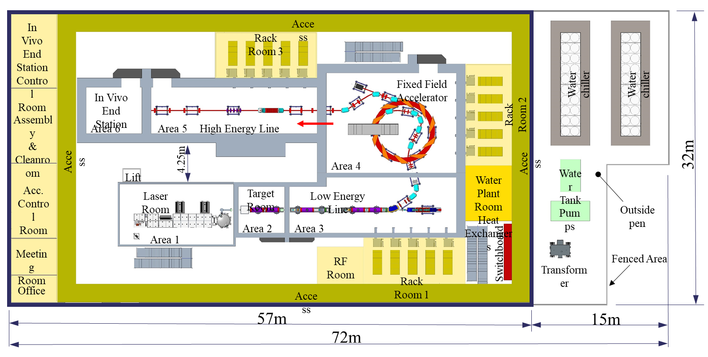
Where do we want to go?
Have robust answers from our internal and external reviews
Know what we can and can’t offer
Be in a good position for the next stage of the project
Sustainability will be pivotal for funding; recent source, Gabor, FFA, engineering, and shielding work allows us to assess the energy and emissions footprint over its lifetime.

