Slide 1




Synergies
UK Muon Collider Detector R&D workshop, Birmingham, 3 July 2024
Stefania Ricciardi
STFC Rutherford Appleton Laboratory

Slide 2


Synergies
Synergy == interaction or cooperation giving rise to a whole that is greater than the simple sum of its parts. From the Greek word synergos, συνεργός, meaning “working together” [Wikipedia]
Along the implementation path
  the muon collider demonstrator(s) can enable new experiments: ENUBET, nuSTORM
Non-collider physics with the full facility
  beam-dump experiments with accelerated muon-beams [arXiv:2310.16110]
  decay products of the muons in the collider ring form an intense high-energy beam of electron- and muon-neutrinos
Technological synergies with other facilities
  target and muon-capture [LBNF, T2HK, COMET, mu2e,..]
  high-quality muon beams [PSI, J-PARC, ISIS,..]
  high-power proton accelerators [neutron-spallation sources, neutrino facilities,..]
  RF cavities with high-gradient
  high-field solenoid magnets
  …
Here only some examples, relevant to UK HEP community
More ideas and detailed information at Muon Collider Synergy Workshop, Orsay, 2023 and Muon4Future, Venice, 2023

Slide 3
1. Along the implementation path
R&D for Muon Collider could begin in the next 5-10 years and could utilize existing infrastructure at laboratories like CERN, Fermilab, or ESS. These dedicated moderate energy and luminosity facilities provide an excellent opportunity for physics studies along the way [arXiv 2310.16110]

Slide 4
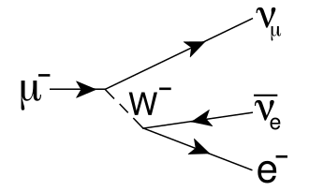
Neutrinos from STORed Muons
C. C. Ahdida et al., “nuSTORM at CERN: Feasibility Study,” CERN-PBC-REPORT-2019-003
Orbit Combination Section
allows stochastic injection of π
~250 m
Novel neutrino beam:
Precise neutrino flux:
Intensity
  %-level from ring-instrumentation
Energy
  spectrum from accelerator tune
Flavour composition
  Unique 50% ν_{e}, 50% ν_{μ}
Rich science programme:
%-level (ν_{e}N) cross-sections
  Multidifferential/Eν scans
BSM searches:
  i.e. sterile beyond FNAL SBN
Testbed for muon collider
NO hadronic uncertainties!

Slide 5
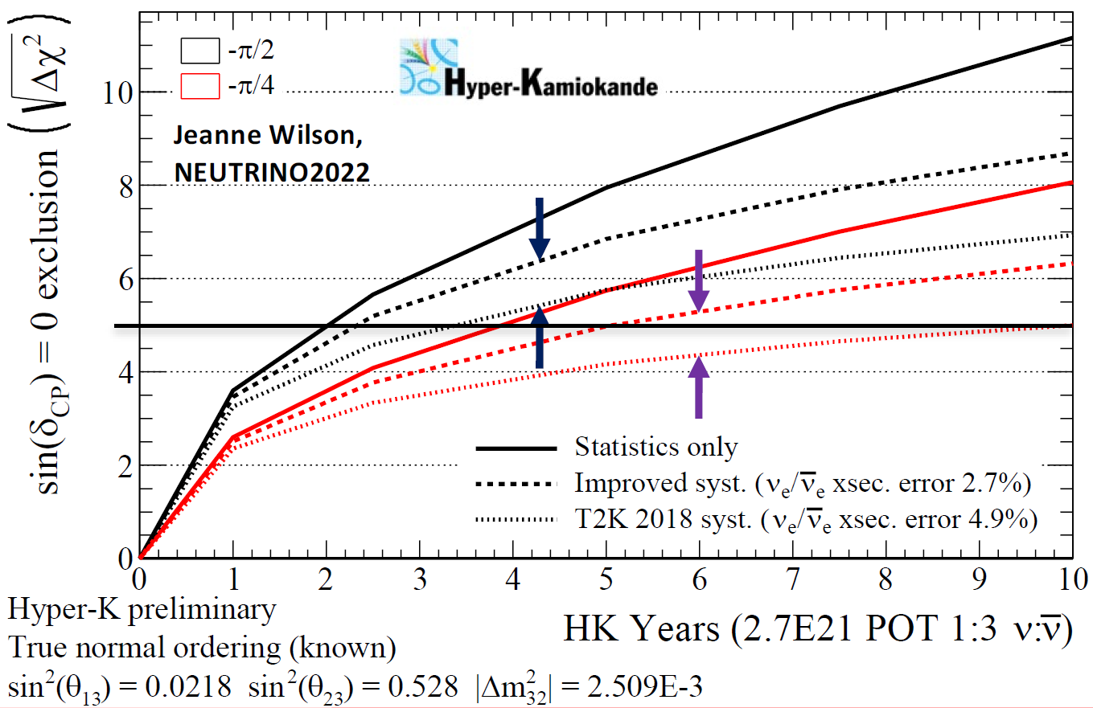
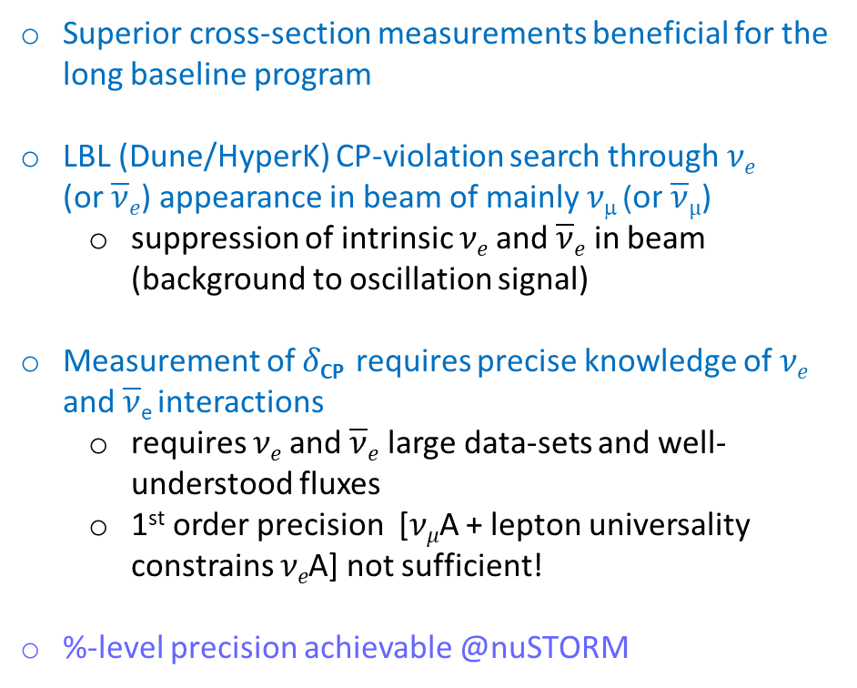
ν_{e} and ν_{e} cross-sections
Superior cross-section measurements beneficial for the long baseline program
LBL (Dune/HyperK) CP-violation search through 𝜈_{𝑒} (or $\overline{\text{ν}}e$) appearance in beam of mainly 𝜈_{μ} (or $\overline{\text{ν}}µ$)
  suppression of intrinsic 𝜈_{𝑒} and $\overline{\text{ν}}e$ in beam (background to oscillation signal)
Measurement of 𝛿_{CP} requires precise knowledge of 𝜈_{𝑒} and $\overline{\text{ν}}$_{e} interactions
  requires 𝜈_{𝑒} and $\overline{\text{ν}}e$ large data-sets and well-understood fluxes
  1st order precision [𝜈_{𝜇}A + lepton universality constrains 𝜈_{𝑒}A] not sufficient!
%-level precision achievable @nuSTORM
Alterations to the nuclear model and the consideration of radiative corrections to cross section calculations can alter the 𝜈_{𝑒} to ν_{μ} cross section ratio by 2-4%, which is not negligible compared to expected statistical uncertainties for Hyper-K and DUNE
[arXiv:2301.09555 and references therein]

Slide 6
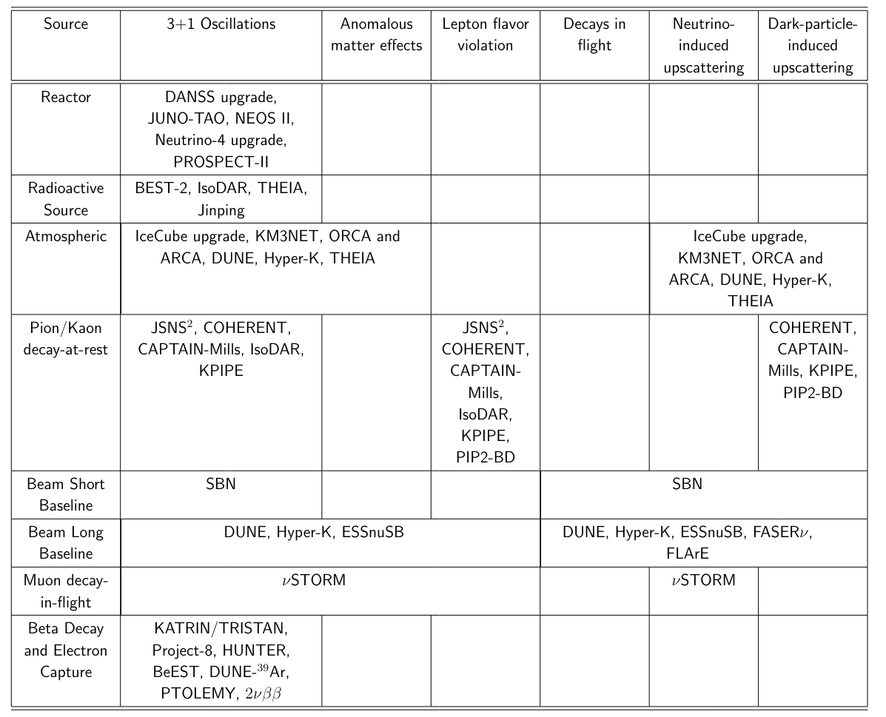
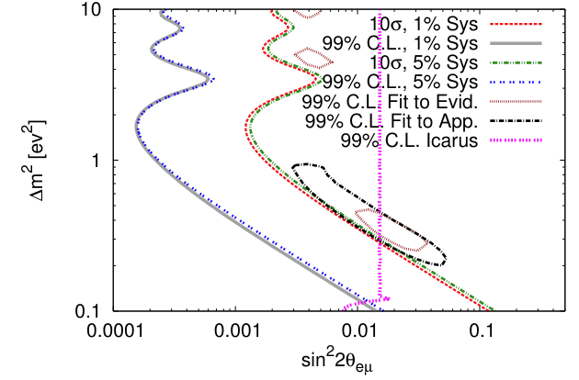
BSM searches
arXiv 2203.07323
Unique sensitivity to light sterile neutrinos
  low-level background ( ν_{e}->ν_{μ} oscillations with muon signature)
  low-systematic uncertainty on the neutrino flux
PhysRevD.89.071301
Sensitive also to alternative explanations of SBL anomalies

Slide 7
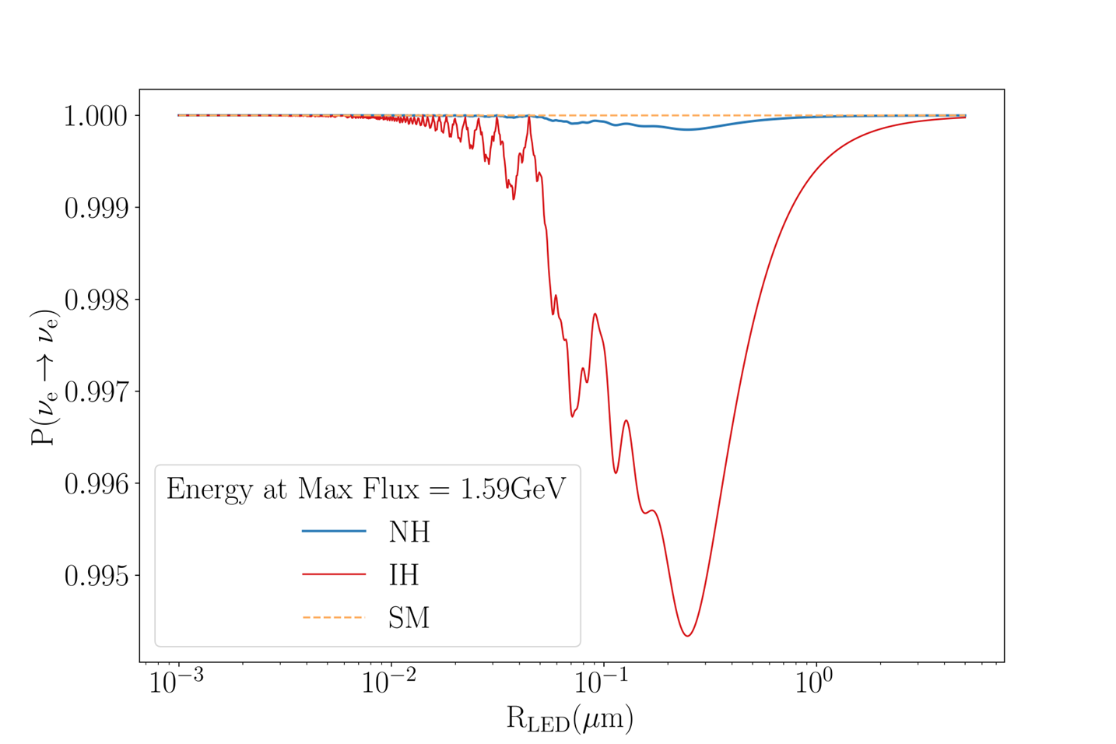
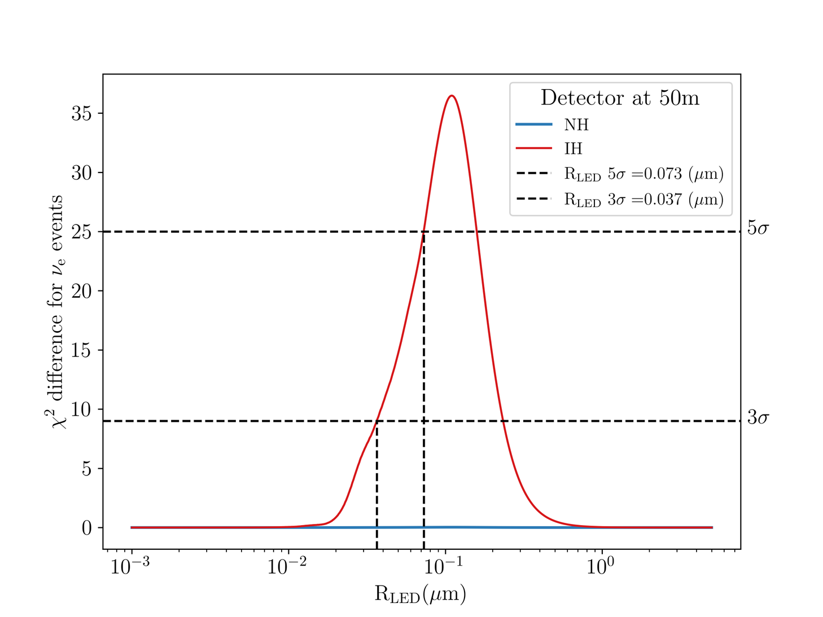
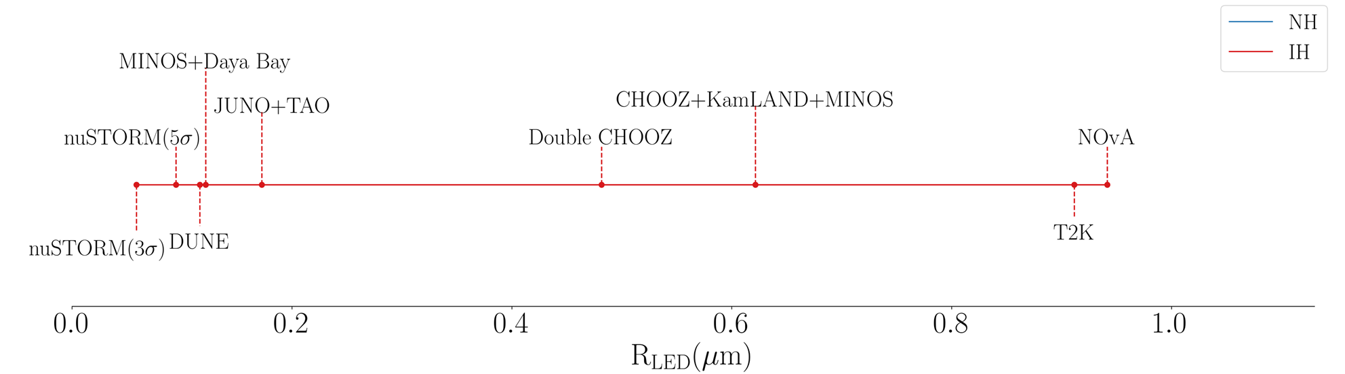
Large Extra Dimension searches
© J. Turner
Large Extra dimension (LED) can explain the lightness of neutrino masses
LED can modify neutrino oscillation probabilities due to the presence of additional sterile states propagating in the bulk
Using protoDune detector @ 50m baseline, nuSTORM has sensitivity to μm scale for inverted ordering
nuSTORM can set very competitive limits on LED length scales

Slide 8
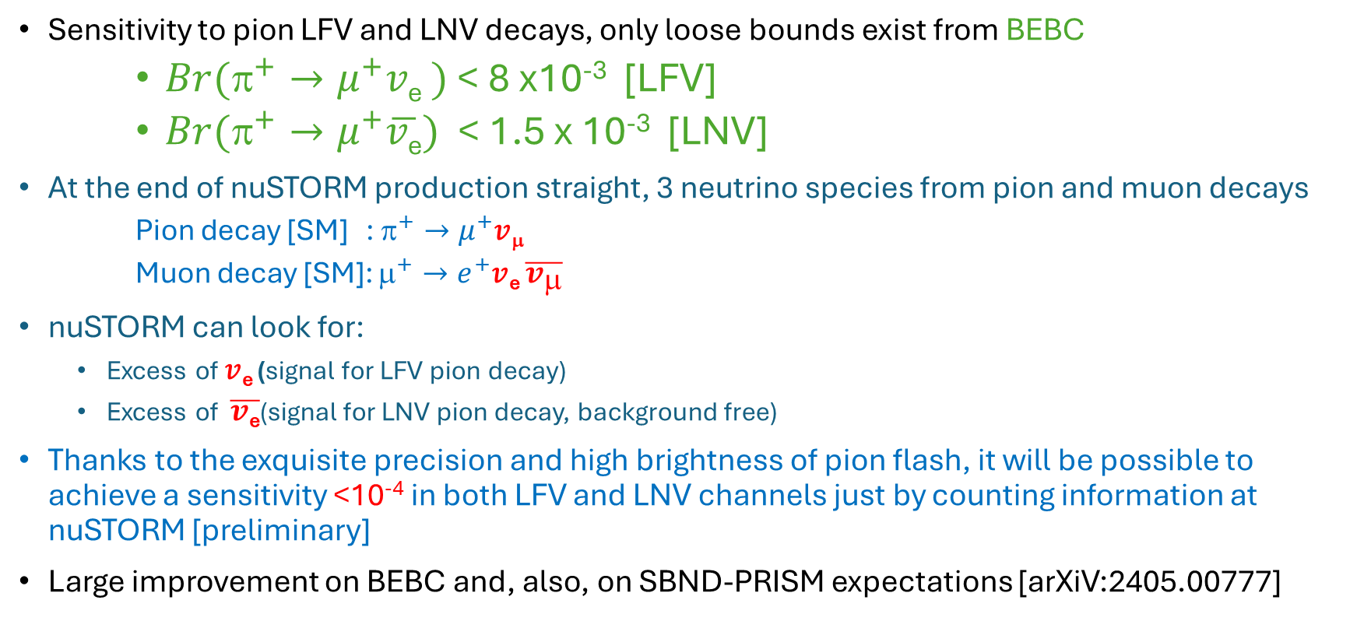
LFV and LNV searches
Sensitivity to pion LFV and LNV decays, only loose bounds exist from BEBC
    $Br(^{+}→μ^{+}$𝑣_{e} $)$ < 8 x10⁻³ [LFV]
    $Br(π^{+}→μ^{+}\overline{v\text{e}})$ < 1.5 x 10⁻³ [LNV]
At the end of nuSTORM production straight, 3 neutrino species from pion and muon decays
    Pion decay [SM] : $^{+}→μ^{+}$𝑣_{μ}
    Muon decay [SM]: $^{+}→e^{+}$𝑣_{e} $\overline{v_{μ}}$
nuSTORM can look for:
  Excess of 𝑣_{e} (signal for LFV pion decay)
  Excess of $\overline{v\text{e}}$(signal for LNV pion decay, background free)
Thanks to the exquisite precision and high brightness of pion flash, it will be possible to achieve a sensitivity <10⁻⁴ in both LFV and LNV channels just by counting information at nuSTORM [preliminary]
Large improvement on BEBC and, also, on SBND-PRISM expectations [arXiV:2405.00777]

Slide 9
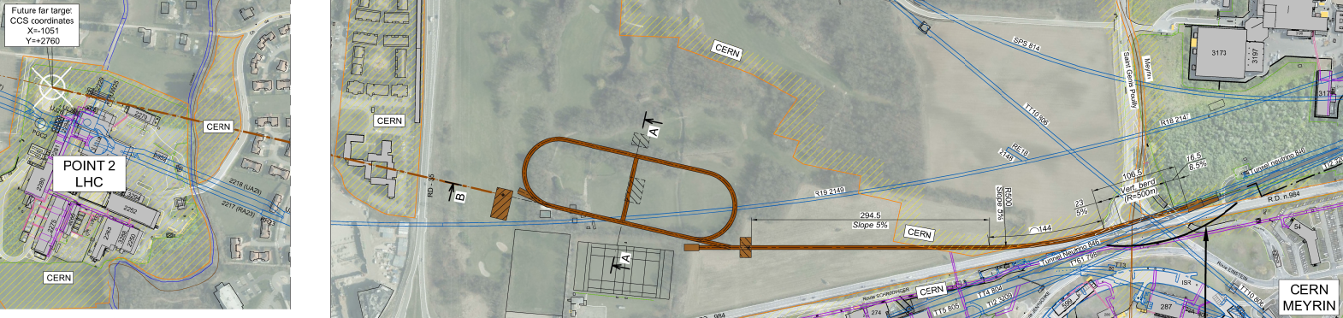
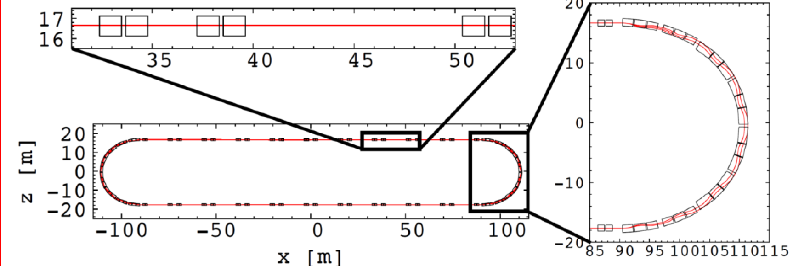
Muon accelerator testbed
CERN-PBC-REPORT-2019-003 – Extraction from SPS through existing tunnel
  Storage ring for muons of variable central momentum 1-6 GeV/c and acceptance ±16%
    FFAs cells in arcs and return straight allow for a large dynamic aperture
    FFA technology has applications for muon fast acceleration and is an attractive option for muon collider
  Instrumentation for muon-beam monitoring

Slide 10
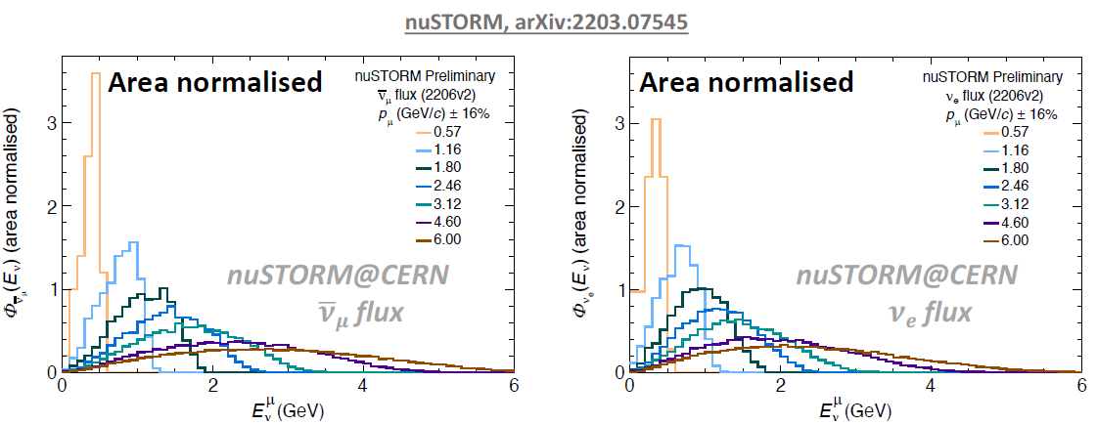
nuSTORM beam simulation
T. Alves, M. Pfaff
Oscillation relevant energy regime:
HyperK - 0.6 GeV
DUNE - 2.4 GeV
set by stored muon momentum
1 ≤ E_{μ} ≤ 6 GeV
Fine control on flux shape by adjusting the ring acceptance
Eν –scan measurements

Slide 11
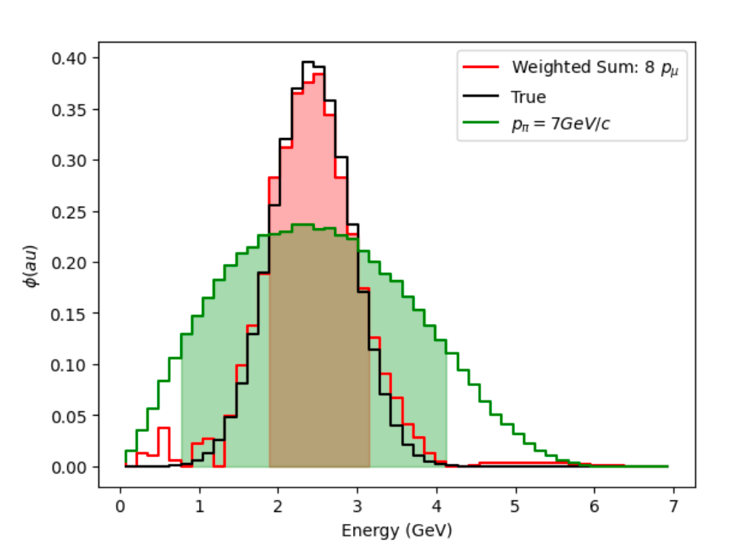
Synthetic beam
Concept similar to PRISM technique of DUNE and HyperK, exploiting movement of near-detectors off-axis
nuSTORM: detector always on-axis, but can combine linearly different fluxes from different stored-muon momenta
Synthetic beam narrower and more Gaussian. In Fig. neutrino peak energy of 2.5 GeV, with 0.5 GeV SD is obtained (large reduction in FWHM compared to neutrinos from muons at 7GeV pion setting)
Uniquely, “quasi mono-energethic” electron-neutrino beams can be synthetised @ nuSTORM!
(PRELIMINARY)
R. Kamath

Slide 12
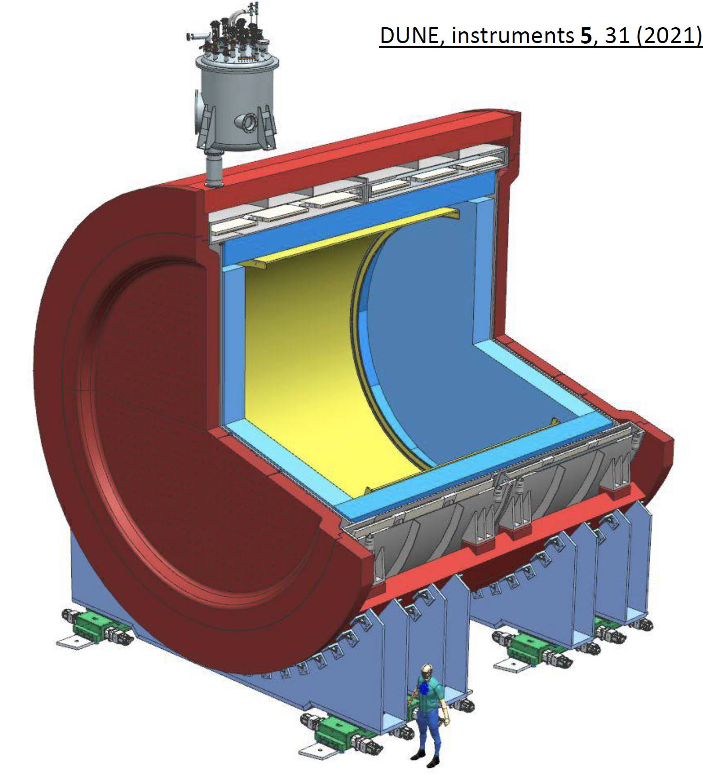
nuSTORM detector
High-specification detector required
  Exclusive final states:
  scattered lepton, hadrons
Initial study use DUNE ND-GAr:
  TPC reference design
    10-bar argon-based gas TPC
    Large gas volume
    Surrounded by calorimeter
  4𝝅 acceptance, very low threshold
  B-field provides sign selection
  e/μ id; final state reconstruction

Slide 13
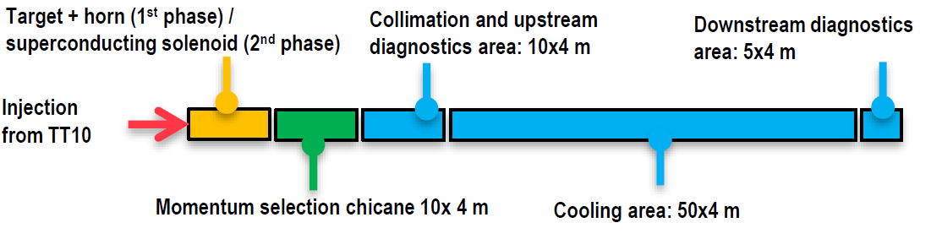
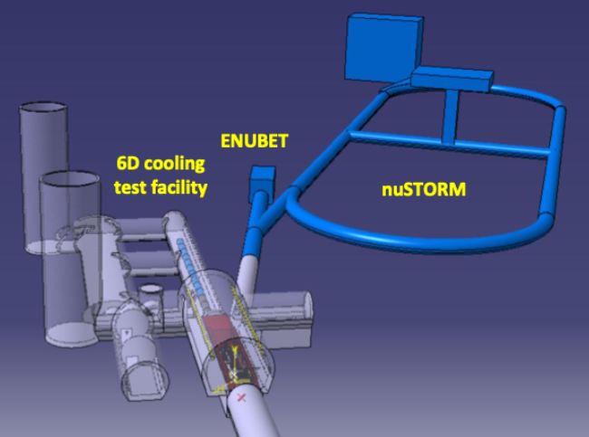
Synergy with 6D cooling demonstrator
K. Long
nuSTORM study now taken forward in the context of the demonstrator facility required by the international Muon Collider Collaboration that includes the 6D muon ionization cooling experiment
Demonstrator facility flexible enough to accommodate other experiments
nuSTORM, and potentially ENUBET, could be branched from the 6D cooling demonstrator
Same target complex, shielding and general target infrastructure
Deflection of beamline could reduce radiation streaming towards nuSTORM ring
Synergies between experiments would reduce costs
Under discussion

Slide 14
Landscape and short-term goals
ESPP 2020 highlights the need of R&D for bright muon beams as a “High Priority Initiative”
To extract the most physics from DUNE and Hyper-Kamiokande, a complementary programme of experimentation to determine neutrino cross-sections and fluxes is required. Several experiments aimed at determining neutrino fluxes exist worldwide. The possible implementation and impact of a facility to measure neutrino cross-sections at the percent level should continue to be studied.
Snowmass 2021, arXiv:2203.07545
With their existing proton-beam infrastructure, CERN and Fermilab are both uniquely well-placed to implement ENUBET, nuSTORM, and the 6D-cooling experiment as part of the required muon collider demonstrator
P5 report 2023
The US should pursue a leading role in the muon collider design effort, in concert with the International Muon Collider Collaboration (IMCC). The US role should include R&D on relevant technologies and preparations for a demonstrator facility
Two IOP workshops in 2023 + regular nuSTORM meetings to prepare for next ESPPU submission
Over next months:
  update and document the science case in peer-reviewed publication
  submission to next ESPPU (March 2025)

Slide 15
2. Non-collider physics at the muon-collider full facility
Further opportunities for neutrino experiments

Slide 16
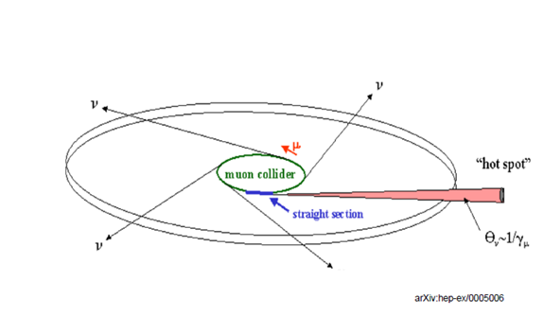
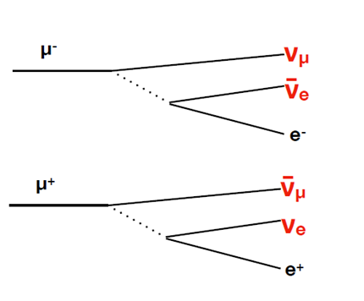
Neutrino physics at the Muon Collider
Neutrino radiation disk emanating out from muon collider ring
High-intensity netrino beam, radiation hot spot downstream of straight sections
High energy range from GeV To TeV
Precisely known composition

Slide 17
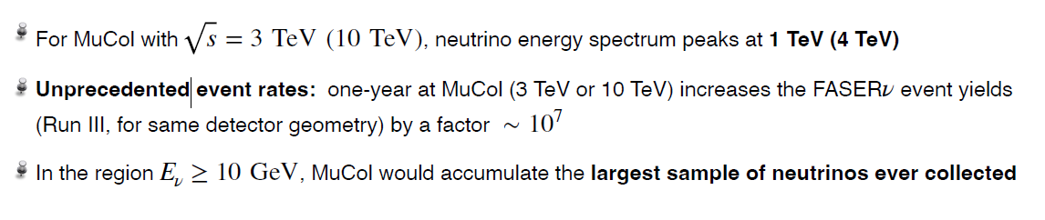
Neutrino spectrum and event rates
Rojo, IMCC, 2024
Assumed a detector of just 10cm radius and 1m length

Slide 18
Physics with high-energy neutrinos
Rojo, IMCC, 2024
In terms of kinematic coverage, similar to the proposed Faserν2 at the HL-LHC
Much higher event rates: multi-differential neutrino DIS measurements, enabling studies of nucleon 3D structure, transverse structure, cold nuclear matter studies
Rich program of hadronic physics with neutrino beams, complementary to the charged-lepton measurements from EIC
Other possible applications of this program include the precise determination of the weak mixing angle, as well as new avenues for BSM searches via rare processes e.g. trident production
Only now starting to explore the novel physics opportunities offered by the high-intensity, high-energy, collimated neutrino beam at Muon Collider

Slide 19
3. Other physics with muons: muon spectroscopy
Technological synergies, the example of ISIS

Slide 20
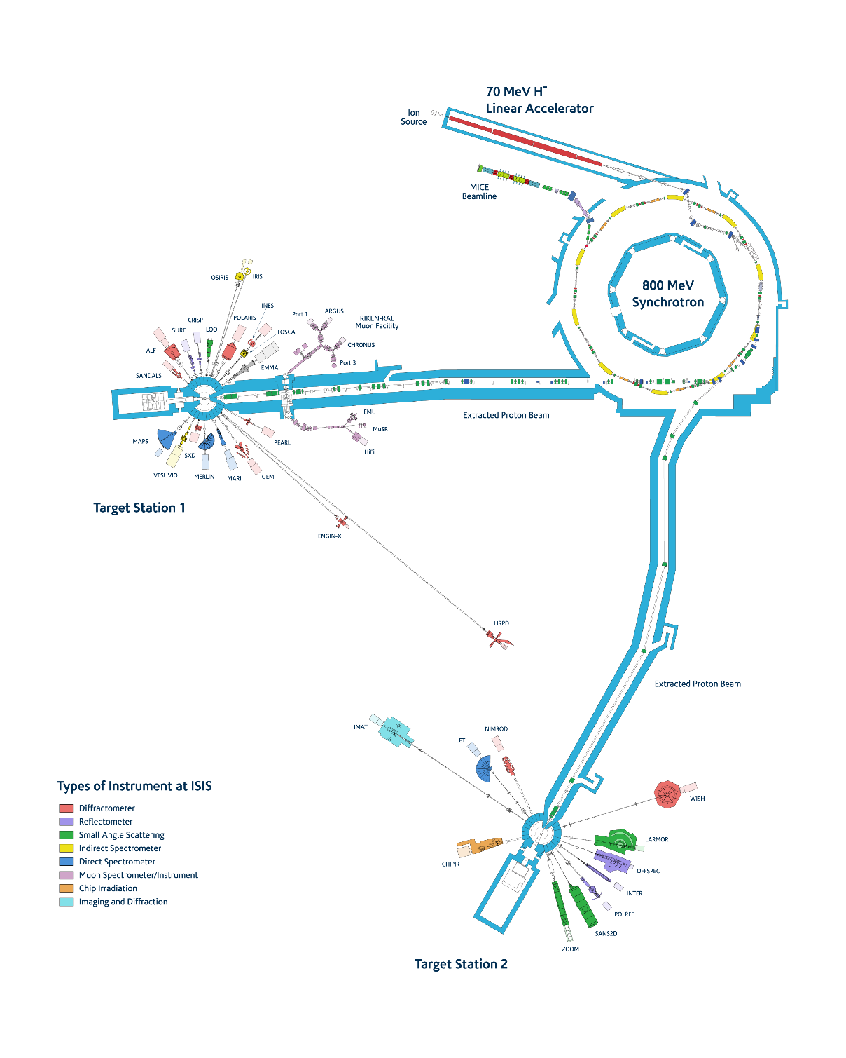
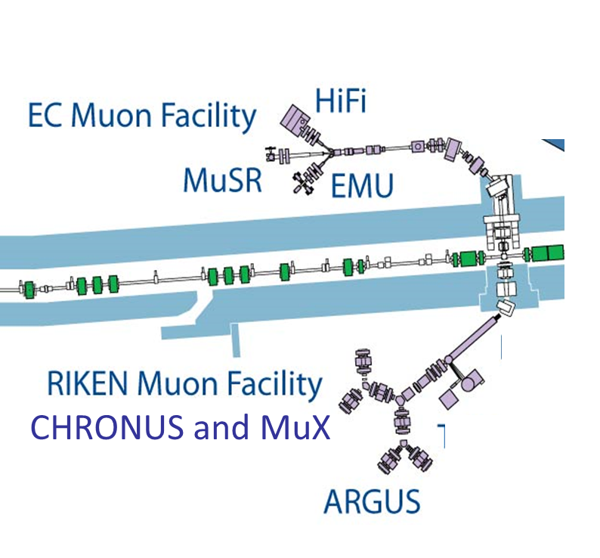
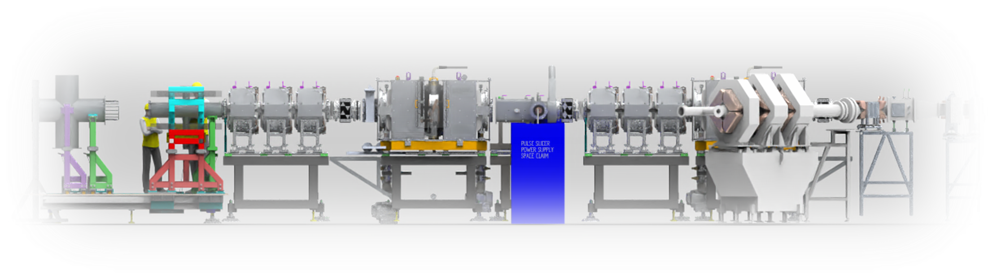

Synergies with muon spectroscopy
Muon Targets
  Increasing target thickness and optimising geometry for improved yield.
  High power targets for ISIS-II.
Optimisation of the synchrotron
  Pulse Compression
  Other tricks to improve muon spectroscopy?
Muon Beamlines
  Development of beamline diagnostics.
  Development of a muon/pion extraction (southside) for negative muon experiments.
  Beamline components e.g. SuperMuSR
Super-MuSR layout
Spin rotators
Pulse slicer
Quads + dipoles
Detectors
A. Hillier (ISIS, RAL)

Slide 21
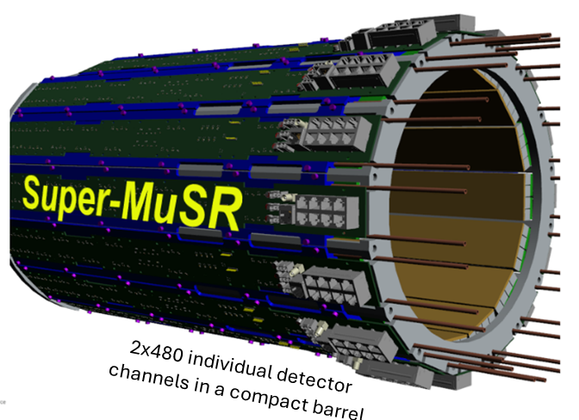
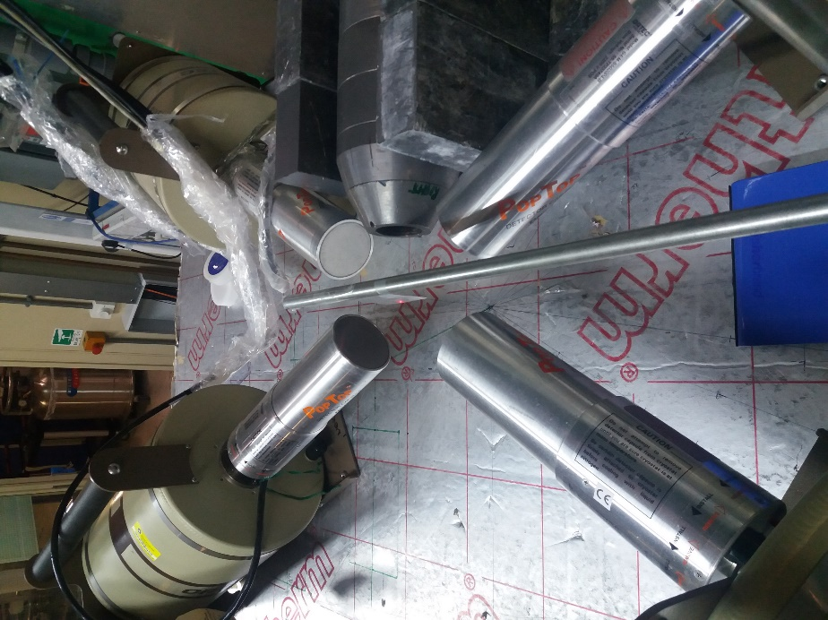
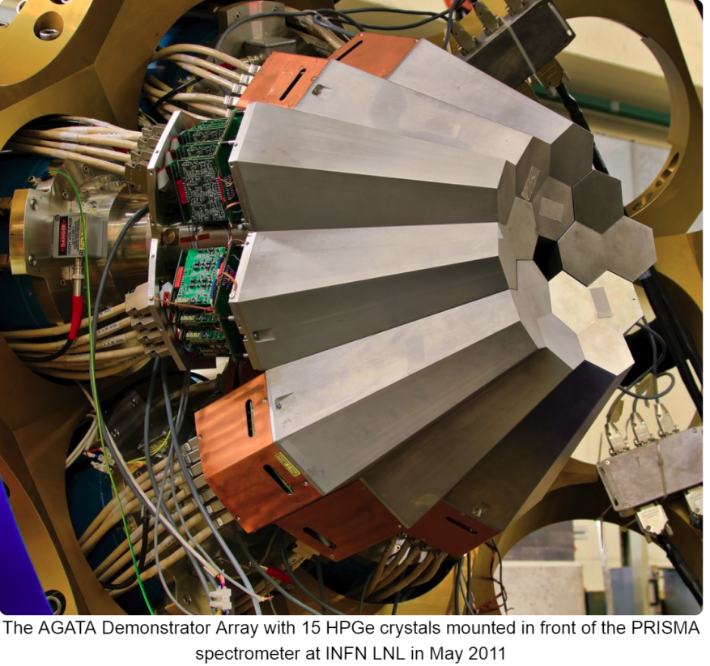
Synergies with muon spectroscopy
Low Energy
Ge X-ray detector
Ge X-ray detector
0.1-10 MeV
Detectors
  Muon Spin spectroscopy
    Tracking detectors
      Positrons
      Muons
      Gains
        background suppression
        Simultaneous samples measured
        Better timing resolution
  Muonic X-rays
    HPGe detectors
    Si(Li) detectors
    Other technologies
Scintillators with SiPMs
~1000 detectors under construction for Super-MuSR
Sample
position
μ⁻ beam
Ge X-ray detector
0.1-10 MeV
Low Energy
Ge X-ray detector
Muons
40mm
Sample
40mm
A. Hillier (ISIS, RAL)

Slide 22
Conclusions
On accelerator/detector science, ample opportunities to collaborate between R&D for muon collider and other existing or future muon facilities: e.g. muon beams at ISIS in the UK
On the physics side there are opportunities for neutrino experiments alongside the muon collider cooling demonstrator
  nuSTORM, UK led, feasibility study performed for facility at CERN
nuSTORM will be a unique facility and a step towards muon collider
  %-level electron and muon neutrino cross-sections
  very sensitive BSM searches
  serve as muon accelerator test-bed
  proof of principle of stored high-brightness muon beams
Longer term, the high-intensity, high-energy, collimated neutrino beam delivered by Muon Collider will offer novel physics opportunities – exploration just started
Imperative to nurture a strong synergetic programme alongside technological R&D for muon collider. Critical for scientific, sociological & funding reasons

Slide 23
Backup

Slide 24
arXiv:2303.08533

Slide 25
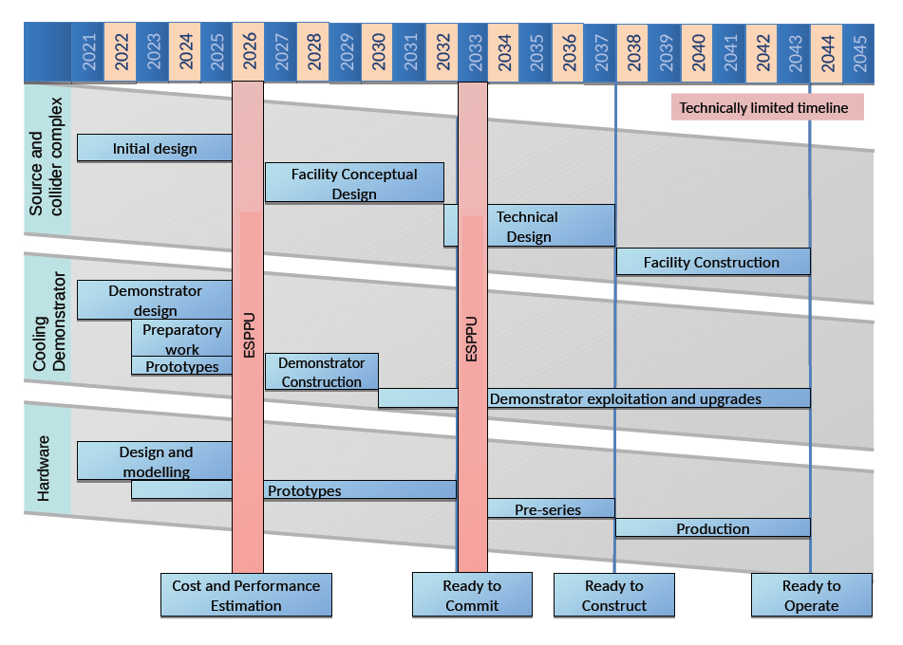

Slide 26
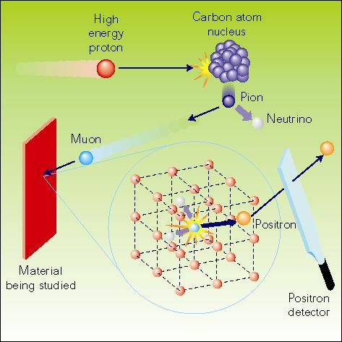
The μSR technique [A. Hillier]
High energy protons
(800 MeV at ISIS)
collide with carbon nuclei
producing pions
π⁺ → μ⁺ + ν_{μ}
4 MeV muons are 100% spin polarised
Decay, lifetime 2.2μs
μ⁺ → e⁺ + ν_{e} + ν_{μ}
we detect decay positrons
Implantation,
(stopped in ~1mm water)
The positrons are preferentially emitted in muon spin direction
Muons interact with local magnetic environment
Monitor the positron distribution to infer the muons’ polarisation after implantation. Learn about the muons’ local environment or the muon behaviour itself.
Notes:
Muon spin relaxation

