Slide 1

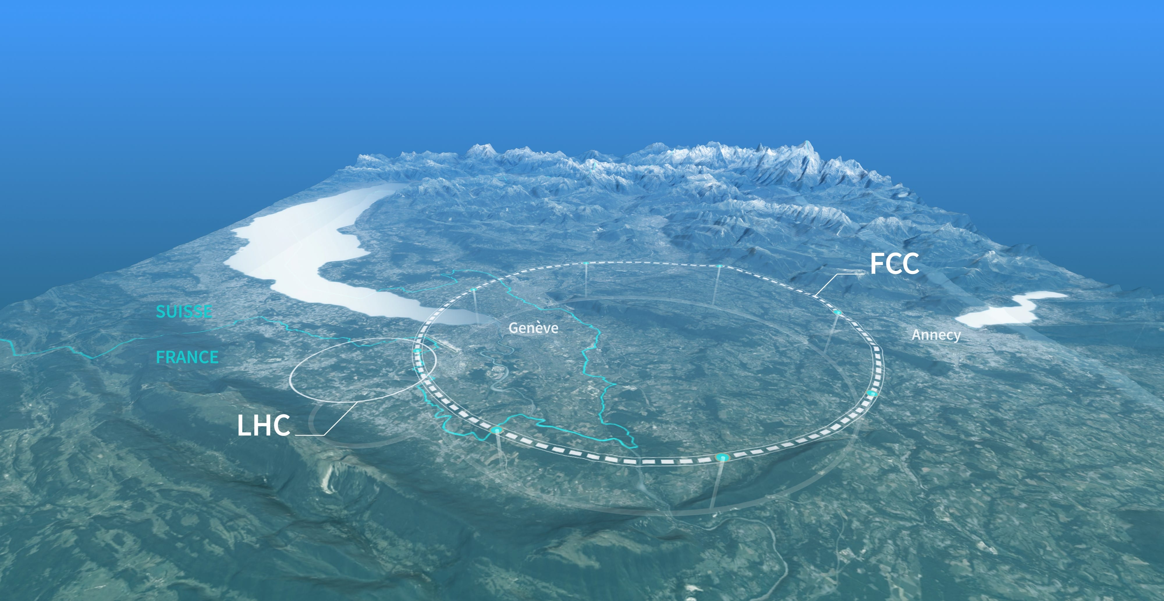
The Future Circular Collider as a Higgs/top/EW Factory: Status and plans for FCC-ee
Dr Sarah Williams, University of Cambridge
Notes:
Thank you for the introduction and to the organisers for inviting me to give this talk. Its great to be here again…

Slide 2
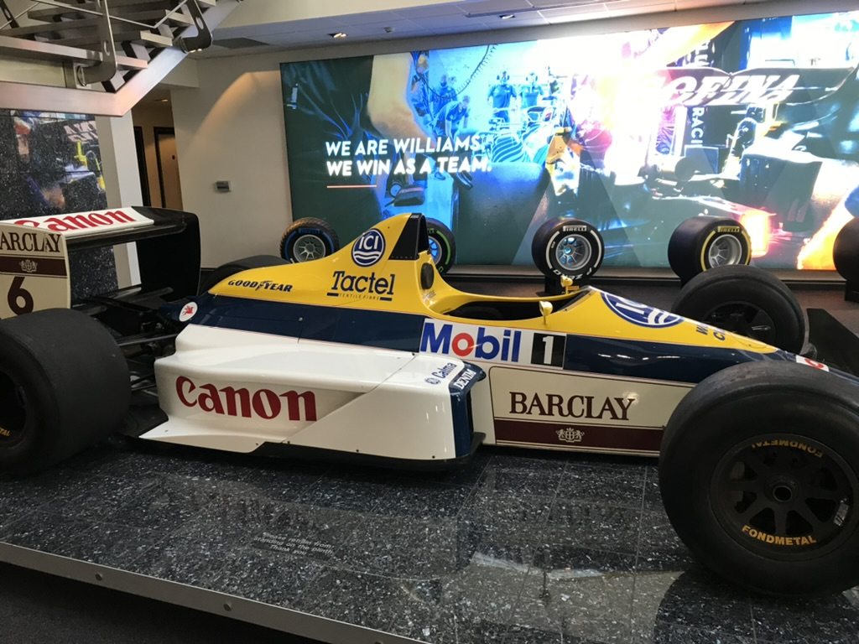
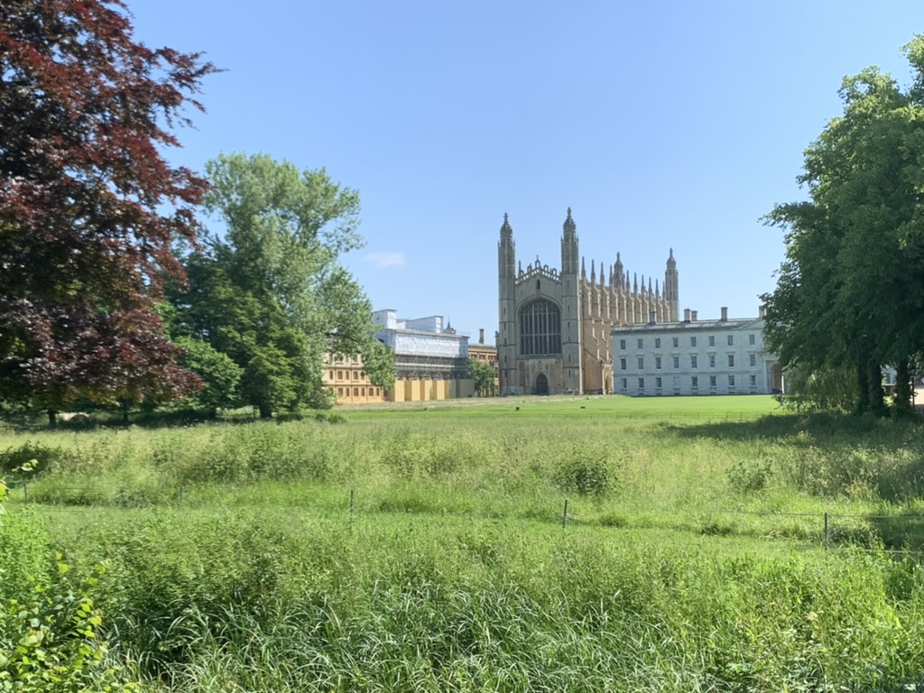
Introduction
Thank you for inviting me to RAL - its great to be here (for the first time since IOP-2022)
In the next ~ 45 minutes I’ll aim to:
  Convince you of the importance of thinking about future colliders now.
  Provide an overview of the Future Circular Collider (FCC) integrated project.
  Discuss the opportunities and challenges associated with the first stage of this project- the lepton collider.

Slide 3
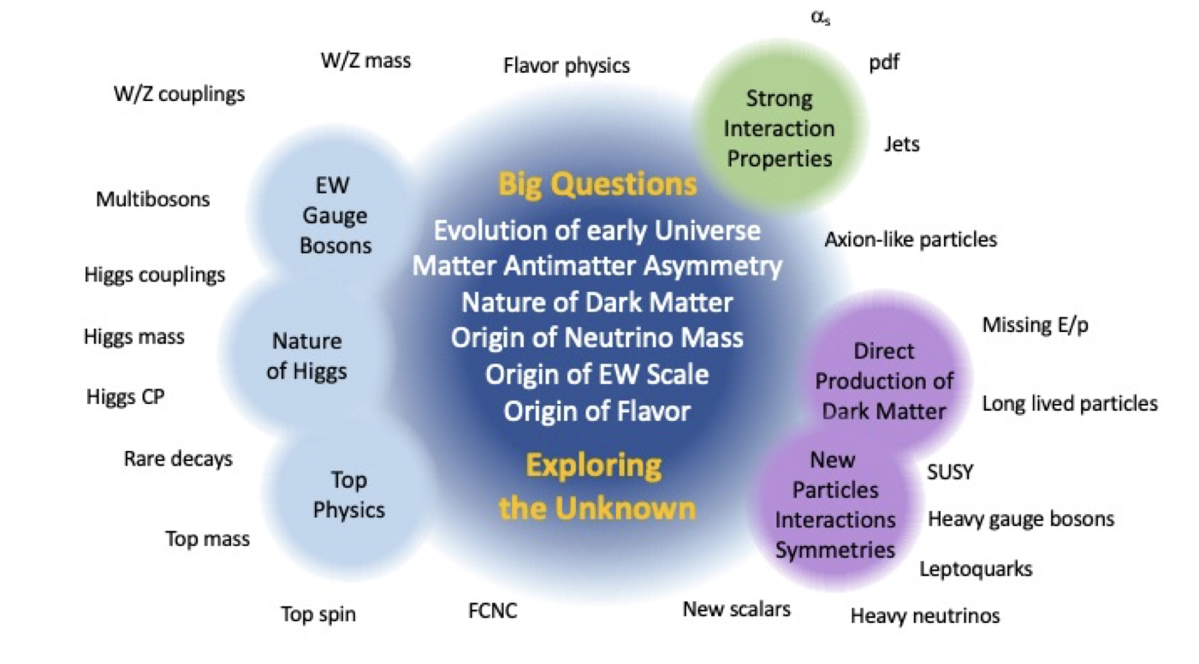
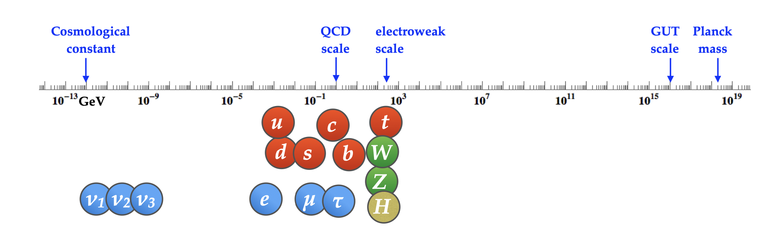

Big questions in particle physics
Image credit: snowmass energy frontier report
Outstanding questions about nature/our universe could be solved through uncovering new physics at particle colliders.
Unlike the Higgs discovery, we no longer have a clear idea of the (energy) scale at which it might appear.
(Maximally) exploring the unknown is key…
Image credit: arXiv:1903.05063

Slide 4
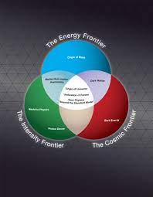
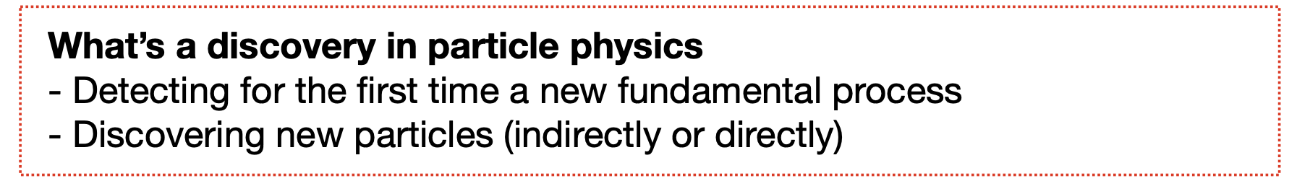
Frontiers in particle physics
… + quantum?
Pushing the intensity and energy frontiers represent two complementary routes for probing new physics.
Whilst the ‘focus’ of e⁺e⁻ machines is precision- a future Higgs factory could meet all definitions of discovery. As a snapshot…
  Possible evidence for electron/strange yukawa?
  Direct discovery of ~ low-mass (very) weakly coupled BSM.
  Indirect discoveries up to ~50-100 TeV.
S. Gori
Please ask lots of questions, either after the talk, during coffee, or via email (sarah.louise.williams@cern.ch)

Slide 5

What should come after the HL-LHC?
In the aftermath of the Higgs discovery, lots of discussion on what machine should follow the LHC…
CLIC (CERN?)
Linear collider?
$e^{+}e^{−}$ machine?
ILC (Japan?)
What should come after the LHC?
Circular collider?
CepC (China)
Hadron collider?
FCC-ee/hh
(CERN)
Muon collider?
How might Europe fit into the global context?
Notes:
Deciding what to build next is an immensely complex discussion that I apologise I won’t be able to do justice to in a few minutes, but I will try and highlight a few points. In the aftermath of the higgs discovery there was a lot of discussion in the field to build a linear electron positron collider. Such experiments would allow Higgs properties, as well as other SM parameters, to be measured to high precision in an incredibly clean collision environment. On the right hand side at the top you can see schematics of two of the current possibilities for future colliders: CLIC which would be based at CERN, and the ILC, which would be based in Japan. A few years ago there was a lot of speculation of whether the Japanese would go ahead and build it, however at the moment it seems there’s no firm commitment without enough international support. Since the beams cannot be recycled there are limits to the collision energies that can be achieved in a linear collider, so other proposals being discussed consider circular machines. On the bottom right you can see a schematic of the future circular collider, or FCC. This is a proposal to build a 100km ring, that could be used to collider either e+e-, or hadrons, with the second scenarios enabling collisions up to 100 TeV. Such high energy machines would provide sensitivity to a range of BSM scenarios above the mass reach of the LHC, so are of great interest to those doing BSM searches. In china there’s also proposals to buold a circular e+e- machine of a similar size, which could be later upgraded to collide hadrons.
One of the complexities of these strategy discussions in Europe are unknowns related to what might be built elsewhere, however I know there’s a strong sense in the community that we would like to have a next generation experiment at CERN. It is a particularly exciting and critical time in our field, and of the various types of consultation taking place last November I was part of the organising committee and a participant in an Early Career Scientist debate on the update for the European strategy. This involved 200 scientists from across Europe and in addition to submitting recommendations to the European strategy group we also now have a public document that is linked from the slides.

Slide 6
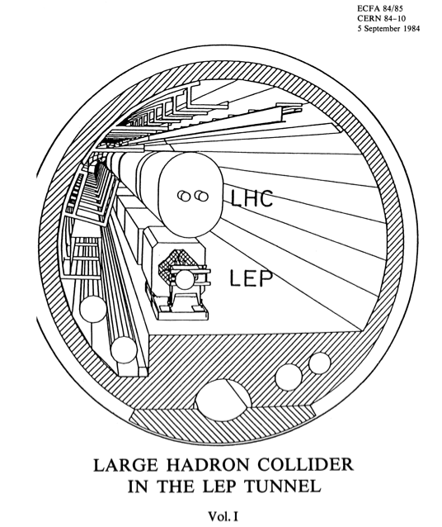
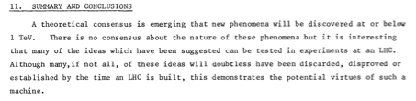
Timescales in particle physics
1984: LHC proposed
1995: LHC approved
2012: Higgs discovery
…are long…
ECFA-84-085-V-2
22 years later in 2006…
http://council-strategygroup.web.cern.ch/council-strategygroup/
Notes:
The Large Hadron Collider at CERN is the best tool available for expanding our knowledge at the energy frontier. Its important to realise that we are currently in the middle of an exciting journey that started a long time ago. The idea of putting a hadron collider in the same tunnel as the Large Electron Positron Collider, or LEP, was first proposed in 1984. It was justified by what is now referred to as the no-lose theorem, that high-energy pp collisions would either enable the Higgs discovery, or would uncover some new physics at the TeV-scale needed to address the known shortcomings of the SM.
Fastforward nearly 20 years to 2006, and the first European Strategy document highlighted the excitement associated with exploring this new frontier, but also mentioned the challenges that would come with the higher energy range. As I’ll be discussing later both the machine and experiments have far surpassed initial performance projections, and we should be hopeful that this trend will continue.

Slide 7



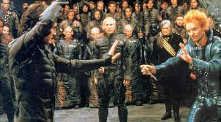


To put this in context...?
Can you guess the films?
1984
1995
2012
Music
Film
… many of us have only been involved in a small part of the LHC journey…

Slide 8

The 2020 European Strategy Update
Following ~ 2 years of consensus gathering within the community, the ESU made several key recommendations to the community:
      An electron-positron Higgs factory is the highest-priority next collider. For the longer term, the European particle physics community has the ambition to operate a proton-proton collider at the highest achievable energy
      Europe, together with its international partners, should investigate the technical and financial feasibility of a future hadron collider at CERN with a centre-of-mass energy of at least 100 TeV and with an electron-positron Higgs and electroweak factory as a possible first stage
Following the 2020 ESU, the FCC feasibility study was launched in 2021, aiming to provide input by 2025 to feed into the next ESU…
Notes:
In order to avoid a significant gap in data-taking decisions need to be made in the coming years to avoid a gap in data-taking after the High-Luminosity LHC…
Strategic priorities for the European High Energy Physics community are defined through updates to the European Strategy for Particle physics which take place roughly every 7 years following extended concensus gathering and discussion within the community. Two key statements from the 2020 update are shown on the slide. The first is that the next high-priority collider is an e+e- higgs factory, and that in the longer term we should be aiming to produce pp collisions at the highest achievable centre of mass energy to push the energy frontier to its limit.
The second states that Europe, together with its international partners, should investigate the technical and financial feasiiliy of operating a 100 TeV hadron collider at CERN.
As the integrated FCC programme provides an exciting route to achieving these goals, the FCC feasibility study was launched in 2021, aiming to be completed by 2025 in order to provide key input to the next European Strategy Update which is expected to take place around 2026 and 2027. The feasibility study is currently undergoing its mid-term review so this talk is particularly timely in terms of taking stock of where we have got to.

Slide 9
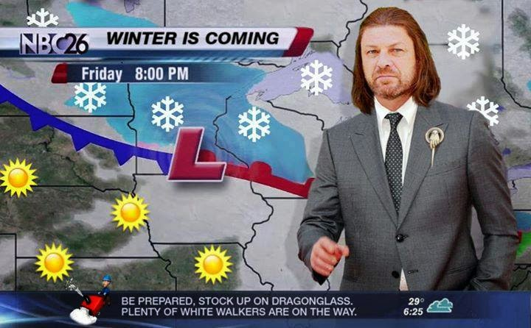
Quick plug- the 2026 European strategy update…
Save the date: 23-26 September ECFA-UK Workshop at IPPP, Durham
Interested to learn more? Check out the slides here:
https://indico.stfc.ac.uk/event/1012/

Slide 10

Integrated FCC programme
Comprehensive long-term programme maximises physics opportunities at the intensity and energy frontier:
FCC-ee (Z, W, H, $t\overline{t}$) as high-luminosity Higgs, EW + top factory.
FCC-hh (~ 100 TeV) to maximise reach at the energy frontier, with pp, AA and e-h options (FCC-eh).
+ AA, eA, ep

Slide 11
Integrated FCC programme
Taken from slides by F. Gianotti at FCC week.
FCC-ee:
Ultra-precise measurements of EW/ Higgs + top sectors of SM -> indirect sensitivity to BSM.
Unique flavour opportunities
Direct sensitivity to feebly interacting particles (LLPs)
FCC-hh:
High-statistics for rare Higgs decays and 5% measurement of Higgs self interaction.
Unprecedented direct sensitivity to BSM.
FCC-eh:
Energy-frontier ep collisions provide ultimate super-microscope to fully resolve hadron structure
and empower physics potential of hadron colliders.
Very precise measurements of Higgs/top and EW parameters in synergy with ee and hh
Notes:
FCC-eh (energy frontier)
High-energy DIS- improved knowledge of proton structure.
Complementary measurements of Higgs/top/EW parameters, and improved PDFs.

Slide 12
Synergies in FCC programme –BSM
https://fcc-cdr.web.cern.ch/
Order of magnitude improvement in Higgs couplings.
Factor of 10-50 improvement in EW precision observables at FCC-ee (indirect sensitivity up to ~ 70 TeV)
Direct sensitivity up to ~ 50 TeV at FCC-hh (and access to Higgs self coupling).
=> FCC-hh could directly discover NP indirectly accessed at FCC-ee!
Notes:
One of the strengths of the FCC programme are the physics synergies, with FCC-ee providing indirect sensitivity to new physics at mass scales up to 70 TeV through ultra-precise SM measurements, and FCC-hh potentially enabling direct access to new phenomena at mass scales up to around 50 TeV. Furthermore the measurements at FCC-hh can be performed in a model-independent way by using results obtained at FCC-ee, and I’ll now briefly discuss this in more detail using Higgs measurements and BSM measurements as examples.

Slide 13

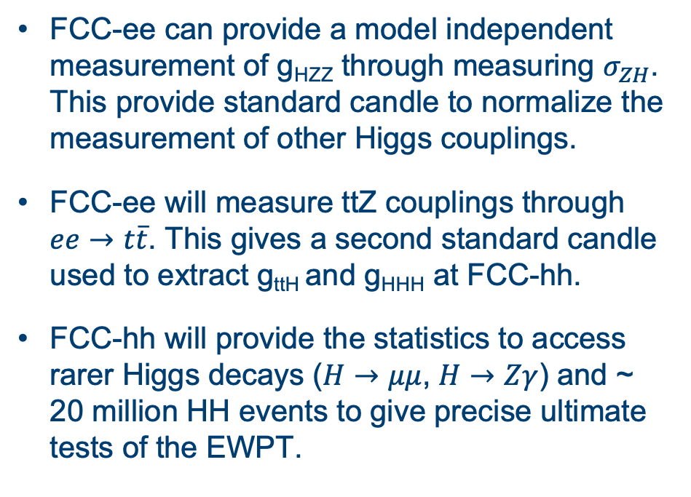
FCC-ee and -hh synergies - Higgs measurements
https://fcc-cdr.web.cern.ch/
FCC-ee can provide a model independent measurement of g_{HZZ} through measuring $σ_{ZH}$. This provide standard candle to normalize the measurement of other Higgs couplings.
FCC-ee will measure ttZ couplings through $ee→t\overline{t}$. This gives a second standard candle used to extract g_{ttH} and g_{HHH} at FCC-hh.
FCC-hh will provide the statistics to access rarer Higgs decays ($H→μμ$, $H→Zγ$) and ~ 20 million HH events to give precise ultimate tests of the EWPT.

Slide 14
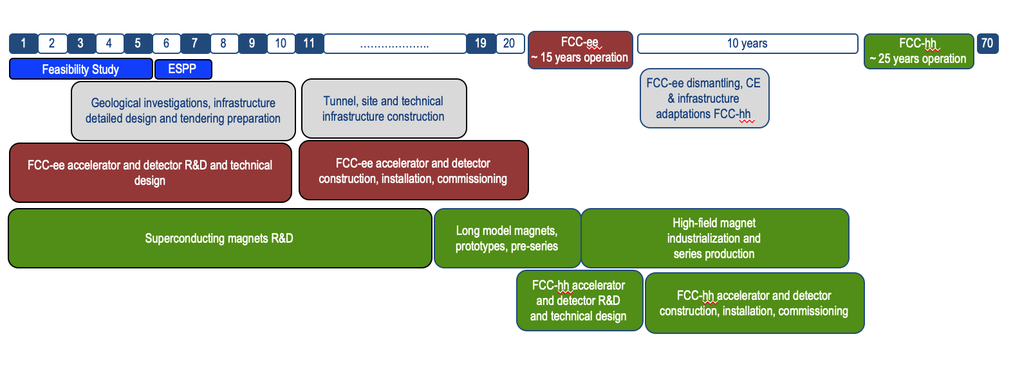
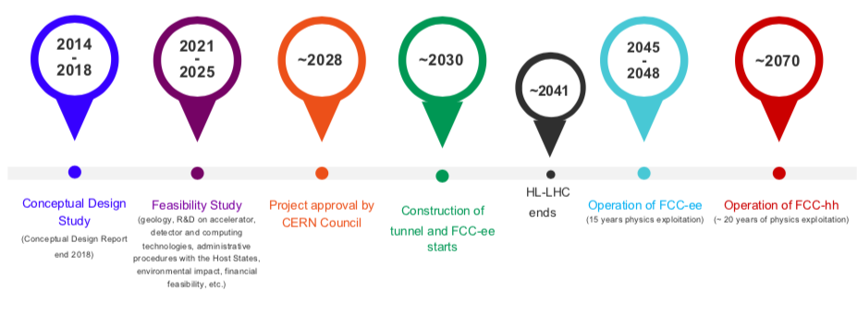
FCC timelines
Taken from slides by F. Gianotti at FCC week.
Based on technical schedule, FCC-ee operation could start in 2040 or earlier.
More realistic schedule, accounting for past experience of building colliders, approval timelines, HL-LHC operation…
Obvious comment: long timescales mean that ECR engagement is key!
Notes:
The next slide shows two sets of timelines for the FCC project that were shown by Fabiola Gianotti, current director general of CERN, at the London FCC week. The main take away is that whilst FCC-ee uses mature technologies meaning that it could in principle start operation in 2040, the current baseline schedule, which is shown at the bottom, is realistic in the context of other activities at CERN and the timelines for concencus gathering, project approval and construction. We are currently in the feasibility study phase here, and were the next European Strategy Update to mandate moving forward with FCC, the earliest the project could be approved is the end of this decade. Furthermore, whilst construction could proceed in parallel, CERN cannot operate another collider until the HL-LHC has finished data-taking, which is why the earliest FCC-ee could commence operation is the mid 2040s.

Slide 15
Status of FCC feasibility study: mid-term review
Mid-term review completed earlier this year => no showstoppers!
Key updates:
  Choice of ring placement and 4 IPs (higher statistics).
  Adaptation of accelerator RF/ optics for new placement (details in backup).
Significant R+D ongoing to improve energy efficiency (including HTS).

Slide 16
Summary of FCC-ee beam parameters
Taken from slides by F. Gianotti at FCC week.
Notes:
On the next slide you can see a summary of the beam parameters at FCC-ee taken directly again from Fabiola’s slides at FCC week. The nominal operating sequence starts with 4-years at the Z-pole run. This tera-Z running will give the LEP datasets in roughly a few minutes, and the high-statistics also provides unique flavour opportunities. This will be followed by 2 years at the WW threshold, and three years at the Zh pole. This will provide the 2-million Higgses needed to reach ultimate precision on the Higgs coulings. This will be followed by 5 years operating at ttbar energies.
Whislt this is the nominal and most technologically straightforward operating plan, there are studies ongoing to investigate the feasibility of beginning with ZH running.

Slide 17
FCC-ee physics landscape
Schematics from slides by M. Selvaggi at FCC week
FCC-ee Physics landscape
=> Broad landscape of physics opportunities!
=> Significant effort ongoing to study impact of detector concepts across range of physics areas!
FCC-ee Detector requirements
Notes:
The physics landscape across these 4 energies is summarized very nicely in the schematic on the next slide that I took from Michele Selveggi’s talk at the London FCC week. The precise measurements of SM parameters including higgs couplings will have exciting indirect sensitivity to new physics, but we also have direct sensitivity to BSM. Within the FCC collaboration there’s a huge effort ongoing to understand how these physics goals can be fed into the development of detector concepts, including ensuring that unconventional signatures like LLPs are considered from the beginning. Generally, we require excellent vertexing and tracking, strong PID for the flavour programme and also very accurate luminosity measurements.

Slide 18
Ultimate precision @ FCC-ee
Plot + table taken from slides by M. Selvaggi at ZPW2024
Unprecedented luminosity at multiple centre of mass energies will enable ultra-precise measurements of Higgs (and EW and top) sectors of the SM…
Rather than listing them… I thought we would play a game…

Slide 19

e⁺e⁻ numbers game
Put these numbers in ascending order (and guess if you can?)
# Z bosons/hour at FCC-ee (Z-pole)
# Higgs bosons/day at FCC-ee (Zh pole)
# Z bosons produced at LEP
# Crème eggs produced by Birmingham Cadbury's factory per day
# Higgs bosons produced by the LHC in 2017.
In the interest of time- try guessing the highest and lowest…
Notes:
360 million.
4. 18 million.

Slide 20
e⁺e⁻ numbers game
Put these numbers in ascending order (and guess if you can/ want to…?)
# Z bosons/hour at FCC-ee (Z-pole) => 360 million (5)
# Higgs bosons/day at FCC-ee (Zh pole) => 2000 (1)
# Z bosons produced at LEP => 18 million (4)
# Crème eggs produced by Birmingham Cadbury's factory per day => 1.5 million (2)
# Higgs bosons produced by the LHC in 2017 => 3 million (3)
Notes:
360 million.
4. 18 million. (also number of Higgses projecged for run 3)

Slide 21
Case study- Higgs physics
Plots taken from vol. 1 of FCC CDR: https://fcc-cdr.web.cern.ch/
> 1 million ZH events
~ 100,000 WW fusion
Large rates, clean experimental environment (no UE, Pileup, triggerless) with no QCD background will open up a new era of Higgs precision physics.
Opportunities to remove model-dependence from measurements and reach sub-percent level for post couplings.

Slide 22
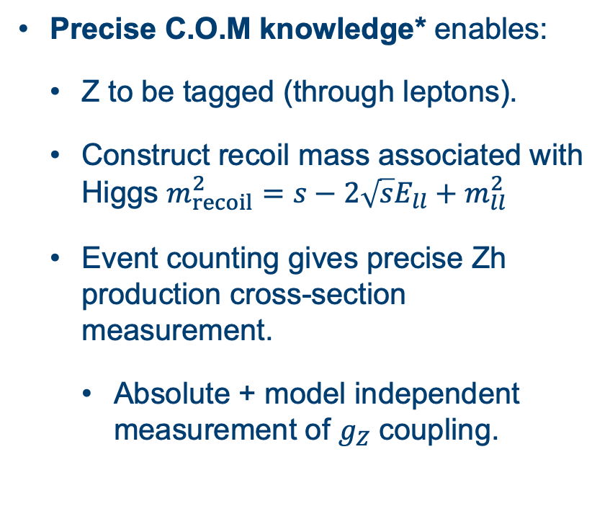
Higgs recoil mass method
Precise C.O.M knowledge* enables:
  Z to be tagged (through leptons).
  Construct recoil mass associated with Higgs $m_{recoil}^{2}=s−2\sqrt{s}E_{ll}+m_{ll}^{2}$
  Event counting gives precise Zh production cross-section measurement.
    Absolute + model independent measurement of $g_{Z}$ coupling.
*Achieved through resonant depolarization (unique to circular l+l- colliders)

Slide 23
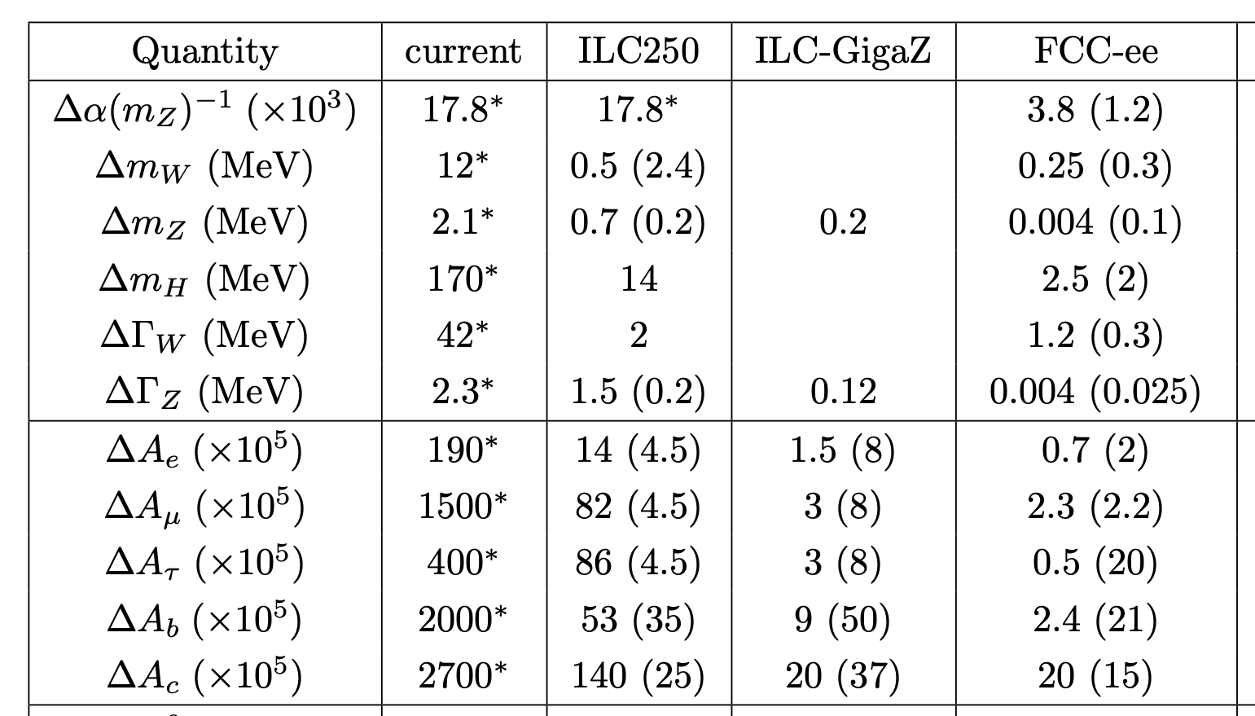
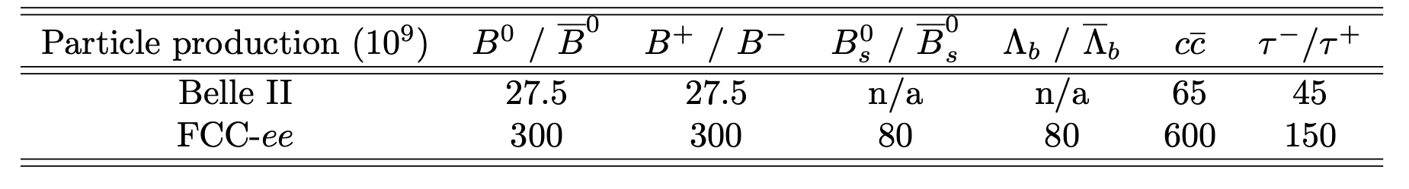
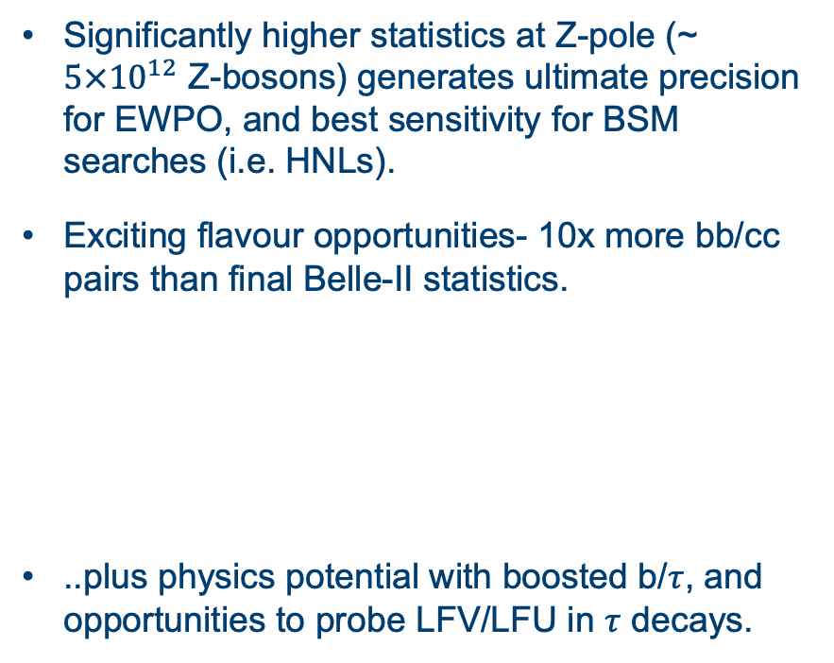
Why do we need tera-Z?
Significantly higher statistics at Z-pole (~ $5×{10}^{12}$ Z-bosons) generates ultimate precision for EWPO, and best sensitivity for BSM searches (i.e. HNLs).
Exciting flavour opportunities- 10x more bb/cc pairs than final Belle-II statistics.
..plus physics potential with boosted b/$τ$, and opportunities to probe LFV/LFU in $τ$ decays.
For flavour, see slides by Jernej. F. Kamenik at London FCC week

Slide 24
EWK precision @ FCC-ee
See slides by Christoph Paus at ZPW2024
Challenges (and opportunities) in theory and on the experimental side (energy calibration/luminosity measurement) to reach ultimate precision…

Slide 25
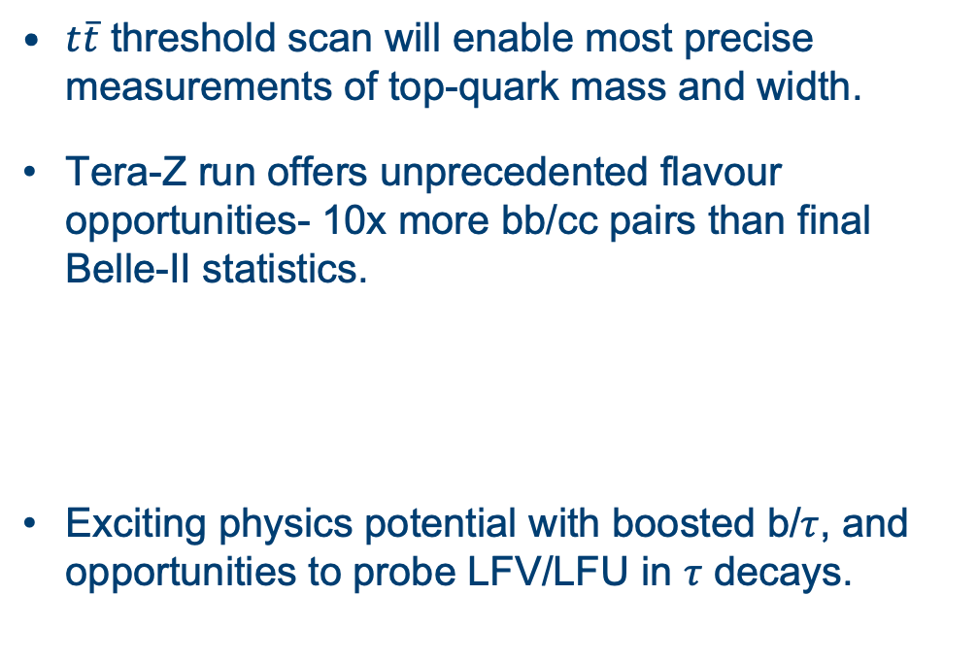
Top and flavour @ FCC-ee
$t\overline{t}$ threshold scan will enable most precise measurements of top-quark mass and width.
Tera-Z run offers unprecedented flavour opportunities- 10x more bb/cc pairs than final Belle-II statistics.
Exciting physics potential with boosted b/$τ$, and opportunities to probe LFV/LFU in $τ$ decays.
For flavour, see slides by Jernej. F. Kamenik at London FCC week

Slide 26
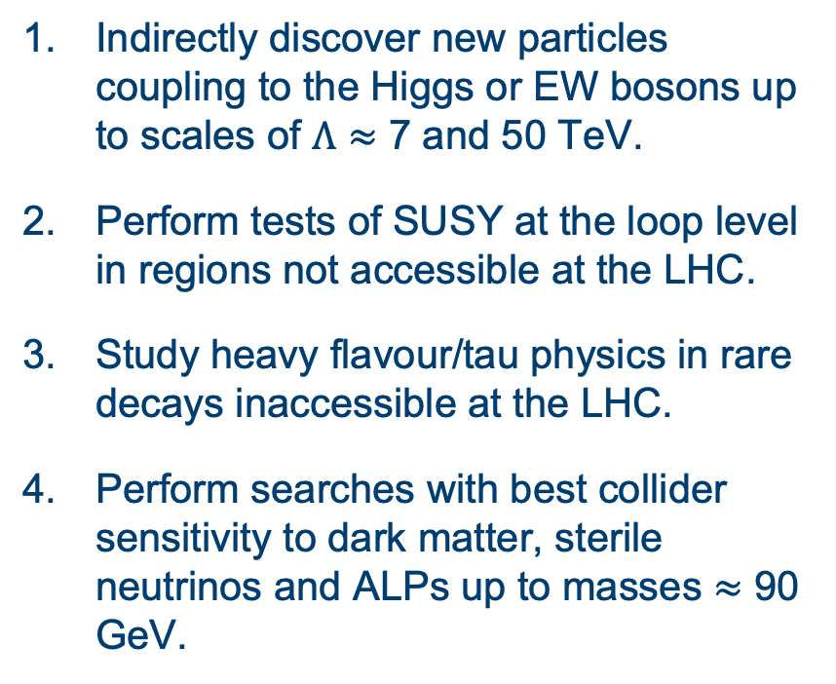
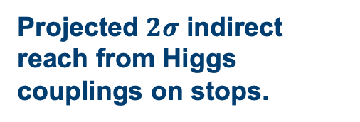
BSM @ FCC-ee - a snapshot
Taken from FCC Snowmass submission
Image credit: FCC CDR
Indirectly discover new particles coupling to the Higgs or EW bosons up to scales of $Λ≈$ 7 and 50 TeV.
Perform tests of SUSY at the loop level in regions not accessible at the LHC.
Study heavy flavour/tau physics in rare decays inaccessible at the LHC.
Perform searches with best collider sensitivity to dark matter, sterile neutrinos and ALPs up to masses $≈$ 90 GeV.
Projected $2σ$ indirect reach from Higgs couplings on stops.

Slide 27
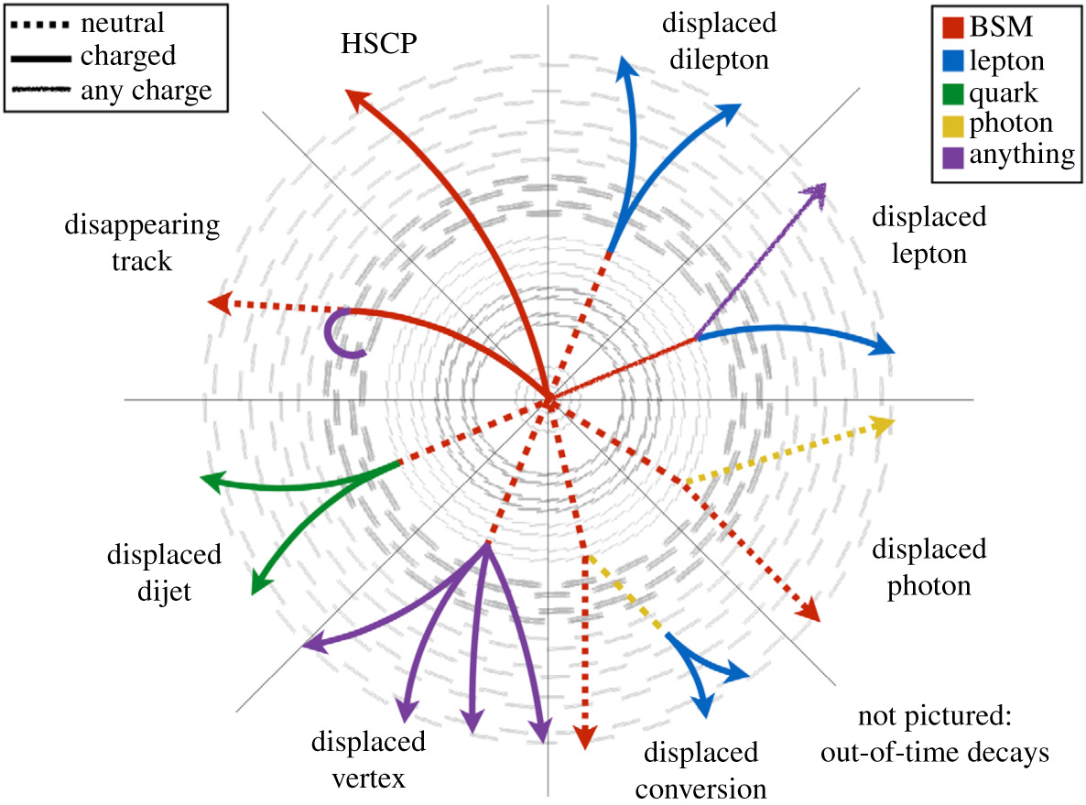
FCC-ee case study: LLPs
LLPs that are semi-stable or decay in the sub-detectors are predicted in a variety of BSM models:
Heavy Neutral Leptons (HNLs)
RPV SUSY
ALPs
Dark sector models
The range of unconventional signatures and rich phenomenology means that understanding the impact of detector design/performance on the sensitivity of future experiments is key!
Notes:
Most generically long-lived particles refer to any particle with a lifetime such that it traverses a significant distance in our subdetectors before decaying, if at all. They occur in a number of well-motivated extensions to the SM as you can see on the right, and common examples include heavy neutral leptons that arise in models trying to explain neutrino masses, r-parity violating susy, axion-like particles and dark sector models. .as you can see on the left hand side this can give a variety of unconventional signatures, with a common one being a displaced vertex that can be reconstructed. As mentioned before, these have been traditionally very hard to search for in hadron colliders due to the need to trigger on unusual events, the large backgrounds and challenges in reconstruction. The significantly cleaner environment in e+e- collisions mean we have unique opportunities to discovery feebly interacting long-lived particles at FCC-ee, and its important we develop benchmarks to ensure these signals are considered in detector design.

Slide 28
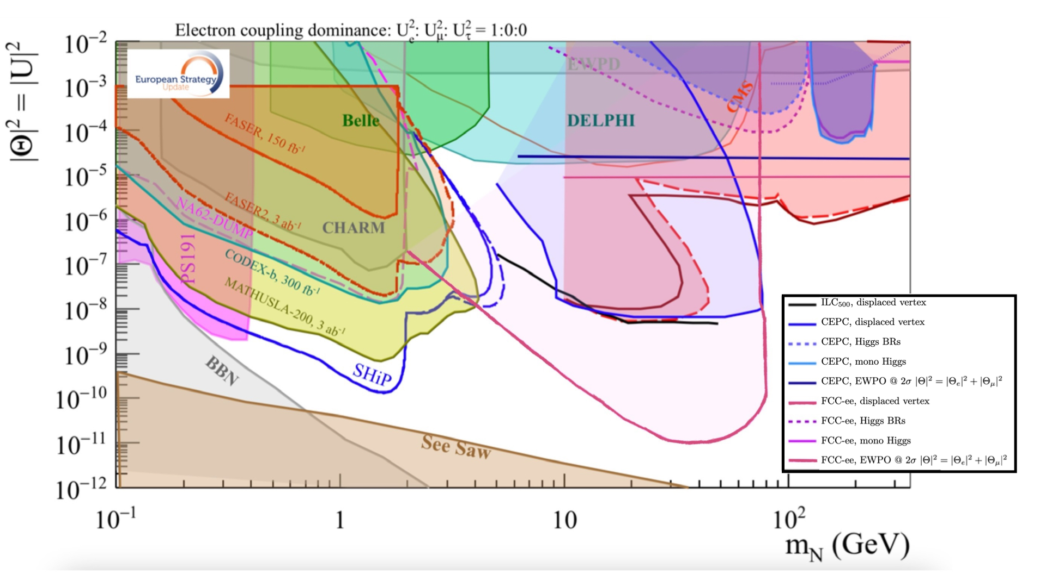
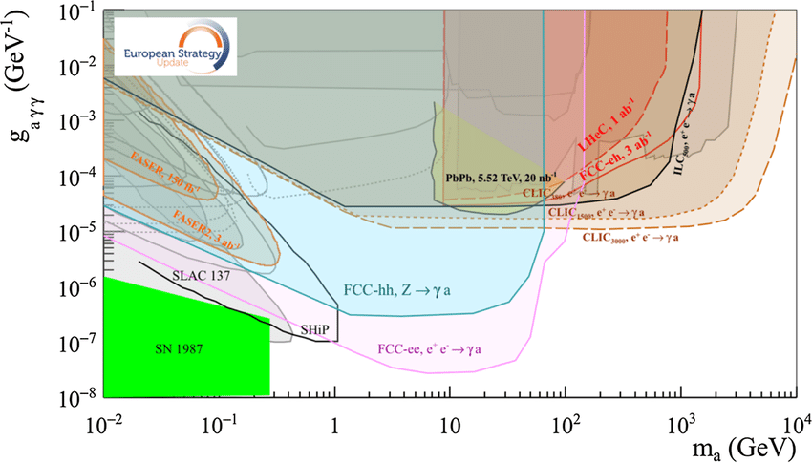
LLPs @ FCC-ee
Interested? There are more details in the backup …
High luminosities at Z-pole and ZH threshold offer unique sensitivity to LLPs coupling to Z or Higgs.
  No trigger requirements.
  Excellent vertex reconstruction and impact parameter resolution can target low LLP lifetimes (this can drive hardware choices).
  Projections often assume background-free searches (we should check these assumptions).
Notes:
As we have heard this week FCC-ee is designed as an electroweak precision factory so the Z-pole and Zh runs provide natural opportunities to target LLPs that couple to the SM through the Z- or Higgs-. In addition to triggerless running, excellent vertex reconstruction and impact parameter resolution can enable low LLP lifetimes to be targeted.
LHC-style searches where we are typically balancing background rejection vs signal acceptance, for LLP searches at FCC-ee we assume background-free searches. On the right hand side you can see two of the plots included in the European Strategy update briefing book, where the top is for HNLs as a function of the HNL mass and the mixing with electron neutrinos, and on the bottom you have ALPs as a function of the ALP mass and alp-photon coupling. Looking towards the feasibility study, its important that we really check these assumptions carefully.

Slide 29
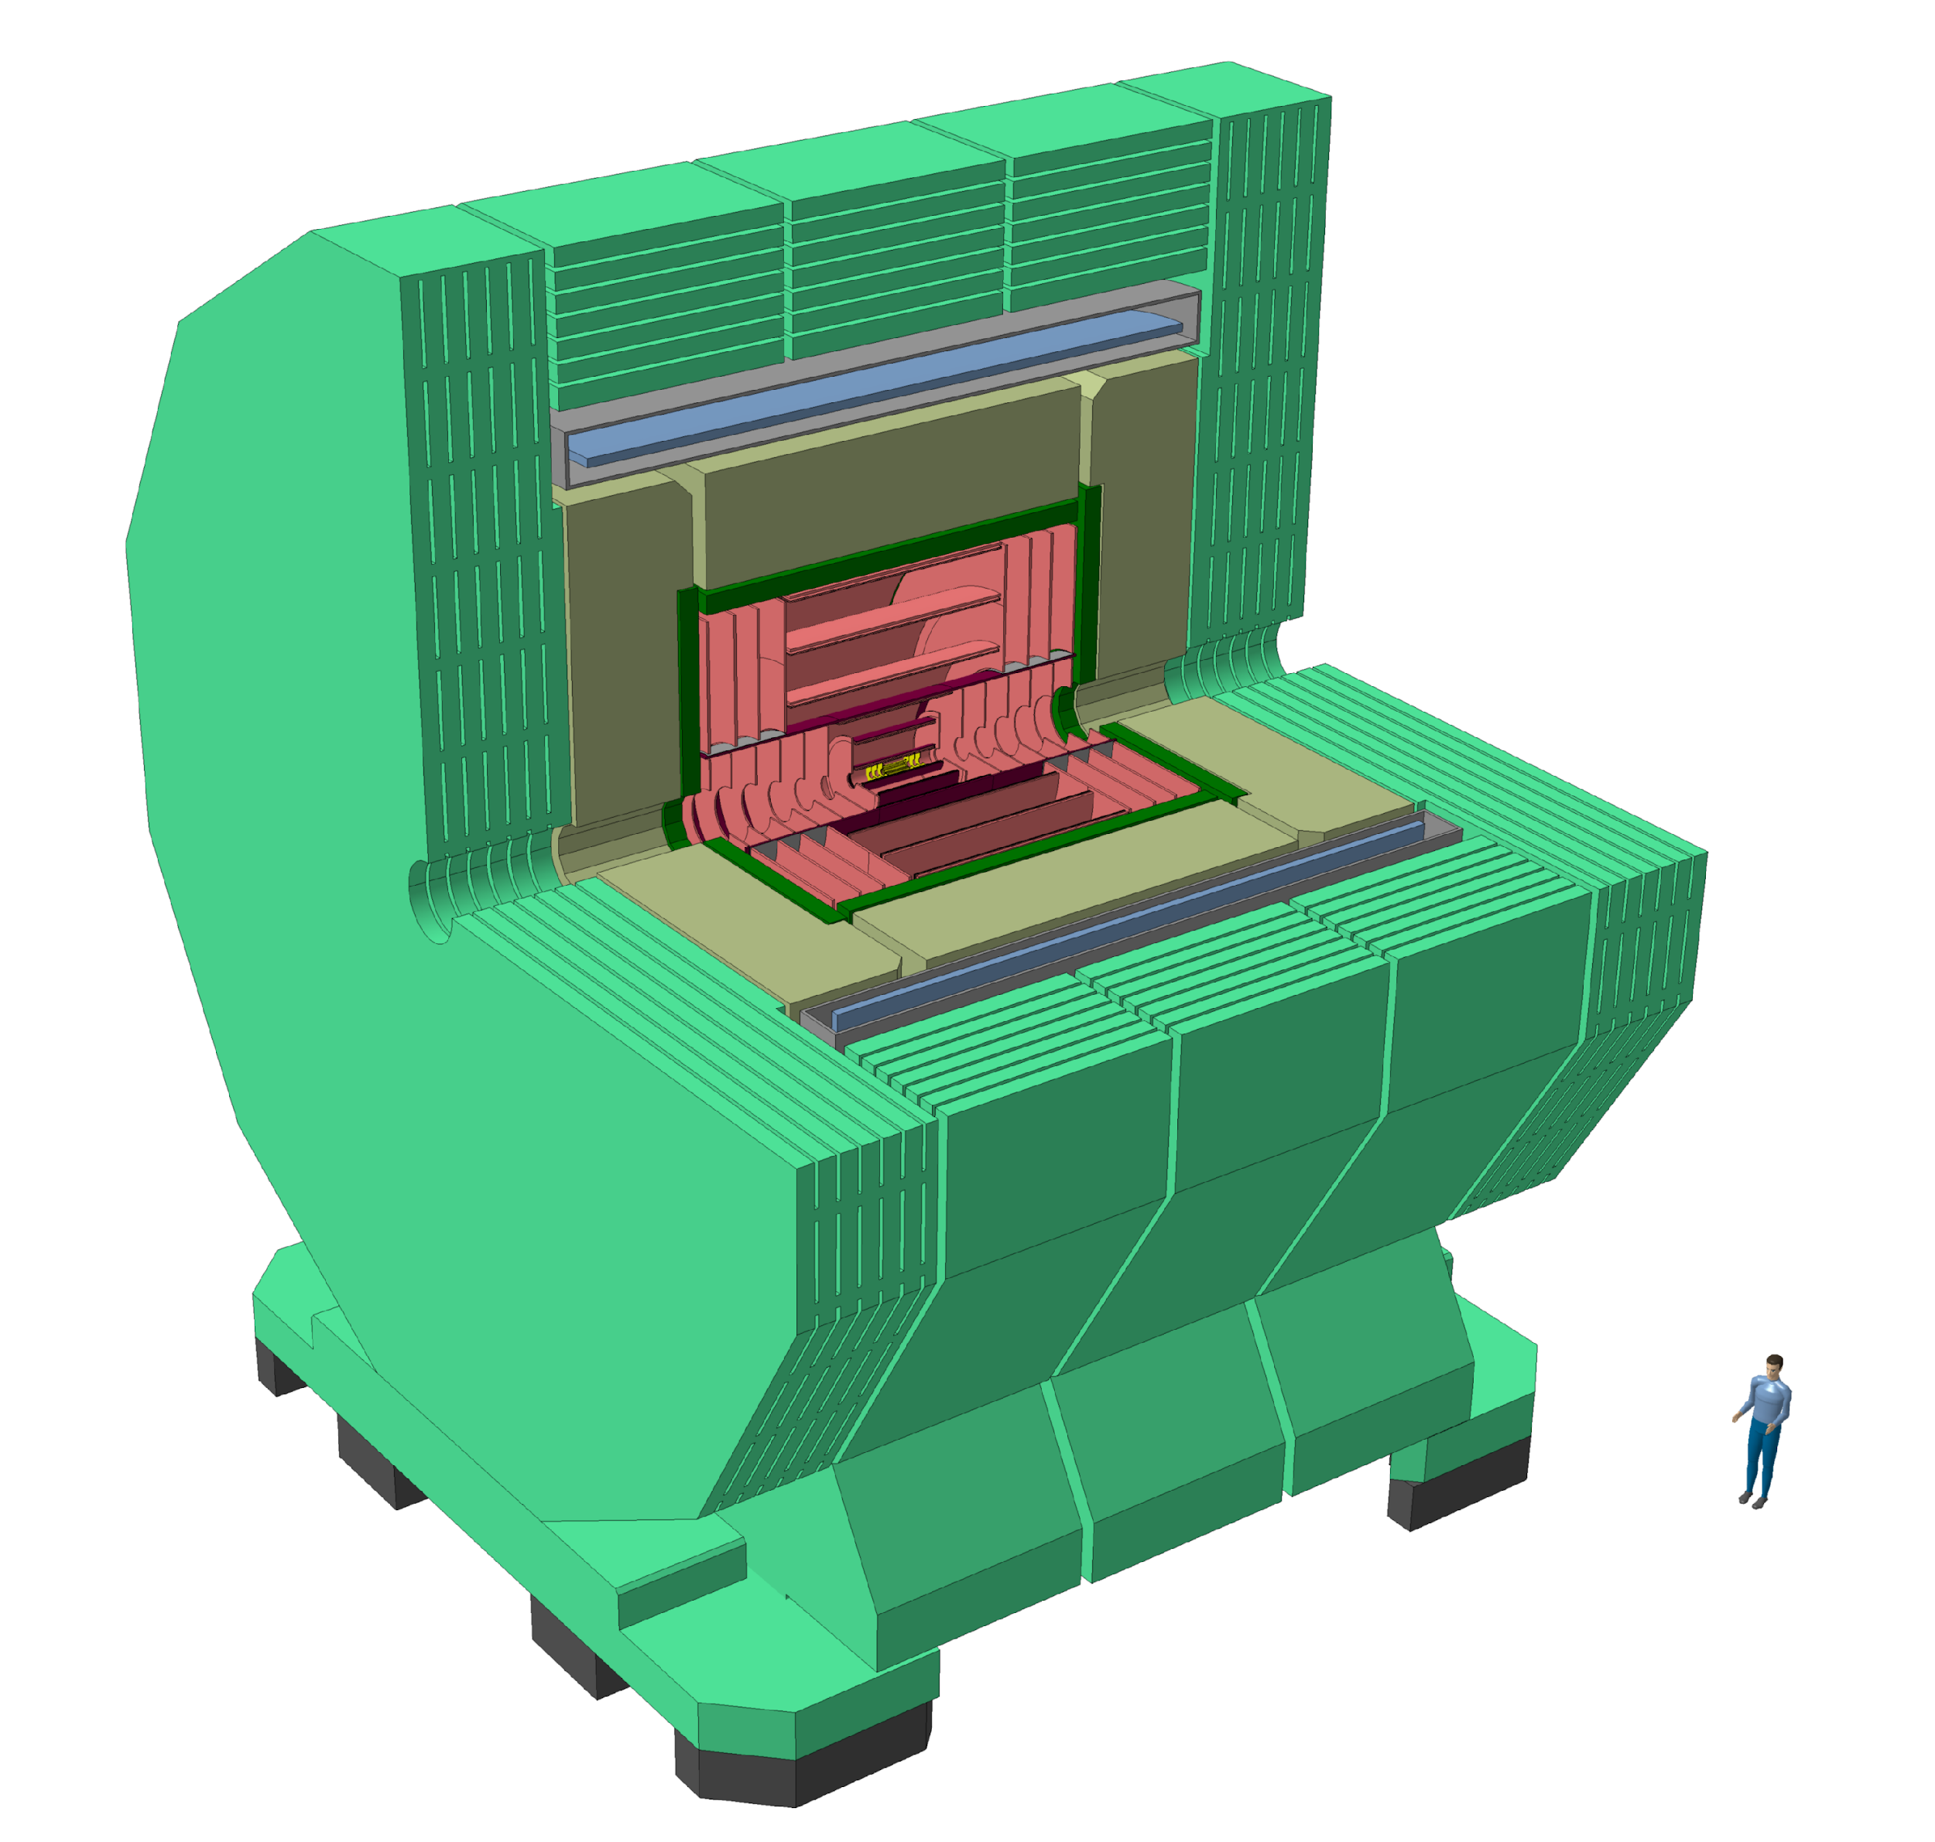
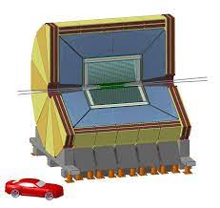
Detector concepts for FCC-ee
CLD (“CLIC-like Detector”)
IDEA (“Innovative Detector for Electron-positron Accelerator”)
“Allegra”
Full silicon vertex-detector+ tracker
3D high-granularity calorimeter
Solenoid outside calorimeter
Silicon vertex detector
Short-drift chamber tracker.
Dual-readout calorimeter
New proposal using liquid LAr calorimeter!
Easy to study impact of detector design on physics sensitivity through FCC software framework…
Notes:
The next slide shows some of the detector concepts available for study within the FCC software suite….

Slide 30
FCC analysis software
Schematic taken from slides by Brieuc Francois at FCC week
Sophisticated software ecosystem in place to perform simulations and physics/detector studies…
Notes:
I’ll now just say a little about the FCC software environment which is playing a key role in facilitating efficient and reliable studies being performed in the feasibility study. FCC already uses a sophisticated software ecosystem for simulation, reconstruction and physics analysis studies that make use of existing frameworks developed for future colliders. For those interested to learn more I’d recommend your looking at Francois’ slides from FCC week, but for now I’ll just day that there’s substantial development ongoing on both the generstors side but also to improve the modelling of e+e- collisions.

Slide 31
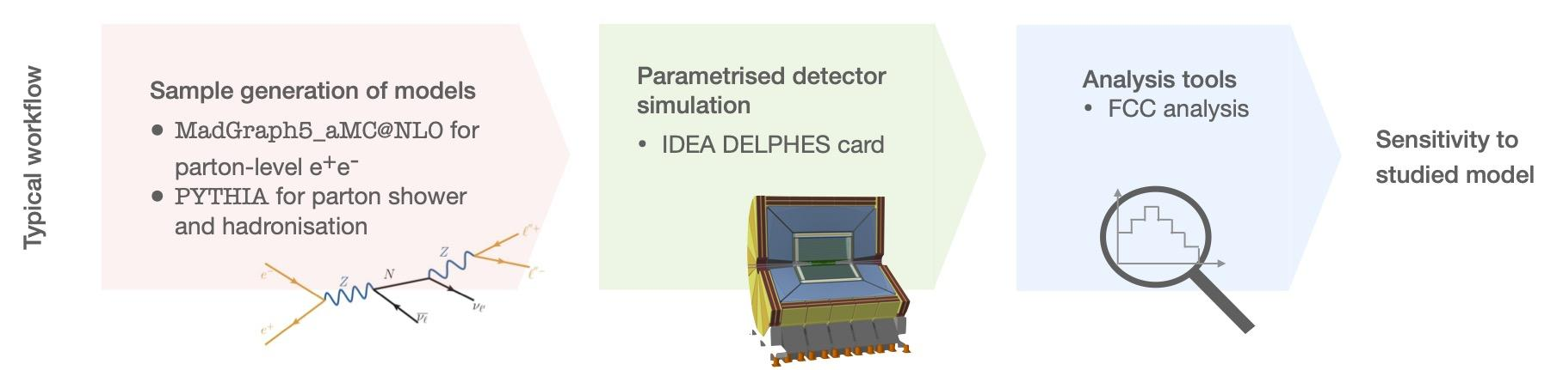
FCC analysis software
https://key4hep.github.io/key4hep-doc/
Integrated in the Key4Hep ecosystem which also provides a common EDM for future collider studies.
Central MC samples produced (in EDM4HEP format) to facilitate physics/detector studies.
FCC Analysis software developed to analyse EDM4HEP files and support sensitivity/detector development studies.
Notes:
The FCC analysis software is buold on the Key4Hep ecosustyem which also provides a common EDM for durue collider studies. Within the FCC study, campaigns of MC samples have been produced centrally to facilitate physics/detector studies being performed in a coherent way, and theres also a set of analysis tools available to process these files using Rdata Frames. The schematic at the bottom shows a typical worklflow for performing physics sensitivity studies within the FCC framwroek.

Slide 32

I’m excited by FCC-ee –
are you?
Conclusion + outlook

Slide 33
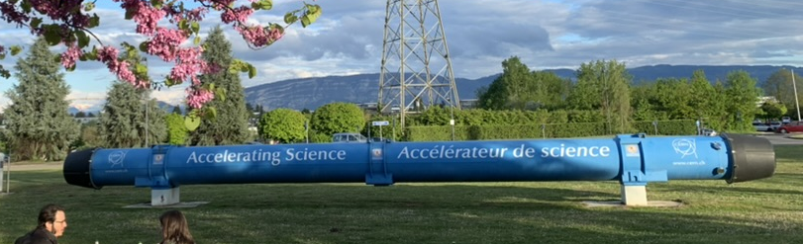
1. Why think about future colliders now?
To avoid a significant gap in data-taking after the High-Luminosity LHC key decisions need to be taken in the coming years.
Knowledge transfer to those that will deliver the project (i.e. ECRs) cannot wait.
We are resource limited (including person power)- making the HL-LHC must be our top priority, so making a future collider reality in parallel will require…
  Consensus in the community.
  Strategic planning and collaboration

Slide 34
2. The integrated FCC project…
Integrated programme combines precision at the intensity frontier (FCC-ee) giving indirect sensitivity to a multitude of NP as well as unique direct sensitivity to low-mass and weakly interacting BSM physics, with discovery potential at the energy frontier (FCC-hh) that will extend the precision achieved at FCC-ee!
Notes:
One of the strengths of the FCC programme are the physics synergies, with FCC-ee providing indirect sensitivity to new physics at mass scales up to 70 TeV through ultra-precise SM measurements, and FCC-hh potentially enabling direct access to new phenomena at mass scales up to around 50 TeV. Furthermore the measurements at FCC-hh can be performed in a model-independent way by using results obtained at FCC-ee, and I’ll now briefly discuss this in more detail using Higgs measurements and BSM measurements as examples.

Slide 35
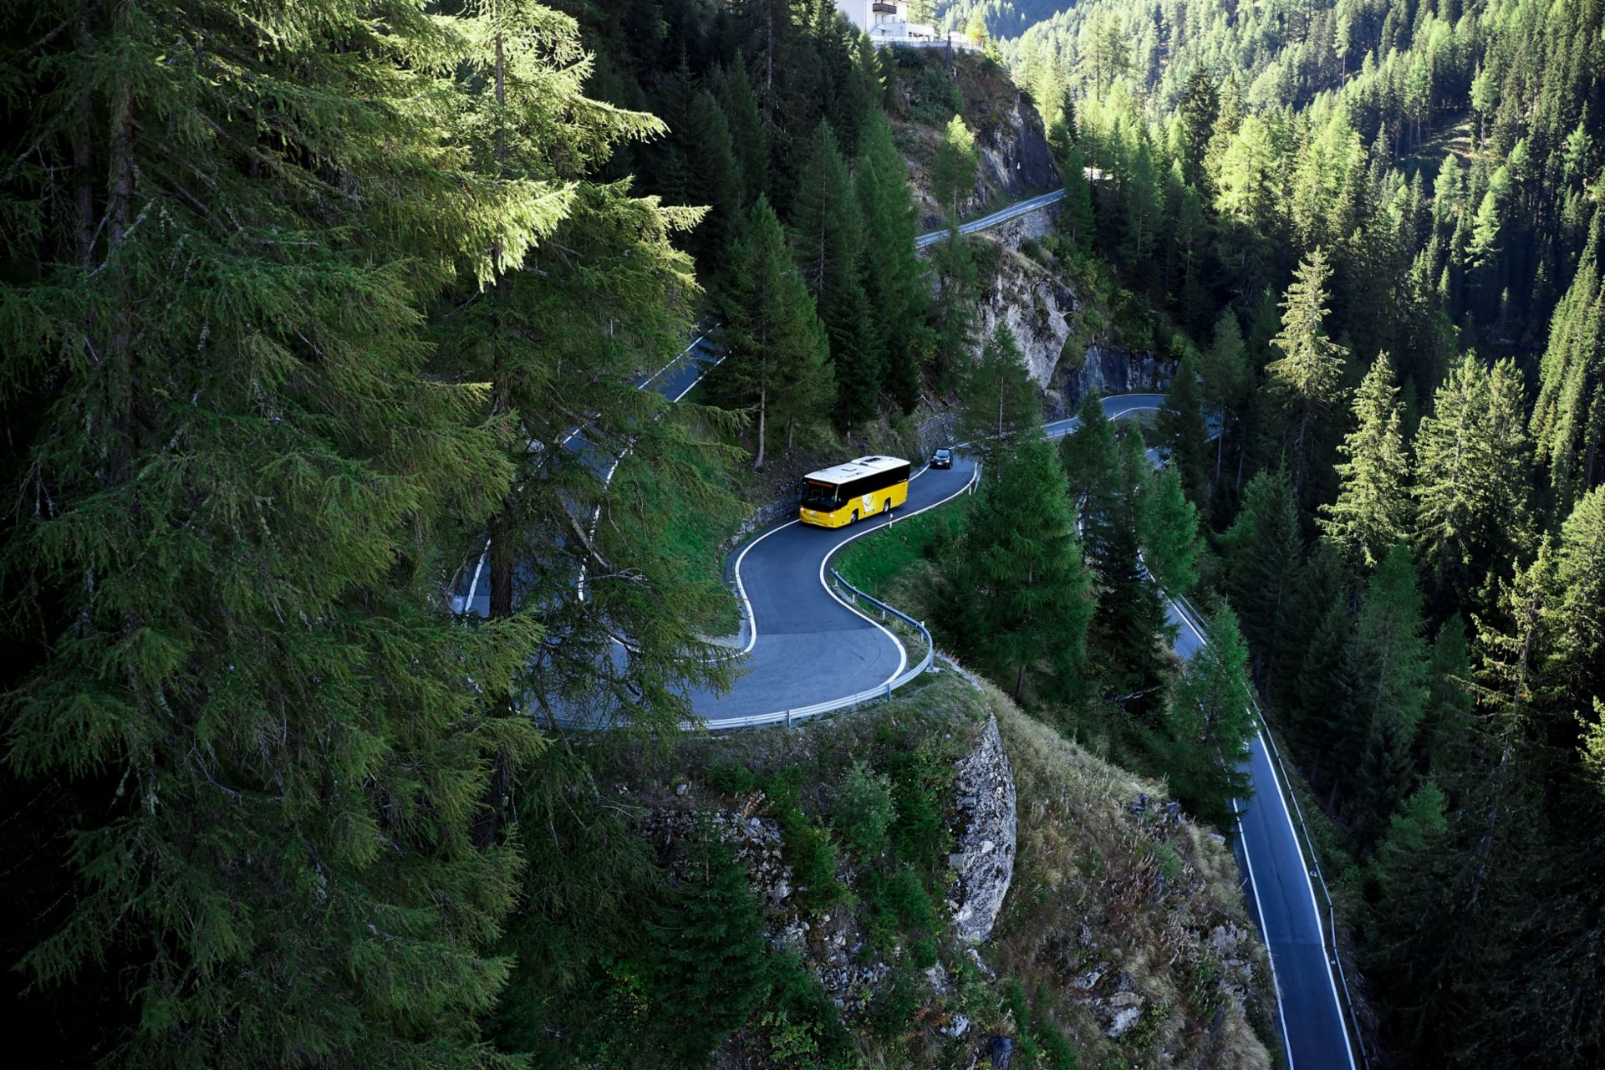
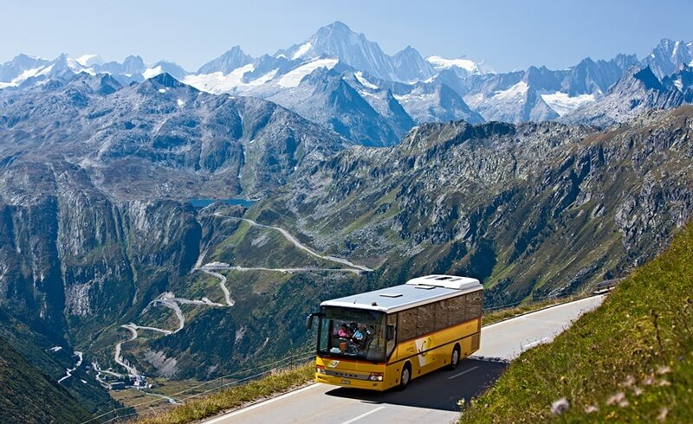
3. Opportunities and challenges associated with FCC-ee
Paradigm shift in precision to EWK/ QCD/ Higgs physics.
Exciting flavour opportunities.
Unprecedented sensitivity to BSM.
(… in combination with FCC-eh/hh)
Suite of challenges we need to overcome to get there:
Theory
Technological (detector development+ design, accelerators, computing).
Sociological.
Political.
Subject to overcoming…
In my opinion- this is achievable and definitely worth it…

Slide 36



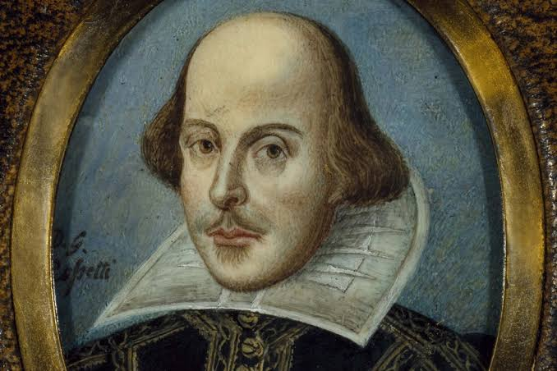
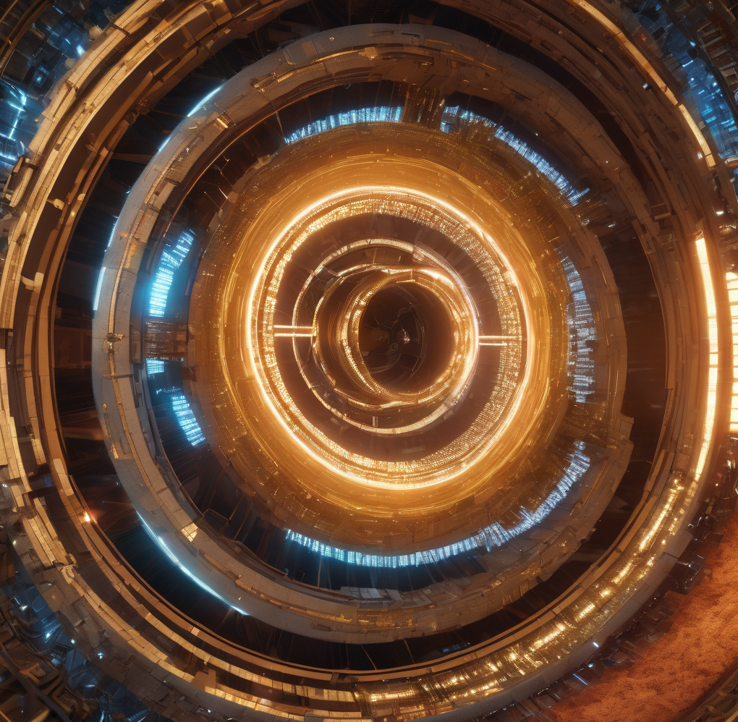
What’s in a name?
Safer starting point?
Next
step
Hopefully
If
only..
Hopefully
Left: AI generated image of “fuzzy circular collider” (from https://gencraft.com/generate )

Slide 37
A possible look to the future- thanks for listening!
Notes:
I’ll now wrap up. I apoloigise that this has really been a whilsestop tour of the FCC project and the status of the feasibility study. there’s been a lot of progress on both the ring placement and adapting the accelerator layout and optics to this choice. There’s also a lot of work ongoing to study detector concepts and their impact on physics sensitivity, and these studies will provide valuable input to the results of the feasibility study. The diagram on the bottom left shows the path towards the first phusics run of FCC-ee in terms of the accelerator and detector technologies, and with key milestones noted, the big upcoming ones of course being the anticipated European strategy update in 2027. For now I’ll just say thank you very much for listening and I am happy to take questions.

Slide 38
Backup

Slide 39
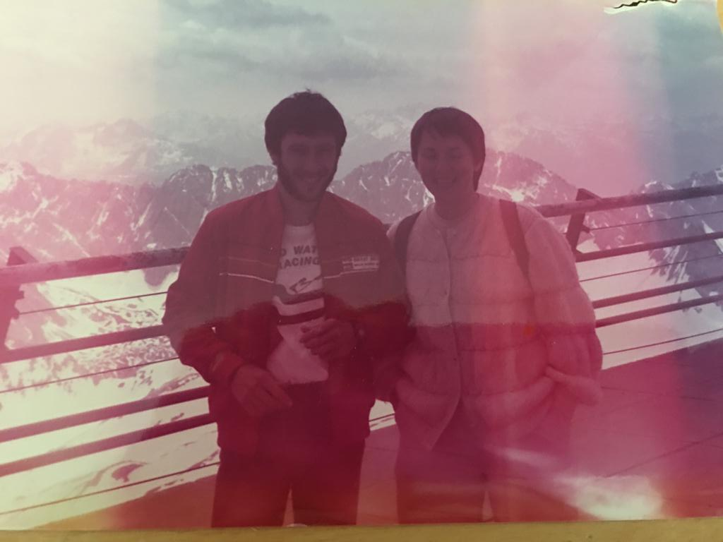
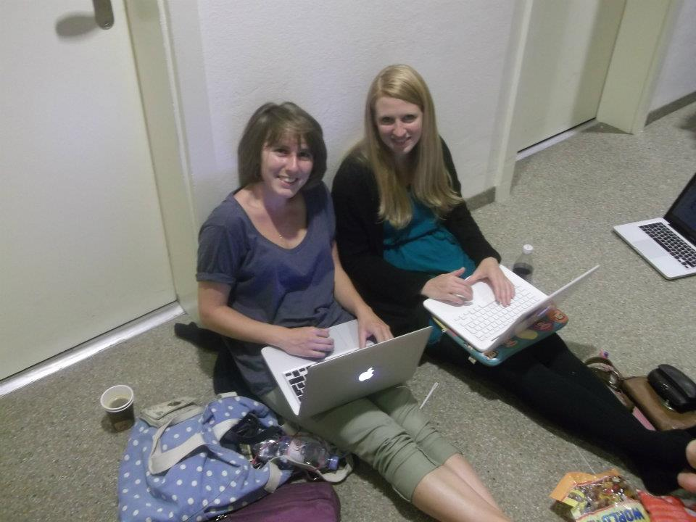

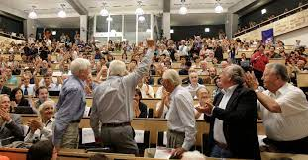
Collider timescale and my life…
1984
1995
2012
SW- aged 7
Queuing for the Higgs seminar
My parents
I have only been involved in a small part of the LHC journey…

Slide 40
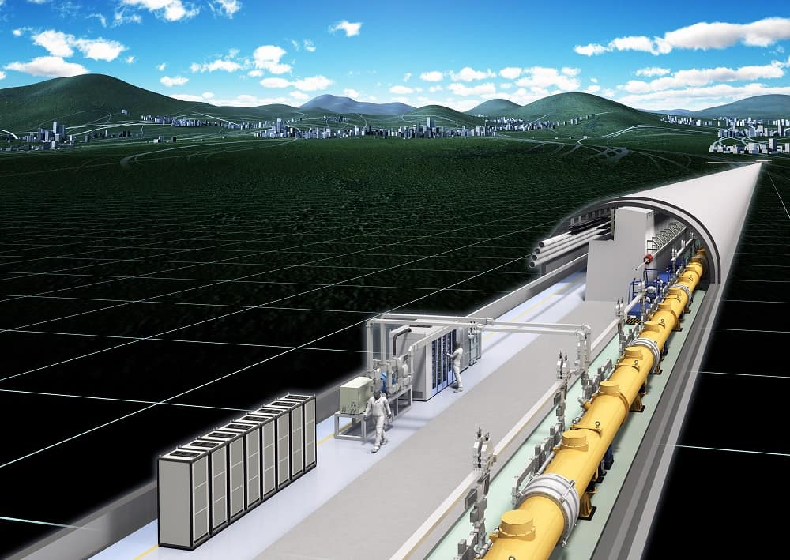
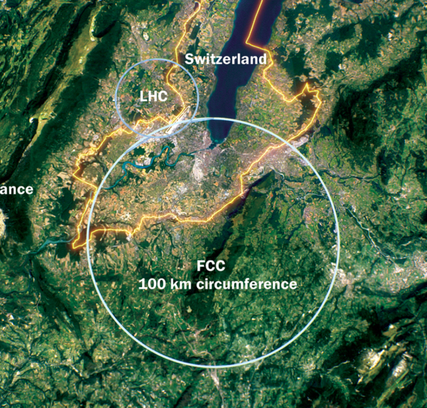
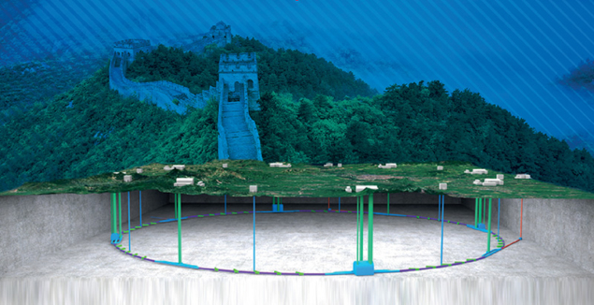
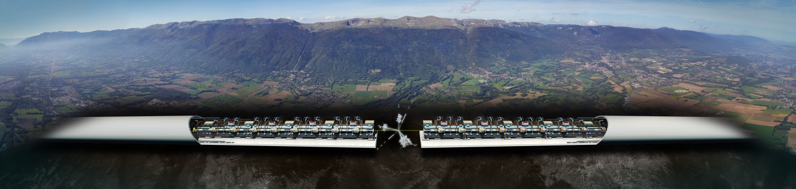
$e^{+}e^{−}$ colliders: circular or linear?
Circular colliders
Multi-pass at IP
Modest accelerating gradients
Limited by synchrotron radiation
No beam polarization
Potential to re-use tunnel for hadron collisions.
Linear colliders
Single pass at IP
Maximum accelerating gradients
No synchrotron radiation
Can exploit (longitudinal) beam polarization
Staged approach to higher energies (energy~length)
Left: FCC-ee (CERN)
Below: CEPC (China)
Right: ILC (Japan)
Below: CLIC (CERN)
Notes:
https://cerncourier.com/a/chinas-bid-for-a-circular-electron-positron-collider/
https://cerncourier.com/a/fcc-ee-beyond-a-higgs-factory/

Slide 41
CEPC vs FCC: similarities
https://home.cern/science/accelerators/future-circular-collider
CEPC: 100km Higgs/EW factory in China
(could be followed by SppC pp collider)
Lots of similarities between CEPC and FCC-ee:
Similar circumference.
Separate beams for e+ and e-
Superconducting RF technology for particle acceleration, with energy booster and top-up injection.
Similar luminosity and energy for Higgs/ Z-pole/ WW and top* threshold runs…
~90 km Higgs/EW factory at CERN
(…to be followed by FCC-hh)
*$t\overline{t}$ run currently optional for CEPC based on TDR.

Slide 42

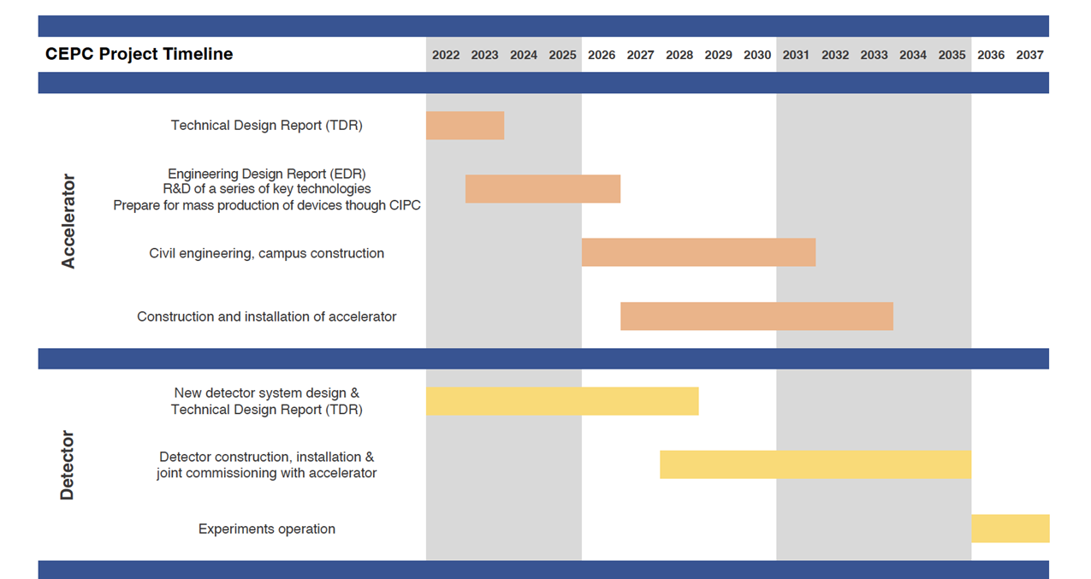
CEPC vs FCC: timelines
Schematics taken from slides from 2023 FCC and CEPC weeks.
Based on current hopes/plans- FCCee would commence operation in mid/late 2040s compared to mid 2030s for CEPC.
This is mainly driven by constraints on FCC from LHC operations => the times from construction to operation are similar.
Notes:
TDR (2023), EDR(2026), start of construction (2027-8)

Slide 43
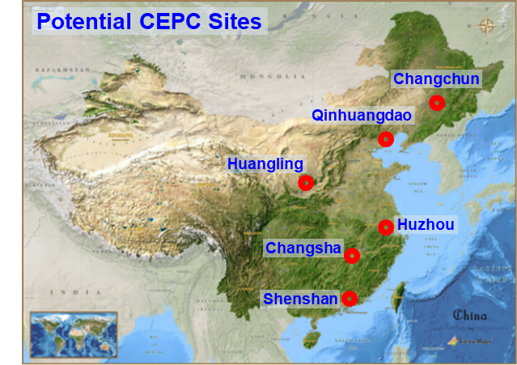
CEPC vs FCC: location and costs
(…which are linked on some level…)
FCC location is (exactly) fixed (one highlight of the feasibility study) whilst of 6 considered sites for CEPC, 3 have been selected for further study.
Quoted expected construction cost of CEPC ~ half that of FCC (variations in purchasing/labour costs)

Slide 44
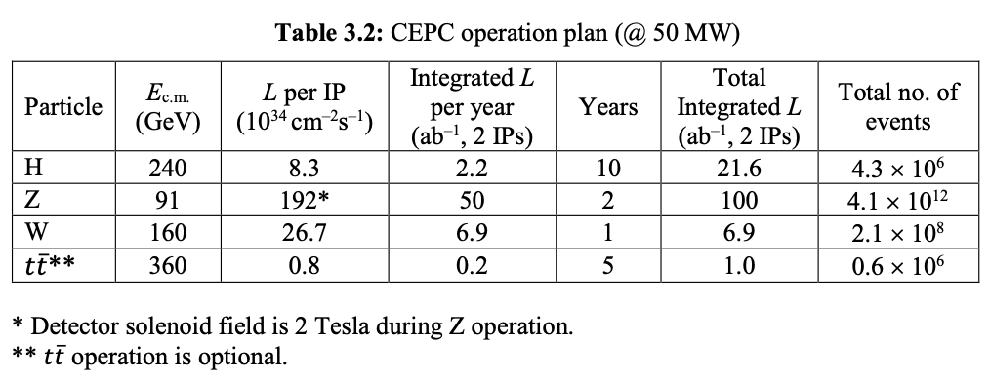
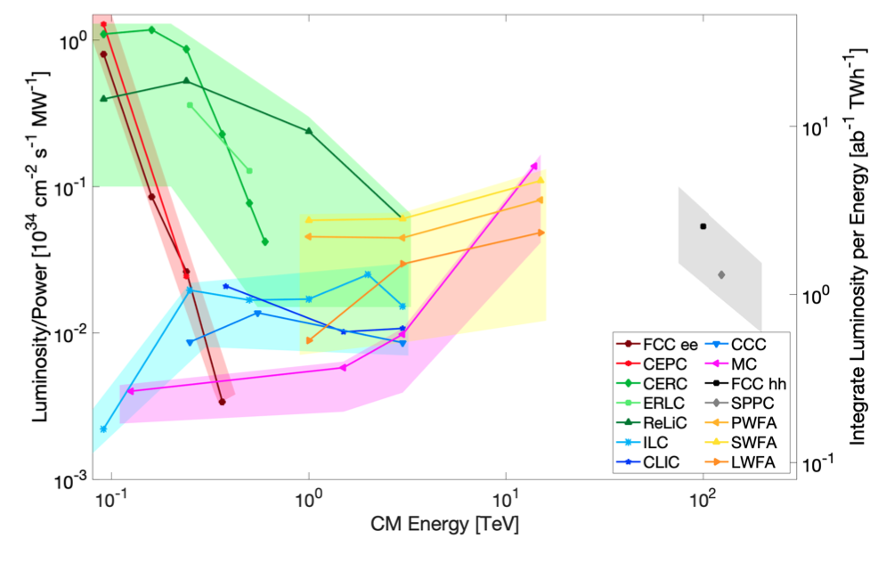
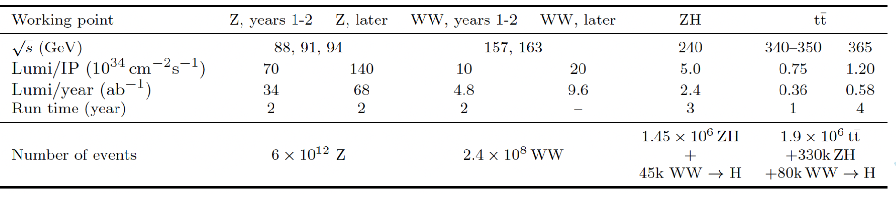
CEPC vs FCC: other differences
#IPs: CEPC has 2, whilst FCC (as of the mid-term review of the feasibility study) has 4.
Different baseline operating plan.
FCC with 4 IPs (not fixed, additional opportunities e.g. 125 GeV)
Power consumption ~ similar but carbon footprint currently higher for CEPC due to China’s (current) prevalent use of coal as an energy source.

Slide 45
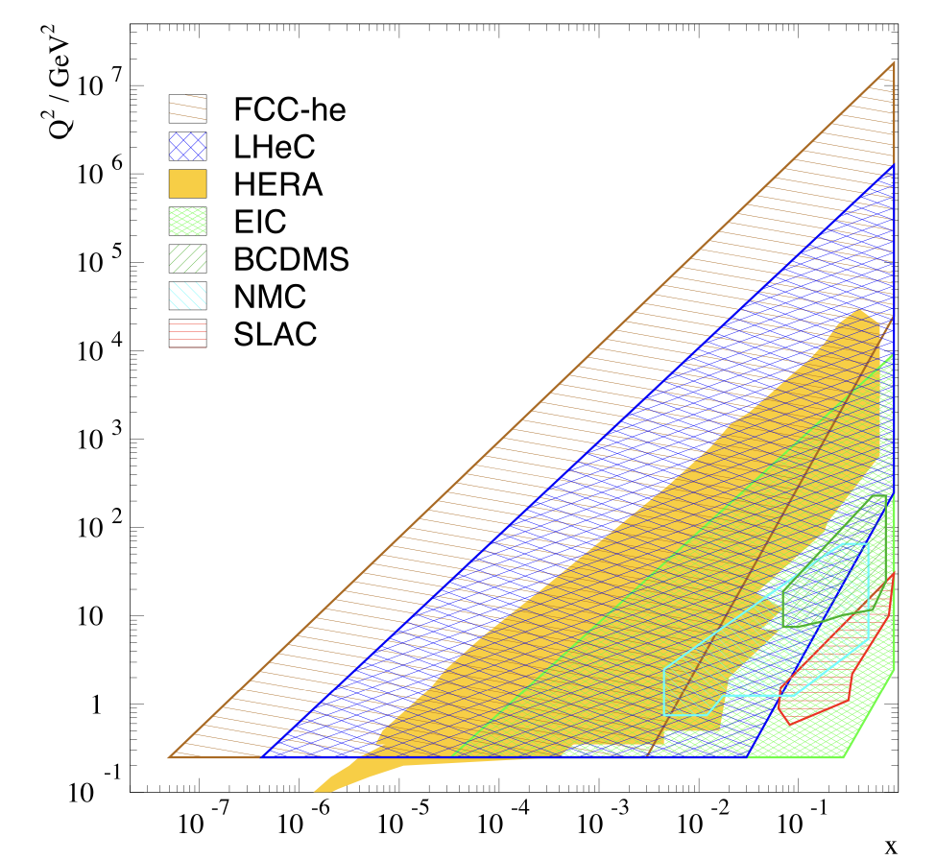
Synergies in FCC programme- FCC-eh
Taken from slides by J. D”Hondt at FCC week
Taken from updated CDR
Higgs
Top
EW
BSM
Precision QCD
Non-linear QCD
Empower FCC-hh with precision input on hadron structure and strong coupling (to permille accuracy) during parallel running.
Complementary measurements of Higgs couplings (CC+NC DIS x-sections, no pile-up, clean)- see slides by U. Klein here
Plus… complementary BSM prospects (LLPs, LFV, not-too-heavy scalars, GeV-scale bosons)
Notes:
- the precision of the dominant Higgs couplings are comparable in eh and ee, where WH is better constraint in eh, and ZH in ee —> thus the full combination disentangles WH and ZH clearly, see also FCC CDR table or my talk.
- If hh at 100 TeV should be a success, it needs precision proton structure knowledge over the same kinematic range as hh (so an EIC cannot solve this, since EIC kinematic coverage is smaller than HERA) and alpha_s, hence the eh option has to be considered from the start to ensure an interaction region. There are ideas of joint eh and AA detectors.

Slide 46
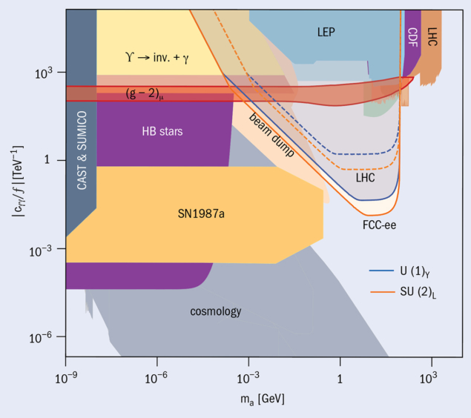

FCC-ee and -hh synergies - BSM
See slides by G. Salam at FCC week
Direct FCC-ee sensitivity
…plus indirect access to a range of BSM phenomena through ultra-precise measurements of SM parameters…
HNLs
Alps
Exotic Higgs decays
$m_{a}:$ ALP mass, $c_{γγ}:$ ALP-photon coupling
Notes:
In terms of BSM, I mentioned earlier that FCC-ee can have unique sensitivity to relatively low mass feebly interacting particles and LLPs, which include Heavy Neutral Leptons, axion-like particles and new exotic particles that couple to the SM through the Higgs. On the bottom left you can see the sensitivity of FCC-ee to ALPs as a function of the pseudoscalar mass a and the axion photon coupling on the y-axis, compared to constraints from astrophysics and cosmology. Heavy neutral leptons refer to sterile RH neutrinos which appear in many BSM models that explain neutrino masses. The high-statistics tera-Z run at FCC-ee would provide an ideal setting to search for HNLs. If the masses and mixing with the LH counterparts are low enough, then the HNL is long-lived and in the middle you can see a schematic showing what a Longlived HNL would look like in an FCC-ee detector, where they could be targeted through searching for displaced vertices. Finally, as I mentioned earlier the significant improvements in precision expected at FCC-ee, where the LEP dataset could be collected in a matter of minutes and we would ultimately improve measurements of EW observables by factors of 10-50, would also translate to huge increases in the sensitivity of indirect searches for BSM, and you can see some of these projected improvement factors on the right.
Heavy Neutral Lepton (HNL)- sterile particles such as those introduced to explain neutrino masses mixing with SM neutrinos would give reactions with EW bosons/charged leptons
"Type 1 seesaw," extends the Standard Model by assuming two or more additional right-handed neutrino fields inert under the electroweak interaction,^{[a]} and the existence of a very large mass scale.
Common solutions to the neutrino mass problem involve hypothetical heavy sterile neutrinos, or Heavy Neutral Leptons (HNLs)

Slide 47
FCC-ee and -hh synergies - BSM searches
More details in FCC TDR and ESU submissions here
FCC-hh sensitivity to direct NP
Cover full mass range for discovery of WIMP dark matter candidates
Substantial discovery reach for heavy resonances
In summary- exciting possibilities to discover/characterize NP that could be indirectly predicted through precision measurements at FCC-ee
Notes:
Provided we could build detectors to operate in the high-pileup conditions of FCC-hh, this would provide unprecedented sensitivity to a wealth of BSM scenarios. Dark matter is one of the biggest outstanding mysteries in our universe, so fully covering the parameter space of possible candidates for weakly interacting massive particles, which are
One of the most popular candidates for dark matter, is a key target. The plots on the left show the projected discovery significance for the chargino, which is the is a charged superpartner of the EW and Higgs particles in supersymmetry, for the scenario that we assume the lighest supersymmetric particle, which is our dark matter candidate, is a wino, which corresponds to the superpartners of the gauge bosons of the unbroken electroweak SU(2) symmetry, or a higgsino, refering to superpartners of the higgs. I don’t have time to discuss these in more detail but the main message is that FCC-hh would be able to reach 5sigma discovery for all of the mass ranges where these models could satisfy constraints from the relic dark matter density in the universe. As you can see on the right, there’s also substantial discovery reach forBSM heavy resonances.
---
gives a model-independent measurement of gHZZ, which is used to normalize the measurements of other Higgs boson couplings, including those at current or future hadron colliders. This is a unique feature of low-energy e+e− colliders.
"Type 1 seesaw," extends the Standard Model by assuming two or more additional right-handed neutrino fields inert under the electroweak interaction,^{[a]} and the existence of a very large mass scale.
Common solutions to the neutrino mass problem involve hypothetical heavy sterile neutrinos, or Heavy Neutral Leptons (HNLs)

Slide 48
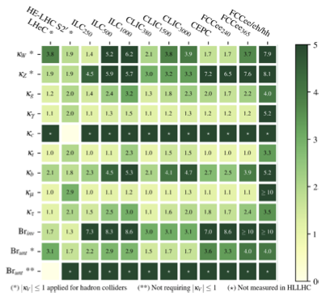
Higgs coupling measurements
Taken from briefing book for 2020 ESU- improvements on Higgs coupling measurements in “kappa” framework:
Red= linear e+e- collider colliders.
Blue= circular e+e- machines.
Orange= integrated FCC programme.

Slide 49
Costs of future projects
Taken from slides by H. Abramowicz at EPS open symposium 2019
Notes:
The estimated cost of this would be around 40 billion CHF, around 7 of which are associated with the tunnel. This is a daunting sum when you realise that some of this would need to be found alongside completing the LHC upgrades.
To compare to other projects, the international space station, including development assembly and running over 10 years, came out at around 100 billion euros. I read an article trying to justify the cost of the European contribution, which came out around 8 billion euros, which is similar to the cost of the tunnel here. It was argued it was around a 1 euro coffee per person every year for 30 years. Now, the cost of coffee has certainly gone up, but this illustrates the benefits of spreading the costs over a large number of collaborating parties. There’s also a risk that if we don’t commit to this programme in the coming years, it will happen elsewhere. China is investigating the feasibility of its own version of this programme- an e+e- circular collider that could later be used to collide protons. There has also been speculation for some time that Japan might commit to building the international linear collider, and were this built the case for building the tunnel for just a 100 TeV hadron collider might become weaker.

Slide 50
FCC costings- planned updates
Taken from slides by M. Benedikt at FCC week

Slide 51
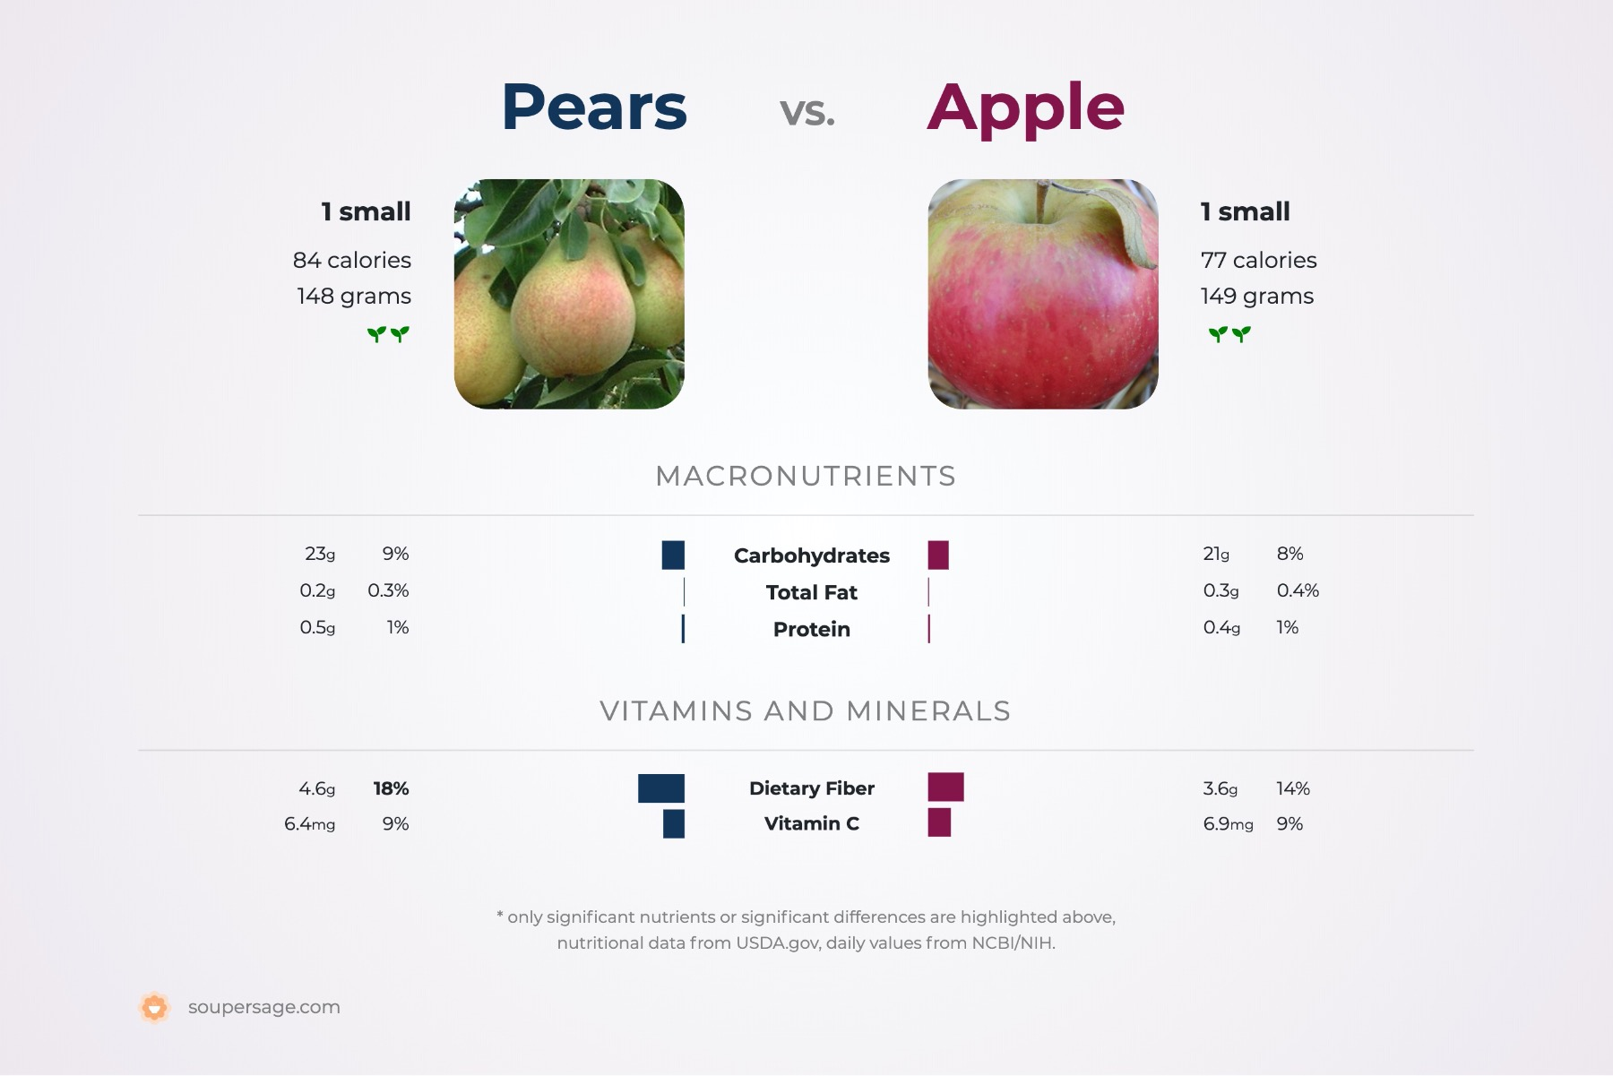
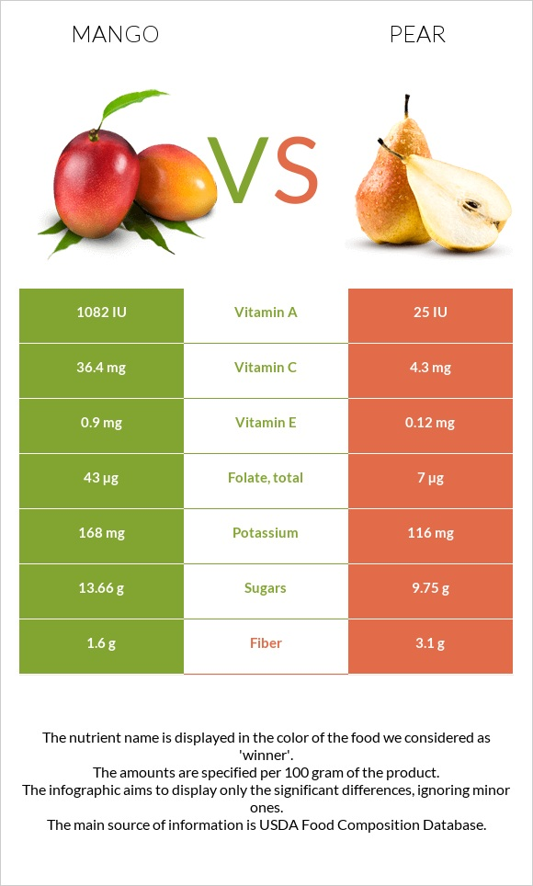

Comparing future colliders
See report from the Snowmass ‘21 Implementation task force
… is hard! Its important to define your comparison metrics carefully and consider the errors involved!
See slides by L. Nevay at IOP-HEPP 2023
Some claim that ”FCC-ee is, by very large factors, the least disruptive in terms of environmental impact” (arXiv:2208.10466).
For discussion of the potential of HTS to make FCC-ee more sustainable see these slides.
(Also consider whether the people making the comparison might prefer apples or pears)
Personal recommendation: go through the numbers, look at the whole picture (physics goals, upgrades, operation time etc) and critique the numbers for yourselves!

Slide 52
FCC-ee accelerators
Separate rings for electrons and positrons and full-energy top-up booster ring in same tunnel.
Max 50MW synchrotron radiation per collider ring across full operating range.
Asymmetric IR layout limits photon synchrotron radiation 500m upstream of IP towards detectors, and generates large 30mrad crossing angle.
Crab waist technique to optimize luminosity.
4 possible experimental sites at PA, PD, PG and PJ with RF stations at PH, PL and injection/extraction and collimation in PB/PF straights.
Notes:
In terms of the accelerators, FCC-ee has separate rings for electrons and positrons as well as an energy booster ring which has lower RF requirements. The machine will operatoe with 50 MW power per beam across the full operating range of COM energies. On the right you can see the updated ring placement, which has experimental sites at the 0, 90, 180 and 270 degree points, and the straight sections that can be used for RF and beam injection/extraction and collimation.

Slide 53



FCC-ee SRF system
Schematic taken from slides by F. Zimmerman at US Snowmass townhall
F. Peauger,
O. Brunner
Z
low R/Q, HOM damping, powered by 1 MW RF coupler and high efficiency klystron
  1-cell
  400 MHz,
  Nb/Cu
W, H
moderate gradient and HOM damping requirements; 500 kW / cavity, allowing reuse of klystrons already installed for Z
  2-cell
  400 MHz,
  Nb/Cu
ttbar,
booster
high RF voltage and limited footprint thanks to multicell cavities and higher RF frequency; 200 kW/ cavity
  5-cell
  800 MHz,
  bulk Nb
RF for collider and booster in separate sections (collider in PH- 400 & 800 MHz, booster in ML- 800 MHz only) with fully separated technical infrastructure (cryogenics)
Notes:
We now have a new RF layput based on the ring placement which is optimized based on the powering options for electricity at the surface sites. Before the RF systems for the collider and booster rings were mixed however based on the updates for the mid-term review all the collider RF is in one place with the booster RF in a different straight section meaning they have fully separated technical infrastructure. On the left you can see RF technologies used for the collider and booster RFs for the different operational runs.

Slide 54




FCC-ee beam optics
Two new projects backed by CHART aim to explore use of HTS to improve energy efficiency. See CERN courier article here
Maximising energy efficiency is a major factor!
Focussing and defocusing by ~3000 quadrupoles and ~ 6000 sextupoles.
Designs being considered to reduce power consumption (single-cells vs super-cells).
arc
interaction region
FODO lattice, many -I sext pairs; periodic unit cell length $\sim$260 m
baseline for 2023 FCC “mid-term” review
Phys. Rev. Accel. Beams 19, 111005
Notes:
The beam optics have also been adapted to the 4-fold symmetry of the new layout, and in terms of ongoing studies maximizing energy efficiency is a key factor. On the bottom of the slide you can see the current optics for the arc sections and interaction region for the current baseline being used for the mid-term review.
Supercells are formed consisting of FODO cells, which are alternating focusing and defocusing quadrupoles, with non interleaved families of sextupole pairs with a –I transformation between sextupoles. The sextupoles correct for off-energy particles.
The y-axis at the top show the square roots of the beta functions in the x- and y- transverse directions which are related to the beam size and the bottom the horizontal and vertical beam dispersions.
At the IR you can see the asymmetric optics which suppress the synchrotron radiation towards the IP.
Alternative solutions are currently being pursued, aiming to maximise the filling factor to reduce power consumption and improve the momentum acceptance, as well as optimizing the dynamic aperture. There’s also additional R+D ongoing to investigate the use of HTS to improve the energy efficiency.
FODO cell = alternative focusing and defocusing magnets.

Slide 55
New FCC-ee injector layout
Taken from slides by M. Benedikt at FCC week
Notes:
There’s also been progress on the injector side to adapt to the new layout, and on this slide you can see the solution for implementing the injector on CERN’s prevessin site. The baseline option uses a 6 GeV linac with the SPS as a pre-booster, however there’s a second option involving a 20 GeV linac overall that goes directly into the booster that is being studied. There are also preparations ongoing for the positron production experiemtn as PSI, which is a demonstrator for a novel positron source for FCC-ee, using high temperature superconductors which can match the high emittance of positron sources, with the beam then contained in large RF cavities surrounded by conventional Superconducting solenoids. Simulations indicate an improvement in the yield of an order of magnitude.

Slide 56

FCC-ee LLP group: past and present
Following a Snowmass LOI, an LLP white paper was recently published in Front. Phys. 10:967881 (2022) which included case studies with the official FCC analysis tools.
These initial studies motivate further optimization of experimental conditions and analysis techniques for LLP signatures.
Currently a very active community, with meetings on Thursdays 13:00 CERN time.
Notes:
Before discussing the latest results I wanted to provide a bit of historical information about the FCCee LLP group. A lot of what I’m presenting today was seeded from an initial study performed for snowmass which looked at three possible LLP scenarios in the official FCC analysis framework. Of the three scenarios considered: heavy neutral leptons, axion-like particles and exotic higgs decays, only HNLs were studied using detector-level reconstructed quantities. For the others the signal samples were validated and the distributions used to motivate further optimisation studies. As you’ll see throughout my talk, since then there’s been a lot of activity in the group extending studies to consider additional decay modes for the HNLs and studying exotics higgs decays using reconstructed quantities.

Slide 57
Ongoing FCC-ee LLP studies
Note: this table will soon be updated following the mid-term review!

Slide 58


FCC-ee LLP studies: recent highlights
Nice overview by Juliette Alimena at EPS 2023
Magdalena Vande Voorde, Giulia Ripellino
First simulation and sensitivity studies for Higgs decays to long-lived scalars
Extend SM with additional scalar.
Probe h→ss→bbbb in events with 2 displaced vertices, tagged by Z
Look at events with at least one scalar within acceptance region 4mm<r<2000mm- all except longest and shortest on RHS.
Aim to develop event selection and perform early sensitivity study.
For further details see presentation by Magda at topical ECFA WG1-SRCH meeting

