Slide 1
The I.FAST Challenge Based Innovation
Presentation to EPS-AG
16th February 2024

Slide 2
Challenge Based Innovation in a few words
A challenge to encourage students to work as a team to propose innovative applications of particle accelerators.
4 teams of 6 students coming from different countries and different academic specialities meet during 10 days at Archamps (near Geneva).
Project presented in from of a Jury.
2 editions fully funded by I. FAST (2022 and 2023). Savings allow a 3rd edition (not initially planned) but need additional sponsors.
Cost of running one challenge: about 65k€ (incl. 25k€ in kind).
Strong positive feedback from the participants and the jury.
Topic 2022 and 2023: “Accelerators for the environment”
Topic 2024: “How can particle accelerators help improving human health?”

Slide 3
The projects after the CBI…
After the CBI we stayed in contact with the teams.
Groups from 3 teams from 2023 decided to continue working on their project.
One group has already conducted beam tests that were positive and decided to create a start-up to market their idea.
Another group has made test experiments and is working on improving their process.
A third group is waiting for plants to grow to test their idea.
Two big players from the clothing industry contacted us to see if they could license one of the idea (but it is too early).

Slide 4
Backup

Slide 5
Choice of topics
Members of the program Committee:
Giovanni Anelli (CERN), Sam Bayat (CHU Grenoble), Christine Darve (ESS), Robert Edgecock (STFC), Angeles Faus-Golfe (CNRS), Markus Nordberg (CERN), Tatiana Pieloni (EPFL), Karolos Potamianos(U. Oxford), Toms Torims (Riga Technical University and CERN) and Carsten P. Welsch (U. Liverpool)
+ the steering committee:
Phil Burrows (Oxford), Bob Holland (ESI), Elias Metral (CERN), Louis Rinolfi (ESI), Valeriia Starovoitova (IAEA), Maurizio Vretenar (CERN) and Nicolas Delerue (CNRS)
We decided to have topics in line with the Horizon Europe missions:
Cancer
Adaptation to climate change including societal transformation
Healthy oceans, seas coastal and inland waters
Climate-neutral and smart cities
Soil health and food
More details on these missions can be found at https://ec.europa.eu/info/horizon-europe/missions-horizon-europe_en
A program committee drawn from experts from I.FAST and beyond was asked to give advice on which topic would be the most suited.

Slide 6
Who/when /where?
The target audience is students sufficiently advanced in their studies but not yet too specialized.
Students in their 2nd cycle of studies (typically 3rd to 5th year of University), before the start of doctoral studies.
Target: 24 students
Multidisciplinarity of the teams is key to have them propose projects that are well suited.
All expenses, including travel (with some limits) are covered by the project.

Slide 7
Applications (2022)
187 applications
85% from I.FAST participant countries
Applications by field of studies:
Engineering 39%
Physics 37%
Environmental science 11%
Other scientific fields: 9 applications
law students: 6 applications
management/business: 5
Humanities: 3
Medicine: 2
Selection rate:
Physics and engineering: 8,5%
Environmental sciences: 20%
Other fields: 20%
Gender: 57% male, 40% female, 6% no answer

Slide 8
Diversity
Diversity is key to foster innovation
The selection panel was careful to ensure diversity:
Diversity of country of study
Diversity of gender (about the same number of male and female).
Diversity of studies (Physics, Engineering, Environmental sciences, law, business, communication)

Slide 9
Selected participants
The 24 selected participants come from institutions in 13 different I.FAST countries, they have 17 different citizenship (some from outside Europe: Colombia, Palestinian Territories,…).
Field of studies (2022):
4 Accelerators scientists
4 Physicists
4 Engineers
4 Environmental scientists
4 Lawyers
4 from other fields
In 2023 we took 2 accelerator specialists per team.

Slide 10
The teams (2024)
In 2024 we aim to have in each team:
One accelerator scientist
One physicist
One engineer
One chemist
One health biologist
One medicine student
This may change depending on the quality of the applications we get in each academic field.

Slide 11
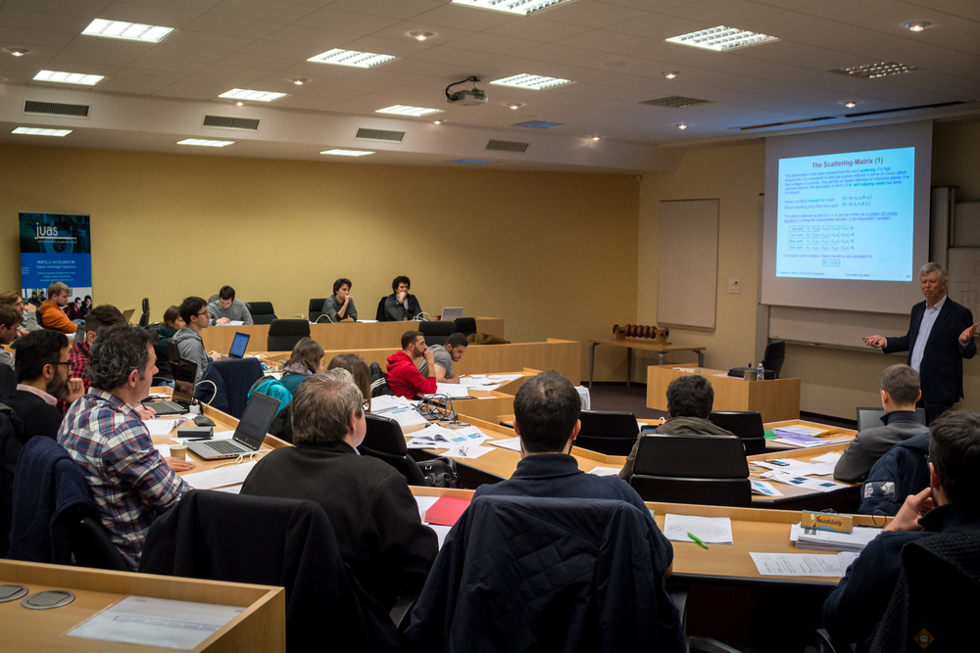
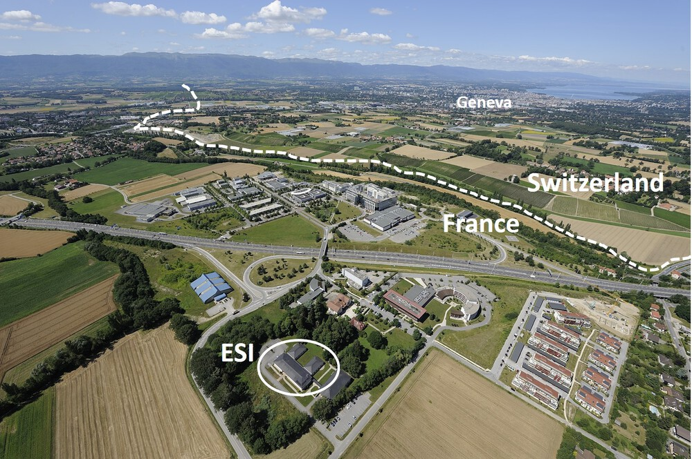
Hosting
The challenge takes place HERE at the European Scientific Institute (ESI) in Archamps near Geneva: https://www.esi-archamps.eu/
ESI has strong experience in hosting scientific schools
The ESI team is taking care of the logistics, full board accommodation and travel arrangements for the participants.

Slide 12
The program
The program is aimed at giving the students the opportunity to learn about accelerators and their applications
4 online seminars before the challenge + video session to get to know each other (all together and by team)
8 in person seminars with experts of accelerators and/or their environmental applications
2 days at CERN
2 “conferences”

Slide 13
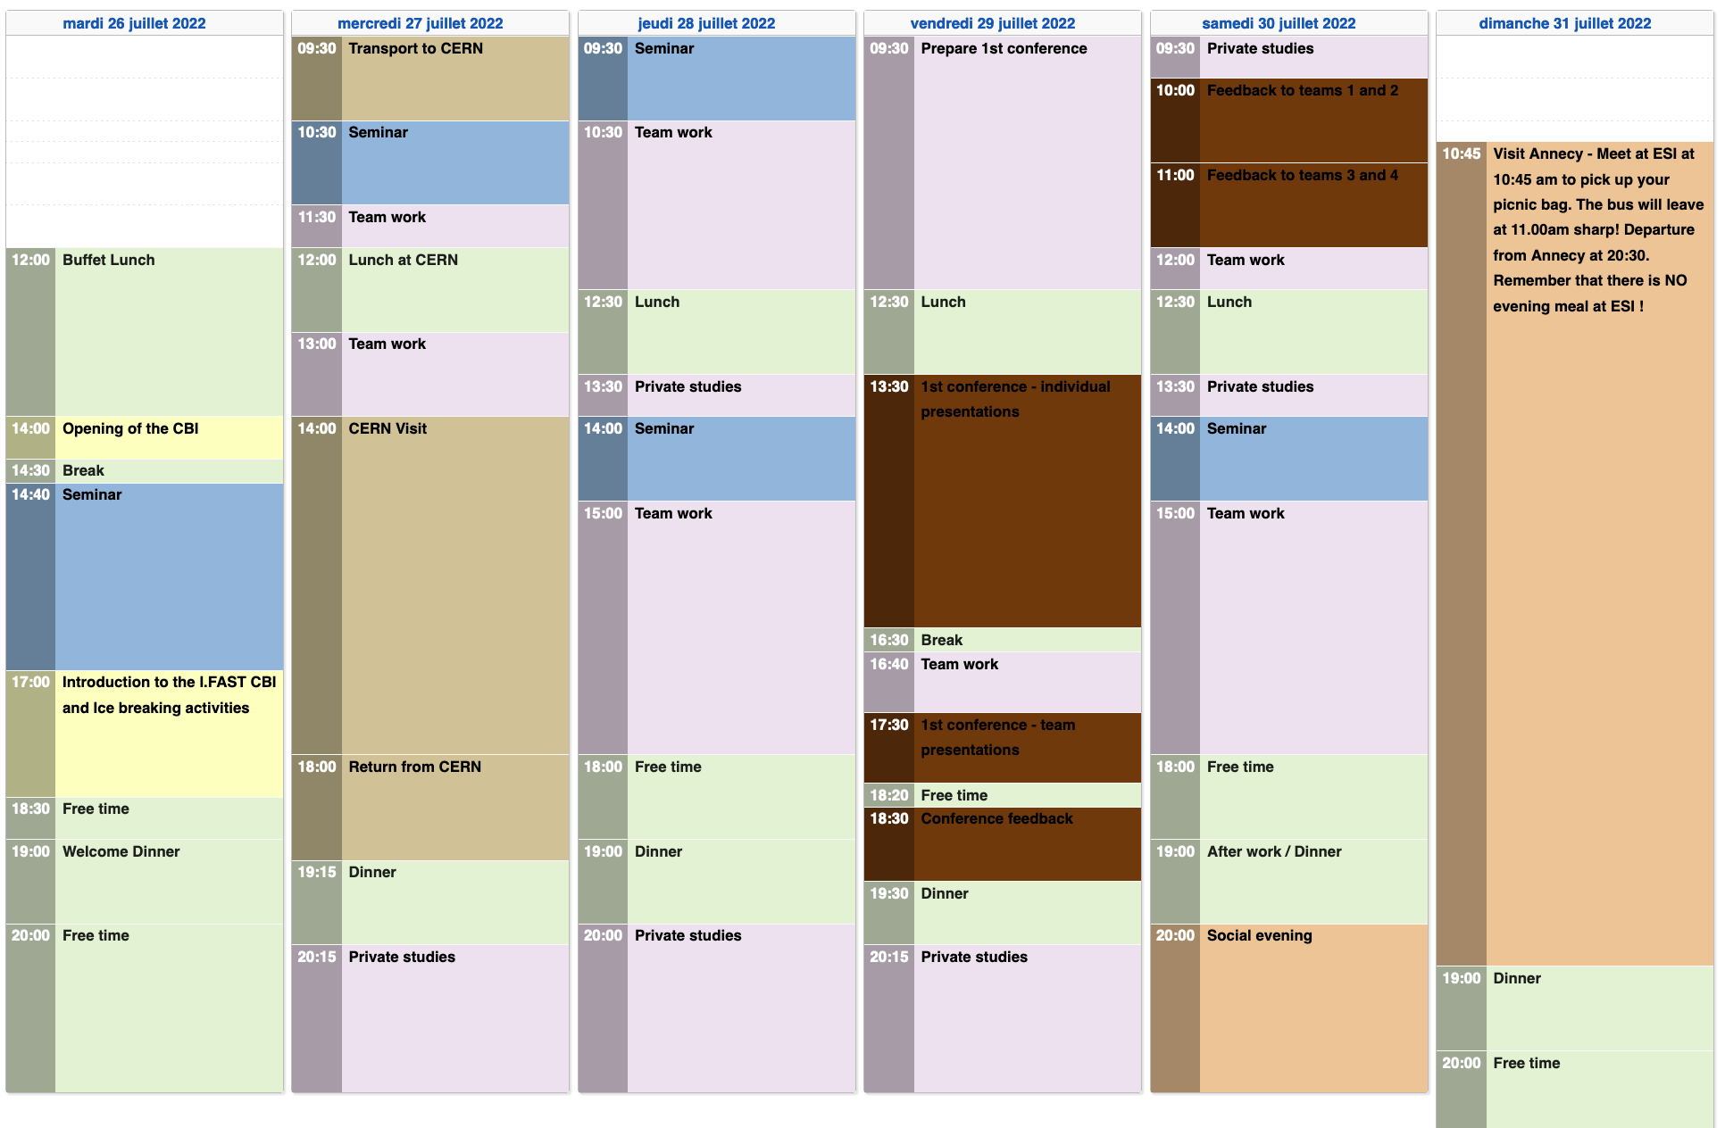

Slide 14
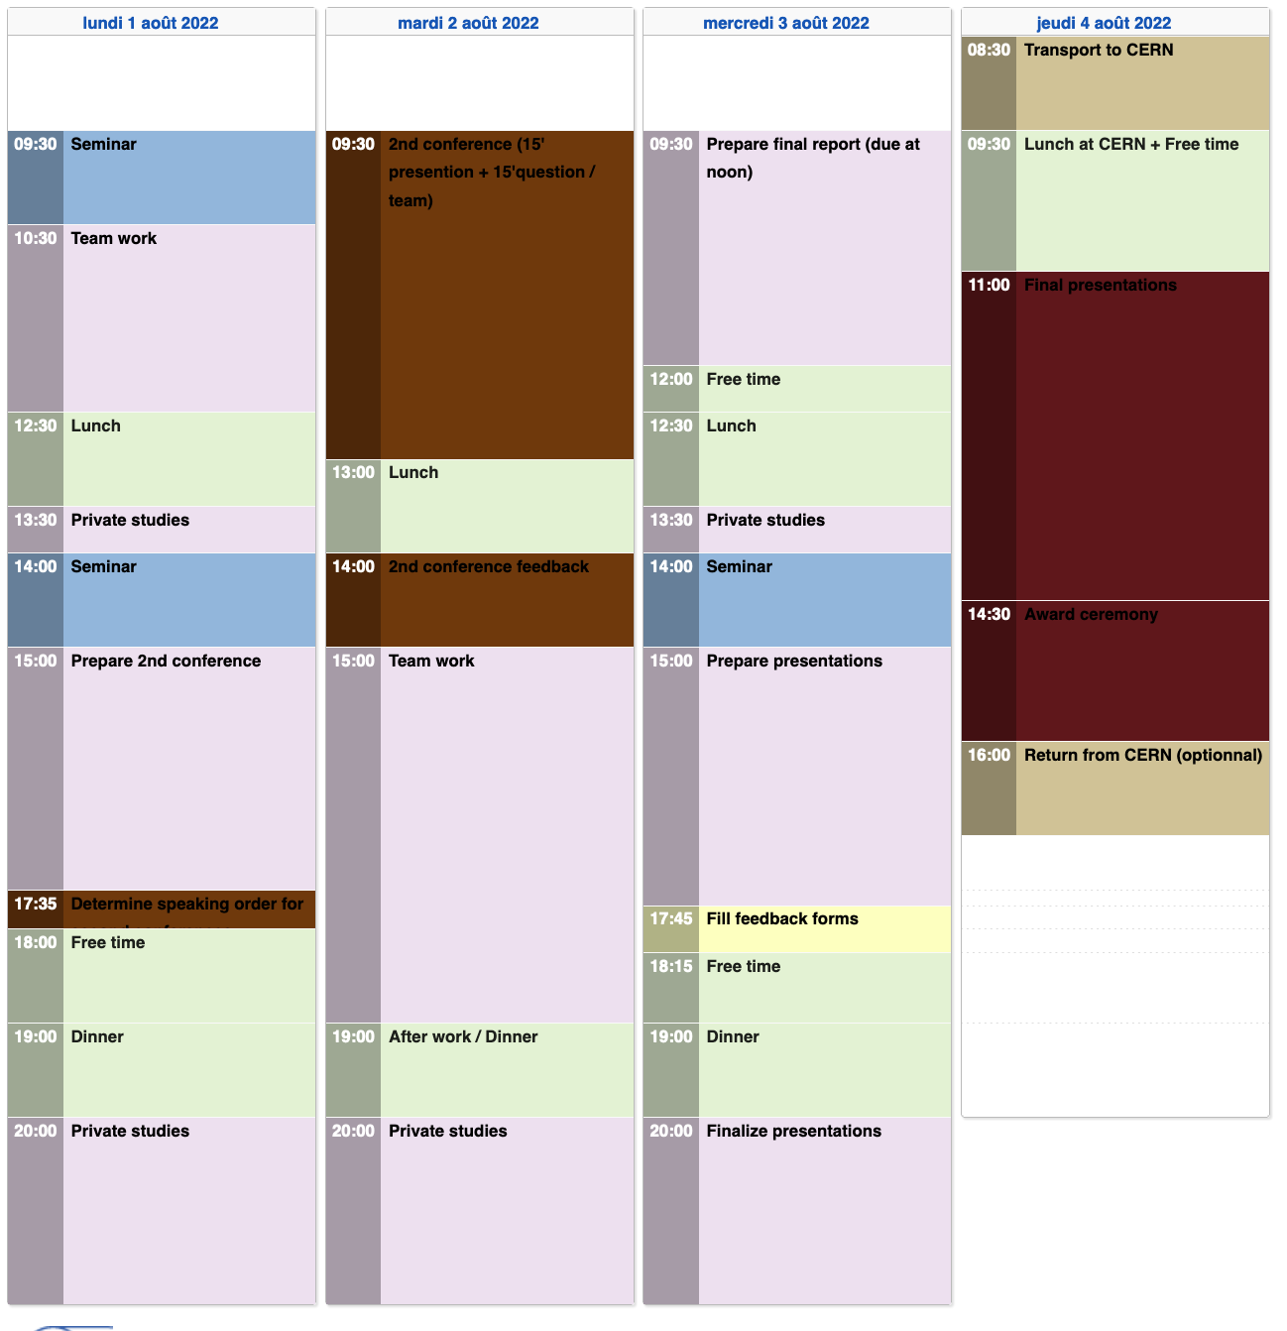

Slide 15
Online seminars 2022
Willy Mondelaers, "Small particle accelerators and their applications in medicine and industry"
Andrzej G Chmielewski, "Accelerators for the environment”
Lenny Rivkin, "Particle accelerators (general view)”
Christophe Goupil, "A physicist's journey through the ecological transition"

Slide 16
Seminar topics and speakers
Accelerators for environment: the IAEA perspective by Valeriia STAROVOITOVA (IAEA)
Overview of accelerators by Maurizio Vretenar (CERN)
Planning around scientific experiment by Estrella Vergara Fernandez (CERN)
Example of applications of accelerators for the environment (Water) by Rob Edgecock
LHC for non-specialists by Xavier Buffat (CERN)
How the synchrotron light could be used for environmental issues by Elena Longo (Elettra)
Enabling Science using Neutrons at the European Spallation Source by Arno Hiess (ESS)
Accelerating your Innovative Ecosystem by Christine Darve (ESS)

Slide 17
CERN visit
Visit of 4 accelerators at CERN:
ELENA/AD
LINAC4
CLOUD
CLEAR or Synchrocyclotron

Slide 18
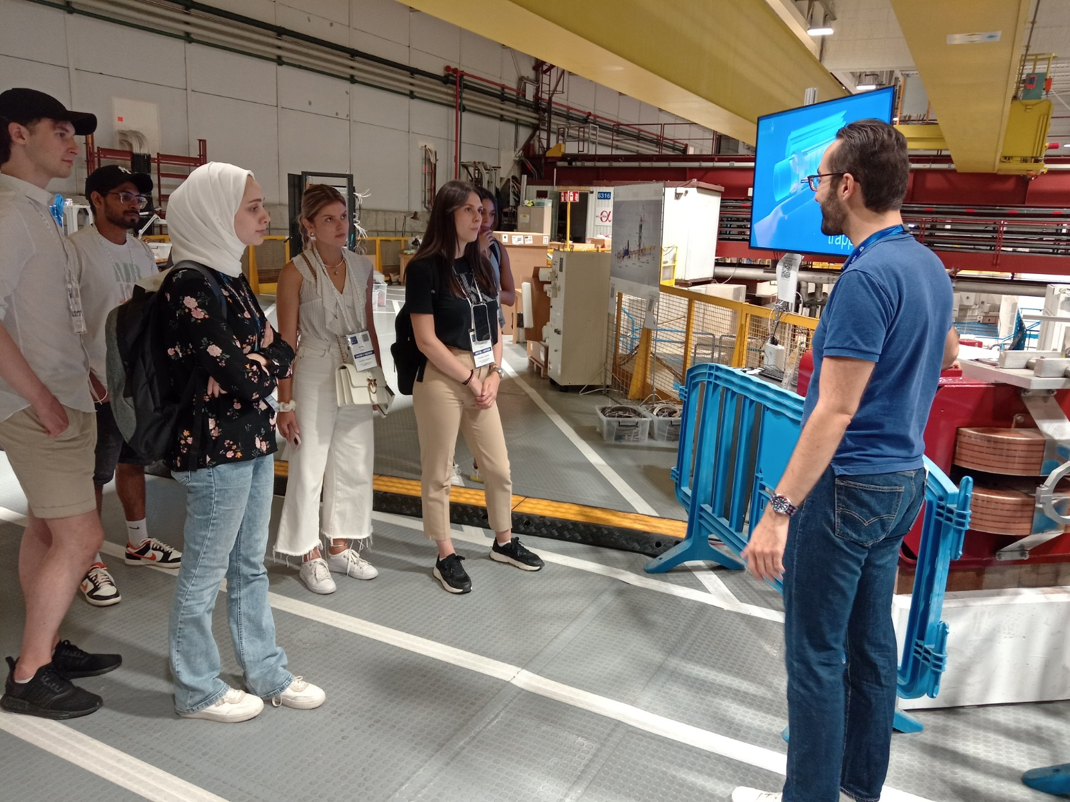
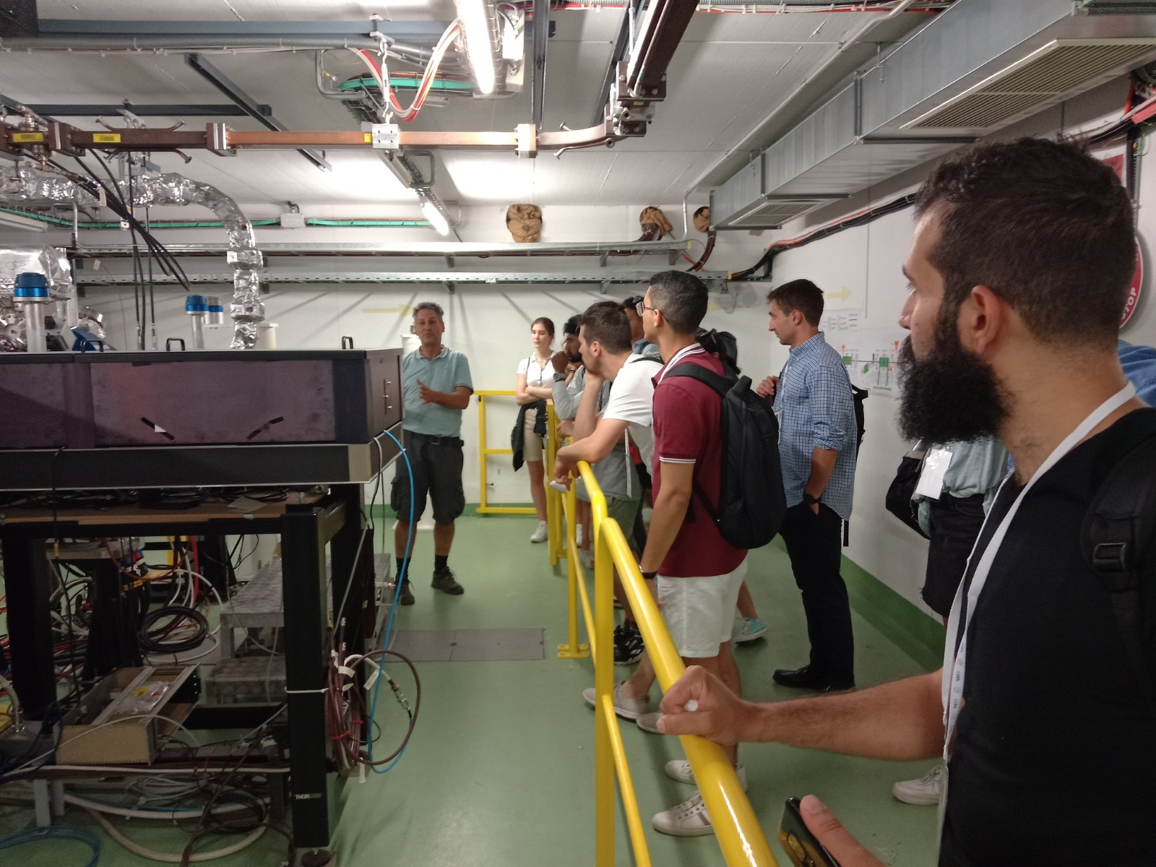
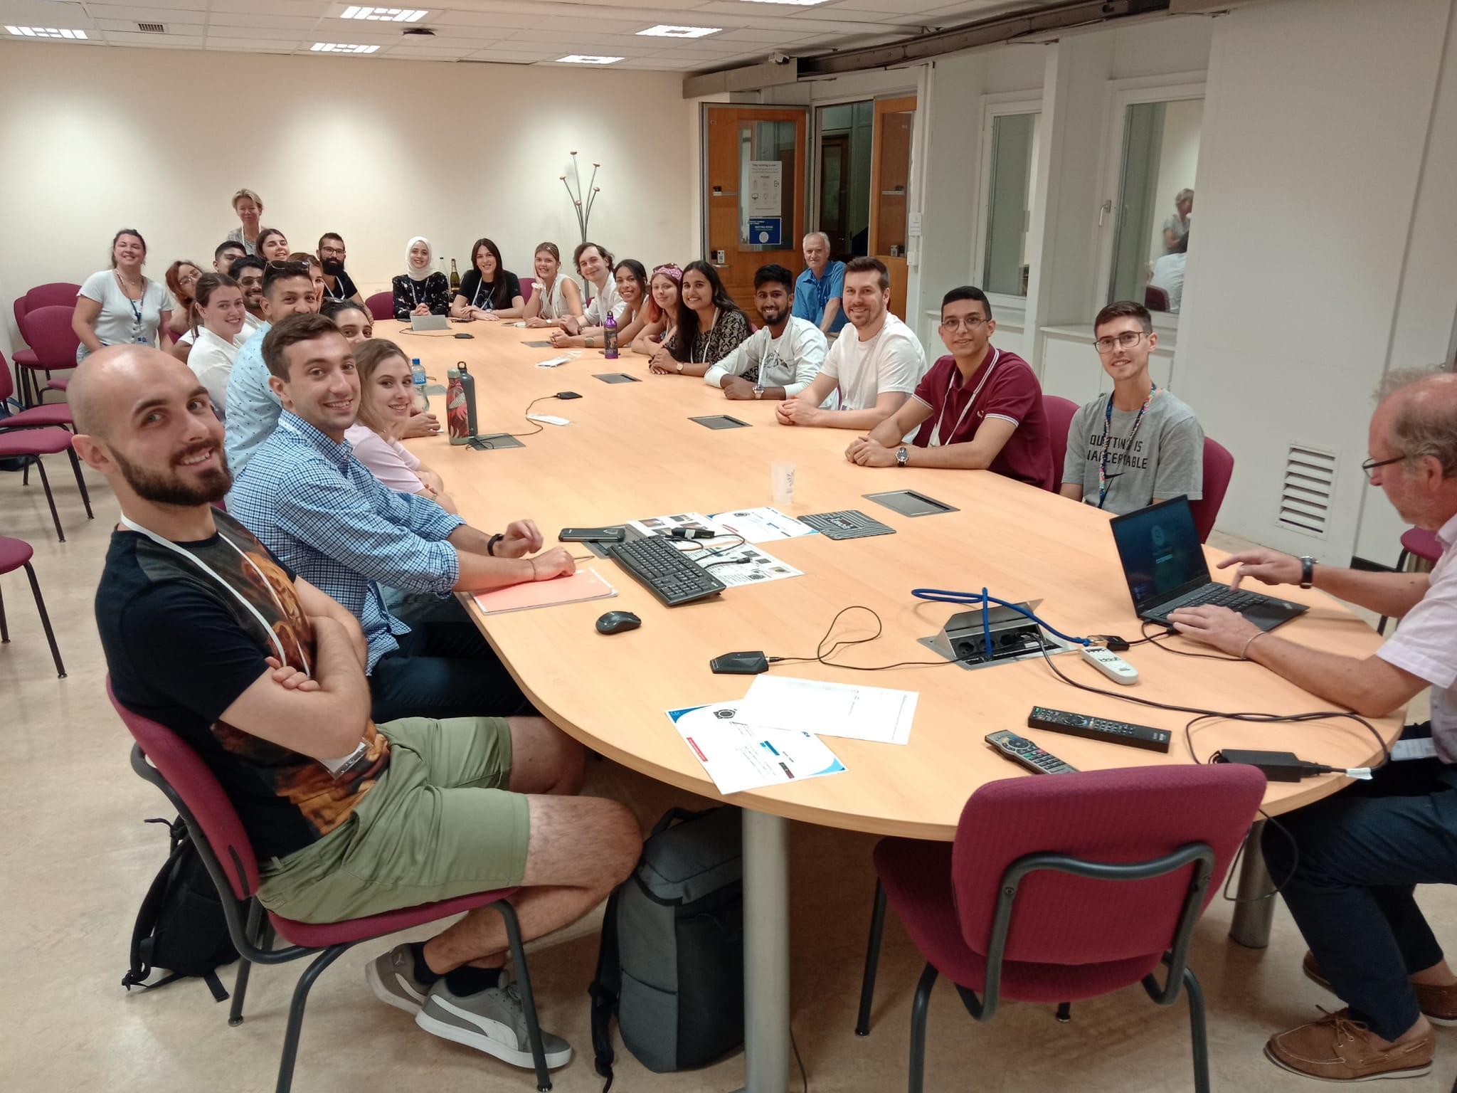
CERN visit

Slide 19
Conferences / Pitching events
Twice during the challenge there is a “conference” or “pitching event” gathering all participants.
The first one is an opportunity for each participants to present the problem from the perspective of her/his field of studies.
The second one is focussed on the solutions proposed by each team with constructive comments from the other teams
We want constructive collaboration rather than competition between the teams.

Slide 20
Competition / collaboration
We want constructive collaboration rather than competition between the teams.
In the accelerator community each institute has its own facilities and tries to do the best with it but we all collaborate and help each other.
This is what we try to emulate during the Challenge.

Slide 21
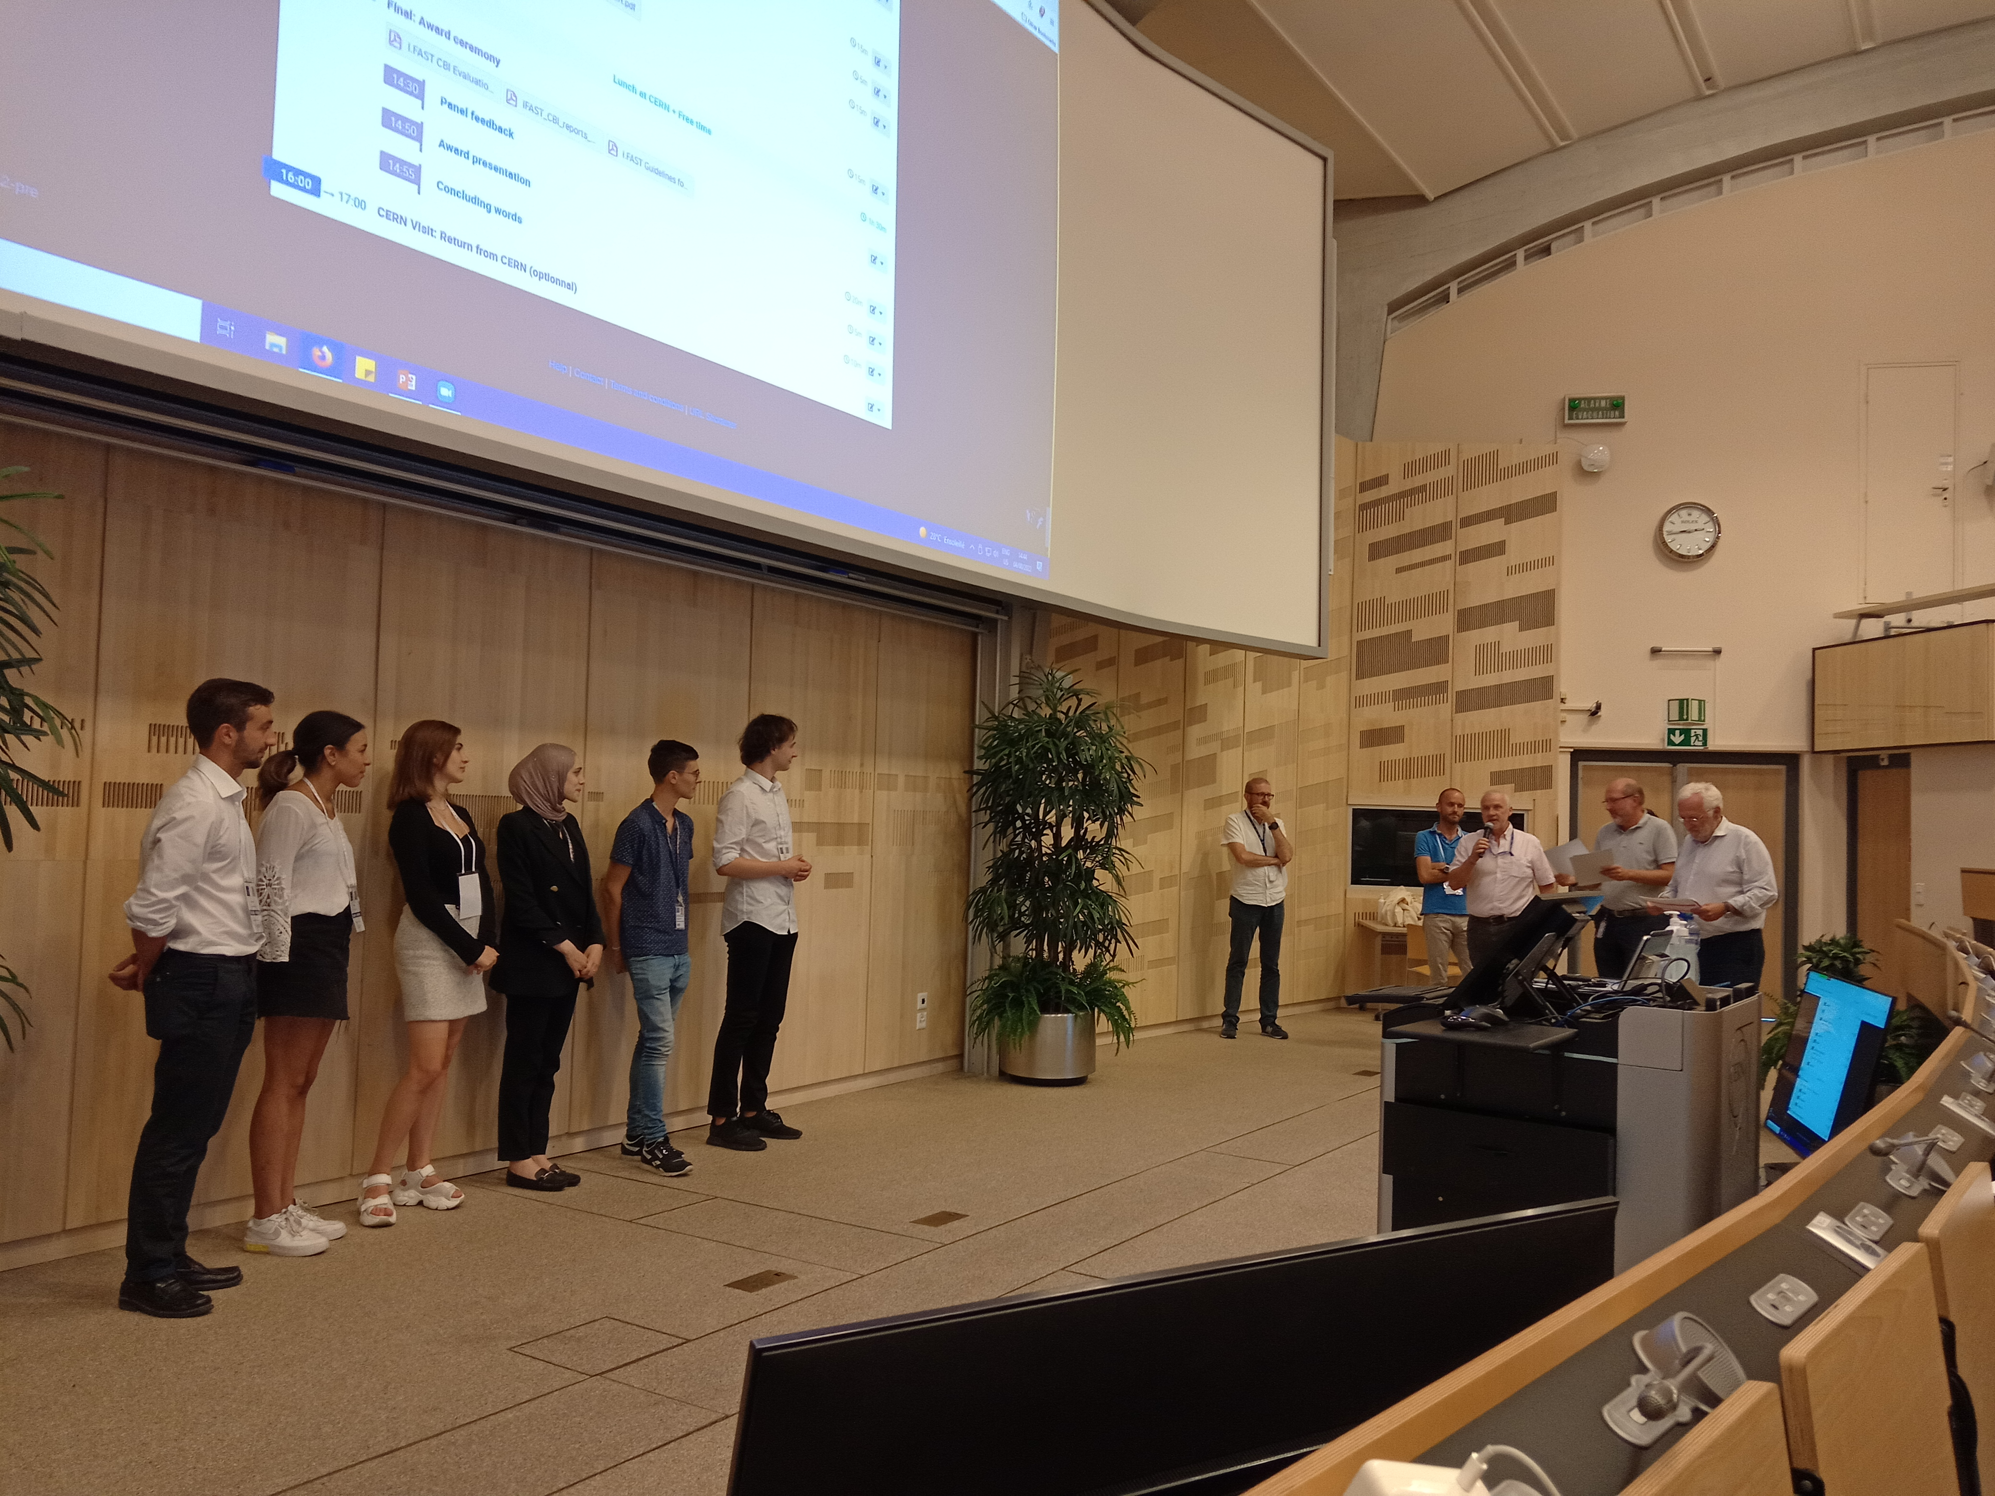
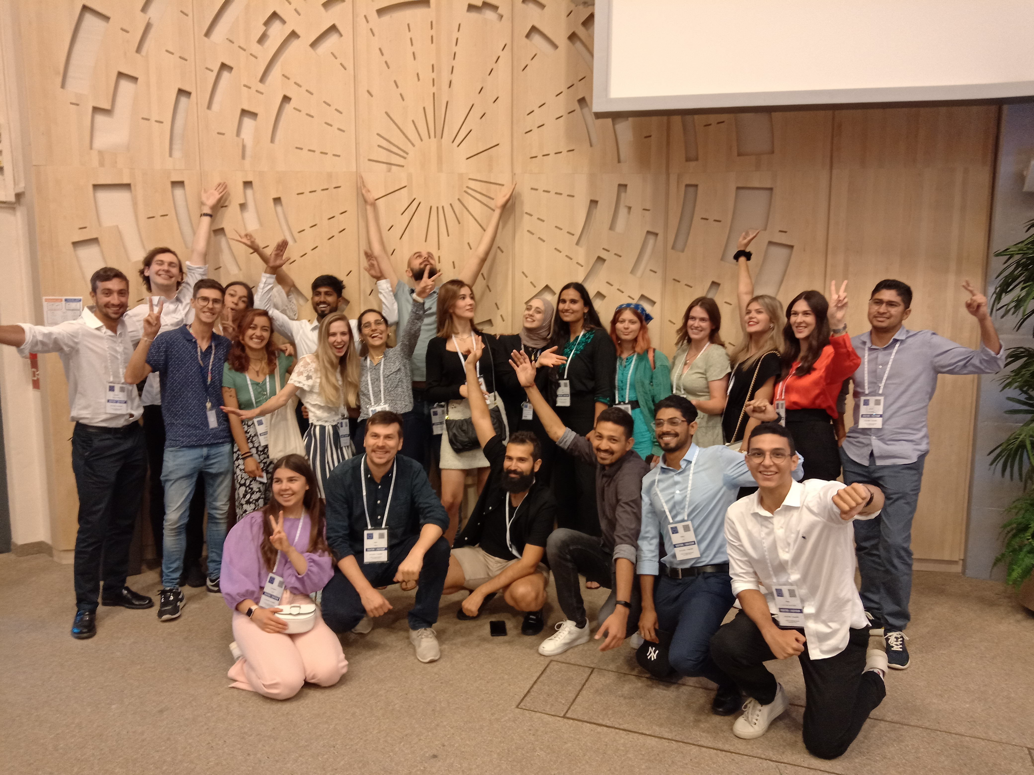
The final presentations
On the last day there were presentations in front of a jury made of senior scientist and knowledge transfer experts.
The order in which the teams present is decided by a quiz on previous seminars.
Each team presented its project and answered questions form the jury.
In the afternoon there was an award ceremony with feedback from the Jury for each team.

Slide 22
The final presentations
Each team presented its project from different point of view:
Environmental science: what is the problem to be addressed? The solution?
Accelerator: how to deliver the required beam?
Physics: how to deliver the expected result?
Engineering: how to make it fit?
Legal: safety or IP
Business: is it economically feasible?
Communication: Would such project be accepted by local communities?

Slide 23
Past projects 2022

Slide 24
Courtesy Team Fellowship of the accelerator ring - Durablade - Accelerating the Green Transition

Slide 25
Courtesy Teams White Light - A.M.M.I.R.A : Accelerators for Marine Microplastics Investigation and Research Agency.

Slide 26
Courtesy Team Wave turners - SOIL SAVIOUR 2.0

Slide 27
Past projects 2023

Slide 28
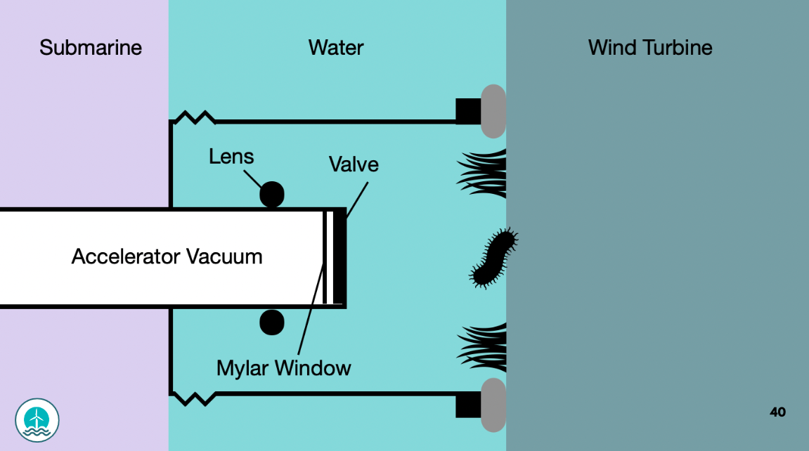

Slide 31
Winning projects

Slide 32
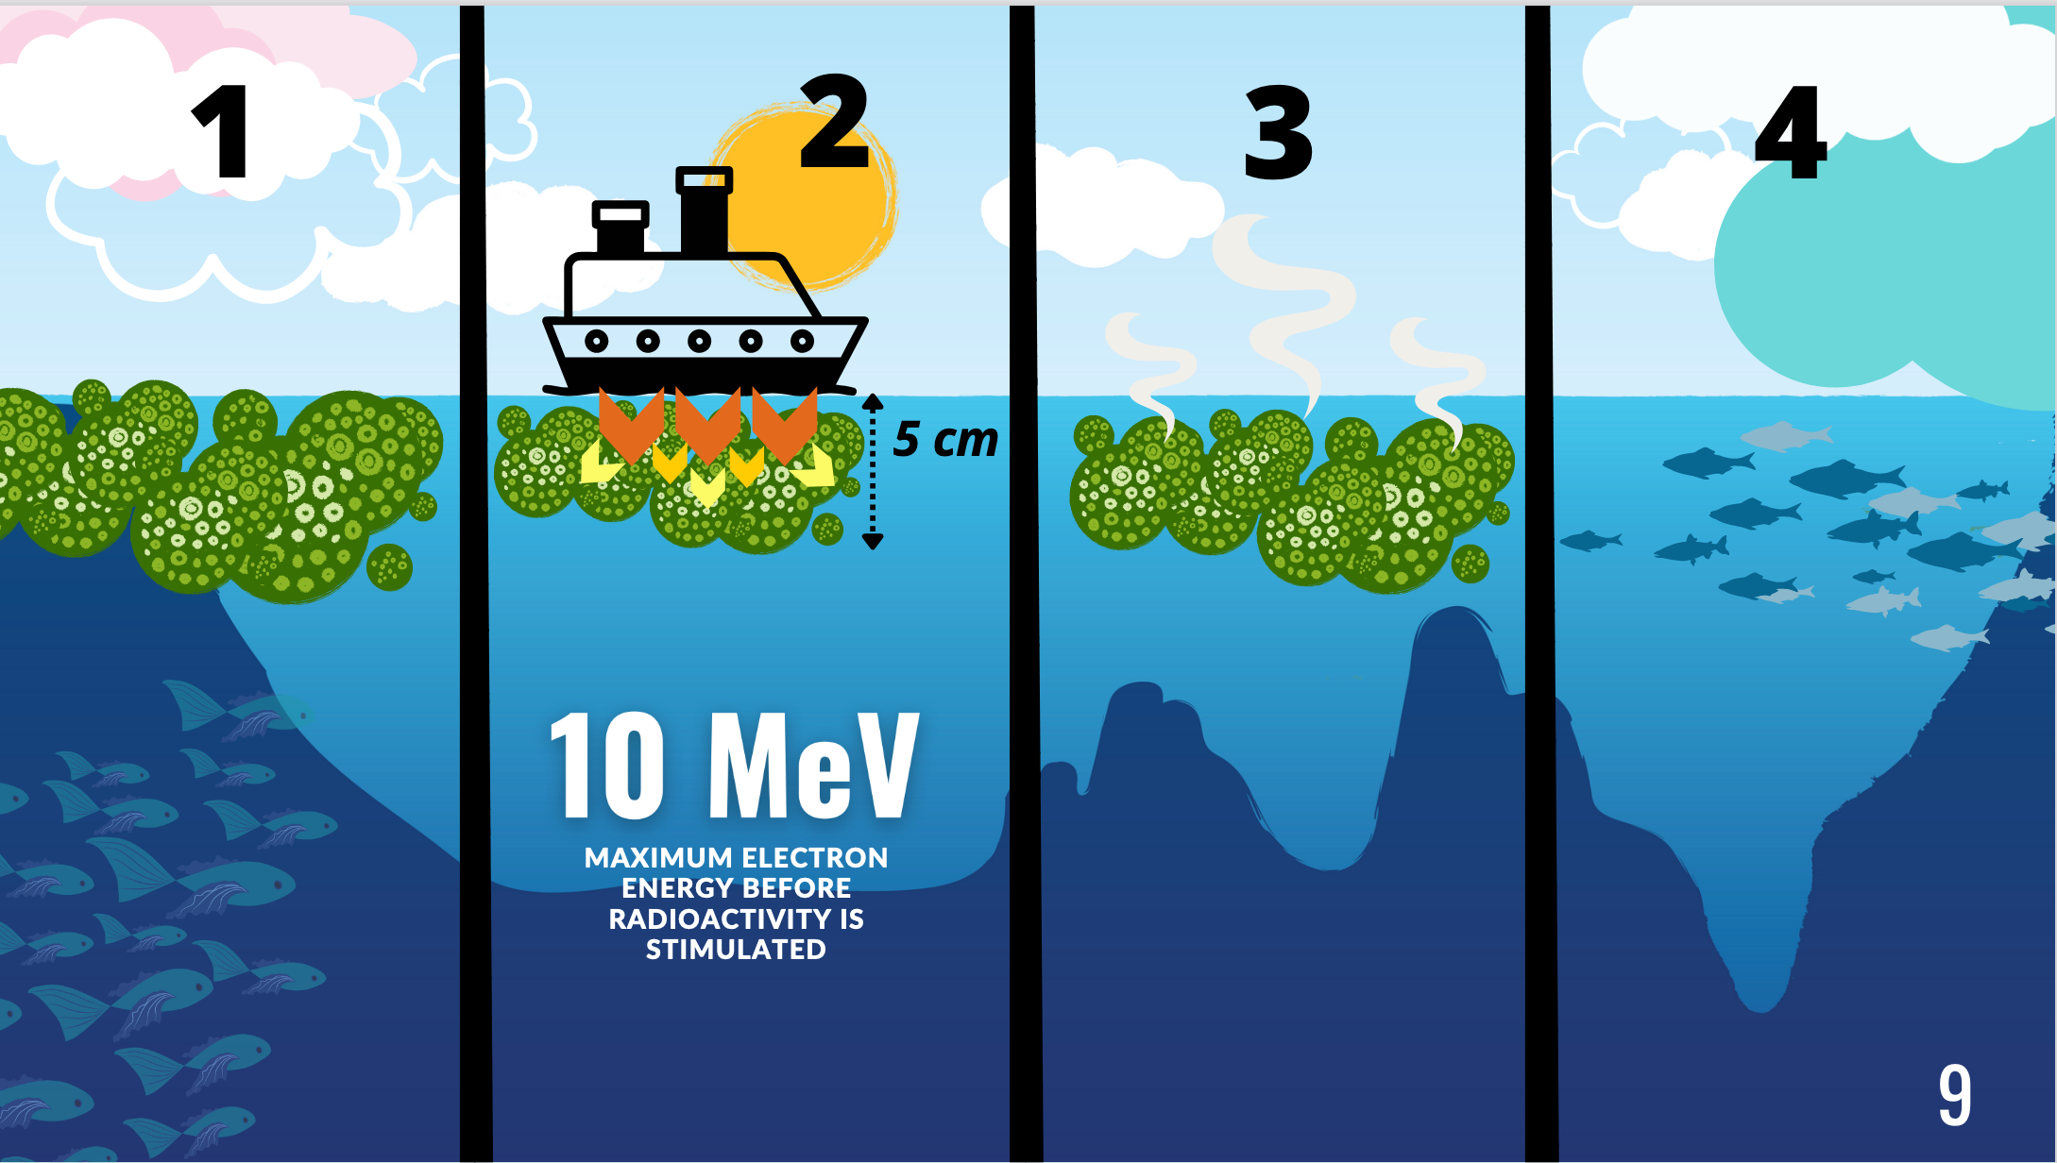
Courtesy team Human beams, project CYAN

Slide 33
Courtesy team Human beams, project CYAN

Slide 34
The CBI 2024
Under preparation.
Already about 60 applications received
Almost same structure than in previous years:
Virtual get together on July 1st
3 Online seminars + 1 online industry event
8-9 in-persons seminars
23rd July – 1st August: in person in Archamps

Slide 35
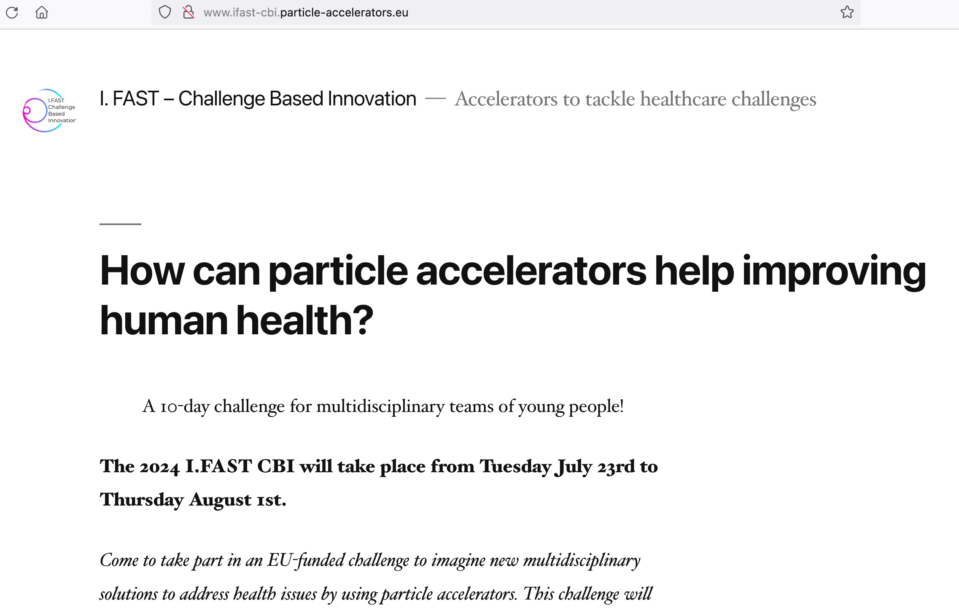
More details and applications
http://www.ifast-cbi.particle-accelerators.eu/

