Slide 1
CROSSJACK
Job Level Metric Accounting/Visualisation for SCARF

Slide 2
Requirements
Main goal for new platform is to help users optimise their jobs
Job feedback must be simple and consolidated
Platform must be maintainable and easy to implement new features
Currently no ‘easy’ way to get metrics specific to your job ...

Slide 3
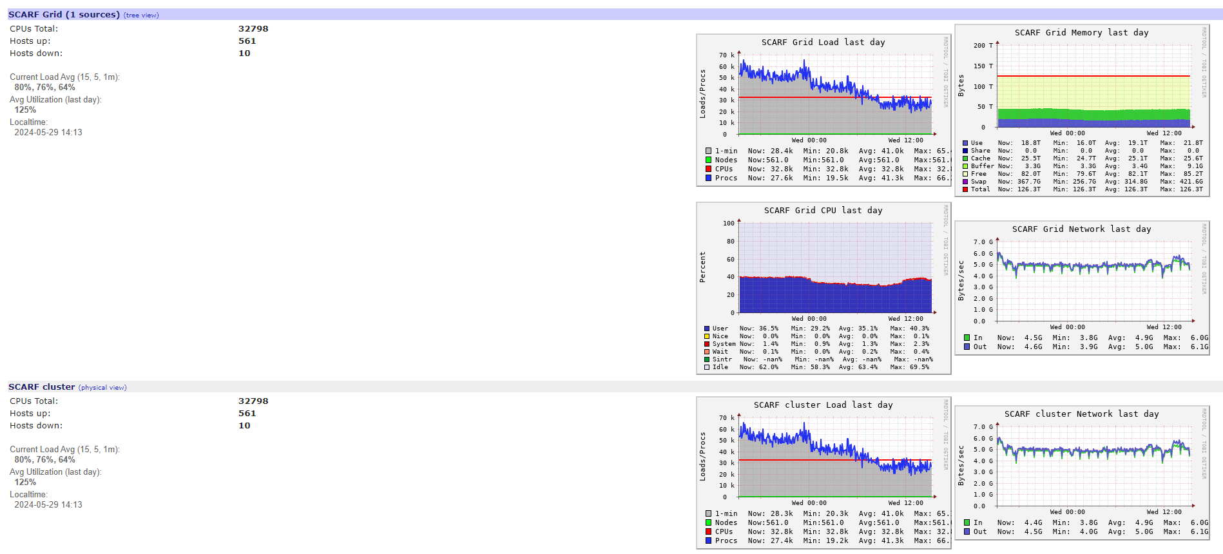
Ganglia – overall visualisations

Slide 4
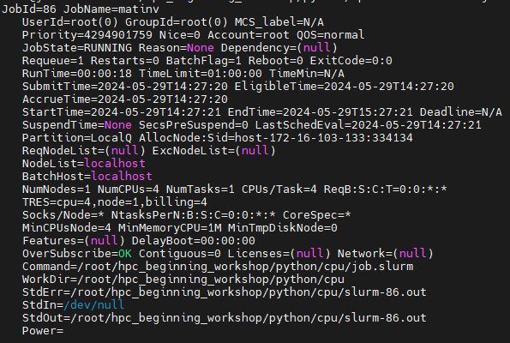
SLURM commands
sacct
seff scontrol

Slide 5
Chosen Technologies
Grafana for visualisation
Prometheus with cgroups/node exporters for data collection/accounting
Jobstats for job feedback
Demo…

Slide 6
What’s next?
Multi node setup
GPU metrics and more
‘Productionise’

Slide 7
Links:
Jobstats - https://github.com/PrincetonUniversity/jobstats
Node Exporter - https://github.com/prometheus/node_exporter
Cgroups Exporter - https://github.com/treydock/cgroup_exporter
Documentation – confluence

