Slide 1


SCD Apprentices
Matthew Richards, February 2024

Slide 2

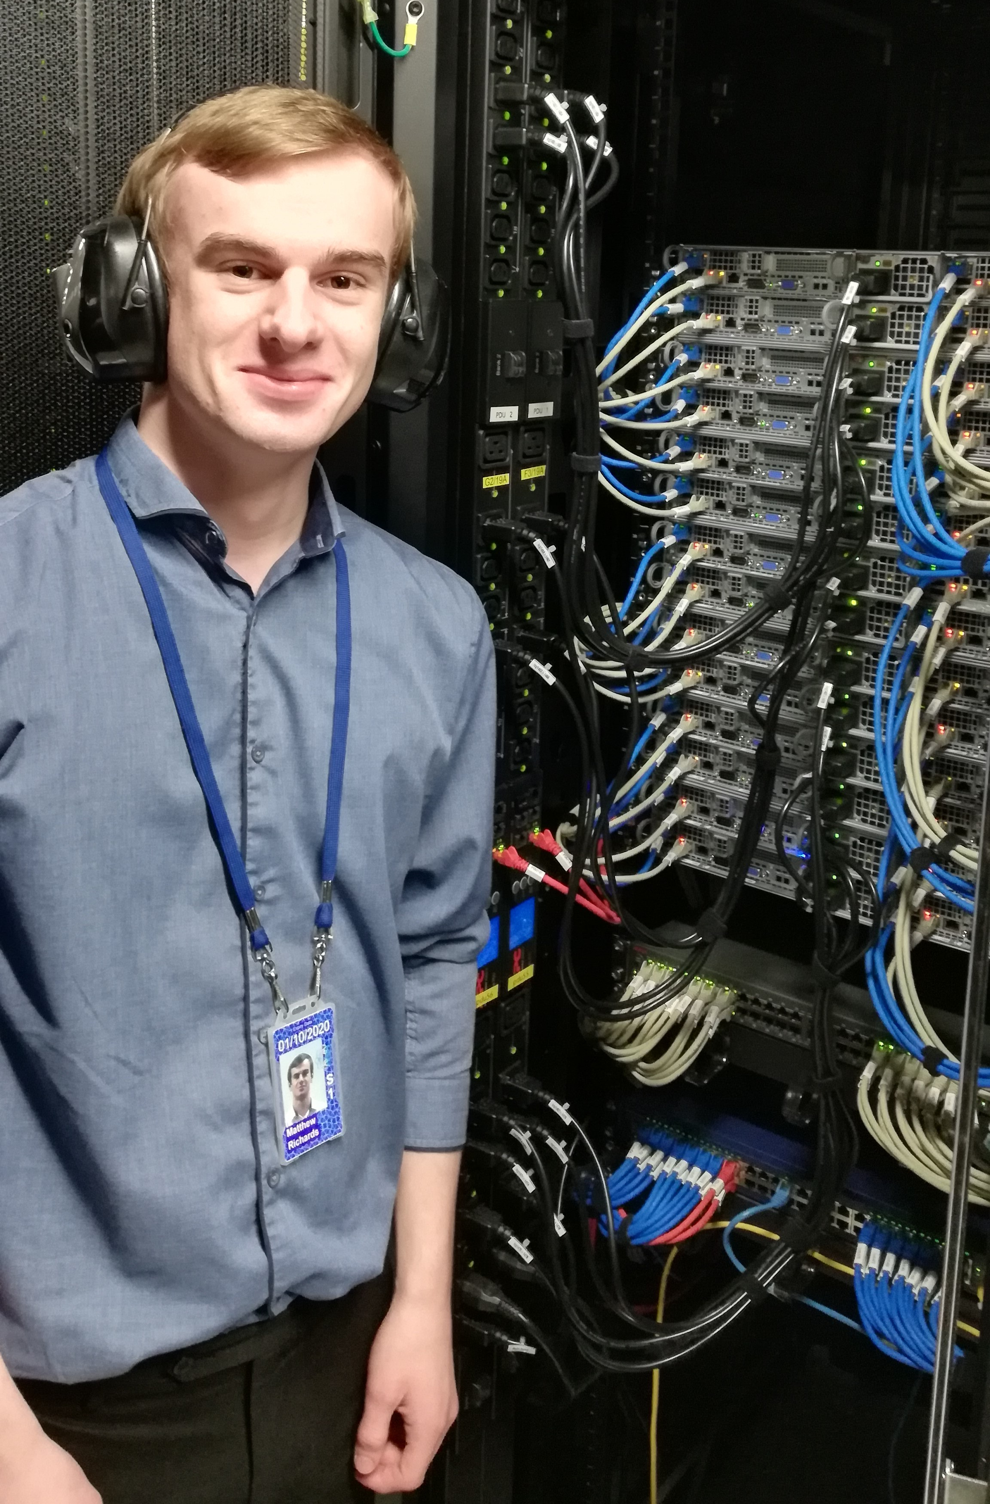
Presenter introduction
Ex-Computing Apprentice (Software Engineer)
Started October 2017, finished January 2022
Rotated around various teams in SCD as well as ISIS, Technology, RAL Space
Full-time Software Engineer as of February 2022
Working in DSEG, primarily on backend development
Currently working on OperationsGateway, system for EPAC’s diagnostic data
SCD’s apprentice coordinator (previously Tom Gowland/Dawn Geatches)

Slide 3
Types of Apprentices
Focus on apprentices that target post A-Level students
  More mature candidates
  Over 18 so less concerns with data centre work
Mixture of static and rotational apprentices in SCD:
  Static – apprentice works in one team for duration of their apprenticeship
  Rotational – apprentice works in different teams throughout their time
Software development and system administration are the primary roles that apprentices do
No matter the type of apprenticeship, apprentices get 1 day per week to focus on their apprentice training

Slide 4
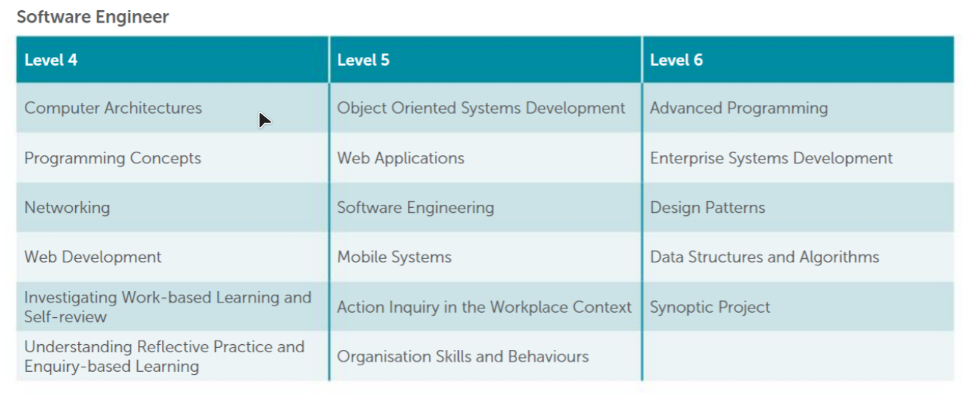
Software Engineer
4-year apprenticeship, rotational (mixture of 6 and 12-month rotations)
L6 Digital & Technology Solutions (Software Engineer)
  Qualification for IT professionals, with a software engineer specialism
  Full BSc degree
Delivered by Buckinghamshire New University as a hybrid offering
  Previously QA Apprenticeships

Slide 5
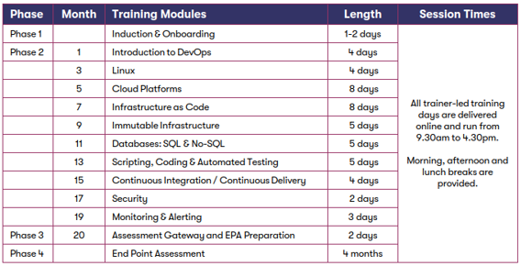
DevOps Engineer
2-year apprenticeship, static
L4 DevOps Engineer (equivalent to HNC/first year of uni)
Delivered by Estio as a remote course
No apprenticeship standard for sys admin work, DevOps Engineer is a good alternative
Open to having a rotational DevOps Apprenticeship, not enough teams interested to create rotations currently

Slide 6
Accessing Apprentice Effort
One-Off:
Contact Matthew Richards who may be able place an apprentice in your team
Regular Rotations or Full-Time Apprentice:
Recruit a new apprentice to join the department – for 2025, let me know that you’re interested around August/September 2024
Funding:
Depends on when the apprentice was recruited
Apprentices prior to 2023 are funded by departments/projects
All apprentices recruited from 2023 onwards are centrally funded (part of STFC Skills Centre)
  ‘free-ish’ staff effort? Not really – remember the supervision capacity
Notes:
Mention ‘proposals’ – bit different to grads

Slide 7
2024 Recruitment Timeline
Stage | Date
Send out EOIs | Early EOI sent out July – to be returned by Friday 01 September to collate numbers. Full EOIs to be sent out in early September to be completed with full vacancy details (Apprenticeship Team will support hiring managers)
EOI Completion Deadline | By 17 November 2023
Go Live | Week commencing 08 January 2024
Applications Close | Sunday 18 February 2024
Screening Deadlines | Friday 01 March
Interviews | March 2024 (To be completed by 29 March)

Slide 8
Final Thoughts
Open to recruiting apprentices in different roles in future years
If you’d like an apprentice to work in your team, let me know
For apprentice queries, please contact me (matthew.richards@stfc.ac.uk)
Always happy to answer any questions – my desk is right next to CR02 on 2nd floor of R89
Notes:
Open to suggestions that would make things easier for apprentices or supervisors

Slide 9


scd.stfc.ac.uk
@SciComp_STFC

