Slide 1
Implementation of MuDirac in GEANT4: a preliminary approach
Matteo Cataldo, INFN Milano Bicocca
SONAR1, 15/04/2024

Slide 2
Muonic atom X-Ray Emission Spectroscopy (µ-XES) is a novel method open to continuous improvement
2
M. Cataldo – SONAR1, 15/04/2024
Introduction
Used to predict the outcome of complex experiments by optimizing an experimental set-up and then support data analysis
In this work the cascade process in a GEANT4 based software was evaluated and implemented with MuDirac
In particular, the development of a protocol for quantitative analysis would be beneficial to the method
An effective tool for improvement is provided by Monte Carlo simulation software
Notes:
Monte Carlo techniques are numerical solutions of a macroscopic problem by simulating the microscopic interaction among the components of the system

Slide 3
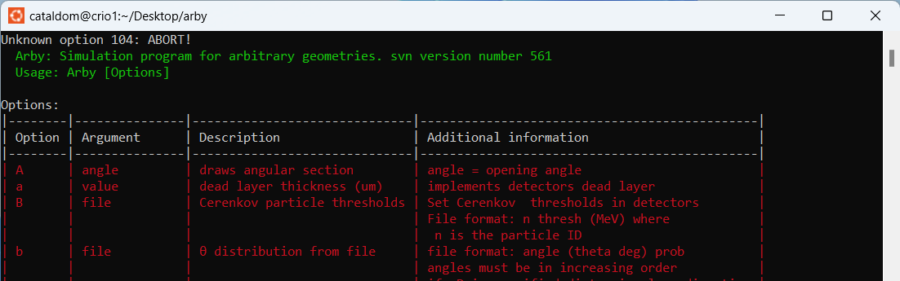
Introduction: GEANT4/ARBY
3
M. Cataldo – SONAR1, 15/04/2024
GEANT4¹ is a toolkit that provides all the component to describe and solve particle transport simulation problems.
At Milano Bicocca GEANT4 is used through ARBY (developed by O.Cremonesi)
ARBY incorporates all the GEANT4 tools in a user-friendly interface, including the propagation of photons, electrons, muons and many others. ARBY is GEANT4. Launched from command line.
¹S. Agostinelli et al. “Nucl. Instrum. Methods Phys.2003
Notes:
What is arby and geant
The experimental setup is described by a configuration file and then the simulation is launched from the command line. With ancillary software the detectors response can be simulated.

Slide 4
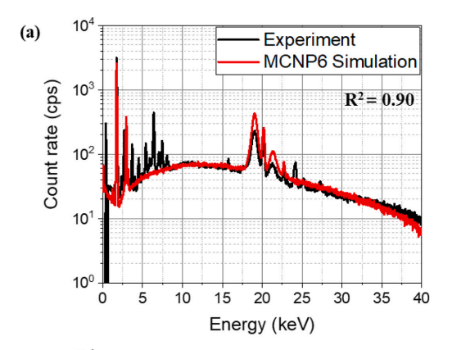
4
M. Cataldo – SONAR1, 15/04/2024
Introduction: GEANT4/ARBY
The idea is to reproduce the muon interaction and the following muonic X-ray spectrum
Similarly to what is already pursued in XRF, where simulation are used to obtain elemental composition of samples²
Problem: GEANT4/ARBY is not yet fully reliable for the simulation of the muon interaction process
²K. Woojin et al., Spect Acta Part B 180 (2021) https://doi.org/10.1016/j.sab.2021.106203
Notes:
Point left: In This will provide another way to perform quantitative analysis. Why: having something similar to what is already done in XRF, where simulations are compared to real measurements for quantitative analysis. But with a non reliable software this can’t be done. Prior to this phd this issue was not investigated/not known

Slide 5
5
M. Cataldo – SONAR1, 15/04/2024
Issues with GEANT4/ARBY
The GEANT4 classes responsible of the muonic cascade are:
G4MuonMinusCapture
G4EmCaptureCascade³
Preliminary simulations highlighted the incorrect or non-complete muonic X-ray emission lines, especially in the high energy range (K-shell transitions).
BUT
Developed years ago and very small modifications have been made since then.
³https://geant4.kek.jp/lxr/source/processes/hadronic/stopping/src/G4EmCaptureCascade.cc. (2012)
Notes:
Point left: In This will provide another way to perform quantitative analysis

Slide 6
M. Cataldo, HPXM 23, 19th June 2023
6
M. Cataldo – SONAR1, 15/04/2024
Issues with GEANT4/ARBY
Copper spectra measured at the ISIS Neutron and Muon source.
Cu is easy identified by a double peak in the low and high energy range
2p_{1/2} – 1s_{1/2}
2p_{3/2} – 1s_{1/2}
3d_{5/2} - 2p_{3/2}
3d_{3/2} - 2p_{1/2}

Slide 7
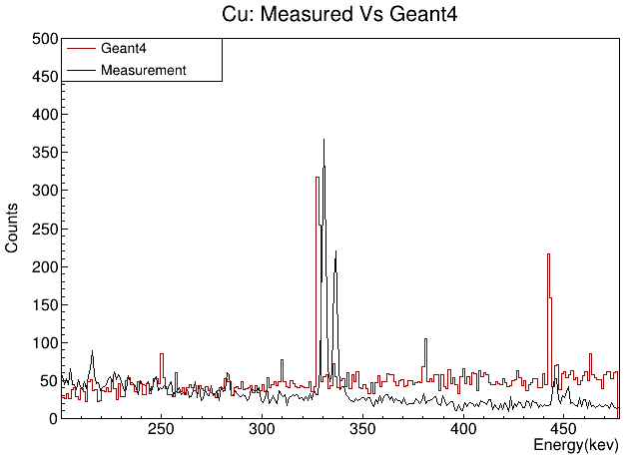
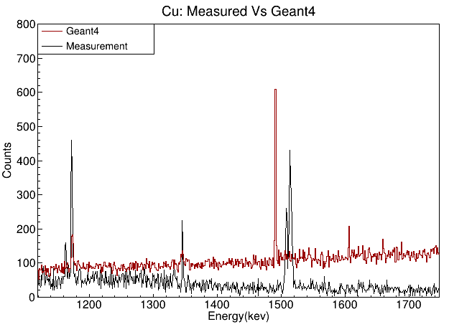
7
M. Cataldo – SONAR1, 15/04/2024
Issues with GEANT4/ARBY
3d_{5/2} - 2p_{3/2}
3d_{3/2} - 2p_{1/2}
2p_{1/2} – 1s_{1/2}
2p_{3/2} – 1s_{1/2}
Cu signature double peak is missing in both spectrum
Notes:
Copper spectra measured at the ISIS Neutron and muon source. Cu is easy identified by a double peak in the low and high energy range
The Cu double peaks are missing (Simulation performed with a HPGe crystal)
Say what transition is: 330: L3-M5 or 3d5/2 2p3/2 336: L2-M4 or 3d3/2 2p1/2 – 1506 2p1/2 1s1/2 or K1-L2 1517 2p3/2 1s1/2 or K1-L3

Slide 8
8
M. Cataldo – SONAR1, 15/04/2024
Issues with GEANT4/ARBY
Big discrepancy between literature and simulation for the K lines
(increases with Z but without a clear pattern)
Good agreement between literature and simulation for L and M lines
Notes:
Copper spectra measured at the ISIS Neutron and muon source. Cu is easy identified by a double peak in the low and high energy range
The Cu double peaks are missing (Simulation performed with a HPGe crystal)
Say what transition is: 330: L3-M5 or 3d5/2 2p3/2 336: L2-M4 or 3d3/2 2p1/2 – 1506 2p1/2 1s1/2 or K1-L2 1517 2p3/2 1s1/2 or K1-L3

Slide 9
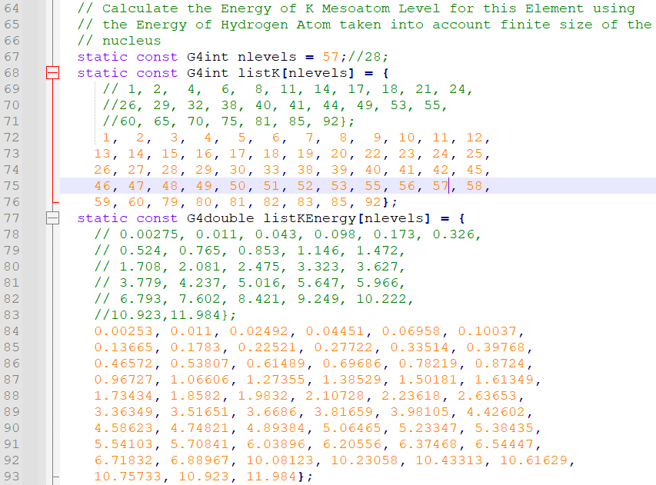
9
M. Cataldo – SONAR1, 15/04/2024
Tentative approach: FAMU implementation
Within the FAMU⁴ experiment, researchers the same issues was addressed
Implementation of the GEANT4 class by increasing the listed number of atoms and by adding a small correction to the class.
FAMU interest was mainly in low Z atoms.
An extensive set of simulations was performed to test the class (here called ARBY _MUX )
⁴ Pizzolotto C. et al DOI: 10.1140/epja/s10050-020-00195-9.
Notes:
FAMU is an international collaboration whose goal is to measure the proton Zemach radius with the measurement of the hyperfine splitting of the muonic hydrogen ground state Added a correction for the K shell calculation

Slide 10
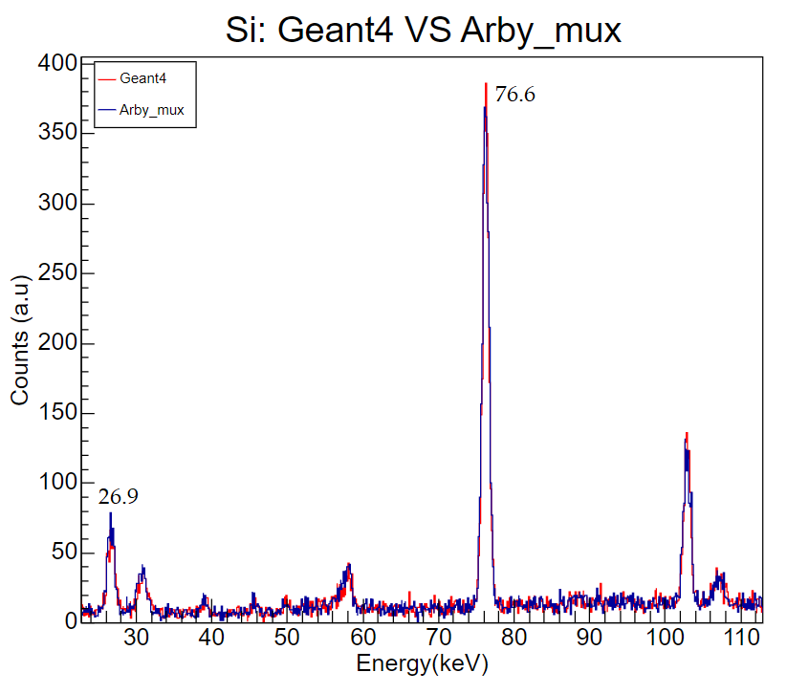
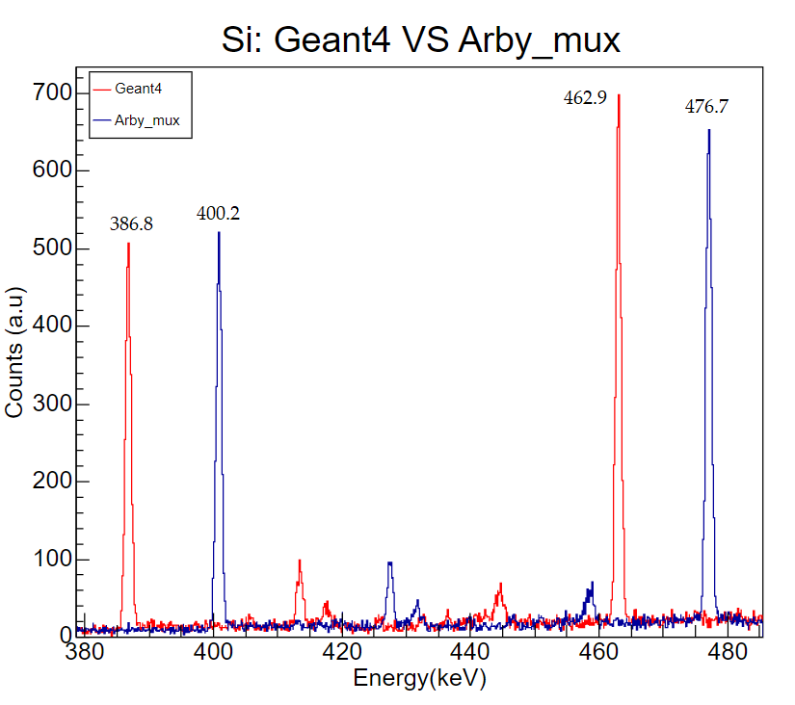
10
M. Cataldo – SONAR1, 15/04/2024
Tentative approach: FAMU implementation
For low Z atoms, the high energy part of the spectrum is improved in Arby_MUX
3d – 2p
3p – 1s
2p – 1s
4f – 3d
Notes:
Copper spectra measured at the ISIS Neutron and muon source. Cu is easy identified by a double peak in the low and high energy range
The Cu double peaks are missing (Simulation performed with a HPGe crystal)
Why this are good at low energy and not at high energy () corrections for high energy do not work properly/ makes approximations that do not work for high energy

Slide 11
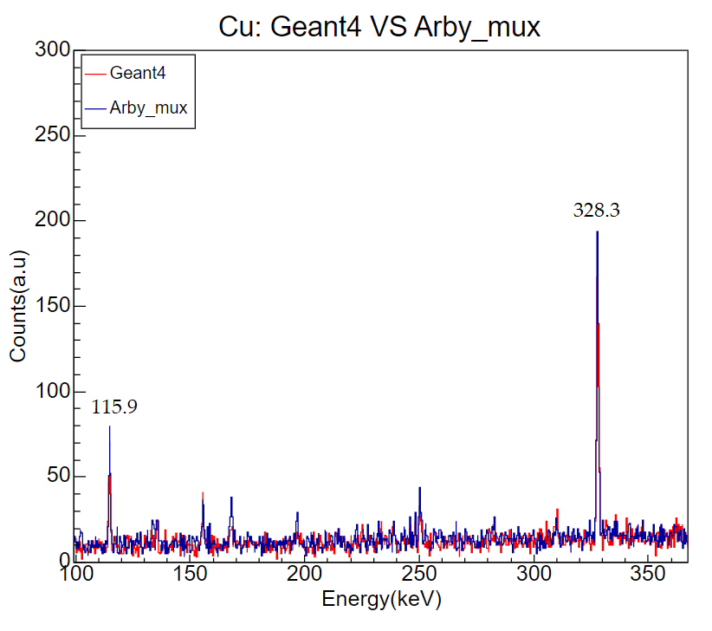
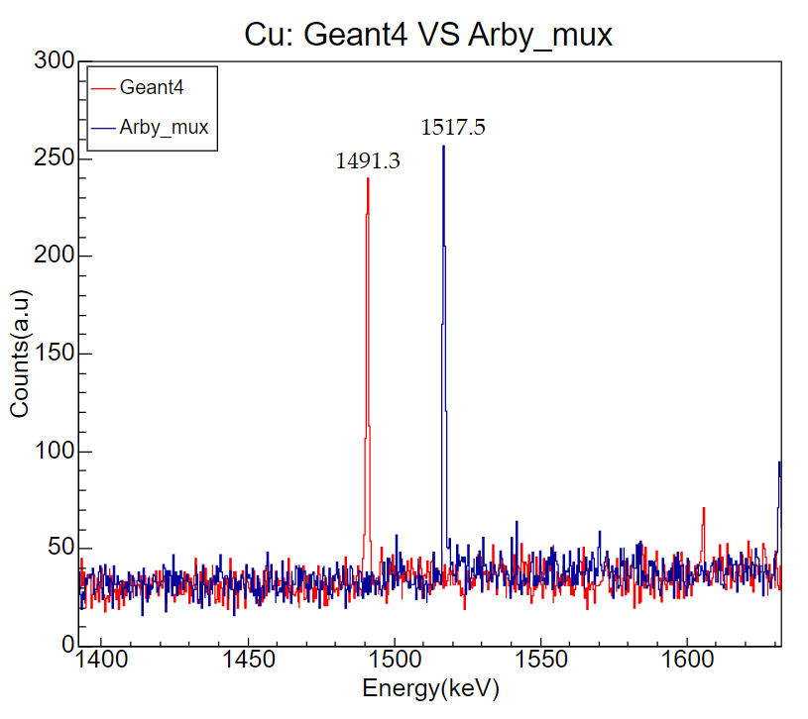
11
M. Cataldo – SONAR1, 15/04/2024
Tentative approach: FAMU implementation
Here, the situation is not improved: peaks are shifted, but the double peaks are still missing
?
?
Notes:
Copper spectra measured at the ISIS Neutron and muon source. Cu is easy identified by a double peak in the low and high energy range
The Cu double peaks are missing (Simulation performed with a HPGe crystal)

Slide 12
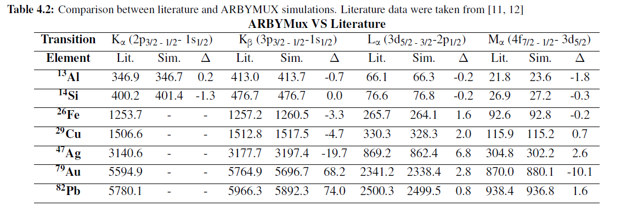
12
M. Cataldo – SONAR1, 15/04/2024
Tentative approach: FAMU implementation
Big discrepancy between literature and simulation for the K lines
(increases with Z)
Good agreement between literature and simulation for L and M lines
Notes:
Copper spectra measured at the ISIS Neutron and muon source. Cu is easy identified by a double peak in the low and high energy range
The Cu double peaks are missing (Simulation performed with a HPGe crystal)
Say what transition is: 330: L3-M5 or 3d5/2 2p3/2 336: L2-M4 or 3d3/2 2p1/2 – 1506 2p1/2 1s1/2 or K1-L2 1517 2p3/2 1s1/2 or K1-L3

Slide 13
M. Cataldo, HPXM 23, 19th June 2023
13
M. Cataldo – SONAR1, 15/04/2024
Tentative approach: MuDirac implementation
A solution was provided by MuDirac, a software that calculates muonic transition energies⁵
The idea was to create a database of energies from which GEANT4 can draw when simulating.
Data-driven libraries have already been employed in GEANT4.
MuDirac is becoming an important source in the negative muon communitity, is open acces and easy to use.
When a simulation is launched (here ARBY is called ARBY_MuDirac):
If a MuDirac file is found, the energy corresponding to the transition is extracted and used by GEANT4.
If the file is missing the program continues the simulation with the standard cascade generation
⁵ Sturniolo, S., et al. X-Ray Spectrometry, (2020)
Notes:
The Muon Spectroscopy Computational Project Scientific Computing department and ISIS STFC.
A collaboration project between the UKRI Scientific Computation Department and the ISIS Muon Group to develop tools for muon spectroscopy.
MuDirac produces two outputs:
A list of the transition energies of the cascade with the associated the transition rate (in s-1).
A simulated spectrum with the calculated transitions.
To create the database, calculations for the most abundant isotopes - from hydrogen to bismuth - were performed.
Vantaggio delle librerie in geant4; tutto rimane uguale
Dati sono generalmente validati, improving simulation acccuracy; give more flexibility to switch to other data librart or else
Precalculated data, can be more efficient

Slide 14
M. Cataldo, HPXM 23, 19th June 2023
14
M. Cataldo – SONAR1, 15/04/2024
MuDirac implementation
For the implementation, the simulated spectra of MuDirac was used

Slide 15
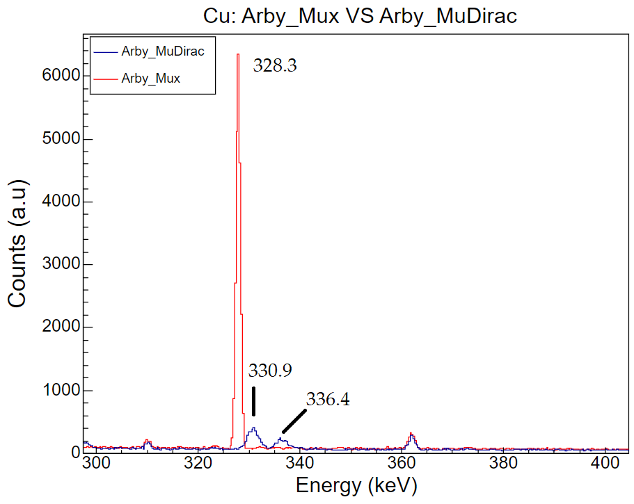
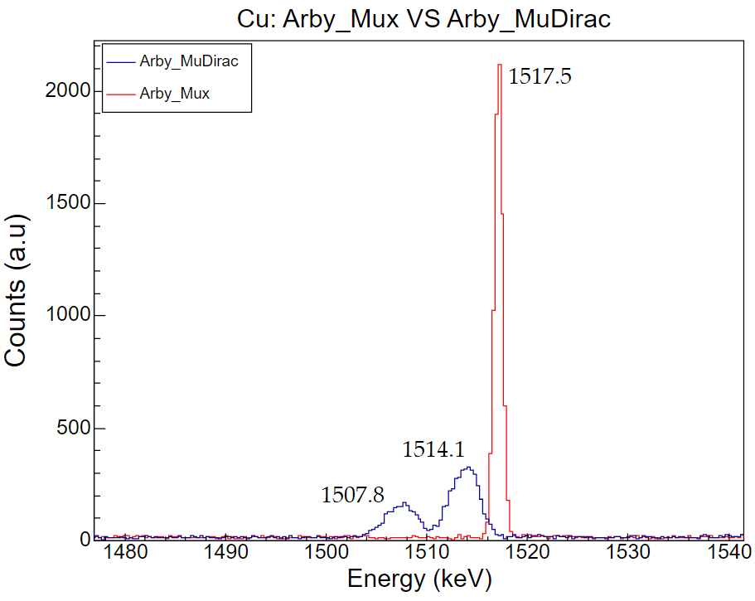
15
M. Cataldo – SONAR1, 15/04/2024
MuDirac implementation
Notes:
Mudirac spectrhas default with of 1 keV and presumabli it enlarges then in the arby spectra!?

Slide 16
16
M. Cataldo – SONAR1, 15/04/2024
MuDirac implementation
Good agreement between literature and simulation
Notes:
Copper spectra measured at the ISIS Neutron and muon source. Cu is easy identified by a double peak in the low and high energy range
The Cu double peaks are missing (Simulation performed with a HPGe crystal)
Say what transition is: 330: L3-M5 or 3d5/2 2p3/2 336: L2-M4 or 3d3/2 2p1/2 – 1506 2p1/2 1s1/2 or K1-L2 1517 2p3/2 1s1/2 or K1-L3

Slide 17
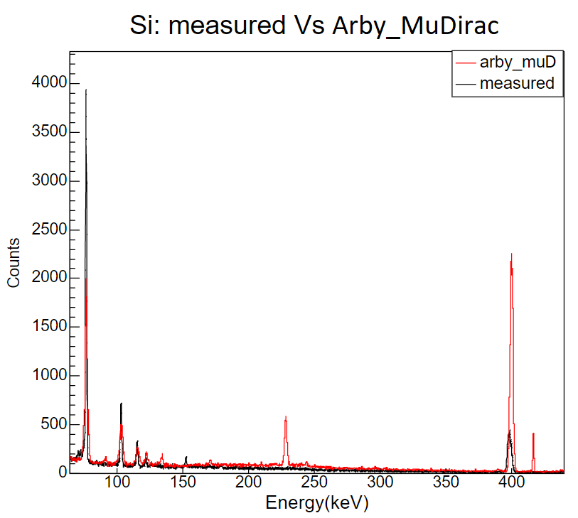
17
M. Cataldo – SONAR1, 15/04/2024
MuDirac implementation
Problems with MuDirac implementation:
The intensities of the simulated spectra are not scaled correctly
When using MuDirac, the information about the cascade process is lost
This implementation is just using the peak position

Slide 18
18
M. Cataldo – SONAR1, 15/04/2024
Conclusions and future work
The MuDirac implementation provided a valid solution to the simulation of the muon interaction, with promising results
By using MuDirac transition energies and probabilities instead of the simulated spectra
By evaluating GEANT4/ARBY intensities to check if they are consistent with measurements
By continuing to collaborate with the scientific computing group: MuDirac 2.0 is being developed
Considering the fact that work or develop a GEANT4 class requires a lot of expertise, manpower and interest from the G4 community, it is the right path to follow
How can it be improved?
Notes:
It would be beneficial to keep simulating the cascade process: using branching ratios could be a solution

Slide 19
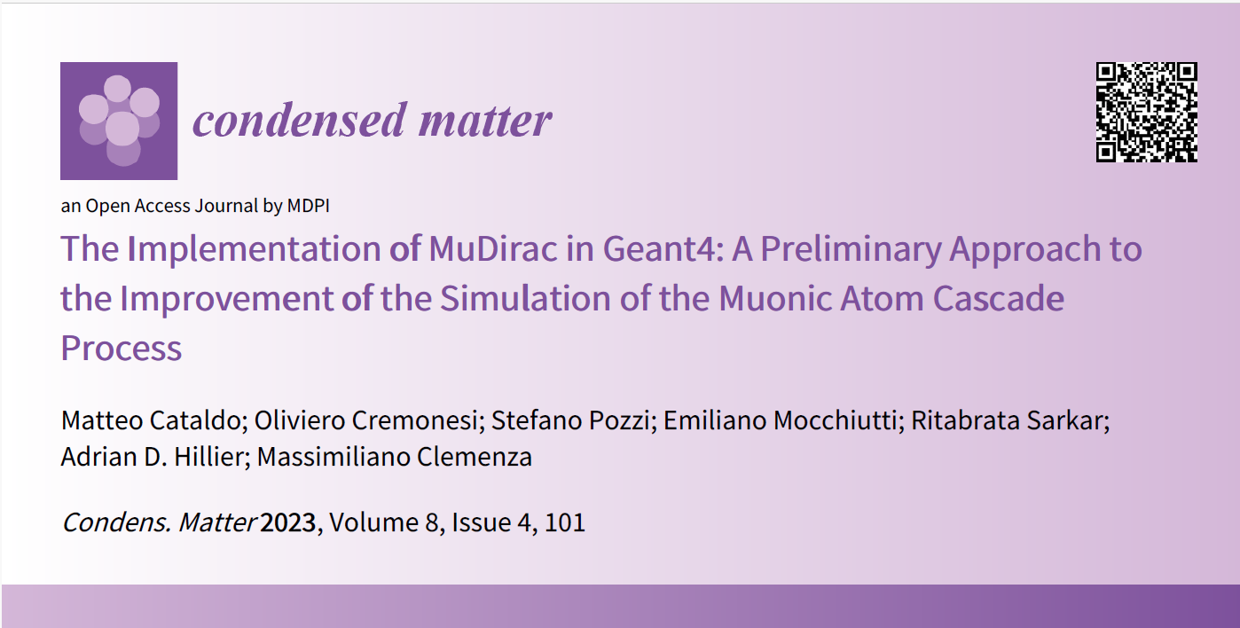
19
M. Cataldo – SONAR1, 15/04/2024

Slide 20
Acknowledgements
Adrian D. Hillier
ISIS Neutron and Muon Source, RAL, Didcot, UK
Massimiliano Clemenza
INFN Sezione Milano Bicocca, Milan, Italy
Thank you for the attention!
Oliviero Cremonesi
INFN Sezione Milano Bicocca, Milan, Italy
Stefano Pozzi
INFN Sezione Milano Bicocca, Milan, Italy
matteo.cataldo@stfc.ac.uk

