Slide 1
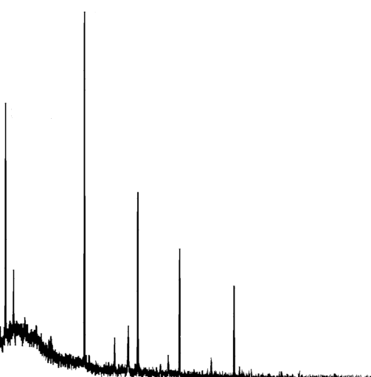
Usage of MuDirac in µ-XES experiments
µ⁻
Muonic X-ray Emission
Spectroscopy
Cu
Ag
Au
Sn
O
Pb
Sayani Biswas
SONAR 1 workshop (virtual)
15th April 2024

Slide 2
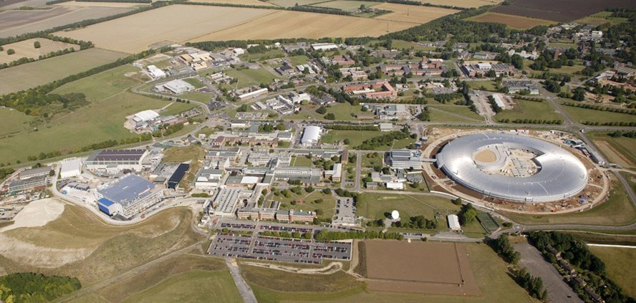
Outline
µ-XES experiments at ISIS
How MuDirac is being used
Possible inclusions in MuDirac
ISIS
Rutherford Appleton Laboratory

Slide 3
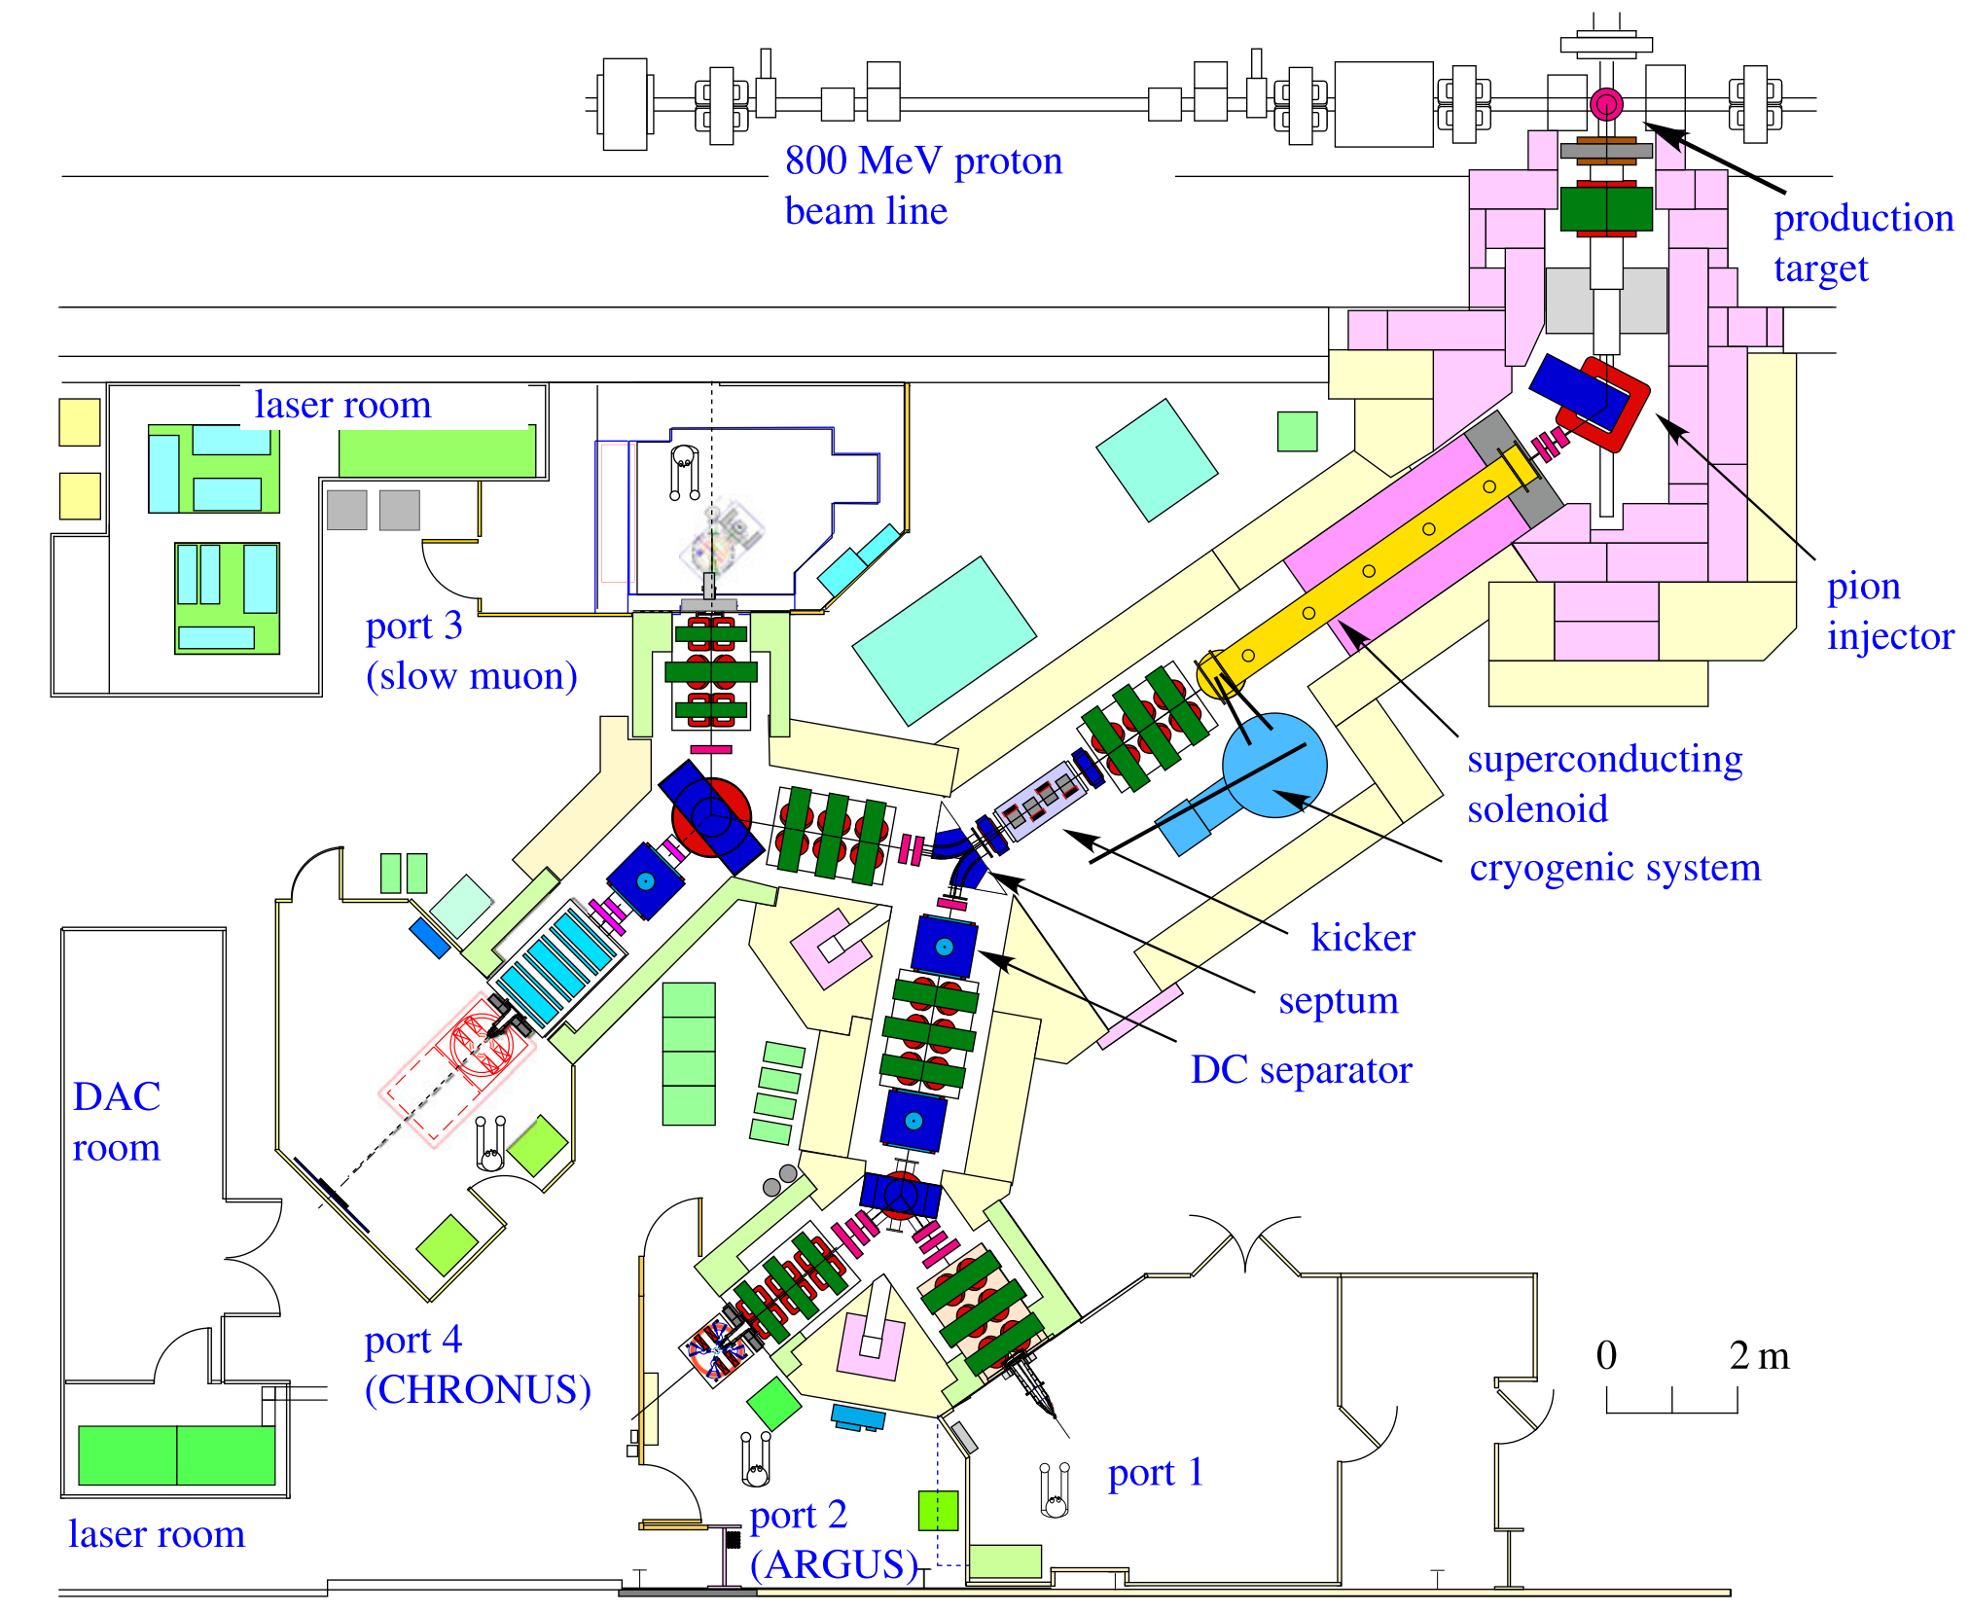
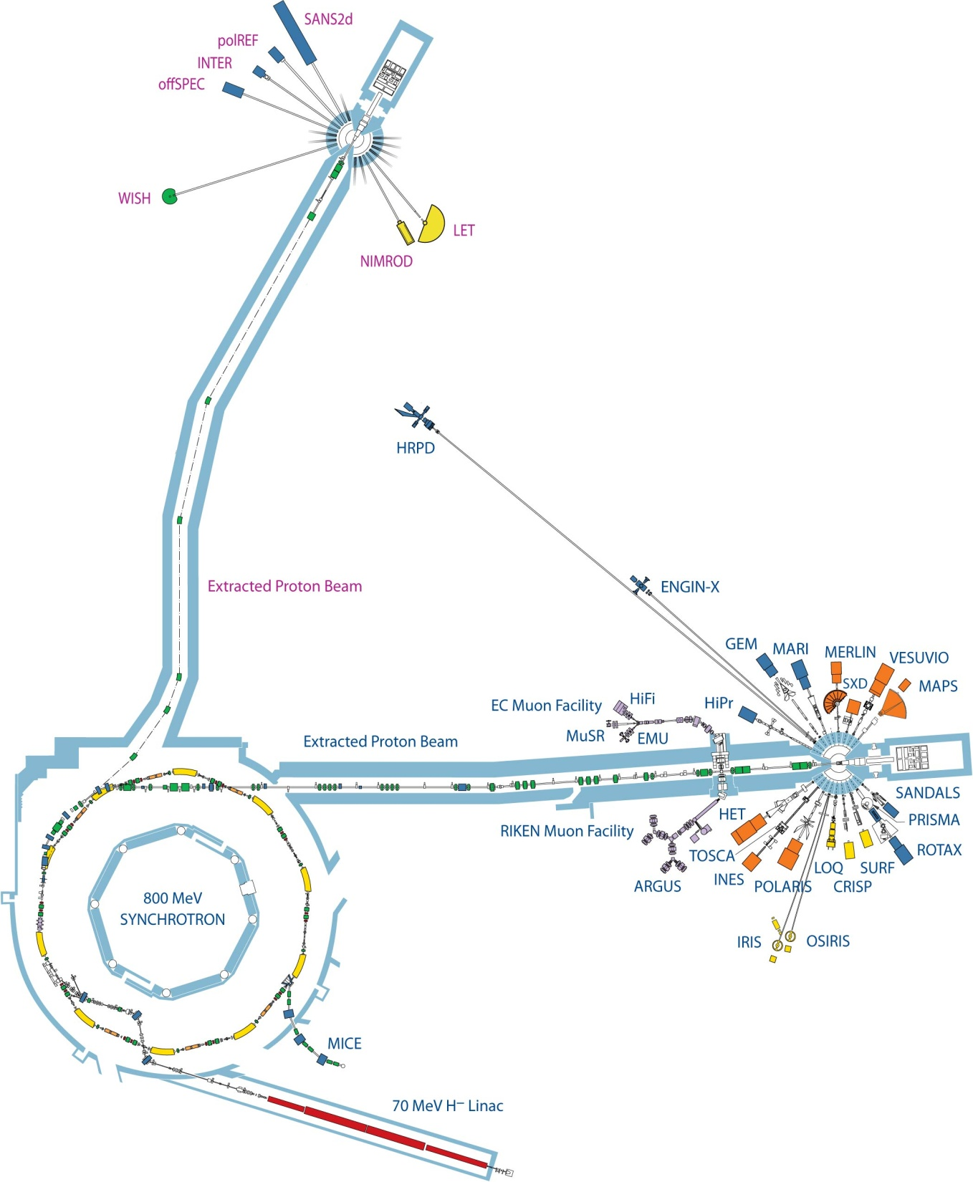
µ-XES experiments at ISIS
C, 45°
10mm
Target Station 2 (TS2)
320 ns
TS1
TS2
20 ms (50 Hz)
CHRONUS
Currently, we perform the
µ-XES experiments in port 4
Target Station 1 (TS1)

Slide 4
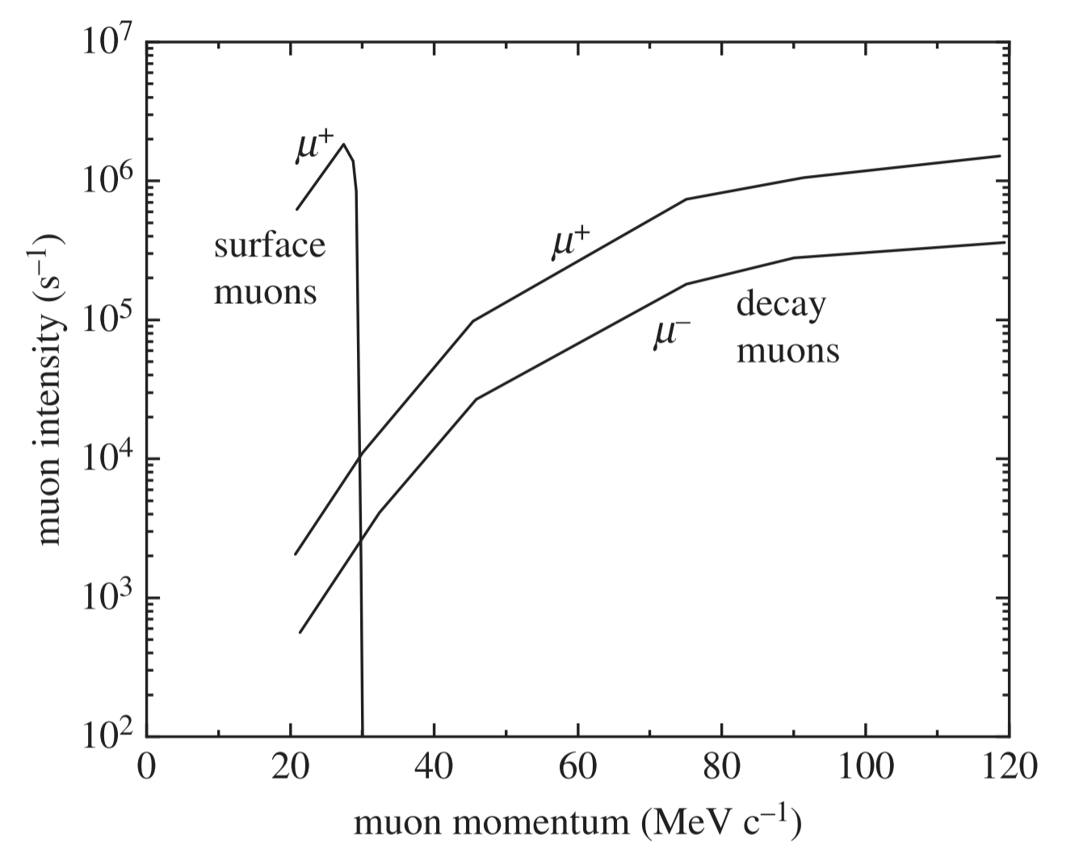
µ-XES experiments at ISIS
C, 45°
10mm
Muon momentum range:
17 MeV/c – 120 MeV/c
(currently 90 MeV/c)
Decay-channel
Currently, we perform the
µ-XES experiments in port 4
A. D. Hillier et al, Phil. Trans. R. Soc. A (2019)

Slide 5
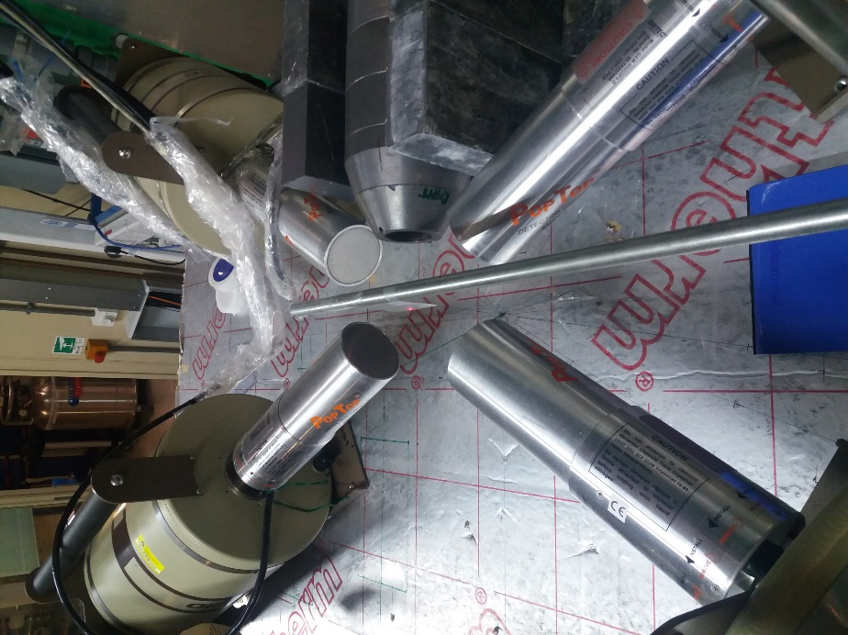
µ-XES experiments at ISIS
C, 45°
10mm
MuX setup (under development)
Ge X-ray detector
low-energy
Ge X-ray detector
0.1-10 MeV
Sample
μ⁻ beam
Ge X-ray detector
low energy
Currently, we perform the
µ-XES experiments in port 4
Ge X-ray detector
0.1-10 MeV

Slide 6
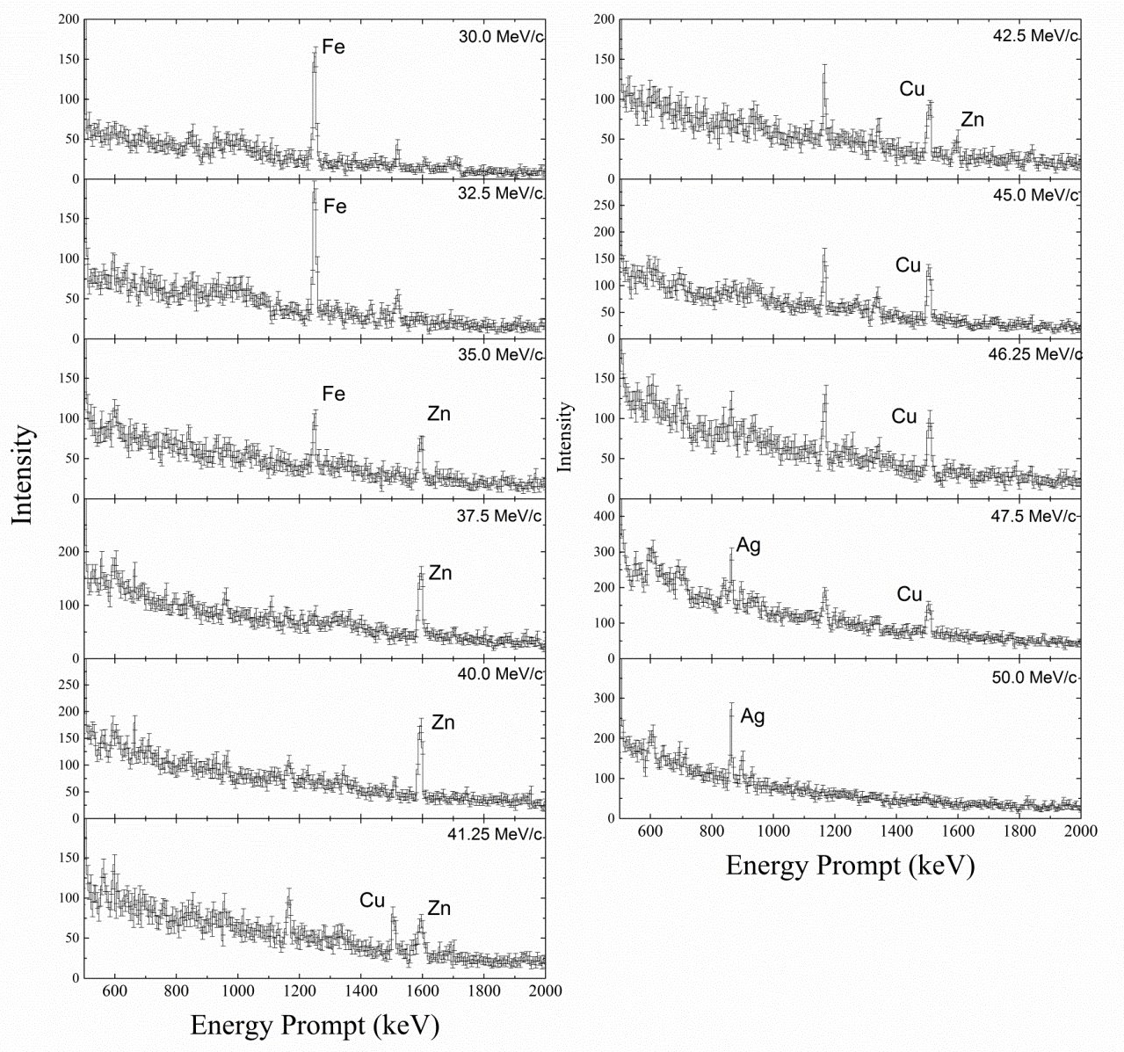
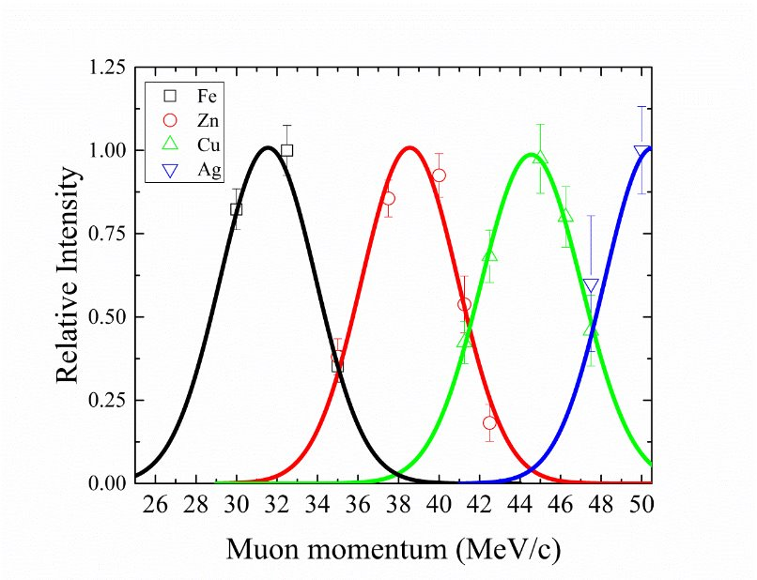
1) Proof-of-concept sample:
µ-XES experiments at ISIS
Fe
500μm
Ge X-ray detector
low-energy
Ge X-ray detector
0.1-10 MeV
μ⁻ beam
Ag
1000μm
Sample
μ⁻ beam
Zn
500μm
Cu
500μm
Ge X-ray detector
low energy
Ge X-ray detector
0.1-10 MeV
A. D. Hillier et al, Microchemical Journal (2016)

Slide 7
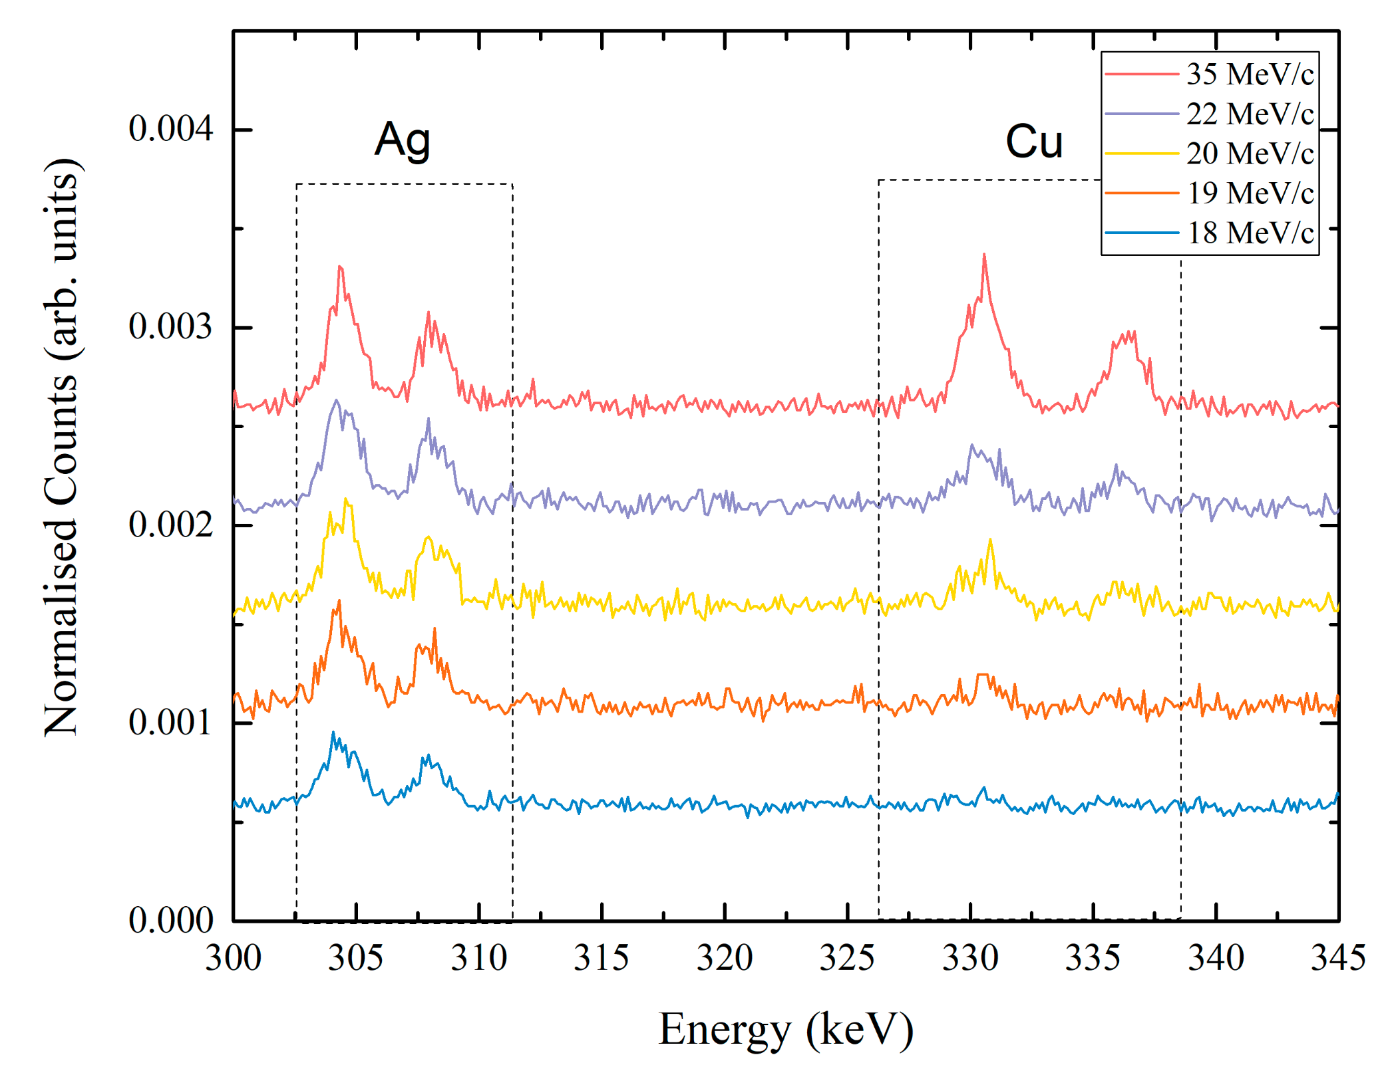
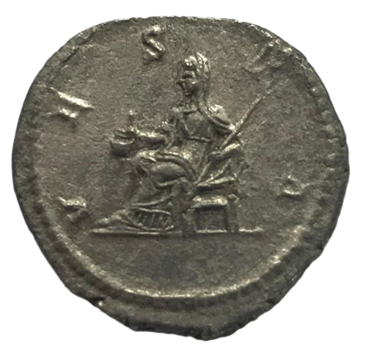
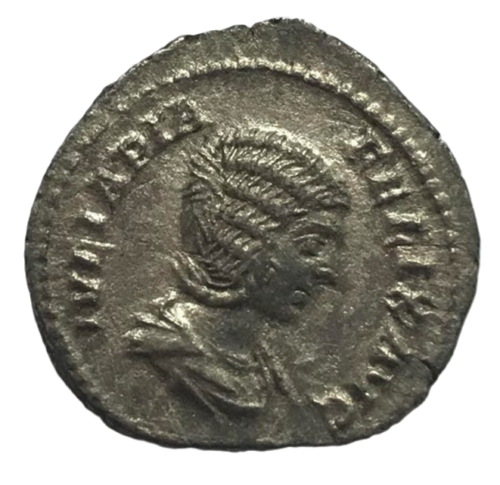
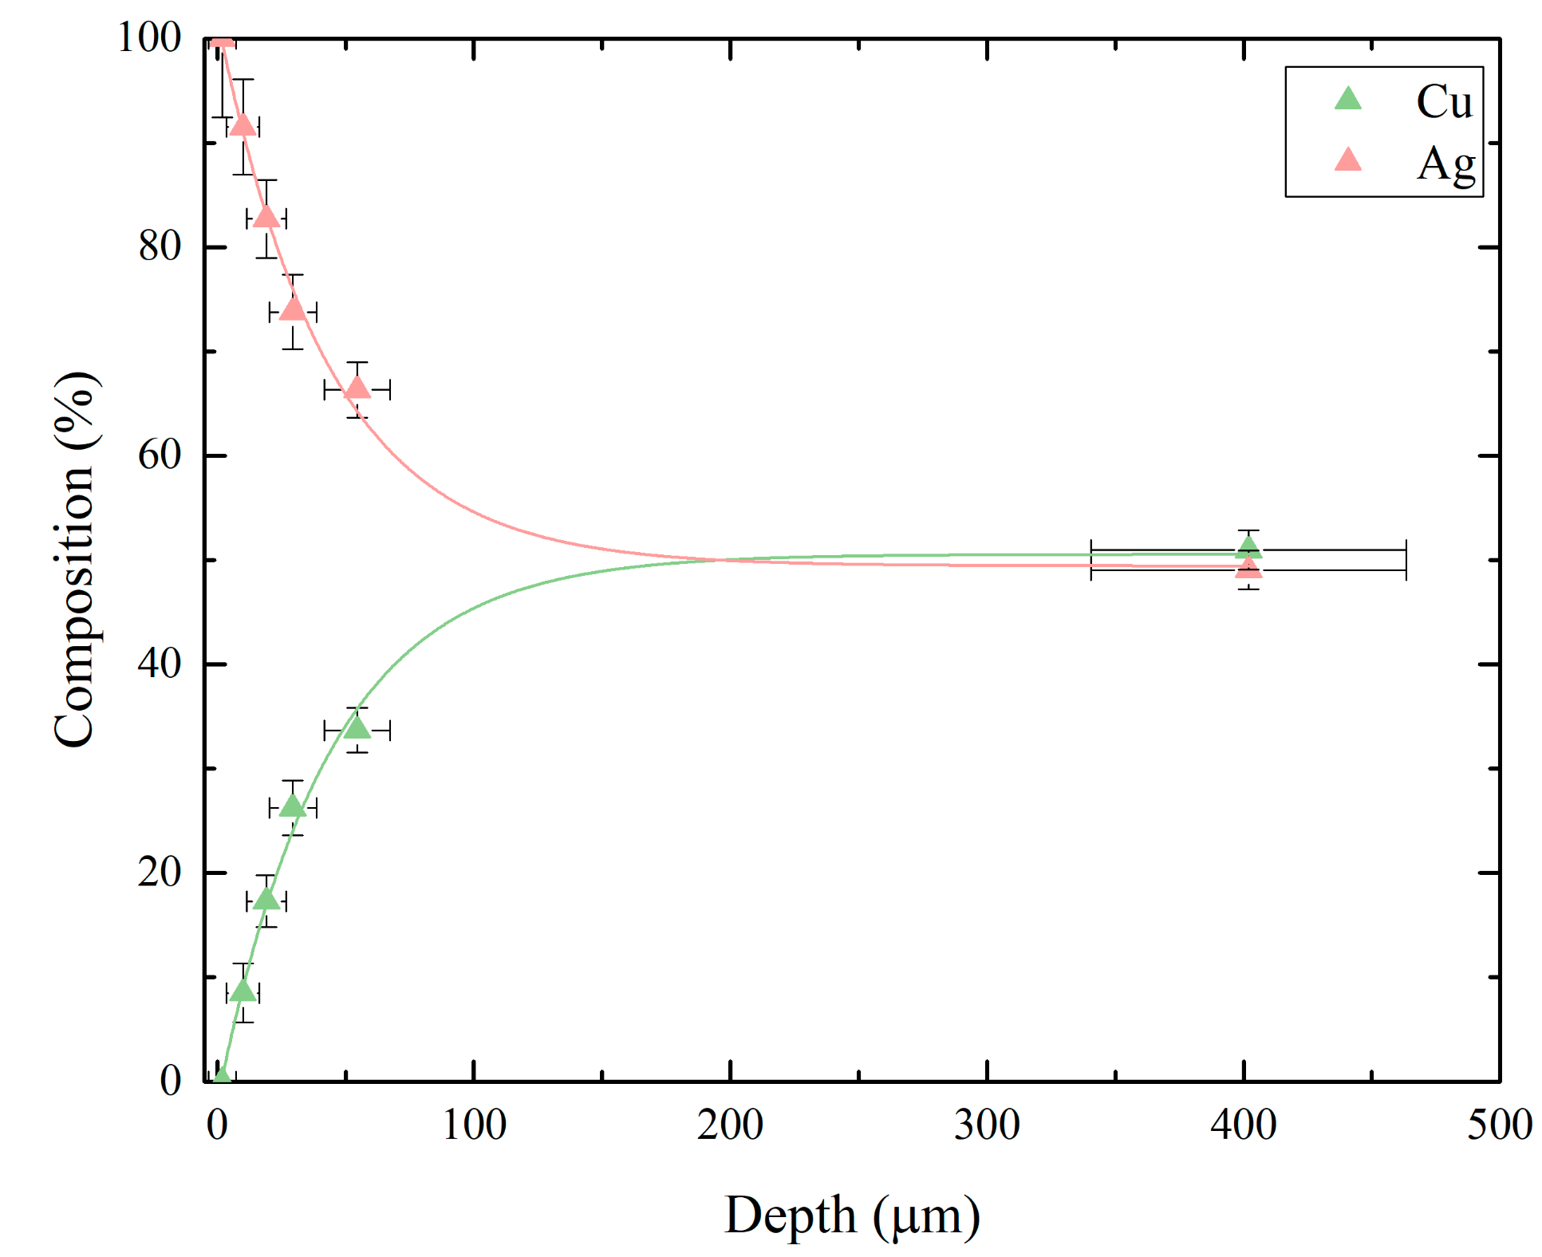
2) Roman silver coins:
µ-XES experiments at ISIS
Ge X-ray detector
low-energy
Ge X-ray detector
0.1-10 MeV
denarius of Julia Domna
3rd century (211-217 CE)
Sample
μ⁻ beam
Ge X-ray detector
low energy
51(1)% Ag
49(1)% Cu
Ge X-ray detector
0.1-10 MeV
190 µm
B. V. Hampshire et al, Heritage (2019)

Slide 8
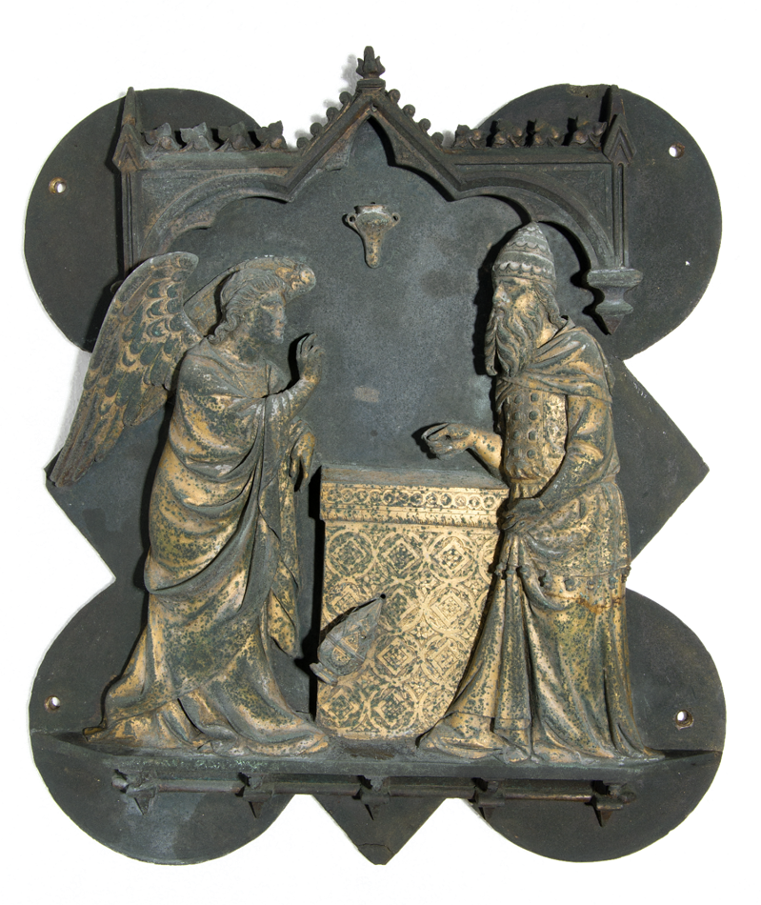
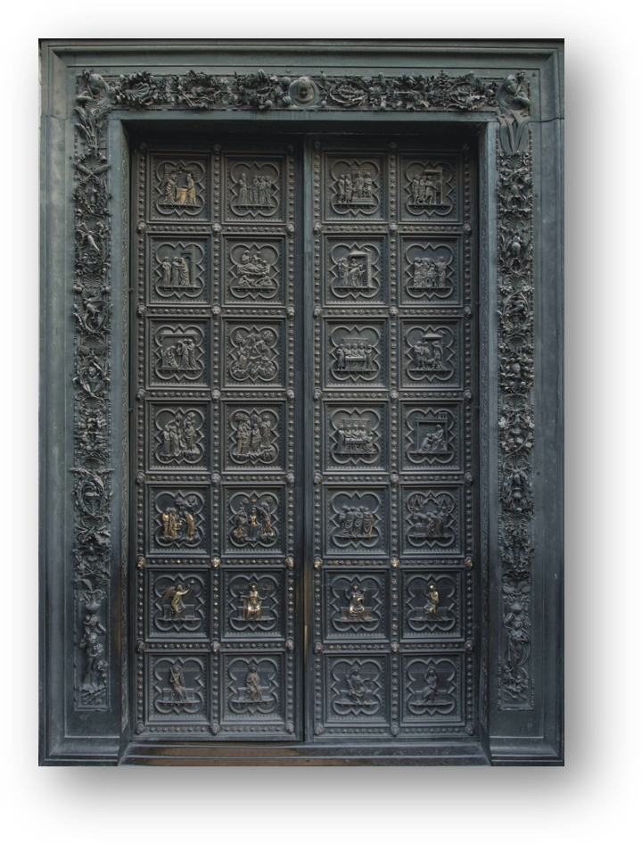
3) Baptistery gate of Florence:
µ-XES experiments at ISIS
Ge X-ray detector
low-energy
Ge X-ray detector
0.1-10 MeV
3
2
Sample
μ⁻ beam
1
Ge X-ray detector
low energy
Position | Name of area | Simulated gold thickness
1 | Altar | 1-50 μm
2 | Zachary body | 15.0(5) μm
3 | Angel body | 16.0(5) μm
Ge X-ray detector
0.1-10 MeV
M. Cataldo, PhD thesis (2024)

Slide 9
µ-XES experiments at ISIS
Ge X-ray detector
low-energy
Ge X-ray detector
0.1-10 MeV
Diverse science areas (measured so far using MuX)
Cultural Heritage
Bronze Age artefacts
Mary Rose artefacts
Swords
Cannon Balls
Sundials
Coins
Mirrors
Statues
Florence baptistery gates (gates of paradise)
Solar cells
Piezoelectric devices
Li batteries
Steel, corrosion and carbon composition
Meteorites
Biomaterials
Sample
μ⁻ beam
Ge X-ray detector
low energy
Ge X-ray detector
0.1-10 MeV

Slide 10
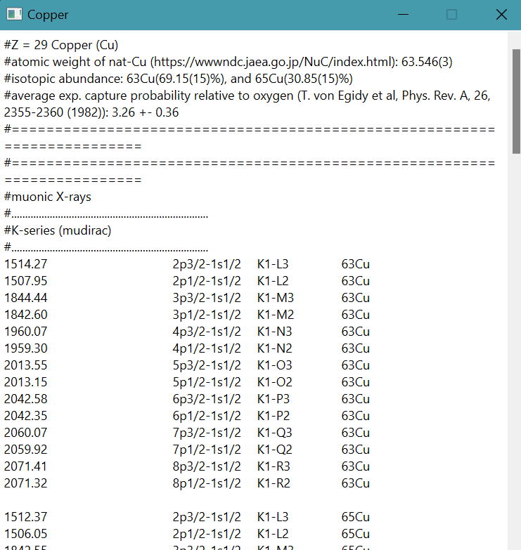
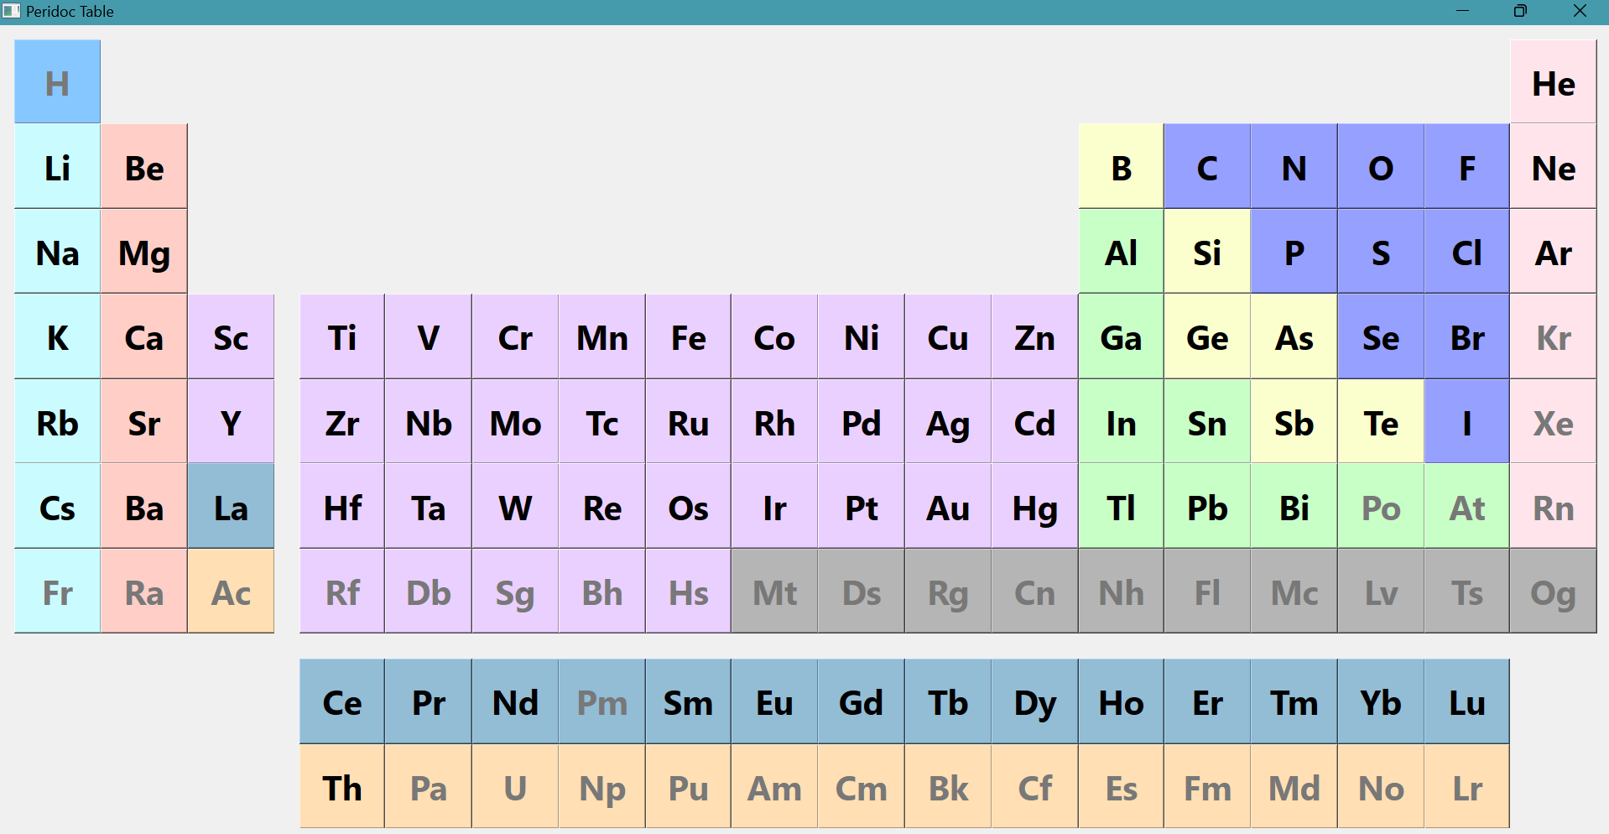
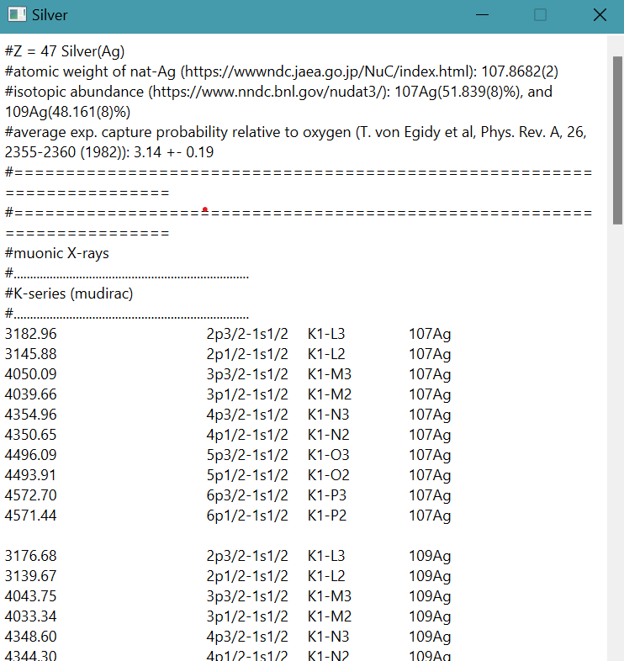
How MuDirac is being used
GUI of periodic table using PyQt6

Slide 11
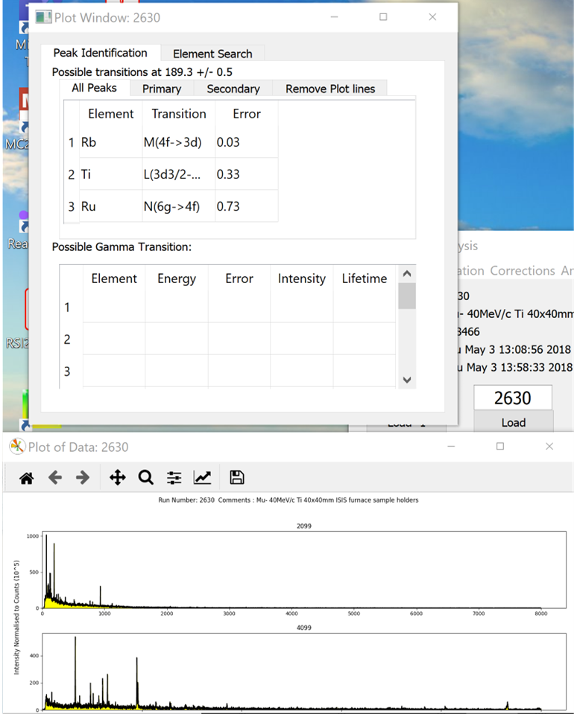
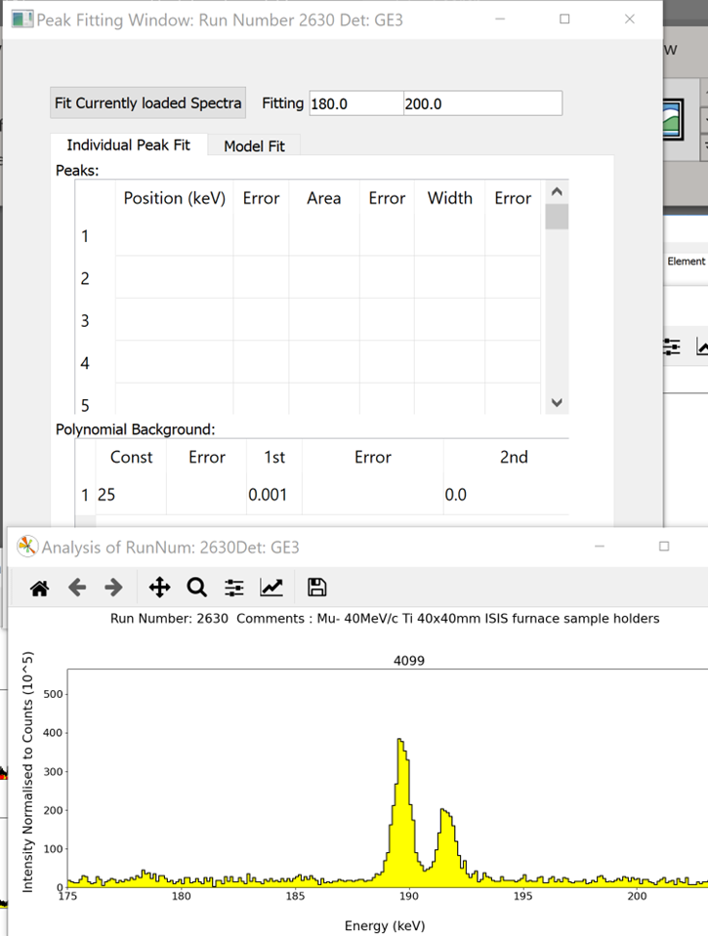
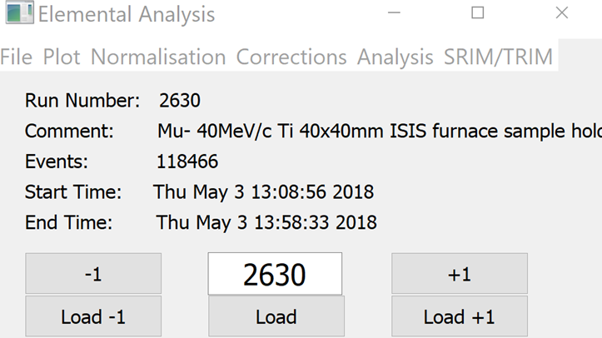
How MuDirac is being used
GUI for elemental analysis
using PyQt5
Most users are not familiar with large facilities, let alone muons
Need simple to use and intuitive software
EVA (Elemental Visualisations and Analysis):
Easy to visualise data
Automatic correction
Easy to identify elements
Peaks
Machine Learning (to be added)
Simple/basic analysis
Easy to extend

Slide 12
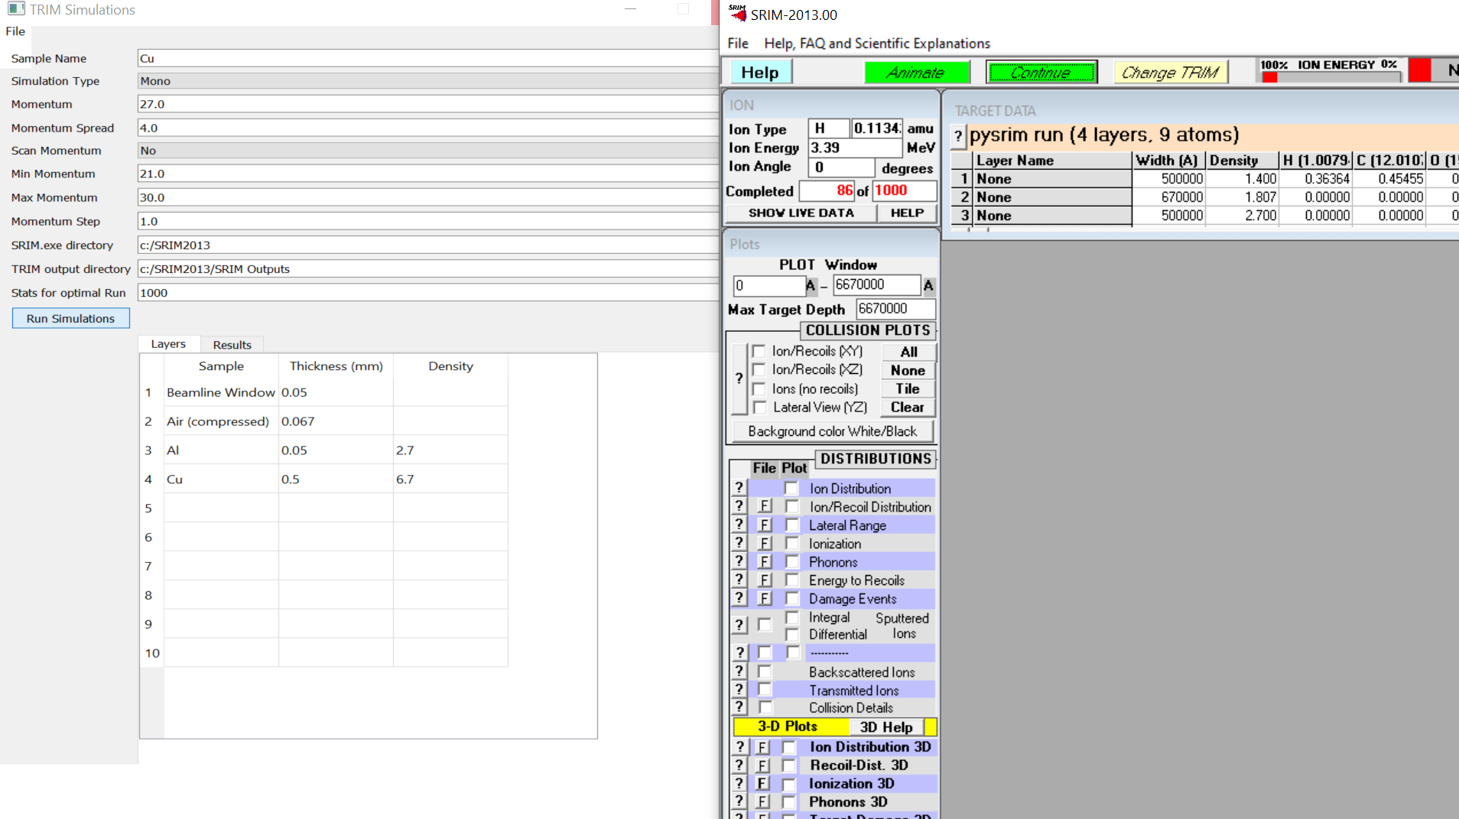
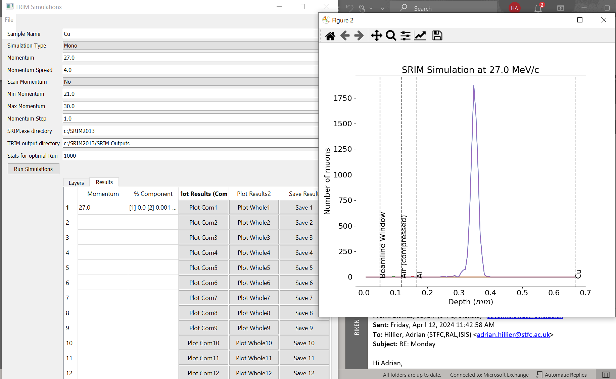
How MuDirac is being used
GUI for elemental analysis
using PyQt5
Easy GUI
Automatically sets up
SRIM/TRIM
Adds momentum spread
Scans momentum
Easy plotting of results
Plots individual components
Saves results

Slide 13
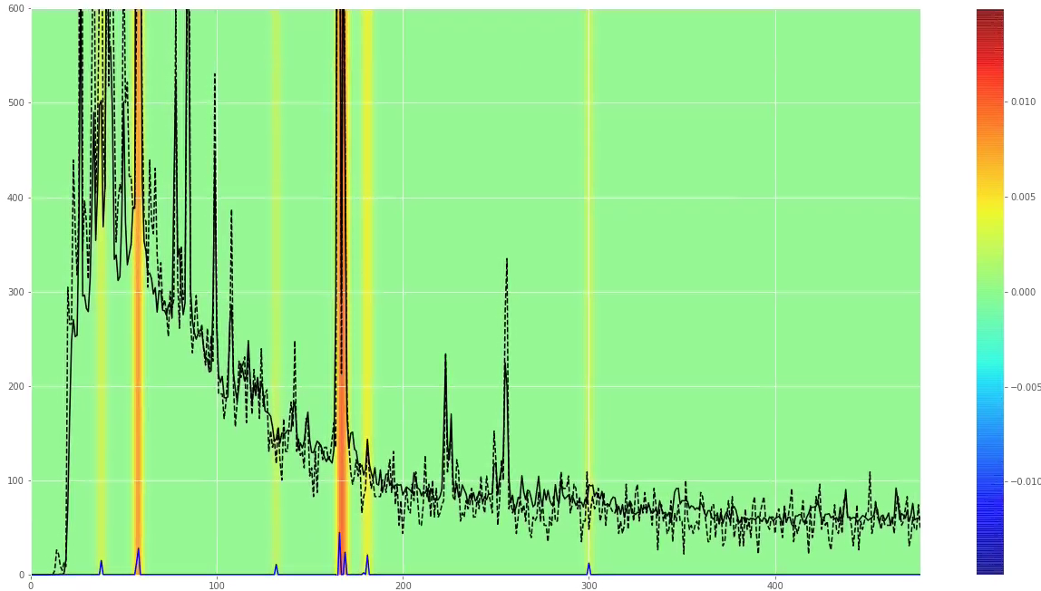
How MuDirac is being used
Element | Train acc (%) | Val acc (%)
Ag | 99.98 | 99.96
Al | 99.89 | 99.83
Au | 99.93 | 99.92
B | 99.90 | 99.85
C | 99.90 | 99.86
Cu | 99.97 | 99.94
Fe | 99.87 | 99.80
In | 99.97 | 99.90
Pb | 99.91 | 99.88
Si | 99.90 | 99.75
Sn | 99.93 | 99.92
Machine Learning offers the potential for a ‘black box’
Deep learning to classify the elemental composition
Trained on standard samples
Pure
Taking pure samples and ‘mixing them’
Works surprisingly well –
Work for Cu Sn real data
And for noisy data

Slide 14
Possible inclusions in MuDirac
Intensities of muonic X-rays -> probably already underway
Gamma rays
Muon capture probabilities
Inclusion of oxidation state of the element

Slide 15
Acknowledgements
Adrian Hillier, all instrument scientists in the MuSR group, and engineers/technicians in
cryogenics, electronics & instrumentation group.
Beth Hampshire - Department of Physics, Warwick University and the ISIS Neutron and Muon Facility
Massimiliano Clemenza, Milan-Bicocca, Italy
Matteo Cataldo, Milan-Bicocca and ISIS Neutron and Muon facility
Don Paul - Department of Physics, Warwick University
Katsu Ishida – RIKEN, Japan
The Matt’s STFC Technology
Simone Sturniolo, Leandro Liboro SCD STFC
Keith Butler, SCD STFC Machine Learning

