Slide 1
Where’s SUSY?
The electroweak SUSY landscape
after ATLAS Run 2 searches
Ben Hodkinson

Slide 2
Outline
SUSY 101
SUSY signal models
The pMSSM
Reinterpreting ATLAS searches
External constraints
Overall ATLAS exclusion of EW SUSY scenarios
Dark matter complementarity
Comparison with Run 1
Surviving models
Summary
Based on the recent ATLAS electroweak pMSSM scan CONF note (ATLAS-CONF-2023-055) and my PhD thesis (https://doi.org/10.17863/CAM.104677)
→ If a plot has an ATLAS label it’s from the CONF note, otherwise from my thesis!

Slide 3
SUSY 101

Slide 4
Hierarchy problem
Corrections to squared Higgs mass
Planck scale O(10¹⁹) GeV
How is the measured Higgs mass only 125 GeV?
Perfect cancellations of loops through 38 orders of magnitude?
A new symmetry between fermions and bosons would naturally produce such a cancellation
Fermion loop
∝ -m(f)²
Scalar loop
∝+m(s)²

Slide 5
Hierarchy problem
Corrections to squared Higgs mass
Planck scale O(10¹⁹) GeV
How is the measured Higgs mass only 125 GeV?
Perfect cancellations of loops through 38 orders of magnitude?
A new symmetry between fermions and bosons would naturally produce such a cancellation
Fermion loop
∝ -m(f)²
Scalar loop
∝+m(s)²

Slide 6
The SUSY particle zoo

Slide 7
The SUSY particle zoo
Electroweak sector

Slide 8
The SUSY particle zoo
Electroweak sector
Pre-EWSB:
U(1) gauge field:
B
SU(2) gauge fields:
W⁰, W⁺, W⁻

Slide 9
The SUSY particle zoo
Electroweak sector
Pre-EWSB:
U(1) gauge field:
B
SU(2) gauge fields:
W⁰, W⁺, W⁻
Partners of the SM pre-EWSB
B and W fields are the “Wino” and “Bino”

Slide 10
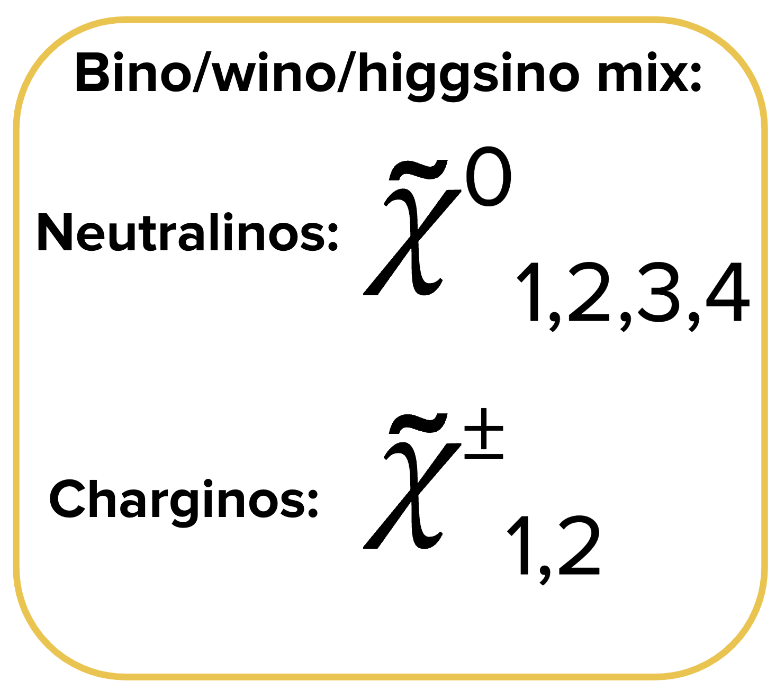
The SUSY particle zoo
Electroweak sector
Pre-EWSB:
U(1) gauge field:
B
SU(2) gauge fields:
W⁰, W⁺, W⁻

Slide 11
The SUSY particle zoo

Slide 12
The MSSM
None of these have been found……
SUSY, if it exists, must be a broken symmetry
Minimal Supersymmetric Standard Model (MSSM)
Includes all these sparticles
“SUSY breaking terms” parameterize our ignorance about the SUSY breaking mechanism
> 100 unknown parameters

Slide 13
Electroweak SUSY
The rest of this seminar will focus on electroweak production, ie. neutralinos and charginos
Interesting because:
Smallest production cross-sections → Limits are weakest.
Lightest neutralino is expected to be the lightest SUSY particle (LSP) and can be a dark matter candidate.
Dark matter constraints favour scenarios with an LSP mass at or below O(1 TeV).

Slide 14
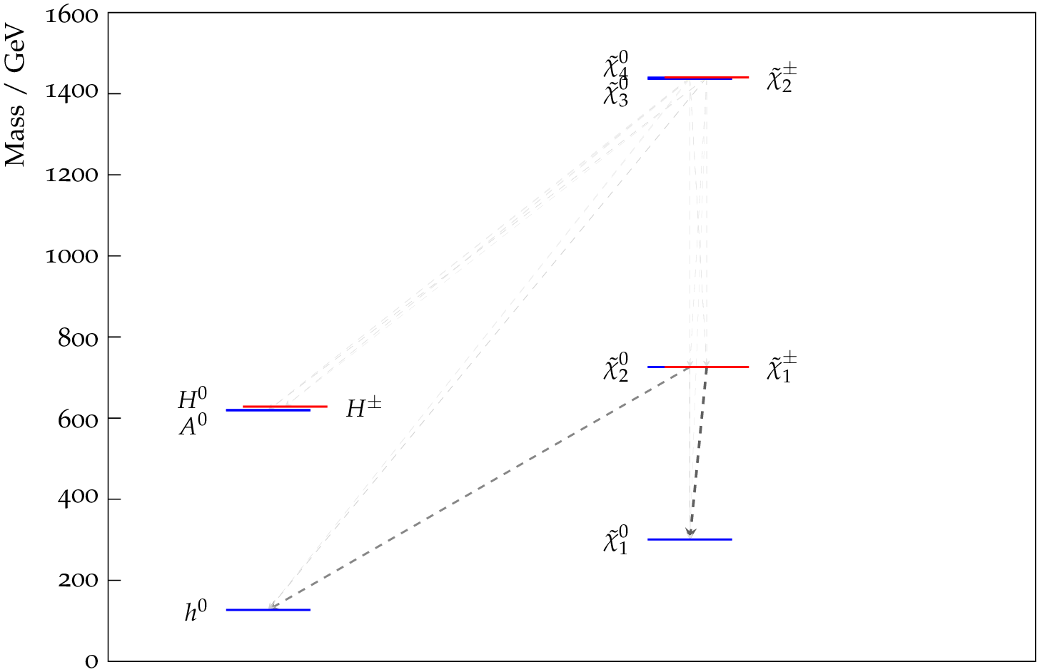
Electroweak SUSY
If bino, wino and higgsino mass parameters are well separated you get…
Higgsinos: Two neutralinos and a chargino(s) close in mass
Winos: One neutralino and chargino(s) close in mass
Bino: One neutralino
“Lightest SUSY particle” = LSP

Slide 15
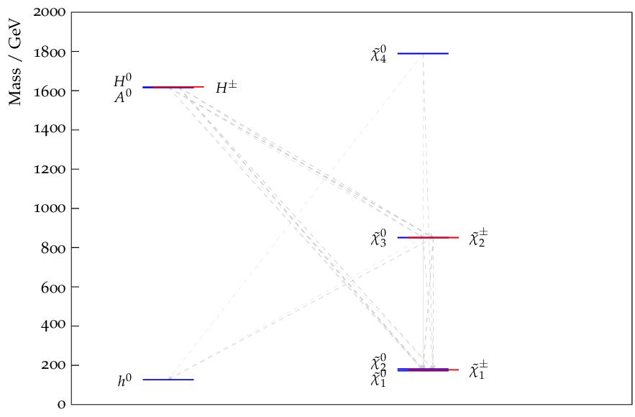
Electroweak SUSY
If bino, wino and higgsino mass parameters are well separated you get…
Higgsinos: Two neutralinos and one chargino close in mass
Winos: One neutralino and one chargino close in mass
Bino: One neutralino
“Lightest SUSY particle” = LSP

Slide 16
SUSY signal models

Slide 17
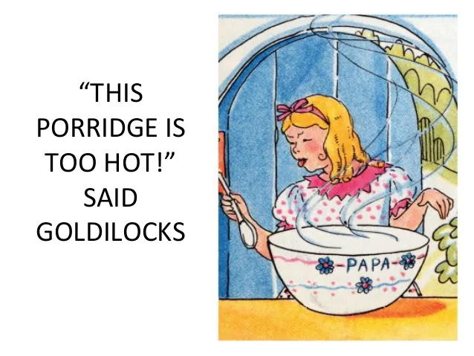
Minimally Supersymmetric Standard Model
Minimum number of new particles and interactions to realize supersymmetry.
100+ free parameters
Very difficult / impossible to interpret analysis results in the MSSM.
SUSY model has
many parameters!”
MSSM

Slide 18
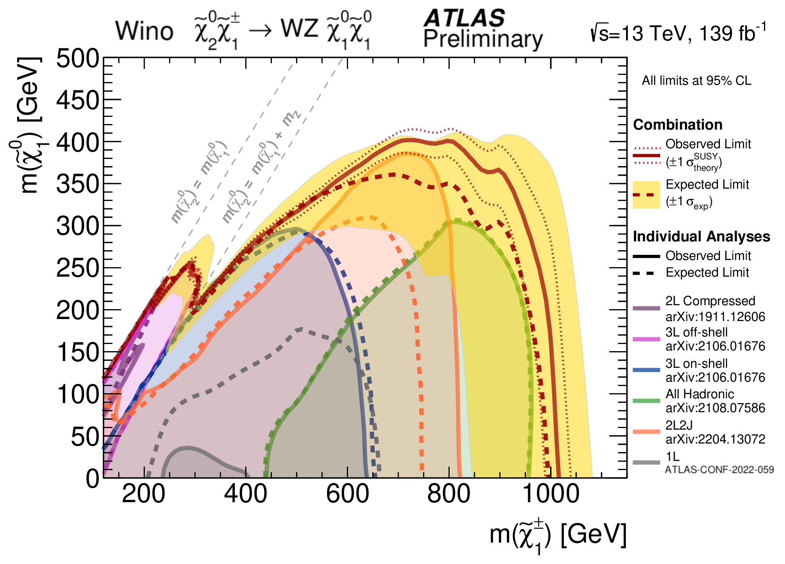
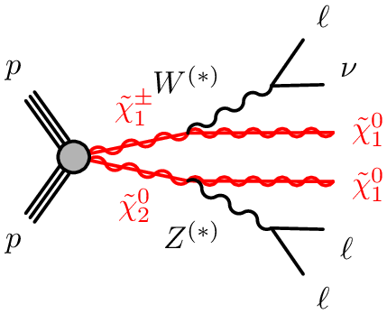
Simplified models
Focus on one SUSY production process and decay chain.
All other particles decoupled
BR(Decay of interest) = 100%
Pure bino/wino/higgsino states
Signature driven approach
ATL-CONF-2023-046

Slide 19
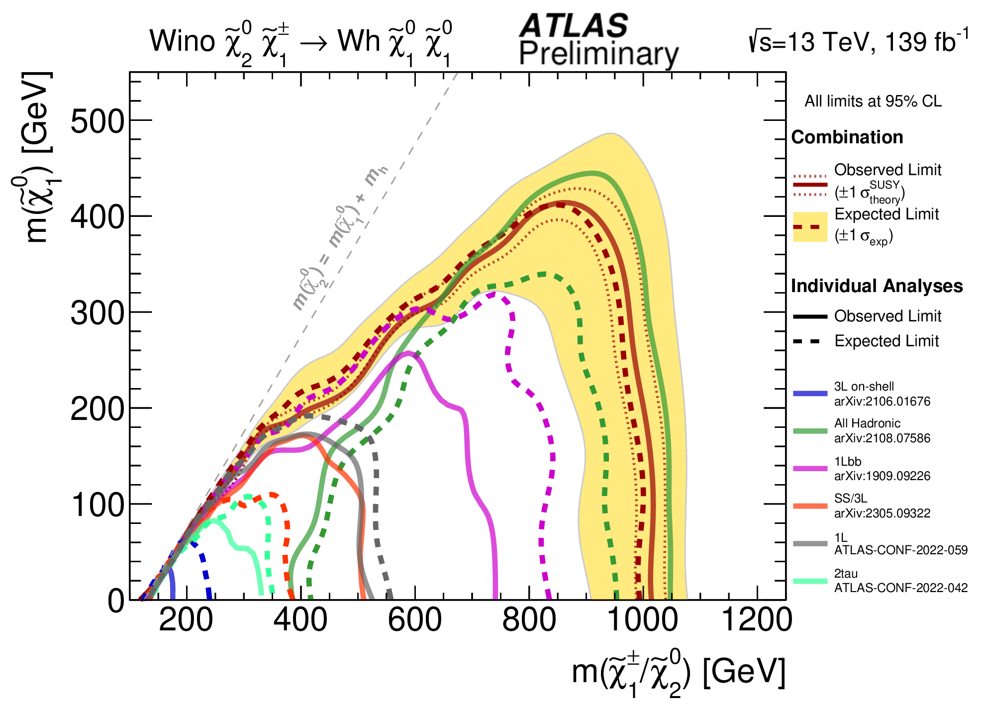
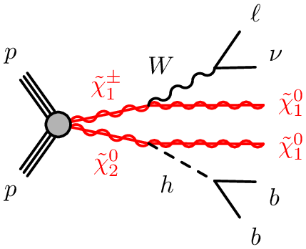
Simplified models
Focus on one SUSY production process and decay chain.
All other particles decoupled
BR(Decay of interest) = 100%
Pure bino/wino/higgsino states
Signature driven approach
ATL-CONF-2023-046

Slide 20
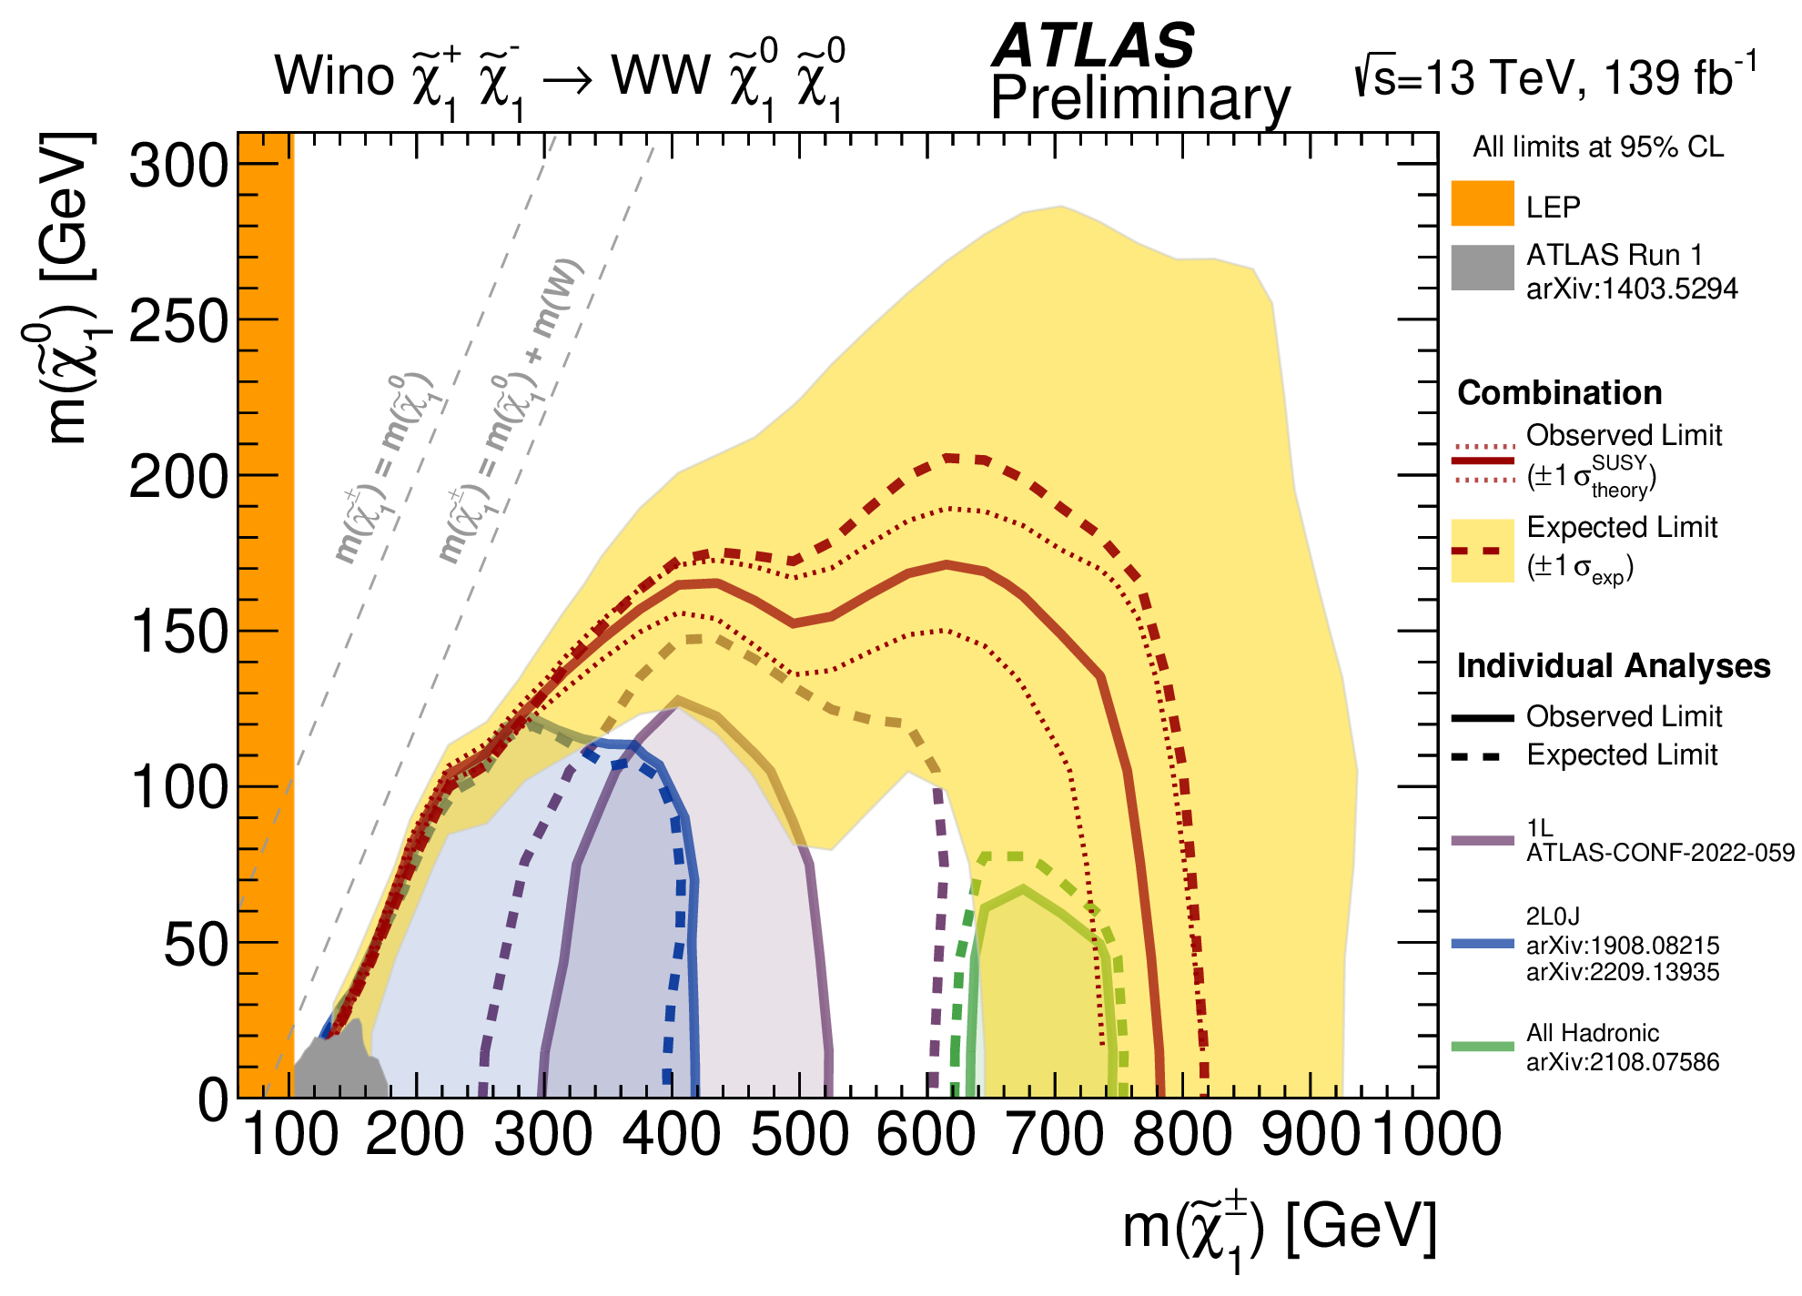
Simplified models
Focus on one SUSY production process and decay chain.
All other particles decoupled
BR(Decay of interest) = 100%
Pure bino/wino/higgsino states
Signature driven approach
ATL-CONF-2023-046

Slide 21
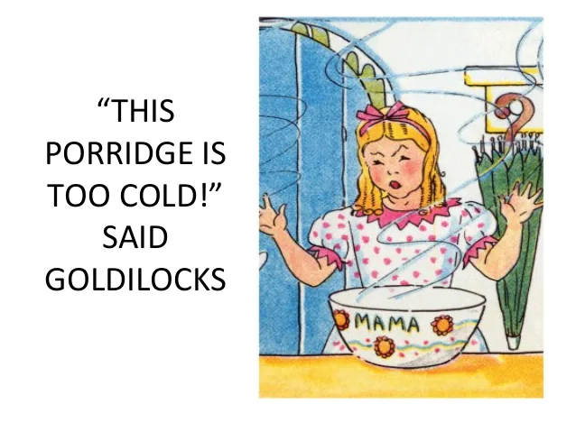
Simplified models
2D grid of signal models for optimising searches
2D exclusion plots
Doesn’t capture more complex phenomenology
How do we connect searches for different models?
How do we build a coherent picture of the global ATLAS constraints on SUSY?
SUSY model
simple!”

Slide 22
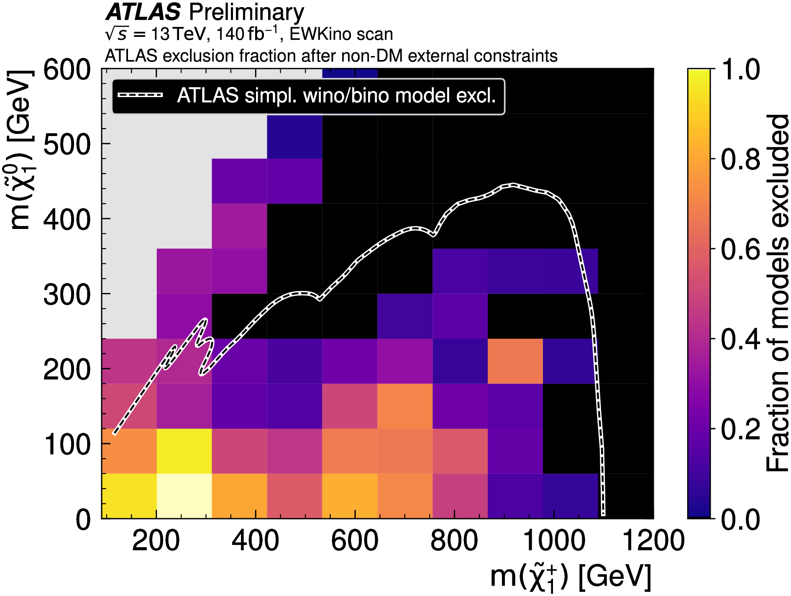
Phenomenological MSSM
Project 19-dim pMSSM into 2D planes and evaluate our sensitivity:
Middle ground between MSSM and simplified models.
MSSM + a few simplifying assumptions
Includes all sparticle production and decay modes
19 parameters
Run-2 EWK scan result

Slide 23
Phenomenological MSSM
Middle ground between MSSM and simplified models.
MSSM + a few simplifying assumptions
Includes all sparticle production and decay modes
19 parameters
SUSY MODEL
could scan and analyse the parameter space on the timescale of her PhD.
pMSSM

Slide 24
pMSSM assumptions
Based on experimental constraints and general features of SUSY breaking mechanisms.
No new sources of CP-violation (beyond CKM matrix)
No flavour-changing neutral currents (FCNCs)
Universality of 1st and 2nd generation sfermions
R-parity conserved
Lightest SUSY particle (LSP) is the lightest neutralino

Slide 25
pMSSM assumptions
Based on experimental constraints and general features of SUSY breaking mechanisms.
No new sources of CP-violation (beyond CKM matrix)
No flavour-changing neutral currents (FCNCs)
Universality of 1st and 2nd generation sfermions
R-parity conserved
Lightest SUSY particle (LSP) is the lightest neutralino

Slide 26
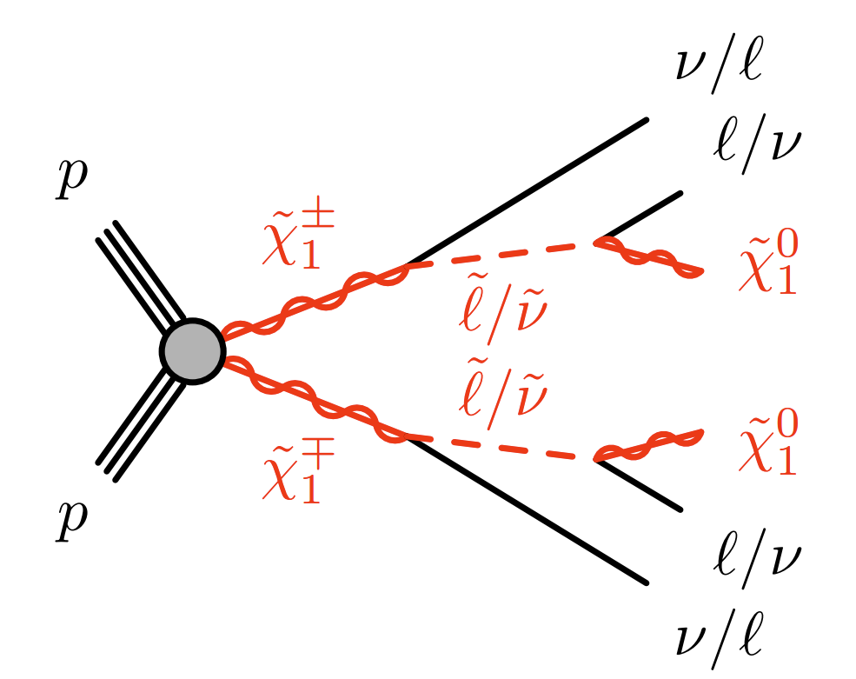
R-parity conservation
Stops proton decaying!
SM particles have P_{R}= +1
SUSY partners have P_{R}= -1
R-parity is conserved multiplicatively
Note: R-parity violating models also exist but have very different collider signatures (not considered here).

Slide 27
R-parity conservation
Stops proton decaying!
SM particles have P_{R}= +1
SUSY partners have P_{R}= -1
R-parity is conserved multiplicatively
→ Sparticles must be produced in pairs at colliders
Note: R-parity violating models also exist but have very different collider signatures (not considered here).

Slide 28
R-parity conservation
Stops proton decaying!
SM particles have P_{R}= +1
SUSY partners have P_{R}= -1
R-parity is conserved multiplicatively
→ Sparticles must be produced in pairs at colliders
→ Lightest SUSY particle (LSP) cannot decay
Note: R-parity violating models also exist but have very different collider signatures (not considered here).

Slide 29
R-parity conservation
Stops proton decaying!
SM particles have P_{R}= +1
SUSY partners have P_{R}= -1
R-parity is conserved multiplicatively
→ Sparticles must be produced in pairs at colliders
→ Lightest SUSY particle (LSP) cannot decay
→ LSP is an ideal cold dark matter candidate!
Note: R-parity violating models also exist but have very different collider signatures (not considered here).

Slide 30
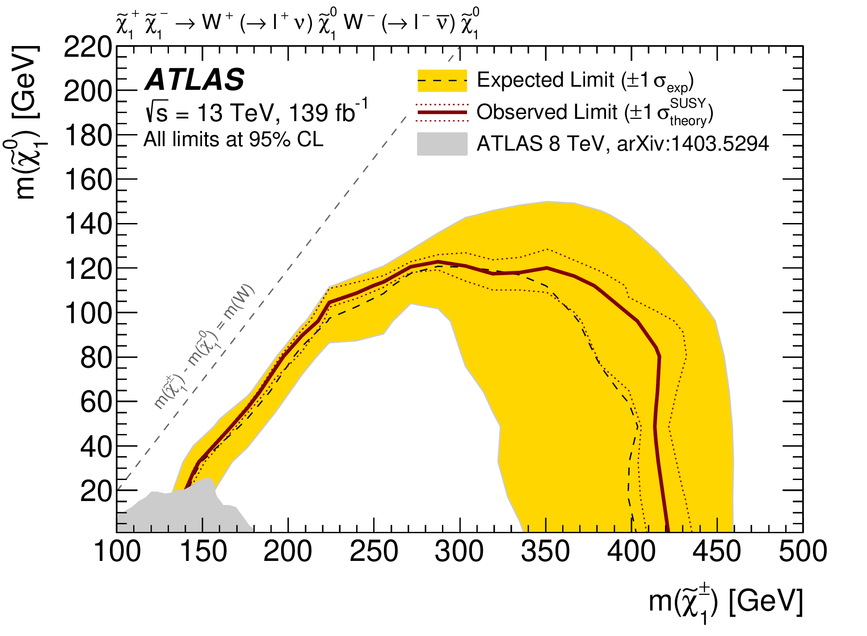
Simplified models are too simple
MSSM
pMSSM
Full MSSM
= 100+ parameters → Too many
Phenomenological MSSM
= MSSM + assumptions
→ 19 parameters
Simplified
model

Slide 31
Scanning the pMSSM

Slide 32
Workflow
Scan the 19-dimensional pMSSM to produce sets of models
Reinterpret Run 2 searches to determine which models are (not) excluded
Produce global picture of ATLAS’ sensitivity to electroweak SUSY
Identify scenarios we’ve missed due to non-simplified phenomenology
Random scan
Generate models & MC events
Evaluate searches with SimpleAnalysis and RECAST

Slide 33
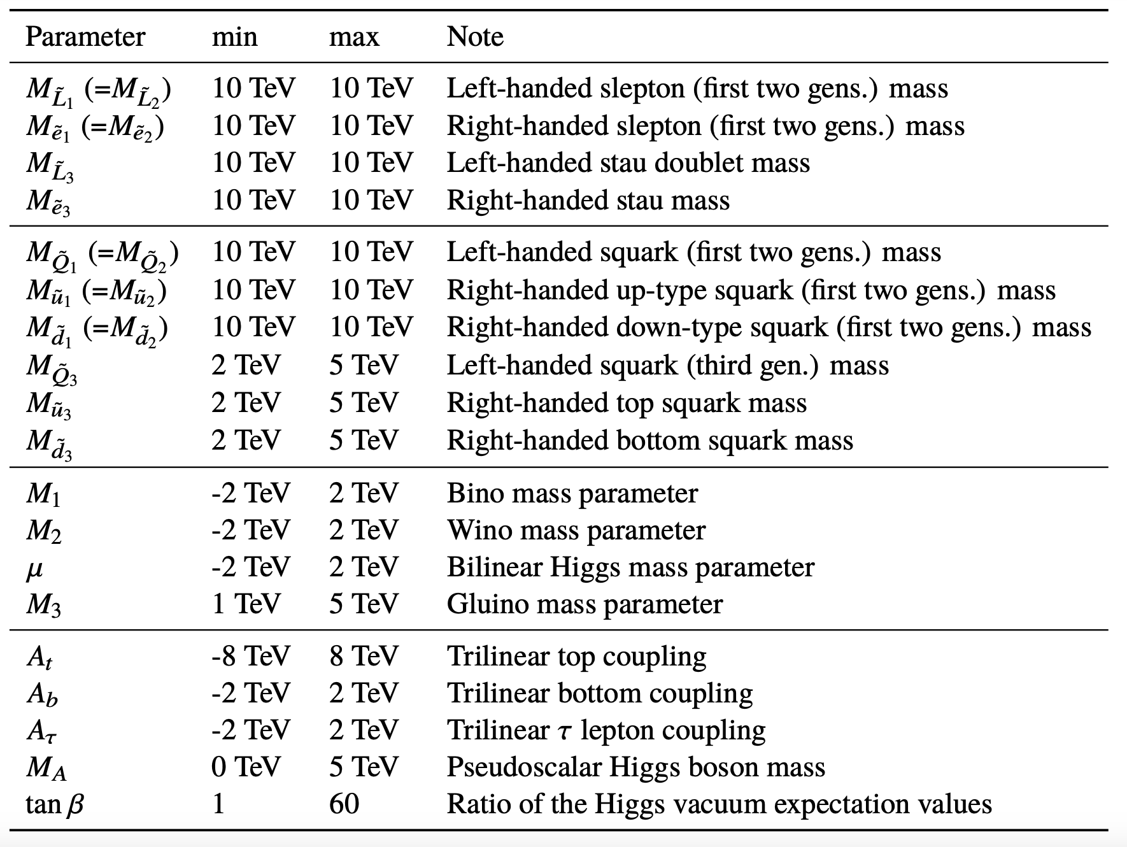
EWK pMSSM scan
Random scan with uniform priors over parameters relevant to production of charginos and neutralinos:

Slide 34
Interlude:
Dark Matter in the pMSSM

Slide 35
Dark Matter: Thermal freeze-out
Planck mission: Observes a “density” of DM in the universe of: Ωh² = 0.12
→ Compared to 0.0224 for baryonic matter
The SUSY story of how we got there (also applies to non-SUSY cold dark matter models):
Early universe: Very hot, lots of sparticles + SM particles being created/annihilated.
Universe cools: Heavier sparticles stop being produced and decay to LSP (which can pair-annihilate into SM particles)
Cosmological expansion: LSP’s spread out so annihilation rate decreases.
“Freeze out” = density of LSP’s remains constant.
The “density” of DM observed today is determined by the LSP annihilation cross-section.

Slide 36
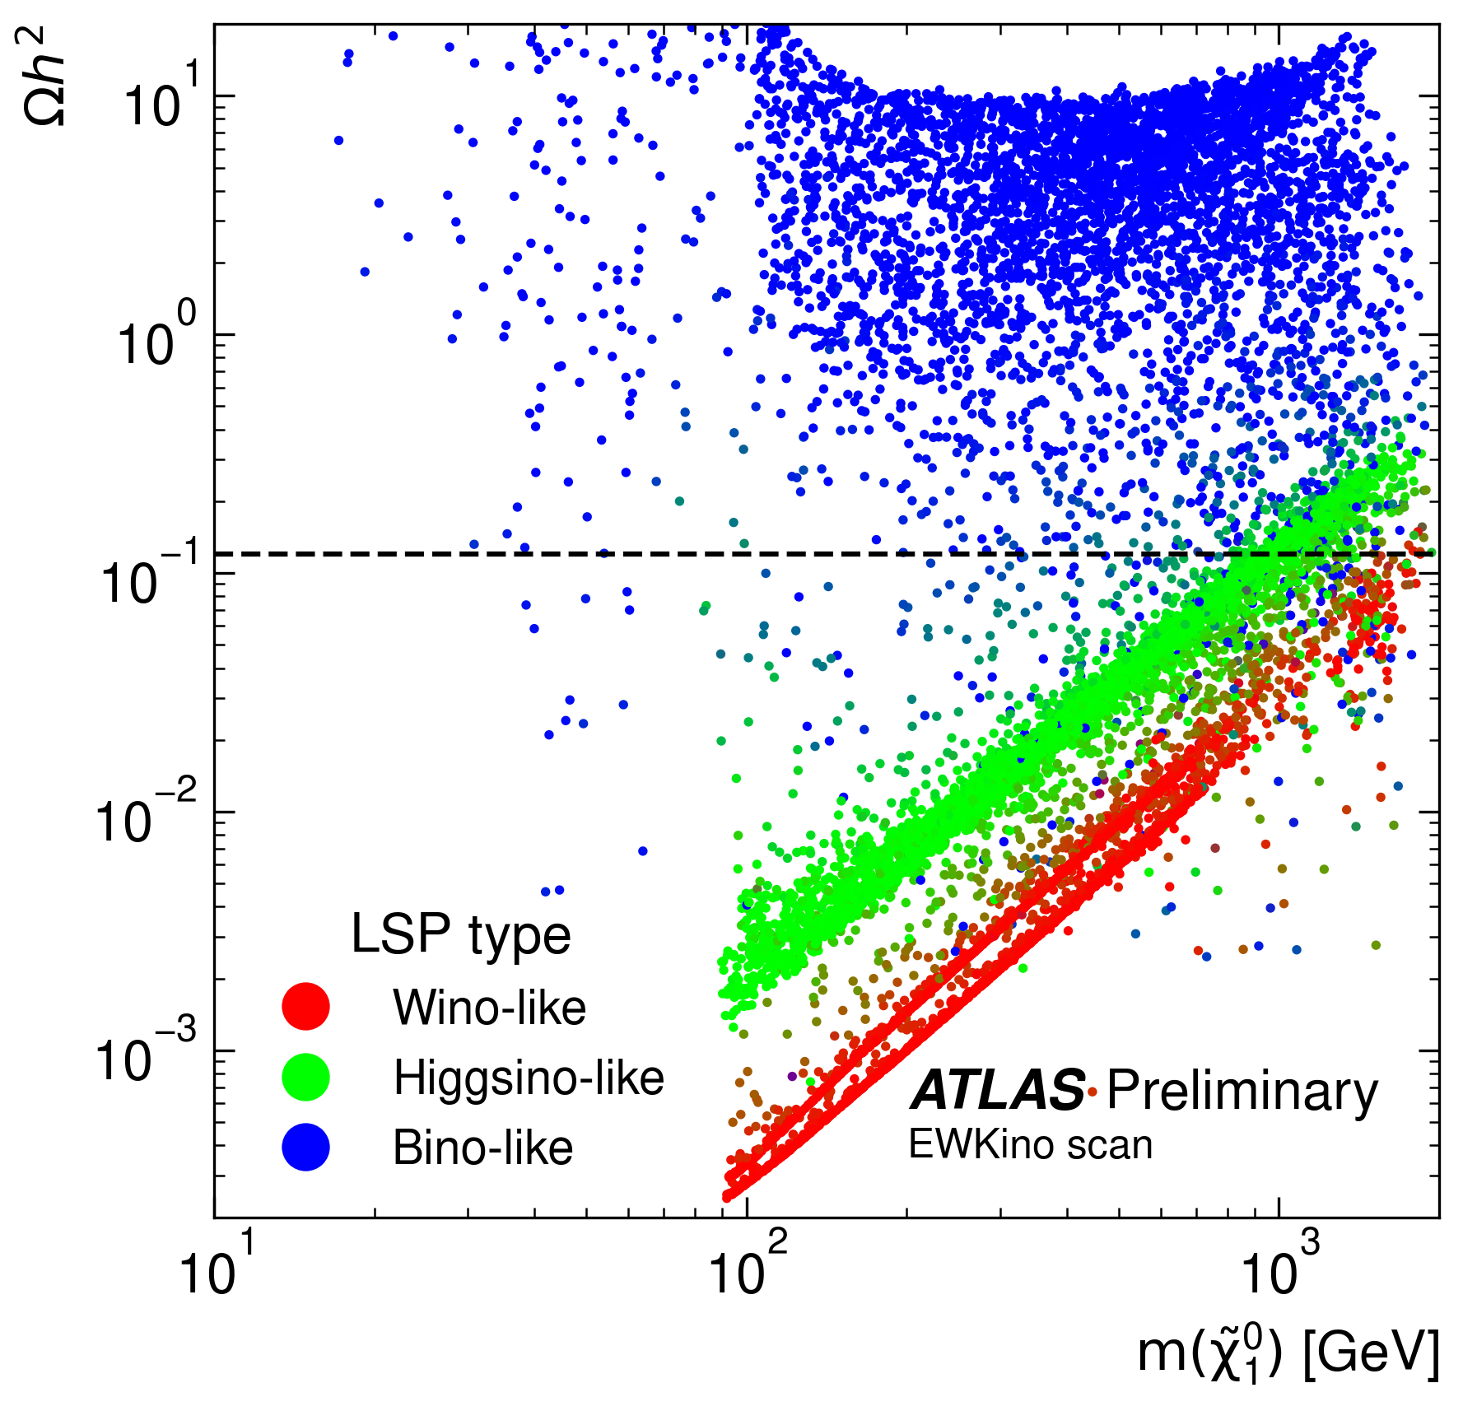
Dark matter in the pMSSM
Recall the SUSY DM candidate is the neutralino (𝜒̃⁰₁ )
Neutralino is a mix of the wino, higgsino and bino fields.
→“Bino-like”, “Higgsino-like” or “Wino-like” depending on dominant component…
DM phenomenology is different for each case…

Slide 37
Dark matter relic density of models
We allow LSP to be a sub-dominant DM component
Require Ωh² ≤ 0.12
Higgsino/Wino-like LSP:
Mass near to chargino / 2nd neutralino
Enhanced co-annihilation with chargino / 2nd neutralino
Underestimates relic density unless m(LSP)~TeV

Slide 38
Dark matter relic density of models
We allow LSP to be a sub-dominant DM component
Require Ωh² ≤ 0.12
Higgsino/Wino-like LSP:
Mass near to chargino / 2nd neutralino
Enhanced co-annihilation with chargino / 2nd neutralino
Underestimates relic density unless m(LSP)~TeV
Bino LSP:
In general overestimates relic density
Flat scanning strategy doesn’t sample many models with satisfactory relic density

Slide 39
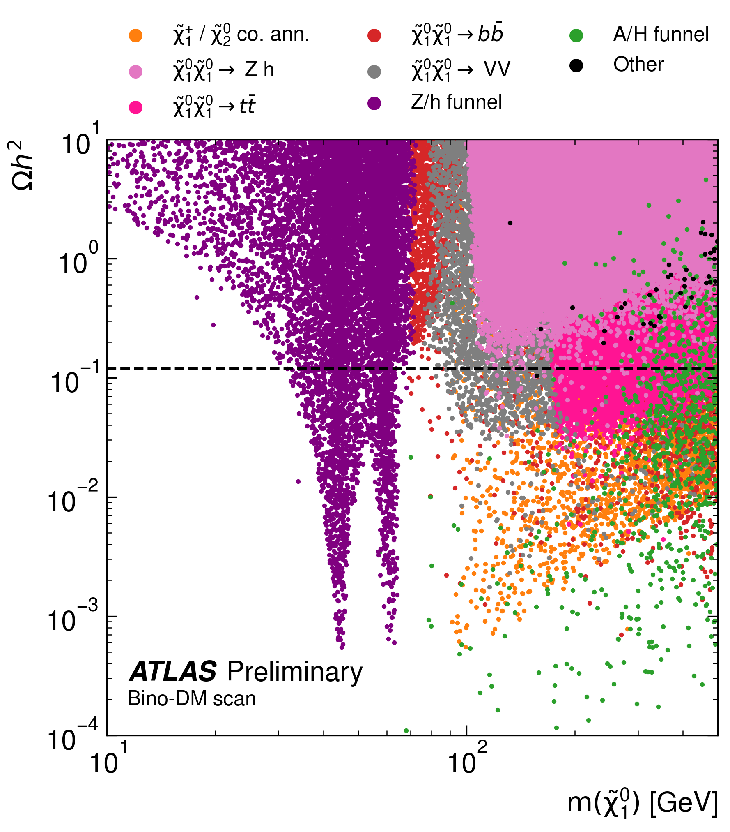
Bino-LSP models: DM relic density
Regions with satisfactory DM relic density for bino-LSP models:
Z/h/A funnel
Enhanced co-annihilation with 2nd neutralino or chargino
Wino-like C1/N2 close in mass
Significant higgsino component
Targeted scan performed to oversample these regions

Slide 40
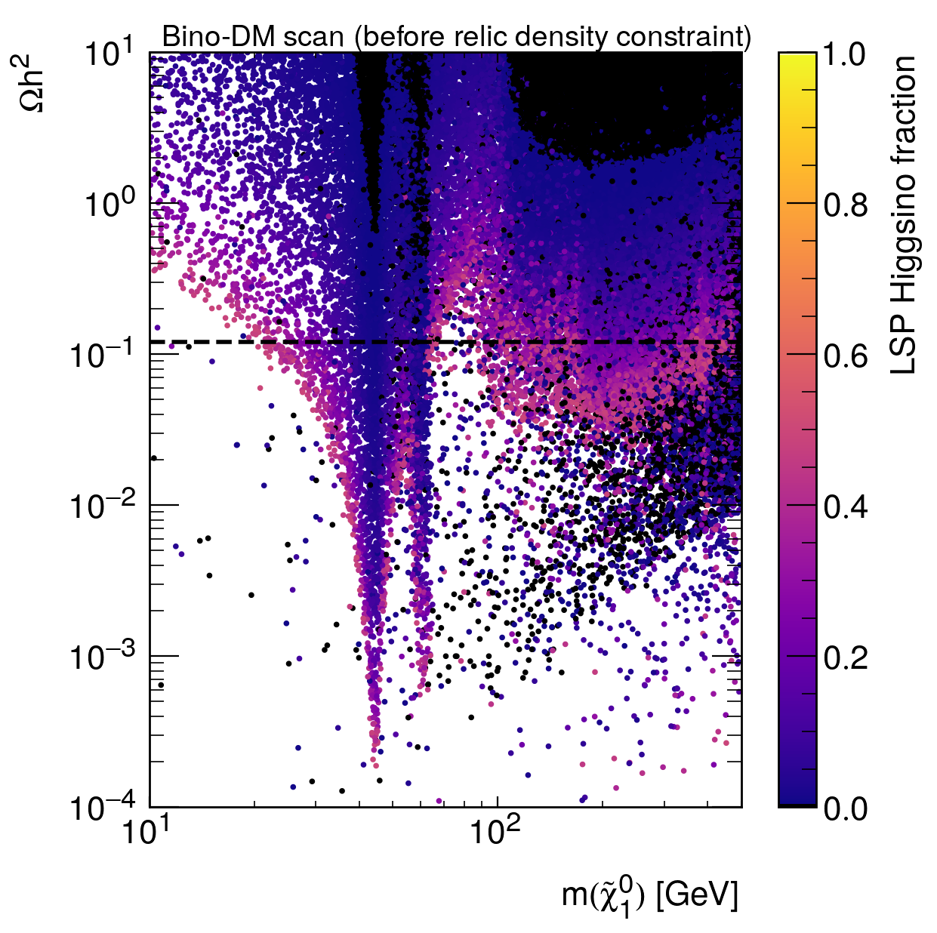
Bino-LSP models: DM relic density
Regions with satisfactory DM relic density for bino-LSP models:
Z/h/A funnel
Enhanced co-annihilation with 2nd neutralino or chargino
Wino-like C1/N2 close in mass
Significant higgsino component
Targeted scan performed to oversample these regions

Slide 41
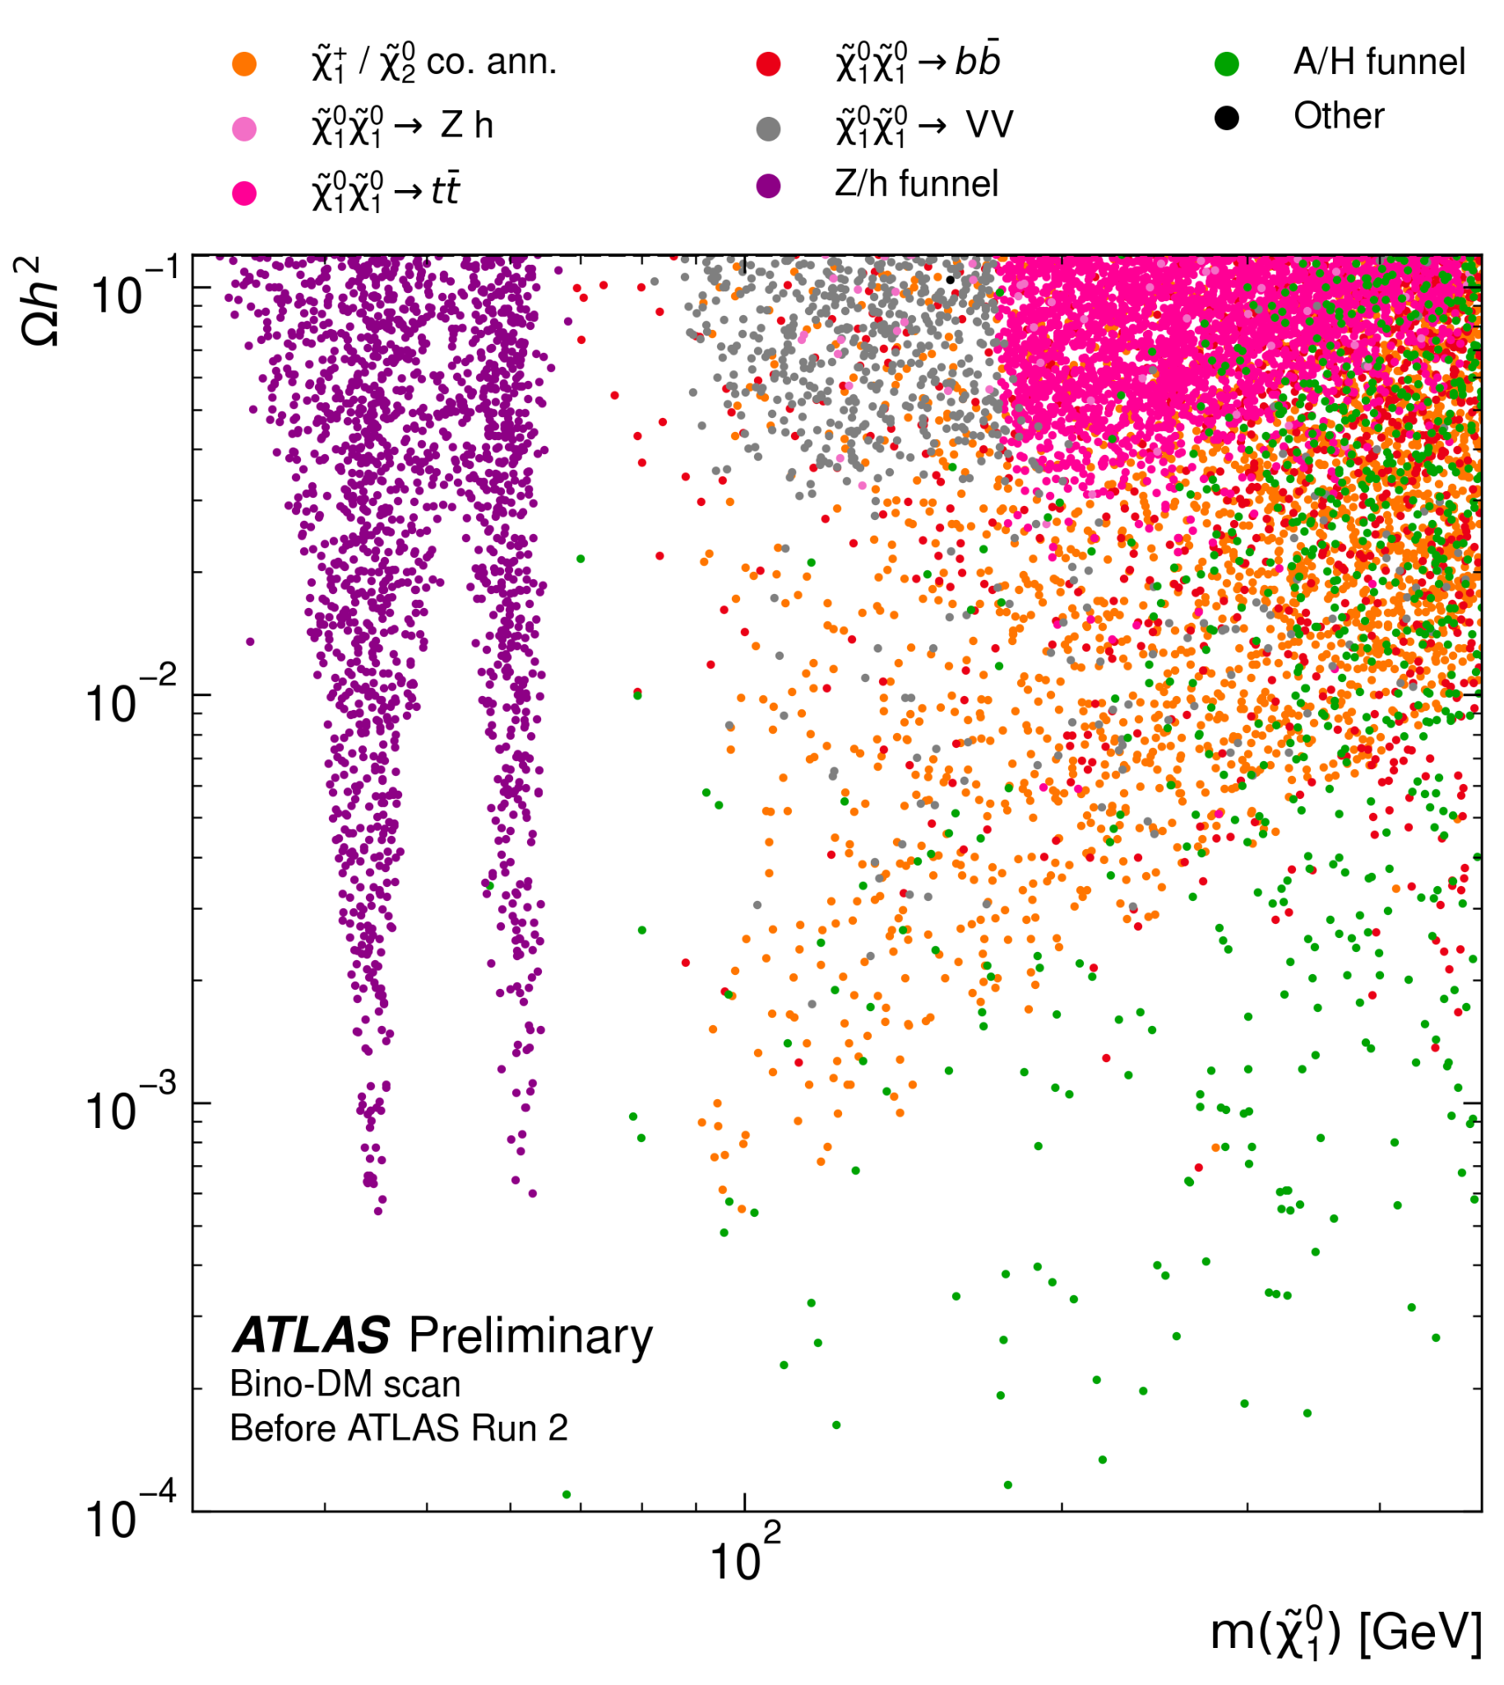
Final pMSSM model samples
Bino-DM scan
Bino-like LSP only
Require Ωh² ≤ 0.12
8,897 models
EWKino scan
All LSP types
Don’t impose dark matter constraint
12,280 models

Slide 42
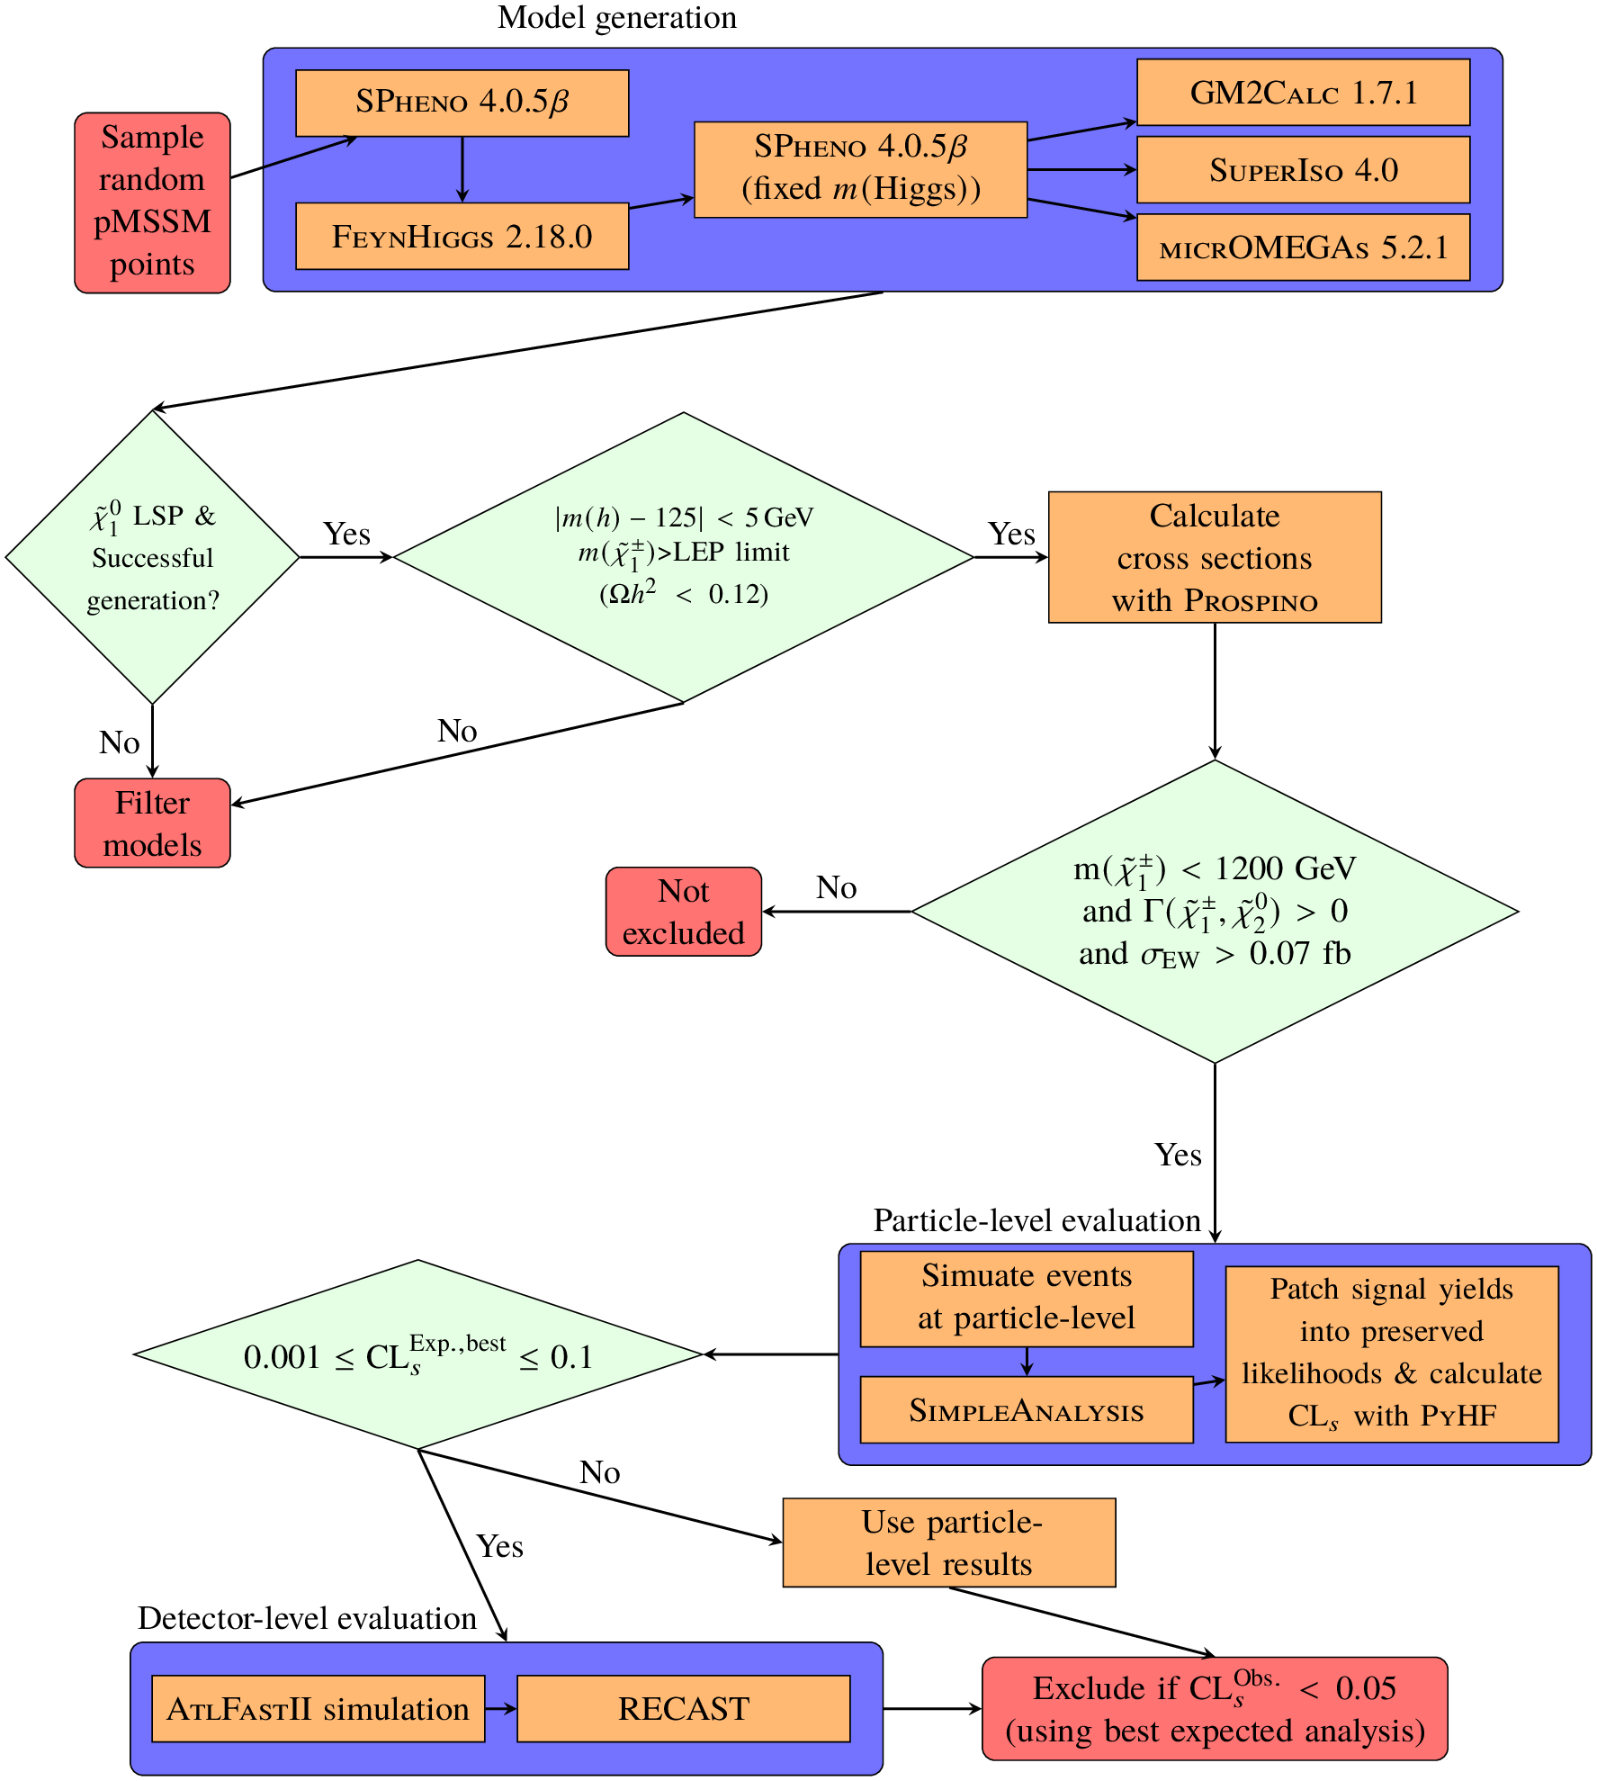
Workflow

Slide 43
Workflow
Initial constraints applied

Slide 44
Workflow
Initial constraints applied
Only simulate models where we expect some sensitivity

Slide 45
Workflow
Initial constraints applied
Only simulate models where we expect some sensitivity
Particle-level evaluation first to check if model is likely to be excluded or not

Slide 46
Workflow
Initial constraints applied
Only simulate models where we expect some sensitivity
Particle-level evaluation first to check if model is likely to be excluded or not
Detector simulation for models where particle-level evaluation is insufficient
→ This is what separates this from non-ATLAS pheno studies

Slide 47
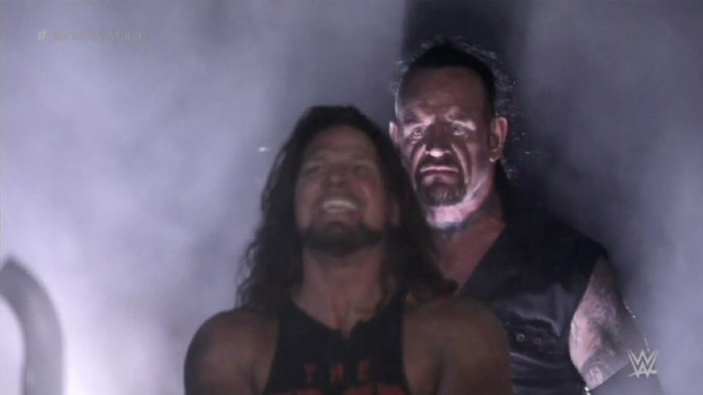
Excluding pMSSM models with ATLAS Run 2 analyses
The ATLAS Run 2 dataset
Phenomenologically viable SUSY models

Slide 48
Searches included
All key signature Run 2 EW searches are included, covering each final-state lepton multiplicity:
Fully hadronic
1 lepton + 2 bjets (1Lbb)
2 leptons + 0 jets (2L0J)
2 leptons + 2 jets (2L2J
Compressed 2 lepton
3 lepton (3L)
4 lepton (4L)
Disappearing track

Slide 49
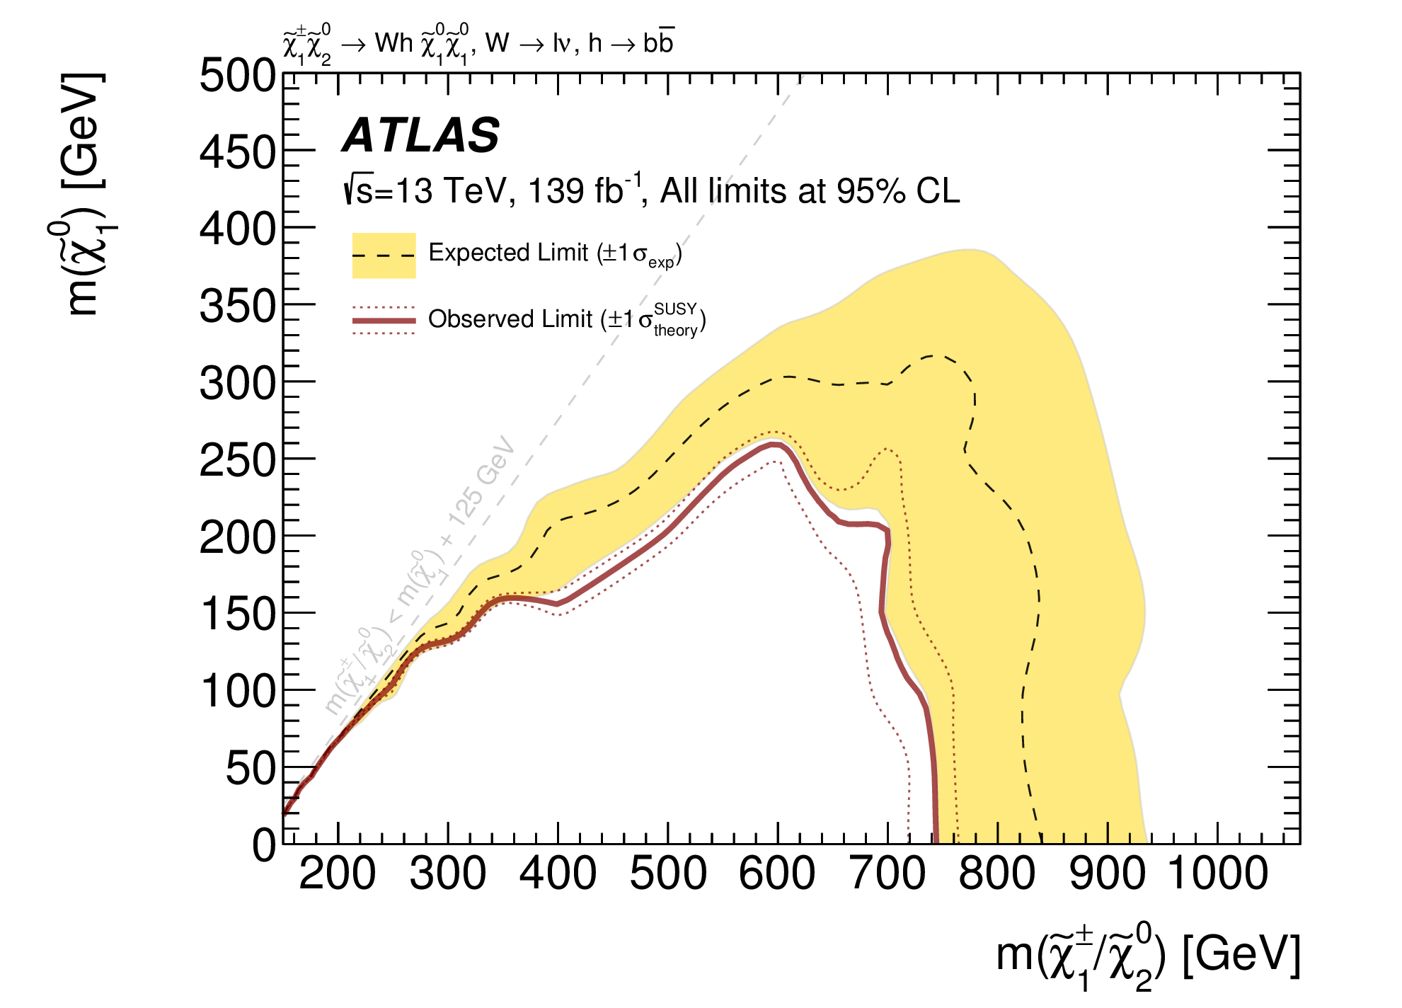
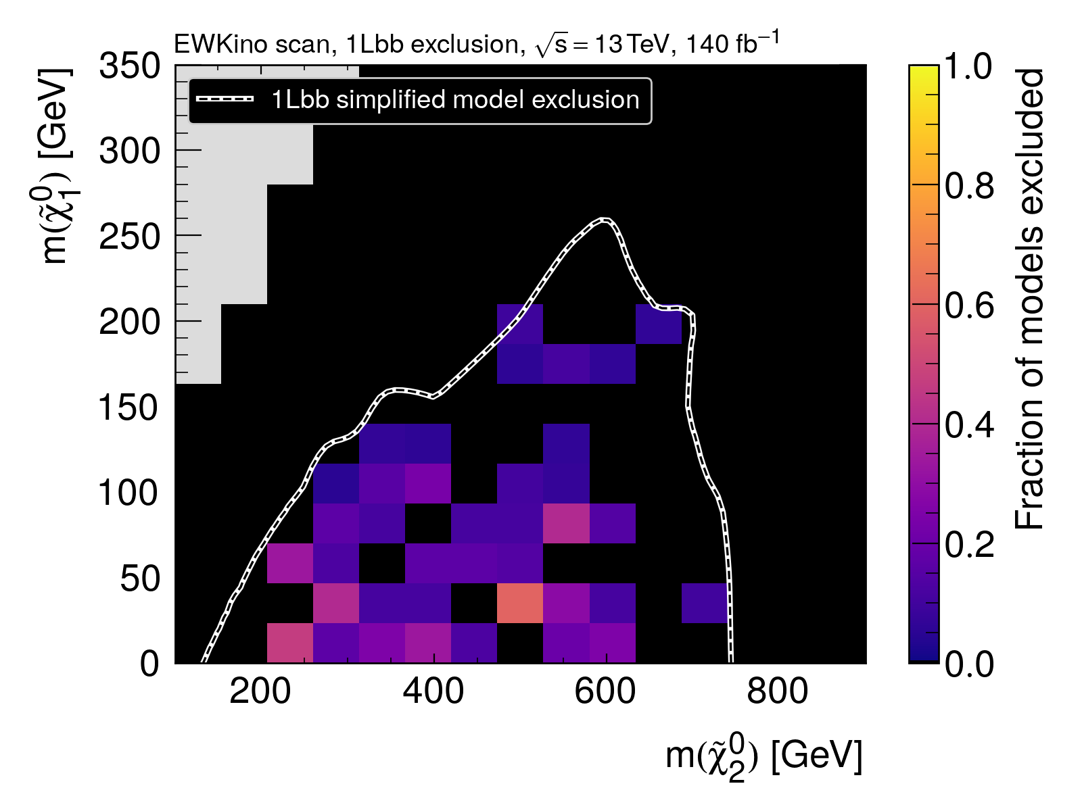
1Lbb
1Lbb simplified model:
Pure-Bino LSP
Pure-Wino chargino and 2nd neutralino
BR(𝜒̃⁰₂→ 𝜒̃⁰₁ h) = 100%
SM-like Higgs decays
Simplified model limits
pMSSM exclusion

Slide 50
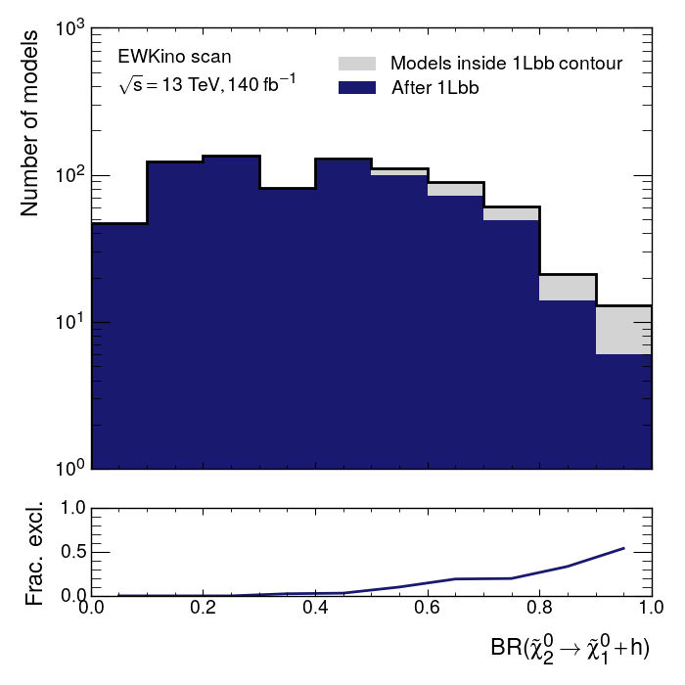
1Lbb
1Lbb simplified model:
Pure-Bino LSP
Pure-Wino chargino and 2nd neutralino
BR(𝜒̃⁰₂→ 𝜒̃⁰₁ h) = 100%
SM-like Higgs decays

Slide 51
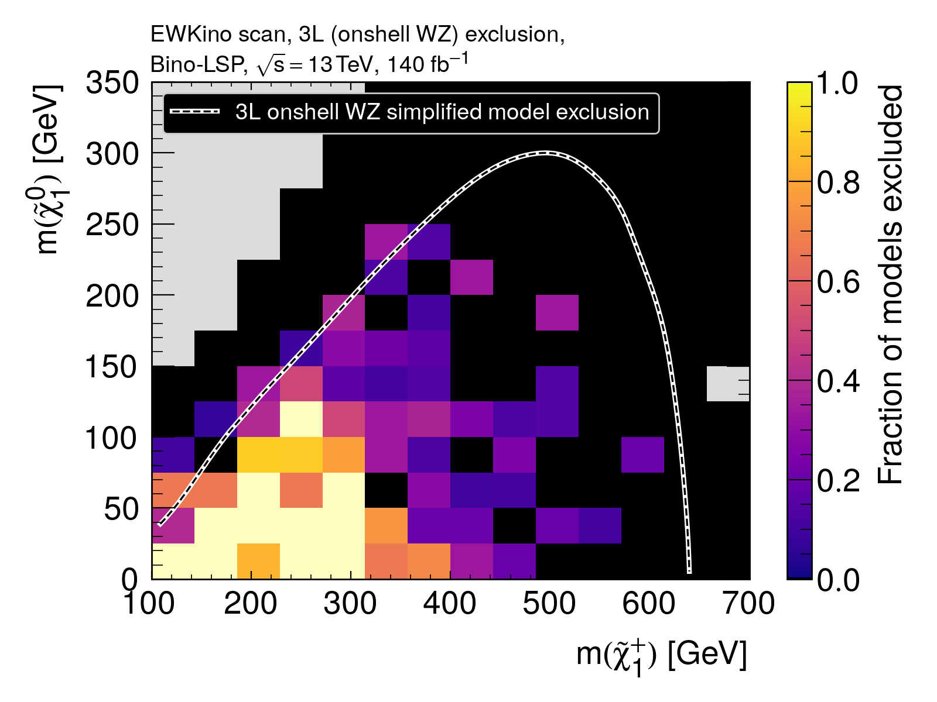
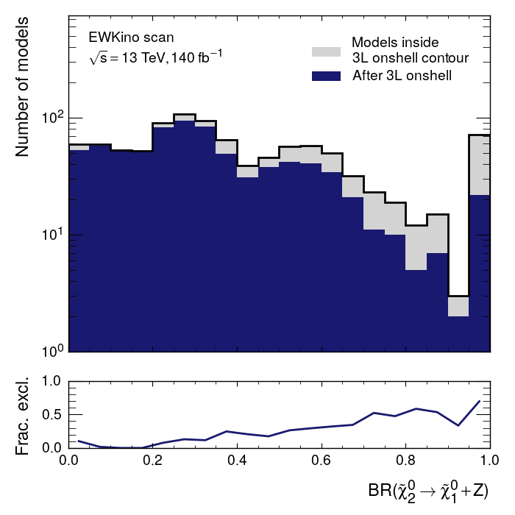
3L
3L simplified model:
Pure-Bino 𝜒̃⁰₁
Pure-Wino 𝜒̃⁰₂ and 𝜒̃±₁
BR(𝜒̃⁰₂→ 𝜒̃⁰₁ Z*)= 100%
BR(𝜒̃±₁→ 𝜒̃⁰₁ W*)= 100%
Preference for Z decay mode

Slide 52
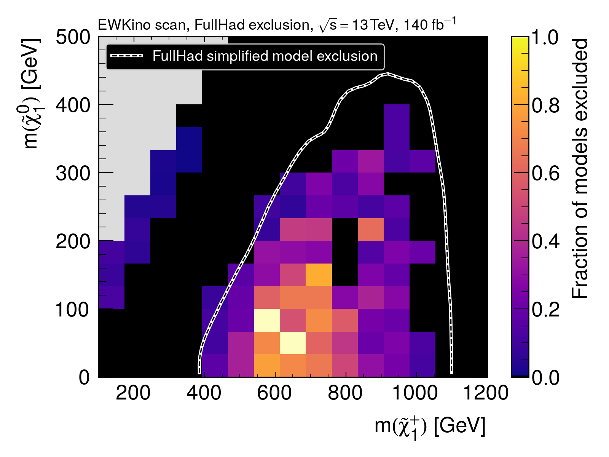
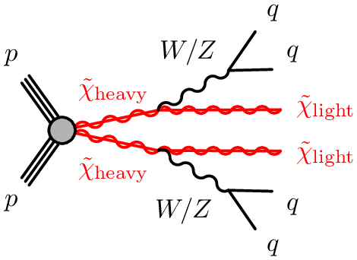
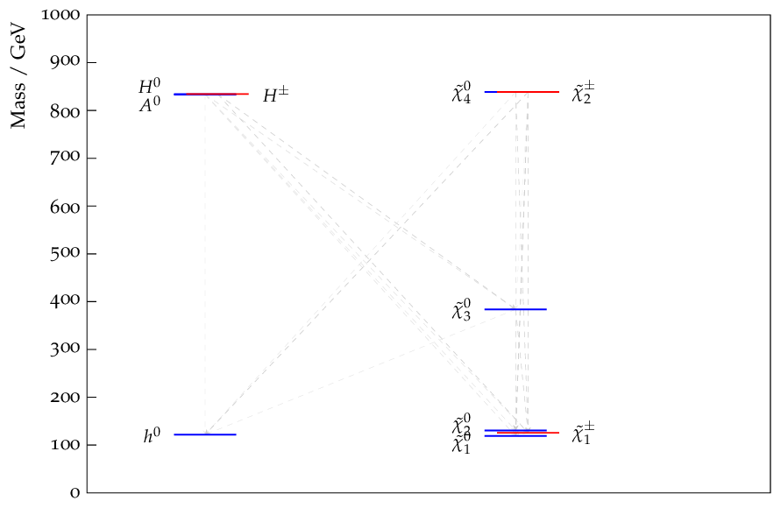
Fully hadronic
Targeted generic heavy electroweakino production
In the pMSSM this includes second chargino and third/fourth neutralino

Slide 53
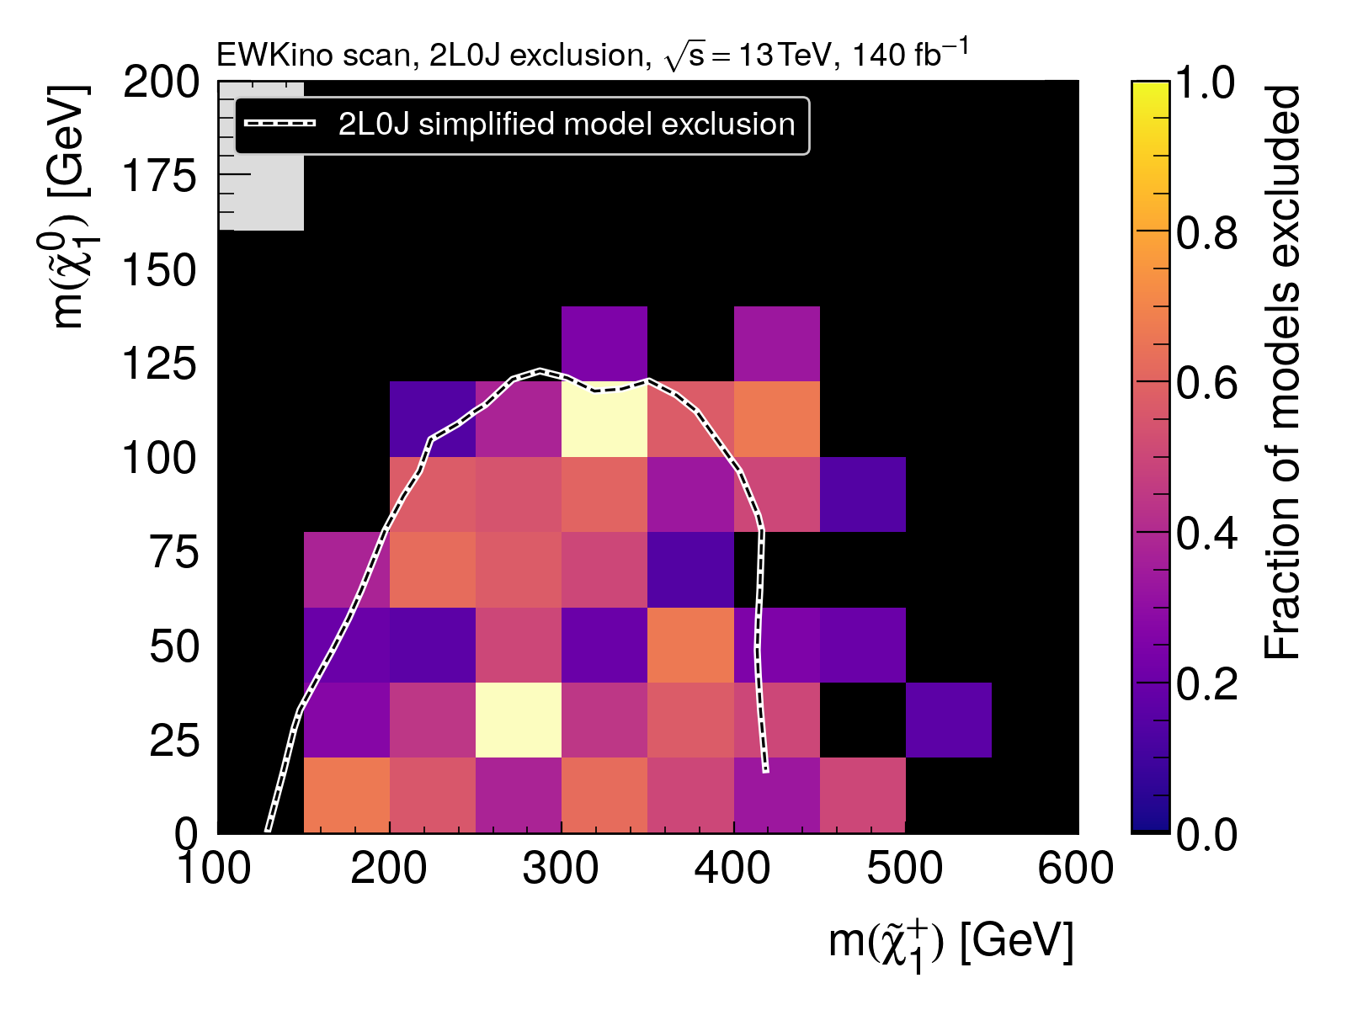
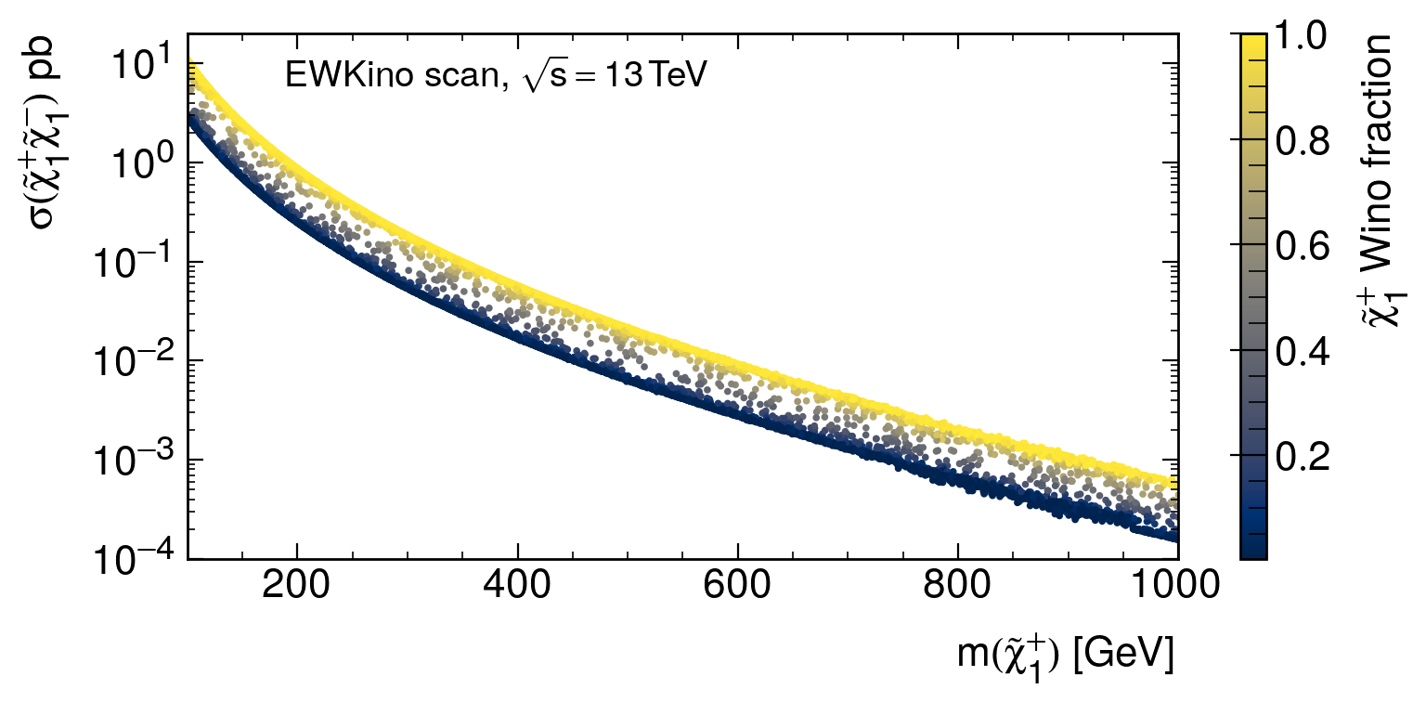
2L0J
2L0J simplified model:
Pure-Bino LSP
Pure-Wino chargino
BR(𝜒̃±₁→𝜒̃⁰₁ W±)= 100%
Preference for Wino-like charginos
→ higher production cross-section

Slide 54
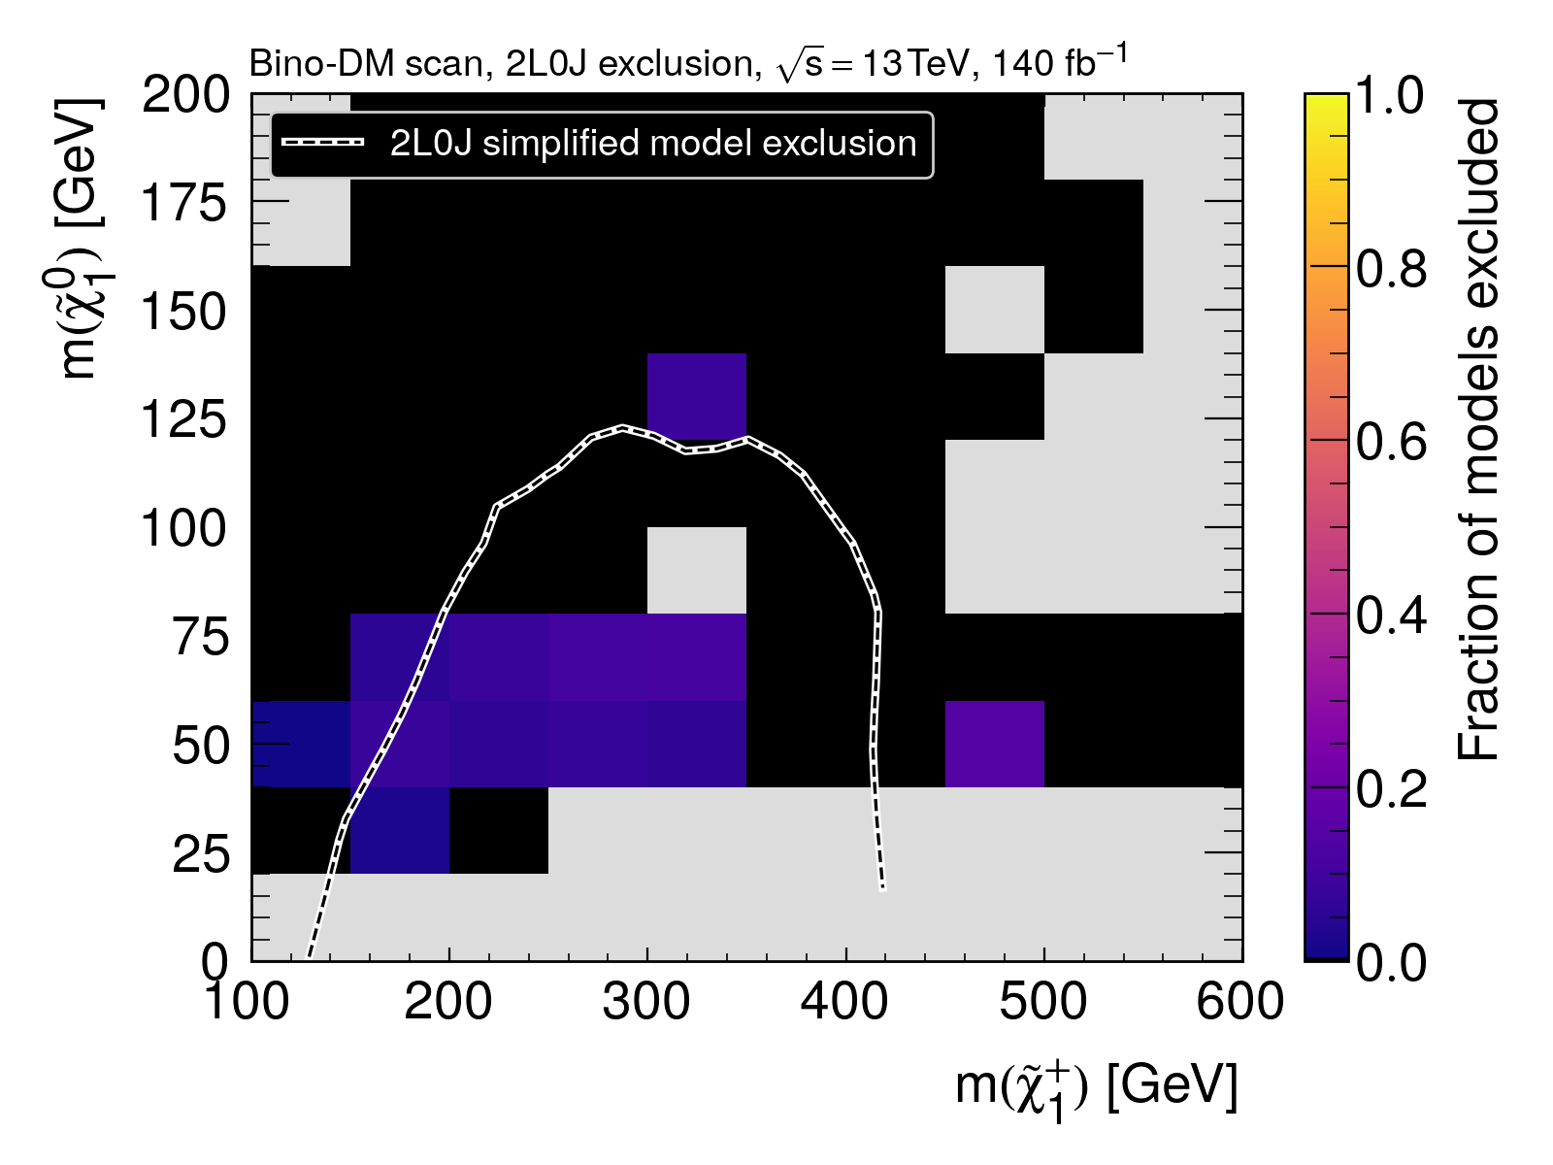
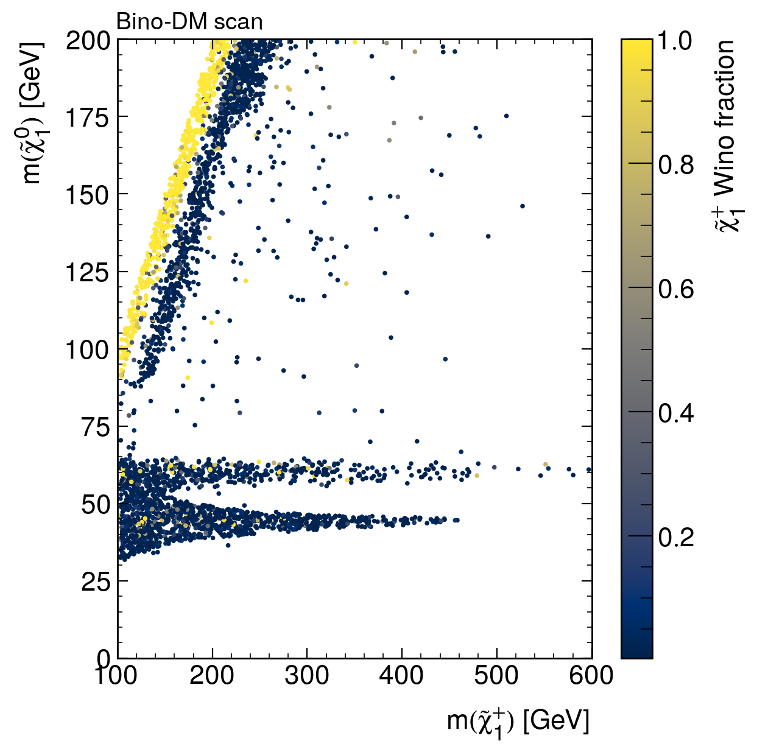
2L0J
2L0J simplified model:
Pure-Bino LSP
Pure-Wino chargino
BR(𝜒̃±₁→𝜒̃⁰₁ W±)= 100%
Higgsino 𝜒̃±₁ preferred in Bino-DM scan
→ weaker sensitivity

Slide 55
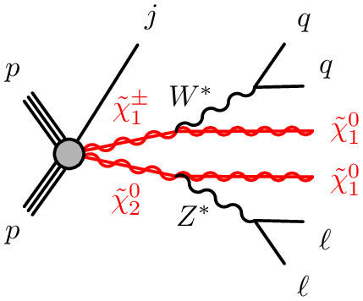
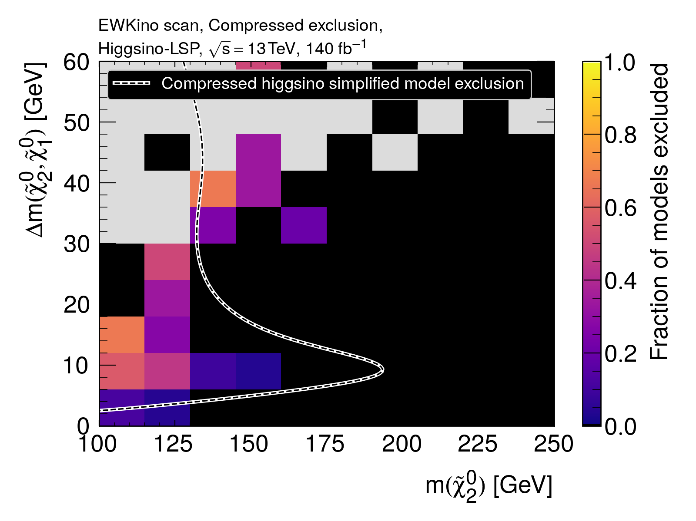
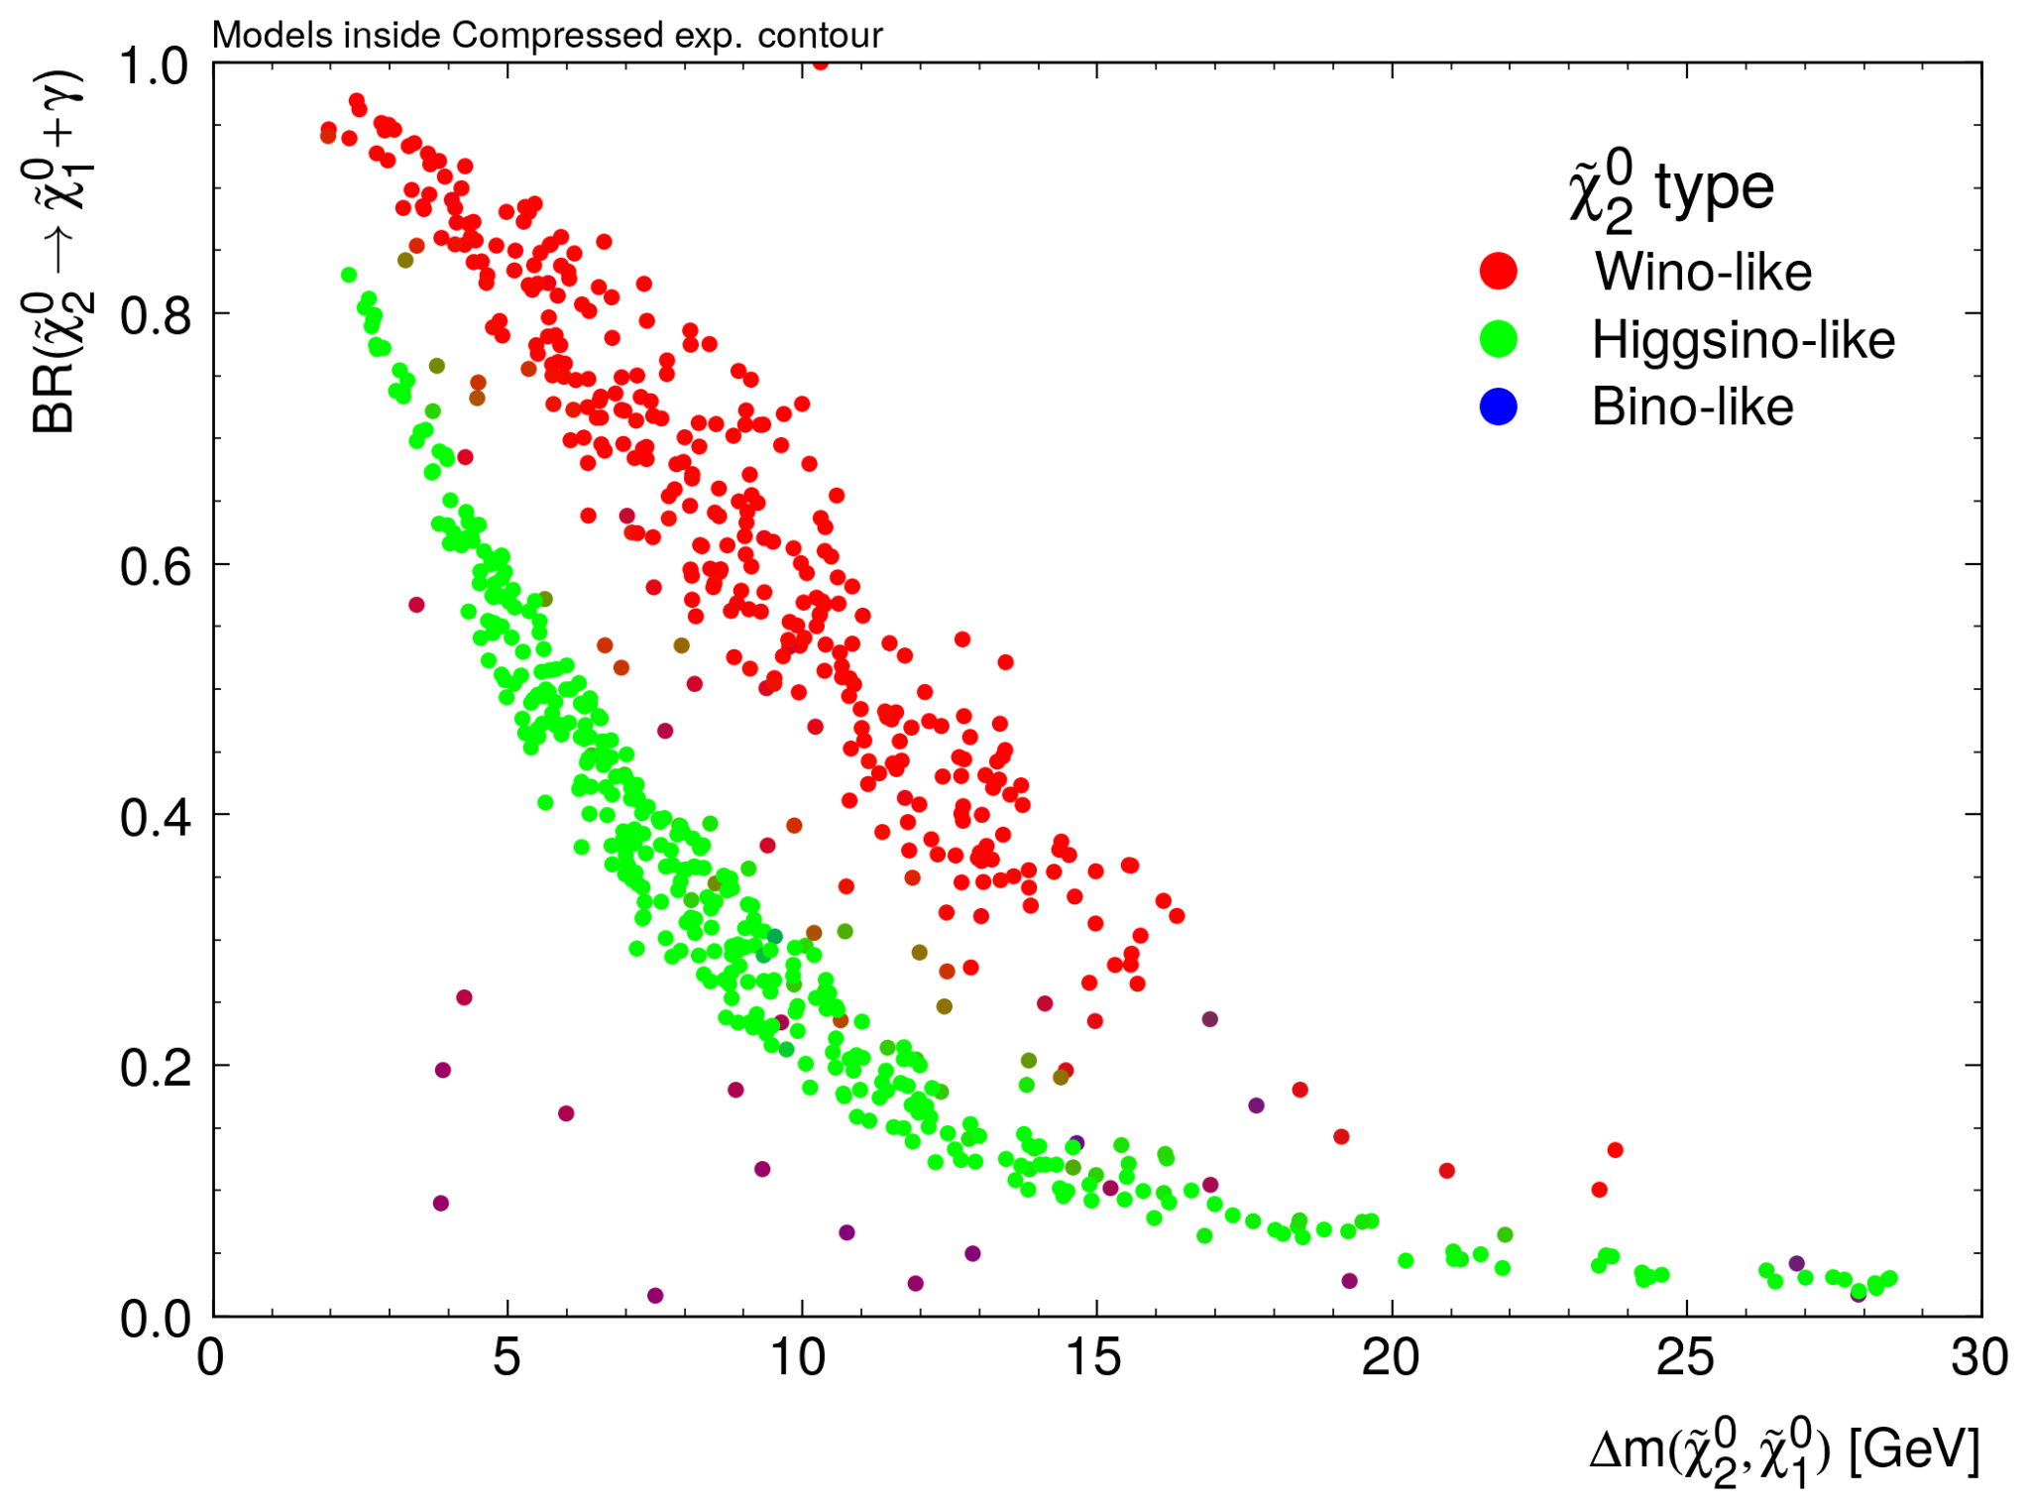
Compressed
Compressed higgsino simplified model:
Pure-higgsino (𝜒̃⁰₁,𝜒̃⁰_{2,}𝜒̃±₁)
BR(𝜒̃⁰₂→ 𝜒̃⁰₁ Z*)= 100%
BR(𝜒̃±₁→ 𝜒̃⁰₁W*)= 100%
At smaller mass-splittings, the radiative decay mode becomes dominant → reduced sensitivity

Slide 56
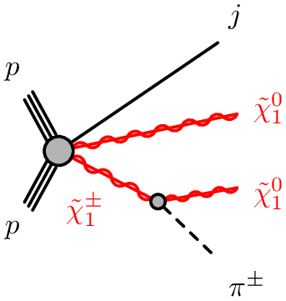
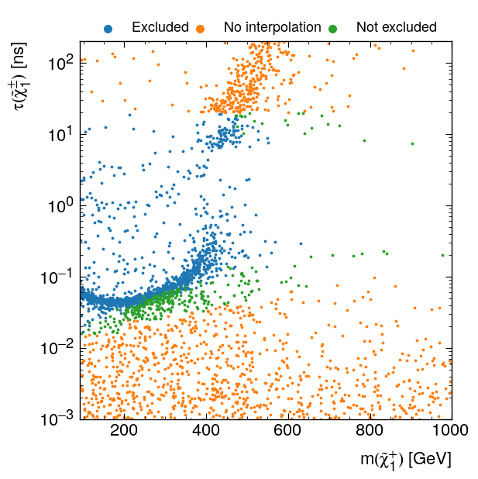
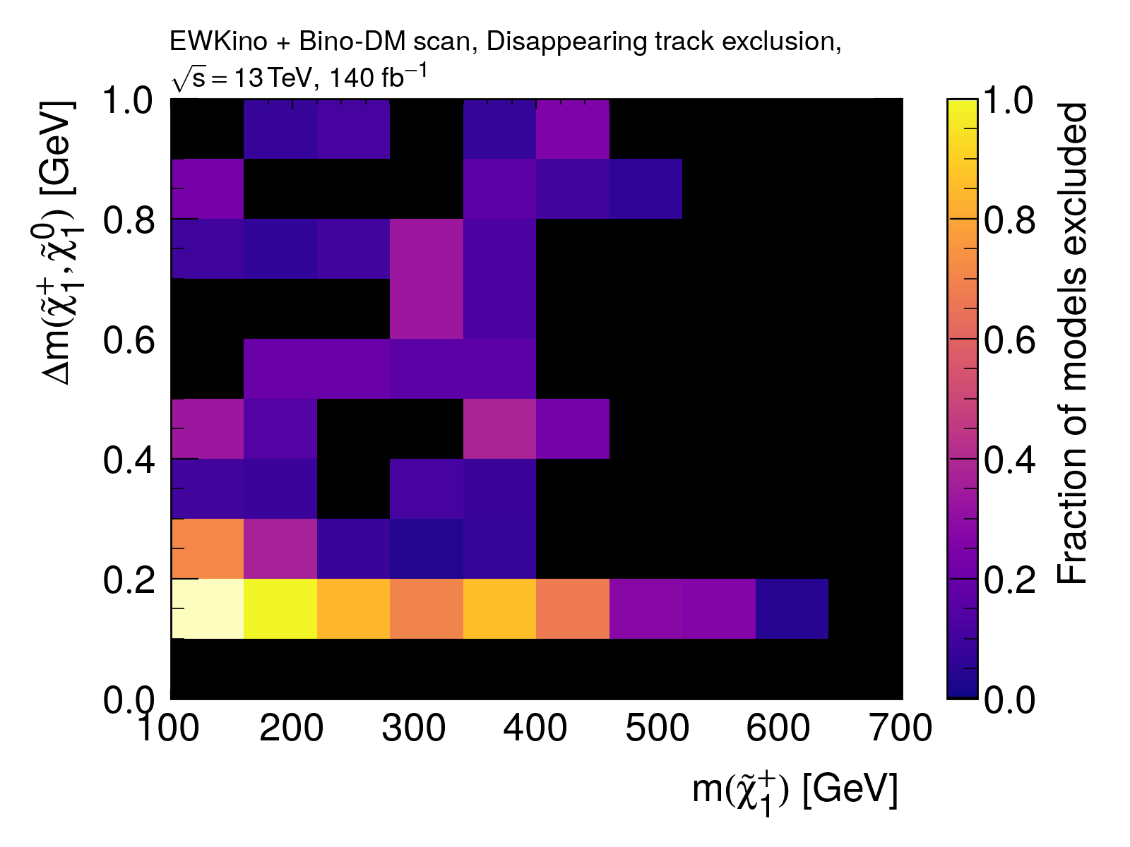
Disappearing track
Evaluated using cross-section upper limits only

Slide 57
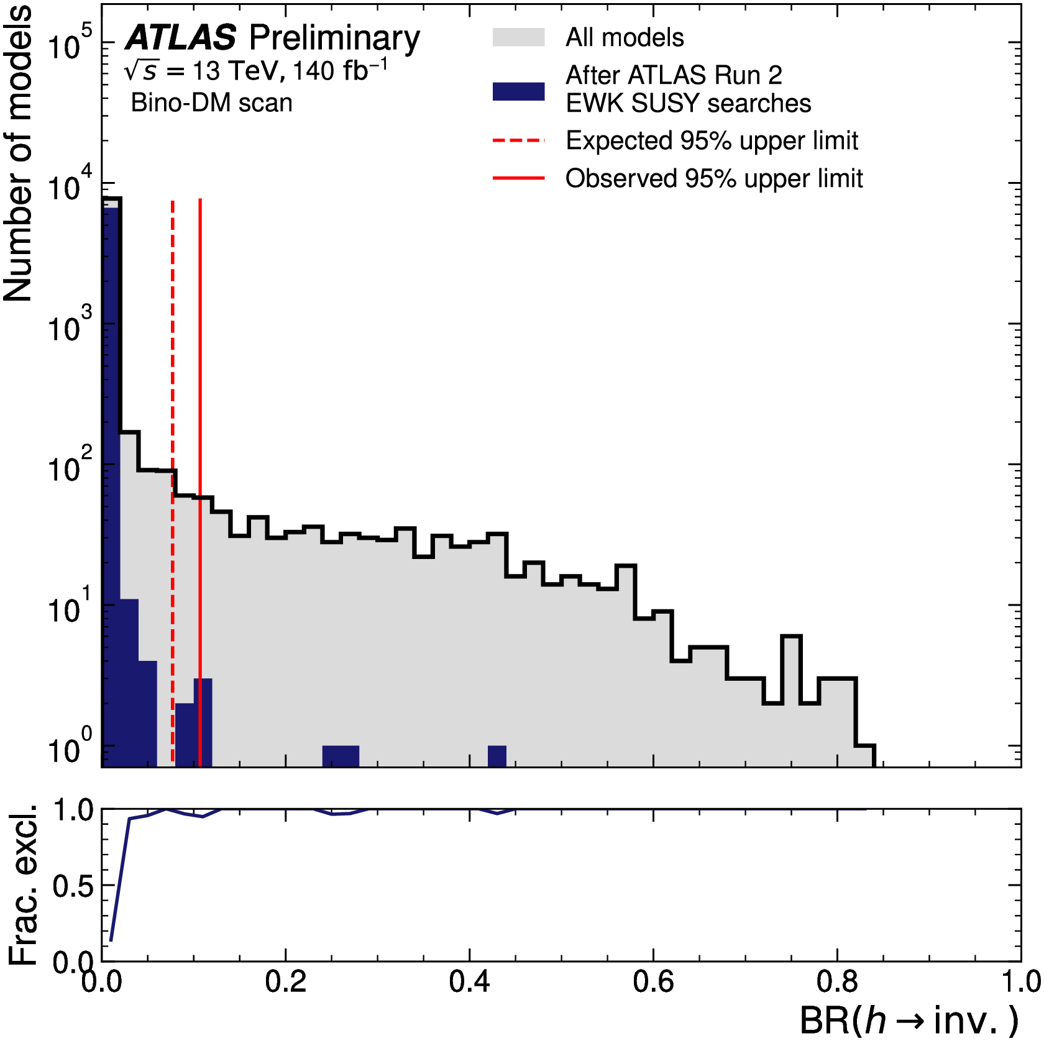
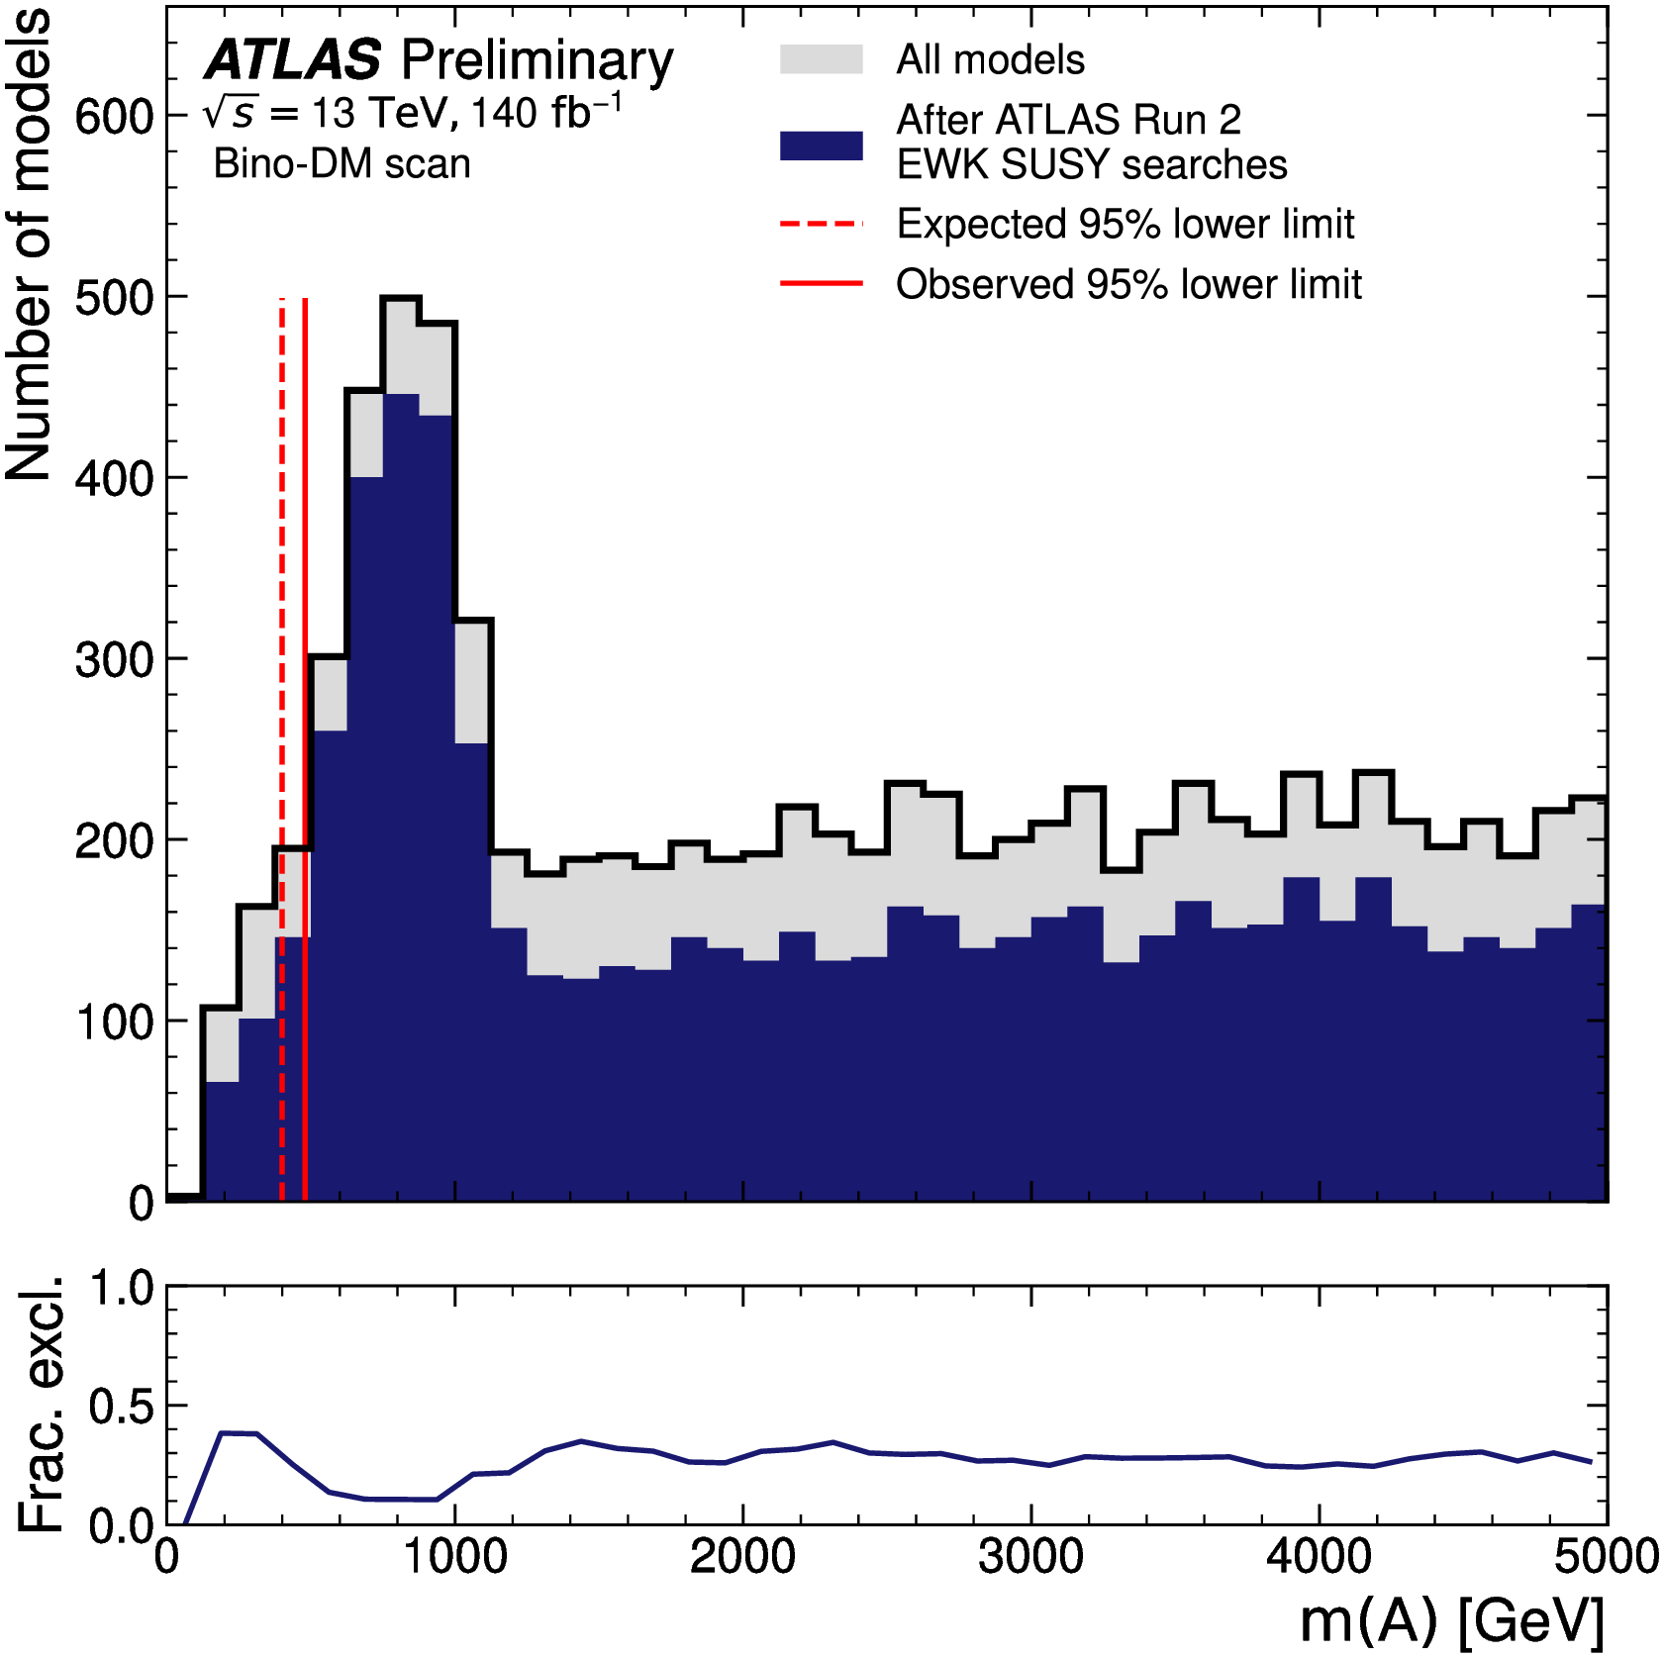
bSM Higgs analyses
Constraints on the mass of the pseudoscalar A from Higgs measurements
BR(h→invisible) gets contributions from h→𝜒̃⁰₁𝜒̃⁰₁

Slide 58
External constraints

Slide 59
External constraints

Slide 60
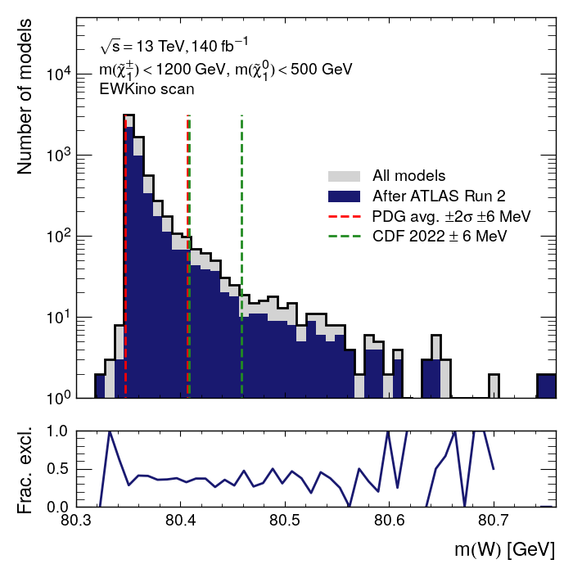
EW precision constraints
Average W mass measurement
→ window widened by 6 MeV to account for uncertainty on top-quark mass
CDF result not used
→ would be strongly constraining if confirmed (~4% models lie in CDF W mass range)
Constraints on Δ⍴ and Γ(Z→invisible) also applied

Slide 61
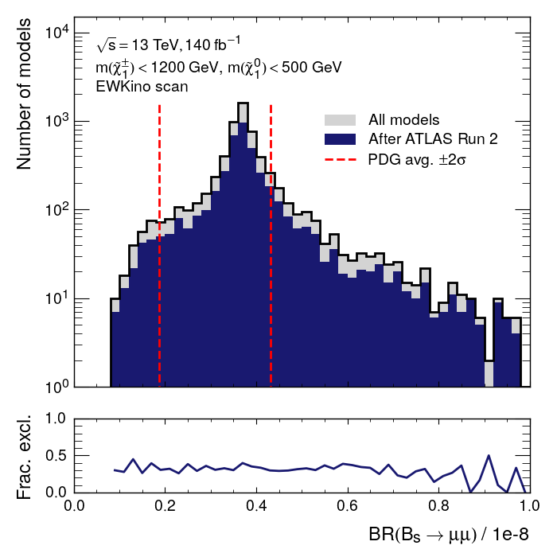
Flavour constraints
Latest LHCb B_{s}→ μμ measurement
pMSSM models get loop contributions
Constraints on B_{u}→ 𝛕 𝝂 and b→s𝜸 also included

Slide 62
Overall exclusion
For each model, the analysis with the best expected CLs is used
If the observed CLs < 0.05 for that analysis, the model is considered “excluded”.
No statistical combinations are performed.
Only models which pass the flavour & precision EW external constraints are included
Dark matter constraints considered separately

Slide 63
Overall ATLAS sensitivity
Sensitivity to compressed scenarios through heavier electroweakino decays
Even low mass bins don’t have 100% exclusion…
Important to improve depth of sensitivity as well as target new regions!

Slide 64
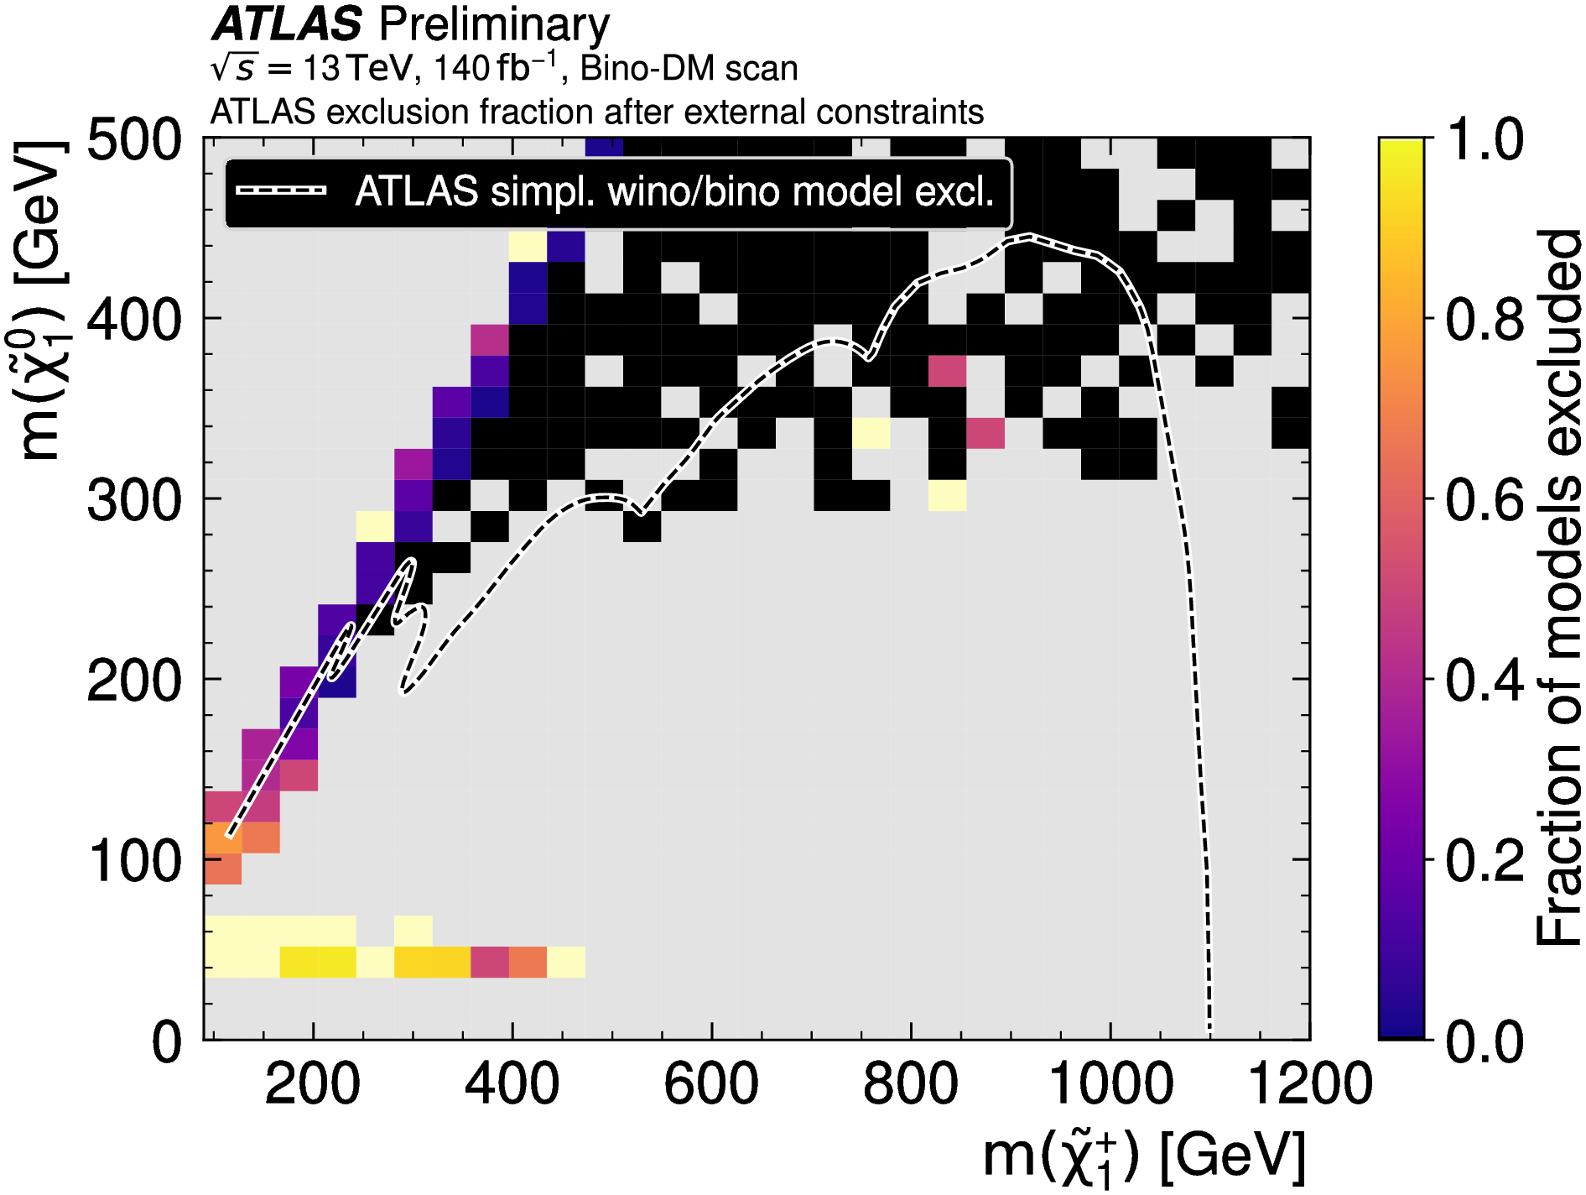
Overall exclusion
Bino-DM scan
When dark matter constraints are included, the region our searches target is not very well populated!
Mostly compressed scenarios remain
Grey bins = No models

Slide 65
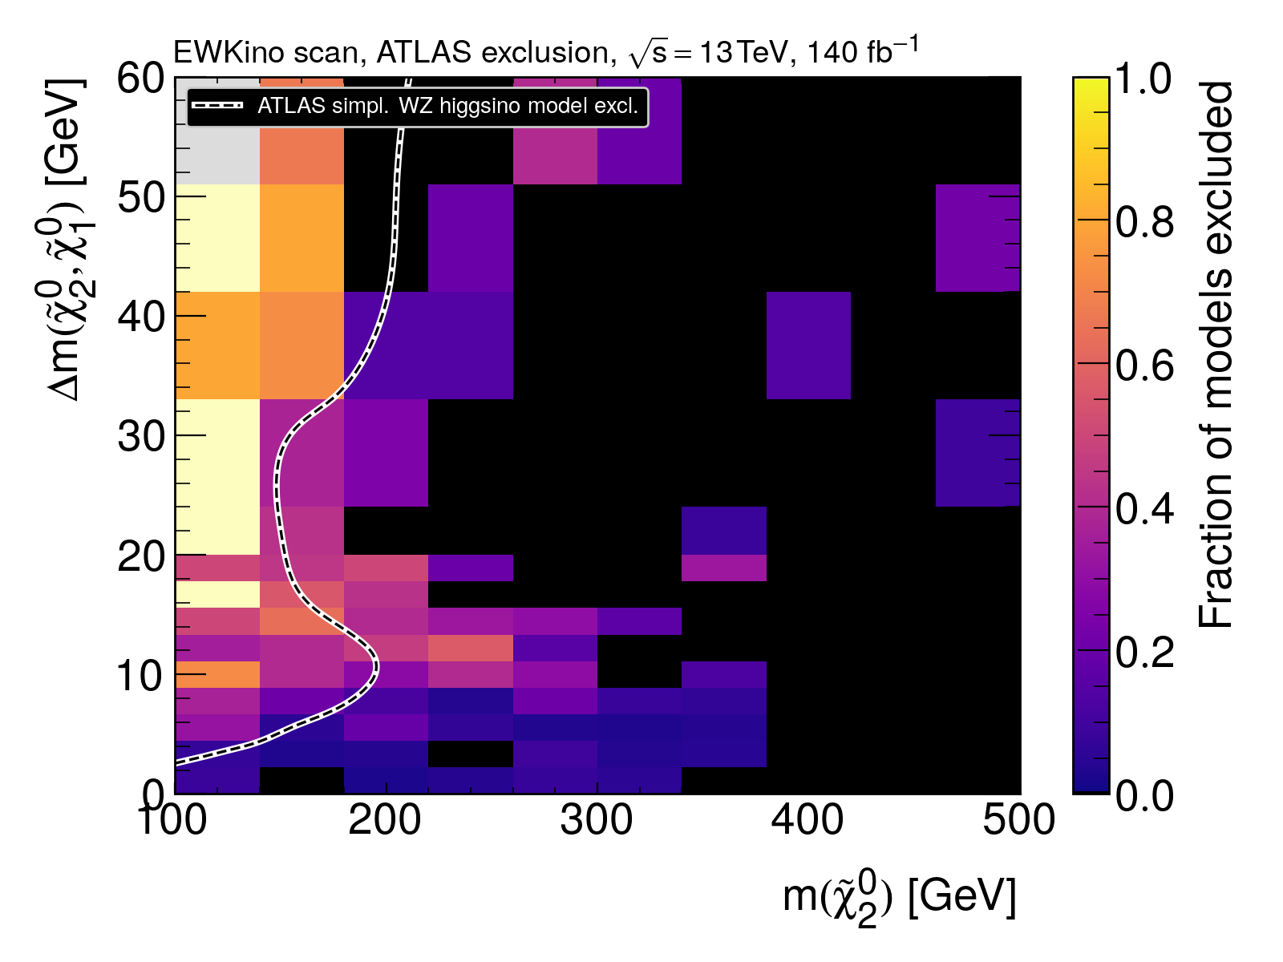
Overall exclusion
Exclusion beyond the overlaid contour from FullHad, 2L2J and Disappearing Track

Slide 66
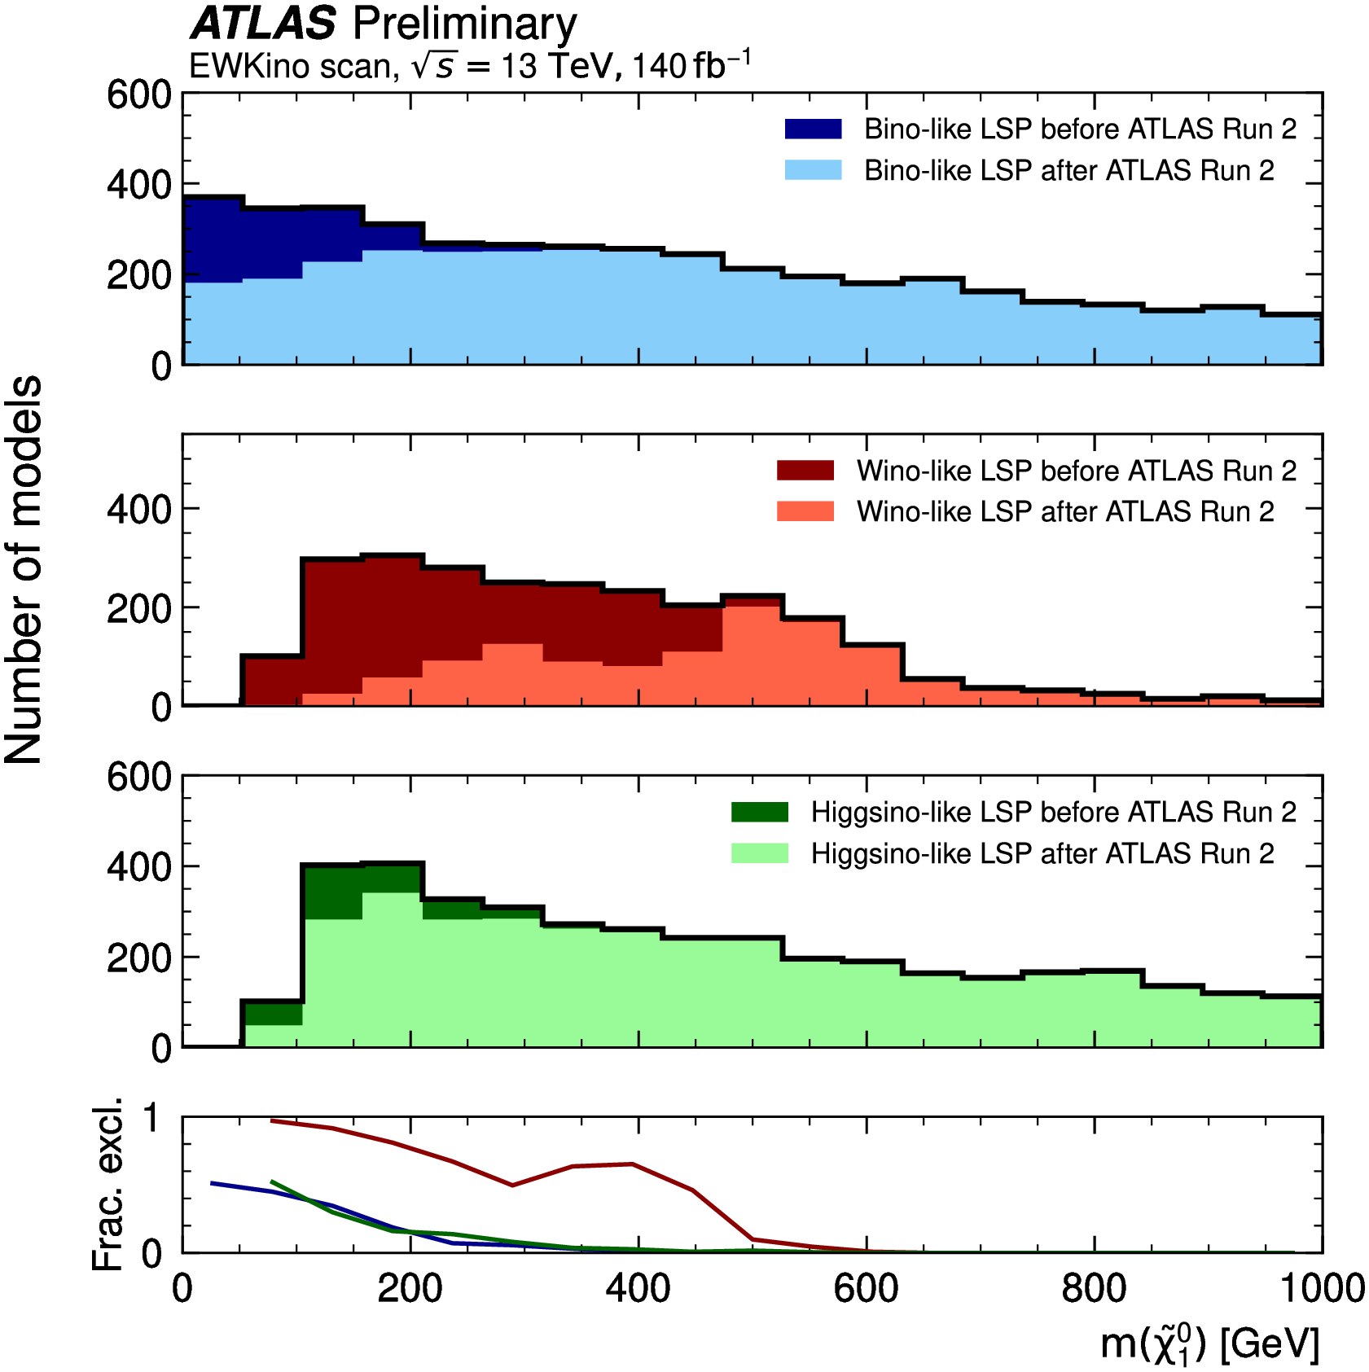
Overall exclusion
Disappearing track does a good job constraining wino-LSP scenarios (red)
Bino and Higgsino-LSP scenarios remain viable even at 100 GeV and below

Slide 67
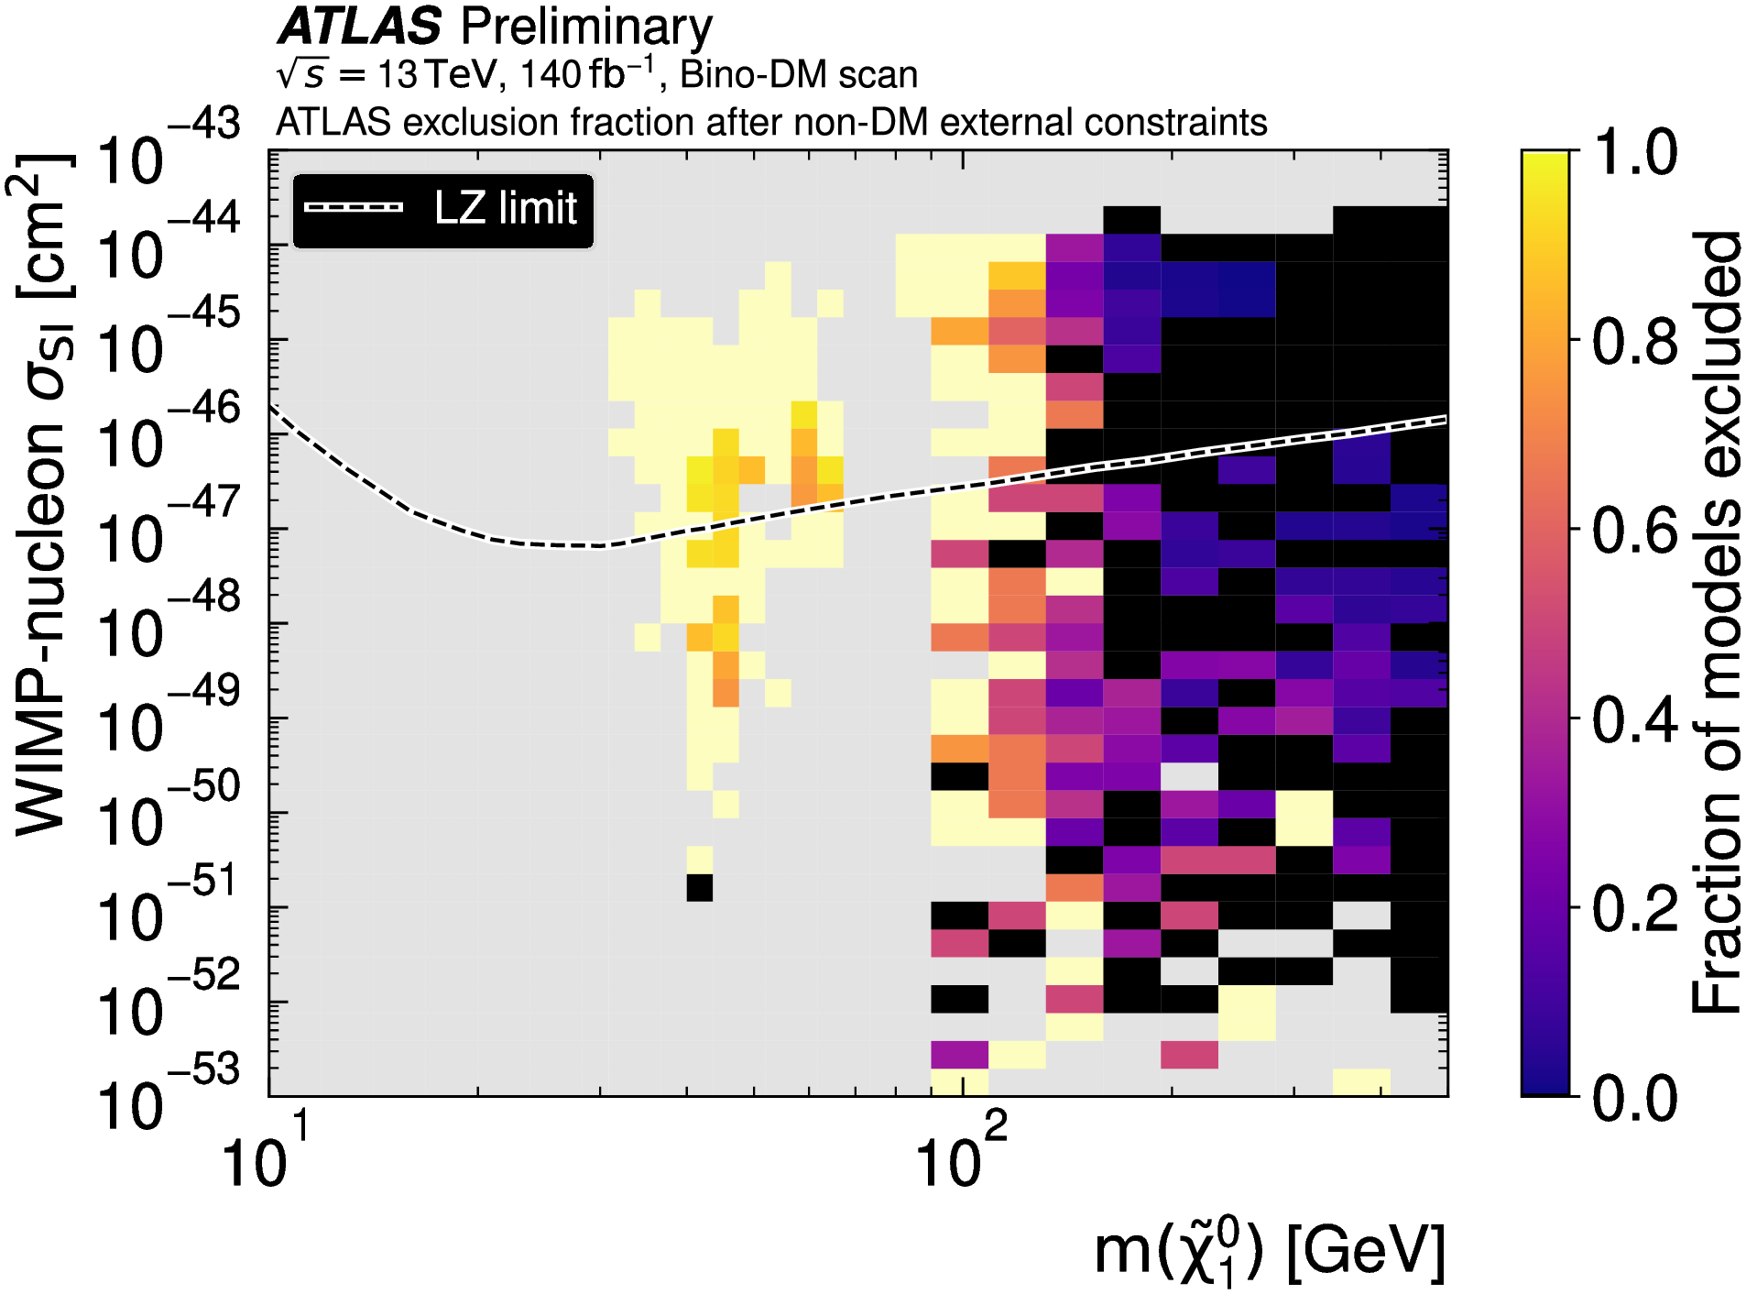
Direct detection complementarity
ATLAS and LZ sensitivity is complementary

Slide 68
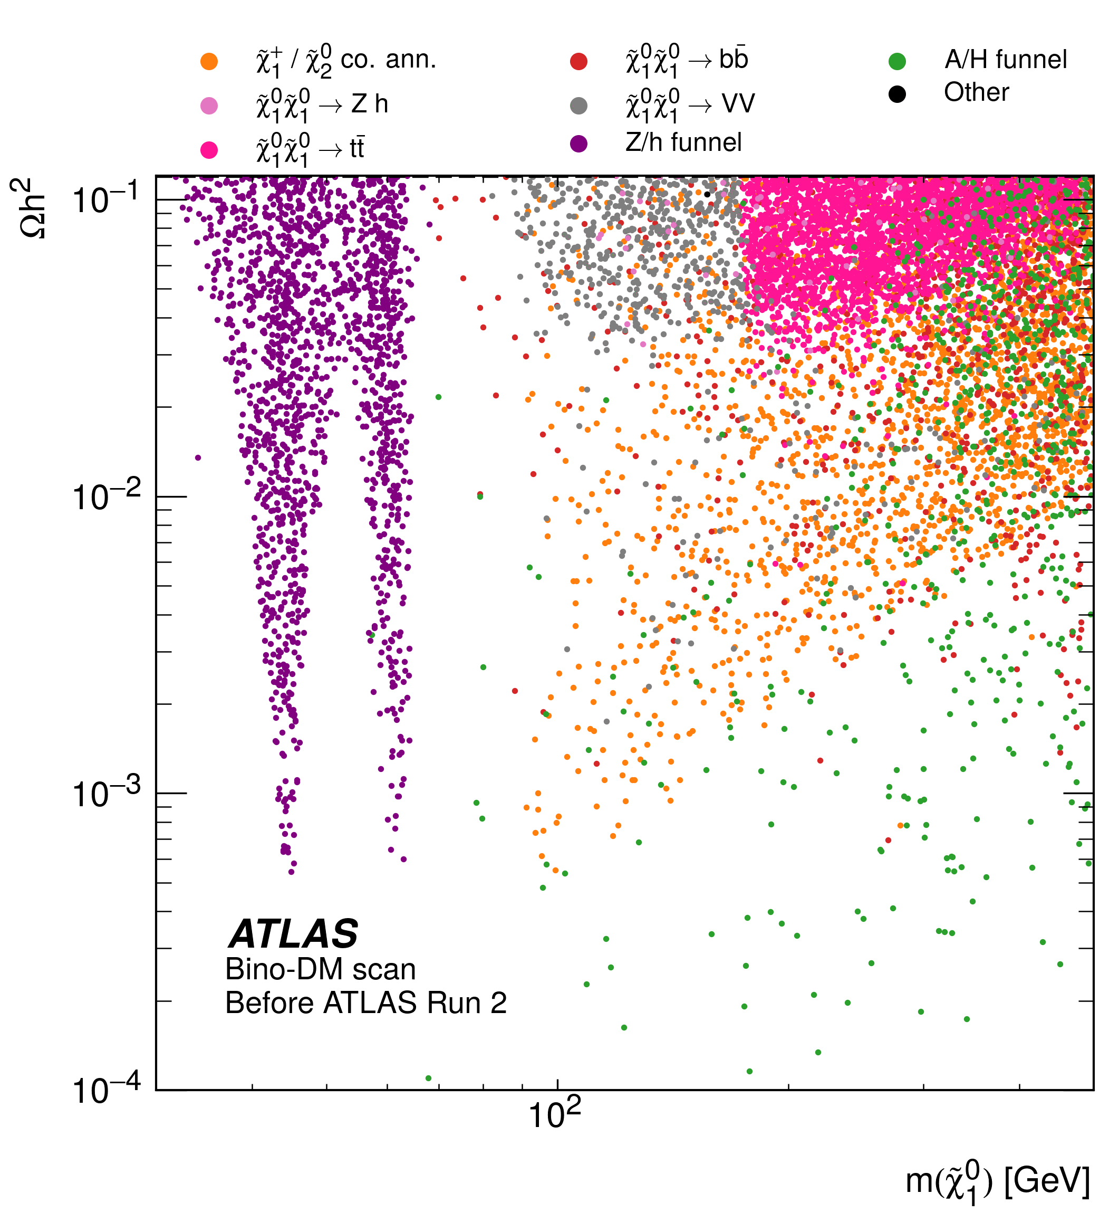
Bino-LSP dark matter
Z/h funnel regions are almost entirely excluded
𝜒̃±₁/𝜒̃⁰₂ co-annihilation scenarios are compressed → hard to target
A/H funnel allows non-compressed models at higher mass

Slide 69
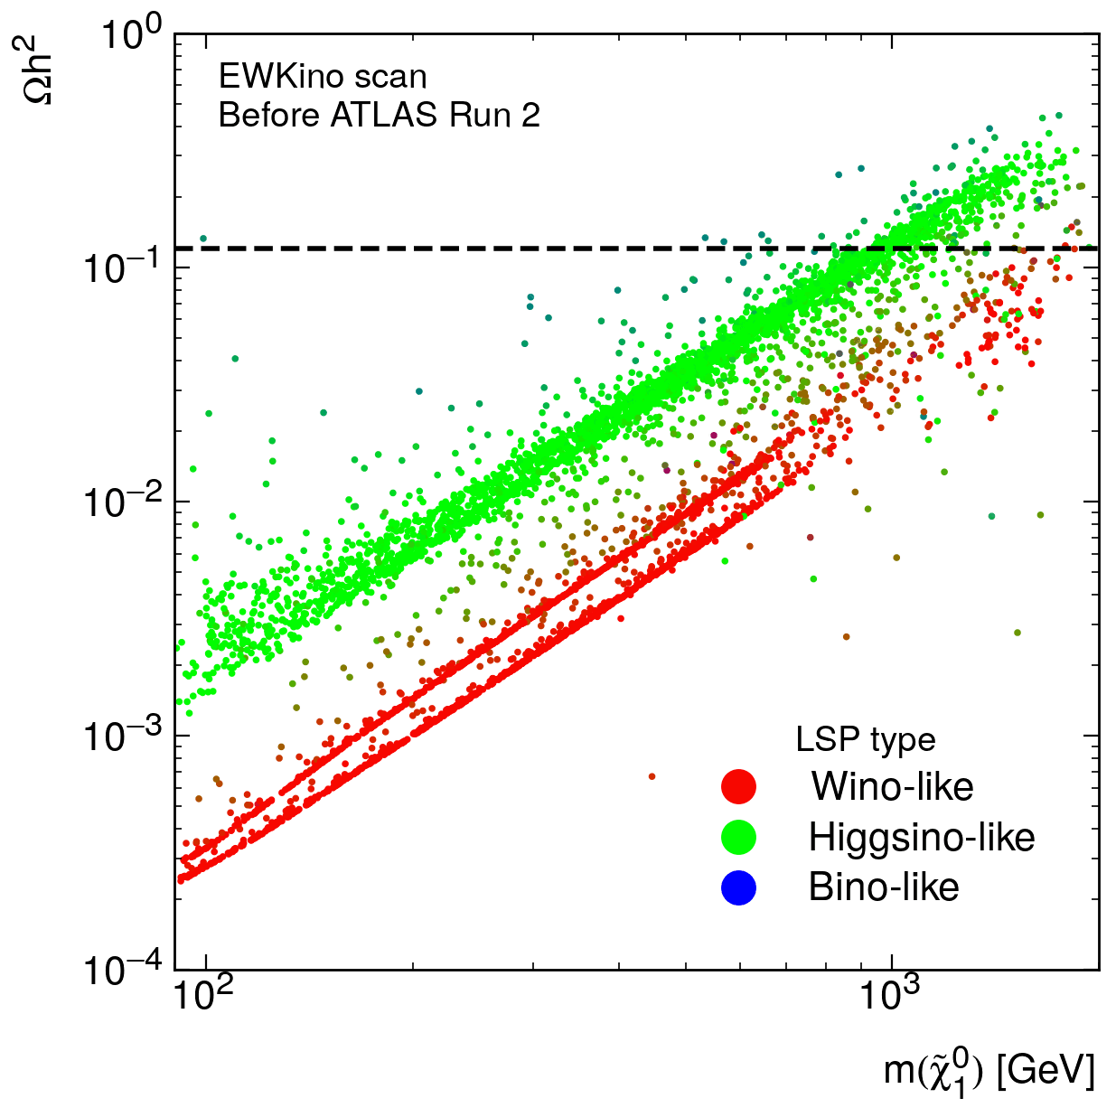
Higgsino/Wino-LSP dark matter
Higgsino-LSP models unexcluded right on the LEP limit!
Wino-LSP scenarios that saturate the relic density are entirely excluded (mostly by direct DM detection experiments)

Slide 70
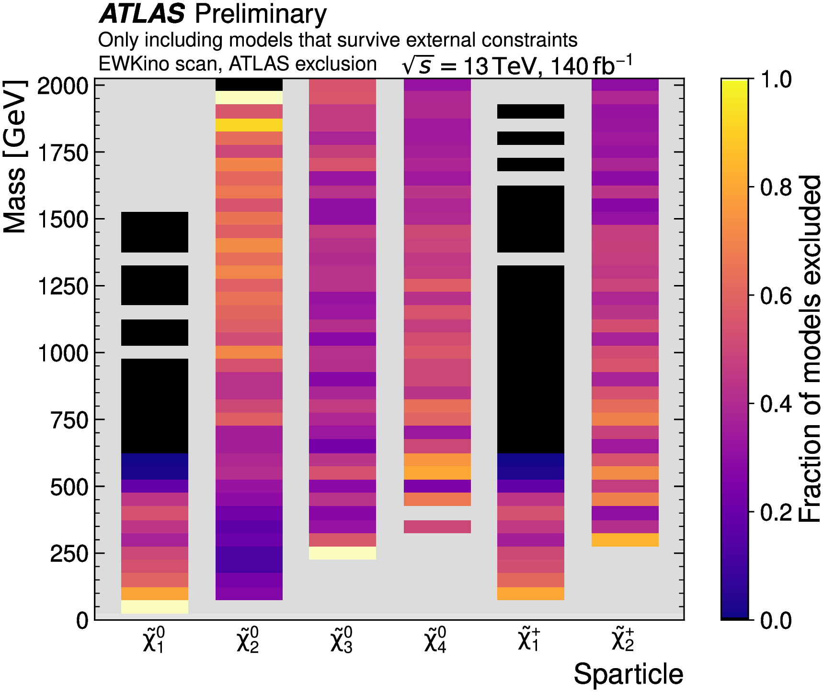
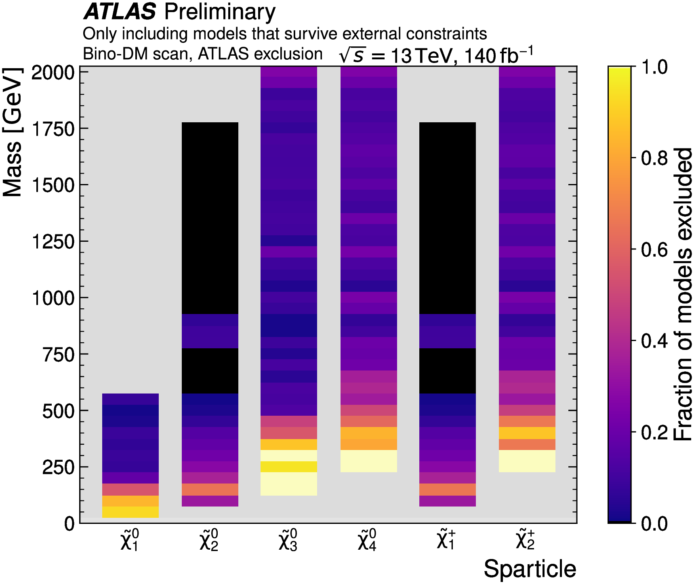
Overall exclusion
ATLAS exclusion of each sparticle (after all external and dark matter constraints)
EWKino scan
Mainly wino/higgsino LSP
Bino-DM scan

Slide 71
Comparison with Run 1
A similar effort was published in 2015 using the Run 1 2L, 3L and 4L searches:
https://atlas.web.cern.ch/Atlas/GROUPS/PHYSICS/PAPERS/SUSY-2015-12/
This used a different model sample and scanning strategy, but we can still compare to get a qualitative idea of how the sensitivity has improved…

Slide 72
Run 1 vs. Run 2 EWK pMSSM scans
Run 1
Run 2

Slide 73
Run-1 vs. Run-2 EWK pMSSM scans
Run 1
Run 2

Slide 74
Uncovered scenarios

Slide 75
Benchmark models
Remaining Z/h funnel region model
Higgsino-like 𝜒̃±₁/𝜒̃⁰₂
→ smaller production cross-section than typical simplified models

Slide 76
Benchmark models
A/H funnel region model with mixed 𝜒̃⁰₂ branching fractions

Slide 77
Benchmark models
Radiative 𝜒̃⁰₂ → 𝜒̃⁰₂ + 𝞬 decay
Heavier electroweakinos in reach

Slide 78
Summary
See ATLAS-CONF-2023-055 for more details!
Electroweak SUSY is alive and well
Future searches shouldn’t forget about improving depth of sensitivity in “covered” regions.
These results can provide benchmark models for future searches.
Results and model files will be made public to allow more detailed phenomenological study of unexcluded models.
Similar scans including sleptons and squarks are in the works!
Thanks for listening!

Slide 79
Backup

Slide 80
Stop limits
BUT simplified assumptions go into these limits too!
→ multiple complex decay chains can dilute signals
, arXiv:1710.11091

Slide 81
Slepton limits
g-2 hints at low-mass smuon

Slide 82
Strong production

Slide 83
How light can squarks and gluinos be?
Squarks and gluinos ~ 1 TeV if g-2 goes away
→ Bagnaschi, Sakurai, Ellis et al, arXiv:1710.11091

Slide 84
SUSY prediction of Higgs mass
From talk by John Ellis at ATLAS SUSY workshop 2022

Slide 85
Run 1 General pMSSM scan

Slide 86
Run 1 General pMSSM scan

Slide 87
Run 1 General pMSSM scan

Slide 88
EWK pMSSM scan range

Slide 89
Scan workflow

Slide 90
External constraints

Slide 92
RECAST
https://recast.docs.cern.ch/
RECAST: Complete preservation of your analysis software environment and workflow
REANA: Infrastructure for running RECASTs on the cloud
I’ve run over 5000 analysis jobs with REANA for 1000s models and multiple analyses!
Analysis environment
→ Preserved in Docker images
Analysis commands
→ How to use the preserved software
Analysis workflow
→ How to connect each analysis step
Automate the re-executution of your analysis on a new signal
DAOD → Event selection → Statistical analysis → CLs

Slide 93
“EWKino” scan
Flat scan of parameters relevant to EWKino production → 20,000 models sampled
Sleptons and squarks decoupled
Most bino-LSP models have 𝝮h² ≥ 0.12

Slide 94
“Bino-DM” scan
Oversample bino-LSP models with satisfactory DM relic density
437,500 models sampled → 11,163 have bino-LSP and 𝝮h² ≤ 0.12

Slide 95
Analysis simplifications
Simplified likelihood used for 3L offshell, Compressed and 4L
Orders of magnitude faster
Merges background samples and nuisance parameters
Sets nominal background yield to the post-background-only-fit value
Truth-smeared yield scaling for FullHad, 1Lbb, 2L0J, 2L2J
Scale factor calculated via least-squares fit of truth-smeared vs reco-level yields for test sample of models
Truth-level fits don’t include signal systematic or statistical uncertainties
Statistical U/C dropped as it would kill sensitivity in very high cross-section models
Disappearing track: Evaluated using upper limits on production cross-sections rather than SimpleAnalysis/RECAST

Slide 98
2L2J
2L2J simplified model:
Pure-Bino 𝜒̃⁰₁
Pure-Wino 𝜒̃⁰₂ and 𝜒̃±₁
BR(𝜒̃⁰₂→ 𝜒̃⁰₁ Z*)= 100%
BR(𝜒̃±₁→ 𝜒̃⁰₁ W*)= 100%
Preference for Z decay mode
Sensitivity to compressed scenarios when X₂⁺⁻ and X₄⁰ contribute

Slide 99
4L
4L targeted GGM and R-parity violating scenarios
Sensitivity to long decay chains involving heavier electroweakinos

Slide 100
EWKino scan unique sensitivity

Slide 101
Higgs mass

Slide 102
Search overlaps
Bino-DM scan
EWKino scan

Slide 103
Constraint overlaps
Bino-DM scan
EWKino scan

Slide 104
Flavour constraints

Slide 105
EW precision constraints

Slide 106
Overall exclusion

Slide 107
Overall exclusion

Slide 108
Overall exclusion

Slide 109
Overall exclusion

Slide 110
Bino-DM scan unique sensitivity

Slide 111
Branching fractions
For a Bino-LSP, searches are favouring the 𝜒̃⁰₂ → Z 𝜒̃⁰₁ decay mode
→ Partly due to the selection of searches used
→ The Z decay mode is also more versatile

Slide 112
Overall exclusion

Slide 113
Direct detection complementarity

Slide 114
Direct detection complementarity
ATLAS and Lux-Zeplin sensitivity is complementary

Slide 115
Run-1 vs. Run-2 EWK pMSSM scans
Run 1
Run 2

