Slide 1
Gas Production in the Proton Beam Window and Target Vessel at SNS
Wei Lu, Franz X. Gallmeier & David McClintock
Oak Ridge National Laboratory, Oak Ridge TN, USA
16th International Workshop on Spallation Materials Technology (IWSMT-16)
Abingdon, Oxfordshire, UK
Oct. 29 2024

Slide 2
Contents
SNS and its proton beam windows & targets
Measurements at the Harp and constructions of proton beam profiles
Cross section calculations for the gas production
Gas productions at PBWs 6&7 and Target 12
Summary

Slide 3
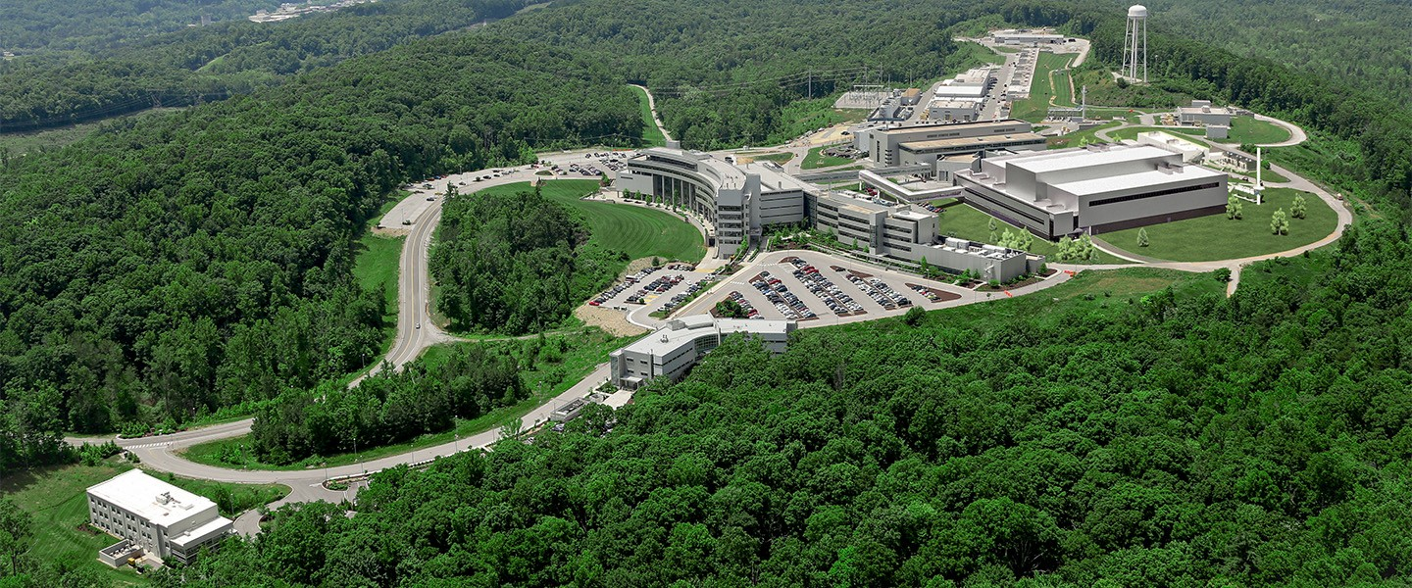
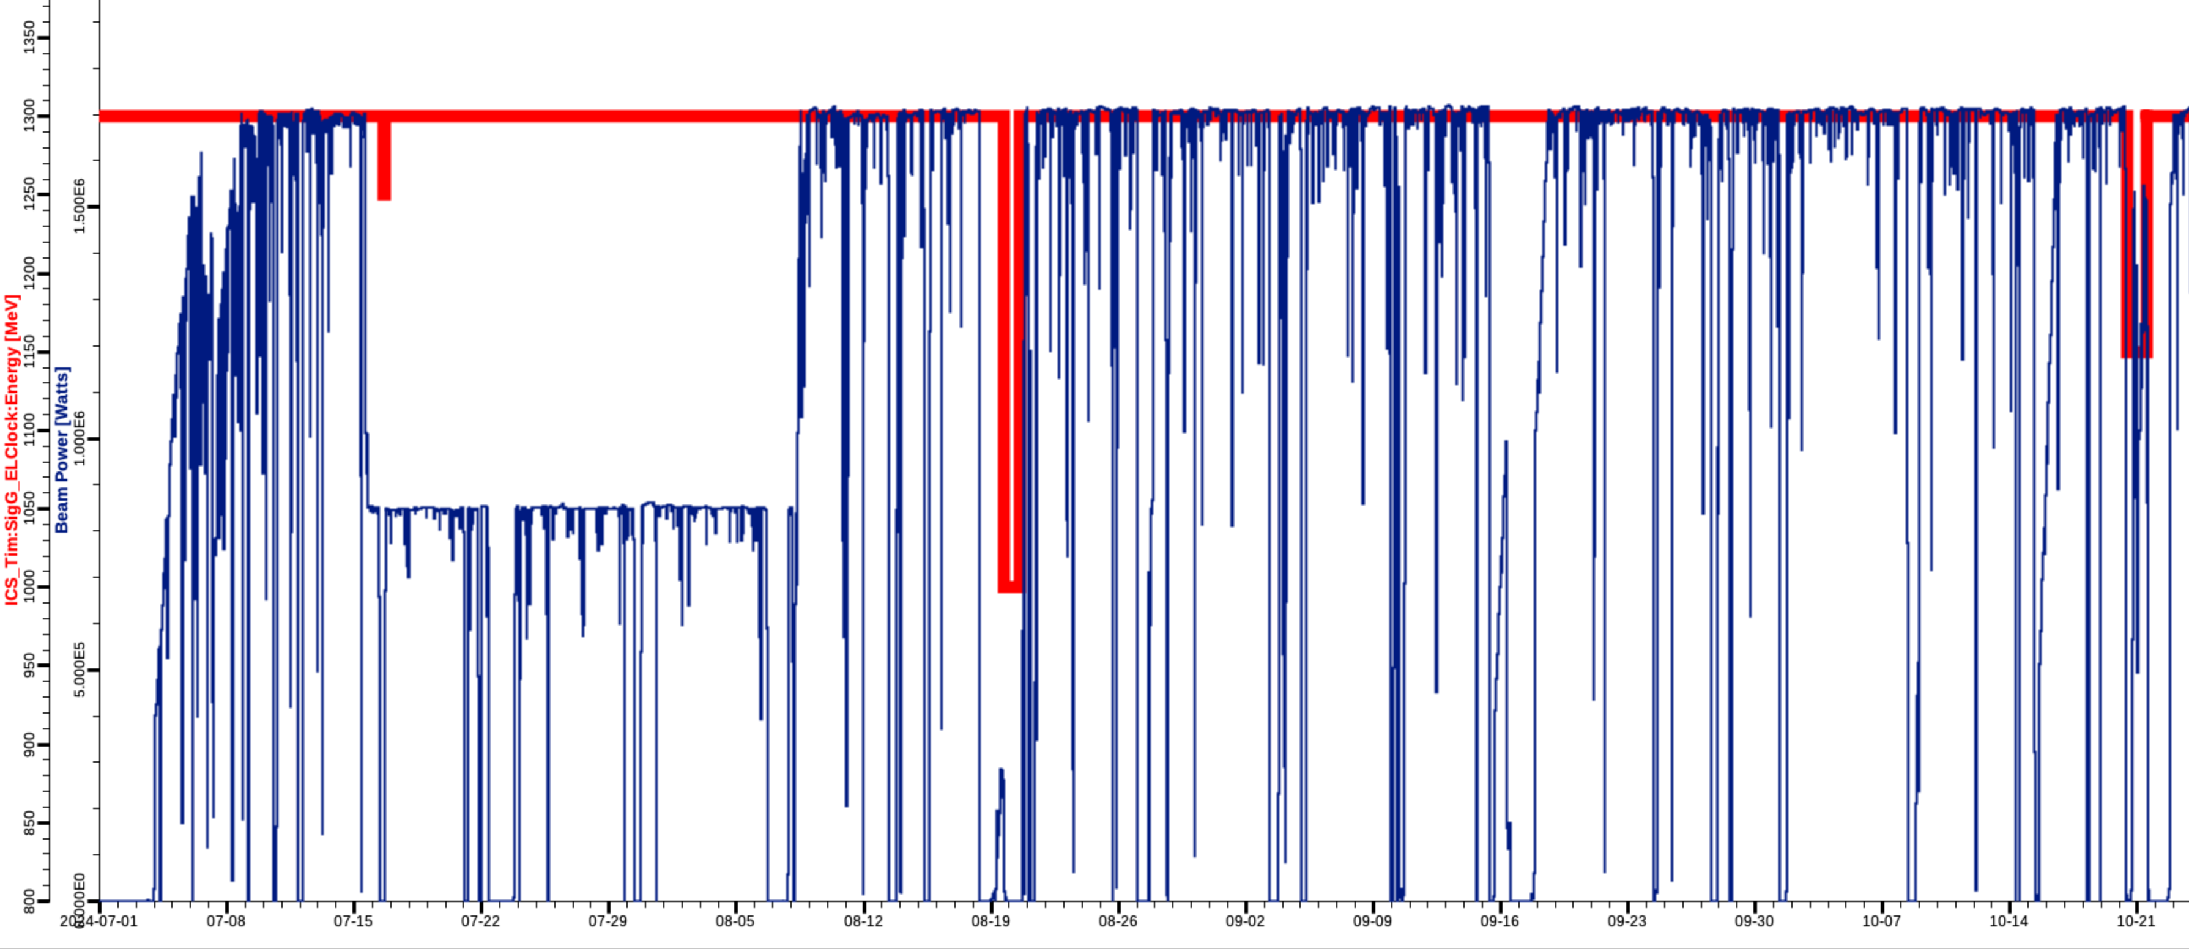
Current Status of SNS
Completion of PPU (Proton Power Upgrade) project this summer
SNS is now operating at 1.3 GeV and 1.7 MW and will reach the designed full capacity of 2 MW in 2026
1.3 GeV
1.7 MW

Slide 4
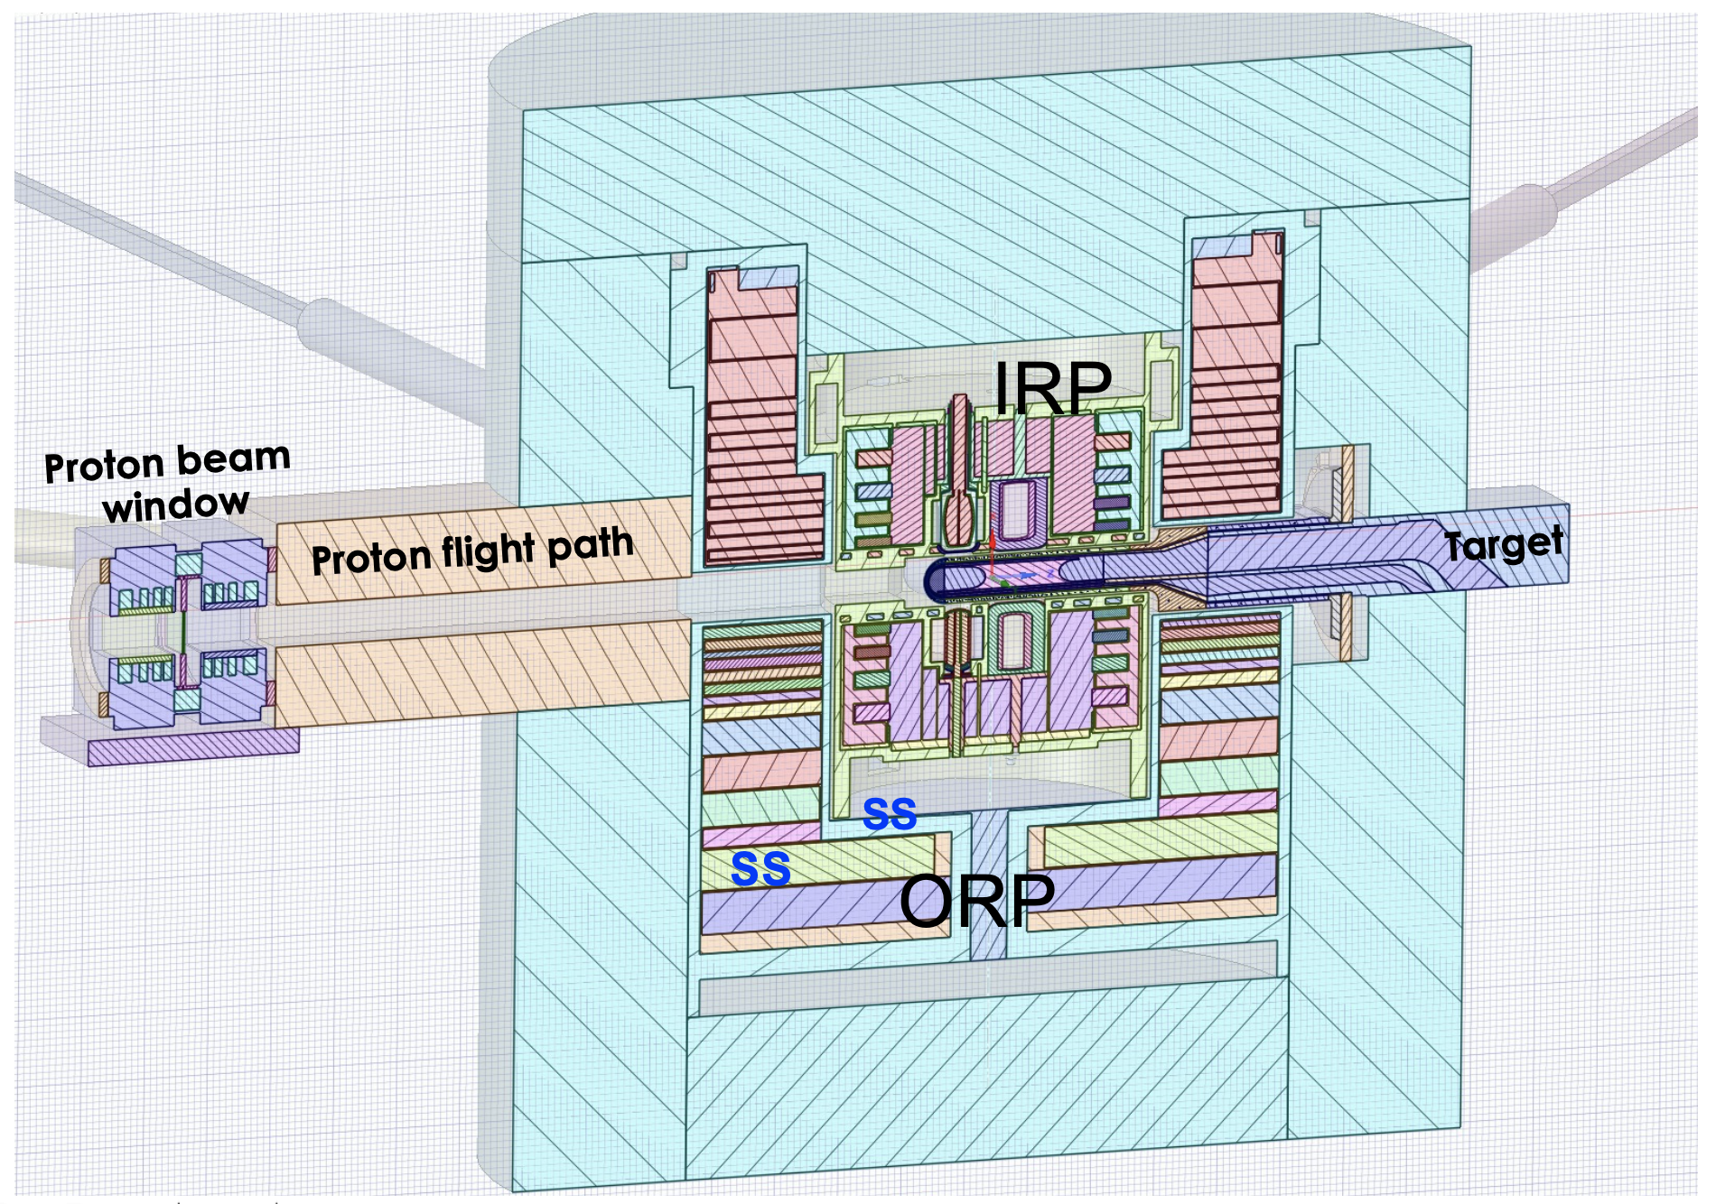
SNS FTS Target-Moderator-Reflector System
Consists of PBW, mercury target, IRP (Inner Reflector Plug) and ORP (Outer Reflector Plug)
IRP, an Al-6061 structure cooled by heavy water, hosts four moderators (3 cryogenic hydrogen moderators and 1 ambient water moderator), beryllium reflector and stainless steel (SS) shielding
ORP, a SS structure cooled by heavy water, consists of SS shielding
PBW is located ~2.35 m upstream of the target nose tip

Slide 5
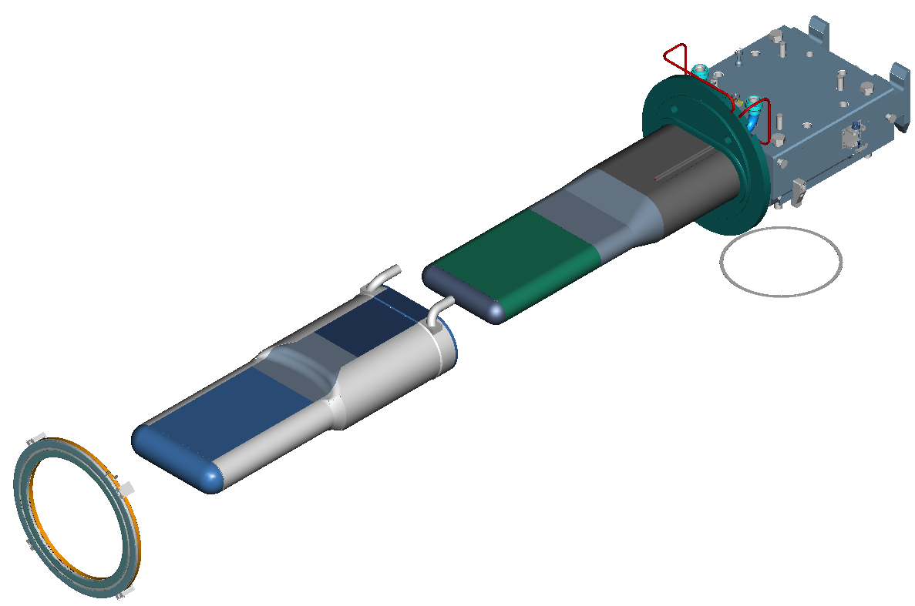
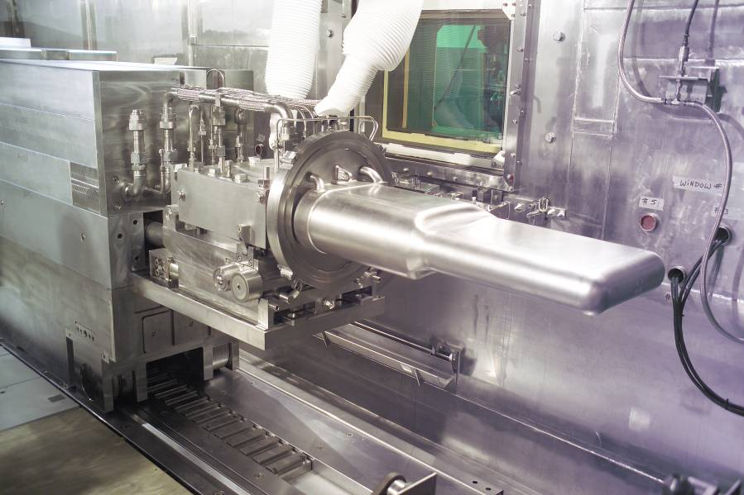
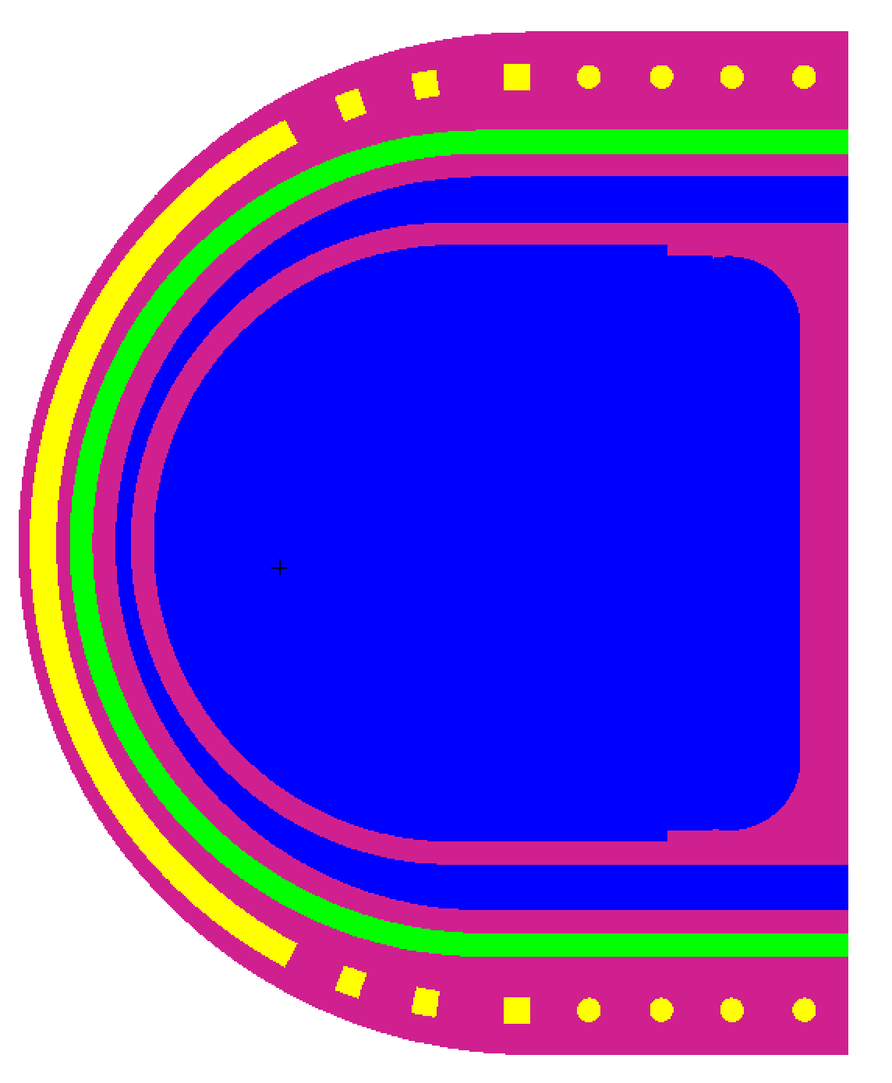
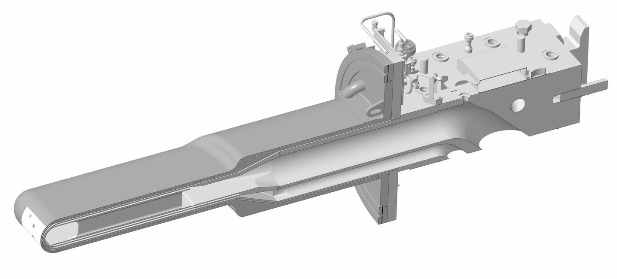
SNS Mercury Target Module
Mercury vessel
Water-cooled shroud
Both water-cooled shroud and mercury vessel nose are double-walled
Water-cooled shroud
  1.52 mm SS
  3.56 mm water
  1.78 mm SS
3.05 mm helium
Mercury vessel
  3.05 mm SS
  2.03 mm mercury
  3.05 mm SS

Slide 6
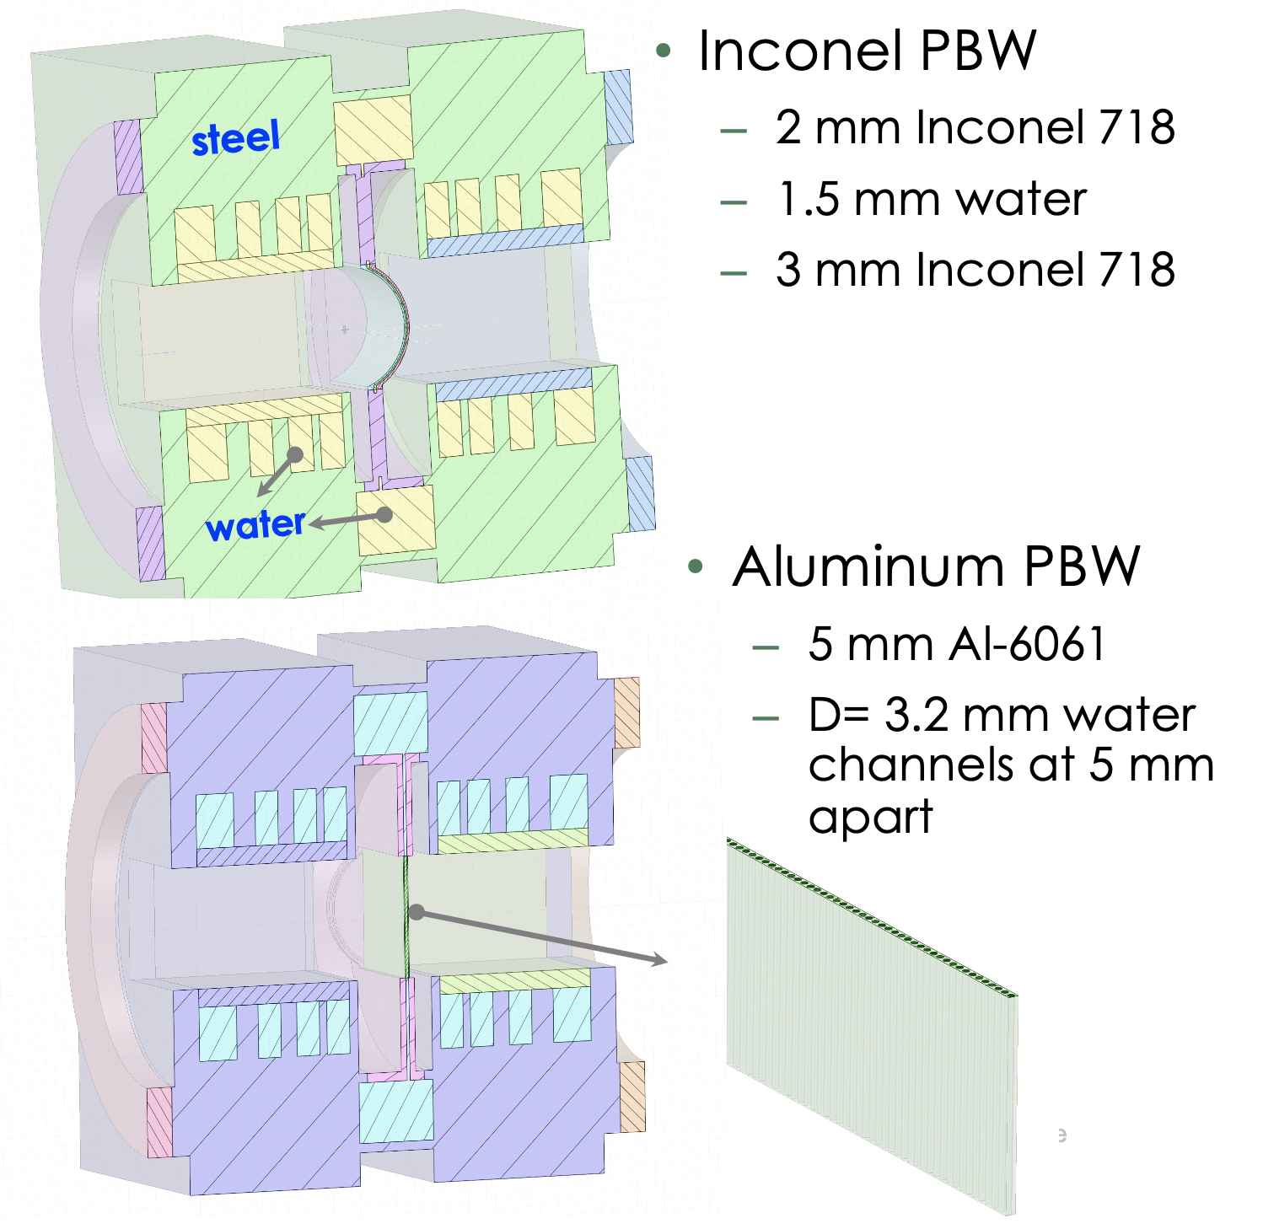
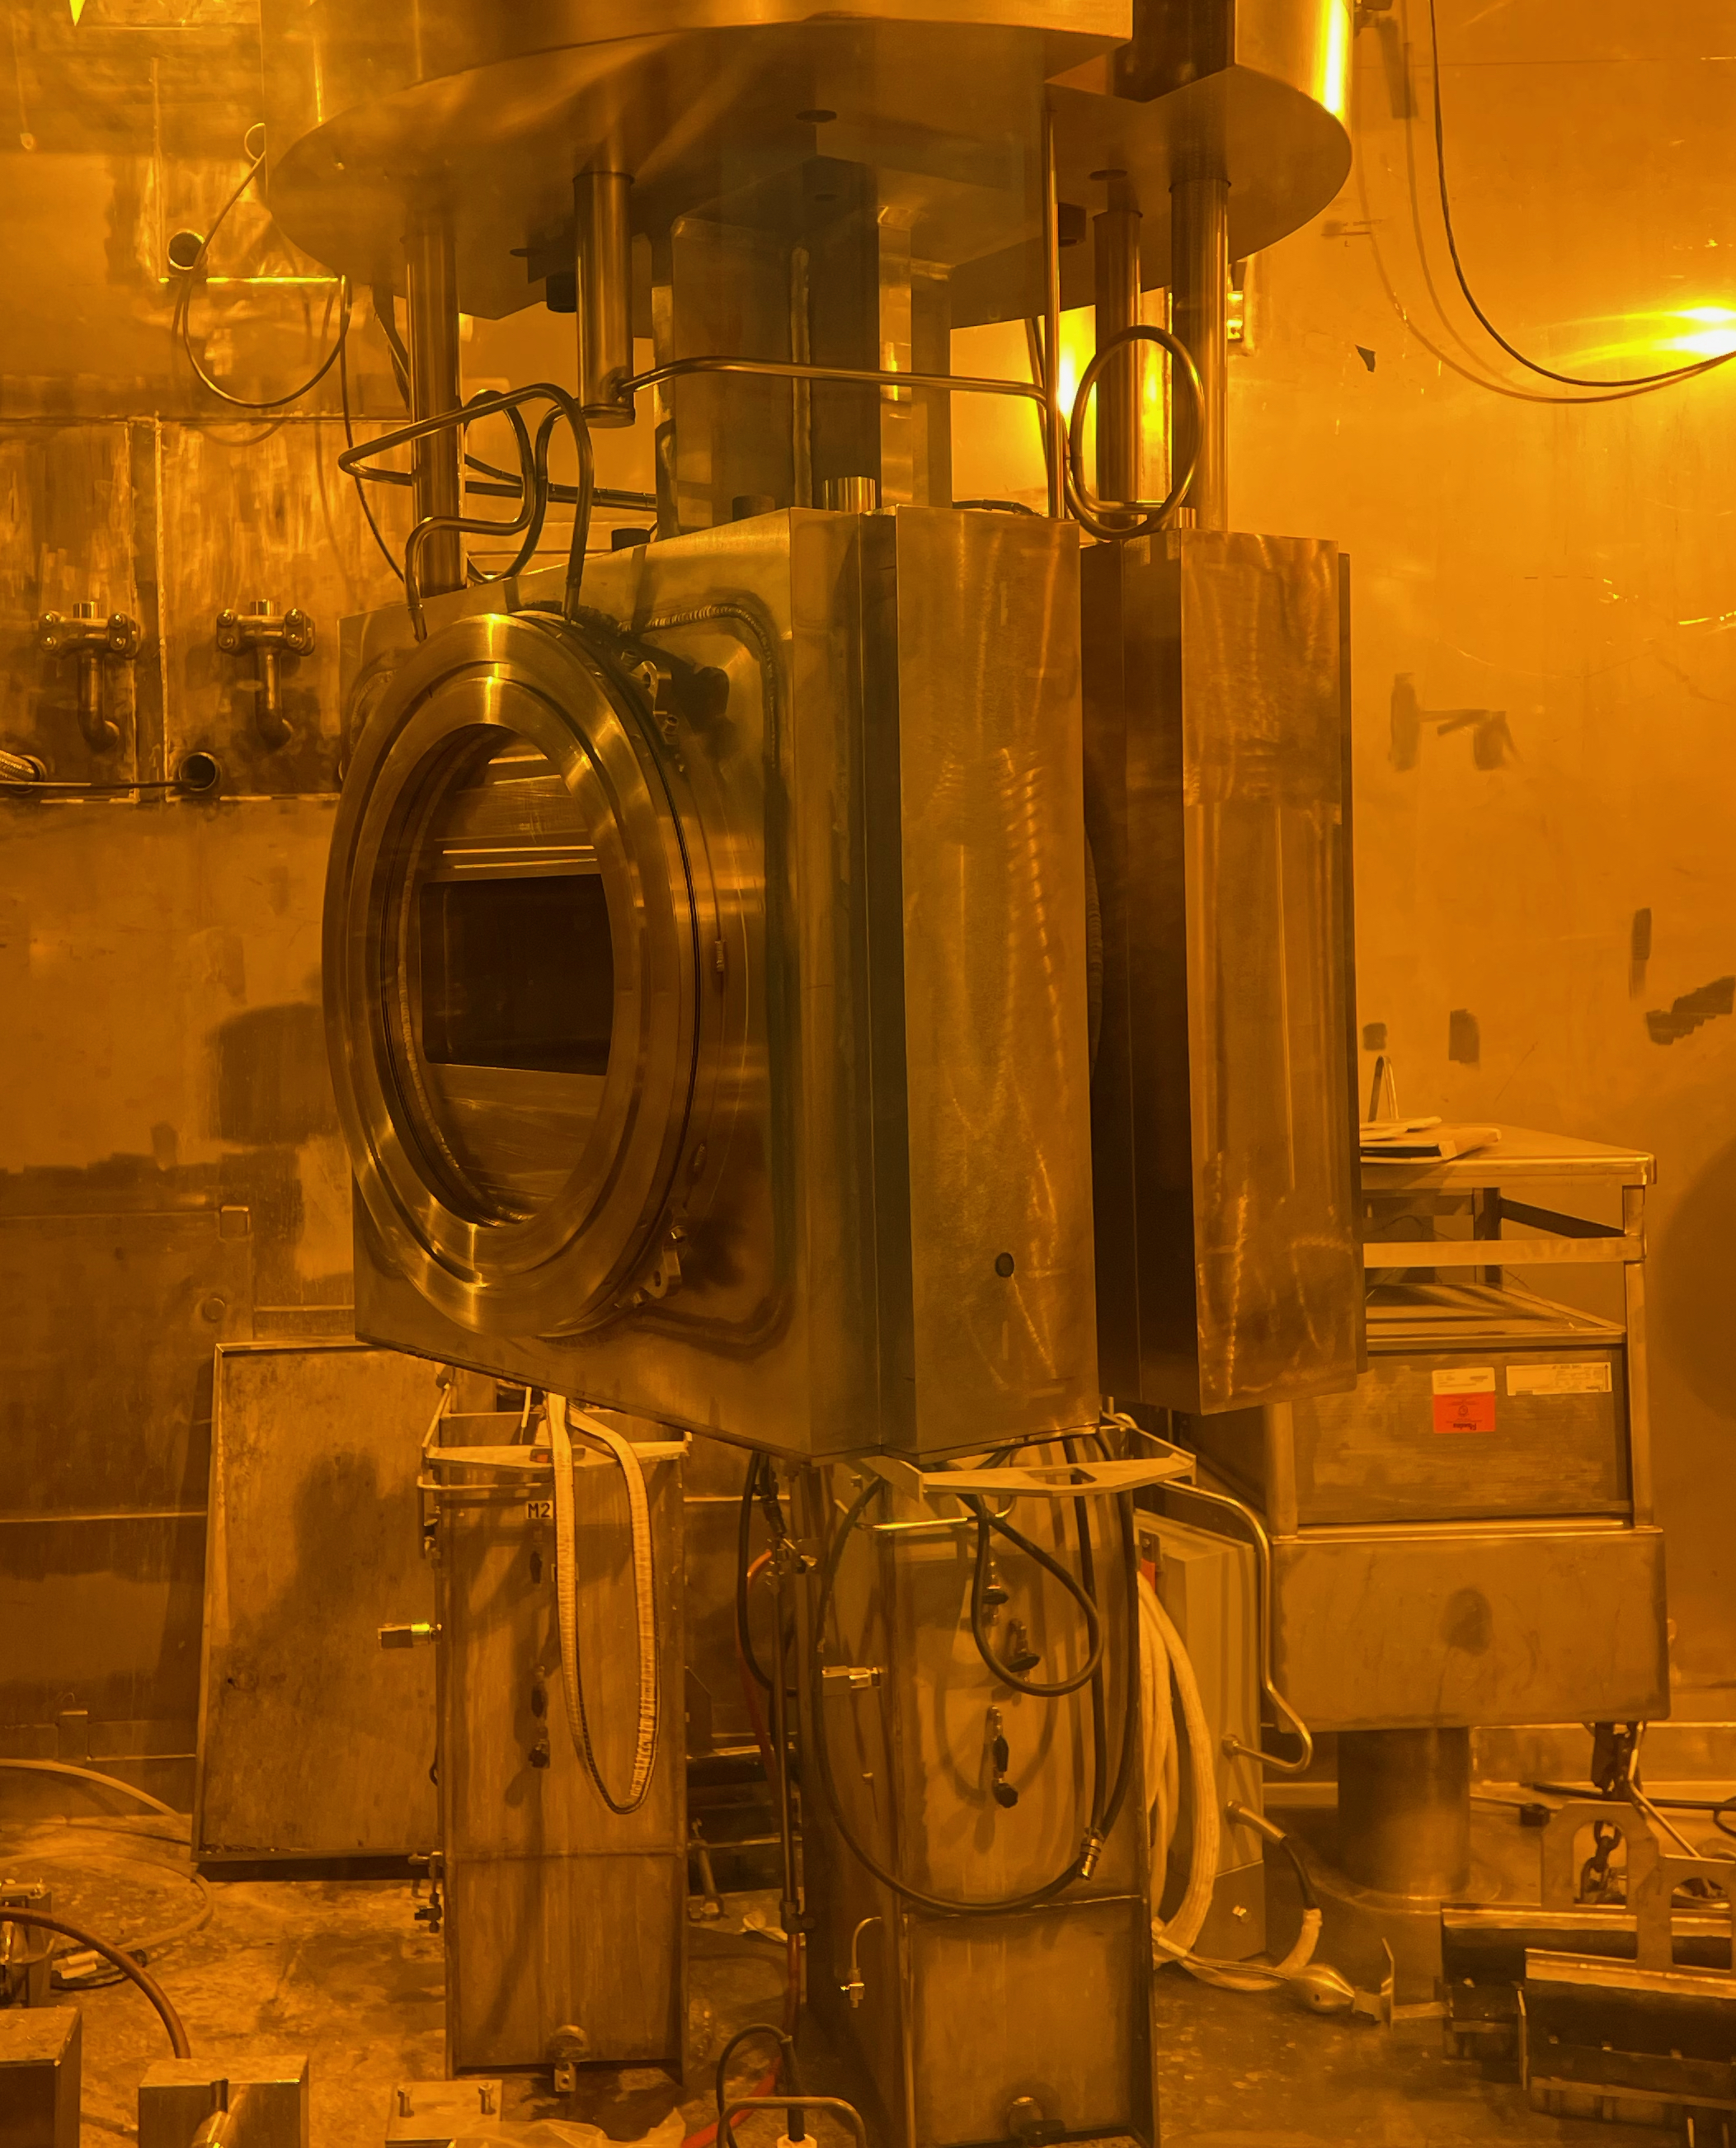
Proton Beam Windows at SNS
PBWs 1-5 & 7
Effective Al thickness
is 3.4 mm
PBWs 6 & 8 (current)
Uninstalled PBW 6

Slide 7
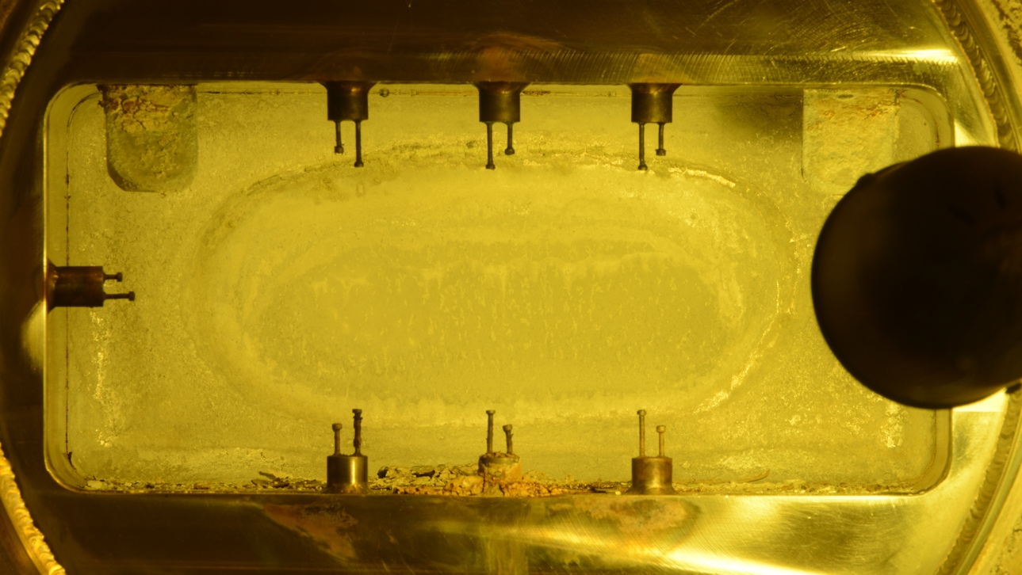
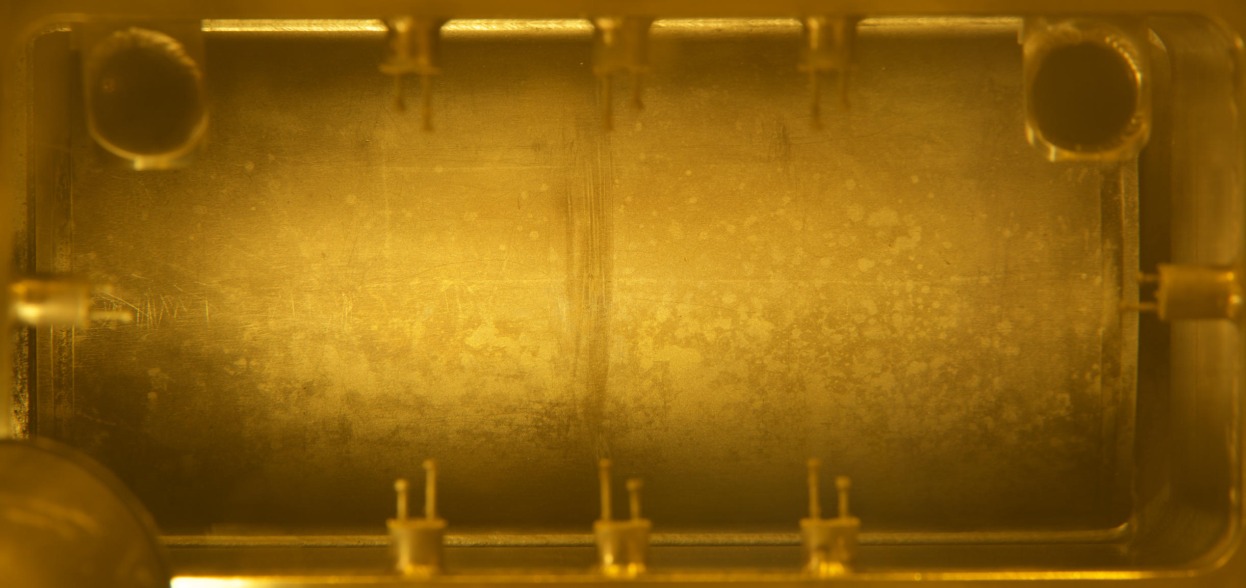
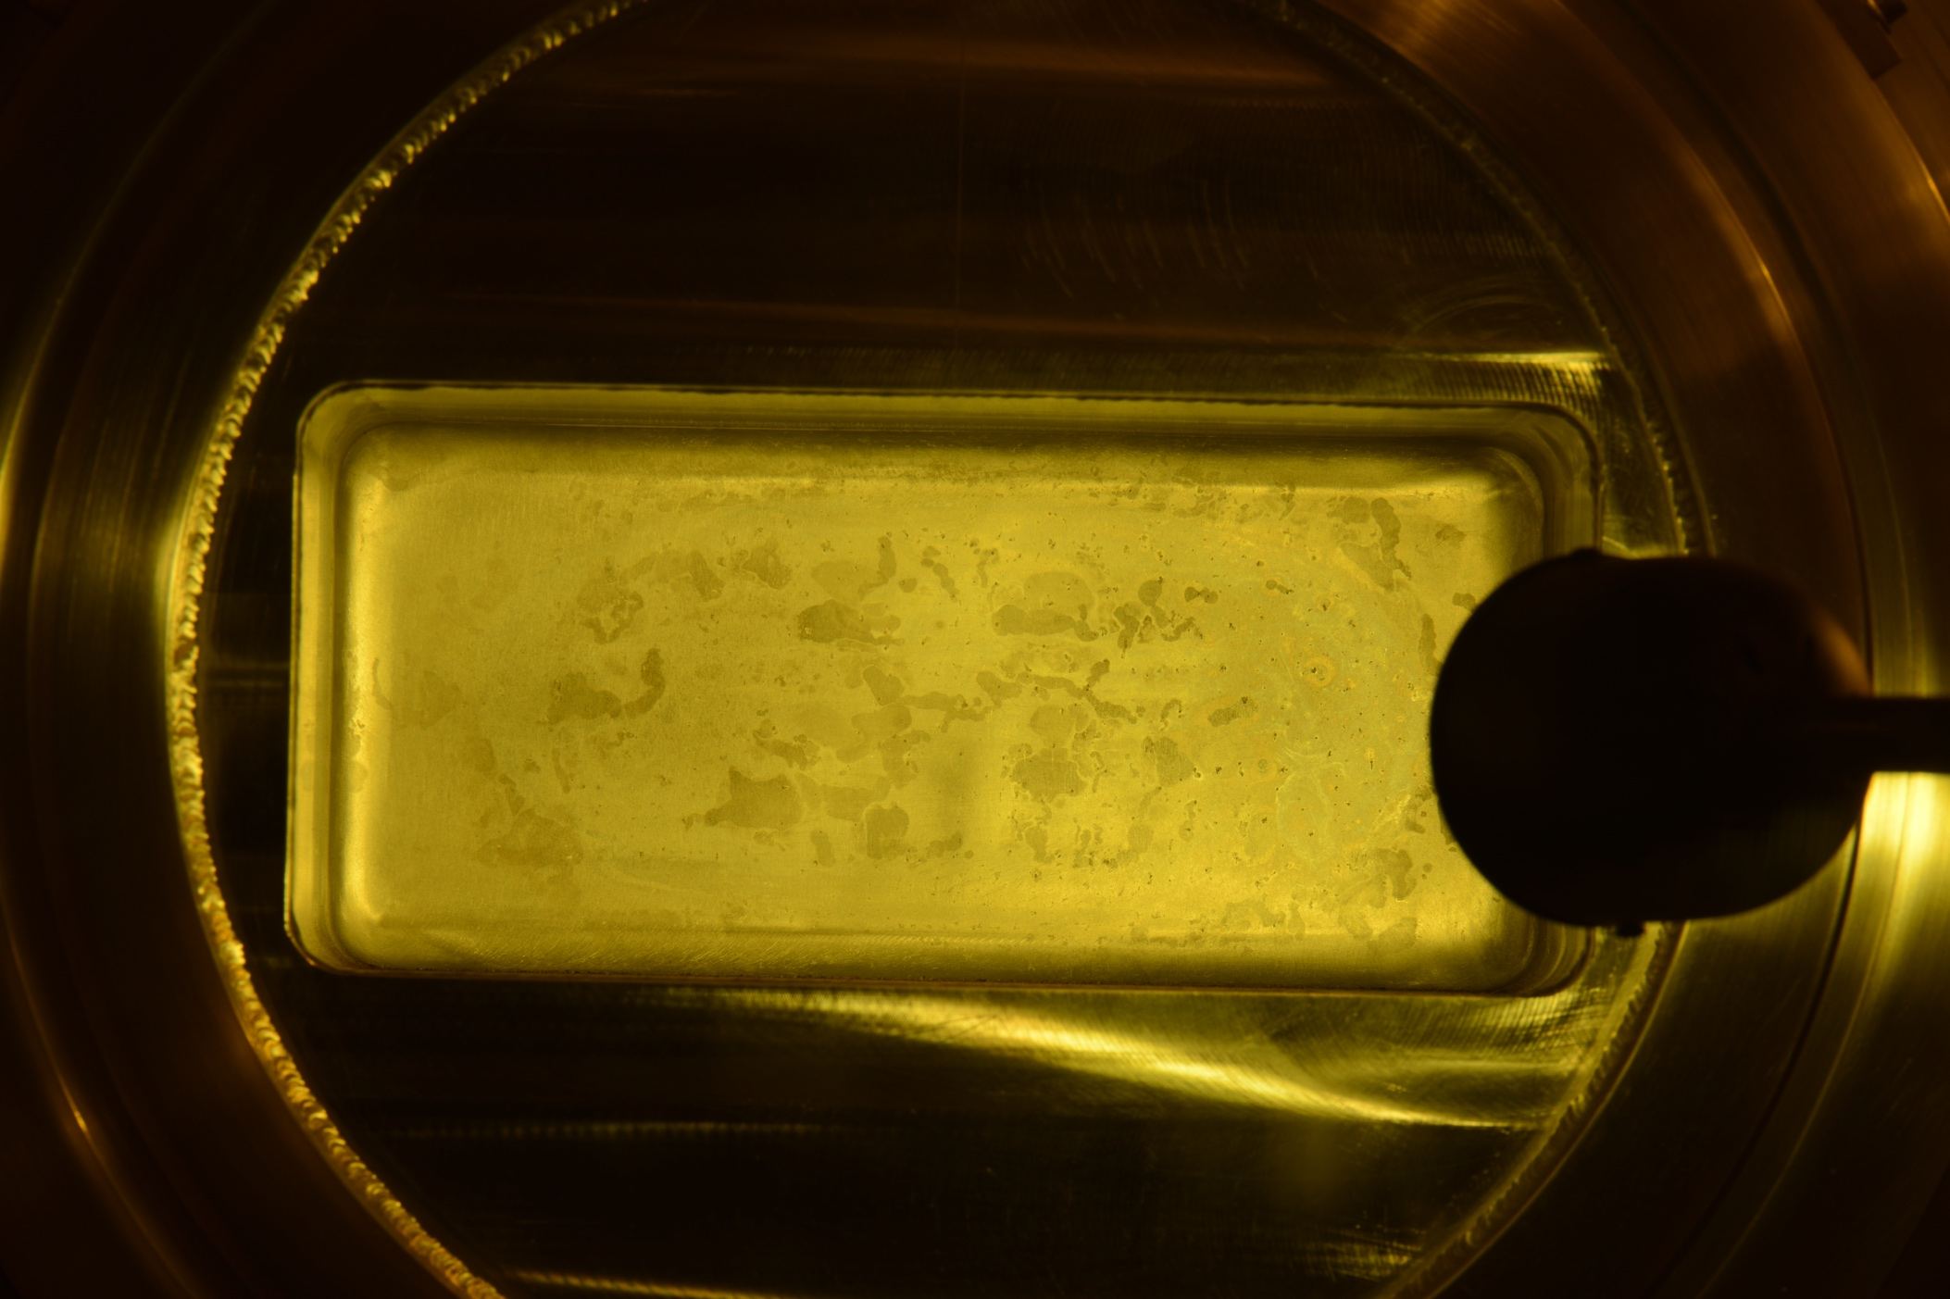
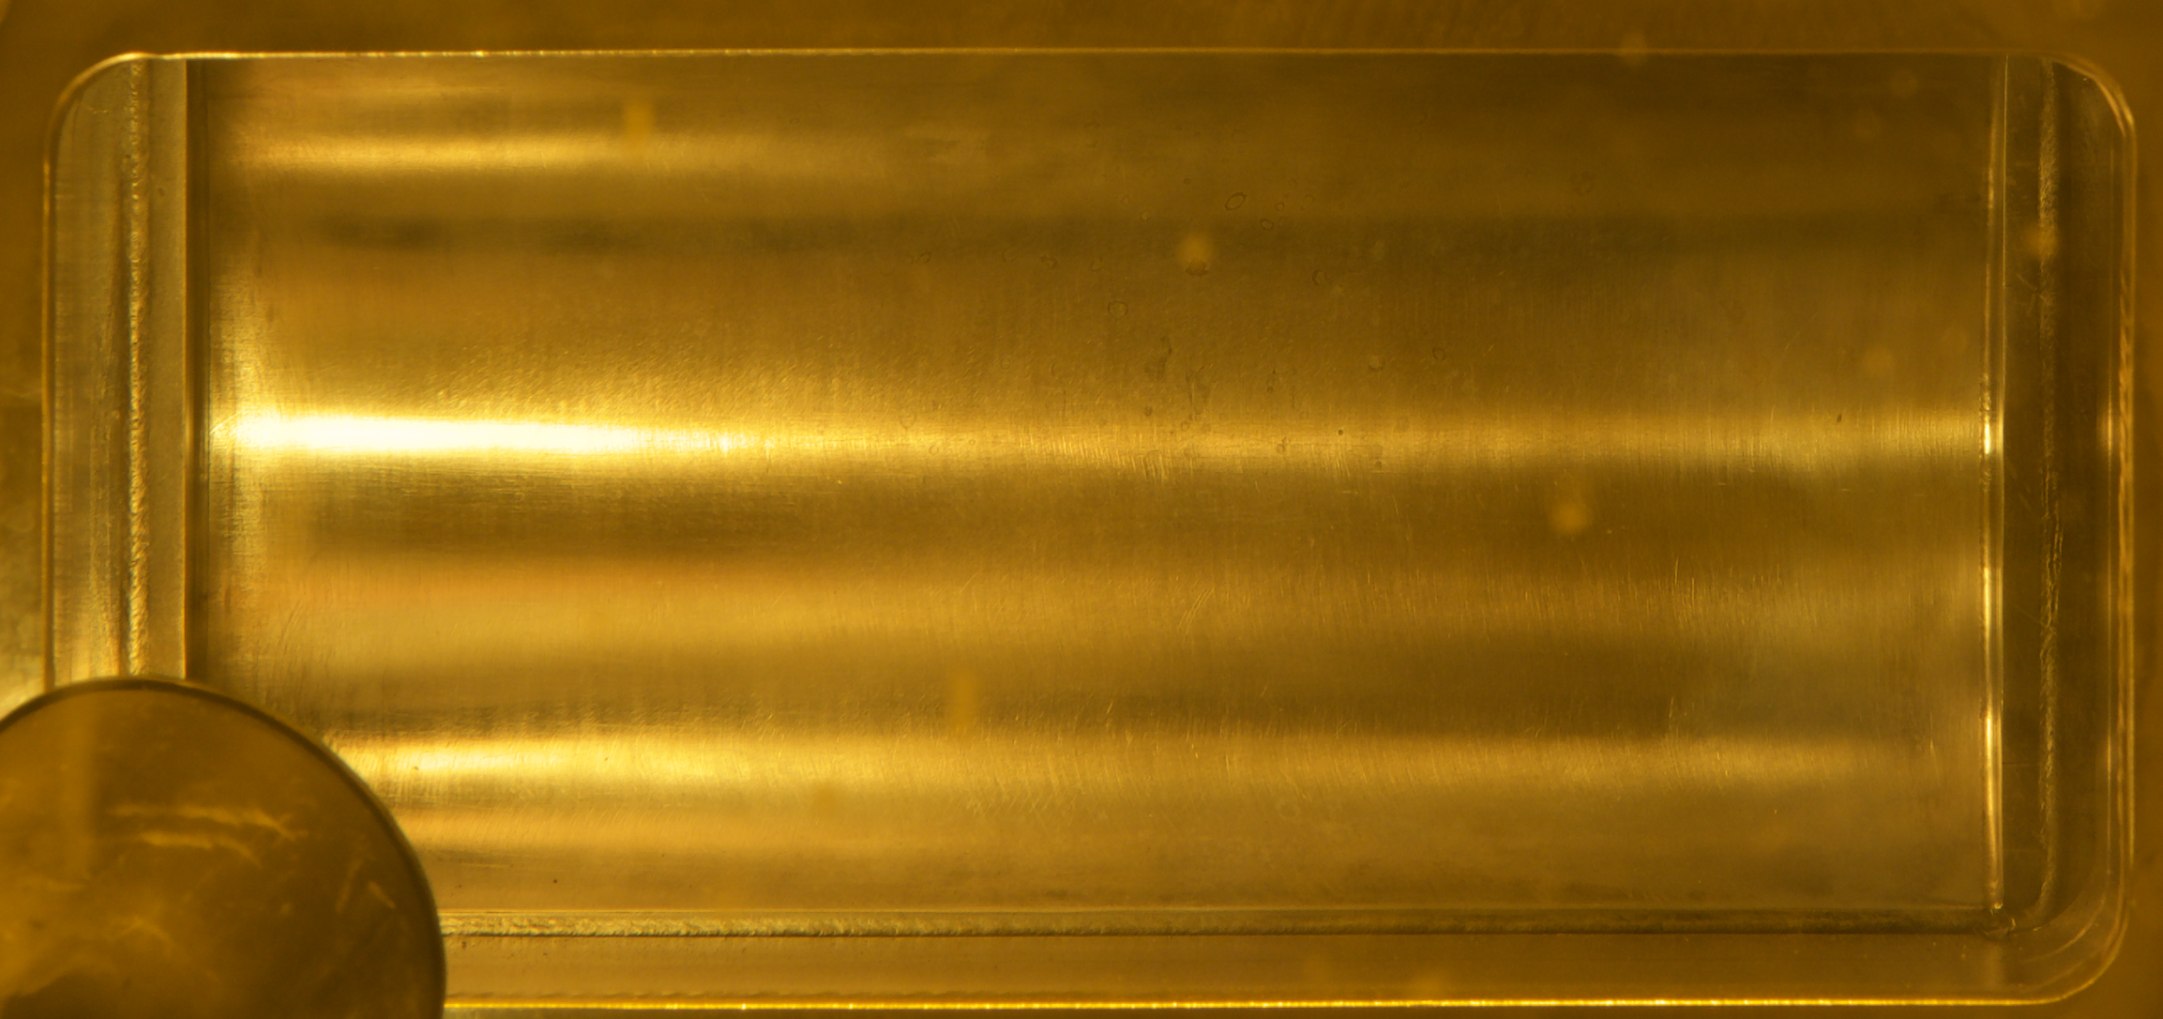
Gas Production Measurements in Plan
Measurements of hydrogen and helium productions on PBWs 6&7 and Target 12 are planned
Target side
PBW 6 (Al-6061)
PBW 7 (Inconel-718)
Accelerator side

Slide 8
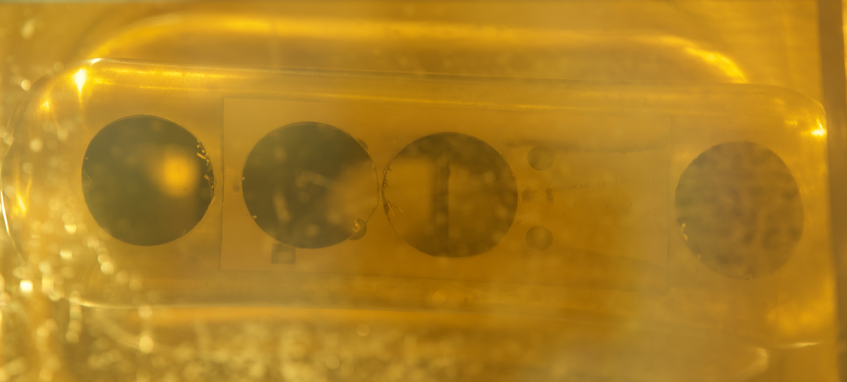
Gas Production Measurements in Plan
Machining map for PBW 6
Target 12 after sample cutting
4 specimens in each disk for PBW 6 and 12 specimens in each disk for PBW 7 & Target 12. 3 disks for PBWs 6&7 and 1 disk for Target 12
Either inductively coupled plasma–mass spectroscopy (ICP-MS), or thermal ionization mass spectroscopy (TIMS) will be applied
Analytical Chemistry Laboratories (ACL) at the Chalk River Laboratories (CRL), Canada
Machining map for PBW 7 & Target 12

Slide 9
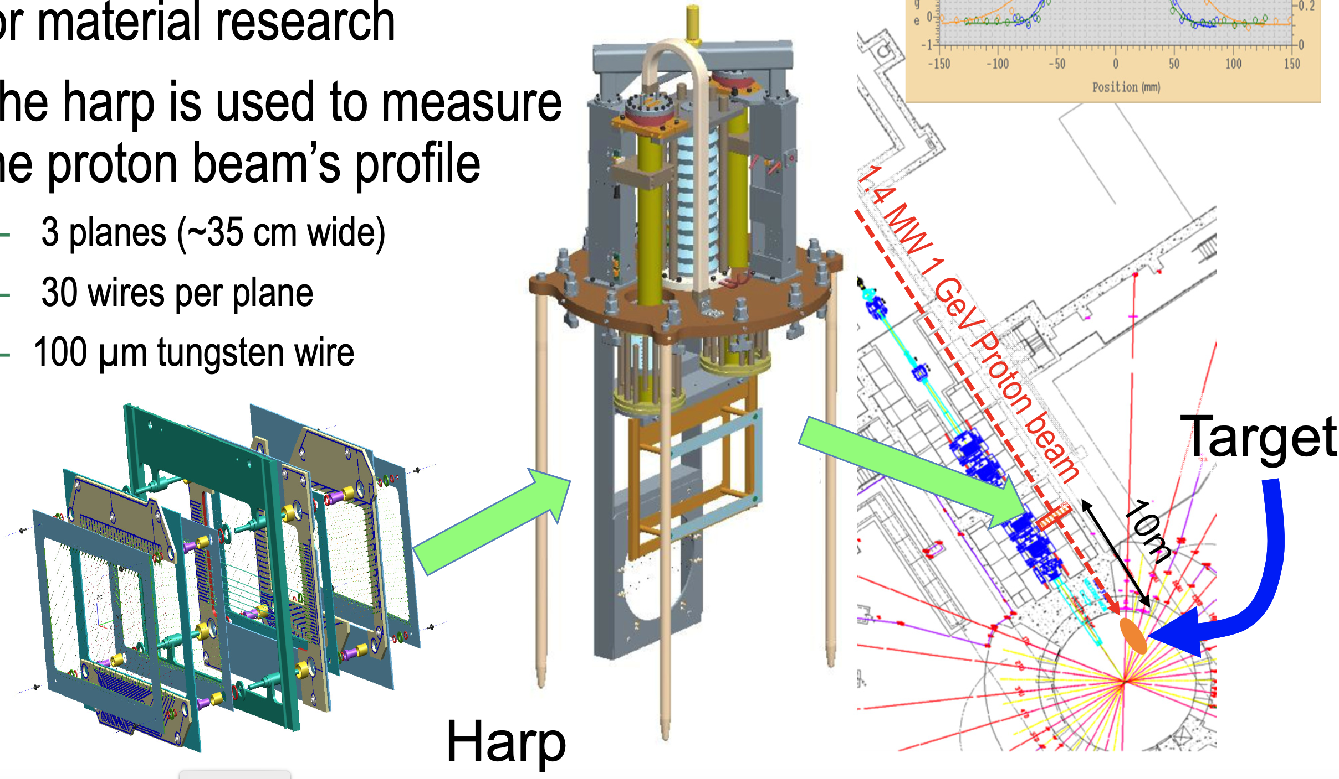
Measurements at the Harp at SNS
Harp is located at 7.192 m from the PBW
Consists of 30 tungsten (100 um) wires for each of the horizontal, vertical, and diagonal planes.
Designed to measure the position, profile and peak current density of the passing proton beam
No magnets downstream of the harp
W. Blokland, HIGH BEAM INTENSITY HARP STUDIES AND DEVELOPMENTS AT SNS, Proceedings of 6th International Particle Accelerator Conference (IPAC-15), Richmond, Virginia, USA , May 3-8, 2015

Slide 10
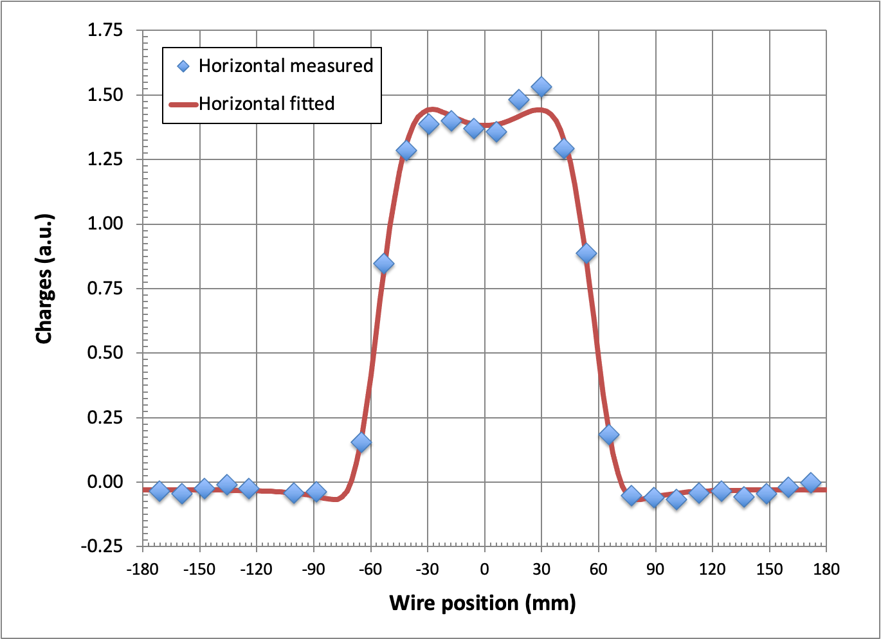
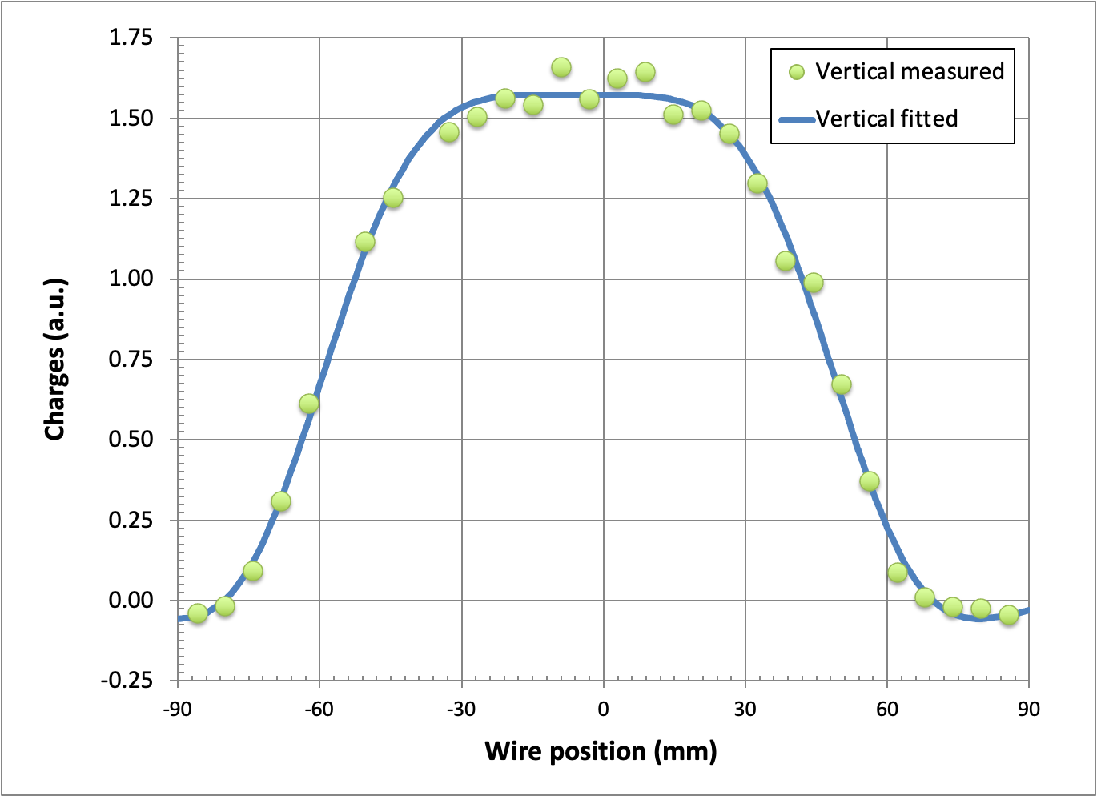
Fitting Harp Measurements
Harp measurements have limited space resolution and show variations due to electronic signals
They are hence fitted:
a > 2

Slide 11
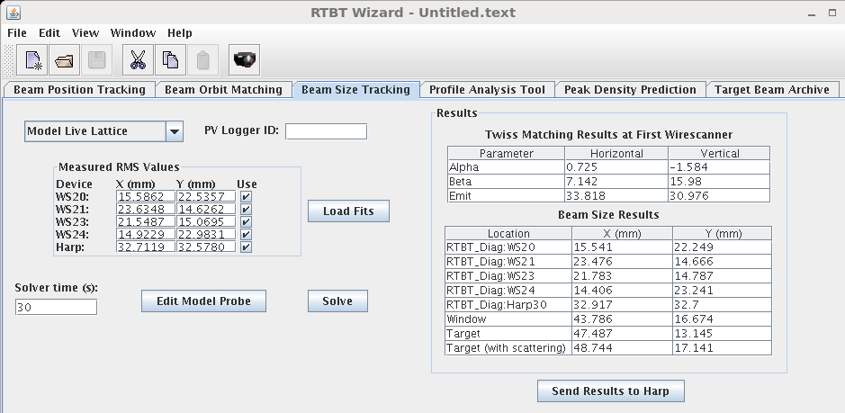
Predicting Beam Profile and Direction at PBW
Since it is free drifting downstream of the harp, the beam size downstream could be predicted by the measurements at the harp and magnets upstream by the RTBT Wizard
The direction of the beam is determined by the expansion/converging of the beam footprint

Slide 12
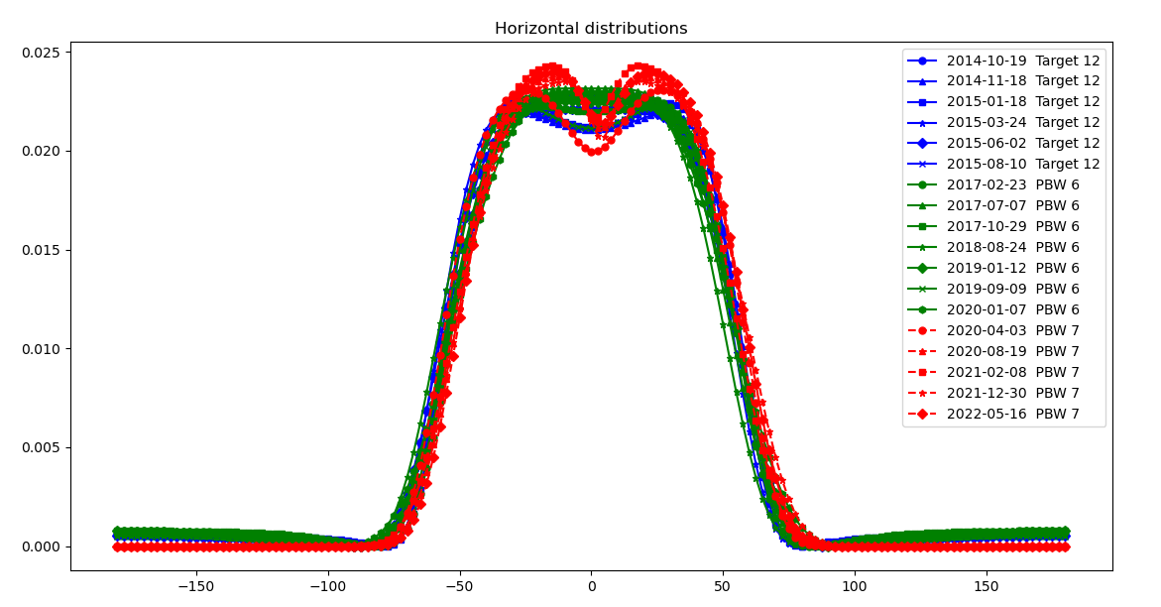
Fitted Harp Measurements

Slide 13
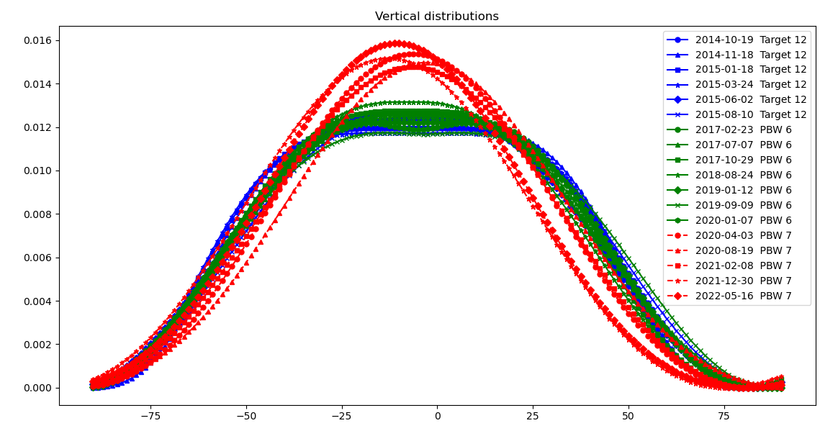
Fitted Harp Measurements

Slide 14
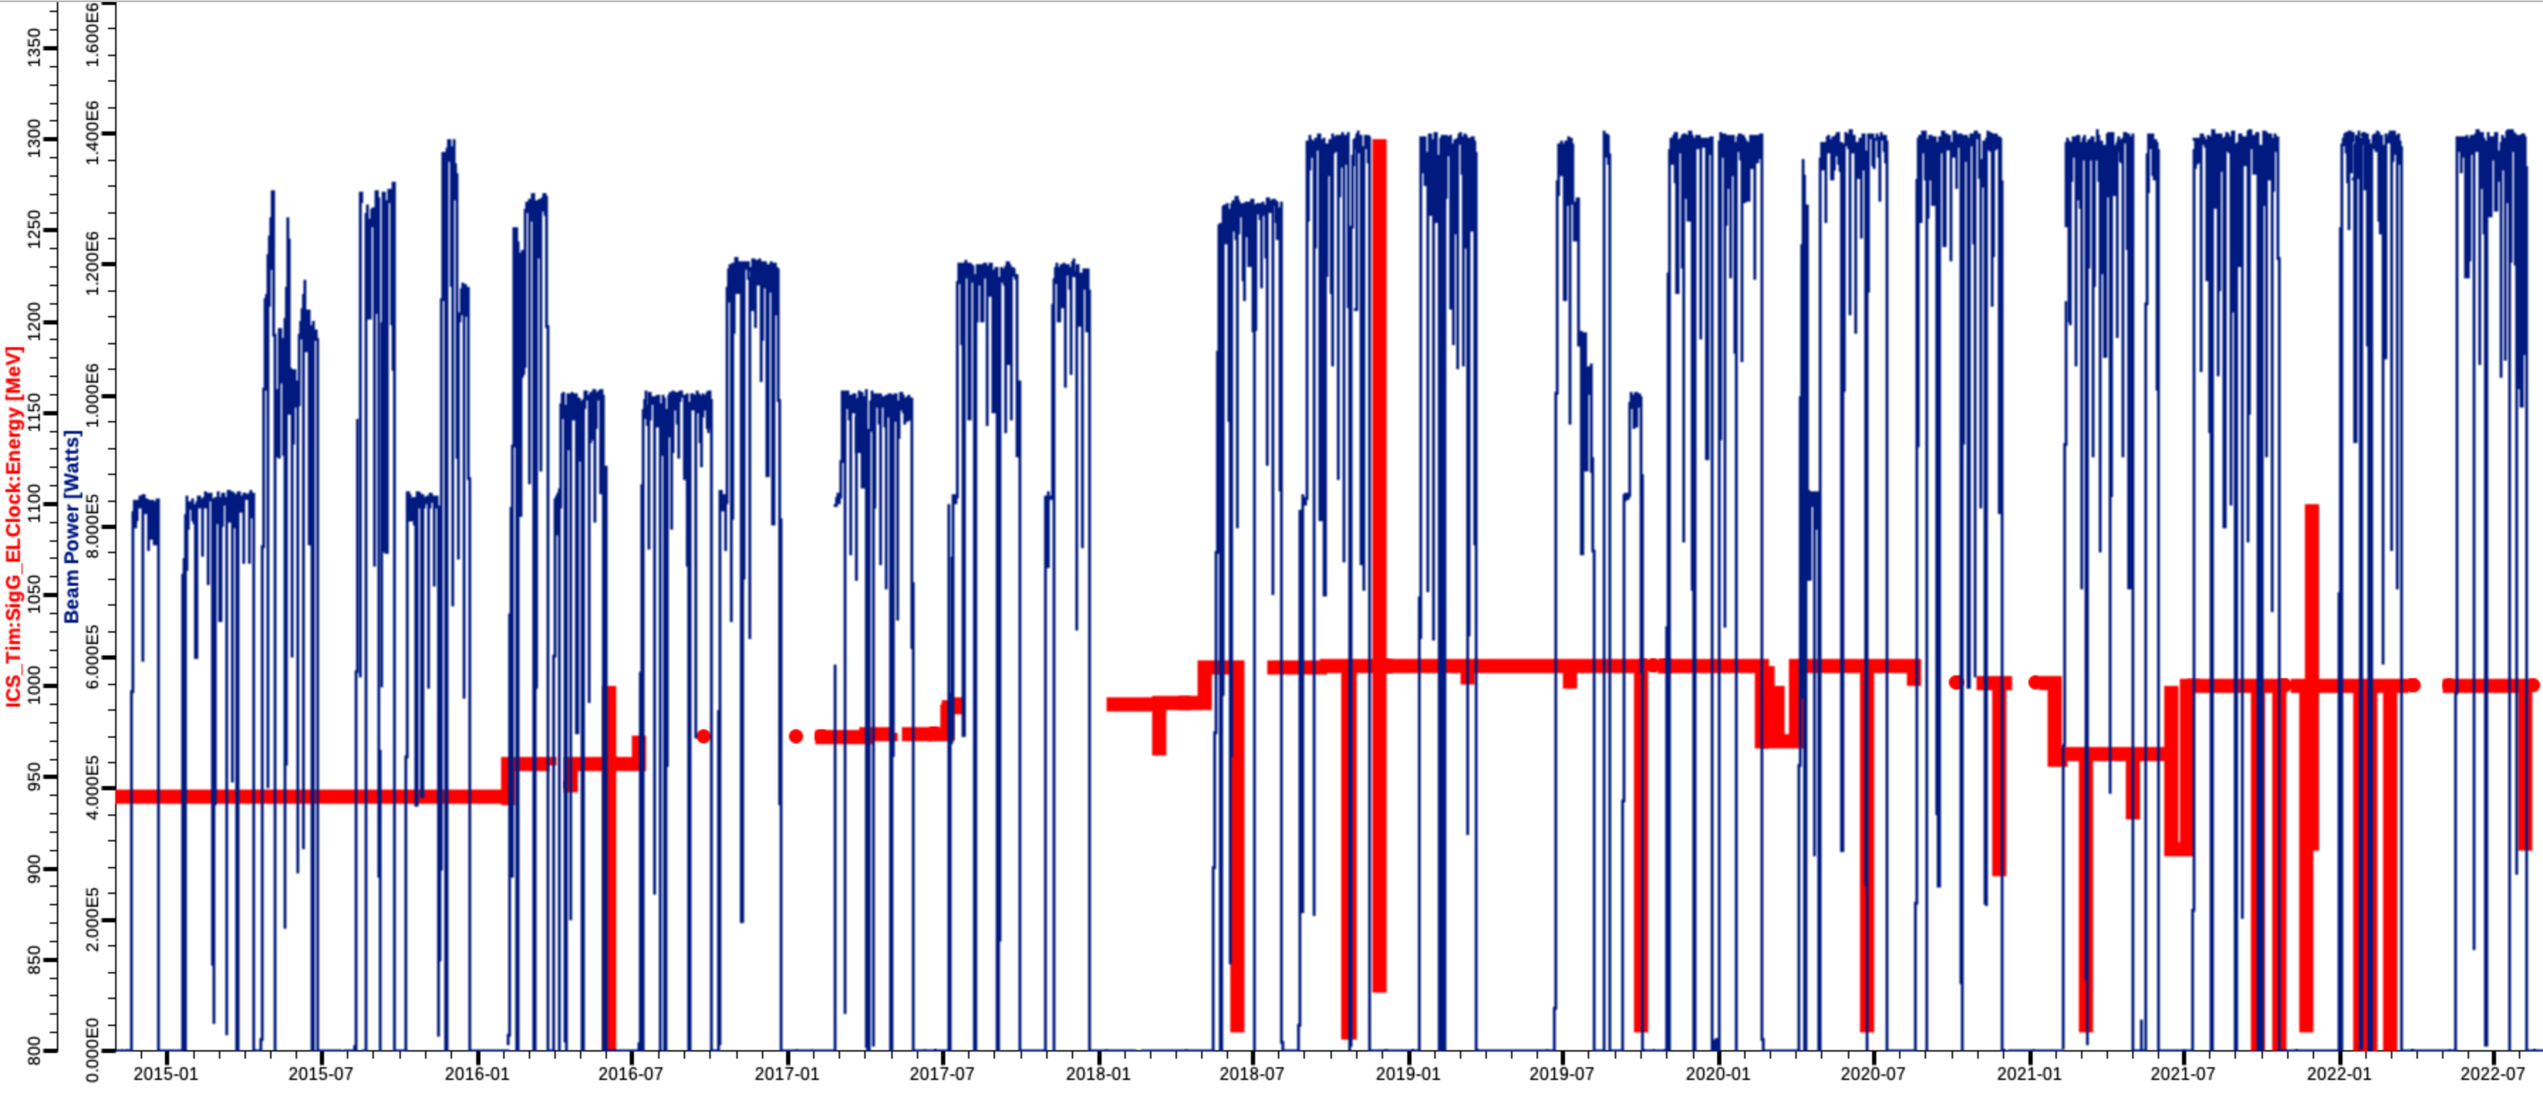
SNS Operation History
Beam power
Beam energy
Target 12
PBW 6 (Aluminum)
PBW 7 (Inconel)

Slide 15
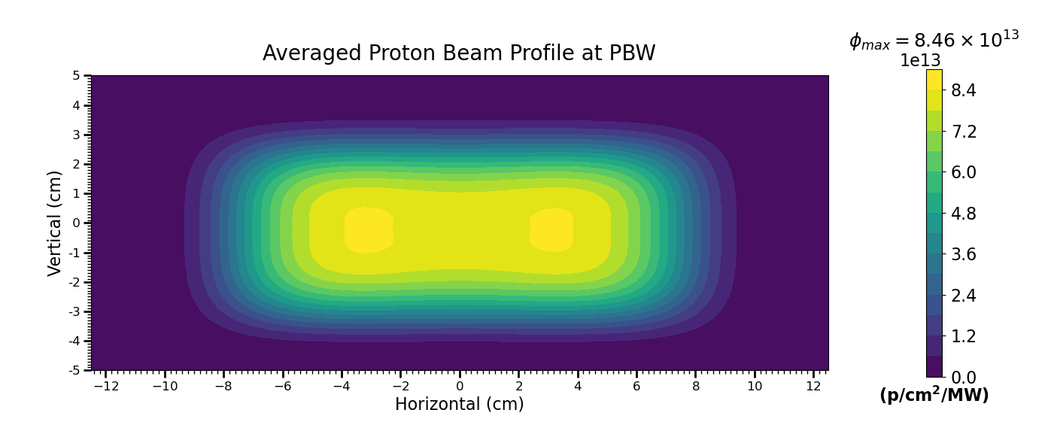
Target 12
Average proton energy: 939.5 MeV
Total energy during operation: 4492.5 MWhr

Slide 16
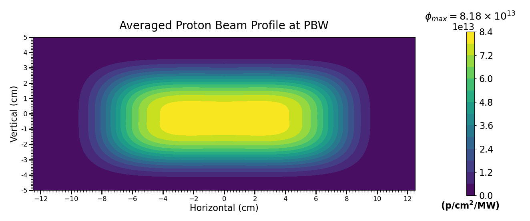
PBW 6
Average proton energy: 1002.2 MeV
Total energy during operation: 15892.6 MWhr

Slide 17
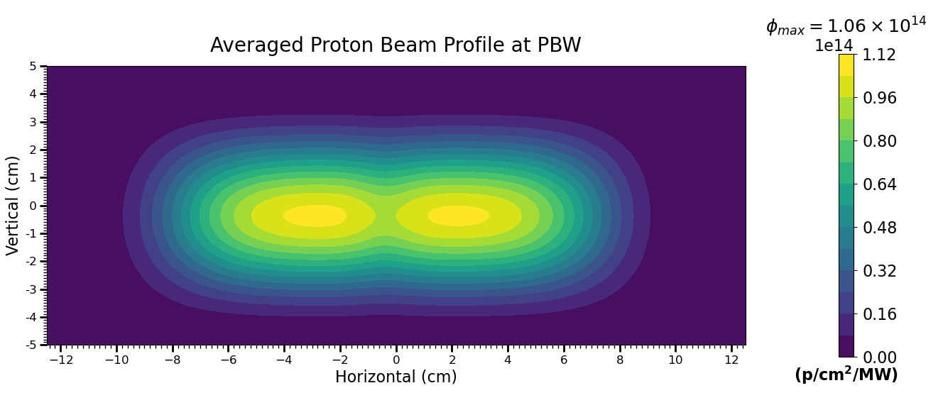
PBW 7
Average proton energy: 996.8 MeV
Total energy during operation: 15239.1 MWhr

Slide 18
Calculations of Gas Production Cross Sections
Recalculation of hydrogen and helium production cross sections
  recent updates of INC models
  many mass spectroscopy techniques capable to distinguish isotopes of hydrogen and helium
Elemental targets:
  C, Mg, Al, Si
  Ti, V, Cr, Mn, Fe, Co, Ni, Cu, Zr, Nb, Mo, Ag, Sn
  Ta, W, Au, Hg, Pb, Bi, U
Particle transport code, MCNP6
  CEM03.03
  INCL4

Slide 19
Calculation Methods for Gas Production Cross Sections
Htape3x not maintained and not correctly working in MCNP6
Production cross sections
  Tally all particles produced
  GENXS card
Residual cross sections
  Tally productions stay within the target
  Thin targets of 1 mm was used
  AARE (Activation in Accelerator Radiation Environments) code
    Prepares MCNP output for nuclide inventory calculation codes, supports
      CINDER(90/2008)
      SP-FISPACT
      ORIHET3
    Applications in burn-up, activation and transmutation analysis
    V-1.0 released by RSICC and V-2.0 is to be submitted
    Reference: Gallmeier, F. and Wohlmuther, M., AARE_ACTIVATION SCRIPT VERSION 2.0 USER GUIDE, ORNL/TM-2018/1036, Oak Ridge National Laboratory, Oak Ridge, TN 2018

Slide 20
Hydrogen and Helium Cross Sections Calculations
- CEM03.03 vs INCL4
INCL4 is not capable to produce light nuclides in transmutation
CEM03 shows synthetic tuning for certain energies
CEM03 is close to realistic transmutation productions

Slide 21
Hydrogen and Helium Cross Sections Calculations
- Production vs Residual Cross Sections
For helium, the difference between production and residual C.S. is not significant ~10% or less
For hydrogen, the difference depends on the target and energy, usually ~ a factor of 2
Issue of residual C.S. is geometry dependent

Slide 22
Hydrogen and Helium Cross Sections Calculations
- Fractions of Isotope contributions
Contributions of hydrogen and helium isotopes are energy and target dependent
Similar for incident protons and neutrons
Generally,
  Proton ~60 – 80%
  Deuteron ~20 – 30%
  Triton ~5 – 10%
  Helion ~20 – 30%
  Alpha ~70 – 80%

Slide 23
Hydrogen and Helium Cross Sections
- 1 GeV protons
Targets | Hydrogen (barn) | Isotope contributions (%) |  |  | Helium (barn) | Isotope contr. (%)
 |  | P | D | T |  | He3 | He4
Al | 1.81 | 72.6 | 22.9 | 4.5 | 0.43 | 21.7 | 78.3
Fe | 3.88 | 72.2 | 22.8 | 4.9 | 0.68 | 23.6 | 76.4
W | 8.01 | 60.8 | 28.7 | 10.4 | 1.40 | 15.7 | 84.3
Production cross section
Targets | Hydrogen (barn) | Isotope contributions (%) |  |  | Helium (barn) | Isotope contr. (%)
 |  | P | D | T |  | He3 | He4
Al | 0.71 | 62.2 | 30.8 | 7.0 | 0.40 | 18.9 | 81.1
Fe | 2.30 | 67.9 | 26.1 | 6.1 | 0.64 | 21.8 | 78.2
W | 5.12 | 55.9 | 31.4 | 12.7 | 1.31 | 14.2 | 85.8
Residual cross section

Slide 24
Displacement Productions at Target 12
Displ_{max} = 10.3
dpa
Displ_{max} = 8.7
dpa
Inner most
Displ_{max} = 7.6
dpa
Displ_{max} = 6.7
dpa
Outer most

Slide 25
Displacement Productions at Target 12
Contr_{max} =39 %
Contr_{max} =47 %
Inner most
Contr_{max} =53 %
Contr_{max} =59 %
Outer most

Slide 26
Helium Productions at Target 12
He_{max} = 915
appm
He_{max} = 919
appm
Inner most
He_{max} = 915
appm
He_{max} = 913
appm
Outer most

Slide 27
Helium Productions at Target 12
Contr_{max} =93 %
Contr_{max} =95 %
Inner most
Contr_{max} =96 %
Contr_{max} =98 %
Outer most

Slide 28
Hydrogen Productions at Target 12
H_{max} = 3582
appm
Inner wall of MV
Contr_{max} =88 %

Slide 29
Helium and Hydrogen Productions at PBW 6
He_{max} = 2133
appm
He_{max} = 3576
appm
Inner most
Displ_{max} = 4.42 dpa
Contr_{max} =99 %
Contr_{max} =99 %
Outer most

Slide 30
Helium and Hydrogen Productions at PBW 7
He_{max} = 3948
appm
He_{max} = 3945
appm
Upstream
Downstream
Displ_{max} = 18.8 dpa
Displ_{max} = 19.6 dpa
H_{max} = 15182
appm
H_{max} = 15299
appm
Outer most
Upstream
Downstream
Proton contribution 95-99%

Slide 31
Peak Gas Productions and Uncertainty
 | Avg. proton energy (MeV) | Total energy received (MWhr) | Peak radiation damage productions
 |  |  | Displacement (dpa) | Helium (appm) | Hydrogen (appm)
Target 12 | 940 | 4493 | 10.3 | 919 | 3582
PBW 6 | 1002 | 15893 | 4.4 | 2133 | 3576
PBW 7 | 997 | 15239 | 19.6 | 3948 | 15299
Proton beam profile
  measurements of Harp: tungsten wire signal variation ~10%
  beam profile fitting: RMS estimate < 5%
Calculations of cross sections
  CEM03 was benchmarked to experimental measurements
  generally ~20%

Slide 32
Summary
With the anticipation of preparing specimens for measurements, the gas productions for PBWs 6&7 and Target 12 were calculated
  Peak helium productions are 2133 appm for aluminum PBW 6 and 3948 appm (19.6 dpa) for Inconel PBW 7, both reached the tentative radiation damage limit of the material
The incident proton beam profiles were carefully constructed from the Harp measurements and averaged over the operation time
The gas production cross sections were updated with more recent INC models and isotope production cross sections
  CEM03 is reasonable in predicting transmutation productions rather than INCL4 though with synthetic tuning
  Different than helium cross section, the hydrogen residual cross section is geometry dependent
  It is better to calculate hydrogen production with the real geometry using the AARE modified MCNP6 code rather than using its cross sections

