Slide 1
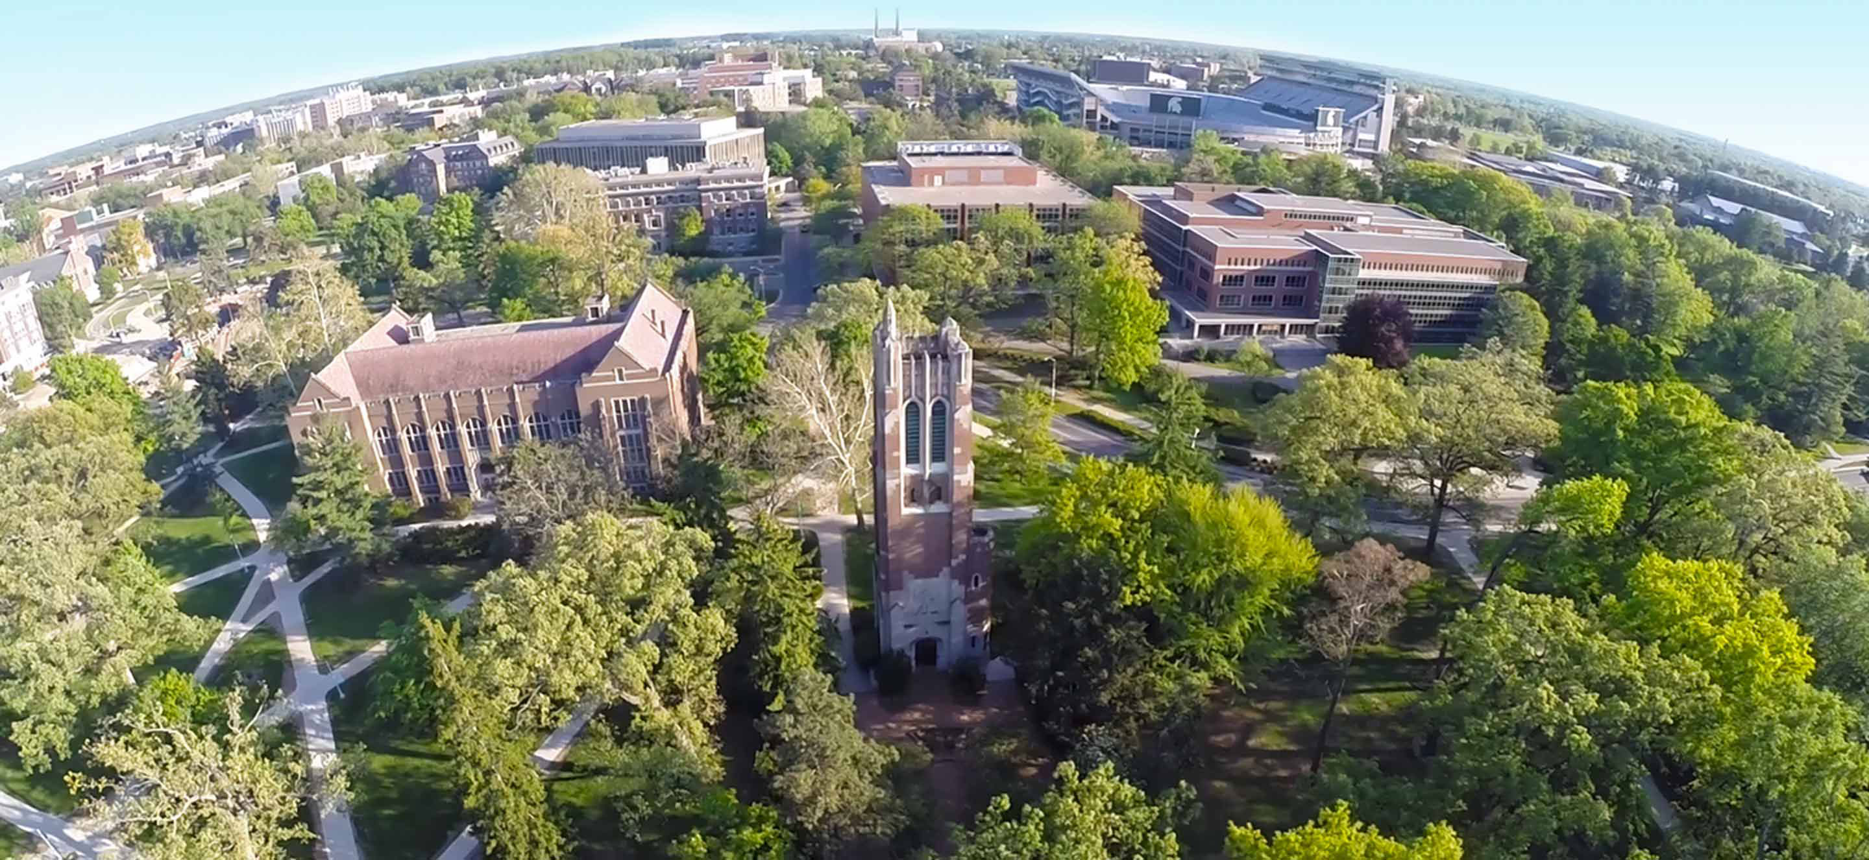
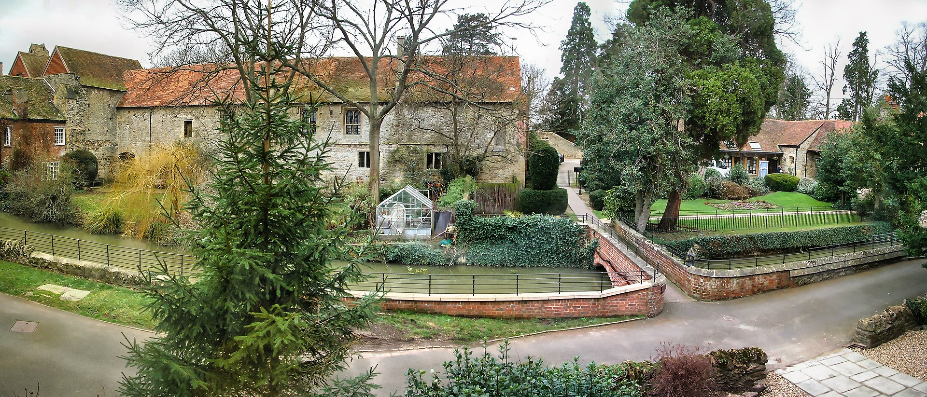
FRIB: Challenges and Current Status
Jie Wei
On Behalf of the FRIB Accelerator Team & Collaboration
IWSMT16, The Cosener’s House, UK
28 October 2024

Slide 2
Outline
Introduction
FRIB operational status
Challenges with beam intercepting systems
Summary

Slide 3
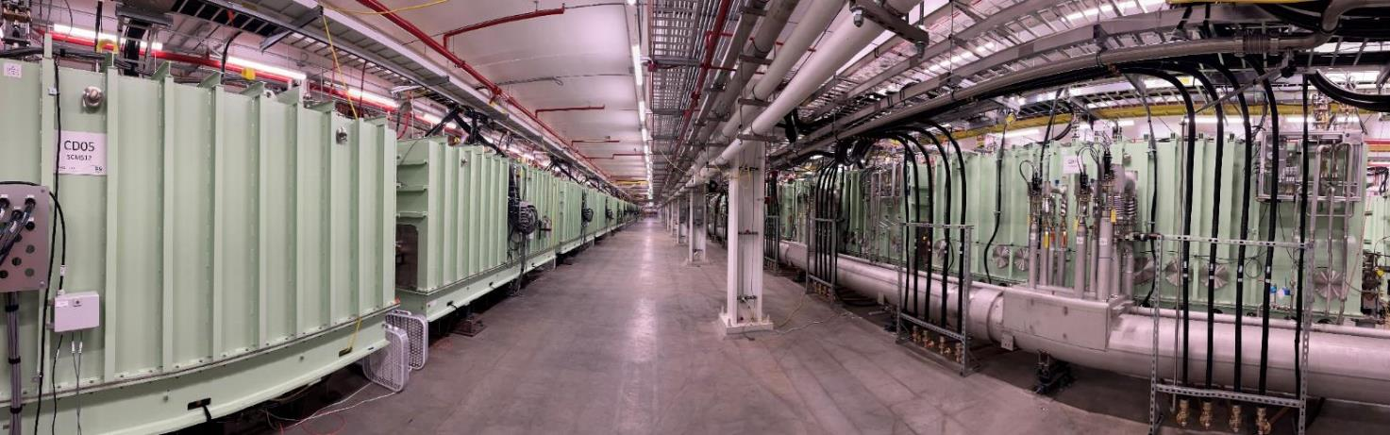
FRIB Project Construction 2014 – 2022
A User Facility with World’s Highest Energy and Most Powerful Heavy Ion Linac
FRIB driver linac in accelerator tunnel
Milestones | Date
DOE and MSU cooperative agreement | Jun 2009
CD-1: preferred alternatives decided | Sep 2010
CD-2/3a: performance baseline, start of civil construction & long lead procurement | Aug 2013
CD-3b: start of technical construction | Aug 2014
FRIB linac construction completion | May 2021
Project technical construction completion | Jan 2022
CD-4: project completion | Apr 2022
Start of PAC1 user experiments at 1 kW primary beam power | May 2022
User experiments at 20 kW primary beam power | Nov 2024
Linac includes front end and 46 SRF cryomodules
  ECR ion sources; RFQ; 324 SRF cavities in 46 cryomodules with velocity β from 0.041 to 0.53
  208 cold magnets, 350 warm magnets
Liquid helium for 2 K, 4 K operations
Liquid lithium charge stripping
Accelerates all stable ions > 200 MeV/u
Slide 3

Slide 4
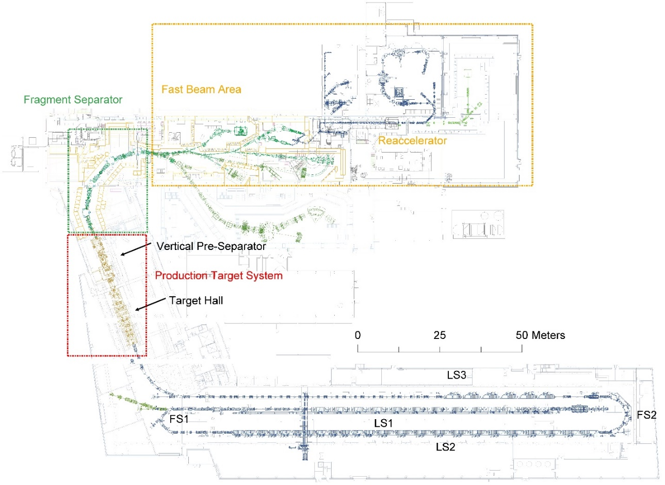
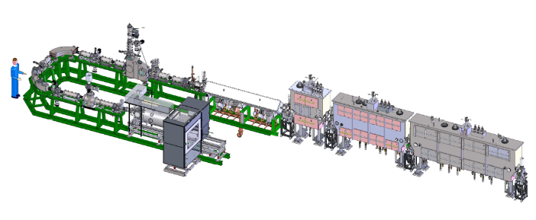
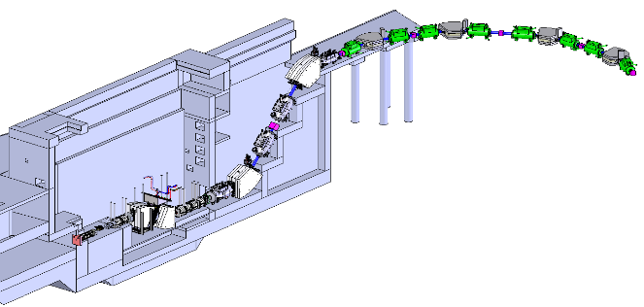
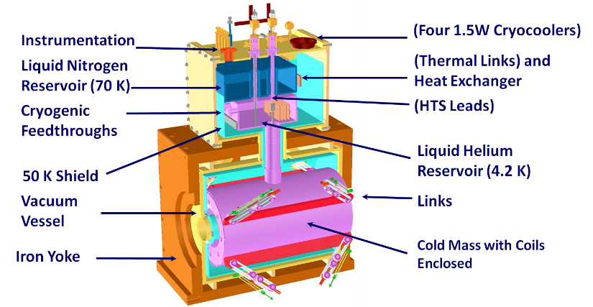
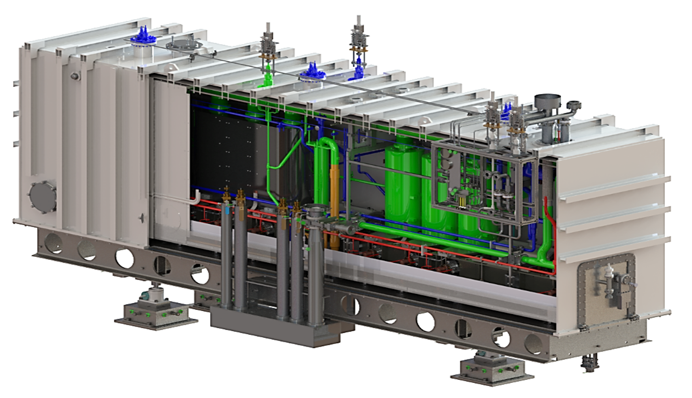
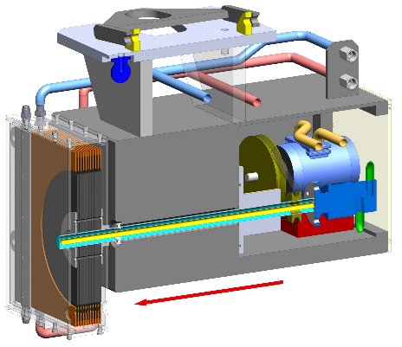
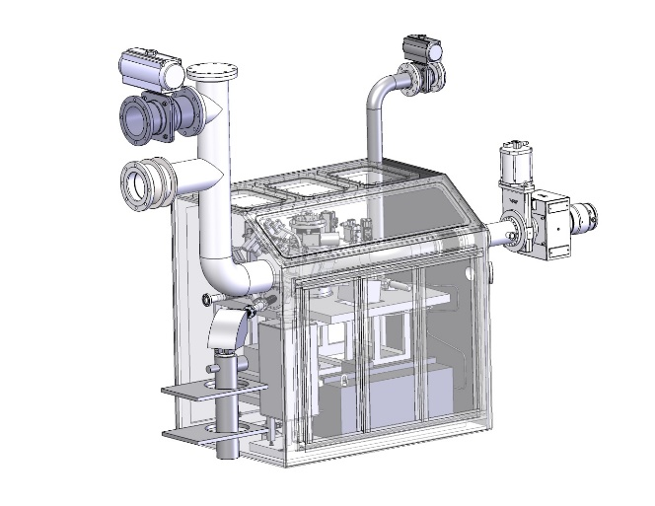
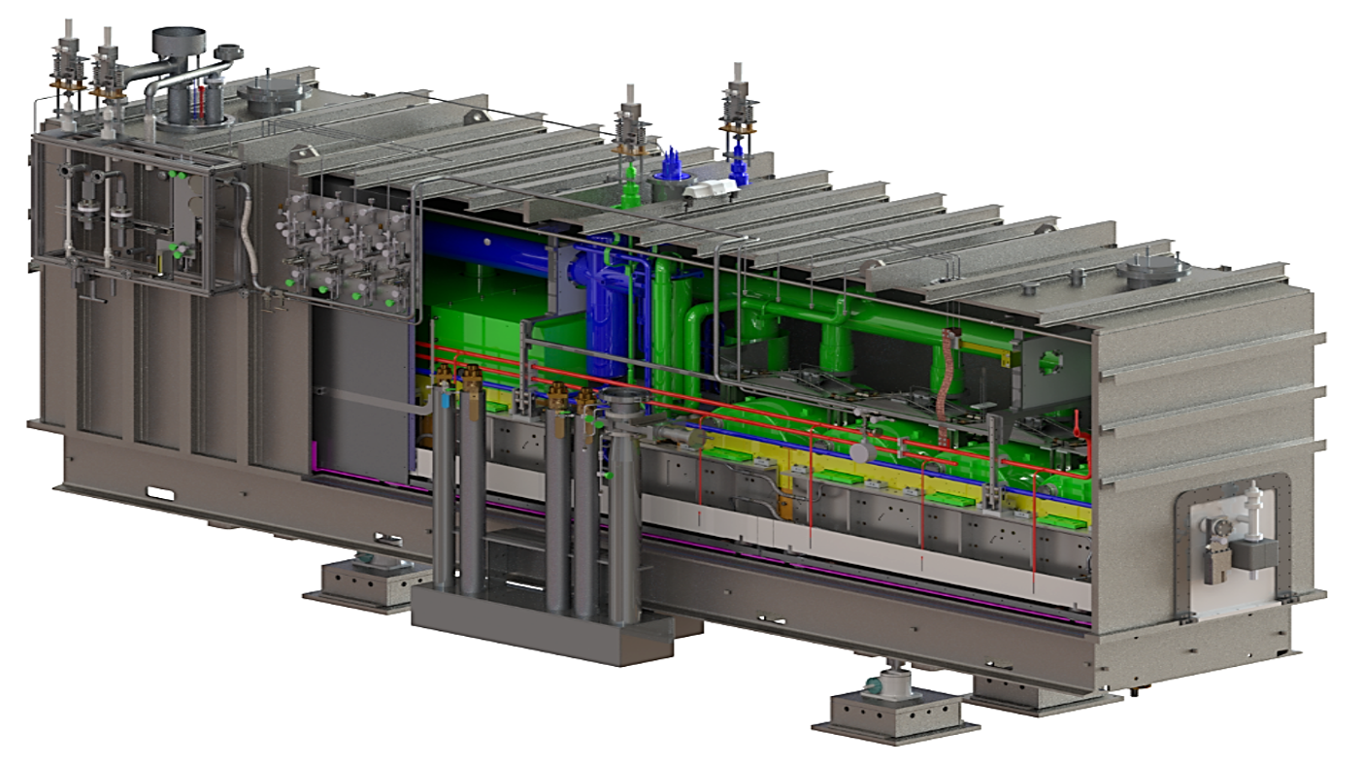
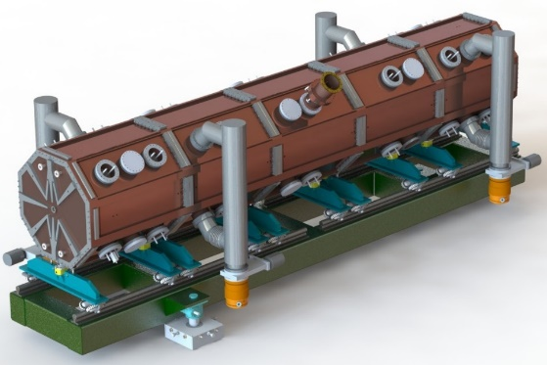
Heavy Ion Accelerator Complex with In-Flight Isotope Separation
Fast, Stopped, and Reaccelerated Rare Isotope Beams
ReAccelerator
Fragment separator
ECR ion source
QWR cryomodules
Target
HWR cryomodules
RFQ
Charge stripper
, Slide 4

Slide 5
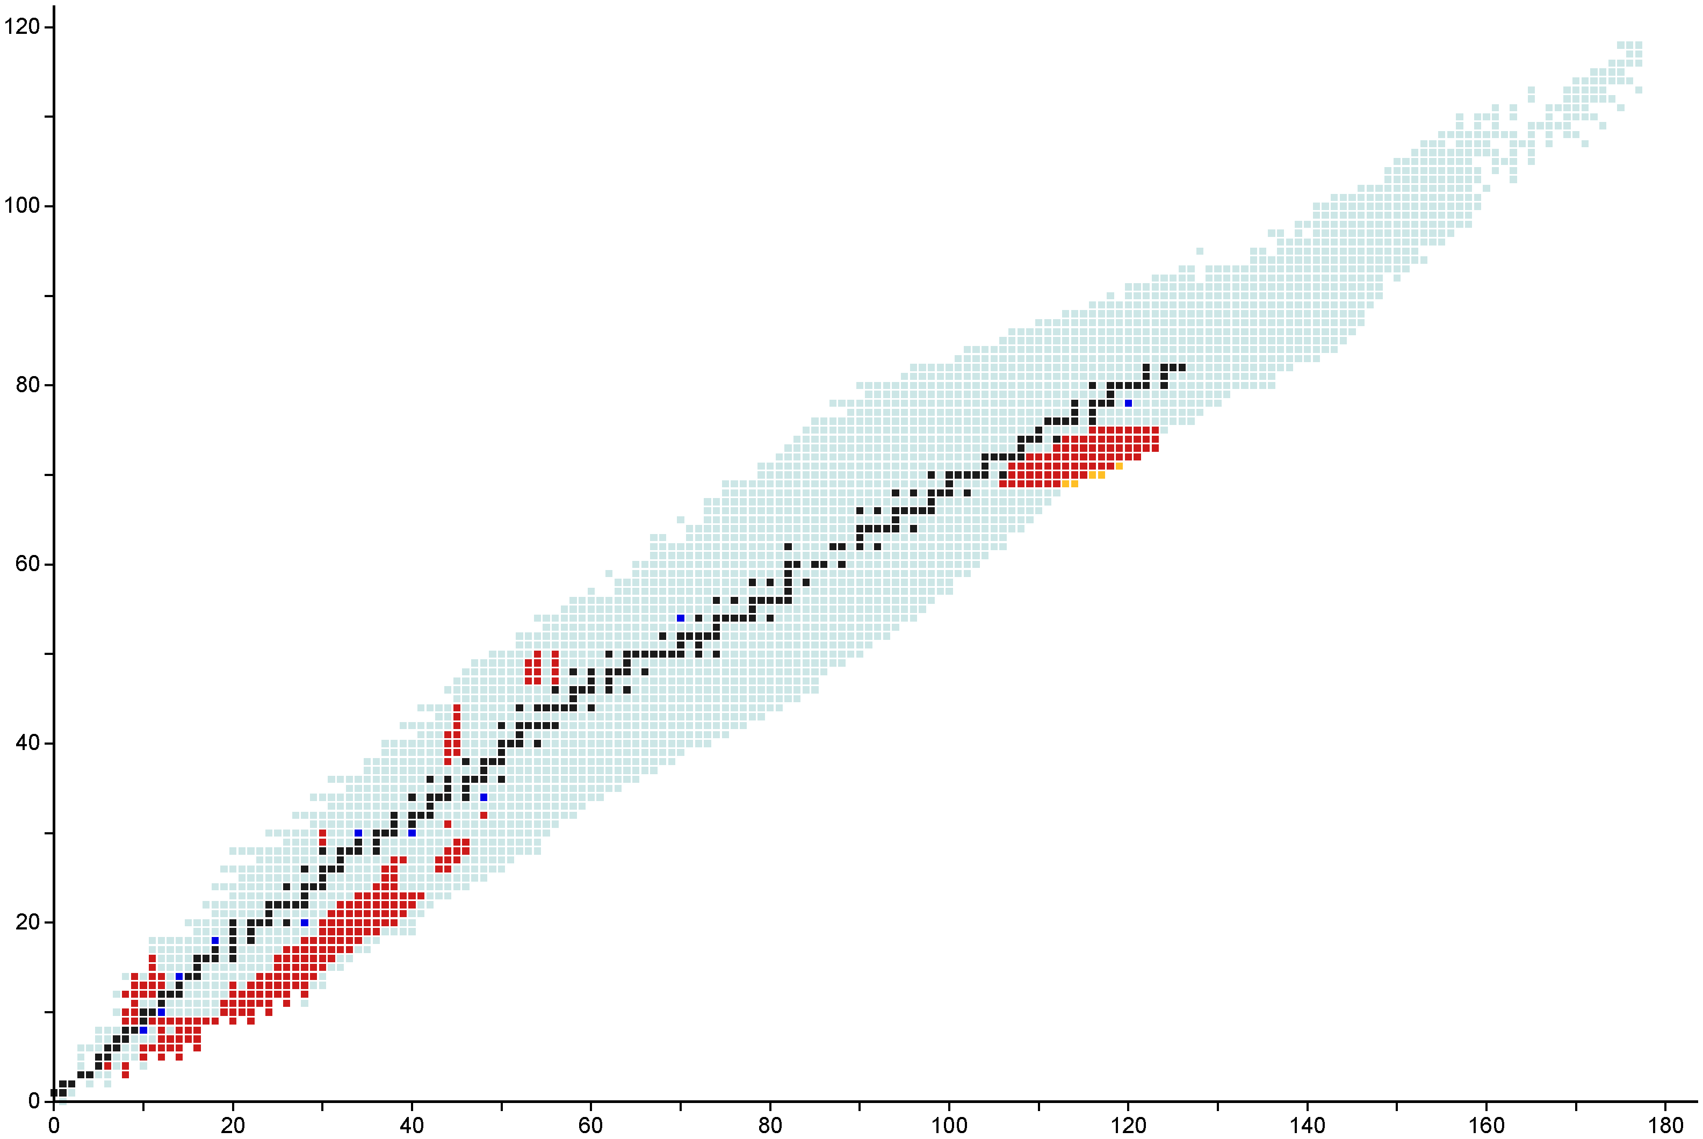
More than 270 Rare Isotope Beams Delivered to FRIB User Experiments with > 5000 Annual Beam Hours
Experiments since January 2024:
E21062B: ^{15,17,19}B, ^{17-20,22}C, ²⁰⁻²³N, ²²⁻²⁴O, ^{26-27,29,31}F, ^{29-32,34}Ne, ^{32-35,37}Na, ^{33-38,40}Mg, ³⁵⁻³⁹Al, ³⁷⁻⁴²Si, ⁴⁰⁻⁴⁵P, ⁴⁴⁻⁴⁷S
E21001: ⁴²Si, ⁴³P, ⁴⁴S E23003: ⁴²Si, ^{42,43}P, ⁴⁴S, ⁴⁵Cl E23009: ¹⁰Be
E23030: ⁶⁹⁻⁷⁰Fe, ⁷⁰⁻⁷²Co, ⁷⁰⁻⁷⁴Ni, ⁷⁴⁻⁷⁵Cu E23004: ⁶⁹⁻⁷⁰Fe, ⁷¹⁻⁷²Co, ⁷²⁻⁷³Ni, ⁷⁴Cu
E21069B: ⁴¹⁻⁴⁷S, ⁴³⁻⁵⁰Cl, ⁴⁶⁻⁵²Ar, ⁴⁹⁻⁵⁵K, ⁵²⁻⁵⁸Ca, ⁵⁵⁻⁶⁰Sc, ⁵⁷⁻⁶²Ti
E22510: ⁸⁰Ge E23084: ⁷⁵Ga E21015: ²¹⁻²³Mg, ²²⁻²⁵Al, ²³Si
E21018: ³²Mg, ³³Al E23031: ¹¹Li, ¹²Be, ¹⁵B
Protons
Primary Beams
¹⁸O
²²Ne
²⁸Si
³⁶Ar
⁴⁸Ca
⁶⁴Zn
⁷⁰Zn
⁸²Se
¹²⁴Xe
¹⁹⁸Pt
²³⁸U
^{182,183}Tm, ^{186,187}Yb, ¹⁹⁰Lu
Stable isotopes
Primary Beams
Observed isotopes
Experiments at FRIB
Discovered at FRIB
Data Date: 2024-07-15
Neutrons

Slide 6
Comparison of Proton and Heavy Ion Beam Power Evolution
Compared to proton-based facilities, lower-energy, heavy-ion based facilities face challenges, including high dissipation-power density and high radiation damage
FRIB status
  FRIB started user operations at 1 kW
  Progressively increasing the average beam current
  10.4 kW uranium beam on target
  Operating up to 22 kW beam on target
  Ultimate beam power goal: 400 kW
, Slide 6

Slide 7
FRIB Facility Challenges and Complexity
Large-scale low-β superconducting linac
Multiple charge-state acceleration
Advanced and complex fragment separation
Legacy system interfacing and integration
Multi-layered machine protection
High-power beam-intercepting devices (charge stripping, charge collection, target, beam dump, collimators)
  Low energy, short range
    Charge stripping / selection ~ 20 MeV/u ; target /beam dump ~ 200 MeV/u
  High charge state, high power density (~ 60 MW/cm³)
  Tightly focused beam on target (φ ~ 1 mm)
  Large number of unwanted charge states / isotopes

Slide 8
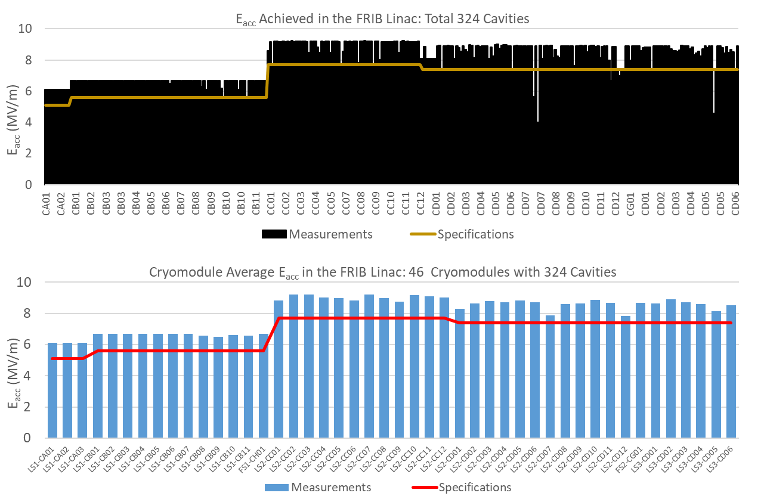
Large-scale Low-β Superconducting Linac: in Operation
Integrated design of cryogenics, cryo-distribution, and cryomodules
All resonators can operate at either 2 K or 4.5 K
Operations: HWR runs at 2 K, while QWR and SC magnets run at 4.5 K
All cryomodules operating at or above design goal
No obvious signs of beam-induced degradation

Slide 9
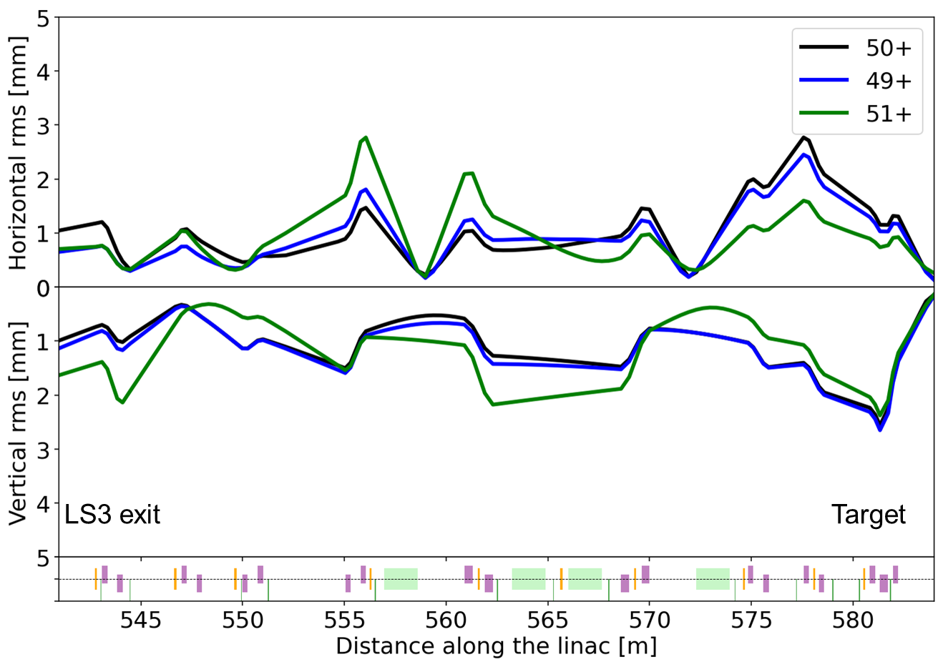
Simultaneous Multiple-charge-state Acceleration
Pioneered at FRIB to Reduce Unwanted Charge States
Routinely accelerating up to 5 charge state (for uranium) simultaneously to enhance beam intensity and reduce controlled beam loss downstream of charge stripper
Simultaneous acceleration of three charge states of ¹²⁴Xe beam in FRIB linac
Multi-charge-state beams tuned to overlap at specified locations
  Target (present)
  Charge stripper (future)
Plan to accelerate multi-charge state beams in Linac Segment 1 (upstream of charge stripper)

Slide 10
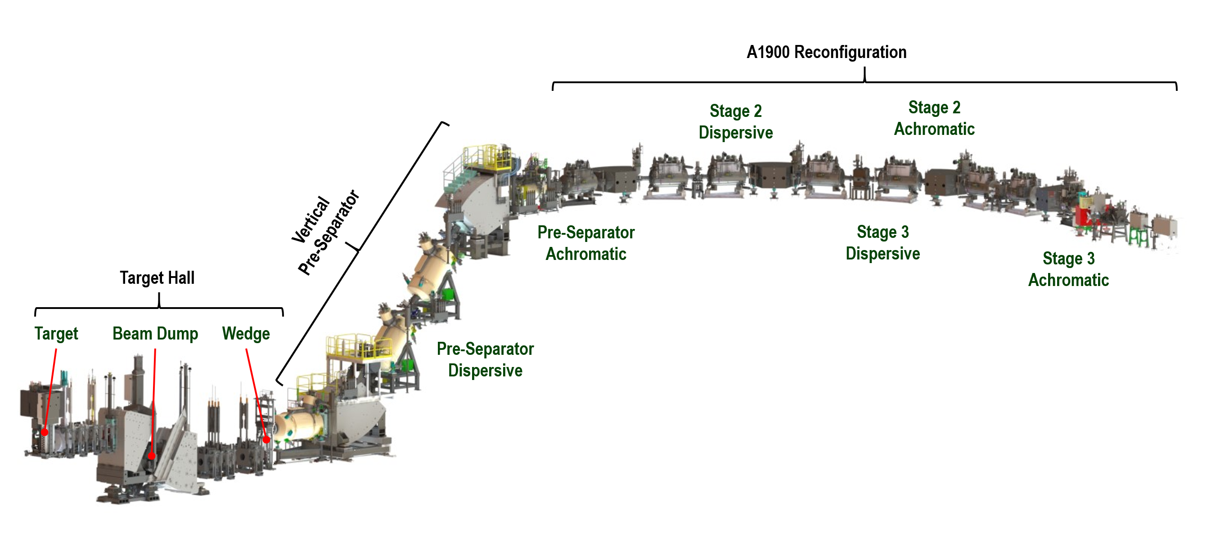
Advanced Rare Isotope Separator Complexity
Collects ~ 100% of fragments produced at the target; selects individual isotopes for delivery to desired experimental station
  Three stages of fragment separation
    In-flight rigidity selection and selective energy loss in profiled degraders
  Combination of vertical and horizontal separation
    Momentum compression in the vertical plane
    Preserves good phase space for gas stopping in the horizontal plane
  Optically corrected to 3rd order and operate over rigidity range of 1 to 8 T∙m
Issues:
  Newly constructed vertical pre-separator meets legacy reconfigured beam lines
    Aperture-limited
    Some magnet aberrations are not compensated for
    Lack of diagnostics and correctors
, Slide 10

Slide 11
List of Irradiation Conditions for Uranium Beam
 | Device | Beam-intercepting material | Beam power at device (power at target) | Thermal load (Uranium) Deposited Power and Density |  | Type | Max. temperature | DPA (irrad. period) | Implanted ion concentration
Linac (FS1) ~ 20 MeV/u | Charge stripper | Graphene sheet | 2.5 kW (20 kW) | 94 W | 4 MW/cm³ | Rotating solid | > 1000 °C | 9 dpa (1 week) | N/A
 |  | Liquid lithium | 50 kW (400 kW) | 1360 W | 60 MW/cm³ | Liquid film w/o window | 800 °C | N/A | N/A
 | Charge selector | Glidcop AL-15 (Cu alloy) | 2.5 kW (20 kW) | 500 W | 0.6 MW/cm³ | Static solid, water cooled | 500 °C | 3000 dpa (1 week, at peak) | 10 at% (1 week)
 |  | Graphite (planned) | 13 kW (100 kW) | 3 kW | 4 MW/cm³ | Rotating solid | > 1000 °C | 80 dpa (1 week at peak) | 0.07 at% (1 week)
 |  | TBD (liquid metal) | 50 kW (400 kW) | 10 kW | ~10 MW/cm³ | Liquid film w/o window | TBD | N/A | N/A
Target Hall ~ 200 MeV/u | Target | Graphite | 400 kW (400 kW) | 100 kW | 60 MW/cm³ | Rotating solid | > 1000 °C | 8 dpa (2 weeks) | N/A
 | Beam dump | CuCrZr | 15 kW (20 kW) | 15 kW | 0.6 MW/cm³ | Static solid, water cooled | 250 °C | 12 dpa (1 week) | 0.02 at% (1 week)
 |  | Water in thin-wall Ti shell | 300 kW (400 kW) | 300 kW | 30 MW/cm³ | Rotating liquid w/ window | 150 °C | 7 dpa in shell (1 year) | N/A
Notes:
Charge stripper suffers the severest condition (beam focused on thin film, high dE/dx due to low energy).
Target will have a similar thermal load but have advantage of thickness (rigid). Graphite is ok.
Beam dump and charge selector for high power operations will be liquid due to Bragg peak.

Slide 12
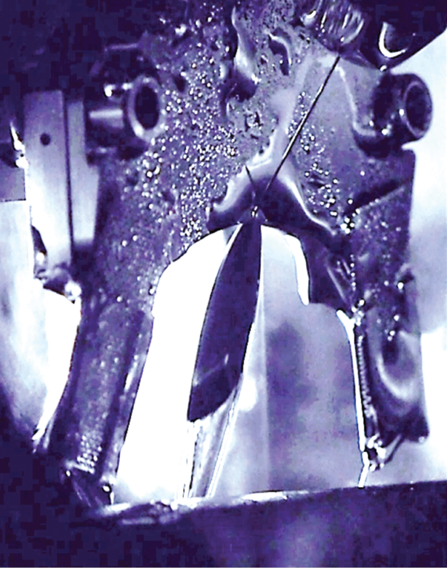
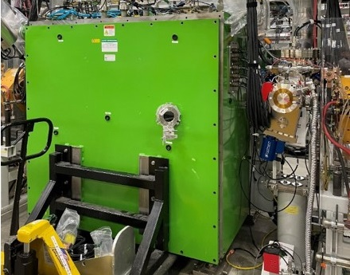
Charge-stripping with Thin-film Liquid Metal
Operating with charge strippers of either liquid-lithium film or rotating carbon foil (for light ions)
Lithium charge stripper secondary container
Carbon charge stripper
Liquid lithium film for charge stripping

Slide 13
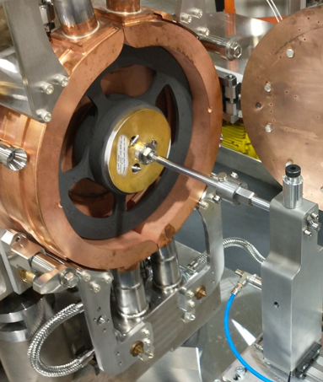
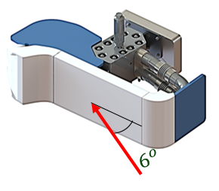
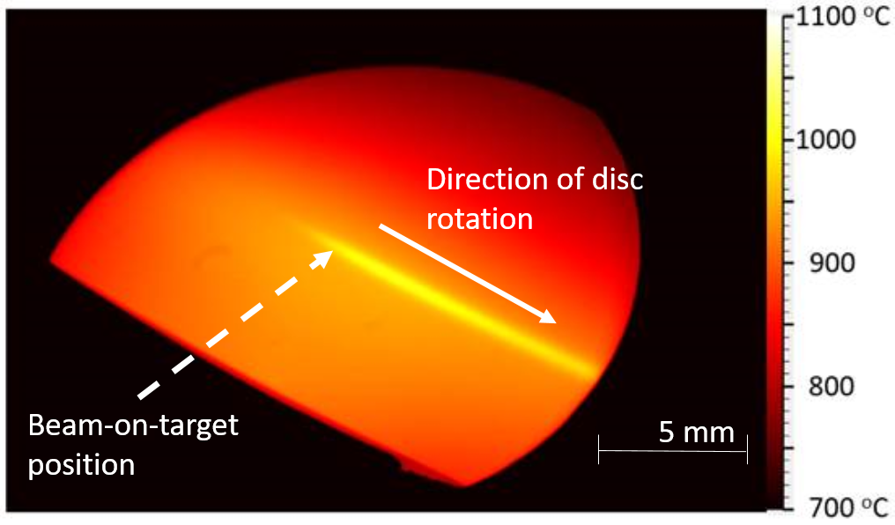
High-power Targetry Devices: in Phased Deployment
Rotating, single-slice graphite target for rare isotope production
  Absorbs ~ 25% beam power; accommodate small (Ø ~ 1 mm) beam size
Static beam dump with shallow beam incident angle
  Absorbs ~ 75% beam power; consideration of radio-activation in water and surroundings
Single-slice graphite production target
10.4 kW ²³⁸U beam on target rotating at 500 rpm reaching 1004ºC peak temperature
Static beam dump with 6º incident angle for incoming beam
, Slide 13

Slide 14
Ensure Safe Power Ramp-Up with Phased Deployments
Progressively Raising the Average Beam Current over Coming Years
EPOCH | 1 |  | 2 |  | 3 |  | 4 |  | 5 |  | 6
Beam Power | 10 kW |  | 20 kW |  | 50 kW |  | 100 kW |  | 200 kW |  | 400 kW
ARTEMIS, light ion beams from gas
ARTEMIS, heavy ion beams from metal
High Power ECR, gas beams
High Power ECR, metal beams
Intermediate power charge selector in FS1
High power charge selector in FS1
Post-stripper chicane
Additional beam collimation in FS2, BDS
Dual charge state heavy ions upstream of the stripper (velocity equalizer)
Rotatable target, 1 slice
Rotatable target, multi-slice
Post-target shield
Beam dump 6º slant (S-shape)
Beam dump 6º slant (S-shape), better cooling
Rotatable beam dump, 1-mm wall
Rotatable beam dump, 0.5-mm wall
Medium power ladder wedge system with adjustable slits (hands on)
High power wedge system (remote handling)
PPS upgrade with fast ionization chambers
Experience must be gained to safely handle increased radiological impacts
  Prompt radiation and radio-activation in devices, ground water, and exhaust
Extensive machine studies and beam tuning: needed to minimize uncontrolled beam losses
High-power targetry systems and beam-intercepting devices: in phased deployment, along with ancillary systems, including non-conventional utilities, and remote handling
Accelerator improvements and renovations to aging legacy systems: being implemented in parallel

Slide 15
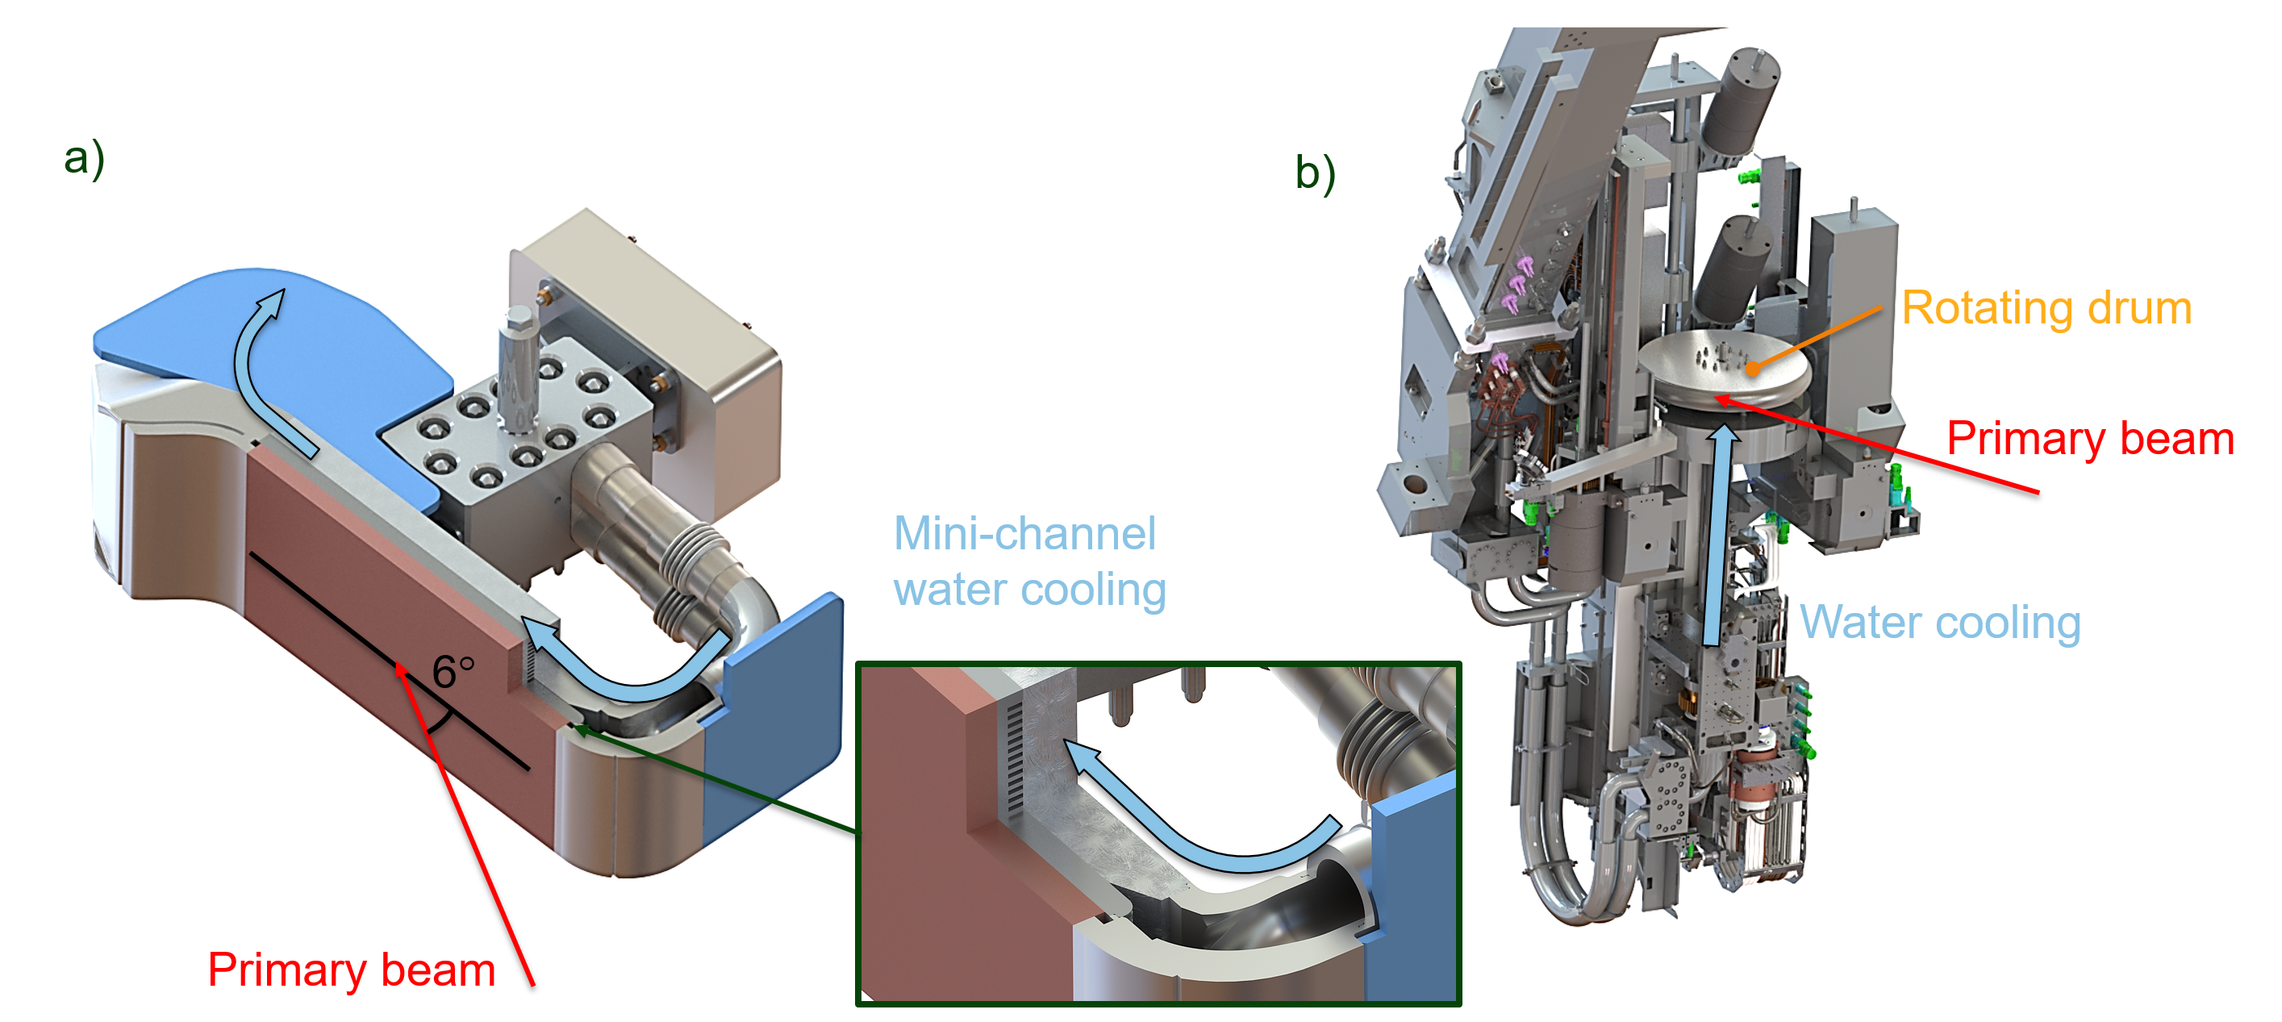
Phased Deployment Example 1: Beam Dump from 20 kW to > 50 kW
Beam dump used for 10 kW run: water-cooled static aluminum plate with beam incident at 6º angle
Current: water-cooled static bi-metal plate with mini-channel cooling (6º static dump version 2)
Next step: 6º static dump version 3 (bi-metal, with further improved cooling on wings/edges)
Ultimate: rotating thin-wall water-filled drums
Current
Ultimate

Slide 16
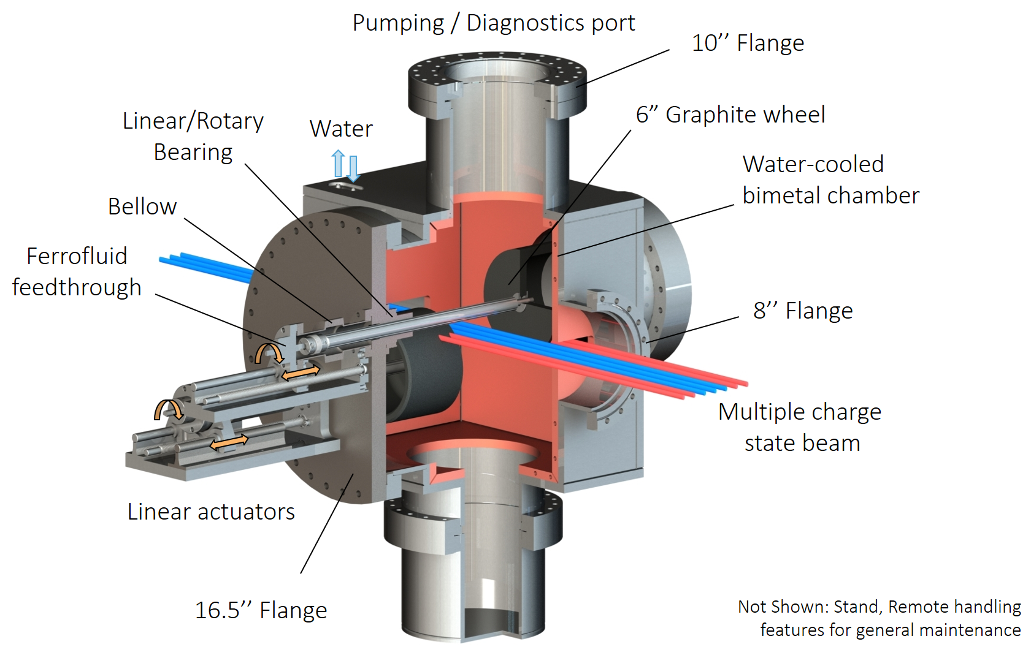
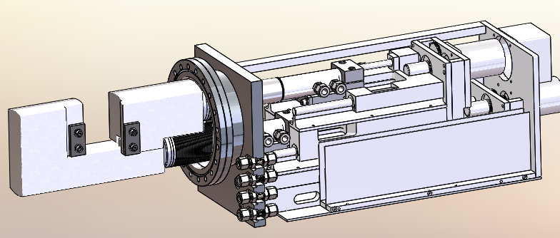
Phased Deployment Example 2: Charge Selector from 20 kW to > 50 kW
Current charge selector: static water-cooled jaws made of Glidcop AL-15
Next step: two rotating graphite drums with ferrofluid feedthrough
Next step
Current

Slide 17
Summary
The FRIB project was completed in 2022 on scope, on cost, and 5 months ahead of schedule baselined > 8 years ago
FRIB has been operating for > 2 years, delivering > 5000 annual hours of beam time for both scientific and industrial experiments with > 92% availability
The primary beam power is being steadily raised from 1 to 20 kW
To ramp up to the ultimate design beam power of 400 kW, efforts are focused on phased linac improvements, phased targetry system deployments, control of beam loss, radiological impacts, legacy system renovation, and automation
The power ramp-up campaign and the proposed FRIB upgrade to double the primary-beam energy to 400 MeV/u will significantly enhance FRIB’s discovery potential
We are deeply grateful to the high-power targetry community for the help in establishing and improving the FRIB facility, and we are looking forward to collaborations to overcome challenges facing FRIB performance ramp up

Slide 18
Acknowledgements
We are deeply grateful to the high-power targetry community for the help in establishing and improving the FRIB facility, in particular the FRIB Targetry Advisory Committee chaired by P. Hurh
Patrick Hurh | hurh@frib.msu.edu
Alex Gottberg | gottberg@triumf.ca
Koichi Yoshida | yoshida@ribf.riken.jp
Shin-ichiro Meigo | meigo@post.j-parc.jp
Michael Wohlmuther | michael.wohlmuther@ess.eu
Marco Calviani | marco.calviani@cern.ch
Mike Dayton | daytonmj@ornl.gov
Drew Winder | winderde@ornl.gov
Michael Fitton | michael.fitton@stfc.ac.uk
John Anderson | jea@fnal.gov
Stu Maloy | stuart.maloy@pnnl.gov
David Senor | david.senor@pnnl.gov
Tatsuhiko Ogawa | ogawa.tatsuhiko@jaea.go.jp
Don Montierth | montierthdn@ornl.gov
Antonio Perillo Marcone | antonio.perillo-marcone@cern.ch
Charlotte Barbier | barbiercn@ornl.gov
Wim Blokland | blokland@ornl.gov

Slide 19
Backup slides

Slide 20







Collaboration with National Laboratories and International Partners: Key to Success
ANL
  Liquid lithium charge stripper
  Beam dynamics verification; β=0.29 HWR processing and testing; SRF tuner validation; beam dump; SRF components development
  RF couplers for multi-gap buncher
  SOLARIS
BNL
  Plasma window & charge stripper, physics modeling, magnets
FNAL
  Diagnostics, SRF processing
JLab
  Cryoplant; cryodistribution design & prototyping
  Cavity hydrogen degassing; e-traveler
  HWR processing & certification
  QWR and HWR cryomodule design and engineering support for production
LANL
  Proton ion source
LBNL
  ECR coldmass; beam dynamics
MIT
  CRIS
ORNL
  Remote handling, diagnostics; large-vessel vacuum, cryoplant controls
  FDSi
SLAC
  Cryogenics, SRF multipacting, physics modeling
RIKEN
  Helium gas charge stripper
TRIUMF
  Beam dynamics design, physics modeling SRF, QWR etching
INFN
  SRF technology
KEK
  SRF technology, SC solenoid prototyping
IMP
  Magnets
Budker Institute, INR Institute
  Diagnostics
Tsinghua Univ. & CAS
  RFQ
ESS
  Accelerator physics
DTRA
  RFQ power supply
CSNSM-JaNNUS
  Nuclear recoil damage to materials
RaDIATE
  Nuclear recoil damage to materials
GANIL
  Rare isotope physics, target development
GSI
  Rare isotope physics, fragment separators
U Notre Dame
  Recoil implantation testing of materials
Slide 20
Notes:
Ask Rae for updates biannually
Updated per TG LECM deck 8/16/2021 AZ
Under ANL, added SOLARIS
Added MIT, w/CRIS sub-bullet and MIT logo
Updated first bullet for ANL to say “liquid lithium charge stripper” (“charge” was missing previously) – 5/21/21 AZ
Per Rae Benington, audit this slide in April, after Lab Managers Budget briefings with DOE are complete in March – 1/27/21, AZ
7/22/2020 - RIKEN, CSNSM-JaNNUS, and U Notre Dame marked as DONE, per Paul Mantica - AZ
1/7/2020: Added “DONE” TO ANL RF couplers, per PM, AZ
10/31/19: Removed “DONE” from INFN SRF technology, per Paul Mantica, AZ
Last updated:
7/19: current per P. Mantica
March 2019: no edits needed, per P. Mantica. KZK
October 2018 with updates from Paul Mantica, ST
Updated 7/18/18 - ST
7/13/18 – updated by Paul Mantica as of 7/13/18

Slide 21
Acknowledgements
FRIB accelerator systems design and construction have been facilitated under work-for-others agreements with many DOE-SC national laboratories including ANL, BNL, FNAL, JLab, LANL, LBNL, ORNL, and SLAC, and in collaboration with institutes worldwide including BINP, KEK, IHEP, IMP, INFN, INR, RIKEN, TRIUMF, and Tsinghua University. The cryogenics system was developed in collaboration with the JLab cryogenics team. The SRF development benefited greatly from the expertise of the low-b SRF community. FRIB has been collaborating with ANL on RF coupler and tuner developments, assisted by JLab for cryomodule design, and by FNAL and JLab on cavity treatments.
We thank the FRIB Accelerator Systems Advisory Committee for their valuable guidance and colleagues who participated in FRIB accelerator peer reviews, including G. Ambrosio, J. Anderson, J. Aoki, D. Arenius, C. Barbier, W. Barletta, G. Bauer, G. Biallas, J. Bisognano, W. Blokland, S. Bousson, P. Brindza, M. Calviani, S. Caspi, M. Champion, D. Cossairt, M. Crofford, C. Cullen, D. Curry, R. Cutler, M. Dayton, G. Decker, J. Delayen, J. Delong, G. Dodson, J. Donald, H. Edwards, J. Error, I. Evans, M. Fitton, J. Fuerst, Y. Iwamoto, T. Khabiboulline, F. Kornegay, K. Kurukawa, J. Galambos, J. Galayda, G. Gassner, P. Ghoshal, J. Gilpatrick, C. Ginsburg, A. Gottberg, S. Gourlay, J. Haines, M. Harrison, S. Hartman, S. Henderson, G. Hoffstaetter, J. Hogan, S. Holmes, M. Howell, P. Hurh, R. Kersevan, A. Hodgkinson, N. Holtkamp, H. Horiike, K. Hosoyama, C. Hovater, H. Imao, R. Janssens, R. Keller, J. Kelley, M. Kelly, P. Kelley, J. Kerby, S. H. Kim, A. Klebaner, J. Knobloch, R. Lambiase, M. Lamm, Y. Li, C. LoCocq, C. Luongo, K. Mahoney, S. Maloy, J. Mammosser, T. Mann, A. P. Marcone, R. May, S. Meigo, W. Meng, N. Mokhov, D. Montierth, G. Murdoch, J. Nolen, W. Norum, H. Okuno, S. Ozaki, R. Pardo, S. Peggs, C. Peters, R. Petkus, C. Pearson, F. Pellemoine, T. Peterson, C. Piller, J. Power, T. Powers, J. Preble, J. Price, D. Raparia, J. Rathke, A. Ratti, T. Roser, M. Ross, R. Ruland, J. Sandberg, R. Schmidt, W. J. Schneider, D. Schrage, P. Schuh, D. Senor, S. Sharma, I. Silverman, K. Smith, J. Sondericker, W. Soyars, C. Spencer, R. Stanek, M. Stettler, W. C. Stone, J. Stovall, H. Strong, L. T. Sun, Y. Than, J. Thomason, J. Theilacker, Y. Tian, M. Thuot, J. Tuozzolo, V. Verzilov, R. Vondrasek, P. Wanderer, K. White, D. Winder, M. Wiseman, W. Wohlmuther, P. Wright, H. Xu, K. Yoshida, L. Young, and A. Zaltsman; and colleagues who advised and collaborated with the FRIB team including A. Burrill, A. C. Crawford, K. Davis, X. Guan, P. He, Y. He, A. Hutton, P. Kneisel, R. Ma, K. Macha, G. Maler, E. A. McEwen, S. Prestemon, J. Qiang, T. Reilly, W. Sommer, R. Talman, J. Vincent, X. W. Wang, J. Xia, Q. Z. Xing, and H. H. Zhang.
The FRIB accelerator design is executed by a dedicated team in the FRIB Accelerator Systems Division in close collab­oration with the Science Division headed by B. Sherrill, the Experimental Systems Division headed by G. Bollen, the Conventional Facility and Infrastructure Division, and the Chief Engineer’s team headed by D. Stout, with support from the FRIB project controls, procurement, and ES&H teams. We thank our industrial partners in the USA and worldwide for their support to FRIB for design, R&D, construction, commissioning, and operations.
Slide 21

Slide 22

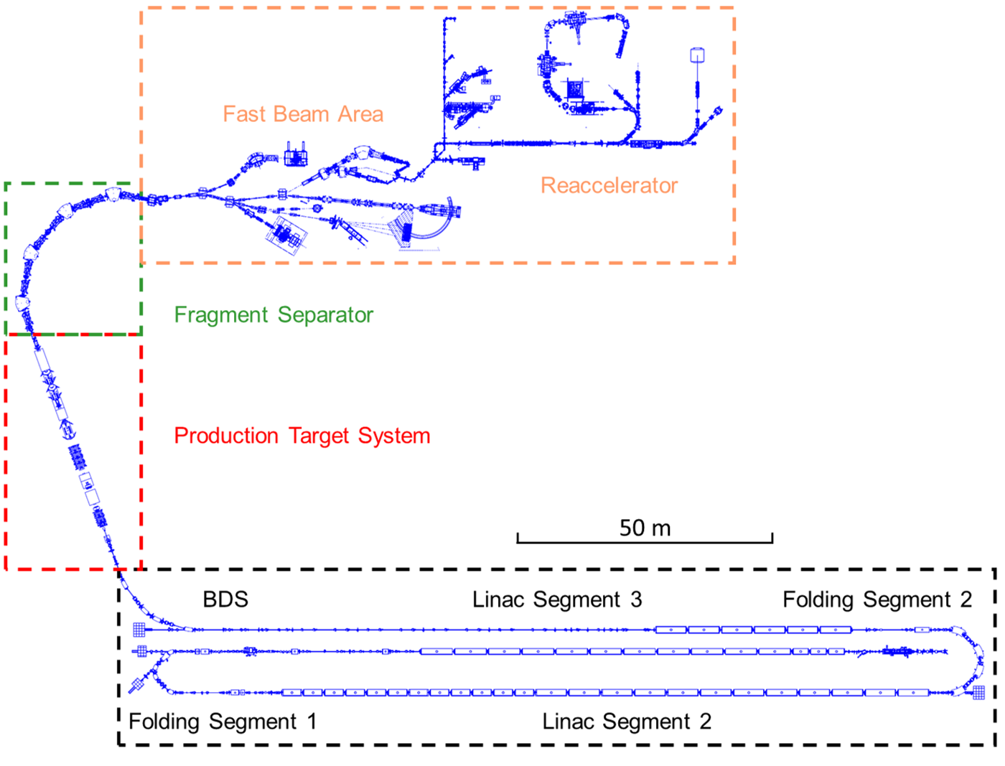
High Power Targetry Devices in FRIB:
Charge Stripper
Charge stripper removes electrons from the beam being accelerated to increase energy gain by a factor of 2 (e.g., ²³⁸U³⁵⁺ >> ²³⁸U⁷⁵⁺).
This process, however, produces multiple charge states after the stripper, and not all charge states can be accepted in post-stripper linac: charge selector is necessary
Required thickness: 1.0-1.5 mg/cm²
Liquid lithium charge stripper is used for user operations
A carbon stripper is available for low power and light ion beams
20 mm
20-μm thick liquid lithium film in vacuum
T. Kanemura, Phys. Rev. Lett. 128, 212301, 2022
~20 MeV/u

Slide 23
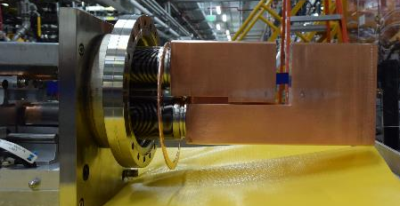
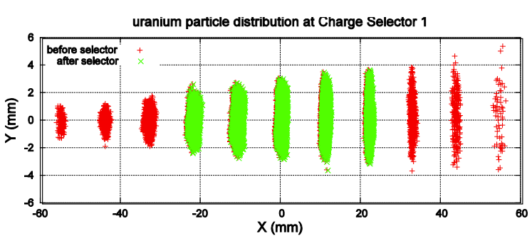
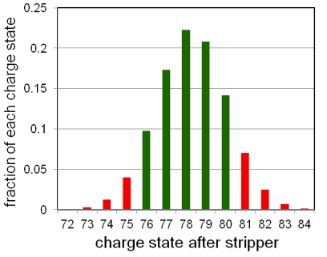
High Power Targetry Devices in FRIB:
Charge Selector
Charge selector stops unwanted charge states of the stripped beam, while transporting wanted charge states to the post-stripper linac.
FRIB linac is capable of multi-charge simultaneous acceleration
Static jaws made of Glidcop AL-15 are used in Low Power Charge Selector
$σ_{x}=0.7 mm$, $σ_{y}=1.25 mm$
~20 MeV/u
Example: ²³⁸U particle distribution (left) and charge state distribution (right)
Charge selector

Slide 24
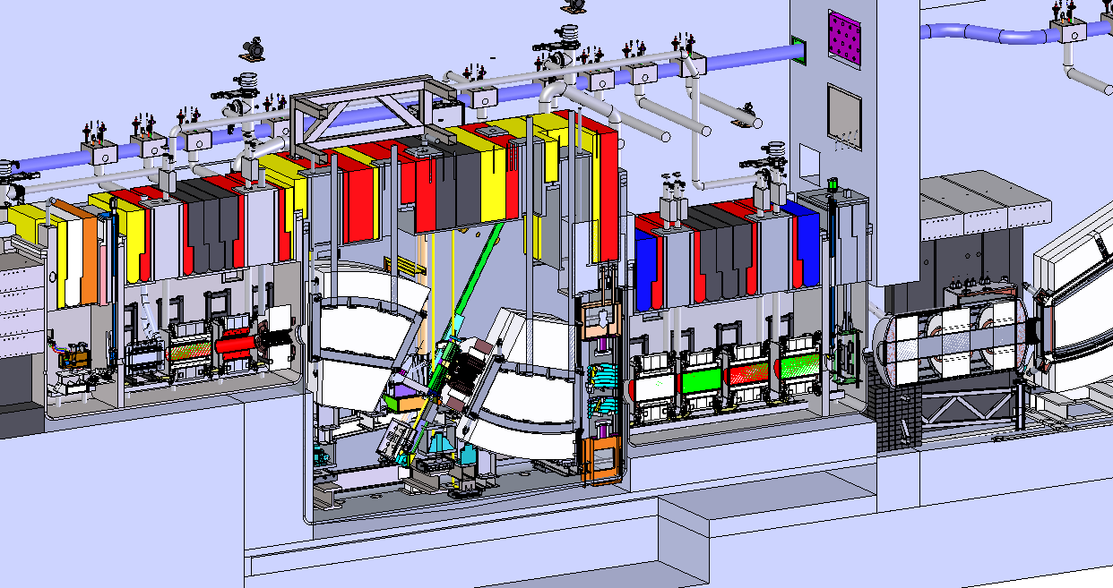
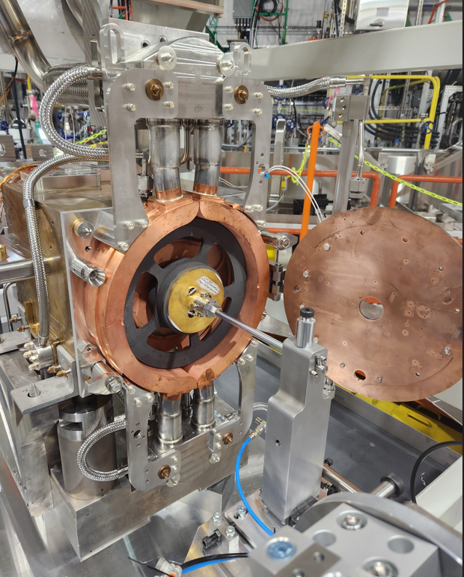
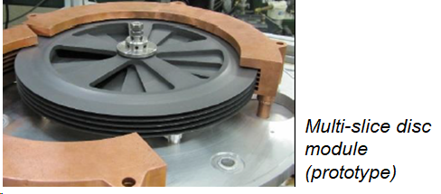
High Power Targetry Devices in FRIB:
Production Target
~25% of primary beam power deposited in target (~100 kW for full power operations)
Single-slice graphite target in use
Multi-slice target and 5000 rpm rotation for full power beam
Beam from linac
(~200 MeV/u)
Production target
Single-slice target in service

Slide 25
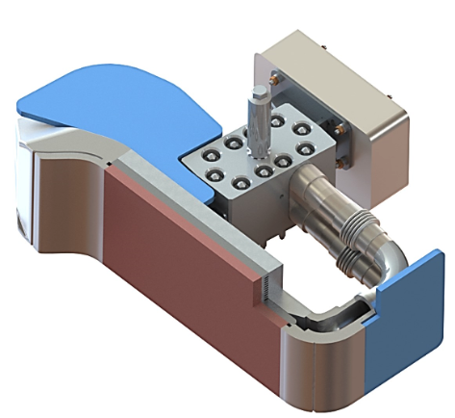
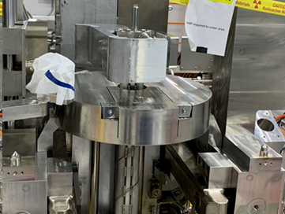
High Power Targetry Devices in FRIB:
Beam Dump
Unreacted primary beam absorbed, ~75% of primary beam power dumped (~300 kW for full power operations)
Water cooled static beam dump in use
Rotating water beam dump for high power beam
Beam from linac
(~200 MeV/u)
Unreacted primary beam
Secondary beam
Production target
Beam dump
$$6^{o}$$
6º static mini-channel beam dump

Slide 26
Phased Deployment Example 2: Charge Selector Upgrade with Rotating Drums for Beam Power > 50 kW
Intermediate-power charge selector design (1ʺ = 25.4 mm)
Charge selector cleans up unwanted charge states downstream of charge stripper
  ²³⁸U: 5 charge states kept for acceleration, the rest removed by charge selector
Present charge selector: adjustable static water-cooled jaws
Next phase: 2 rotating graphite drums

Slide 27
Multi-layered Machine Protection for Heavy Ion Beams
High power, low-energy ions beams: short stopping range and high power density
Must mitigate both acute & chronic beam loss (by beam inhibition)
Used extensively in driver linac
Need to extend use to high-power targetry systems

Slide 28
References
[1] J. Wei et al., “Accelerator commissioning and rare isotope identification at the Facility for Rare Isotope Beams”, Mod. Phys Lett. A, vol. 37, p. 2230006, 2022.
doi:10.1142/S0217732322300063
[2] P. N. Ostroumov et al., “First simultaneous acceleration of multiple charge states of heavy ion beams in a large-scale superconducting linear accelerator”, Phys. Rev. Lett., vol. 126, p. 114801, 2021.
doi:10.1103/PhysRevLett.126.114801
[3] T. Kanemura et al., “Experimental demonstration of the thin-film liquid-metal jet as a charge stripper”, Phys. Rev. Lett., vol. 128, p. 212301, 2022.
doi:10.1103/PhysRevLett.128.212301
[4] H. Ren et al., “Development and status of the FRIB 28 GHz SC ECRIS”, J. Phys.: Conf. Ser., vol. 2244, p. 012008, 2022.
doi:10.1088/1742-6596/2244/1/012008
[5] F. Pellemoine et al., “Thermo-mechanical behaviour of a single slice test device for the FRIB high power target”, Nucl. Instrum. Methods Phys. Res., Sect. A, vol. 655, pp 3-9, 2011 doi:10.1016/j.nima.2011.06.010
[6] T. Xu et al., “Completion of FRIB superconducting linac and phased beam commissioning”, in Proc. SRF’21, East Lansing, MI, USA, Jun.-Jul. 2021, pp. 197-202.
doi:10.18429/JACoW-SRF2021-MOOFAV10
[7] J. Guo et al., “FRIB ECR ion sources operation and future development” presented at ICIS’23, Victoria, Canada, Sep. 2023, Paper 131, unpublished.
[8] T. Shen et al., “Design and Development of a 28 GHz Nb3Sn ECR Ion Source Superconducting Magnet”, submitted to IEEE Trans. Appl. Supercond.
[9] M. Avilov et al., “Thermal, mechanical and fluid flow aspects of the high power beam dump for FRIB”, Nucl. Instrum. Methods Phys. Res., Sect. B, vol. 376, pp 24-27, 2016. doi:10.1016/j.nimb.2016.02.068.
[10] P. Knudsen et al., “FRIB helium refrigeration system commissioning and performance test results”, IOP Conf. Ser.: Mater. Sci. Eng., vol. 755, p. 012090, 2020.
doi: 10.1088/1757-899X/755/1/012090
[11] N. Hasan et al., “Design, Fabrication and Installation of the Cryogenic Distribution System for Re-configured FRIB A1900 Fragment Separator”, in Proc.ICEC28-ICMC 2022, Hangzhou, China, Apr. 2022.
[12] V. Ganni and P. Knudsen; “Optimal Design and Operation of Helium Refrigeration Systems Using the Ganni Cycle”. AIP Conf. Proc., vol. 1218, pp.1057-1071, 2010.
doi: 10.1063/1.3422267
[13] Y. Choi et al., “Overview of fragment separator superconducting magnets in the Facility for Rare Isotope Beams”, IEEE Trans. Appl. Supercond., vol. 33, no. 5, p. 4100305, 2023. doi: 10.1109/TASC.2023.3244141
[14] S. Zhao et al., “Automation of RF and Cryomodule Operation at FRIB”, in Proc. HIAT'22, Darmstadt, Germany, Jun.-Jul. 2022, pp. 136-139.
doi:10.18429/JACoW-HIAT2022-TH1C3
[15] S. Lidia et al., “A Heavy-Ion Single-Event Effects Test Facility at Michigan State University”, 2022 IEEE Radiation Effects Data Workshop (REDW) (in conjunction with 2022 NSREC), Provo, UT, USA, Jul. 2022, pp. 1-7.
doi: 10.1109/REDW56037.2022.9921718
[16] W. Chang et al., “Automation of FRIB SRF cavities and SC solenoid turn-on/off”, presented at SRF’23, Grand Rapids, MI, USA, Jun. 2023, Paper FRIBA05, in press.
[17] P. Ostroumov et al., “FRIB from Commissioning to Operation”, presented at HB’23, Geneva, Switzerland, Oct. 2023, Paper MOA1I2, this conference.
[18] A. D. Tran and Y. Hao, “Beam tomography with coupling using maximum entropy technique”, in Proc. IPAC’23, Venice, Italy, May 2023, pp. 3944-3947.
doi: 10.18429/JACoW-IPAC2023-THOGB2
[19] A. Gade et al. Eds., “FRIB400: The Scientific Case for the 400 MeV/u Energy Upgrade of FRIB,” FRIB, Michigan State University, East Lansing, MI, USA, June 2019, updated Feb. 2023, https://frib.msu.edu/_files/pdfs/frib400_final.pdf
Slide 28

Slide 29
Thank you!

