Slide 1

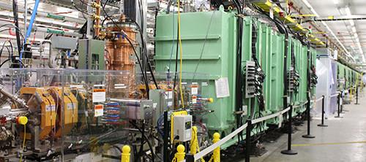
Status and Plan of Materials and the Radiation Damage Analysis in FRIB
Eiichi Wakai (FRIB, Michigan State University)
T. Kanemura,(FRIB), S. MILLER (FRIB), J. WEI (FRIB), S. MAKIMUA(J-PARC), T. ISHIDA (J-PARC), K. Ammigan(Fermilab)
November 1, 2024

Slide 2
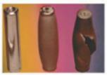
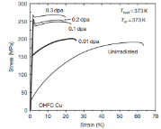

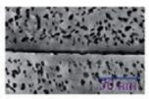


Radiation Damage – General Phenomena and Design Requirement for lifetime
0
0.5
1
Phnomena | Temp. (K) | Displacement Damage
Radiation hardening and embrittlement | < 0.35 - 0.4T_{M} | >0.1 dpa
Irradiation creep | <0.40 - 0.45T_{M} | >10 dpa
Volumetric swelling from void formation | 0.3-0.6 T_{M} | >10 dpa
Phase instability from radiation-induced precipitation | 0.3-0.6 T_{M} | >10 dpa
High temperature He embrittlement | >0.45 - 0.5 T_{M} | >10 dpa
Radiation-induced amorphization | >0.18 T_{M} (graphite) | >0.5 – 10 dpa
Al-193ºC
Melting point (T_{M})
0 K
Cu-405ºC
Ti-698ºC
Graphite-1778ºC
Radiation hardening and embrittlement
Irradiation creep
Volumetric swelling from void formation
Phase instability from radiation-induced precipitation
Radiation-induced amorphization in Graphite
High temperature He embrittlement (aggregated at grain boundaries)

Slide 3
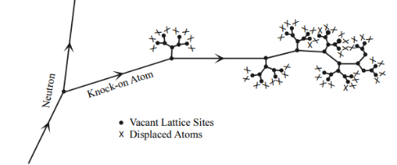
Materials for High-Power Targetry System
Threshold displacement energy (Td) is the minimum kinetic energy that an atom in a solid needs to be permanently displaced from its site in the lattice to a defect position
Material | Melting Point (ºC) | Crystal structure at RT | Threshold displacement energy (eV)
Al | 660 | FCC | 27(*4), 16.5(*5)
Graphite | 3800 - 3950 | Hexagonal | 60 (*1), 24 at 0 dpa (*2, *3) and 12 at 1dpa (*2), 69 (*4), 25(*5)
Cu | 1084 | FCC | 33(*4), 19(*5), 30 (*6),
Ti | 1668 | HCP | 19(*5), 21 (0.3-0.5 MeV electron), 31 ( 0.5-2.5 MeV) (*7)
Ti-64 Alloy |  | HCP+BCC | 66 (in α-phase), 46 (in β-phase) (*8)
*1: UK Nuclear Industry Standard
*2: (For pristine graphite, the best estimate of Ed is 24 eV. Ed decreases with increasing irradiation damage, dropping by nearly a factor of 2 at a dose of one displacement per atom. For a fully disordered amorphous-carbon structure, Ed is around 5 eV. )
*3: IAEA Techdoc-1154 in 2000, Irradiation damage in graphite due to fast neutrons in fission and fusion systems.
*4: Y. Iwamoto, S. Meigo, S. Hashimoto, Estimation of reliable displacements-per-atom based on athermal recombination-corrected model in radiation environments at nuclear
fission, fusion, and accelerator facilities, Journal of Nuclear Materials 538 (2020) 152261
*5: H.H. Anderson, The Depth Resolution of Sputter Profiling, Appl. Phys. 18, 131--140 (1979).
*6: A.Yu. Konobeye, U. Fischer, Yu.A. Korovin, S.P. Simakov, Evaluation of effective threshold displacement energies and other data required for the calculation of advanced atomic displacement cross-sections, Nuclear Energy and Technology 3 (2017) 169–175.
*7: G. Sattonnay, et al., Determination of displacement threshold energies in pure Ti and in c-TiAl alloys by electron irradiation, J. Nucl. Mater. s 275 (1999) 63-73.
*8: Ankit Roy, et al., Insights into radiation resistance of titanium alloys from displacement cascade simulations, J. Nucl. Mater. Volume 586, 2023, 154695.

Slide 4
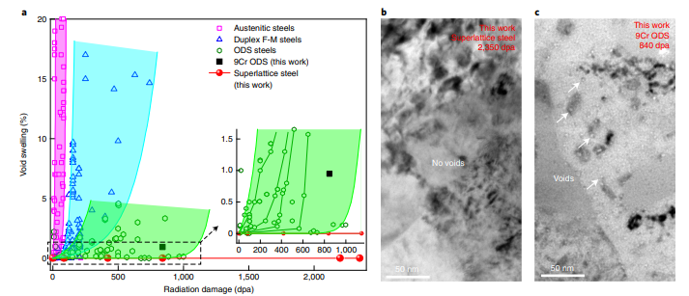
Void Swelling Resistance
Jinlong Du, Suihe Jiang, Peipei Cao, Chuan Xu, Yuan Wu, Huaqiang Chen, Engang Fu & Zhaoping Lu, Superior radiation tolerance via reversible disordering–ordering transition of coherent superlattices, Nature Materials 22, pages442–449 (2023)
500ºC
Superior radiation tolerance of superlattice steel containing high-density Ni(Al,Fe) NPs. Comparison of b and c shows that the superlattice steel exhibits much stronger void swelling resistance than 9Cr ODS steel. a, Void swelling in superlattice steel compared with that of typical conventional austenitic steels, ferritic–martensitic (F-M) steels and ODS steels (Supplementary Information gives detailed descriptions). The coloured areas are guides to the eye. The inset (zoomed-in view of the dashed rectangular box) shows that superlattice steels exhibit zero void swelling compared with several typical ODS steels. b, TEM micrograph of the superlattice steel after average radiation damage of 2,350 dpa within the investigated region at 500 °C, and no voids were observed. c, TEM micrograph of 9Cr ODS steel after average radiation damage of 840 dpa at 500 °C, and numerous voids were observed. The images in b and c were recorded in underfocus with a defocus distance of −2.0 μm

Slide 5

FRIB (Facility for Rare Isotope Beams)
Michigan State University's research in nuclear physics has made it one of the top universities in the USA.
It can accelerate ions from protons to uranium to 200 MeV/u(Currently at the 20 kW level. In the future (5 years later) 400 KW) FRIB is conducting research mainly in nuclear physics, but it will also pursue isotope production.

Slide 6
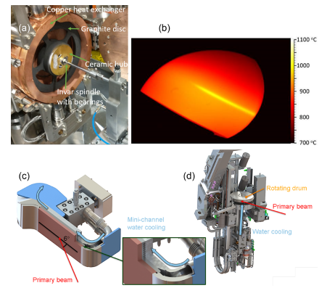
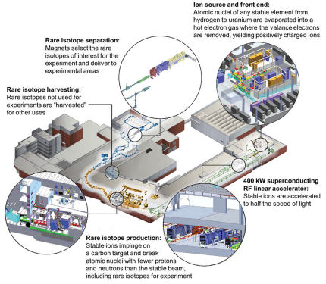
Background FRIB (Facility for Rare Isotope Beams)
Thomas Glasmacher, Alexandra Gade, Georg Bollen & Jie Wei, The Facility for Rare Isotope Beams: Providing New Opportunities for Science, Nuclear Physics News, Vol. 34, No. 3, 2024, pp.5-12.
a) Single-slice graphite target inside the water-cooled copper enclosure; (b) thermal image of a 10.4kW, 177MeV/u 238U beam on the target rotating at 500 revolutions per minute; (c) intermediate mini-channel beam dump and (d) rotating beam dump.
FRIB facility graphic showing layout of all areas

Slide 7
FRIB Rump-up Schedule
As increasing beam power, materials and devices receive radiation damage and the related phenomena.
The analysis of the status of property changing of materials/devices needs to check for safety longer operation.
Some Subjects for the Power Upgrades:
Higher design standards and manufacturing techniques like ISIS
Highly inspection of materials and device (including development) before operation
PIE of the devices (inside and outside FRIB ) after operation
Simulated irradiation experiments using MIBL and the others
Collaborative researches
Intense Working teams for high-power targetry systems
EPOCH | 1 |  | 2 |  | 3 |  | 4 |  | 5 |  | 6
Beam Power | 10 kW |  | 20 kW |  | 50 kW |  | 100 kW |  | 200 kW |  | 400 kW
ARTEMIS, light ion beams from gas
ARTEMIS, heavy ion beams from metal
High Power ECR, gas beams
High Power ECR, metal beams
Intermediate power charge selector in FS1
High power charge selector in FS1
Post-stripper chicane
Additional beam collimation in FS2, BDS
Dual charge state heavy ions upstream of the stripper (velocity equalizer)
Rotatable target, 1 slice
Rotatable target, multi-slice
Post-target shield
Beam dump 6º slant (S-shape)
Beam dump 6º slant (S-shape), better cooling
Rotatable beam dump, 1-mm wall
Rotatable beam dump, 0.5-mm wall
Medium power ladder wedge system with adjustable slits (hands on)
High power wedge system (remote handling)
PPS upgrade with fast ionization chambers

Slide 8
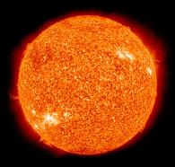



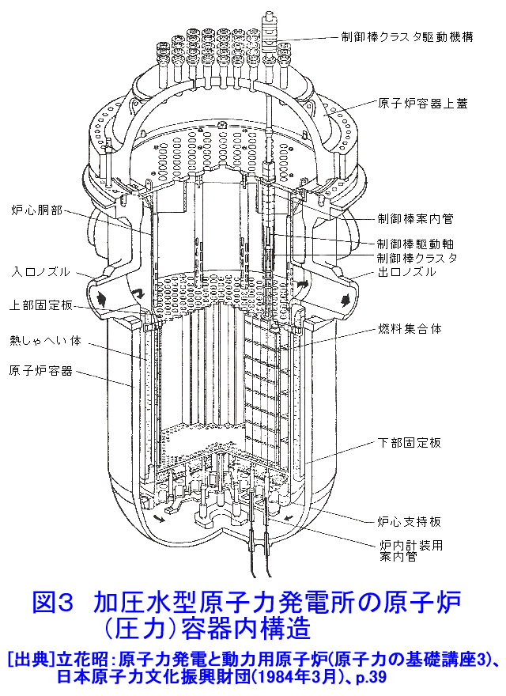
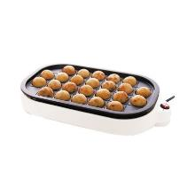
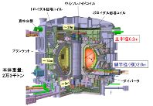
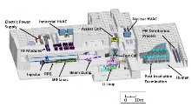
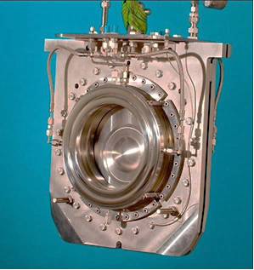

How challenging is FRIB?: Areal Heat Density (W/m²)
Grand surface
Nozzel of Rokket Engine
Transient heat flux of plasma
in Fusion reactor
Pressure vessel in light-water reactor
Surface of the Sun
FRIB:
10-400 GW/m²
Hot Plate
IFMIF
（Design Phase）
ITER
0.001
0.01
0.1
1
10
100
1,000
10,000
100,000
(MW/m²)
Present
Operation (20 kW)
in beam with 1 mm diameter
J-PARC and SNS - Proton beam
Neutrino Facility in J-PARC (Beam window)

Slide 9
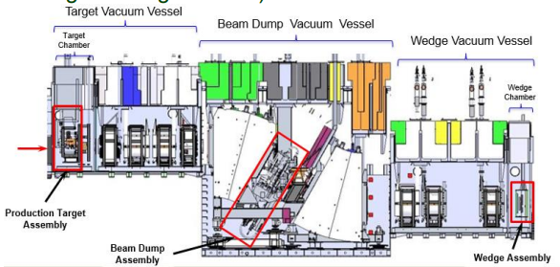
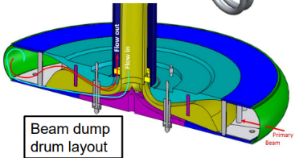
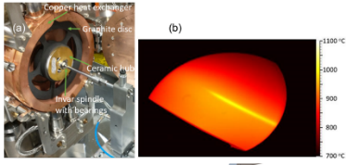
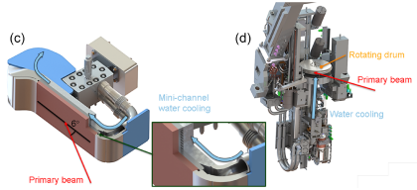
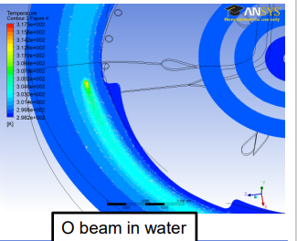
FRIB Target and Beam Dump (including plan)
Ti-alloy shell thickness 0.5 mm to reduce power deposition in the shell
600 rpm and 70 cm diameter to limit maximum temperature and amplitude of temperature changes
60 gpm water flow to provide cooling
Ion Beam
Target (graphite)
Present Beam Bump (20 kW operation)
Next Step Beam Bump (more than 50 kW)
From M.Avilov, HPTW-2018, June 4th - 8th 2018.
T. Glasmacher, A. Gade, G. Bollen & J. Wei, The Facility for Rare Isotope Beams: Providing New Opportunities for Science, Nuclear Physics News, Vol. 34, No. 3, 2024, pp.5-12.

Slide 10
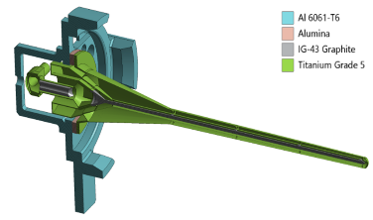
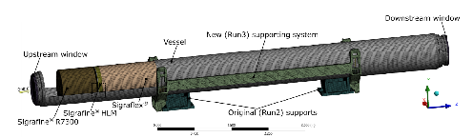
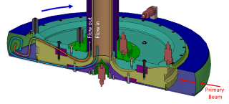
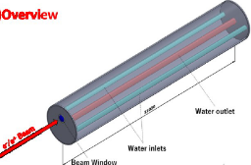
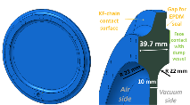
World’s Accelerator Device Employing or Planning Ti-6Al-4V Alloy
Information By Taku Ishida (J-PARC)
LBNF target container and beam window
J-PARC Neutorino’s beam window
CERN LHC Main beam dump beam window
MSU-FRIB beam dump
ILC 14MW main beam dump (water) beam window
FNAL LBNF Neutrino Target
Neutrino Facility in J-PARC (Beam window)
LHC Main Dump Window
for Run-3
ILC Water Main Dump
Window
Previous design: MSU-FRIB Water Cooling Rotating Beam Dump, 300 kW, 7dpa/yr
10

Slide 11
Device List of high-power targetry system of FRIB
(Uranium beam case) (including conceptual design evaluation)
 | Device | Beam-intercepting material | Beam power at device (power at target) | Thermal load (Uranium) Deposited Power |  | Type | DPA (irrad. period) | Implanted ion concentration
Linac (FS1) ~ 20 MeV/u | Charge stripper | Graphene sheet | 2.5 kW (20 kW) | 94 W |  | Rotating solid | 9 dpa (1 week) | N/A
 |  | Liquid lithium | 50 kW (400 kW) | 1360 W |  | Liquid film w/o window | N/A | N/A
 | Charge selector | Glidcop AL-15 (Cu alloy) | 2.5 kW (20 kW) | 500 W |  | Static solid, water cooled | 3000 dpa (1 week, at peak) | 10 at% (1 week)
 |  | Graphite (planned) | 13 kW (100 kW) | 3 kW |  | Rotating solid | 80 dpa (1 week at peak) | 0.07 at% (1 week)
 |  | TBD (liquid metal) | 50 kW (400 kW) | 10 kW |  | Liquid film w/o window | N/A | N/A
Target Hall ~ 200 MeV/u | Target | Graphite | 400 kW (400 kW) | 100 kW |  | Rotating solid | 8 dpa (2 weeks) | N/A
 | Beam dump | CuCrZr | 15 kW (20 kW) | 15 kW |  | Static solid, water cooled | 12 dpa (1 week) | 0.02 at% (1 week)
 |  | Water in thin-wall Ti shell | 37.5 kW (50 kW) | 300 kW |  | Rotating liquid water/ window | 7 dpa in shell (1 year) | N/A
Urgent Issue Device
Notes:
Charge stripper suffers the severest condition (beam focused on thin film, high dE/dx due to low energy).
Target will have a similar thermal load but have advantage of thickness (rigid). Graphite is ok.
Beam dump and charge selector for high power operations will be liquid due to Bragg peak.

Slide 12
Beam Dump
Ti Alloys - Irradiation Damage Behavior
Under RaDIATE Collaboration,
several Ti alloys have been examined.
(1) How long can Ti-64 withstand irradiation?
(2) Are there any titanium alloys that are superior in the irradiation environment?

Slide 13
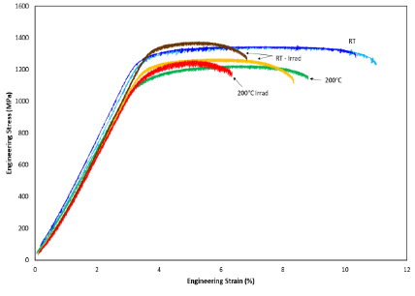
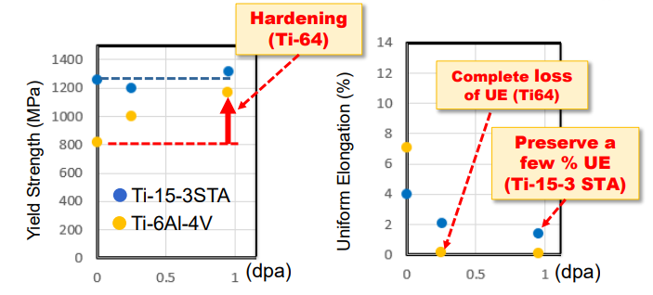
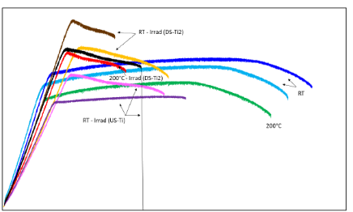
BLIP Irradiation of BLN Results under RaDIATE Collaboration
Tensile Property of irradiated Ti-64 and Ti-15-3
0.95DPA
Unirr.
0.25DPA
Tensile Property
1.5％ uniform elongation after irradiation
Ti-15V-3Cr-3Sn-3Al
Solution-Treatment and Aged (STA)
1250
Confidential
Hardening
0.95DPA
Before
Irradiation
1000
0.25DPA
750
Stress (MPa)
500
Entirely Brittle
250
After irradiaiton
：0.0％
Uniform Elongation
7.0%
0
Stress
range
0
5
10
15
Strain (%) ＝ Elongation÷Gauge length

Slide 14

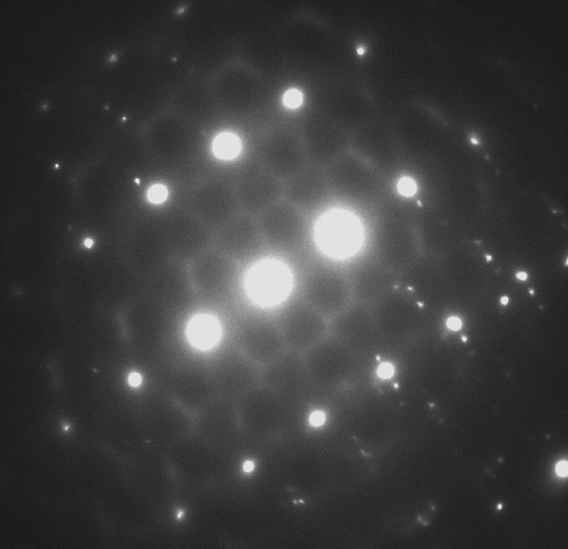
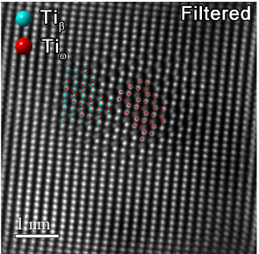
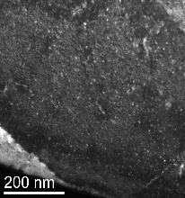
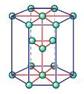
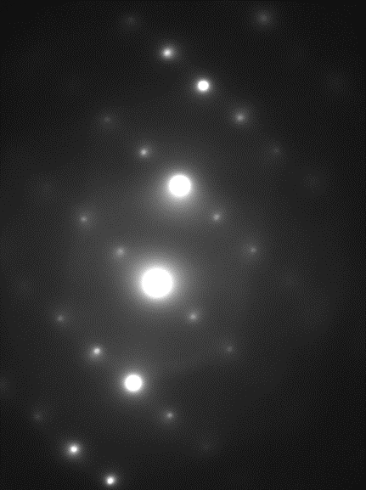
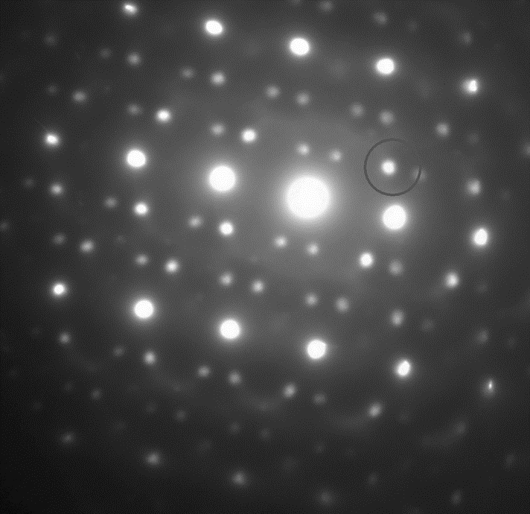
Radiation damage effect of Ti-64 (annealed) by high energy protons
1250
Confidential
T.Ishida, E.Wakai et al. J. Nucl. Mat. 541 (2020) 152413
Hardening
0.95DPA
Before
Irradiation
Immediately after irradiation, at about 0.1 DPA, Ti-6Al-4V is radiation hardened and loses ductility
Formation of dense nano-sized a-type defect clusters in the main α(HCP)-phase: main cause of irradiation hardening and embrittlement.
Radiation-induced ω phase formed in β(BCC)-phase
1000
0.25DPA
750
Stress (MPa)
500
Entirely Brittle
250
After irradiaiton
：0.0％
Uniform Elongation
7.0%
Atomic column imaging
By M.Olszta, D.Edwards(PNNL)
0
（0.23dpa）
Stress
range
0
5
10
15
I-FFT
Strain (%) ＝ Elongation÷Gauge length
a-type loops only
β phase
(BCC)
Unirr.
α phase
(HCP)
ｇ=0111
<0001>_{ω}
// <11１>_{β}
｛110｝_{β}
Z＝ <113>_{β}
ω phase
Z= <110>_{β}
//<1120>_{ω}
-
ZA<113>_{β}
（Hexagonal non-CPed）
0.95 dpa

Slide 15

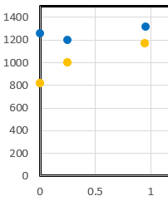
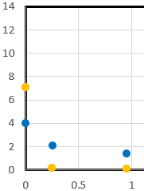
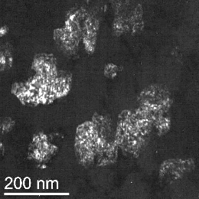
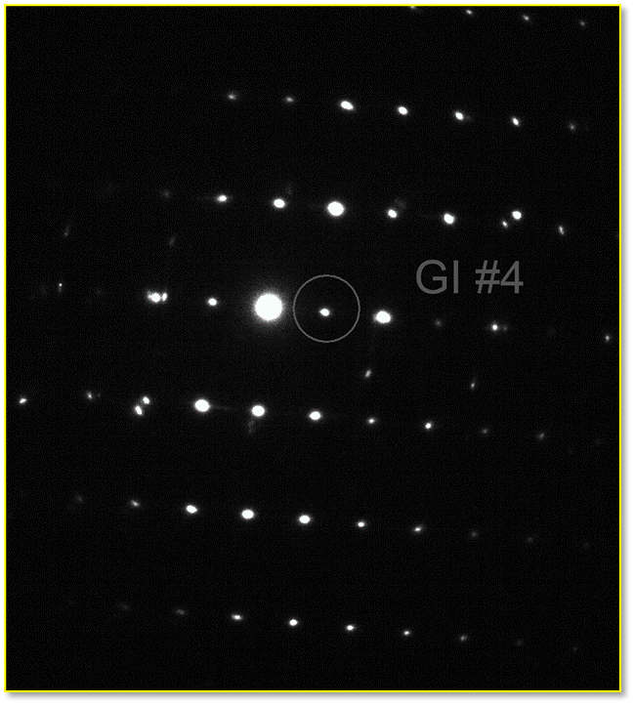
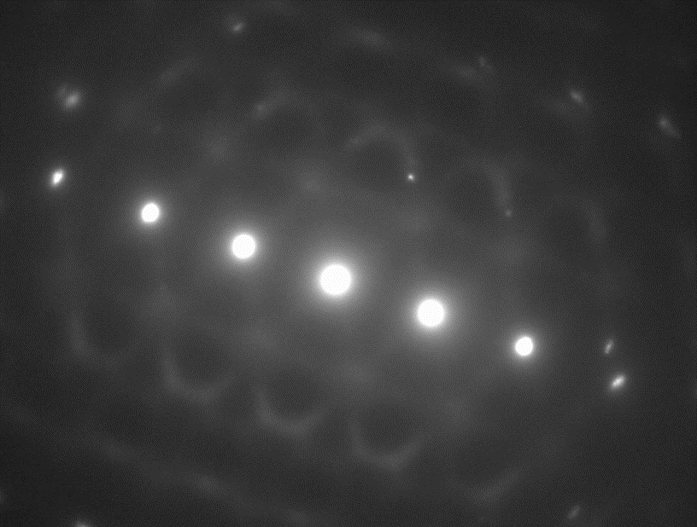
Radiation damage effect of Ti-15-3 (STA) by high energy protons
0.95DPA
Confidential
Hardening
(Ti-64)
Unirr.
Complete loss of UE (Ti64)
0.25DPA
1.5％ uniform elongation after irradiation
Yield Strength (MPa)
Uniform Elongation (%)
Preserve a few % UE
(Ti-15-3 STA)
Ti-15-3STA
Ti-6Al-4V
Ti-15V-3Cr-3Sn-3Al
Solution-Treatment and Aged (STA)
(dpa)
(dpa)
0.95DPA
Confidential
Ti-15-3STA shows only slight hardening and retains ductility after irradiation at ～1 dpa.
Fine, highly distorted β+α phase structure reduces irradiation effects.
No irradiation-induced damage was found.
Diffuse streaks characteristic of ω-phase precursors. Irradiation did not grow the ω phase.
α
β
β
α
ZA<1120> _{α}
ZA<113> _{β}

Slide 16
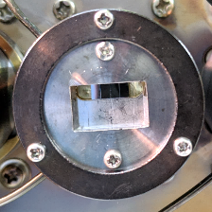
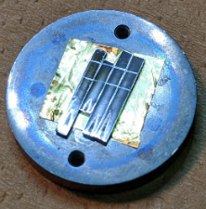
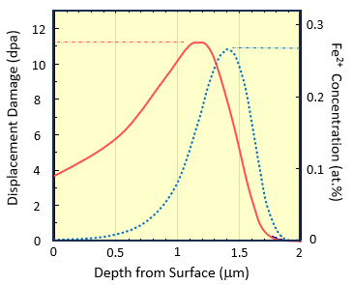
Higher dpa - Low energy Ion Irradiation Experiment
Materials： KSW KS15-3-3-3 (Ti-15V-3Cr-3Sn-3Al) sheet material manufactured by Kobe Steel, Ltd. undergoes a two-step (low → high temperature) aging treatment (ST2A)
  Unaged (ST), aged (STA) and Ti-64 annealed (A)
  Mechanical polishing on strip-shaped specimens ⇒ Electropolishing to remove the machined layer.
Irradiation： 2.8MeV-Fe²⁺ion beam at HIT facility, Univ.Tokyo
  ~1x10⁻³ dpa/s, up to ~11 dpa, damage peak at 1.2 μm depth
  Under room temperature (RT) and 300℃
  Masking produces unirradiated areas on the same specimen
Nano-indentation： Shimadzu Co. DUH-211S
  Berkovich-type, indentation with 150 nm depth×120 times (10μm intervals)
  Compare irradiated and un-irradiated areas
Microscopic observations on radiation damage signatures：
  Focused Ion Beam (FIB) sampling and thin lamellae production
  Electropolishing and/or gentle milling by low-energy Ar ion to remove FIB damage layers and surface oxide layer
  Transmission Electron Microscope: JEOL Ltd. JEM-2100F・JEM-ARM200F・ FEI TITAN3G2 60-300, CTEM/STEM/HREM/EELS/EDS
16

Slide 17
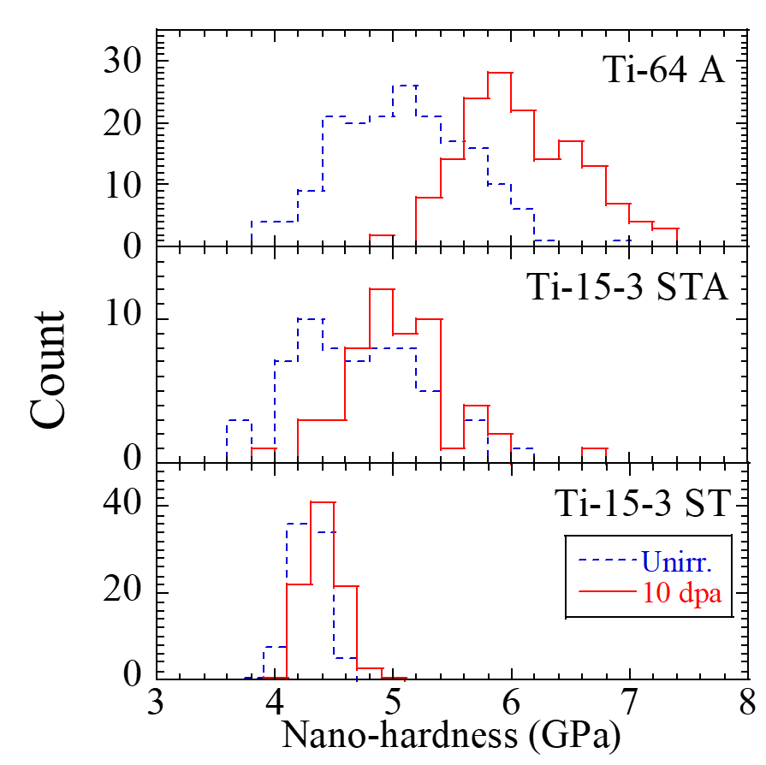
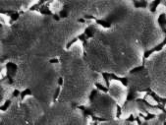
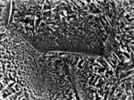

Nano-Hardness (Irradiation at RT)
Ti-64
78% α/ 22% β
Radiation Hardening
Ti-15-3STA
53% β / 47% α
Ti-15-3ST
100% β
10 μm
In Ti-64, irradiation hardening as large as 1 GPa is observed.
For Ti-15-3, STA material shows some hardening, but ST material without aging treatment (100% metastable β-phase) shows almost no irradiation hardening.

Slide 18
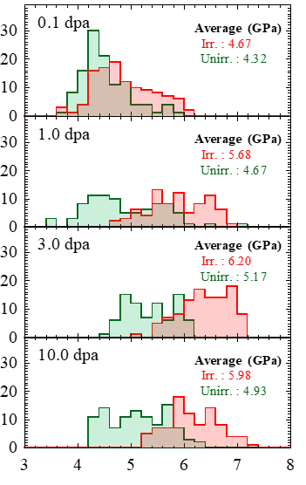
Ti-15-3ST2A (irradiated at 300℃) nano-hardness
Ti-6Al-4V, A
Ti-15-3 ST2A
Ti-64, A
Ti-15-3, ST2A
Nano-hardness (GPa)
Nano-hardness (GPa)
Both Ti-64/Ti-15-3 showed a slight hardening
Radiation Hardeing: 1GPa（Ti-64） >> 0.2GPa（Ti-15-3ST2A）

Slide 19
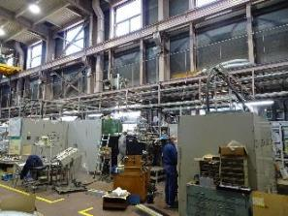
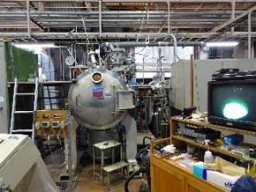
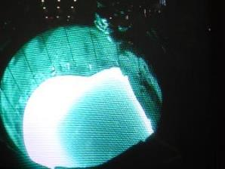
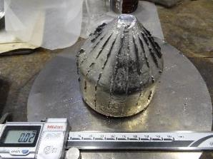
Materials Challenge (High Entropy Ti-Based Alloy)
For Application
(at%)
 | Ti | V | Cr | Zr | Ta | Al | W
Ti-HEA No. 1 | 30 | ● | ● | ● | ●
Ti-HEA No. 2 | 20 | ● | ● | ● | ●
Ti-HEA No. 4 | 30 | ● |  | ● | ● | ●
Ti-HEA No. 5 | 30 | ● | ● | ● |  |  | ●
Ti-based alloys by cold crucible levitation melting (CCLM) in the NIMS (National Institute for Materials Science)
After CCLM melting, normalizing treatments were done at 1200ºC for 5 hrs in air, and hot rolling tests were examined for four Ti-HEA.

Slide 20
Advanced Materials Challenge (High Entropy Ti-Based Alloy)
For Application
Seeking the possibility of titanium alloys that can be used at higher temperatures (depending on time schedule and resource)
Our data (Ti-HEA)
0.1/s
0.01/s
Ti-HEA
The best titanium alloys, which can be used industrially for long periods of time, have a maximum temperature of up to 600°C (such as DAT54).
Ti-based HEA can be over the Inconel 718 strength.
1500
Inconel 718
Preliminary
1000
Yield Strength (MPa)
VNbMoTaW
(O.N. Senkov)
500
NbMoTaW
(O.N. Senkov)
0
0
500
1000
1500
E. Wakai, T. Ishida, K. Furuya, et al., (to be published）
Temperature (ºC)
Compression Tests at high temperature in a vacuum performed in NIMS Facility of Japan
Ref. O.N. Senkov et al. / Intermetallics 19 (2011) 698-706

Slide 21
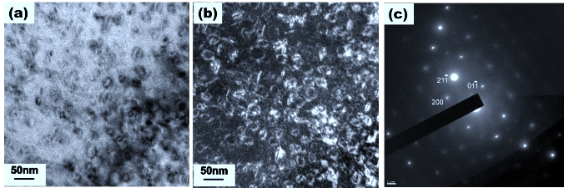

Fe-Mn-Cr-V-Al-C HEA
(a)
E. Wakai et al, Materials Characterization, 2024.
Fe+He ion irradiation
300ºC Irradiation
100appmHe/dpa
Dislocation loops with burgers vector of (1/2)<111> type formed in the irradiated Fe-based HEA irradiated at 300ºC to 1 dpa under 100 appm He/dpa by Fe³⁺ and He⁺ ions. The pictures of (a) bright-field image, (b) weak beam dark-field image, and (c) diffraction pattern were taken from near 011 pole using g=211.
(b)
300ºC Irrad. case
σ_{y} = MαGb(Nd) ^{0.5}
Nano-hardness (GPa)
500ºC Irradiation
Δσ_{y}(MPa) = 3.06 ΔHv (kg/mm²)
100appmHe/dpa
ΔH_{v} (GPa) = 0.937 ΔH_{N} (GPa),

Slide 22

Advanced Materials Challenge (High Entropy W-Based Alloy)
For Application
Seek higher strength for high temp. application (in metallic materials)
W-rich W-Fe-Si-V-Cr HEA
Preliminary
Our data (W-HEA)
E. Wakai, H. Noto, et al., (to be published）

Slide 23


Next Step-1 plan for 50 kW (Mid. 2025) and 100 kW operation
- This draft plan is still a private plan and will be discussed within the FRIB. -
FRIB Beam Dump Design Requirement - Basic
Since the beam dump plans to produce isotopes in water, materials with good water corrosion resistance and excellent resistance to irradiation damage are essential.
The thin-walled vessel to receive the beam must be thinner than 1 mm to prevent heat generation under the unprecedented beam load (10⁵ MW/m²), which exceeds that of a fusion reactor divertor, and must be rotatable.
Materials that meet these requirements are limited, and Ti-15-3 material will be selected as a candidate; Ti-15-3 alloy has excellent press workability at room temperature, and thermal processing and optimal heat treatment using this alloy should be performed to take advantage of its characteristics.
Creep evaluation is essential for the long time of 6,000 hours of use, depending on the temperature, but at high temperatures. In titanium alloys, industrially available commercially available materials (e.g., DAT54) have a maximum temperature of 600°C.

Slide 24



Next Step-2 plan for 50 kW (Mid. 2025) and 100 kW operation
- This draft plan is still a private plan and will be discussed within the FRIB. -
FRIB Beam Dump Design Requirement - dpa cal., nuclear heating effect, and others
After these, we plan to evaluate the exact dpa and other parameters (the calculated annual damage due to the beam burst was about 7 dpa, but we also plan to evaluate the dpa due to neutrons produced by the reaction between energetic particles and water).
In addition, nuclear heating due to radio-activation will be calculated.
Based on these processes, thermal stress analysis will be carried out, and the conventional design will be modified and updated to achieve the optimum shape for design and fabrication.
In addition, it would be safer to evaluate irradiated materials in bulk materials as much as possible.There are evaluations of thermal fatigue and fatigue with pulsed ions, the former for cycles in the 10⁸ range, while the latter is considered to be a shock wave of low stress, but it will be subjected to fatigue over gigacycles.
Wolverine:
3 MV Tandem particle accelerator
Water corrosion
400 KV Ion
Implanter
Maize:
1.7 MV Tandem particle accelerator
In-situ TEM

Slide 25


Next Step-3 plan for 50 kW (Mid. 2025) and 100 kW operation
- This draft plan is still a private plan and will be discussed within the FRIB. -
FRIB PIE and related exams for assignment evaluation
PIE and materials characterization are planned to be proceeded in order to correctly understand the state of before and after irradiation in damage of used devices.
Titanium 15-3 is known to have good availability of thin sheets but poor availability of bulk materials, so we will either find a company that can obtain it or fabricate it at a facility such as NIMS in Japan.
Since there are only a limited number of places and facilities where thermal load tests exceeding 100 kW can be performed, it is necessary to proceed with the evaluation of thermal load experiments using electron beams up to 300 kW, such as those at NIFS in Japan.
Since ion irradiation at low energies can be performed to high dpa in a short time, it will be important to promote further material selection.
Wolverine:
3 MV Tandem particle accelerator
Water corrosion
400 KV Ion
Implanter
Maize:
1.7 MV Tandem particle accelerator
In-situ TEM

Slide 26
Summary
The Facility for Rare Isotope Beams (FRIB) is a scientific user facility for nuclear science. FRIB’s superconducting radio frequency (SRF) linear heavy-ion accelerator can accelerate all the ions from hydrogen up to uranium to energies above 200 MeV/u.
FRIB currently operates at a primary beam power of 10 kW→ 20 kW. Then in particular, the function of the beam dump is planned to include isotope production in water.
The status and private draft plan of urgent devices of the FRIB have been shown, and the radiation damage analysis of Ti alloys and advanced materials are mainly analyzing and should be developing for the application of beam dump in FRIB, etc.
To proceed from 20 kW to over 50 kW, the development of beam dump is urgent issue and thermal fatigue effect (2x10⁸ cycles) due to rotation and evaluation of the synergistic effects of irradiation and water (corrosion), etc. are very important.

Slide 27

Acknowledgments
We are very thanks to the members of engineering and research teams of FRIB.
The PIE after BLIP irradiation was performed in PNNL and we are grateful to Drs. D. Edwards, D. Senor, A. Casella (PNNL) for their work and P. Hurth (Fermilab) for his coordination in the RaDIATE collaboration.
In low energy ion irradiation experiment of University of Tokyo, we are grateful to Dr. S. Kano and Prof. H. Abe.
In the microstructural analysis, we are grateful to Prof. T. Shibayama (Hokkaido University), Prof. K. Furuya (Hachinohe College) and Dr. A. Hasegawa and Y. Nakayama (National Institute of Materials Science) for their support and discussion.
In compressive tests at high temperature, we are grateful to Ms. N. Motohashi and Mr. S. Kuroda (NIMS), and Dr. Y. Noto (NIFS) for several related tests under a collaboration study.
A part of this work was supported by JSPS Grants-in-Aid for Scientific Research (21H04668, 21H04480), MEXT‘s Nanotechnology Platform (JPMXP09A21HK0074) and NIFS general collaboration program. A part of this work was also conducted at the Hokkaido University and NIMS as a program of “Nanotechnology Platform” and “ARIM” and NOF of NIMS in the Ministry of Education, Culture, Sports, Science and Technology (MEXT), Japan, and the Japan-US Science and Technology Cooperation Program （High Energy Physics）

Slide 28
Back-up Slides

Slide 29




Updated Fabrication Test of Beam Window in J-PARC (Neutrino Facility)
Beam Window of Neutrino Facility of J-PARC under collaboration of UKRI
Recent New Fabrication Test in J-PARC
0.5 mm thickness in minimum
T.Ishida, E.Wakai et al. J.Nucl. Mat. 541 (2020) 152413

Slide 30





Radiation Damage Tolerance of Metastable β-phase Ti-15-3(ST)
Beam profile monitor receiving a small amount of proton beam at J-PARC
Post Irradiation Exam of 50μm-thick Ti-15V-3Cr-3Sn-3Al (Ti-15-3) alloy foils
T.Ishida, E.Wakai et al.
Nucl. Mater. En. 15 (2018) 169-174
Ti-1: 1.4×10²⁰pot
0.12 peak DPA ＠RT
Very low density of defect clusters No significant changes on micro-Vickers hardness
A high density of nano-clusters of ω phase precursor (athermal ω phase)
stable after irradiation
“15-3 Ti alloy may have a high resistance for radiation damage due to nanoscale precipitates working as point defect sink cites”
2D concentration map of Ti varied 79-69at% with amplitude less than 5nm

Slide 31


Phase transformation of ω phase precursor in metastable β phase of Ti-15-3 ST (irrad. at RT)
Tentative
Tentative
E.Wakai, S.Kano, T.Ishida et al. JIMM 2022 Autumn Meeting
E.Wakai et al., HPTW2023, Riken, Nov.7.2023
Hardness measurements using a nano-indenter show that irradiation hardening of about 1 GPa appears in Ti-64, whereas almost no irradiation hardening is observed in Ti-15-3 ST, indicating that it is expected to have high irradiation resistance.
The distribution of radiation damage was found to be depth-dependent from the incident surface, with no dislocation loops observed up to a region of ~ 6 dpa.
The diffraction pattern analysis revealed no clear spots due to the ω phase, but nano-sized atomic disorder, which may be precursors of the ω phase , was observed, and the diffuse streaks seemed to become stronger with increasing dpa. The streaks seem to weaken with further dpa.
Correlation possibly exists between dislocation loop formation and ω phase transformation
＋0.2GPa
Tentative
Loop formation starts
Tentative
No loops

Slide 32







Nano-hardness change of Ti-64 (irradiated at RT) & TEM observation
α-phase
I-FFT Filtered
[$0\overline{1}1$]
β-phase
[$200$]
Dark contrast in red/yellow,
light contrast in blue/purple
Nanoindentation hardness increases at 1 dpa and remains constant up to 11 dpa.
This is because the number density of nano-size defect clusters in the dominant α phase saturates at 1 dpa.
In contrast, in the β phase, there are very few dislocations and no phase transformations.
In the I-FFT image of HREM, regular lattice disorders uniformly distributed in the β-phase corresponding to the precursor of the ω-phase are observed.
Why does this structure have a sink effect ?
Cf. E.Sukedai et al.(2019) https://doi.org/10.2320/matertrans.ME201910
T.Ishida, S.Kano, E.Wakai et al, J. Alloys and Compounds 995 (2024) 174701 / arXiv:2405.00517 [cond-mat.mtrl-sci]

Slide 33


Graphite Radiation Damage - Amorphous below 500ºC
Graphite Structural Change
Amorphous is induced by irradiation below about 500ºC
For pristine graphite
The best estimate of Ed is 24 eV. Ed decreases with increasing irradiation damage, dropping by nearly a factor of 2 at a dose of one displacement per atom. For a fully disordered amorphous-carbon structure, Ed is around 5 eV
(Very careful: 60 eV is adopted in UK Nuclear Industry Standard)
Tetsuo Tanabe , et al., Radiation damage of graphite - degradation of material parameters and defect structures, Phys. Scr. T64,1996, pp.7-16.
Filip Vukovic, Jean-Marc Leyssale,Philippe Aurel,Nigel A. Marks, Evolution of Threshold Displacement Energy in Irradiated Graphite, PHYSICAL REVIEW APPLIED 10, 064040 (2018)

Slide 34
Ion 238.05 amu, 47.6 GeV
Ti = 1mm thickness
Density=4.51 g/cm3
Water = 10 mm thickness
Density=1.0 g/cm3
Total displacements: 229,664/Ion
(Total Vacancies: 229,664/Ion, Replacement collision: 0/Ion)
Ion longitudinal = 6.32 mm
Ti = 0.5mm thickness
Density=4.51 g/cm3
Water = 10 mm thickness
Density=1.0 g/cm3
Total displacements: 231,663/Ion
(Total Vacancies: 231,663/Ion, Replacement collision: 0/Ion)
Ion longitudinal = 7.63 mm

Slide 35
Ducted fume food
Cutting, Polishing
X-ray Reflation Diffraction
SEM/EDS/EBSD
Materials Testing (draft private)Plan
Shelves
Shelves
Ultra sonic test
4-terminal electric resistivity
Optical Microscope
Ultra-sonic vibration
Work desk
Work desk
Work desk
Laser Microscope
Optical Microscope
True-stress and strain
Mechanical and Corrosion Testing (water)
Mechanical Testing (long time test for fatigue)
Mechanical Testing (long time test for creep)
Heat Furnace
Arc Melting
Mechanical Testing (short time for tensile or )
Hardness
Nano-Indentation Testing

