Slide 1
Boiler and Pressure Vessel Analysis of a Mini-Channel Beam Dump
Samuel J. Miller
Mechanical Engineering Department Manager
millers@frib.msu.edu
29 October 2024

Slide 2
Outline
Motivation
Facility of Rare Isotope Beams overview
  Target Hall Interceptive Devices
Beam Dump roadmap
Mini-Channel Beam Dump (MCBD) design
  Mechanical Design
  Mechanical Design Choices
  Requirements
Boiler and Pressure Code (BPVC) application
Future beam dump design
Summary
Acknowledgement

Slide 3
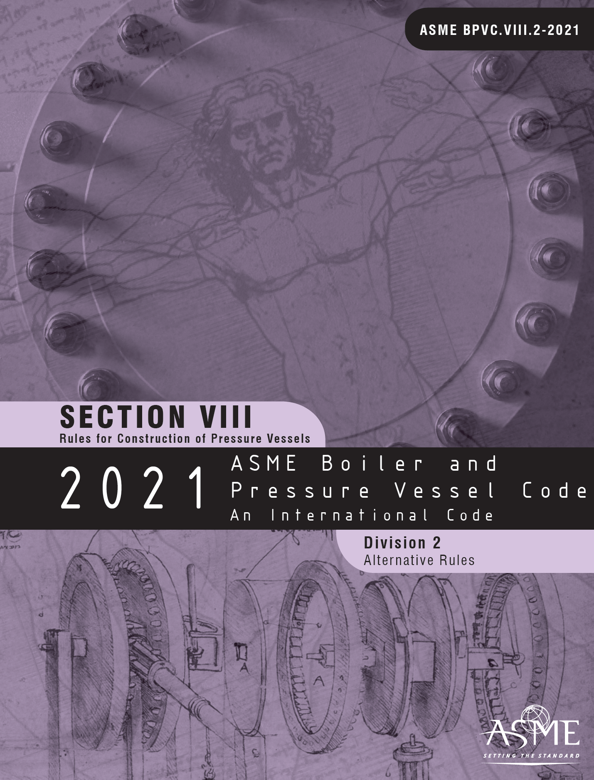
Motivation: Boiler and Pressure Vessel Analysis
Objective, comprehensive, code-based approach to design/qualify beam interceptive devices for use
Previous approach, while technically viable, was not repeatable
Codes investigated:
  Boiler and Pressure Vessel Code (BPVC) Division 2 Alternative Rules
    Part 5: Design by Analysis Requirements
  RCC-MRx: Design and construction rules for mechanical components of nuclear installations
    High temperature, research and fusion reactors
BPVC was selected as the code of choice, but was recognized the RCC-MRx does account for radiation damage and creep

Slide 4
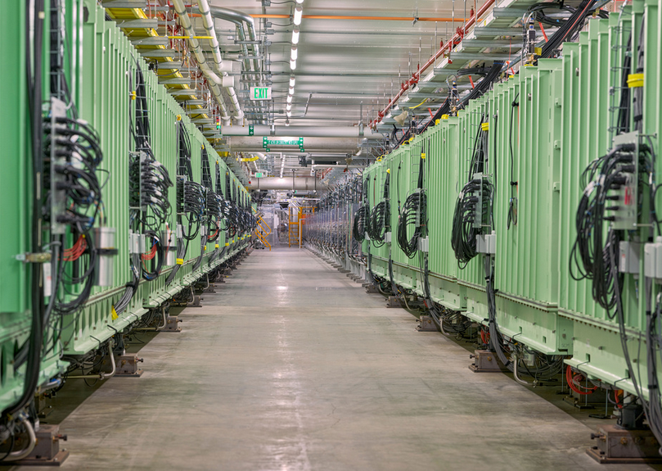
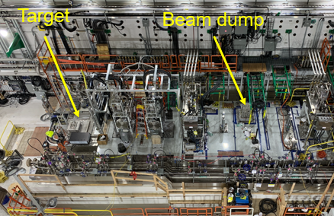
Facility for Rare Isotope Beams Overview
High-power heavy ion accelerator facility at Michigan State University completed in 2022
  The driver linac is designed to accelerate all stable ions to energies above 200 MeV/u with beam power of up to 400 kW.
  The facility is currently commissioned to 10 kW primary beam
Rare isotope beams are produced in a rotating graphite target and magnetically separated in the fragment separator
is planned in fall of 2024.

Slide 5
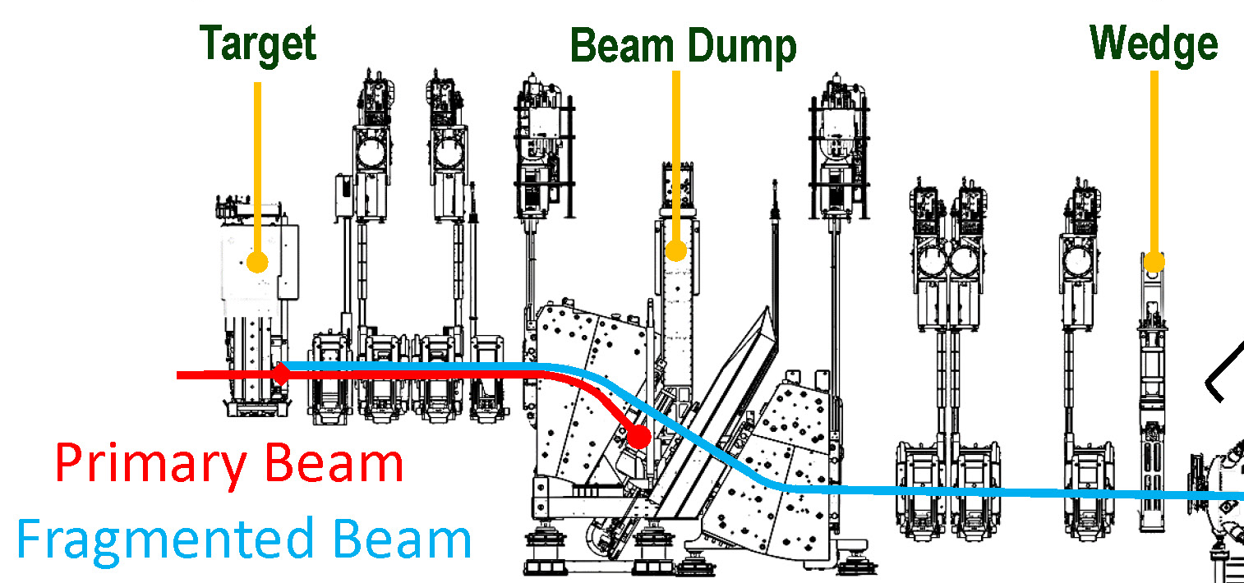
Target Hall Interceptive Devices
~25% beam deposit
~75% beam deposit

Slide 6
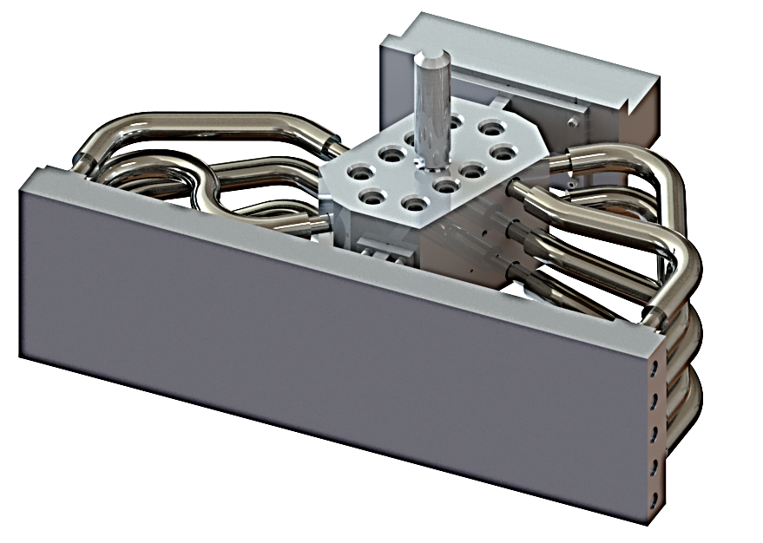
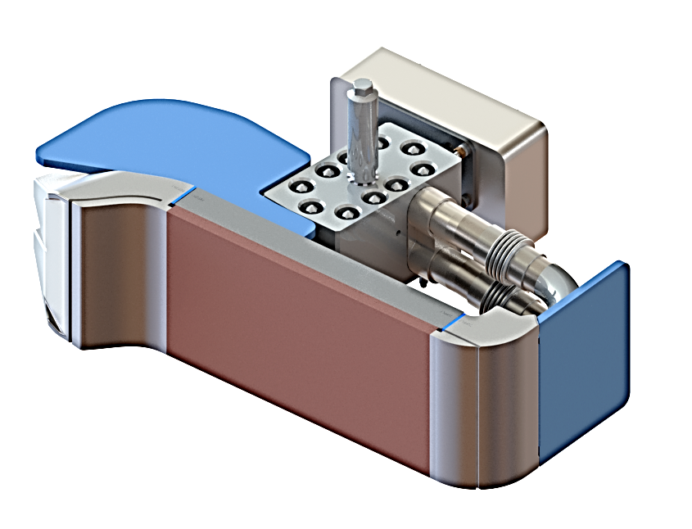
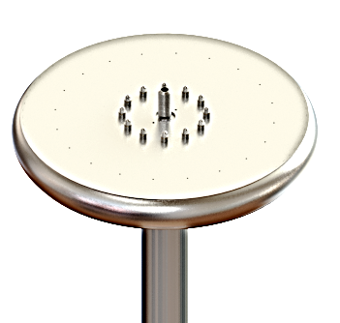
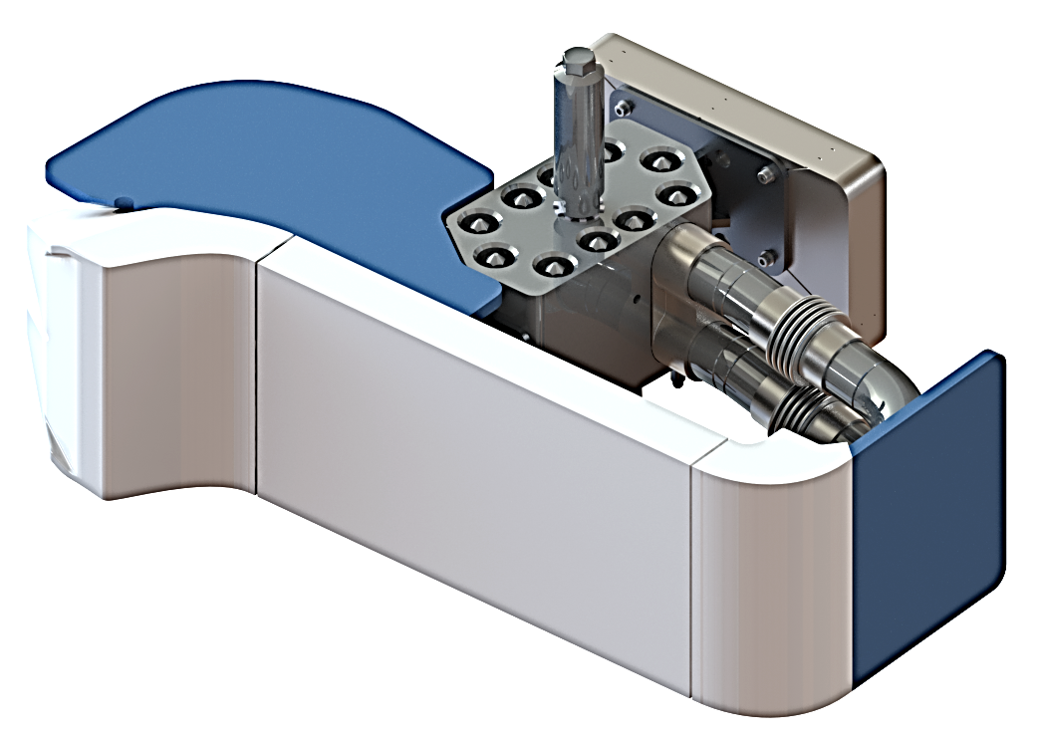



Beam Dump Roadmap:
Implementing Phased Deployment with Increasing Power
Present beam dump (EPOCH 2): 6º mini-channel beam dump
Next phase (EPOCH 3): rotating water beam dump as baseline, with alternative options
EPOCH
1
2
3
4
5
Beam power
10 kW
20 kW
50 kW
100 kW
200 kW
Rotating water beam dump (0.5 mm shell)
$${20}^{o}$$
$$6^{o}$$
$$6^{o}$$
20º static Al beam dump < 1 kW
6º static Al beam dump ≤ 10 kW
Mini-channel beam dump
≤ 20 kW
Rotating water beam dump (1 mm shell) ≤ 100 kW

Slide 7
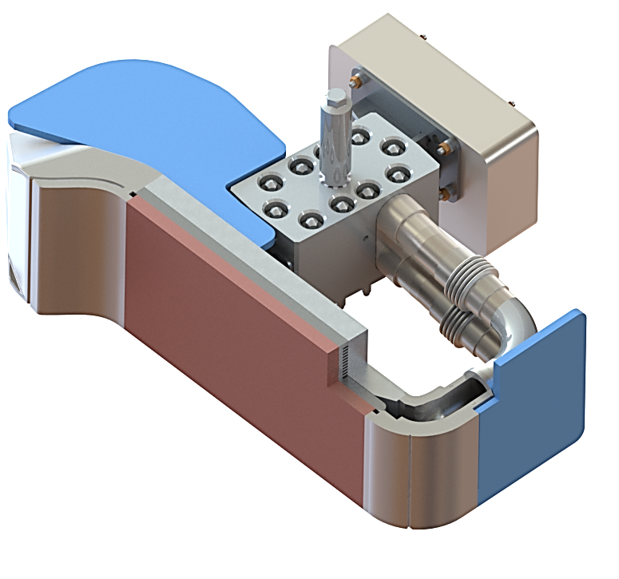
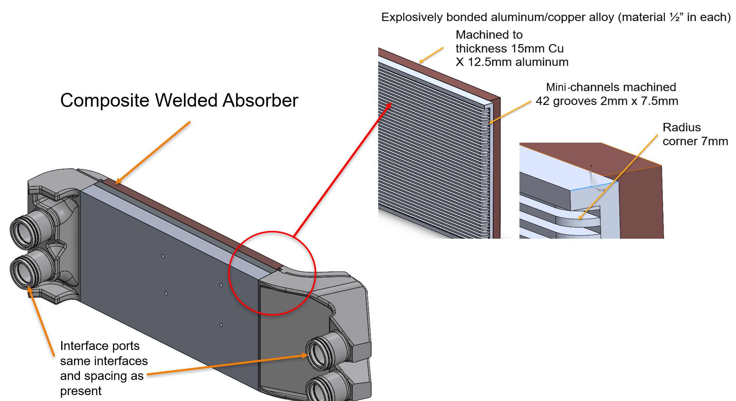
MCBD Mechanical Design
Return Shield
Counterweight
Return
Hook
Remote-Handling
Pick Point
Supply/Return
Interface
Bi-Metal
Absorber
Supply Lines
Supply Shield
Supply Hook

Slide 8
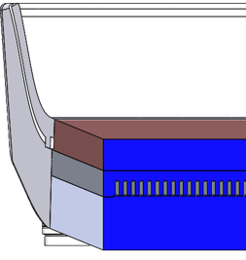
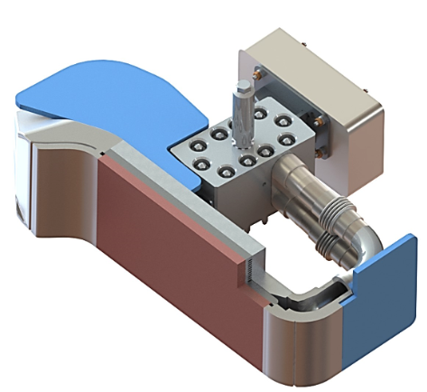

MCBD Mechanical Design Choices
MCBD
  The primary beam stops at the mini-channel beam dump
  Penetration depth < 1mm
    238U ~ 0.1mm, 48Ca ~ 0.5mm
Beam intercepting plate
  CuCrZr(C18150)/Al2219 (bimetal)
    Cu alloy (15 mm)
    Al alloy (5 mm)
  Mini-channel
    Water channel (2mm) wall (2mm)
CuCrZr selection
  High thermal conductivity (320 W/m*K)
  High yield strength (430 MPa at RT)
  High radiation resistance
Minichannel Water cooling
CuCrZr
Al2219
2mm width minichannel
Interstitial layer is extremely fine:
Nb is ~0.25mm
Al-1100 O is ~1.25 mm
$$6^{o}$$
Primary beam

Slide 9
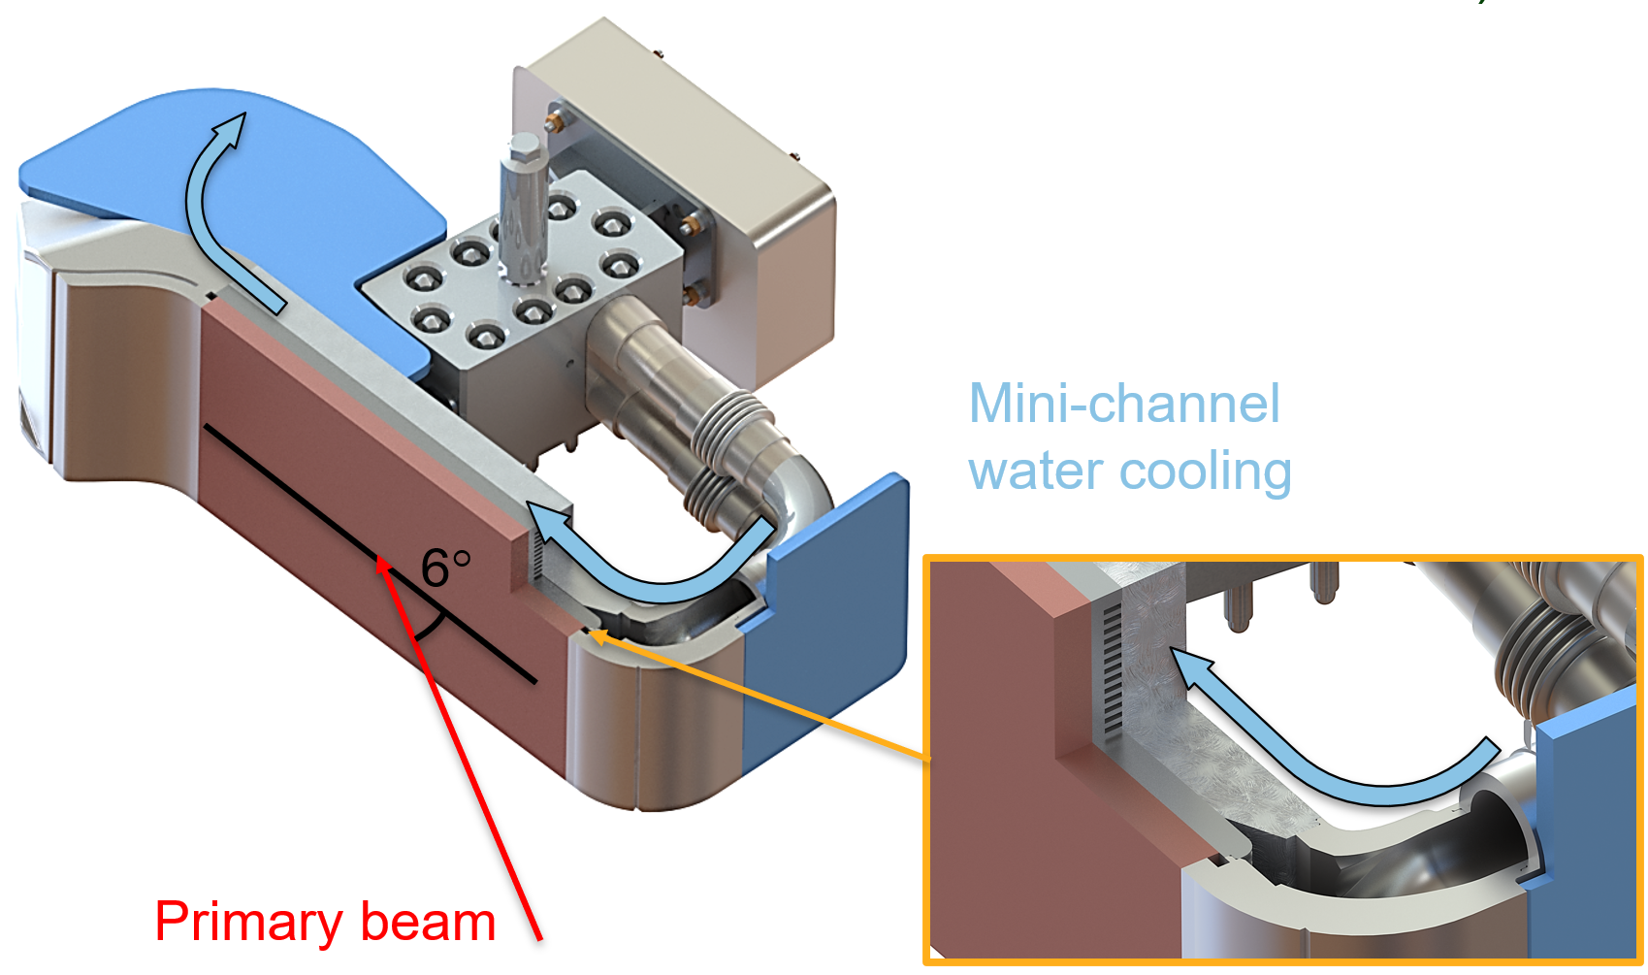
MCBD Requirements and Design Guidelines
MCBD must have sufficient thermal and structural capacity to safely absorb the residual primary under 20kW operating conditions during Epoch 2
High Power Targetry and Mechanical Engineering Departments design beam dump to stay within material capability
Beam dump head to be replaced annually.
  Ensure 1-year operation (4500 hours) with no water leaks; maintain vacuum, water, thermal, alignment stability
Detailed access, maintenance, and replacement plan required; design for remote replacement with existing tools
Materials must be compatible with NCU water system
  No direct contact of copper/copper alloys with NCU water
  Max water flow rate: 227 LPM (60 GPM) and water speed: ≤ 4.0 m/s in mini-channel in the impingement areas
Perform structural, thermal, and pressure drop analysis
Perform radiation transport analysis and estimate residual dose, activity inventory, isotopic content

Slide 10
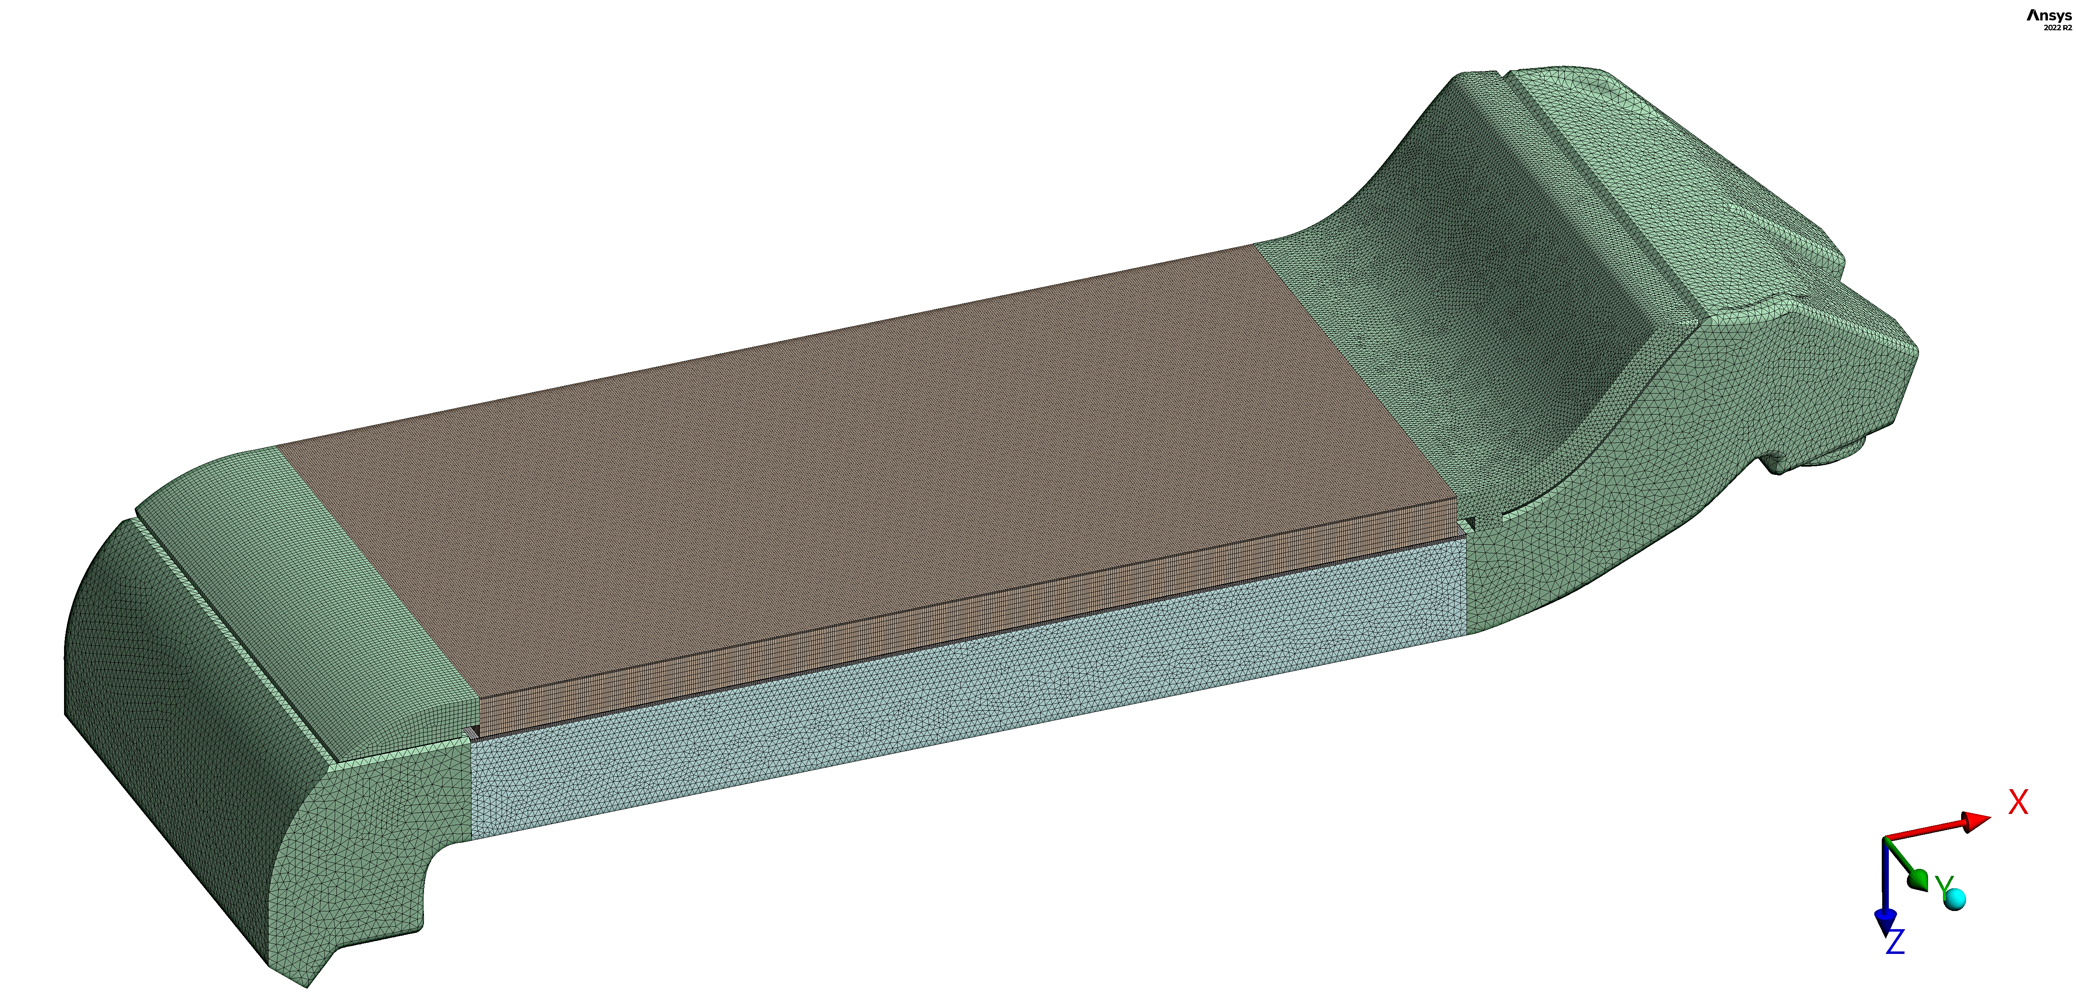
Boiler and Pressure Code (BPVC) – Design by Analysis Introduction
BPVC Div. 2 Alternative Rules, Part 5: Design by Analysis Requirements is applied to the MCBD for structural validation
Normal operation and off normal cases during 20kW FRIB operations are considered
MCBD uses non-code materials and hence material properties used are compiled from material testing, Material properties database (MPDB software), literature, and testing
Radiation damage and high temperature creep effects are not considered
MCBD Mechanical Design
Ansys® Mesh for BVPC

Slide 11
Boiler and Pressure Code (BPVC) – Design by Analysis
Protection against plastic collapse:
  Elastic Stress Analysis method
  Limit Load Analysis method
  Elastic Plastic Stress Analysis method
Protection against local failure:
  Elastic Stress analysis
  Elastic Plastic analysis
Protection against collapse from buckling:
  Bifurcation Buckling using Elastic Stress analysis
  Bifurcation Buckling using Elastic Plastic Stress analysis
Protection against failure from cyclic loading
  Fatigue analysis
  Ratcheting analysis
The MCBD model was developed in SolidWorks and then imported as a .step file to ANSYS WB for FEA
The initial thermo/fluids analysis is performed in ANSYS Fluent and then linked to ANSYS Mechanical
The FEA meshed model has approximately 14 million nodes.
  The mesh in the explosion bonded interstitial layer is extremely fine as the thickness of the Nb is ~0.25mm and the Al-1100 O is ~1.25 mm

Slide 12
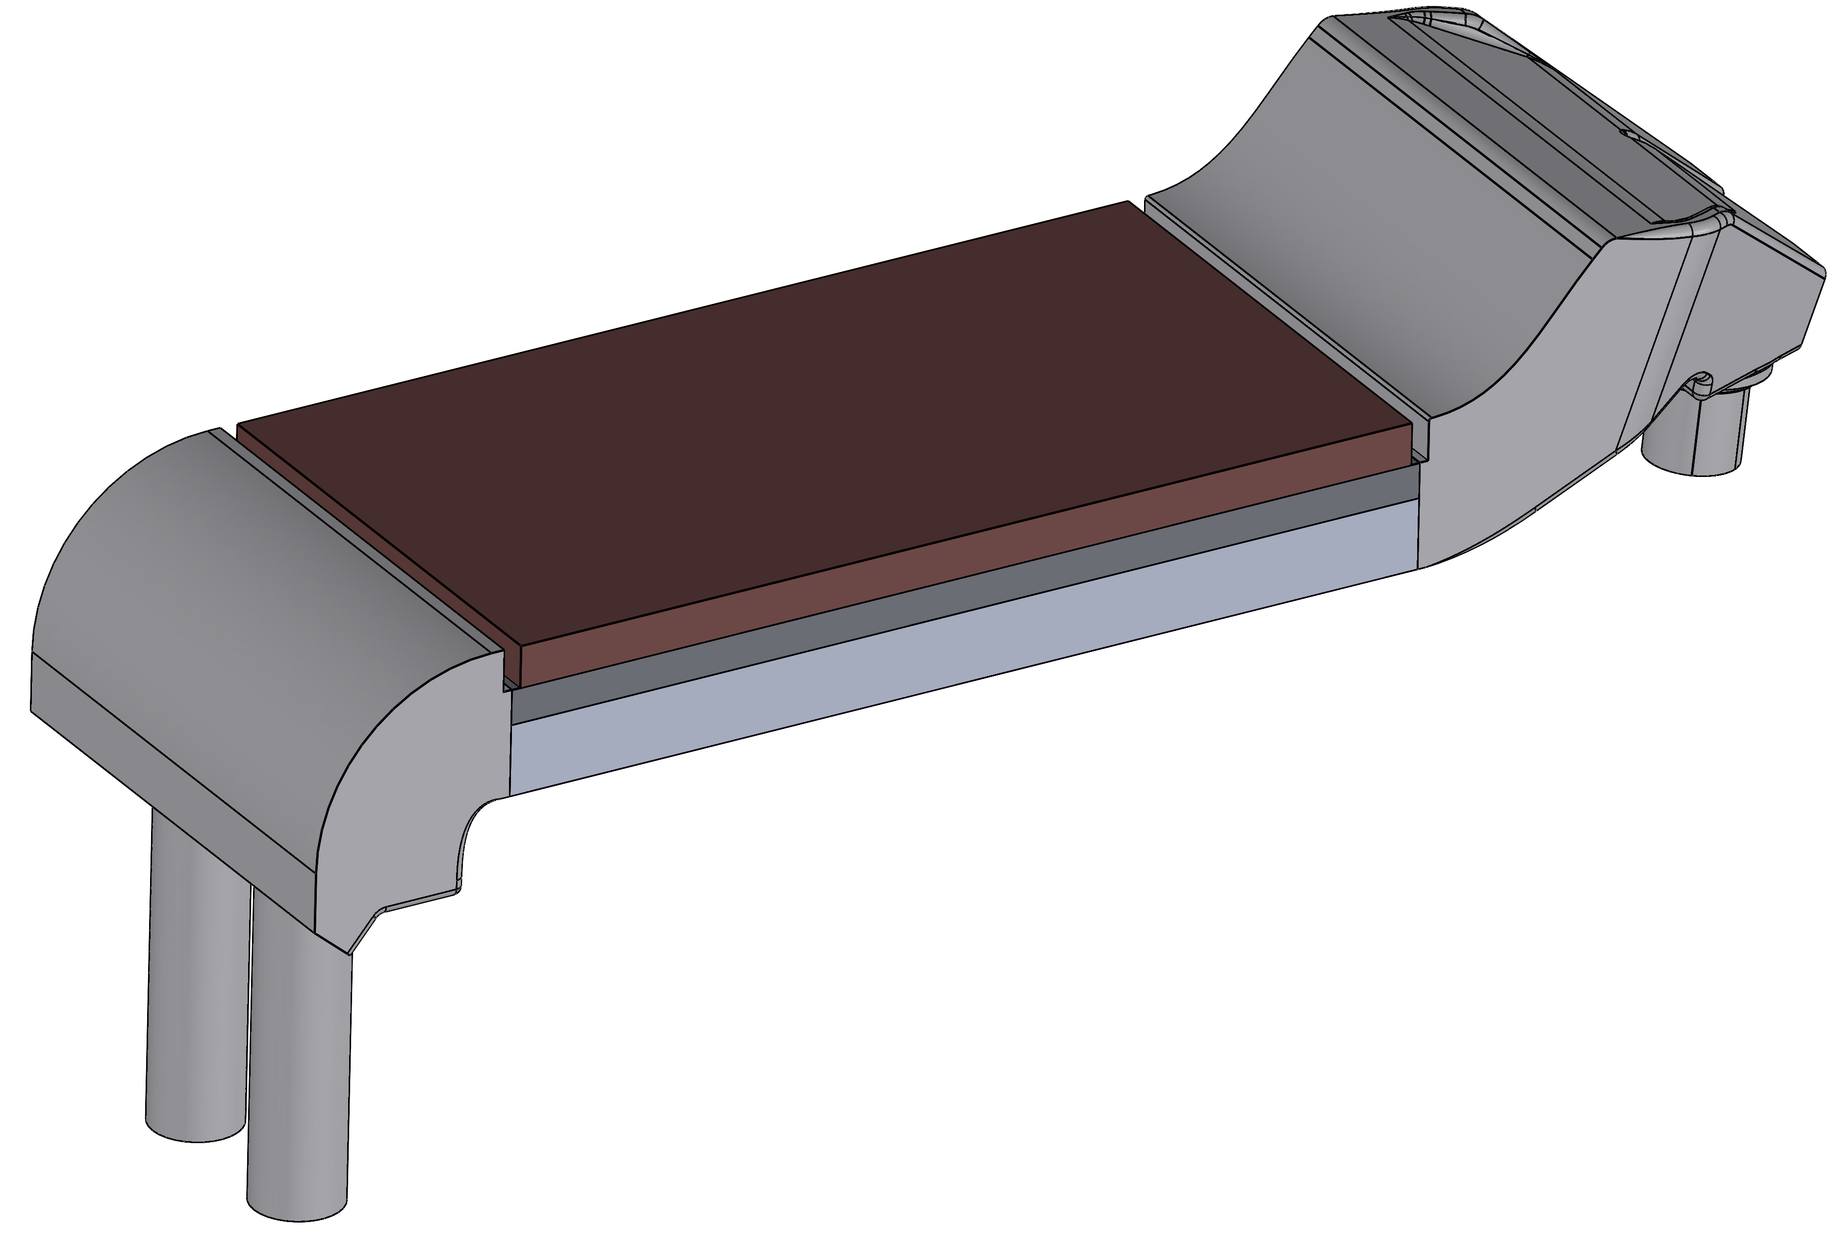
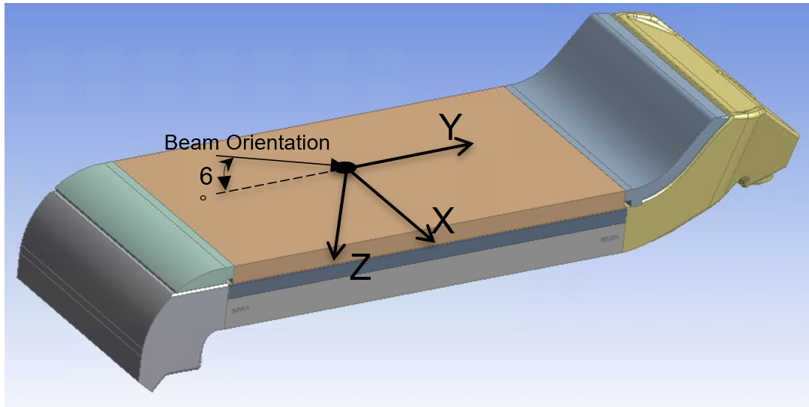
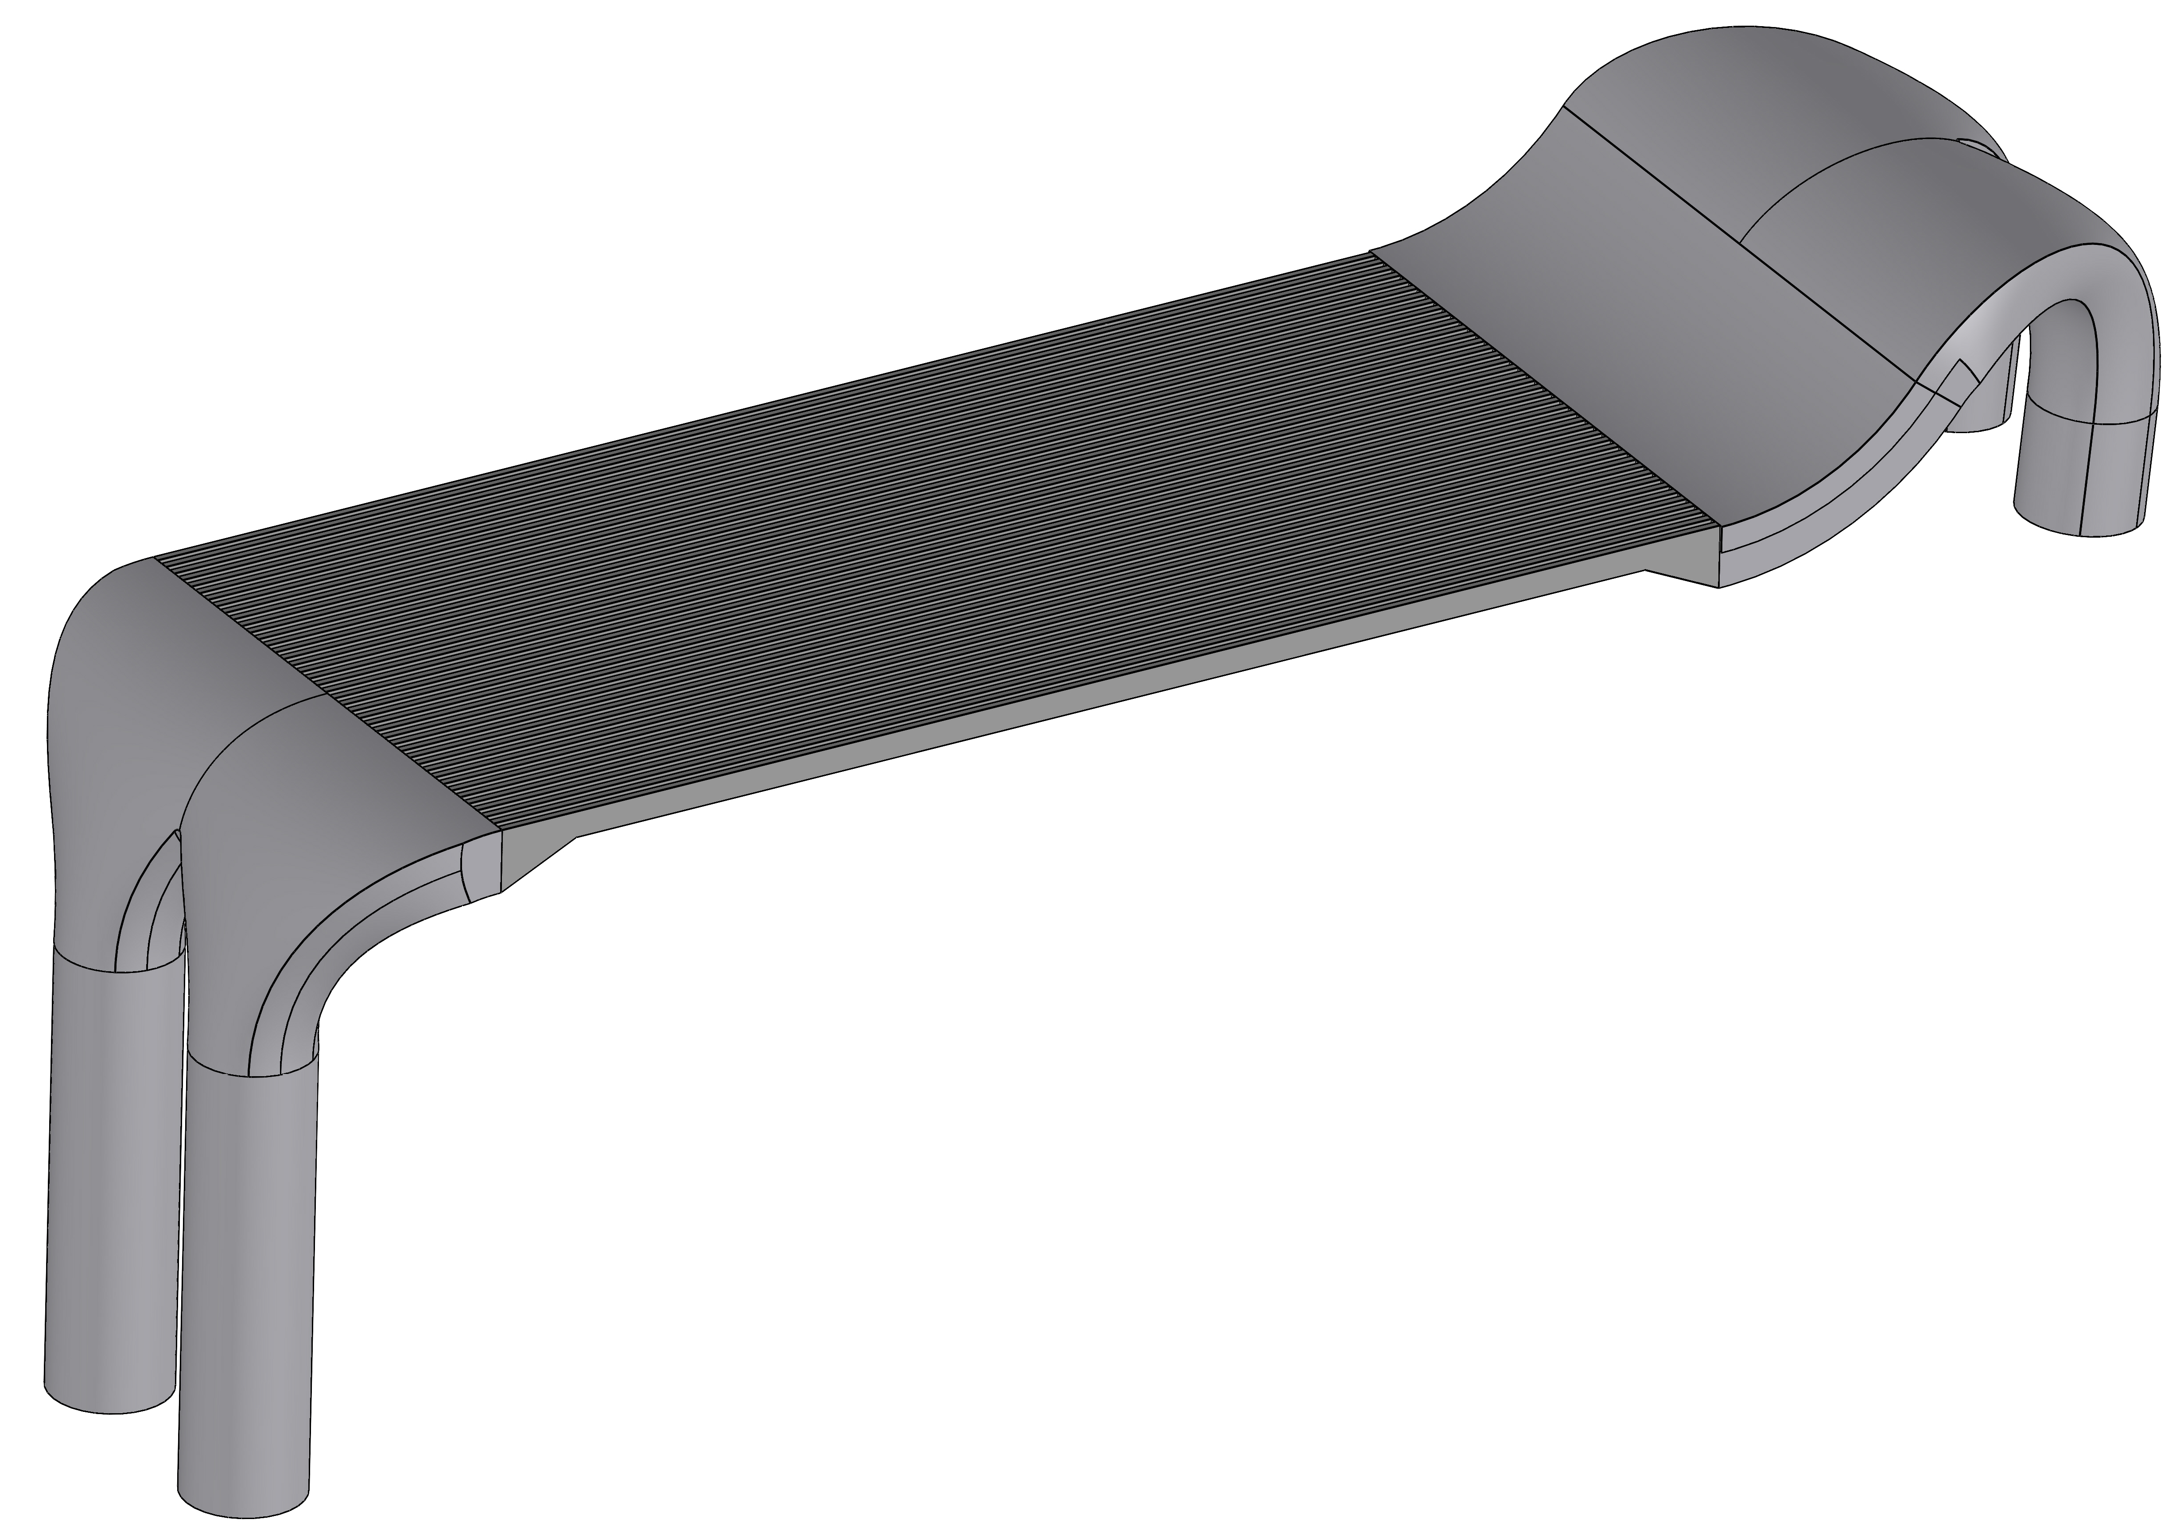
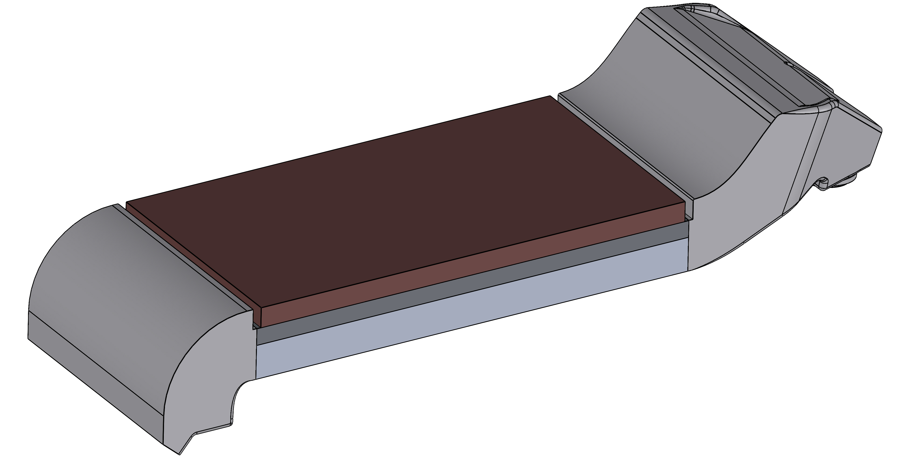
Geometry for CFD Model using Representative Beam: 238 Uranium Beam
Gaussian Features |  | Beam Power | Power Deposited | Depth
σ_{x} (mm) | σ_{y} (mm) | kW | kW | mm
2.32 | 9.77 | 20 | 15 | 0.2833
Mini-channel for thermal-fluid analysis
Solid- model
Fluid model

Slide 13
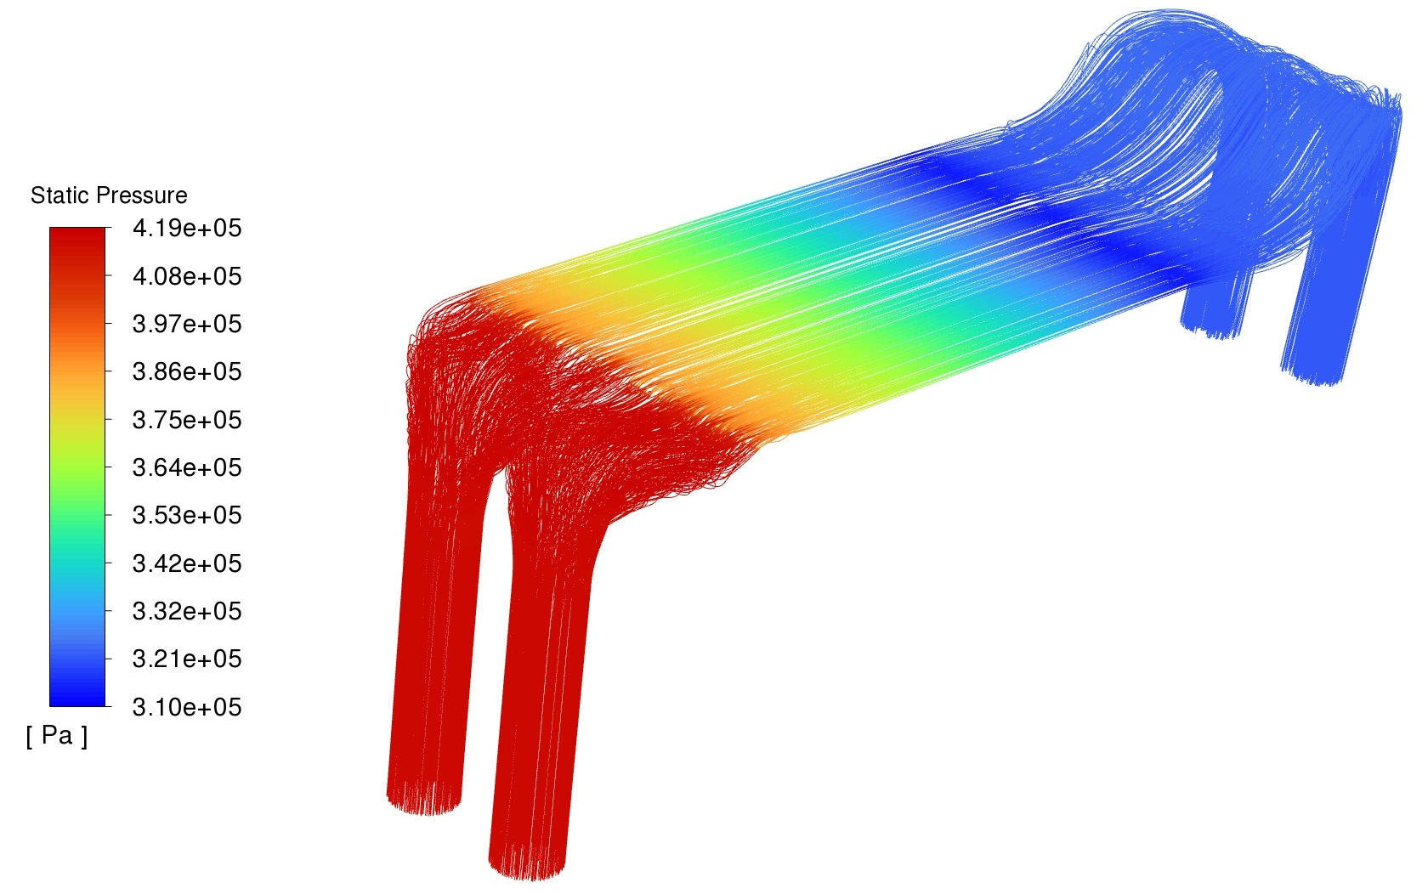
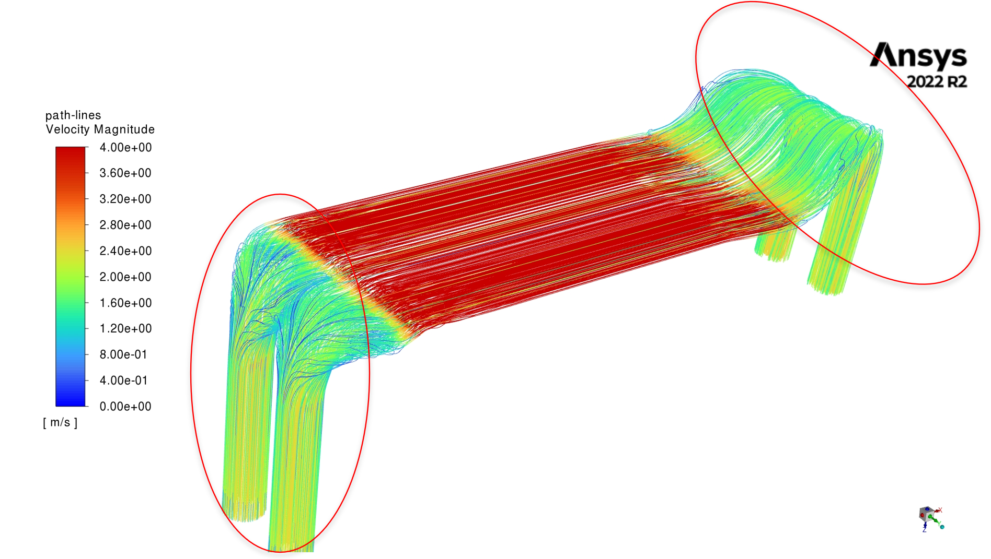
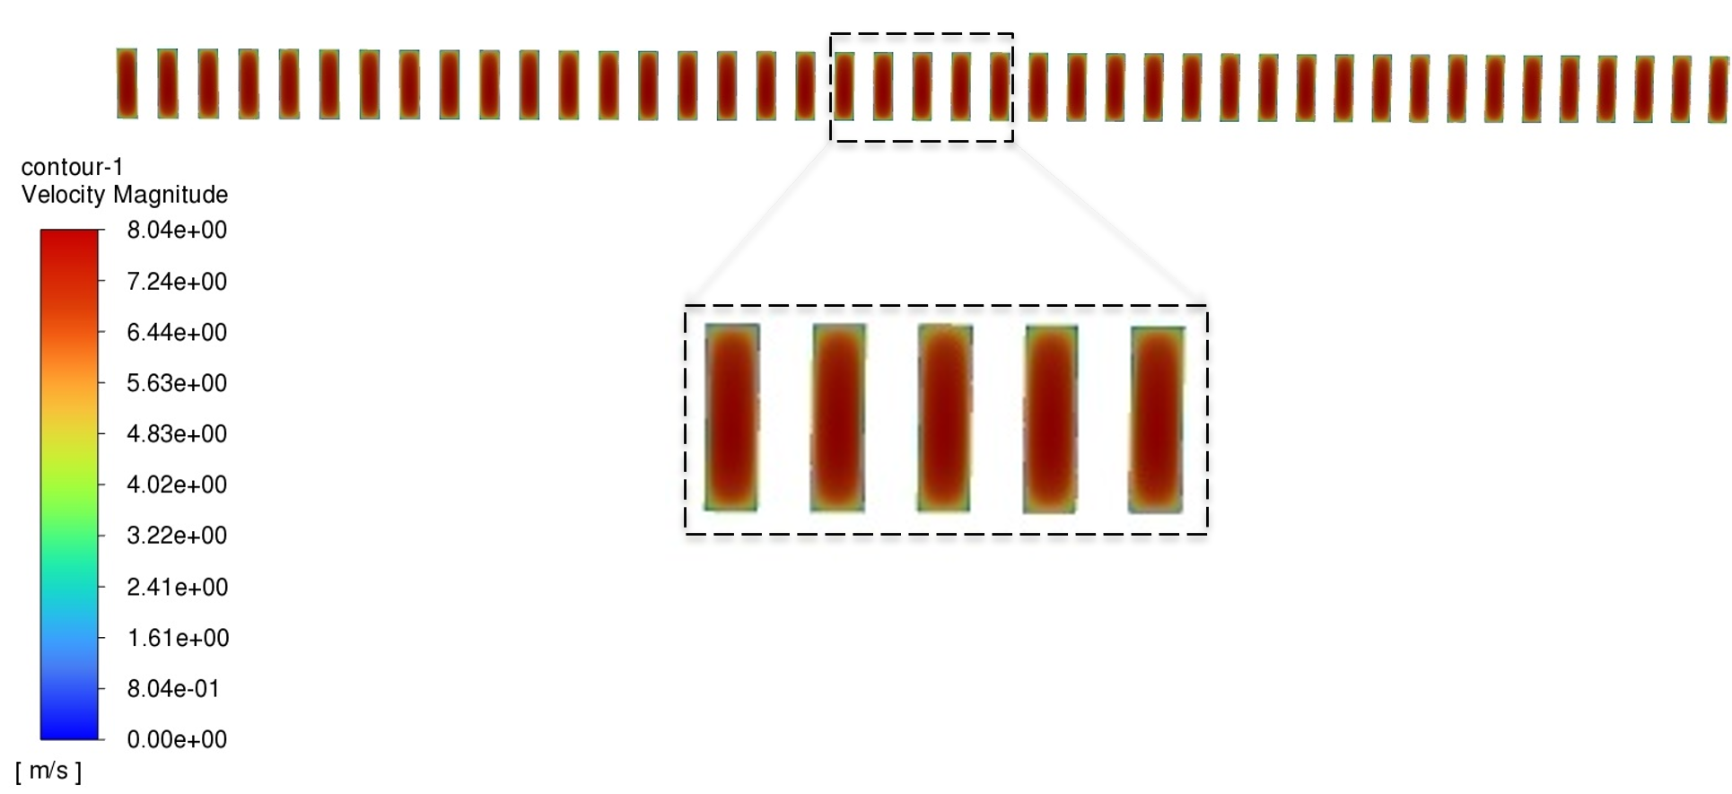
Thermal Fluid-Solid Analysis of the Mini-channel Beam Dump
Water Speed ≤ 4 m/s in the impingement areas 227 LPM (60 GPM) flowrate
Path-lines of Static pressure (Pa)
Location | Pressure (psi) | Pressure Drop (psi)
Inlet 1 | 60.29 | 13.77
Outlet 1 | 46.52
Inlet 2 | 60.32 | 13.80
Outlet 2 | 46.52
Uniform flow along all mini-channels

Slide 14
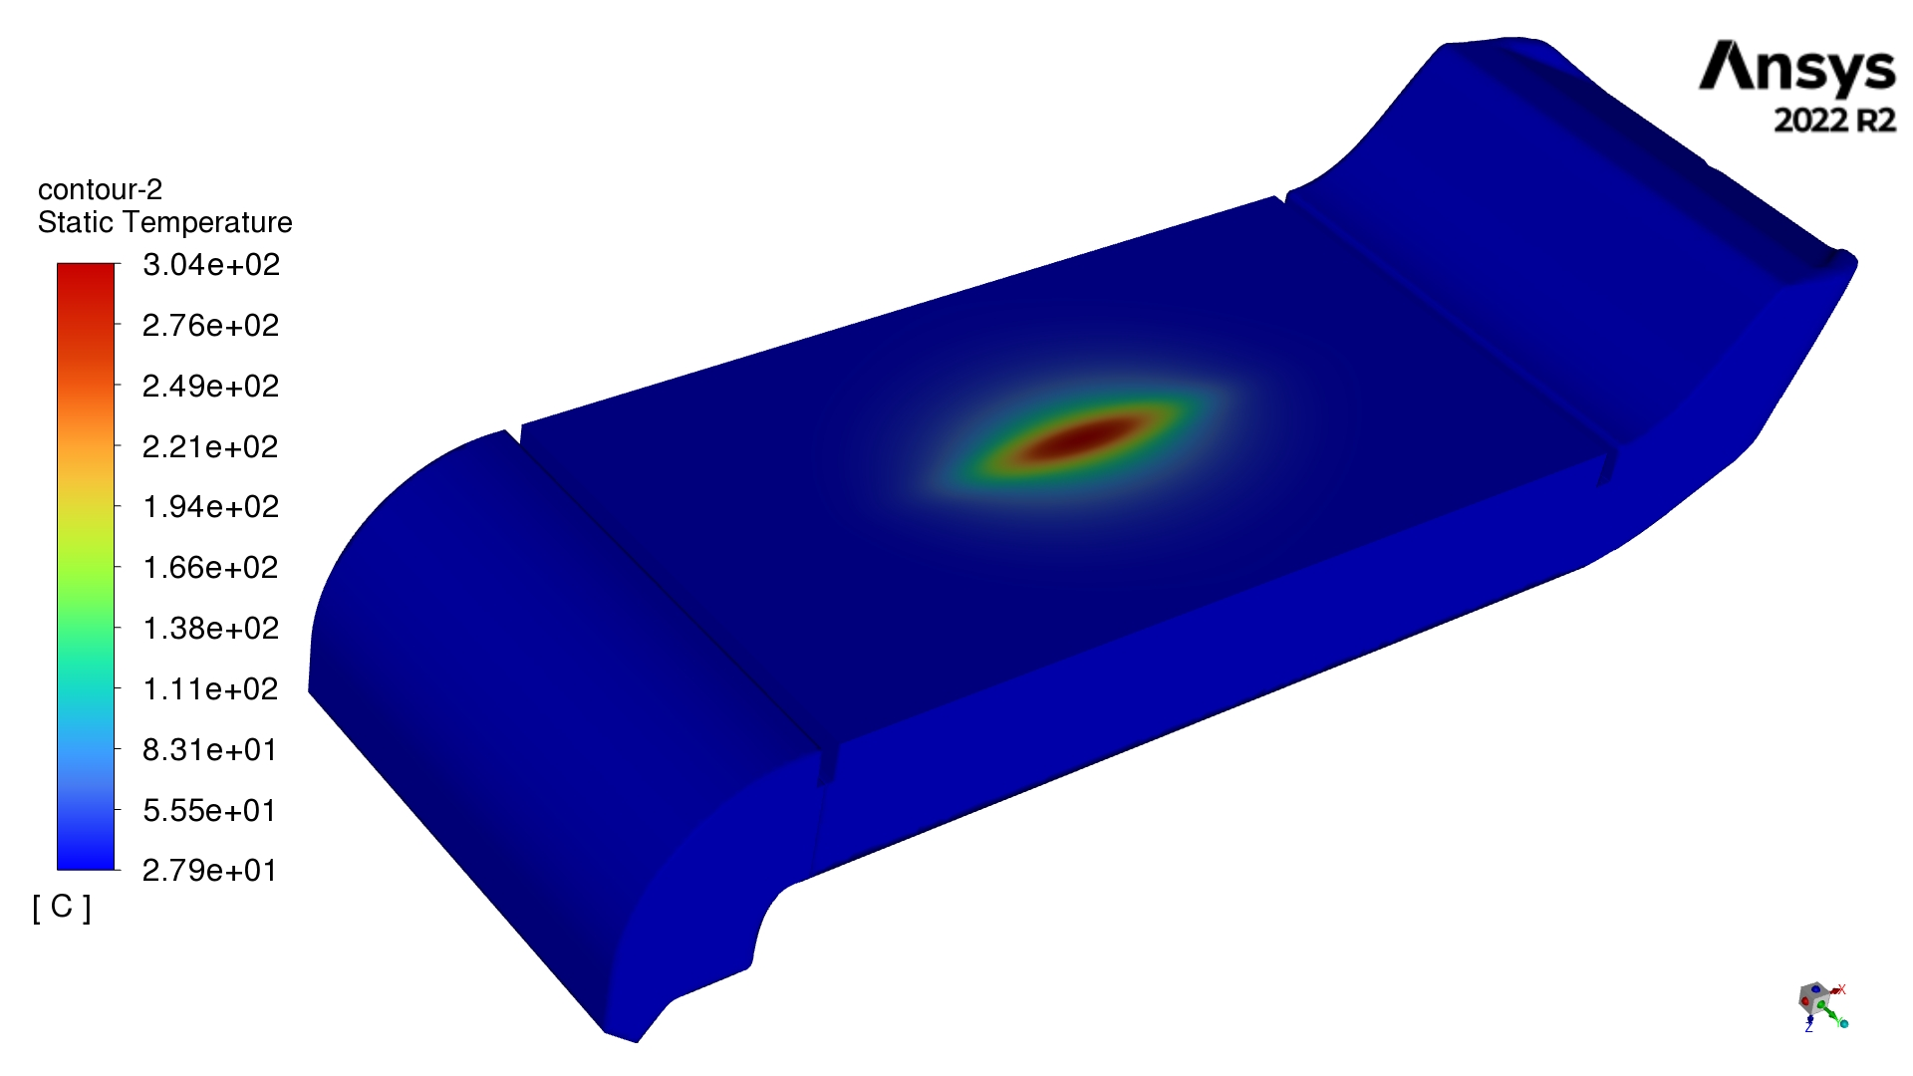
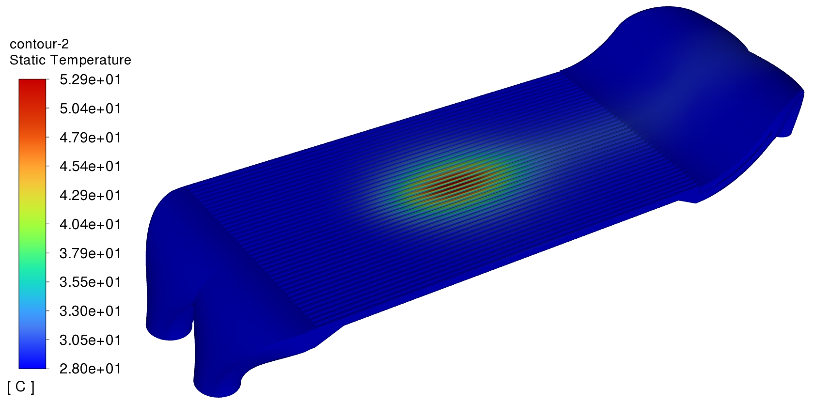
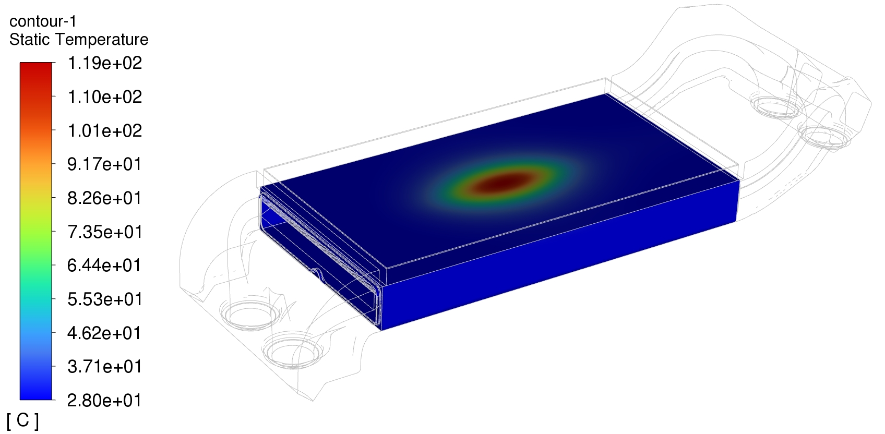
Temperature Results Supply Inputs into the BPVC Analysis
Max. Temperature = 304 C
Max. Fluid Temperature = 35.14 C
Max. Wall Temperature (Fluid Domain) = 52.9 C
Maximum Temperature on the mini-channel housing= 118.9 C
Flow Direction

Slide 15
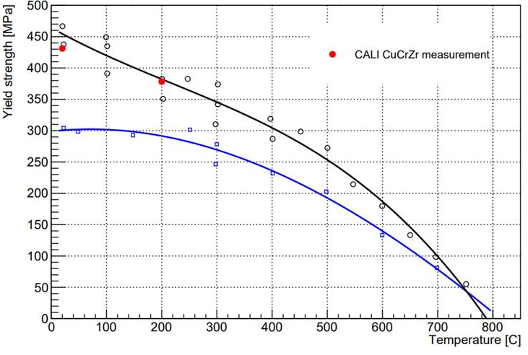
BPVC Analysis Material Properties: C18150
  Data taken from “M. Li, Physical and Mechanical Properties of Copper and Copper alloys ” , and Measurement from DataPoint

Slide 16
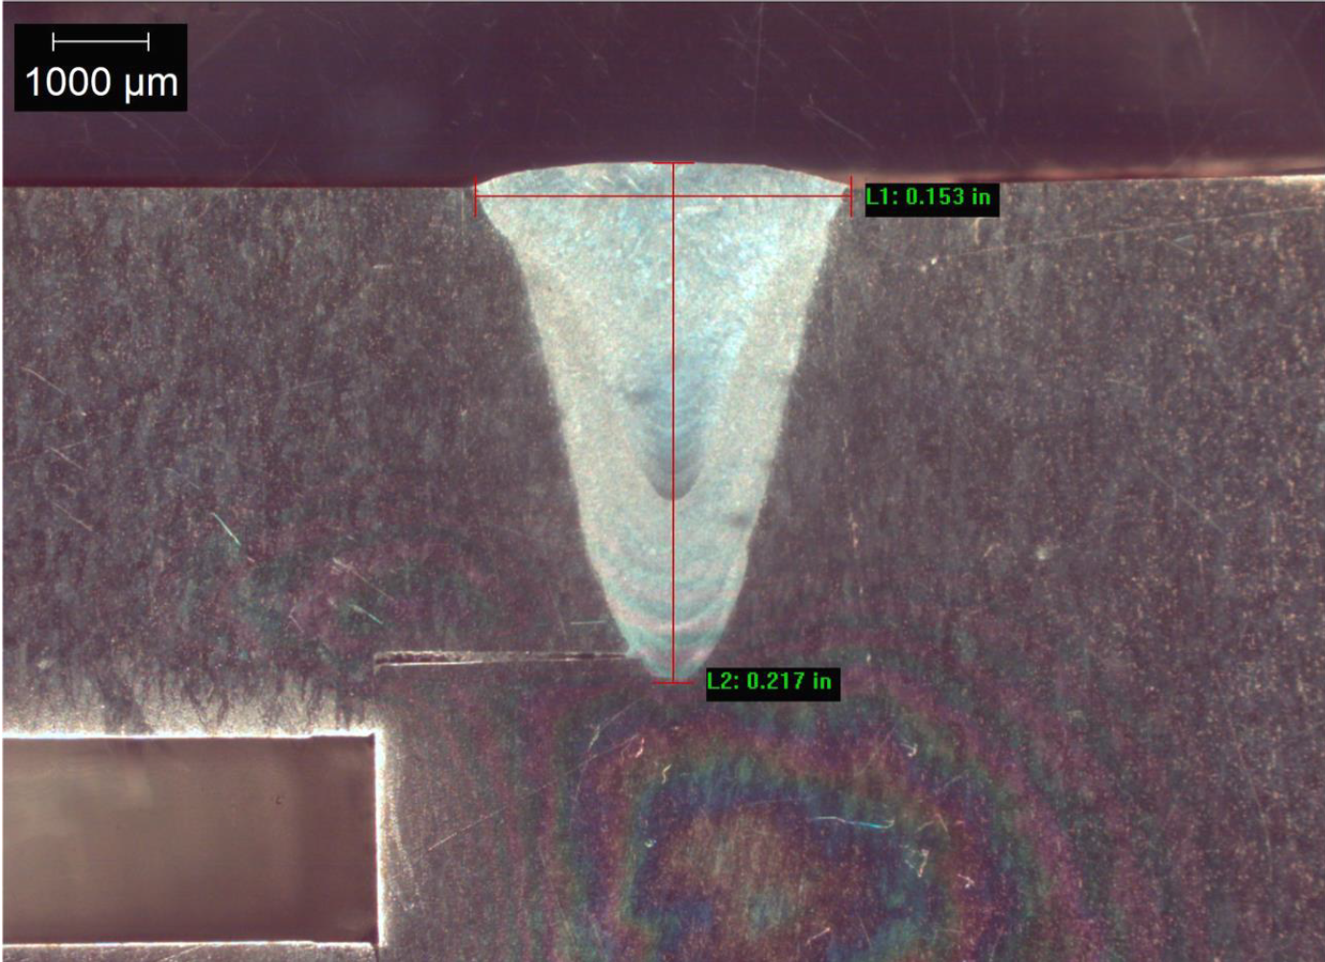
BPVC Analysis Material Properties: Al2219-T851
Property | Mean Value | Std Dev | Units
Yield Stress in Tension | 164 | 3.45 | MPa
Poisson's Ratio | .322 | .00872 | -
Tensile Modulus | 73900 | 576 | MPa
Tensile Strength | 306 | 1.23 | MPa
Elongation | 9.02 | .067 | %
  Data taken from Tensile Testing of E-beam welded aluminum on pressure boundary
Marco cross-sectional examination of e-beam weld

Slide 17
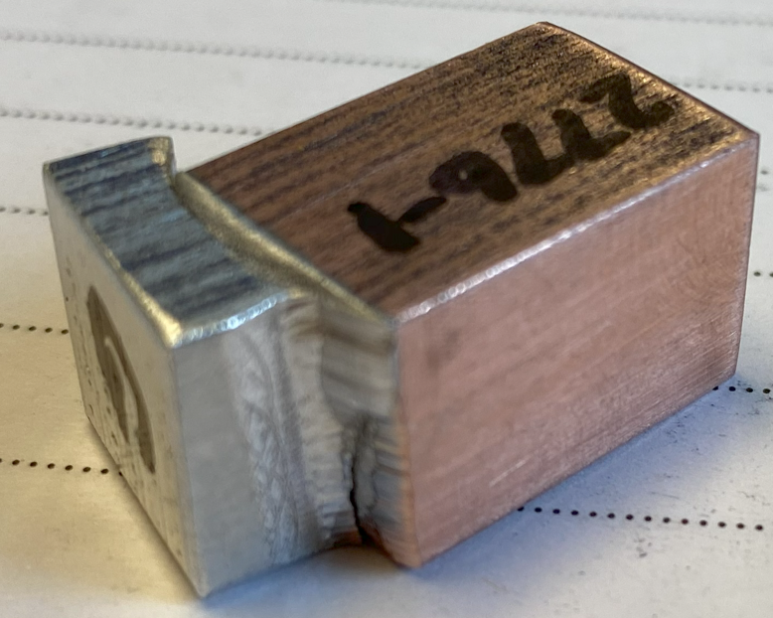
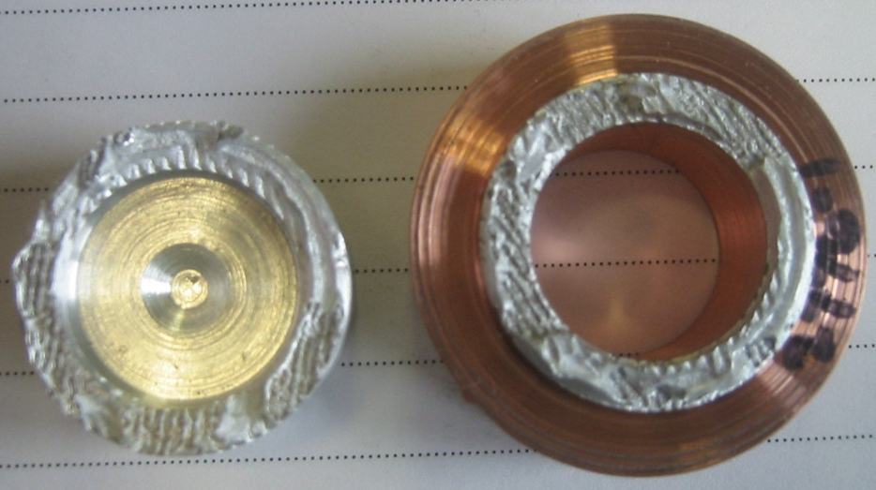
Explosion Bond Bi-Metal Material Property Measurements
Bimetal tensile/shear tests were completed
  Shear stress is consistent with the Al1100 interstitial material
Tensile Sample | Yield Strength (MPa)
1 | 214
2 | 250
Shear test sample
Shear Sample | Shear Strength (MPa)
1 | 75
2 | 81
3 | 69
4 | 83
Tensile test sample

Slide 18
BPVC Loading Cases
The MCBD is subjected to three basic loads:
  Gravity
    Primary & secondary stress
  Pressure (water)
    Primary & secondary stress
  Thermal Load (Beam Heating)
    Displacement-controlled loads-secondary stresses only
20 kW operation:
  U238 beam with σ₁ = 9.77mm and σ₂ = 2.32mm
    Worst case beam load for the C18150 absorber plate
    Deposit 15 kW of power in the dump. (P = pressure, T = beam power)
Load | Description | Loads
1 | Normal Operation | P+T
2 | 30% decrease in thermal conductivity | P+T
3 | Operation with blocked water channel | P+T
4 | Off center beam (Y direction) | P+T
5 | Off center beam (X direction) | P+T

Slide 19
Protection Against Plastic Collapse Application and Results
Limit-load analysis addresses the failure modes of ductile rupture and the onset of gross plastic deformation (plastic collapse) of a structure
Displacements and strains indicated by a limit analysis solution have no physical meaning
Protection against plastic collapse using limit load analysis is based on the theory of limit analysis that defines a lower bound to the limit load of a structure as the solution of a numerical model with the following properties:
  The material model is elastic-perfectly plastic with a specified yield strength
  The strain-displacement relations are those of small displacement theory
  Equilibrium is satisfied in the undeformed configuration
The limit load is obtained using a numerical analysis technique (e.g., finite element method) by incorporating an elastic-perfectly-plastic material model and small displacement theory to obtain a solution.
The limit load is the load that causes overall structural instability.
This point is indicated by the inability to achieve an equilibrium solution for a small increase in load (i.e., the solution will not converge)
Load | Description | Loads | Design Load Combination | Converge
1 | Normal Operation | P+T | 1.3(P+T) | Yes
2 | 30% decrease in thermal conductivity | P+T | 1.3(P+T) | Yes
3 | Operation with blocked water channel | P+T | 1.3(P+T) | Yes
4 | Off center beam (Y direction) | P+T | 1.3(P+T) | Yes
5 | Off center beam (X direction) | P+T | 1.3(P+T) | Yes

Slide 20
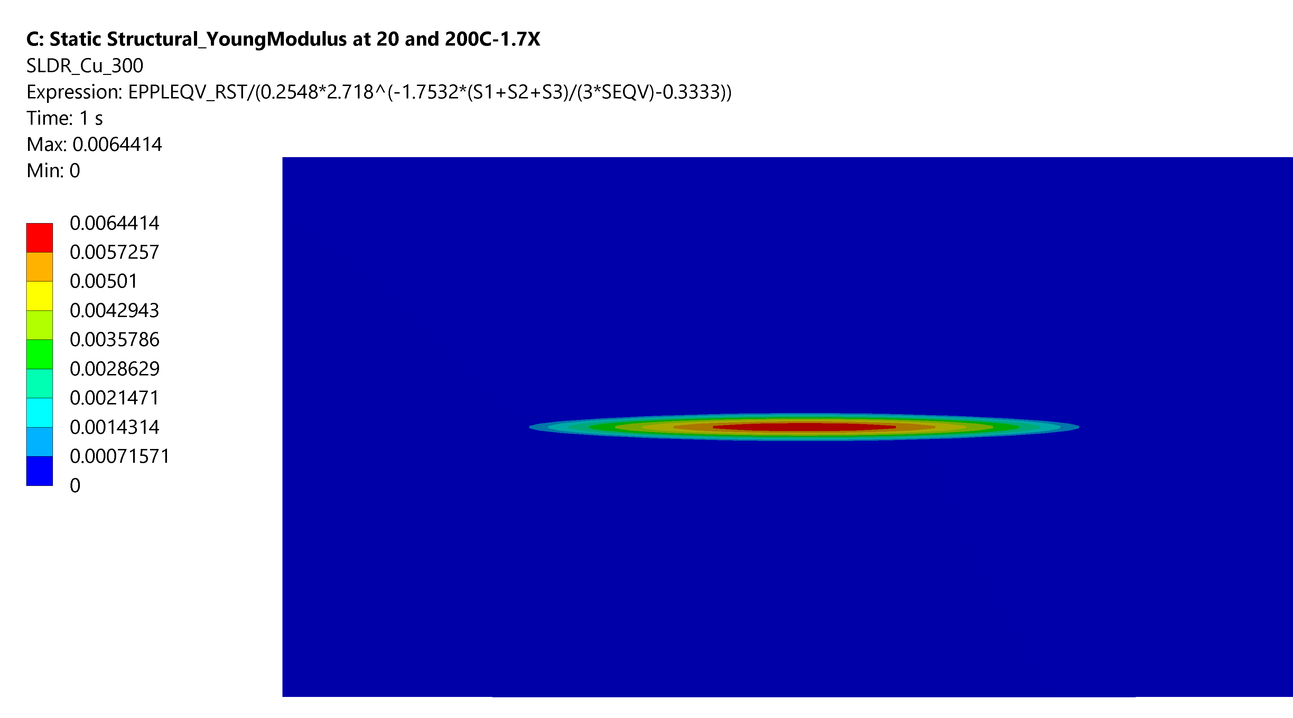
Protection Against Local Failure: Elastic Plastic Analysis
In addition to the stress-based failure criteria, ASME BPVC also considers criteria based on local strain limits, particularly those related to the triaxial state of stress
As per section 5.3.3 of Div.2 of The Code, the requirements are met when the combination of the limiting triaxial strain, ϵ_{L}, and forming strain, ϵ_{cf}, are less than the strain that occurs as a result of an elastic-plastic simulation at the required load factors as per table 5.5
The Strain Limit Damage Ratio (SLDR) calculated from ANSYS models was found to be lower than 1 for each node on the MCBD model.
  The SLDR was calculated for all materials: C18150, Al2219, Al1100-O, Niobium and AlSi10Mg
Load | Description | Loads | Design Load Combination | SLDR<1
1 | Normal Operation | P+T | 1.7(P+T) | Yes
2 | 30% decrease in thermal conductivity | P+T | 1.7(P+T) | Yes
3 | Operation with blocked water channel | P+T | 1.7(P+T) | Yes
4 | Off center beam (Y direction) | P+T | 1.7(P+T) | Yes
5 | Off center beam (X direction) | P+T | 1.7(P+T) | Yes

Slide 21
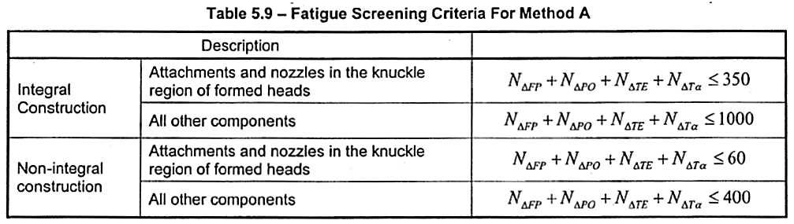
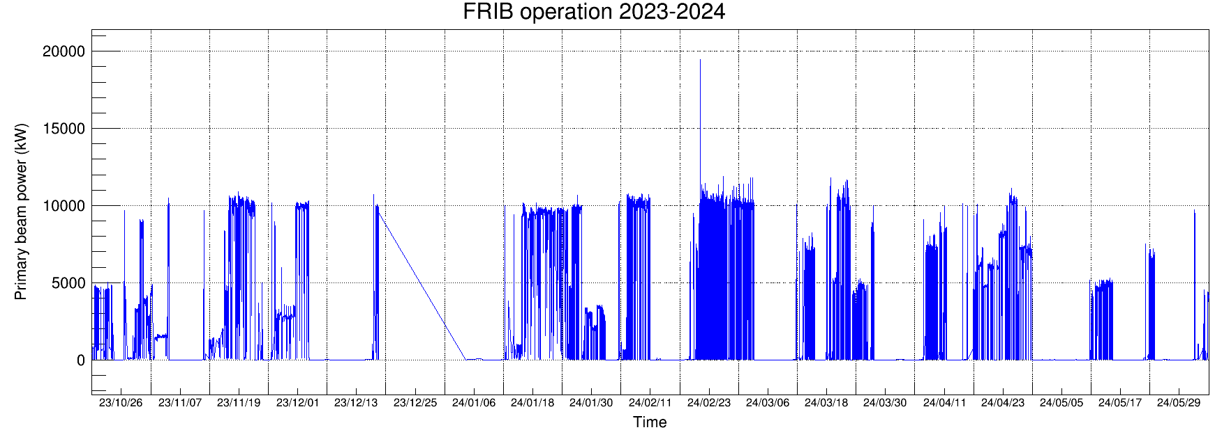
Protection Against Failure from Cyclic Loading
Screening Criteria for Fatigue Analysis – Part 5.5.2
  Comparable equipment operating under similar conditions – Part 5.5.2.2
  Provisions of Part 5.5.2.3, Method A for Materials that have Room Temperature Ultimate Strength less than 552 MPa
    All materials used in this assembly, meet this criteria
Total number of beam trips as estimated from the data ~1500
  Majority of the beam trips are very short duration and the change in power level
    ΔT for beam dump absorber face would be very small
  This is not a complete cycle as per the code
    Conservative assumption is all beam trips are assumed as complete cycle
Since the total cycles 1500>1000, per Method A, a fatigue analysis is required

Slide 22
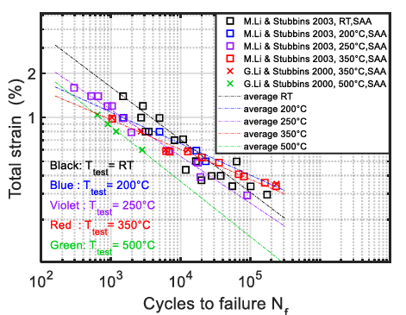
Fatigue Assessment on C18150
At 1500 cycles and T=250º C, total strain of 1% would cause fatigue failure – Violet Line
  Similar trend observed in other literature sources
For the case of the U beam at 20 kW operation, the total strain is 0.29%
  Elastic Strain
Lower than the 1% limit for 1500 cycles - Pass
For FRIB operations, every experimental run has a different beam spot and may have multiple charge states which means the beam may not hit the same spot repeatedly
Radiation effects of the material are not considered
  One year of operation before replacement of component
K.Zhang et al Development of the material property handbook and database of CuCrZr. Fusion Engineering and Design 144 (2019) 148–153

Slide 23
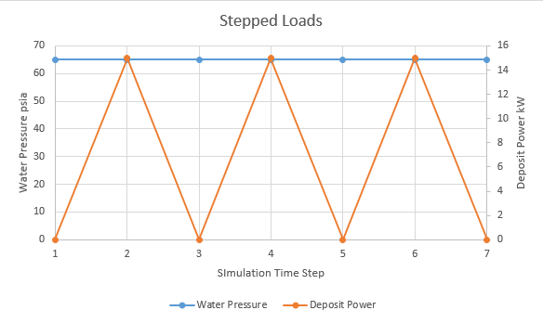
Protection Against Cyclic Loading - Ratcheting
Ratcheting Assessment – Elastic-Plastic Stress Analysis Part 5.5.7.2
Finite Element Model
  Elastic Perfectly Plastic material properties
  Non-Linear Geometry
  Loads to include MAWP and beam heating load
  Cycle the beam heating with constant water pressure
  Criteria - If any one of the following conditions is met, the ratcheting criteria are satisfied
    Structure should have an elastic core
    Repeated cycles result in no change in geometry
    There is no plastic action
Load Case
  MAWP = 0.45 MPa (65 psia), constant
  Deposited Beam Power = 15 kW varied

Slide 24
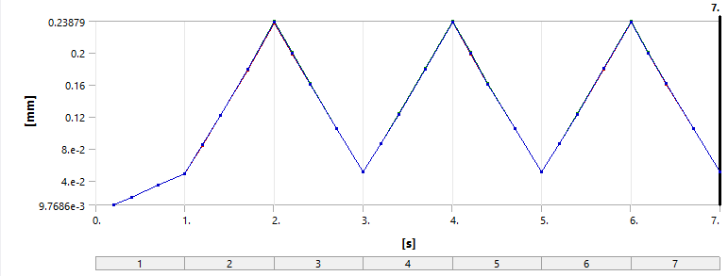
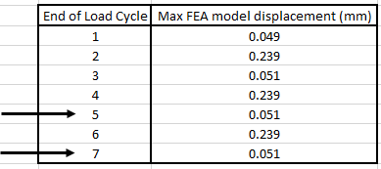
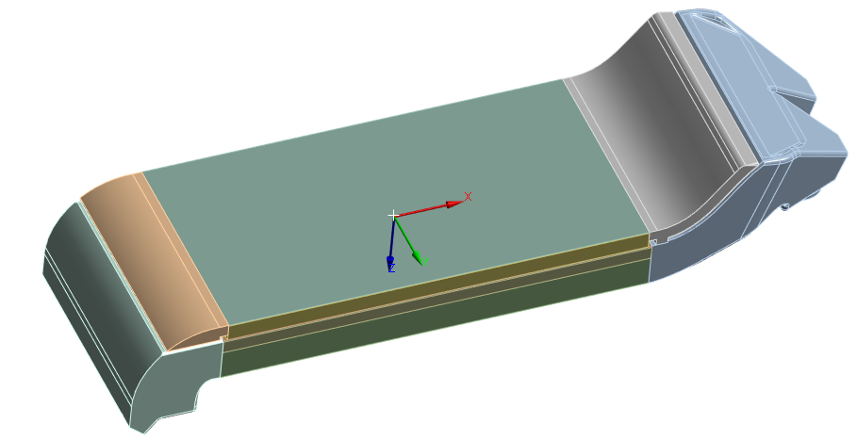
Protection Against Cyclic Loading – Ratcheting C18150 Results
Analysis shows that there is no change in dimension between the last and next to last cycles (load cycle 5 and 7)
  Demonstrates convergence
  Indicates that the structure has an elastic core - Pass
  No permanent change in overall dimensions - Pass
Overall plastic strain is approximately zero in C18150.
  There is no plastic action - Pass
Middle element of the C18150 absorber plate face

Slide 25
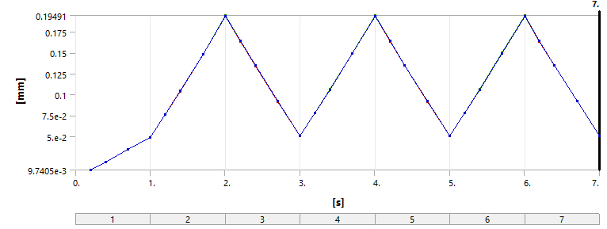
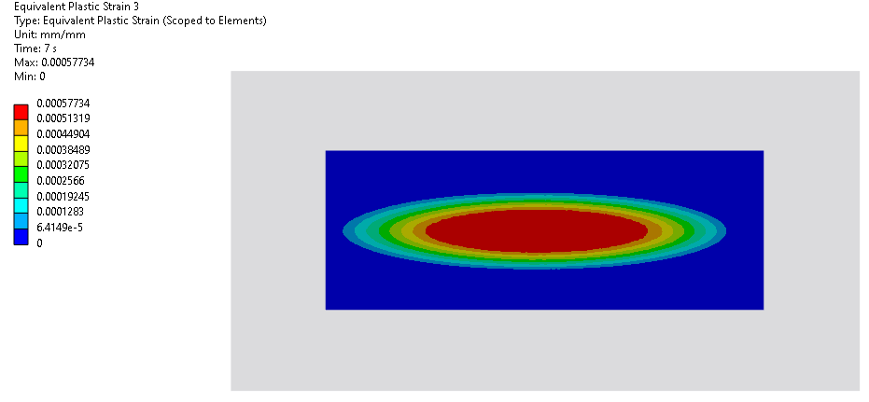
Protection Against Cyclic Loading – Ratcheting Al1100-O Results
Analysis shows that there is no change in dimension between the last and next to last cycles (load cycle 5 and 7)
  Demonstrates convergence
  Indicates that the structure has an elastic core - Pass
  No permanent change in overall dimensions - Pass
The Al-1100O material does have plastic strain, albeit very small at the end of load cycle 7 (0.057%).
  There is no plastic action – Conditional Pass
Middle element of the Al1100-O interstitial layer

Slide 26
ASME Section VIII Division II Code Summary
Protection against plastic collapse:
  Limit Load Analysis method – meets Code
Protection against local failure:
  Elastic Plastic analysis – meets Code
Protection against collapse from buckling:
  Not Applicable - (Buckling not identified as a failure mode)
Protection against failure from cyclic loading
  Fatigue analysis – Required – meets Code
  Ratcheting analysis – meets Code

Slide 27
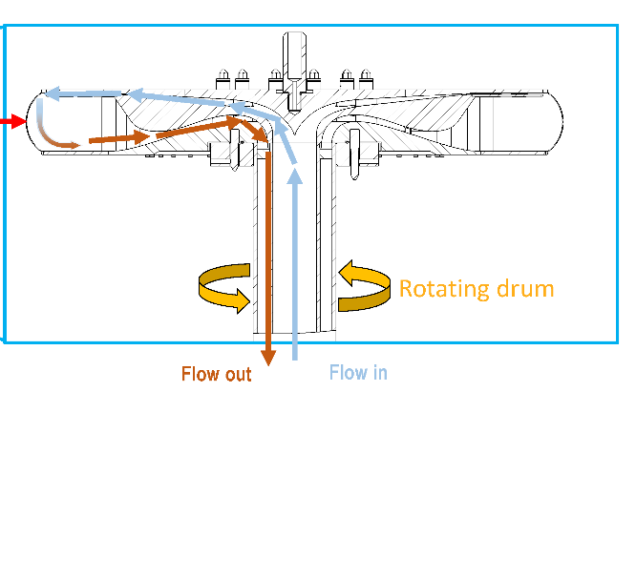
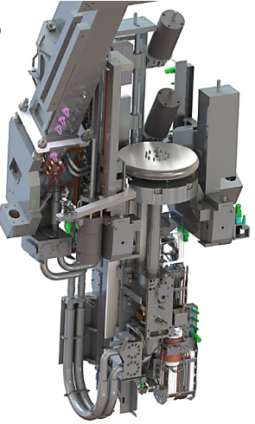
Summary and Path Forward Code Application
Beam Dump for > 50 kW Operation
FRIB baseline: Rotating water beam dump concept chosen for high power operations
Ti-6Al-4V alloy selected for the beam dump shell material
Design parameters
  Ti-alloy shell thickness 0.5 mm for full power uranium beams to minimize heat deposition in the shell
  1mm shell has been manufactured
  600 rpm and 70 cm diameter to limit maximum temperature
  and amplitude of temperature changes
  60 gpm water flow
Technical challenges
  Rotary water seal
  Radiation damage in Ti-alloy shell, integrity must be guaranteed as pressure boundary
Primary beam
Rotating drum
Primary beam
Water cooling

Slide 28
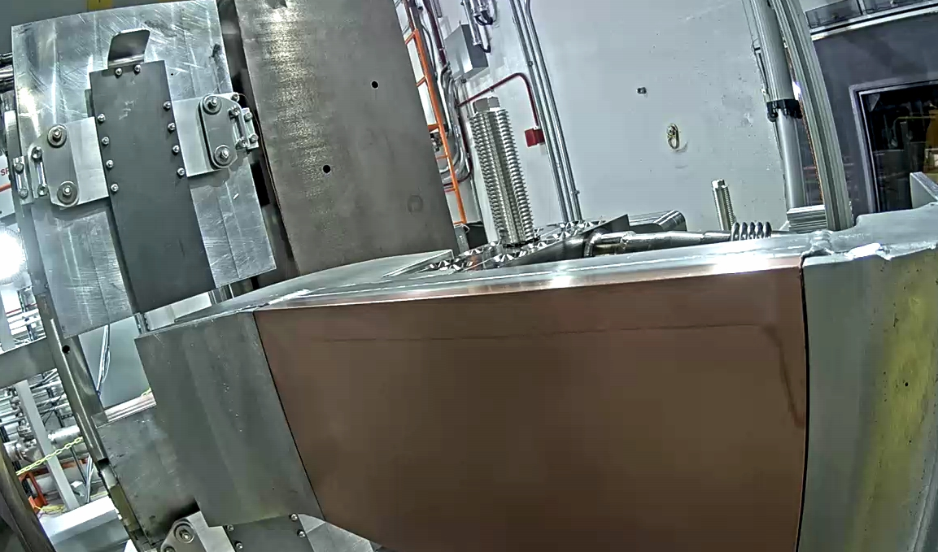
Summary
The BPVC was applied to the MCBD
  The MCBD passes the applicable sections of the code
The MCBD has been fabricated and installed for the next operational period at FRIB
FRIB will continue to apply BPVC on interceptive devices as a design qualification
  Rotating water dump is the next approach to achieve high stopped beam power at the beam dump

Slide 29
Acknowledgements:
Primary contributions on the technical application and development
Song, J. Status and R&D of the target and beam dump at FRIB, HPWT2023, Topic 4-3
Patil, M., BPVC Pressure Analysis Applied to Mini-Channel Beam Dump, FRIB Engineering Documentation
Quispe-Abad, R, Thermal Fluid-Solid Analysis of the Mini-channel Beam Dump, FRIB Engineering Documentation

Slide 30
References
K. Yoshida et al., High-power beam dump system for the BigRIPS fragment separator at RIKEN RI Beam Factory NIMB 317 (2013)
A. Cackett et al., Effects of radiation damage and precipitate distribution on micro-pillar compression testing of irradiated CuCrZr Journal of Nuclear Materials 553 (2021)
ITER material

