Slide 1
STS Rotating Target Design Update
Aaron Jacques
Lead Engineer, Target Assembly
with Aaron Jacques, Yongjoong Lee, Joel Montross, Thomas Muth, Joseph Tipton, Min-Tsung Kao and a laboratory of support
October 29, 2024
16th International Workshop on Spallation Materials Technology, Abingdon, UK​
​

Slide 2
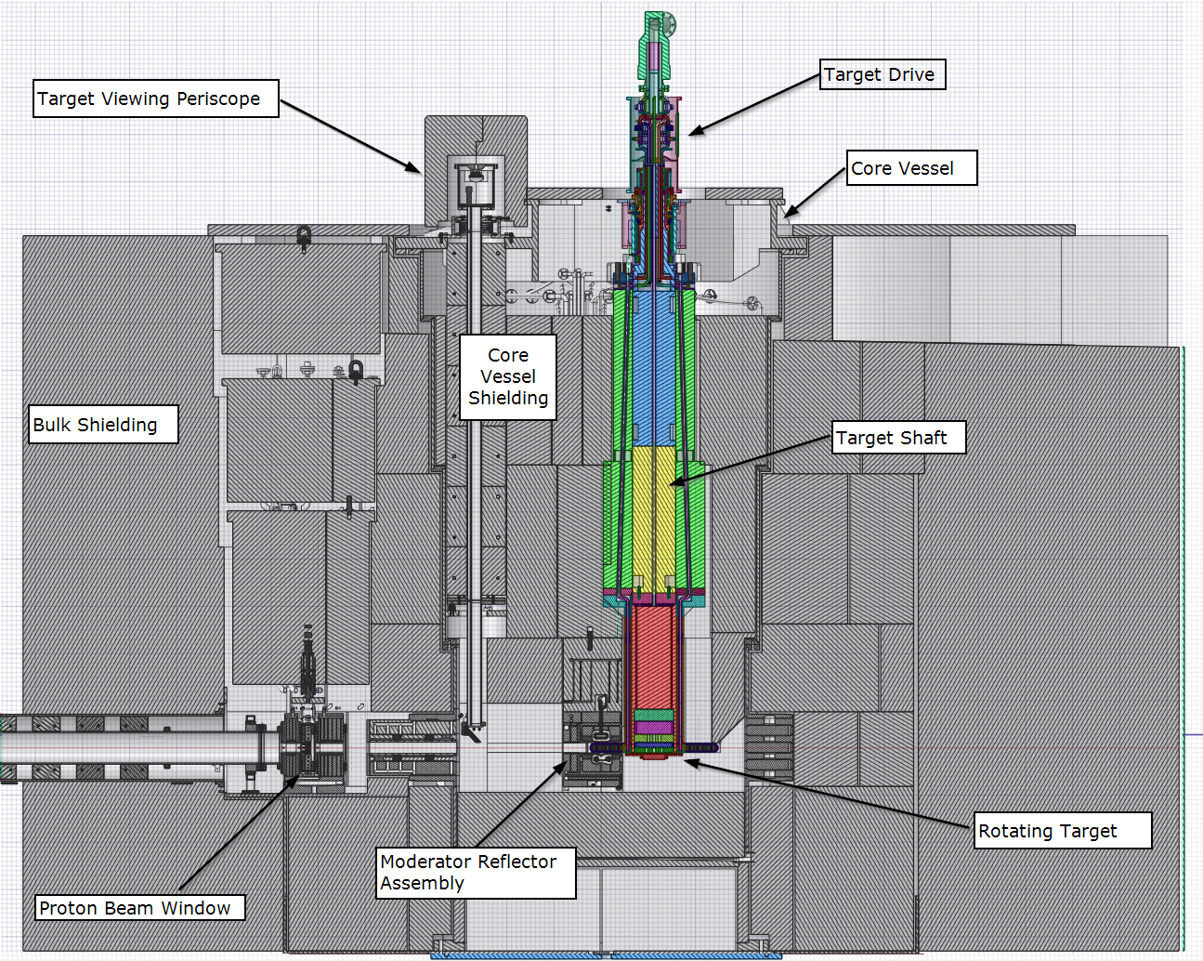
The rotating targets, drive, and shaft are integrated closely with other components in the core vessel

Slide 3
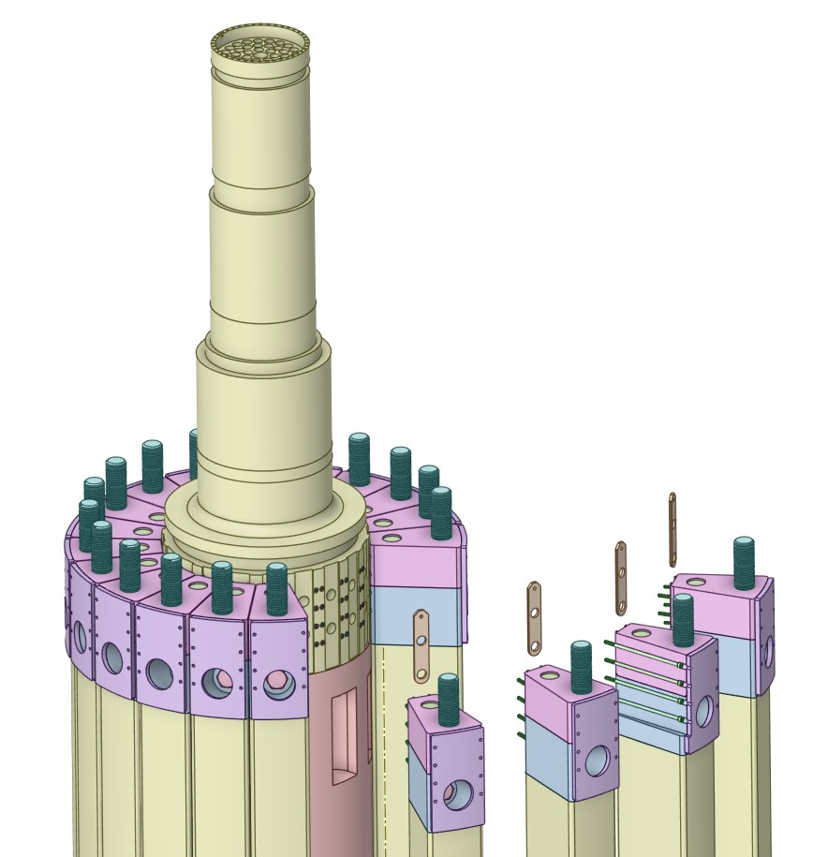
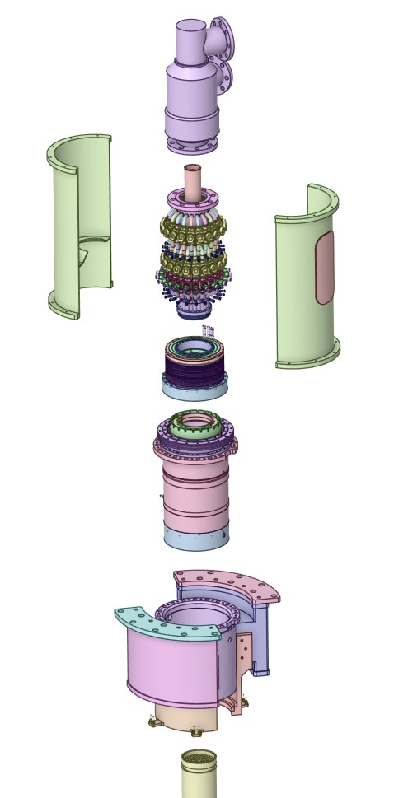
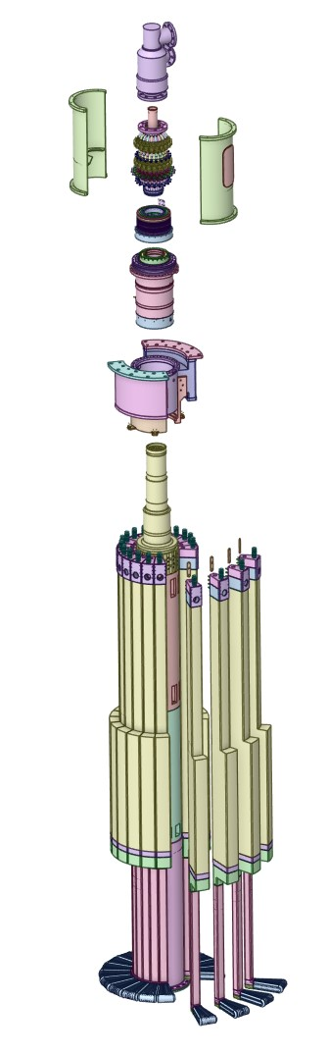
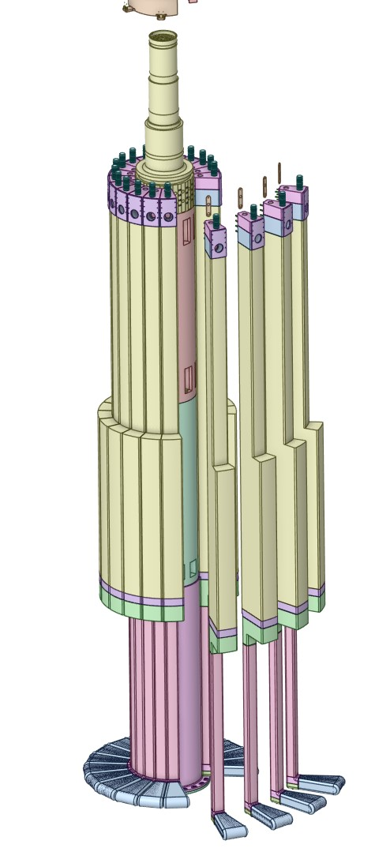
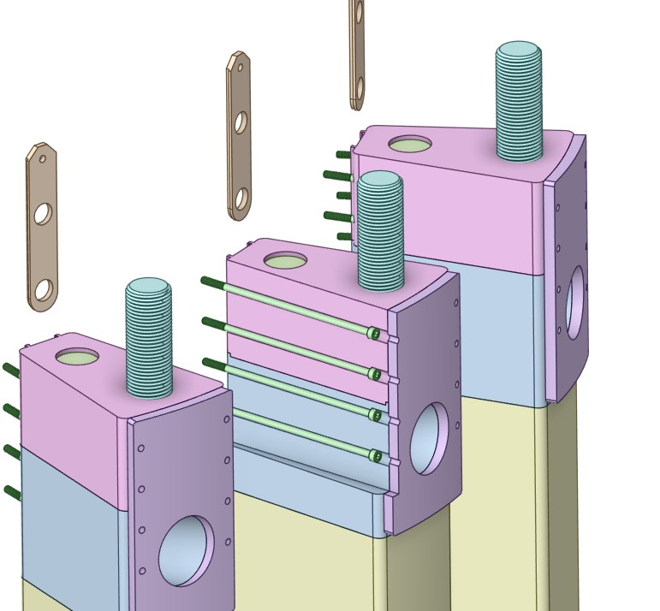
The Segmented target design permits maintenance access to components

Slide 4
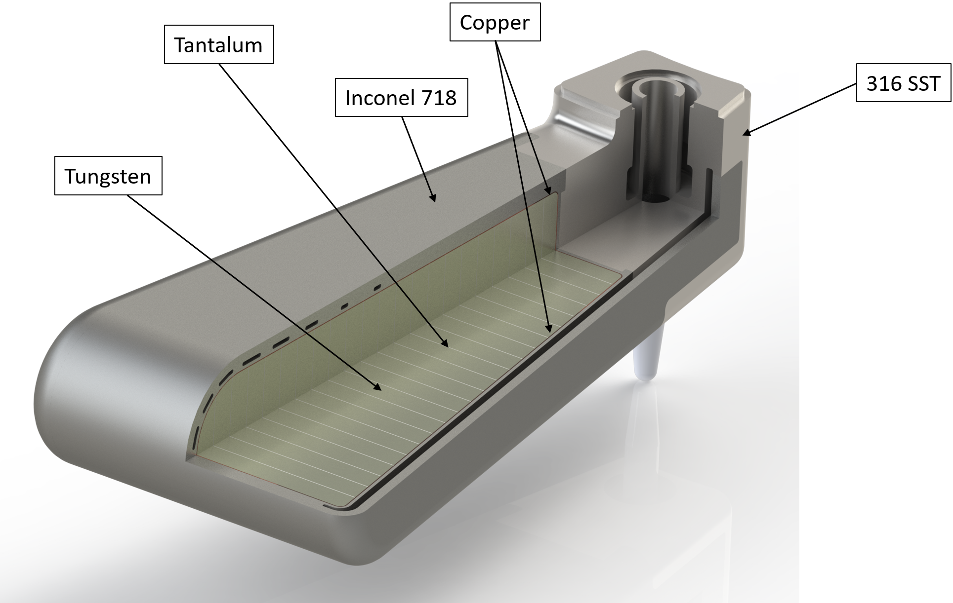
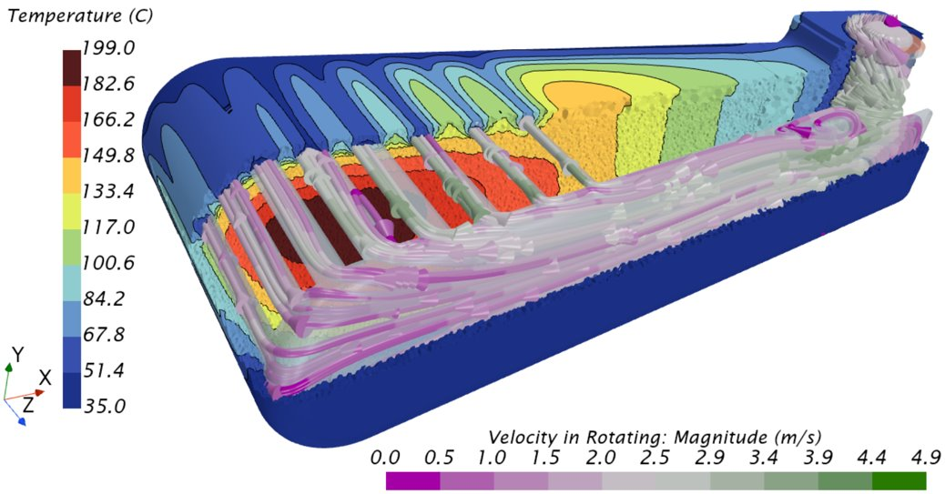
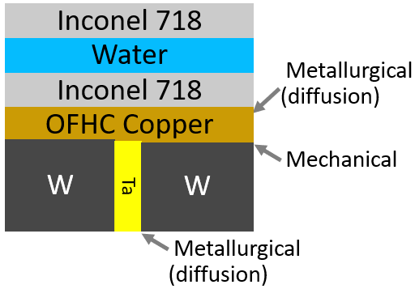
The STS design utilizes an edge cooled target design
Water channels
Water flow

Slide 5
Target construction is relatively straightforward

Slide 6
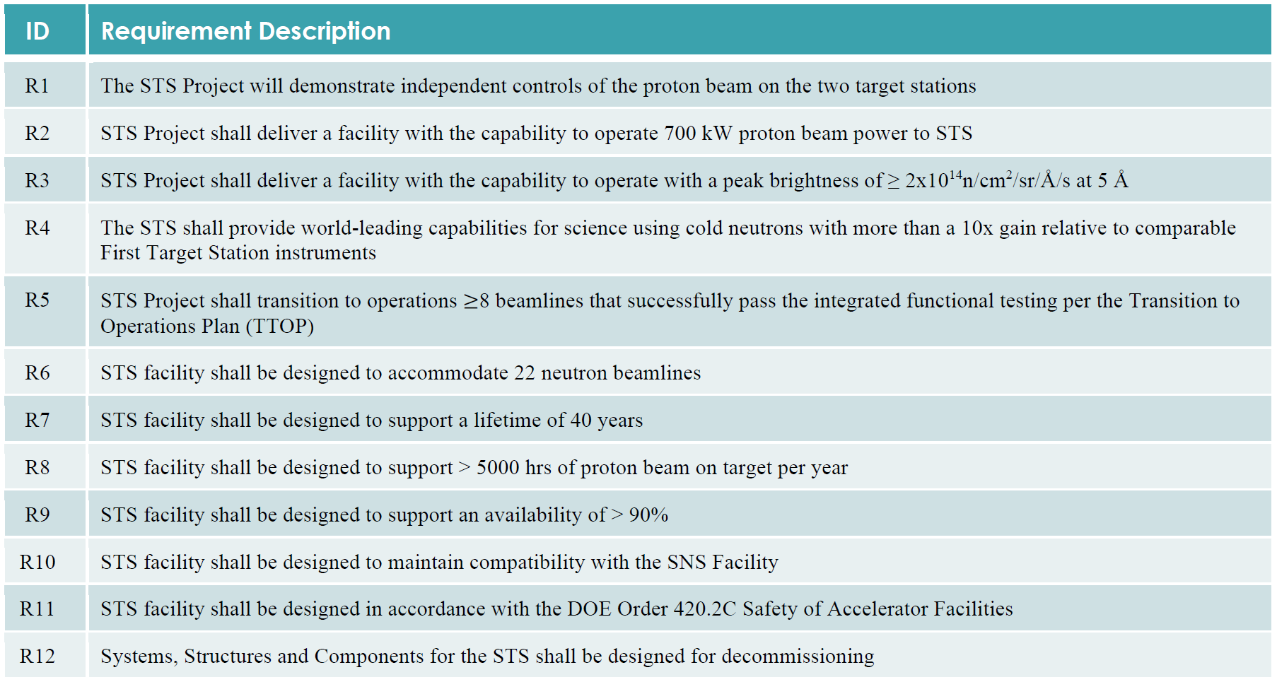
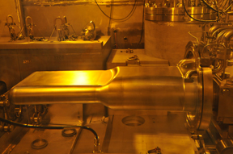
The STS requirements enforce reliability and brightness

Slide 7
The STS is unique in power per target and peak deposition to achieve brightness
Parameter | LANSCE MkIII | ISIS TS1 | ISIS TS2 MkII | CSNS | STS
Power (kW) | 80 | 160 | 32 | 100 | 700
Energy (GeV)/proton | 0.8 | 0.8 | 0.8 | 1.6 | 1.3
Frequency, f (Hz) | 20 | 50 | 10 | 25 | 15
Pusle Duration (ns) | 125 | 500 | 500 | 400 | 700
Average current (µA) | 100 | 200 | 40 | 63 | 538
Protons/pulse, N_{p} (10¹⁴) | 0.312 | 0.250 | 0.250 | 0.156 | 2.241
Energy/Pulse (kJ/pulse) | 4.0 | 3.2 | 3.2 | 4.0 | 46.7
Gaussian horizontal, σ_{x} (mm) | 15.0 | 17.9 | 6.0 | 30.0 | 58.8
Super Gaussian, n_{x} | 2.0 | 2.0 | 2.0 | 2.0 | 6.0
Gaussian vertical, σ_{y} (mm) | 15.0 | 17.9 | 6.0 | 10.0 | 20.9
Super Gaussian, n_{y} | 2.0 | 2.0 | 2.0 | 2.0 | 5.1
Peak protons/m²/pulse, I₀ (10¹⁶) | 2.2 | 1.2 | 11.0 | 0.8 | 4.2
Peak Energy Flux (kJ/m2/s) | 28.3 | 4.0 | 35.4 | 3.3 | 9.5
If you see an error – let me know!

Slide 8
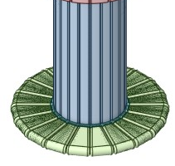
The STS is unique in power per target and peak deposition to achieve brightness
35
Parameter | LANSCE MkIII | ISIS TS1 | ISIS TS2 MkII | CSNS | STS
Power (kW) | 80 | 160 | 32 | 100 | 700
Energy (GeV)/proton | 0.8 | 0.8 | 0.8 | 1.6 | 1.3
Frequency, f (Hz) | 20 | 50 | 10 | 25 | 15
Pusle Duration (ns) | 125 | 500 | 500 | 400 | 700
Average current (µA) | 100 | 200 | 40 | 63 | 538
Protons/pulse, N_{p} (10¹⁴) | 0.312 | 0.250 | 0.250 | 0.156 | 2.241
Energy/Pulse (kJ/pulse) | 4.0 | 3.2 | 3.2 | 4.0 | 46.7
Gaussian horizontal, σ_{x} (mm) | 15.0 | 17.9 | 6.0 | 30.0 | 58.8
Super Gaussian, n_{x} | 2.0 | 2.0 | 2.0 | 2.0 | 6.0
Gaussian vertical, σ_{y} (mm) | 15.0 | 17.9 | 6.0 | 10.0 | 20.9
Super Gaussian, n_{y} | 2.0 | 2.0 | 2.0 | 2.0 | 5.1
Peak protons/m²/pulse, I₀ (10¹⁶) | 2.2 | 1.2 | 11.0 | 0.8 | 4.2
Peak Energy Flux (kJ/m2/s) | 28.3 | 4.0 | 35.4 | 3.3 | 9.5

Slide 9
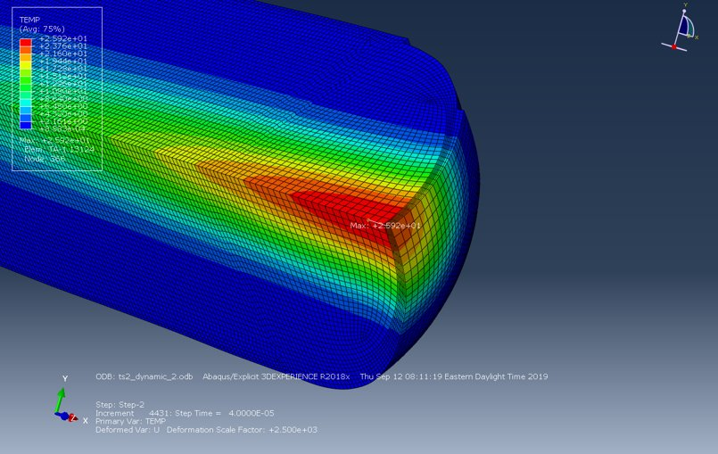
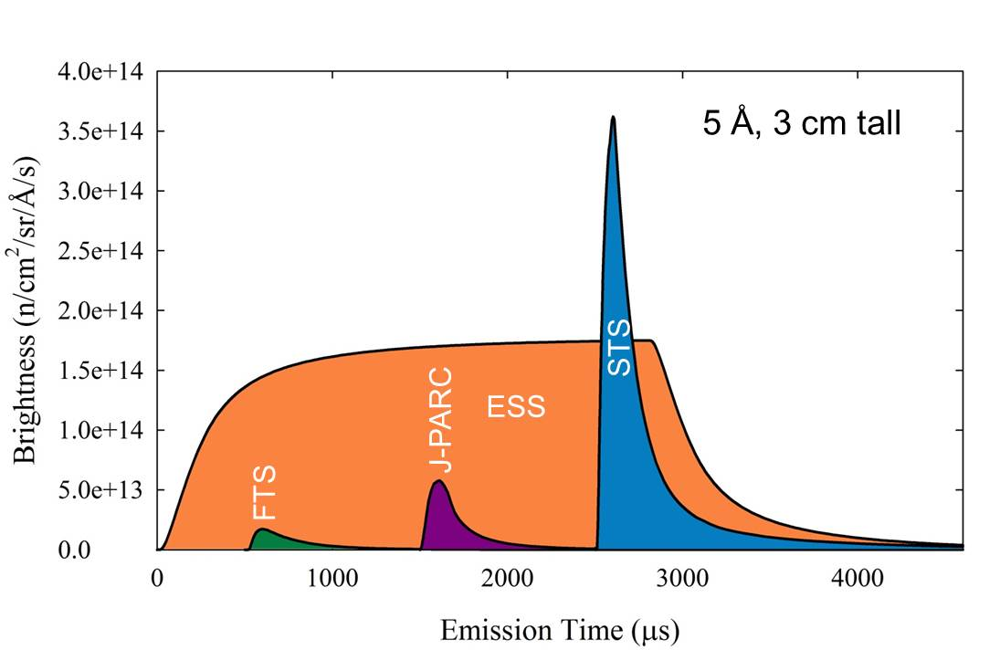
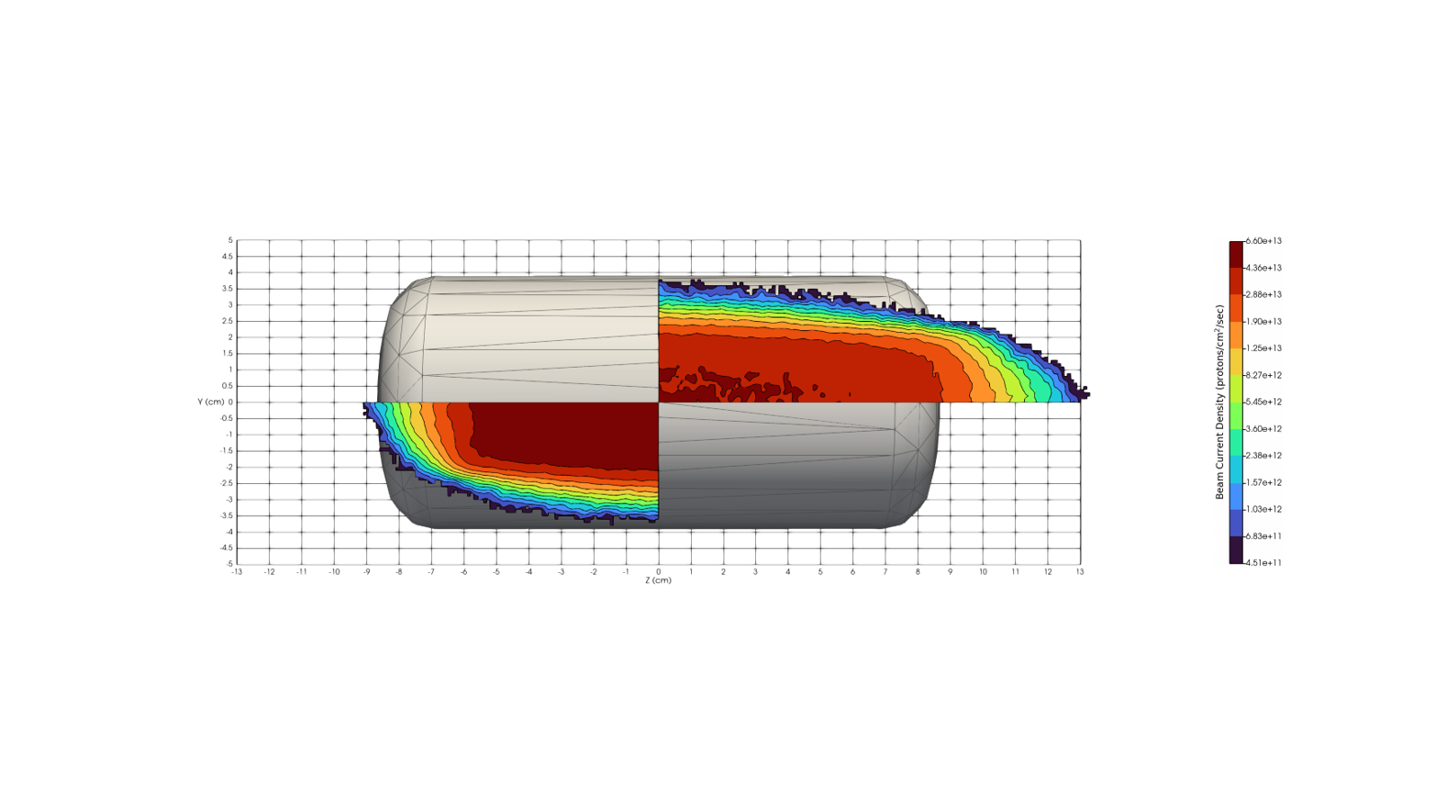
The STS is unique in power per target and peak deposition to achieve brightness
Image courtesy of Ken Herwig
Parameter | LANSCE MkIII | ISIS TS1 | ISIS TS2 MkII | CSNS | STS
Power (kW) | 80 | 160 | 32 | 100 | 700
Energy (GeV)/proton | 0.8 | 0.8 | 0.8 | 1.6 | 1.3
Frequency, f (Hz) | 20 | 50 | 10 | 25 | 15
Pusle Duration (ns) | 125 | 500 | 500 | 400 | 700
Average current (µA) | 100 | 200 | 40 | 63 | 538
Protons/pulse, N_{p} (10¹⁴) | 0.312 | 0.250 | 0.250 | 0.156 | 2.241
Energy/Pulse (kJ/pulse) | 4.0 | 3.2 | 3.2 | 4.0 | 46.7
Gaussian horizontal, σ_{x} (mm) | 15.0 | 17.9 | 6.0 | 30.0 | 58.8
Super Gaussian, n_{x} | 2.0 | 2.0 | 2.0 | 2.0 | 6.0
Gaussian vertical, σ_{y} (mm) | 15.0 | 17.9 | 6.0 | 10.0 | 20.9
Super Gaussian, n_{y} | 2.0 | 2.0 | 2.0 | 2.0 | 5.1
Peak protons/m²/pulse, I₀ (10¹⁶) | 2.2 | 1.2 | 11.0 | 0.8 | 4.2
Peak Energy Flux (kJ/m2/s) | 28.3 | 4.0 | 35.4 | 3.3 | 9.5
35
TS2

Slide 10
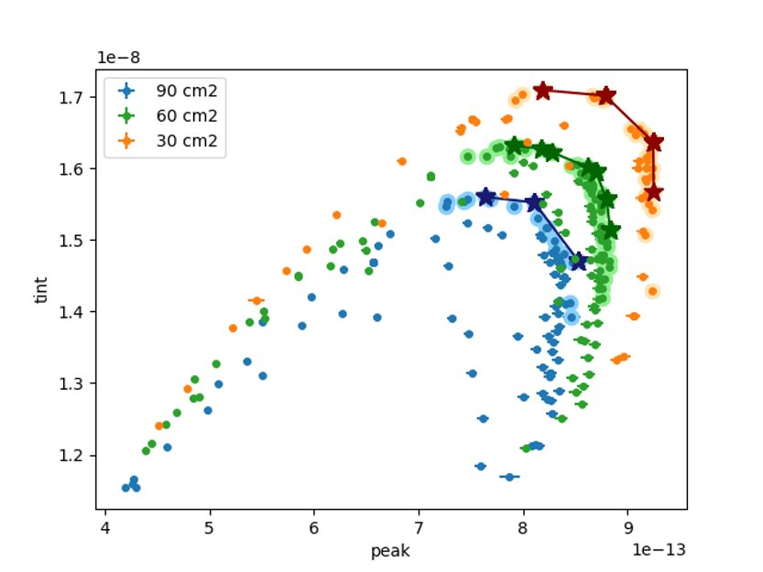
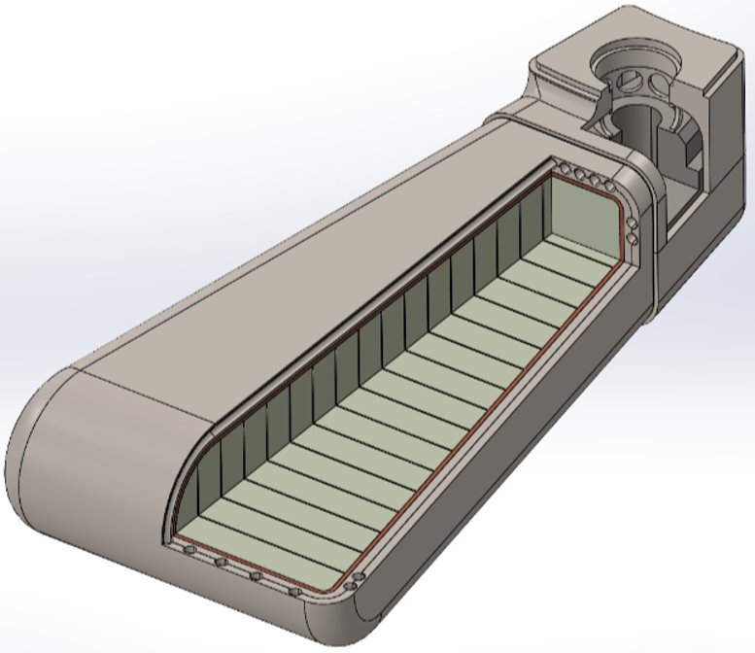

Brightness is governed by amount of tungsten and beam spot
Brightness variations due to beam footprint
~10%
~3%
~3%
Plot courtesy of Kristel Ghoos, “Summary target-beam-moderator neutronics optimization results” ORNL internal presentation, October 2023

Slide 11
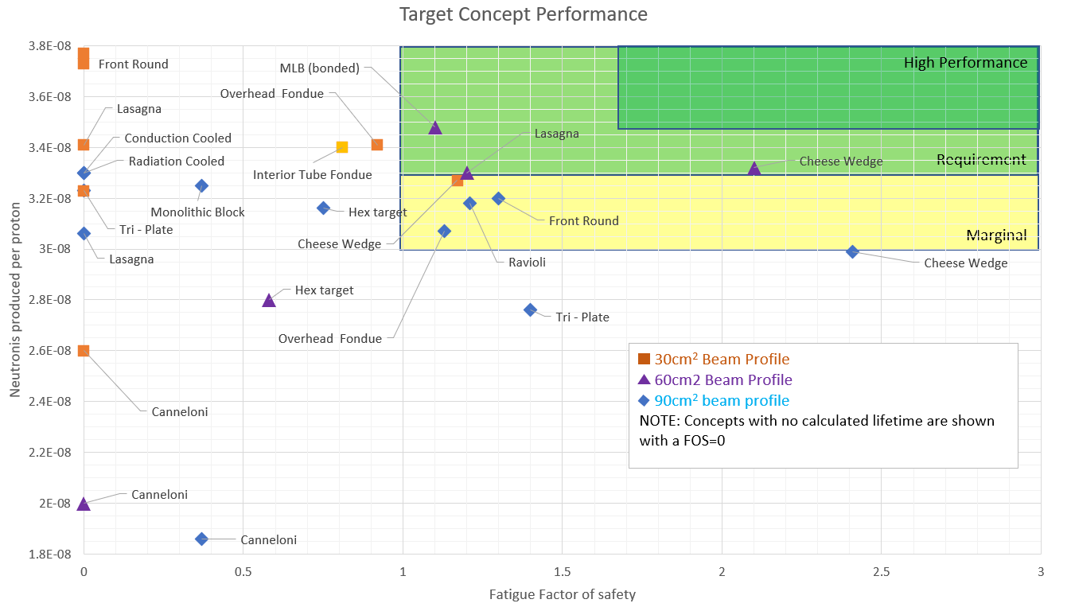
Beam spot can compensate for limited density changes but has fatigue implications

Slide 12
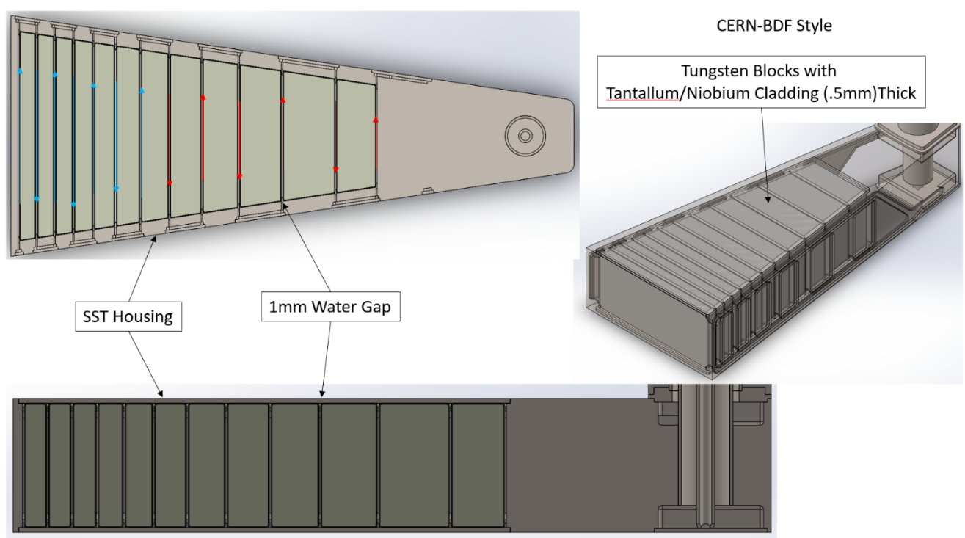
The optimal target design for high beam power was NOT selected
Tantalum

Slide 13
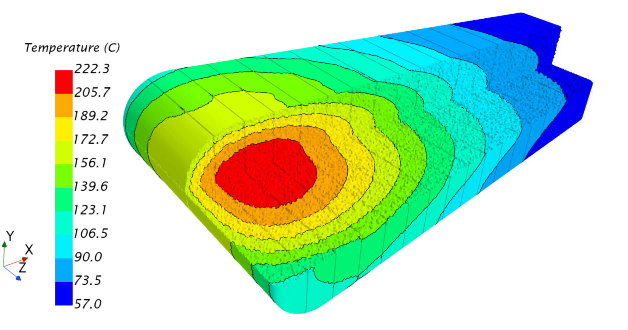
Edge cooling has improved reliably for high energy pulses but is limited in time averaged power per target
Durable container/shell
Material thickness
High density target (no water)- brightness
Reduced average power density
(rotating target, diffuse beam)

Slide 14
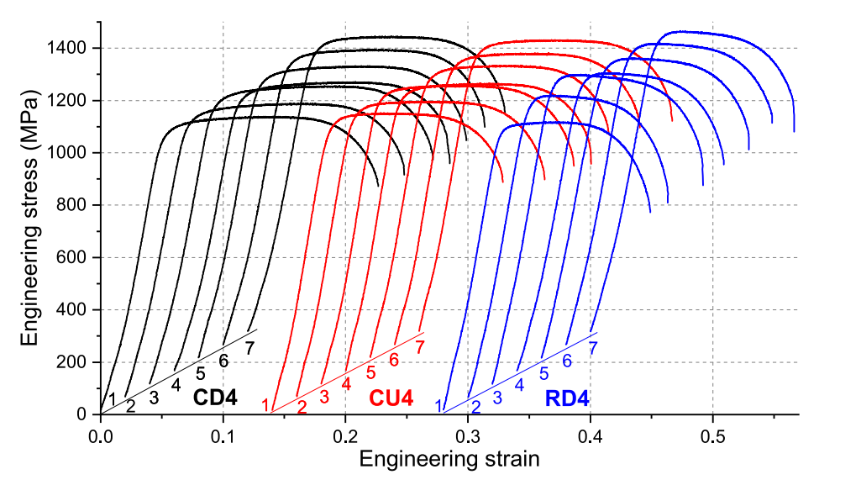
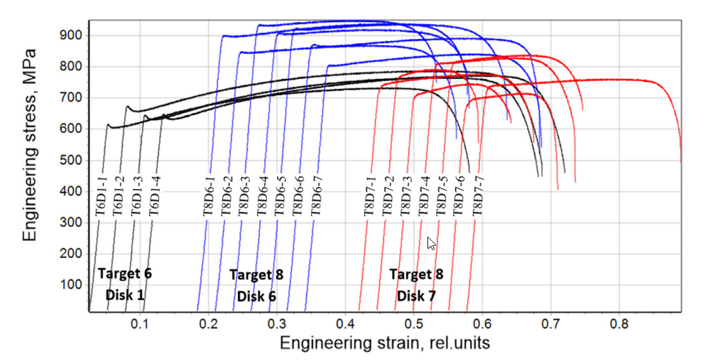
Edge cooling with 718SA affords higher level of performance and compression in tungsten after HIP
2.5-9.7 DPA
0-7.6 DPA
McClintock et. Al. “Observations of radiation-enhanced ductility in irradiated Inconel 718: Tensile properties, deformation behavior, and microstructure” Acta Materialia 231 (2022)
McClintock et. Al. “Characterization of mechanical properties and deformation behavior of highly irradiated 316L stainless steel from target modules at the Spallation Neutron Source using digital image correlation analysis” J. Nuclear Materials, 545 (2021)
12.8x10⁻⁶/°C
16x10⁻⁶/°C
4.5x10⁻⁶/°C

Slide 15
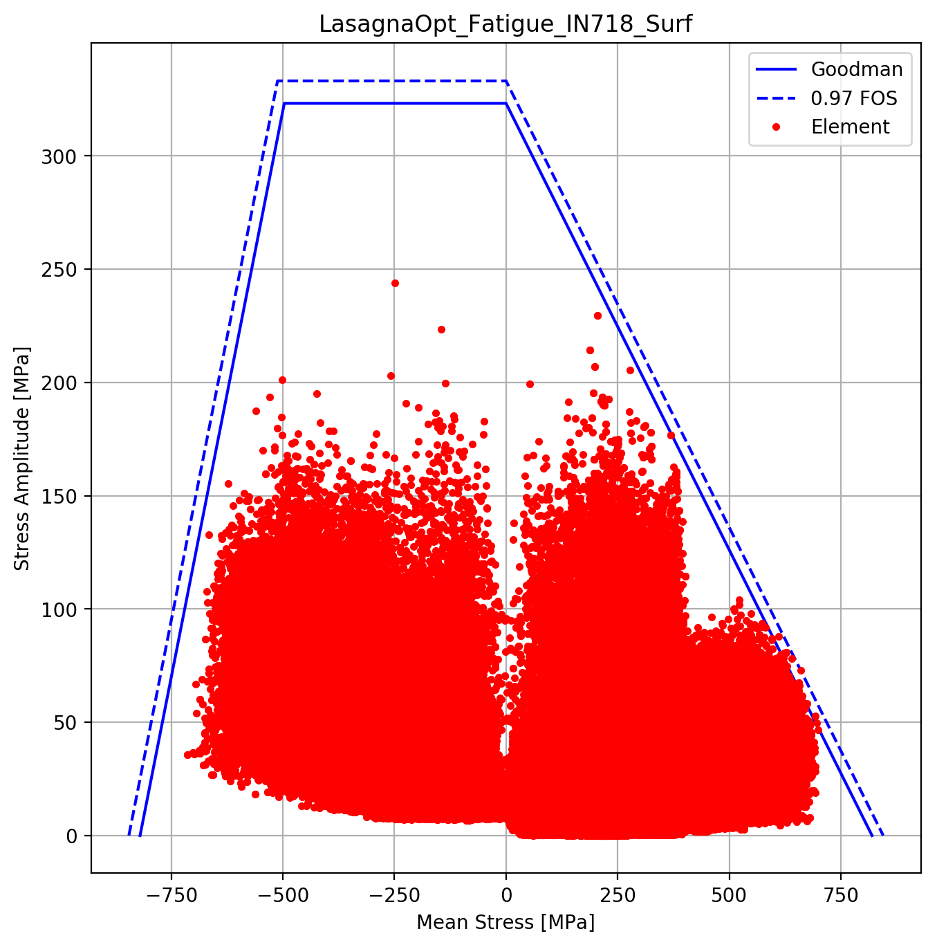
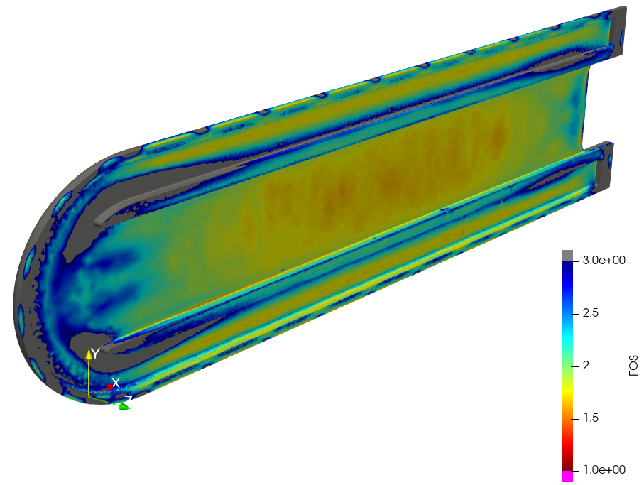
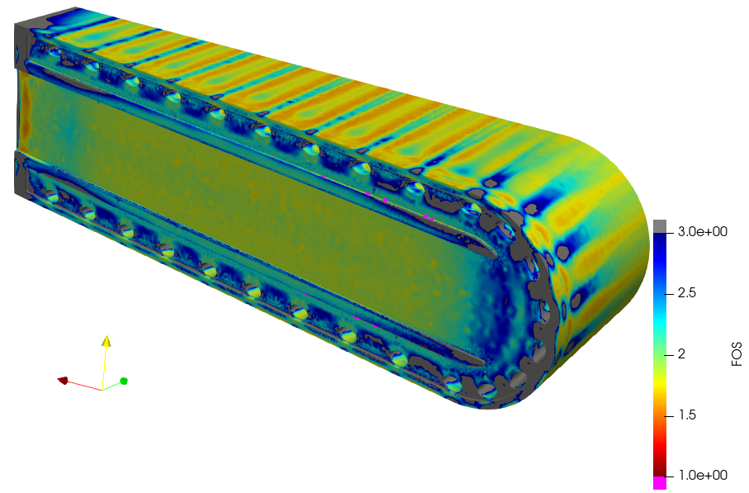
HIP bonding and edge cooling produce acceptable fatigue lives for tungsten and Inconel
Reference Talk by Dr. Joseph Tipton

Slide 16
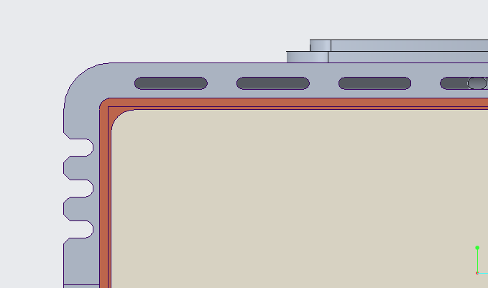

Edge cooling manages failures that occur from dynamic pulses

Slide 17
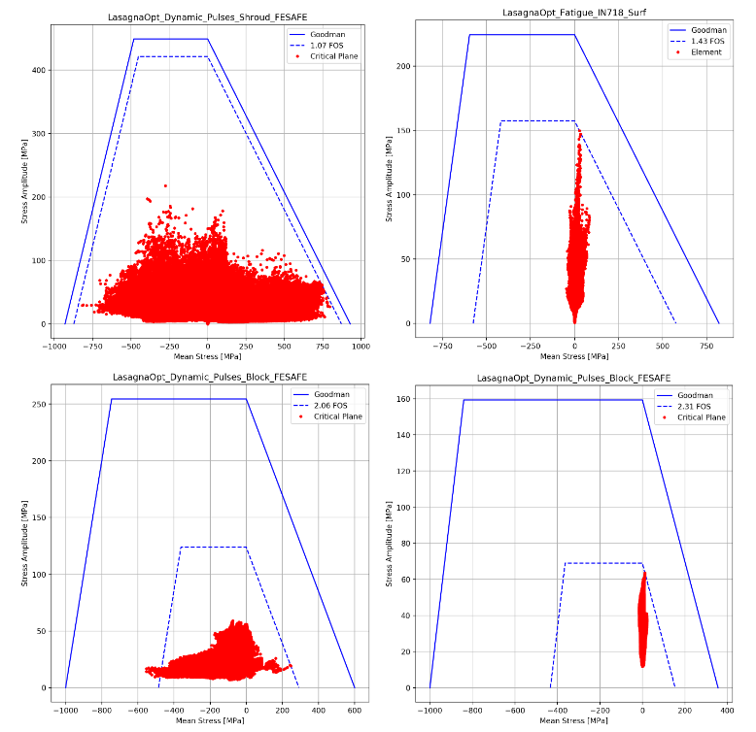
Edge cooling manages failures that occur from dynamic pulses

Slide 18
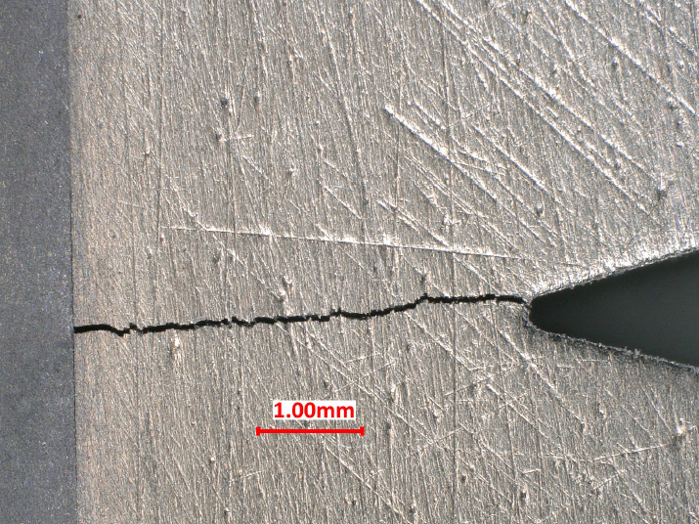
Edge cooling manages failures that occur from dynamic pulses
Ta
W

Slide 19
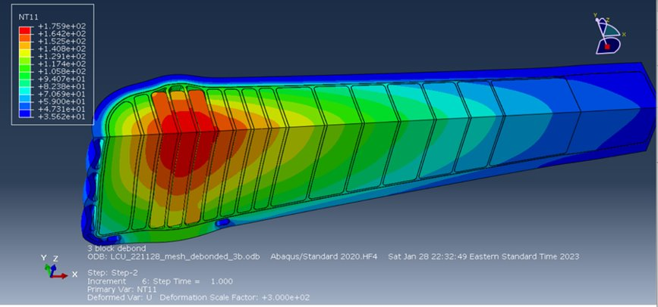
Edge cooling manages failures that occur from dynamic pulses

Slide 20
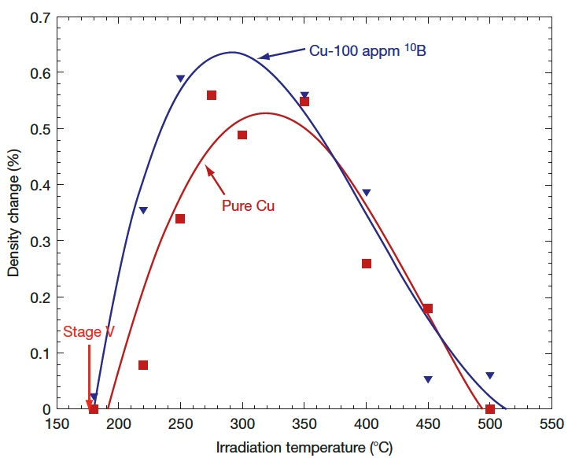
Edge cooling manages failures that occur from dynamic pulses
Li M. and Zinkle S.J. (2012) Physical and Mechanical Properties of Copper and Copper Alloys. In: Konings R.J.M., (ed.) Comprehensive Nuclear Materials, volume 4, pp. 667-690 Amsterdam: Elsevier.

Slide 21

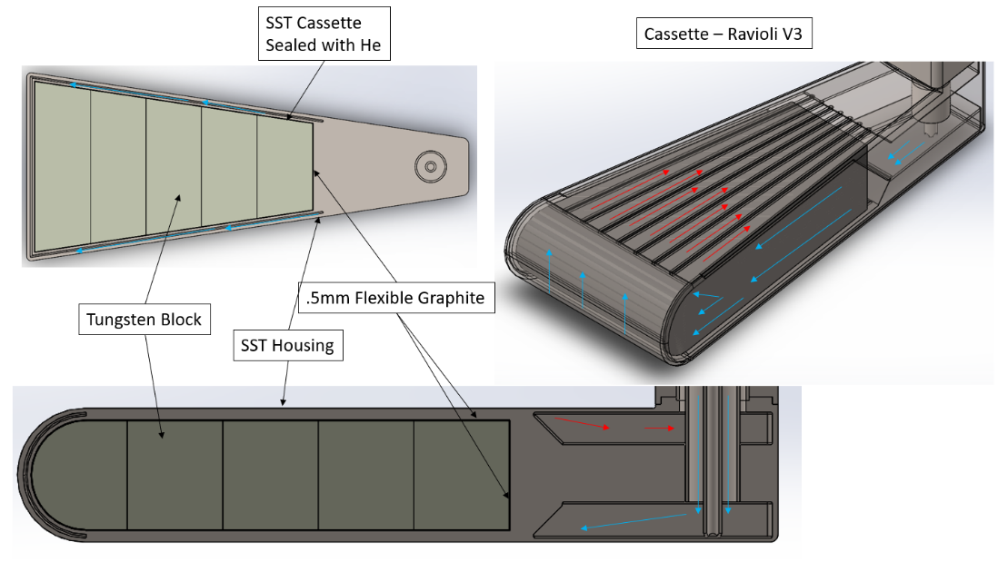
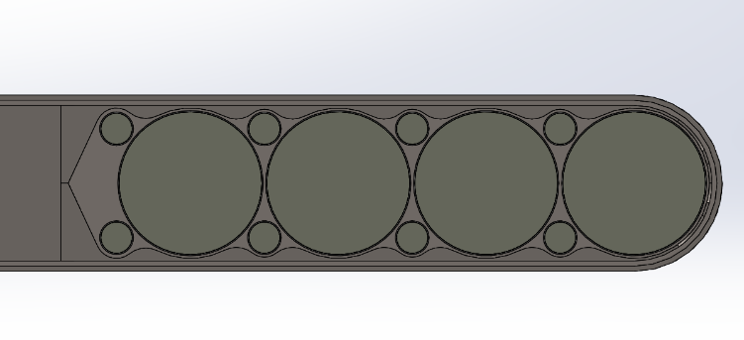
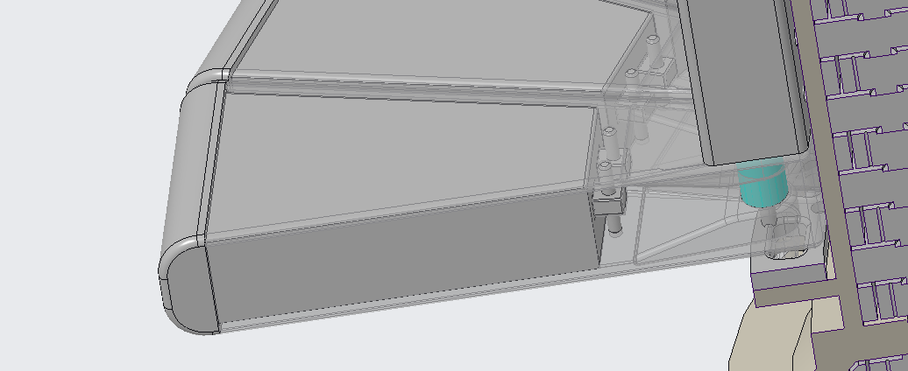
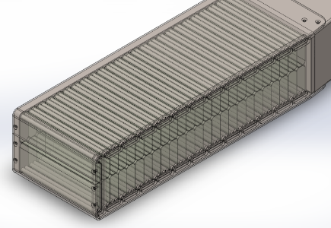
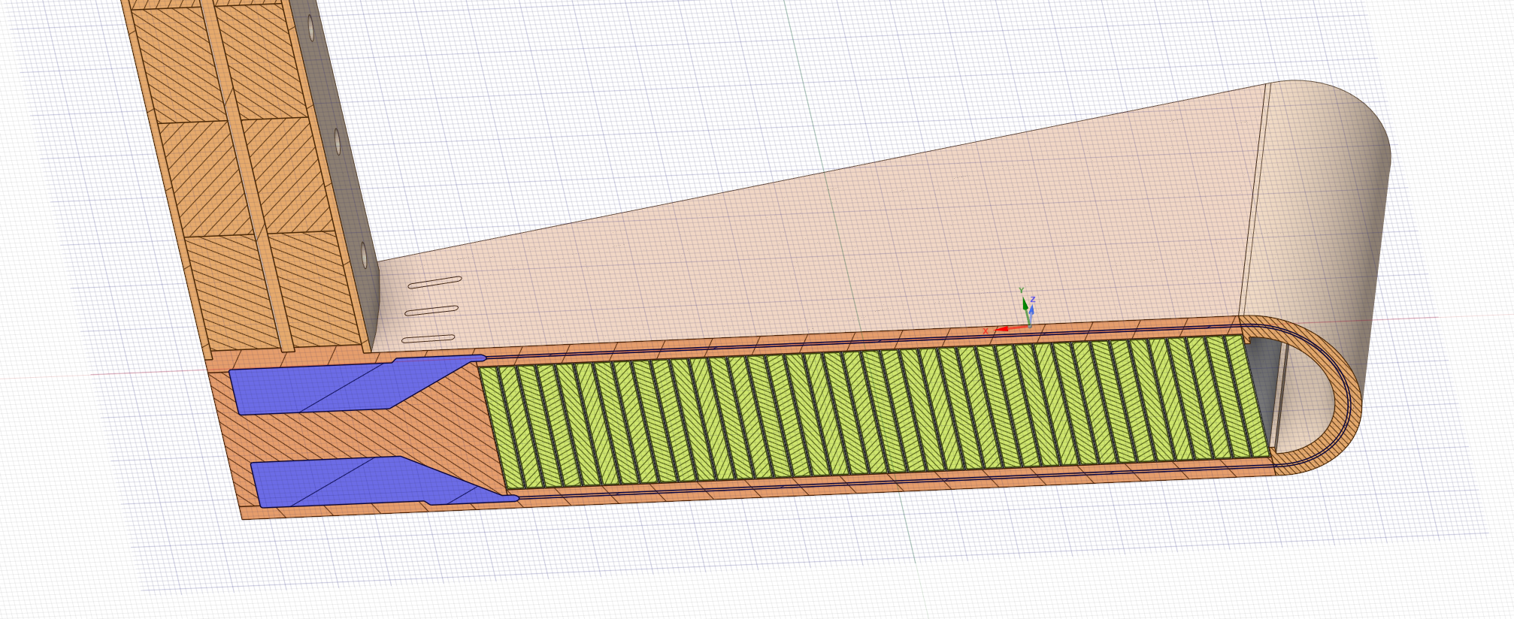
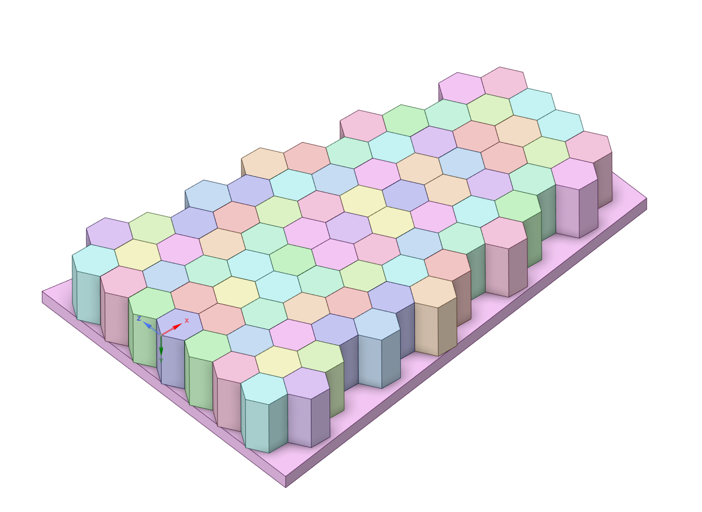
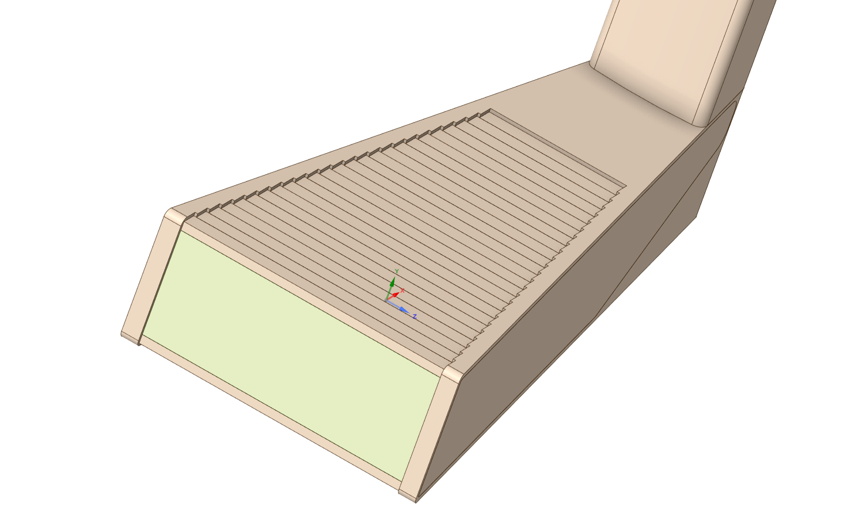
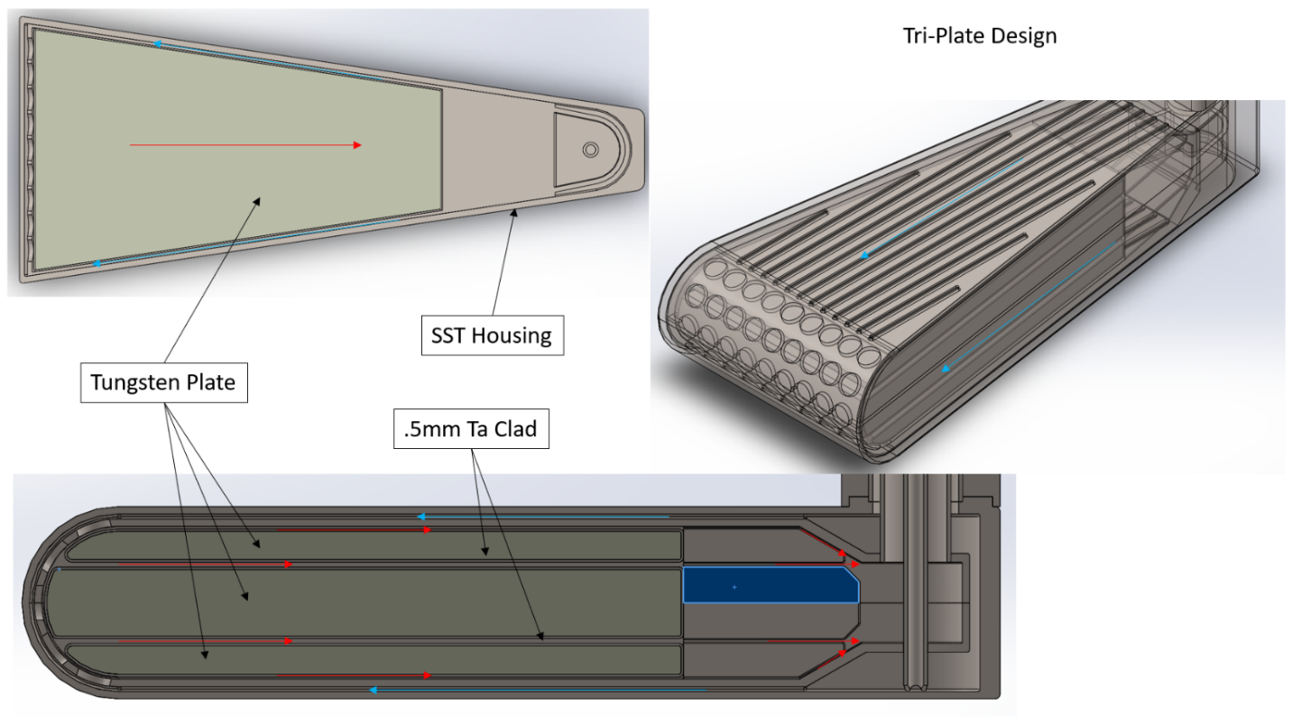
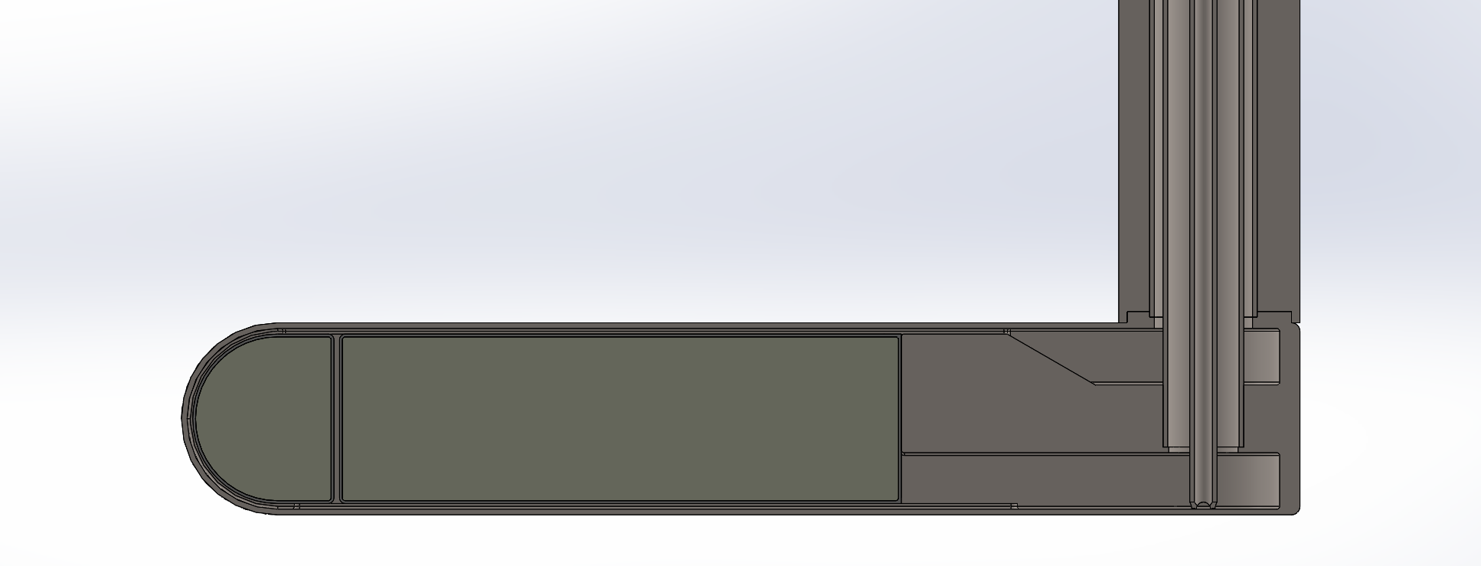
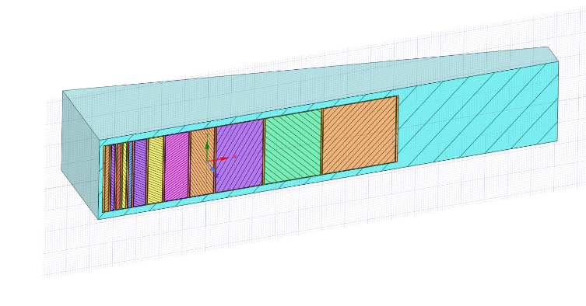
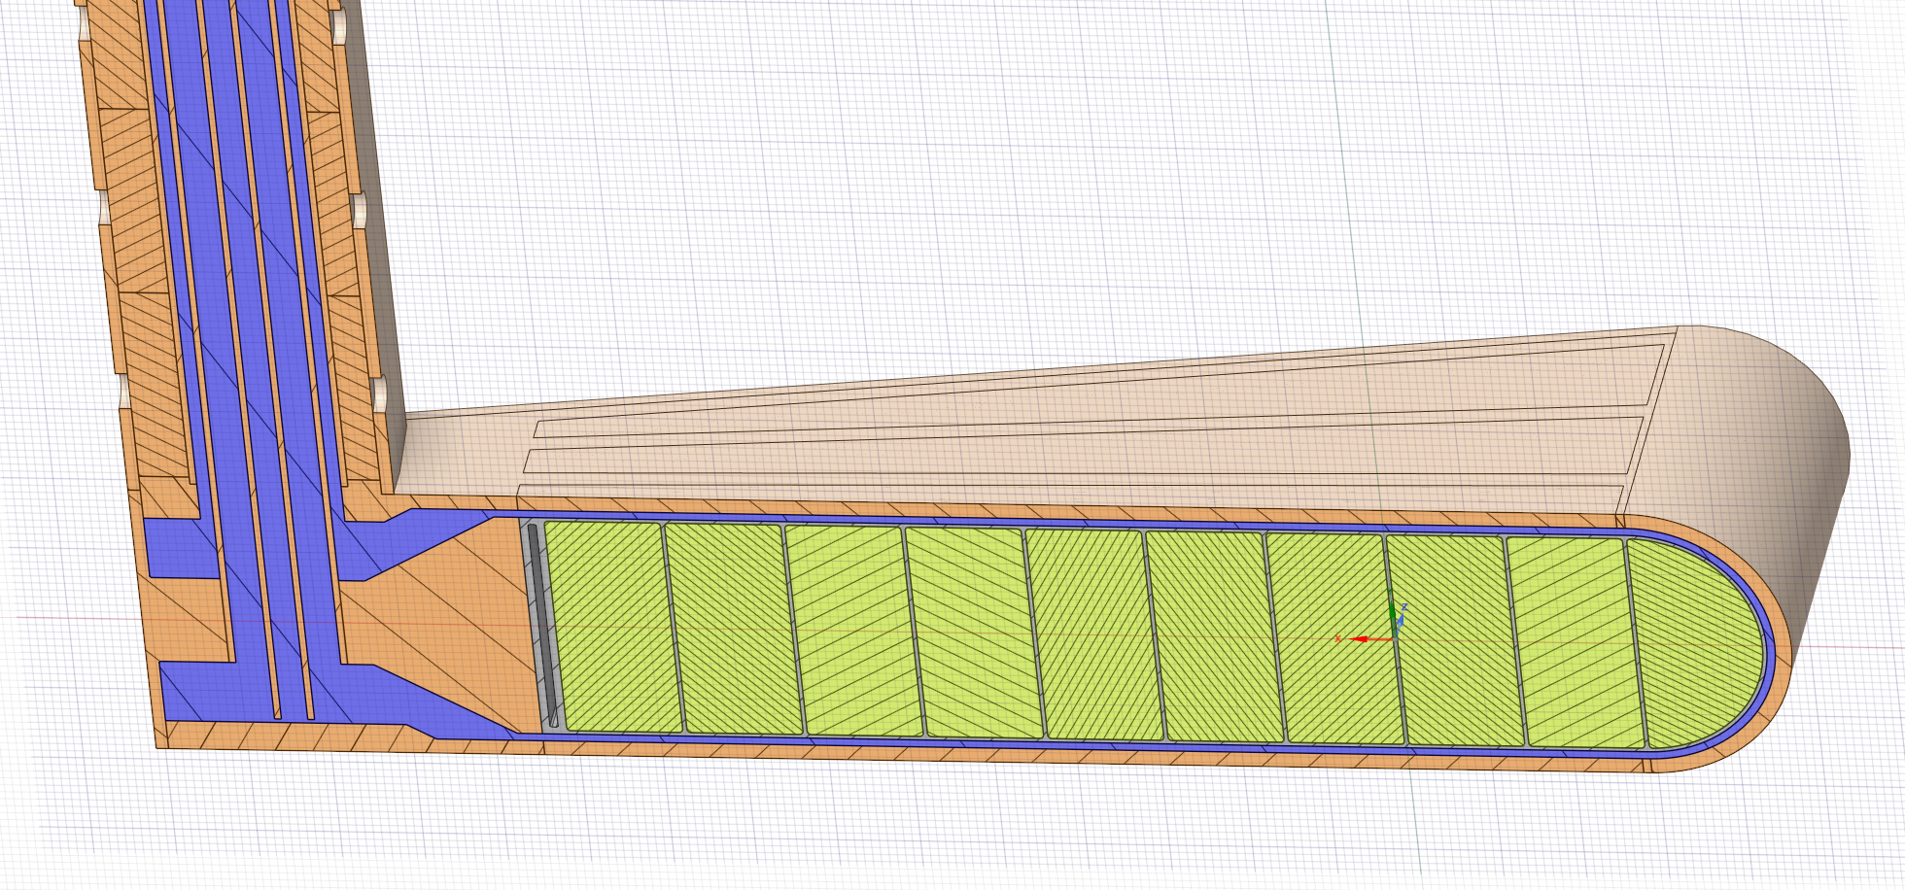
The modular segmented approach permits the STS to upgrade targets as beam power increases
ΔT=10°C
3x/yr

Slide 22
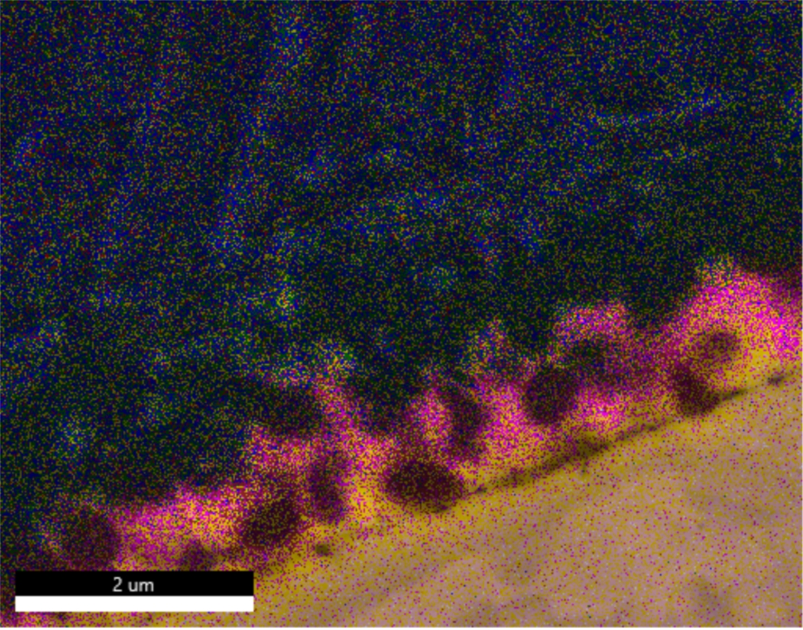
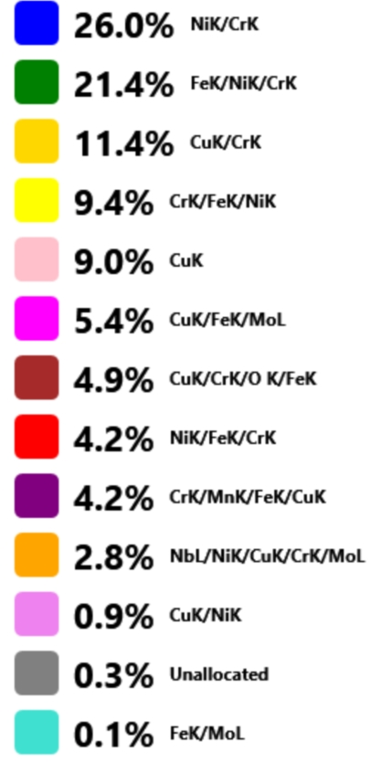
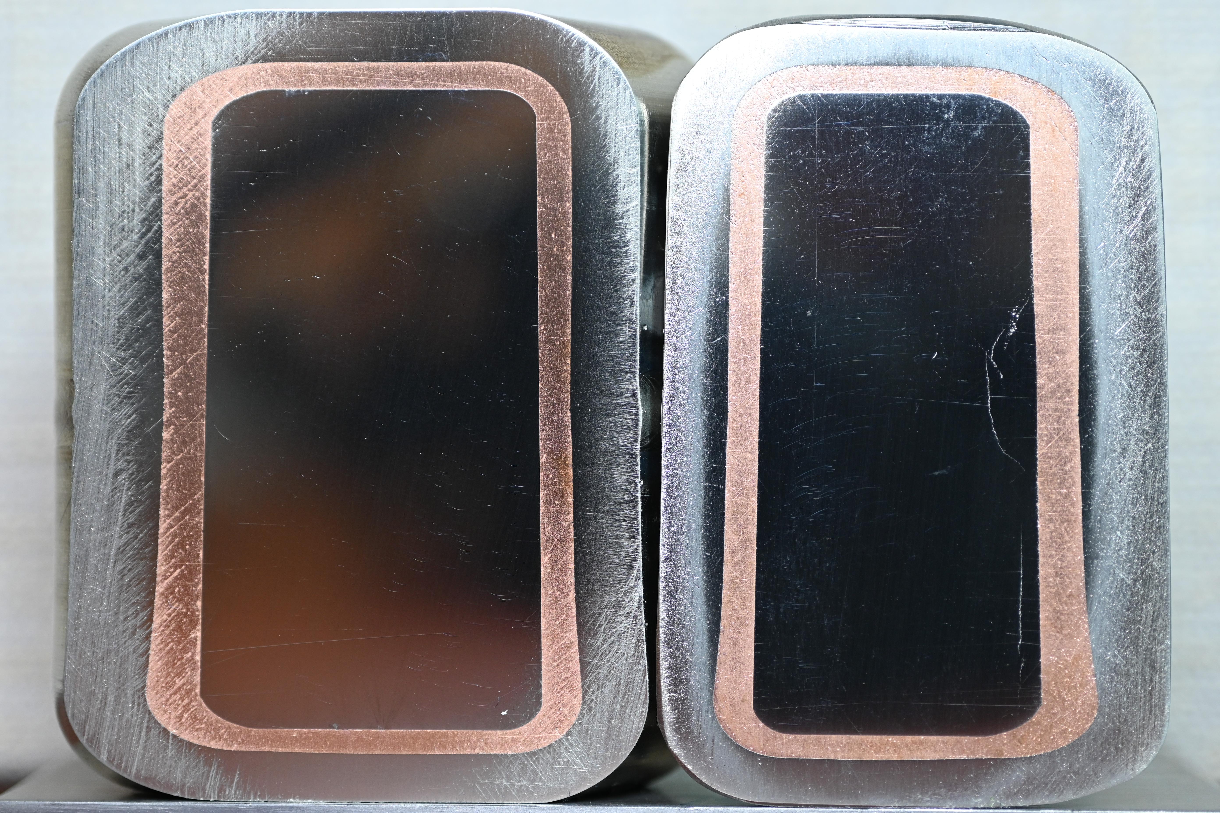
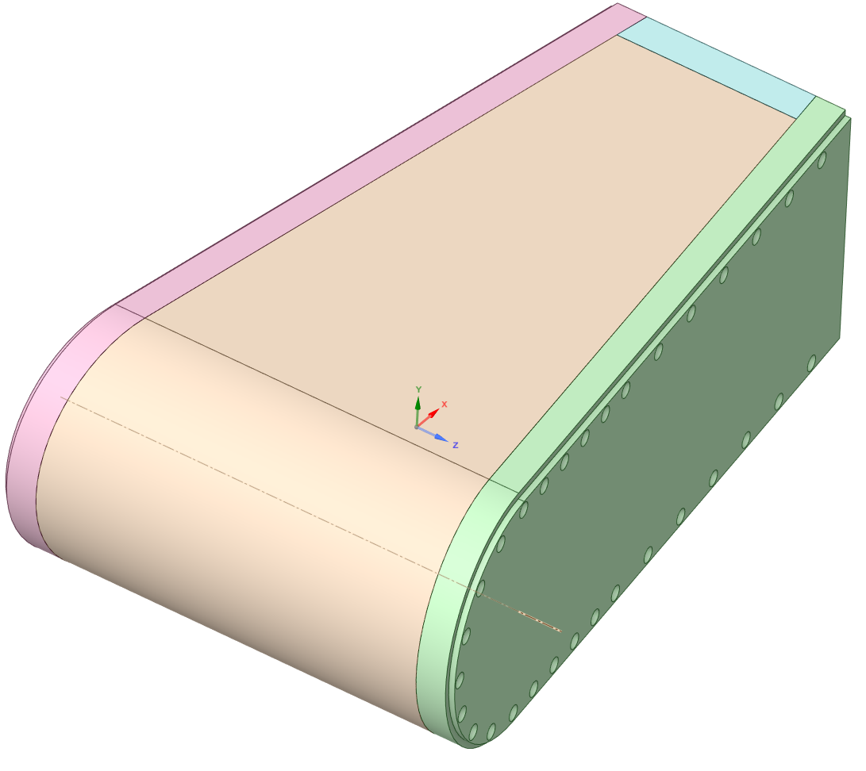
The design has fabrication uncertainty that is currently being retired
Reference Talk by Dr. Justin Mach (next)

Slide 23
When should an edge cooled target be considered?
High Energy Pulse
Reduced power
Pulse Energy
Power
Reliability
Brightness
NFL-0053-2DC-6N

