Slide 1
Applying a Pressure System Safety Code to Spallation Target Design
IWSMT-16
29 October 2024
Joseph B. Tipton, Jr. & Justin Mach
Second Target Station (STS) Project
Notes:
Image - 2021-P09584: Aerial overview of the Spallation Neutron Source, SNS, and the future location for the SNS Second Target Station, September 30, 2021. This image has been reviewed by an ORNL Releasing Official and is approved for public release, September 26, 2022.

Slide 2
Agenda: This talk shows the challenges of applying the ASME BPVC and ways it has focused design efforts
To the Code, the HIPed target is like one giant weld
Code fatigue curves bake-in mean stress & margins
Philosophical questions for consideration
Can’t use a factored load methodology due to rotating loads
Good final design means simulating manufacturing stresses

Slide 3
Philosophical question: Is it even a pressure vessel since it can run to failure and is replaceable?

Slide 4
Philosophical question: Is it even a pressure vessel since it can run to failure and is replaceable?
Target segment is below ASME/BPVC volume minimums

Slide 5
Philosophical question: Is it even a pressure vessel since it can run to failure and is replaceable?
Target segment is below ASME/BPVC volume minimums
PHAR/SAD/ASE process required by DOE O 420.2 ensures a level of safety greater than the protection afforded by the ASME/BPVC

Slide 6
Philosophical question: Is it even a pressure vessel since it can run to failure and is replaceable?
Target segment is below ASME/BPVC volume minimums
PHAR/SAD/ASE process required by DOE O 420.2 ensures a level of safety greater than the protection afforded by the ASME/BPVC
Structural failure of the target segment would not present a safety hazard.

Slide 7
Philosophical question: Is it even a pressure vessel since it can run to failure and is replaceable?
Target segment is below ASME/BPVC volume minimums
PHAR/SAD/ASE process required by DOE O 420.2 ensures a level of safety greater than the protection afforded by the ASME/BPVC
Structural failure of the target segment would not present a safety hazard.
Pressure safety and worker safety are provided through the core vessel.

Slide 8
Philosophical question: Is it even a pressure vessel since it can run to failure and is replaceable?
Target segment is below ASME/BPVC volume minimums
PHAR/SAD/ASE process required by DOE O 420.2 ensures a level of safety greater than the protection afforded by the ASME/BPVC
Structural failure of the target segment would not present a safety hazard.
Pressure safety and worker safety are provided through the core vessel.
Akin to B31.3 concept of safeguarding through “barricades or shields”

Slide 9
Philosophical question: Is it even a pressure vessel since it can run to failure and is replaceable?
Target segment is below ASME/BPVC volume minimums
PHAR/SAD/ASE process required by DOE O 420.2 ensures a level of safety greater than the protection afforded by the ASME/BPVC
Structural failure of the target segment would not present a safety hazard.
Pressure safety and worker safety are provided through the core vessel.
Akin to B31.3 concept of safeguarding through “barricades or shields”

Slide 10
Target design relies on HIP that imparts significant residual stresses. It’s as if the entire target foot is a weld.

Slide 11
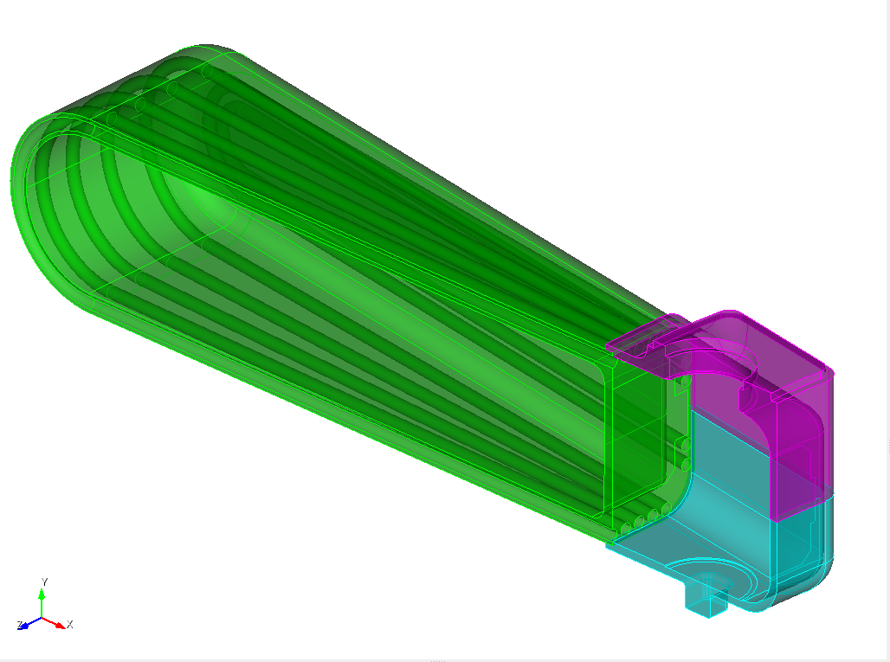
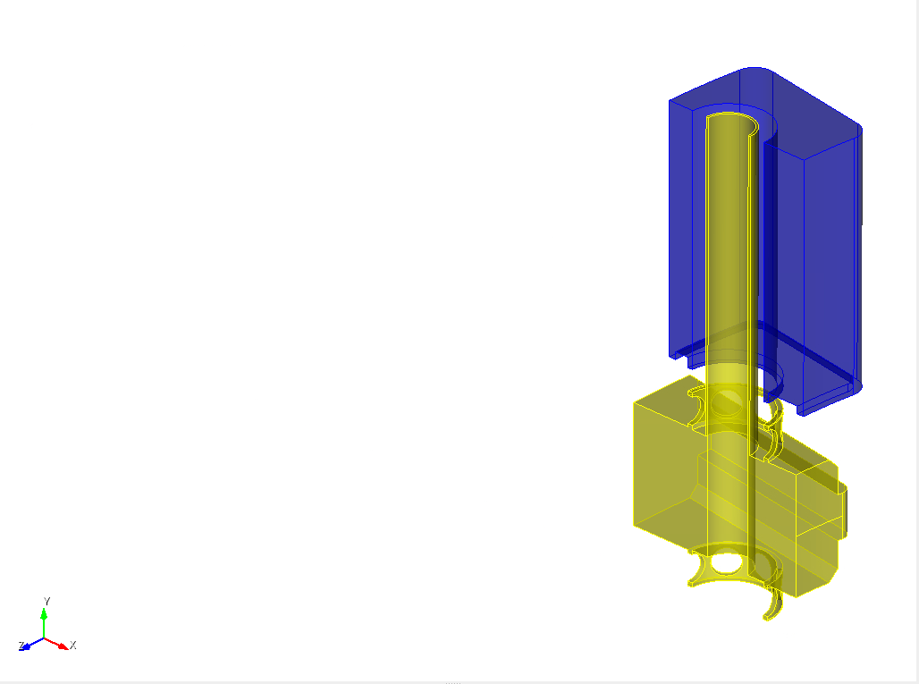
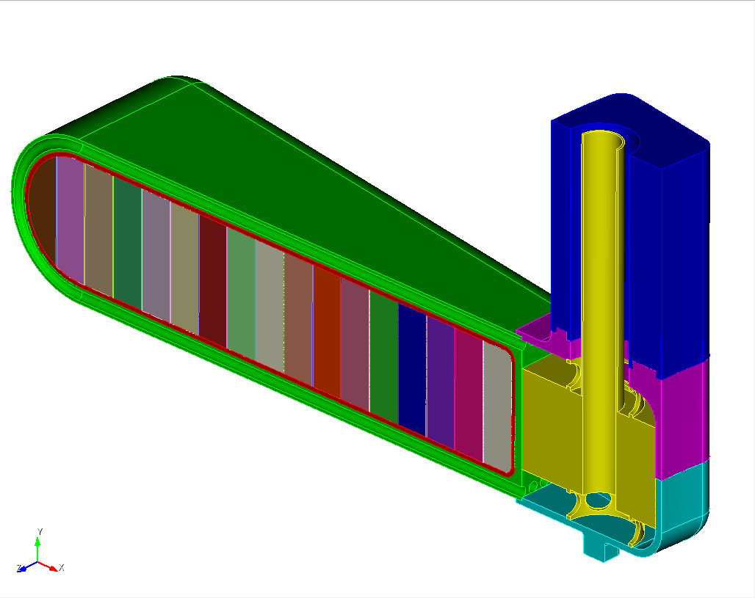
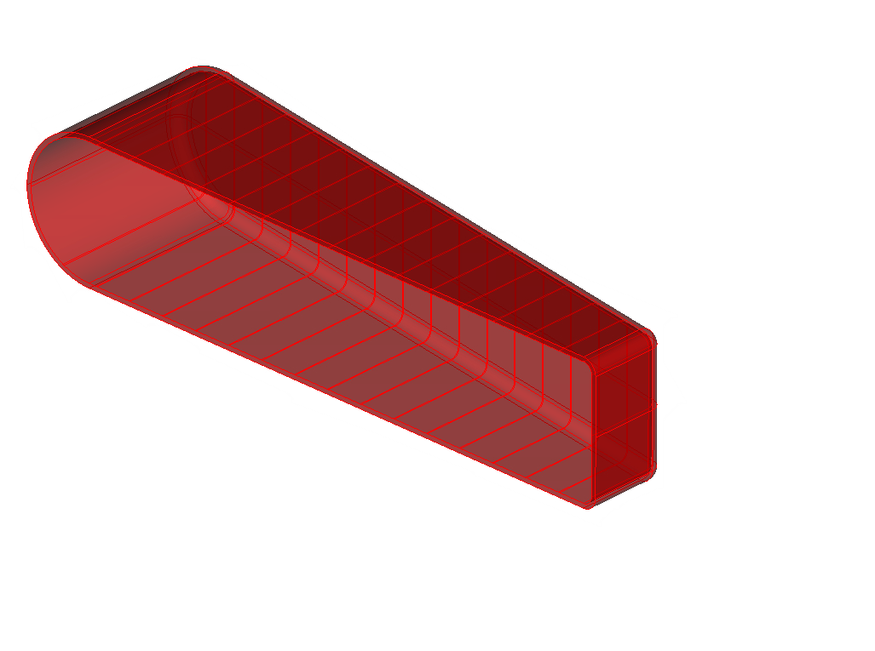
Target design relies on HIP that imparts significant residual stresses. It’s as if the entire target foot is a weld.
Coolant
Inconel Shroud
Stainless Steel Heel
Cu Clad
Target Leg
W
Ta
Target
Foot

Slide 12
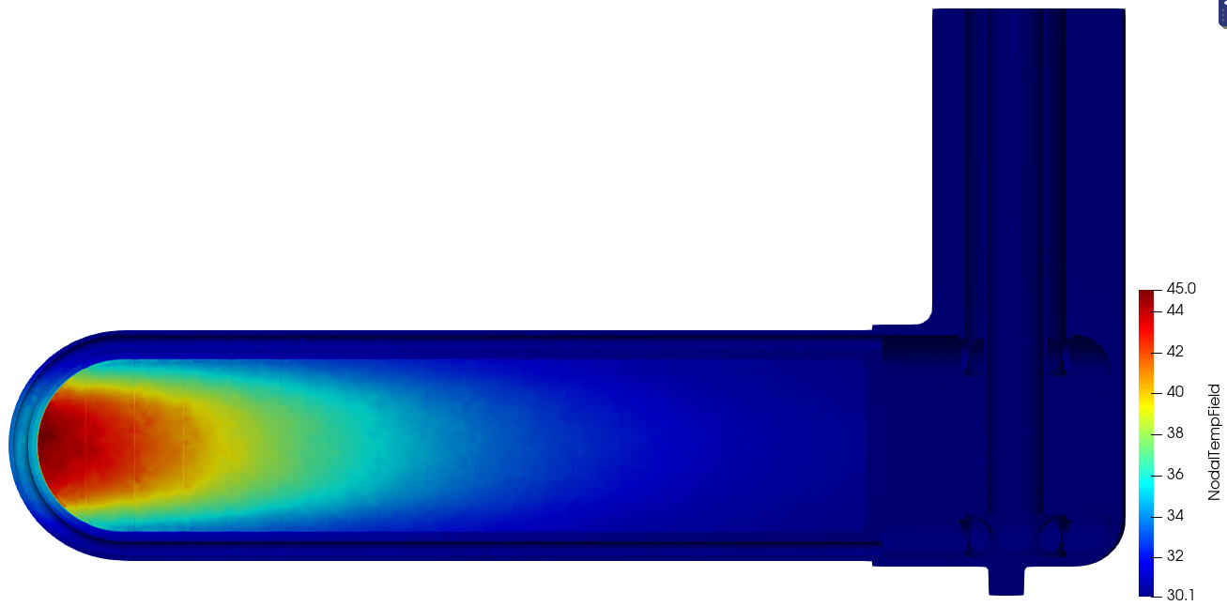
Target design relies on HIP that imparts significant residual stresses. It’s as if the entire target foot is a weld.
Shift x = -0.75mm
T = 700°C
T = 30°C
Beginning-of-Life (BOL) Fatigue Analysis Methodology
T = 30°C;
(then Water Pressure )
T = 30°C + PulseΔT

Slide 13
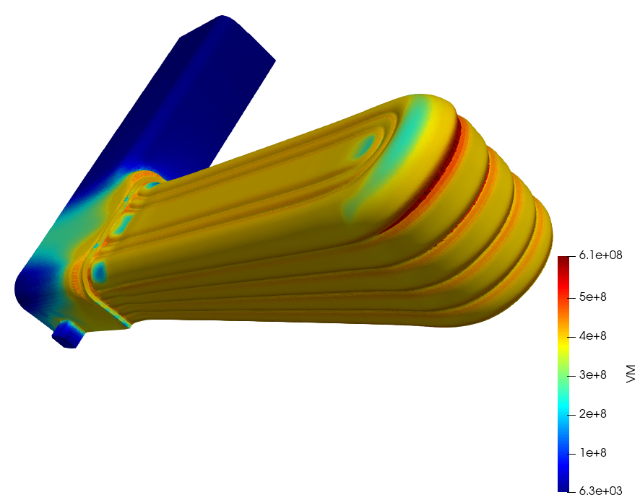
Target design relies on HIP that imparts significant residual stresses. It’s as if the entire target foot is a weld.
Shift x = -0.75mm
Manufacturing Residual Stresses
T = 700°C
T = 30°C
T = 30°C

Slide 14
Rotating loads create unforeseen problems with elastic-plastic static analysis.

Slide 15
Rotating loads create unforeseen problems with elastic-plastic static analysis.
ASME BPVC.VIII.2 Part 5 “Design by Analysis”
Stress categorization
Stress linearization for singularities
Elastic-Plastic Method
Thermoelastic-plastic curves with hardening
Load & Resistance Factor Design (LRFD)
Convergence = Acceptance
Elastic Method

Slide 16
Rotating loads create unforeseen problems with elastic-plastic static analysis.
ASME BPVC.VIII.2 Part 5 “Design by Analysis”
Stress categorization
Stress linearization for singularities
Elastic-Plastic Method
Thermoelastic-plastic curves with hardening
Load & Resistance Factor Design (LRFD)
Convergence = Acceptance
Elastic Method
$$1.13βL=2.7L=2.7(45 \text{rpm})$$

Slide 17
Rotating loads create unforeseen problems with elastic-plastic static analysis.
ASME BPVC.VIII.2 Part 5 “Design by Analysis”
Elastic Method
Stress categorization
Stress linearization for singularities
Limit-Load Method
Elastic-Plastic Method
Thermoelastic-plastic curves with hardening
Load & Resistance Factor Design (LRFD)
Convergence = Acceptance
$$1.13βL=2.7L=2.7(45 \text{rpm})$$

Slide 18
Code fatigue curves bake-in mean stress and stress margins.

Slide 19
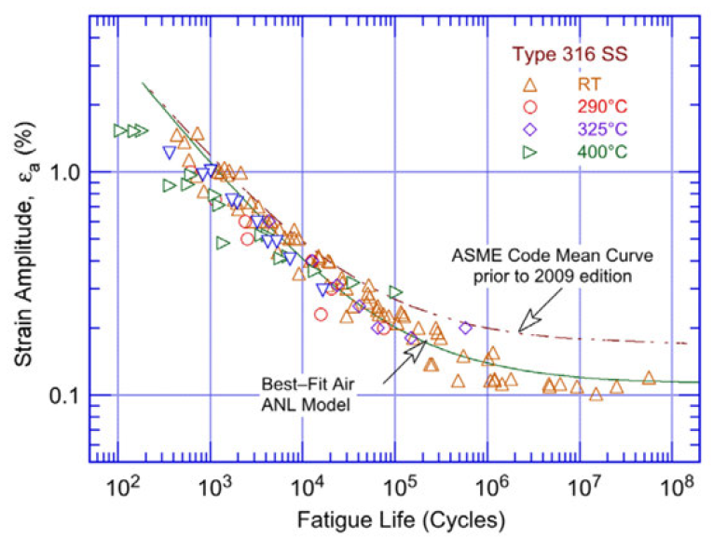
Code fatigue curves bake-in mean stress and stress margins.
Start with SN curve fit to data
NUREG/CR–6909

Slide 20
Code fatigue curves bake-in mean stress and stress margins.
Start with SN curve fit to data
NUREG/CR–6909
Adjust curve down to include max possible mean stress (no hardening)
$$S_{y}$$
$$S_{N}$$
Alternating Stress
$$S_{y}$$
$$S_{u}$$
Mean Stress

Slide 21
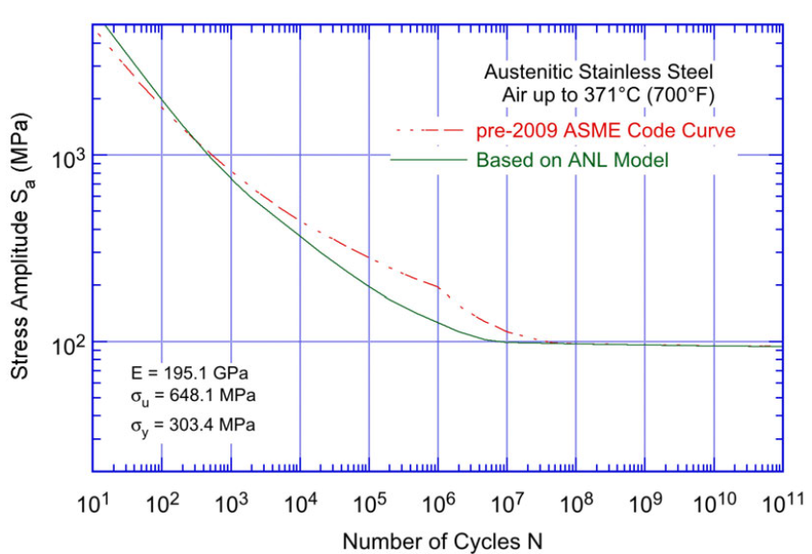
Code fatigue curves bake-in mean stress and stress margins.
Start with SN curve fit to data
NUREG/CR–6909
Adjust curve down to include max possible mean stress (no hardening)
$$S_{y}$$
Add margin as worst of x12 cycles or x2 stress
$$S_{N}$$
Alternating Stress
NUREG/CR–6909
$$S_{y}$$
$$S_{u}$$
Mean Stress

Slide 22
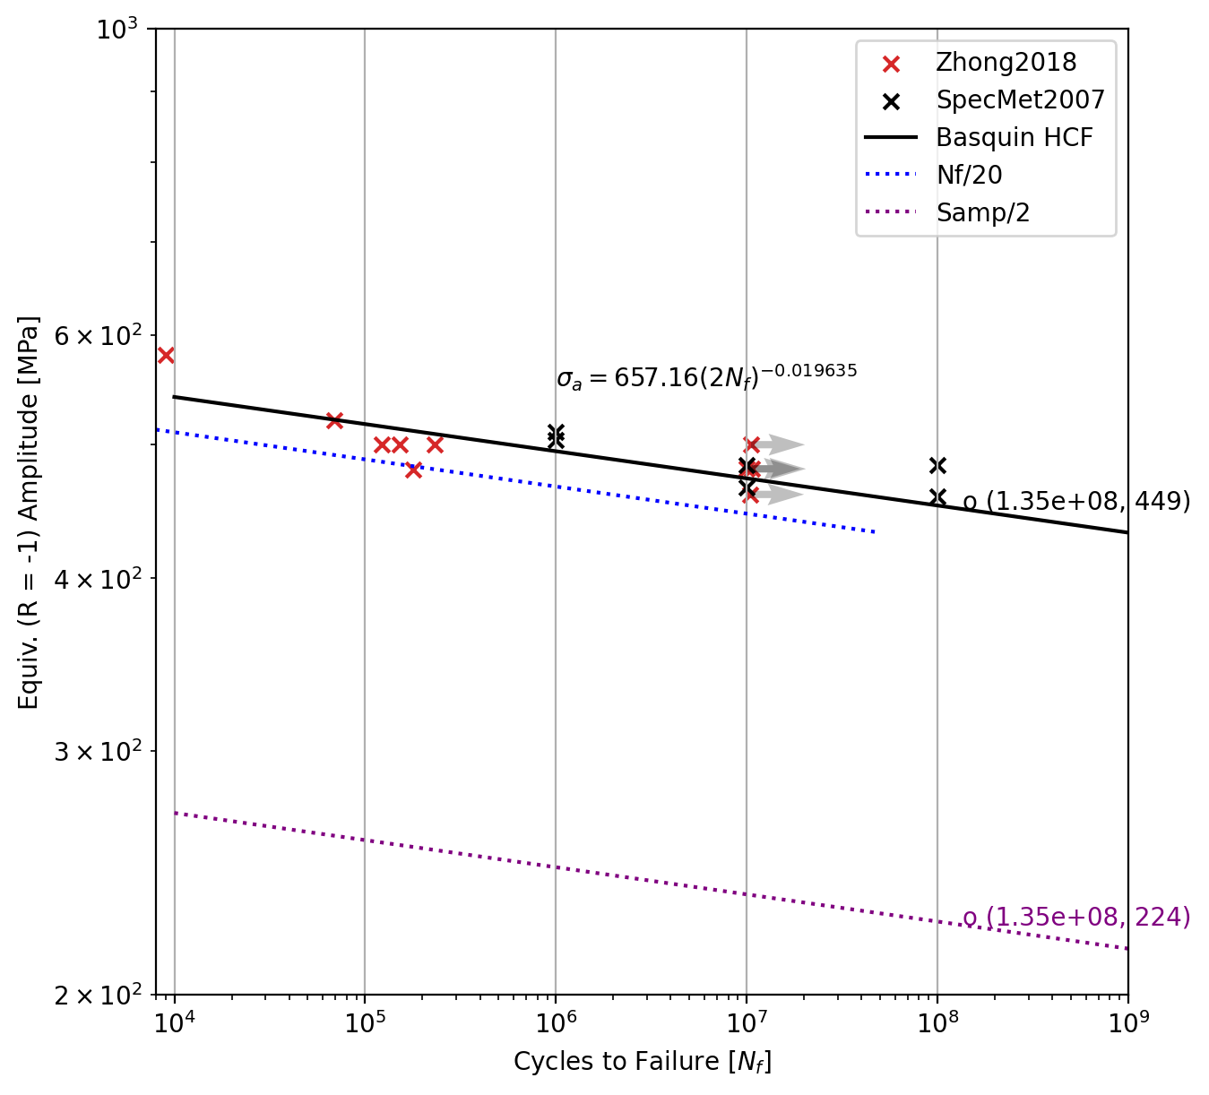
Code fatigue curves bake-in mean stress and stress margins.
Inconel 718 (Solution Annealed)

Slide 23
Code fatigue curves bake-in mean stress and stress margins.
Inconel 718 (Solution Annealed)
"These ASME curves are not useful for predicting the cycle life of equipment. They are used to specify a permissible design life which includes a large factor of safety.“
https://www.pveng.com/origins-of-the-asme-fatigue-life-curves-post/

Slide 24
Code fatigue curves bake-in mean stress and stress margins. Instead we utilize…

Slide 25
Code fatigue curves bake-in mean stress and stress margins. Instead we utilize…
Nominal S-N Curves
SS316L nominal curve
IN718(SA) with grain size

Slide 26
Code fatigue curves bake-in mean stress and stress margins. Instead we utilize…
Nominal S-N Curves
SS316L nominal curve
IN718(SA) with grain size
High Fidelity FEA
Manufacturing (HIP, machining, welding)
Start-up (pressure, quasi-steady state)
Pulse & Response

Slide 27
Code fatigue curves bake-in mean stress and stress margins. Instead we utilize…
Nominal S-N Curves
SS316L nominal curve
IN718(SA) with grain size
High Fidelity FEA
Manufacturing (HIP, machining, welding)
Start-up (pressure, quasi-steady state)
FEA Fatigue
Critical Plane Theory
Ductile/Brittle Fatigue Models
Pulse & Response
Goodman Mean Stress Correction

Slide 28
Code fatigue curves bake-in mean stress and stress margins. Instead we utilize…
Nominal S-N Curves
SS316L nominal curve
IN718(SA) with grain size
High Fidelity FEA
Manufacturing (HIP, machining, welding)
Start-up (pressure, quasi-steady state)
FEA Fatigue
Critical Plane Theory
Ductile/Brittle Fatigue Models
Pulse & Response
Goodman Mean Stress Correction
FFOS (Fatigue Factor-of-Safety)

Slide 29
Residual stresses drive the design performance. Final design simulations need HIP, machining, and welding fidelity.

Slide 30
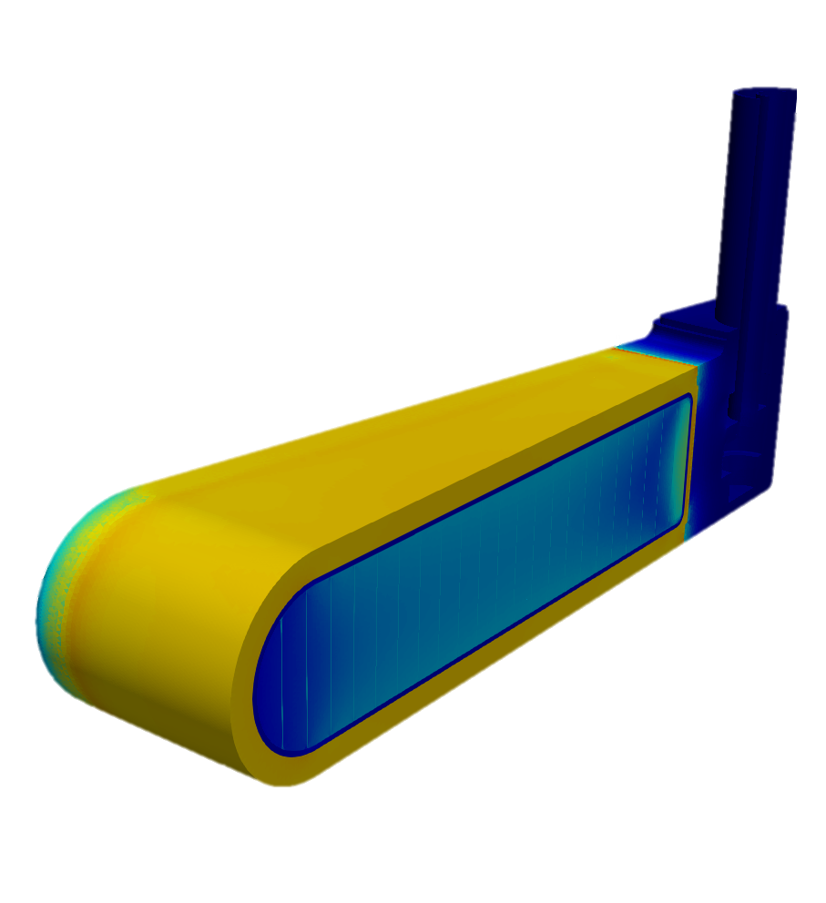
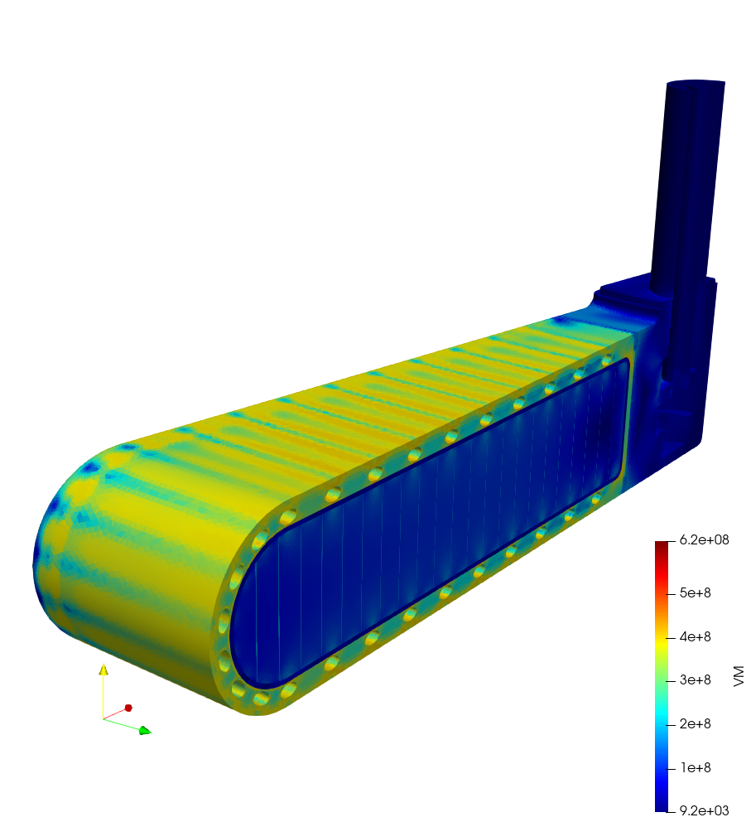
Residual stresses drive the design performance. Final design simulations need HIP, machining, and welding fidelity.
Solid shroud through HIP
Reduced stresses after cooling passage drilling

Slide 31
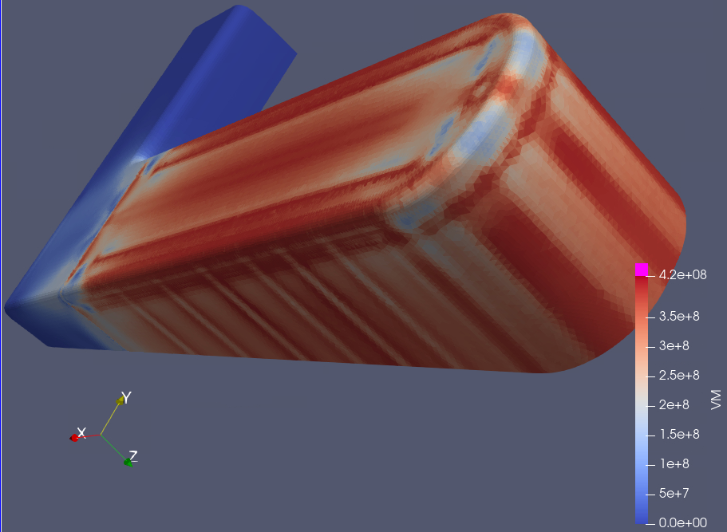
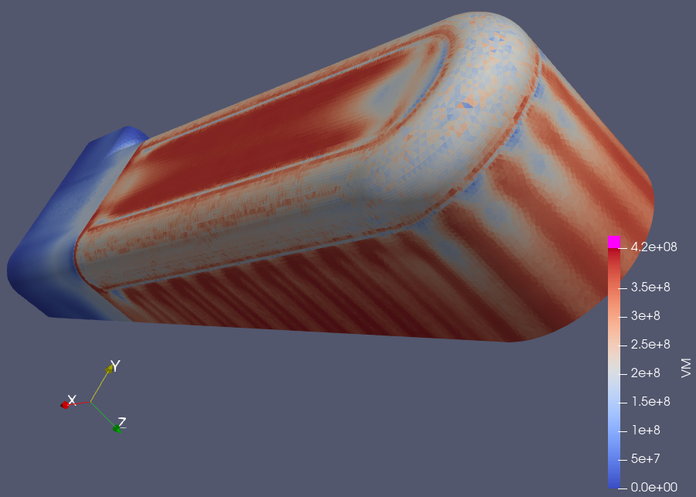
Residual stresses drive the design performance. Final design simulations need HIP, machining, and welding fidelity.
Solid shroud through HIP
Permanent Cover – High Stresses after HIP
Cover added after HIP & machining – Reduced Stresses
Reduced stresses after cooling passage drilling

Slide 32
Commercial pressure safety codes don’t fit spallation targets…

Slide 33
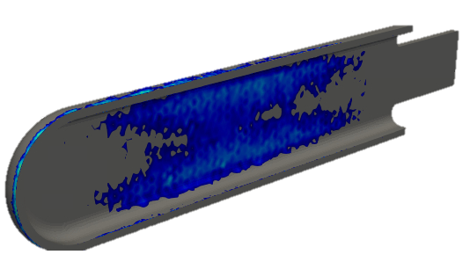
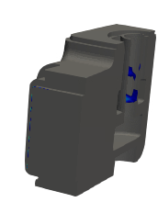
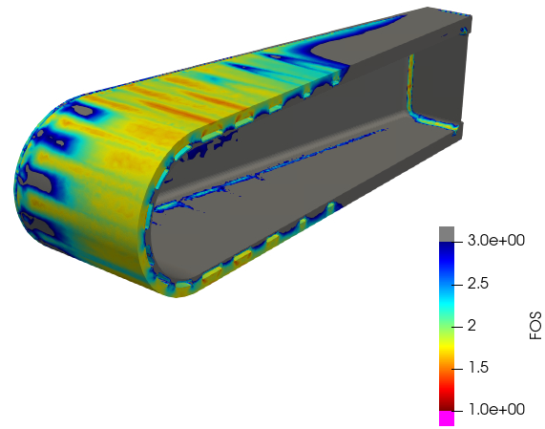
Commercial pressure safety codes don’t fit spallation targets…
…but they can guide good target design.

