Slide 1
Feasibility Study of Diffusion Bonding of Zirconium to Tungsten Using Vanadium Interlayer and Its Implication on Decay Heat Driven Power Limit of Water-Cooled W-Target
IWSMT-16, Oct 28-Nov 1, 2024, Abingdon, UK
Yong Joong Lee
Thomas Muth, Justin Mach, Joel Montross

Slide 2
Challenges with High Power Target Design
Thermomechanical: Would it keep its structural integrity upon increased beam power?
Neutron Production Efficiency: How to minimize the neutron production efficiency loss for complicated design features?
Radiation Damage: Would it sustain progressive radiation damage for an economically reasonable lifetime?
Decay Heat: Would it pose safety hazard concerns in loss of coolant accidents?
Manufacturability: How to address added complexities in design related to increased beam power?

Slide 3
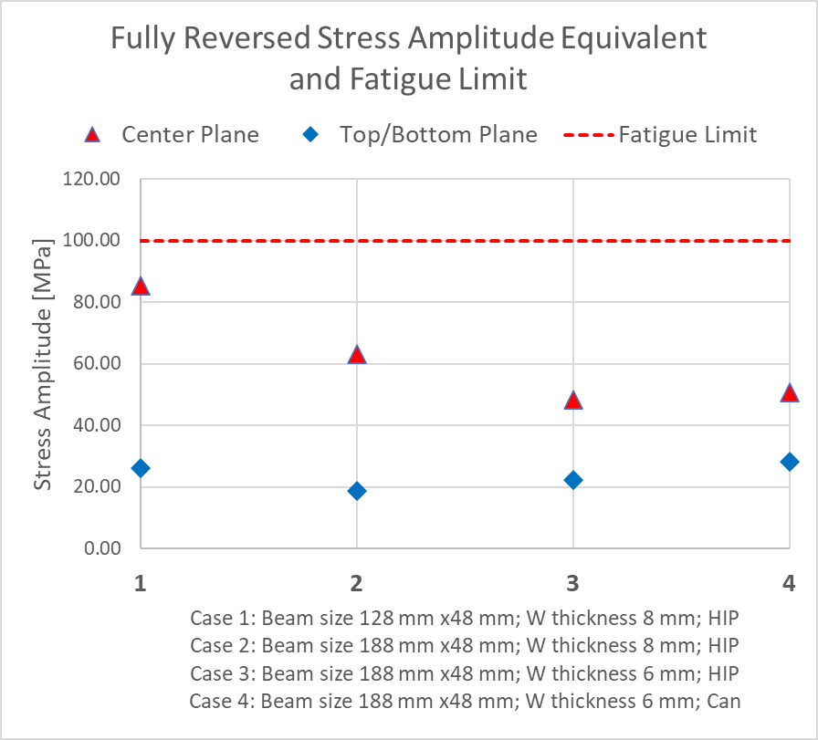
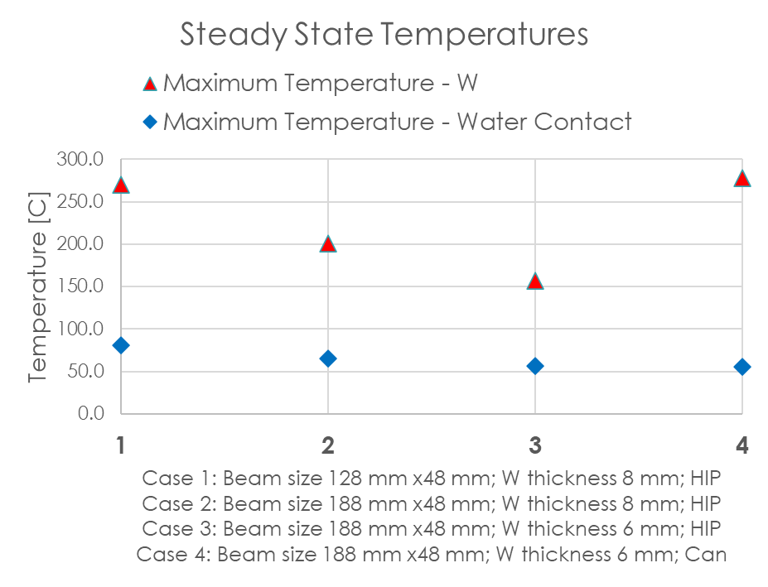
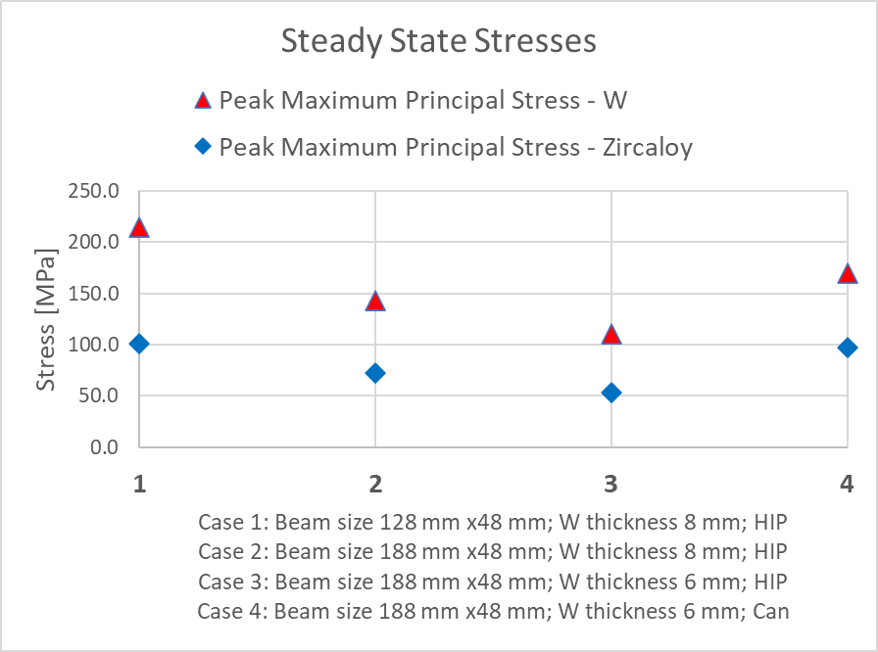
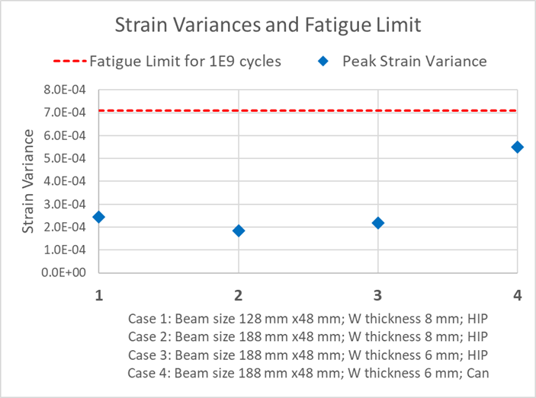
Keeping its structural integrity upon increased beam power
Methods to reduce temperature, thermal stress and fatigue loads
  Volume cooling
  Increasing beam footprint on target
  Increasing coolant flux to achieve higher wall heat transfer coefficient
  Downsizing coolant volume
  Rotating the target
Beam expansion
W thickness reduction
Canning
Beam expansion
Canning
W thickness reduction
Canning
Canning
Beam expansion
W thickness reduction
W thickness reduction
Beam expansion

Slide 4
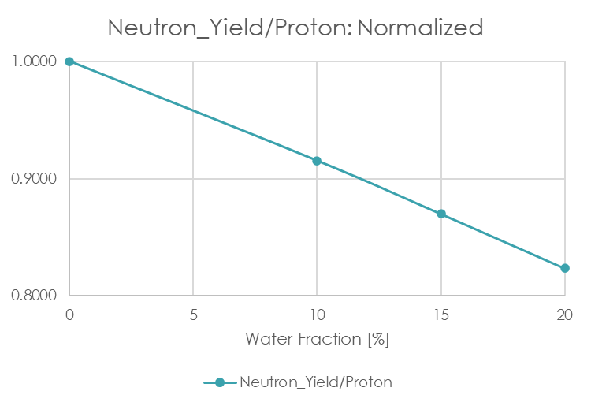
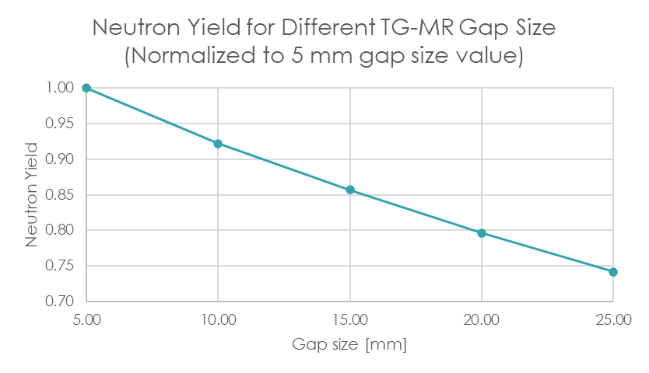
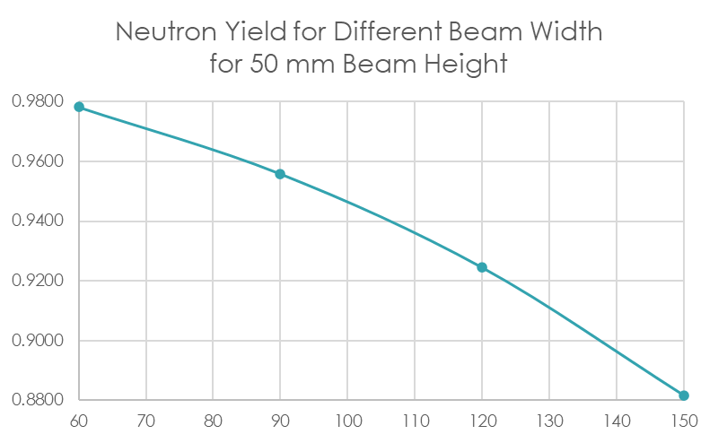
Neutron Production Efficiency
Volume cooling reduces the neutron yield
  High power target needs higher coolant volume fraction
Expanded beam reduces the neutron yield
  High power target needs low beam current density by expanding the beam on the target
Increased target-moderator gap reduces neutron yield
  Rotating target needs a larger gap tolerance between the target and moderator

Slide 5
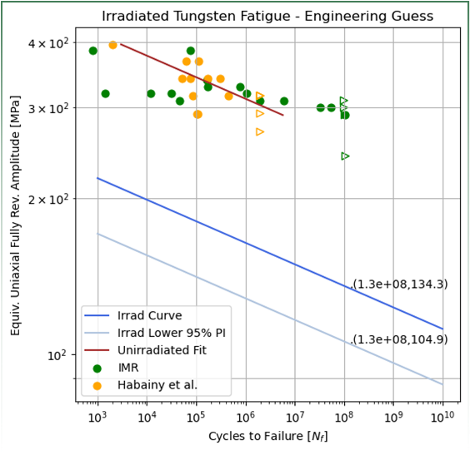
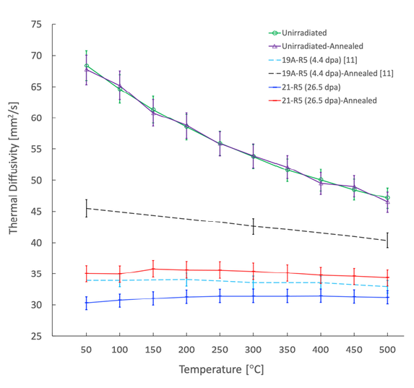
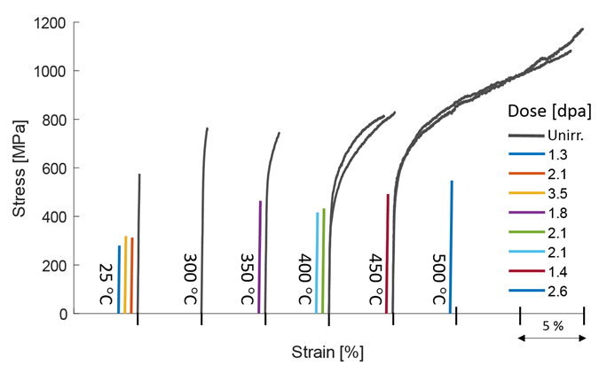
Radiation Damage - Tungsten
Radiation induced embrittlement: DBTT > 500 C - Proton irradiation with 575 MeV protons
Fatigue: Stochastic data points – No data available with radiation damage
Radiation induced thermal diffusivity decrease
J. Tipton
J. Habainy et al., JNM 514, 2019
H. Sina et al., JNM 601, 2024

Slide 6
Why Does Decay Heat Matter?
G. A. Greene and C. C. Finfrock,
Exp. Thermal and Fluid Sci. 25 (2001) 87-99
At above 800 C, W in steam forms a hydrated tungsten oxide with a high vapor pressure.
Readily evaporate posing risk of inhalation hazard of highly activated isotopes in tungsten
Decay heat increases with beam power
In a loss of coolant accident (LOCA), decay heat in tungsten can drive the W temperature above 800 C
Decay heat risk mitigation:
Increase the surface to volume ratio enabling more efficient passive cooling
Design with an improved heat transfer path enabling a better conduction, convection and radiative heat transfer
Adopt low activation cladding material.
However, whether 800 C should serve as absolute criterion can be disputed.

Slide 7
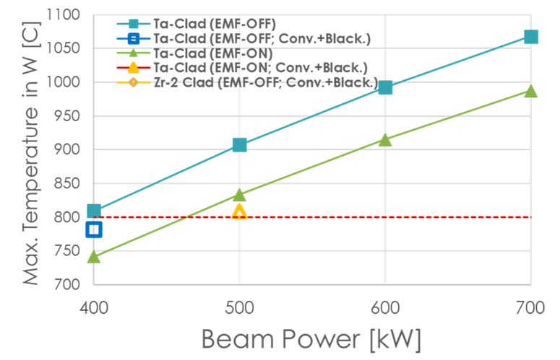
Beam Power Limit Constrained by Decay Heat
Decay heat prediction uncertainties
  Experimental Code Validation Study: L. Quintieri et al., J. of Neutron Res. 24 (2022)
  Comparative Code Verification Study: Finer resolution of resonance peaks in radiative capture cross sections result in reasonable agreement with ~10% uncertainty [Y. Lee and T. McClanahan, IPAC’24, 3833-3836]
Model Study: ISIS-TS1-Type Ta-clad (1 mm) target
  Assumption taken: Water cooled tungsten target
    D2O and He coolants could lower decay heat by 10-20%
  Maximum beam power limited by tungsten temperature in LOCA is 400 kW
Y. Lee, IPAC’24, 3841-3844

Slide 8
Pushing the Power Limit Beyond 400 kW - Low Activation Cladding Material
Application of low activation cladding material will push the power limit upward
  Decay heat in Ta volume accounts for a large fraction of the total
Which low activity material can replace tantalum?
  Operational records in spallation environment
  Radiation damage characteristics in spallation environment
  Manufacturability: Weldability and good diffusion bonding characteristics to tungsten
  Survivability and reasonable lifetime under intensive pulsed beam conditions

Slide 9
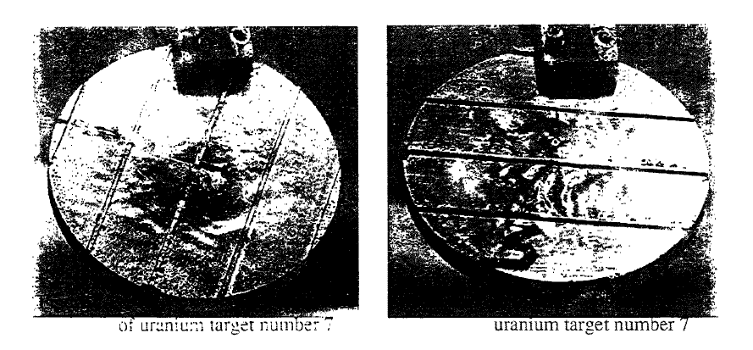
Zirconium Alloys – Operational Records
T. A. Broome, ICANS-XIII, 1995
Water-Cooled Zircaloy Clad Depleted Uranium Target
  IPNS@ANL (1981 – 2008)
    450 MeV; 30 Hz; 15 uA; 6.75 kW
  TS1@ISIS (1984 – 1992)
    800 MeV; 50 Hz; 120 uA; 96 kW
SINQ@PSI
  Solid Zircaloy Target (1996 – 1999)
  Water-Cooled Zircaloy Canned Lead Target (2009 – 2018)
  Hybrid Solid Zircaloy and Lead filled Zircaloy Tube Target
    575 MeV; Continuous Wave; 1700 uA; 1 MW
W. Wagner et al., HPTW, 2011

Slide 10
Zirconium Alloys – Radiation Damage
RCC-MRx Design Code – Zircaloy 4
  Maximum allowable irradiation is defined by a fast neutron (> 1 MeV) fluence of up to 2.8E22 n/cm2
    STS Proton fluence per 5000h for a 60 cm2 beam: 1.01E21 p/cm2
SINQ@PSI (Target 9) – Zircaloy 2
  Maximum proton fluence: 8.33E21 p/cm2
  Maximum neutron fluence: 1.99E22 n/cm2
Y. Dai et al., Materials Science Forum
vol. 1024, pp. 41-52 (2021)

Slide 11
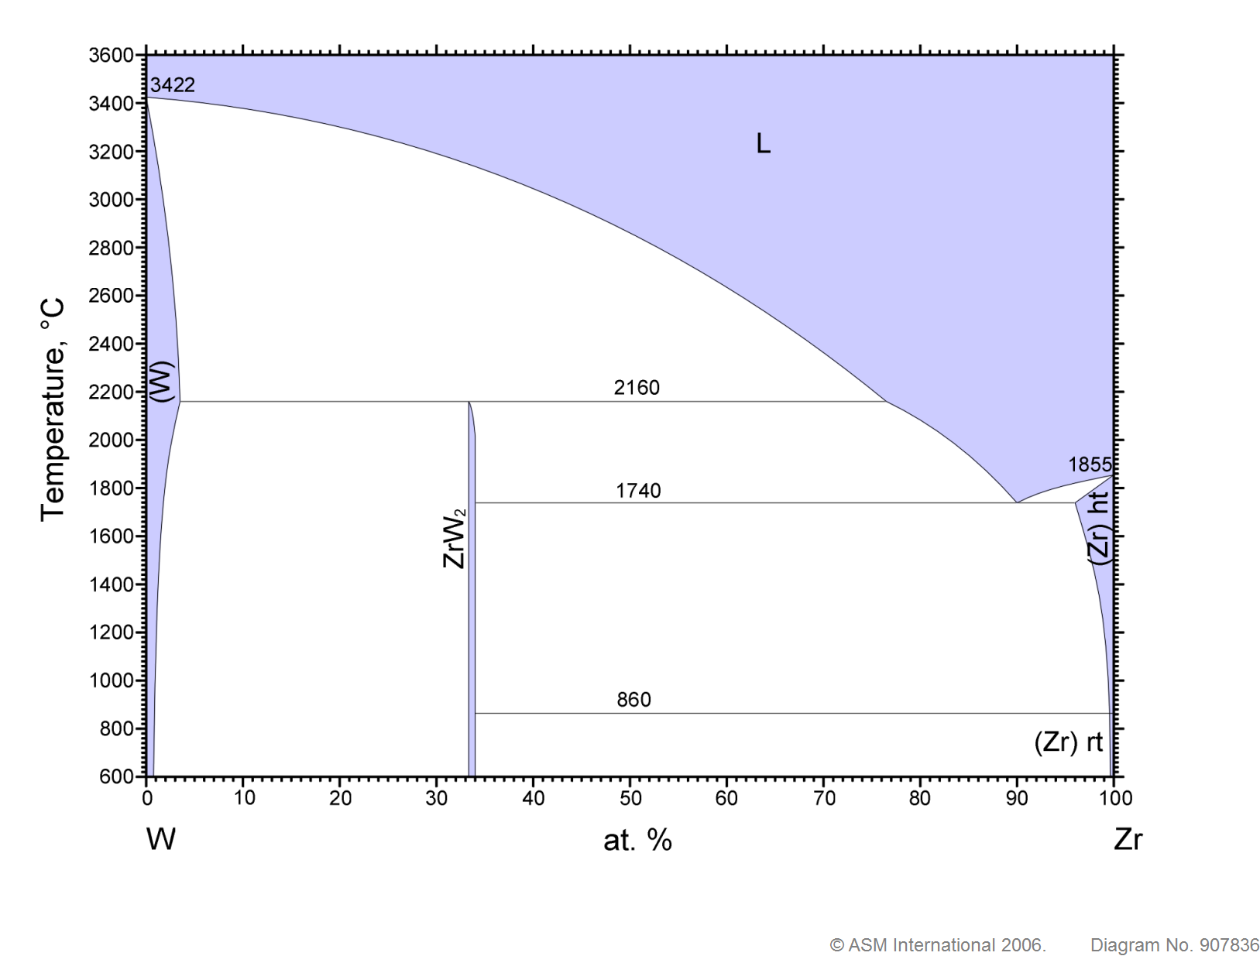
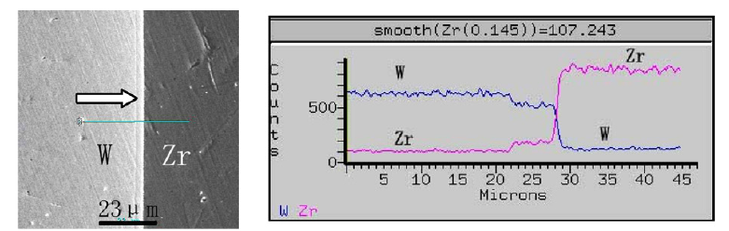
Zirconium Cladding – Manufacturability
Diffusion Bonding: NO GO?
  Bonding cross-section of HIP processed W-Zr showed a formation of brittle intermetallic (ZrW2) compounds
Canning:
  Possibility as water pressure enables thermal contact between the spallation and skin volumes: Not explored in this study
A. K. H. Robertson, Instruments 2019, 3(1), 18;
https://doi.org/10.3390/instruments3010018
180 MPa at 1200 C for 4 hours
Y. Xu et al., JNM 377 (2008) 97-100

Slide 12
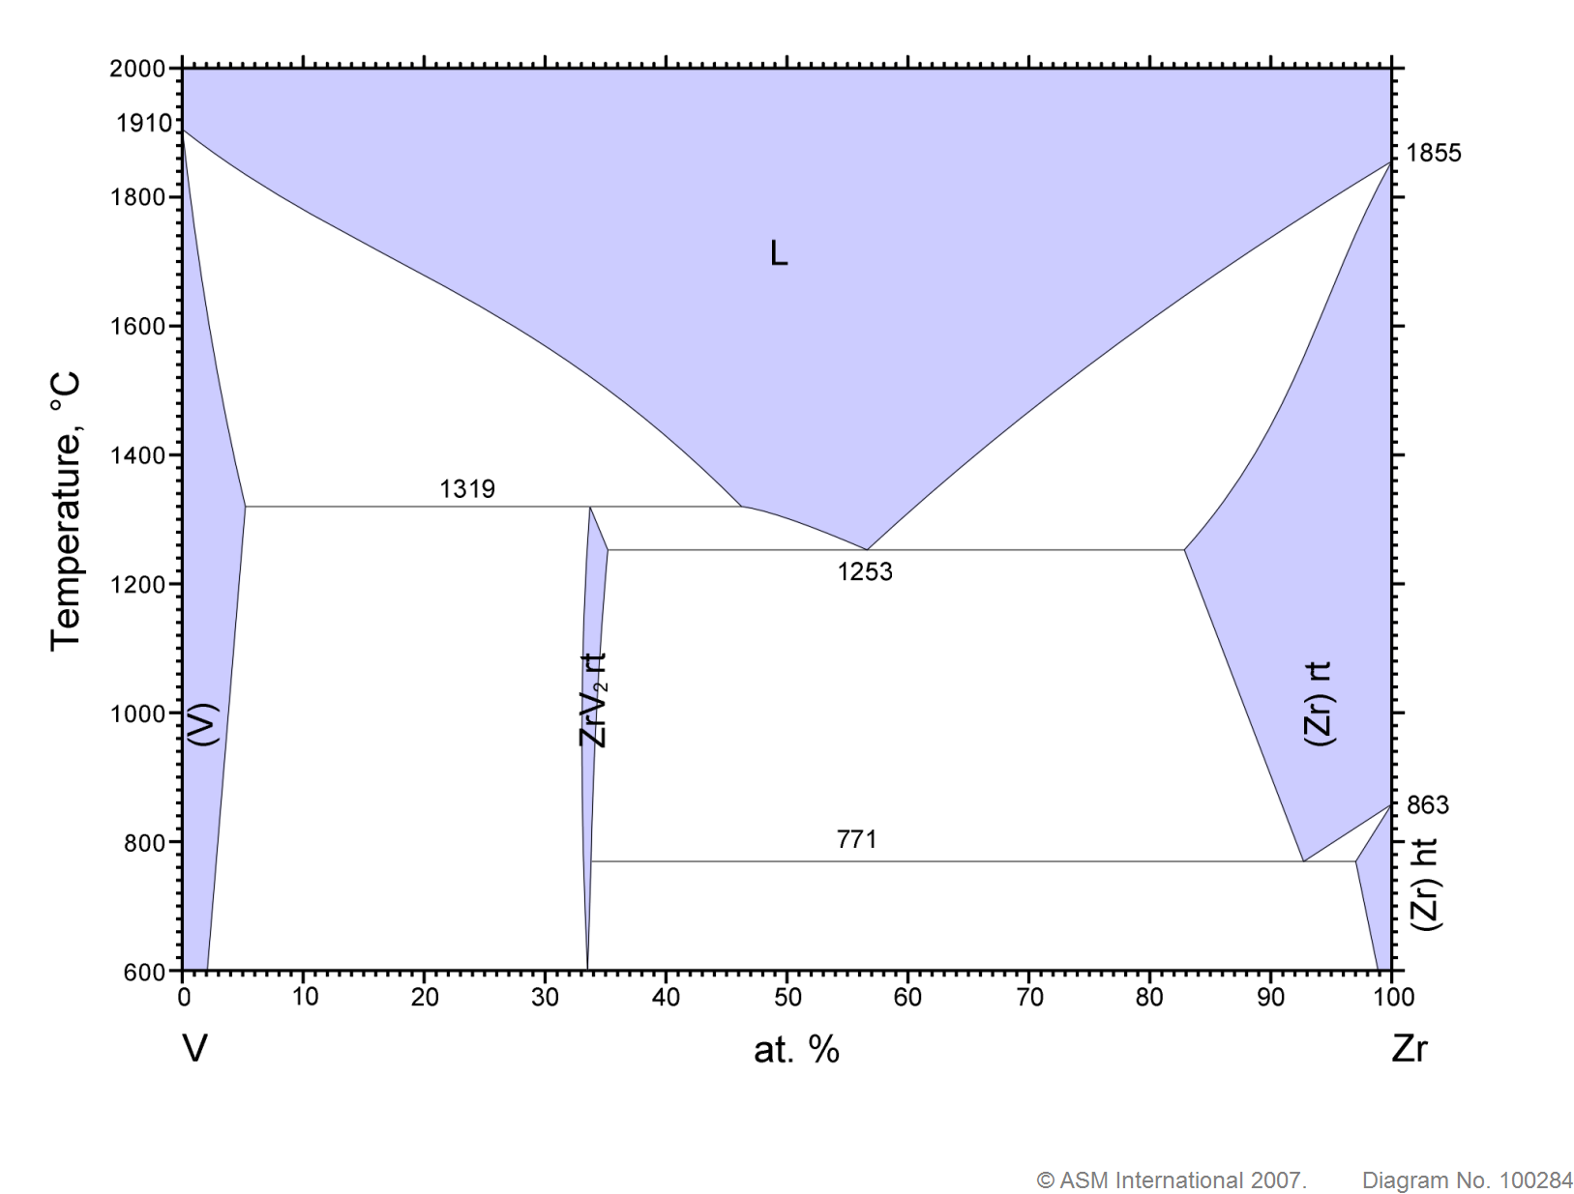
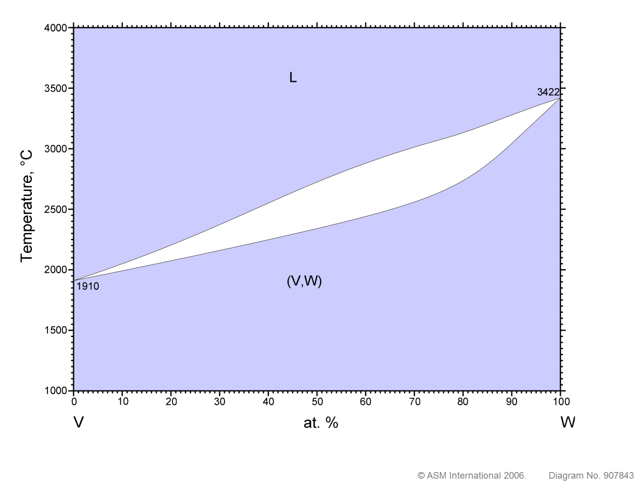
Zirconium Cladding – Manufacturability
Diffusion Bonding of Zr to W – V interlayer
Feasibility of diffusion bonding of Zr to W using V interlayer
  V-51 (n, g) V-52 (half life = 3.743 min) => Cr-52: Low activity
  The ideal processing window is predicted in the temperature range between 840 ◦C and 860 ◦C for the V-Zr bonding.
Risk
Play
Room

Slide 13
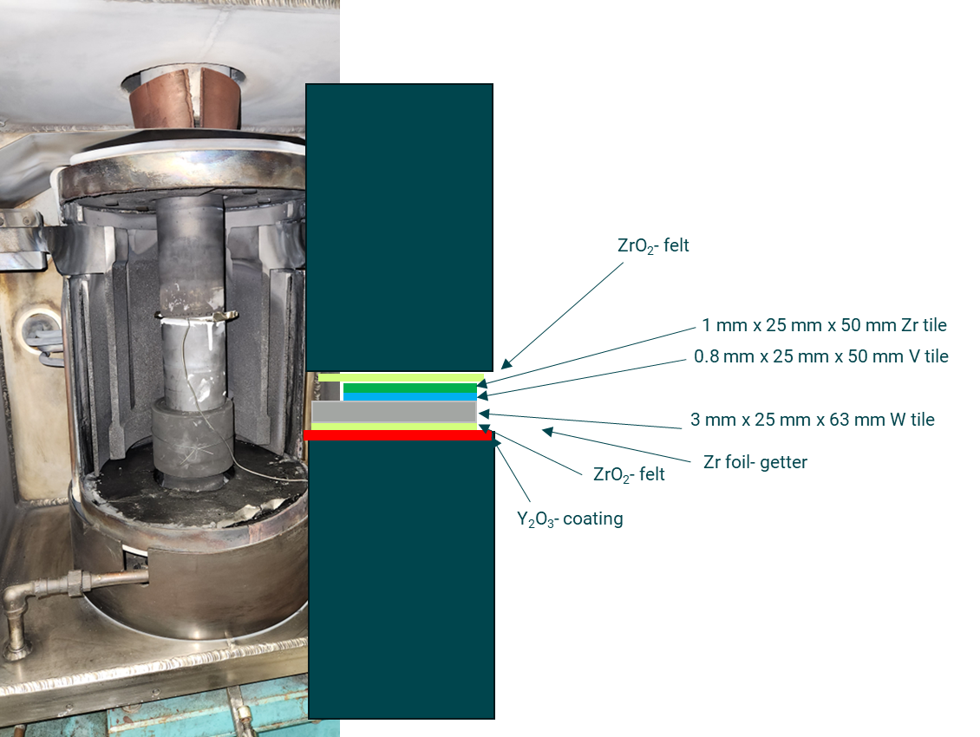
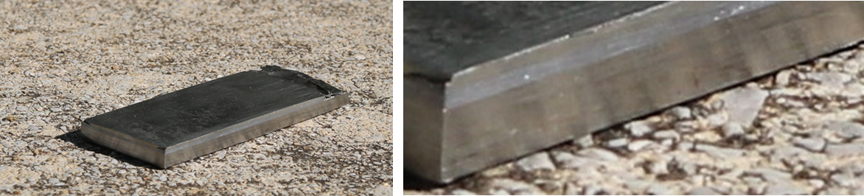
Single Step VHP: W-V-Zr
Vacuum Hot Pressing (VHP) of W, V, Zr coupons
  Sample preparation:
    The bonding surfaces of each material were prepared by using an ethyl alcohol plus 70 μm diamond abrasive slurry to remove native oxide just prior to the thermal cycle. The slurry was manually rubbed on the mating surfaces until a fresh surface was observed.
  VHP parameters
    Temperature: 860 C
    VHP pressure: 75 MPa
    VHP duration: 4 hours
Y. Lee et al.,
IPAC’24, 3837-3840

Slide 14
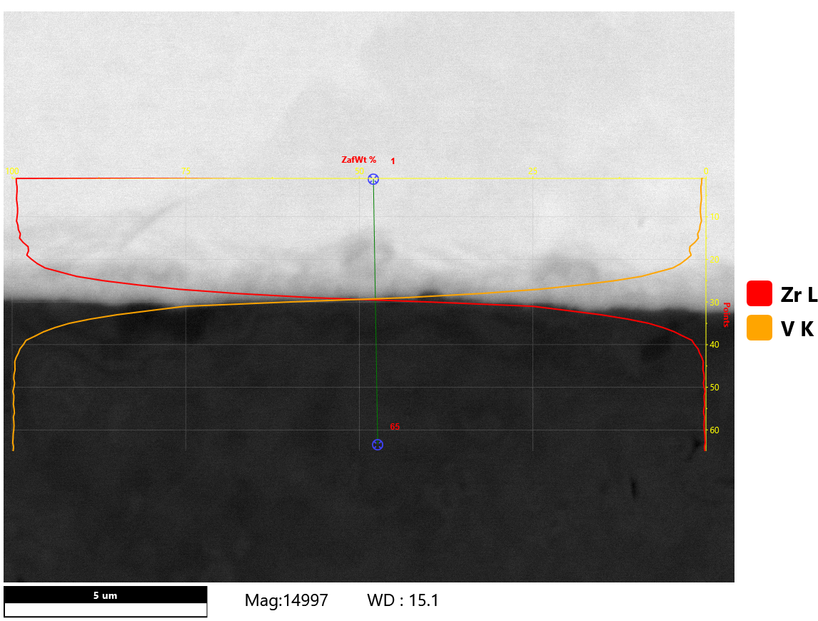
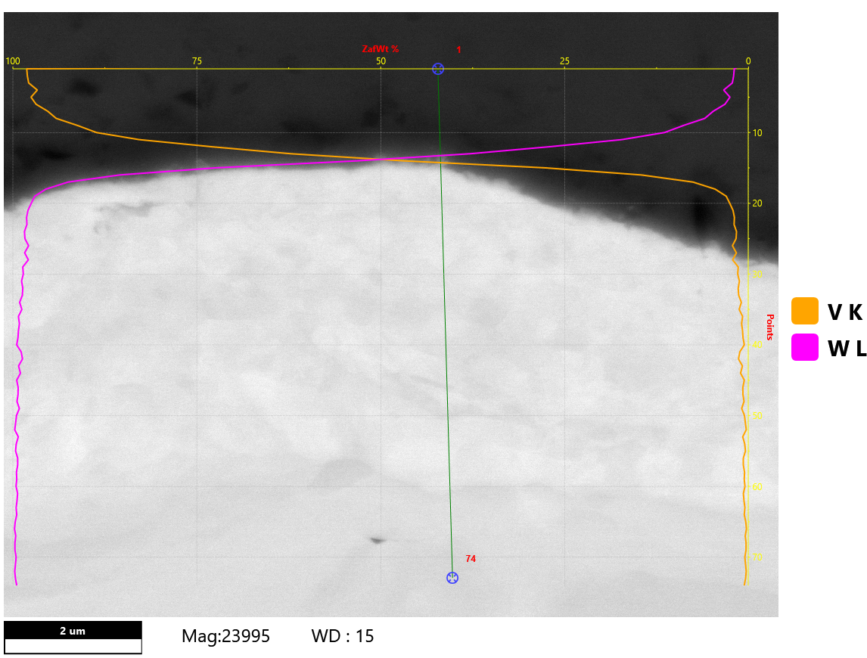
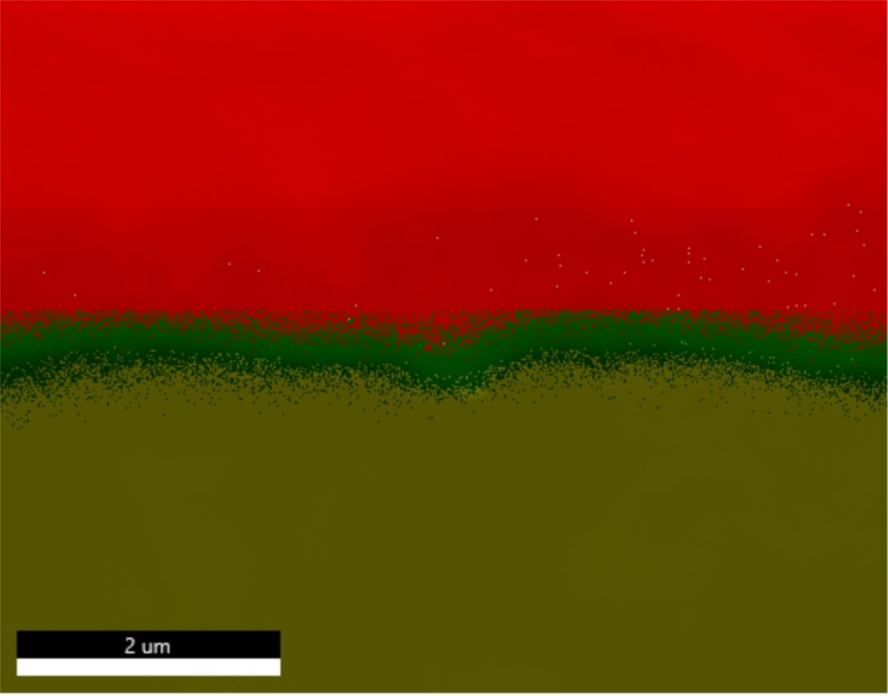
Single Step VHP: W-V-Zr
No indication of brittle ZrV2 intermetallic layer formation in V-Zr bonding region.
  1 um interaction region
  1:1 elemental mixture of Zr and V in the bonding layer
V-W bonding: 1 um interaction zone
Y. Lee et al.,
IPAC’24, 3837-3840

Slide 15
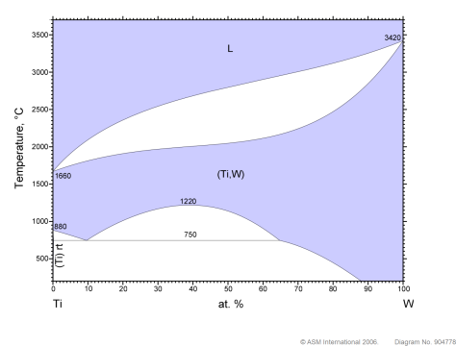
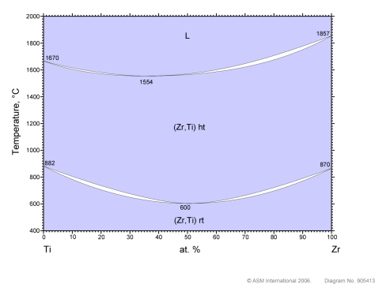
Zirconium Cladding – Manufacturability
Diffusion Bonding of Zr to W – Ti interlayer
Feasibility of diffusion bonding of Zr to W using Ti interlayer
  Ti-50 (n, g) Ti-51 (half life = 3.743 min) => V-51: Low activity

Slide 16
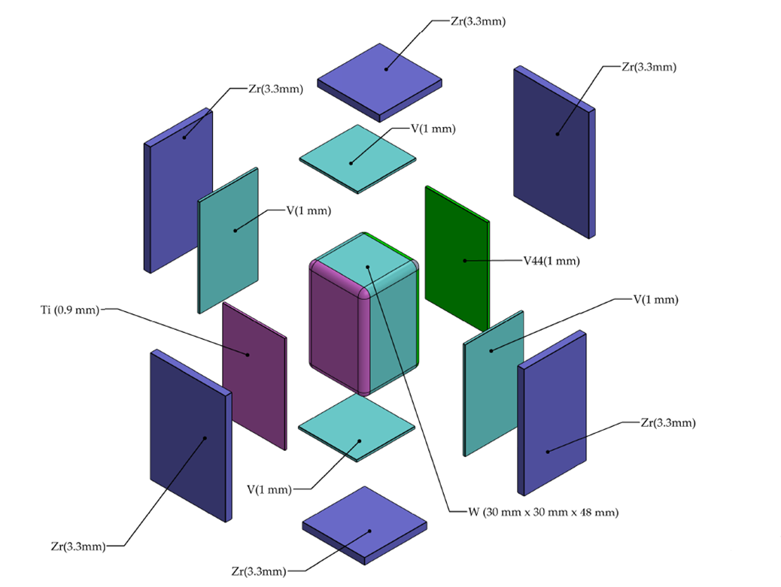
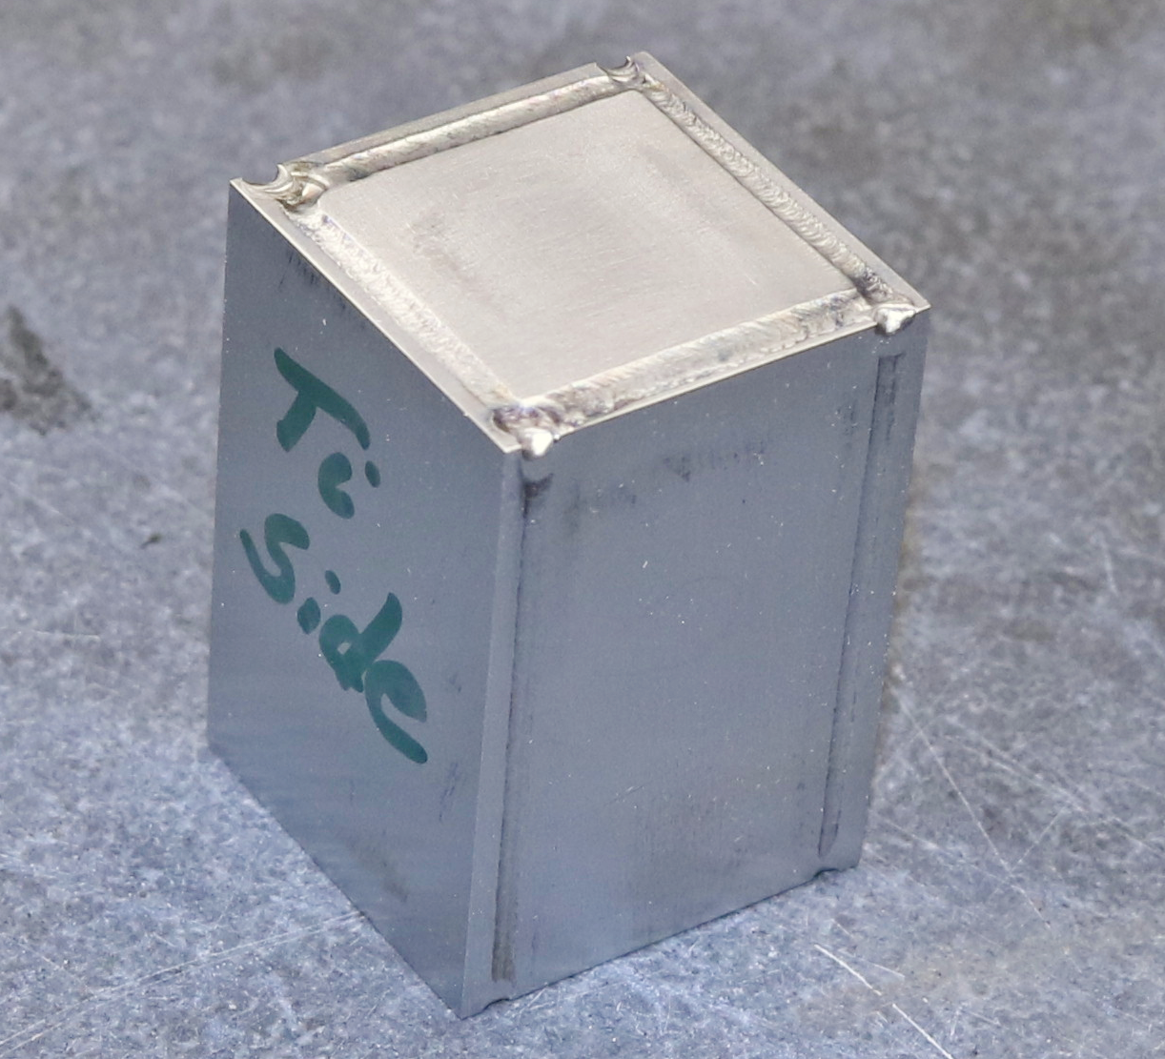
Single Step 3D-HIP: V; V-4Cr-4Ti; Ti Interlayers
Hot Isostatic Pressing (HIP) with a combination of 3 candidate interlayer materials
  Candidate interlayer materials:
    V, V-4Cr-4Ti, Ti
  All pieces including the tungsten core were abraded by hand with 70 µm free diamond abrasive on the major faces to remove the native oxide layer
  Inner and outer cladding layers are EB welded before HIP
  HIP condition: 855 C; 70 MPa; 2.5 hours
  Current Status:
    HIP operation completed
    Post-HIP bonding quality characterizations pending

Slide 17
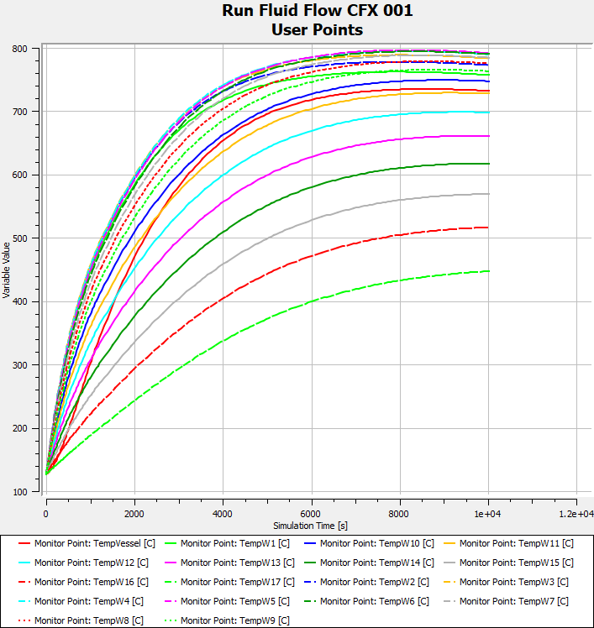
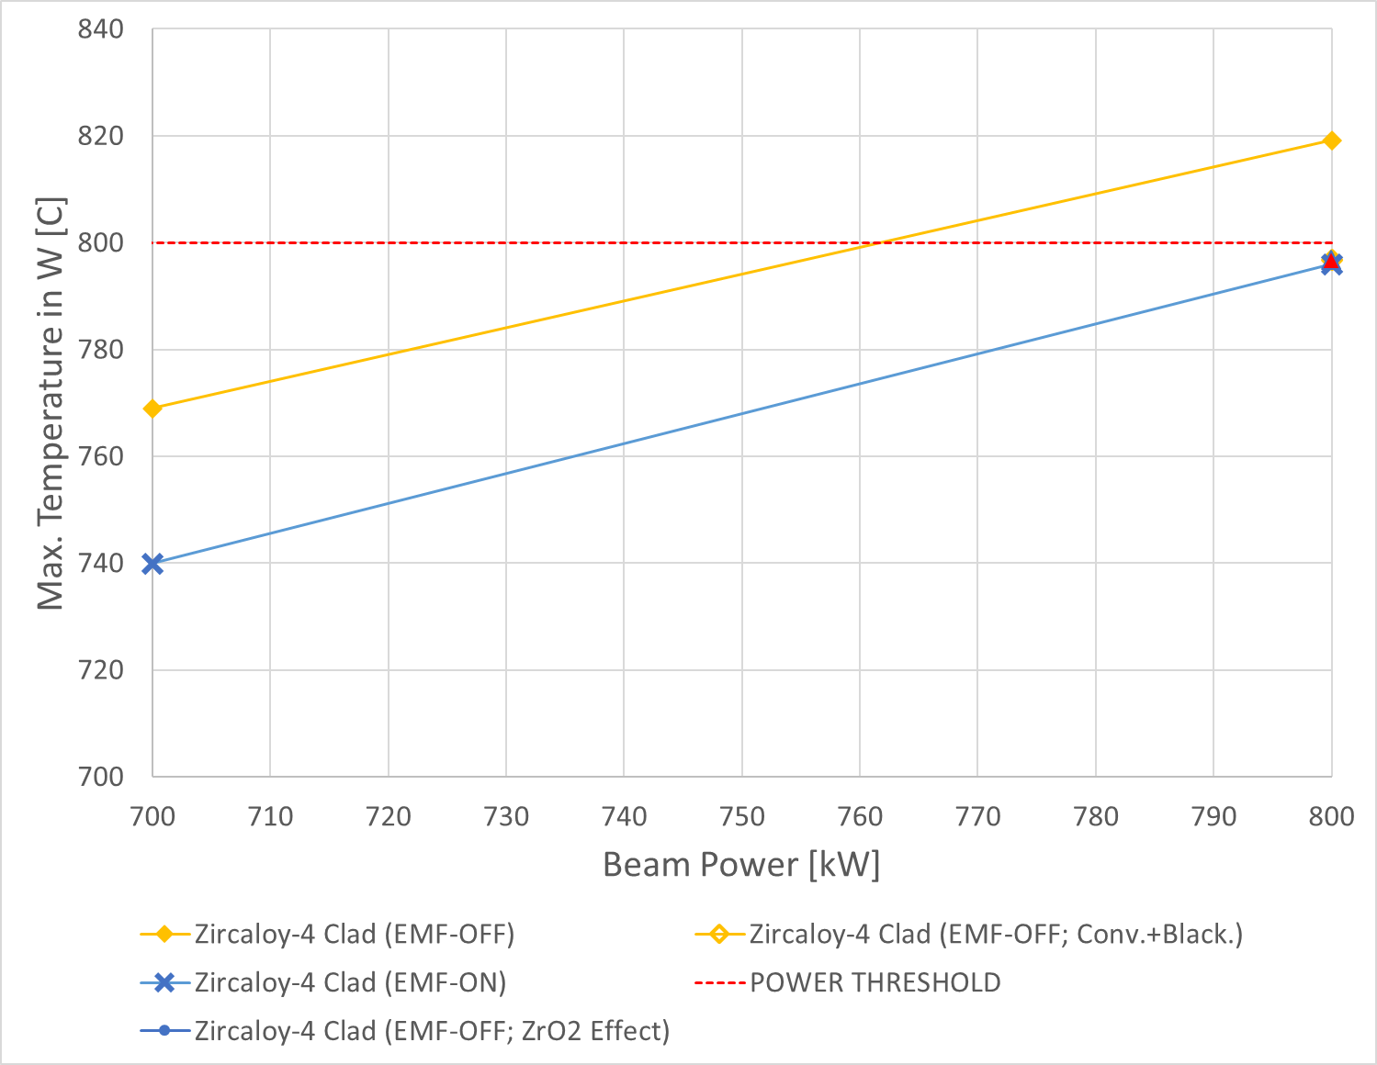
Beam Power Limit Constrained by Decay Heat – Zr Clad
Maximum temperature in tungsten in LOCA is kept below 800 C up to 800 kW beam power
The peak temperature is reached at about 3 hours in LOCA
Maximum beam power limited by tungsten temperature in LOCA is 800 kW
Y. Lee, IPAC’24, 3841-3844

Slide 18
Conclusions
Low activation material cladding
  Technical feasibility of zircaloy cladding:
    To avoid formation of brittle ZrW2 intermetallic layer, V interlayer was used.
    1D VHP process resulted in smooth elemental transitions in V-W and V-Zr bonding regions
      Mechanical qualifications to follow
    For target applications, V-Zircaloy-IV bonding is to be confirmed:
      If negative, applying a thin Zr interlayer between V and Zircaloy-IV could be an option
  Motivated by positive outcome from 1D VHP, 3D HIP has been performed
    Other interlayer options than V was tried: V, V-4Cr-4Ti, Ti
    HIP has run successfully
    Post-HIP bonding characterizations will follow
Beam power limit constrained by decay heat
  The proton beam power limit of a Zr-clad W target model studied is calculated to be 800 kW whereas that of a Ta-clad target model is 400 kW.

Slide 19
A Question …
Reasons why V or Ti have not been applied as skin materials for spallation cores made of tungsten?

Slide 20
Thank you for your attention!

