Slide 1
Post irradiation examination and lifetime limits of highly irradiated components at the Spallation Neutron Source and High Flux Isotope Reactor
David McClintock
16th International Workshop on Spallation Materials Technology (IWSMT-16)
Abingdon, United Kingdom
Oct. 21 – Nov. 1, 2024
This research used resources at the Spallation Neutron Source, a DOE Office of Science User Facility operated by the Oak Ridge National Laboratory.

Slide 2
Presentation Goals and Outline
Review status of post irradiation examination (PIE), dose limit philosophies, and future work
316L
Inconel 718
Aluminum 6061-T6

Slide 3
Post irradiation examination (PIE) is performed to learn about radiation-induced changed that occur in SNS target modules and PBWs
Mechanical properties of the target and PBW materials are altered during operation from displacement damage and H/He generation
  There is uncertainty with the rate of change in mechanical properties due to high H and He production rates of SNS components
Mechanical testing is performed to provide information to modify administrative dose limits to ensure lifetimes of components are optimized
Targets and PBWs are regularly sampled and tested to inform decisions on administrative lifetime limits and diagnose failures

Slide 4
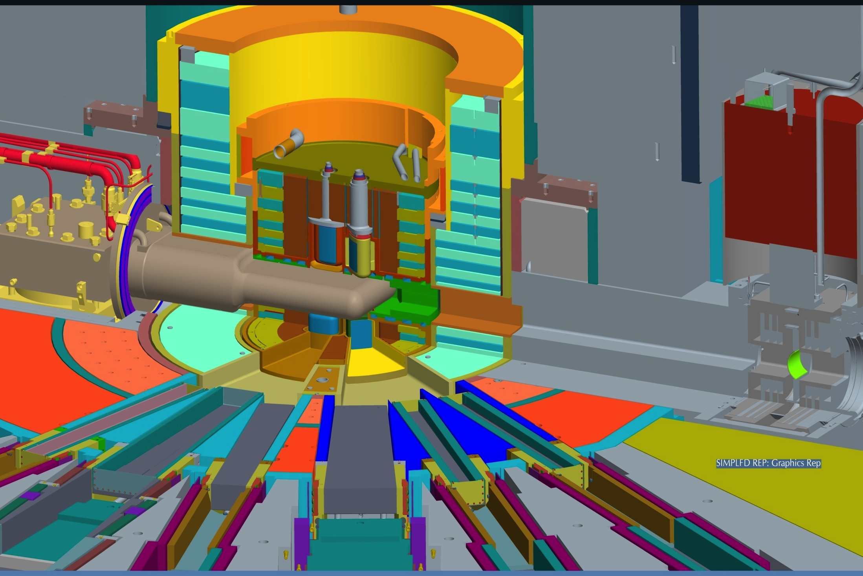
The target provides neutrons to 24 beam lines
Target
Inner Reflector Plug
Outer Reflector Plug
Core Vessel
Core Vessel Insert
Shutter
Proton Beam Window
Notes:
The SNS has 4 Moderators:
1. Two downstream and one upstream liquid hydrogen
2. One upstream ambient water
Proton Beam Window:
Currently – Inconel 718 (precipitation hardened nickel alloy)
Next Generation Design – 6061-T651

Slide 5
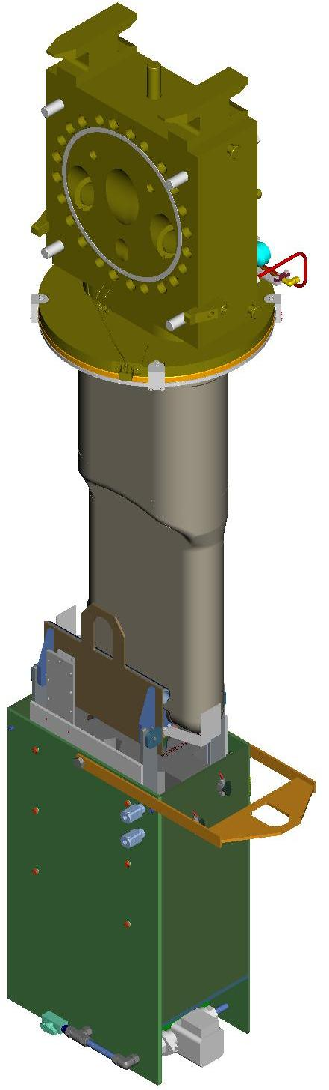
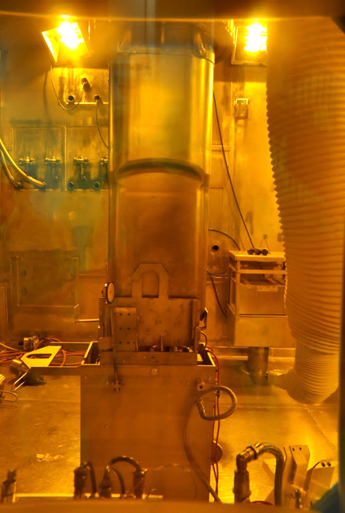
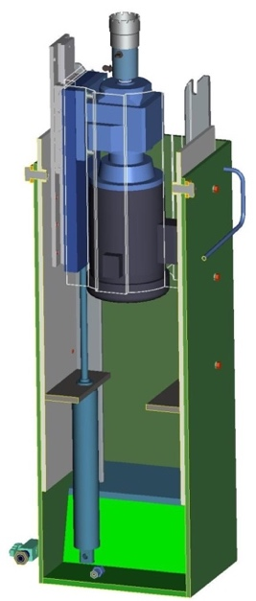
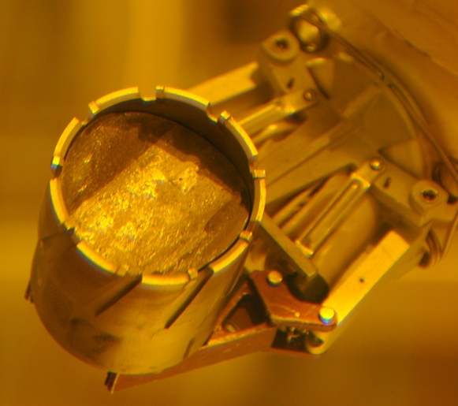
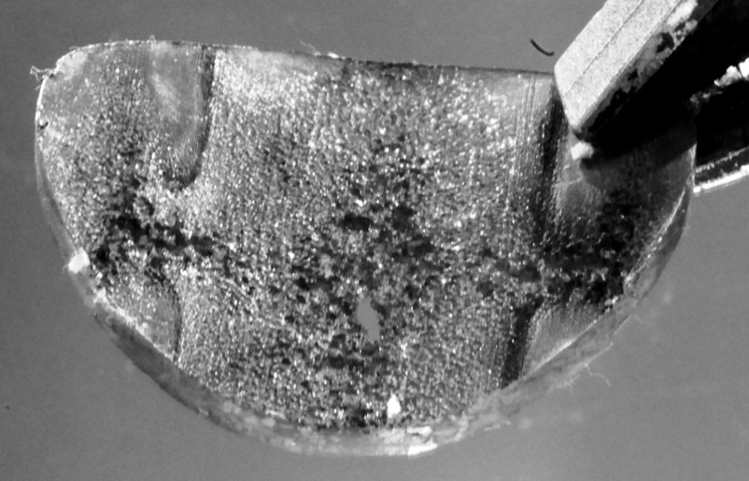
Disk-shaped specimens are routinely sampled from the beam entrance region of SNS targets after service
Target During and After Sampling
Annular Cutter
Low-profile Linear Slide
Electric Drill Motor
Samples In a Cutter
Target 1 Inner-wall Sample
Pneumatic Piston
To date, 31 SNS targets have been sampled – world record?

Slide 6
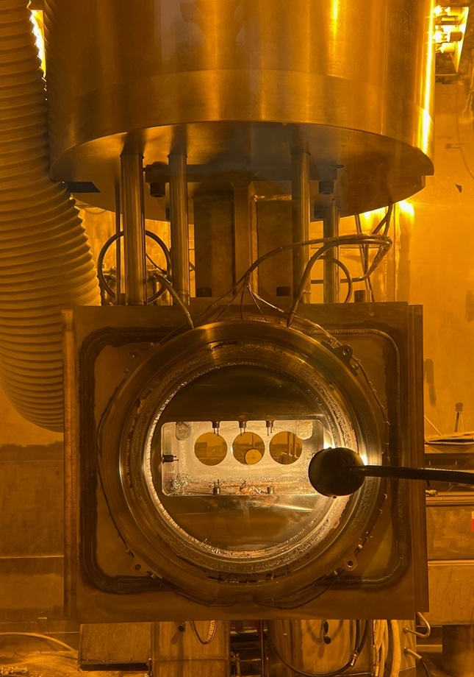
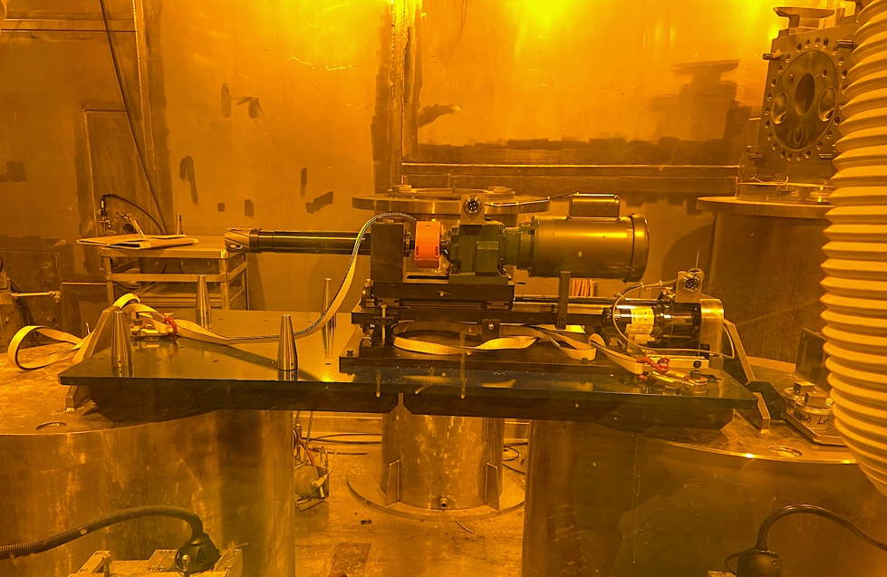
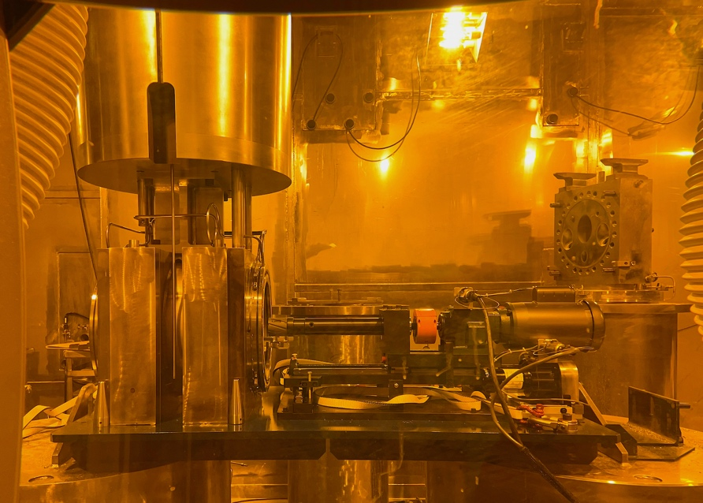
Proton beam windows are sampled using a custom device
PIE samples (~58 mm diameter) are cut from window using an annular cutter
Samples have been removed from three PBWs to date:
  PBW-4 (Inconel 718, 9.7 dpa, 1833 appm He, 7211appm H)
  PBW-6 (Al 6061-T6, ~4 dpa, ~2000 appm He)
  PBW-7 (Inconel 718, ~15 dpa)
PBW-6 After Sampling
PBW Sampler
Sampler with PBW Assembly
Annular Cutter
Translating Carriage
Electric Motor
Alignment Pins
PBW Assembly

Slide 7
Majority of initial PIE research was focused on 316L and resulted in appreciable success
Tensile specimens were fabricated and tested from samples removed from SNS Targets 1, 2, 6, 8, and 9
Initial tensile testing results from Targets 1 and 2 were abnormal, disappointing, and confusing
However, additional testing and characterizations showed a clear cause for the abnormal behavior
The SNS PIE testing with irradiated 316L revealed a new deformation mechanism not previously reported in the literature

Slide 8
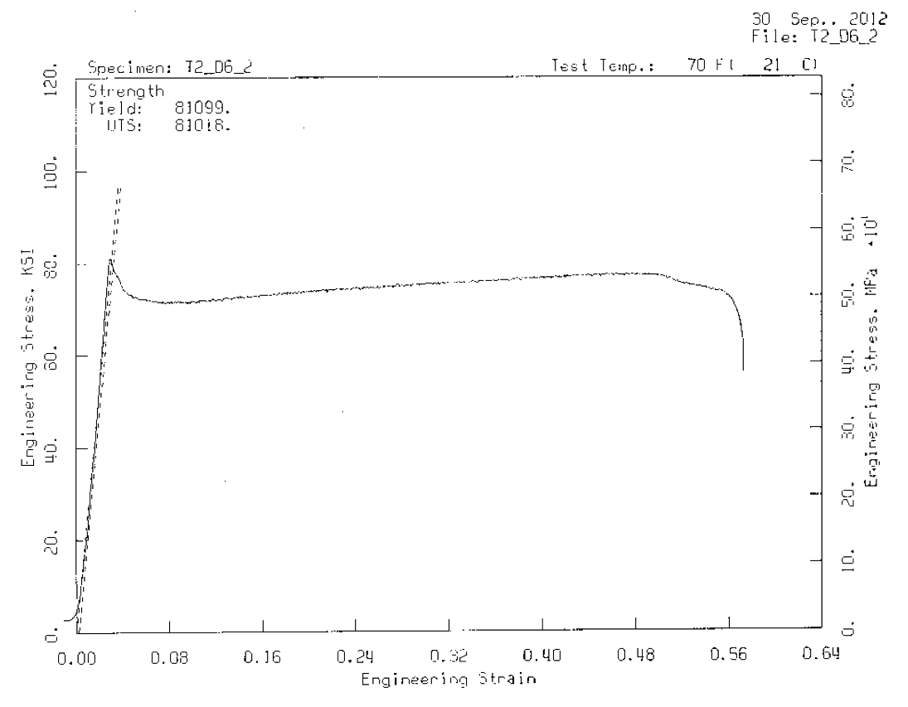
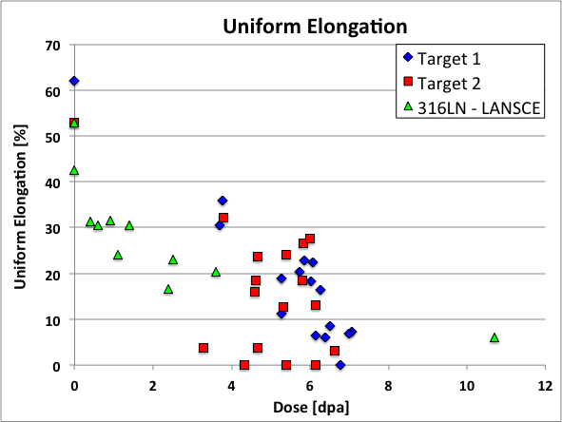
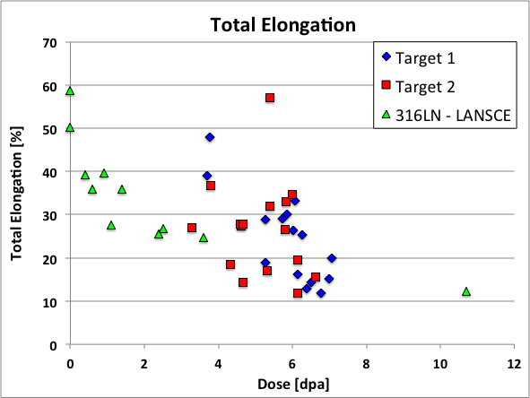
Tensile data from Target 2 showed appreciable total elongation after ~7 dpa
Wire EDM Trial Cuts
Reduction in uniform elongation observed in Targets 1 and 2 were generally consistent with previous LANSCE data*
However, appreciable scatter was observed in the elongation data and an extraordinary elongation was observed
D.A. McCintock et al., Journal of Nuclear Materials 450 (2014) 130-140
*K. Farrell and T.S. Byun, Journal of Nuclear Materials, 296 ( 2001) 129-138
D.A. McCintock et al., Journal of Nuclear Materials 450 (2014) 130-140.
Notes:
Doses were calculated using MCMPX with Tom McManamy’s proton beam profile (peaking factor ~1.18)
Irradiation temperature = 50-125°C
Test temperature = room temperature (~22°C)

Slide 9
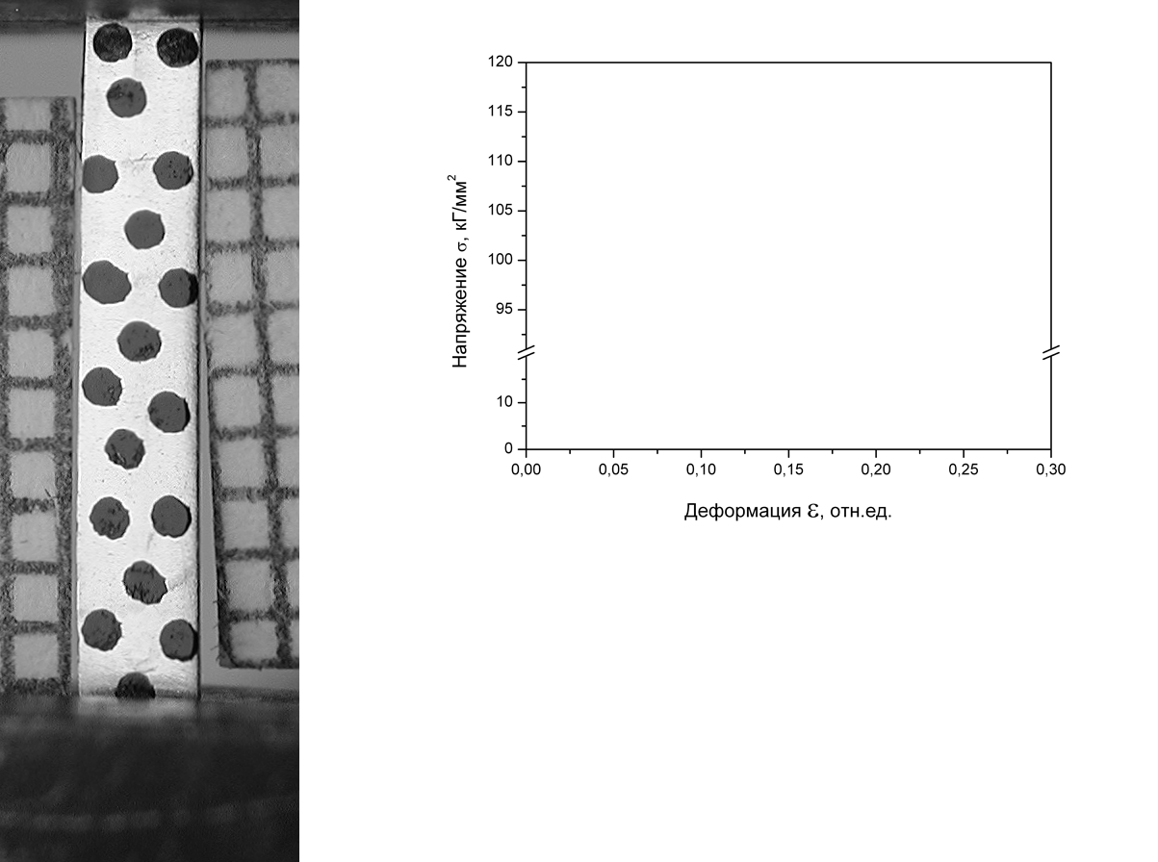
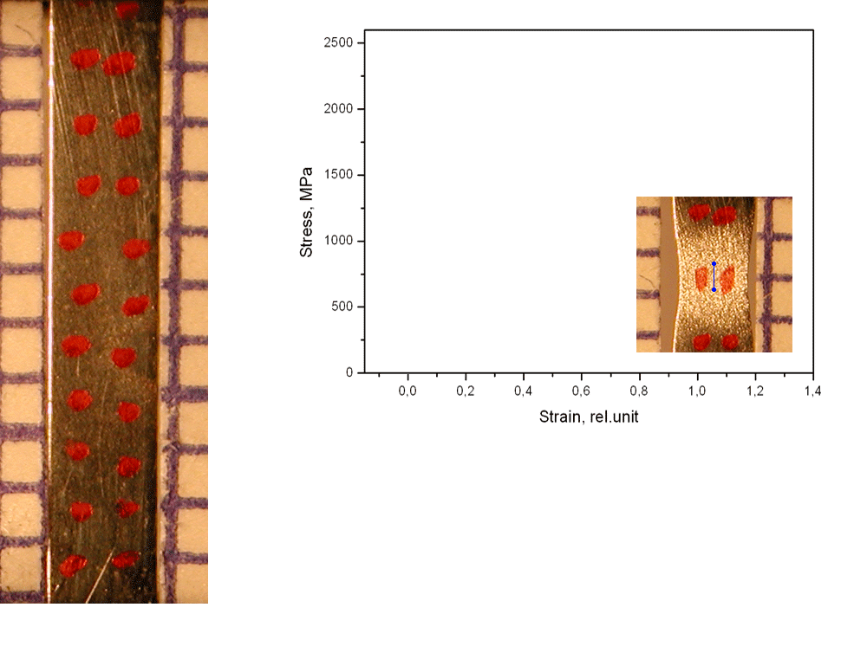
Irradiated austenitic steels can deform in non-typically processes*
Engineering and true stress-strain curves
Engineering stress-strain curve
true
Stress, kg/mm²
engineering
Strain
Austenitic steel Cr16Ni11Mo3
Russian analog of 316 stainless steel
12 dpa at 300 ºC
BN-350 reactor
55 dpa, 310ºC in BN-350
Russian analog of 321 stainless steel
Room Temperature Test
9-11% total elongation of specimen but >100% local deformation
A “deformation wave” appears on the surface and moves along the specimen gauge section
Gusev et al., J. Nucl. Mater. 386–388 (2009) 273–276
Gusev et al., J. Nucl. Mater. 403 (2010) 121–125
*Slide Courtesy of Frank Garner and Maxim Gusev

Slide 10
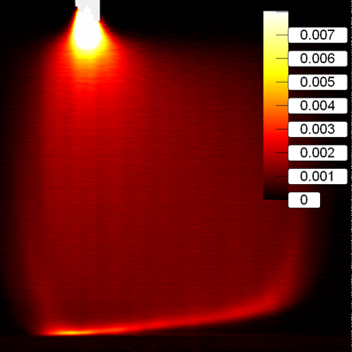
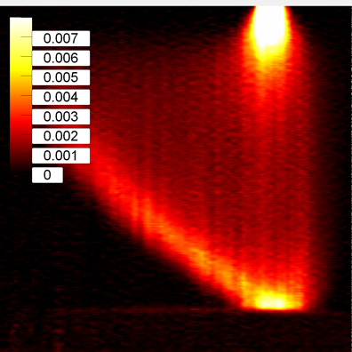
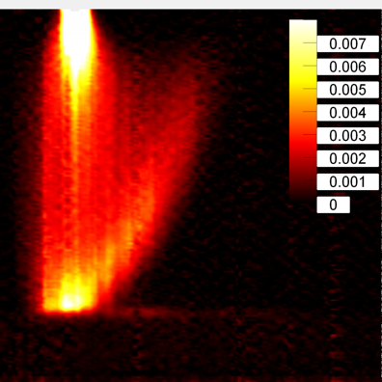
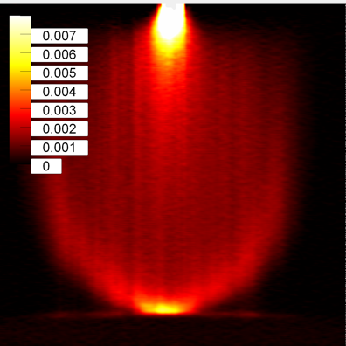
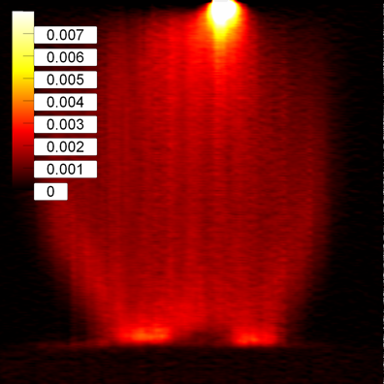
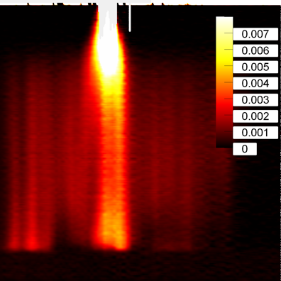
316L tensile specimen deformation was characterized using DIC
Digital Image Correlation (DIC) was used to characterize specimen deformation behavior
Several different types of deformation waves were observed during testing of the irradiated 316L from SNS targets
  Single deformation waves: entire or half of gauge section
  Double deformation waves
  Localized deformation
DIC Testing Setup
Specimen
Specimen
High-resolution Camera
Single Weak Wave
Single Strong Wave
Half-specimen Wave
Typical Behavior (No Wave)
Double Waves
Multiple Waves
Strain Localization

Slide 11
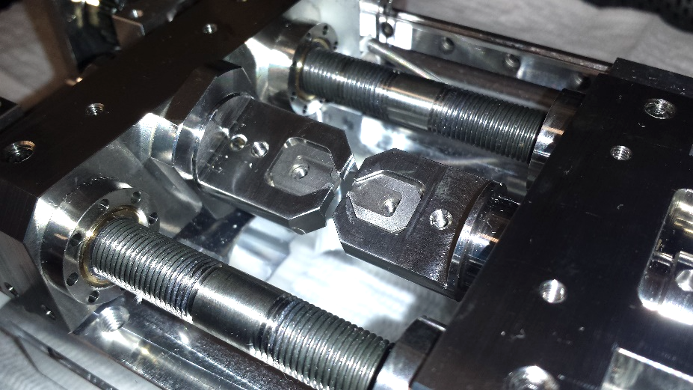
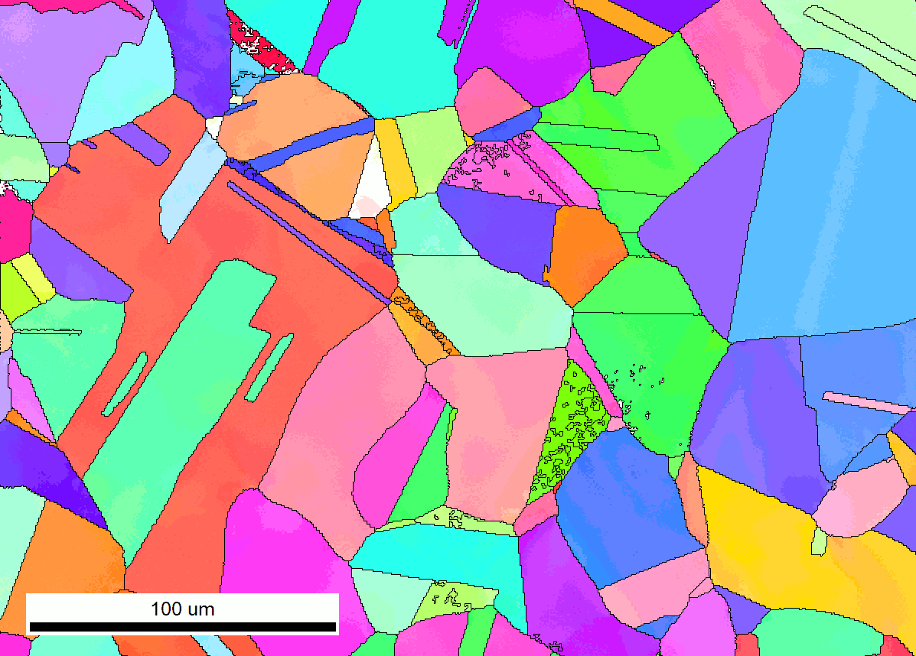
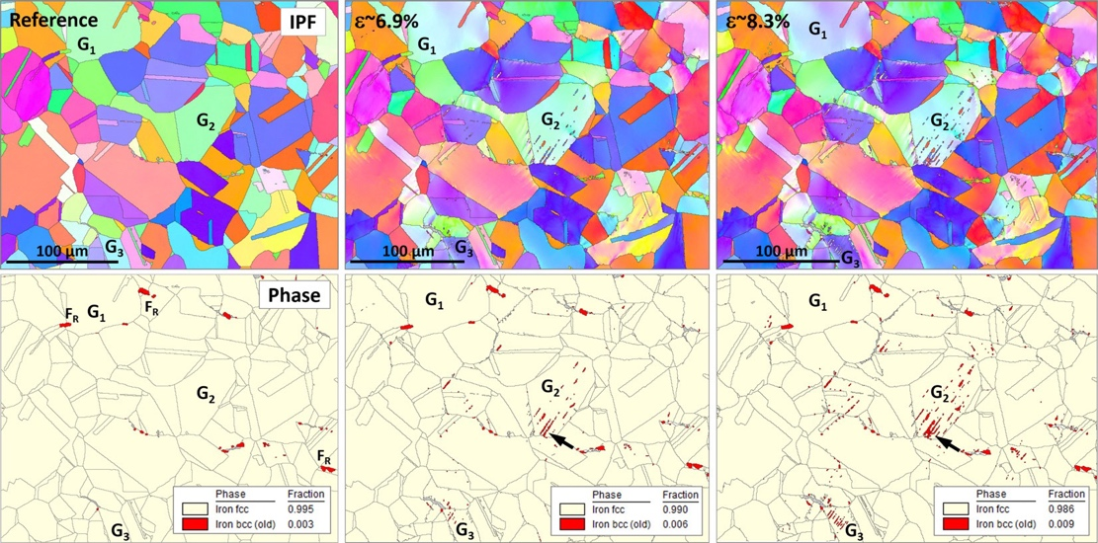
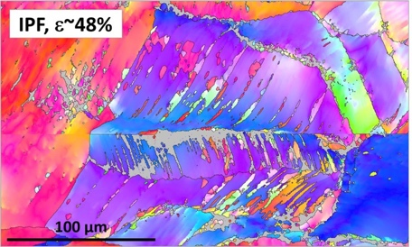
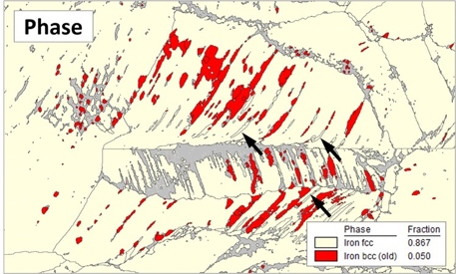
Testing showed the phenomenon was not related to TRIP or TWIP effects
SEM in-situ tensile testing of irradiated 316L was performed with electron-backscatter diffraction (EBSD) characterization
Results showed transformation-induced plasticity (TRIP) was not related to wave formation and propagation
  <1% of martensite formed after the active wave evolution occurred; typically, ~30% martensite is observed in TRIP steels
  Less than 5% bcc martensite was observed after 48% strain
An insufficient density of twins were observed to attribute wave formation to twinning-induced plasticity (TWIP)
  The largest EBSD-detected volume fraction of twins was below 2–3% and most grains had no twins
SEM in-situ load frame
IPF maps during test
Tensile specimen
𝜀 ~ 0%
𝜀 ~ 6.9%
𝜀 ~ 8.3%
𝜀 ~ 48%
0.9% bcc martensite
5% bcc martensite
M. N. Gussev, D.A. McClintock, T.G. Lach, Origin, parameters, and underlying deformation mechanisms of propagating deformation bands in irradiated 316L stainless steel, Acta Materialia 242 (2023) 118434.

Slide 12
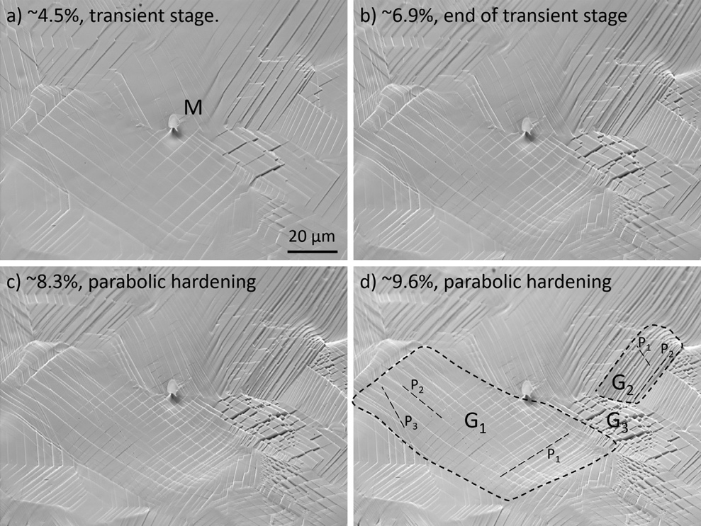
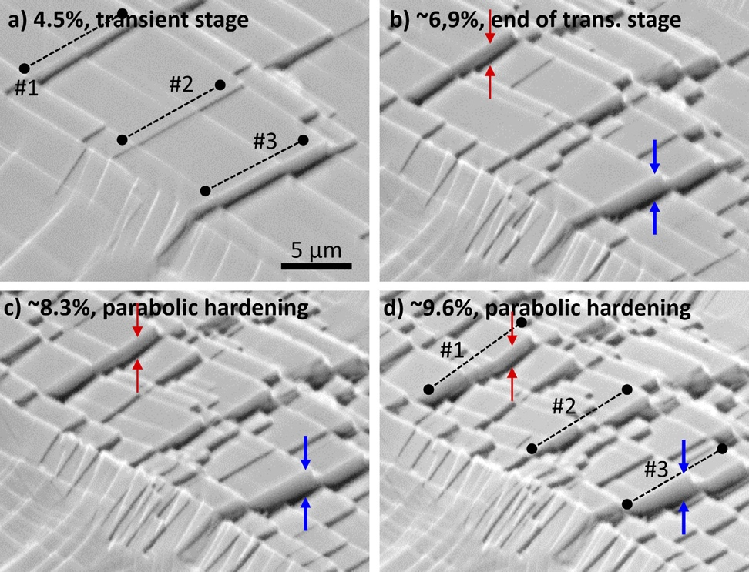
Deformation-wave behavior at small-strain values in irradiated 316L was associated with dislocation channel formation
Results suggest formation and propagation of Lüders-type bands were related to the formation and evolution of defect-free channels (dislocation channels) — analogous to slip bands
Although the number of active slip planes may change with strain, most of the active slip planes form during deformation in the small strain region of the test
Surface morphology and evolution of defect-free channels
Bright field TEM of 316L from Target 8
Evolution of Grain G₃
M. N. Gussev, D.A. McClintock, T.G. Lach, Origin, parameters, and underlying deformation mechanisms of propagating deformation bands in irradiated 316L stainless steel, Acta Materialia 242 (2023) 118434.

Slide 13
Lifetime limit for the SNS target was continuously increased and administrative dose limits no longer restrict operation
Tensile testing revealed showed 316L had appreciable elongation after irradiation
Advanced characterizations showed dislocation channel formation and evolution was responsible for traveling wave deformation
Approximately 7757 MW-h is required to reach the current limit (12 dpa)
  It is unlikely we will reach this level of total absorbed energy any time soon…
Testing of specimens from Target 12 is planned to explore mechanisms governing traveling wave deformation behavior
316L Administrative Limit
Vulnerability: Embrittlement through defect/He(?) production
Property Limit: 10 % total elongation
Dose Limit: 12 dpa (outer layer of shroud)
7.6 dpa
(Target 12)

Slide 14
Inconel 718 from PBW-4 displayed radiation-enhanced ductility
Yield strength and ultimate tensile strength values were remarkable consistent
  ΔYS = 112 MPa
  Δ UTS = 83 MPa
Uniform and total elongation values increased with increasing dose
An increase with ductility is not typical and has not been reported in the literature for irradiated Inconel 718
What radiation-induced change caused this behavior?
  483-1833 appm He
  1881-7211 appm H
D.A. McClintock et al., Observations of radiation-enhanced ductility in irradiated Inconel 718: Tensile properties, deformation behavior, and microstructure, Acta Materialia 231 (2022) 117889.

Slide 15
HRTEM and STEM-EELS showed a high number density of regions with vacancy clusters were present and they were associated with hydrogen
Small clusters (1-3 nm) of vacancies were observed during HRTEM examinations
STEM-EELS showed H (and He) were associated with these clusters
These features were remarkably stable after exposure to high-temperature annealing treatments (Tim Lach presentation)
We suspect these features are a major factor influencing the deformation behavior
D.A. McClintock, M. N. Gussev, C. Campbell, K. Mao, T.G. Lach, Wei Lu, J.A. Hachtel, Kinga A. Unocic, Acta Materialia 231 (2022) 117889.
Hydrogen

Slide 16
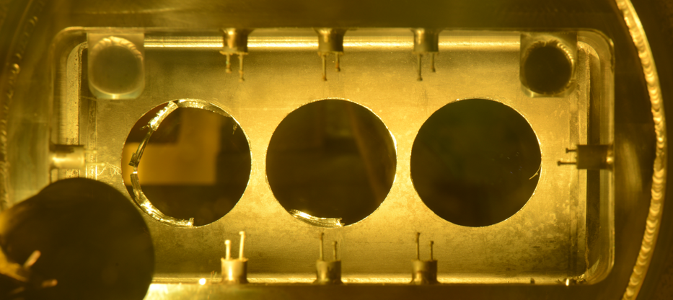
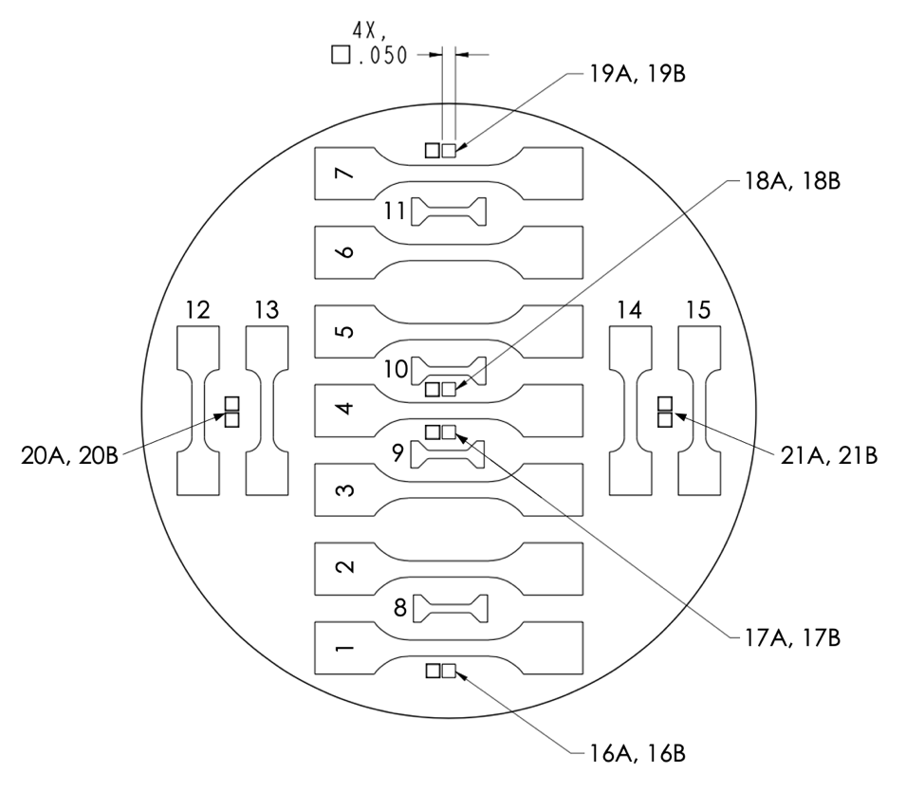
Future Work: PBW-7 was successfully sampled
PBW-7 (Inconel 718) received peak dose of 19.6 dpa and 3948 appm He and 15,299 appm H was generated
Samples were successfully removed from PBW-7 and a contract for specimen fabrication was signed with a vendor
In-situ TEM deformation studies are underway, and more are planned; next IWSMT?
?
?
PBW-7 After Sampling
PBW-7 After Sample Machining Map
?
?

Slide 17
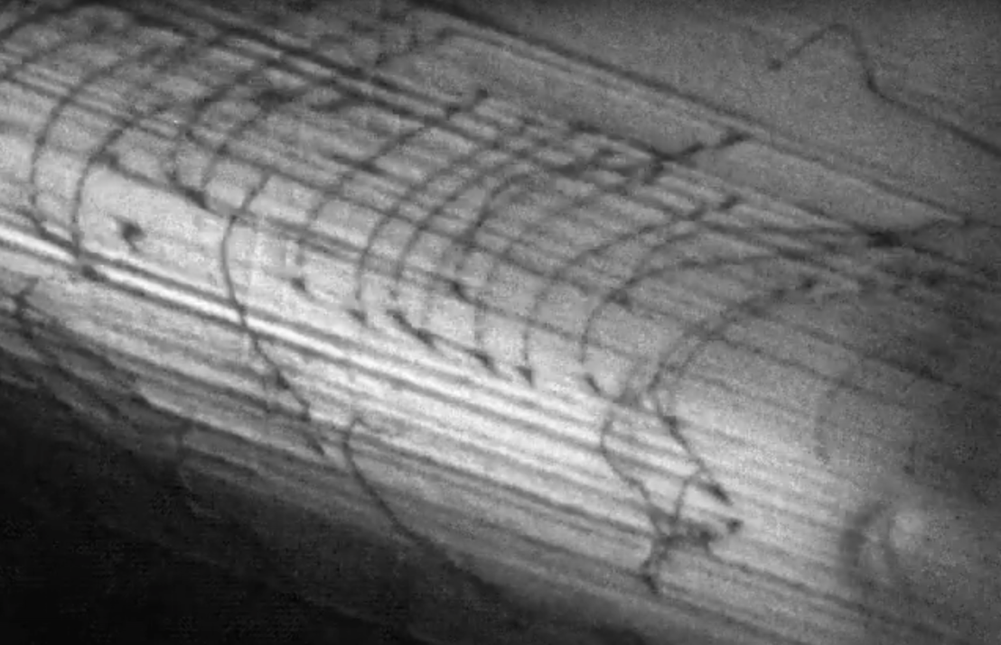
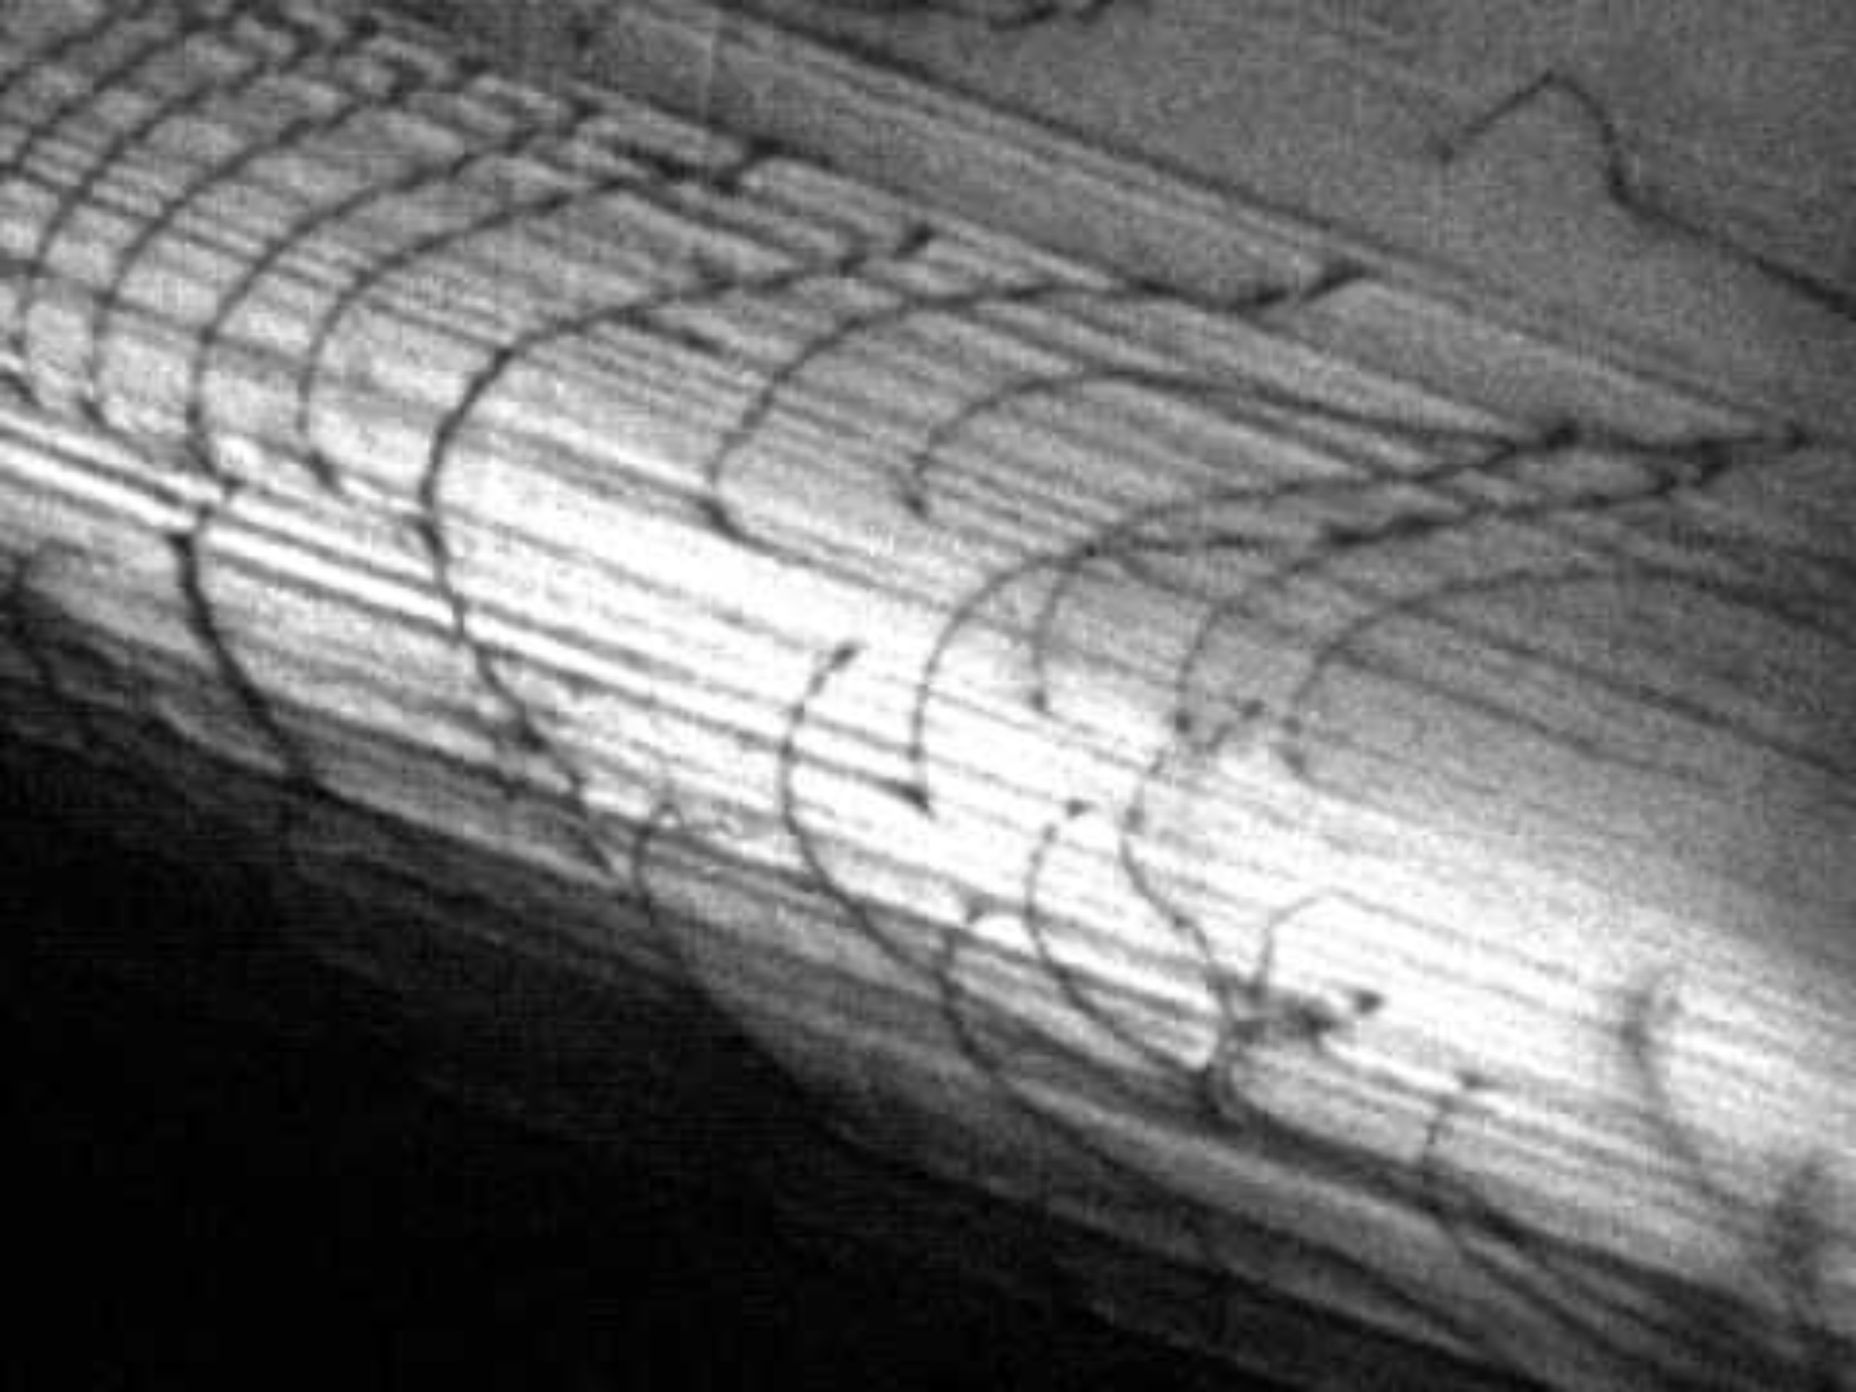
In-situ TEM deformation testing is underway to understand dislocation behavior during straining
We hypothesize the the nanoclusters of vacancies and H/He may be dislocation generation sites and barriers to dislocation propagation
In situ TEM deformation studies may reveal the dislocation generation and propagation behavior, and their interactions with the vacancy clusters
Specimens from tested SS-3 tensile specimens were prepared and are undergoing testing at Los Alamos National Laboratory
Dislocation glide during in situ TEM straining at 400°C of 304 stainless steel. (Josh Kacher – GA Tech)

Slide 18
Lifetime limit for Inconel 718 is currently 18 dpa, but might be increased to much higher values if trend in data continues
Tensile testing showed the elongation increased with increasing dose for Inconel 718
The cause of this increase is still a mystery, though we have some ideas…
In situ TEM and in situ SEM deformation testing is ongoing and may reveal clues to behavior
A contract was signed to fabricated specimens from 3 irradiated Inconel 718 samples from PBW-7
  19.6 dpa
  3,948 appm He
  15,299 appm H
Inconel 718 Administrative Limit
Vulnerability: Embrittlement through He production?
Property Limit: 10 % total elongation
Dose Limit: 18 dpa

Slide 19
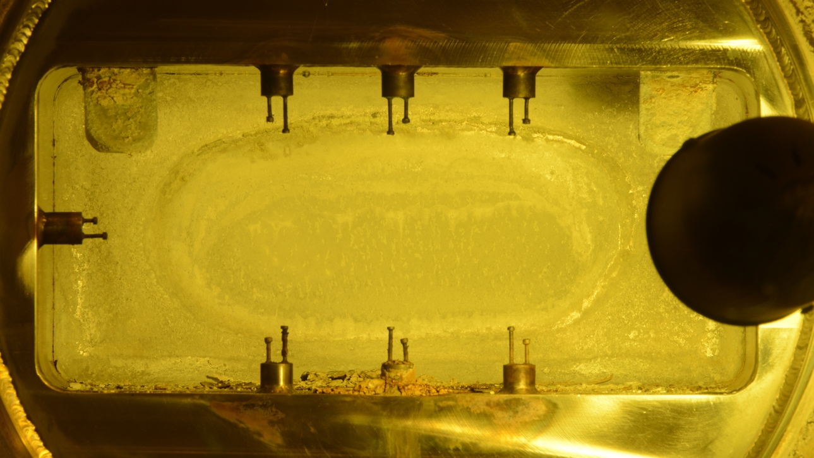
PBW-6 had appreciable amount of corrosion products on the window and “beam flight” cavity
Large clumps of flaky corrosion products concentrated near the edge of proton beam footprint
Bright metallic reflections of underlying aluminum where debris fell off window
Debris clumped together between the window and beam position thermocouples

Slide 20
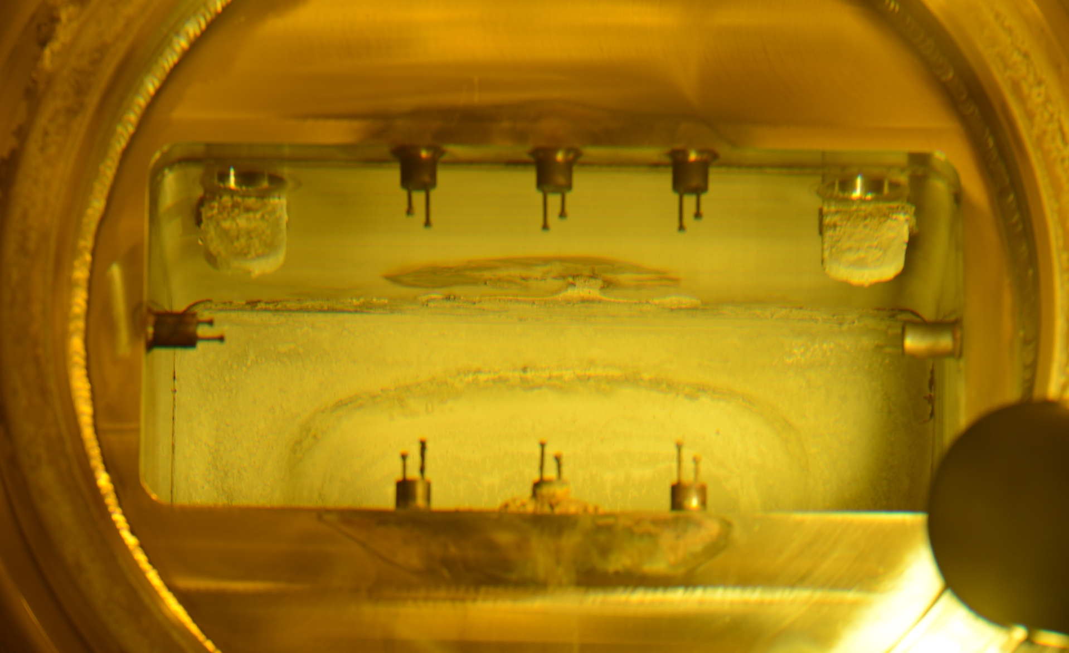
Water appears to have flowed along the top of the down-stream proton flight passage
Deposits of corrosion products appear heavy around the window periphery and relatively uniform across the entire window
Water appears to have flowed from the window to this area and “dripped off”
It is likely the cool water flowing through the PBW when the beam was off caused the window to be come cold to cause condensation accumulation from the moist environment present in the target area during the IRP leak.
Therefore, the window itself appears to be the source of the water that corroded the aluminum window in PBW 6.

Slide 21
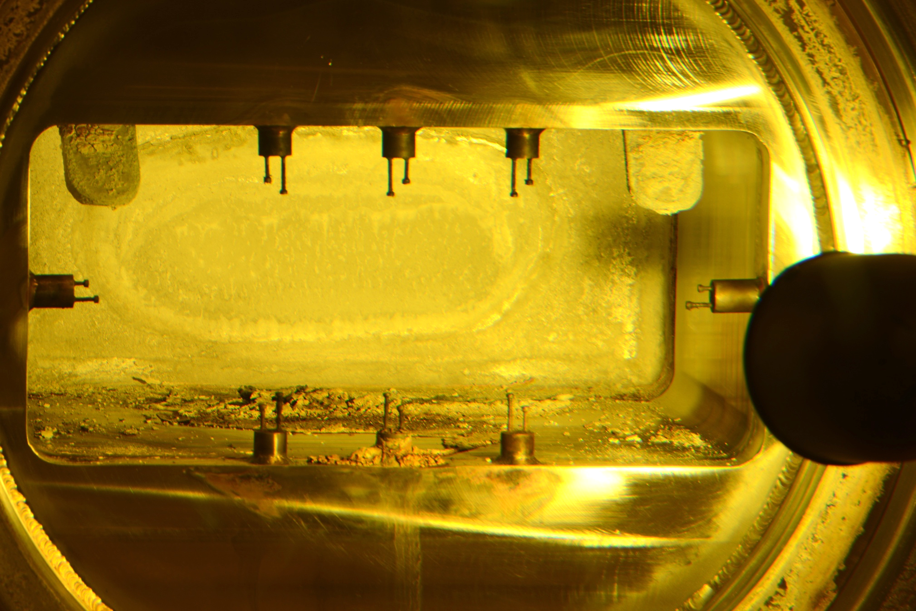
The corrosion products and water from the window flowed toward the downstream beam-positioning thermocouples
Corrosion products and water flowed from the window toward the thermocouples and seal interface

Slide 22
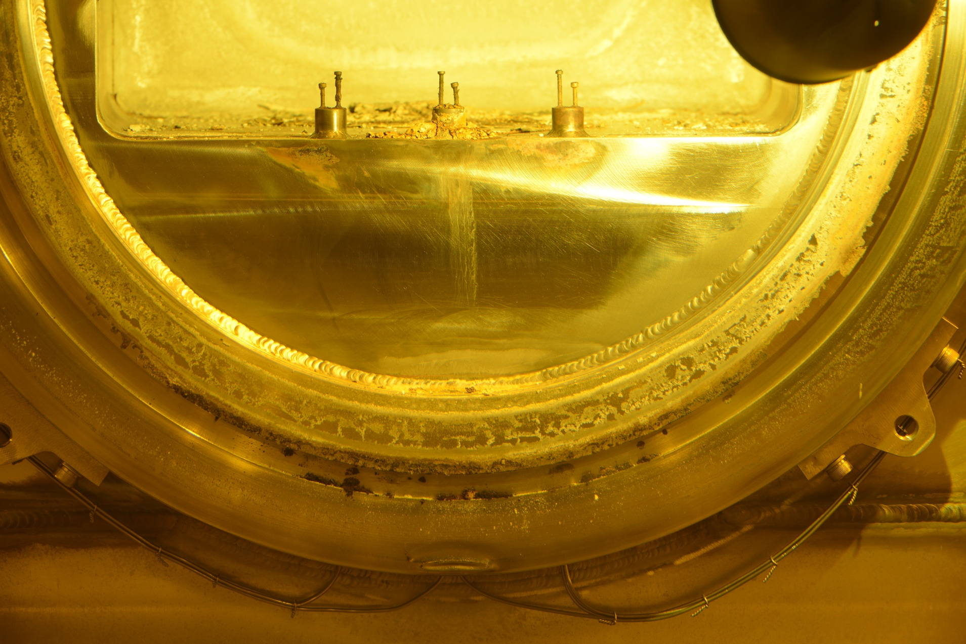
Corrosion products likely collected between sealing surfaces
Corrosion products and water likely collected between the PBW and seal interface

Slide 23
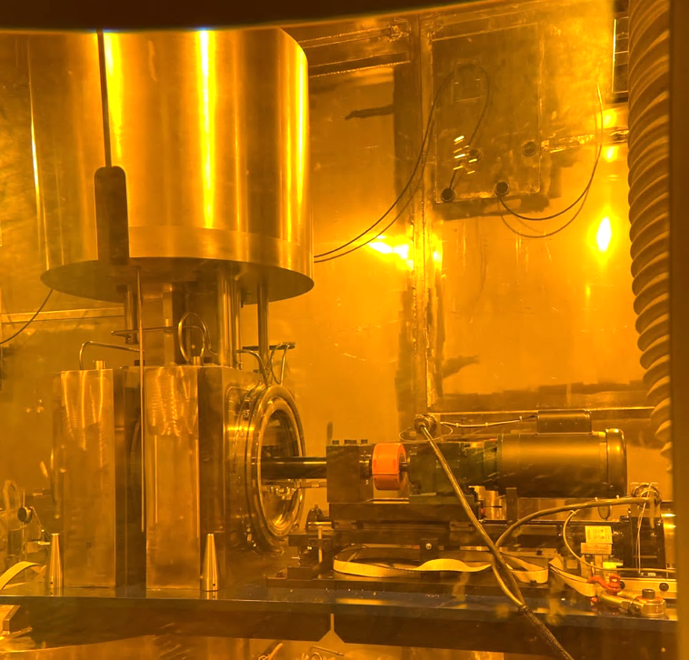
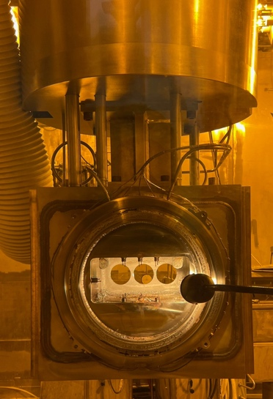
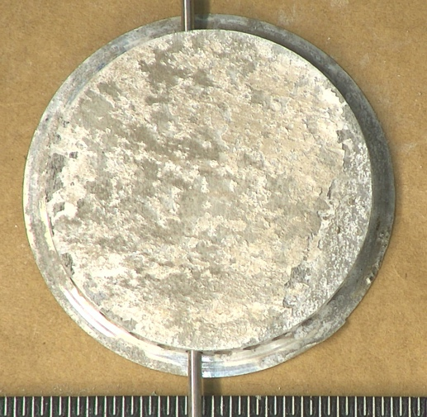
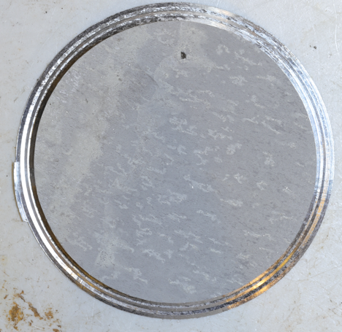
Future Work: PIE of 6061-T6 aluminum PBW samples is underway
Administrative dose limits are currently based on helium production…Is this wise?
Samples were removed from the first operational 6061-T6 aluminum PBW
  4.4 dpa
  2,133 appm He and 3570 appm H
Work is underway to perform tensile testing and characterizations at ORNL
  DIC, DSC, TDS, in-situ testing with EBSD, thermophysical properties measurements
PBW 6 During and After Sampling
PBW 6 Sample
PBW 6 Sample Machining Map
Before Shipment
After Shipment

Slide 24
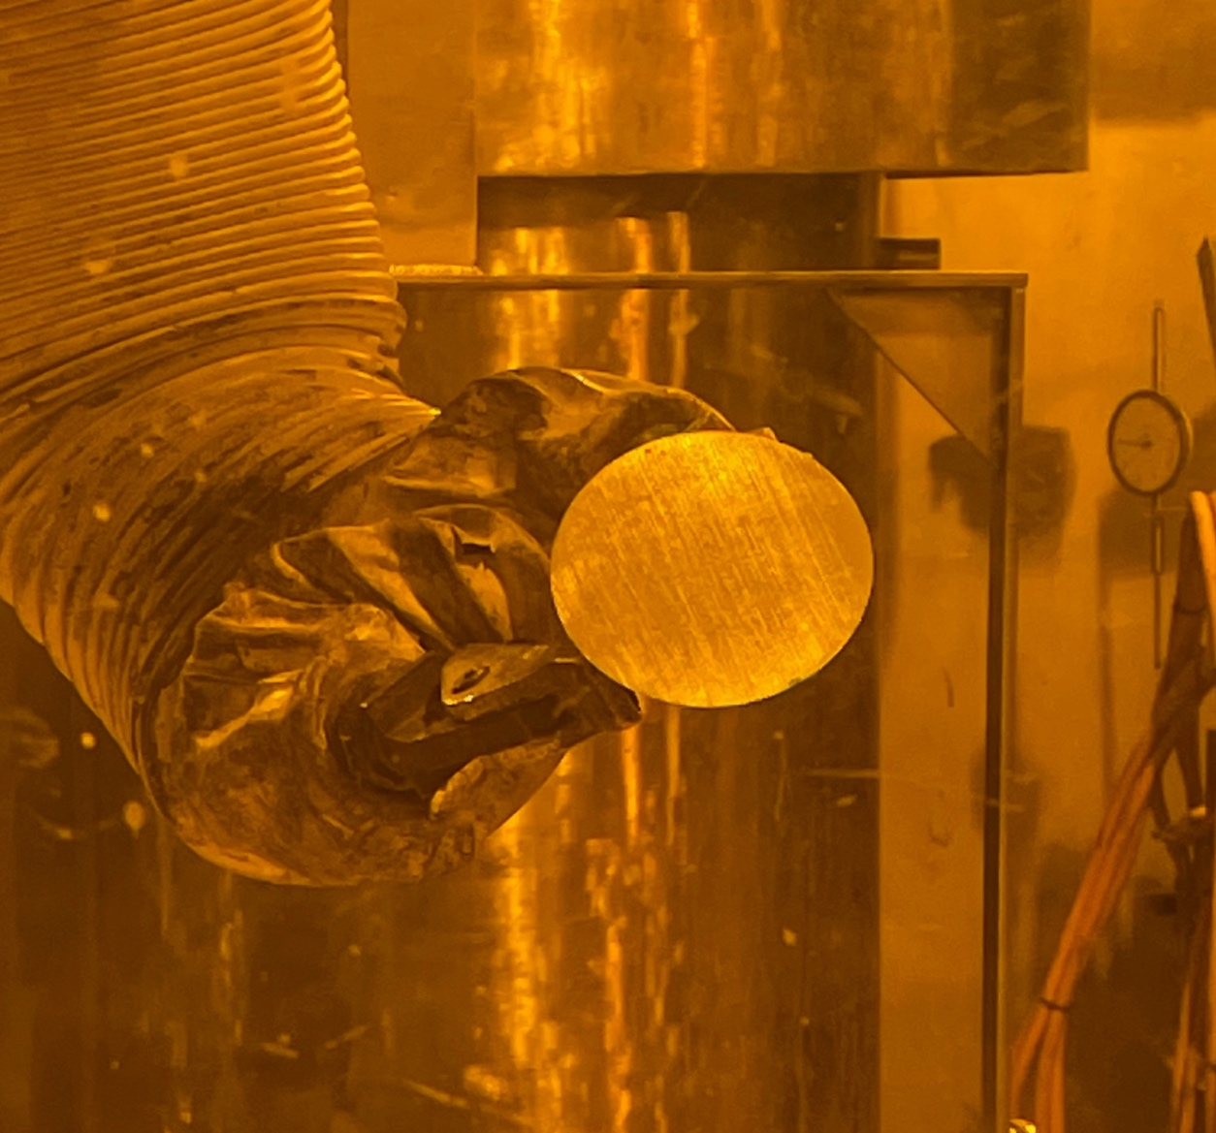
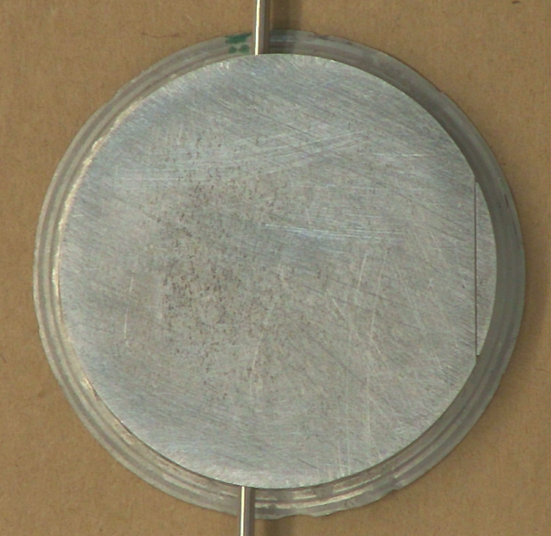


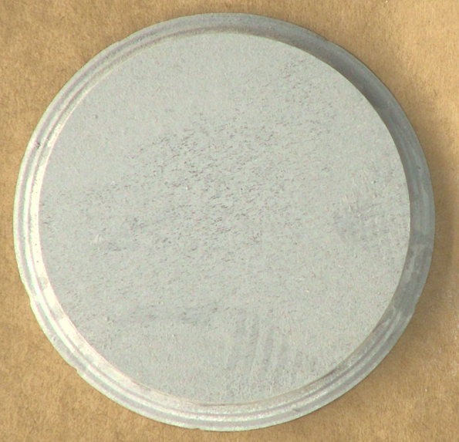
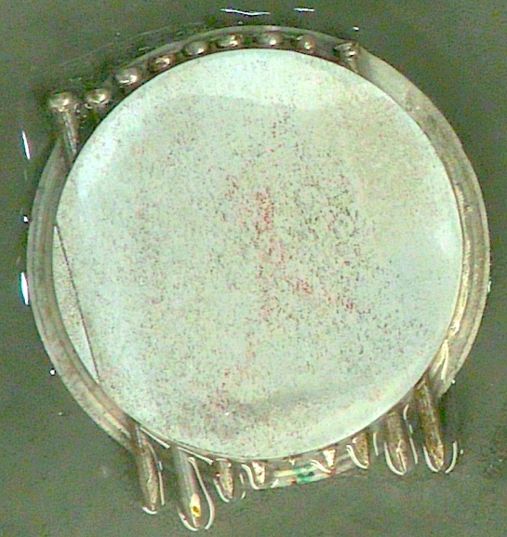
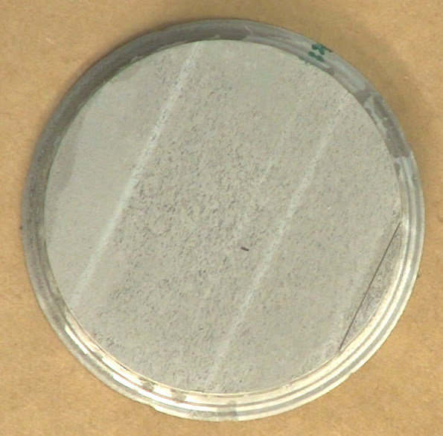
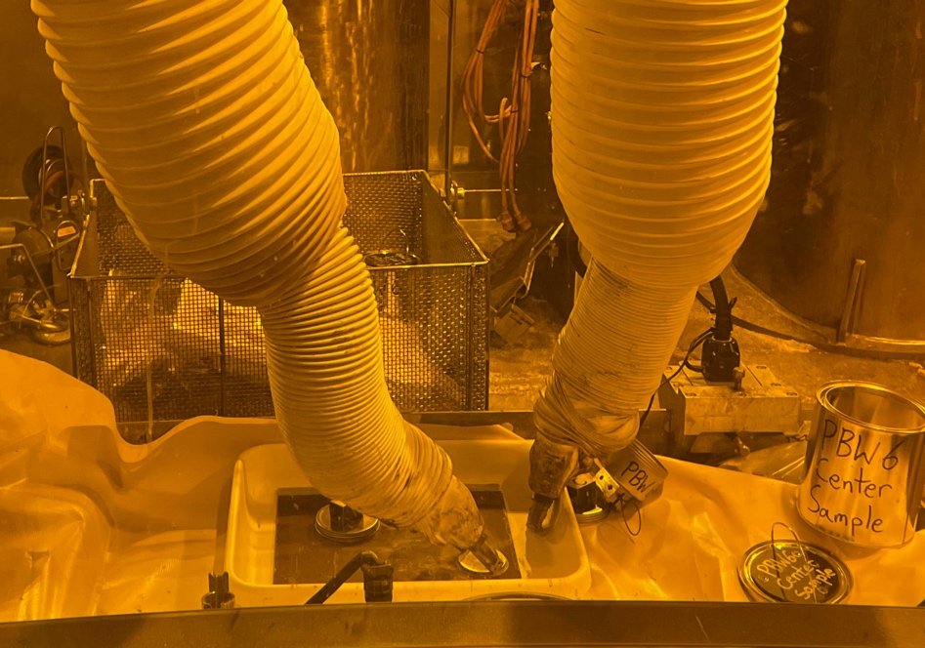
The oxide layer prevented electrical contact and had to be removed before electrical-discharge machining
Before Shipment
After Shipment
After Media Tumbling
After 600-grit Sanding
Touch-off attempts after 600 grit sanding
Removing oxide layer from samples at SNS
Attempts at a Second Touch-off Point
(Not Successful)
Entrance of Skim-cut Attempt
First Touch-off Point (Successful)

Slide 25
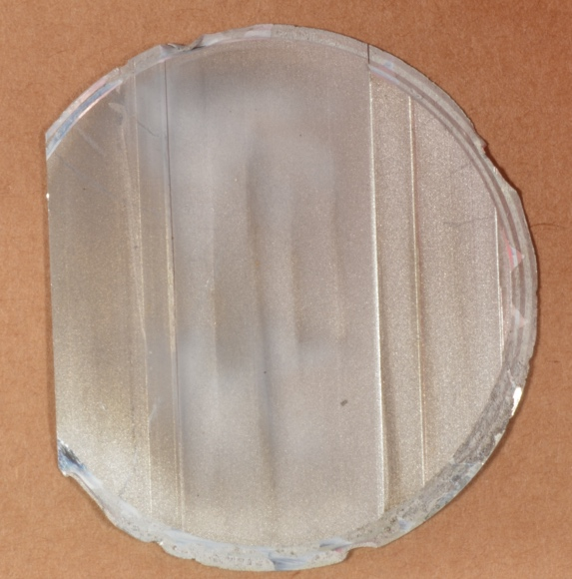
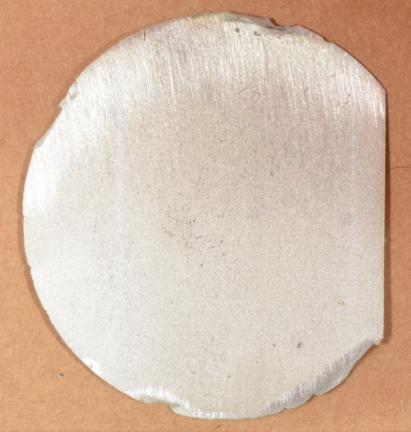
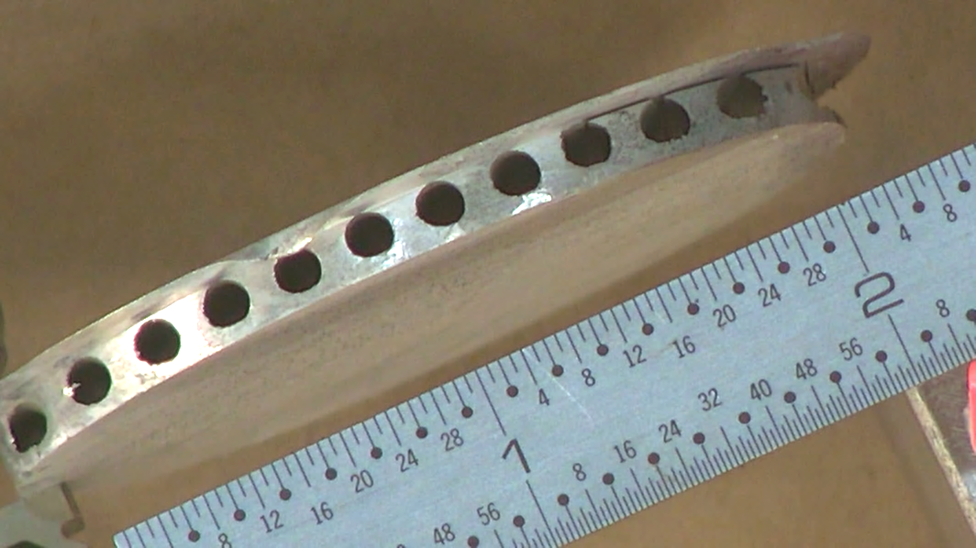
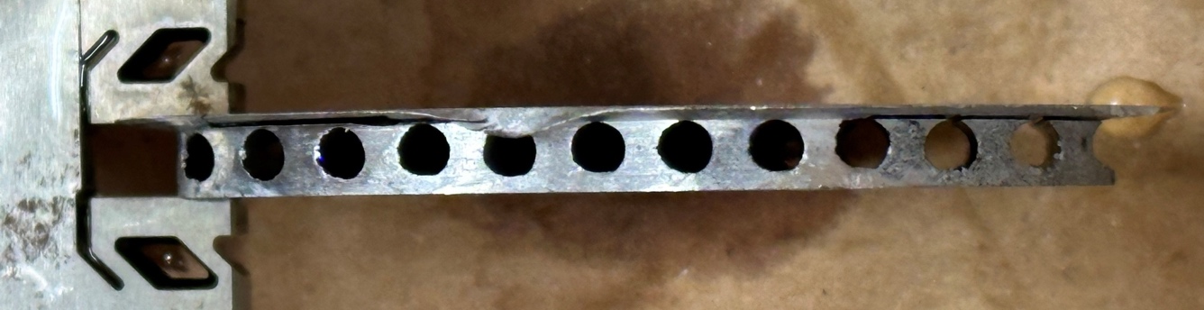
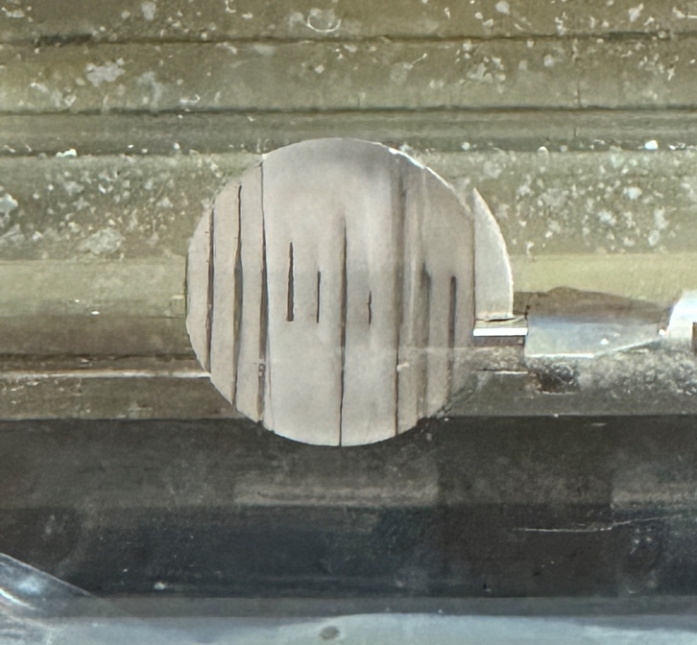
After much delay…progress was made on fabricating specimens from the Al6061-T6 PBW samples
Upstream side of Right-side sample facing holes
Upstream side of Right-side sample facing upstream
First cut stopped at oxide on channel
Right-side sample after first cut
Second cut stopped at large burr (with oxide) – burr was mechanical removed, and cut was successfully made

Slide 26




Downstream cut was successful, and specimens have been fabricated!
Remnants of downstream slab of right-side sample
Remnants of the right-side sample
Downstream slab from right-side sample

Slide 27
Lifetime limits are based on material specific vulnerabilities
Prompt brittle behavior was observed during testing of AlMg3 specimens from the SINQ Target 9 safety hull
The lifetime of Al 6061-T6 PBWs is based on He concentration to prevent (grain boundary?) embrittlement
  Currently 2,000 appm He
A contract was signed to fabricated specimens from 3 irradiated AL 6061-T6 samples from PBW-6
  4.4 dpa
  2,133 appm He
  3,576 appm H
Aluminum 6061-T6
Vulnerability: Embrittlement through helium production
Property Limit: 5-10 % total elongation
Dose Limit: 2,000 appm He
Tensile Properties of SINQ AlMg3
Y. Dai, IWSMT-13 (2016)
SINQ Target 7

Slide 28



Future Work: Planning is underway to sample and characterize high-dose 6061-T6 beam tube samples from HFIR
The Al 6061-T6 beam tubes removed from HFIR in 2000 have 100s of dpa (>300 dpa) but only a “few dozen” appm He – considered by some as national treasures
Efforts are underway to sample and ship a beam tube sample for specimen fabrication
The observations should be fascinating…
Si Precipitates in Irradiated Al 1100
100% Si Precipitates
Si-coated vacuum filled voids
Beam Tubes of the HFIR core
HFIR HB-2 Beam Tube
1100 grade aluminum (99% pure)
3 years at 55°C, producing 5.3 at% silicon
Courtesy of Frank Garner and Ken Farrell
HB-2 is the most desirable beam tube due to highest dose

Slide 29
Summary
A new deformation mechanism in irradiated 316L was identified during SNS PIE research
  Future tensile testing is planned to investigate mechanisms governing traveling wave deformation
Tensile testing of irradiated Inconel 718 showed ductility increased with increasing dose
  HR-TEM and STEM-EELS showed small 1-3 nm vacancy clusters were associated with H (and He); much more testing is planned to further investigate
Specimen fabrication from PBW-6 (Al 6061 T6) has been difficult but is now proceeding more steadily
Contract was signed to fabricate specimens from high-dose Inconel 718 and 316L samples

Slide 30


Thank you and get ready for much more data!
Al 6061-T6
78 tensile
24 H/He
Inconel 718
45 tensile
36 H/He
316L
15 tensile
12 H/He
Total Specimens
138 tensile
72 H/He

Slide 31
Backup slides

Slide 32


NEW RESULTS – Postirradiation annealing of Inconel 718 specimens showed no embrittlement
Annealing treatments were performed on irradiated Inconel 718 specimens to investigate H/He embrittlement
Miniature tensile specimens were fabricated from PBW-4 (Inconel 718) specimens and annealed at 500, 700, and 900°C
Results of tensile testing showed no embrittlement occurred and instead ductility was recovered
TDS, DSC, and TEM was also performed on specimens after annealing
  Remarkable observations were made
  Tim Lach will present the results in next presentation
Fracture Surface After 900°C Annealing

Slide 33
Calculations from Wei Lu for upcoming testing
 | Avg. proton energy (MeV) | Total energy received (MWhr) | Peak radiation damage productions
 |  |  | Displacement (dpa) | Helium (appm) | Hydrogen (appm)
Target 12 | 940 | 4493 | 10.3 | 919 | 3582
PBW 6 | 1002 | 15893 | 4.4 | 2133 | 3576
PBW 7 | 997 | 15239 | 19.6 | 3948 | 15299

Slide 34
Appreciable transmutation gas was produced in the PBW samples – perhaps the He and H are playing a role…?
 |  | Helium Production [appm] |  |  |  | Hydrogen Production [appm]
Sample | Specimen | Proton Induced | Neutron Induced | Total |  | Proton Induced | Neutron Induced | Total
CU4 | CU4-1 | 1486 | 35 | 1521 |  | 5757 | 226 | 5982
 | CU4-2 | 1673 | 40 | 1713 |  | 6485 | 254 | 6739
 | CU4-3 | 1791 | 42 | 1833 |  | 6941 | 270 | 7211
 | CU4-4 | 1720 | 40 | 1761 |  | 6669 | 261 | 6930
 | CU4-5 | 1499 | 36 | 1535 |  | 5811 | 231 | 6042
 | CU4-6 | 1254 | 30 | 1284 |  | 4858 | 193 | 5050
 | CU4-7 | 847 | 21 | 867 |  | 3280 | 134 | 3413
CD4 | CD4-1 | 1496 | 23 | 1519 |  | 5761 | 156 | 5917
 | CD4-2 | 1684 | 26 | 1710 |  | 6485 | 171 | 6656
 | CD4-3 | 1803 | 28 | 1831 |  | 6942 | 185 | 7127
 | CD4-4 | 1731 | 27 | 1757 |  | 6662 | 178 | 6841
 | CD4-5 | 1510 | 24 | 1535 |  | 5817 | 162 | 5979
 | CD4-6 | 1264 | 20 | 1283 |  | 4864 | 133 | 4997
 | CD4-7 | 854 | 14 | 868 |  | 3289 | 94 | 3383
RD4 | RD4-1 | 833 | 13 | 845 |  | 3206 | 86 | 3292
 | RD4-2 | 942 | 14 | 956 |  | 3627 | 94 | 3721
 | RD4-3 | 991 | 15 | 1006 |  | 3816 | 101 | 3917
 | RD4-4 | 967 | 15 | 982 |  | 3723 | 100 | 3823
 | RD4-5 | 848 | 13 | 861 |  | 3267 | 89 | 3356
 | RD4-6 | 709 | 11 | 720 |  | 2730 | 75 | 2805
 | RD4-7 | 475 | 8 | 483 |  | 1829 | 51 | 1881
 |  | Displacement Dose [dpa] |  |  |  | Gas Production Rates
Sample | Specimen | Proton Induced | Neutron Induced | Total |  | [appm He/dpa] | [appm H/dpa]
CU4 | CU4-1 | 7.04 | 1.06 | 8.10 |  | 188 | 738
 | CU4-2 | 7.94 | 1.18 | 9.12 |  | 188 | 739
 | CU4-3 | 8.49 | 1.25 | 9.74 |  | 188 | 740
 | CU4-4 | 8.16 | 1.21 | 9.37 |  | 188 | 740
 | CU4-5 | 7.11 | 1.08 | 8.19 |  | 187 | 738
 | CU4-6 | 5.94 | 0.91 | 6.85 |  | 188 | 738
 | CU4-7 | 4.01 | 0.64 | 4.65 |  | 186 | 734
CD4 | CD4-1 | 6.94 | 0.84 | 7.78 |  | 195 | 761
 | CD4-2 | 7.80 | 0.92 | 8.72 |  | 196 | 763
 | CD4-3 | 8.36 | 0.99 | 9.35 |  | 196 | 762
 | CD4-4 | 8.03 | 0.95 | 8.98 |  | 196 | 762
 | CD4-5 | 7.01 | 0.87 | 7.89 |  | 195 | 758
 | CD4-6 | 5.86 | 0.72 | 6.58 |  | 195 | 759
 | CD4-7 | 3.96 | 0.51 | 4.47 |  | 194 | 756
RD4 | RD4-1 | 3.86 | 0.46 | 4.33 |  | 195 | 761
 | RD4-2 | 4.37 | 0.51 | 4.88 |  | 196 | 762
 | RD4-3 | 4.60 | 0.54 | 5.14 |  | 196 | 762
 | RD4-4 | 4.49 | 0.54 | 5.03 |  | 195 | 760
 | RD4-5 | 3.94 | 0.48 | 4.43 |  | 195 | 758
 | RD4-6 | 3.29 | 0.41 | 3.70 |  | 195 | 759
 | RD4-7 | 2.20 | 0.29 | 2.49 |  | 194 | 755
483-1833 appm He
188-196 appm He/dpa
738-763 appm H/dpa
1881-7211 appm H

Slide 35



BWXT is contracted to fabricate specimens from the PBW-6 samples
Top of Sample
PBW-6 Center Sample
Bottom of Sample
Wire EDM cuts
(b)
2.293 in
0.0375 in
~0.120 in
0.0375 in
2.293 in
(a)
(c)

Slide 36


The sample thicknesses are not as-expected
Measurements from images
Right Side Sample
Size of tensile specimen needed
Grain size [µm] | Grain size [m] | Grain Size [in] | Thickness for x7 (grains needed) | Thickness for x5 (grains needed)
125 | 0.000125 | 0.00492 | 0.0344 | 0.0246
150 | 0.000150 | 0.00591 | 0.0413 | 0.0295
175 | 0.000175 | 0.00689 | 0.0482 | 0.0344
200 | 0.000200 | 0.00787 | 0.0551 | 0.0394
225 | 0.000225 | 0.00886 | 0.0620 | 0.0443

