Slide 1
ISIS-II Target Concept Development
Dan Wilcox, High Power Targets Group, Rutherford Appleton Laboratory
16th International Workshop on Spallation Materials Technology, Abingdon, UK
29th October 2024

Slide 2
Contents
Overview of proposed target stations
Pushing the limits of a static target
Rotating target concepts
Alternative material options
Summary
An ariel photograph of the ISIS facility

Slide 3
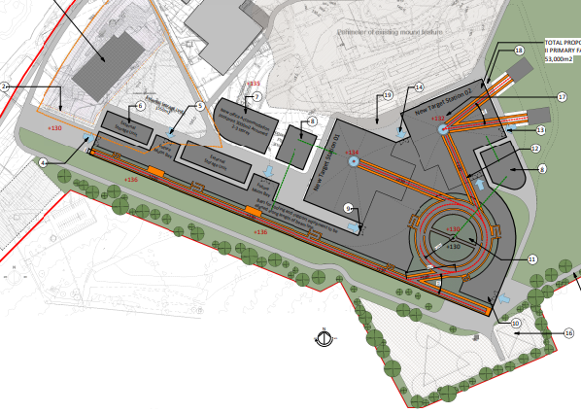
ISIS-II: the UK’s next generation Neutron and Muon source
Current phase: “Feasibility, Design Studies and R&D”
MW-class short-pulse spallation source
New accelerator and two new target stations from day one, optimised for different things
Power on targets: 1.6 MW and 0.8 MW
Preferred location: Greenfield site at RAL
Notes:
Short pulse makes us complementary to ESS and makes use of existing expertise. Designing for efficiency rather than pure power. Part of that efficiency is having two target stations from day one.

Slide 4
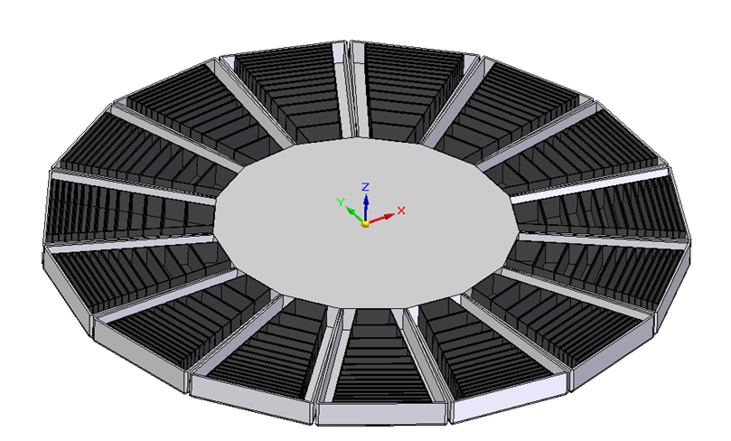
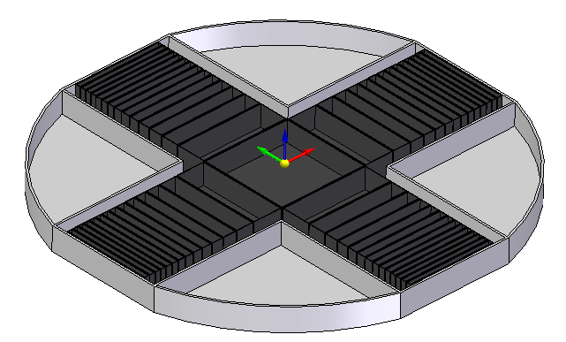
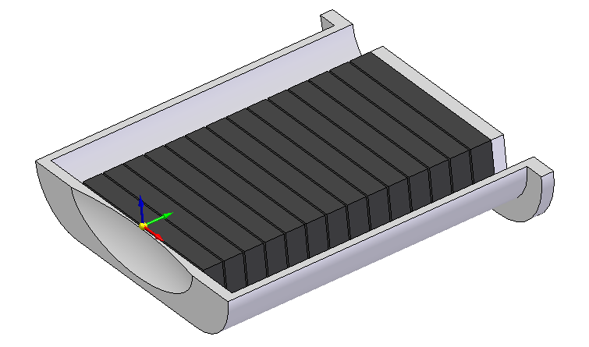
ISIS-II Target Concepts
Initial focus on “Conventional” ISIS target technology – Ta-clad W plates
Stationary Target
Familiar technology
Water cooled or helium cooled?
Limited acceptable beam power
4-Segment Target Wheel
Compact wheel option
Relatively familiar manufacture
15-Segment Target Wheel
Highest acceptable beam power
Complex manufacture and handling
Notes:
Aim of the initial study is to define the limits of “conventional” ISIS tungsten plate targets. Particular focus on defining the power limit for a stationary target.

Slide 5
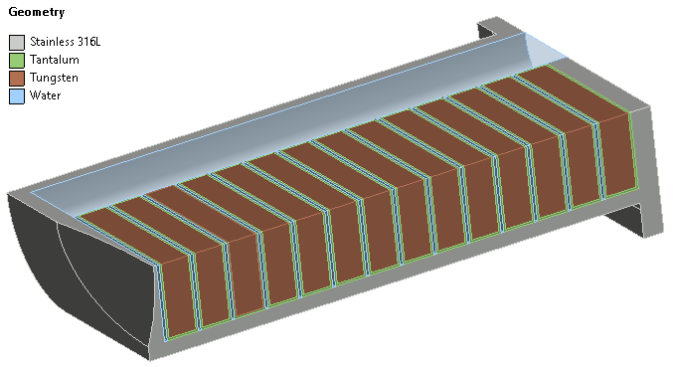
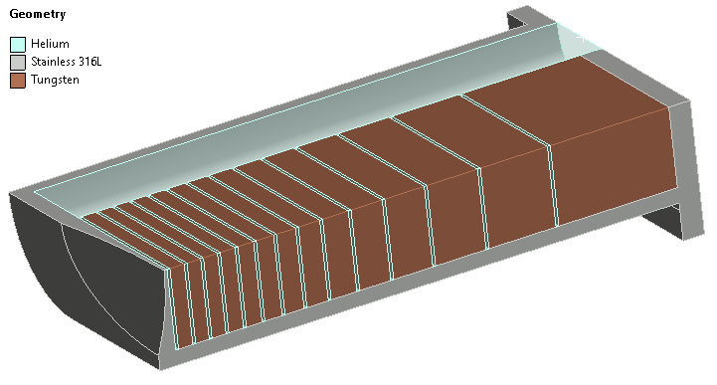
Starting Point for Optimisations
Current TS1 target height, double current width
Beam profile Gaussian (worst case) or flattened
Coolant: heavy water or helium gas
Baseline materials: pure tungsten, Ta-clad if water cooled
Up to 14 plates (about the highest number possible with tantalum-cladding before the front plates become too thin to manufacture)
Custom Python script optimises plate thicknesses and maximum beam power for each concept
Notes:
14 plates is approximately the limit for clad plates, before the front plates become difficult to manufacture. For very thin plates, the cladding thickness is a large fraction of the total plate thickness.
For a given beam power, a custom python script adjusts the plate thicknesses to get an even distribution of thermal stress, then scales the beam power to find the maximum allowable without exceeding a defined thermal stress limit.

Slide 6
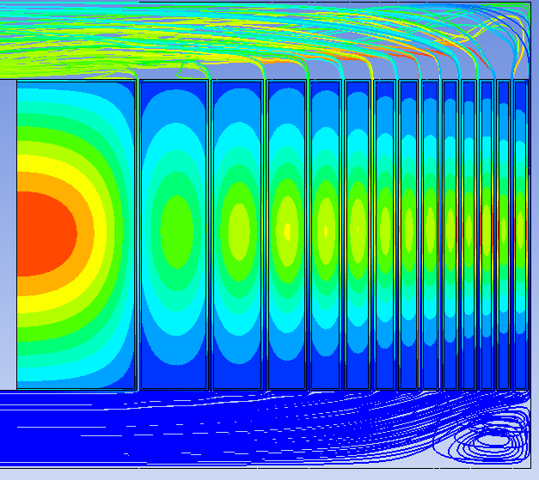
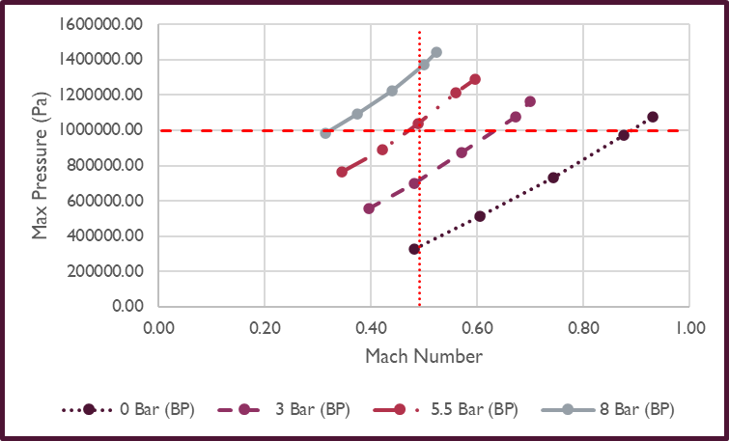
Helium Gas Coolant Parameters
Best heat transfer coefficient requires high velocity and high pressure
Velocity limited to Mach number <0.5
Pressure limited by vessel wall thickness to ~10 bar
Outlet temperature may be limited by sealing technologies to ~180°C (currently ~60°C, so not an issue)
Can’t match HTC of water cooling, but with more target segmentation can still increase beam power, which seems acceptable to neutronics so far
With achievable helium parameters and 14 plates, the maximum allowable beam power is ~400 kW
Pressure too high
Velocity too high
Images courtesy of Daniel Wells Calvo

Slide 7
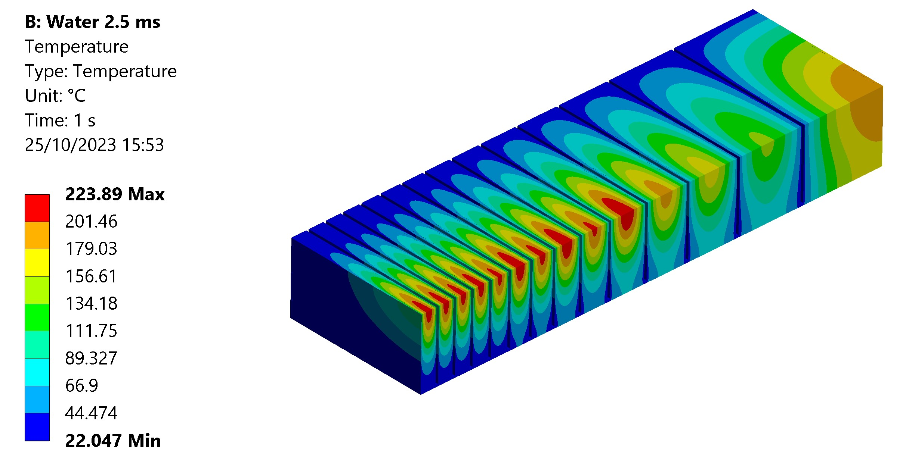
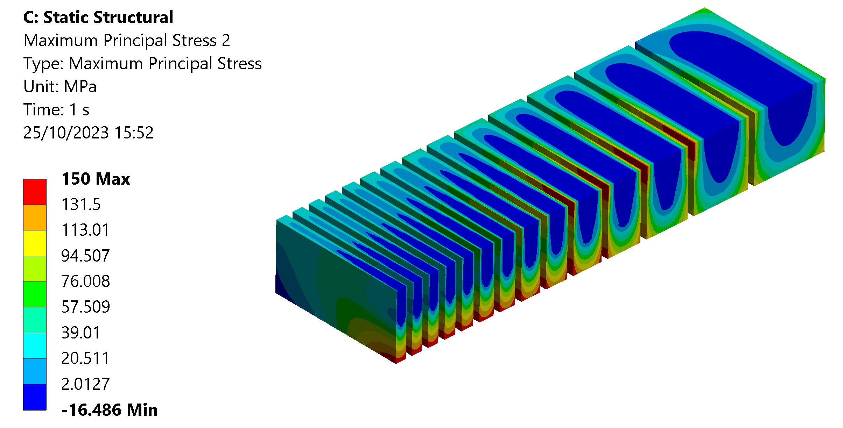
Static Target Results
Achievable beam power with 14 plates: 622kW water cooled, or 400kW helium cooled
Limited by thermal stress <150 MPa in both cases
Decay heat limit reached first?
Peak temperature limit 800°C
In LOCA simulations, peak temperature occurs 1-5 hours after cooling loss
After 1 hour, decay heat in pure W is 50% lower than in W+Ta (for the same beam power)
Temperature and stress results are similar for water cooling at 622kW and helium cooling at 400kW
Images courtesy of Daniel Wells Calvo

Slide 8
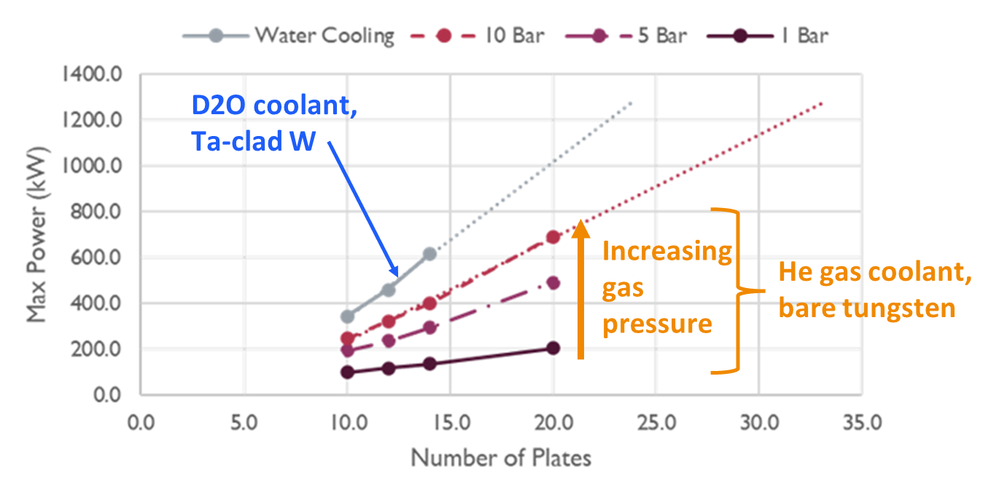
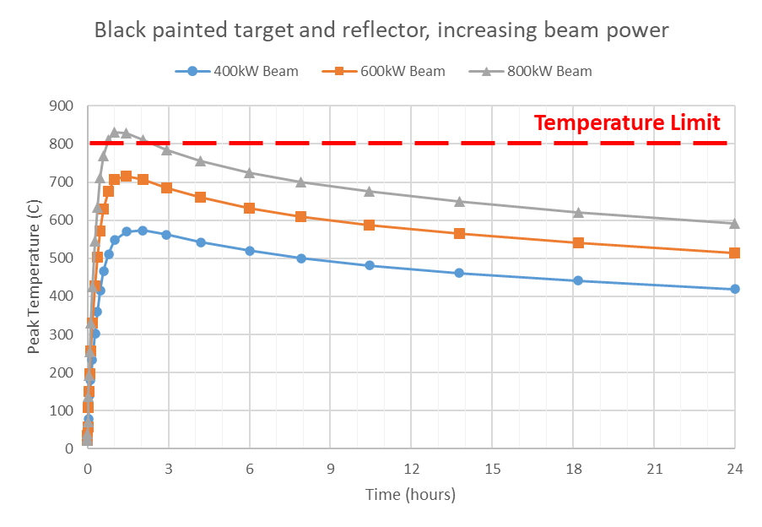
Static Target Limiting Factors
Water cooled target with Ta cladding
Direct beam limit: ~600kW
~14 plates max, before front plates have more cladding than core
Decay heat limit: ~200-400kW
Cladding roughly doubles the decay heat
Helium cooled target, bare tungsten
Direct beam limit: 1MW+
Requires many thin plates or cannelloni rods
Neutronic performance may prevent this
Decay heat limit: ~400-800kW
Upper limit assumes mitigating strategies such as black paint/coating can be guaranteed to work
Neutronic limit: ???kW
Initial studies currently underway
As presented at ICANS 2023
Notes:
We have strategies to push the direct beam limit further, e.g. widening and flattening the beam spot. However this does not help with decay heat, which was found to be the limiting factor for static targets. Agrees with what others have found.

Slide 9
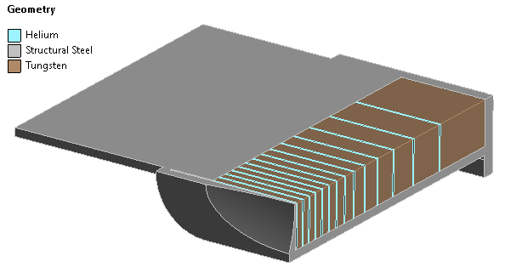
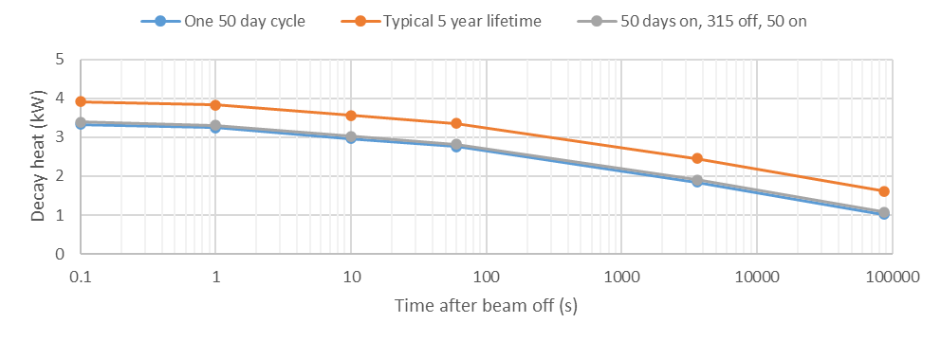
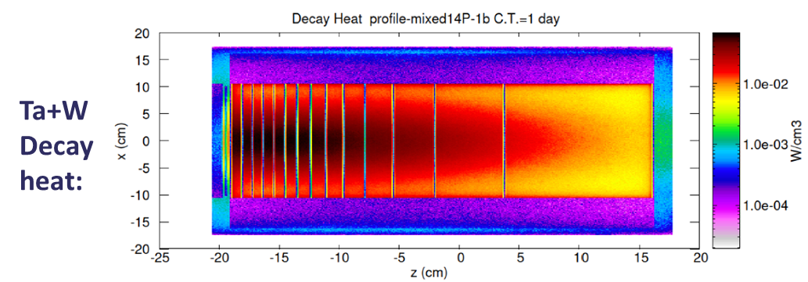
Decay Heat Mitigations to Reach 0.8 MW
Risk mitigation and FMEA
Backup cooling, e.g. water tank on roof
Maintaining void vessel – containment, He environment
Passive cooling improvements
Increased emissivity – black coating, surface texturing?
Increased surface area – “wings”, conduction to base?
Swap targets after every user cycle?
Test case: TS1 Project target geometry at 650kW, 1200MeV

Slide 10
Static Target Summary
0.8 MW looks challenging but maybe not impossible
Decay heat rules out any mm-scale Ta cladding
Alternatives; >0.3mm Ta layer, Niobium (activation issue), Zircaloy, other?
Or abandon water cooling and use helium gas on bare tungsten
Will bare tungsten survive thermal shock from short-pulse beam?
Heat removal from static target also challenging, particularly if He-cooled
Fine segmentation (rods or foils); beam power increase may be worth neutronic penalty?
Flat-topping of beam to spread out thermal shock
1.6 MW target will almost certainly have to rotate
Neutronics would ideally like more power on both targets if possible, but 0.8 MW may already be at or just above a step change in required target technology – is this worthwhile?

Slide 11
Rotating Target Concept
Each segment based on static target option
Decay heat is now manageable, so focusing on water-cooled Ta-clad option for now
Aim to keep target as compact as possible for ease of manufacture and handling
For >4 segments, aim to make each segment individually replaceable if possible
4 Segments
15 Segments

Slide 12
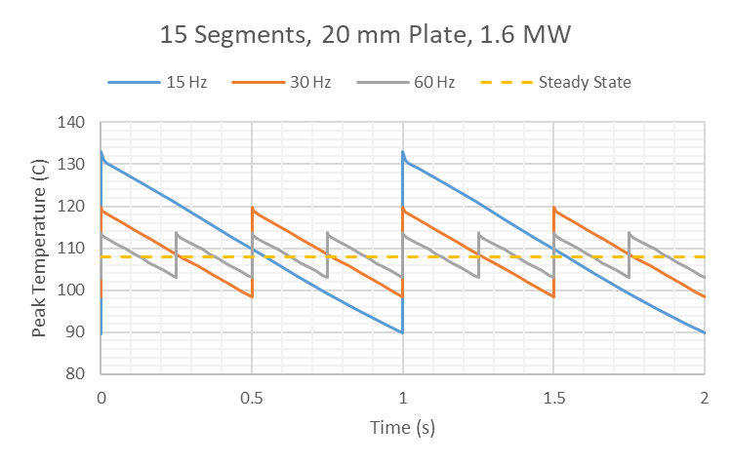
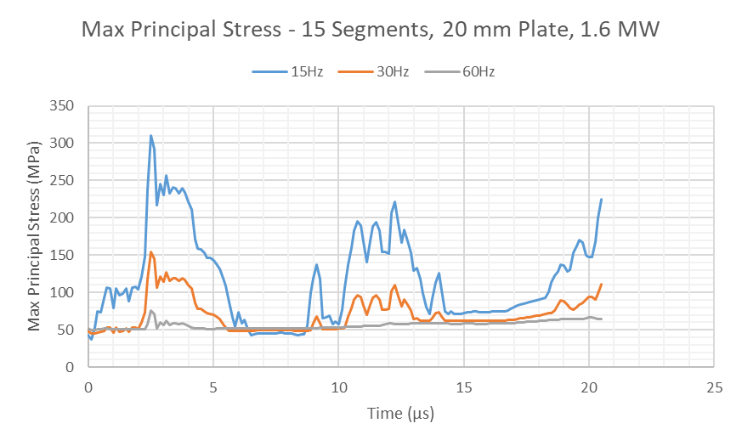
Stress Waves and Thermal Shock
Adding segments does not reduce thermal shock
Stress waves could be avoided with a long pulse duration or a highly segmented target
Long pulse is not possible neutronically (we are a short pulse facility)
Speed of sound in tungsten ~5200m/s, ISIS bunch length =100ns, therefore distance travelled by a stress wave during one bunch ~0.52mm
Highly segmented target e.g. packed bed limits dissipation of decay heat
For a constant beam power, increasing pulse frequency reduces pulse intensity
Neutronic constraints on increasing pulse frequency above ~30-40Hz
Widening and flattening the beam spot is the main stress wave mitigation strategy available to us
Average temperature depends on power only. Peak temperature also depends on frequency
Pulse stress
1E9 cycle endurance limit of irradiated tungsten
Steady state stress
Peak stress mainly driven by pulses, particularly at low pulse frequencies

Slide 13
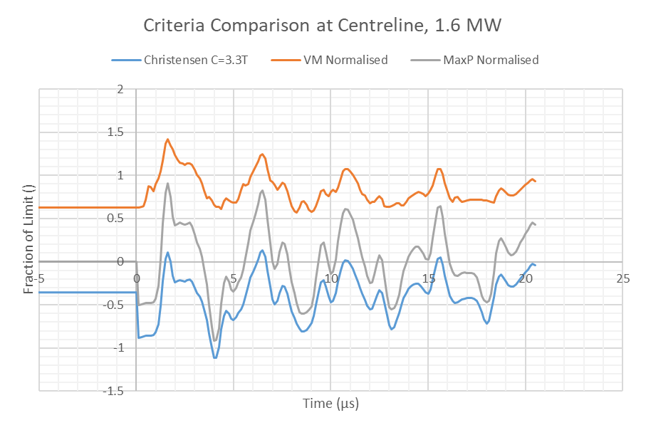
Design Criteria
Direct stress:
Christensen and max principal stress for tungsten
Von Mises stress for tantalum
Fatigue:
Goodman equivalent stress
How to account for triaxial stress in brittle materials?
Strain rate dependence is ignored – conservative for stress waves
Temperature:
Bare tungsten surface limited to <500°C to prevent oxidation
Tantalum surface temperature limited by heat flux <3MW/m^3 (burnout) rather than temperature
All criteria normalised to a limit of 1
Results for 4 segments, 30 Hz, 1.6 MW, 11 mm plate

Slide 14
Rotating Target Summary
For 1.6 MW, 30 Hz, at least 15 segments are required with a Gaussian beam profile
Next steps:
Reduce thermal shock severity by flattening the beam profile
Simulation of decay heat in rotating wheel – does tantalum accumulate decay heat even outside of direct proton beam?
Consider failure modes – are tungsten particles in helium gas worse than dissolved tungsten in cooling water? Does the cladding serve a structural function?
Aims for future development:
Minimise number of segments, and therefore size and complexity of wheel
Minimise number of plates, and therefore volume of tantalum

Slide 15
Alternative Materials
Core
Pure tungsten (baseline)
Densimet
W+few%Ta (stronger for unclad plates?)
TFGR (Toughened, Fine Grained, Recrystallized) W-1.1%TiC – not yet manufacturable in bulk?
Cladding
HIPed Ta; 1.5mm (baseline) to 0.3mm (min)
Ta with few % W?
CVD thin tantalum?
Niobium – if waste can be managed
Canning (i.e. unbonded cladding)
Zircaloy
Inconel?
Stainless or ODS steel
High entropy alloys?

Slide 16
Irradiated Material Properties Summary
 | Tungsten | Tantalum
Tensile Data | Product size/form dependent | Some variability – impurities and product form?
Tensile after Irradiation | Good data | Retained ductility quite variable – effect of impurities?
Fatigue | Good data | Good data
High Cycle Fatigue | No data above ~2E6 cycles | Up to ~1E8 cycles, high and low frequency
Fatigue after Irradiation | No data | No data
Thermal Conductivity | Limited data with protons. Critical for core temperature | No data, but small effect from thin cladding
Tantalum can retain high ductility after 11dpa, however there is a lot of scatter in the (limited) available data
Tantalum impurities and gas production in the irradiation environment may explain this
Peak dose after 5 years operation:
30 dpa on TS1, 70dpa on TS2
Very limited data above ~20dpa
Other unknown effects:
Is HIP residual stress annealed by irradiation?
Cold creep in Ta?

Slide 17
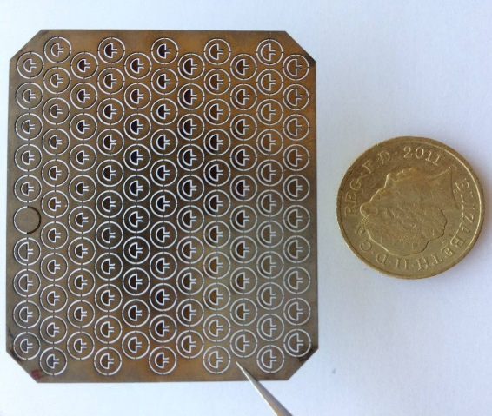
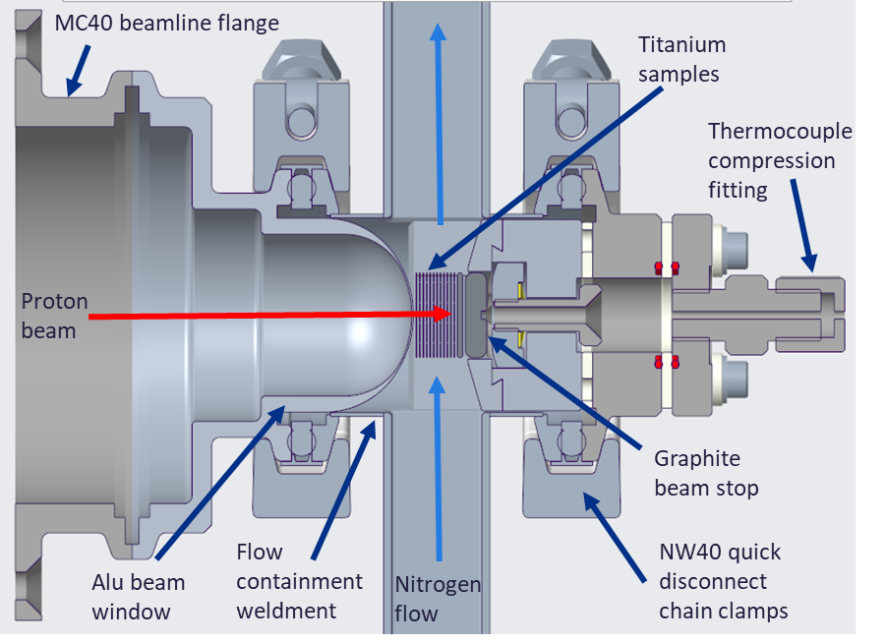
Overlap with RaDIATE Collaboration
Mesoscale fatigue tests on tantalum and tungsten
20kHz test = 1E9 cycles in 14 hours
Already have low frequency data for comparison
Proof of concept test on 100 µm thick tungsten foil completed
Followed by irradiated fatigue tests if possible
Ti irradiation with active cooling planned at Birmingham University cyclotron, could be adapted for Ta and W
Small scale laser flash analysis also demonstrated at Oxford University
Thermal diffusivity measurements on irradiated foils
In addition to in-situ measurements on new TS1

Slide 18
Summary
ISIS-II currently under design, will operate at more than 10x higher power
Two neutron target stations from day one, stationary and rotating options under consideration
Preferred option: one static target, one compact rotating target
Limiting factors: decay heat on static target, thermal stress on rotating target
Investigation into alternative materials is in early stages

Slide 19
Thank you for your attention.
Any questions?

