Slide 1

16th International Workshop on Spallation Materials Technology
October 31st, 2024
Study on Electromigration Effect
on corrosion and mass transfer
in High-temperature Liquid Metal Pool
HUMAM¹, Susumu HATAKEYAMA², Masatoshi KONDO³
¹ School of Environment and Society, Institute of Science Tokyo, Japan
² School of Engineering, Institute of Science Tokyo, Japan
³ Institute of Integrated Research, Institute of Science Tokyo, Japan
Yoshiki Kitamura¹ is going to present on behalf of Mr. Humam.

Slide 2
Introduction
Liquid lead (Pb) and its alloy have been proposed as a spallation target of accelerator driven systems (ADSs), a coolant of fast reactors (FRs) and a tritium breeder of fusion reactors. The chemical compatibility of liquid Pb with structural materials is one of the important issues to be addressed.
M. Kondo et al. JNST (2006 )
Corrosion behaviors of austenitic steels
in heavy liquid metal coolants (HLMCs) Pb and LBE
316 specimen after exposure
to flowing LBE
Austenitic steels could cause a selective leaching of Ni and Cr in liquid LBE(C. Shroer et al., Corrosion Science 2014), since the solubility of these elements in liquid LBE was quite large at high temperature.
The corrosion of austenitic steels in HLMC was mainly influenced by the temperature, flow velocity and oxygen concentration (G. Ilincev et al., Nucl. Eng. Des. 2006).
Oxide
layer
Fe
Depletion of Ni and
penetration of LBE
Fig. 1 Cross-sectional SEM/EDX analysis of 316 specimen after exposure to flowing LBE

Slide 3
Electron stream in ADS and Fusion reactors
The electron stream through the interface between liquid metals and structural materials can be produced according to the proton irradiation in ADSs and the α-particle irradiation in fusion reactors.
I. Dutta et al.
Appl. Phys. Lett. 94, 184104 (2009)
Electromigration (EM) and its effect on corrosion and mass transfer in high-temperature liquid metals
Electromigration phenomenon in liquid metals was reported. That technology was applied for the coating of micro patterned structures (For example, I. Dutta et al. (2009)).
However, the effect of electromigration on the material corrosion in liquid metal pools was not clarified so far.
Fig. 2 Time-lapse photographs of a molten stream emanating from a Ga bead placed on a Cu stripe on Si, and traveling from right to
left, along the current direction.

Slide 4
Purpose of present study
To clarify the effect of electromigration on the material corrosion in liquid metal Pb by means of electromigration experiment in high-temperature liquid Pb pool.
To clarify the theoretical model of electromigration in high-temperature liquid metals.

Slide 5
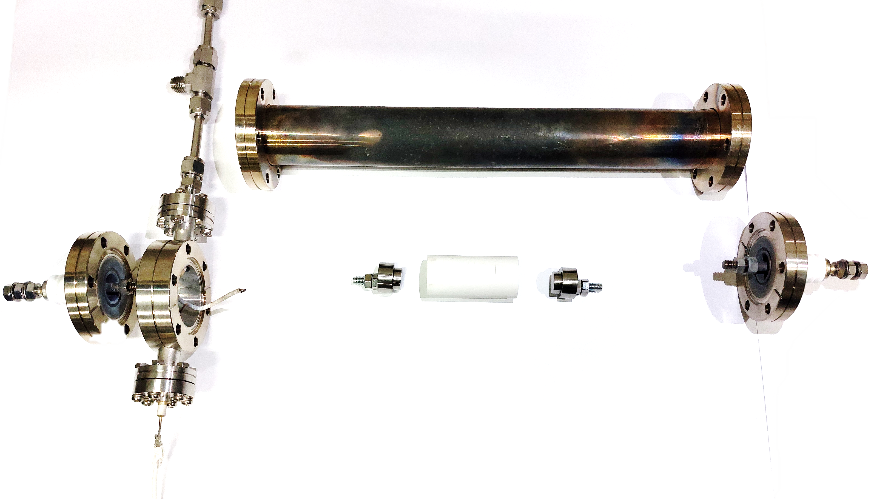
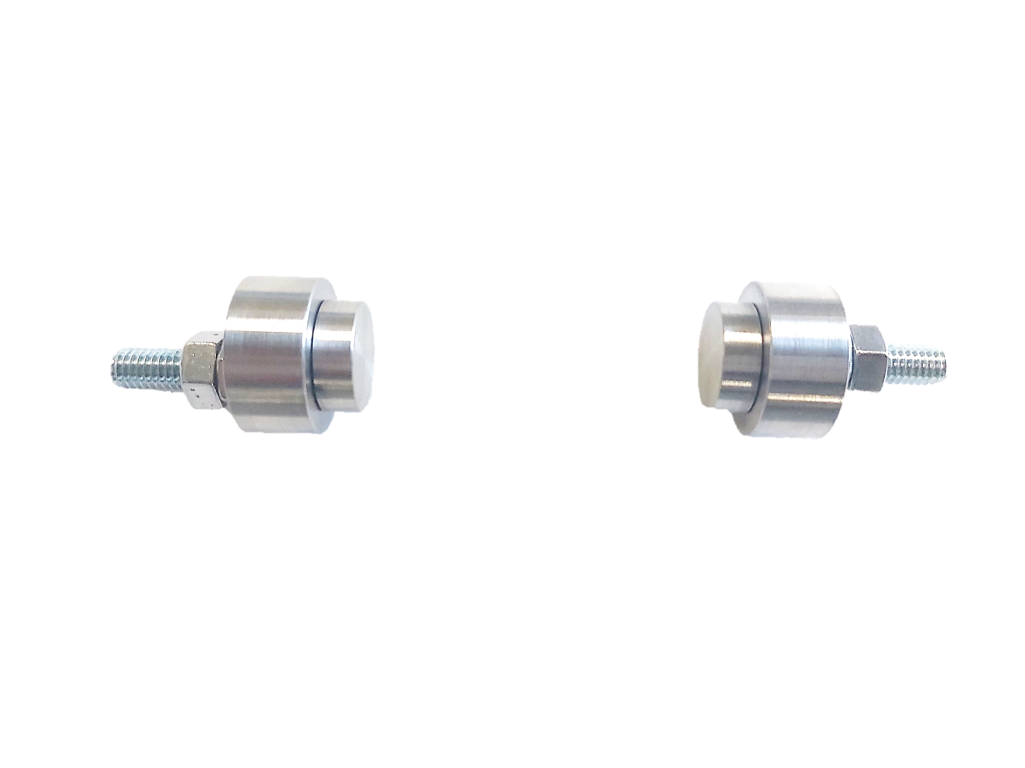



Experimental apparatus
used for electromigration test
Outer vessel
Test capsule
(crucible)
Test material: 304 austenitic steel
(Fe-18Cr-12Ni)
Liquid metal: Pb
(approximately 100 g: 10cc)
V/S ratio: approximately 2.5 ×10⁻²
Two 304 specimens were installed. The current flowed through the specimen and liquid Pb.
Cover gas: Ar gas
The temperature inside the vessel was monitored by thermocouple.
Ar gas
Specimen
Staging
Thermocouple
63
43
33
TC
(Test temp.)
Copper wire
Ar
304
Ar gas
Ф20
$$\text{Ф}\text{2}\text{2}$$
$$\text{Ф}\text{2}\text{8.5}$$
Staging
Crucible (Al₂O₃ SiO₂)
Outer vessel
304 specimen
(Electron down stream)
Liquid Pb pool
304 specimen
(Electron
up stream)
Heater
Insulator
Fig. 3 Experimental apparatus used for electromigration test

Slide 6
Experimental conditions of electromigration test in liquid Pb
Table 1 Experimental conditions
Temperature | 773 K
Test material | 304 (Fe-18Cr-12Ni)
Liquid metal | Pb
Test current density (electromigration) | 3.7 A/m²
Test duration | 250 hours
Specimens are cleaned using a solution with a mixture of acetic acid, ethanol, and 30% H₂O₂ (1:1:1).
The 304 specimens (tested in upstream and downstream) were observed and analyzed by SEM/EDX, FE-SEM, Auger and EBSD.
Static corrosion tests were also performed without electron current flow.

Slide 7
Experimental results
304 specimen
(Electron downstream)
(Electrical current)
304 specimen
(Electron upstream)
Simple static immersion
(304/Pb, 773 K, 250 hr)
50 μm
Cavity
1 μm
304
50 μm
Electron stream
Fig. 4 SEM surface tilt image of dimple-like structure on 304 specimen installed in electron downstream
Fig. 5 SEM surface tilt image of precipitations on 304 specimen installed in electron upstream
Fig. 6 SEM surface image of of 304 specimen tested without electrical current flow.
The 304 specimens installed in upstream and downstream revealed different morphology. The surface morphology was different from that after simple static immersion
The morphology of the specimen installed
in electron downstream side is explained in next slide.

Slide 8
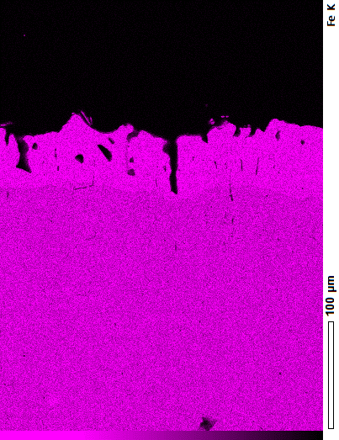
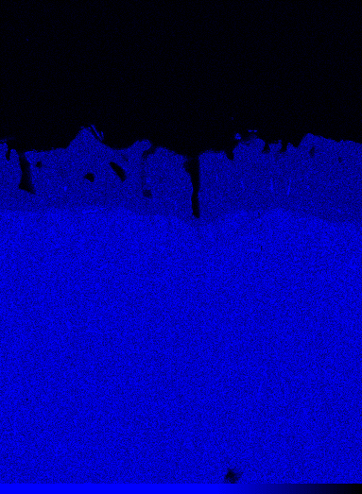
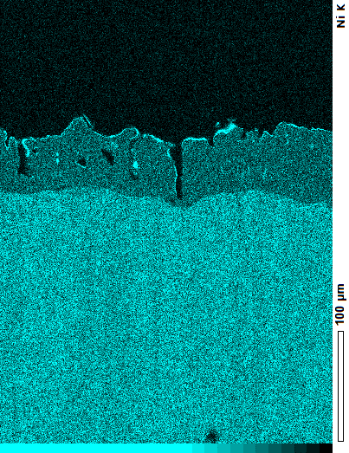
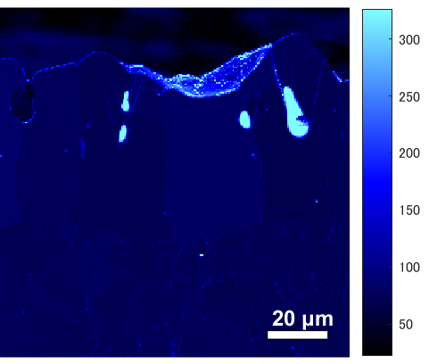
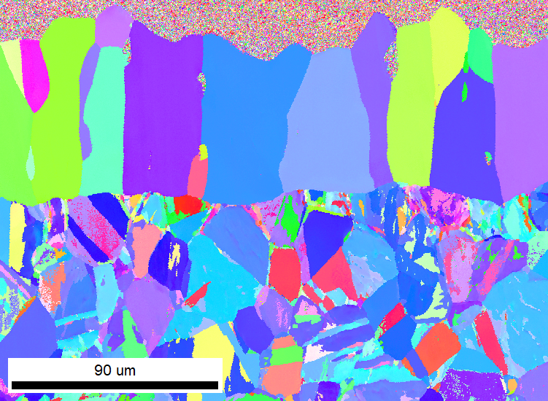
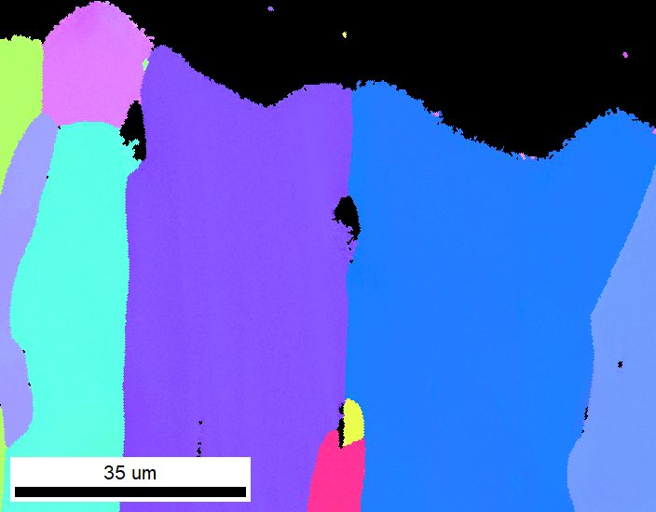
Morphology of 304 specimen (electron downstream side)
Dimple-like structures were observed on the electron downstream side.
The ferritization of specimen surface was caused by the depletion of Ni in the dissolution corrosion process. (The thickness was approximately 55 μm)
The penetration of Pb elements into the test material was detected according to the results of EDX and AES analysis indicated
Some cavities were also detected on the corroded surface. These cavities were located along the grain boundaries.
(a) Fe mapping
Resin
(b) Cr mapping
(c) Ni mapping
Cavities
Fe enrichment
Cr depletion
Ni depletion
50 μm
304
Fig. 7 EDX mapping analysis on 304 specimen installed in electron downstream side.
Ferritization
Cavities
Depleted region
Pb penetration
Grain boundary
Matrix region
Fig. 8 EDX mapping analysis on 304 specimen in stalled in electron downstream side.
Fig. 9 AES Pb mapping analysis on 304 specimen in stalled in electron downstream side. (Tilting angle: 30 degree)

Slide 9
Experimental results
304 specimen
(Electron downstream)
304 specimen
(Electron upstream)
50 μm
Cavity
(Electrical current)
1 μm
304
Electron stream
Liquid Pb pool
Fig. 4 Dimple-like structure on 304 specimen installed in electron downstream
Fig. 5 Precipitations on 304 specimen installed in electron upstream
The 304 specimens installed in upstream and downstream revealed different morphology.
The morphology of the specimen installed
in electron upstream side is explained in next slide.

Slide 10
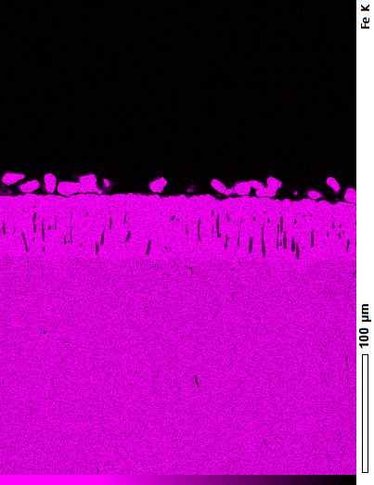
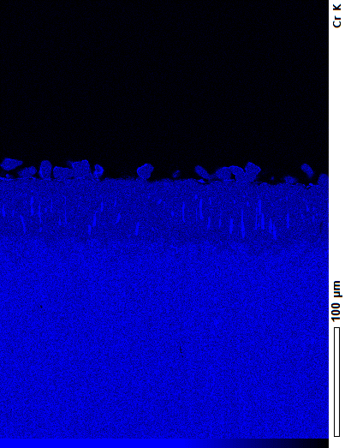
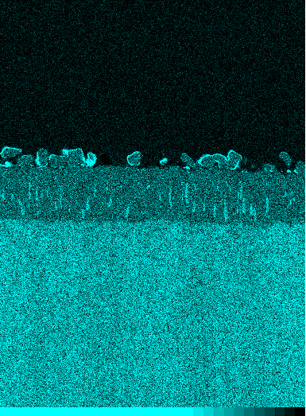
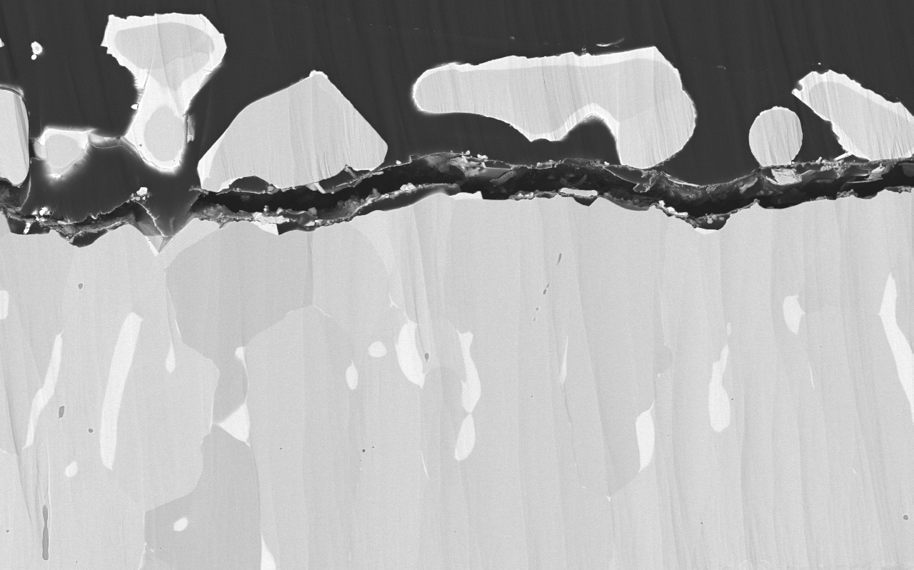
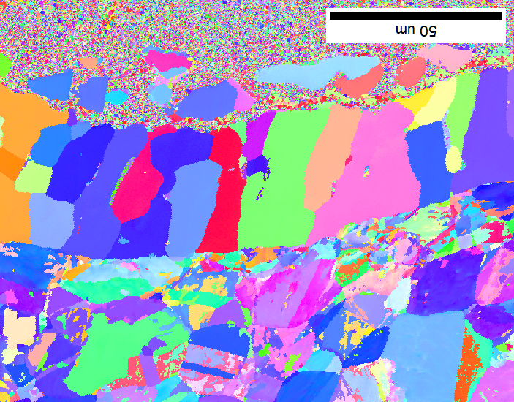
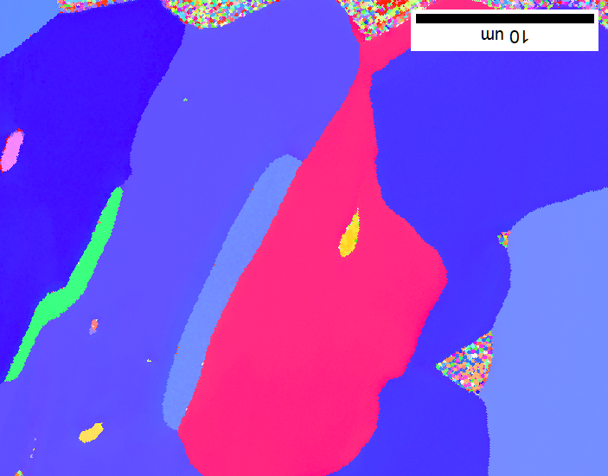
Morphology of 304 specimen (electron upstream side)
(a) Fe mapping
Resin
(b) Cr mapping
(c) Ni mapping
Precipitations were detected on the electron upstream side.
The ferritization of specimen surface was caused by the depletion of Ni in the dissolution corrosion process.
The Cr and Ni enrichment regions were partly detected in the ferritized region. These regions are located along the grain boundaries of ferritized region
Precipitations
Cr depletion
Ni depletion
Fe enrichment
50 μm
Cr enrichment
(partly)
Ni enrichment
(partly)
304
Fig. 10 EDX mapping analysis on 304 specimen installed in electron upstream side.
Precipitations
10 μm
Cr and Ni rich region
(Fe was not included)
Fig. 11 Surface cross sectional FE-SEM COMPO image of specimen installed in electron upstream side.
Fig. 12 EDX mapping analysis on 304 specimen in stalled in electron upstream side.

Slide 11
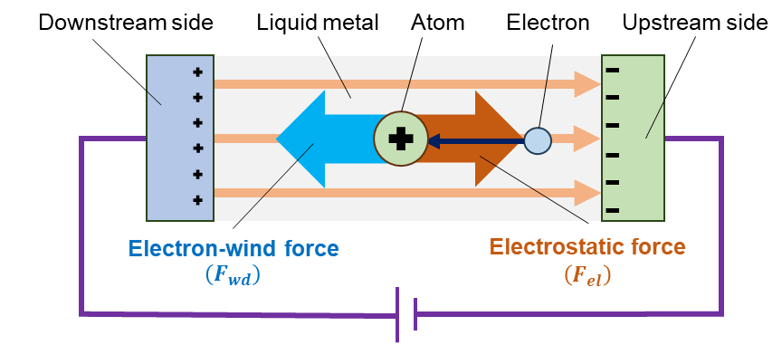
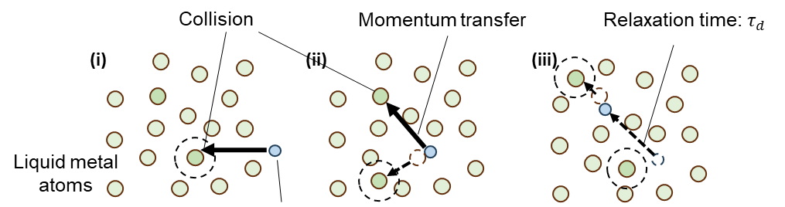
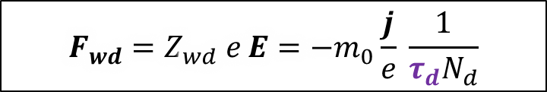
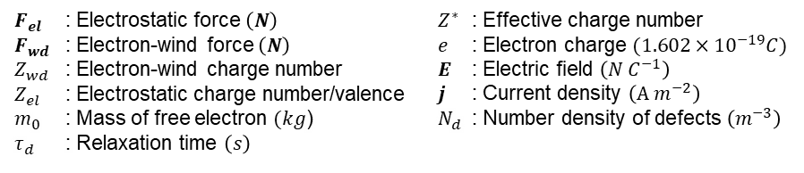
Theoretical model of electromigration in liquid Pb pool (1)
Electromigration is a mass transport phenomenon of metal atoms driven by electrical current.
Forces in electromigration
$$F=F_{el}+F_{wd}=Z_{el}eE+Z_{wd}eE=Z^{∗}eE$$
$$F_{wd}=Z_{wd} e E=−m_{0}\frac{j}{e} \frac{1}{τ_{d}N_{d}}$$
$F_{el}$ : Electrostatic force $\left(N\right)$ $F_{wd}$ : Electron-wind force $\left(N\right)$ $Z_{wd}$ : Electron-wind charge number $Z_{el}$ : Electrostatic charge number/valence $m_{0}$ : Mass of free electron $(kg$) $τ_{d}$ : Relaxation time $\left(s\right)$ | $Z^{∗}$ : Effective charge number $e$ : Electron charge $(1.602×{10}^{−19}C)$ $E$ : Electric field $\left(N C^{−1}\right)$ $j$ : Current density $\left(A{ m}^{−2}\right)$ $N_{d}$ : Number density of defects $\left(m^{−3}\right)$
The electron stream through the metal will be scattered by the metal ions. The momentum transfer will drive the metal atoms to migrate along the direction of the electron stream.
Fig. 13 Forces working on liquid metal atoms and momentum transfer between liquid metal atoms and electrons

Slide 12
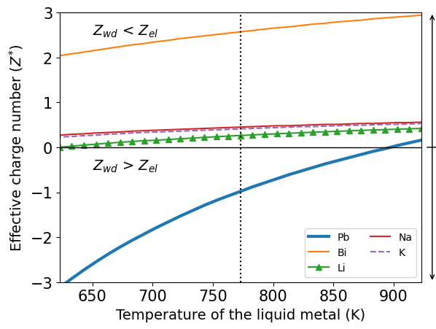
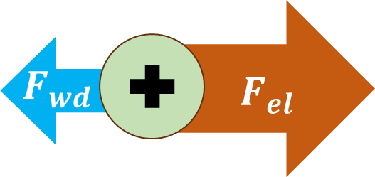
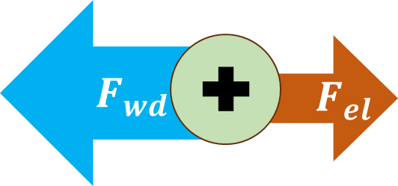
Theoretical model of electromigration in liquid Pb pool (2)
The direction of the electromigration is determined by the liquid metal element.
Electron-wind force is more dominant than electrostatic force in liquid Pb.
Force: Downstream to upstream
Electrostatic force dominant
Pb
Force: Upstream to downstream
Electron-wind force dominant
Fig. 14 Direction of migration of liquid metal atoms

Slide 13
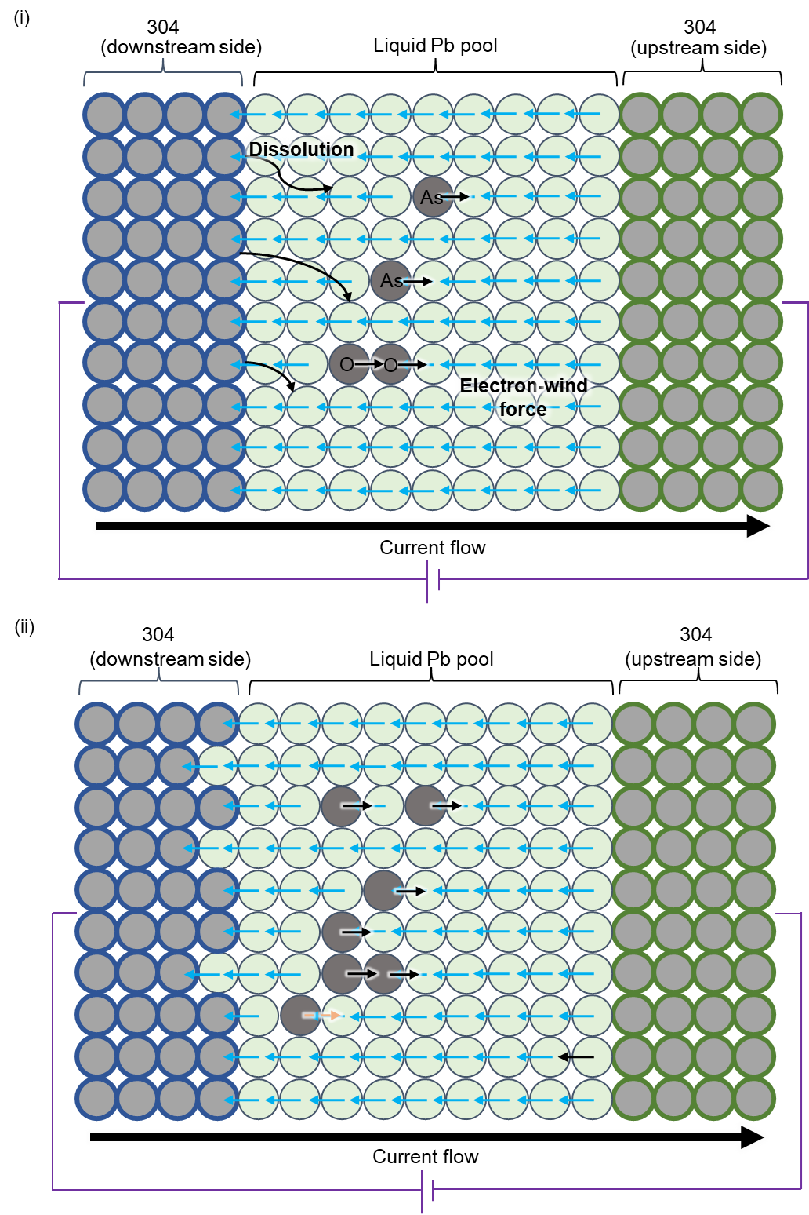
Theoretical model of electromigration in liquid Pb pool (3)
Cr and Ni dissolved from 304 specimen installed in the downstream side according to the dissolution corrosion.
Pb atoms were pushed onto the 304 specimen surface in the down stream side.
Cr and Ni atoms could migrated along the direction opposite to the electron migration as they escaped from the Pb migration.
The dissolution corrosion could be promoted by the electromigration effect. The Pb penetration into 304 matrix was also promoted by the electromigration effect. (The removal of Pb penetrated could form the cavities)
Cavities
Fig. 15 Effect of electromigration on corrosion and mass transfer in liquid Pb

Slide 14
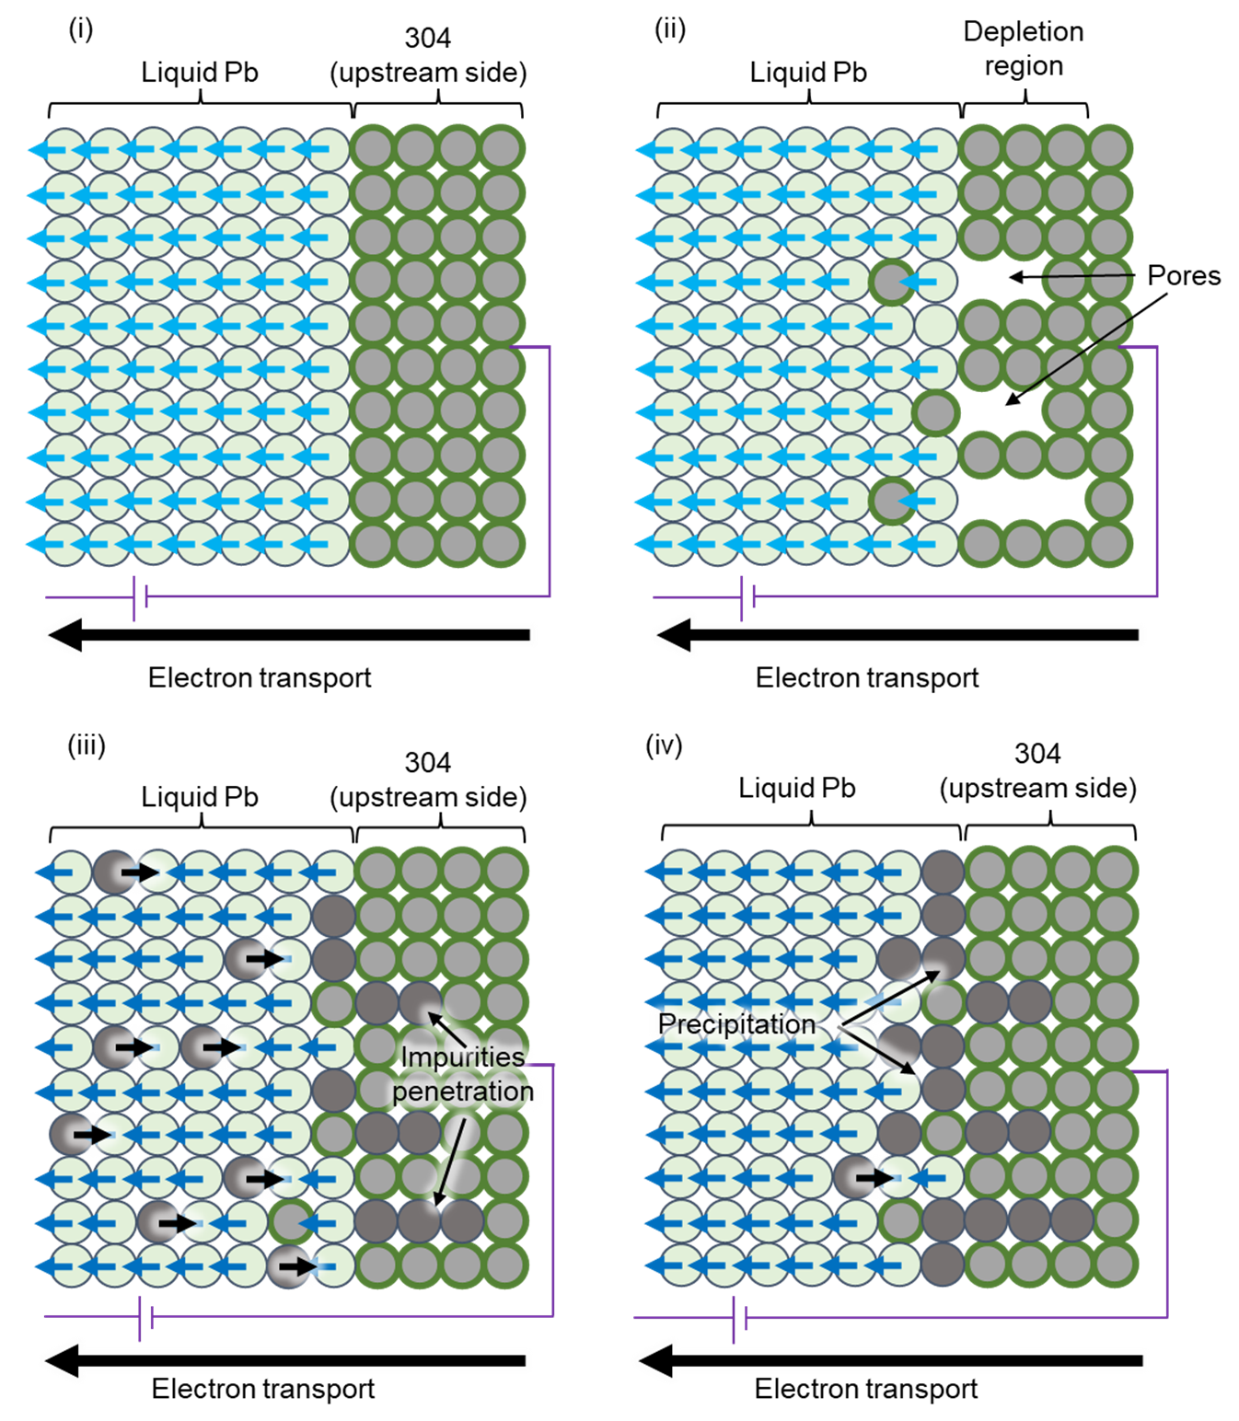
Theoretical model of electromigration in liquid Pb pool (4)
  The metal elements on the grain boundary could be pushed into liquid Pb by the electrons. Some pores could be then formed.
The migration of Pb atoms to the downstream side caused the migration of dissolved elements and impurities from downstream side to upstream side.
Some metallic impurities could move into the pores.
Oversaturation of elements on the upstream side resulted in the formation of precipitations.
Fig. 16 Effect of electromigration on corrosion and precipitation in liquid Pb

Slide 15
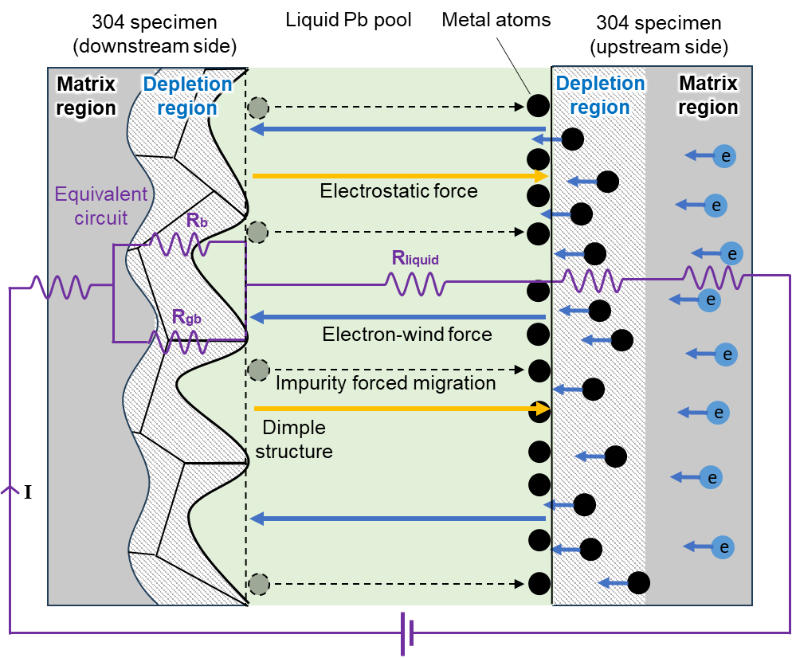
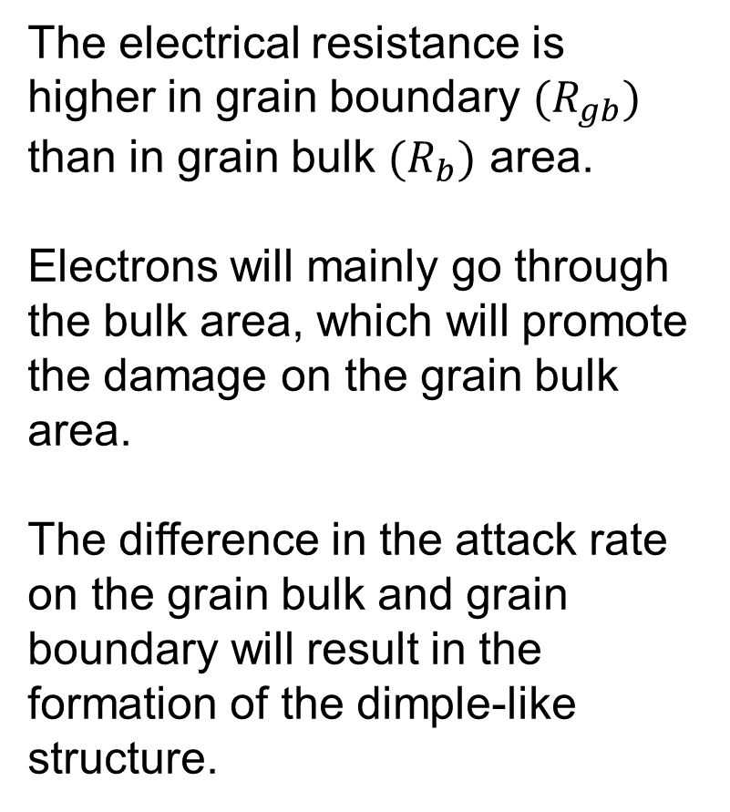
Theoretical model of electromigration in liquid Pb pool (5)
The electrical resistance is higher in grain boundary $(R_{gb})$ than in grain bulk $(R_{b})$ area.
Electrons will mainly go through the bulk area, which will promote the damage on the grain bulk area.
The difference in the attack rate on the grain bulk and grain boundary will result in the formation of the dimple-like structure.

Slide 16
Conclusions
The corrosion behavior of 304 steel in liquid Pb pool was promoted by the electromigration which was installed in the downstream side of electron stream. Different rate of attack between the grain bulk and grain boundary area will result in the formation of dimple-like structure.
The migration of liquid Pb will cause the secondary migration of dissolved elements to the upstream of electron stream. This effect could promote the dissolution corrosion in the down stream side. The secondary migration of dissolved elements and impurities will lead to the formation of precipitations on the specimen surface located in the electron upstream side.
Humam’s e-mail : humam.h.32a6@m.isct.ac.jp
Acknowledgement: Dr. Hamaji from NIFS for discussion, Minho O sensei from Tokyo Institute of Technology for help in SEM and EDS analysis, Materials Analysis Division Open Facility Center Tokyo Institute of Technology for help with XRD analysis, Hokkaido University for AES/EBSD and STEM analysis.

Slide 17
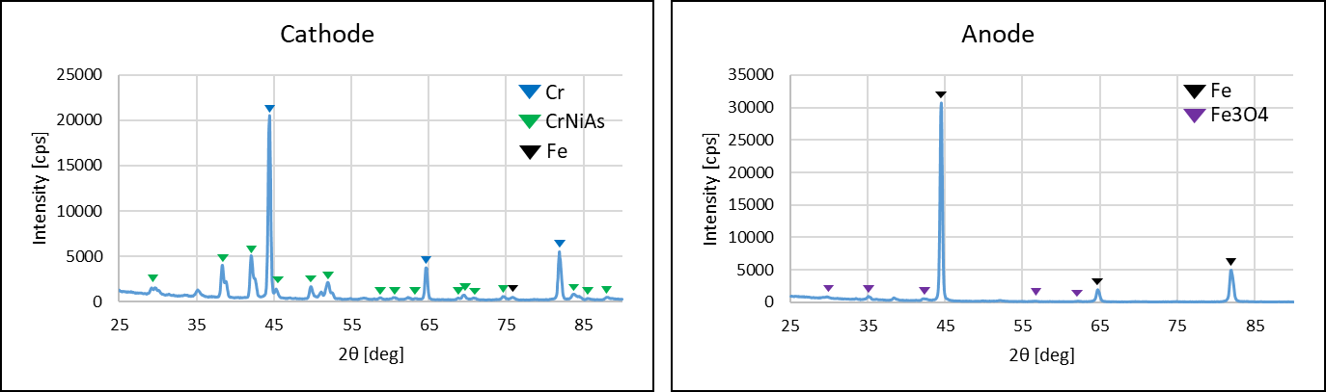
Supporting Data
XRD analysis

Slide 18
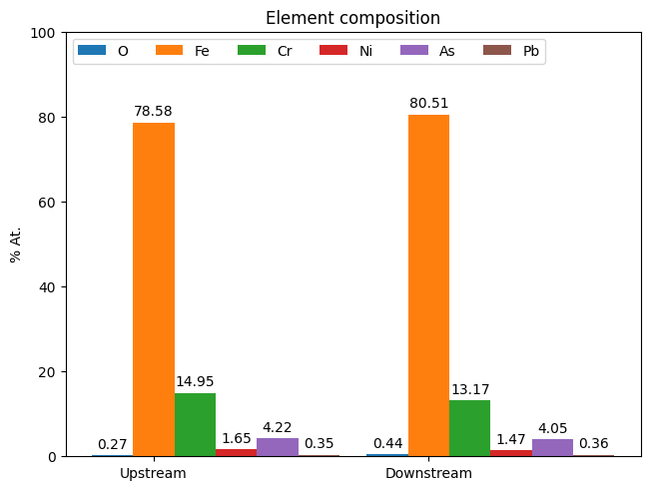
4. Results
Static corrosion test
100 μm
100 μm
Cr
10 μm
No formation of precipitations, cavities, or dimple-like structures were found.
Some surface areas are corroded and exfoliated.
Corrosion damage is less severe with a mass loss of 0.002 g.
Upstream | Downstream
Precipitation layer ~13.80 μm | No precipitation layer
Depleted region ~49.26 μm | Depleted region ~55.06 μm
Flat | Dimple-like structures
Cavities were formed | Precipitations diffused into cavities/pores

Slide 19
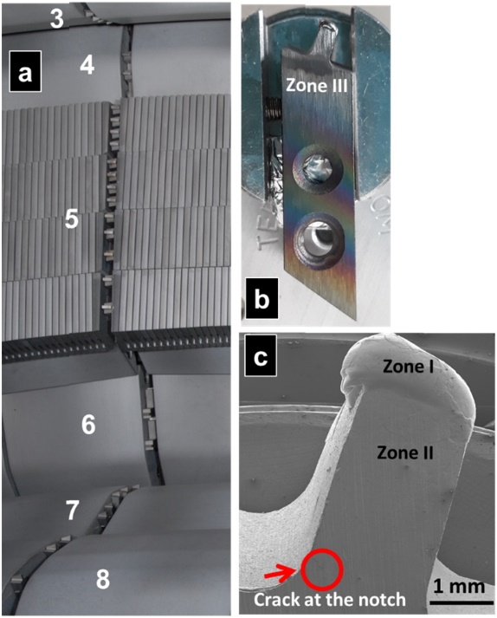
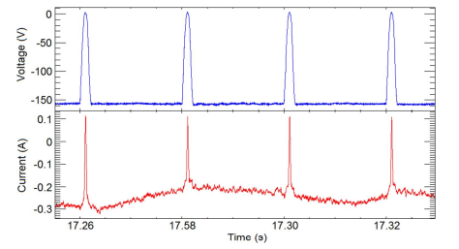
The divertor in JET-ILW is rectangular, as shown on the right.
The effective area of the diverter is complicated, but it can be approximated as approximately the same as the area of the rectangle,
0.1 A / (0.6 x 0.2 cm) = 0.83 A/cm²
[1] M. Spychalski et al., “Tungsten Langmuir probes from JET-with the ITER-Like Wall: Assessment of mechanical properties by nano-indentation,” Phys. Scr., vol. 96, no. 12, 2021.

Slide 20
