Slide 1
Status of the STS Target Segment Manufacturing R&D
Justin Mach Senior Target Systems R&D Engineer
with Aaron Jacques, Yongjoong Lee, Joel Montross, Thomas Muth, Joseph Tipton
October 28th – November 2nd, 2024
16th International Workshop on Spallation Materials Technology, Abingdon, UK

Slide 2
Outline
STS target foot assembly and risks
Manufacturing R&D overview
Full-scale HIP demonstration
Initial HIP bonding results
Copper swelling risk
Potential thermal interface alternative
Open questions
Summary

Slide 3
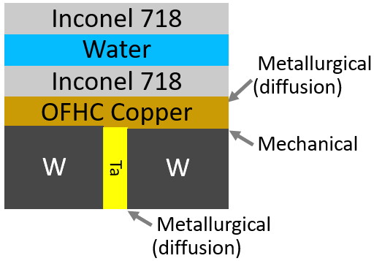
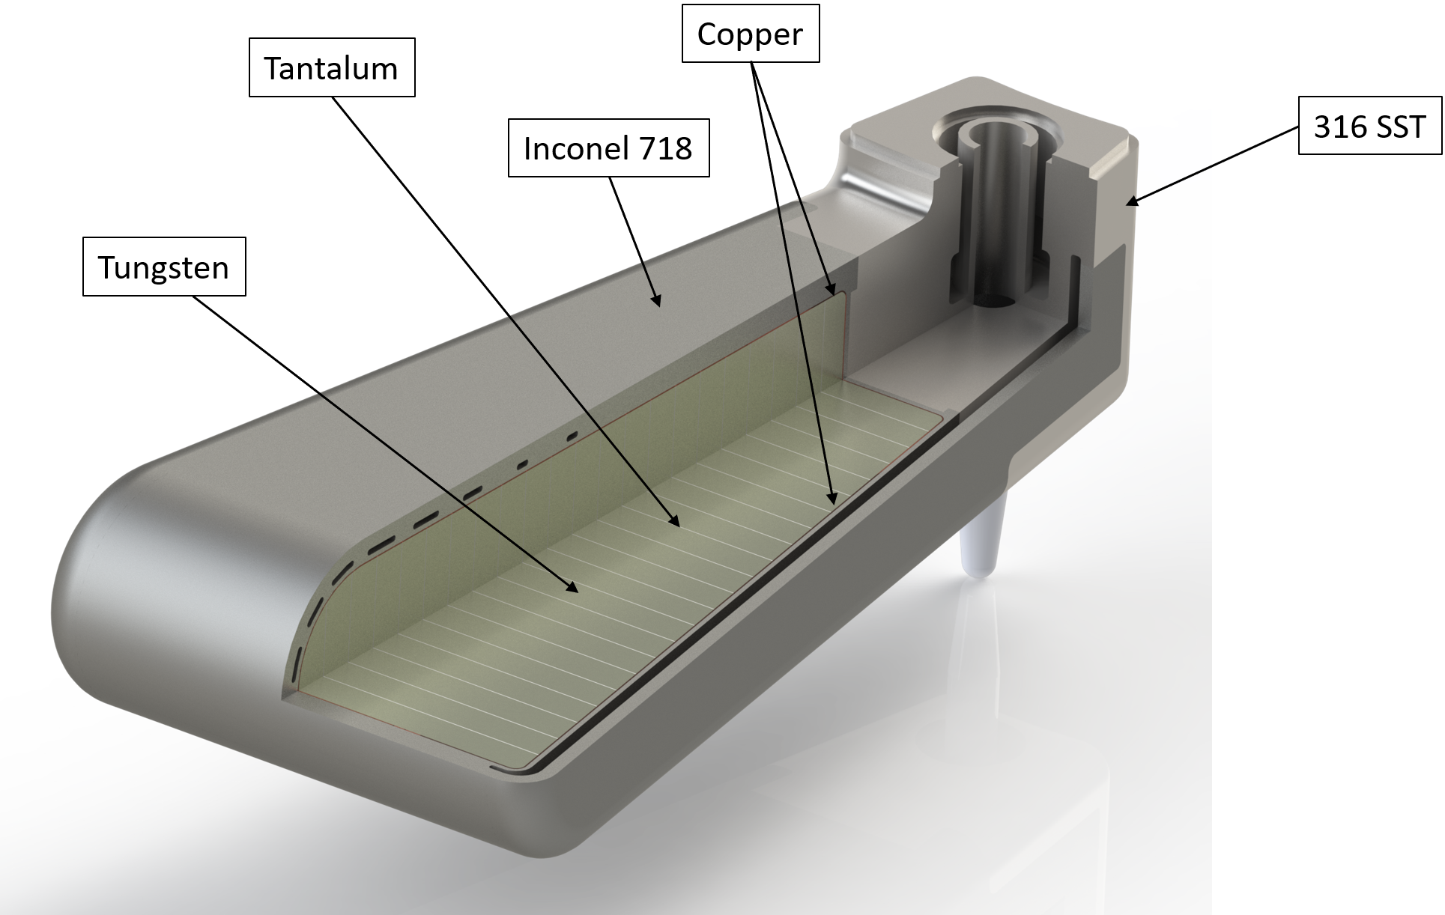
Target foot: key elements & risks
Water flow
Inconel CTE ~ 3X tungsten CTE
HIP bonding (1-step)
Copper to tungsten/tantalum
Copper to Inconel
HIP bonding challenged by small radii, length, and wedge shape
Water channels
~300 mm
Prediction of the post-HIP residual stress state

Slide 4
Target foot assembly

Slide 5
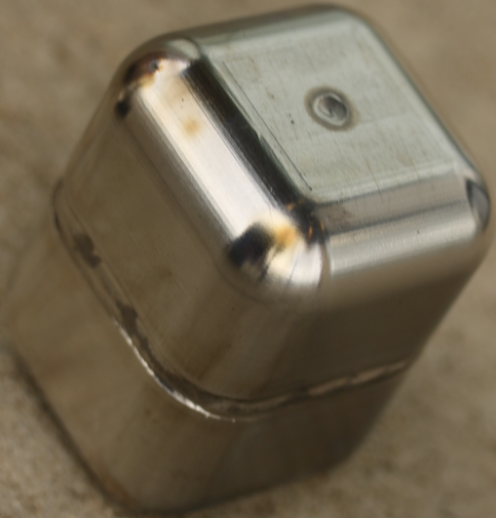
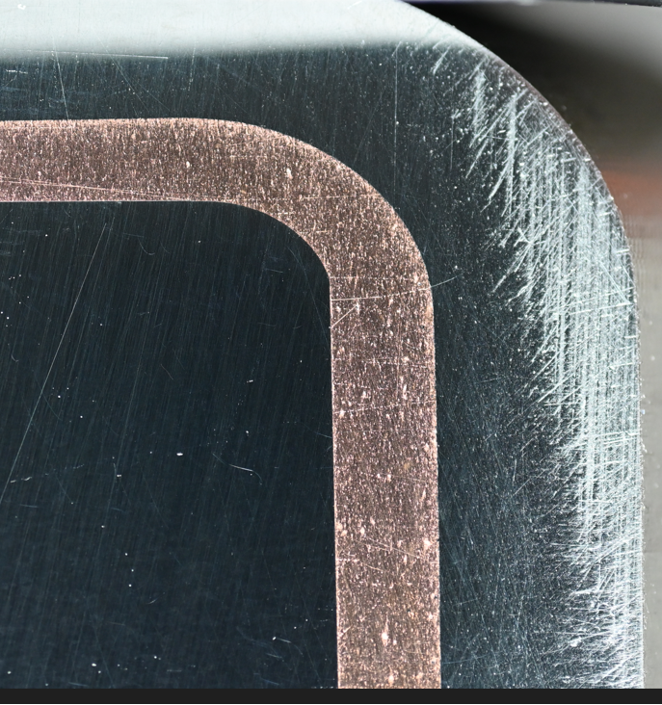
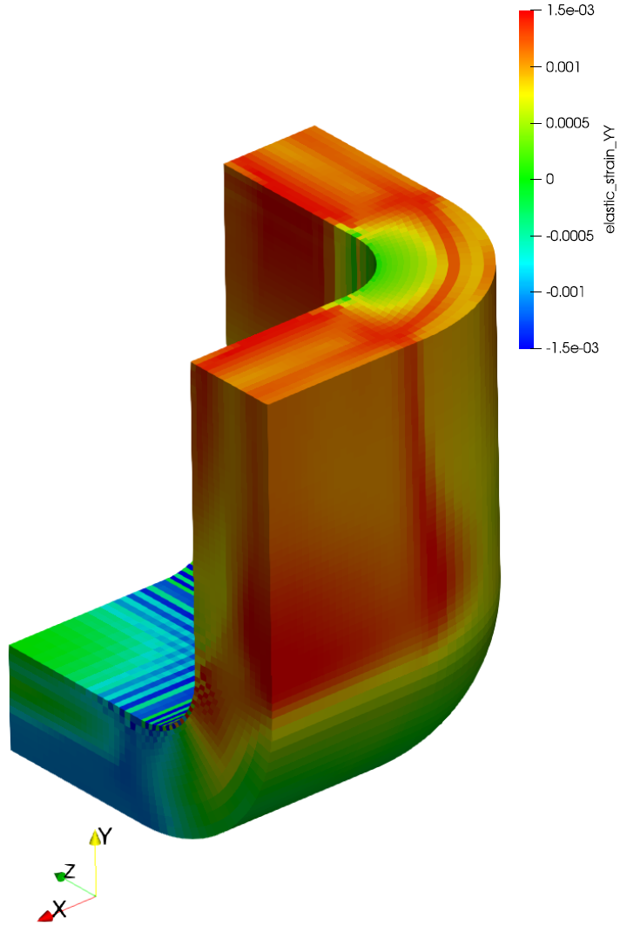
Mfg. R&D input to aid preparation for final design approval
 |  | R&D Requirements
 |  | Measure material interfaces’ properties vs. bonding pressure | Predict material interfaces’ bonding pressure | Develop HIP / confirm residual stress prediction is conservative | Fabrication review & approval | Confirm (observe) material interface bonding | Confirm (measure) as-manufactured Inconel properties
Design Deliverables | Analysis confirms material interfaces pass requirements | VHP coupon samples (Q1 FY25) | Full-scale HIP simulation (Q3 FY24 – Q3 FY25)
 | Analysis confirms Inconel FOS > 1 |  |  | Small-scale prototypes & simulation (Q3 FY24 – Q3 FY25)
 | Verify design & analysis |  |  |  | Full-scale fabrication (Q1-Q2 FY25) | Full-scale destructive examination (Q2-Q3 FY25) | Full-scale material testing (Q3-Q4 FY25)
in progress
not started
Production

Slide 6
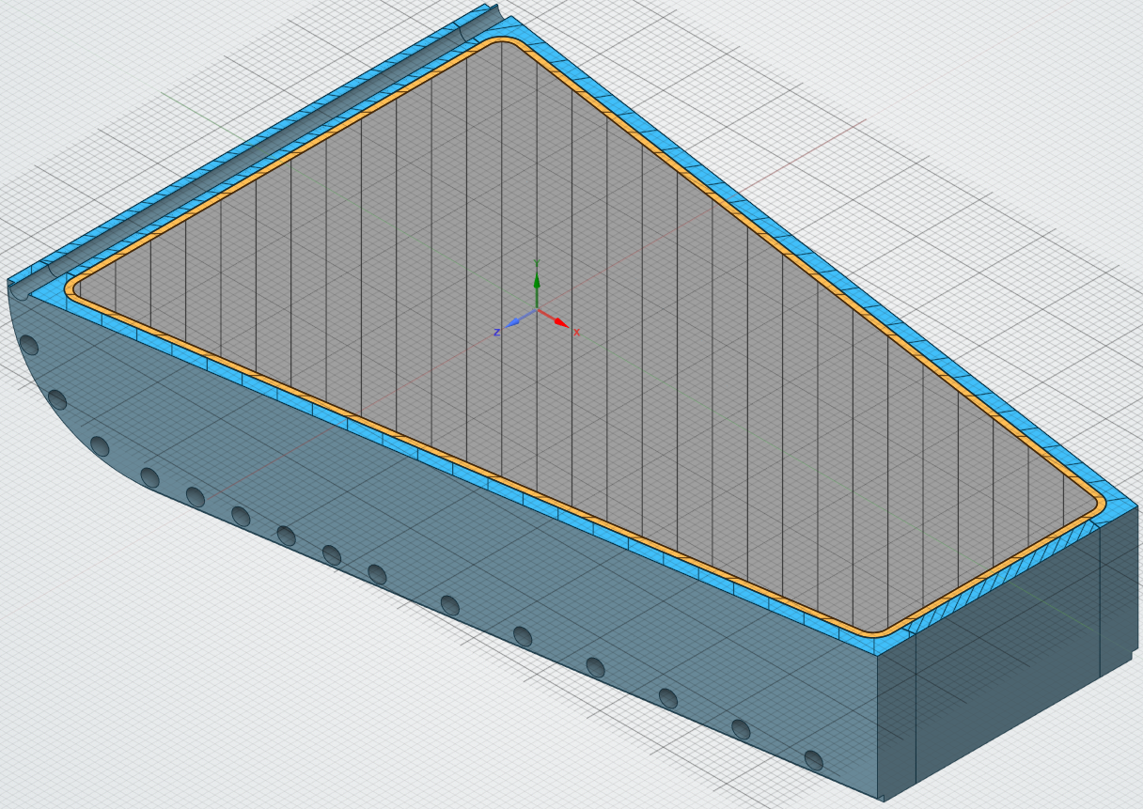
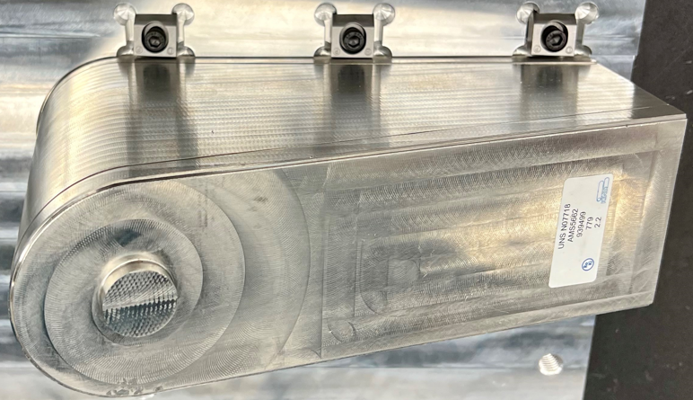
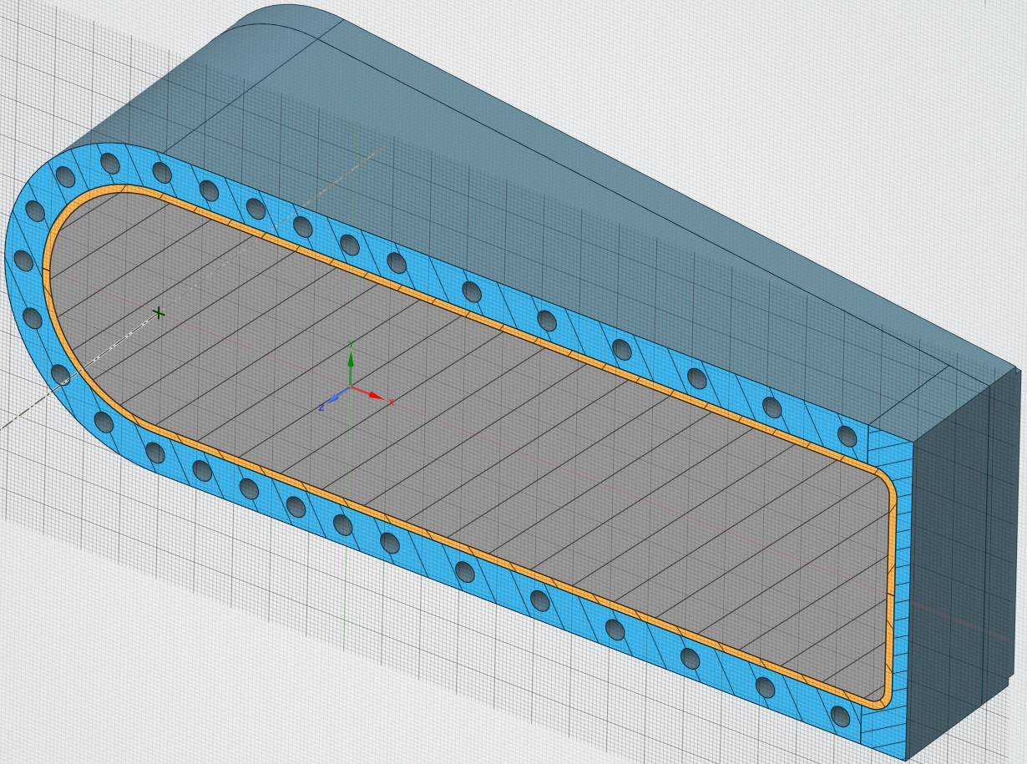
Near full-scale HIP test assembly fabrication in process
Simplified core and water passages to enable faster fabrication and HIP results by end of 2024

Slide 7
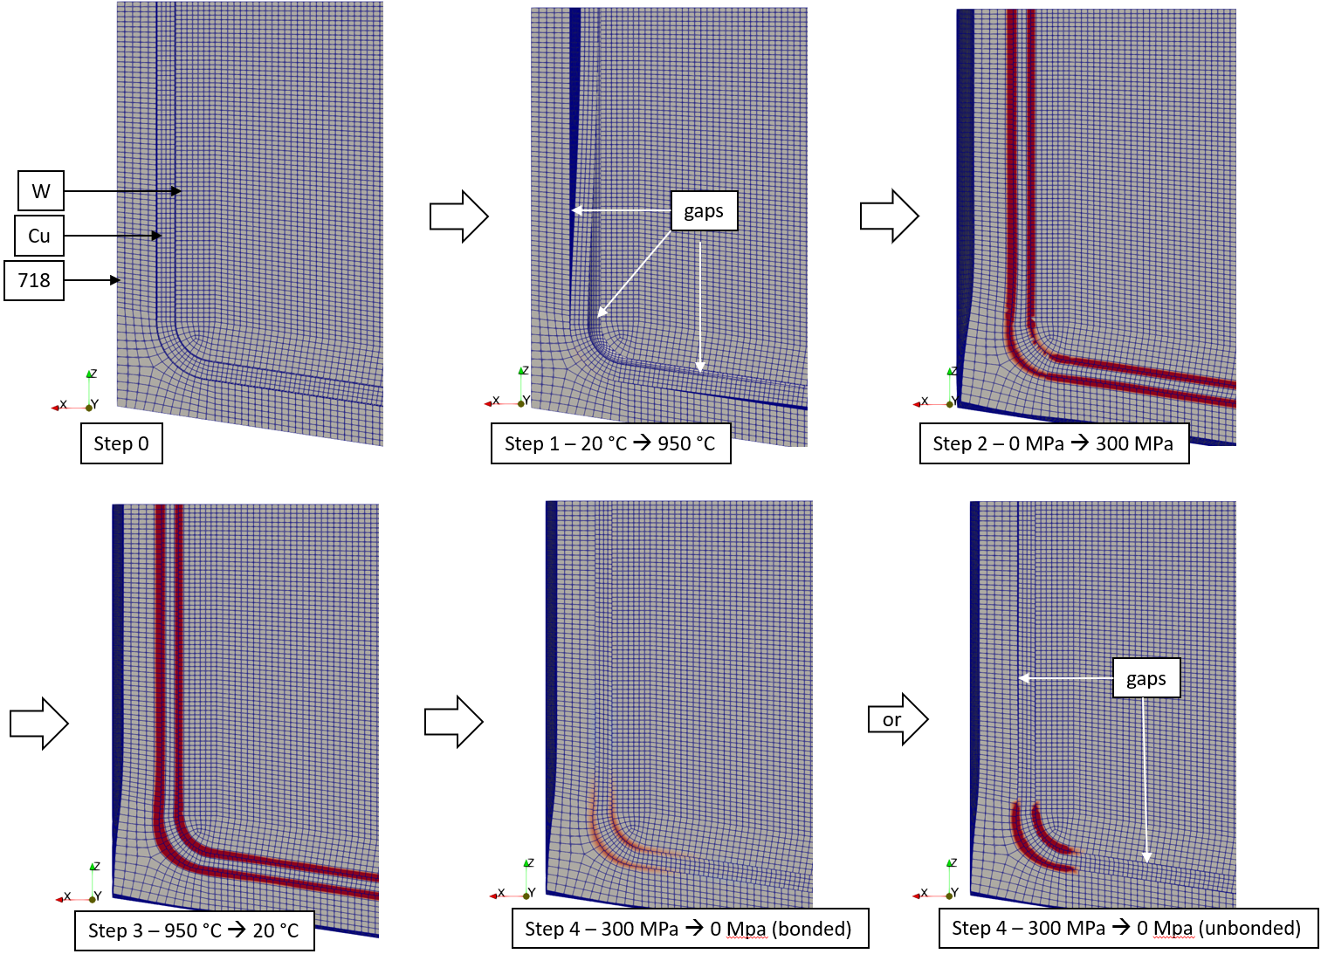
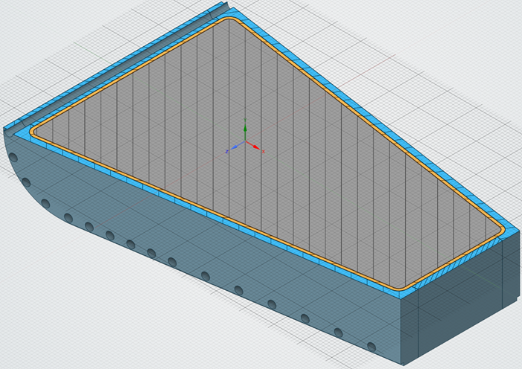
HIP simulation reveals heat transfer assisted by residual compressive interface pressure post-HIP (regardless of bond quality)
1. Heat up
Dark Red ≥ 100 MPa
Compression
2. Pressure on
(hold)
Grey ~ 0 MPa
Dark Blue ≥ 100 MPa
Tension
FEA model view is looking down at a center cross-section of a rear edge (one of more difficult regions to bond)
3. Cool down
“shrink fit”
4. Pressure off
“spring back”
(bonded)
4. Pressure off
“spring back”
(unbonded)
High compression on all radiused surfaces remains even without bonding

Slide 8
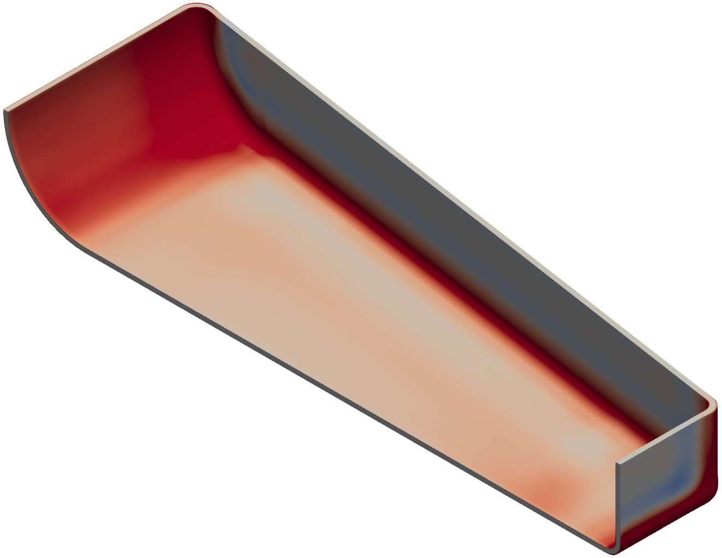
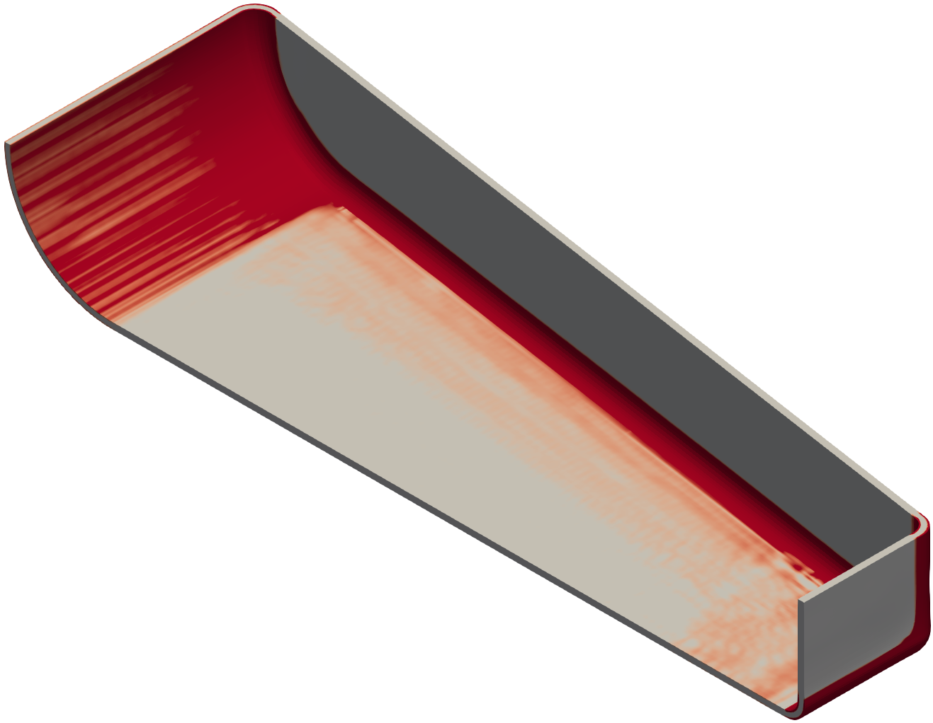
HIP simulation reveals heat transfer assisted by residual compressive interface pressure post-HIP (regardless of bond quality)
Bonded interfaces
Unbonded interfaces
Dark Red ≥ 100 MPa
Compression
Grey ~ 0 MPa
Dark Blue ≥ 100 MPa
Tension
¼ symmetry model (tungsten and Inconel removed for clarity)

Slide 9
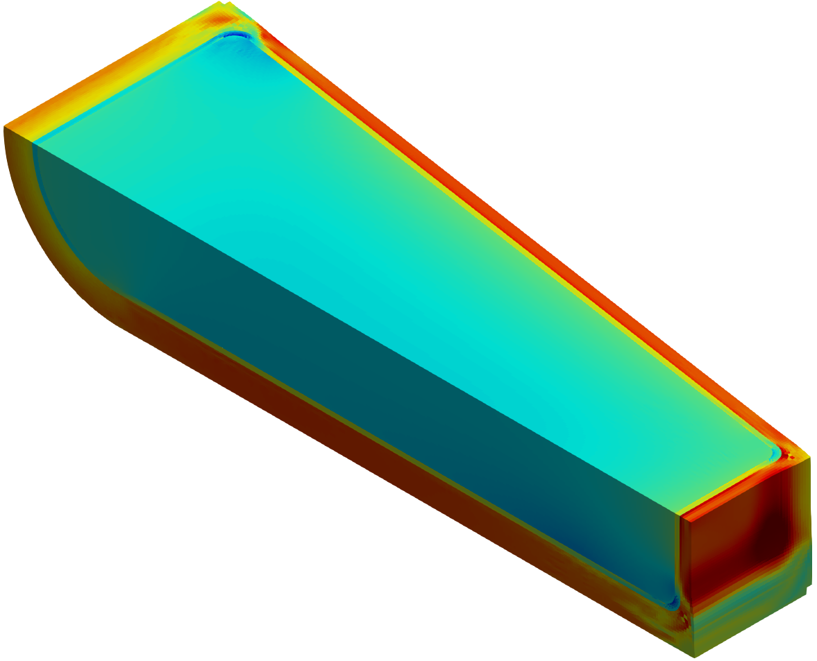
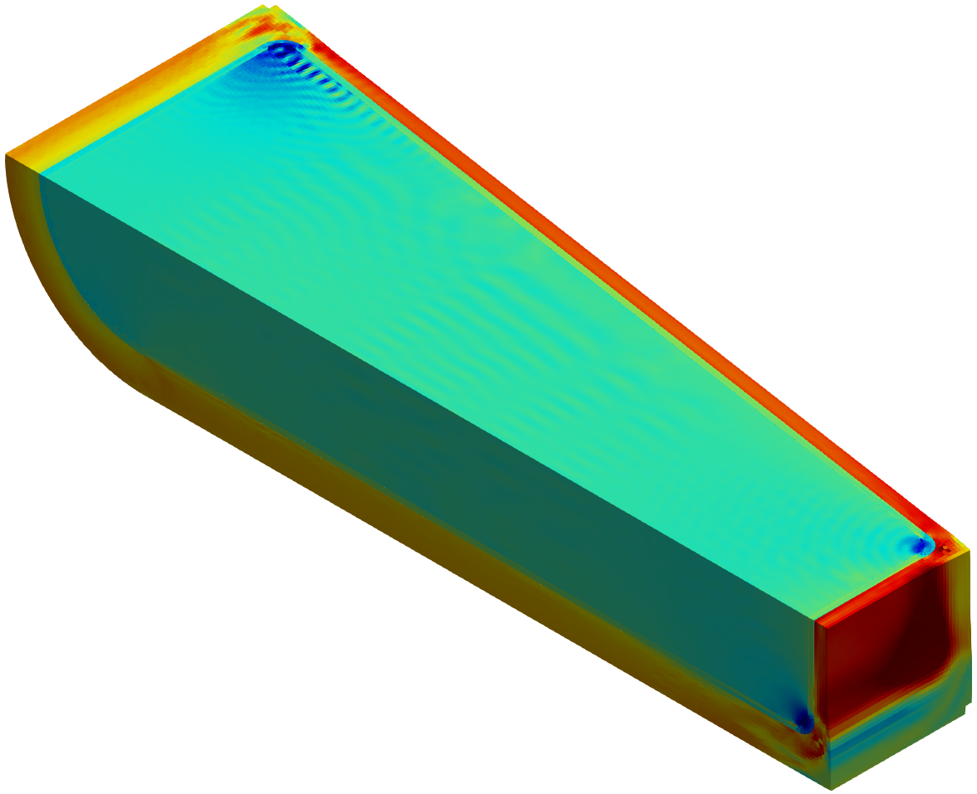
In general, stress state is similar (regardless of bond quality) – Inconel in tension, tungsten in compression
Hydrostatic stress
[Pa, ±400 MPa]
Bonded interfaces
Unbonded interfaces
¼ symmetry (solid tungsten block used for spallation material)

Slide 10
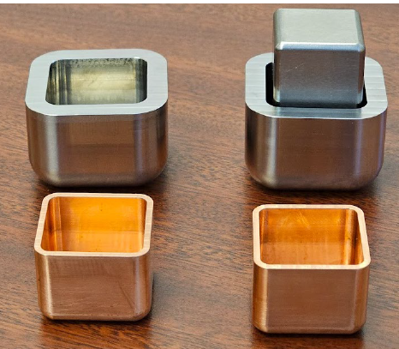
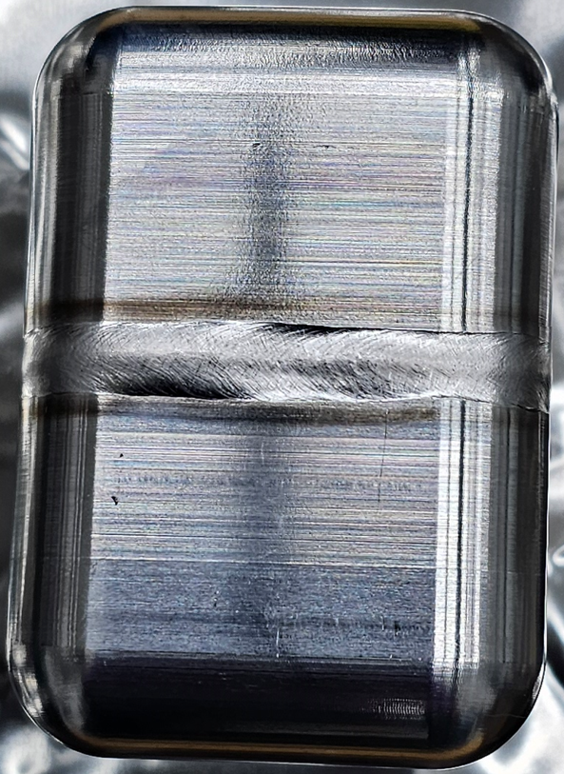
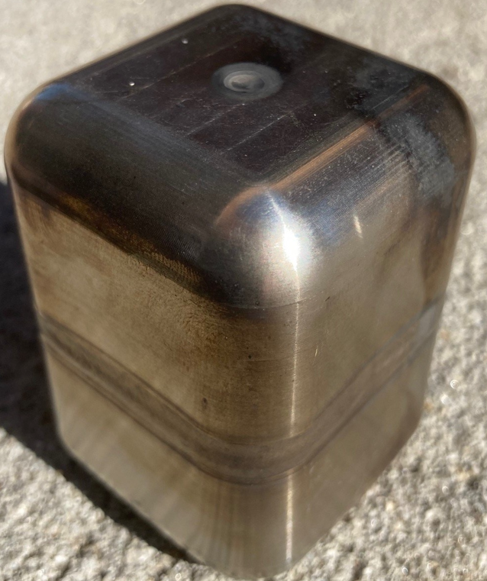
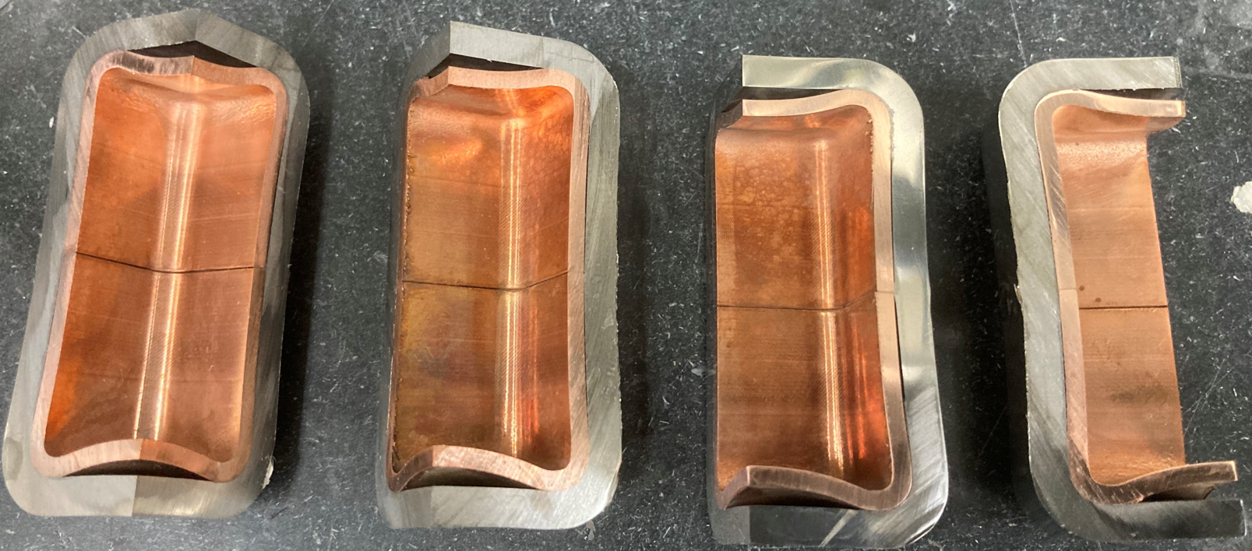
Small-scale HIP test articles – 4/7-mm Inconel shells
Inconel 718
tungsten
7 mm shell
OFHC copper
Piece parts
Pre-HIP
60-66 mm
EB weld development
(note: tungsten core not used, copper buckled during assembly)
Post-HIP

Slide 11
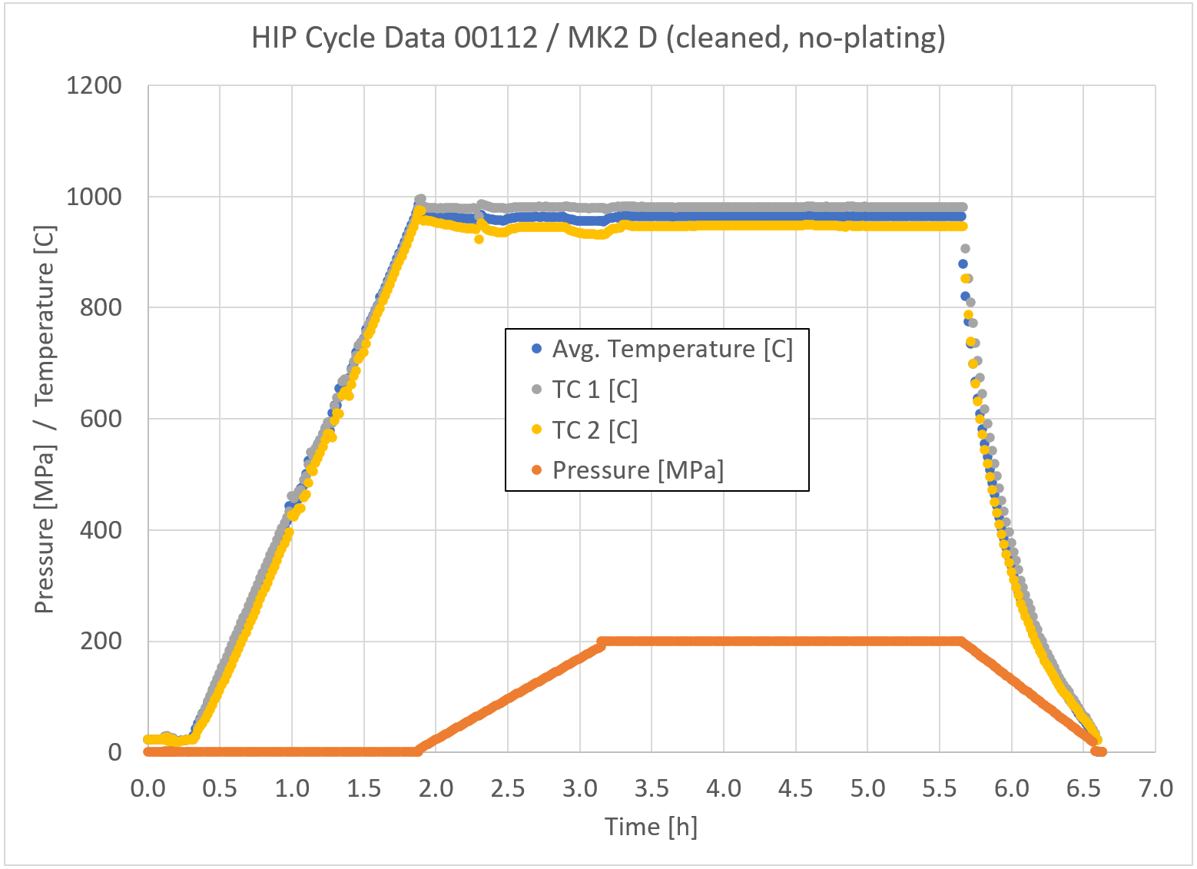
Typical HIP cycle – 950 °C, 200-300 MPa, 2.5 hour hold time

Slide 12
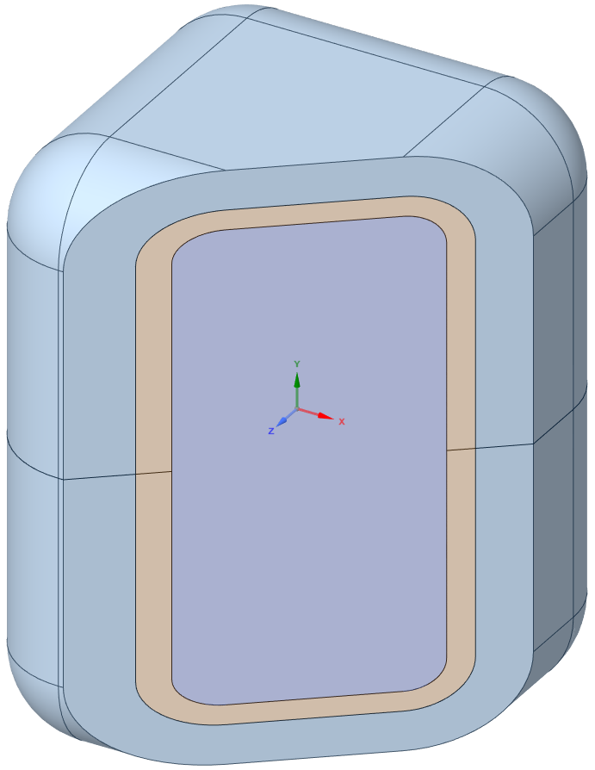
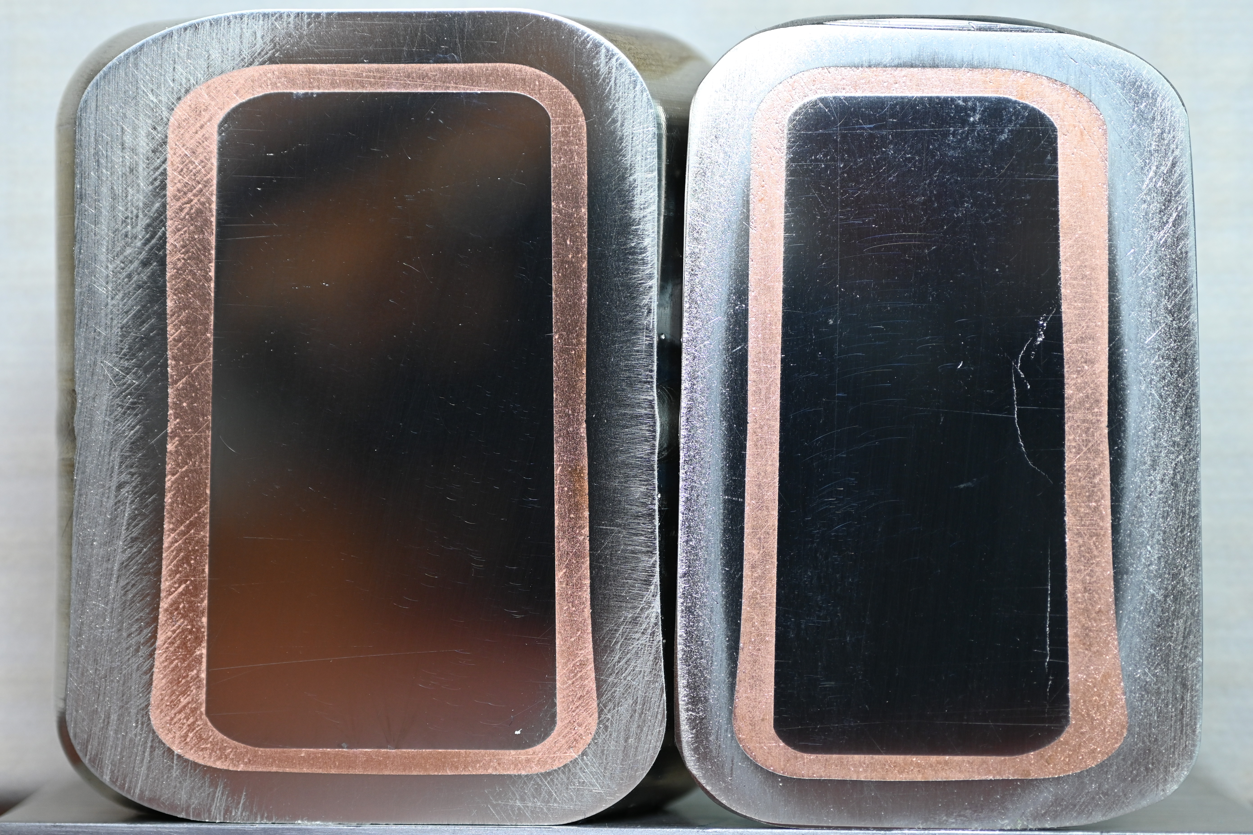
Mk1 4-mm thick Inconel – 1st cut reveals a mechanically tight structure
oblique cut angle to reduce damage from sectioning
tungsten
OFHC copper
718 Inconel
Initial observations:
Appears mechanically tight everywhere
Inconel/copper appear well bonded
Tungsten cracking caused by sectioning → residual stress relaxation and redistribution upon cutting
Expectations from simulation predictions correspond to failure location and direction
Tungsten damage from sectioning
(polishing and metallography in process)

Slide 13
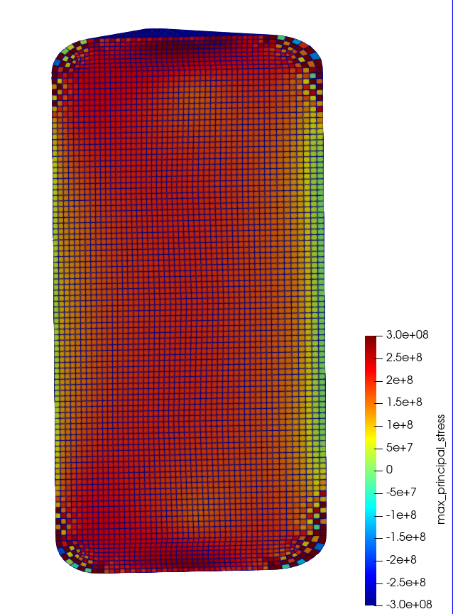
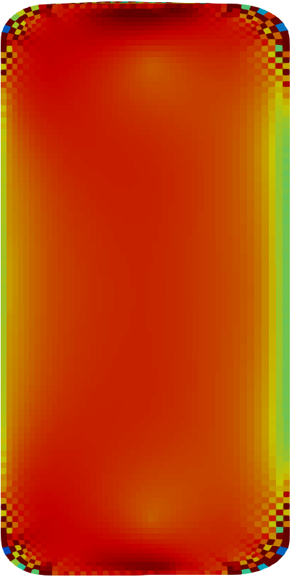
Post-cut maximum principal stress prediction shows vertical crack / damage away from W-Cu interface most likely → prediction matches behavior
[Pa]
No damage
In-plane of pancake forging (likely to be stronger direction)
Max. principal stress orientation
Tungsten face
Tungsten face
Unconstrained (anything between forging axis and in-plane → likely to be weaker direction)
Max. principal stress orientation

Slide 14
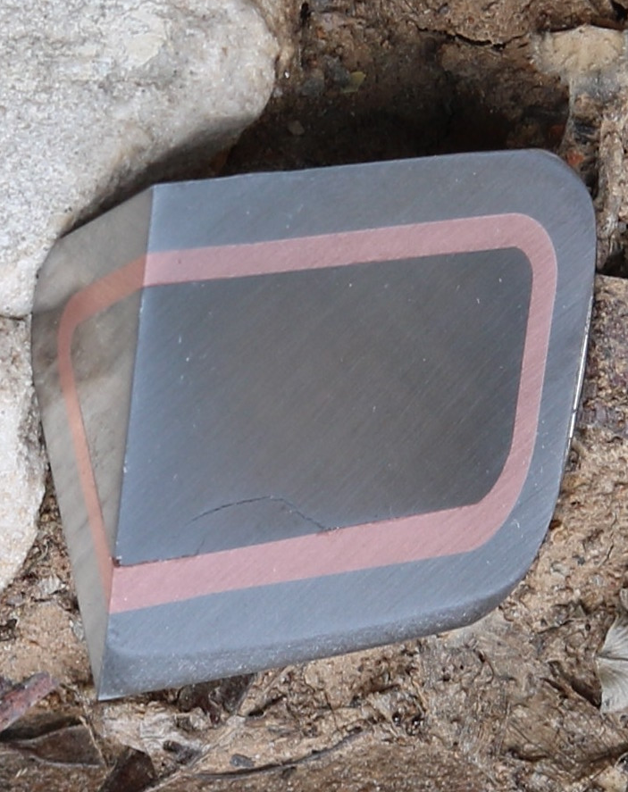
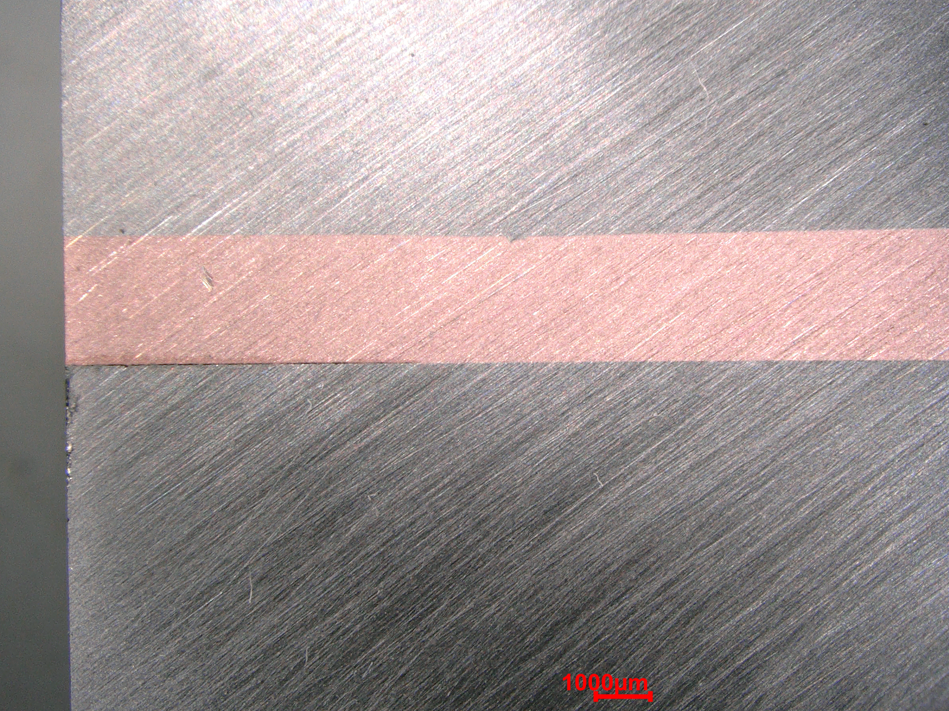
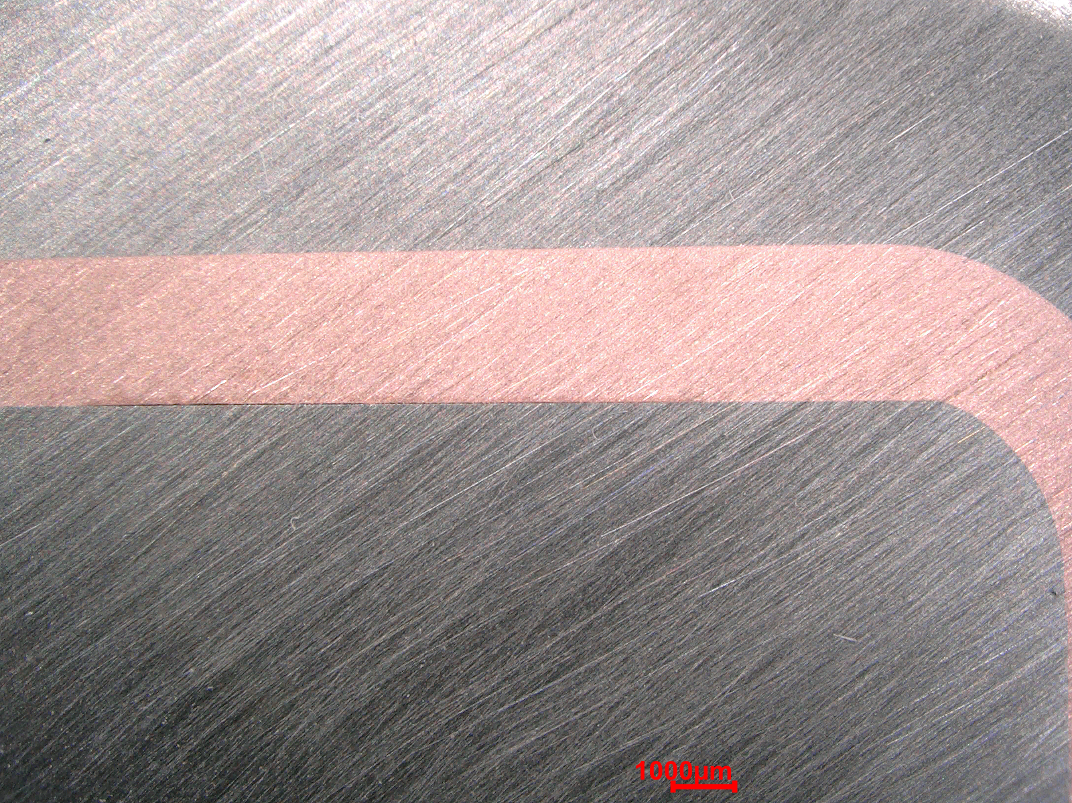
Delaminations visible at W-Cu interface (after 2nd cut)
(expected with additional destructive examination due to residual stress relaxation and redistribution)

Slide 15
Post-HIP copper and Inconel 718 appear tightly bonded in corner (most difficult place to bond)
Differential Image Contrast (creates depth of field)
Large grained copper post-HIP
Initial hardness HRF 80 (~1/2 hard Cu, ~250 MPa 0.5%YS)
Post-HIP hardness HRF 48 (~as hot-rolled, ~70 MPa 0.5%YS)

Slide 16
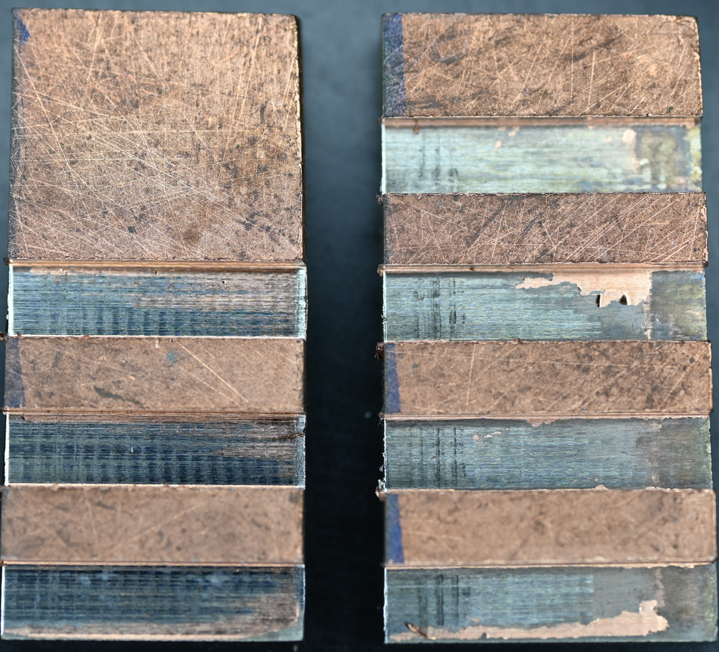
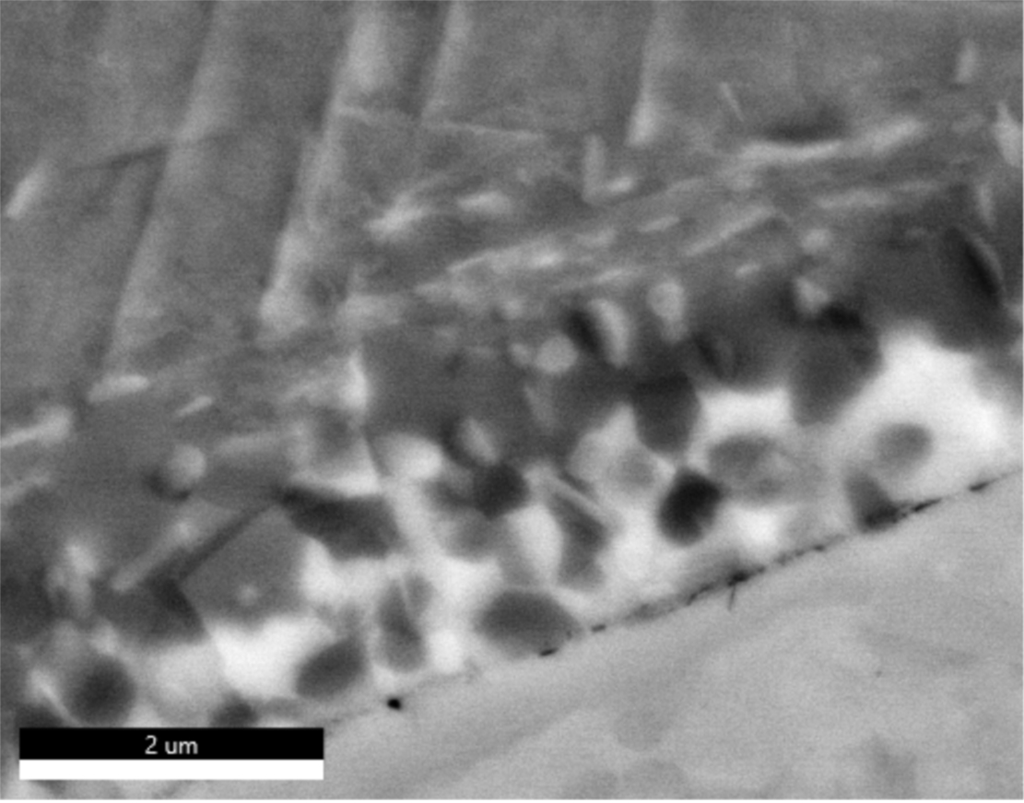
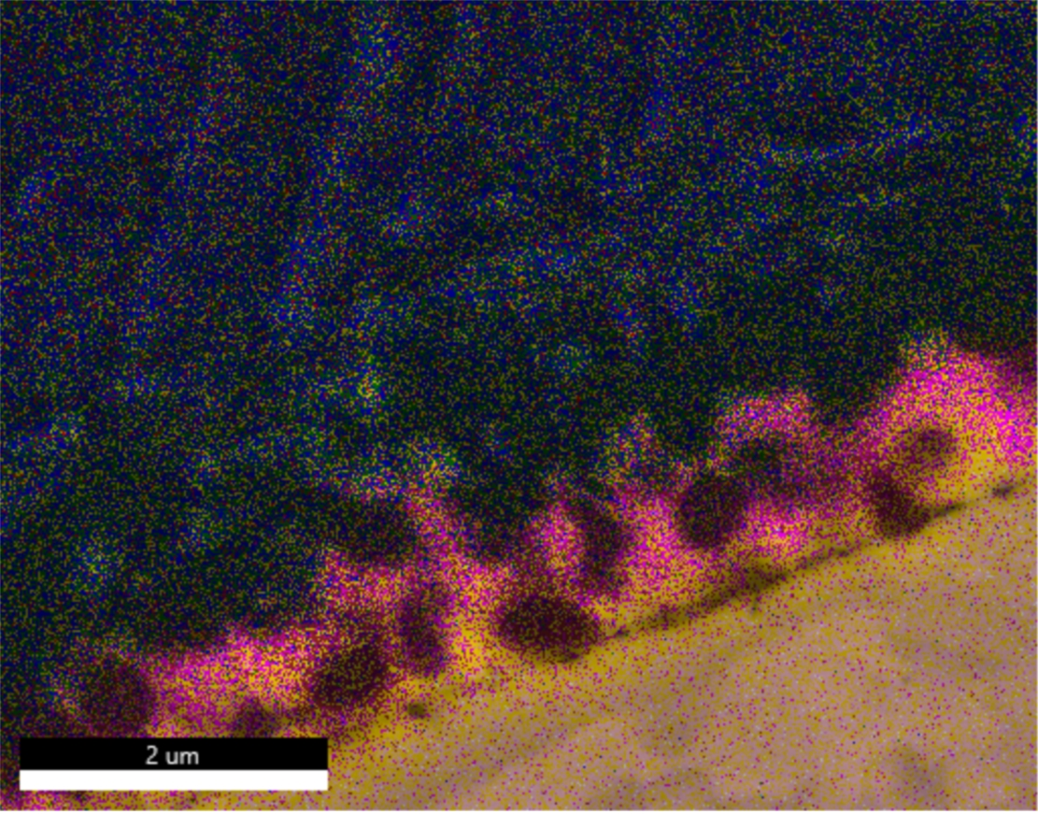
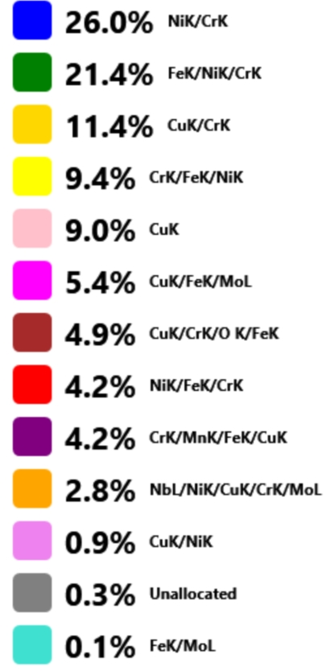
Diffusion across bond line with multiple alloys present (shear/thermal testing in process)
25 mm
Inconel
VHP bonded shear sample testing in process
Inconel
Cu
Cu

Slide 17
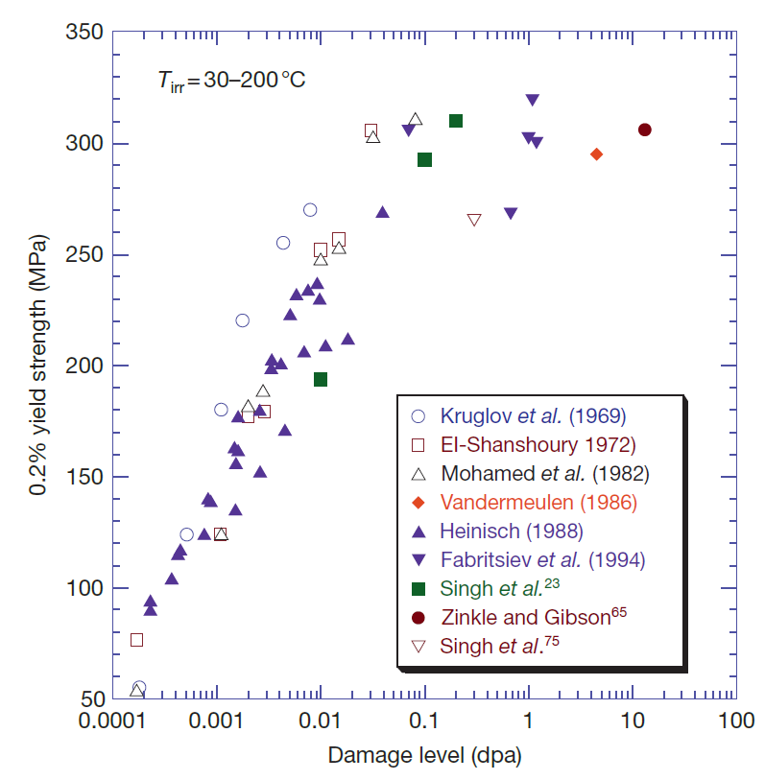
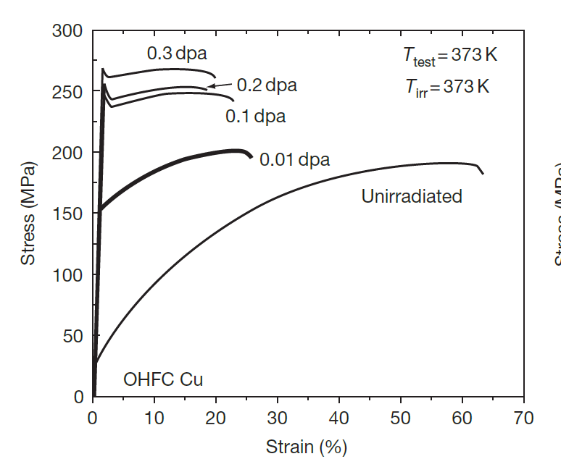
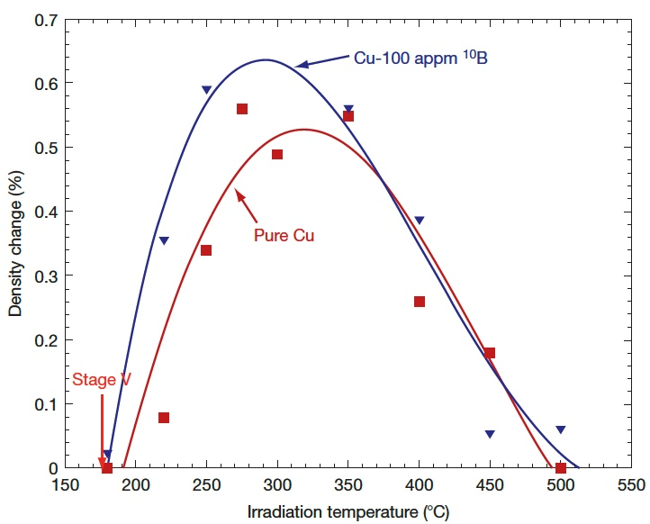
Copper Swelling
Typical pure metal swelling temperature is ~1/3 T_{m} [°K], which is 180 °C for Cu
~0.6% Δρ / dpa / 100 appm He
Li M. and Zinkle S.J. (2012) Physical and Mechanical Properties of Copper and Copper Alloys. In: Konings R.J.M., (ed.) Comprehensive Nuclear Materials, volume 4, pp. 667-690 Amsterdam: Elsevier.
What is the lower bound Cu swelling temperature for STS?
180 °C? Less?
STS – Cu:
~1 dpa / yr
~50 He-appm / dpa
Proton irradiation campaign by Yong Joong Lee to investigate effects of He implantation & DPA damage

Slide 18
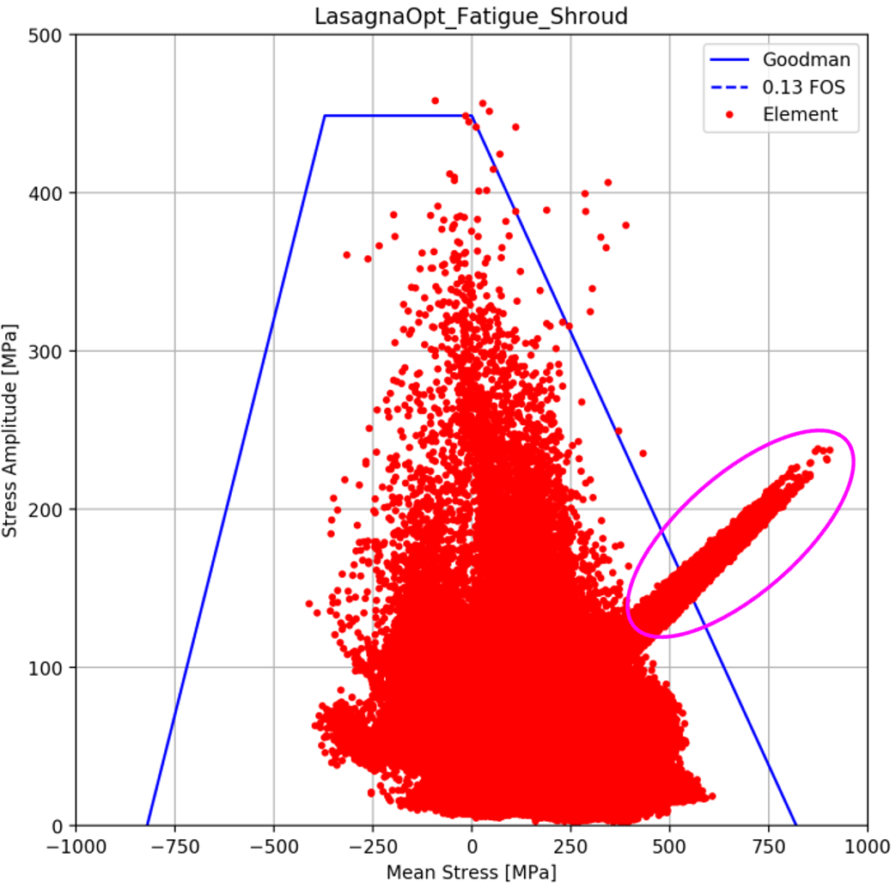
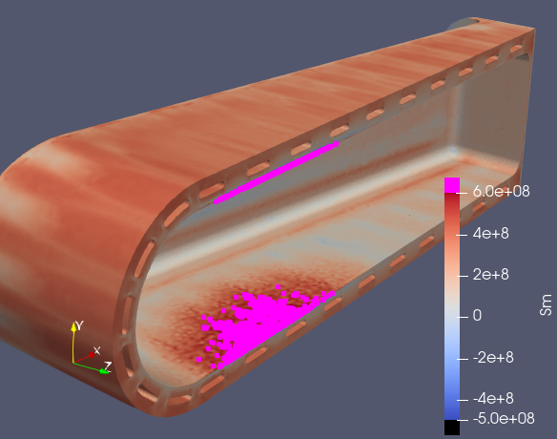
Early design iteration shows copper swelling can reduce fatigue FOS to << 1
Copper swelling zone

Slide 19
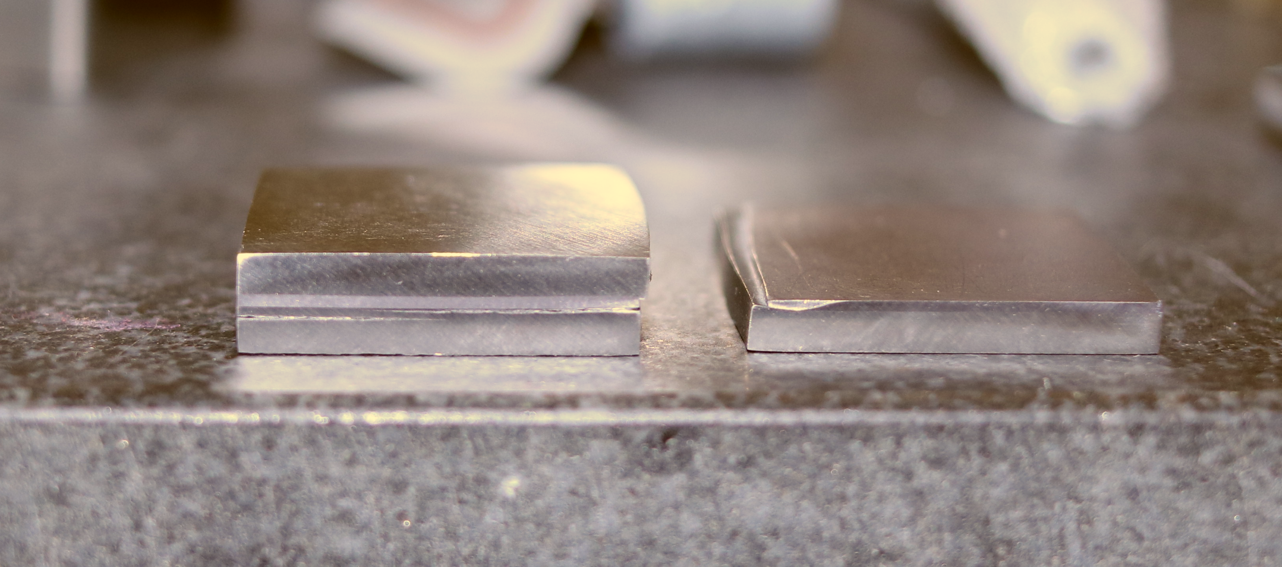
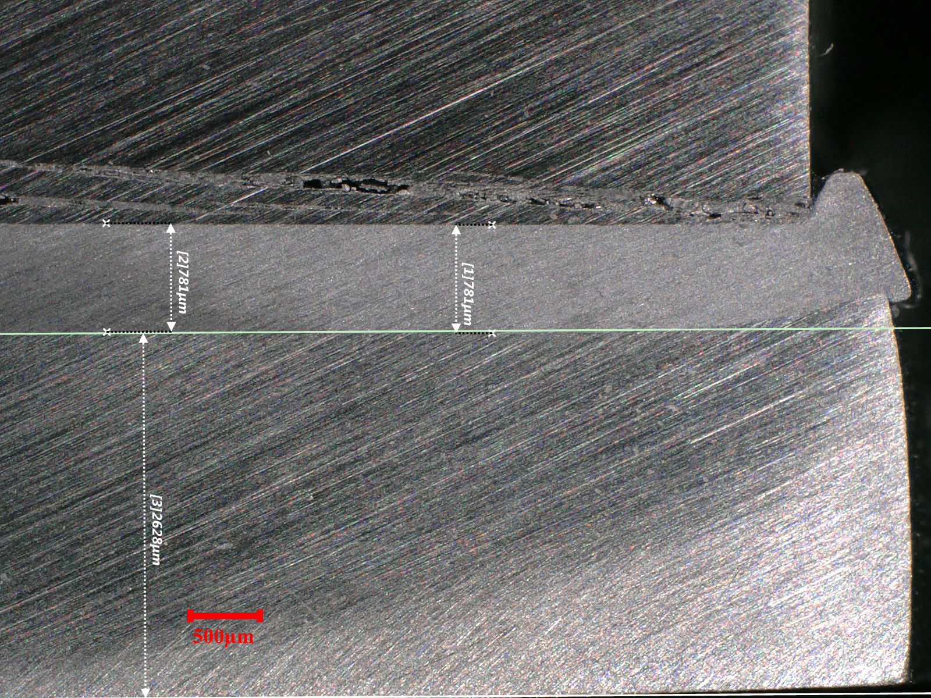
Can Ta replace Cu and eliminate the swelling risk?
Vacuum hot press:
950 °C, 120 MPa, 2.5 hours
Inconel 718
27 x 27 mm
Ta
Ta
W
Inconel 718
Tungsten cracked during cooldown → interface bonds strong enough to resist delamination at edge stress concentrations
W
W
Ta
Significant creep in Ta & 718
Ta
Inconel 718
Inconel 718

Slide 20
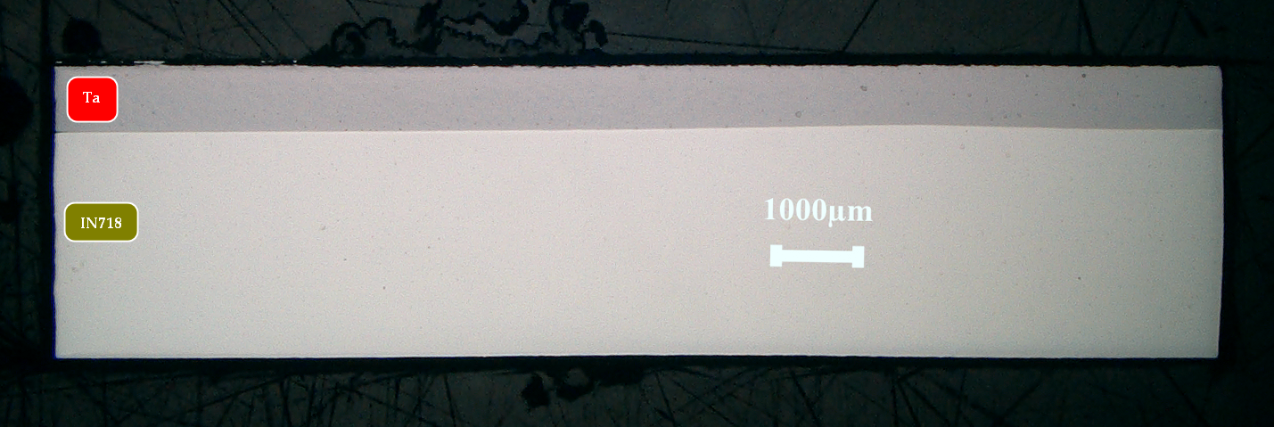
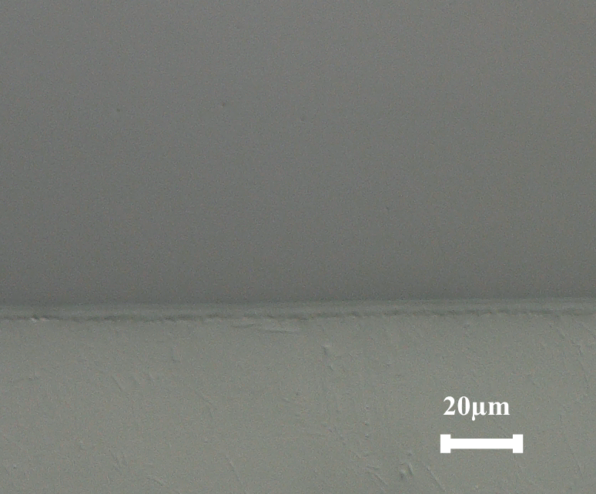
Achieved ~7 μm diffusion band between Ta and IN718
Ta
~7 μm
SEM investigation in progress
IN718
Notes:
There is a diffusion band of ≈ 7 µm that is being evaluated in the SEM

Slide 21
Thermal interface: open questions
Should we be concerned about copper swelling if the predicted copper temperature is < 180 °C?
Are there known issues with diffusion bonding Ta and Inconel 718?
How do diffusion bonded interface properties change with irradiation?
or Ta?

Slide 22
Summary
Target foot manufacturing R&D is focused on verifying HIP process produces bonded interfaces
Small-scale HIP results confirm mechanically tight tungsten-copper interface and diffusion bonding at copper-Inconel interface
Copper swelling risk has motivated research on use of tantalum as an alternative thermal interface material
Results forthcoming on interface strength, heat transfer, and residual stresses

