Slide 1



Conceptual Study of Post Irradiation Examination (PIE) Facility at J-PARC
Shigeru SAITO¹, Shinichiro MEIGO¹, Shunsuke MAKIMURA²,
Yukinori HIRANO¹, Kazuyoshi TSUTSUMI¹ and Fujio MAEKAWA¹
¹J-PARC Center, JAEA
² J-PARC Center, High Energy Accelerator Research Organization (KEK)

Slide 2
Contents
1. Introduction
2. Test items and required instruments
3. Facility layout plan
4. Construction plan, R&D
5. Summary

Slide 3
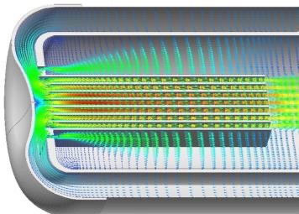
1. Introduction
- Current concept of the proton irradiation facility -
Irradiation samples (fusion & fission)
PBW
Pb-Bi
Four important areas of application have been identified.
400 MeV, 250 kW
Proton beam
LBE target
Sample specimens （SS･T91）
Irradiation samples
(Accelerators)
H⁻ beam from Linac
400 MeV, 250 kW,
625 μA, 500 μs, 25 Hz
Water or He cooling
Materials irradiation
high-energy accelerator facilities including ADS
fusion and fission reactors
A part of the proton beam is branched with flexibly changing its intensity and pulse width.
RI production
Soft error testing of semi-conductor devises
PIE specimens
Proton beam applications
TEF-P
J-PARC’s existing facilities
PIE facility
PIE of irradiated samples
Chemical processing for RI production
MLF
HD
NU
PIE specimens
Overseas facilities

Slide 4
- Post irradiation examination (PIE) facility -
・Post irradiation examination (PIE) facility is under consideration and to be constructed near the proton irradiation facility at J-PARC.
・The needs for this PIE facility are
(1) PIE of irradiated samples
(2) Chemical processing for RI production
・As for PIE, there is a need to accept irradiated samples from other facilities in J-PARC and samples irradiated by accelerators in Japan and overseas.
・As for RI production, alpha-emitter Ac-225 considered effective for prostate cancer, is a promising candidate.
・In this study, list the instruments and equipment needed to carry out these tasks, consider whether they are feasible on the current site, and prepare a layout plan for the facility.
https://jopss.jaea.go.jp/pdfdata/JAEA-Technology-2023-025.pdf
(in Japanese)

Slide 5
- Hot cells in the facilities -
From other J-PARC facilities
Irradiated targets
irradiated coupons
Proton irradiation facility
PIE facility
Large component handling room
Cask
Various cells, GB, etc.
Sample fabrication and processing
Post irradiation testing
Mechanical strength test
Surface observation
Microstructure observation
Analysis, etc.
RI separation and purification
PBW
0 cm
Crane
PM
MSM
Truck yard
Proton beamline
Small Cell
Gamma scan
Measuring dimensions
Target
Irradiation test plate holder
Target head
irradiation capsule
Target
trolley
Sample preparation cell
Capsule disassembly
Specimen Removal
RI Target Removal
Specimen preparation
Target assembly for re-irradiation
Target Maintenance Cell
Target Replacement
Target dismantling
Coupon cutting
Target station
Other PIE facilities
Irradiated specimens from overseas accelerator facilities
Specimens/RI target (via underground pit)

Slide 6
2. Test items and required instruments
- Test items -
PIE
1. Specimen preparing
1.1 Cutting machine
1.2 Milling machine
1.3 Notching machine
1.4 Grinding machine
1.5 Dimensional measuring instruments
1.6 Silicon oil bath
2. Mechanical properties testing
2.1 Tensile and compression test
2.2 Fatigue test
2.3 Creep test
2.4 Charpy impact test
2.5 SP (small punch) test
2.6 Hardness test
2.7 Nano-indentation
3. Surface observation
3.1 Cutting machine
3.2 Resin-filling equipment
3.3 Grinding machine
3.4 Optical microscope
3.5 Metallurgical microscope
3.6 Scanning electron microscope （SEM）
3.7 Field emission scanning electron
microscope （FE-SEM）
4. Microstructure observation
4.1 Electrolytic polishing
4.2 Focused ion beam（FIB）
4.3 Transmission electron microscope
（TEM）
5. Graphite testing
5.1 Density measurement
5.2 Thermal diffusivity measurement
6. LBE analysis
6.1 Transpiration method
6.2 Thermal chromatography
7. Other equipment
7.1 Gas analysis
Specimen for Charpy, SP, fatigue and creep.
Hadron and Neutrino target
Testing in LBE
Important for ADS R&D
DBTT shift
Ac-225 production
1. Dismantling of sealed containers
2. Dissolution of Th
3. Separation and purification
4. Weighing and sorting
5. Storage and shipping
Observation of LBE corrosion under irradiation

Slide 7
- Specimens from the proton irradiation facility -
Testing | Specimen | Irradiation dose | Atmosphere | Ttest | Number
Tensile | Plate （SS-J3） | High（14-20 dpa） Middle（7-14 dpa） Low（-7 dpa） | Inert gas | Tirr* | >36 （Each dose 6×3×2 conditions）
 |  |  | LBE | Tirr
SSRT** | Plate （SS-J3） | Middle（7-14 dpa） Low（-7 dpa） | Inert gas | Tirr | >16 （Each dose 4×2×2 conditions）
 |  |  | LBE | Tirr
Fatigue | Plate with round section | Middle（7-14 dpa） Low（-7 dpa） | Inert gas | Tirr | >36 （Each dose 9×2×2 conditions）
 |  |  | LBE | Tirr
Creep | Plate with round section | Middle（7-14 dpa） Low（-7 dpa） | Inert gas | Tirr | >24 （Each dose 6×2×2 conditions）
 |  |  | LBE | Tirr
Tensile/SSRT
Fatigue
*: Irradiation temperature
**: Slow strain rate tensile test
Charpy
Testing | Specimen | Irradiation dose | Atmosphere | Ttest | Number
Charpy impact | □3.3 mm | Middle（7-14 dpa） Low（-7 dpa） | Air | -196°C –250°C | >20 (Each dose 10×2）
SP (Small punch) | φ3.0 mm □4.0 mm | High（14-20 dpa） Middle（7-14 dpa） Low（-7 dpa） | Air | -196°C –250°C | >36 (Each dose 12×3）
Hardness test | Resin-filled | High（14-20 dpa） Middle（7-14 dpa） Low（-7 dpa） | Air | RT | TBD
nano-indentation | Resin-filled | High（14-20 dpa） Middle（7-14 dpa） Low（-7 dpa） | Air | RT | TBD
TEM/SP

Slide 8
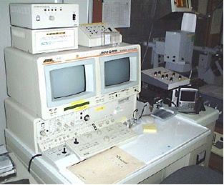
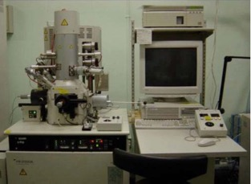
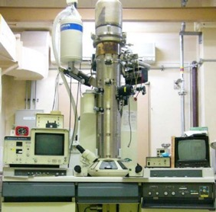
- Test items common to metal samples and LBE-
 | Specimen | Purpose | Number
Optical microscope Laser microscope | 3×7×2 mm | Corrosion surface observation | > 30（Beam injection window, irradiation sample plate, etc.）
Metallurgical microscope | Resin-filled | Metallographic observation | Some mechanical strength specimens
SEM | Tested specimen | Fracture surface observation | All mechanical strength specimen
FE-SEM | Resin-filled | Corrosion cross-sectional observation Elemental analysis | > 30 (Beam injection window, irradiation sample plate, etc.）
SEM
 | Specimen | Purpose | Number
TEM | Electrolytic polishing, FIB* | Microstructural Observation | > 30
Gas analysis | > 10 mg | Determination of transmutation gas | TBD
FIB
TEM
*: Focused ion beam
Analysis | Sample | Information | Number
γ-ray measurement | g | Nuclides and their amounts | TBD
Transpiration method | mg | Evaporation behavior | TBD
Thermo-chromatography | g | Adsorption behavior | TBD

Slide 9
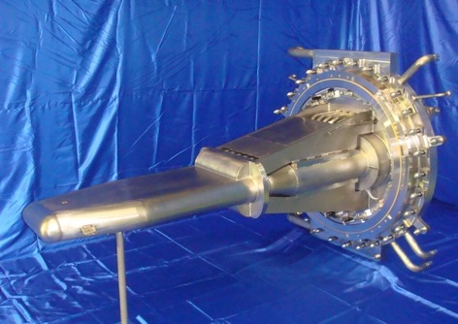
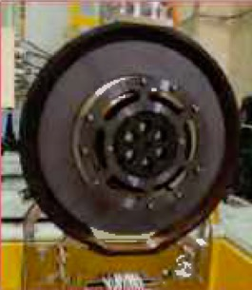
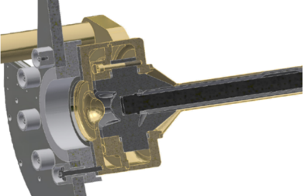
- Components, materials and testing items planned for PIE (J-PARC MLF, Neutrino) -
Component | Size | Material | Testing | Number
Hg target vessel | φ50×2.5 mmt, 50 g | SUS316L | Tensile, microhardness, surface observation, TEM, gas analysis | 4 /year
Proton beam window | φ50×2.5 mmt, 15 g | A5083 | Tensile, microhardness, surface observation, TEM, gas analysis | 2 /2years
Moderator vessel | φ50×2.5 mmt, 15 g | A6061-T6 | Tensile, microhardness, surface observation, TEM, gas analysis | １ /year
Moderator vessel | φ50×2.5 mmt, 15 g | A5083 | Tensile, microhardness, surface observation, TEM, gas analysis | １ /year
Moderator vessel | φ50×2.5 mmt, 17 g | Ag-In-Cd A5083 | Tensile, microhardness, surface observation, TEM, gas analysis | １ /year
Muon target | φ40×20 mmt, 45 g | Graphite | Compression, microhardness, surface observation, TEM, gas, thermal diffusivity, dimensional change, ultrasonic conduction | 1 /3years
Muon target | φ40×20 mmt, 80 g | SiC/SiC composite | Compression, microhardness, surface observation, TEM, gas, thermal diffusivity, dimensional change, ultrasonic conduction | 1 /3years
2 m
MLF target
Muon target
Component | Size | Material | Testing | Number
Beam window | φ40×0.3 mmt, 1.8g | Ti-6Al-4V | Microhardness, surface observation, TEM, radiochemical analysis | 2 /5years
OTR | φ50×50 μmt | Ti-15V-3Cr-3Sn-3Al | Microhardness, surface observation, TEM, radiochemical analysis | 2 /5years
SSEM | 2~5 mm ×5 μmt | Pure Ti | Microhardness, surface observation, TEM, radiochemical analysis | ～10 /5years
Neutrino target | TBD | Isotropic graphite | TBD | 1 /5years
Graphite IG-430U
26 mmφ x ~900 mm
Ti alloy
(BW=0.3 mm)
Neutrino target

Slide 10
- Components, materials and testing items planned for PIE (J-PARC Hadron) -
Component | Size （Before cutting） | Material | Testing | Number
Ti window （50 kW target upstream） | φ265×2～20 mmt 3.3 kg | Ti-6Al-4V | Tensile, Microhardness | 1 /3 years
Ti window （50 kW target downstream） | φ440×4～24 mmt 9.9 kg | Ti-6Al-4V | Tensile, Microhardness
Be window (90kW target upstream） | φ300×6 mmt 0.8 kg | Pure Be（S-200F） | Tensile, Microhardness | １ /6 years
Be window (90kW target downstream） | φ455×8 mmt 2.4 kg | Pure Be （S-200F） | Tensile, Microhardness
Al window for SY vacuum partition (2016 replacement) | φ230×0.1 mmt 11 g | Pure Al （A1060-H18） | Tensile, Microhardness, Elemental analysis
Al window for SY vacuum partition (2018 replacement) | φ260×0.1～35 mmt 2.1 kg | Al alloy （A7N01-T6） | Tensile, Microhardness, Elemental analysis
COMET Phase 1.5 target | φ20 mm× 400 mm, 400 g | SiC/SiC composite | Tensile, microhardness, surface observation, TEM, gas analysis, thermal diffusivity | 2 in total
COMET Phase 2 target | φ20 mm× 160 mm, 1 kg | W alloy | Tensile, microhardness, surface observation, TEM, gas analysis, thermal diffusivity | 2 in total
COMET target

Slide 11
- Process flow diagram -
Metal specimens
Specimens
storage cell
Specimens
Mechanical strength testing
Specimens
Specimen processing
Specimens
Surface observation
Hardness testing
SEM, FE-SEM
Solid wastes
Solid wastes
Solid wastes
Specimens
Specimens
Charpy impact
SP test
Specimens
Cooling water
Specimens
Cooling water
Gas
analysis
Microstructural
Observation
Cooling water
Etching waste
Cooling water
Cooling water
Etching waste
Exhaust
Wastes management systems
Exhaust
Stack
LBE analysis
Specimen
storage cell
Samples
Samples
Solid wastes
LBE handling cell
Pre-treatment of LBE
LBE Analysis
Solid wastes
Using these flows as a reference, the layout of the facility was studied to ensure efficient flow lines for irradiated samples and waste.
Liquid wastes
Exhaust
Wastes management systems
Exhaust
Stack

Slide 12
- Process flow diagram of Ac-225 production -
α-γ concrete cell
Under ground pit
Proton irradiation facility
Th target
Dissolution of Th
Dissolved solution
Separation of Ra and Ac
Dissolved solution
Extraction of Ra
Ac-225, 227
Solidified and stored
Wastes containing Th
Solidified and stored
Ra-225
Shipment to pharmaceutical manufacturers
Ac-225
Sealed in container
Ac-225
Radiation and
weight measurement
Ac-225
Ac-225 extraction decayed from Ra-225
Milking
Exhaust
Liquid wastes
Wastes management systems
Exhaust
Stack
A. K. H. Robertson, et.al., “²³²Th-spallation-produced ²²⁵Ac with reduced ²²⁷Ac content”, Inorg. Chem. 2020, Vol. 59, No. 17, 12156−12165. DOI:10.1021/acs.inorgchem.0c01081

Slide 13
The equipment required for post irradiation testing
The equipment required for post irradiation testing
Test items | Type of cells, lab, etc. | Number
Receiving and storage specimens | β-γ concrete cell（120ｃｍ） | 1
Mechanical strength testing | β-γ concrete cell（90ｃｍ） | 4
Specimen processing | β-γ concrete cell（90ｃｍ） | 1
Surface observation | Iron cell（15ｃｍ） | 2
Graphite samples testing | Iron cell（15ｃｍ） | 1
Activated LBE handling | Iron cell（15ｃｍ） | 1
Preparation for chemical method | Lab, hood with lead shielding | 1
Electropolishing, FIB, TEM observation | Lab, hood with lead shielding | 1
Impurity analysis for LBE | Lab, GB with lead shielding | 1
Thermal diffusivity measurement and density measurement of graphite | Lab, equipment with lead shielding | 1
Maintenance and modification of testing and analysis equipment | Lab | 2
6 β-γ
concrete cells
4 iron cells
6 labs
The equipment required for the separation and purification of Ac-225
Test items | Type of cells, lab, etc. | Number
Receiving, separation and purification, weighing, fractionation, storage | α-γ concrete cell（90ｃｍ） | 1
1 α-γ
concrete cell

Slide 14
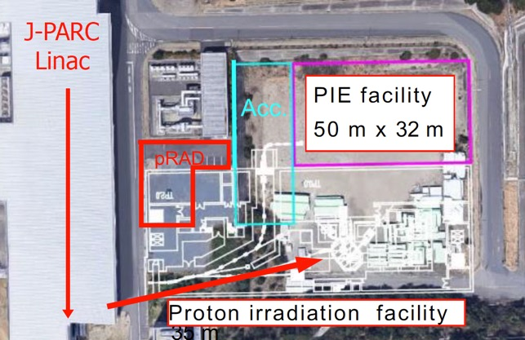
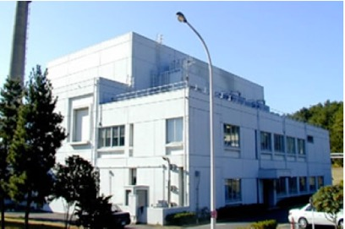
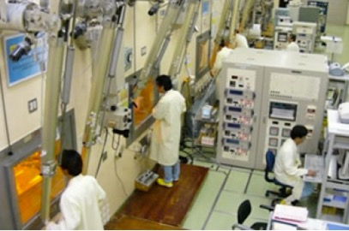
3. Facility layout plan
- Facility design restrictions -
① Proposed construction site for the PIE facility.
5 m down, 50 m x 32 m. Close to WASTEF.
Cliff
Slope
Truck approach position
Underground tunnel
Exterior view of WASTEF
② Irradiation samples from the proton irradiation facility are transported through the underground tunnel.
③ Irradiation samples from other facilities in J-PARC are transported from the truck yard.
④ Samples and wastes to be transported to other PIE facilities are taken out from the truck yard.
WASTEF operation room

Slide 15
- Facility layout plan -
Ground floor
50 m x 32 m
DBTT shift
-Charpy impact test
-Small punch (SP) test
Mechanical property tests
-Tensile, fatigue, creep
FIB
5 m
Entrance
TEM
EV
Corridor
MSM Maintenance room
Control room
Stairs
women's restroom
Men's restroom
Staff room
Staff room
Radiation control room
Control Room
Stairs
L-1
L-2
Operation room
Specimen preparation and processing
Waste storage
Separation and purification of medical RIs
β-6
β-5
β-4
β-3
β-2
β-1
Storage pit
Isolation room
F-1
Isolation room
α-1
SEM/FE-SEM
F-2
F-3
F-4
L-3
Service area
L-4
Truckyard
Analysis of activated LBE
High-power target materials from J-PARC and other facilities in Japan and overseas

Slide 16
- B1F -
50 m x 32 m
B1F
5 m
Stairs
Cold machinery room
Stairs
Hot machinery room
Fire extinguishing system room
Low-level liquid waste storage tank room
High-level liquid waste storage tank room
Sampling room
Storage pit
Emergency power supply room
αγ liquid waste storage tank room
Hot machinery room
Liquid waste storage tank rooms
Hot machinery rooms
Cold machinery rooms, etc.

Slide 17
- 2nd and 3rd floor -
2nd floor
3rd floor
5 m
5 m
EV
EV
Stairs
Staff room
Staff room
Staff room
Staff room
Stairs
Staff room
Staff room
Staff room
Staff room
Stairs
Cold machinery room
Meeting room
C402
Cold machinery room
L-1
Workshop
Cold mock-up room
Meeting room
Meeting room
L-5
L-6
Staff rooms, workshop, cold mock-up room
Cold machinery room
Labs, etc.
Staff rooms, Meeting rooms
Cold machinery room

Slide 18
- Location of the proton irradiation facility and PIE facility -
Plane view
Elevation view
PIE facility
PIE facility
17.8 m
Proton irradiation facility
Proton beam
Proton irradiation facility
LBE target

Slide 19
4. Construction plan, R&D
- Road map -
Year
1
5
10
Irradiation Facility
Facility Design
Facility Construction
operation
10 → 250 kW
Full-scale operation
PIE facility
Facility Design
Facility Construction
Facility Operation
Roadmap of the Materials Division of the Atomic Energy Society of Japan
Needs for facilities
Phase 1
DX and AI implementation for upgrading
Phase 2
Construction of new irradiation facility
Material Irradiation
Irradiation and PIE
Soft error
Soft error test
RI Medicine
RI production
JAXA Roadmap
Gateway construction completed
Enhanced space stay technology beyond Mars
Space use
Space equipment test

Slide 20
- Development of PIE technique -
Specimen preparation machines
Accessible by MSM
Main unit and control unit should be separate.
Cutting machine
Disk while cutter
EDM→Wires should be automatically replaceable.
Milling machine with rotating jig
for fatigue and creep specimen with round section preparation
Mock-up test
Notching machine for Charpy specimen preparation
Wire cutting
Disk grinding
Grinding machine for SP (small punch) specimen preparation
Performed on MEGAPIE specimens
Desk-top electrical discharge machine,
Sankyo Engineering, Inc.

Slide 21
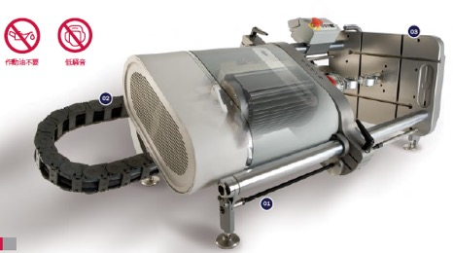
- Development of PIE technique -
Testing machine in LBE
Accessible by MSM
Main unit and control unit should be separate.
Test in LBE
Tensile, fatigue and creep test in LBE
Accessible by MSM
Setting of test specimen and strain gauge
Installation of oxygen sensor
→Ｈorizontal type
LBE bath
No lagging material
Coating
Level gauges(H&L)
T.C.
Oxygen Sensor
Cover
Flange
Rod
Rod
Tensile/Fatigue testing machine, Instron, linear type 5 kN
Drain tank
Jigs and specimen
Specifications for the specimen preparation machines and testing machine are under considering with reference to the experience of STIP and MEGAPIE.

Slide 22
5. Summary
Based on the PIE flow, test items, RI separation and purification process, etc., we determined the space required and examined the layout, which we believe is feasible in the current space.
The next issues are as follows,
  -Specification review of hot cells
  -Revision of the proposed building layout
  -Space for piping, cables and ventilation ducts, etc.
  -Development of PIE technique with unirradiated sample
This facility will contribute greatly to research on ADS materials and accelerator materials.

Slide 23
Thank you!

