Slide 1
FERMILAB-SLIDES-24-0292-AD
High-Entropy Alloy R&D for Accelerator Beam Window Applications
Abe Burleigh
16th International Workshop on Spallation Materials Technology (IWSMT16)
10/31/24

Slide 2
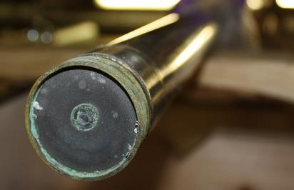
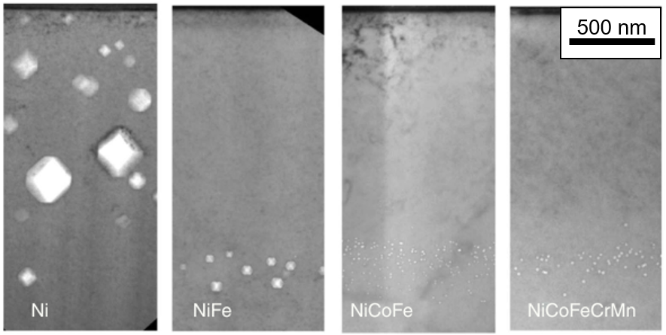
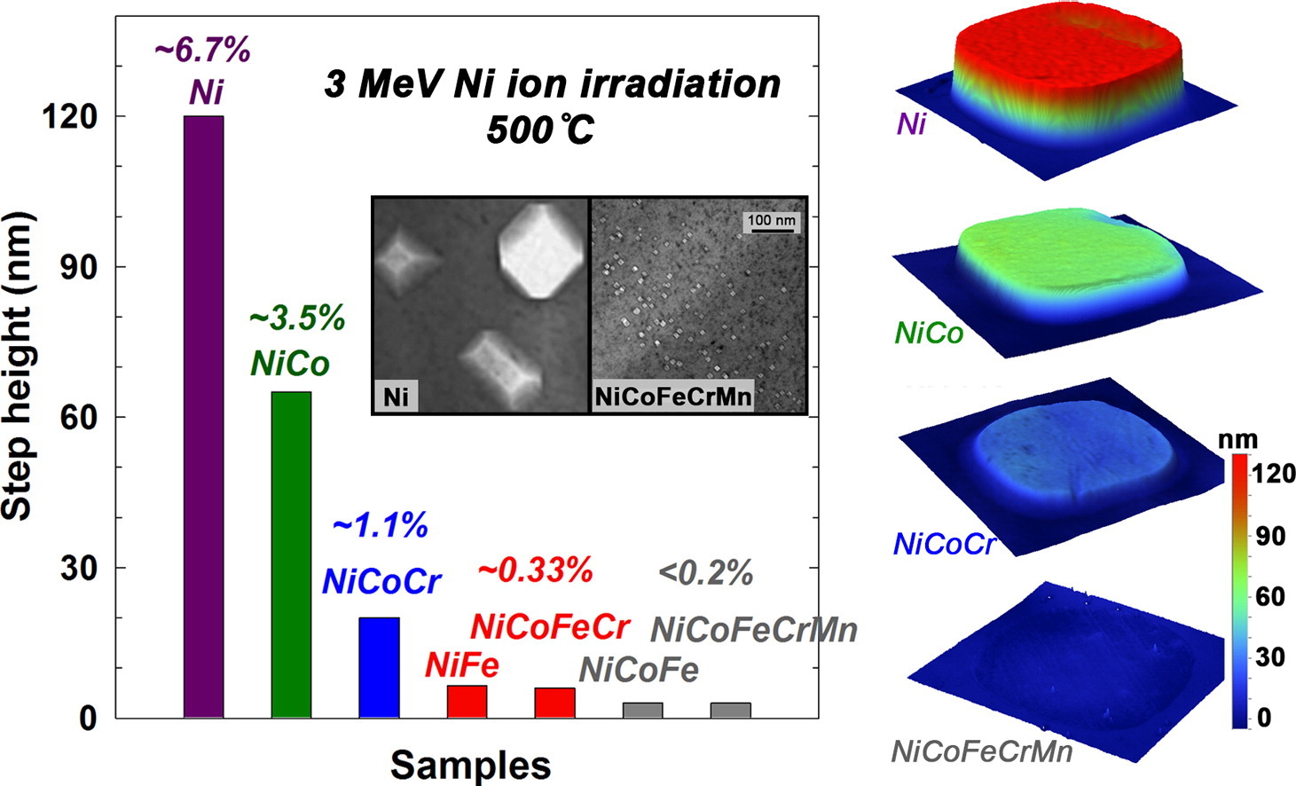
Novel high-entropy alloys for beam window applications
Primary Be window embrittlement (FNAL)
Developed leak during service
Crack formation during PIE work
Proton target beam windows:
Intercept high-energy/intensity beams
1 MW Beam power (FNAL current), up to 2.4 MW for LBNF
Survive radiation damage, thermal shock in extreme environment
HEA microstructure to combat radiation damage
Sluggish atom diffusion
Reduce defect segregation, increase recombination during damage cascade
  Minimize void/bulk swelling
Phase stability + B2 precipitates (defect sinks)
Void swelling lessened in more complex alloys (3-MeV Ni⁺, 5 x 10¹⁶/cm², 773 K), Lu et al., Nature Comm., 2016
Swelling of increasingly complex alloys under ion irradiation, Jin et al., Scripta Materialia 119 (2016)
Abe Burleigh | High-Entropy Alloy R&D for Accelerator Beam Window Applications
Notes:
DISCUSS → B2 phase: ordered 2-component BCC structure (Ti, Co)
→ Describe beam windows
HEA potential benefits
Hypothesized mechanism: sluggish diffusion, distortion/size mismatch → specific compositions
BCC: Increased ductility/machinability
Research: Phonon scattering/migration energies
CrMnV + Ti (Barron, et al. Scripta Materialia 176 (2020) 12–16)
+ Al (Tung, et al. Materials letters 61.1 (2007): 1-5.)
+ Co (?)

Slide 3
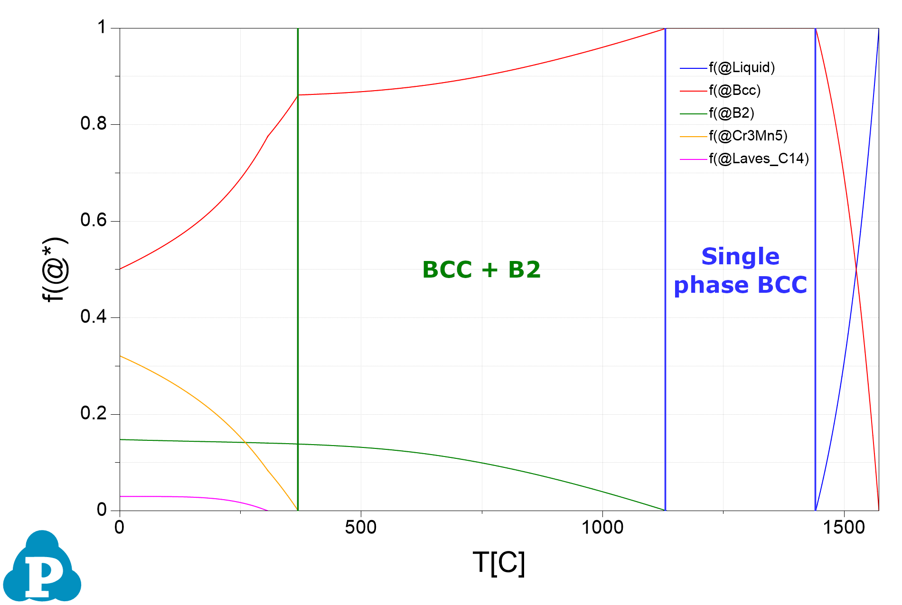
HEA properties and compositions
CALPHAD: CALculation of PHAse Diagrams
Low Z elements → reduce density
  Decreased energy deposition and scattering
  Maximize beam transparency
Broad range: single-phase BCC
  High melting point, good ductility
  Reduced void swelling/defect production compared to FCC
  B2 precipitates: room temp. ductility, high temp. strength, defect sinks
Phase fraction
Targeted
Barron, et al. "Towards V-based high-entropy alloys ..." Scripta Materialia 176 (2020): 12-16.
CrMnV
Equimolar BCC single phase
Ti
CrMnTiV
Impurity getter (<8%)
Al
AlCrMnTiV
BCC phase stabilizer, low-Z
Co
AlCoCrMnTiV
Semi-coherent 2nd phase
Abe Burleigh | High-Entropy Alloy R&D for Accelerator Beam Window Applications
Notes:
Phase Diagram: 2.4 (Al16 Co4 Cr25 Mn30 Ti1 V24)
Co activation: low concentrations, small volumes

Slide 4
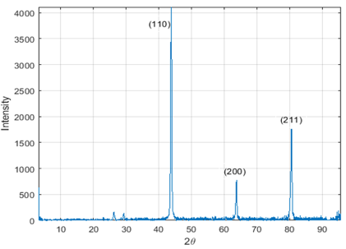

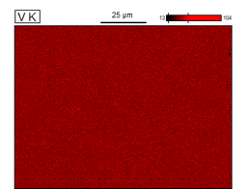
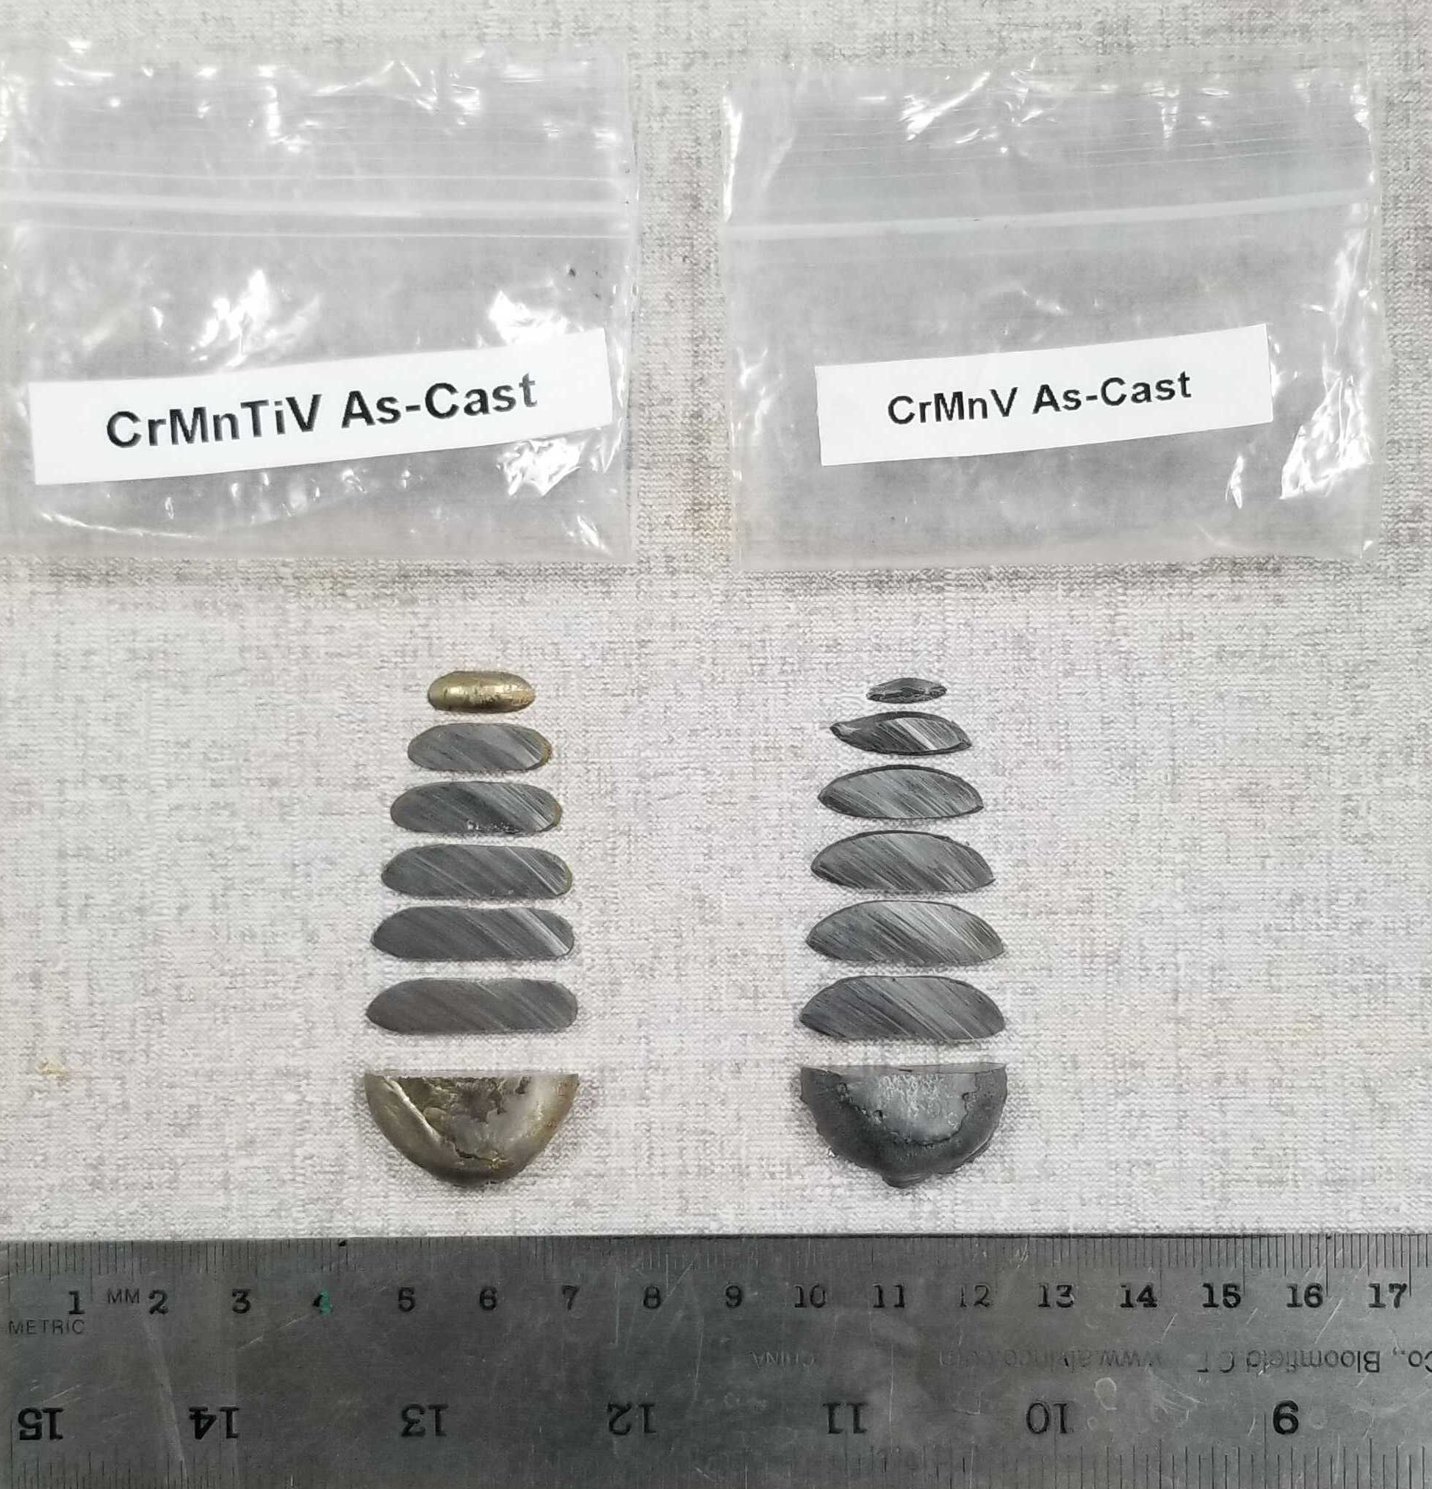
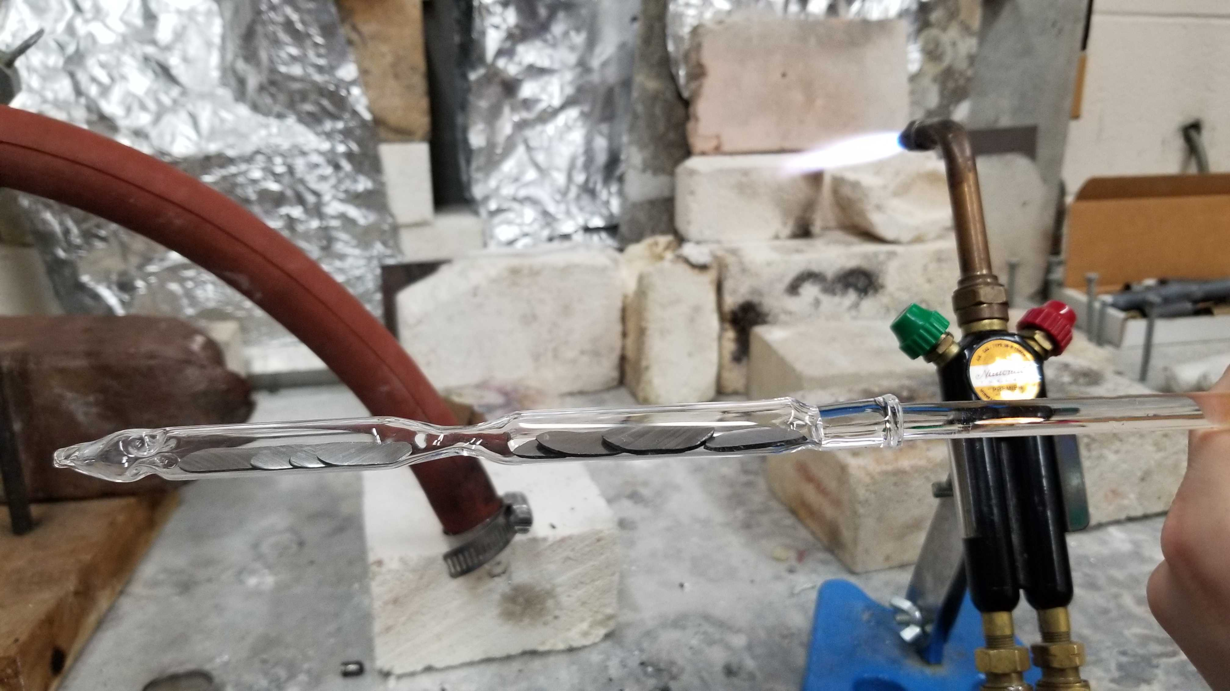
Initial HEA synthesis
4 Gen. 1 HEA compositions developed at UW-Madison
Small batch, lab-scale production
Varying number of alloying elements:
  CrMnV, CrMnTiV, AlCrMnTiV, AlCoCrMnTiV
Initial XRD, SEM/EDS confirms BCC phase + composition/homogeneity
Synthesis
  Arc-melted
  Homogenized at 1200 ºC for 48 hr
SEM-EDS map showing homogenous V content in CrMnV alloy
BCC XRD peaks in CrMnV alloy. N. Crnkovich, UW-Madison
Sectioned, arc-melted ingots
HEA samples sealed in quartz under vacuum before heat treatment
Abe Burleigh | High-Entropy Alloy R&D for Accelerator Beam Window Applications
Notes:
HEA Compositions
Predict density, c_{p}, mechanical properties
Gen.1 : compositions to test CrMnV + additions
arc-melt → Homogenized at 1200 ºC for 48 hr

Slide 5
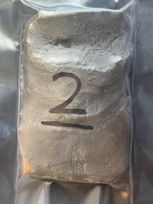
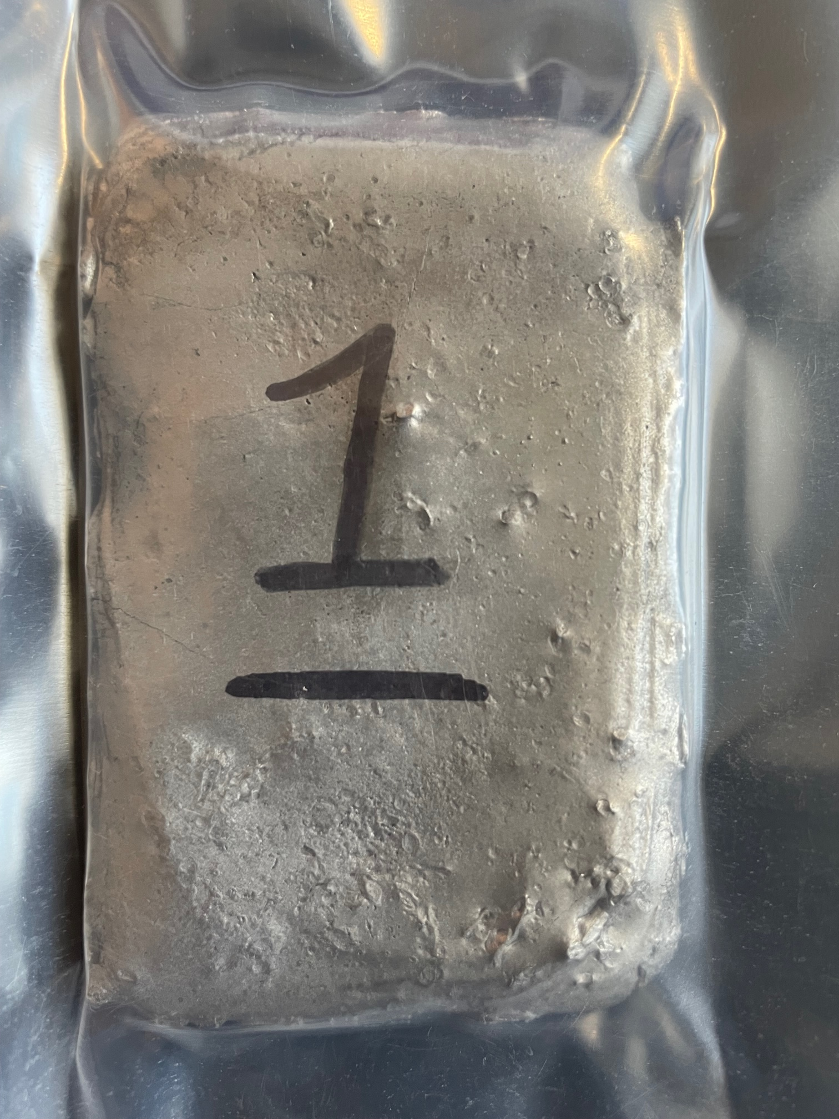

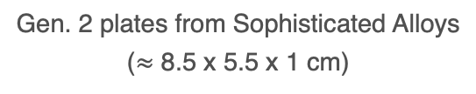
2nd Generation alloy refinement and synthesis
8 Gen. 2 compositions fabricated by Sophisticated Alloys
Study effects of relative concentration
Refined compositions with high-throughput CALPHAD simulations
5 AlCoCrMnTiV compositions to study:
  Varied Ti concentration as impurity getter
  Varied Co concentration $→$secondary B2 phase
Increased Al content without Cr (2 alloys)
  BCC phase stability
Absence of Co & Cr (1 alloy)
  Al as B2 phase enhancer
Gen. 2 plates from Sophisticated Alloys
($≈$ 8.5 x 5.5 x 1 cm)
Abe Burleigh | High-Entropy Alloy R&D for Accelerator Beam Window Applications
Notes:
HEA Compositions
Gen. 2 : Test effect of Ti, Co, Al concentrations
4 hr HIP under Argon, 1200 ºC, 100 MPa → Vacuum Anneal: 1200 ºC for 4 hrs → Cool to 650 ºC : Soak for 36 hr → Force cool to < 55 ºC in Ar

Slide 6
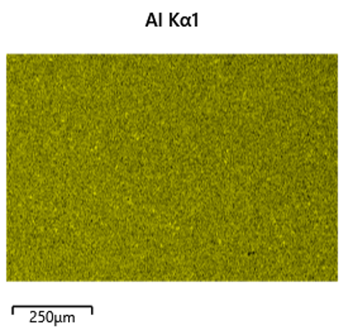
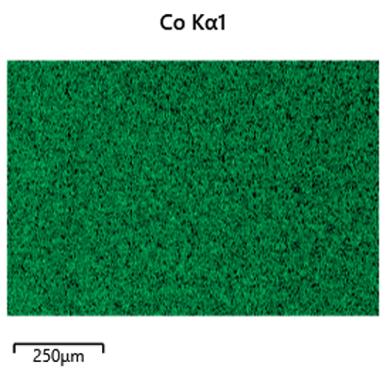
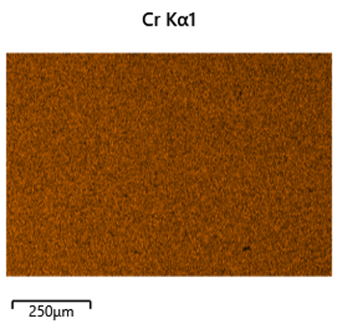
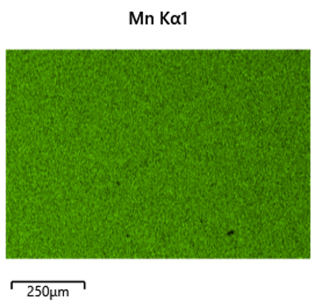
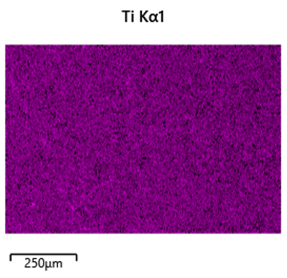
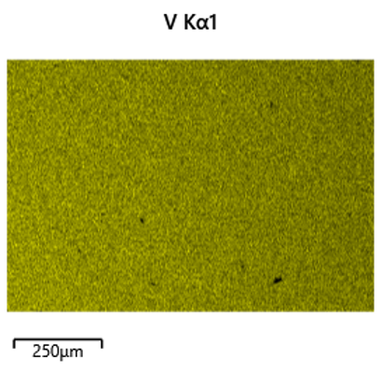
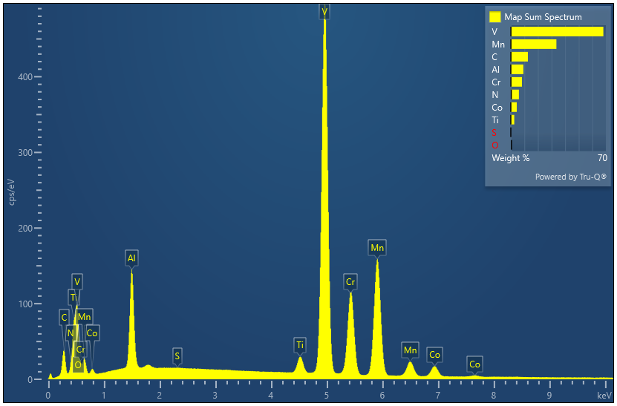
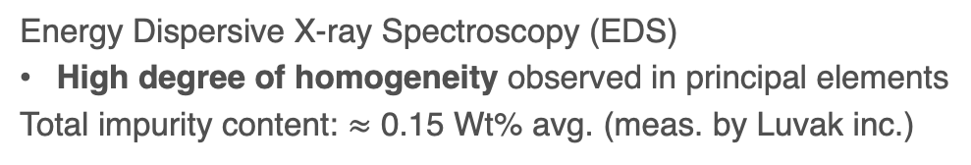
EDS shows homogeneity of principal elements in HEAs
AlCoCrMnTiV
Energy Dispersive X-ray Spectroscopy (EDS)
High degree of homogeneity observed in principal elements
Total impurity content: $≈$ 0.15 Wt% avg. (meas. by Luvak inc.)
Abe Burleigh | High-Entropy Alloy R&D for Accelerator Beam Window Applications
Notes:
EDS shows:
Oxygen & Nitrogen - Inert gas fusion - ASTM E 1409-13
Carbon & Sulfur - Combustion infrared detection - ASTM E 1941-16
Hydrogen - Inert gas fusion – ASTM E 1447- 16
All comps:
Wt% : 0.05 – 0.25 % of total
2.1 Wt %:
C (0.02), N (0.15), O (0.08), S (0.01) = 0.25%

Slide 7
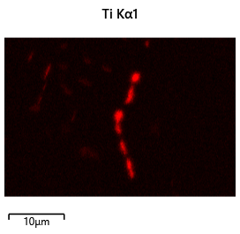
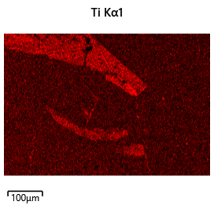
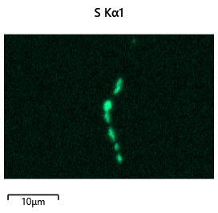
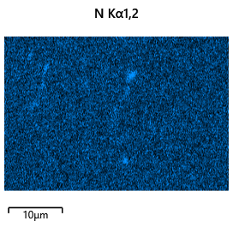
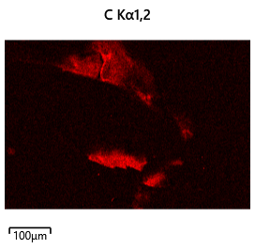
Titanium acts as impurity getter
Al₁₀Co₄Cr₂₅Mn₂₆Ti₁V₃₄ Maps and linescan data
#1 : Ti (35 At%), S (18 At%) enrichment at GB with Al, Co, Cr, Mn, V depletion
#1
#2
SEM SE image of regions examined by linescan (right)
Titanium effects on impurity concentrations/segregation
Captures C, N, O, S, predominantly at grain boundaries
AlO formation within grains also prevalent
Avoid negative effects on hardness, strength, ductility, toughness
#2 : Ti (5 At%) in needle morphology captures N (5 At%) within grains
Abe Burleigh | High-Entropy Alloy R&D for Accelerator Beam Window Applications
Notes:
-impurities: negative effect
hardness, strength, embrittlement/ductility, toughness
oxidation/corrosion (high T), inclusions
Maps/Line scans: 2.1 Al10 Co4 Cr25 Mn26 Ti1 V34 ← describe significance of plots
Carbon:
Primarily affects hardness and strength in steels.
High carbon content can lead to brittleness.
Nitrogen:
Can segregate at grain boundaries, impacting ductility and toughness.
In some cases, controlled nitrogen addition can enhance specific properties.
Sulfur:
Improves machinability by creating small chips during cutting.
High sulfur content can severely reduce ductility and lead to poor weldability.
Oxygen:
Can contribute to oxidation and corrosion, especially at elevated temperatures.
May form oxide inclusions within the alloy, impacting mechanical properties.

Slide 8
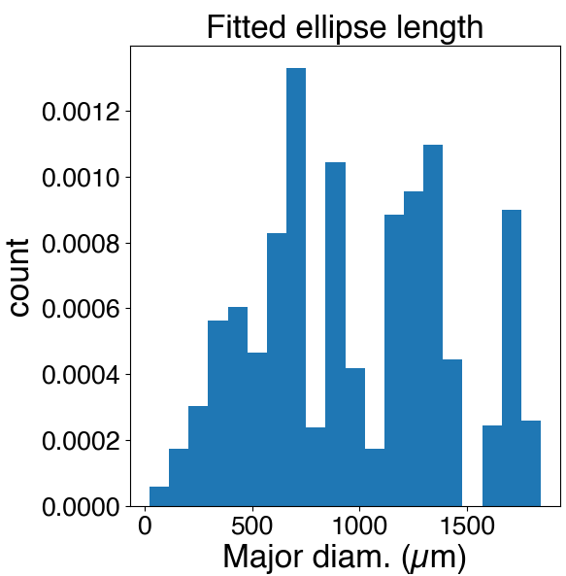
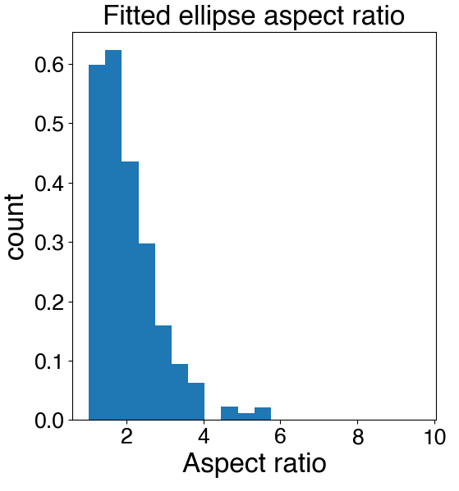
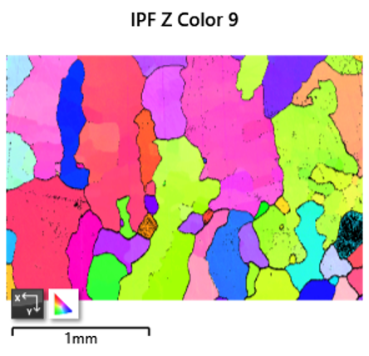
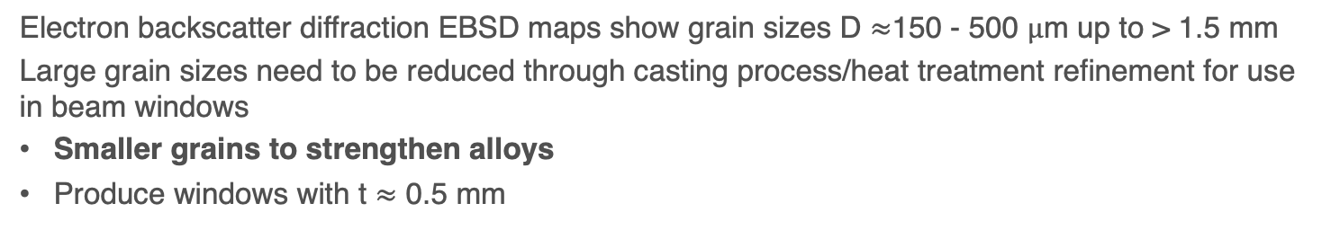
HEA grain structure and orientation
Electron backscatter diffraction EBSD maps show grain sizes D $≈$150 - 500 $μ$m up to > 1.5 mm
Large grain sizes need to be reduced through casting process/heat treatment refinement for use in beam windows
Smaller grains to strengthen alloys
Produce windows with t $≈$ 0.5 mm
Area weighted grain size, shape distributions
EBSD map, statistics for Al₁₂Co₃Cr₆Mn₂₇Ti₂V₅₀
Abe Burleigh | High-Entropy Alloy R&D for Accelerator Beam Window Applications
Notes:
2.6 mapped: Al₁₂Co₃Cr₆Mn₂₇Ti₂V₅₀
Other properties effecting grain size: thermal history …
STEEL (wiki):
heated to a temperature that is just above the upper critical temperature, in order to prevent the grains of solution from growing too large, grow larger as the temperature is increased
Larger grains have large grain-boundaries, which serve as weak spots
cooling rate can be used to control the rate of grain growth
generally temperature and the rate of cooling that controls the grain size and microstructure

Slide 9
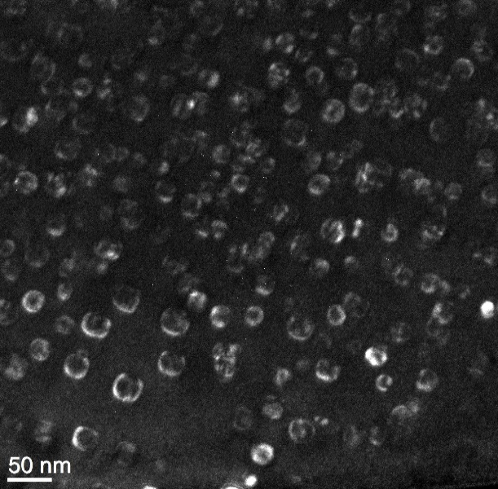
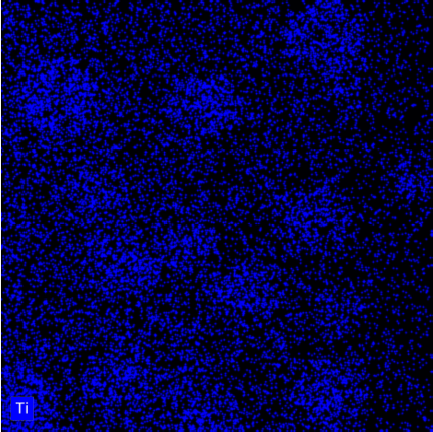
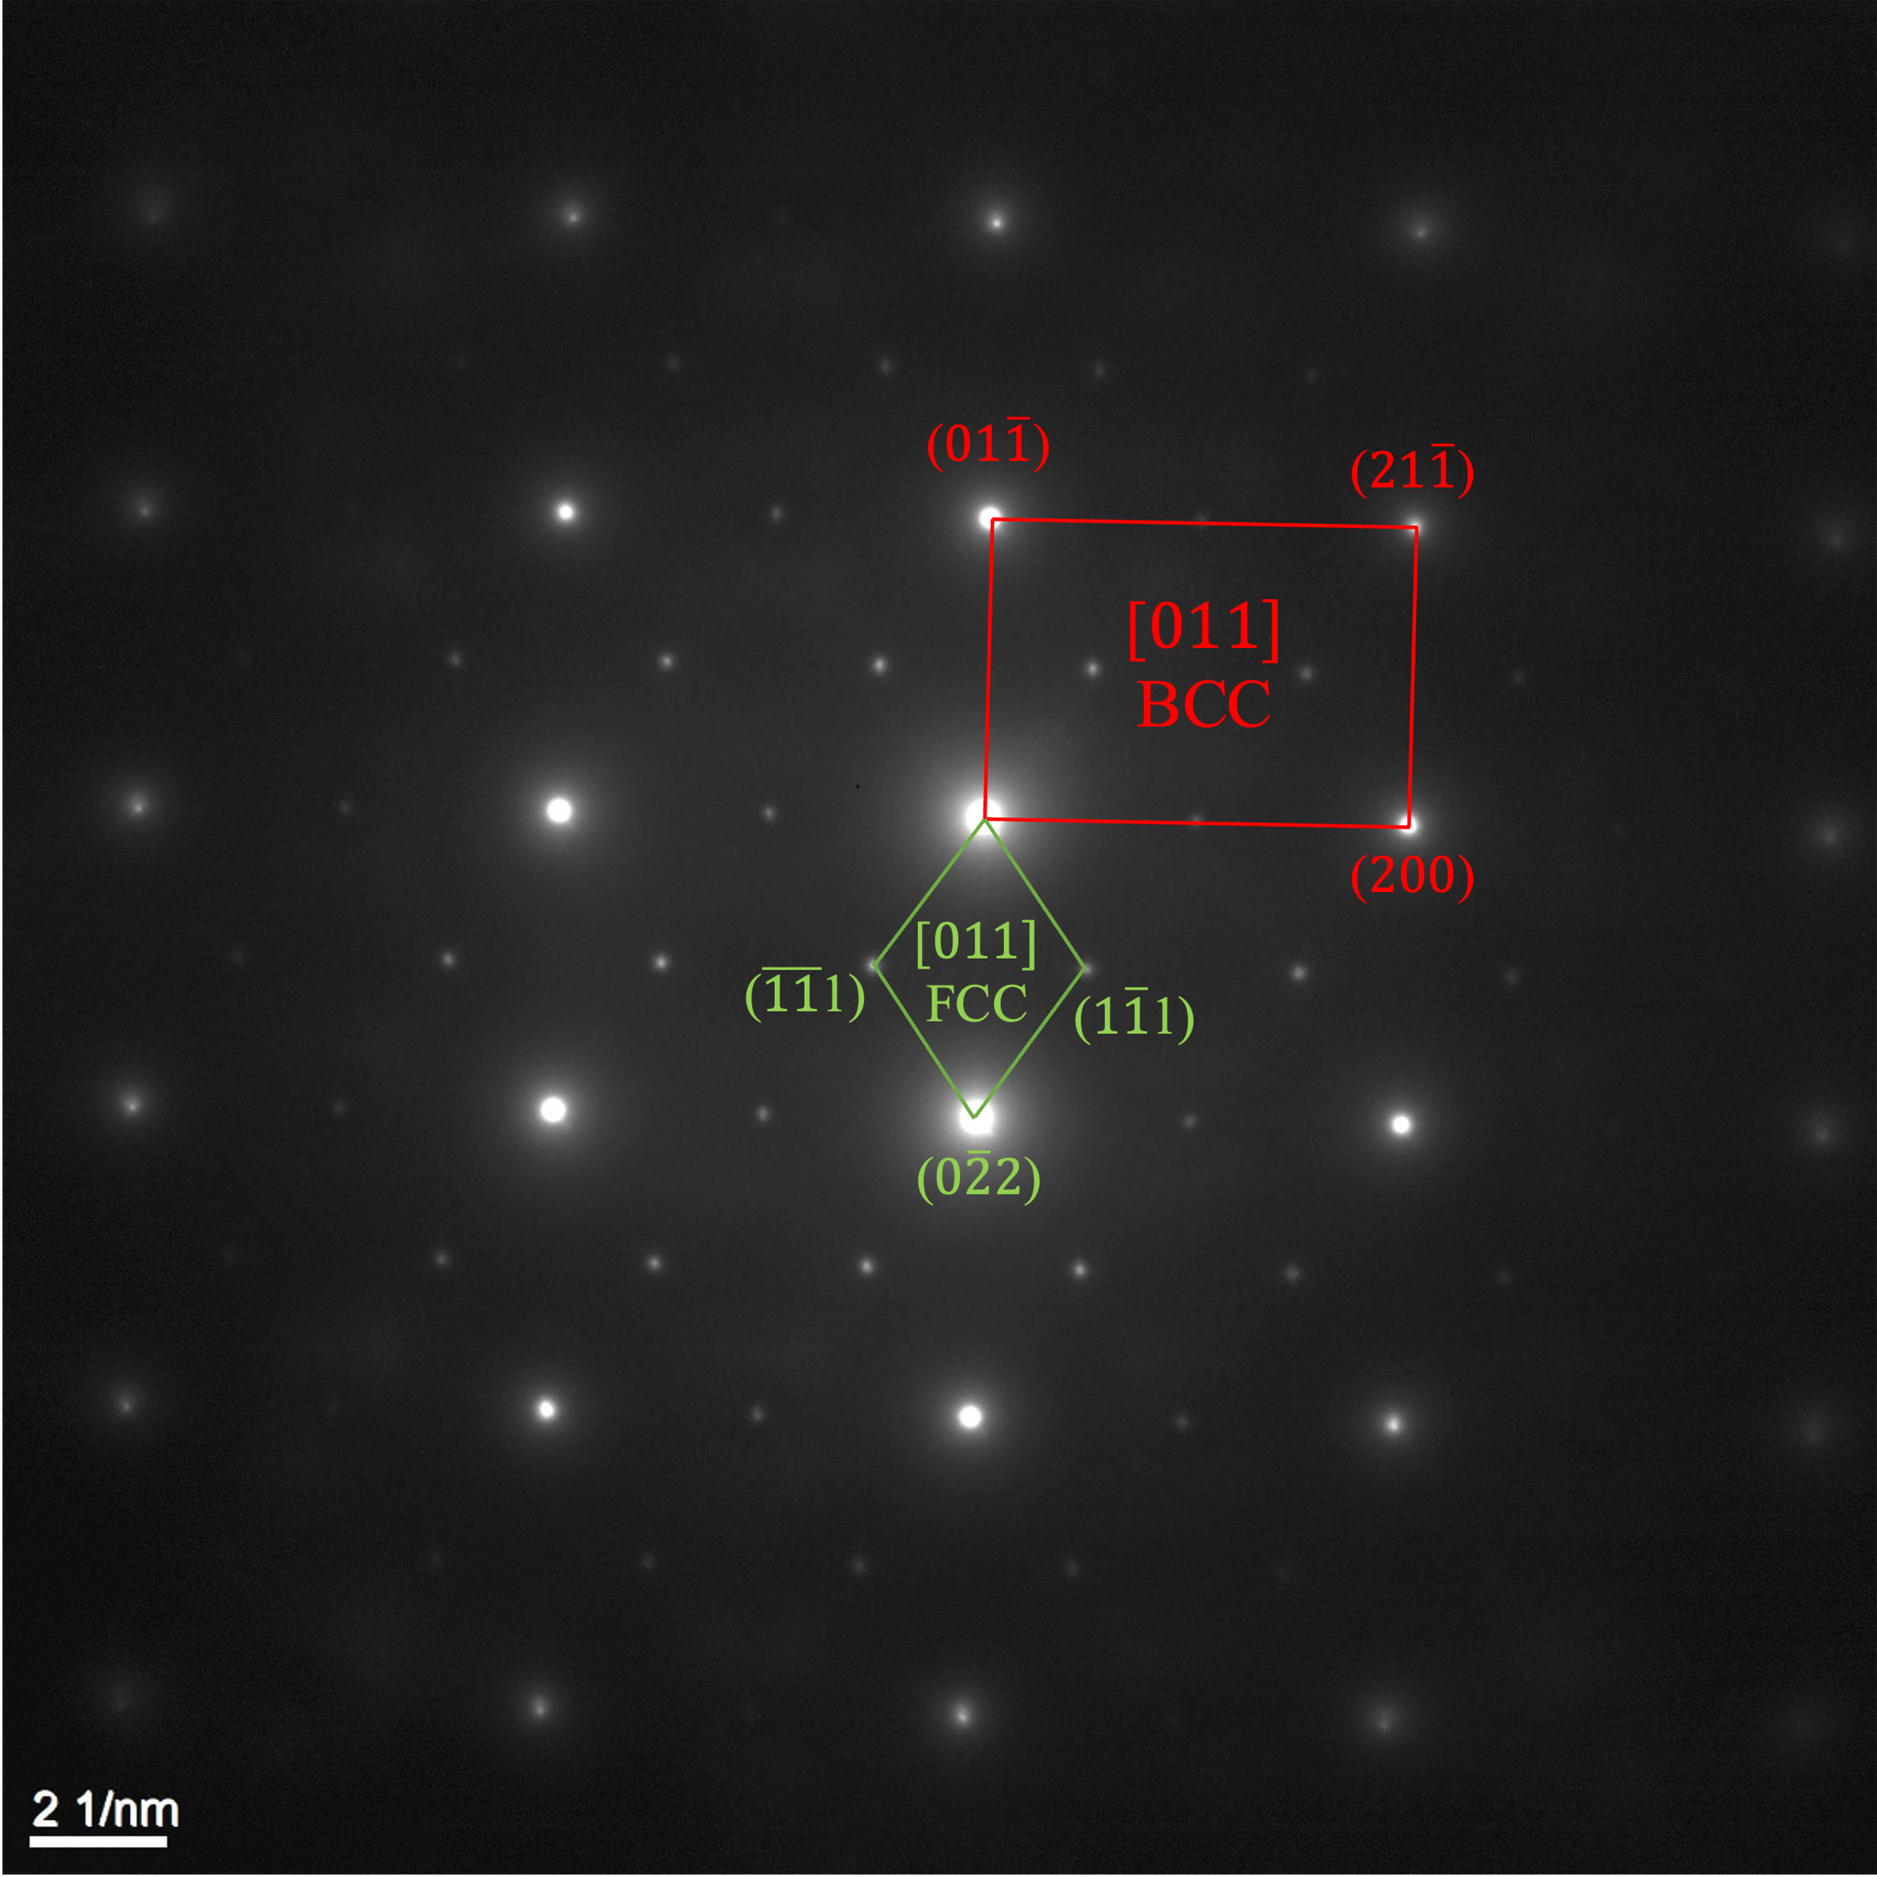
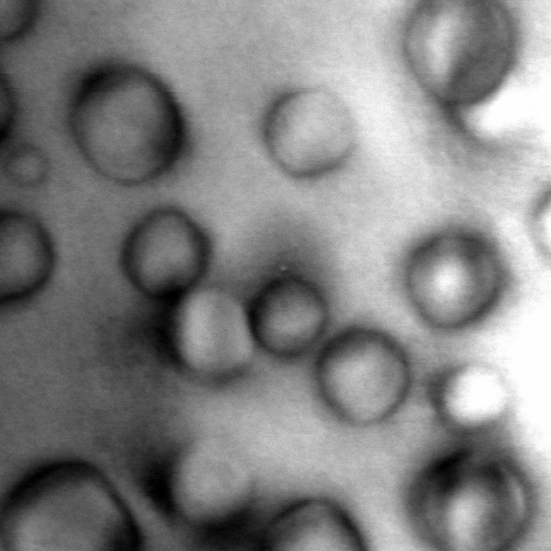
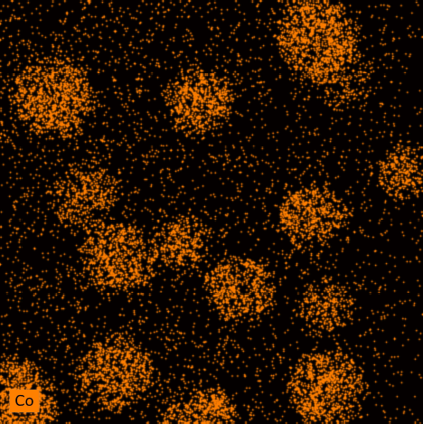
FCC precipitates observed in heat treated, 6-component alloy
(011) DF
Al₁₅Co₄Cr₂₀Mn₂₀Ti₆V₃₅
Transmission EDS shows Co, Ti enrichment in precipitates
Al, Cr, Mn, V depletion
Ordered components match CALPHAD predictions
  But FCC phase instead of B2!
Ti
~ 20 nm
Co
N. Crnkovich, UW-Madison
Abe Burleigh | High-Entropy Alloy R&D for Accelerator Beam Window Applications
Notes:
1st Gen, 1.6 + HT
Solutionized 2 hours, 1200 °C
Aged 7 days, 750 °C

Slide 10
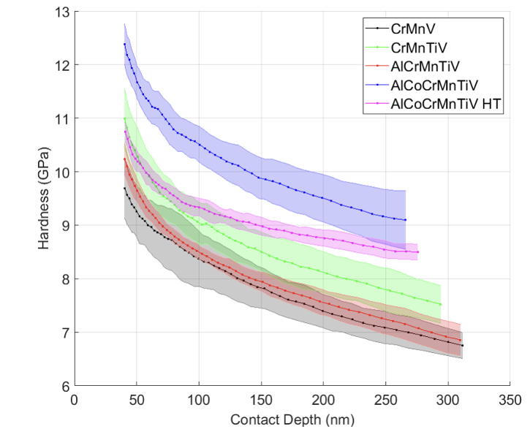
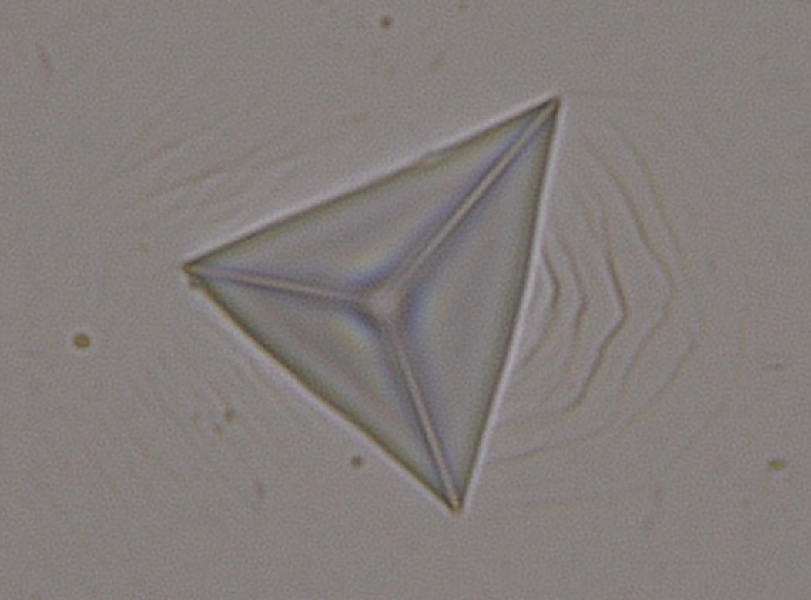
Nanoindentation studies
Thermal shock magnitude (1D)
Desire good (high-temperature) mechanical properties
  Perform in extreme environment
Signs of ductility
  No cracking + pile-up
  All compositions
  Pre/post irradiation (low dose)
Gen. 1 (ABOVE, N. Crnkovich, UW-Madison)
Significant hardening with more complexity
  Mitigated by heat treatment
Gen. 2 (LEFT)
Less hardness compared to Gen. 1
  Reduced hardness/modulus for high V content alloys
High Vanadium
Median Vanadium
Low Vanadium
Abe Burleigh | High-Entropy Alloy R&D for Accelerator Beam Window Applications
Notes:
Ned credit
Gen 1 Heat treatment: 400 C – 44 days
VERBAL
Stiffer than Ti-64 ($E=110$ GPa)
Less stiff than Beryllium ($E=303$ GPa)
2_5-1000mN-2500X-mix_20240506_132456.jpg

Slide 11
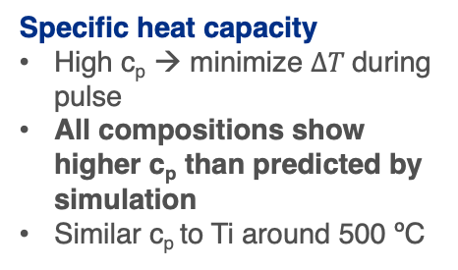
Promising thermal properties at elevated temperatures
Thermal conductivity
Time domain thermal reflectance at UC Riverside
High thermal conductivity → heat removal
Low thermal conductivity reported in literature
Large increase with temperature observed
Coefficient of thermal expansion
Low CTE → minimize stress during pulse
Similar CTE values for examined alloys at temperatures relevant to beam window applications
Specific heat capacity
High c_{p} → minimize $ΔT$during pulse
All compositions show higher c_{p} than predicted by simulation
Similar c_{p} to Ti around 500 ºC
10/31/24
Abe Burleigh | High-Entropy Alloy R&D for Accelerator Beam Window Applications
Notes:
Rene, Rich, Gaurav at UCR credit
Cp
Ti: 0.72 J/(g K) @ 600 C
Be: 1.9 J/(g K) @ RT
Verbal
descript. Of techniques + discuss TDTR
Next steps

Slide 12
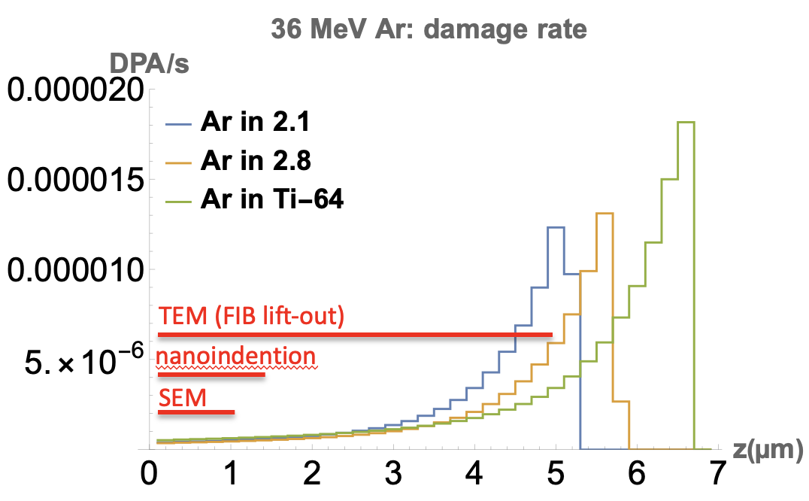


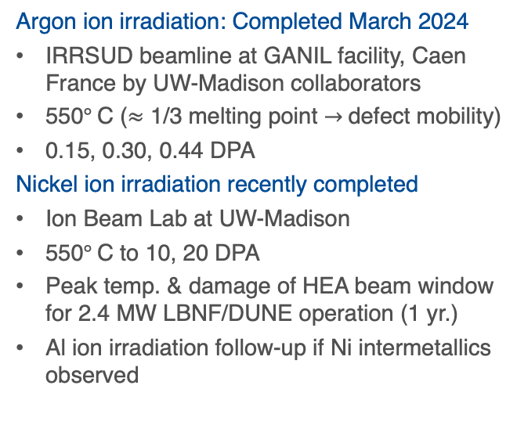
Low energy ion irradiation studies to mimic protons
Study: defect formation, void formation/stability
Ti-64 for baseline comparison (current windows)
Argon ion irradiation: Completed March 2024
IRRSUD beamline at GANIL facility, Caen France by UW-Madison collaborators
550$°$C ($≈$ 1/3 melting point $→$defect mobility)
0.15, 0.30, 0.44 DPA
Nickel ion irradiation recently completed
Ion Beam Lab at UW-Madison
550$°$C to 10, 20 DPA
Peak temp. & damage of HEA beam window for 2.4 MW LBNF/DUNE operation (1 yr.)
Al ion irradiation follow-up if Ni intermetallics observed
Abe Burleigh | High-Entropy Alloy R&D for Accelerator Beam Window Applications
Notes:
Upcoming irradiation studies
Ion irradiation: fast/inexpensive for screening
No transmutation
³⁶Ar¹⁰⁺, 1 MeV/A →Expected 5E10 Ar/cm²/s at 36 MeV → lower damage (0.1, 0.3, and 0.4 DPA)
V²⁺: Expected 0.1 μA/cm² at 4.5 MeV → higher damage (1, 5, and 10 DPA) ~ 10 min. (peak) – 40 min. (surf.) for 1 (ARC)DPA

Slide 13
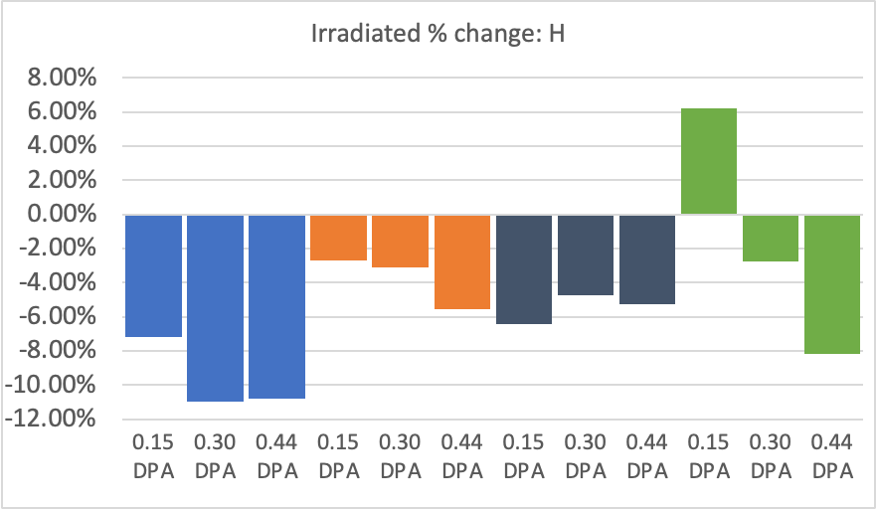
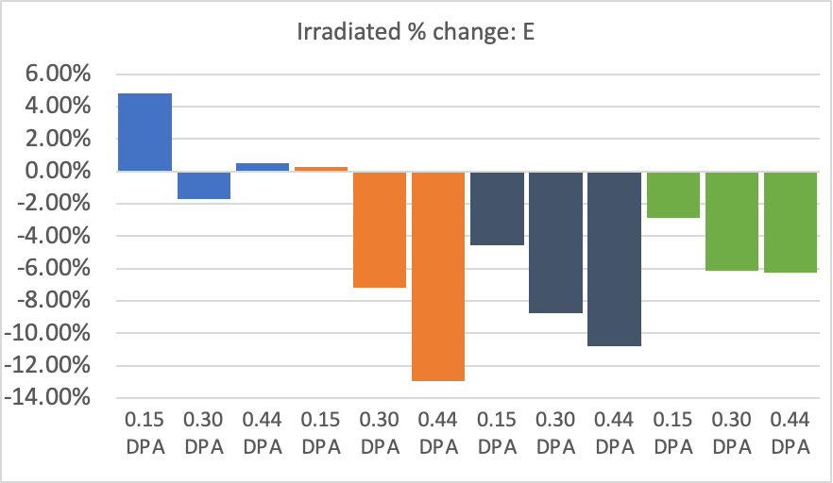
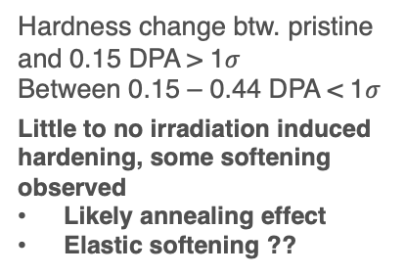
Low energy Ar ion irradiated micro-mechanical properties
Hardness change btw. pristine and 0.15 DPA > 1$σ$
Between 0.15 – 0.44 DPA < 1$σ$
Little to no irradiation induced hardening, some softening observed
Likely annealing effect
Elastic softening ??
EBSD study of orientation dependence underway
2.1
Al₁₀Co₄Cr₂₅Mn₂₆Ti₁V₃₄
2.5
Al₂₀Co₁Mn₂₇Ti₂V₅₀
2.6
Al₁₂Co₃Cr₆Mn₂₇Ti₂V₅₀
2.7
Al₁₈Mn₃₀Ti₂V₅₀
2.1
2.5
2.6
2.7
2.1
2.5
2.6
2.7
Abe Burleigh | High-Entropy Alloy R&D for Accelerator Beam Window Applications
Notes:
Solicit feedback/insights: irradiation induced vs annealing/temp. effect?
Designations → Compositions

Slide 14
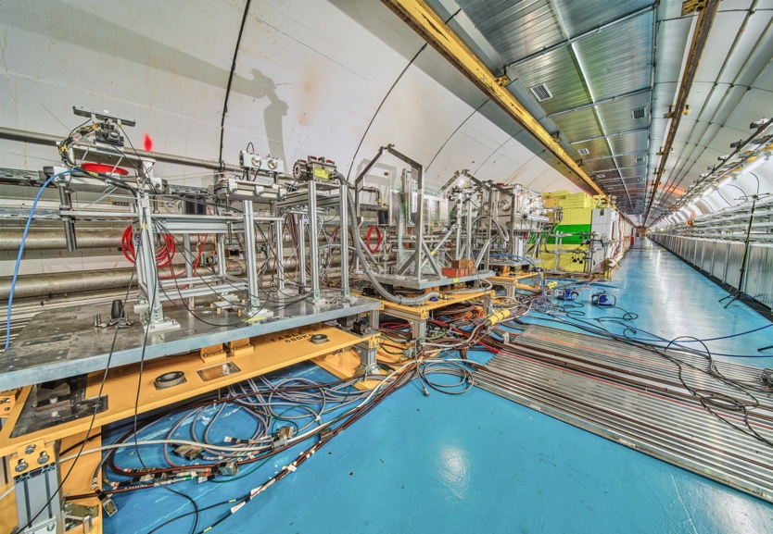



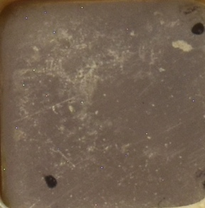
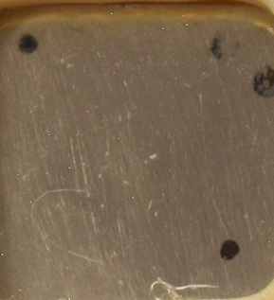
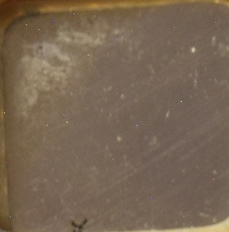
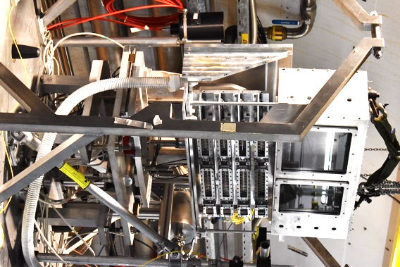
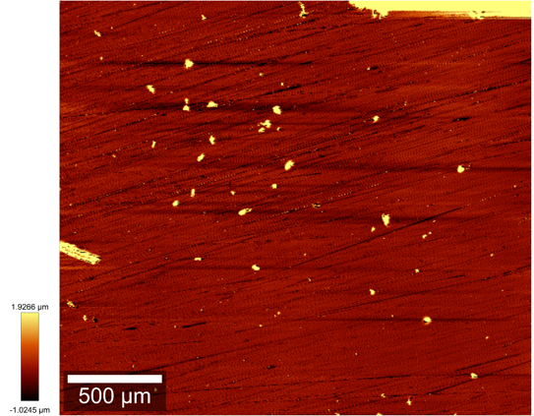
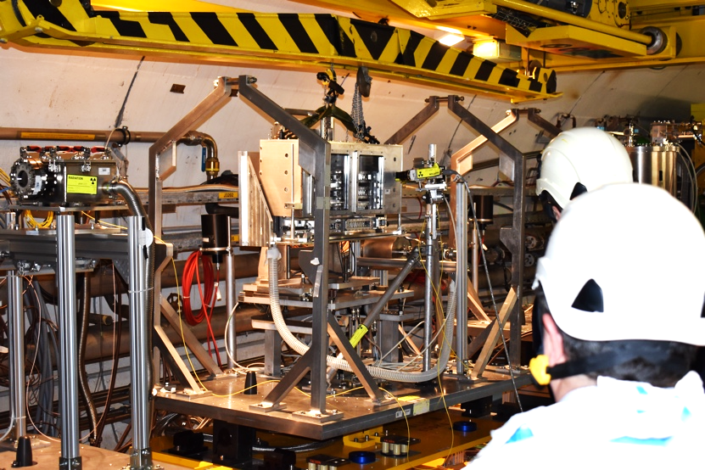
HEAs Tested at CERN’s HiRadMat Facility (2022)
Thermal shock test of several HEA specimens
  Single-shots: 7×10¹² protons/pulse, 440 GeV, 𝜎: 0.25 mm
  ΔT ~1200 ºC in ~8 μs
Post-experiment optical images of HEAs
All HEA samples survived testing
Profilometry and SEM completed at UKAEA-Materials Research Facility (MRF) → no resolvable surface damage observed
Promising results for future beam window application
Testing with multiple pulses and same ΔT/pulse scheduled for 2025
Abe Burleigh | High-Entropy Alloy R&D for Accelerator Beam Window Applications
Notes:
SEM of samples A3.23/24/25/26 showed no resolvable surface damage attributable to the beam in the centre of the sample.
There were surface marks that are consistent with the preparation of the samples, representative micrographs were taken close to the centre of the samples to illustrate this at 200, k and 3k magnification.
Also check if Sujit has some additional results based on his profilometry analysis to share
Highlight that the HEAs will be tested again at HiRadMat in 2025 under multiple beam pulses.

Slide 15
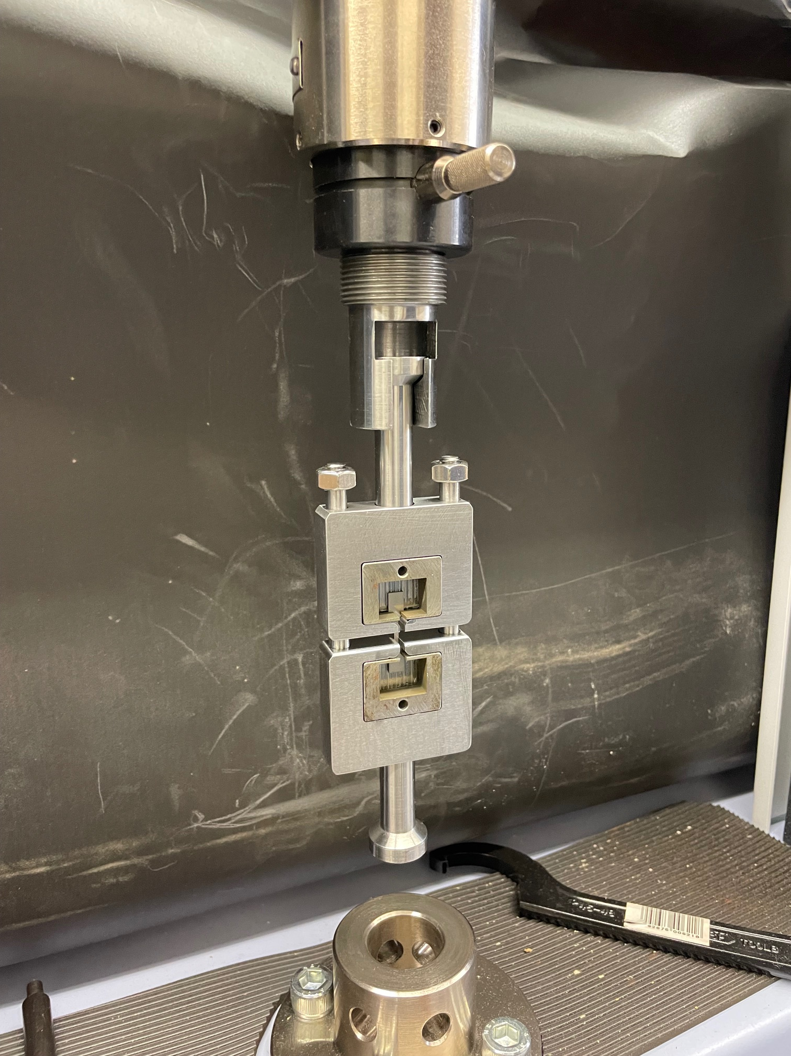

Miniature tensile testing at MI-8
Shimadzu tensile tester + custom grips
Desire high strength/ductility to survive extreme environment
Miniature tensile specimens to preserve material
Digital image correlation (DIC) to precisely measure strain
1”
Abe Burleigh | High-Entropy Alloy R&D for Accelerator Beam Window Applications

Slide 16





Transient Grating Spectroscopy (TGS) System at Fermilab
S. Bidhar (Fermilab)
Ultrafast optical technique: study dynamics of materials by creating a periodic modulation (grating) using two interfering laser pulses
Real-time, non-destructive thermal diffusivity & elastic modulus measurements
Probes thin damage layer (sub-$μ$m to few $μ$m)
Detect radiation-induced strain fields, stress waves
Reveal how defects form, migrate, anneal during irradiation
Pre/post-ion irradiation examination of specimens
TGS test on NT-02 graphite target fin (MIT)
Abe Burleigh | High-Entropy Alloy R&D for Accelerator Beam Window Applications
Notes:
Just started setting up the TGS system at Fermilab. Plan to complete set up and commission over the next few months.
Will allow measurement of property change with irradiation (ion irradiation)
Highlight test on NT-02 graphite fin (might need to enlarge image). Check with Sujit to make sure you understand the measurement.

Slide 17



HEA simulation work
Developed in-house interatomic potential for CrMnV to study the effect of B2/ordered phase on radiation damage properties
  Study effect of B2/ordered phase mono-vacancy migration → formation of B2 layered structured in CrMnV
Frequency
More stable at low T
More stable at high T
Migration barrier (eV)
Increased temperature favors randomness
  Possibly due to increased entropy at higher temperatures
Average migration barrier in ordered structure is 1.46 eV
  Higher than random structure (1.24 eV)
Harder for vacancies to move around and form extended defects with higher migration barriers
G. Arora, Fermilab
Abe Burleigh | High-Entropy Alloy R&D for Accelerator Beam Window Applications

Slide 18


Next steps
Upcoming experimental work
  Complete thermal property testing (c_{p}, CTE) of all compositions
  Measure bulk mechanical properties (miniature tensile testing)
  TEM characterization of low-energy ion irradiated samples
  Continue radiation damage simulation studies of how composition, microstructure, defects, short-range order of HEAs control their radiation damage resistance
Irradiation studies over next year
  2025 2nd Gen. HEA HiRadMat tests
  Intermediate energy proton irradiation
    Considering Birmingham MC40 facility
  Follow-up LE ion irradiation at UW-Madison
    Remaining 4 Gen. 2 compositions (Al or Ni)
  Prototypic irradiation following down-selection
    Transmutation effects & bulk irradiated properties
Abe Burleigh | High-Entropy Alloy R&D for Accelerator Beam Window Applications

Slide 19
Conclusions
High entropy alloys show promising properties for high-energy proton target beam windows
  Low Z elements to minimize density
  Alloys show good homogeneity, impurity segregation w/ Ti, but large grains
  Nanoindentation studies show range of micro-mechanical properties, some ductility
  No hardening observed following low dose ion irradiation, high dose studies underway
  Thermal properties similar to existing material (Ti-64), tend to improve at high temps
  Survived high intensity, single pulse proton irradiation tests, multi-pulse tests upcoming
  Promising properties observed for service as high-intensity proton target beam window
    More testing to determine radiation damage resistance, high temp. mechanical properties
    Additional qualification prior to down-selection: LE ion & intermediate energy proton irradiations + PIE
    Casting/heat treatment optimization to improve manufacturability, microstructure, grain size
Abe Burleigh | High-Entropy Alloy R&D for Accelerator Beam Window Applications

Slide 20

Acknowledgements:
Fermilab HPT group: K. Ammigan, G. Arora, S. Bidhar, F. Pellemoine
  Summer Interns: Ned Sigler (U Chicago) and Rene Pacheco Uribe (Harper College)
UW-Madison group: A. Couet, N. Crnkovich, M. Moorehead, I. Szufarska
Thermal Conductivity measurements: Richard Wilson, UC Riverside
Work being done in the framework of the RaDIATE Collaboration (https://radiate.fnal.gov)
Funded by DOE Early Career Award (Kavin Ammigan)
Abe Burleigh | High-Entropy Alloy R&D for Accelerator Beam Window Applications

Slide 21
Bonus slides

Slide 22


Crystal lattice structure and spacing
Transmission electron microscopy (TEM) at UW-Madison
Properties of interest
Lattice spacing/expansion
  - Body centered cubic (BCC)
B2 precipitates
  - Strengthening through dislocation pinning
Transmission EDS
  - Composition of precipitates
Irradiation induced defects
BCC
B2
Lindahl, B. B., Burton, B. P., & Selleby, M. (2015). Ordering in ternary BCC alloys applied to the Al–Fe–Mn system. Calphad, 51, 211-219.

