Slide 1
Radiation damage assessment of the 7th irradiated experiment in SINQ target irradiation program based on MCNPX simulation
Wei Jiang, Yong Dai
Paul Scherrer Institute (PSI), Switzerland
IWSMT16
On Oct. 28th—Nov. 1st, 2024, Abingdon in UK
Notes:
Good moring, everyone. I am Wie Jiang, from PSI. My report title is “Radiation damage assessment of the 7th irradiated experiment in SINQ target irradiation program based on MCNPX simulation“

Slide 2
Contents
Introduction
STIP-VII Description
Simulations
Results
Summary
Notes:
My report is divided into 5 parts

Slide 3
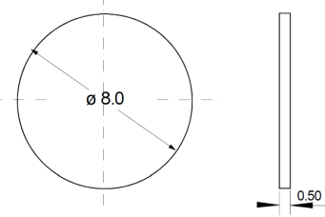
Introduction
SINQ Target Irradiation Program (STIP)
Objectives:
Studying radiation damage produced in target and structural materials
Microstructure and mechanical properties
Participants:
CAS, CEA, FZJ, JAEA, LANL, ……
Experiments:
In 1996 , STIP was initiated under a collaboration;
……
In 2013 and 2014, STIP-VII was performed;
In 2018 and 2020, STIP-VIII was performed;
Experimental parameters：
Irradiating numbers of specimens: >8000；
Range of doses: 5–30 dpa；
Experimental temperatures: 80–600 °C.
TEM or SP
LSP
ST
LT
Different types of STIP specimens
Yong Dai, et al., NME, Volume 39, June 2024, 101638.
Notes:
STIP represent SINQ target irradiation program.
Its objectives is to study radiation damage produced in target and structural materials.
Main participants include CAS, CEA, FZJ, JAEA and so on.
Since now, eighth irradiated experiments have been performed.
In these experiments, irradiating numbers of speciments is more than 8000.
Rang of doses is from 5 to 30 dpa.
Experimental temperatures range is from 80 to 600 degrees celsius.
The right picture shows different STIP specimens.

Slide 4
Introduction
Radiation damage assessment
Applications:
Advance spallation sources
Fission reactor
Fusion reactor
The material properties can be greatly degraded by the radiation damage.
Irradiation parameters:
Displacement damage, DPA
Helium (He) production
Hydrogen (H) production
A precise prediction is important for the safety assessment of these facilities.
Neutronic calculation:
MCNPX code, USA, LANL, INCL4/ABLA model, CEM03.03 model
PHITS code , Japan, JAEA, INCL4.6 model, GEM model
FLUKA code, Europe, intra-nuclear cascade, pre-equilibrium emission
GEANT4 code, Europe, CERN, G4INCL++/G4ABLA3, time and nuclear reaction processes
STIP-VII Radiation damage assessment based on MCNPX simulation.
Lijuan Cui, et al., NIMB 502(2021) 1-9
Notes:
Radiation damage can degrade the material property. Therefore, it is very crucial in many nuclear applications, such as advance spallation sources, fission reactor and fusion reactor.
The precise prediction of irradiation parameters is very important for the safety assessment of these facilities. Including DPA, helium production and hydrogen production.
Neutronic calculation is the normal way to calculate irradiation parameters.
Simulation softwares include, USA MCNPX, JAPAN PHITS, EUROPE Fluka and Geat4 code.
In this work, MCNPX is used to perform the STIP-VII radiation assessment.

Slide 5
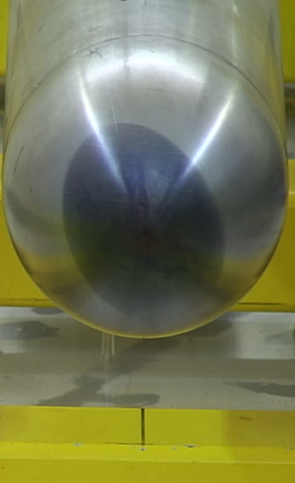
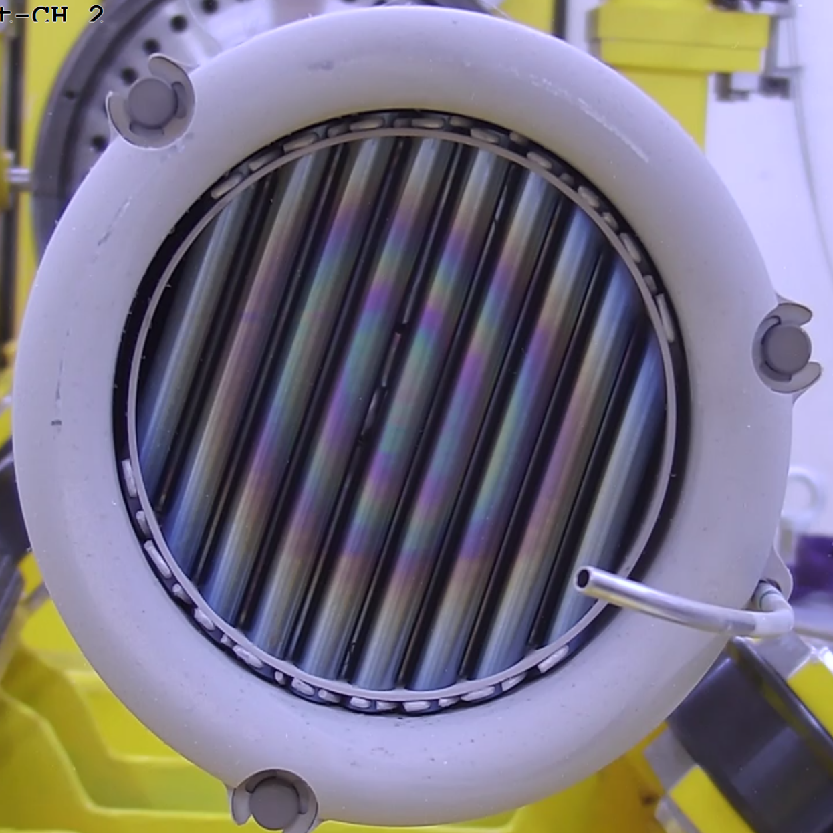
STIP-VII Description
The 7th SINQ Target Irradiation Program (STIP-VII)
Basic parameters of irradiation:
Proton energy: 575 MeV
Beam profile: Oval
Total proton charge: 11.7 Ah
Average proton beam current: 1.45 mA
Target 10:
Al alloy Safety Hull Tube
Coolant D₂O
9 rods filled with D₂O in Row 0
16 specimen rods for materials research
Lead-filled Target rods
16th specimen rod
Row 0
SINQ Target 10 in STIP-VII
Notes:
In STIP-VII, basic parameters of irradiations is as follows:
Proton energy is about 575 MeV;
Beam profile is oval;
During the experiment, the total proton charge is 11.7 Ah. (Ampere Hour)
We can see this picture, low head, a convex-shaped beam entrance window, after irradiations, the oval beam profile;
This picture can show the cylindrical rods.
SINQ Target 10 is also cylindrical. Integrated in the double-walled AlMg3 Safety Hull Tube (SHT).
During operation all these components are cooled by heavy water (𝐷2O).
In row0, there are 9 rods filled with D2O
In target 10, 16 specimen rods are placed and other rods is filled with lead .

Slide 6
Simulations
MCNPX neutronic calculations
Cross section
Calculation flow chart
Irradiation parameters calculations
The expression is described as:
𝑅 Radiation Damage. The unit is dpa or appm.
𝛷(𝐸) Neutron and Proton fluence. The unit is n/m² or p/m².
X (𝐸) Cross section. The units are expressed in barns (10⁻²⁸ m²).
Note: Cross section data is from LANL/ORNL.
D. Aulet, et al., NIMA 922 (2019) 310–321
W. Lu, et al., JNM 356 (2006) 280–286
W. Lu, et al., JNM 318 (2003) 176–184
Notes:
MCNPX is used to perform the neutronic calculations on the STIP-VII.
We can see the calculation flow chart,
First, MCNPX input file should be written, including geometry modeling and material compositions.
Then, run the input to obtain the proton and neutron spectra.
At last, irradiation parameters can be calculated with the spectra and cross sections.
The formula is R=flux multiply by cross section and then integral for energy.
The cross section data is from LANL/ORNL.

Slide 7
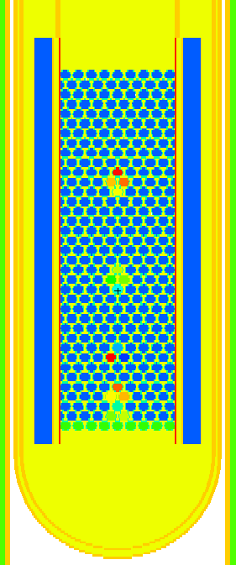
Simulations
MCNPX geometry model
XOZ plane
XOY plane
9 rods filled with D₂O in row 0;
16 specimen rods for materials research;
Other target rods with lead-filler;
Row 36
Al Safety Hull Tube
Lead filled reflector
Target rods
Speciment rods
Coolant D₂O
MCNPX source settings
SDEF, NPS=10,000,000
Proton Energy=575 MeV
Beam direction: +Z direction
MCNPX tally settings
Row 0
Energy deposition F8
Neutron and proton flux distributions F4
Neutron and proton spectra F4
Proton beam
SINQ Target 10 in STIP-VII
Notes:
Ten millions protons.
We can see the MCNPX model pictures.
The row0 is heavy water rods;
The different colorful rods represents the 16 specimen rods;
The blue rods represent the lead-filled rods.
We can see the specimen cylindrical rods.

Slide 8
Simulations
Materials of 16 specimen rods
Specimen Rod | Cladding Tube | Sample Materials
Rod 1 | Zircaloy | W,SS 316L,Ta,Zry-2
Rod 2 | Zircaloy | SIMP,SS 316L,T91,CLAM,Al
Rod 3 | SS316 | SIMP,CLAM,SS 316L,T91
Rod 4 | SS316 | SIMP,Al6061,CLAM,SS 316L,T91,Ti6Al4V,Ti3AlC2,Ti3SiC2,Ti2AlC,W
Rod 5 | Zircaloy | SIMP,Al6061,CLAM,SS 316L,T91,Ti6Al4V,Ti
Rod 6 | Zircaloy | W
Rod 7 | Zircaloy | W,Pb
Rod 8 | Zircaloy | W,Ta
Rod 9 | Zircaloy | SIMP,SS 316L,Ti6Al4V,W,Al6061
Rod 10 | SS316 | CLAM,SS 316L,T91,Al6061,Ti
Rod 11 | SS316 | SIMP,T91,W
Rod 12 | Zircaloy | SIMP,SS 316L,CLAM,Ti3AlC2,Ti3SiC2,Ti6Al4V,Al6061
Rod 13 | Zircaloy | 9Cr-ODS,14Cr-ODS,SS 316L,Ti3SiC2,Ti2AlC,Al6061
Rod 14 | Zircaloy | 9Cr-ODS,T91,SiC
Rod 15 | Zircaloy | 9Cr-ODS,T91,SiC
Rod 16 | Zircaloy | T91,Fe-Cr alloy, SS 316L,Al6061
A specimen rod material was adopted by taking the average composition of all materials.
Notes:
The 16 specimen rods are filled with different materials.
We can see the table, only Rod3, rod4, rod10 and rod11 have the SS316 (Stainless steel) cladding tube.
Other cladding tube material is zircaloy. [ˈzərkəˌloi]

Slide 9
Simulations
Radiation damage in 16 specimen rods
4 typical rod positions are selected:
Rod 1, Rod 6 , Rod 10 and Rod 14,
Representing rods placed in the four parts of the target 10.
6 typical materials are selected:
T91 martensitic steel (9Cr-1Mo)
Zircaloy-2
Aluminium
SiC
Tantalum (Ta)
Tungsten (W)
The calculated irradiation parameters:
displacement damage DPA
Helium production
hydrogen production
He-to-dpa ratio
H-to-dpa ratio
14
a Zone
10
b Zone
6
c Zone
d Zone
1

Slide 10
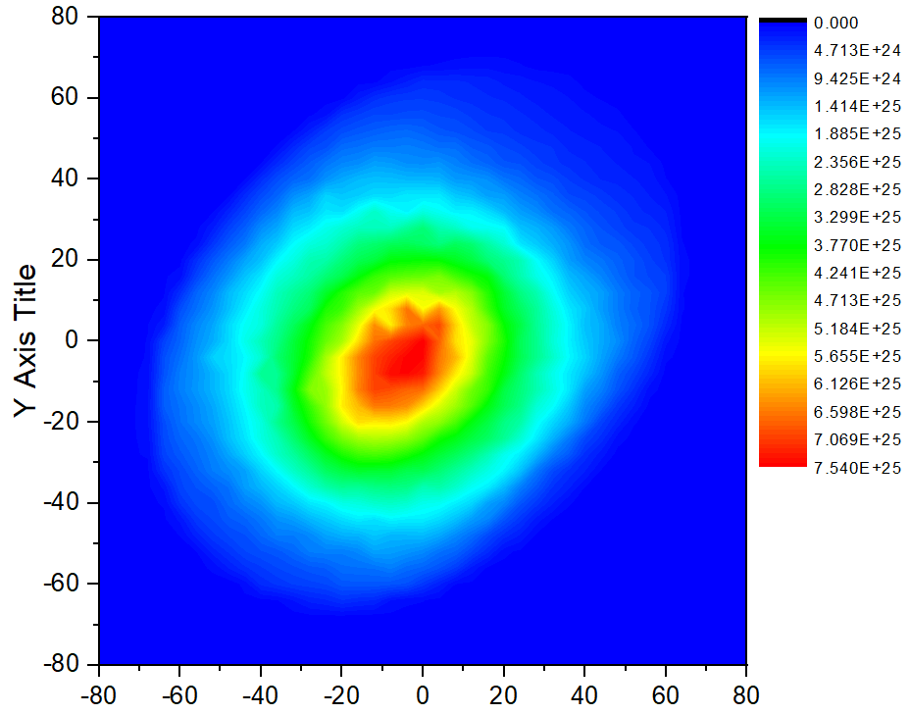
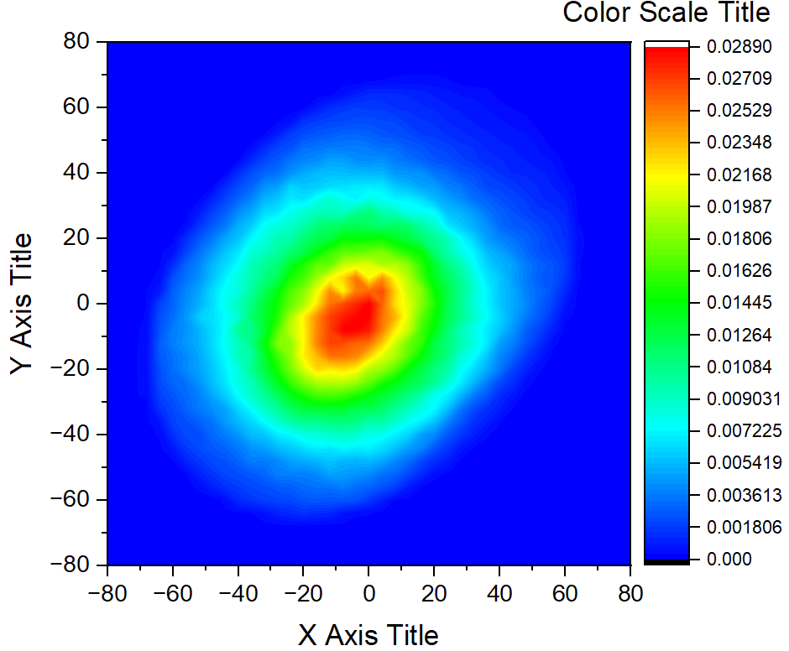
Results
Proton beam profile
The measured proton beam profile was obtained from the gamma mapping performed on BEW
The simulated proton beam profile was obtained from MCNPX simulation by Tmesh Card
Measured
Simulated
Two profile shapes fit very well, which can validate the proton source input settings.

Slide 11
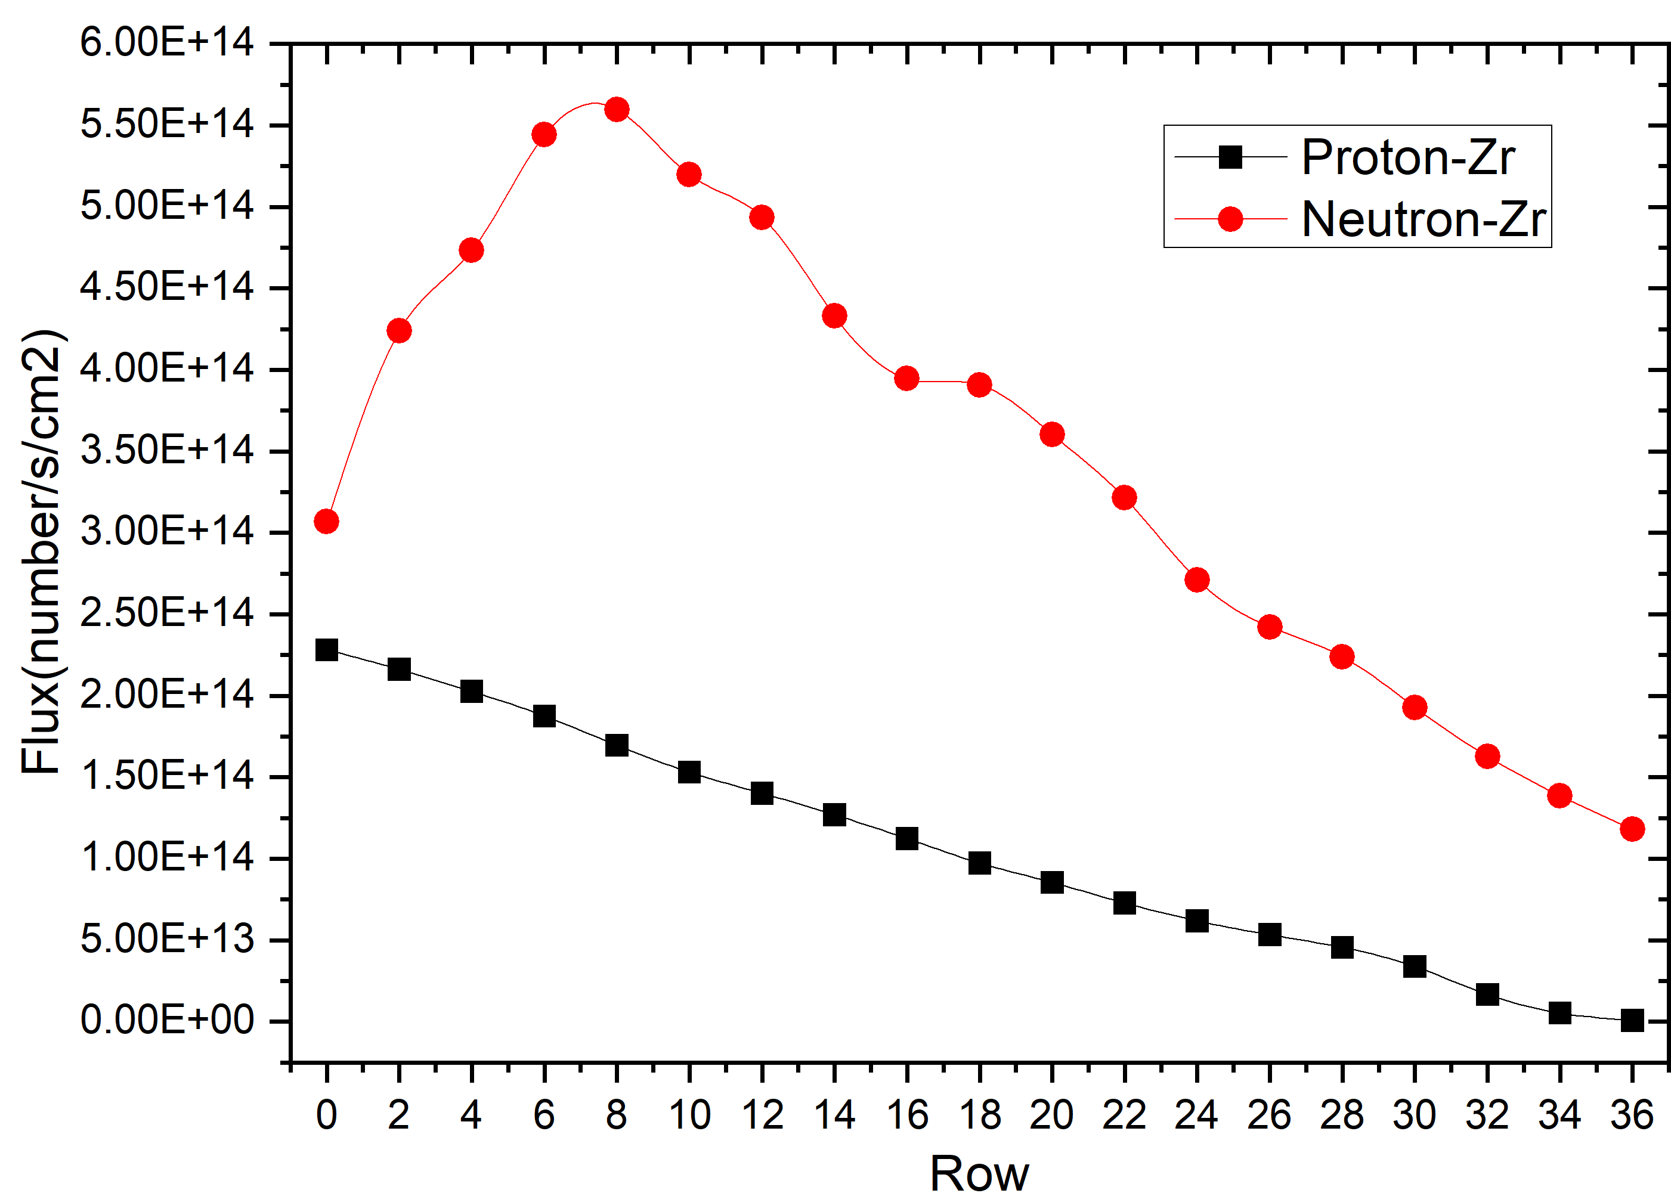
Results
Proton and neutron flux in Z-axial direction
Note:
Even rows
From 0-36
Row 36
Row 8
Z
X
The proton and neutron flux
The proton flux decreases along the 𝑍-axis, due to the loss of proton energy and the enlargement of beam size.
The neutron flux increases from the 1th row to the 8th row. Then it decreases due to the less spallation reactions of lower energy protons.
Notes:
The distributions of proton and neutron flux at each central section of zircaloy-2 tubes in the central column
The proton flux decreases gradually along the 𝑍-axis of the target, due to the loss of proton energy and the enlargement of beam size caused by scattering interactions. [inˈlärjm(ə)nt]
The neutron flux increases gradually from the first row to the eighth row of target rods. Afterwards it decreases gradually due to the less spallation reactions of lower energy protons.

Slide 12
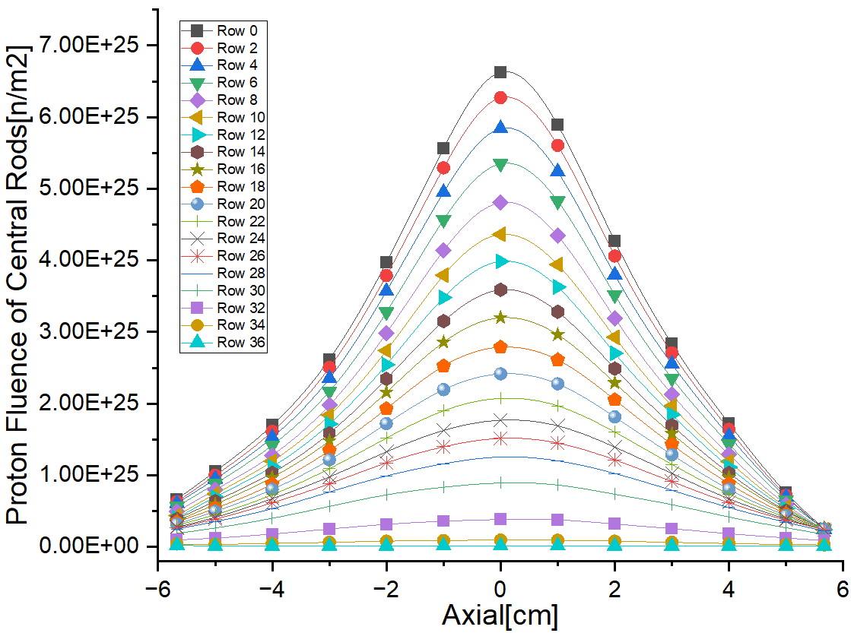
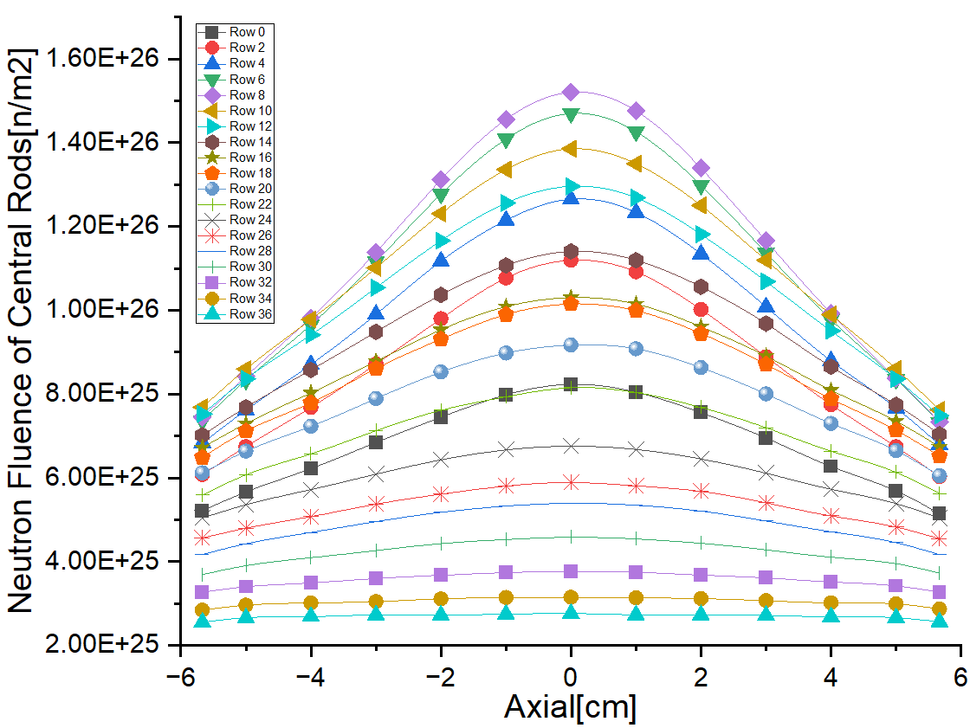
Results
Proton and Neutron fluence in Z-axial
Even rows
From 0-36
Row 36
Row 8
Z
Proton fluence in cladding tubes
Neutron fluence in cladding tubes
X
The proton fluence decreases gradually along the 𝑍-axis of target 10.
The fluence is high in the center and low on both sides for all rod claddings.
The curves become flatter in Z-axial direction, due to the scattering of high energy particle.
Notes:
Proton and neutron fluence distribution in of the radial center rods

Slide 13
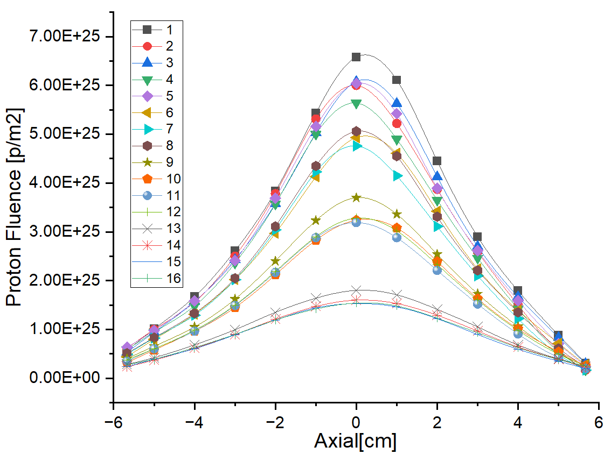
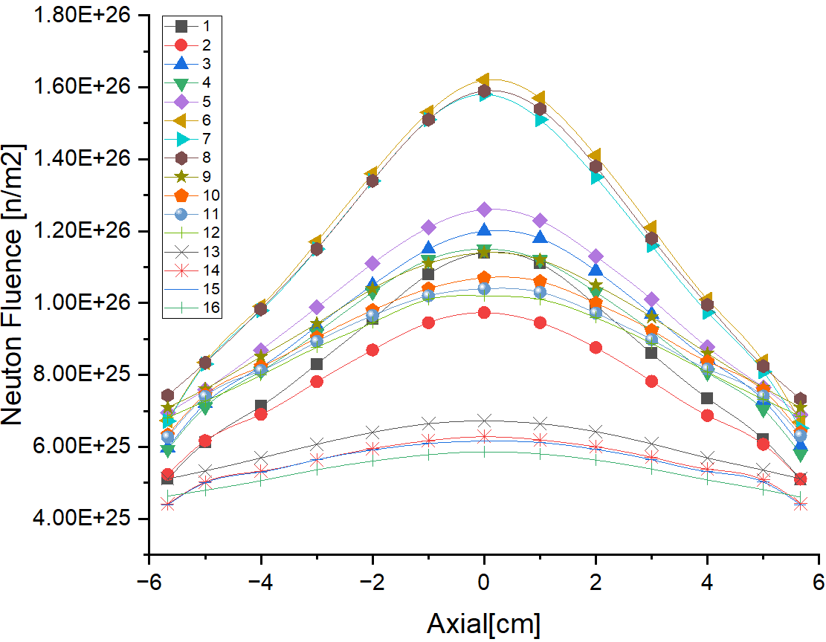
Results
Proton and Neutron fluence in the specimen rods
14
16
13
15
1-5
6-8
9-12
13-16
12
11
10
9
8
7
6
5
4
3
2
1
XOZ plane
Proton fluence Neutron fluence
The proton fluences are clearly separated into four groups according to positions.
The neutron fluence data cannot be simply grouped.
Correlation between neutron fluence values ​​and positions is much smaller.
Rod Axis
XOY plane

Slide 14
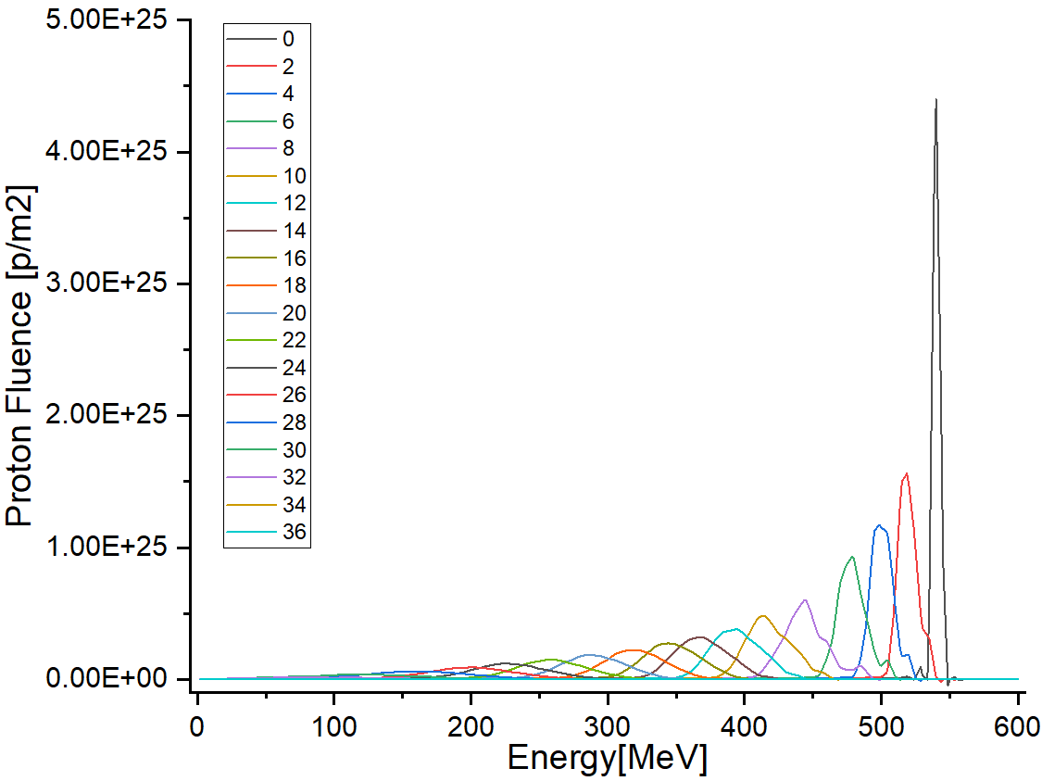
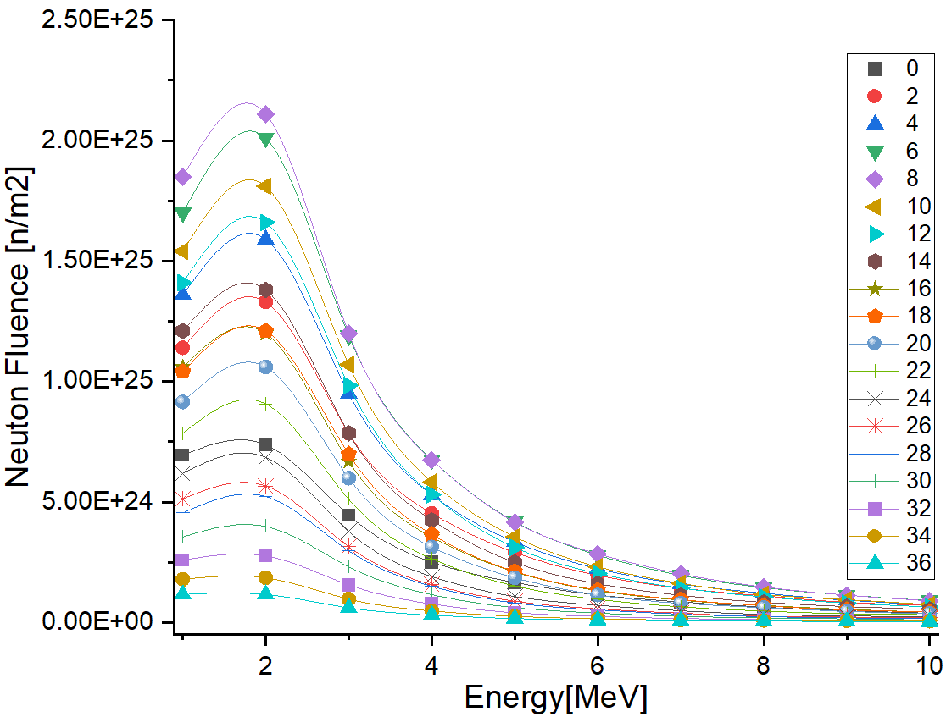
Results
Proton and Neutron spectra in Z-axial
Row 36
Z
Row 0
central
column
X
Proton spectra in the cladding tubes Neutron spectra in the cladding tubes
The energy of protons decreases, and the spectrum profile broadens due to spallation reactions.
The peak in neutron spectra is about 2 MeV without significant change in shape except for the magnitude.

Slide 15
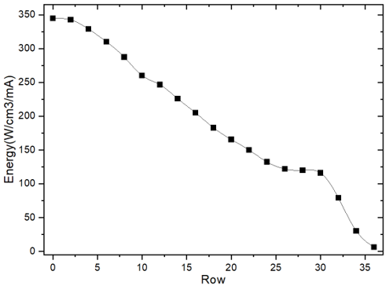
Results
Energy deposition in cladding tubes of different rows
Row 36
Row 30
Z
Row 0
X
Energy deposition in the Z-Axial direction
A gentle decrease from Row 0 to Row 2. After that, energy deposition decreases till Row 26.
A slow decrease from Row 26 to Row 30. Then, energy deposition rapidly decreases.
Notes:
Row 0 is just water filling zircaloy-2 tubes
26-28-30, Why is it relatively flat?

Slide 16
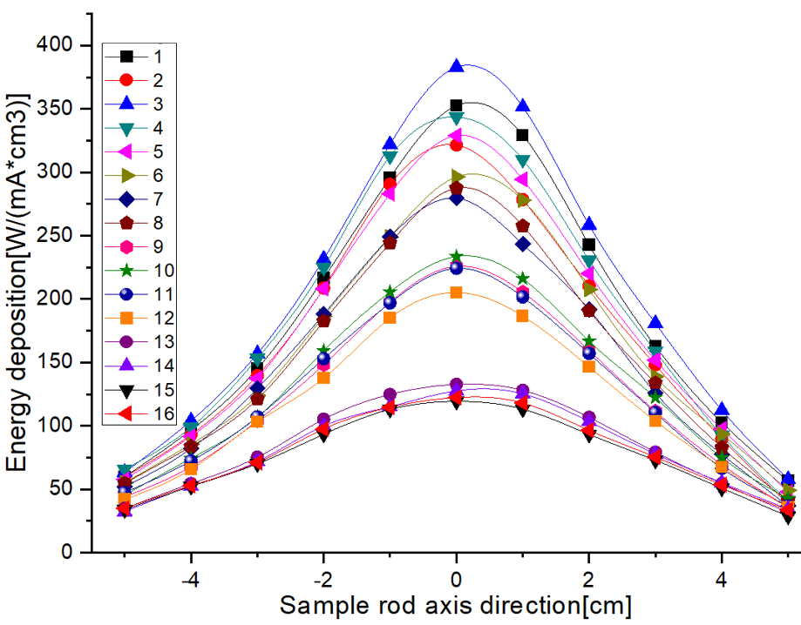
Results
Energy deposition in cladding tubes of specimen rods
14
16
13
15
12
11
10
9
8
6
7
5
3
4
1
2
XOZ plane
Energy deposition in 16 specimen rods
Rod Axis
Energy deposition in Rod 3 clad is highest with about 400 W/cm³.
The max deposition in zircaloy cladding tubes is about 350 W/cm³.
XOY plane
Notes:
because of the third row and the SS316.
缺一个在样品棒包壳内的质子通量分布。
The energy deposition in the cladding tubes is a similar behavior to the proton fluence.
The energy deposition is dominated by high energy protons.

Slide 17
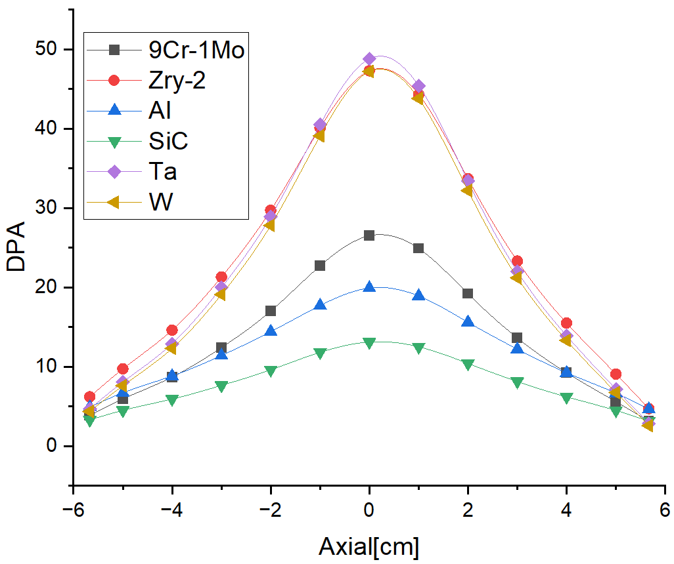
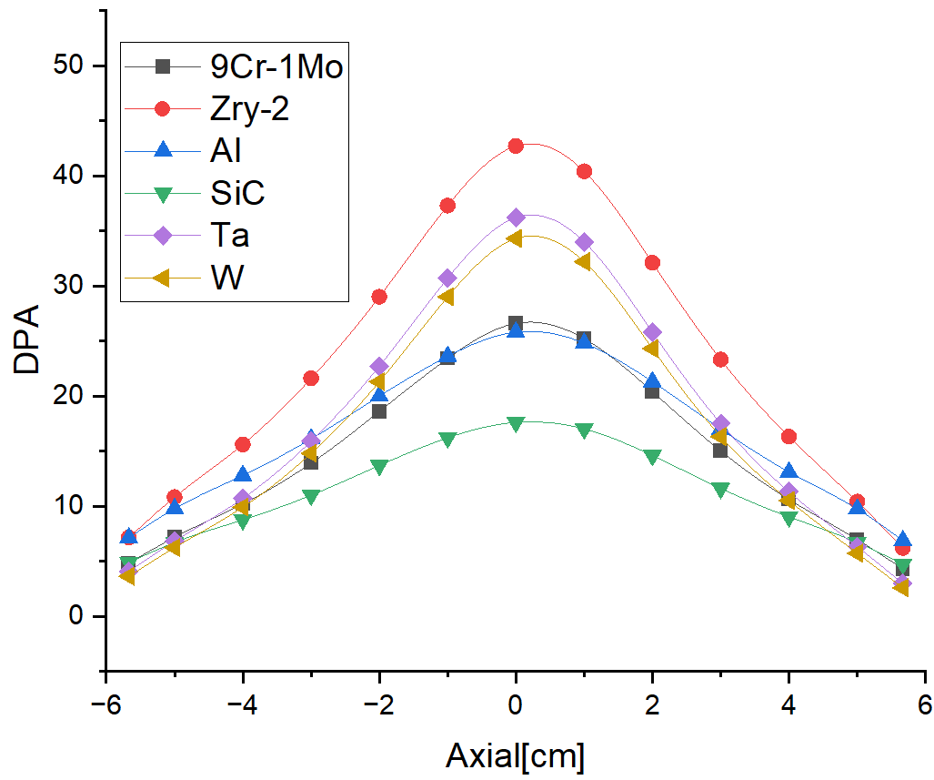
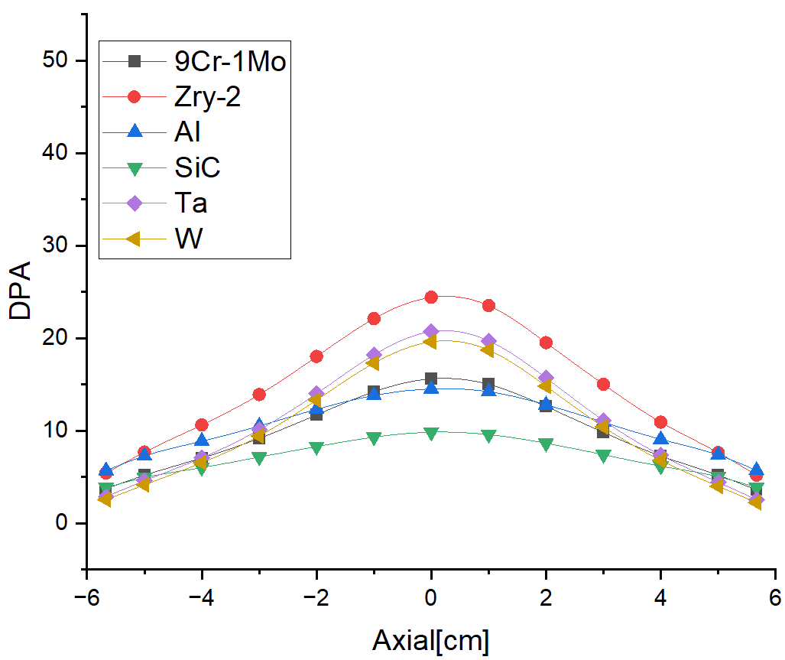
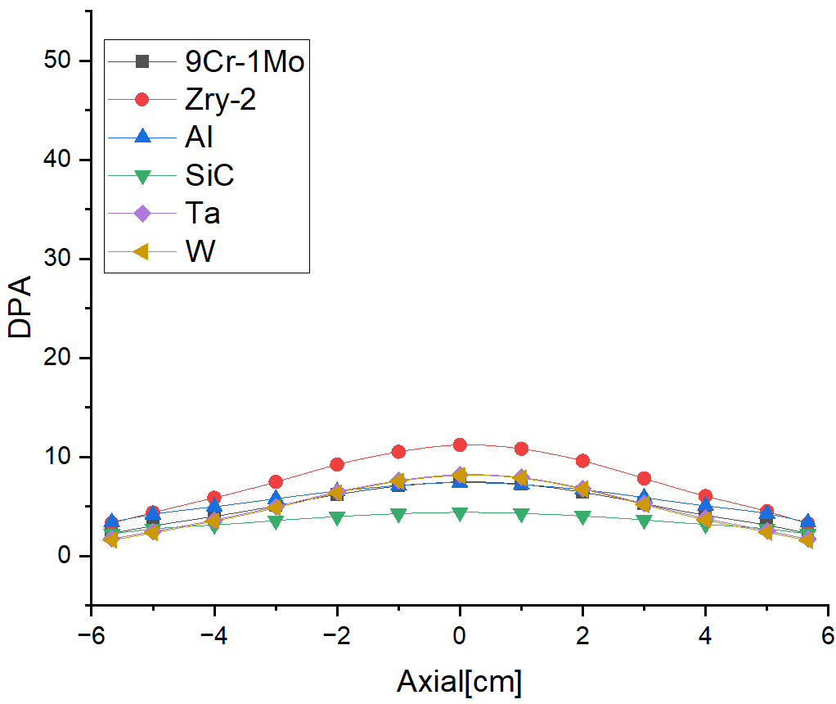
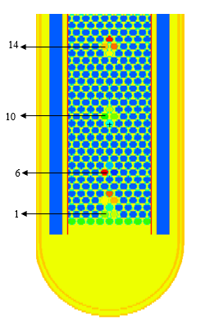
Results
Radiation damage in specimen rods
Irradiation dose distribution (DPA):
Rod 1
Rod 6
Rod 10
Rod 14
The DPA value decreases along the 𝑍-axis.
The differences among the different curves are getting smaller.
The max DPA is obtained for tantalum in Rod 1 and for zircaloy in Rod 6, Rod10 and Rod 14.

Slide 18
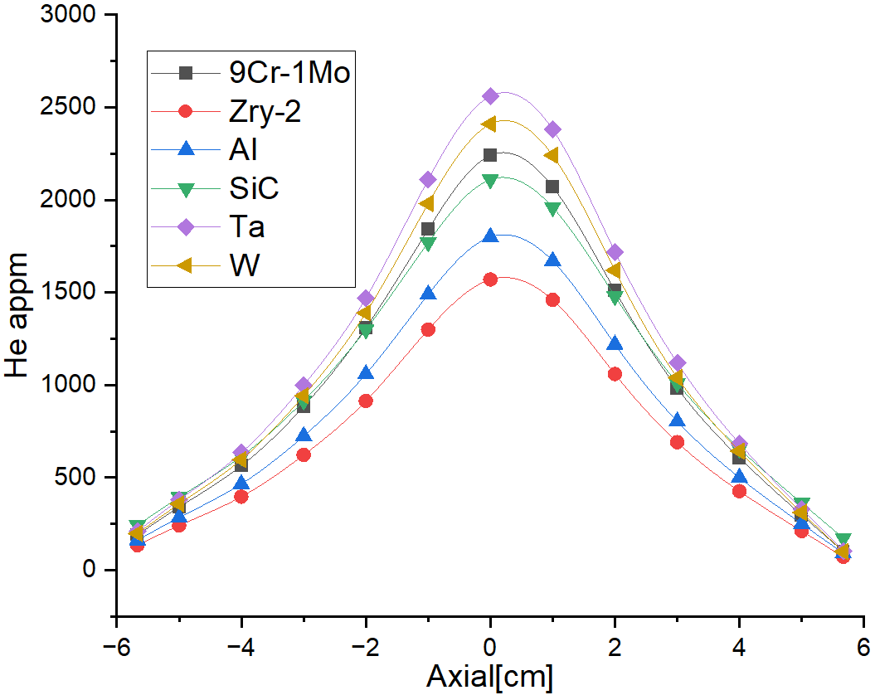
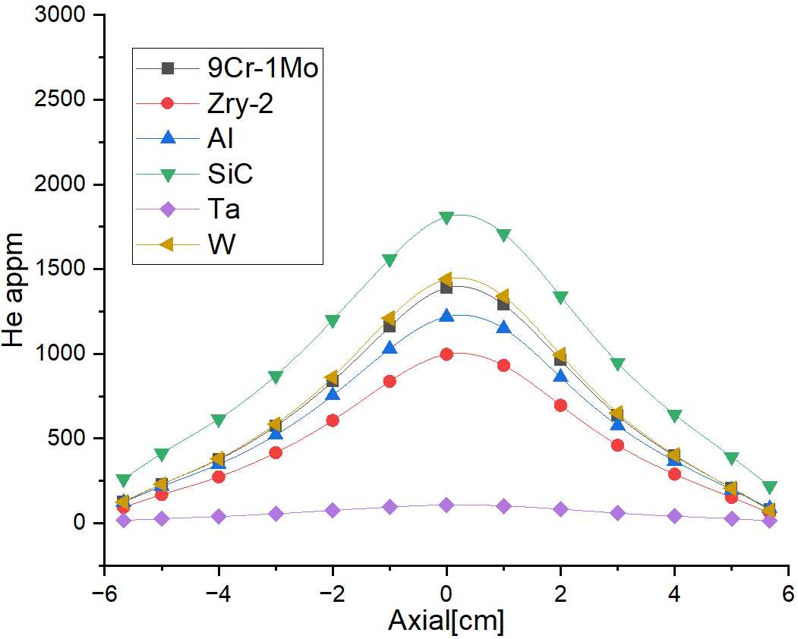
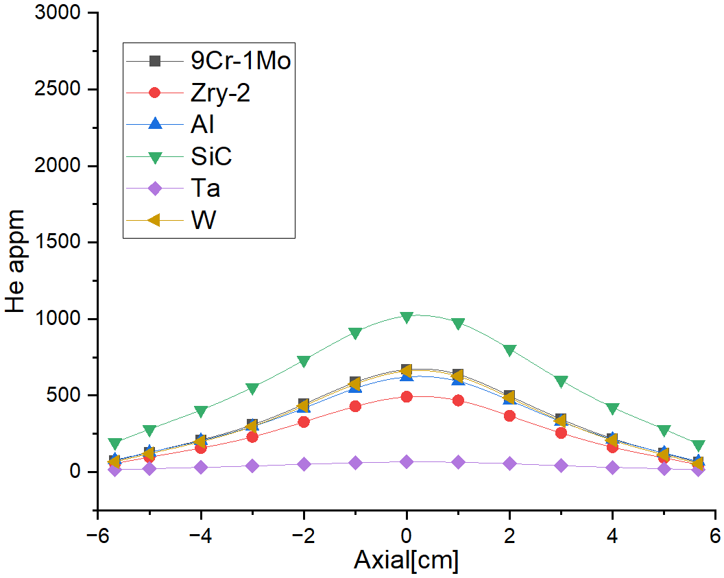
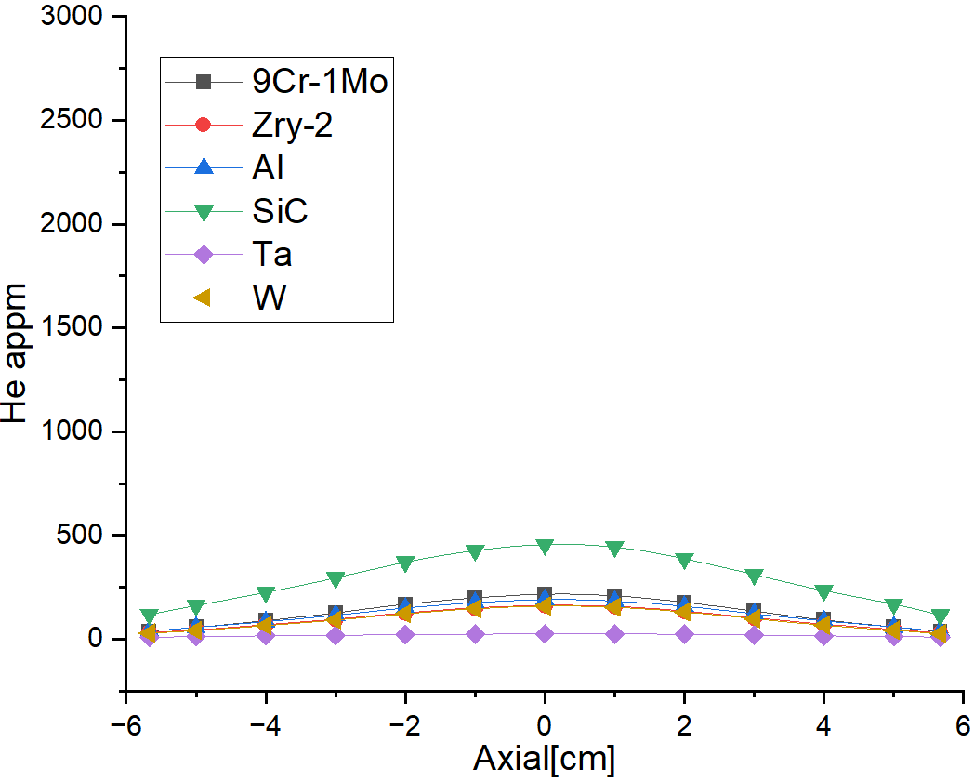
Results
Radiation damage in specimen rods
Helium concentration distribution:
Rod 1
Rod 6
Rod 10
Rod 14
He production decreases along the 𝑍-axis.
In rod1, max He concentration 2560 appm is obtained for Tantalum.
In Rod 6, Rod10 and Rod 14, max He concentration is obtained for Silicon Carbide.
Notes:
Silicon Carbide

Slide 19
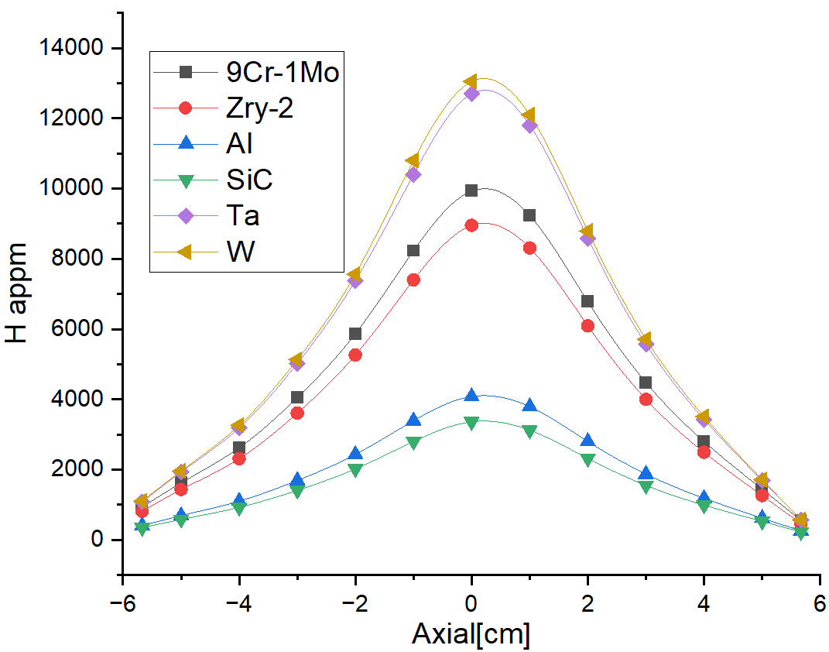
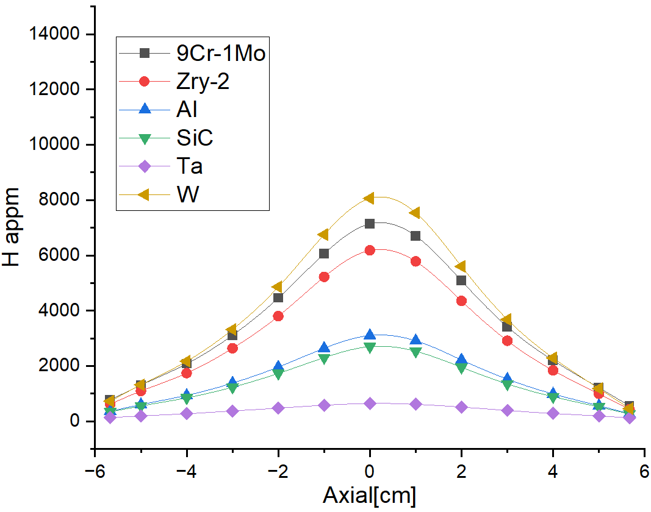
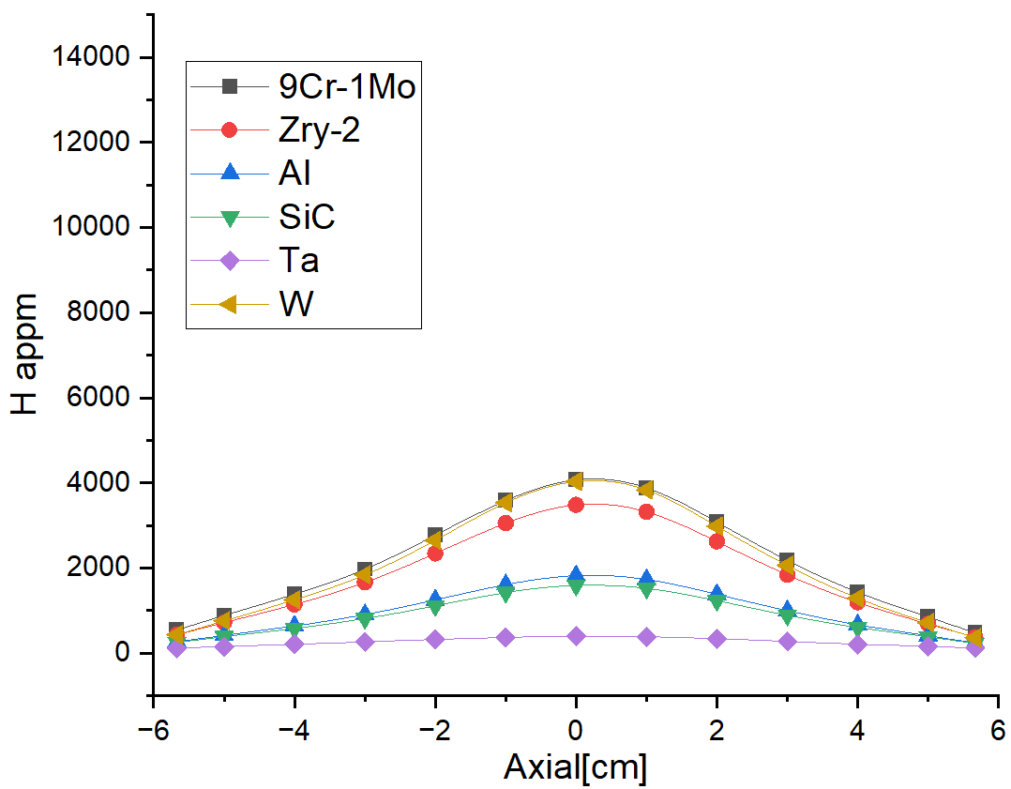
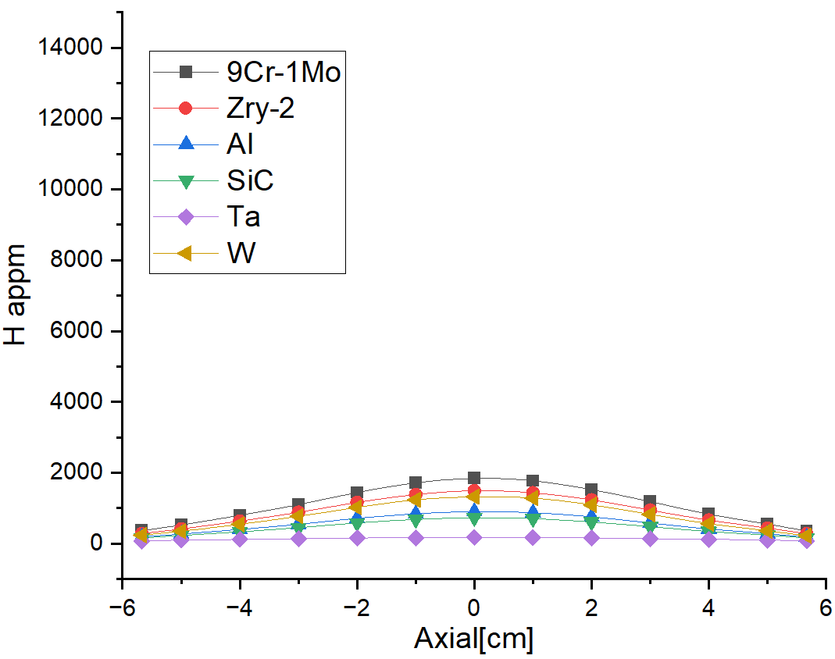
Results
Radiation damage in specimen rods
Hydrogen concentration distribution:
Rod 1
Rod 6
Rod 10
Rod 14
The max H concentration is obtained in tungsten of Rod 1, Rod 6, Rod10.
The max H concentration is obtained in T91 of Rod 14.
Notes:
The maximum hydrogen concentration was calculated for tungsten in Rod 1 with a value of 13050 appm

Slide 20
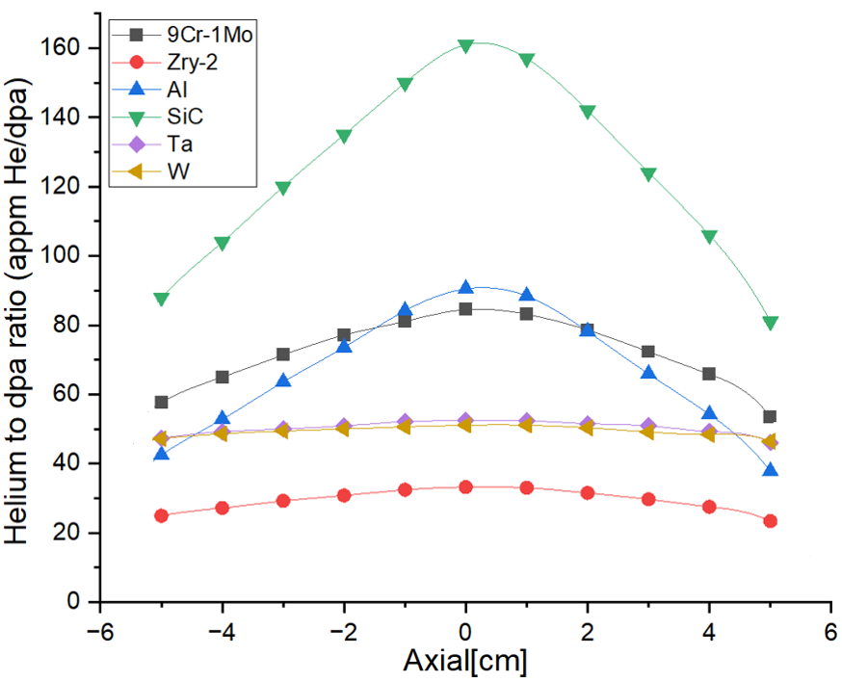
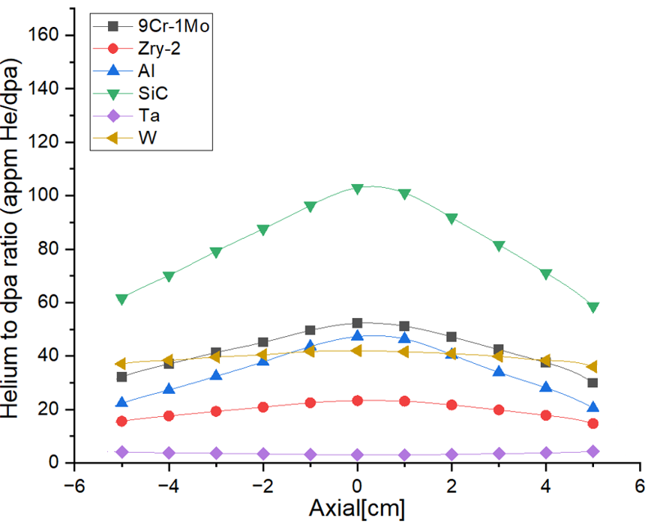
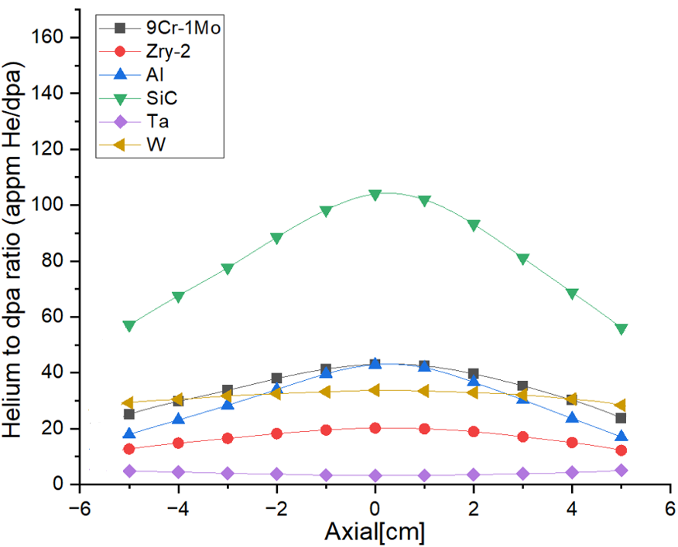
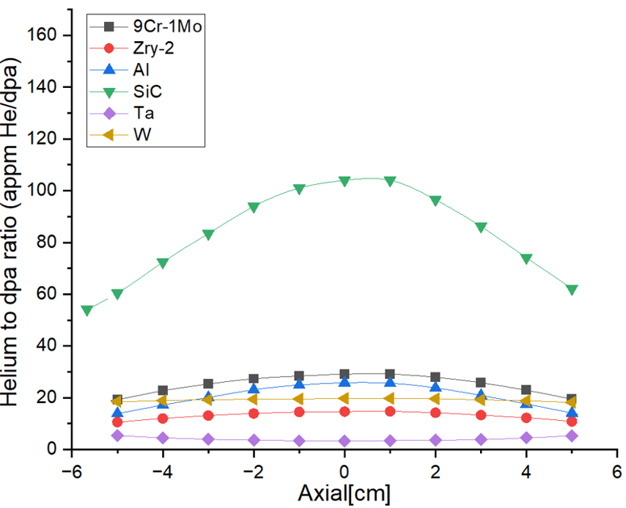
Results
Radiation damage in specimen rods
He-to-dpa ratio:
Rod 1
Rod 6
Rod 10
Rod 14
The max He-to-dpa ratio 163 is obtained in SiC for the four rods.
The ratio curves are similar in SiC of Rod6, Rod10 and Rod14.
Notes:
Silicon Carbide
provides a good possibility for studying helium and hydrogen effects on materials properties

Slide 21
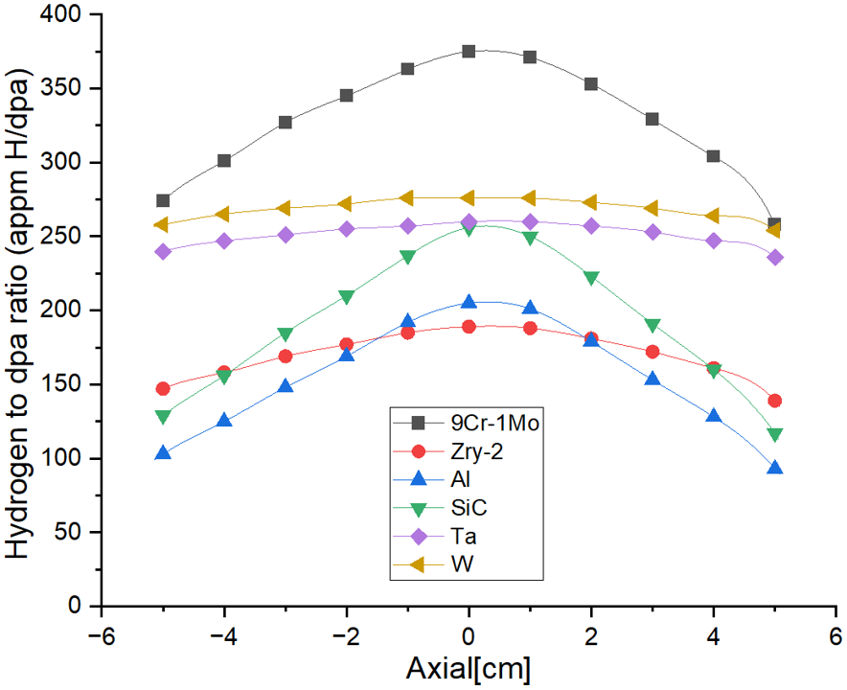
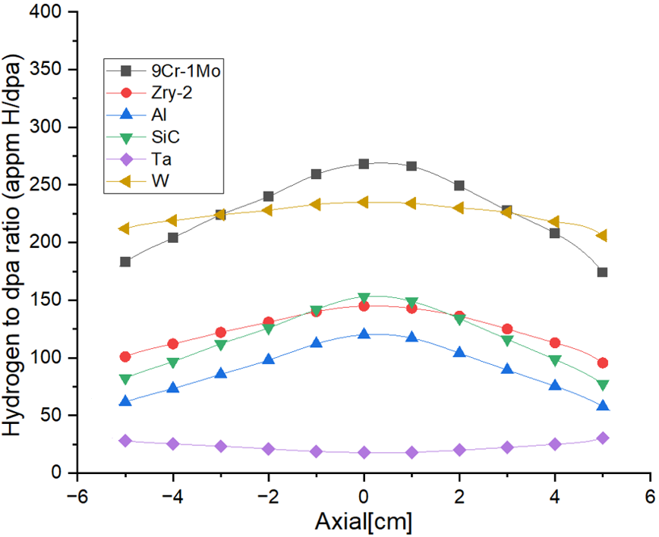
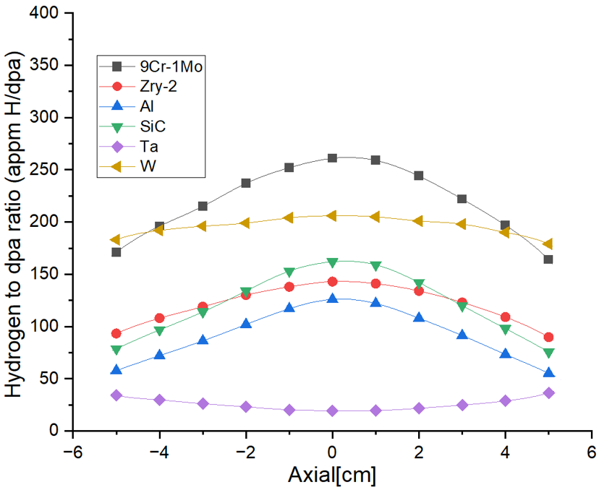
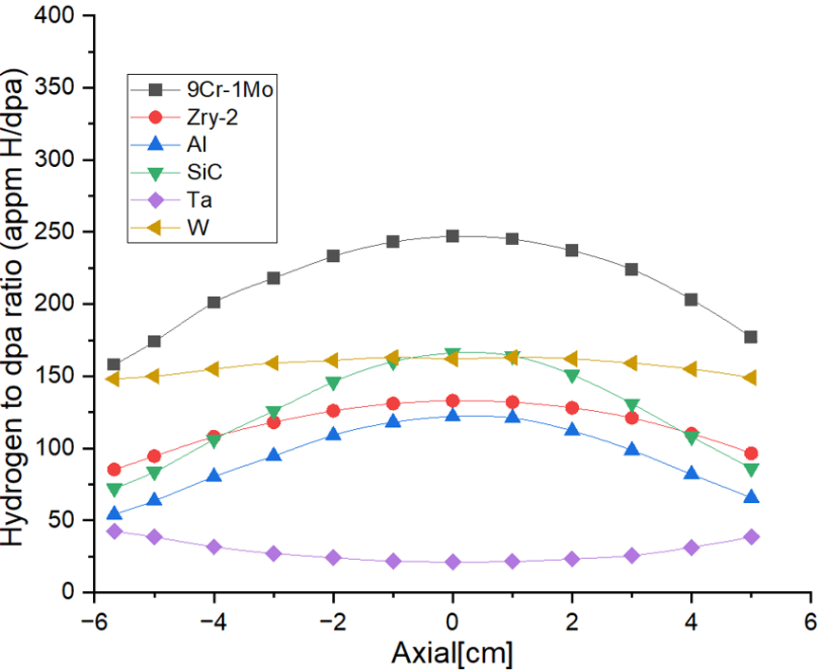
Results
Radiation damage in specimen rods
H-to-dpa ratio:
Rod 1
Rod 6
Rod 10
Rod 14
The max H-to-dpa ratios are obtained in T91 for the four rods.
In Rod 1, T91 H-to-dpa ratio varies in the range of 258–375.
Notes:
provides a good possibility for studying helium
and hydrogen effects on materials properties

Slide 22
Summary
STIP-VII Radiation damage assessment:
Proton and neutron calculation:
The max proton and neutron fluxes obtained are 2.3×10¹⁴ p/(cm²⋅s) and 5.6×10¹⁴ n/(cm²⋅s)
The max energy deposition in 16 specimen rod cladding tubes is about 400 W/cm³
Irradiation parameters calculation:
Qualitative
The irradiation parameters decreases along the 𝑍-axis
The differences among the curves are getting smaller along the 𝑍-axis
Lower He and H-to-dpa ratios can be obtained in the top part of the target 10
Quantitative
The max displacement damage was calculated for Tantalum with 49 DPA
The max helium concentration was calculated for Tantalum with 2560 appm
The max hydrogen concentration was calculated for Tungsten with 13050 appm
Notes:
The max irradiation parameters occur in Rod 1.

Slide 23
Acknowledgements
Thank you for your attentions !

