Slide 1
Using TZM as a Potential Target
Cladding Material
Alan Prothero, Target Manufacture Technician,
ISIS, RAL
IWSMT 16, 28th October 2024

Slide 2
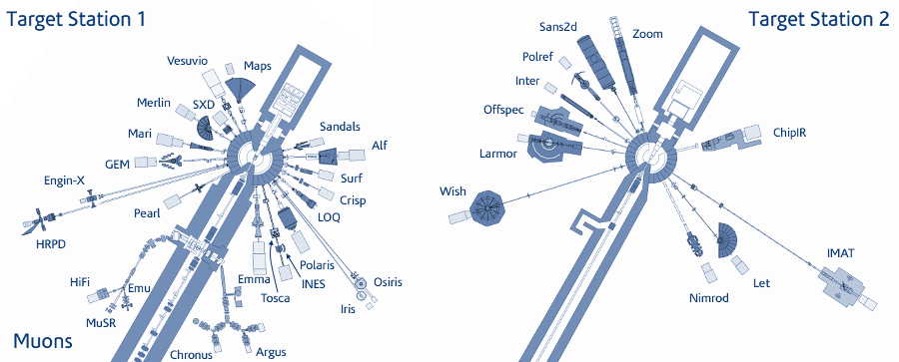
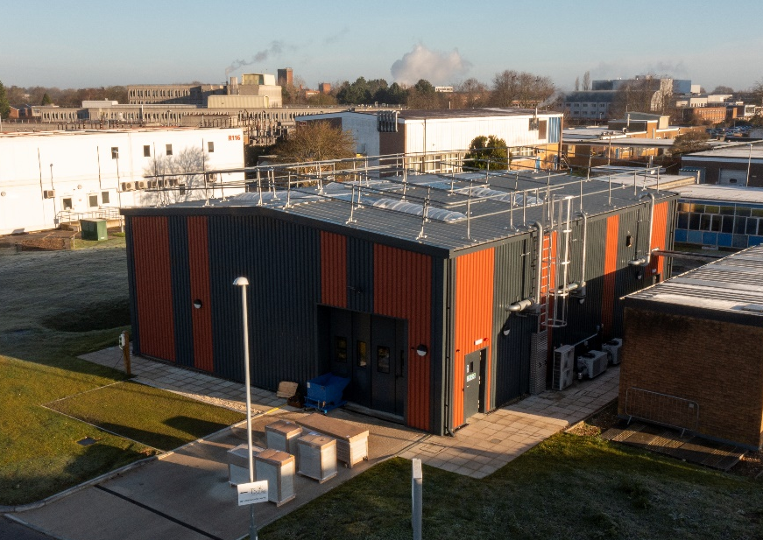
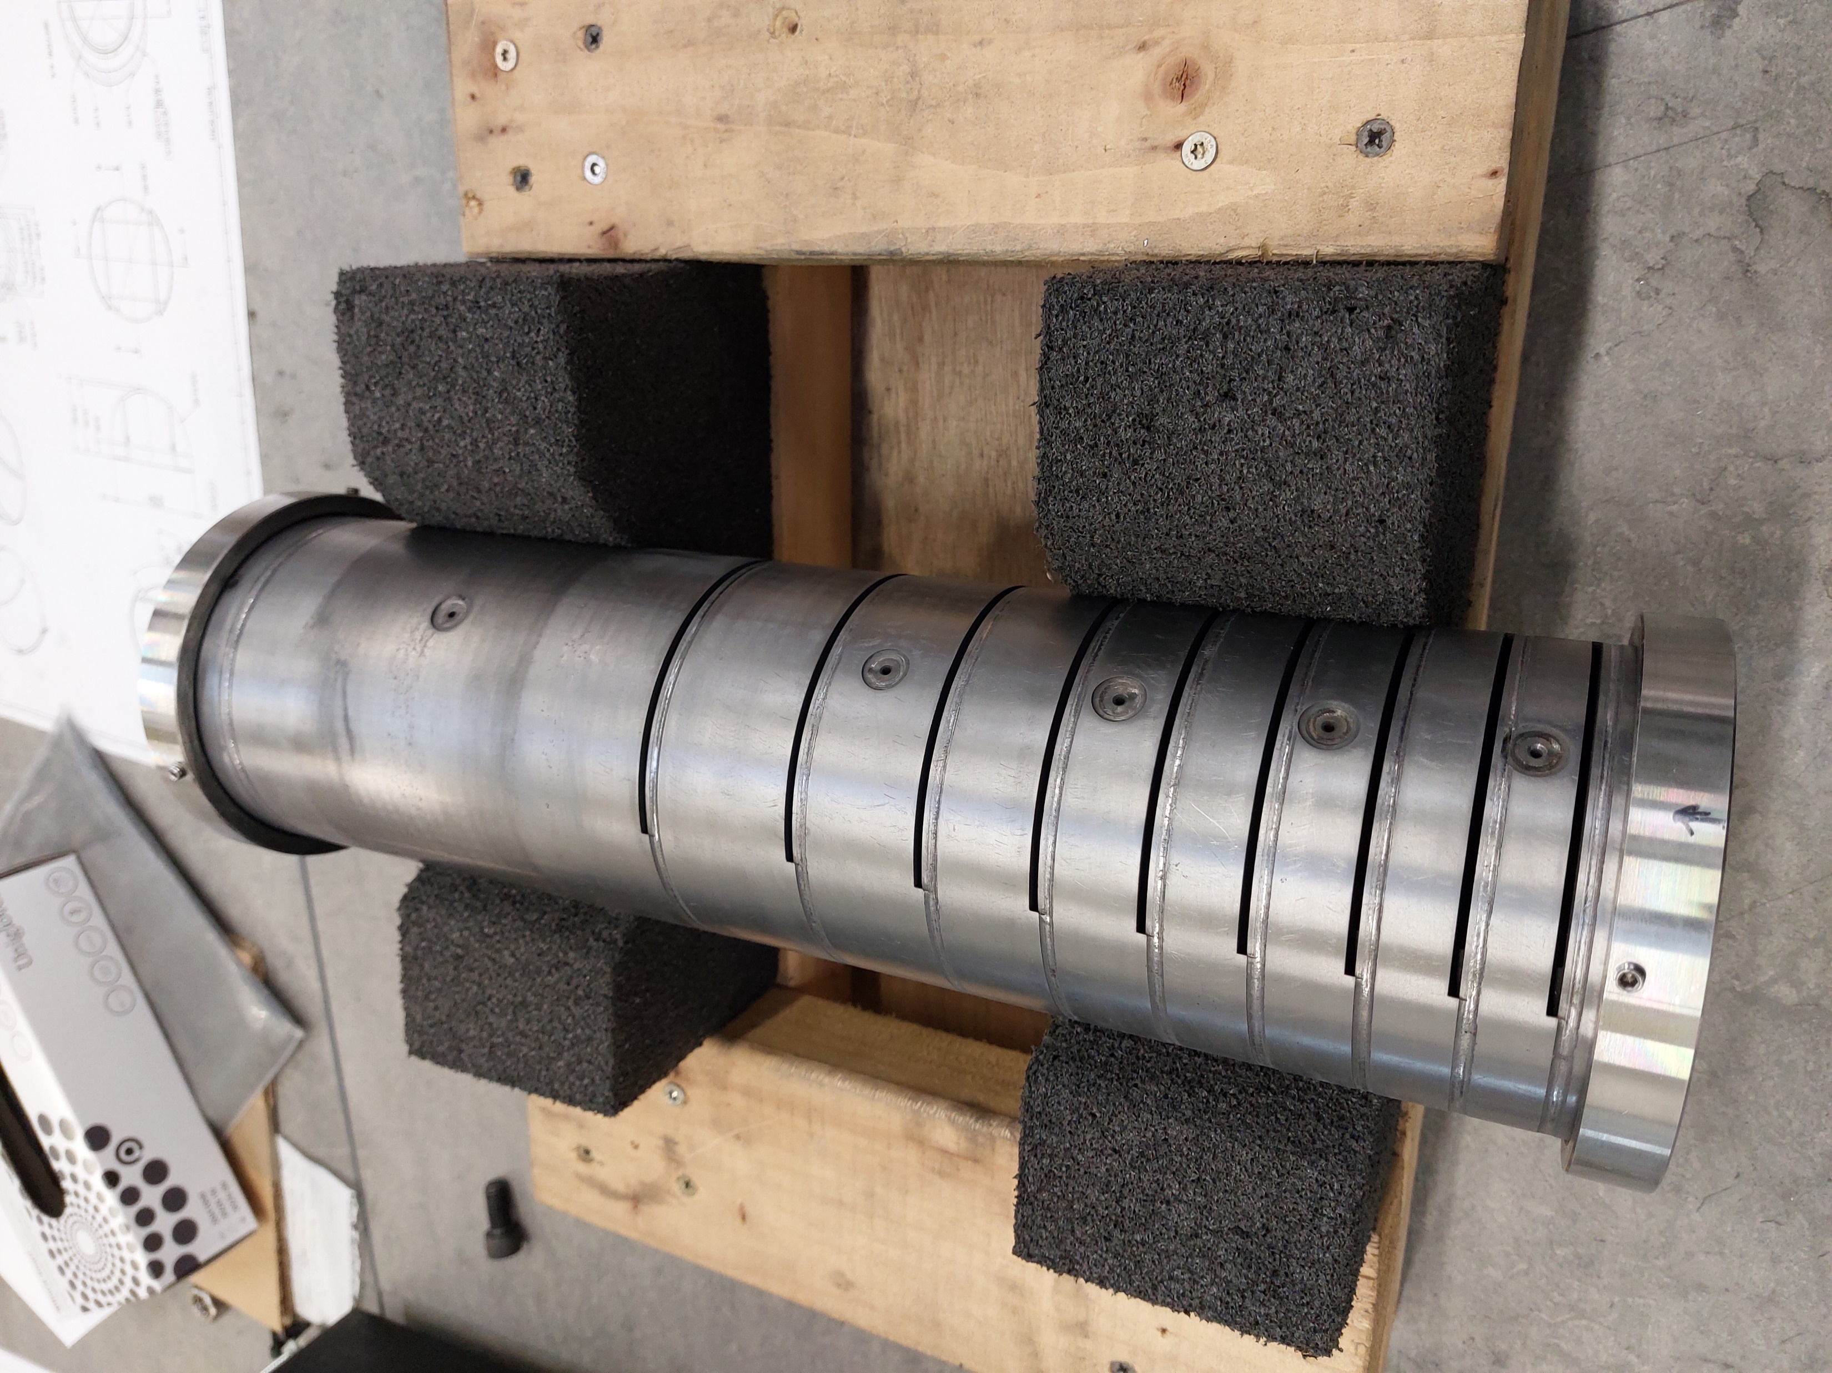
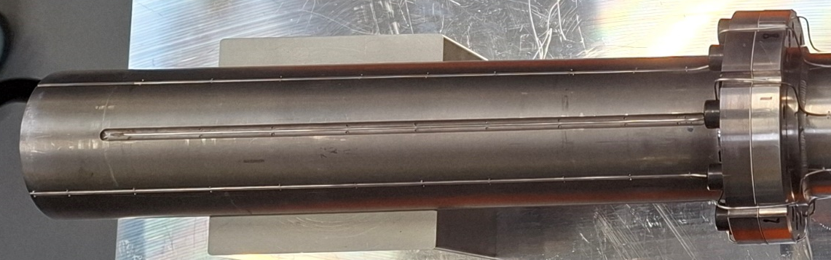
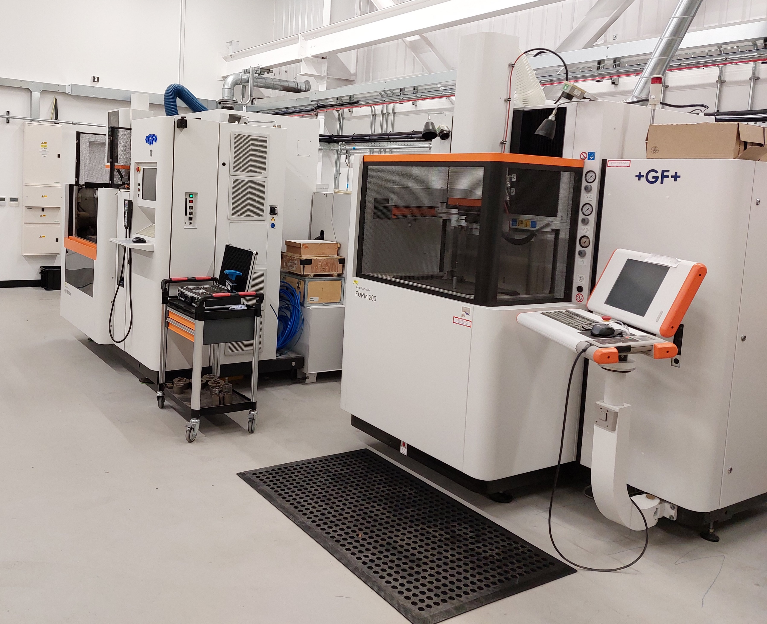
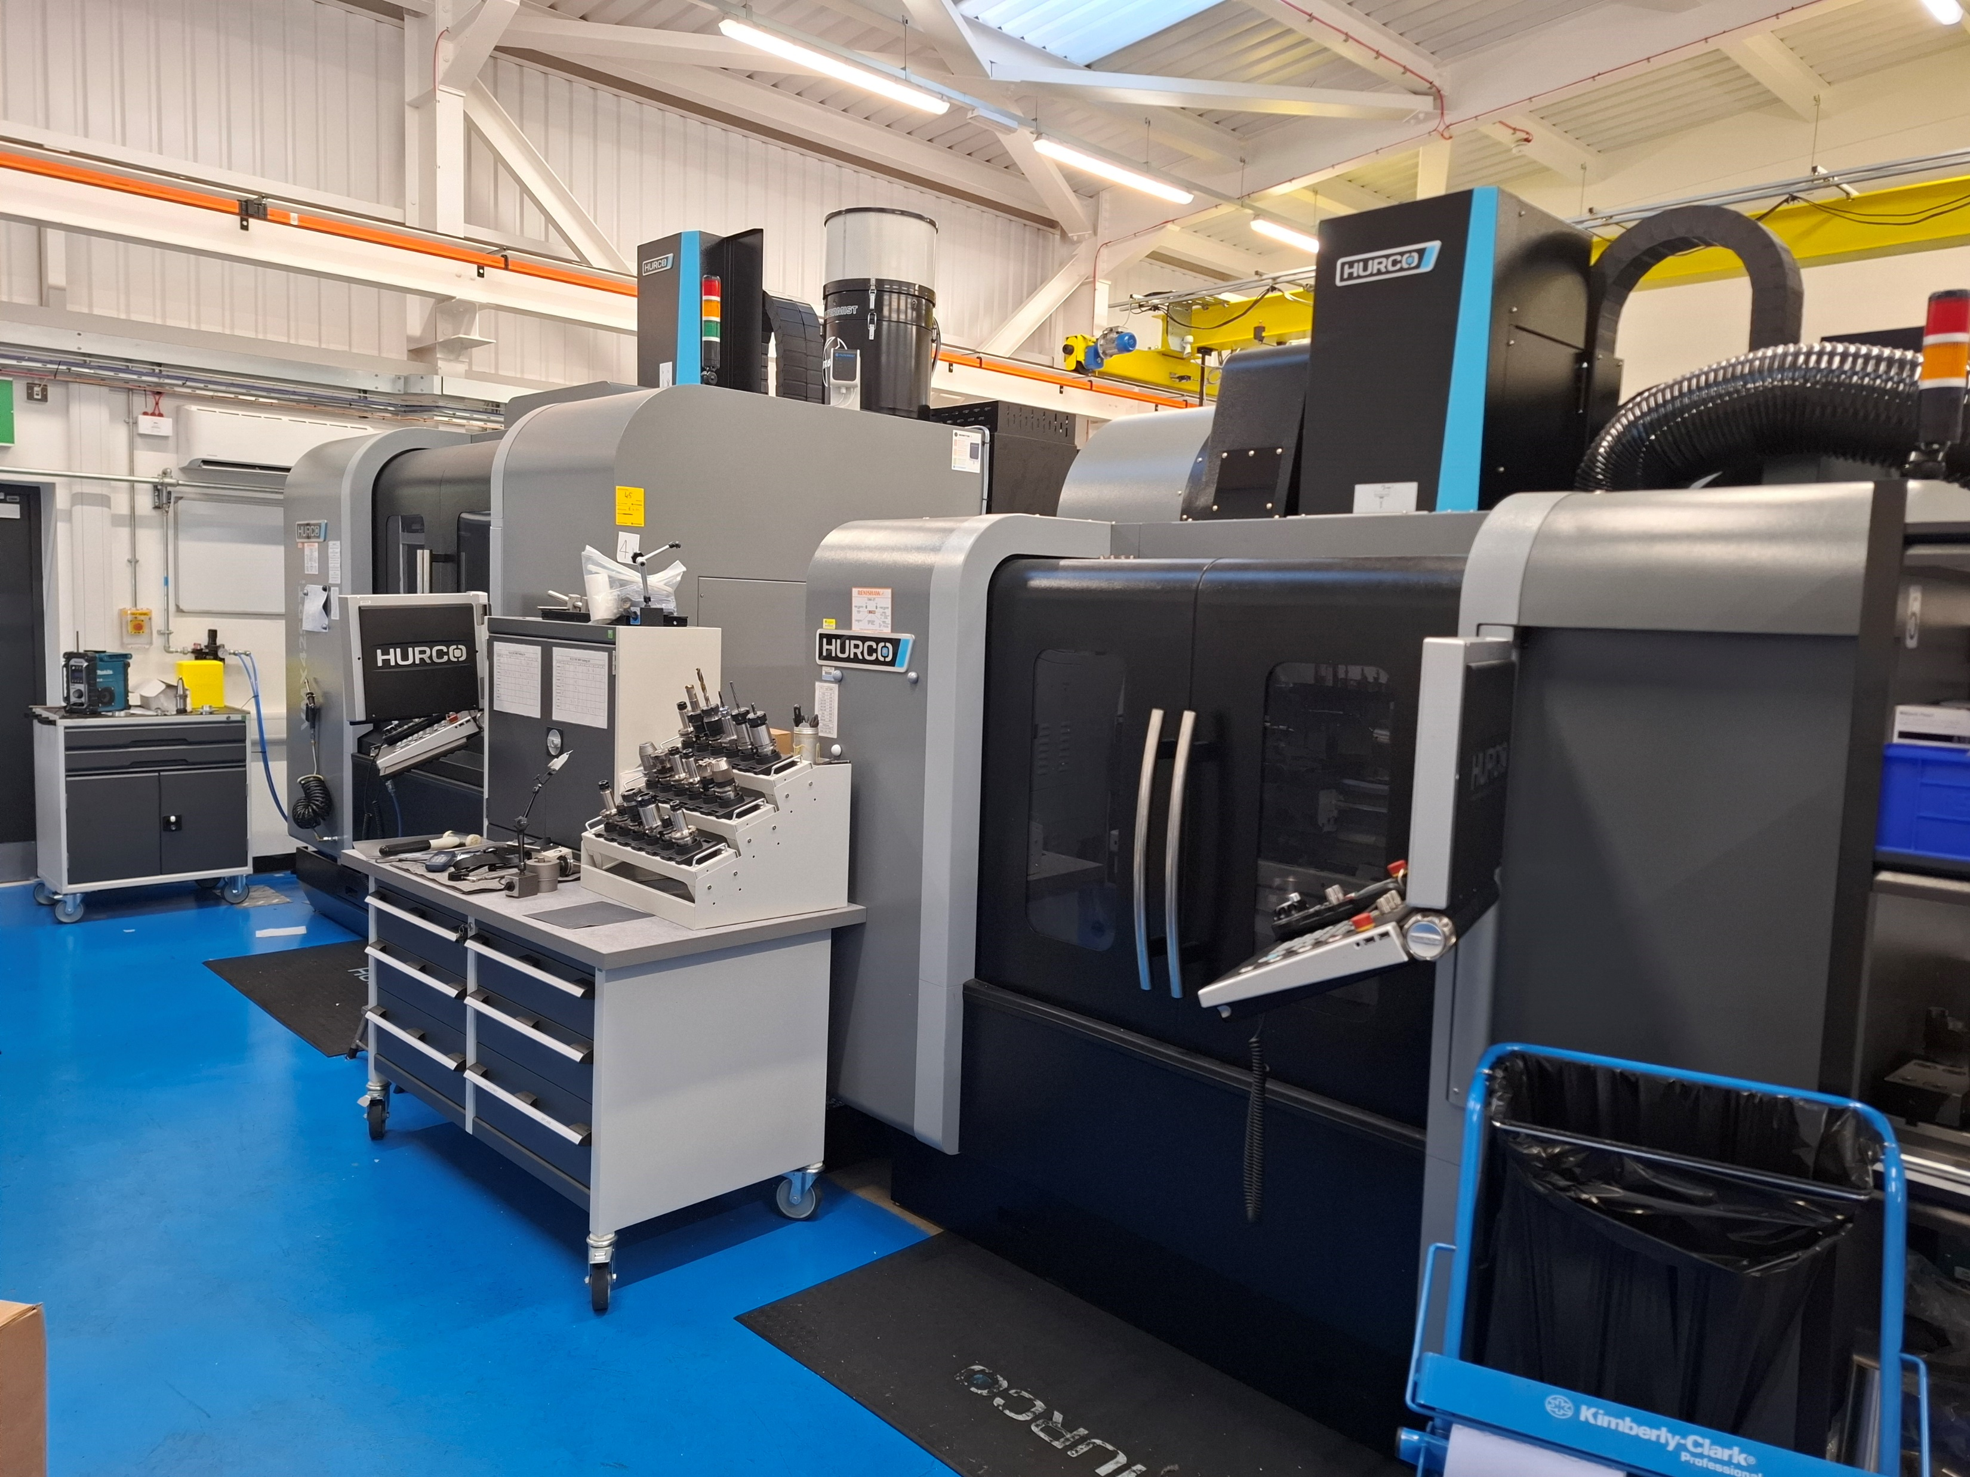
Introduction To ISIS and Target Group
Neutron and Muon Source on Harwell Campus, Oxfordshire
Supporting scientific research worldwide
Target manufacture group is a small team specialising in Machining ISIS targets and peripheral components for both Target stations
Targets are made using a variety of common and uncommon manufacture methods
CNC,EDM, EB Welding, HIP bonding and Ultrasonic Scanning
Notes:
Team of 5 - TS1 higher power – 2 different target shapes - ts1 108mm dia - ts2 68mm

Slide 3
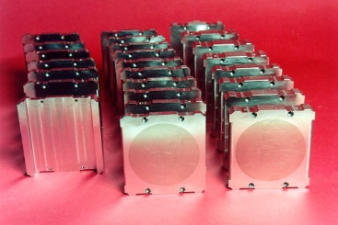
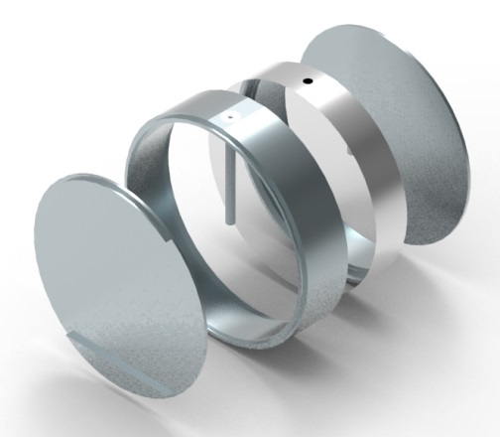
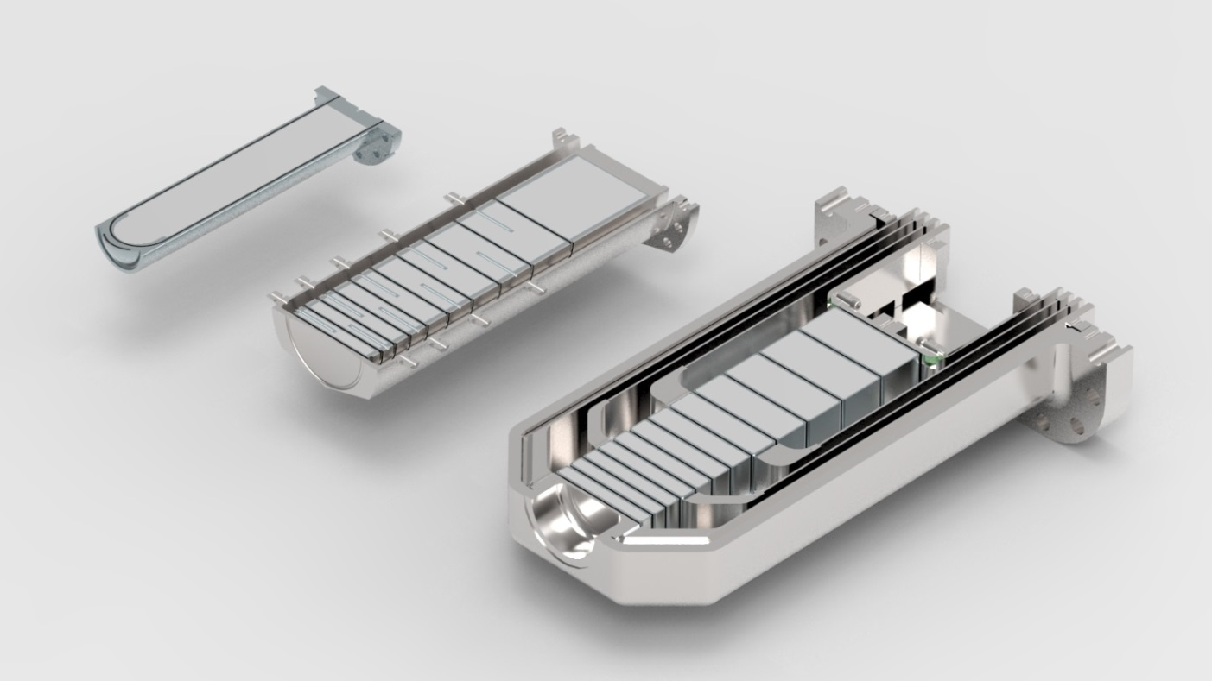
Target materials – A Need For New Materials?
Originally made from Uranium clad in Zircalloy
ISIS currently uses Ta/W targets
Tungsten core bonded to a Tantalum cladding
Tantalum is rare, expensive and difficult to work with
Limited suppliers and long lead times
Shallow pool of suitable materials
Any new material should be investigated
Notes:
Tantalum 0.7PPM

Slide 4
Target Materials - What’s Required?
There is a long list of requirements for Target materials due to the application and conditions, this includes:
Density/Atomic Number
Radiation resistance
Corrosion resistance
Thermal properties – Melting point, Thermal conductivity, Thermal expansion are also critical
Machinability and availability of material and cost are a key aspect to consider
Notes:
Density – the more neutrons the better Radiation resistance – radioactive particles are a by-product of spallation may cause embrittlement or other issues /corrosion resistance – cooled with high pressure water
6m/s flow ts1 - 9m/s flow ts2 reason we clad tungsten -

Slide 5
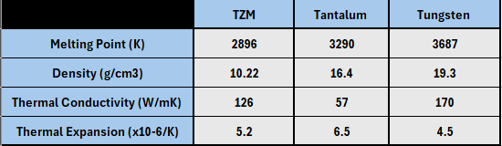
Trialling a New Material:
Molybdenum alloy, TZM (Mo 99%, Ti 0.5%, Zr 0.1%)
Good thermal properties
Cheaper than Tantalum
Needs to be trialled in a manufacturing setting
Notes:
Zircaloys thermal conductivity is terrible 21.5 W/mK

Slide 6
Project Objectives:
To test the suitability of TZM as a Target cladding material
Trial the manufacturing properties of TZM
  Milling/Turning
  EDM
  EB Welding
Create a mini trial target plate using current target methods
Trial HIP bonding recipe for TZM and W

Slide 7
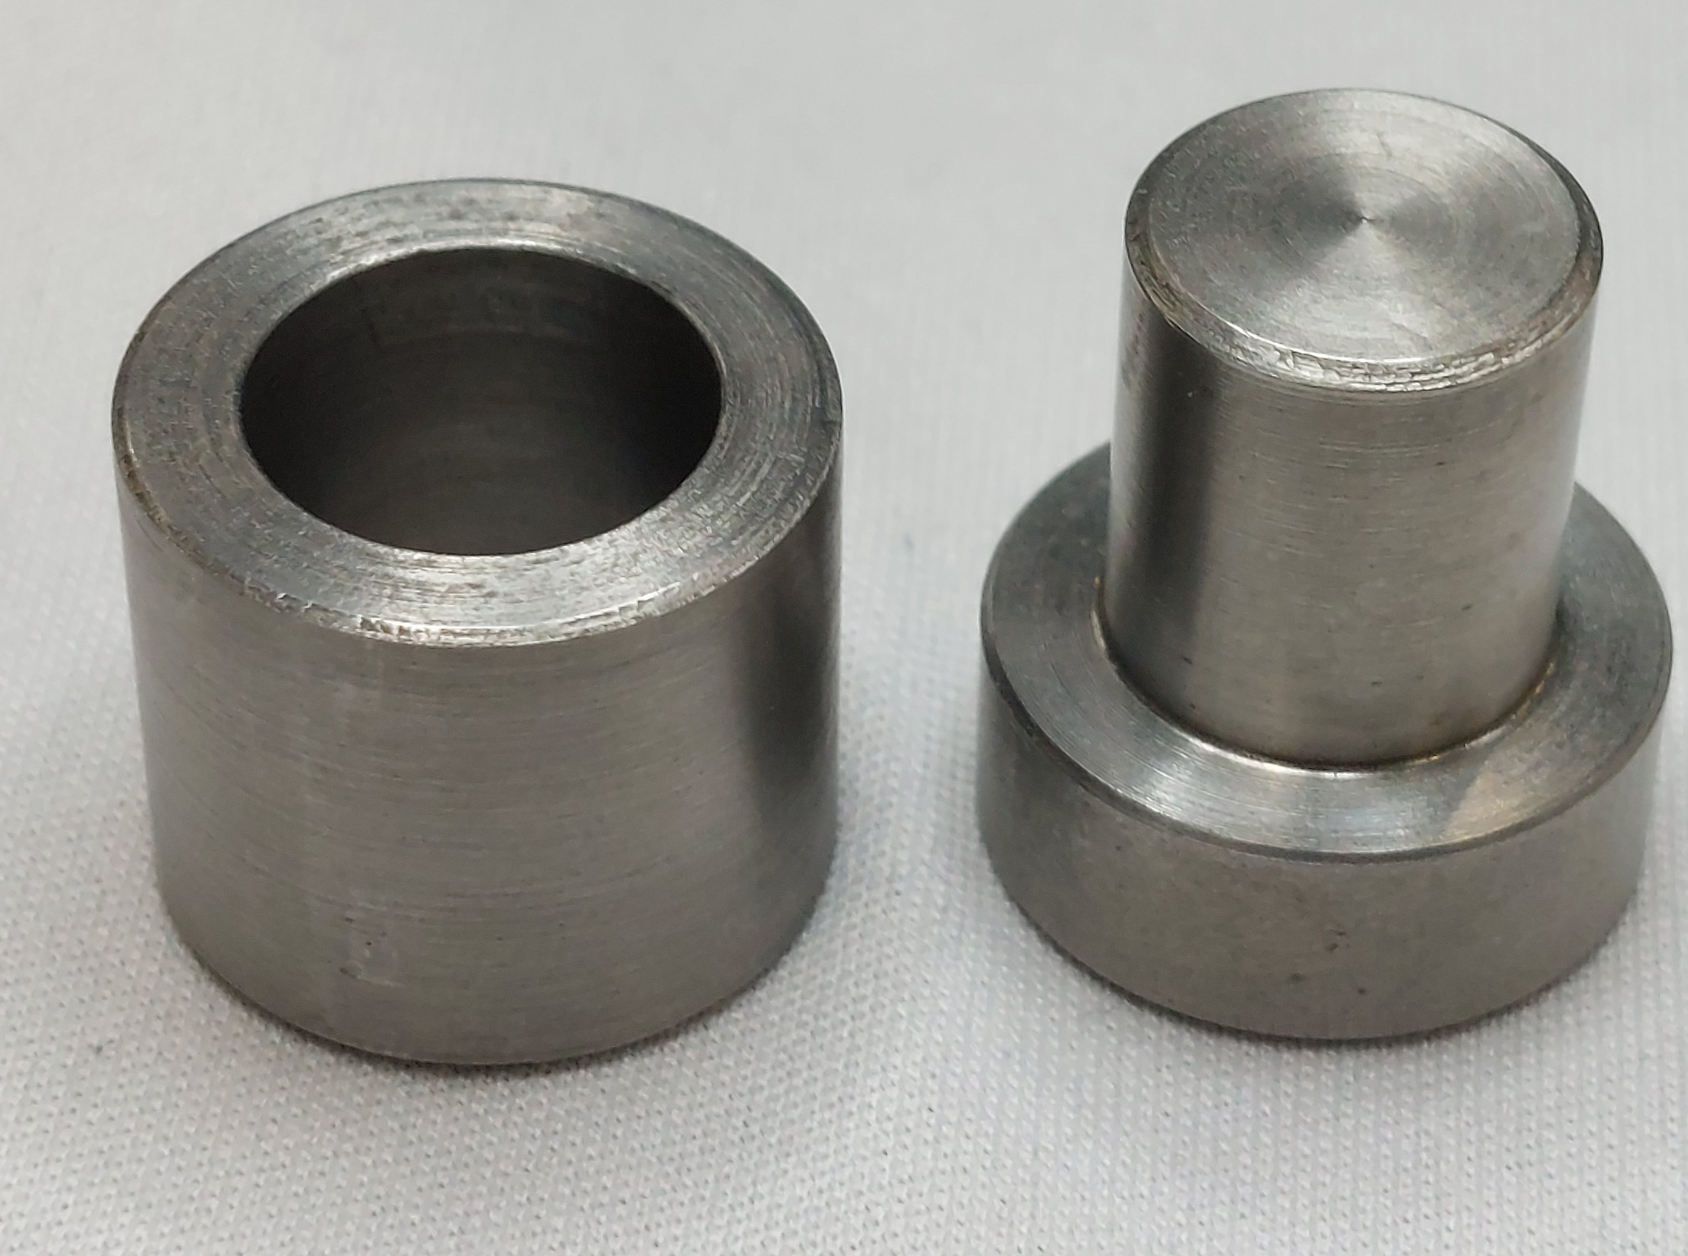
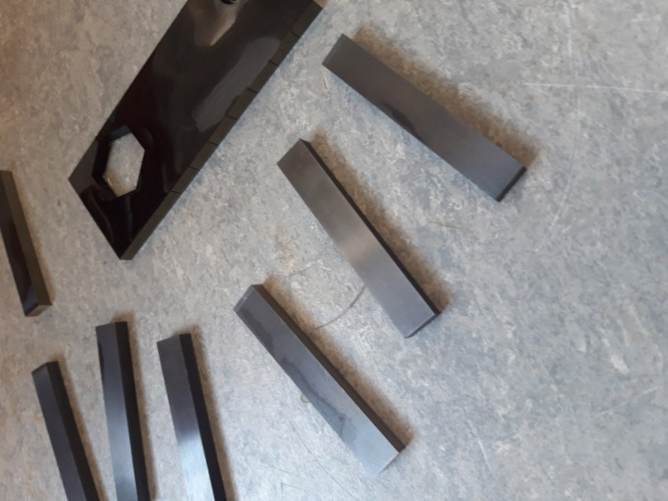
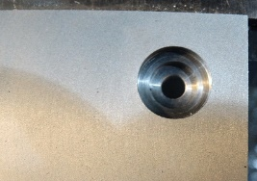
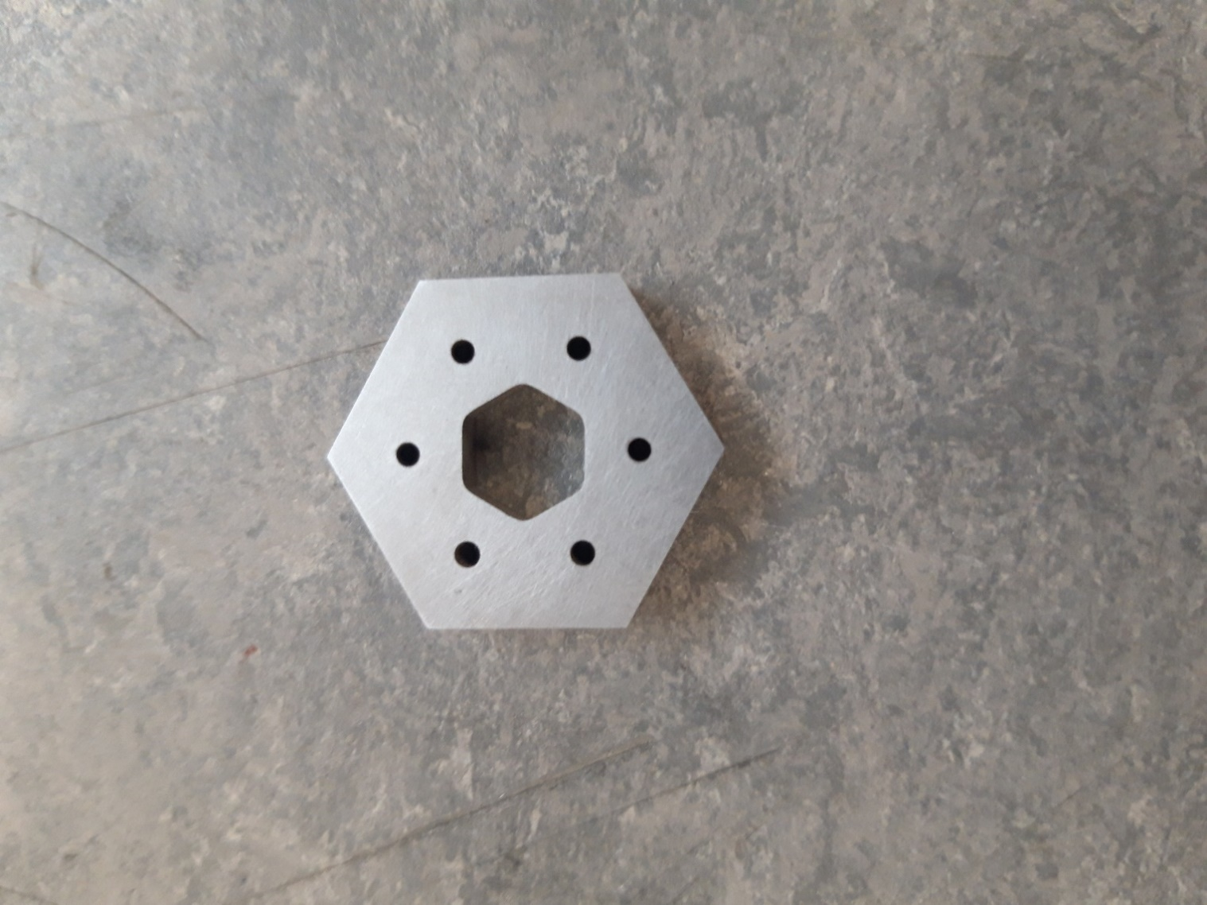
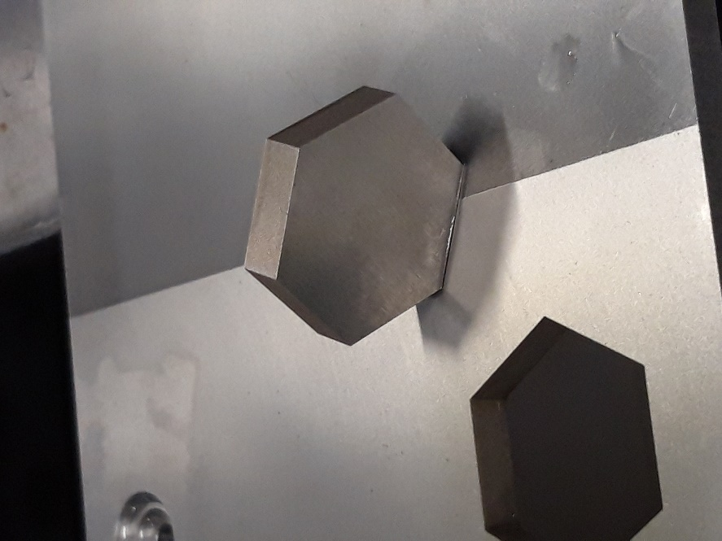
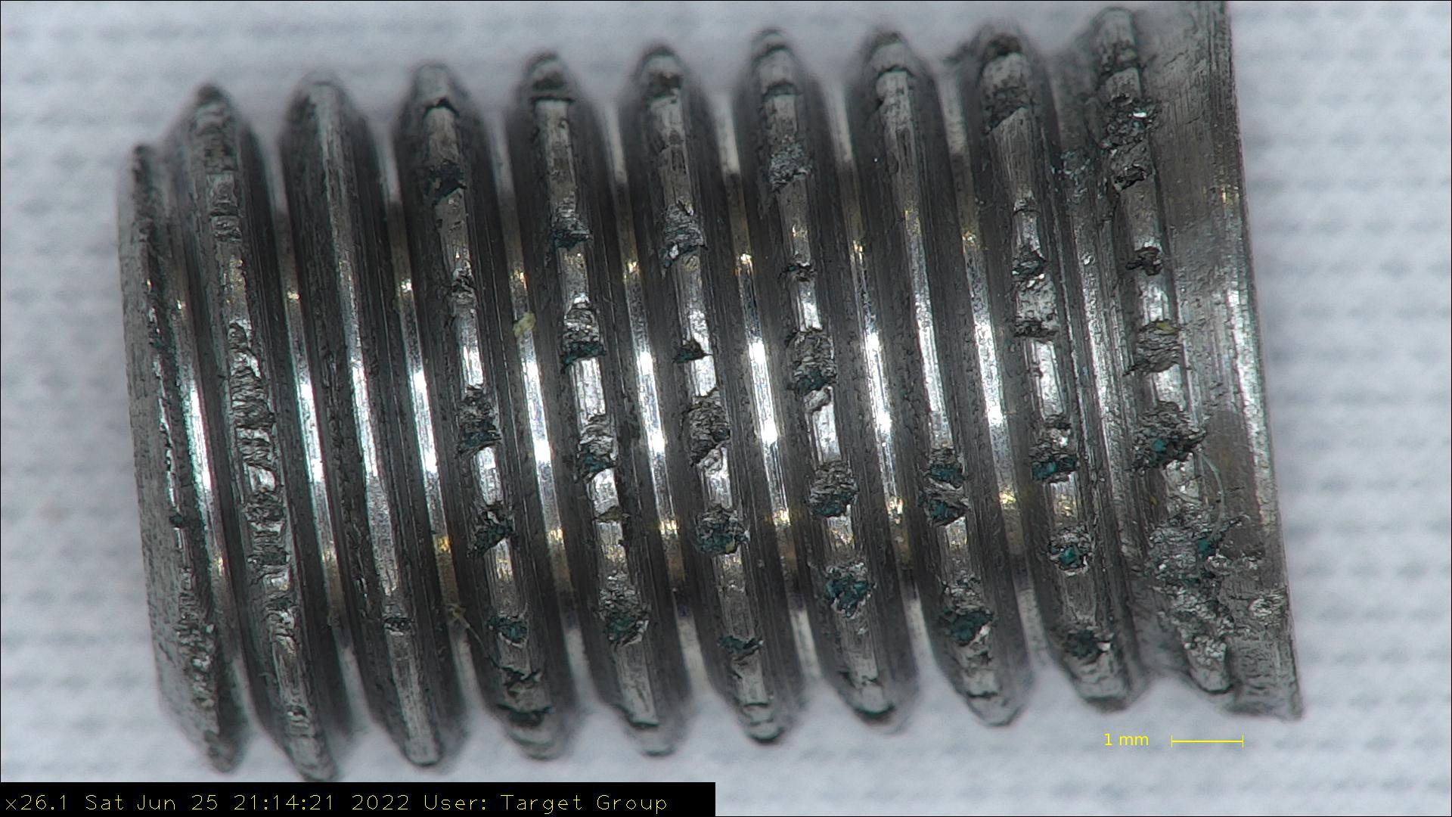
Manufacture Trials:
Notes:
1mm cuts mill/lathe 10 – 13mm/min on WEDM Ta is around 3mm/min
Die sink carbide tech
Ti tech didn’t work
WEDM Hard metal +
Spark High chromium steel/hard metal

Slide 8
Manufacture Trials:
TZM machines well
Easier to work with than Tantalum
Brittleness in screw threads
Material goes black after EDM machining?

Slide 9
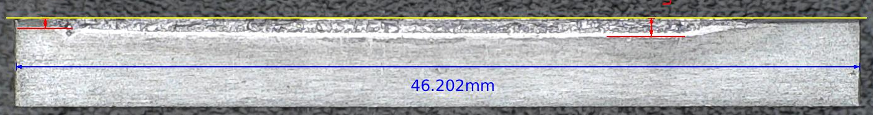
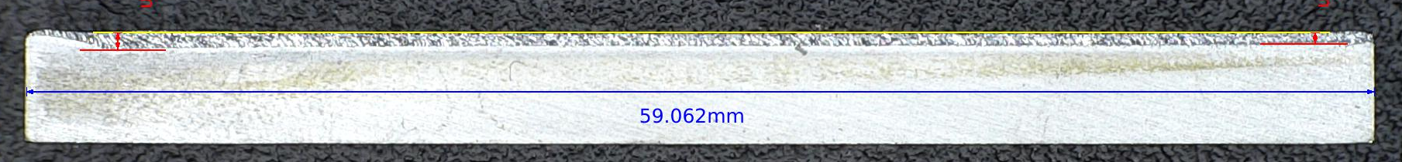
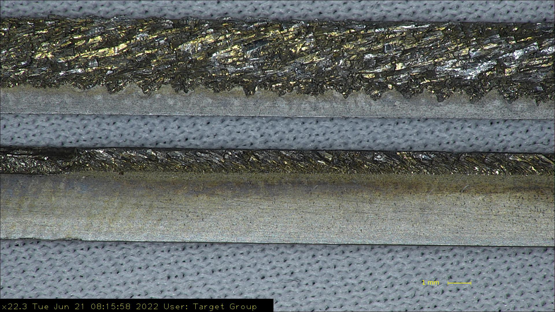
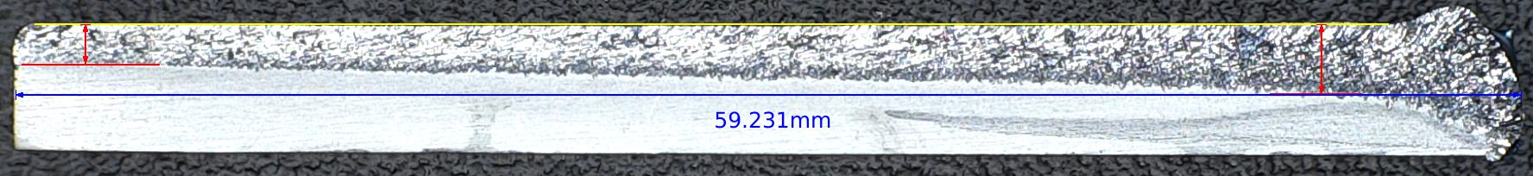
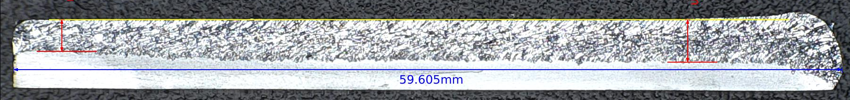
Welding Trials:
Notes:
Top – Ta test strip
TZM @ Ta parameters
TZM @ 25mA
TZM @ 30mA
Right – TZM @25mA 150mm/min + Ta
Tack @10 SF
Seal @10 SF
Full @20 Below SF
Polish@10 Above SF

Slide 10
Welding Trials:
TZM produces weak and brittle welds
Tantalum is better for welding purposes
Final parameters gave best possible weld for TZM
Slower feed rate and higher weld amperage
Final weld parameters 25mA power 150mm/min feed with 5 Pre-heats

Slide 11
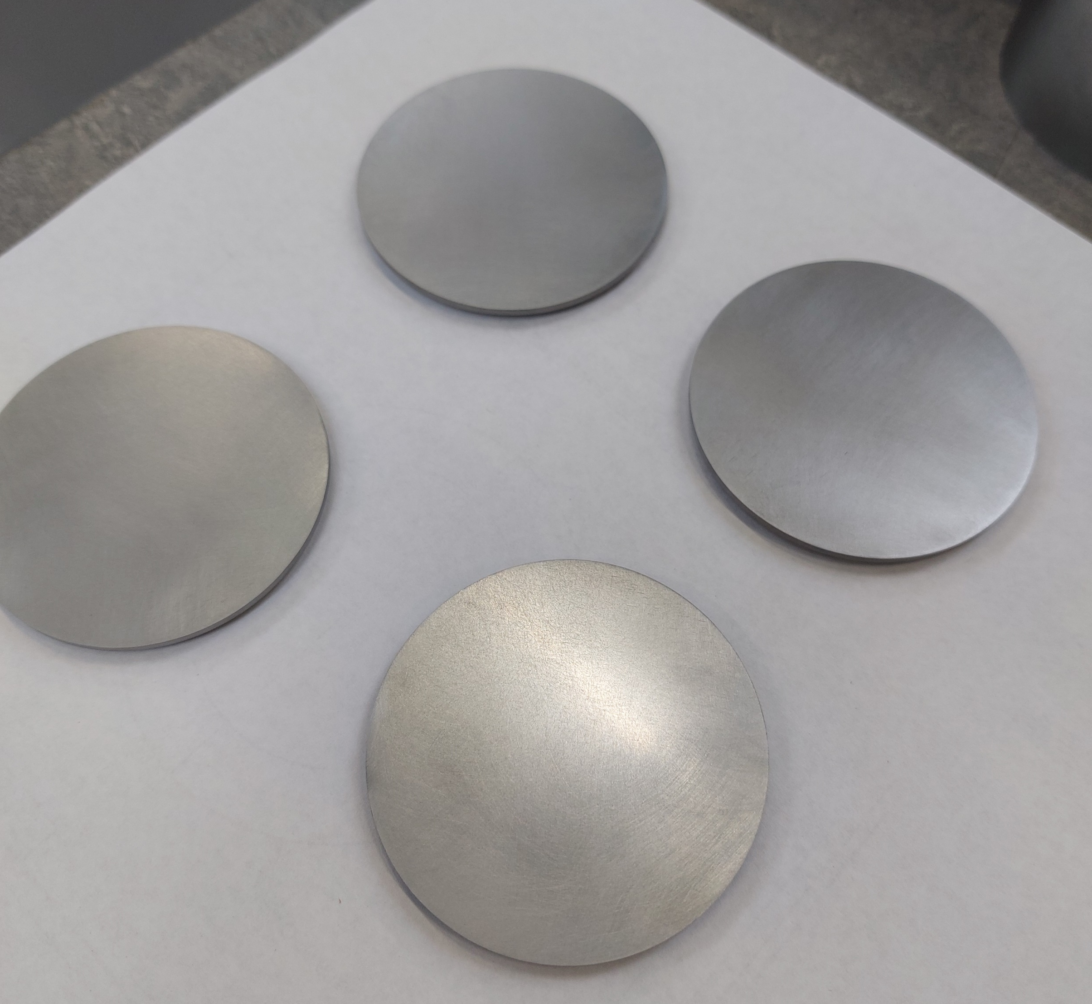
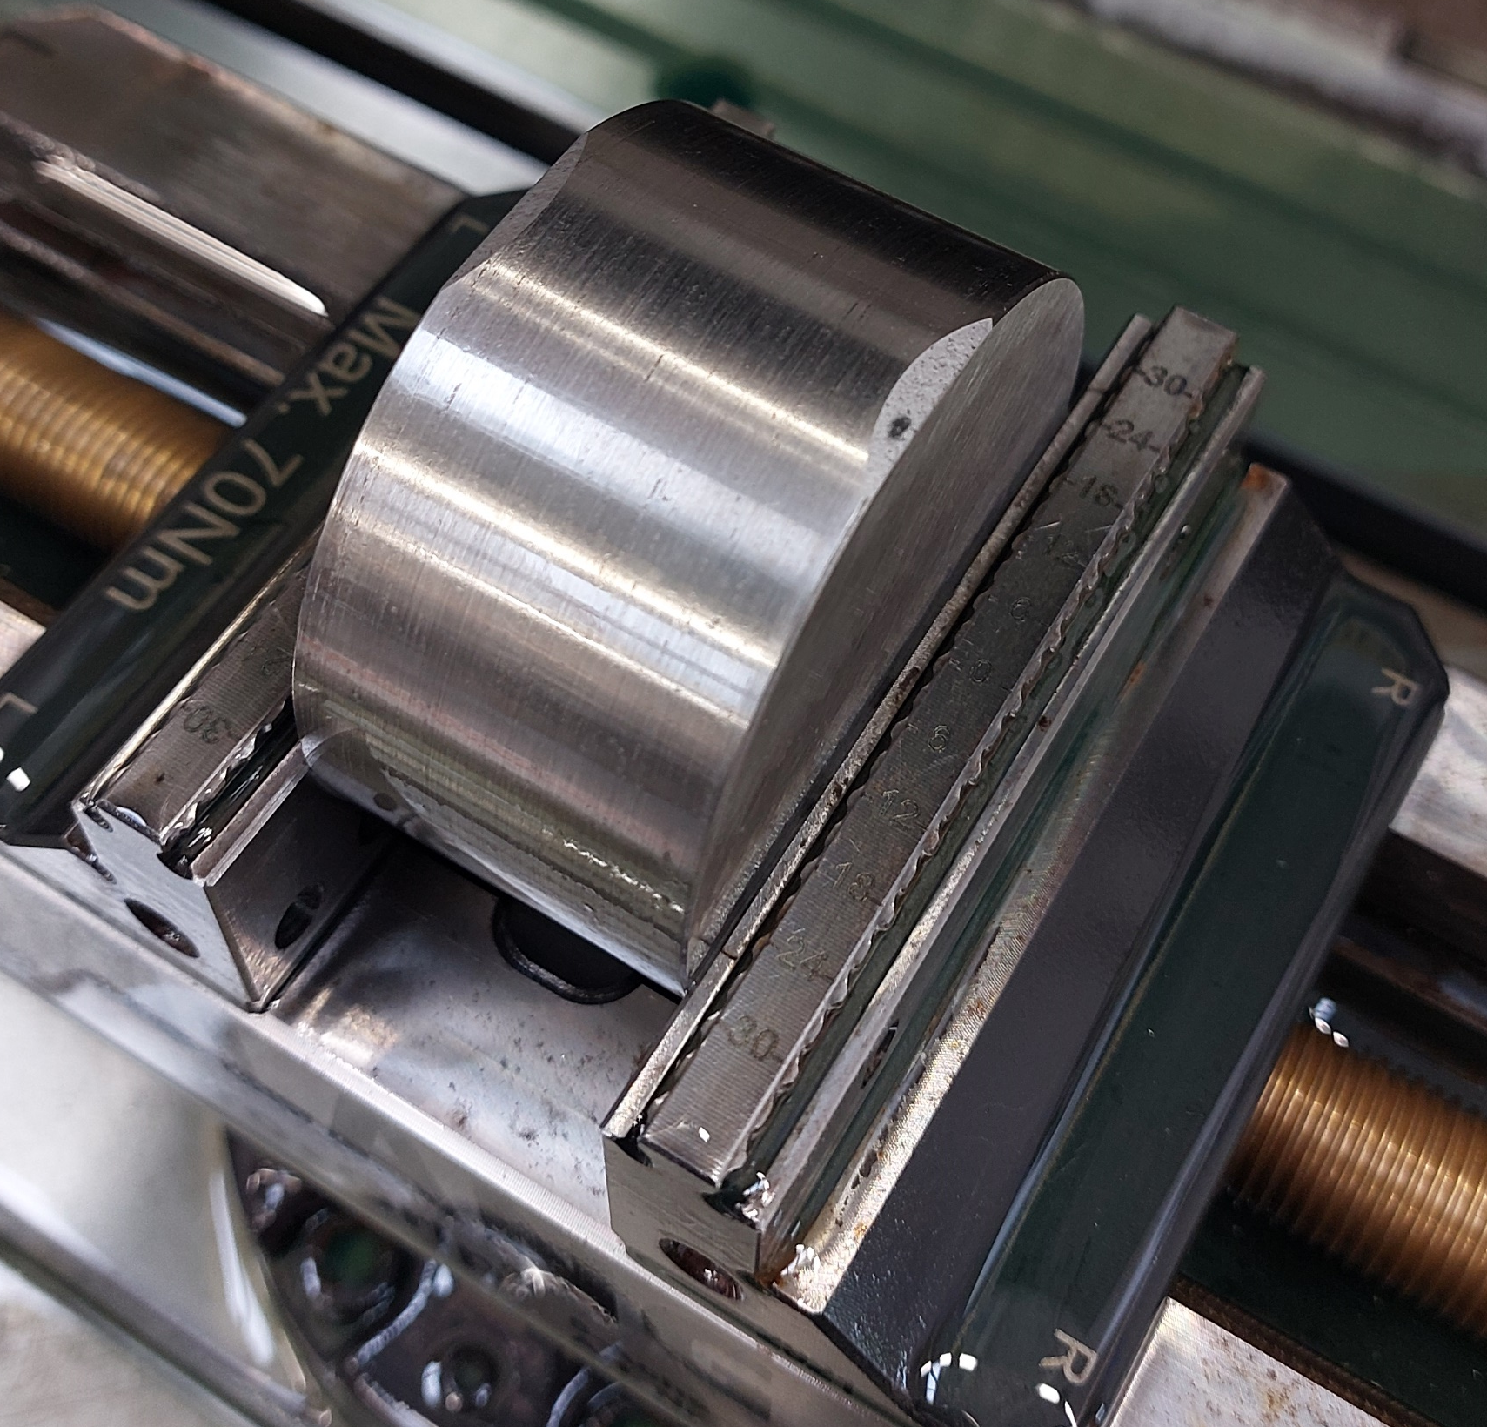
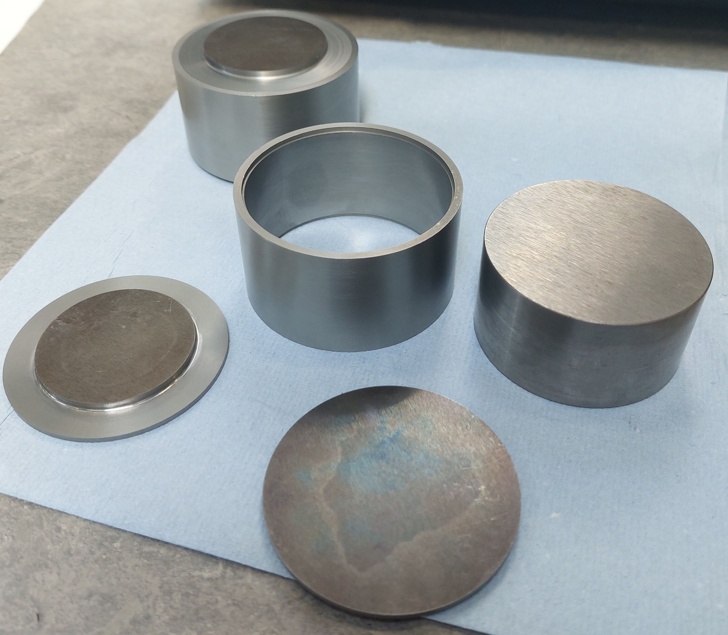
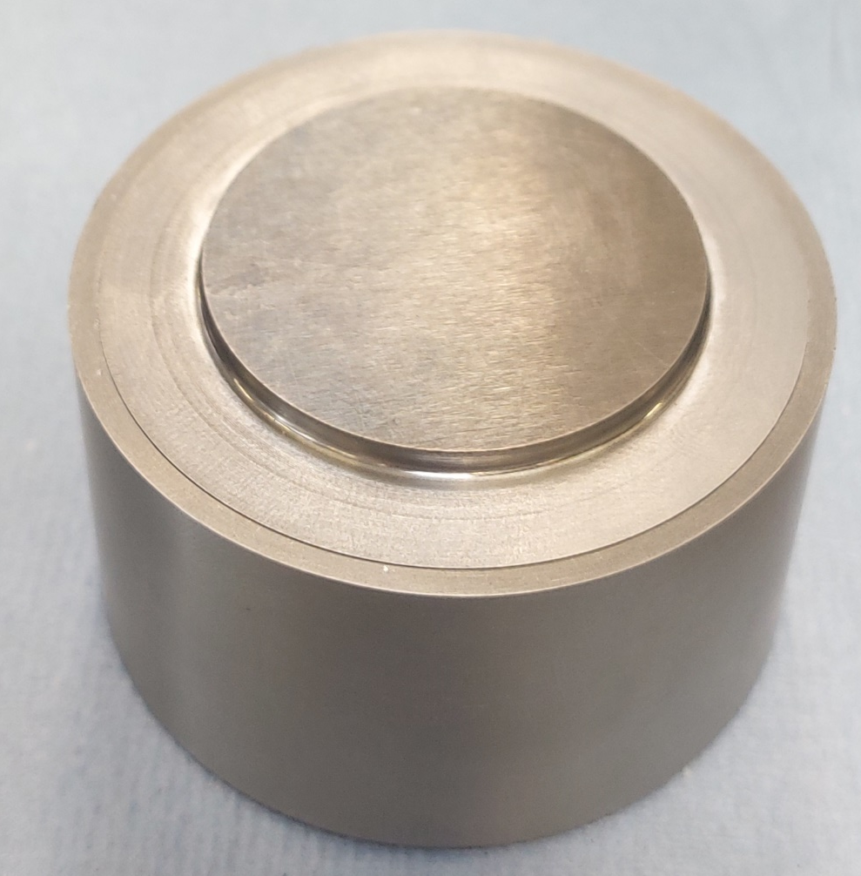
Mini Trial Plate Manufacture:
Trial plate is a mini version of a TS1 plate
Machining, polishing and cleaning process identical to real plate manufacture for consistency

Slide 12
Mini Trial Plate Further photos:

Slide 13
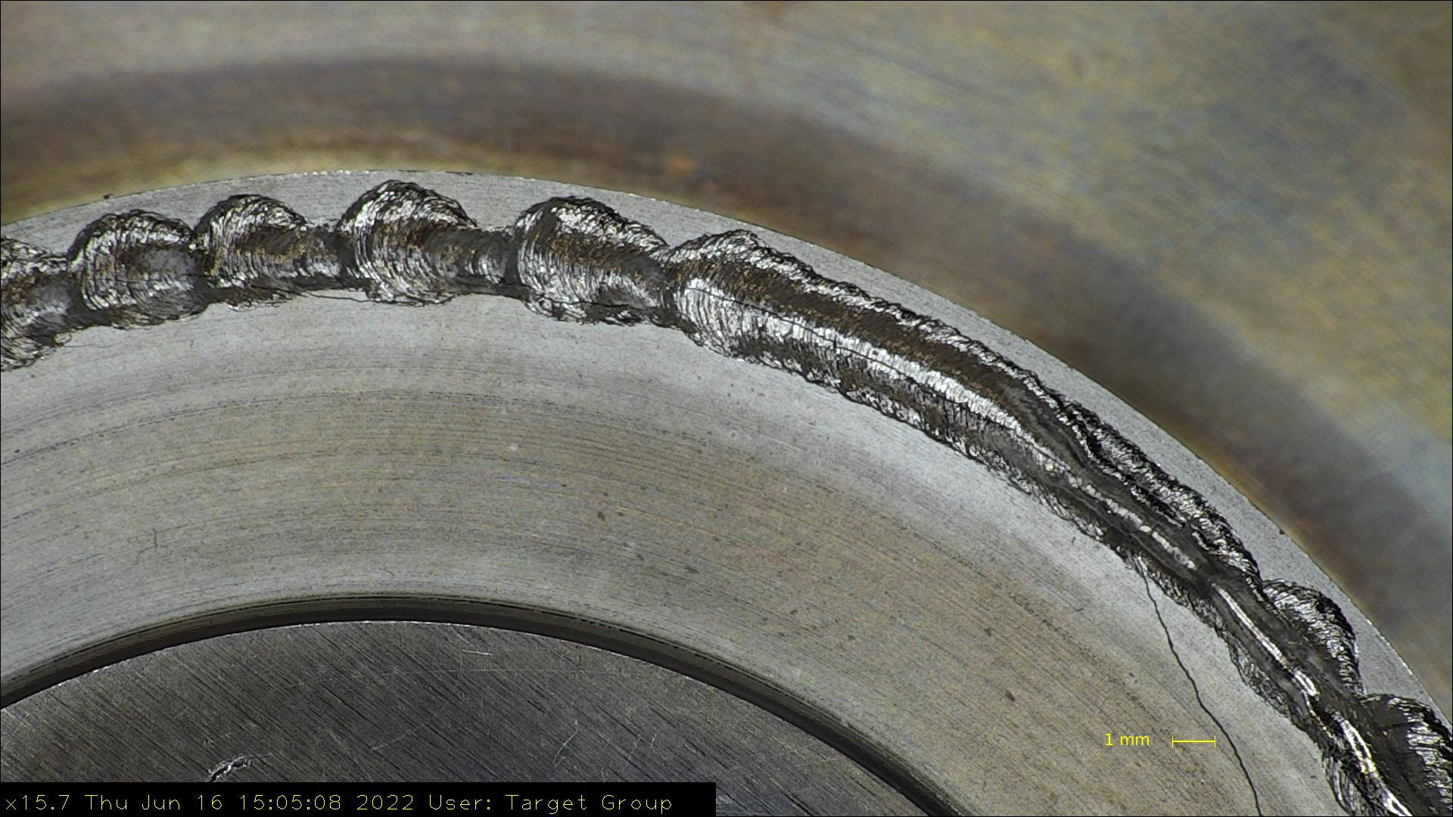
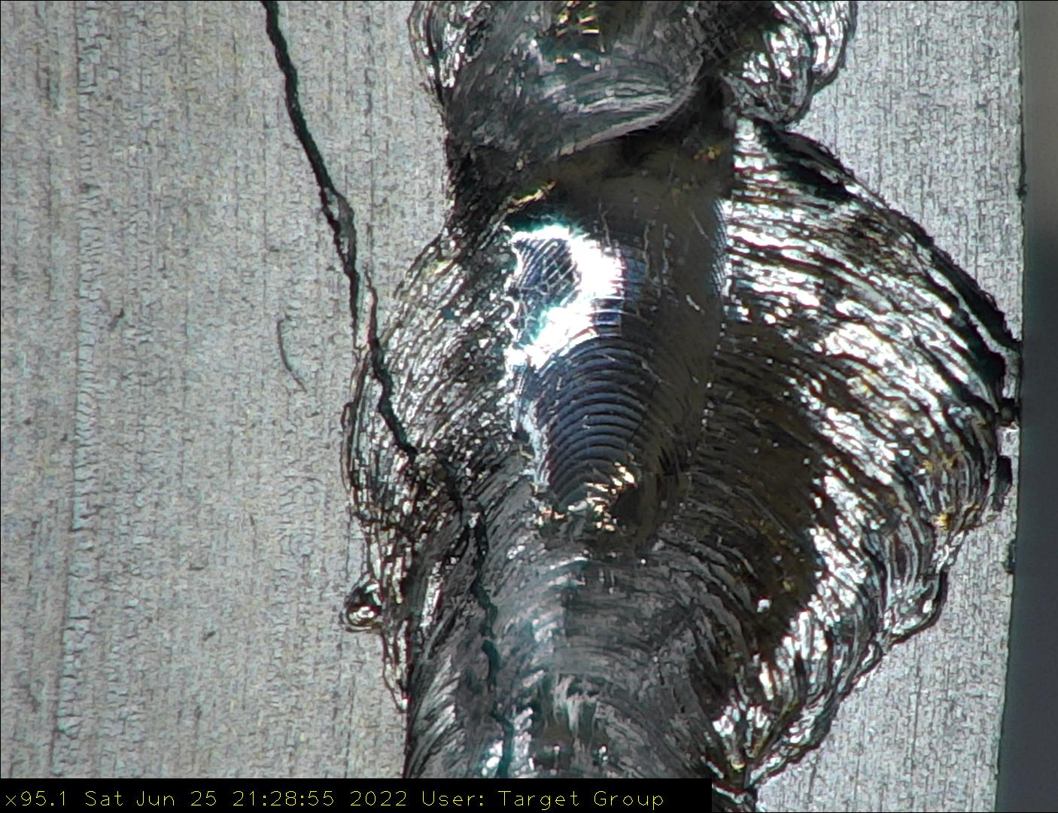
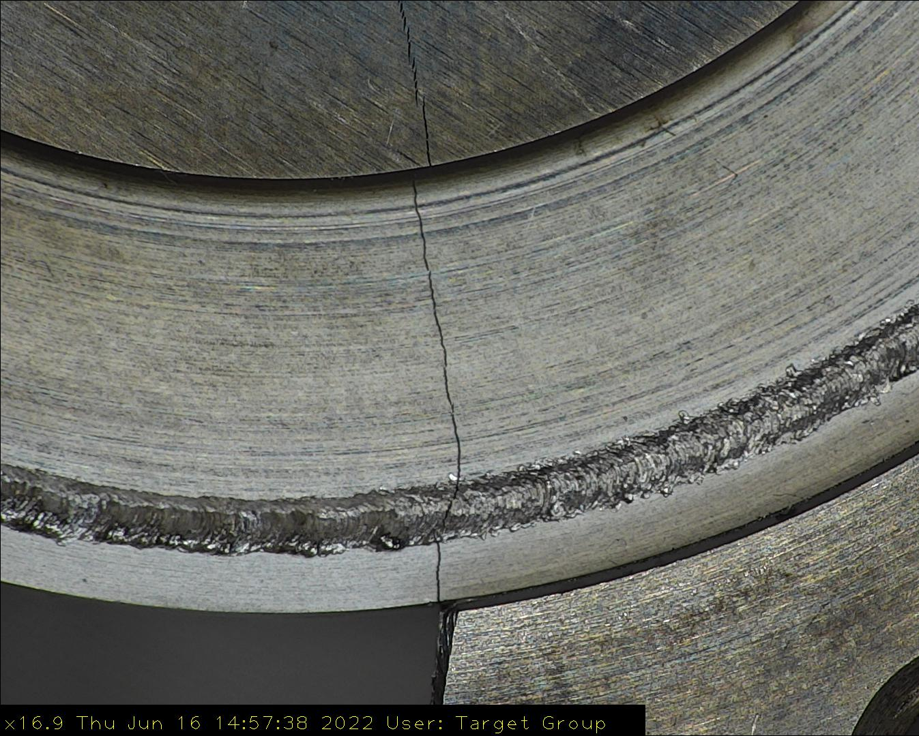
Results and Conclusion:
Plate lids and ring subject to severe cracking after welding
Oxidisation of alloy creates porosity in welds
Welded TZM sees a major drop in UTS and Elongation to fracture
TZM not currently viable as a target cladding material
Differentiation to be made between Target core and cladding properties?
Further research into other materials is still worthwhile
Notes:
Does cladding need to be more ductile/malleable – longer welds = more stress than test strips

Slide 14
TZM Trial Plate Failure Investigation:
Reference:
B.Tabernig, N. Reheis, “Joining of Refractory Metals and its Application” 17th Plansee Seminar Vol. 4, 2009.

Slide 15
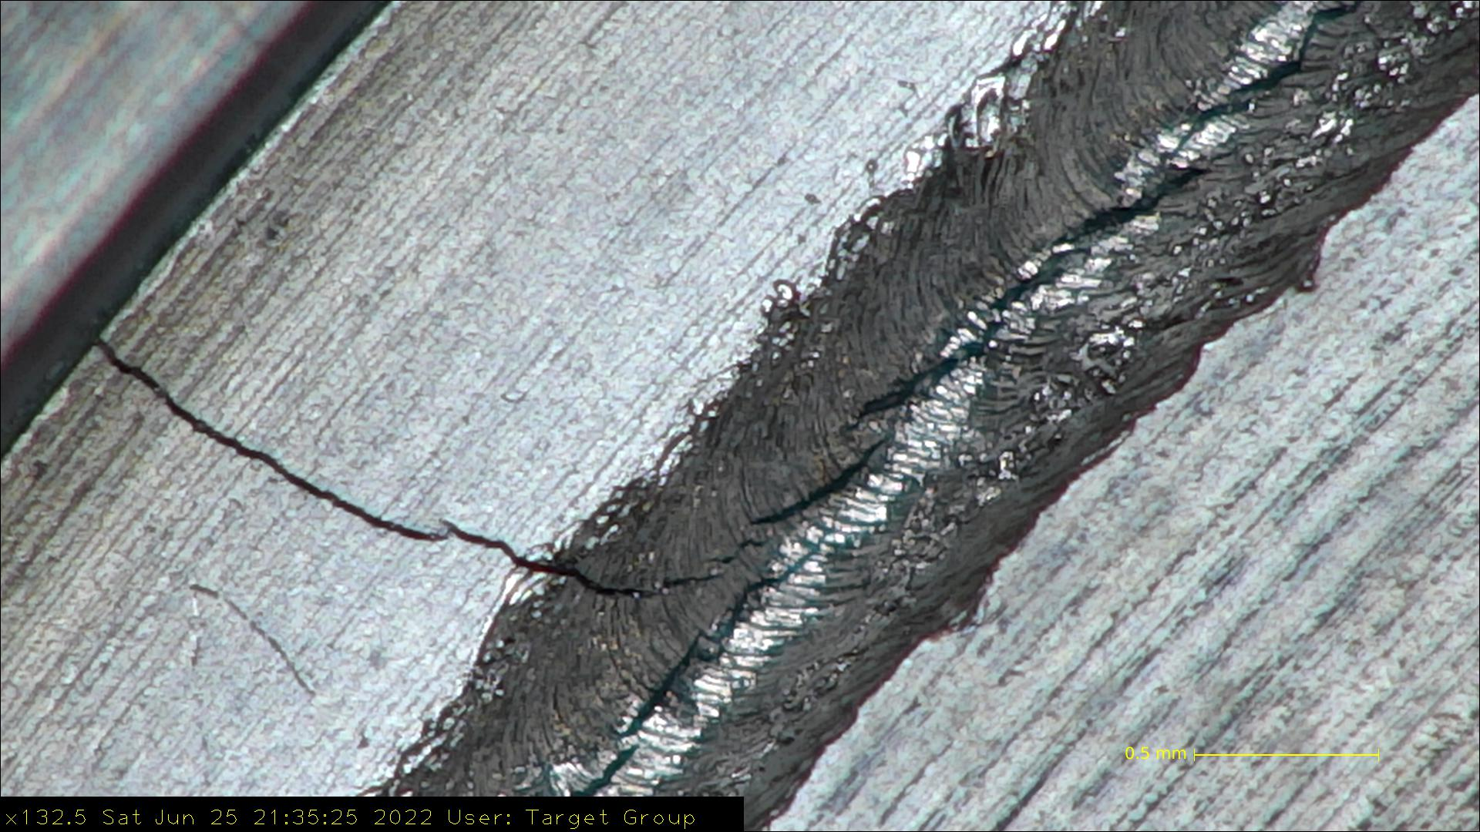
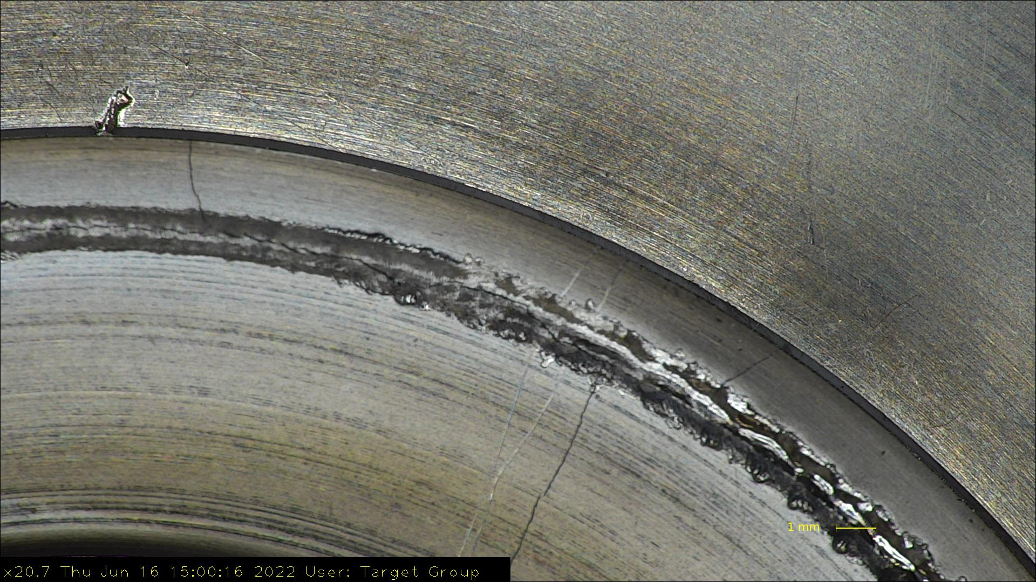
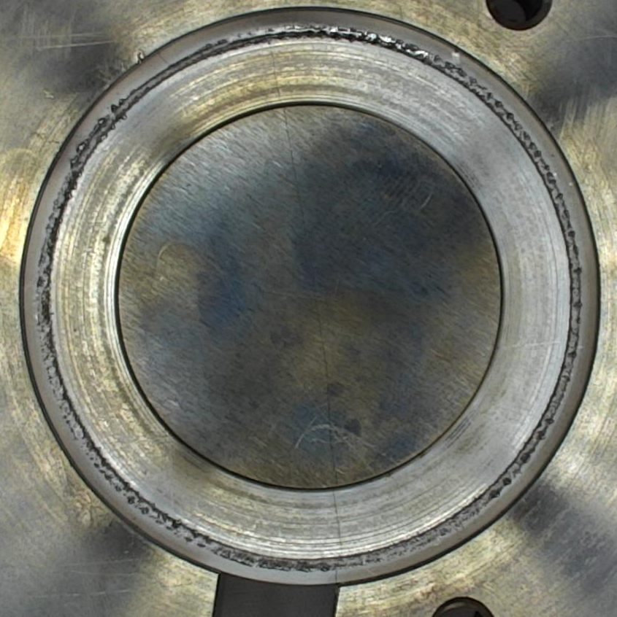
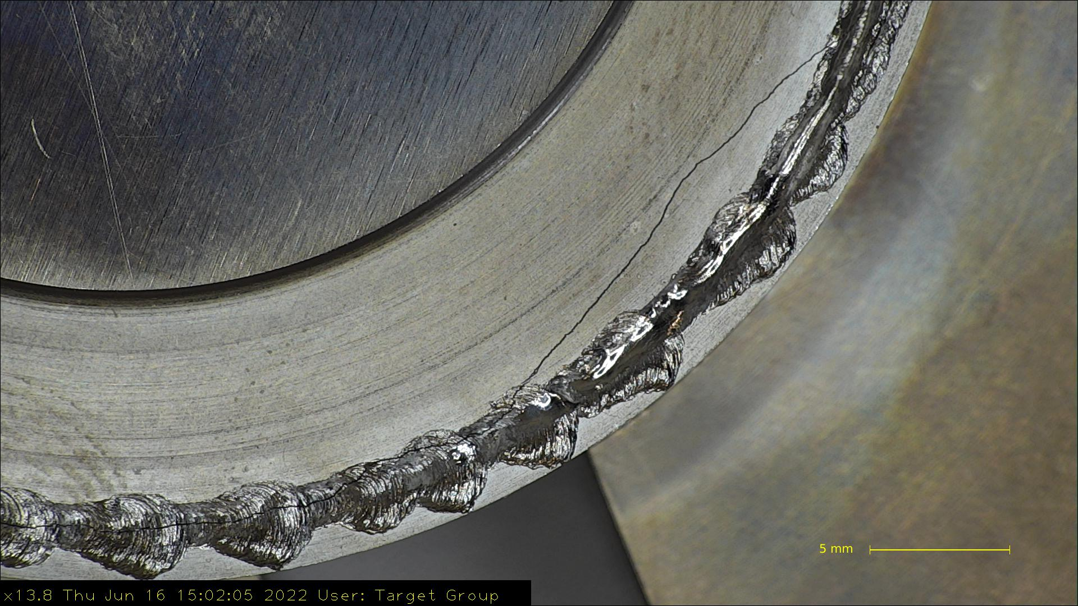
TZM Trial Plate Failure – Further Photos

Slide 16
Future Potential and Direction:
More research and development would be necessary to make TZM work
Project has kick-started interest into new materials
Room for development and further testing
Notes:
Moly Rhenium alloy? Mo lanthanum Alloy? Titanium can method/no welding

Slide 17
Thank you for listening.
Any questions?

