Slide 1
Comparison of simulated and observed cavitation-induced erosion damage in Spallation Neutron Source target vessels
Hao Jiang, David A. McClintock, Drew E. Winder
Spallation Neutron Source
Oak Ridge National Laboratory
IWSMT-16
Oct.28th - Nov.1st , 2024

Slide 2
Outline
Background
Cavitation damage simulation and calculation procedure
Saturation time metric
Maximum bubble size metric
Results and comparison
Without gas injection
Maps of target inner wall surface facing mercury bulk flow
Maps of target inner and outer wall surfaces facing mercury window flow
Maps of target vessel interior surfaces facing mercury flow
With gas injection in mercury bulk flow
Maps of target inner wall surface facing mercury bulk flow
Maps of target inner and outer wall surfaces facing mercury window flow
Summary

Slide 3
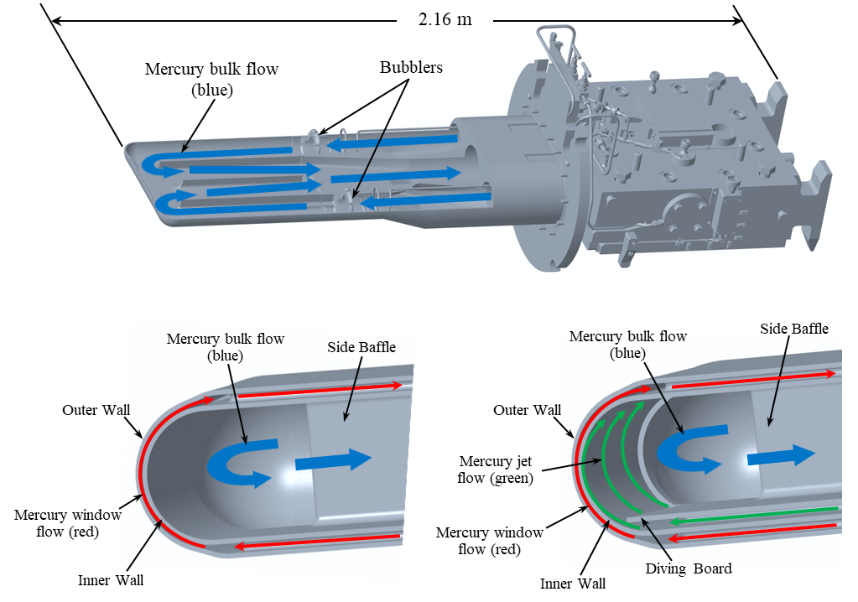
SNS Original design and Jet-flow design target with mercury flow passages
Original target
Jet-flow target

Slide 4
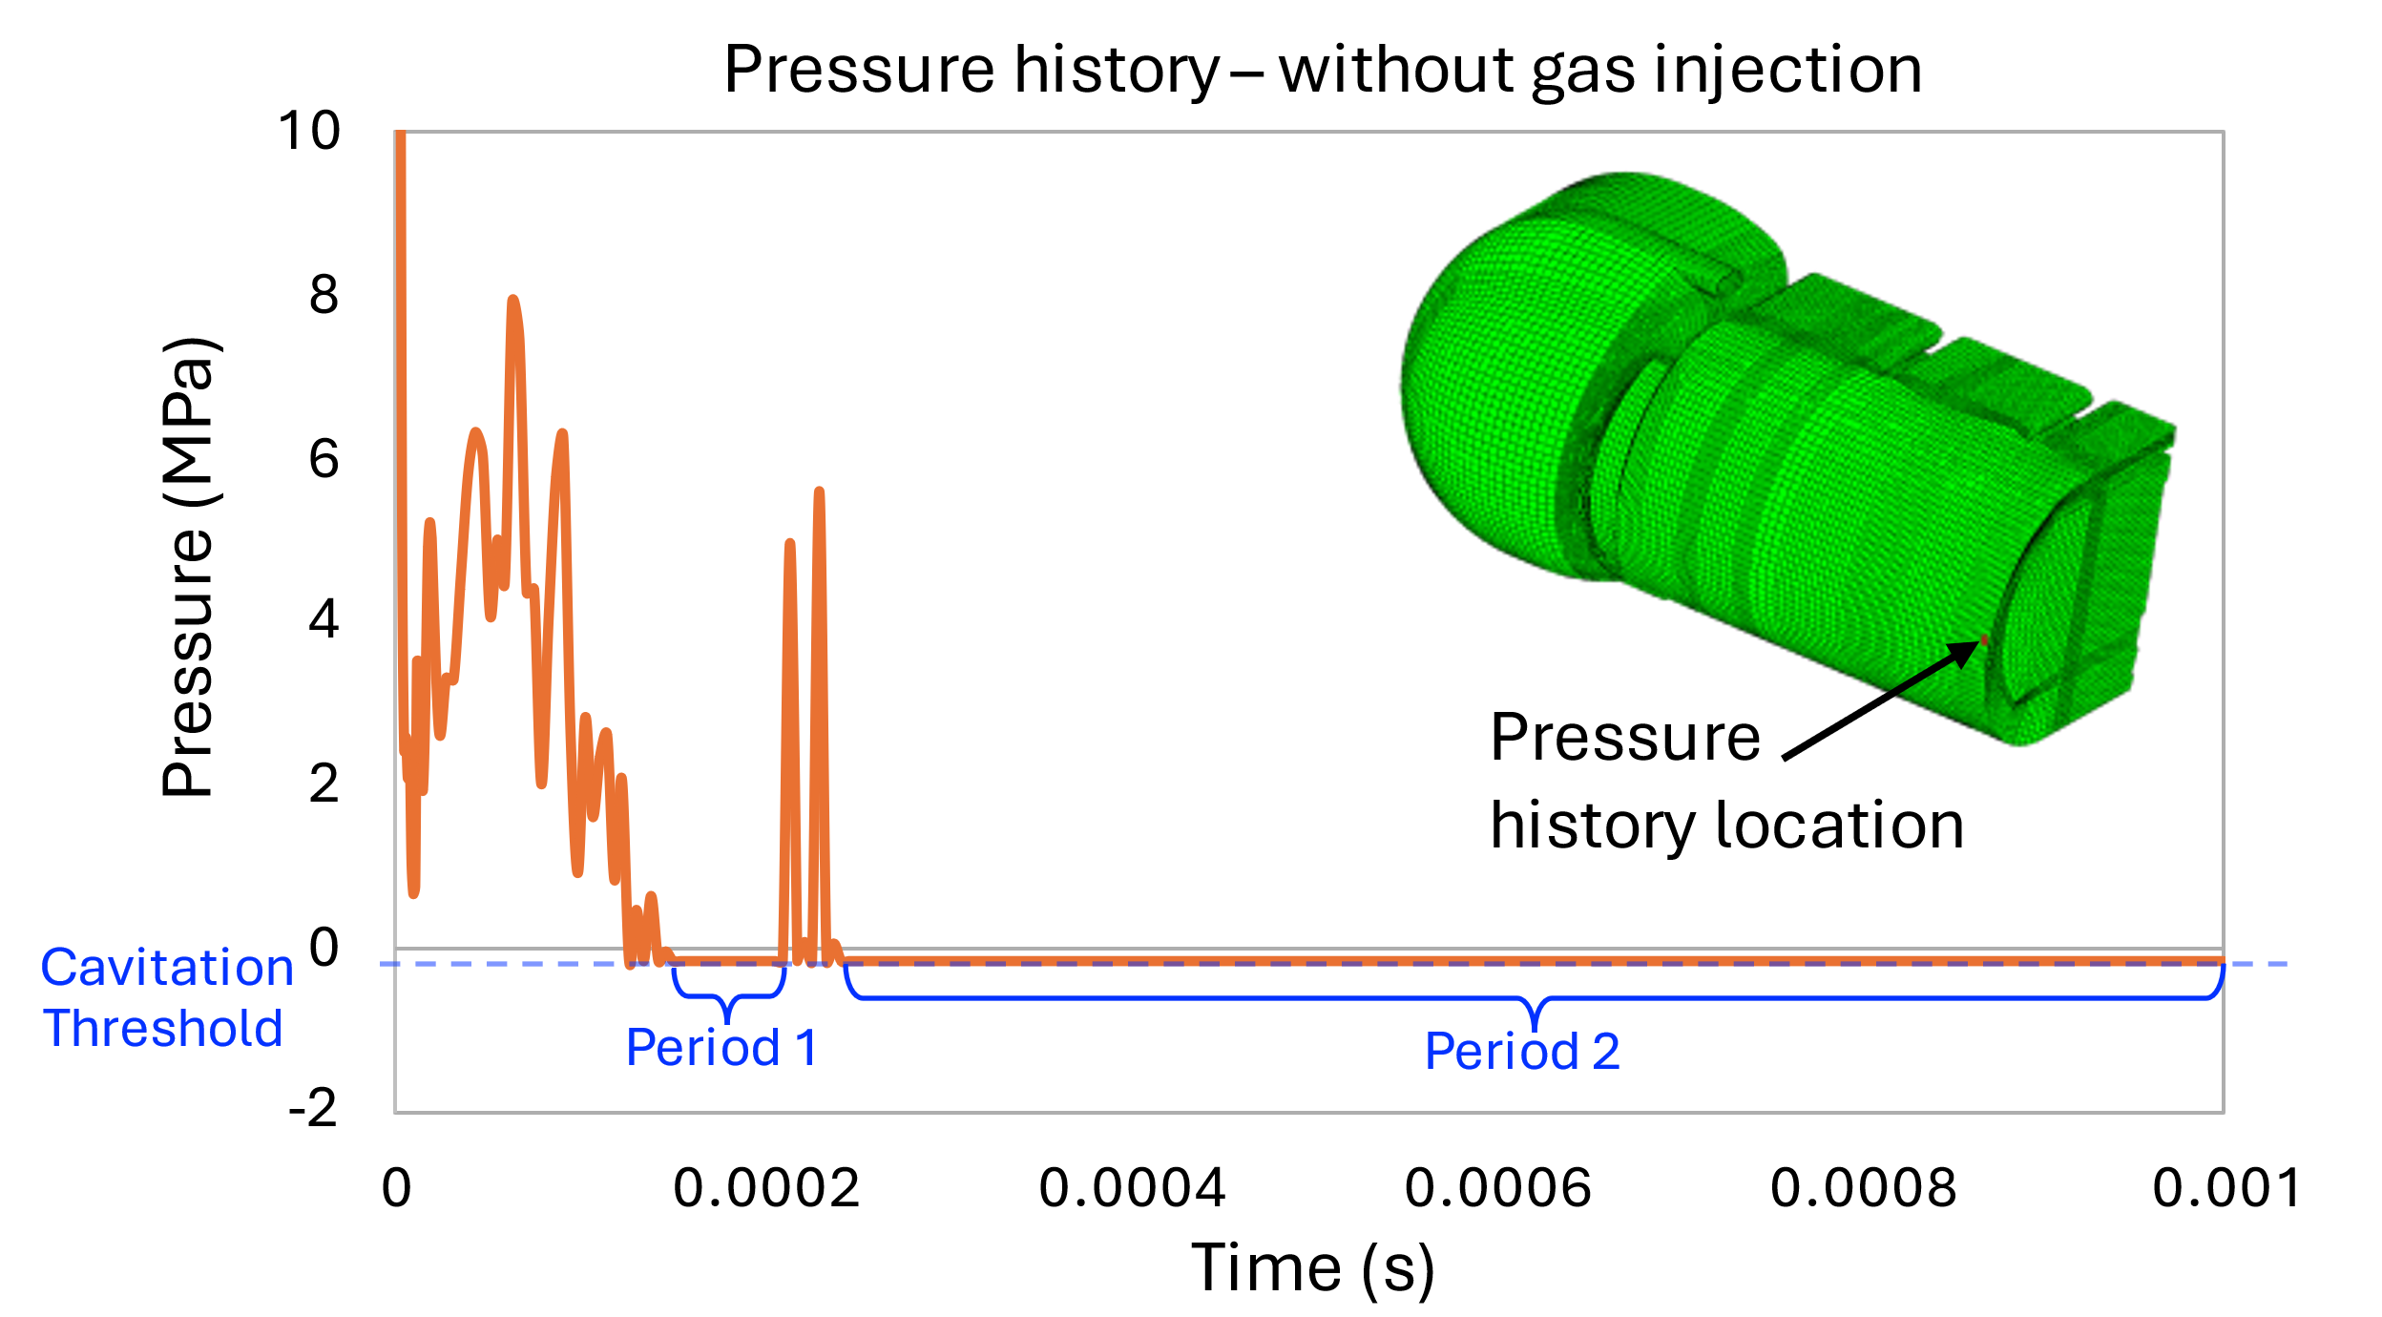
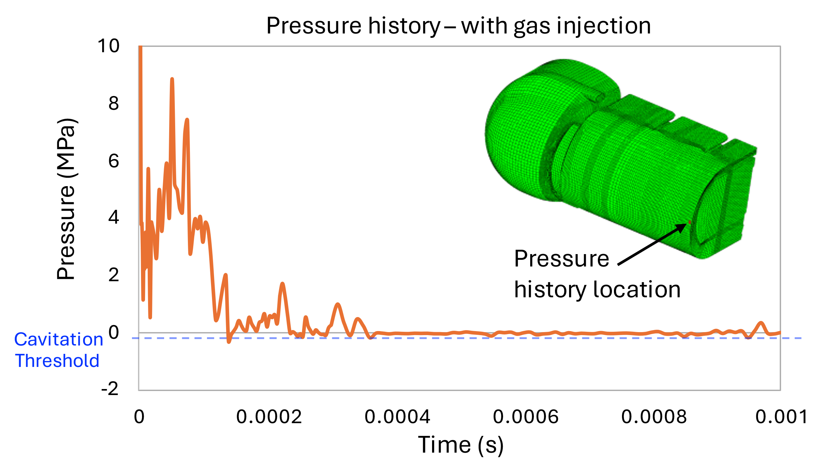
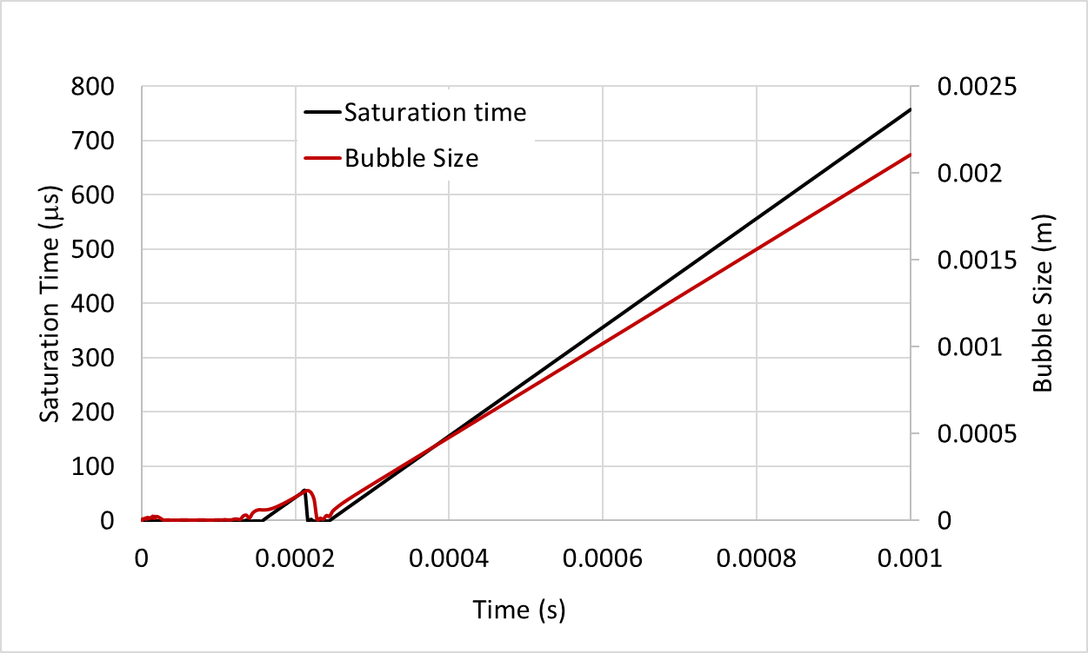
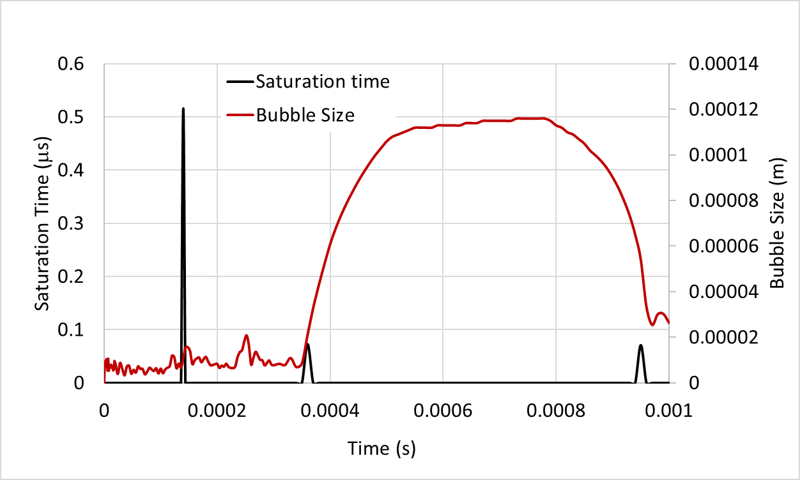
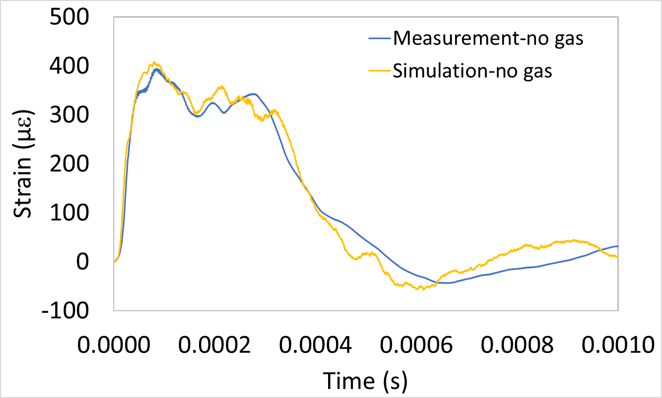
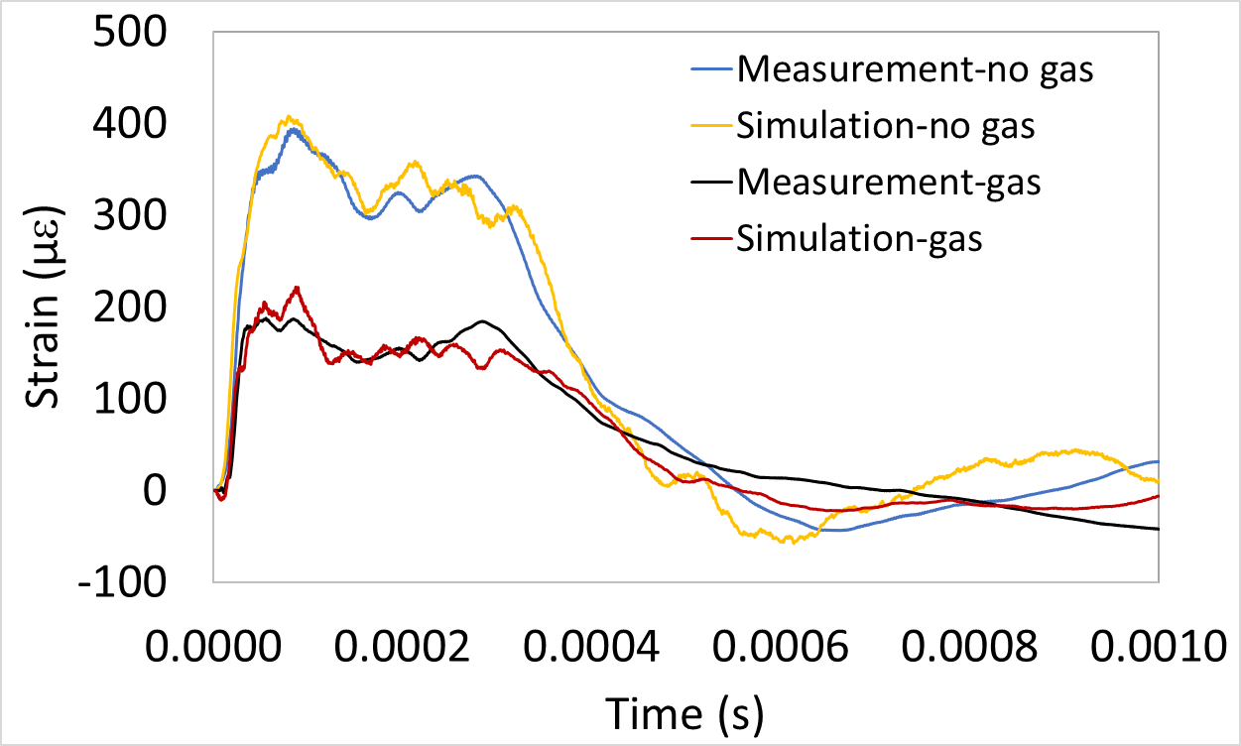
Simulation and Calculation Procedure
Structural response simulation using R-P model
$R\ddot{R}+\frac{3}{2}{(\dot{R})}^{2}=\frac{1}{ρ}\left[P^{b}−P_{∞}^{Hg}−\frac{4µ\dot{R}}{R}−\frac{2}{σR}\right]$
Structural response simulation using Riemer’s model
Structural response simulation using R-P model
$R\ddot{R}+\frac{3}{2}{(\dot{R})}^{2}=\frac{1}{ρ}\left[P^{b}−P_{∞}^{Hg}−\frac{4µ\dot{R}}{R}−\frac{2}{σR}\right]$
Structural response simulation using Riemer’s model
Cavitation potential metrics calculated from simulation without gas injection
Cavitation potential metrics calculated from simulation with gas injection
Cavitation potential metrics calculated from simulation without gas injection
Cavitation potential metrics calculated from simulation with gas injection
(old metric)
(old metric)
(old metric)
(old metric)
(new metric)
(new metric)
(new metric)
(new metric)

Slide 5
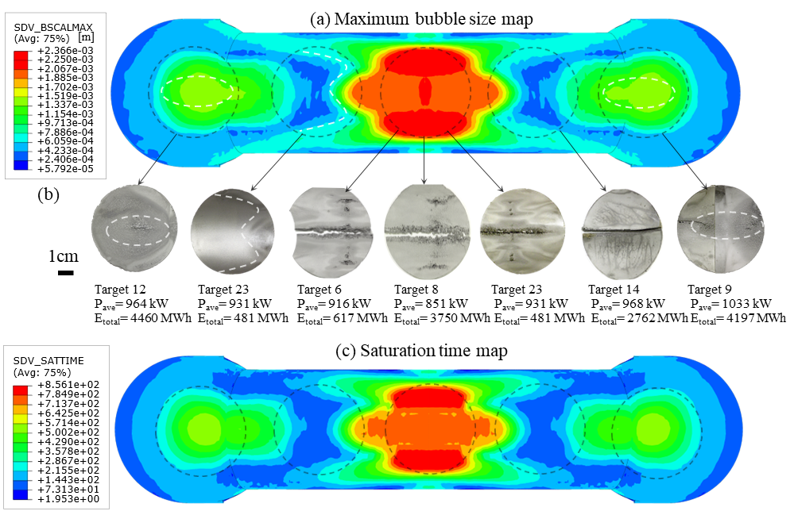
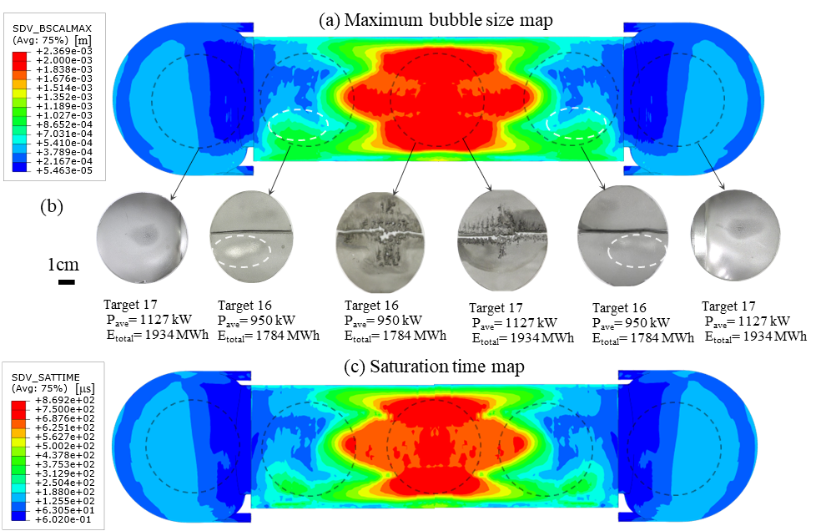
Without gas injection: Maps of target inner wall surface facing the mercury bulk flow
Original target
Jet-flow target
Φ

Slide 6
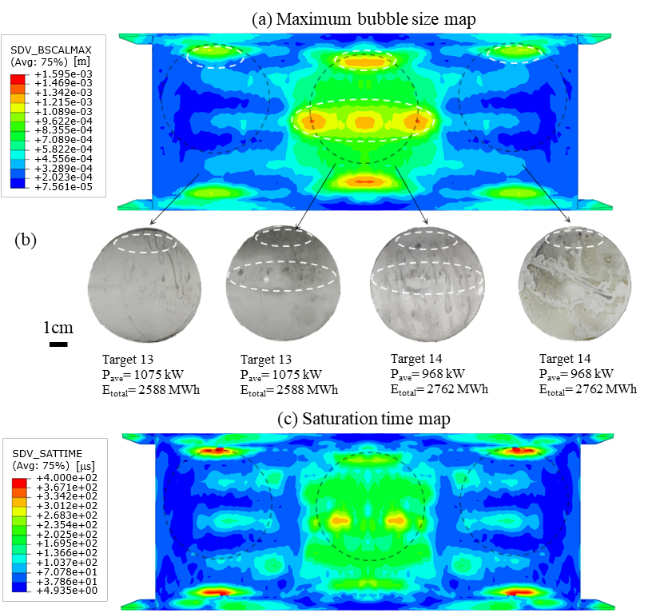
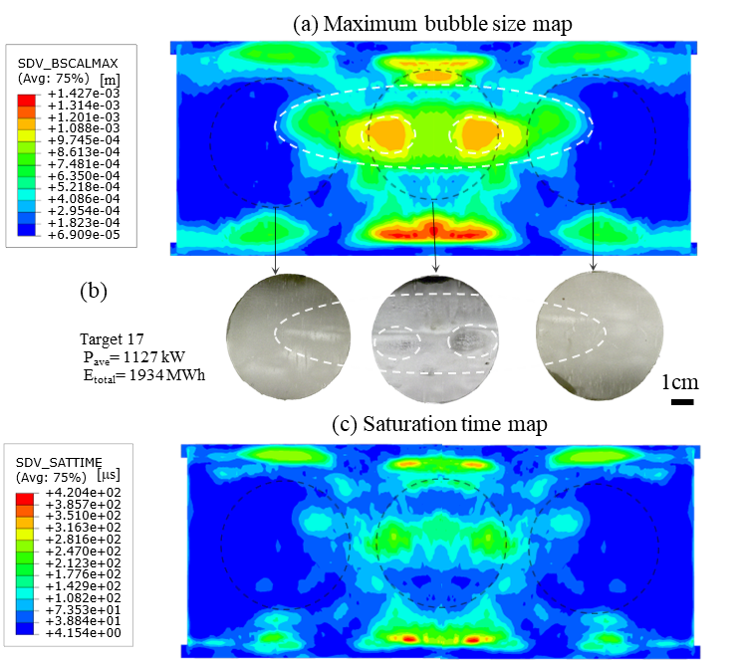
Without gas injection: Maps of target outer wall surfaces facing the mercury window flow
Original target
Jet-flow target
Bulk flow max 2.366e-3 m
Bulk flow max 2.369e-3 m

Slide 7
Without gas injection: Saturation time vs. Bubble size in mercury window flow

Slide 8
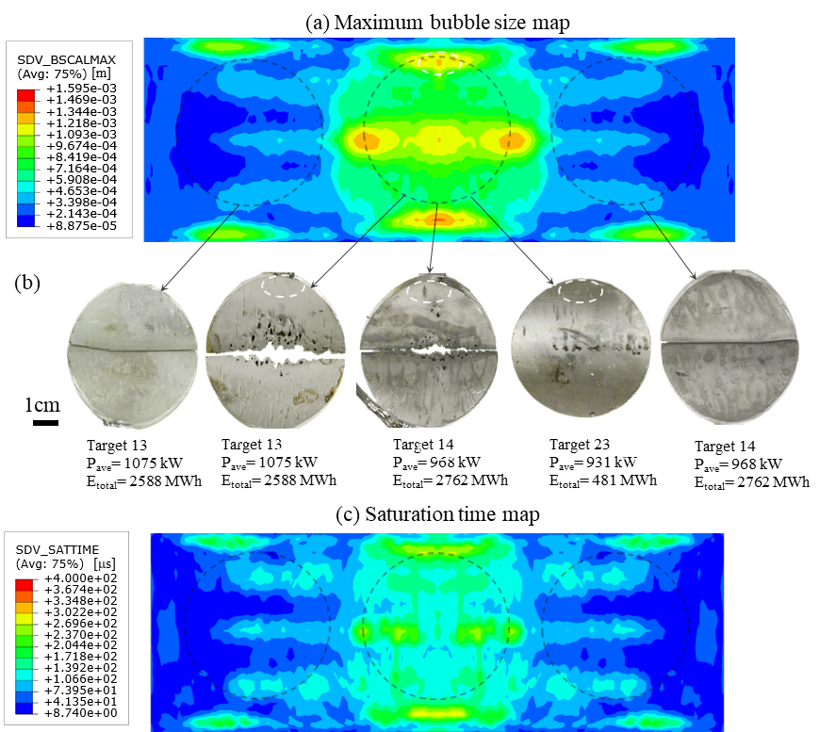
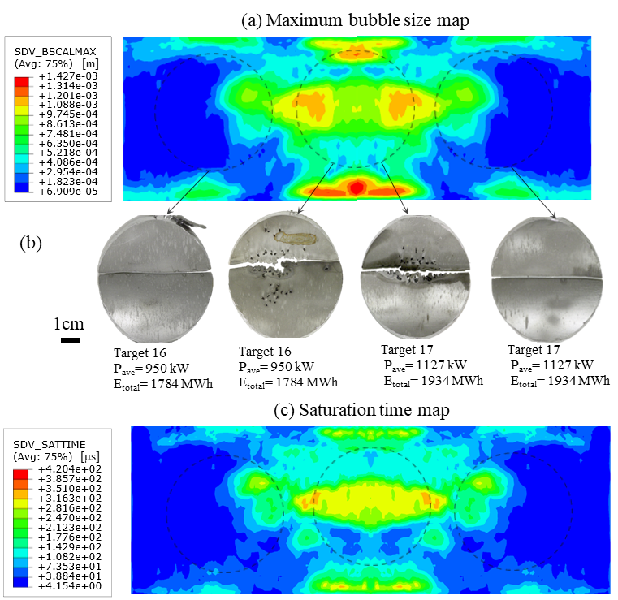
Without gas injection: Maps of target inner wall surfaces facing the mercury window flow
Original target
Jet-flow target

Slide 9
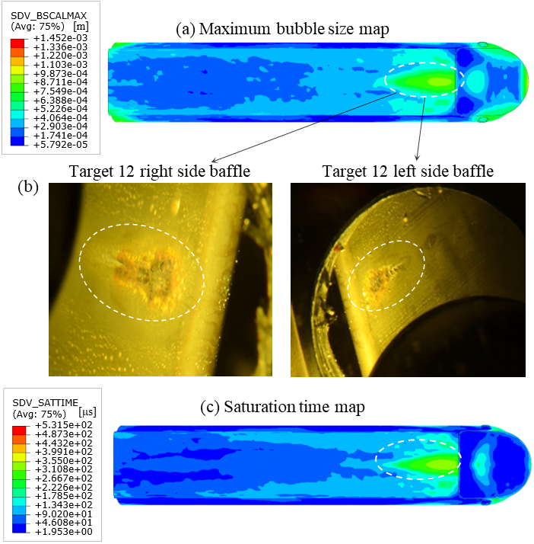
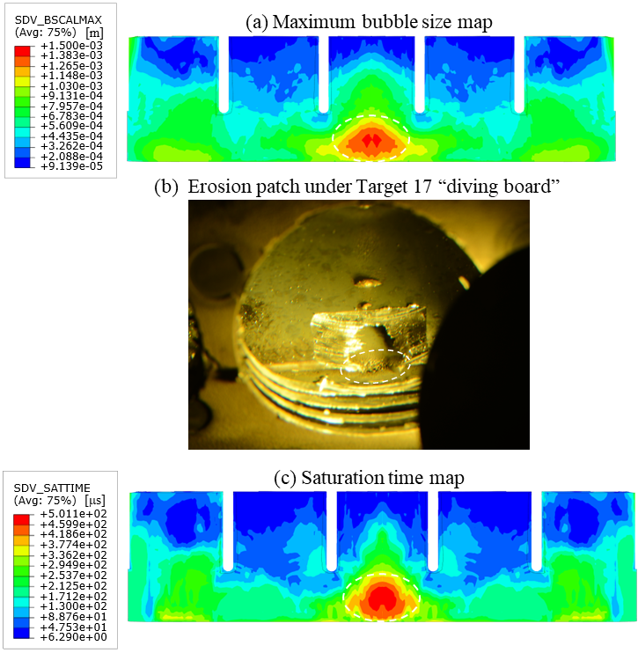
Without gas injection: Maps of target vessel interior surfaces facing the mercury flow
Original target side baffle surfaces facing supply side of mercury bulk flow
Jet-flow target sample under “diving board” facing mercury jet flow

Slide 10
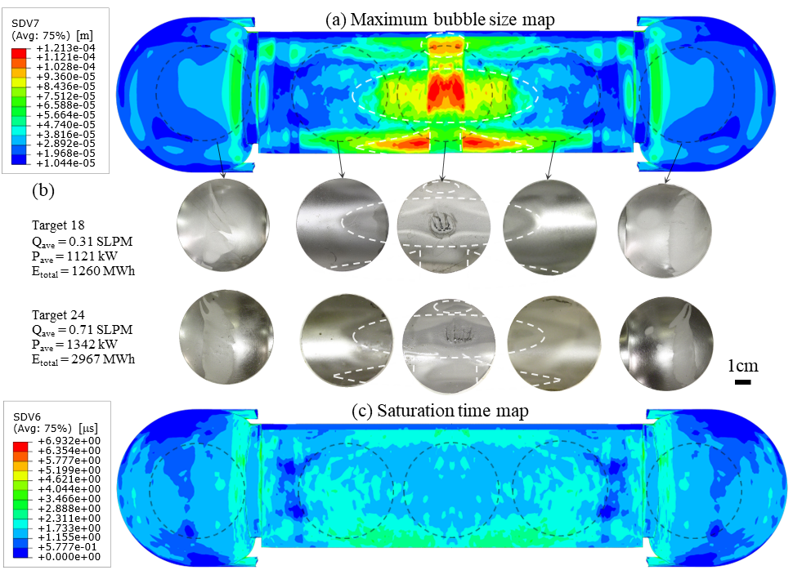
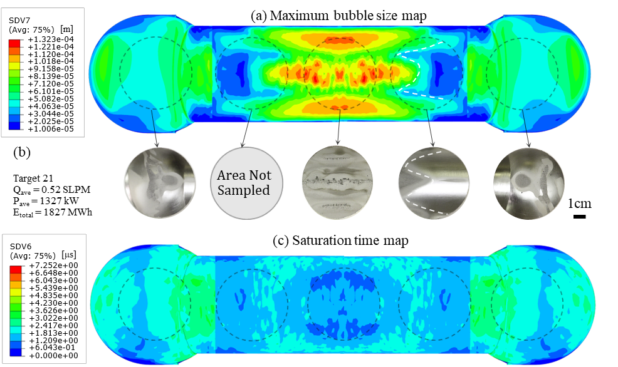
With gas injection: Maps of target inner wall surface facing the mercury bulk flow
Jet-flow target
Original target
Gas injected into bulk flow (blue) through bubblers
Gas injected into bulk flow (blue) through bubblers
No gas in window flow (red)
No gas in window flow (red)
No gas in jet flow (green)
Without gas: max 2.369e-3 m
Without gas: max 2.366e-3 m

Slide 11
Simulation and Calculation Procedure
Structural response simulation using Riemer’s model
Structural response simulation using R-P model
$R\ddot{R}+\frac{3}{2}{(\dot{R})}^{2}=\frac{1}{ρ}\left[P^{b}−P_{∞}^{Hg}−\frac{4µ\dot{R}}{R}−\frac{2}{σR}\right]$
Cavitation potential metrics calculated from simulation without gas injection
Cavitation potential metrics calculated from simulation with gas injection
(old metric)
(old metric)
(new metric)
(new metric)

Slide 12
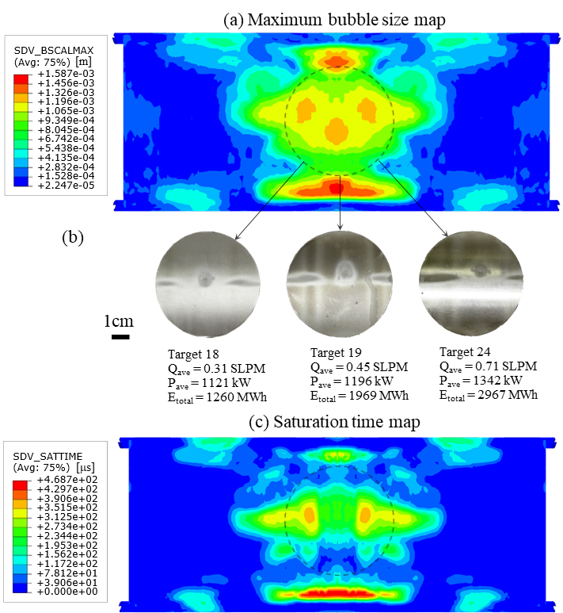
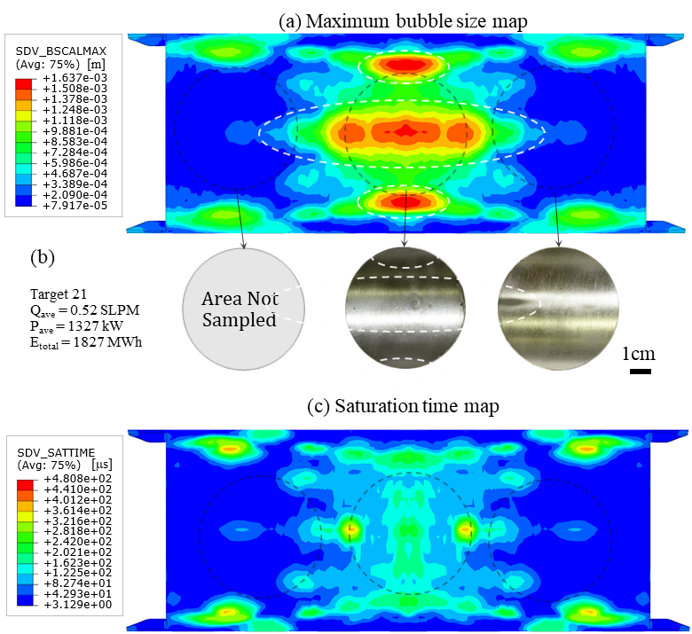
With gas injection: Maps of target outer wall surfaces facing the mercury window flow
Original target
Jet-flow target
Gas injected into bulk flow (blue) through bubblers
Gas injected into bulk flow (blue) through bubblers
No gas in window flow (red)
No gas in window flow (red)
No gas in jet flow (green)

Slide 13
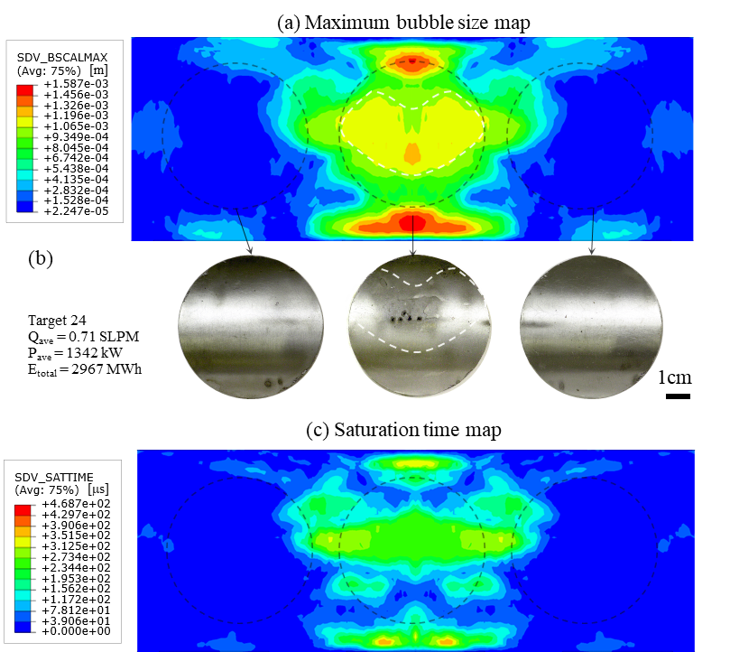
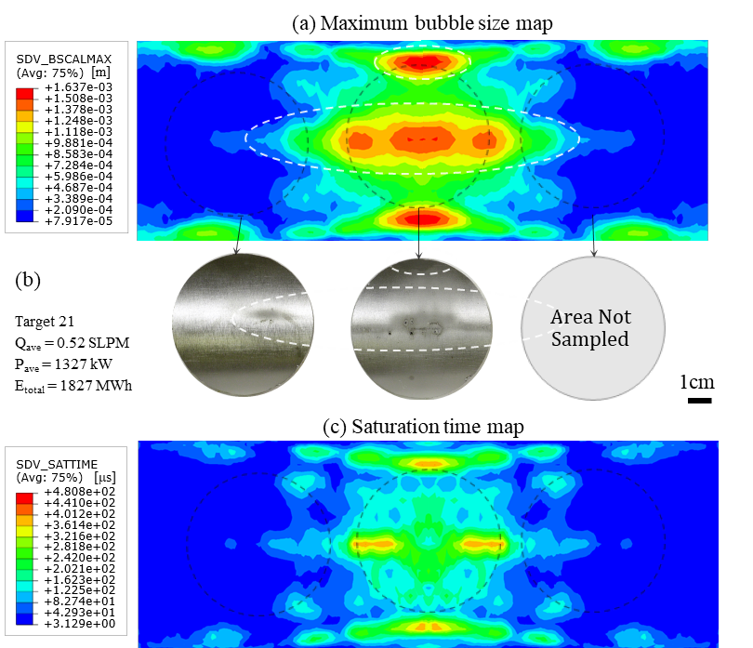
With gas injection: Maps of target inner wall surfaces facing the mercury window flow
Original target
Jet-flow target
Gas injected into bulk flow (blue) through bubblers
Gas injected into bulk flow (blue) through bubblers
No gas in window flow (red)
No gas in window flow (red)
No gas in jet flow (green)

Slide 14
Summary
Using the maximum bubble size as a new metric, the simulated cavitation-induced erosion pattern closely matched damage patterns observed in PIE samples from the operated target vessels.
The maximum bubble size metric works better than the saturation time metric for most cases with and without gas injection.
The simulation technique could be further improved by incorporating other factors, such mercury flow.

Slide 15
References
Bernard W. Riemer, Hao Jiang , and Drew E. Winder, Strain prediction and benchmark with measurement in the Spallation Neutron Source mercury target without gas injection. Phys. Rev. Accel. Beams 25 (2022) 093001.
T. Naoe and M. Futakawa, Optically observation of mercury cavitation bubble collapsing, Experimental Thermal and Fluid Science, 44 (2013) 550-555. doi: 10.1016/j.expthermflusci.2012.08.017.
B.W. Riemer, D.A. McClintock, S. Kaminskas, A.A. Abdou, Correlation between simulations and cavitation-induced erosion damage in Spallation Neutron Source target modules after operation, J. Nucl. Mater. 450 (2014) 183–191.
D. Winder, L. Lin, J. Mach, Incorporating bubble growth volume feedback to improve simulation of the response of a structure containing liquid and gas to sudden energy input, Nucl. Instrum. Methods Phys. Res. A 1005 (2021) 165371.
H. Jiang, D. Winder, C. Barbier, B. W. Riemer, Implementing bubbly mercury material model (R-P model) in the pulse simulation to predict strain on the Spallation Neutron Source target vessel with gas injection, Results Phys. 49 (2023) 106511.
Hao Jiang, David McClintock, Drew Winder, Assessment of simulated and observed cavitation-induced erosion damage in Spallation Neutron Source target vessels , Submitted to Wear, currently in final revision.
Thank you for your attention!

