Slide 1


Investigation of some operational properties of the
new-style ISIS TS-1 target
David Findlay
ISIS, RAL
IWSMT-16
Abingdon
28 October 2024 – 1 November 2024

Slide 2
TS-1 target
ISIS Spallation Neutron and Muon Source
TS-2 target

Slide 3
But when running,
we actually see nothing
use proxies to monitor target thermal performance and structural integrity

Slide 4


4.5 µC, 3.6 kJ per pulse, 40 pps
TS-1 W target
10 plates
$r_{1/e}=$ 2.53 cm
4.0 µC, 3.2 kJ per pulse, 10 pps
TS-2 W target
solid cylinder
$r_{1/e}=$ 0.85 cm
Heat per unit area:
TS-2 / TS-1 =
(4.0 / 4.5) / (0.85² / 2.53²) ≈ 8
Nucl. Instr. Meth.
A 889 (2018) 113–117

Slide 5
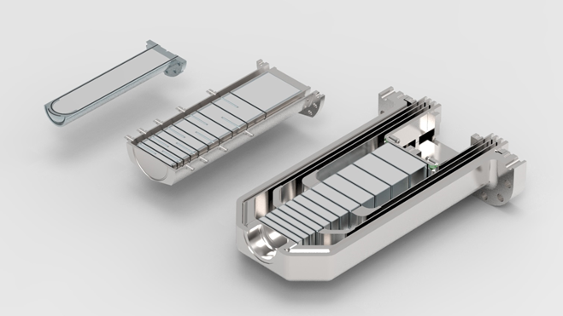
Comparison of ISIS neutron-producing targets – all Ta-clad W
TS-2 target
New-style TS-1 target
Old-style TS-1 target
Single input and single output manifolds — all water cooling channels in parallel
Three input and output manifolds

Slide 6
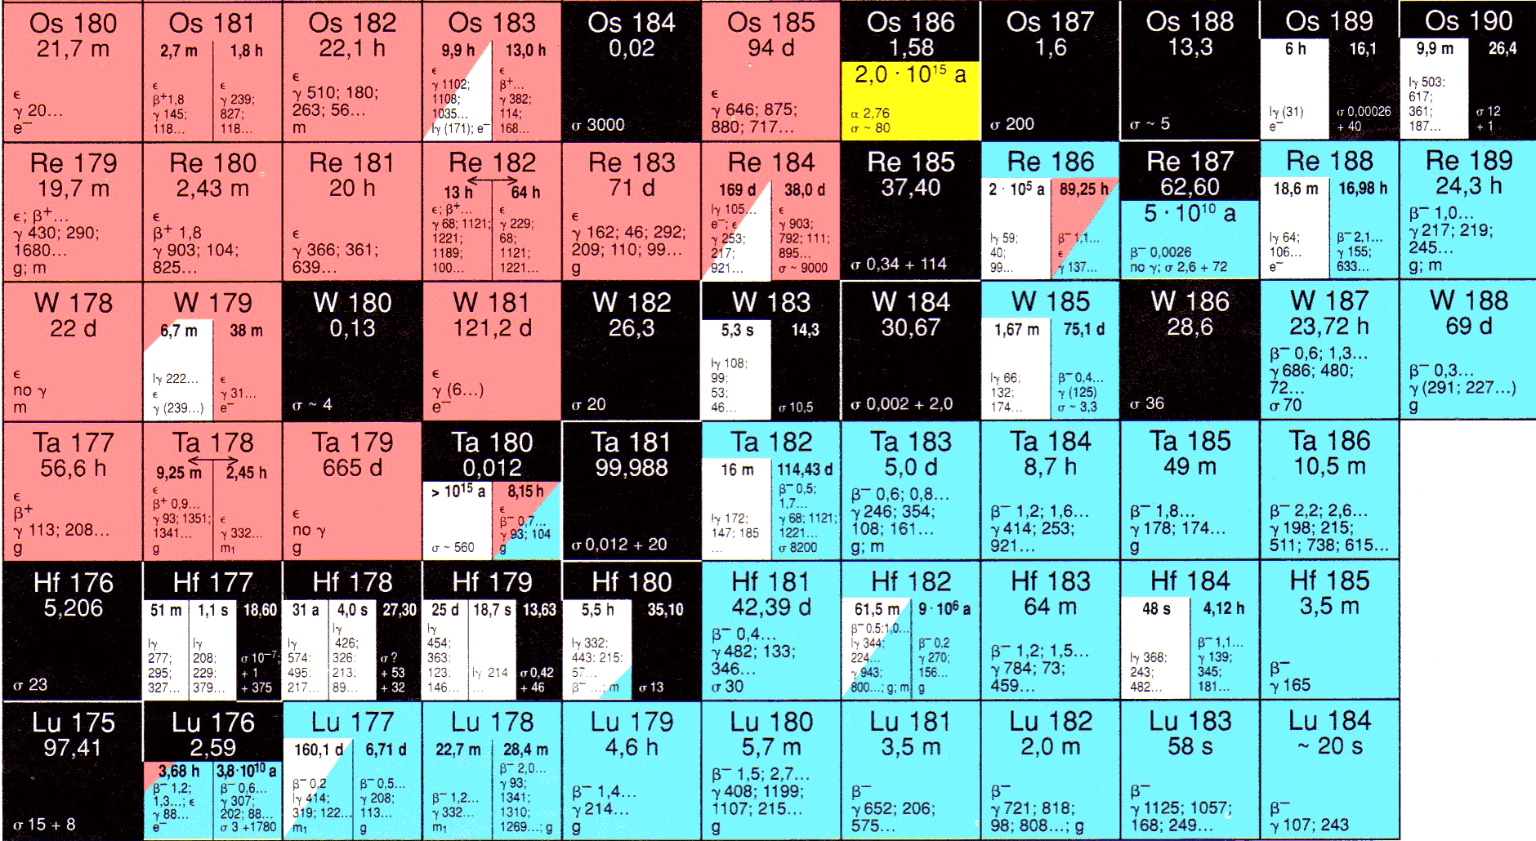
Checking operational performance of ISIS targets
— structural
— thermal
Structural — integrity of Ta cladding?
breach?
Water
Ta
W
N
Z

Slide 7
Target services area
Shielding on trolleys
Cooling water
Target
Gamma-ray detector
Gamma spectrometry measurement after end of each user cycle
TSA1, no W-187 seen, neither in old-style nor new-style target
→ Ta cladding intact
TSA2, W-187 seen
→ breach in Ta cladding
Both TSA1 and TSA2, Ta-182 seen — simply erosion of cladding

Slide 8
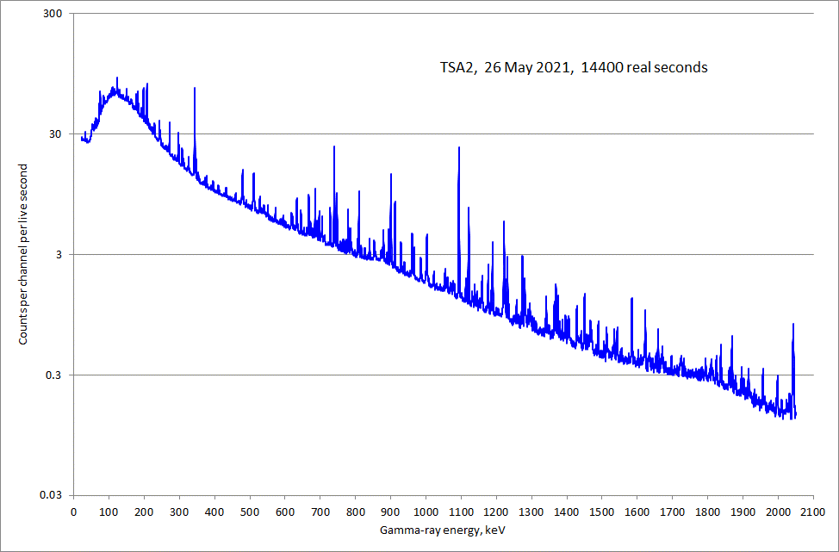

Slide 9
Complicated spectrum, many overlapping lines
analyse smoothed second derivative of spectrum, whereby
background is effectively eliminated, and
structure inconsistent with the expected widths of gamma-ray peaks is removed
Nucl. Instr. Meth. A 1046 (2023) 167708
Start with most likely isotope
Look up ENDF/B decay lines
Calculate smoothed second derivative of entire spectrum assuming
energy-dependent HPGe detector efficiency
energy-dependent attenuation in material between source and detector
energy-dependent FWHM of peaks
Fit to smoothed second derivative of measured spectrum
From energies of missed peaks, add other isotope(s)
Iterate

Slide 10
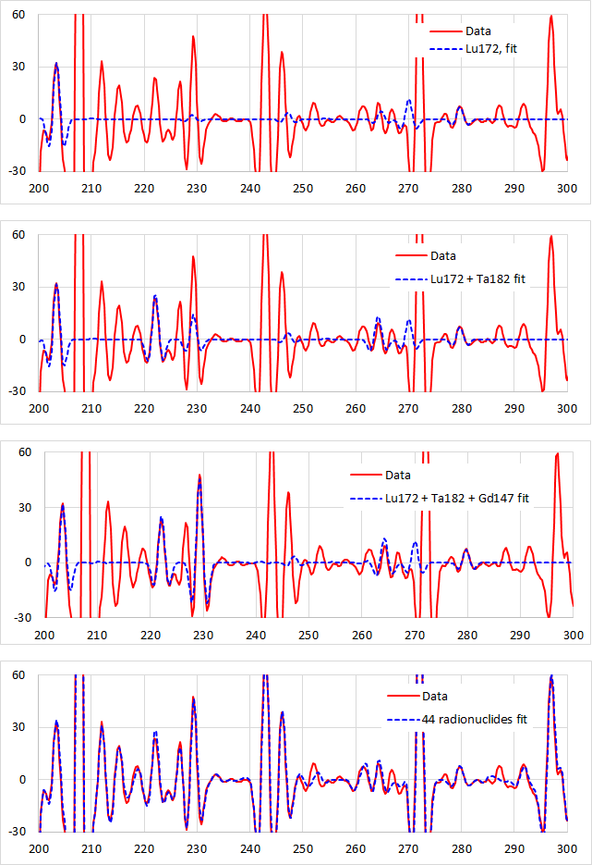
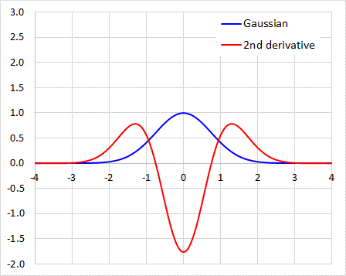
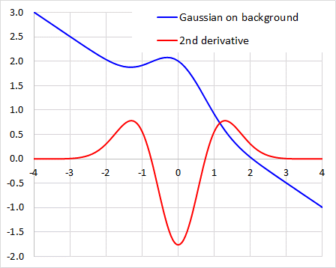

Slide 11
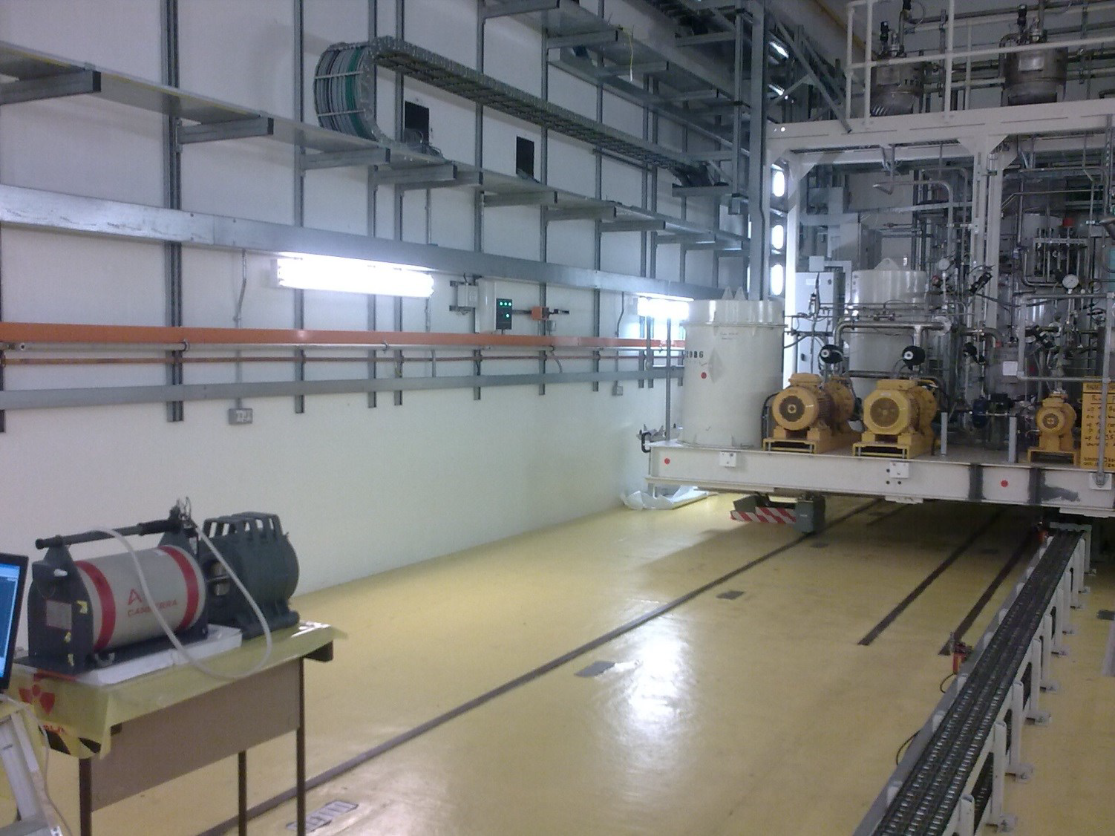
Can’t measure gamma-ray spectrum from every component in target services area
Instead, rely on an effective thickness of material between effective source position and HPGe detector — determined by data
themselves
Get absolute activities of radionuclides
Involves approximations, obviously, but
faute de mieux
TSA2, TS-2 target services area

Slide 12
From activities eroded from target,
and from calculated activities in target (MCNPX, etc.),
get masses of material eroded
TS-1 target, old-style: erosion consistent with zero from measurement statistics
TS-1 target, new-style: ~25 mg/year from cladding only
TS-2 target: ~1 g eroded during target lifetime, from and through cladding
Nucl. Instr. Meth. B 521 (2022) 7–16

Slide 13
Checking operational performance of ISIS targets
— structural
— thermal
Decay heat measured in old-style TS-1 target
Nucl. Instr. Meth. A 933 (2019) 8–11
— consistent with MCNPX calculations
(basically switch off coolant flow and measure increasing plate temperatures)
Decay heat in new-style TS-1 target
Provisionally scheduled for Christmas 2024 / New Year
— need ~2 weeks uninterrupted

Slide 14
Prompt heat deduced from thermocouple temperatures
New-style TS-1 target
Single input and single output manifolds — all water cooling channels in parallel
→ important to know water is going through all cooling channels
ANSYS + similar
Put in power dissipations,
thermal conductances, etc.
Get out temperatures
We have tried to
put in observed temperatures
get out power dissipations and
thermal conductances
Not easy to ‘reverse’ ANSYS

Slide 15
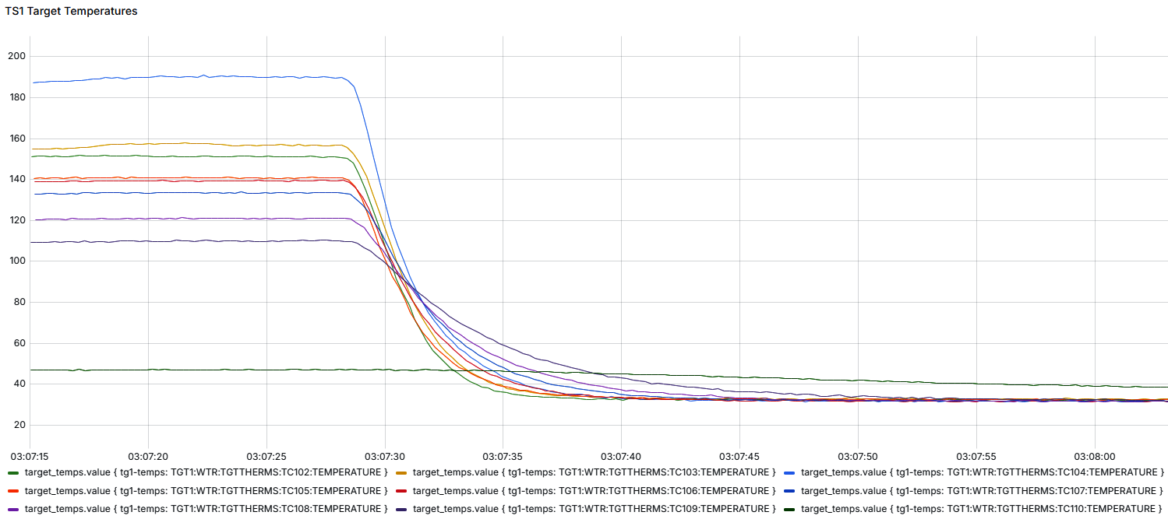
Beam off
To get power dissipation and heat transfer coefficient to coolant independently for each plate, need to analyse temperature transients

Slide 16
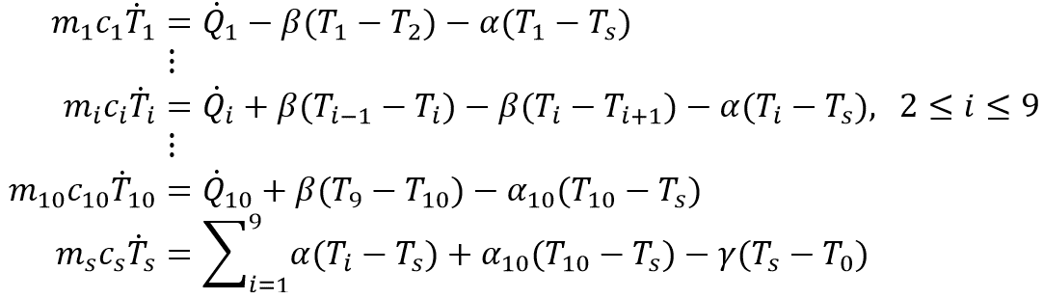






















Plate 1
Plate 2
Plate $i−1$
Plate $i$
Plate $i+1$
Plate 9
Plate 10
$m_{1}$ $c_{1}$ ${\dot{Q}}_{1}$ $T_{1}$
$m_{2}$ $c_{2}$ ${\dot{Q}}_{2}$ $T_{2}$
$m_{i−1}$ $c_{i−1}$ ${\dot{Q}}_{i−1}$ $T_{i−1}$
$m_{i}$ $c_{i}$ ${\dot{Q}}_{i}$ $T_{i}$
$m_{i+1}$ $c_{i+1}$ ${\dot{Q}}_{i+1}$ $T_{i+1}$
$m_{9}$ $c_{9}$ ${\dot{Q}}_{9}$ $T_{9}$
$m_{10}$ $c_{10}$ ${\dot{Q}}_{10}$ $T_{10}$
$$β$$
$$β$$
$$β$$
$$β$$
$$α$$
$$α$$
$$α$$
$α$
$$α$$
$$α$$
$$α_{10}$$
Coolant
$m_{s},$ $c_{s}$, ${\dot{Q}}_{s}$, $T_{s}$
$α$, $β$, $γ$: thermal conductances
$$γ$$
$$T_{0}$$
Thermal sink
Solve coupled differential equations and fit to data
But for fast decays, plates really aren’t ‘point’ masses

Slide 17
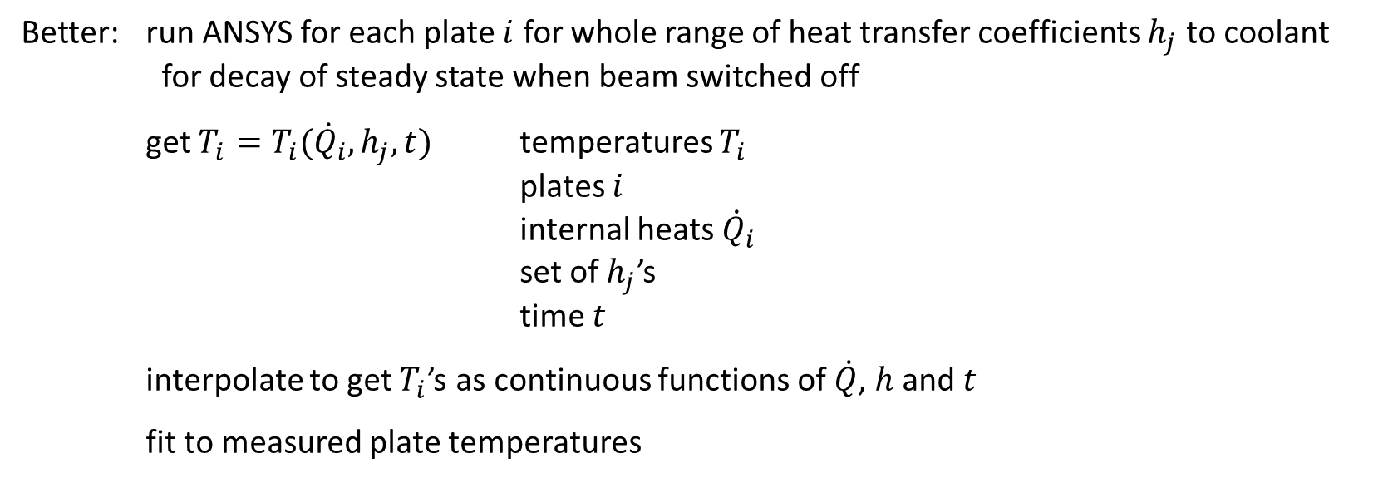
Better: run ANSYS for each plate $i$ for whole range of heat transfer coefficients $h_{j}$ to coolant
for decay of steady state when beam switched off
get $T_{i}=T_{i}({\dot{Q}}_{i}, h_{j}, t)$ temperatures $T_{i}$
plates $i$
internal heats ${\dot{Q}}_{i}$
set of $h_{j}$’s
time $t$
interpolate to get $T_{i}$’s as continuous functions of $\dot{Q}$, $h$ and $t$
fit to measured plate temperatures

Slide 18
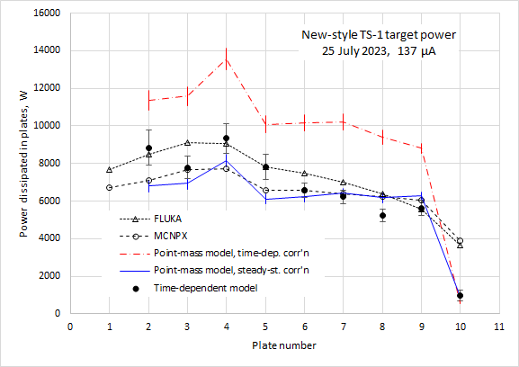
Plate 1 power omitted
— thermocouple anomaly
— not fully understood
— but not serious problem
operationally
Plate 10 power discrepancy
— operationally insignificant
But plates 2–9 agree well with FLUKA and MCNPX
Nucl. Instr. Meth.
A 1059 (2024) 168986
A 1067 (2024) 169701

Slide 19
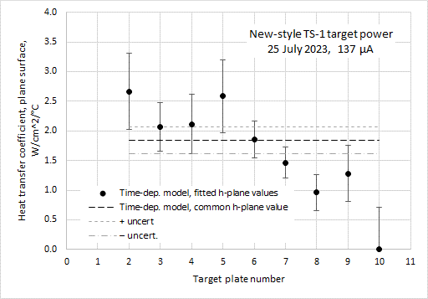
Heat transfer coefficients essentially consistent with design ‘good water cooling’ value of 2 W/cm²/°C
Nucl. Instr. Meth.
A 1059 (2024) 168986
Overall, apart from a couple of small anomalies, new-style TS-1 target is working well
[End]

Slide 20
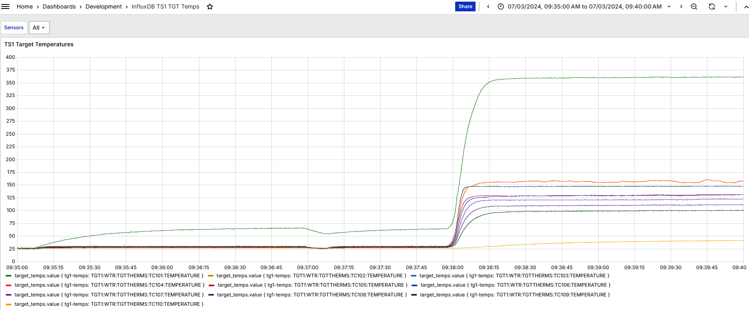
Thermocouple 1 anomaly
Beam to 40 pps
Beam on, 40/32 pps
Thermocouples 2–9

Slide 21
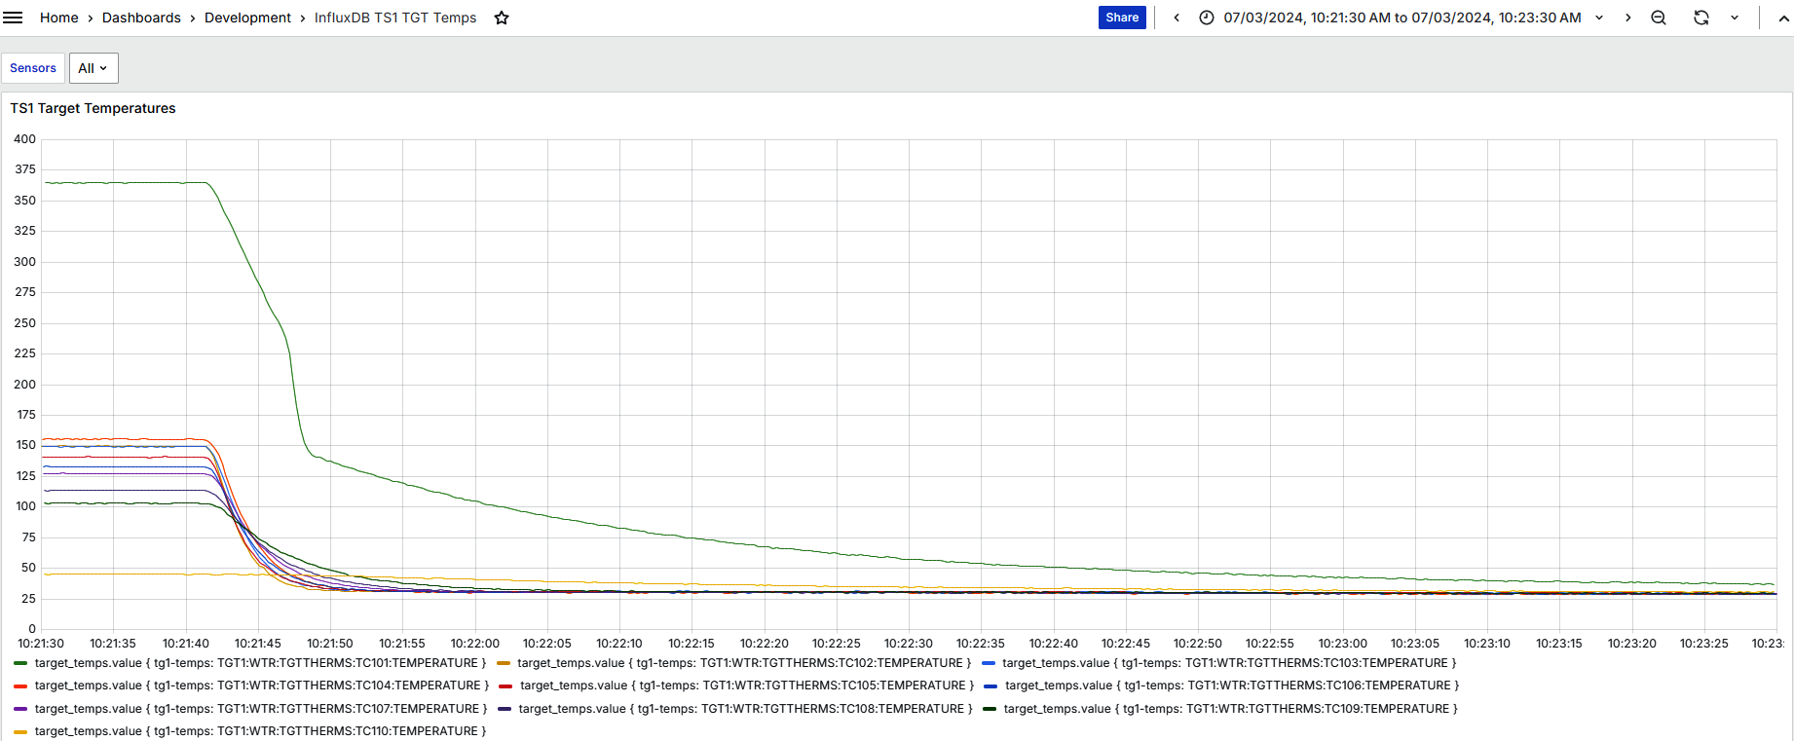
Thermocouple 1
— three different decay
time constants

Slide 22
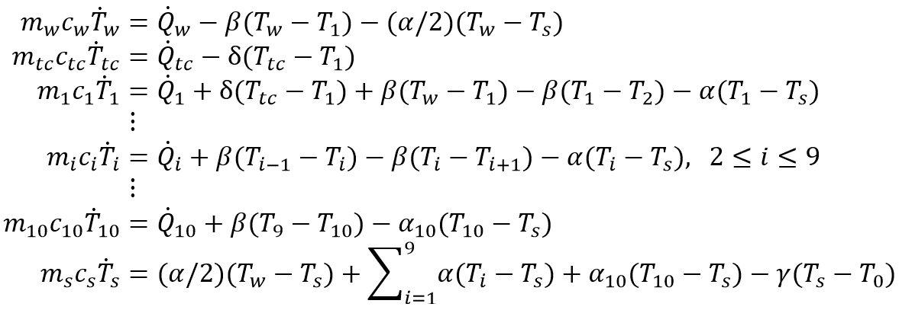




















$m_{tc}$ $c_{tc}$ ${\dot{Q}}_{tc}$ $T_{tc}$
Plate 1 thermocouple
$$δ$$
Plate 9
Plate 10
Window
Plate $i−1$
Plate $i$
Plate $i+1$
Plate 1
$m_{w}$ $c_{w}$ ${\dot{Q}}_{w}$ $T_{w}$
$m_{1}$ $c_{1}$ ${\dot{Q}}_{1}$ $T_{1}$
$m_{i−1}$ $c_{i−1}$ ${\dot{Q}}_{i−1}$ $T_{i−1}$
$m_{i}$ $c_{i}$ ${\dot{Q}}_{i}$ $T_{i}$
$m_{i+1}$ $c_{i+1}$ ${\dot{Q}}_{i+1}$ $T_{i+1}$
$m_{9}$ $c_{9}$ ${\dot{Q}}_{9}$ $T_{9}$
$m_{10}$ $c_{10}$ ${\dot{Q}}_{10}$ $T_{10}$
$$β$$
$$β$$
$$β$$
$$β$$
$α$/2
$$α$$
$$α$$
$α$
$$α$$
$$α$$
$$α_{10}$$
Coolant
$m_{s},$ $c_{s}$, ${\dot{Q}}_{s}$, $T_{s}$
$α$, $β$, $γ$ and $δ$: thermal conductances
$$γ$$
$$T_{0}$$
Thermal sink

Slide 23
Pressure
vessel
Water
Thermocouple
Thimble
Ta
Ta
Not to scale!
W

Slide 24
Plate 1 anomaly in TS-1 target not serious operationally because
  ~700 milliamp-hours clocked up, and no problem
  from plate 2 temperature,
  downstream side of plate 1 must be being cooled
  endoscopic examination revealed no blockages

