Slide 1
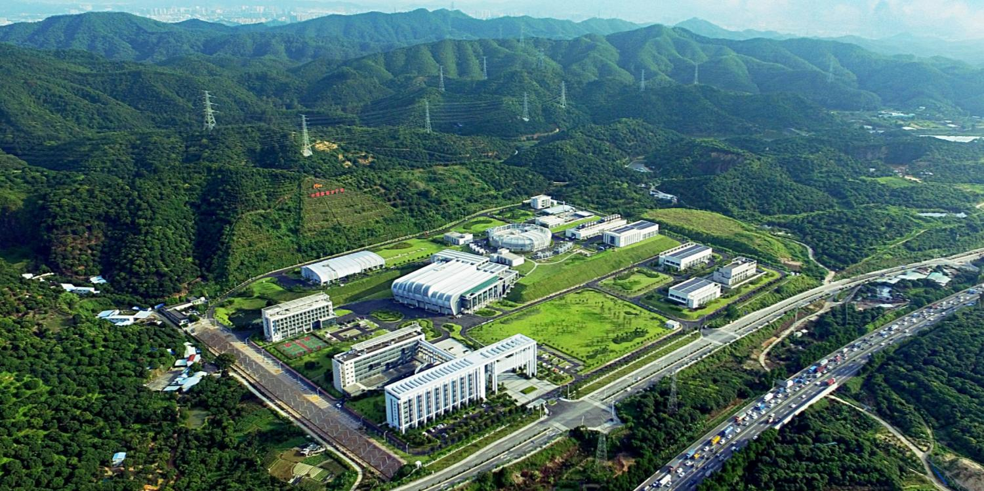
Capacity building and PIE research on CSNS remote handling sample preparation and mechanical property testing
Remote handling & shielding team, Neutron Science Department, CSNS, IHEP, CAS
Dongguan Key Laboratory of Advanced Nuclear Equipment
Chongguang Zhao
Wen Yin, Changfeng Li, Shaohong Wei, Zhiduo Li, Ruiqiang Zhang, Zhouteng Wu, Xi Chen
The 16th International Workshop on Spallation Materials Technology, IWSMT-16

Slide 2
Outline
Introduction of CSNS hot cell & solid target
Progress of CSNS target PIE
Sampling and small sample preparation
Examination environment
Remote handling test
PIE plan
2

Slide 3
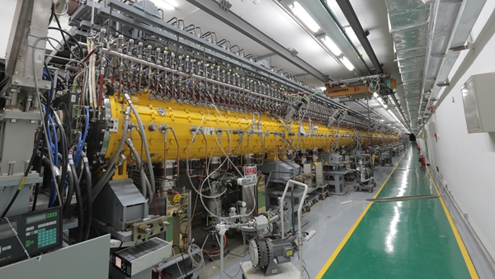
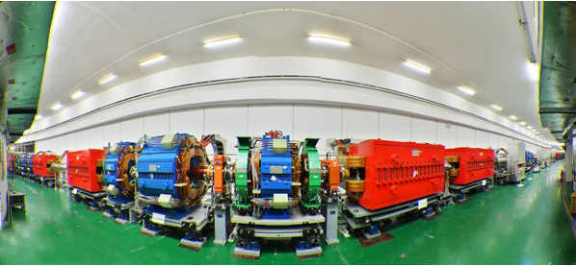
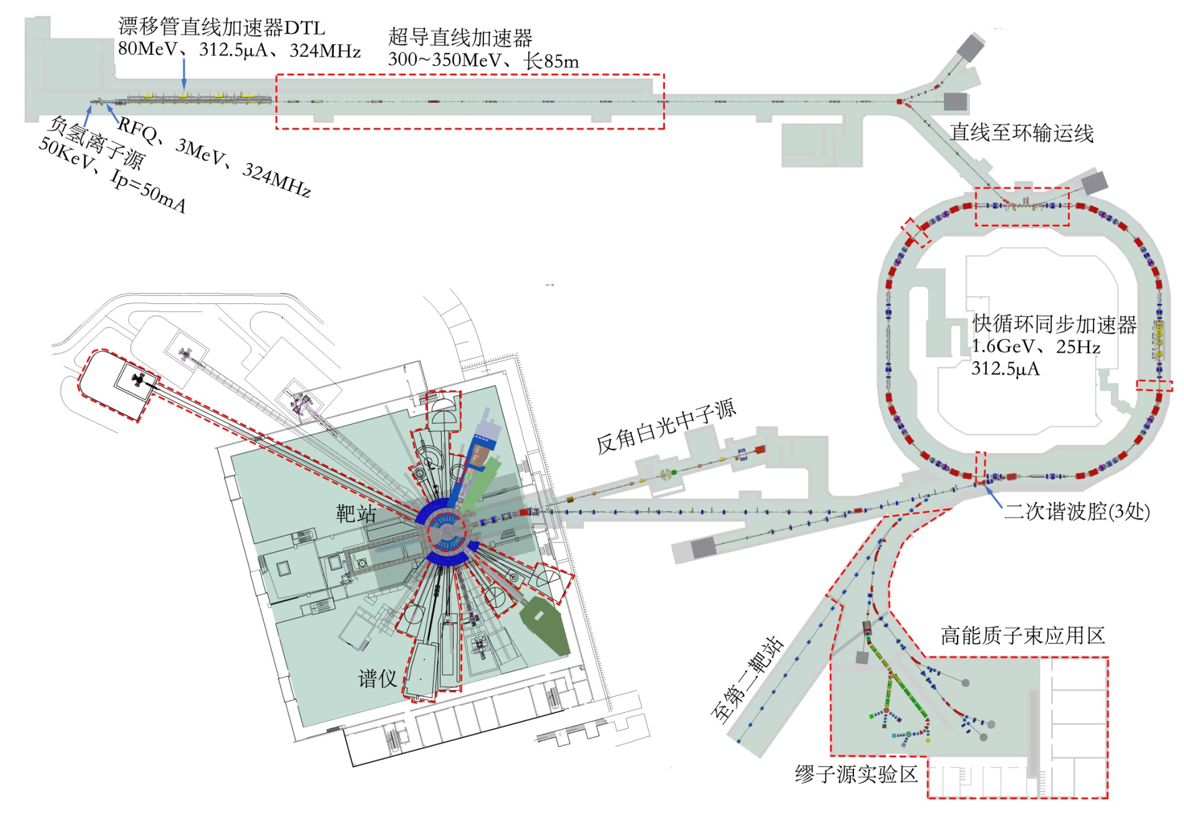
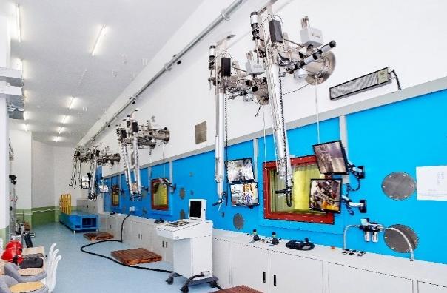
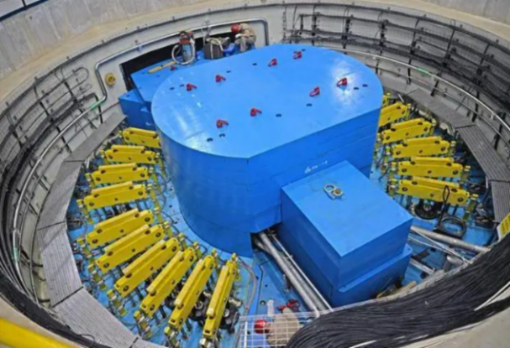
1.Introduction of CSNS hot cell & solid target
1.1 CSNS introduction
Linear accelerator
Fast cycle synchrotron
MR
SANS
Hot cell
GPPD
ANIS
MPI
Schematic diagram of CSNS
Target station
3

Slide 4
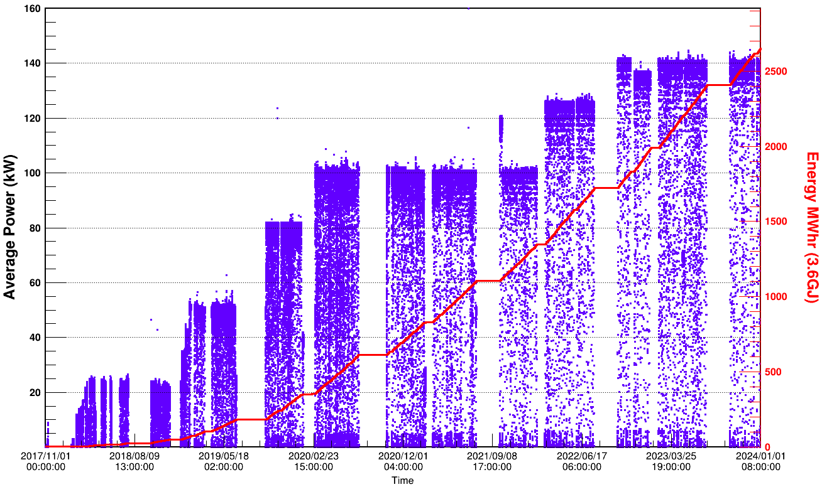
1.Introduction of CSNS hot cell & solid target
1.1 CSNS introduction
Oct 2017
Aug 2020
May 2022
Dec 2023
Target-1
Target-2
Target-3
Overview of CSNS Operation

Slide 5
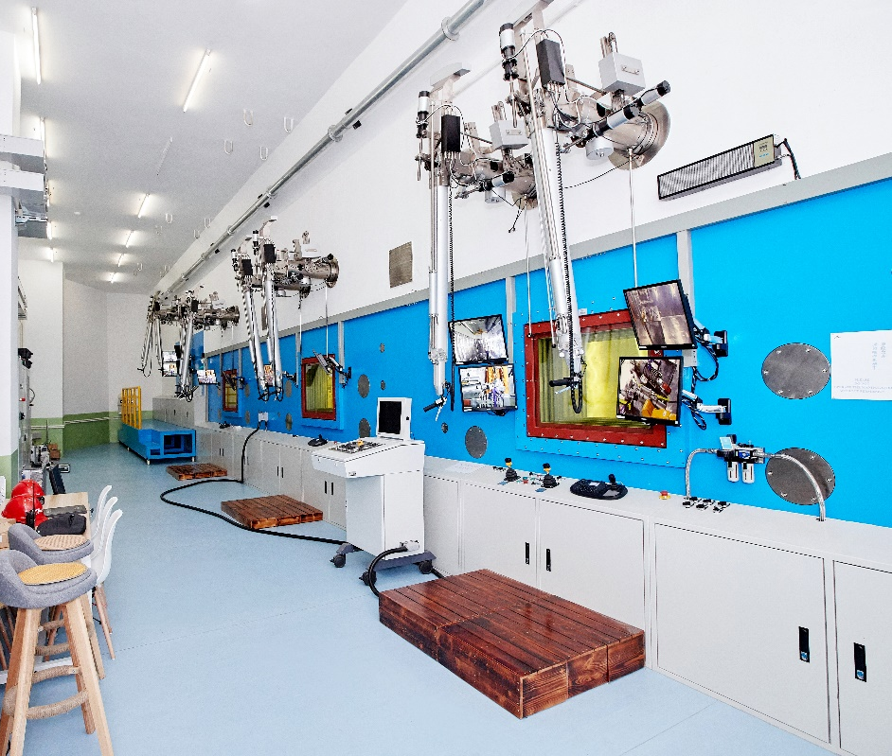
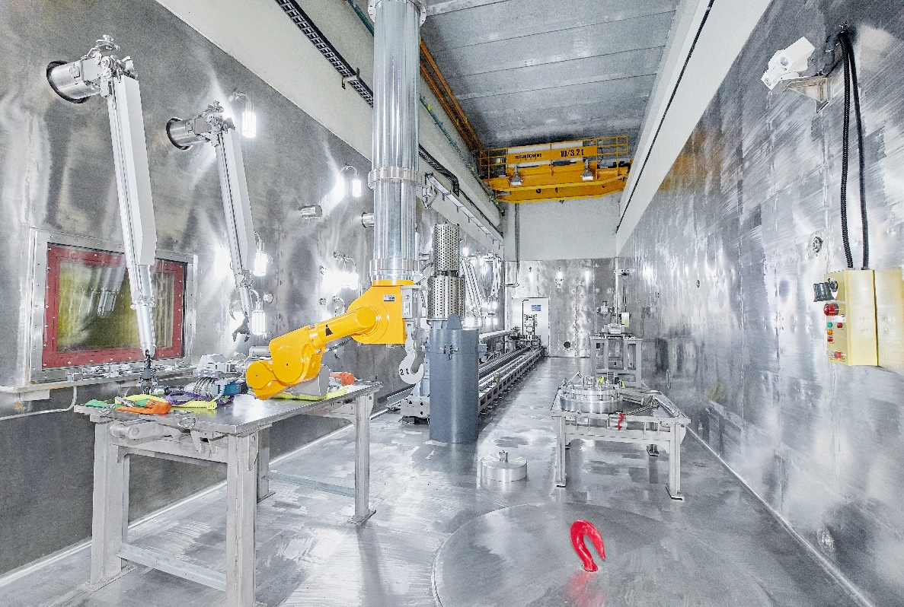
1.Introduction of CSNS hot cell & solid target
1.2 CSNS hot cell introduction
1) adequate shielding capability for radioactive operations, ＞100kCi 2) necessary operating and monitoring conditions 3) conditions for retaining annual entry
Operation room
Inside the hot cell
5

Slide 6
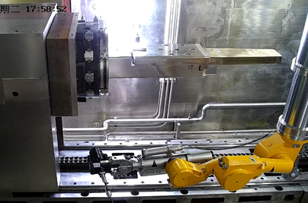
1.Introduction of CSNS hot cell & solid target
1.2 CSNS hot cell introduction
Operating stably for more than 6 years and is inspected every summer
Three spent targets have been replaced remotely
Visual observation of the target and helium vessel sealing surface and seal inspection of spent target
6

Slide 7
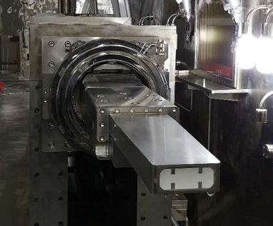
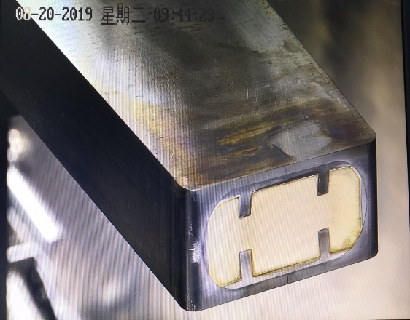
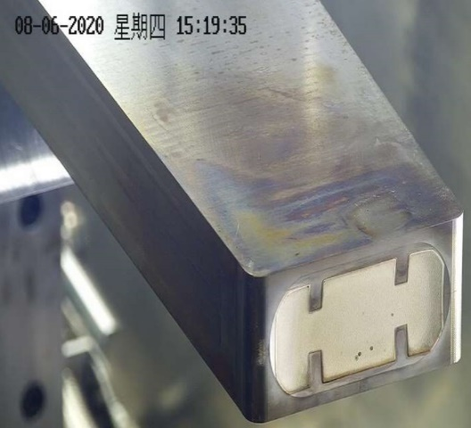
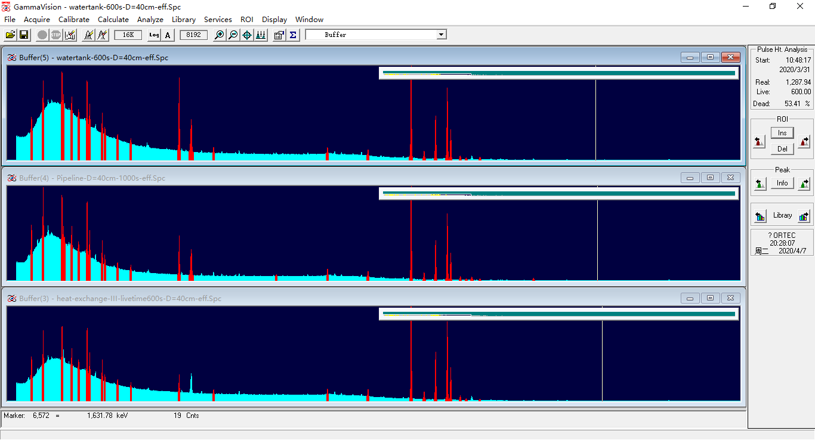
1.Introduction of CSNS hot cell & solid target
1.3 CSNS target introduction
Target-1 operation
2019.8
2020.8
2017.8
2019.8
2020.8
target-1 was replaced in advance in 2020, because target-2 adds thermocouples inside
Operation time：2017.8.26----2020.8.13；
Proton beam：$8.65×{10}^{21}$
Total Current: 381.9mAH
The performance of target is directly related to the operational safety of the target station!

Slide 8
Outline
Introduction of CSNS hot cell & solid target
Progress of CSNS target PIE
Sampling and preparation
Examination environment
Remote handling test
PIE plan
8

Slide 9
2. Progress of CSNS target PIE
Main purposes:
Build the capacity of sample preparation in hot cell
Carry out post irradiation experiments on target materials & structure materials. Obtain post irradiation performance data

Slide 10
2. Progress of CSNS target PIE
In order to meet the requirements of PIE, relevant equipments needs to be developed.
Development equipment list
Equipment | Composition | Function | Position
Test room | Manipulator, shield, lighting, video, | Sample mechanics test space | Beside the hot cell
Milling machine |  | Milling and sampling of target container | Hot cell
Wire Electrical Discharge Machine | Wire cutting, Water purification | Preparation of mechanical property samples | Hot cell
Test equipment | Optical microscope | Tantalum layer surface detection, | Hot cell
 | Eddy current thickness gauge | Tantalum layer thickness measurement | Hot cell
 | Mechanical test platform | Mechanical property test | Test room

Slide 11
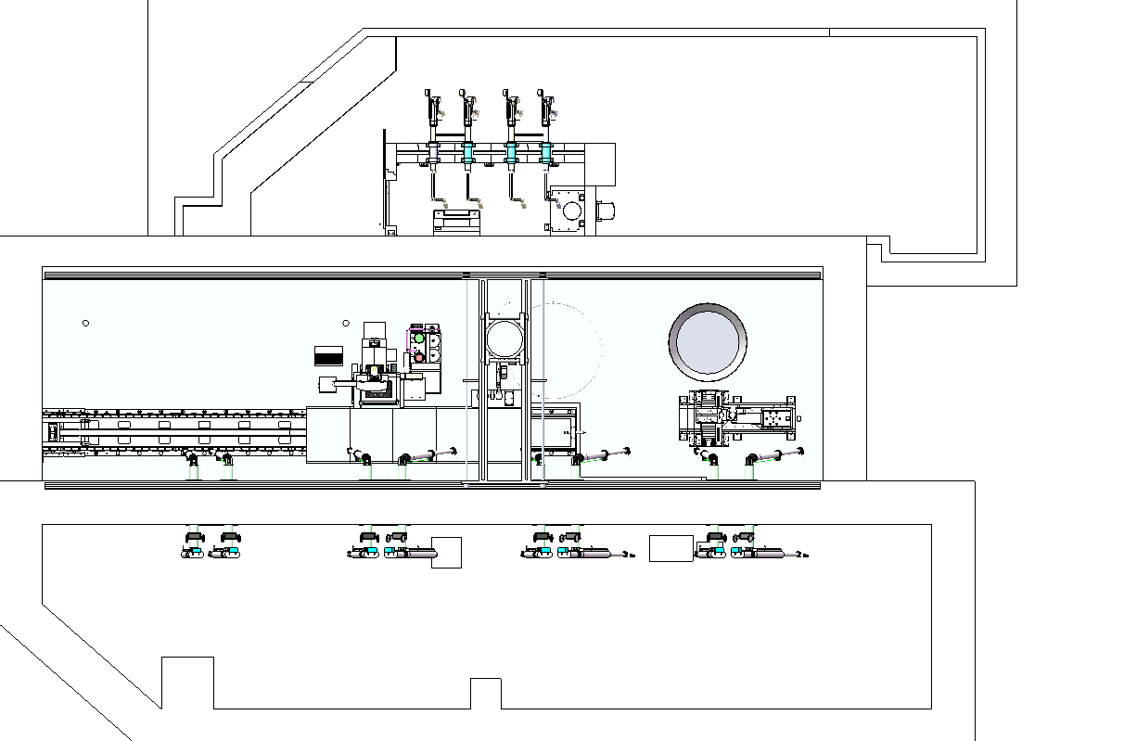
2. Progress of CSNS target PIE
The layout
Test room
mechanical testing
Hot Cell
W-EDM
Milling
Sample
transport route
Handling
Room
Wire-EDM
control cabinet
Milling
control cabinet

Slide 12
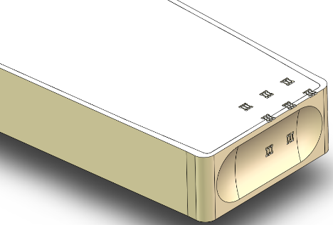
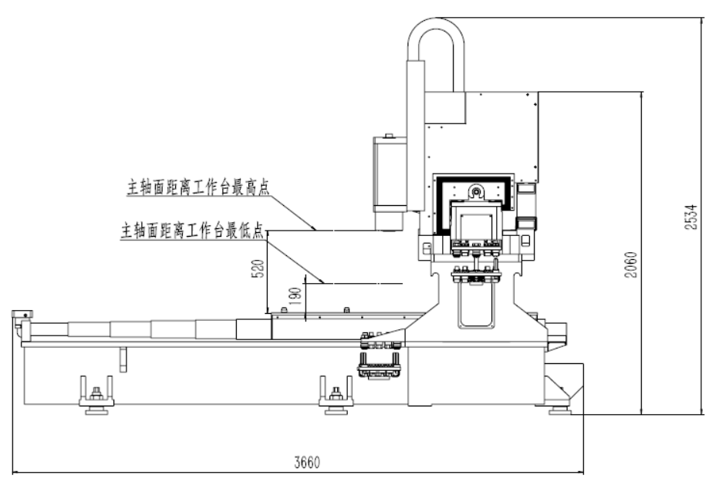
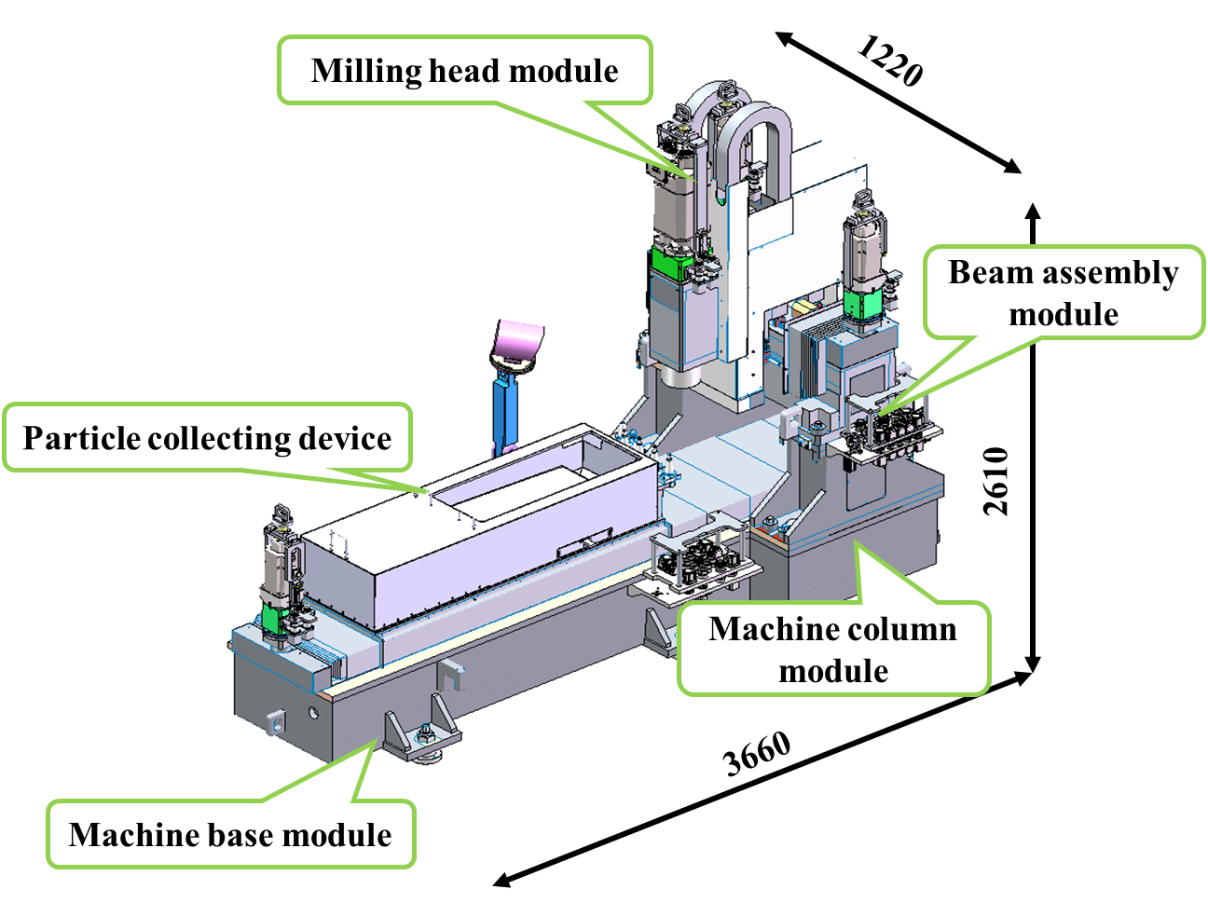
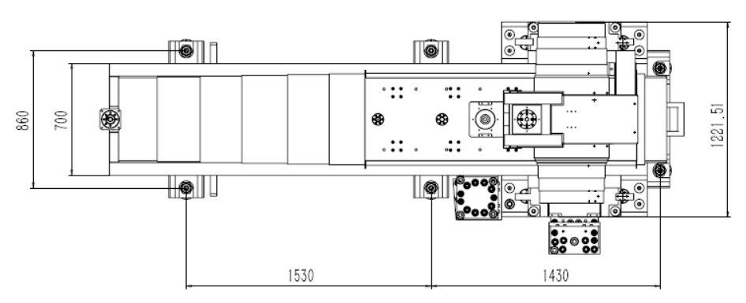
2. Progress of CSNS target PIE
2.1 Sampling and preparation
Key technologies and characteristics
Modular and quick disassembly design
Rotary servo motor and quick disassembly
Stainless steel machine components
Design of automatic milling cutter changing and debris collecting
General drawing of special planomiller
12

Slide 13
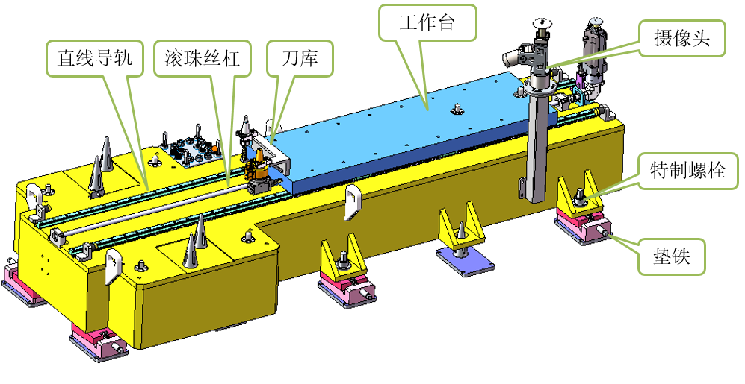
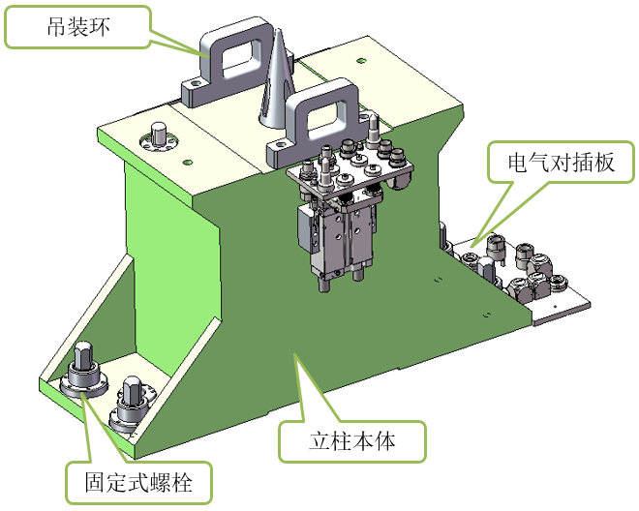
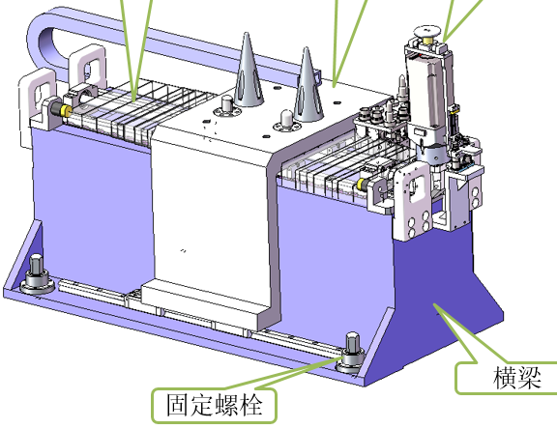
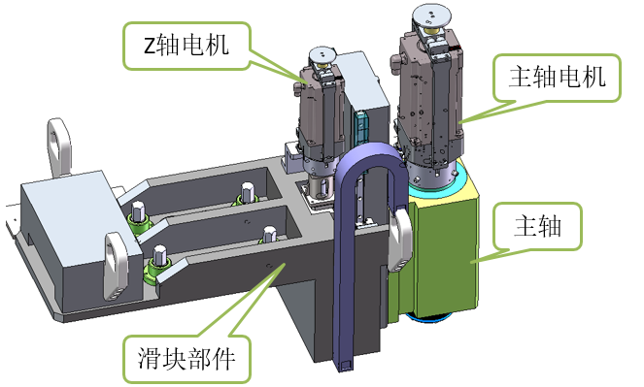
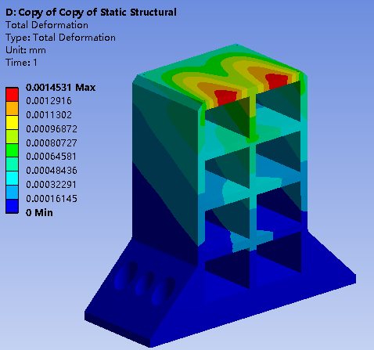
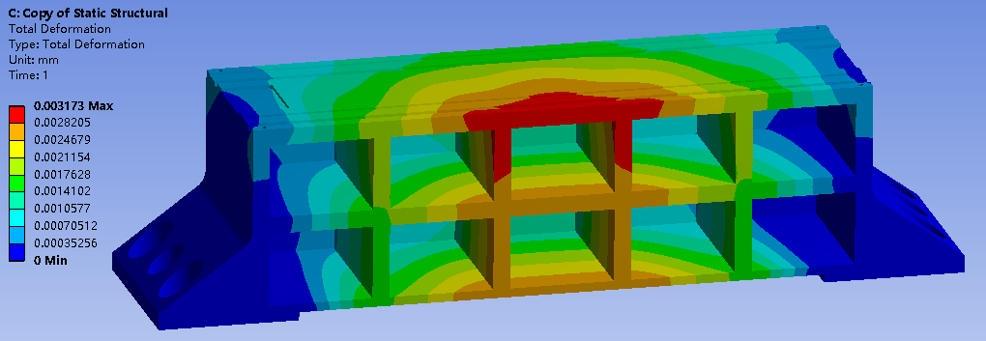
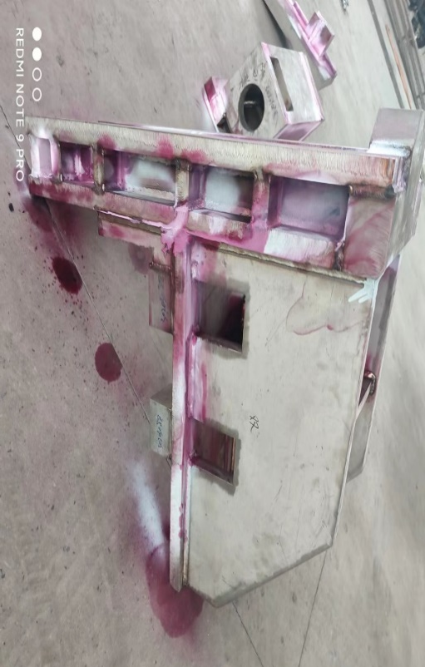
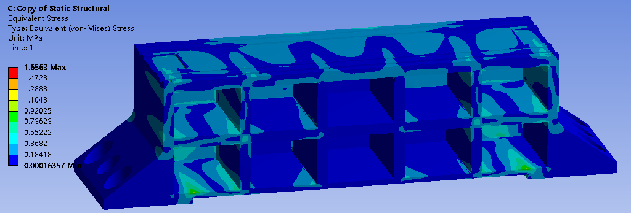
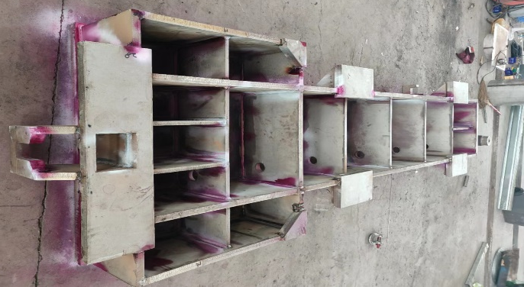
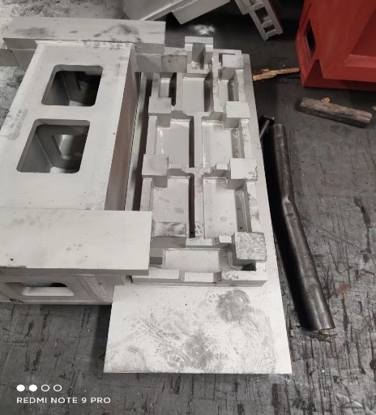
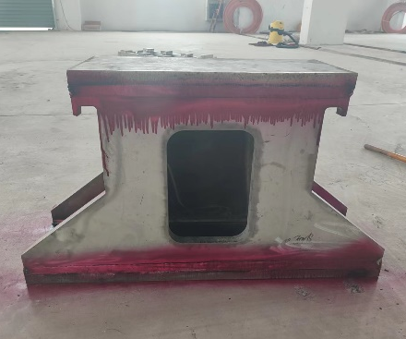
2. Progress of CSNS target PIE
2.1 Sampling and preparation
machine base module
column module
beam assembly
milling spindle
13

Slide 14
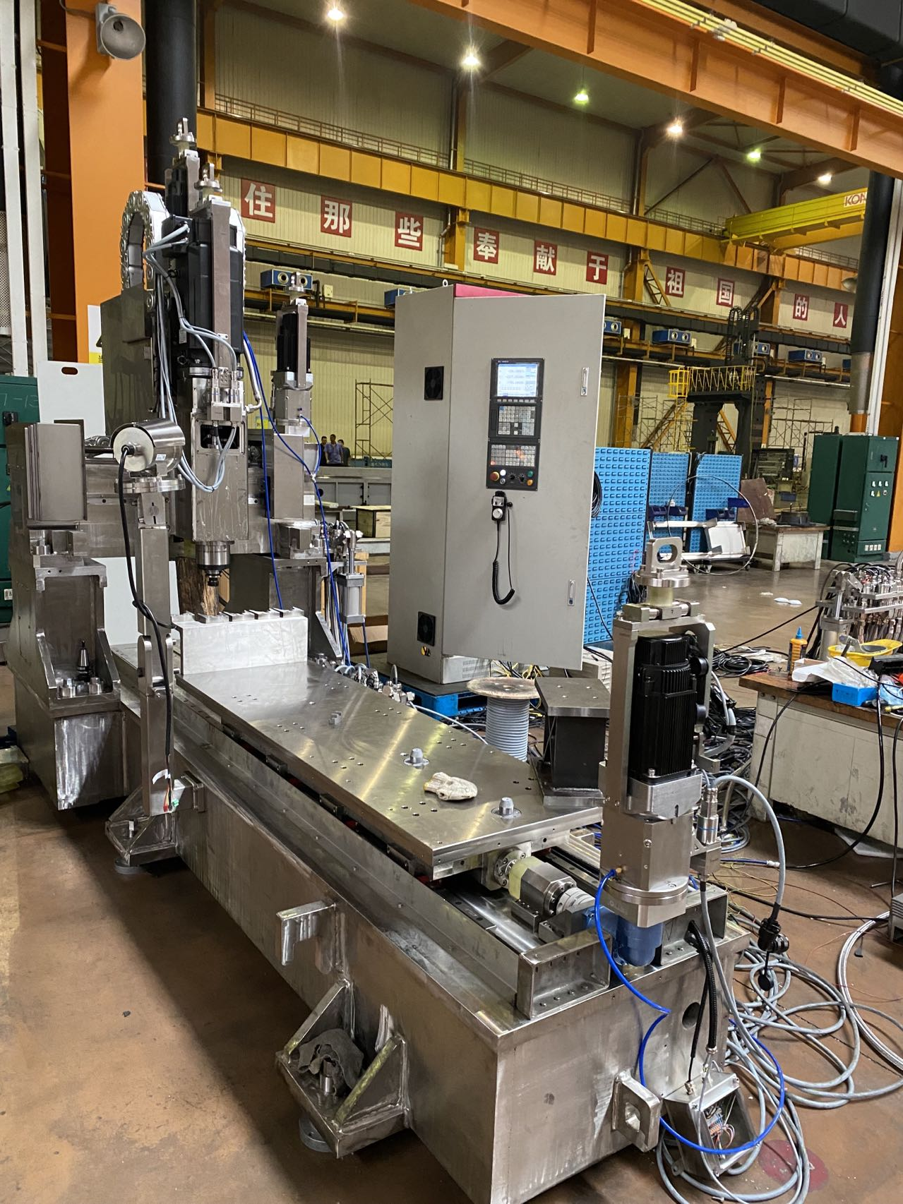
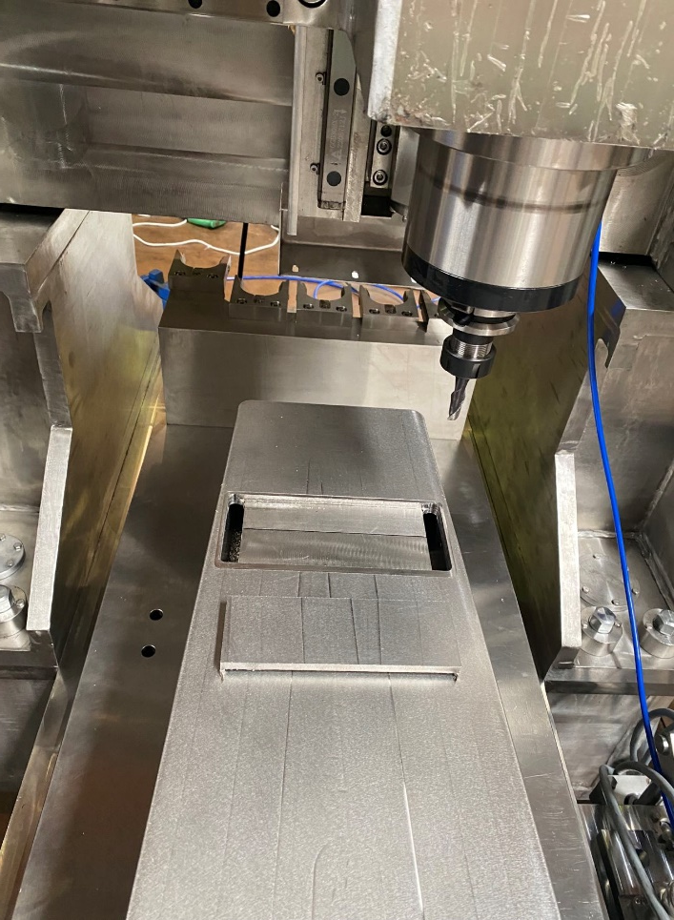
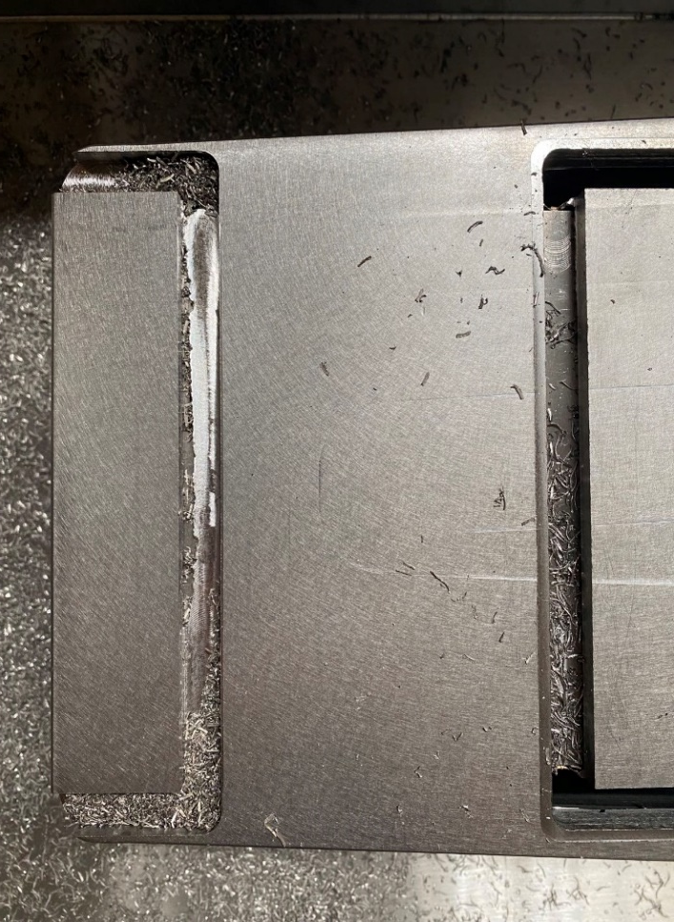
2. Progress of CSNS target PIE
2.1 Sampling and preparation
The blank of the vessel cover and front window of the target can be sampled effectively.
14

Slide 15
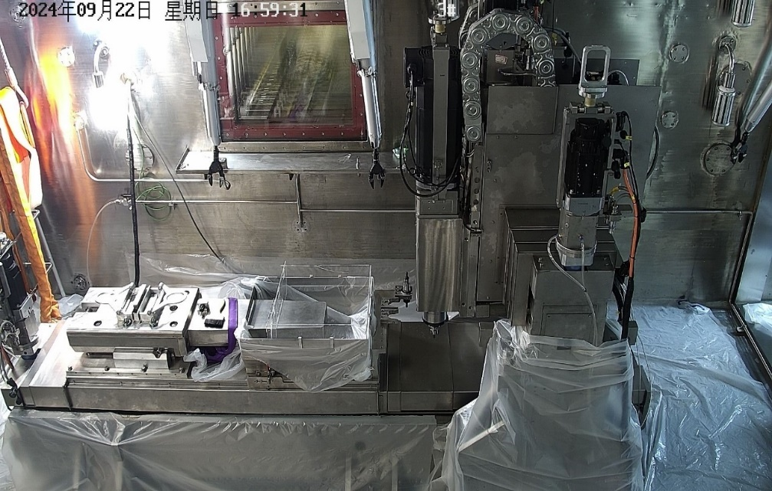
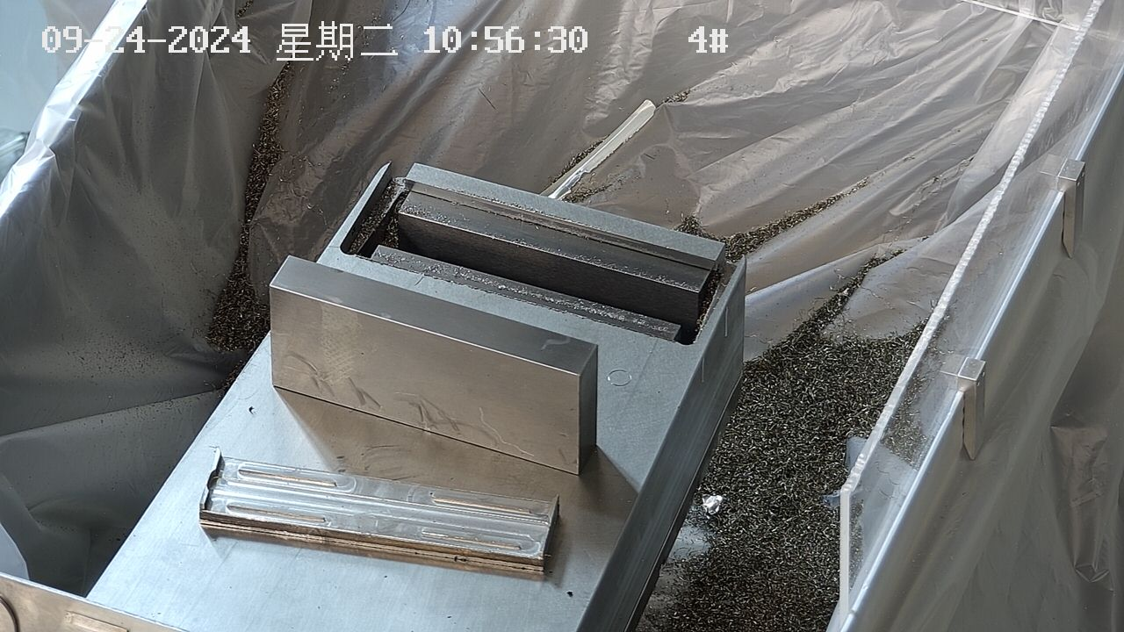
2. Progress of CSNS target PIE
2.1 Sampling and preparation
Item |  | technical specification | unit
Workbench | size | ≤1500×500 | mm
 | Load-bearing | ≤1 | T
Processing range | X-axis | ≤900 | mm
 | Y-axis | ≤600 | mm
 | Z-axis | ≤300 | mm
Cutting accuracy | accuracy | 0.08/full range | mm
three-axis milling machine

Slide 16
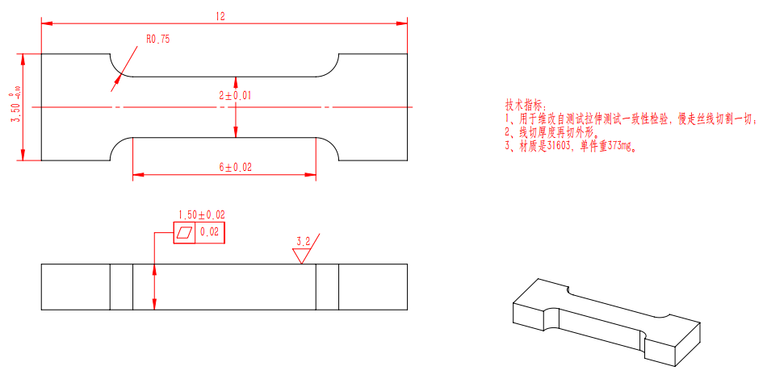
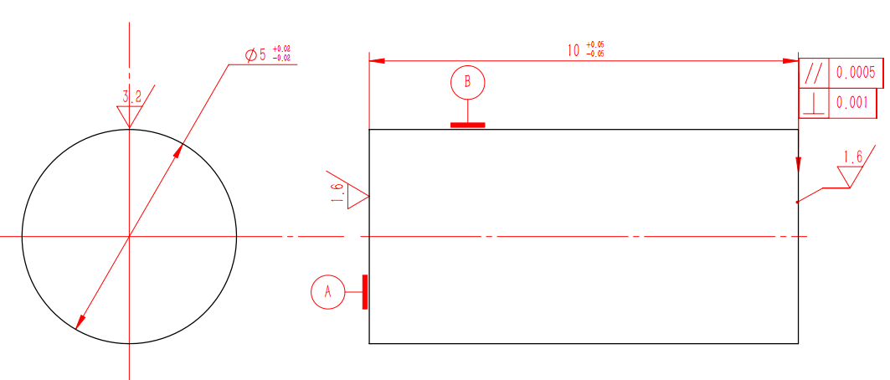
2. Progress of CSNS target PIE
2.1 Sampling and preparation
Tensile S31603-12*1.5mm
Compression W- φ5*10mm
References
Dai, Y., et al. “Tensile properties of EC316LN irradiated in SINQ to 20 dpa.”
Maloy, S. A., et al. “The mechanical properties of 316L/304L stainless steels, Alloy 718 and Mod 9Cr–1Mo after irradiation in a spallation environment.”
国标GB/T 228.1-2010《金属材料 拉伸试验第1部分：室温试验方法》
国标GB/T 7314-2017《金属材料 室温压缩试验方法》
16

Slide 17
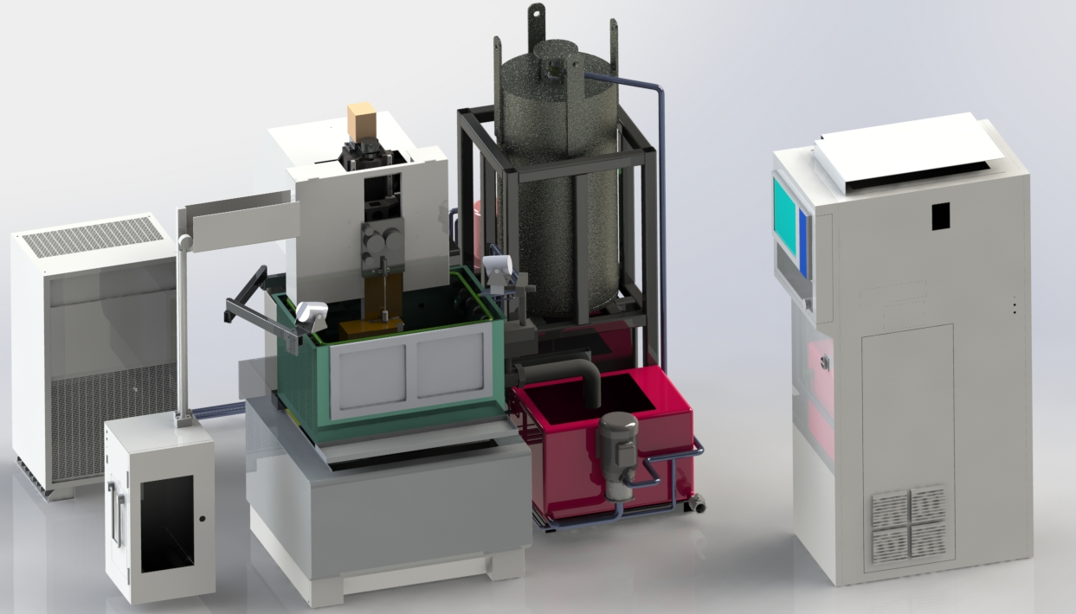
2. Progress of CSNS target PIE
2.1 Sampling and preparation
Development of Wire EDM System
1) The drives are centralized in the control cabinet with the cables are extended to 20m, the cabinet is away from the radioactive environment 2) 20mm thick lead shield are installed for servo motors 3) customized purification system enables regular overall replacement
4) custom cut sink for easy cleaning 5) radiation-resistant transformation of lubrication and pipelines
1 servo motor
1
2
2 purification system
3 water chiller
3
4
5
4 AWT
5 control cabinet
6 wire supply
6
7
8
7 cut sink
8 water tanks
9 waste silk bin
17

Slide 18
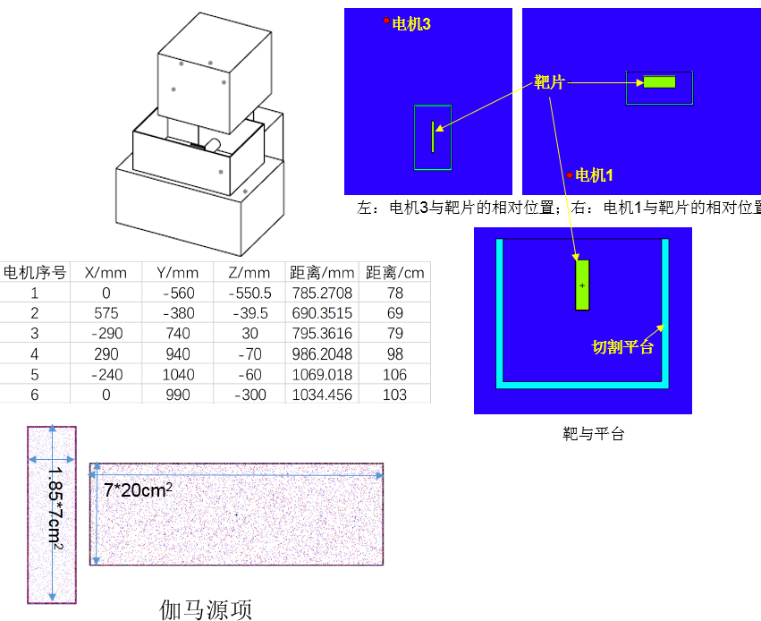
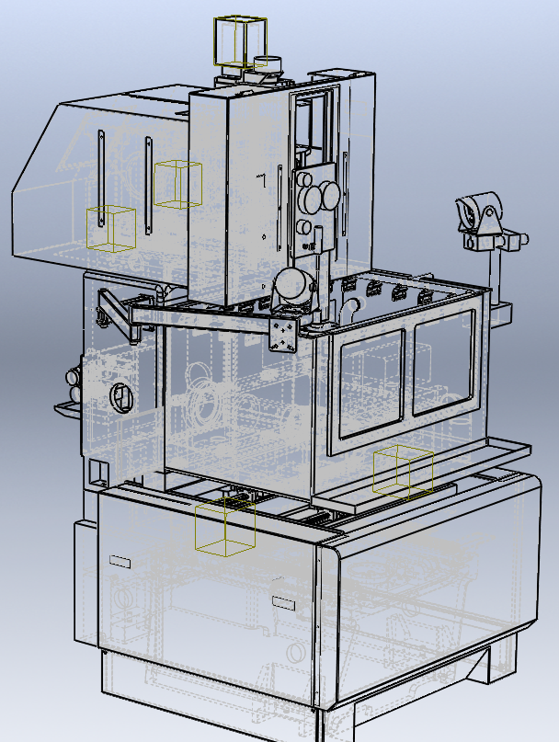
2. Progress of CSNS target PIE
2.1 Sampling and preparation
Shielding for servo motors
calculate the absorption dose of the motor at the strongest gamma
radiation resistance test of key components using activated target
shield all the five servo motors
Several~Gy/h
18

Slide 19
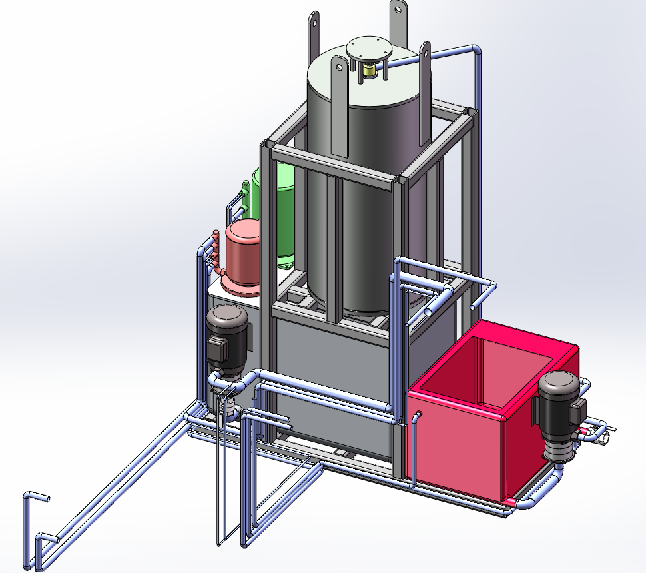
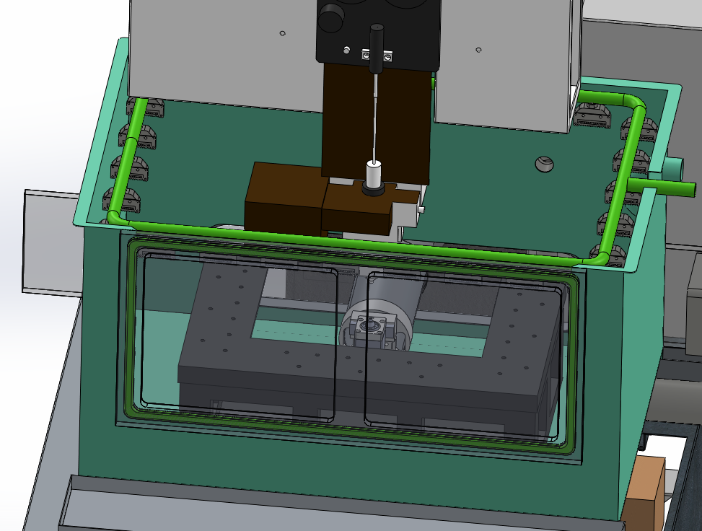
2. Progress of CSNS target PIE
2.1 Sampling and preparation
Customized purification system
Integrate the filter and ion exchanger in the shielding container, making it easier to replace, while maintaining the original function
keep the original control system and detection method to ensure cutting quality
19

Slide 20
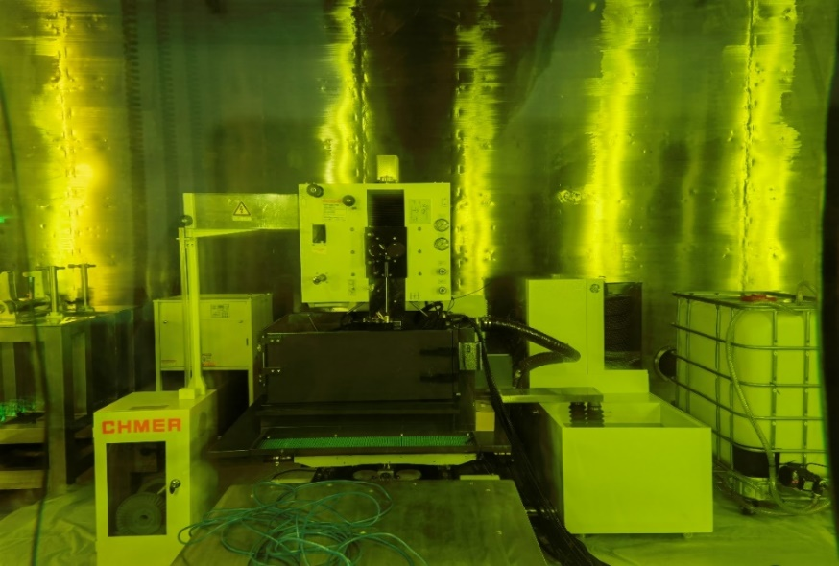
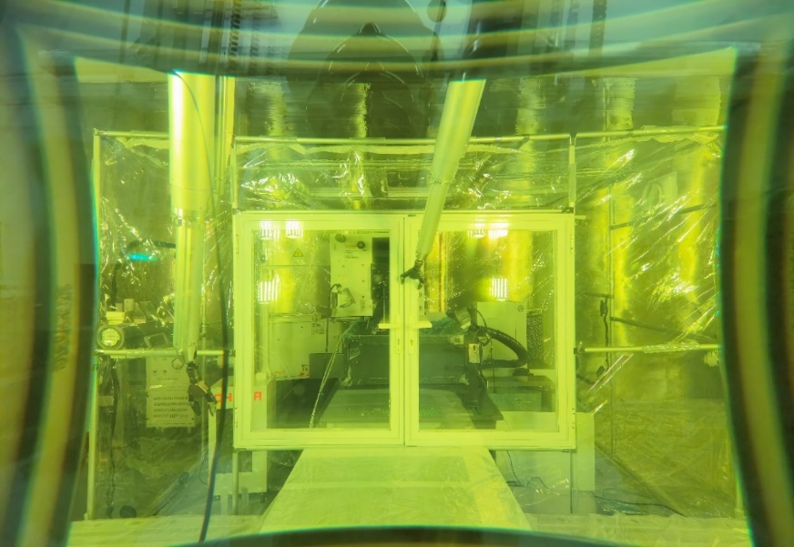
2. Progress of CSNS target PIE
2.1 Sampling and preparation
Item |  | technical specification | unit
Machining range | X-axis | 360 | mm
 | Y-axis | 250 | mm
 | Z-axis | 220 | mm
 | U-axis | 60 | mm
 | V-axis | 60 | mm
Min acute angle | Wire diameter | φ0.15-0.3 | mm
Slope | Max slope | ±14.5°/80 | mm
Wire EDM in Negative pressure air tent

Slide 21
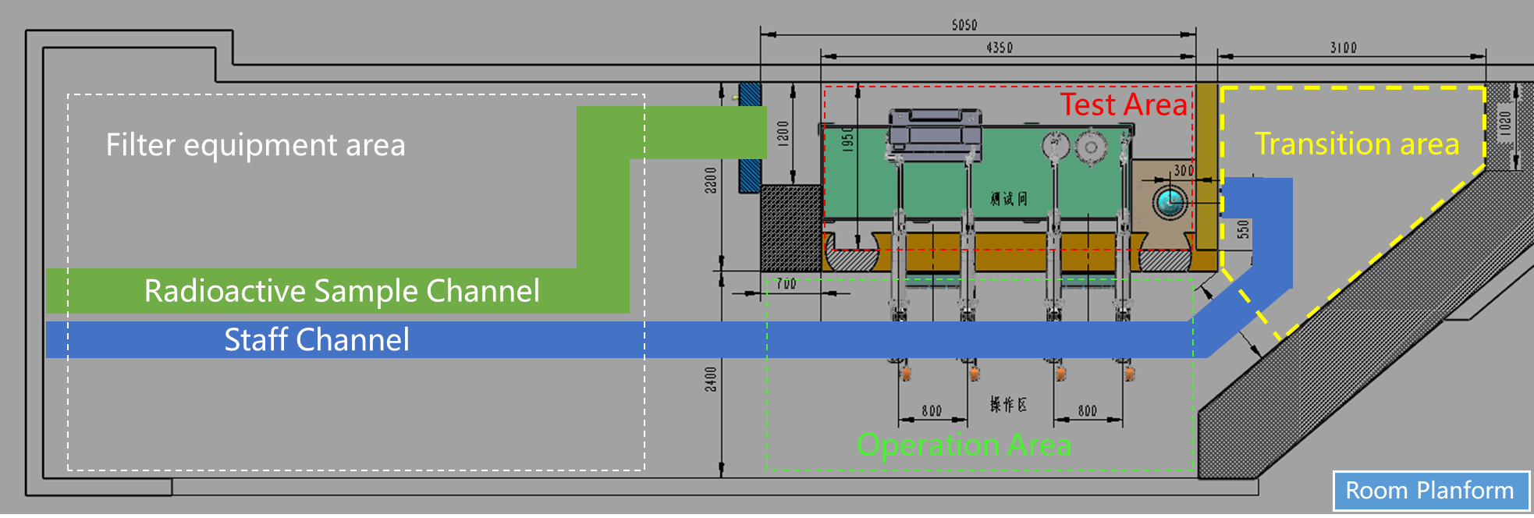
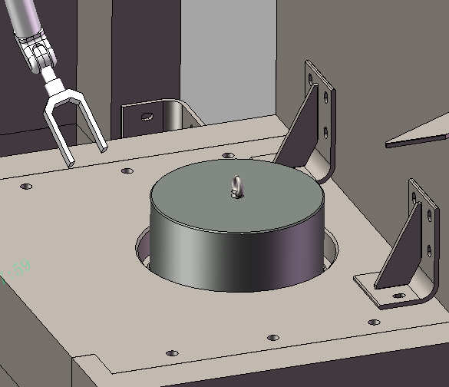
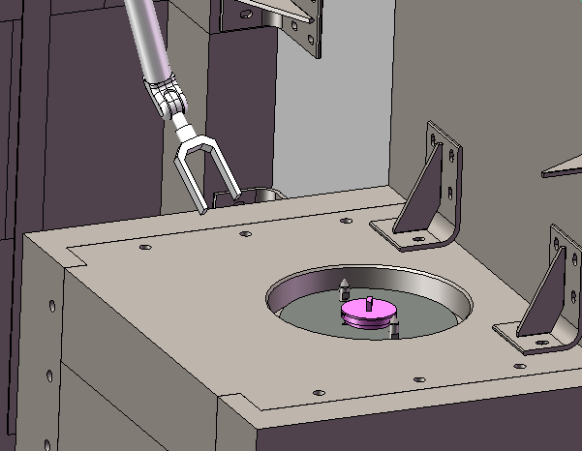
2. Progress of CSNS target PIE
2.2 Examination environment
Sample transport
into test room
In addition to having sufficient shielding capabilities(＞1.5Ci), the test hot cell can also meet the needs of remote handling, transportation, measurement, cleaning and temporary storage of small samples after irradiation.
21

Slide 22
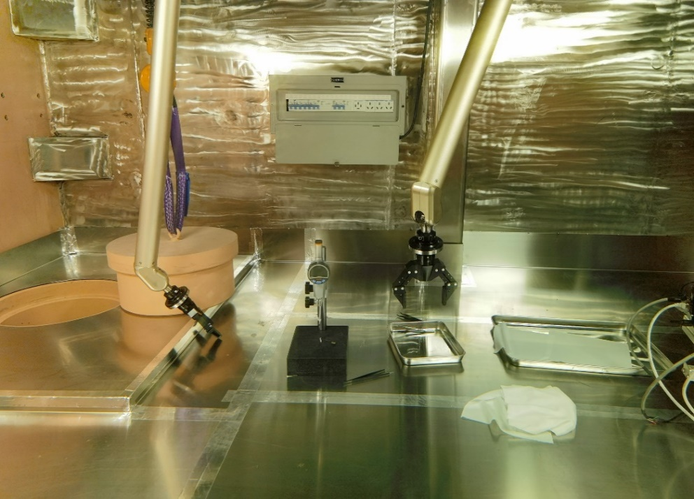
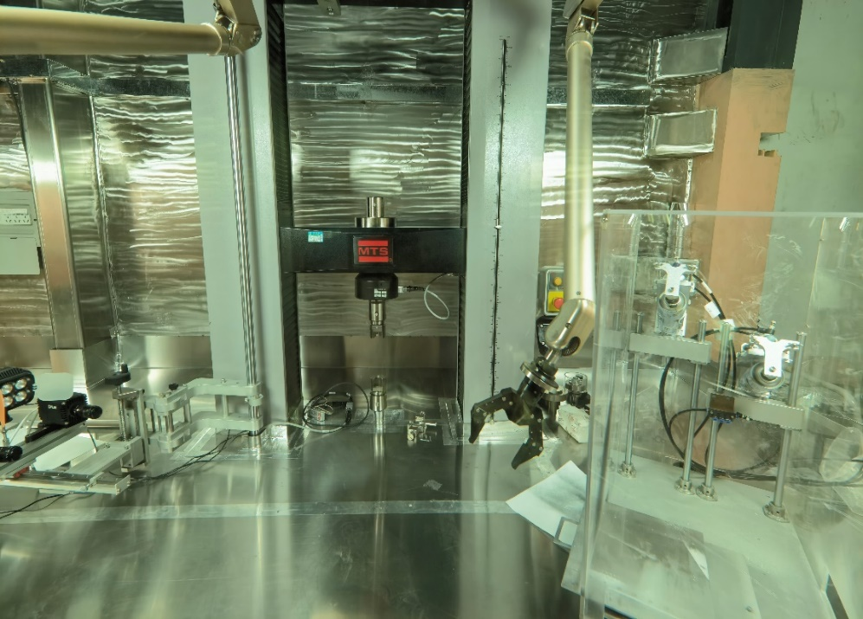
2. Progress of CSNS target PIE
2.2 Examination environment
22

Slide 23
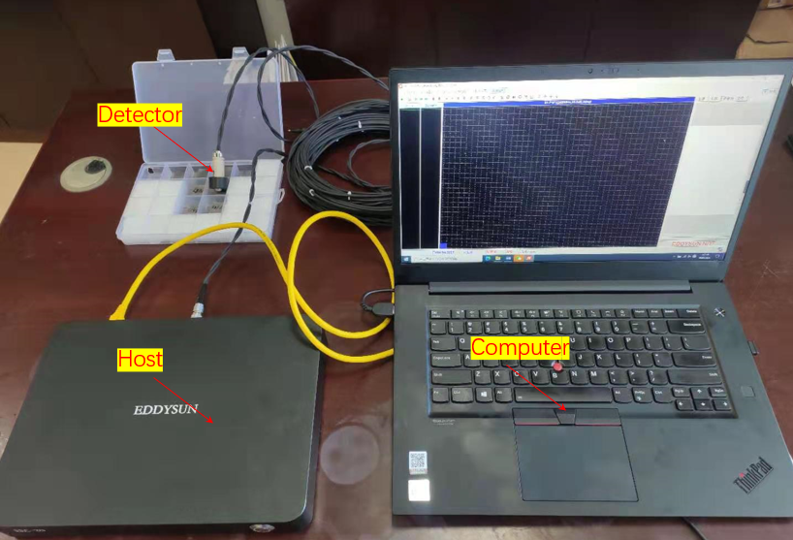
2. Progress of CSNS target PIE
2.2 Examination environment
(1) Eddy current thickness measurement
Measure the thickness of tantalum layer by eddy current thickness measurement.
Compare the thickness change of target coating before and after use.
Composition of thickness gauge
Measurement exercise in hot cell
23

Slide 24
2. Progress of CSNS target PIE
2.2 Examination environment
(2) Automatic optical microscope
Surface inspection of tungsten cladded tantalum target plates after use.
Target plate surface simulation observation in radioactive environment has been carried out.
The results show that all performances of the microscope are normal at the maximum dose rate of 4.9 Sv/h and the accumulated dose of 24.5 Sv (5 hours).
radioactive environment test
Automatic sample scanning
observation results (20X)

Slide 25
2. Progress of CSNS target PIE
2.2 Examination environment
(3) Mechanical test platform
MTS universal machine for testing.
The strain measurement of small sample adopts digital image processing technology ( Correlated Solutions 3D-VIC)
Special tooling is used for testing small radioactive tensile samples
Universal testing machine(MTS)
Tensile test clamping tooling
Digital image processing system
(Measuring strain)
Tensile test clamping tooling

Slide 26
2. Progress of CSNS target PIE
2.3 Remote handling test
Tungsten and stainless steel clamping and transfer
three stainless steel milling blanks and one tungsten block blank
0.1-6kg，5-170mm
26

Slide 27
2. Progress of CSNS target PIE
2.3 Remote handling test
Tungsten and stainless steel clamping and transfer
development of special pneumatic fixture;
power manipulator and pneumatic quick change disc are used to realize tool head replacement and full-range movement in hot cell
Transport tool storage and small sample preparation area
Target Vessel Milling Sampling Position
Preliminary observation and detection area
27

Slide 28
2. Progress of CSNS target PIE
2.3 Remote handling test
Blank clamping and positioning design
compression of blanks of different specifications
using air cylinder and remote control valve
28

Slide 29
2. Progress of CSNS target PIE
2.3 Remote handling test
Sample preparation process test
three times clamping, first thickness, then the shape
automatic alignment through servo control and touching the blank after laying flat
29

Slide 30
2. Progress of CSNS target PIE
2.3 Remote handling test
Small sample remote operation and clamping test
test how small the samples can be remote-handling
reduce the amount of waste and the difficulty of transportation between the hot cells
develop the necessary operation tools
10mm
Tensile S31603-12*0.4mm
Compression W- φ5*10mm
30

Slide 31
2. Progress of CSNS target PIE
2.3 Remote handling test
Sample thickness measurement is done with a digital micrometer. The results show that the sample cross-sectional area error is better than the design index of 2%.
Compressed sample size | Height /mm | Diameter /mm | Cross-sectional area deviation
1# | 10.002 | 5.015 | 0.60%
2# | 10.002 | 5.013 | 0.37%
3# | 9.991 | 5.006 | 0.37%
4# | 10.000 | 5.003 | 0.29%
Tensile sample size | Width /mm | Thickness /mm | Cross-sectional area deviation
1# | 1.992 | 1.495 | 0.73%
2# | 1.996 | 1.493 | 0.63%
3# | 2.001 | 1.497 | 0.11%
4# | 1.995 | 1.491 | 0.83%
31

Slide 32
2. Progress of CSNS target PIE
2.3 Remote handling test
During the 2022 maintenance period, key process tests were completed.
32

Slide 33
2. Progress of CSNS target PIE
2.3 Remote handling test
Last year we completed the full process test with good results.
33

Slide 34
2. Progress of CSNS target PIE
2.3 Remote handling test
Project officially accepted in September 2024 and awaiting approval of the environmental impact assessment.
Through the full-scale simulation target full-process test, the feasibility of milling and wire EDM sample preparation was verified and a lot of remote operation experience was accumulated.
Wire EDM in Negative pressure air tent
three-axis milling machine in hot cell
34

Slide 35
3 PIE plan
3.1 target PIE
2021.12---2023.12 Equipment commissioning
2024.1----2025.8 Target cutting preparation and review
2025.9----2025.11 Target cutting & samples Preparation
2025.12---2026.8 Tantalum layer surface detection
Tantalum layer thickness measurement
Mechanical property test
2025.01----2026.12 New laboratory fabricate & SEM-FIB ready

Slide 36
3 PIE plan
3.2 CNIP（CSNS Neutron Irradiation Program）
1meV-1GeV 2.3E+11n/cm2/s ＜30℃
-to be published

Slide 37
3 PIE plan
3.3 other PIE
New laboratory fabricate with SEM-FIB
Sample prepare
Sample
in
Cooling
Vacuum
High voltage
Observation
SEM
OM
cabinet
HV
Observation
Dose
measure
Observe
door
clean
Tensile
test
Charpy
test
door
TC
TS
measure
37

Slide 38
Summary
Capacity building for the target PIE has done on CSNS hot cell and now is awaiting for approval
For more PIE object, PBW…need more development
New laboratory fabricate with SEM-FIB enable CSNS to do more characterization
38

Slide 39
Thank you for your attention
Chongguang Zhao
zhaocg@ihep.ac.cn

Slide 40
3 PIE plan
3.1 target PIE
Sample No | Size | DPA
SS-EBW-1 | Long:12mm, Thickness:1.5mm | 0.5
SS-EBW-2 | Long:12mm, Thickness:1.5mm | 0.5
SS-EBW-3 | Long:12mm, Thickness:1.5mm | 0.5
SS-EBW-4 | Long:12mm, Thickness:1.5mm | 0.3
SS-EBW-5 | Long:12mm, Thickness:1.5mm | 0.3
SS-EBW-6 | Long:12mm, Thickness:1.5mm | 0.3
SS-EBW-7 | Long:12mm, Thickness:1.5mm | 0.2
SS-EBW-8 | Long:12mm, Thickness:1.5mm | 0.2
SS-EBW-9 | Long:12mm, Thickness:1.5mm | 0.2
SS-vessel-1 | Long:12mm, Thickness:1.5mm | 0.8
SS-vessel-2 | Long:12mm, Thickness:1.5mm | 0.8
SS-vessel-3 | Long:12mm, Thickness:1.5mm | 0.8
SS-vessel-4 | Long:12mm, Thickness:1.5mm | 0.5
SS-vessel-5 | Long:12mm, Thickness:1.5mm | 0.5
SS-vessel-6 | Long:12mm, Thickness:1.5mm | 0.5
SS-vessel-7 | Long:12mm, Thickness:1.5mm | 0.4
SS-vessel-8 | Long:12mm, Thickness:1.5mm | 0.4
SS-vessel-9 | Long:12mm, Thickness:1.5mm | 0.4
SS-Window-1 | Long:12mm, Thickness:1.5mm | 1.2
SS-Window-2 | Long:12mm, Thickness:1.5mm | 1.2
SS-Window-3 | Long:12mm, Thickness:1.5mm | 1.2
SS-Window-4 | Long:12mm, Thickness:1.5mm | 1.0
SS-Window-5 | Long:12mm, Thickness:1.5mm | 1.0
SS-Window-6 | Long:12mm, Thickness:1.5mm | 1.0
SS-EBW sample
Welding line
Sampling position of target-1 samples
Compare the performance changes of different DPA samples after irradiation;
Compare the performance changes of welded samples and non welded samples after irradiation.

Slide 41
1.Introduction of CSNS hot cell & solid target
1.3 CSNS target introduction
380
1380
260
208
P
86
Target Plug
Target plates
(W cladded Ta)
Target vessel
(SS316L)
Counterweight connector
(SS316L)
41

Slide 42
1.Introduction of CSNS hot cell & solid target
1.2 CSNS hot cell introduction
Target#1 front window & part of top surface
Seal surface at Helium vessel
seal ring inspect
42

Slide 43
1.Introduction of CSNS hot cell & solid target
1.3 CSNS target introduction
1.2mm
inlet
0.5mm
0.5mm
Cooling channel
outlet
target is trapezoidal structure, and tantalum coated tungsten parallel in the container
front five target with cooling water channels upper and lower
Maximum deformation of vessel: 0.58mm@0.4MPa
The temperature distribution in the target
Max 176.34℃

Slide 44
1.Introduction of CSNS hot cell & solid target
1.3 CSNS target introduction
Target-1—DPA
Calculation program:PHITS3.26
Data base: JENDL
W—1.8dpa
Vessel cover—0.8dpa
Vessel window---1.2dpa

