Slide 1


40 years of ISIS targets
Presented by Stephen Gallimore*
Cosner’s house, Abingdon, UK
28th Oct 2024
Based on the work and slides of many others*

Slide 2
Contents
40 Years …
How it all started
An ISIS overview
TS-1 Targets over time
TS-2 Targets over time
Where we are now
A look to the future

Slide 3
40 Years …

Slide 4

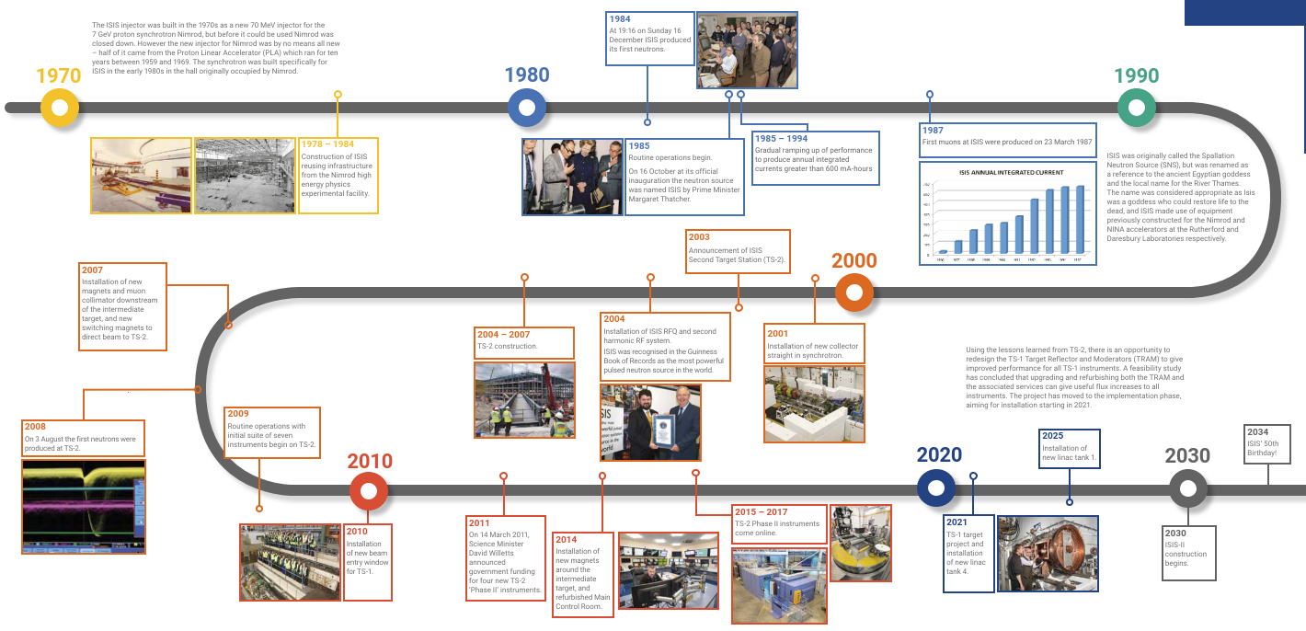
40 Years … of Development

Slide 5
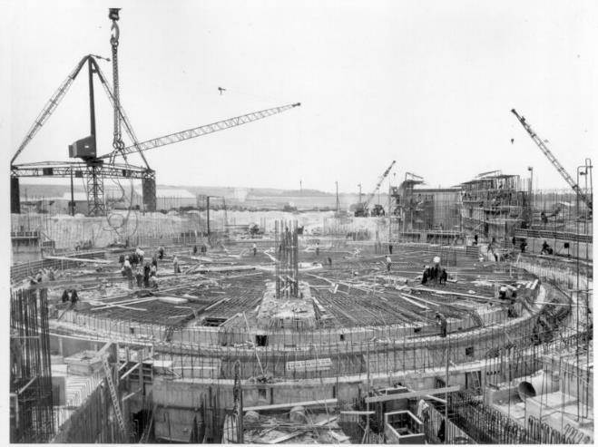
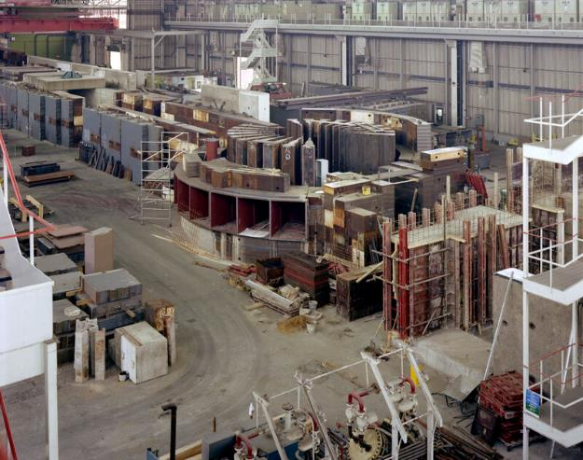
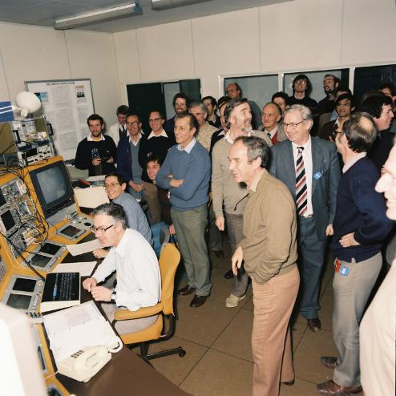
40 Years …
On 16 December 2024, ISIS will mark 40 years since first neutrons.
Leading up to this significant milestone, ISIS is planning a series of events that celebrate four decades of scientific discoveries, technological innovation and productive partnerships.

Slide 6
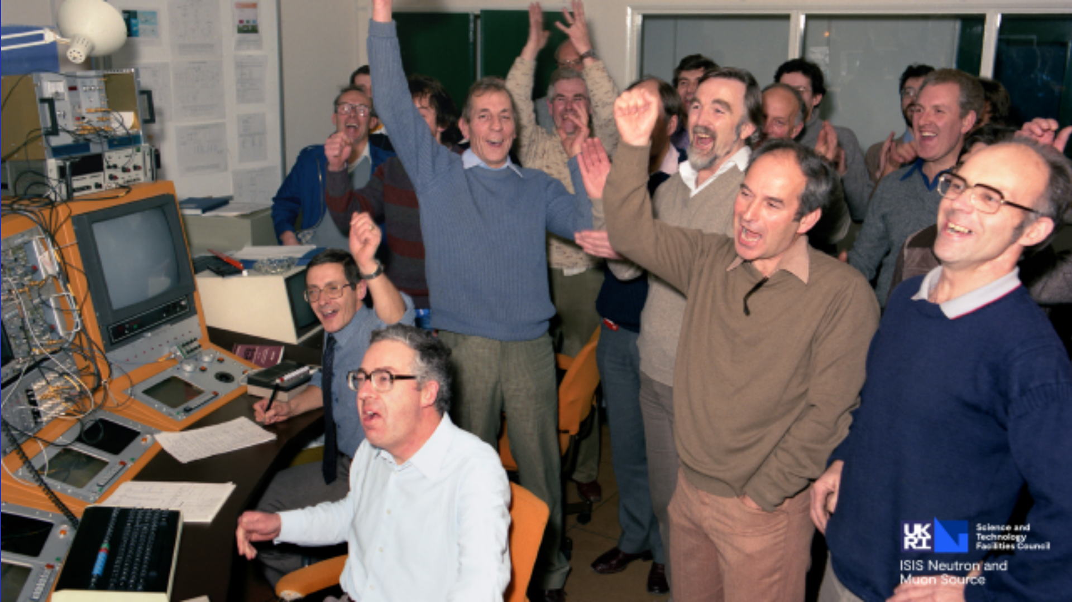

Slide 7
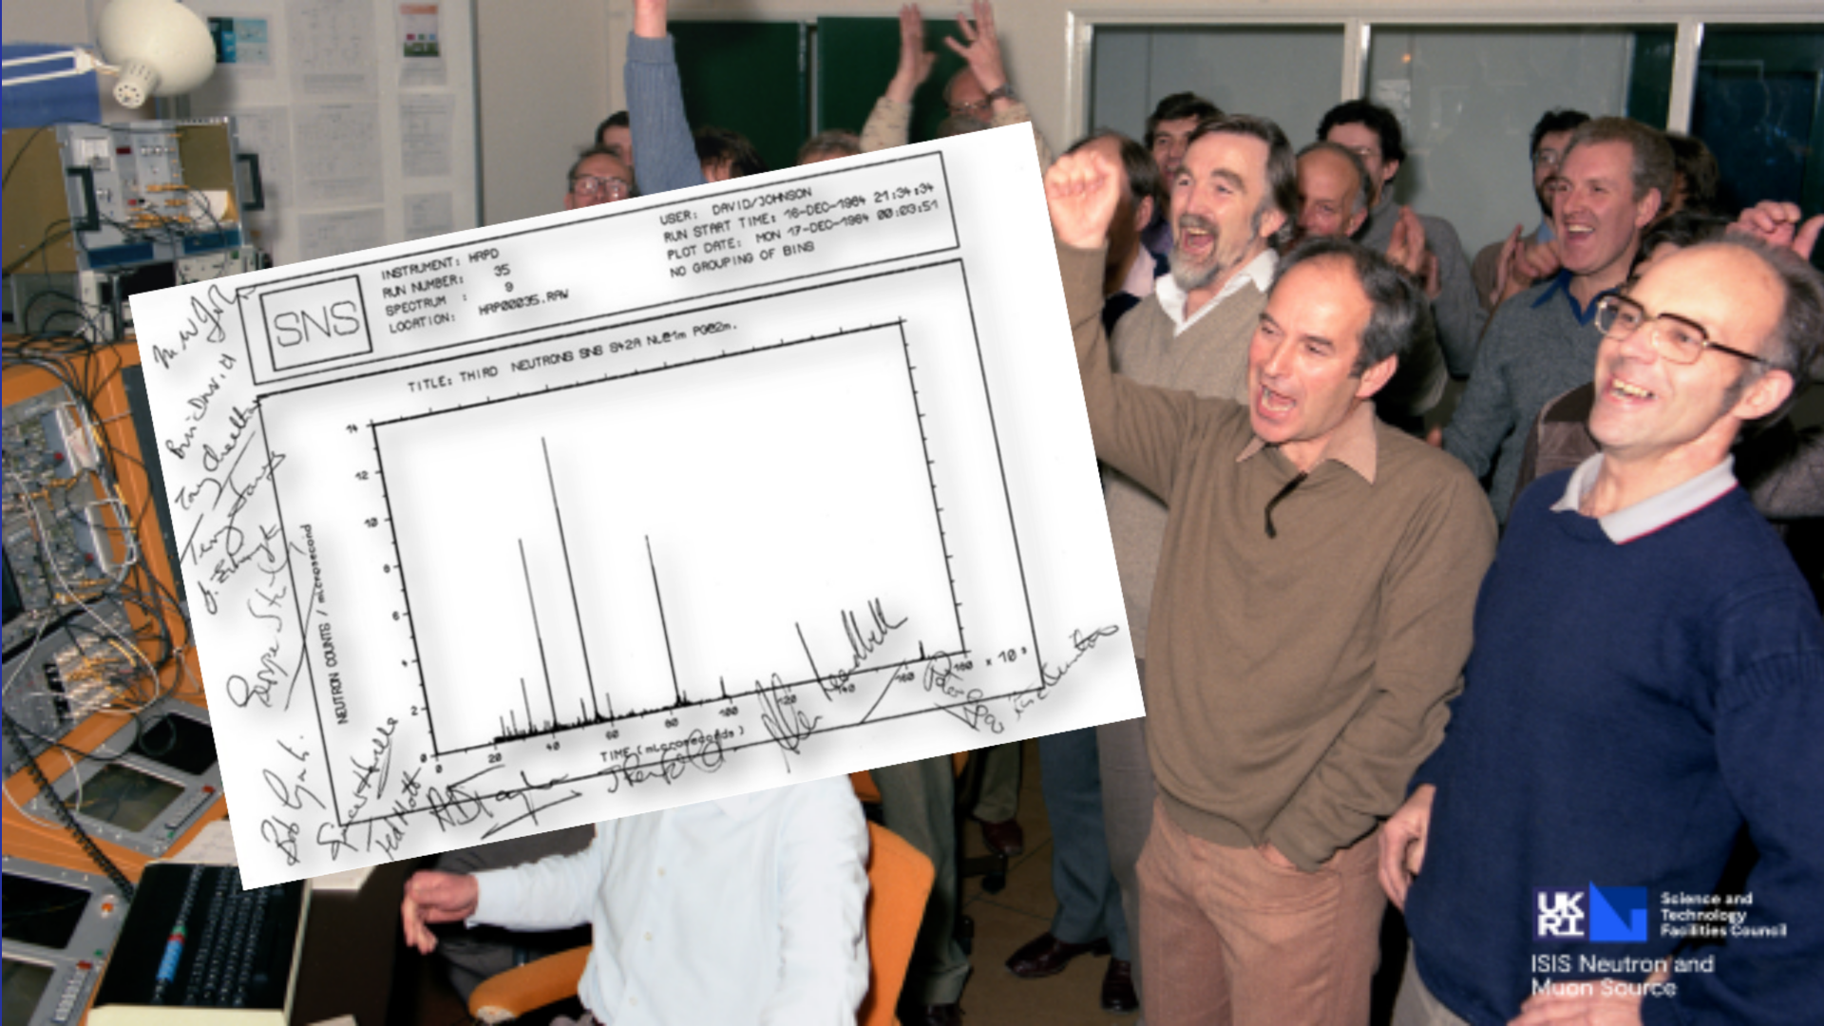
Celebrating 40 years of neutrons at ISIS
On 16 December 2024, ISIS will mark 40 years since first neutrons.

Slide 8
How it all started

Slide 9
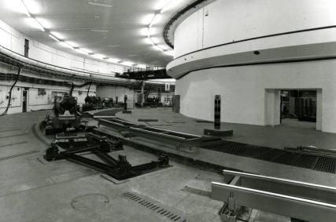
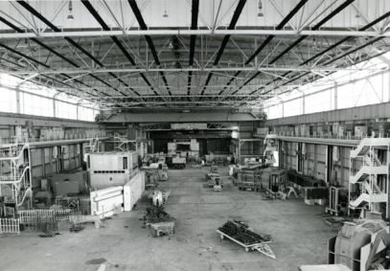
How it all started – from the ashes of Nimrod…
Nimrod was a 7 GeV proton synchrotron operating in the Rutherford Appleton Laboratory in the United Kingdom between 1964 and 1978. It was used for studies of nuclear and sub-nuclear phenomena. Nimrod was dismantled and the space it occupied reused for the synchrotron of the ISIS neutron source.

Slide 10
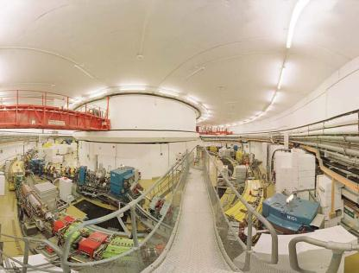
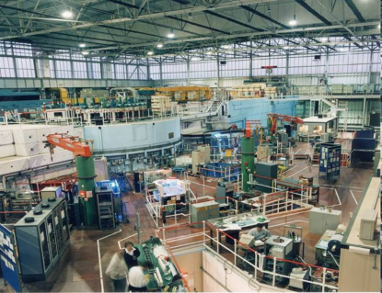
How it all started – Rises ISIS
The name ISIS is not an acronym: it refers to the Ancient Egyptian goddess who could restore life to the dead and the local name for the River Thames. The name was selected for the official opening of the facility in 1985, prior to this it was known as the SNS, or Spallation Neutron Source.

Slide 11
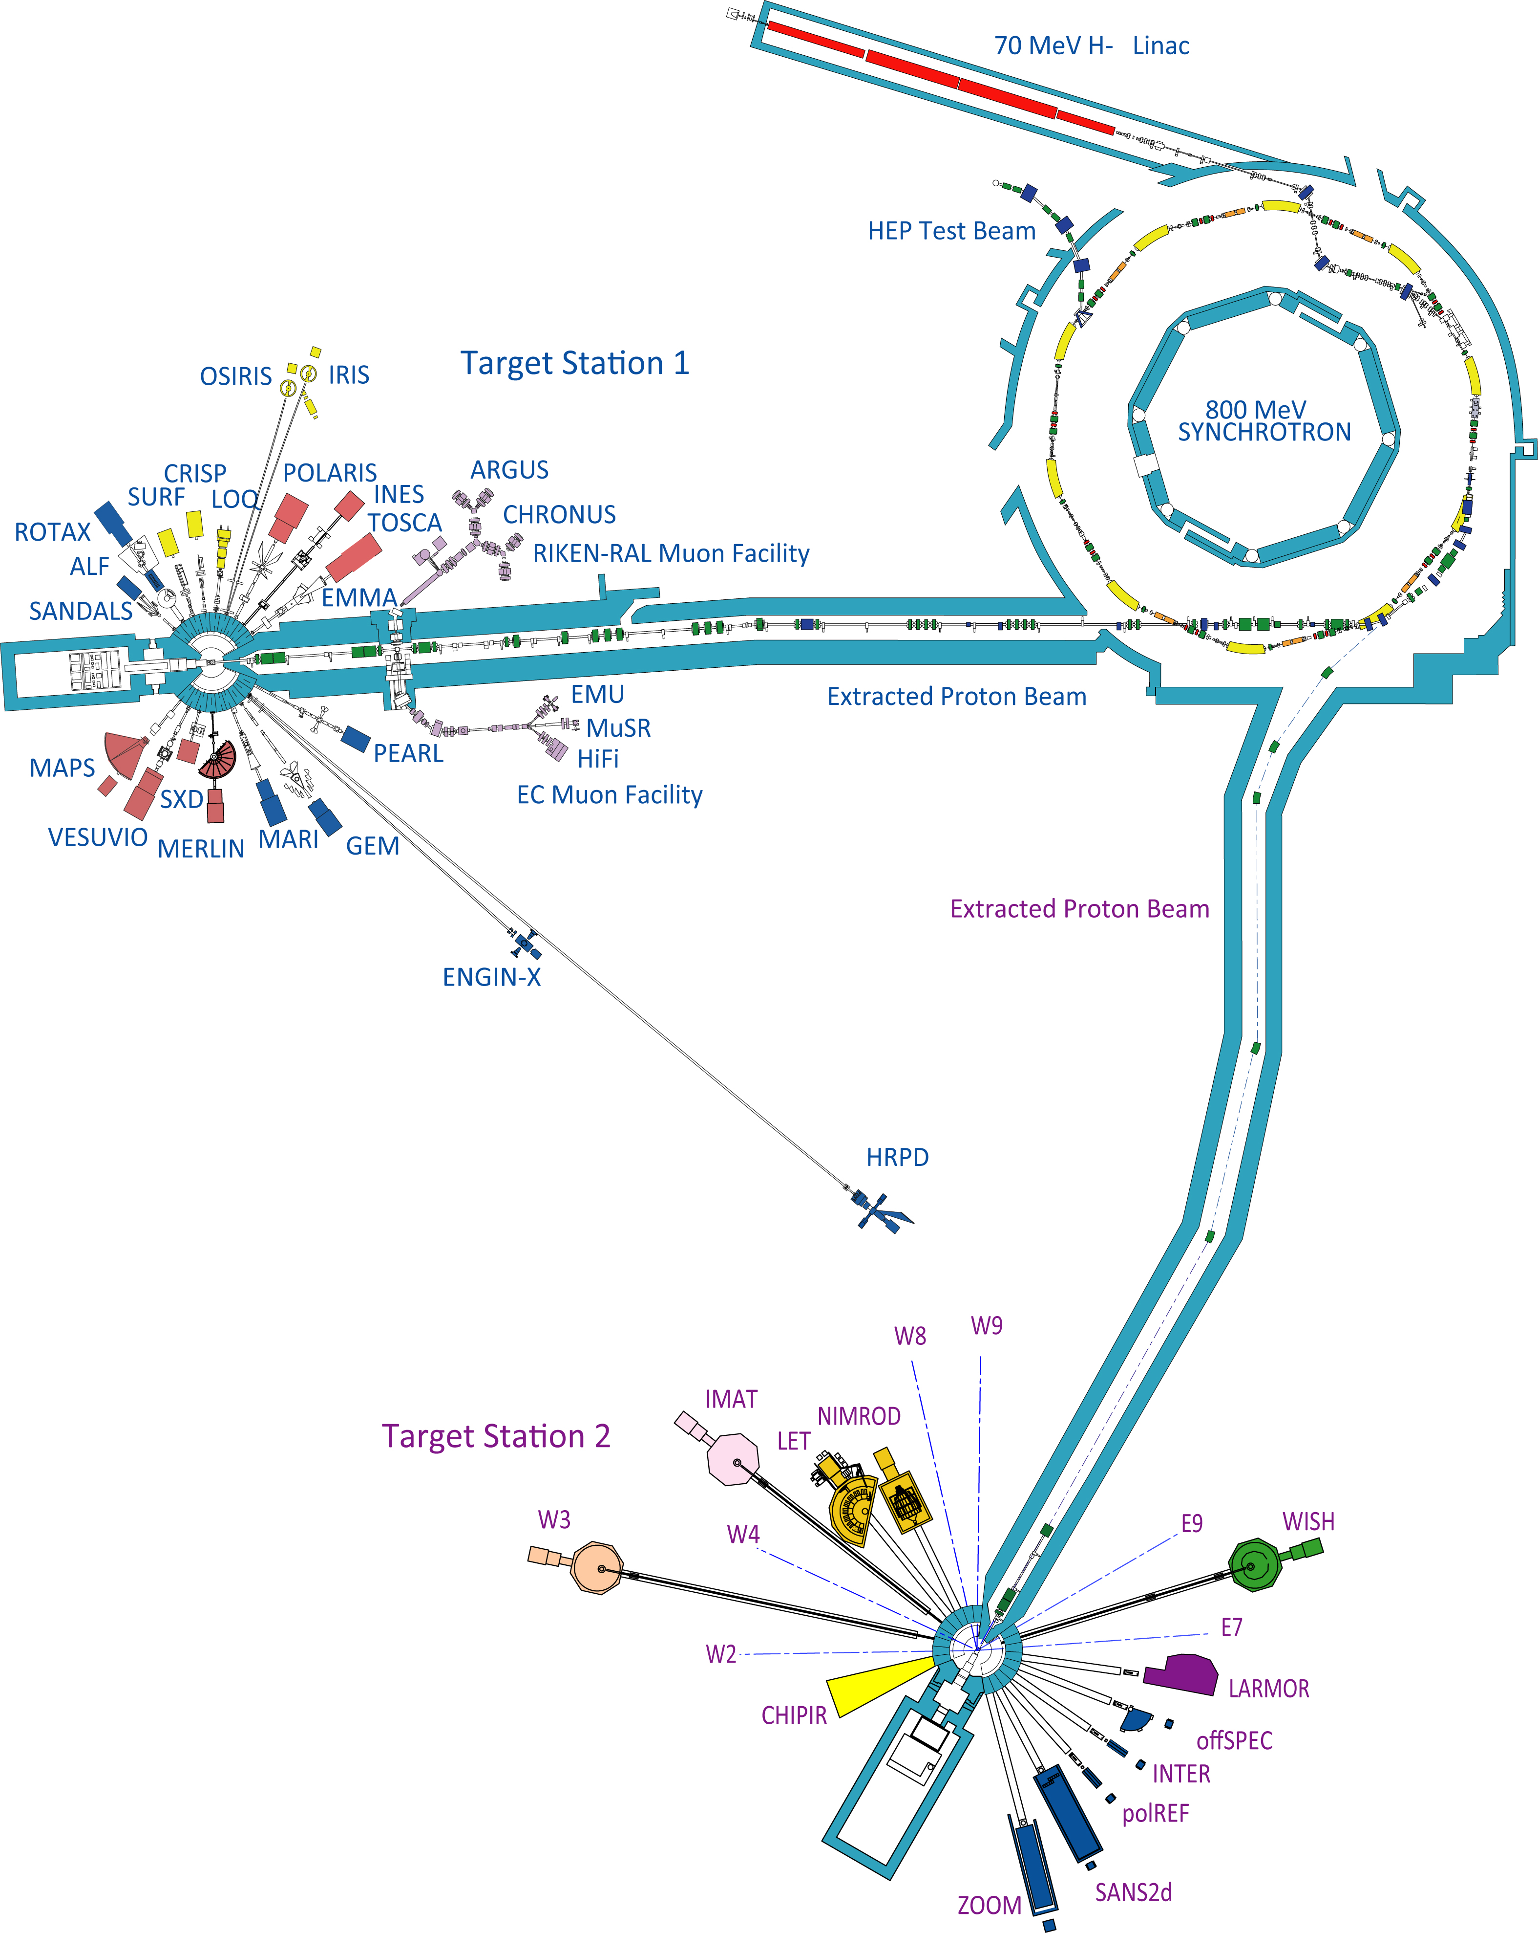
How it all started – Major milestones
First neutrons Dec 1984
Regular runs from Jan 1985 (25Hz, 10uA, 550MeV)
Operational phase began in 1986 (50Hz, 30uA, 550MeV)
First muons 1987
Design energy and current achieved in 1994 (50Hz, 200uA, 800MeV)
TS-2 constructed completed in 2007, operational from 2009

Slide 12
How it all started – Power ramp-up

Slide 13
An ISIS Overview

Slide 14
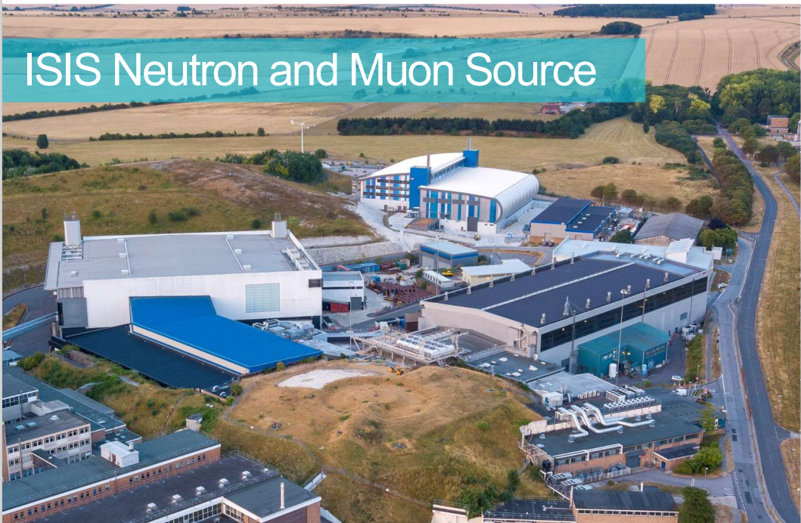

Slide 15
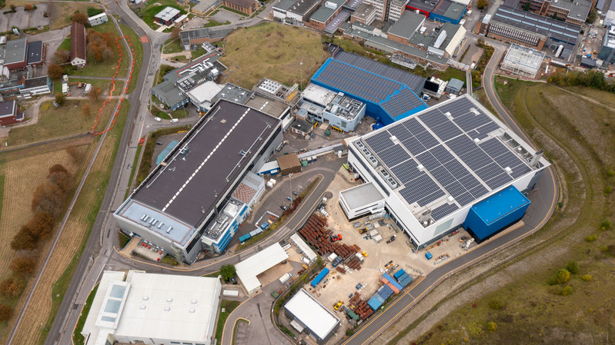
800 MeV protons
muons
neutrons
neutrons
Target 2
Target 1
Notes:
800 MeV protons to 2 target stations

Slide 16
An ISIS Overview
800 MeV proton synchrotron, 200µA, 50 Hz
TS1 Target designed to provide tight-pulse shapes and high-flux of epi-thermal neutrons
Second Target Station operational since 2009
TS2 Target designed for long-wavelength neutrons
160µA to TS1 (4 pulses), 40µA to TS2 (I pulse)
Upgrades to synchrotron give the potential for 300µA
Continue to operate @ 200µA (target limited – TS2)
Briefly operated @ 245µA before long shutdown (2021)

Slide 17
TS-1 Targets over time

Slide 18
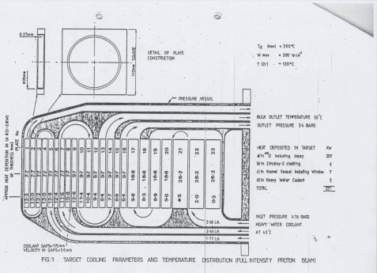
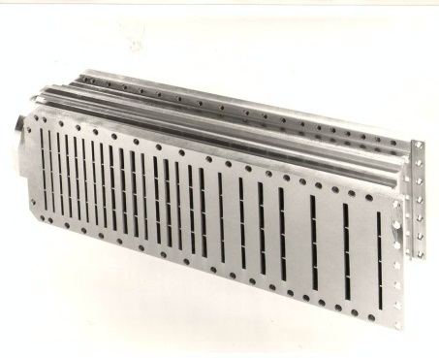
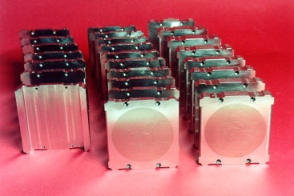
TS-1 Targets over time – Neutron targets
Uranium targets (#1 to #9)
  1984 to 1995
  Total of 9 Uranium targets all run for very short periods of time due to failure by radiation damage
  Tantalum targets #1 and #2 used at various times as a stop gap between Uranium targets
16th Dec 1984, 7.16pm first neutrons produced
  Target zircaloy clad depleted uranium
Target Module
Zircaloy clad Uranium discs in st. st. frames

Slide 19
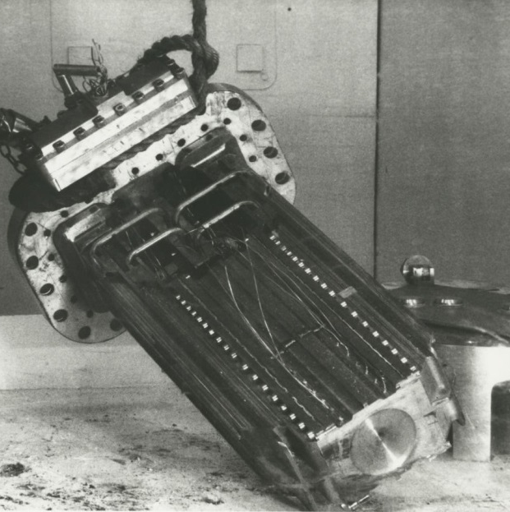
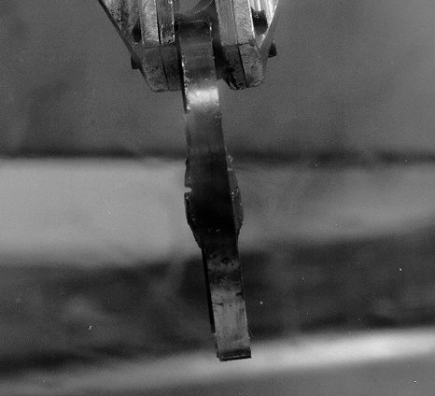
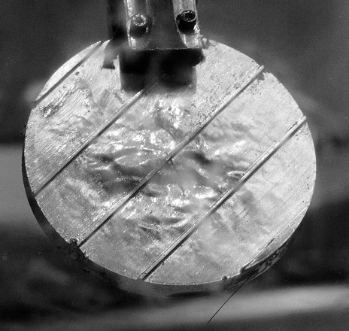
TS-1 Targets over time – Neutron targets
TS-1 target PIE clearly showed the swelling of the uranium following irradiation

Slide 20
TS-1 Targets over time – Neutron targets
Tantalum targets (#1 to #4)
  1995 to 2001 Tantalum only running
  Starting with Tantalum target #2 a total of 3 targets
  Ran reliably but ~50% down on total neutrons produced compared to Uranium targets
Target Module
Tantalum discs in st. st. frames

Slide 21
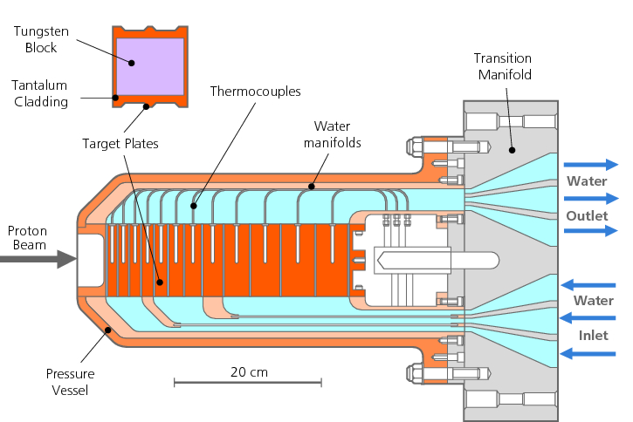
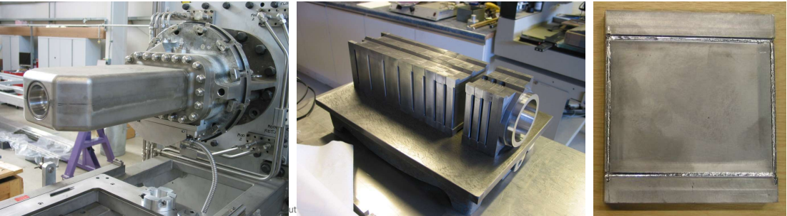
TS-1 Targets over time – Neutron targets
Tungsten targets #1 to #4
  2001 to 2021
  12 target plates – tungsten clad with tantalum
Target Module

Slide 22
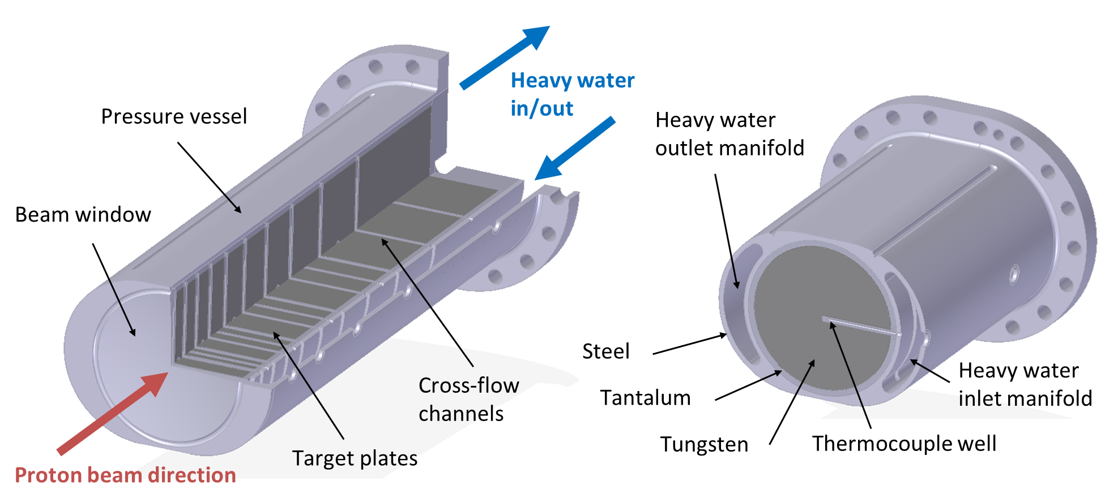
TS-1 Targets over time – Neutron targets
“TS-1 Project” targets
  2022 to present
  10 target plates – tungsten clad with tantalum
  Secondary cooling circuit removed

Slide 23
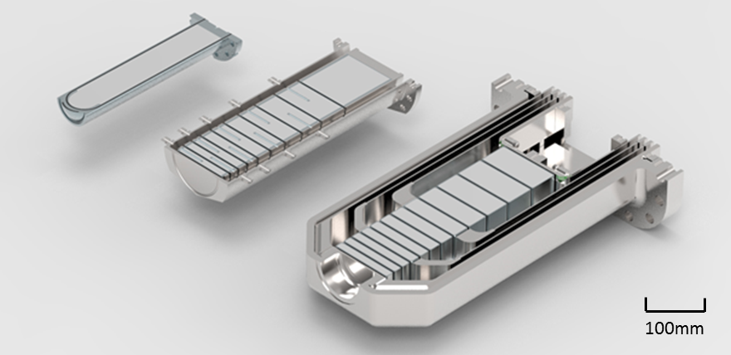
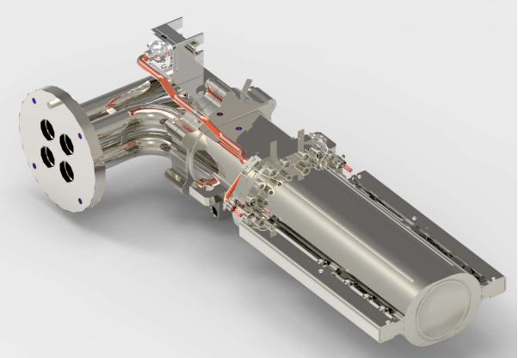
TS-1 Targets over time – Neutron targets
“TS-1 Project” targets
  Major redesign; plate thicknesses, plate and assembly construction, vessel, water manifold, etc.
  Reduction in Ta and stainless steel mass in target
TS2
TS1 Project
Previous TS1

Slide 24
TS-1 Targets over time – Neutron target recap
TS1 fully operational since 1985 through 4 generations of target design
Gen 1 - U/Zr Alloy – 24 plates
Gen 2 – Tantalum – 24 plates
Gen 3 - W/Ta – 12 Tungsten plates clad in Tantalum
Gen 4 - W/Ta – 10 Tungsten plates clad in Tantalum
Operates @160µA, 800 MeV, 50 Hz (now 40 Hz) >5-year service life (latest design installed/first beam in 2022)

Slide 25
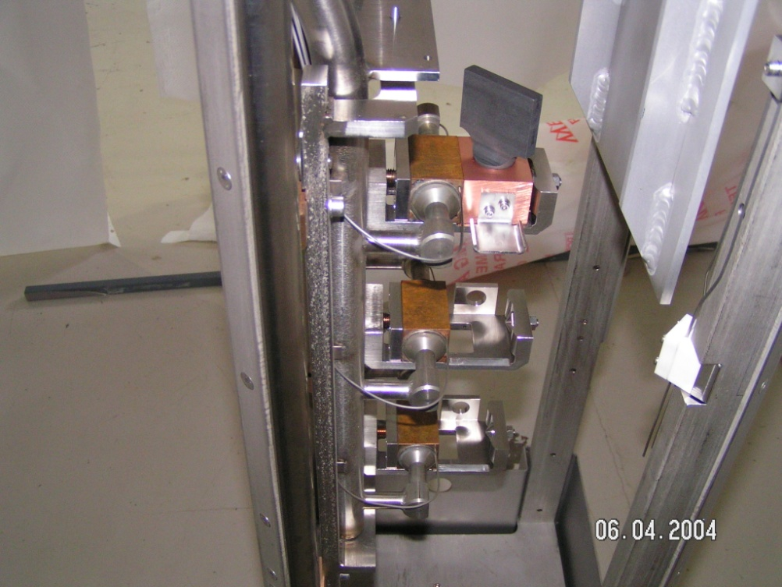
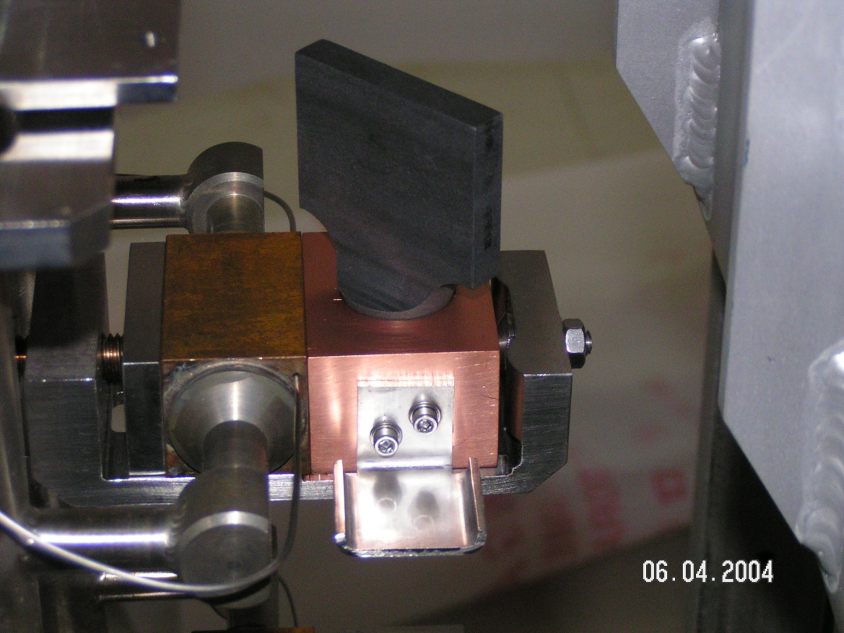
TS-1 Targets over time – Muon targets
Graphite targets
  Thickness of graphite has changed
  3 targets held in 1 ‘ladder’ assembly
  Design has been ‘tweaked’ over the years, but largely the same
Proton beam

Slide 26
TS-2 Targets over time

Slide 27
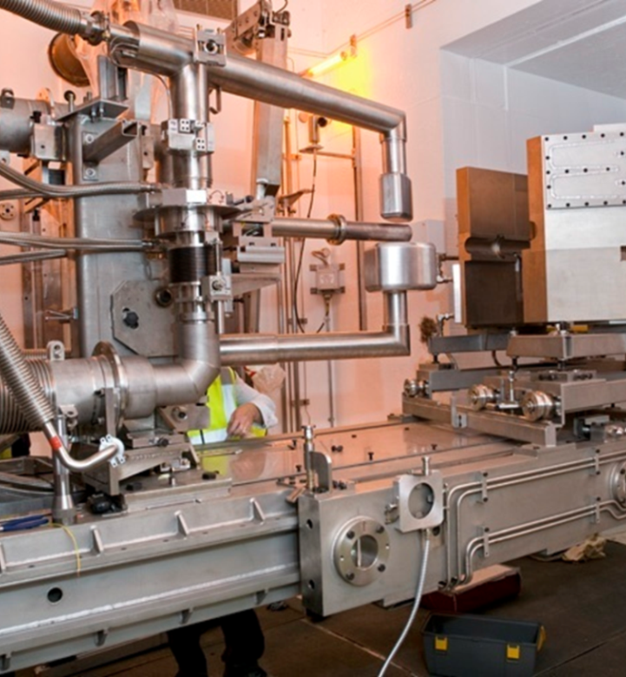
TS-2 Targets over time – Neutron targets
First operated 2008
40kW, 1 in 5 pulses of 50Hz
Solid target – edge cooled
Solid Be Reflector
Neutronic model prediction matches the output

Slide 28
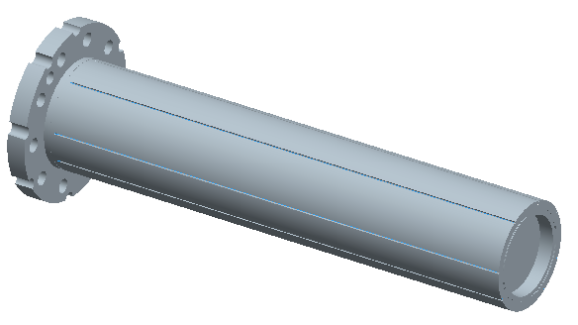
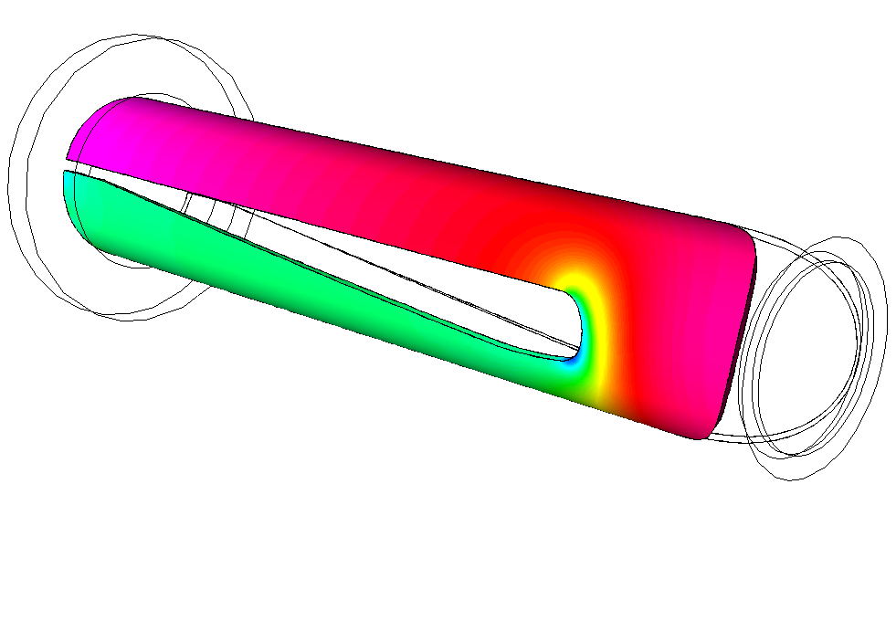
TS-2 Targets over time – Neutron targets
Thermocouples
laid in grooves
Mk 1
Single solid rod of Tungsten clad in tantalum with flat front face.
Tantalum cooling sleeve with aerofoil cooling channels on both sides along the length of the target.
Operational from Sept 2009 at typically 40µA, beam 6mm sigma
Front face uncooled
Thermocouples in the outer surface of the cooling sleeve only, terminating close to the front edge.
Aerofoil cooling channel
mirrored on opposite side

Slide 29
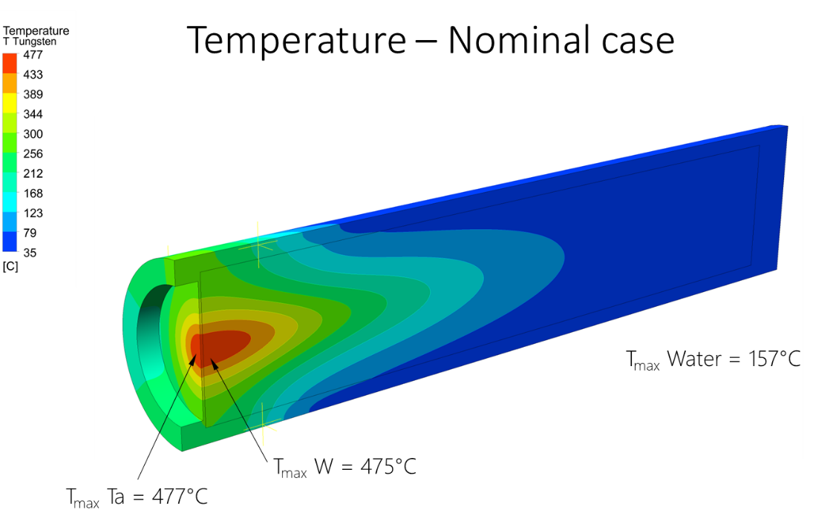
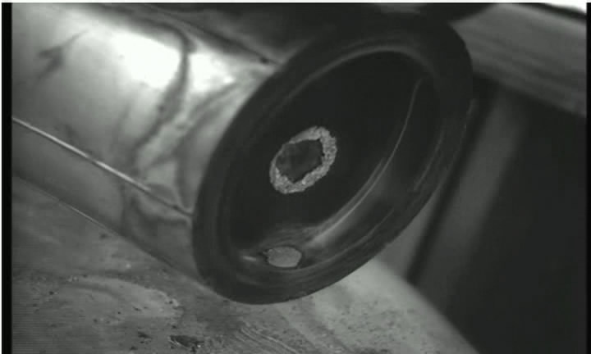
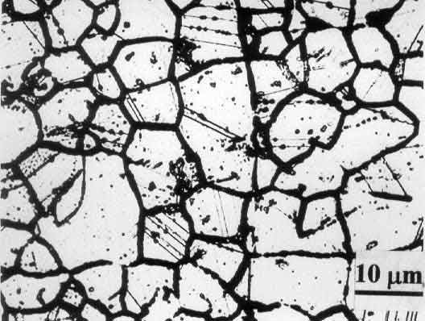
TS-2 Targets over time – Neutron targets
Mk 1
Later analysis confirmed the front face temperature to be ~480ºC
Hole in the Tantalum Cladding exposed the Tungsten core
Like some other high melting point materials, it reacts with oxygen and other gasses at high temperatures, >200°C the presence of water vapour can bring about rapid oxidation of the material – intergranular corrosion
Void Vessel atmosphere compromised by water leaks from pre-moderator.

Slide 30
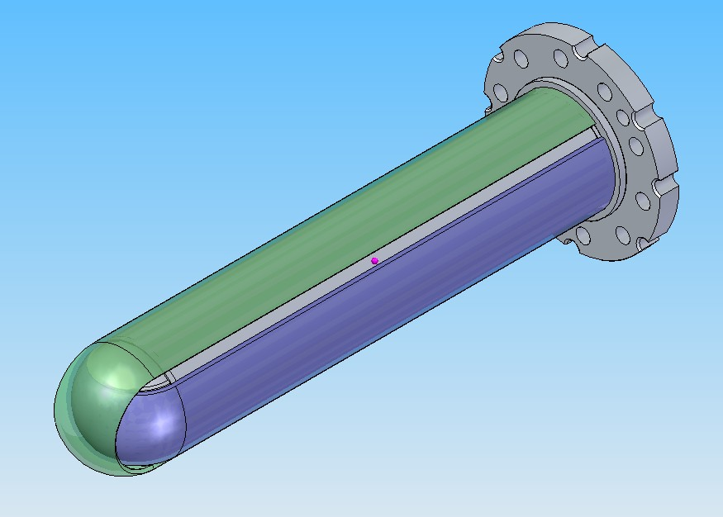
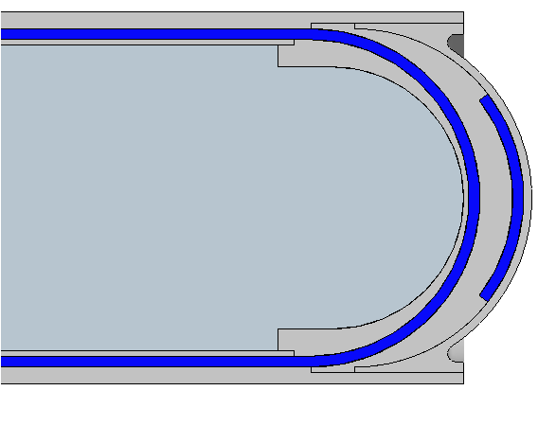
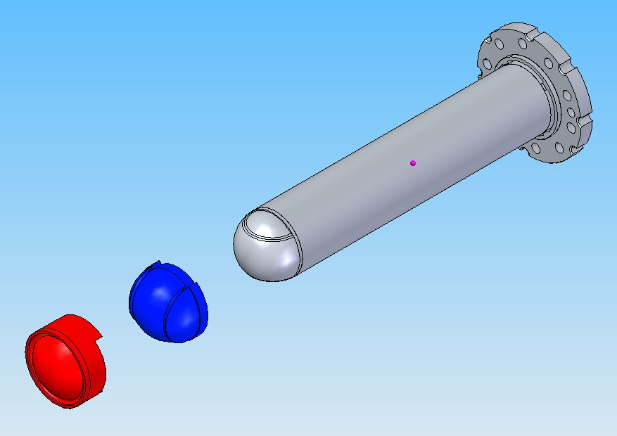
TS-2 Targets over time – Neutron targets
Mk 2
Only 8 months to re-design, manufacture and install (long shutdown).
Cross Flow Guide and Window Cap direct water across the front face.
Tantalum
Cross Flow Guide
Tantalum
Window Cap
Tungsten
Core
Water Channel
Tantalum Cladding
- reduced to 1mm
Water Channel
Tantalum Pressure Vessel
Tantalum Cladding 1mm thick

Slide 31
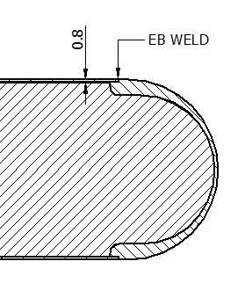
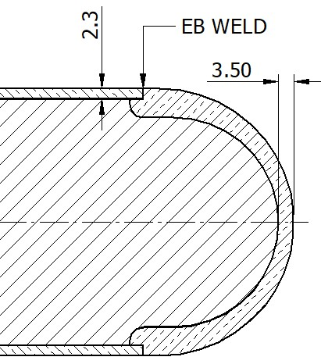
TS-2 Targets over time – Neutron targets
Mk 2
The MK 2 Target solved the original problem of the front face oxidising and extended the service life of the target - then presented a new problem!
Short lived isotopes Ta 182 & W 187 detected in the cooling water.
Now manufacturing targets in-house
Early analysis suggested a breach in the Ta cladding in the location of an EB Welded joint in the Target HIP Assembly.
EB Weld trials concluded insufficient weld penetration
Other factors to consider are erosion and corrosion, and erosion/corrosion effects
POST WELD
MACHINING
EB WELD/HIP
STAGE

Slide 32
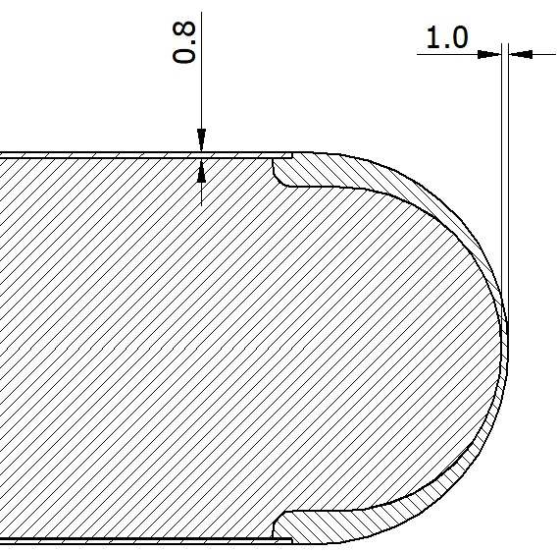
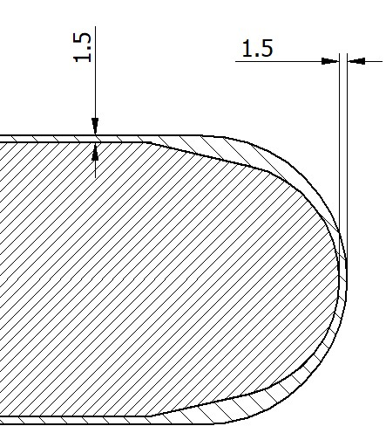
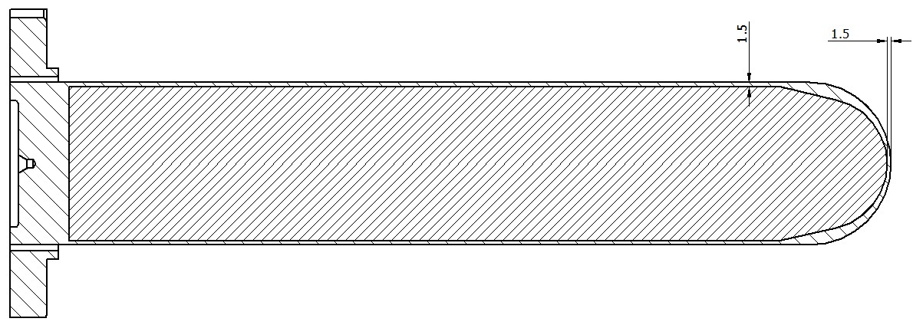
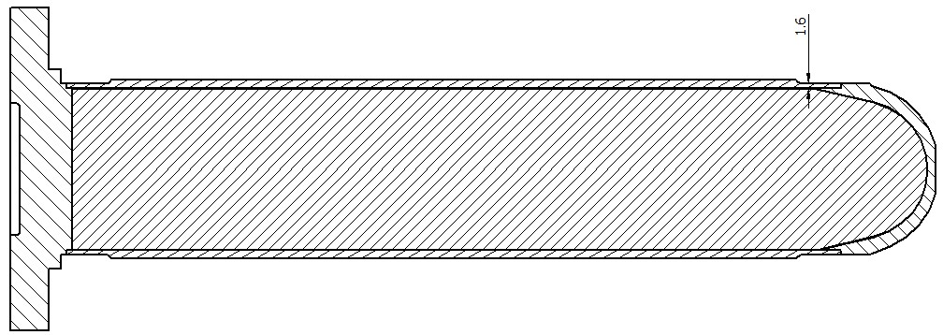
TS-2 Targets over time – Neutron targets
Mk 3
The MK 3 Target has a reprofiled front on the W Core
Cladding thickness has been increased from 0.8 mm to 1.5 mm
If erosion and/or corrosion are a big factor this should help prolong the service life of the target
MK2 Target
MK3 Target
MK3 Target – fully machined
MK3 Target – EB Welding

Slide 33
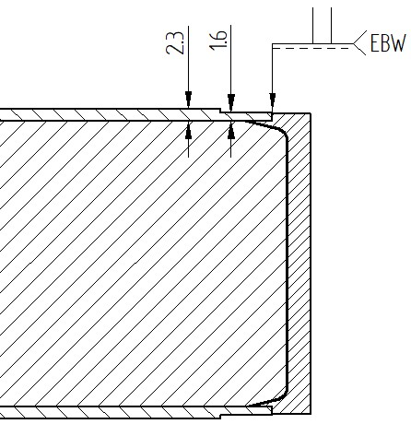
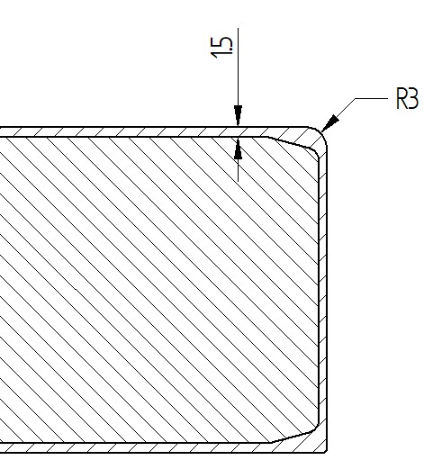
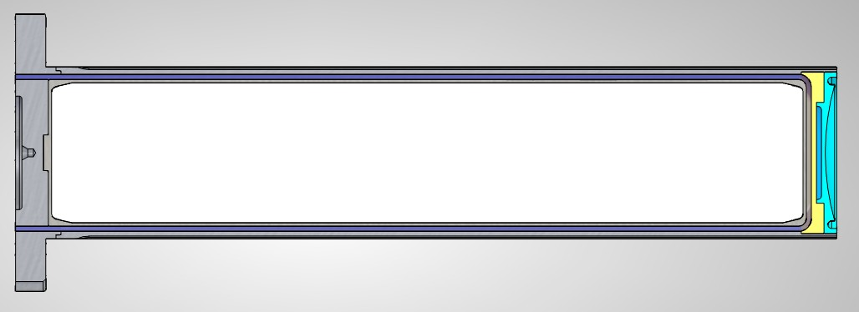
TS-2 Targets over time – Neutron targets
Mk 4
This design is not yet in service, but in manufacture
Analysis shows that changing to a flat face relocates the position of the EB weld and reduces stress in the cladding.
Single plate is simpler to manufacture than Mk3
Significantly reduces stress in the weld area
Core temp remains the same 250°C
Pre-weld Detail
Fully Machined

Slide 34
TS-2 Targets over time – Neutron target recap
Mk1 Target uncooled front face, Mk2 & Mk3 cooled front face.
Mk4 ‘single plate’ design in manufacture
Changes to design and manufacturing techniques have solved some issues and extended service life (aim to reach 5 years) - some way to go!
Studies into erosion and corrosion of tantalum – Sheffield Hallam University
Detailed analysis of water flow in the target to understand possible cavitation and generation of Hydrogen in the water circuit - Daresbury Scientific Computing
Continue to look into methods for understanding and improving water chemistry
PIE planned for Nov ‘24 to remove front cap from (Mk2) target and carry out visual examination

Slide 35
Where we are now

Slide 36
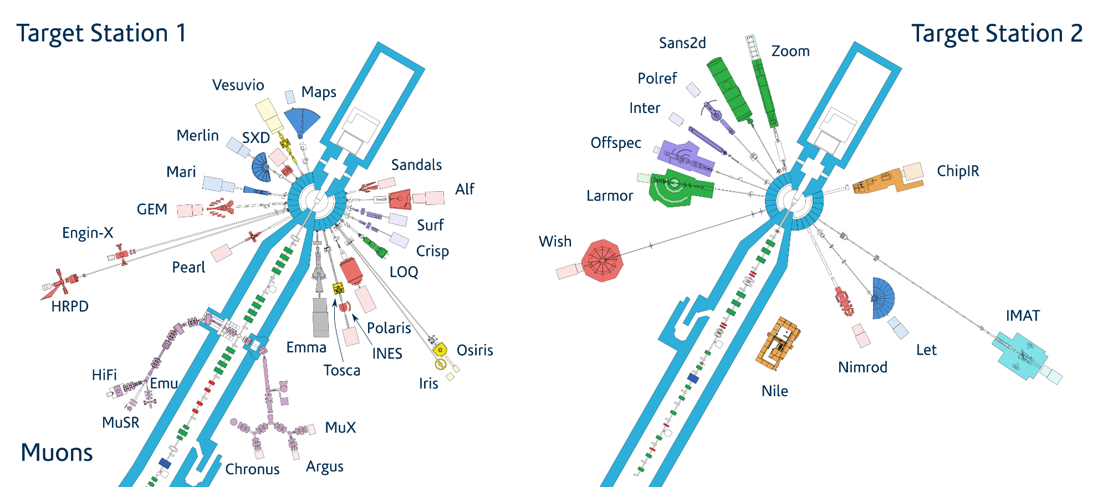
40 Years of Innovation

Slide 37
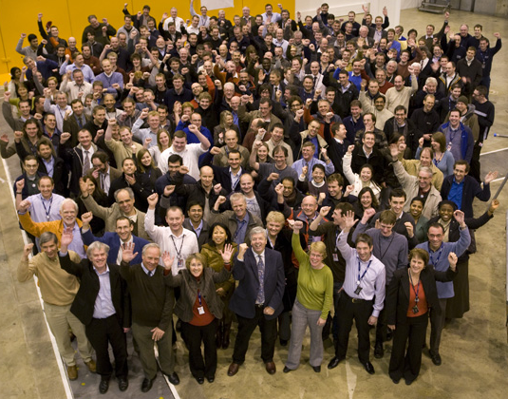
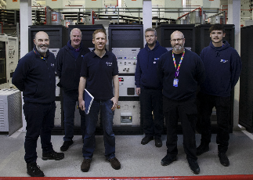
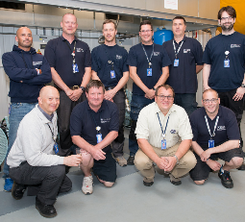
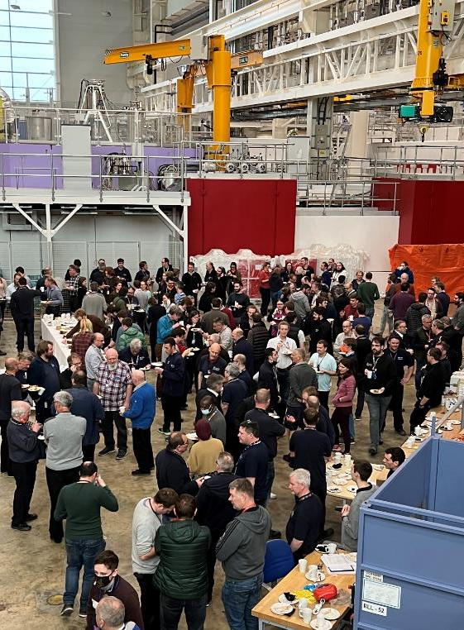
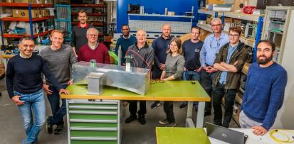


40 Years of Remarkable People, Teams & Partnership

Slide 38
A look to the future

Slide 39



A look to the future …
RRHF
Endeavour
TS-2 Advance
Post-Endeavour
ISIS-II

Slide 40


The RRHF
Key Features:
Crane capacity,
  De-lidding, 6,000 kg
  Active cell, 1,000 kg
Through wall manipulators, 2 per cell
  In the existing target stations we use: CARRS VNE 80 dynamic balance, 3.3m reach
Transfer tunnel, 1m x 1m aperture, 1,000 kg capacity
To be situated in R105
This will be the first time we’ve had a hot cell not connected to target station operation

Slide 41







SuperMuSR
SuperMuSR
Mushroom
Sandals-2
Mushroom
Sandals-2
HRPD-x
HRPD-x
Tosca+
Tosca+
LMX
Wish-2
LMX
eMap

Slide 42




TS-2 Advance
Project not even in concept phase
  Will look at increasing power on target possibly up to 60µA
  Similar scope to TS1 Project in terms of potential changes to TRaM components and services infrastructure
  Only really makes sense if target (& de-coupled CH4 moderator) lifetime can be increased
  Looking at a multiplate design needed to dissipate additional heat load

Slide 43





Post-Endeavour
Sherpa: polarisation analysis spectrometer
Post-Endeavour instrument development programme
Maximising capacity, capability and operating efficiency
Filling TS-2 spare ports; upgrading / replacing TS-1 instruments
Specific projects will be refined through user consultation, FSAG, ISIS SAC and Facility Board
May well require target and TRaM design changes
ETNA: Epithermal neutron analysis
Pearl-x: advanced pressure studies
Energ-I: thermal neutron imaging station
Brill: Brillouin neutron spectrometer

Slide 44




ISIS-II
The next generation of ISIS - A MW-class Neutron and Muon source
New accelerator and two new target stations from day one, optimised for different things:
Preferred location: Greenfield site at RAL

Slide 45

Concept of how ISIS-II might look
Image not to be shared widely – only indicative

Slide 46
Acknowledgements
I do just want to acknowledge the large number people who have helped in the putting together of this talk, either through materials or slides used, or through advice and supporting papers.
Those people include Roger Eccleston, David Findlay, David Jenkins, Leslie Jones & Dan Wilcox

Slide 47
Thank you for your attention, any questions

Slide 48
Back-up Slides

Slide 49
ISIS History
16th Dec 1984, 7.16pm first neutrons produced
  Target zircaloy clad depleted uranium
1986 – 9 instruments – accelerator increasing energy and current
1987 – Muon facility construction
1989 – 4th Uranium target failed
1990 – target now tantalum – 50% yield of Uranium
1991 – 6th Uranium target replaced with tantalum
1992 – 15 instruments
  Uranium target 7 failed – decision to keep with tantalum made

Slide 50
1994 – accelerator at 200uA, 800MeV
1999 – Design of Ta clad W targets
2001 – Ta clad W target installed
2002 – one spare beamport on TS1 – earmarked for Merlin
2003 – Merlin instrument construction
2007 – TS2 first protons to target
2009 - 7 instruments commissioning on TS2
2011 – Construction start on 4 new TS2 instruments

Slide 51
Celebrating 40 years of neutrons at ISIS
ISIS Facility – Brief overview and history 40th year
Overview of TS1 Target - History & Evolution
Overview of TS2 Target - History & Evolution
Target Plate design and manufacturing
ISIS Target Man

Slide 52

Project
Overview of TS1 Project Target design
Target Cross-section
Water
Manifold
Target
Spacer
Target Stack
(10 Plates)
Target Vessel
Thermocouple
Protector
Window

Slide 53



Project
Manufacturing Target Components
  Construction principle of Target Plates same as existing TS1 target
  Round profile reduces no of welds from 13 to 3

Slide 54

Project
Manufacturing Target Components
Meticulous surface preparation and
cleaning required before EB welding
in vacuum
Note: Welds are carefully positioned
to remain untouched by the post HIP
machining operations

Slide 55

Project
Manufacturing Target Components
  Target plates interlock to ensure correct positioning of thermocouples
  EB welded together to prevent vibration from cooling water
Machined features fix orientation and provide weld feature

Slide 56




TS2 Target MK2
The MK 2 Target solved the original problem of the front face oxidising and extended the service life of the target - then presented a new problem!
Short lived isotopes Ta 182 & W 187 detected in the cooling water.
Early analysis suggested a breach in the Ta cladding in the location of an EB Welded joint in the Target HIP Assembly.
Reasoning
Arghya Dey, Leslie Jones. (2018). Strategies to improve ISIS TS2 target life.
Journal of Nuclear Materials
32 KW Energy deposited causes the core to expand in all directions
Electron Beam welding creates large grains in HAZ
The weld joint is in a vulnerable position
Tantalum and Tungsten have different material expansion rates.
In the cooldown after HIP Tantalum shrinks more and is in tension.
Potential for stress crack at the weld joint
EB Weld Line

Slide 57


TS2 Target MK2
Now manufacturing targets in-house.
EB Weld trials concluded insufficient weld penetration.
Tantalum has extremely high density and melting point (3000°C ).
Post HIP machining operation reduces cladding thickness to 0.8 mm, likely removing most/all the weld.
Target no. 7 was rewelded after HIP/Machining and lasted longer
EB WELD/HIP
STAGE
POST WELD
MACHINING
Rewelded

Slide 58






TS2 Target MK2 – Manufacturing
*Requires final
Machining
After HIP
Raw Materials
Ta Tube + W Core
Ta Flange
Ta Flange
+
W Core
Ta Flange
+
W Core
+
Ta Tube
Ta Flange
+
W Core
+
Ta Tube
+
Ta Cap
EB Welded
+
HIP
1250 °C
1400 MPa

Slide 59






TS2 Target MK2 – Assembly
Cross Flow
Guide
Window Cap
Target HIP Assembly
(after final machining)
Target HIP Assembly
+
Cooling Sleeve
+
Cross Flow Guide
+
Window Cap
Machined from
solid Ta rod
Final Assembly
(ALL COMPONENTS FITTED AND
THERMOCOUPLE GROVES MACHINED)

