Slide 1
Report of Dongguan Branch
Current Status and Upgrading Progress of CSNS
Remote Handling System and PIE
Zhiduo Li
CSNS-II RH system/CSNS RH&SH group
Institute of High Energy Physics, Chinese Academy of Sciences, China
16th International Workshop on Spallation Materials Technology10.28-11.02/2024 Abingdon, UK

Slide 2
Outline
CSNS Remote Handling(RH) Overview
Current Status of CSNS RH
Progress of CSNS-II RH upgrade
R&D on key technology/equipment
PIE progress & plan
Summary & Outlook

Slide 3
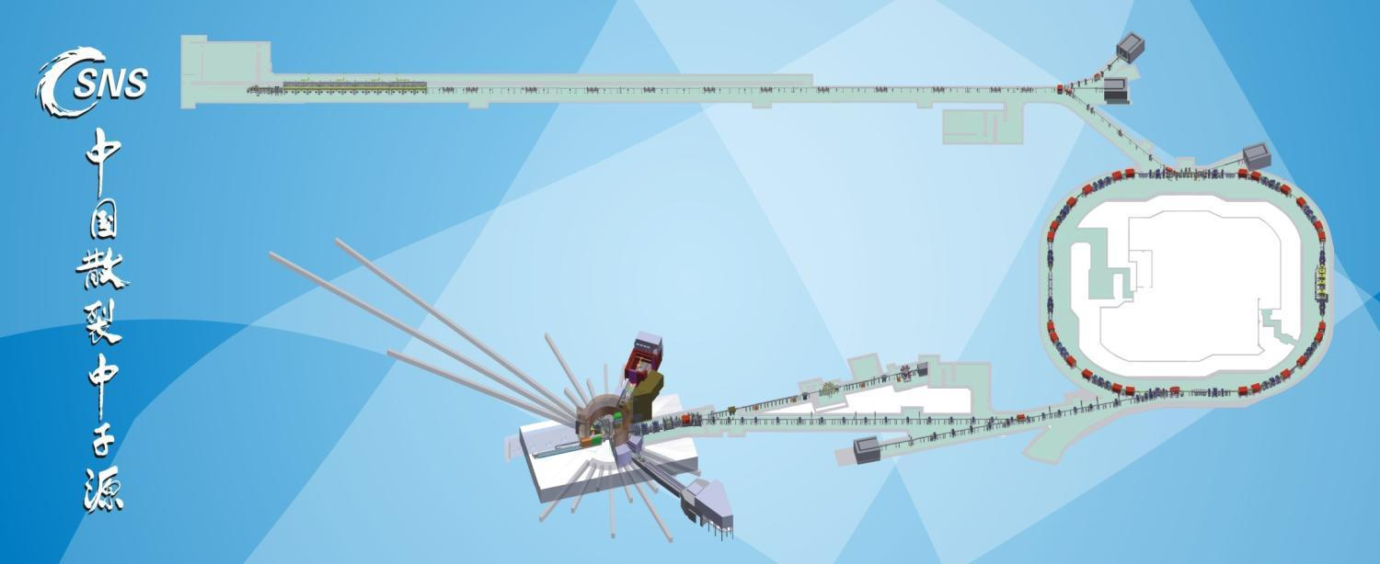
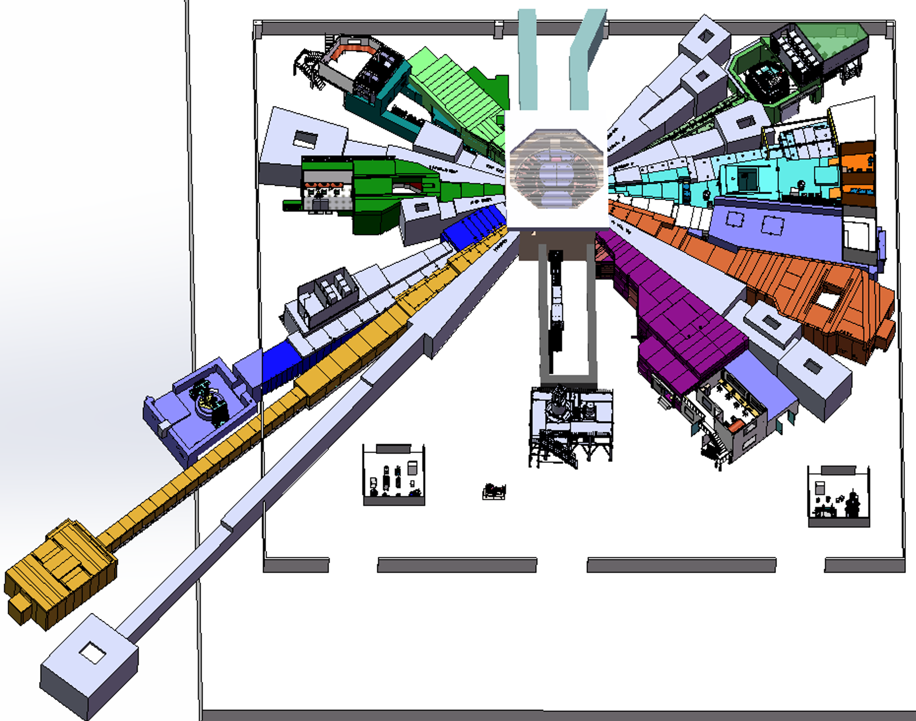
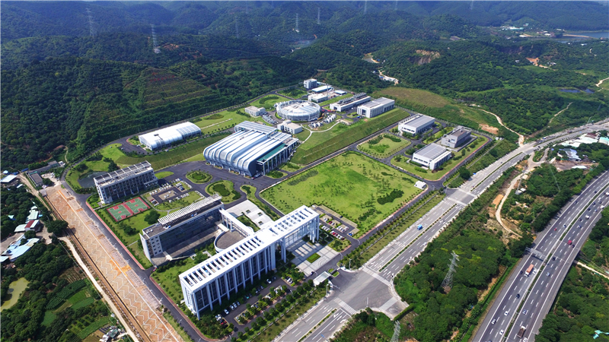
CSNS overview
The CSNS facility in Dongguan, Guangdong, is an accelerator driven neutron scattering facility for materials research
CSNS operates presently at 170 kW@25Hz proton beam power incident on a solid tungsten target
Equipped with 20 neutron beamline shutters in the target station
Presently 6 neutron instruments are open for operation
BL#02
BL#18
BL#01
BL#16
Target building
BL#14
BL#13
Target & Instrument building layout

Slide 4
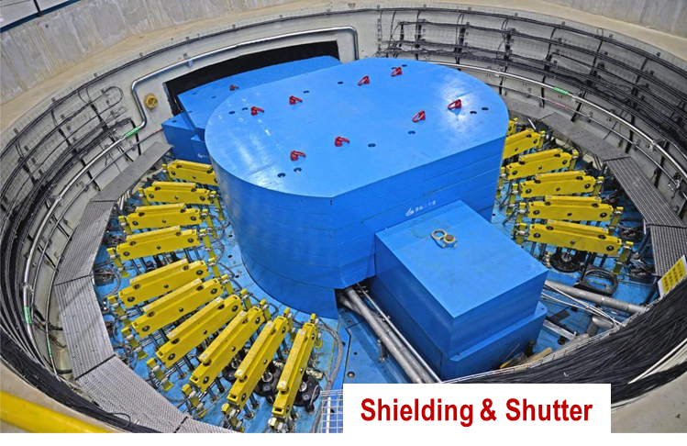
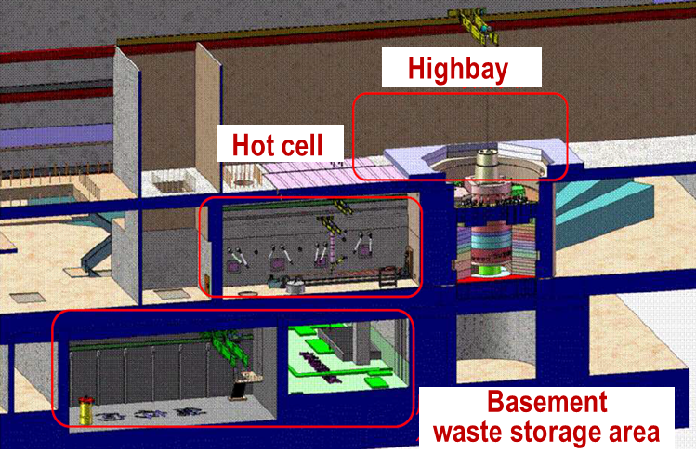
Remote Handling(RH) overview
The main task of remote handling system at CSNS:
Operation and maintenance of shielding (shutter ) system
Remote handling for maintenance objects at Neutron & MuonTarget Station
CSNS Remote handling mainly includes:
Major key comp. replacement (e.g.Target, PBW, MR, Shutter Insert, NBW, Ion exchanger and filter, etc.) & process development
Waste handling operations (Cask loading, shipment, waste volume reduction, waste storage and decommissioning at CSNS campus)
R&D on key technology/equipment and remote handling for potential weak spot maintenance needs of the facility
Emergency handling safeguard for abnormal working conditions(e.g. sudden key component failures, etc.)
PIE application and operations development
Advanced shielding materials and comp. development
3S
Supporting
Safeguard
Service

Slide 5
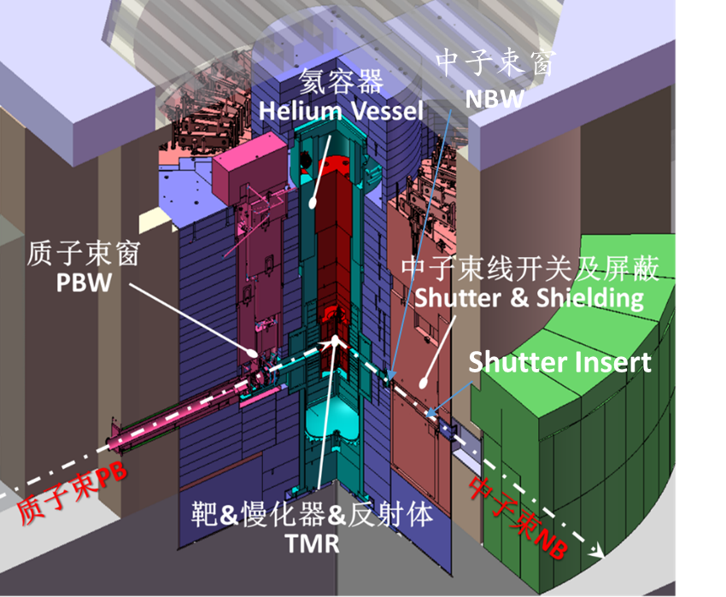
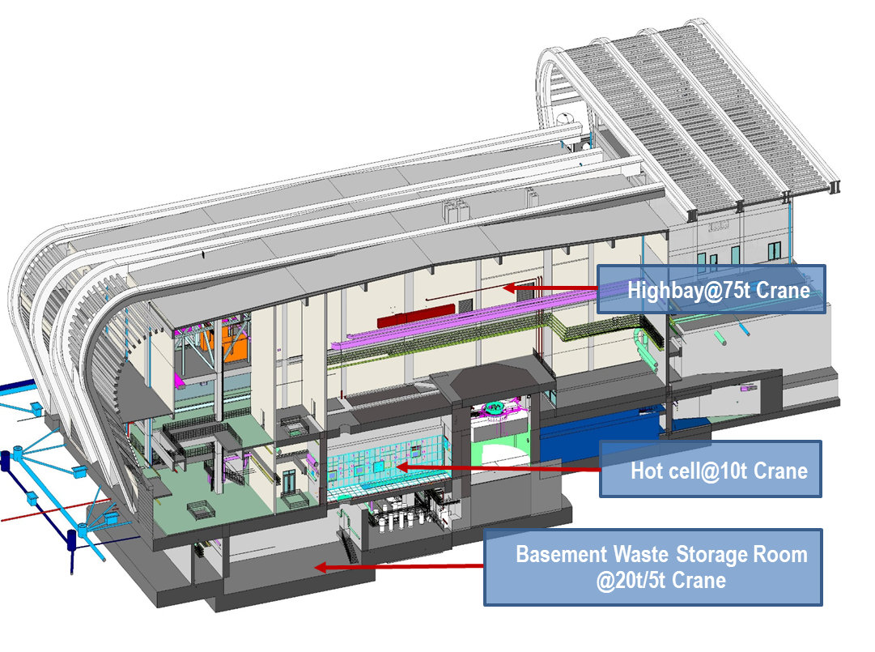
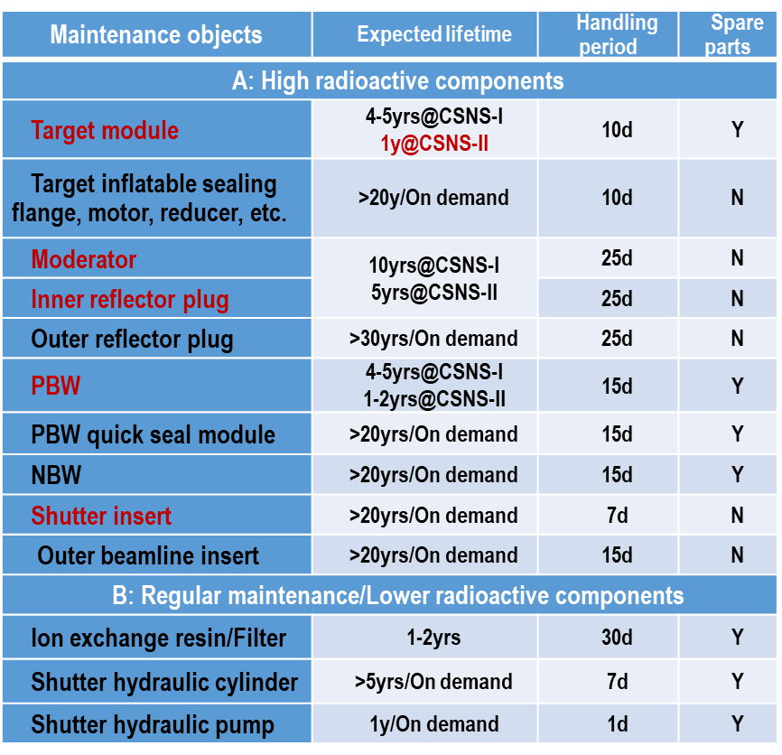
RH goals & general principle
Refer to ALARA /time-distance-shielding principle and CSNS Safety Management Regulations
Safe, reliable, reasonable and effective completion of replacement/disassembly, volume reduction, transfer, storage and decommissioning of radioactive maintenance objects
Target station
Target & trolley system: Horizontal handling
MR/PBW/NBW/Shutter insert: Vertical handling

Slide 6
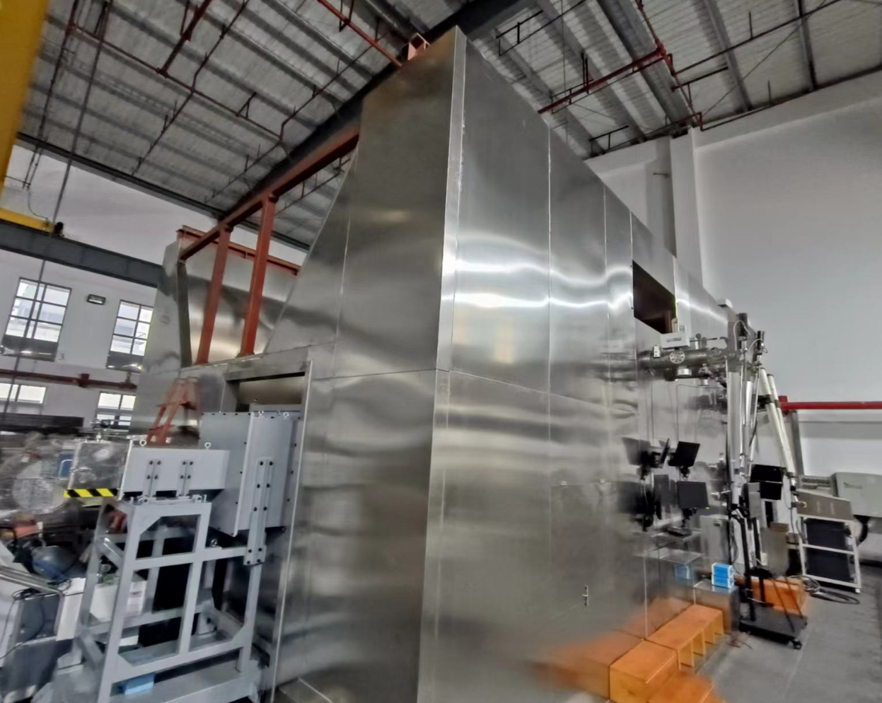
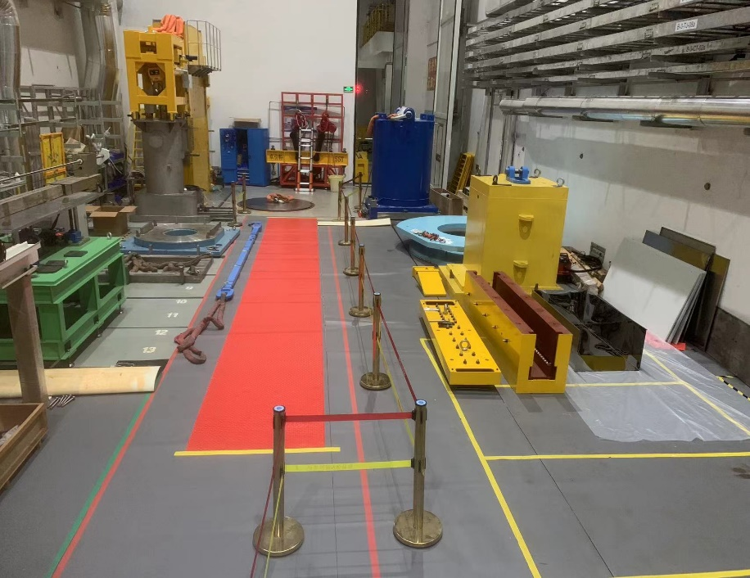
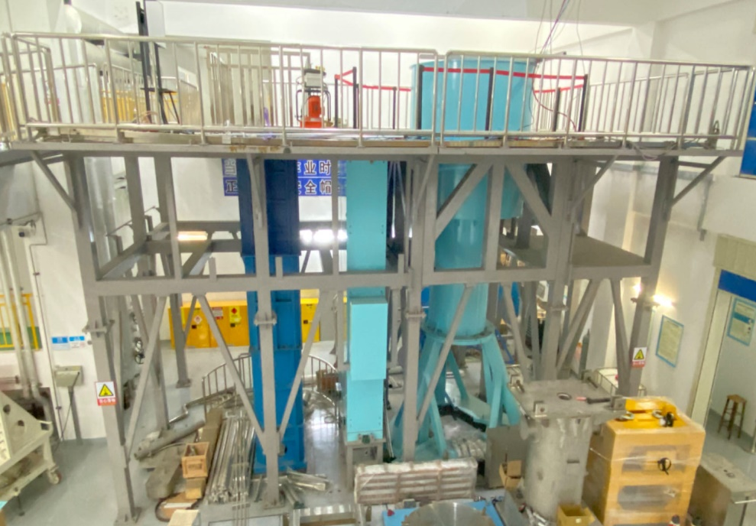
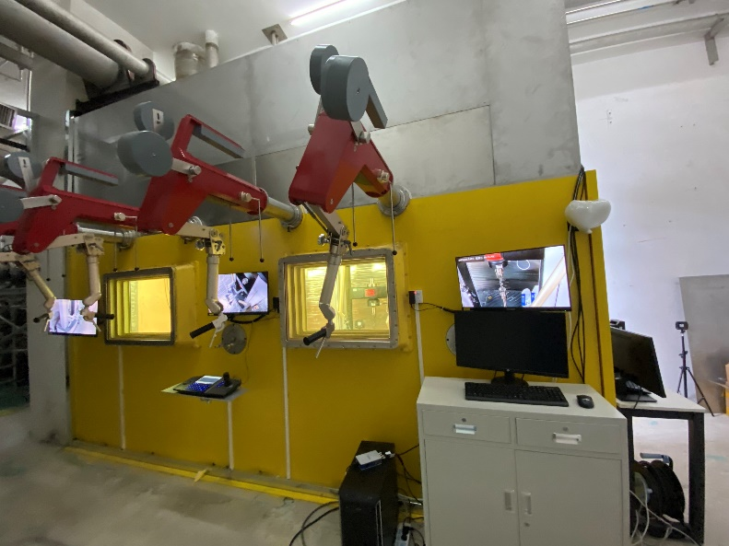
RH equipment & test platforms
Hot cell mockup
at maintenance building
Shutter Insert/MR/PBW replace device
at Highbay
Large comp. handling mockup
at target building (MR,PBW,NBW)
PIE test room
adjacent to Hot-cell

Slide 7
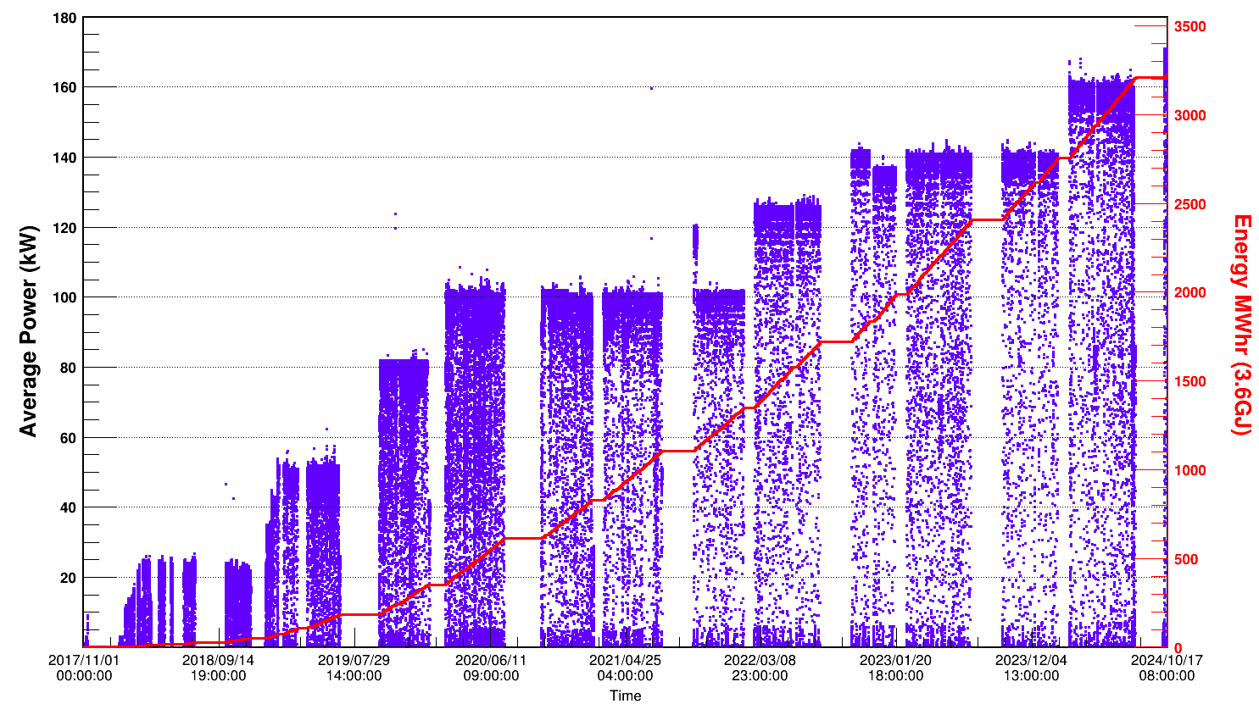
Beam power-Key comp. replacement history
Since CSNS formal operation began in 2018, a significant amount of remote operations have been successfully completed
170kW
2024.10.11
3*IE
PBW
BL #9 SI
T #3
T #2
BL #8/#13/1#4/#15 SI
3*IE
T #1
BL #5/#11/1#6 SI
Shutter Inserts:3+8
Targets:3
Ion Exchangers:3+3
PBW:1

Slide 8
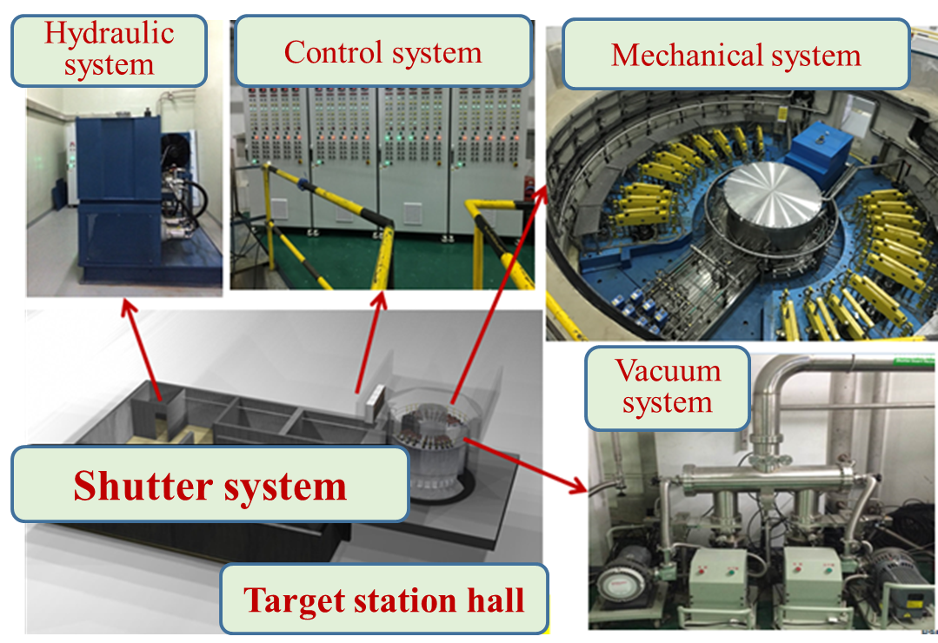
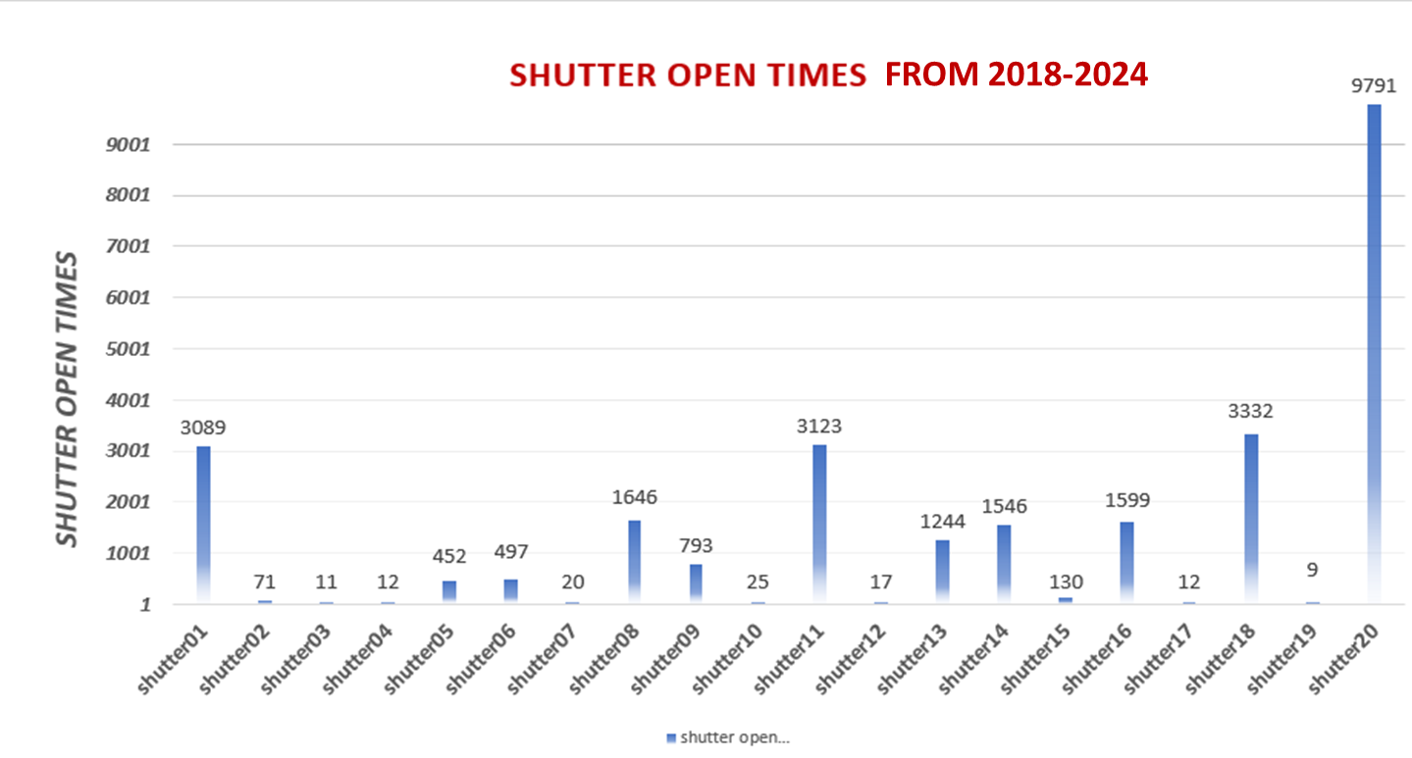
Shutter system operation status
Maintain high-efficiency and stable operation! Running time > 6000h/y, > 6 years basically trouble-free!

Slide 9
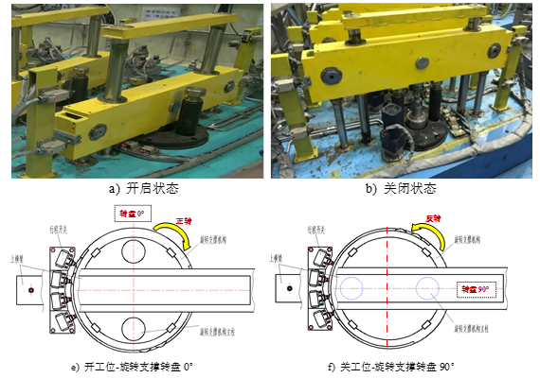
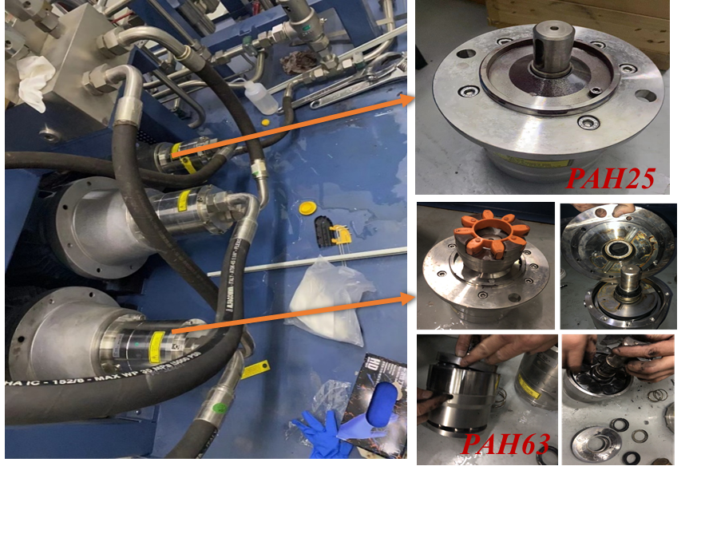
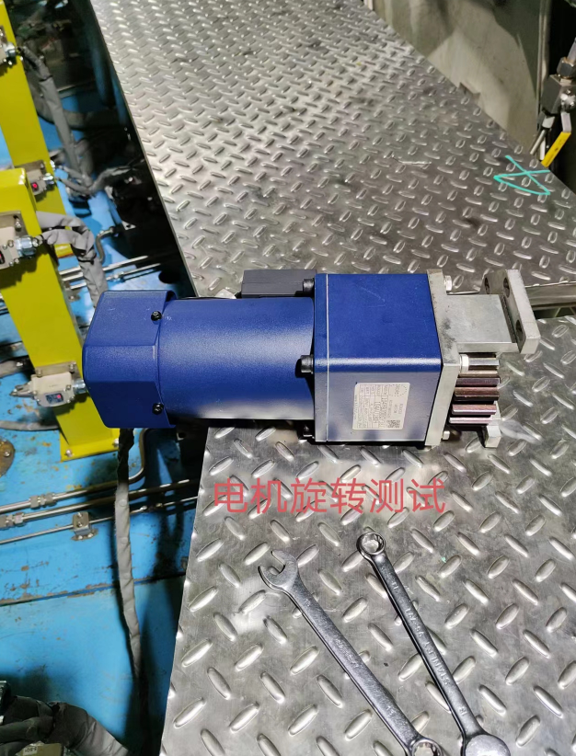
Shutter system maintenance
Replaced 4 water Hydraulic Pumps and gained the actual operation lifetime from the pump for wear failure:
Water hydraulic pump 01# (PAH63) replaced in 2020 @~16000h
Water hydraulic pump 02# (PAH63) replaced in 2022 @~12000h
Water Circulate pump 01# (PAH25) replaced in 2023
Water hydraulic pump 04# (PAH63) replaced in 2024
Self-developed pure Water Hydraulic Cylinder with radiation resistant works very well and has not been replaced yet
Shutter Open
Shutter Closed
WHC
Rotation Motor
Replaced 2 rotation motors(AC 3 phase/380V@200W) from Rotating Support for aging and short circuit in Dec. 2023
Open-Rotating Support
Closed-Rotating Support

Slide 10
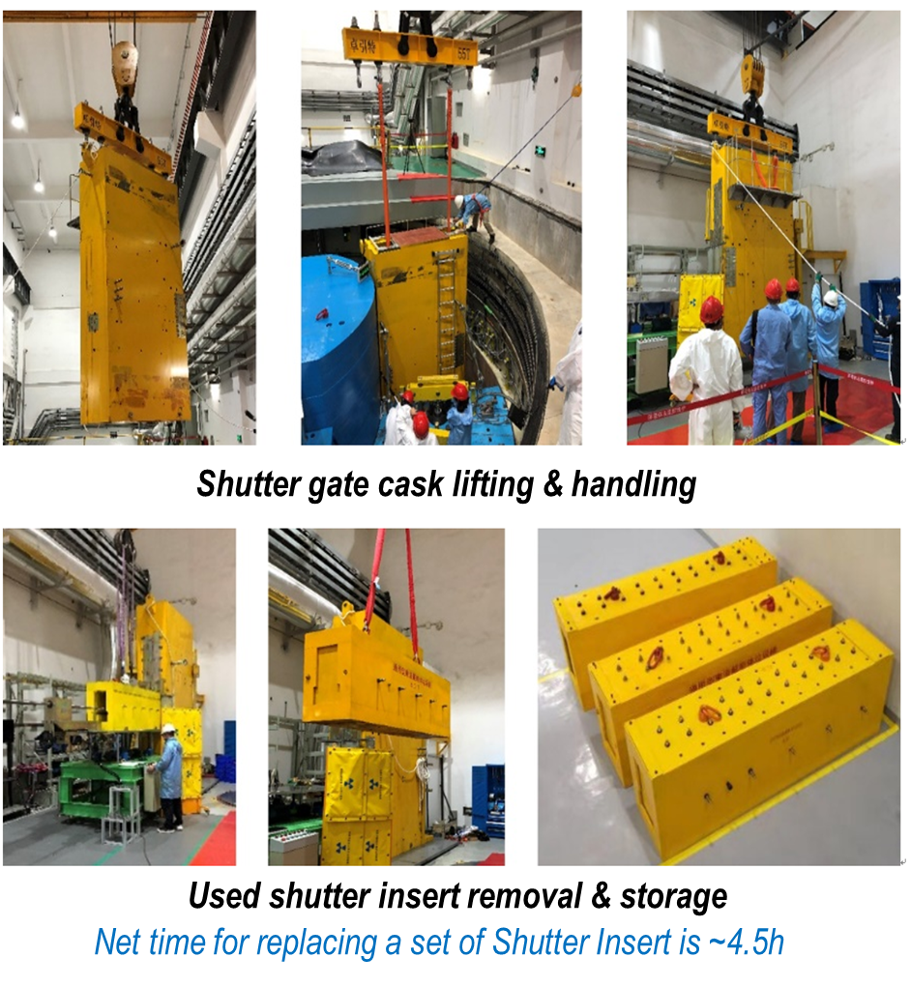
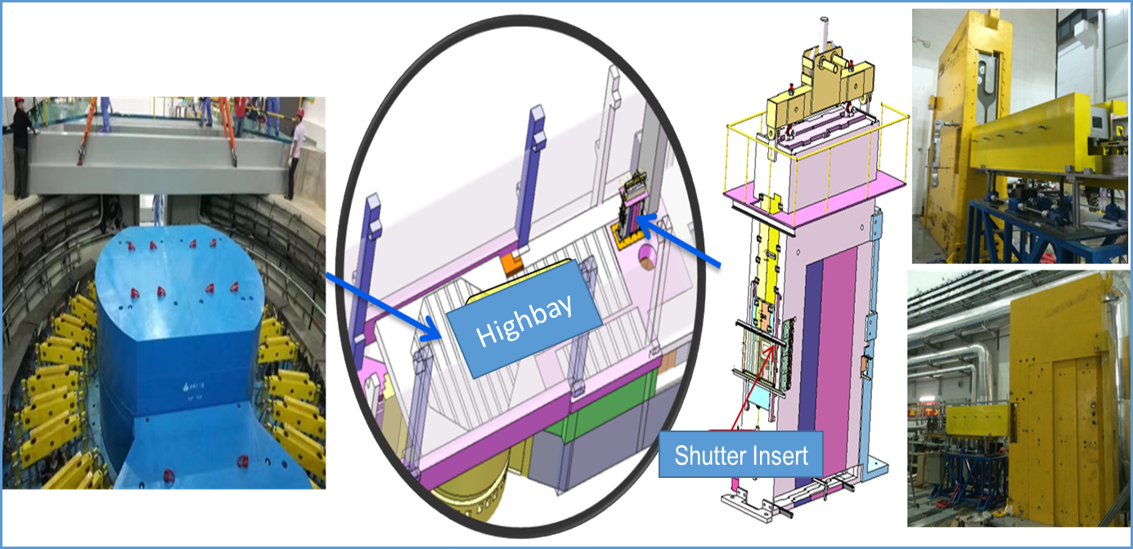
Shutter Insert Replacement
Smoothly completed the replacement of 11 sets of Shutter Inserts in total with safety and high efficiency
Gained valuable experience through the replacement of 8 radioactive Shutter Inserts from 2018 to 2022
Maintenance processes for SI have also gradually been standardized
Surface dose rate Max. 2.5μSv/h
CSNS-II will replace 8 sets in total in the summer of 2025 and 2026, left one(Beam line 07#) set as reserve

Slide 11
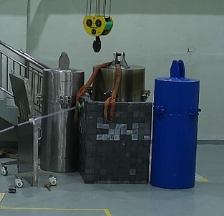
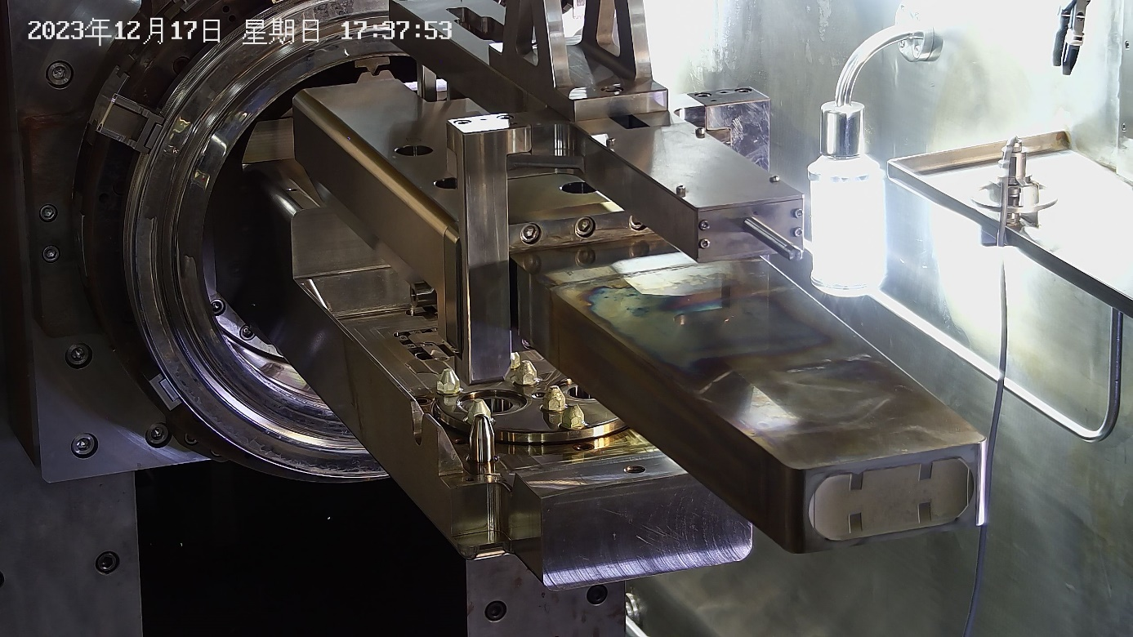
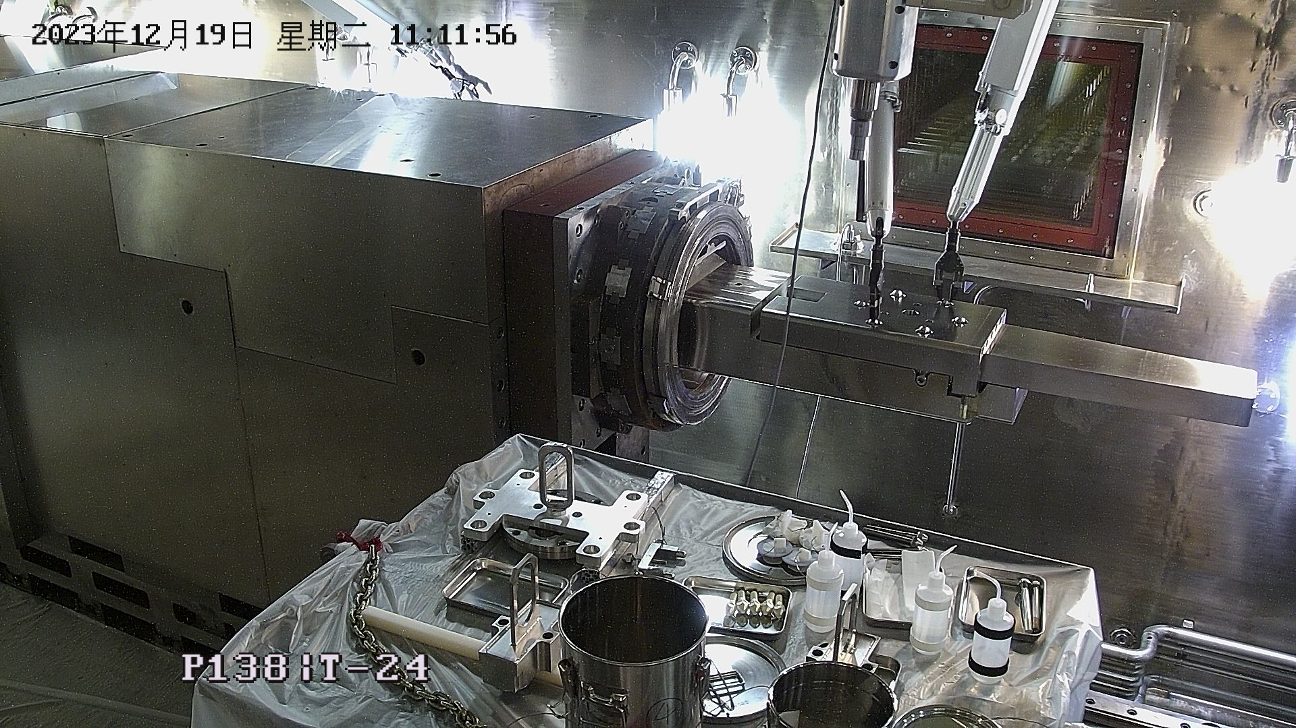
Target Replacement
Successful replacement of the target modules is accomplished using only remote handling tooling and procedures in Hot cell
So far, CSNS has completed the remote replacement of 3 targets
Replaced the first Target #1 (No thermocouple) as maintenance panning in 2020
Urgently replaced the 2nd Target #2 for the seal leakage of target module in May 2022
Urgently replaced the 3rd Target #3 for the seal leakage of target module in Dec. 2023
UT#3
UT#2
UT#1
Used target cask storage
Target activity: 2E+14Bq, surface gamma dose rate: 2000Sv/h
Typical target change requires: ~5 days
usedTarget#3 removal and lifting
New Target#4 installation

Slide 12
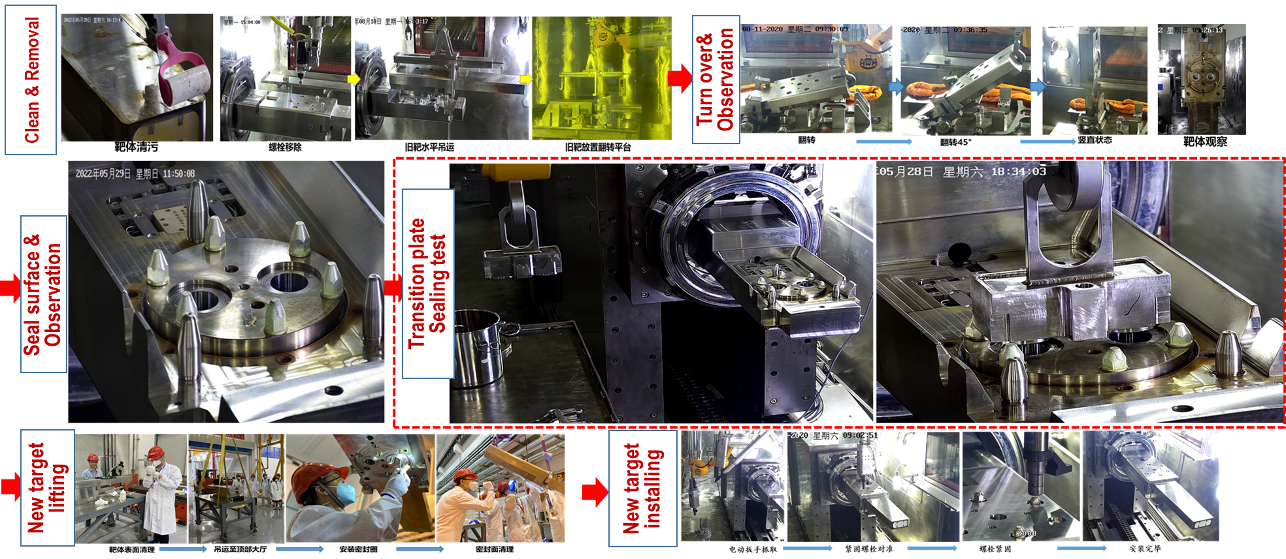
Target Replacement
Accumulated valuable experience in the remote operation of target module through 3 targets replacement
Remote operation replacement processes for target module have also gradually been standardized

Slide 13
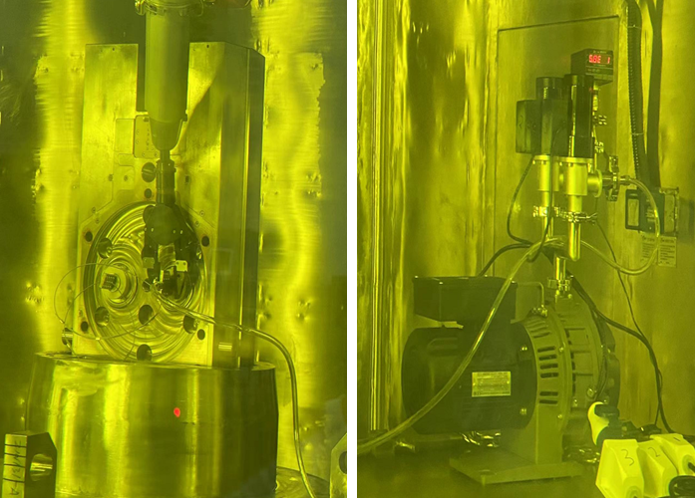
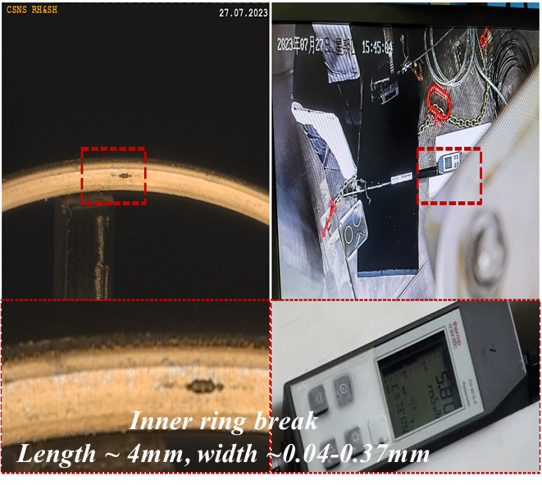
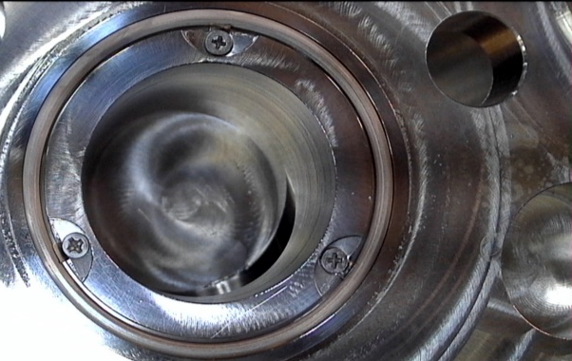
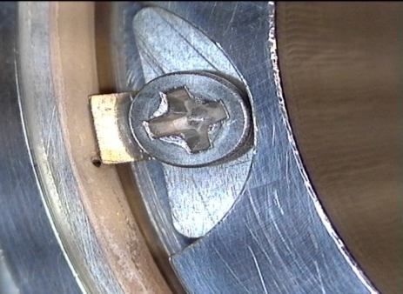
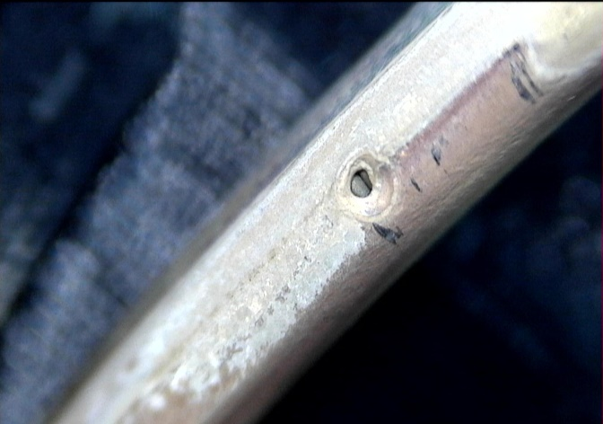
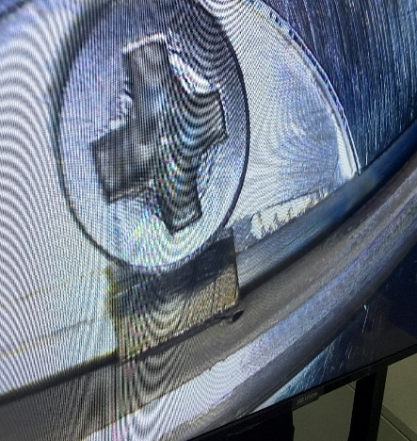
Target Replacement
Target #2/#3 failure analysis and examination for remote operations in Hot cell
Carried out target fault detection through remote operation and respectively completed the following in the high radioactive environment:
Target #2 sealing performance test in Summer maintenance period of 2022
Removal and observation of metal sealing ring in Summer maintenance period of 2022 & 2023
➔The test results show that the sealing performance of the target container is good (no leakage)
➔ The leakage is caused by the damage from the silver metal sealing O-ring at the bottom of the target module
Used target #2/#3 sealing vacuum test
Removal & observation of sealing O-ring of target #2
Removal & observation of sealing O-ring of target #3

Slide 14
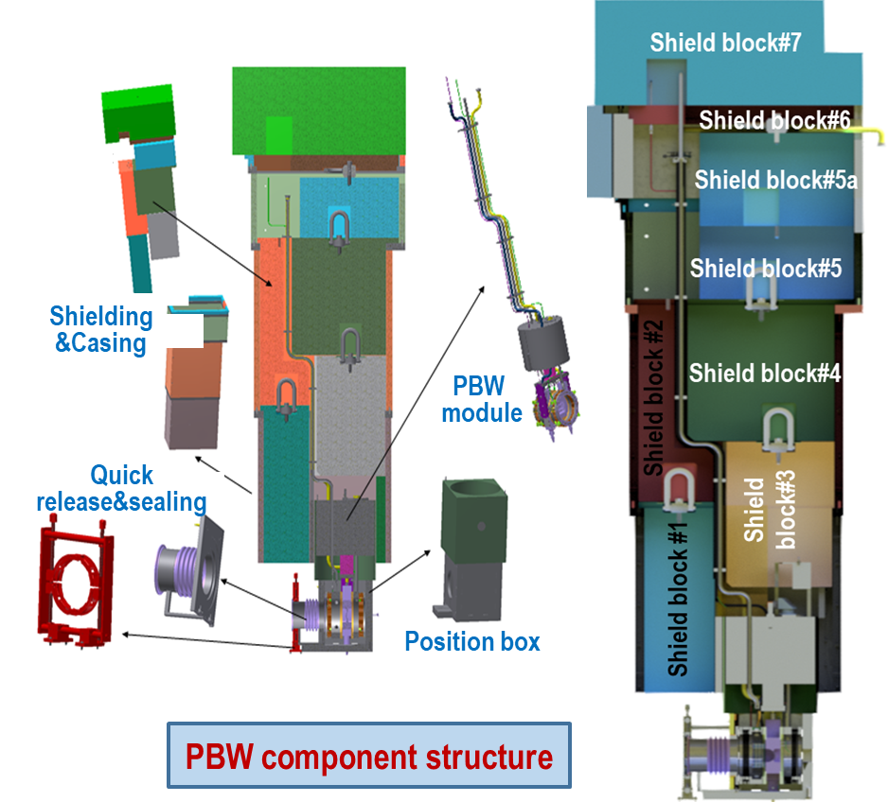
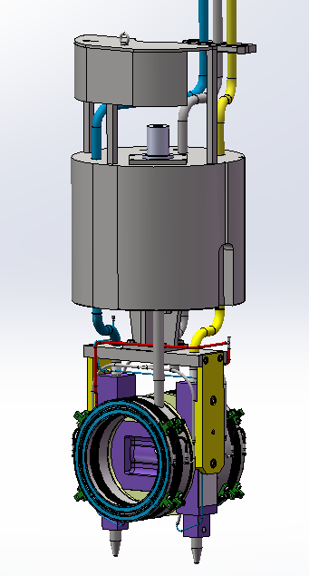
Proton Beam Window(PBW) Replacement
Located at the interface between the RTBT transport line and the target station, which plays the role of isolating the high vacuum of the accelerator and the helium environment of the target station
PBW component is designed for vertical maintenance, including PBW module, inflatable bellows sealing, wire target & cable, main frame, cooling water pipeline, vacuum pipeline, shielding iron and quick sealing structure
Propose the replacement task and confirm the interface at the target station in 2022
Completed maintenance related tooling / mock-up tests and operational exercise in 2023
Successfully completed the first PBW replacement during summer maintenance of 2024
See Yuanguang Xia’s report for details!
Old PBW 1# @A5083-O
Designed by 100kW
Single layer window & edge water-cooled
New PBW 2# @A5083-O
Designed by 500kW
Double-layer window & center water-cooled
PBW module

Slide 15
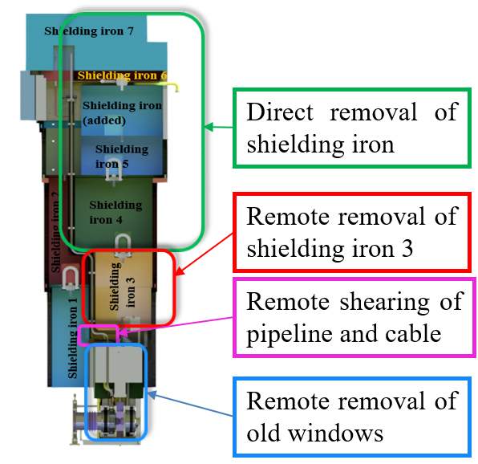
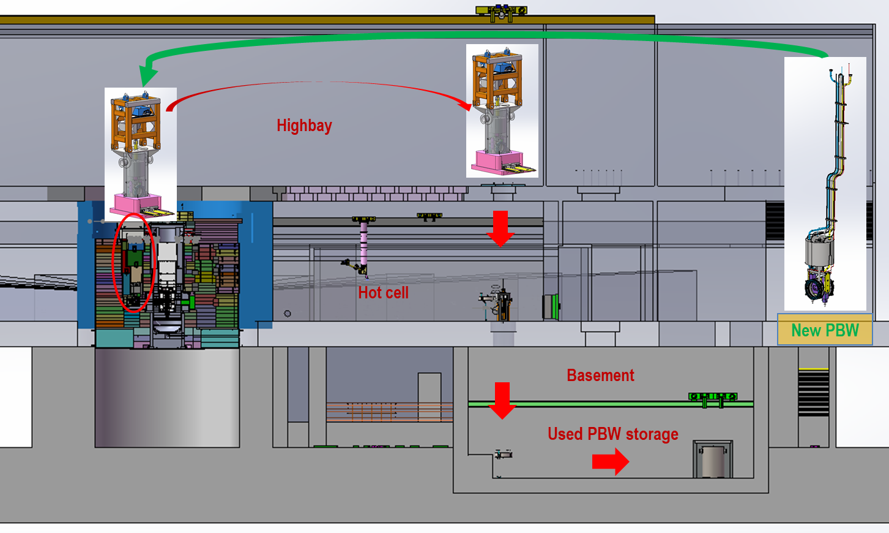
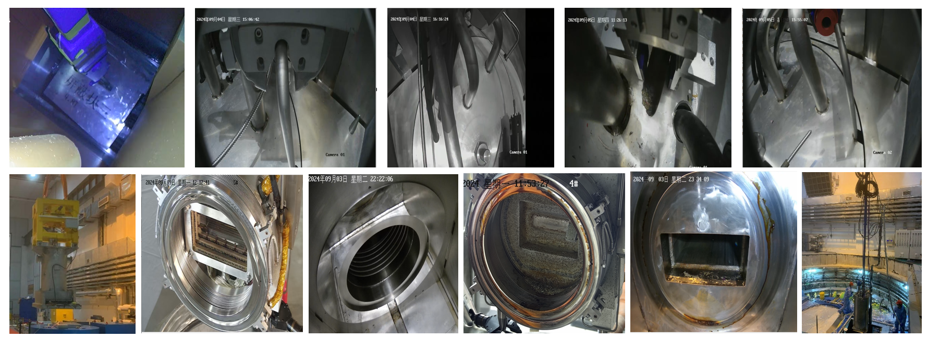
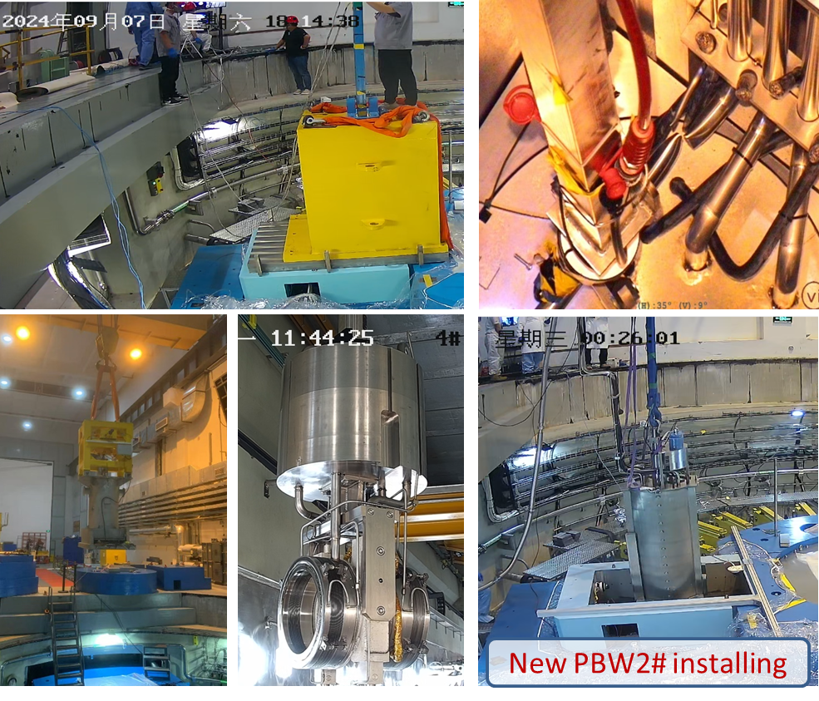
Proton Beam Window(PBW) Replacement
Remote replacement of PBW module
Handling difficulties: Shearing/cut of utility pipes and cables
Key Points: Ensure the sealing surfaces of PBW is intact, and the vacuum degree at the accelerator side is below 10⁻⁴Pa
Main operations for replacement of a PBW:
Build a negative pressure air chamber to collect
activated gas and monitor tritium content
Removal of shield blocks (reuse)
Water pipe drying & removal of PBW module
Cutting & removal of activated water & vacuum piping
Remote installation of quick connector for vacuum pipe
Remote removal, transportation, observation and
storage of old beam window
Mirror surface observation
Installation of new PBW module
Connection of utility piping
Leak testing of inflatable seals and piping connections
Re-installation of shielding and system recovery

Slide 16
Proton Beam Window(PBW) Replacement
Maintenance summary for the first time PBW replacement
The maintenance of PBW was smoothly completed, and the remote operation of maintenance tools and devices was normal
The radiation dose monitoring means is perfect, and the radiation dose level is equivalent to the theoretical calculation
The protection and monitoring of gas tritium is very important @ Gas tritium in inflatable seal bellows: Max.3520Bq/L
After the installation of the new window, the vacuum index meets the expected requirements
Personnel protection, equipment safety and other measures are considered comprehensively
After further improvement of the maintenance process, standardized remote replacement process will be achieved

Slide 17
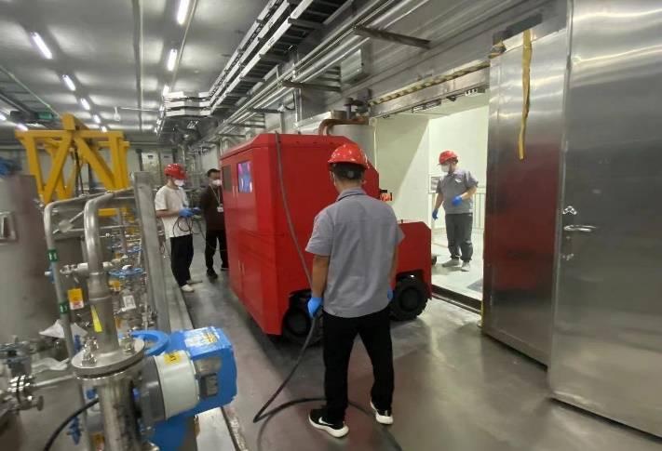
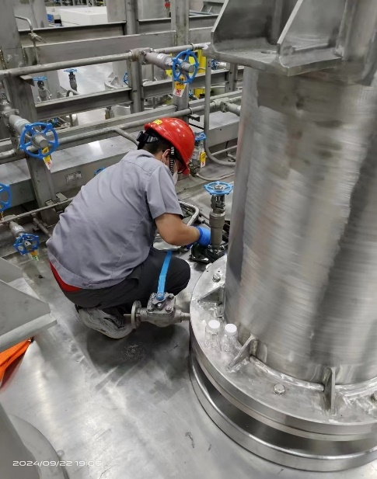
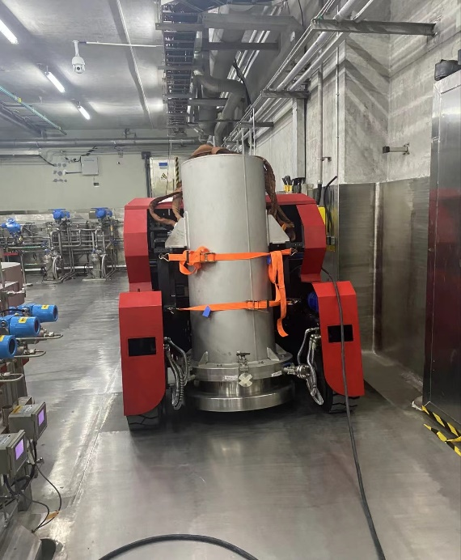
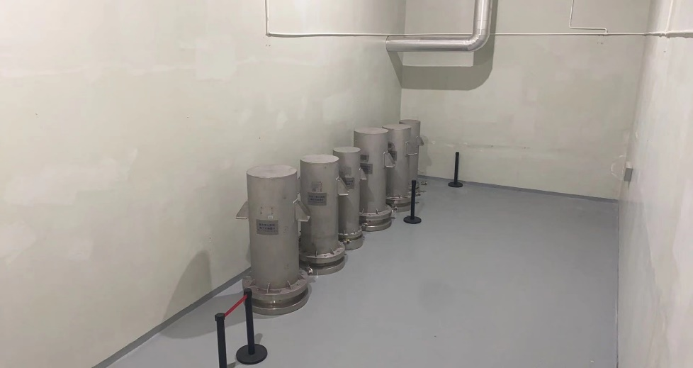
Ion Exchanger Replacement
Main maintenance experience
Completed 6 sets of ion exchangers replacement ( 2020 and 2024)
Strengthen gas tritium protection and monitoring. When the metal hose is disassembled, a short time (about 10s) of gas tritium produces 400-500Bq/L
Transfer trolley needs to be further improved

Slide 18
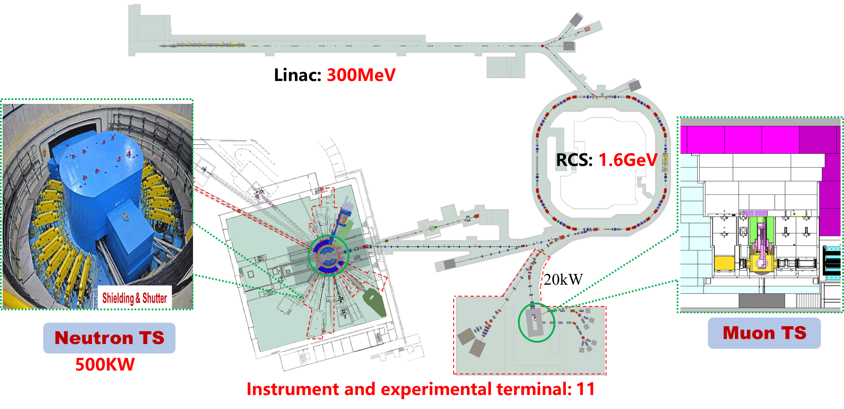
Progress of CSNS-II Remote Handling System
Completed preliminary design of upgrade proposal
Carrying out detail design, R&D on key equipment, and mockup test. The system upgrade mainly includes:
Hot cell upgrade
RH design and upgrade of key comp. in target station
TMR/PBW/NBW +muon target station RH construction
Shutter system, water cooling system purification equipment, etc.
Waste storage/basement space plan & construction
Storage of retired components such as TMR and PBWs
Decommissioned ion exchanger reduce volume, storage, etc.
Upgrade and improve the handling capabilities under abnormal & emergency working conditions for target station maintenance objects
R&D on Key technology and equipment
PIE capacity building for retired core components
CSNS-II RH overall goal: Comprehensively strengthen the building and improvement of remote handling capabilities!

Slide 19
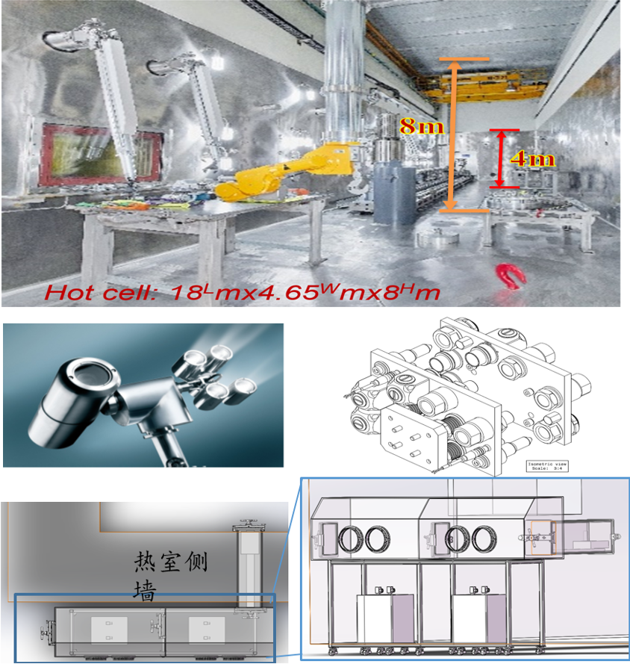
Hot cell & maintenance equipment upgrade
Hot cell upgrade
Upgrade construction of the remaining stainless steel liner on the inner wall of hot cell
Add equipment transfer channels in the hot room/transition room
Maintenance equipment upgrade
Equipped with special cleaning, volume reduction, transfer and other devices
Power manipulator driving upgrade (add the drive redundancy system, emergency drive system, etc.)
Add one pair of master-slave manipulator spare parts
Upgrading part of the original industrial camera system inside the hot cell to a radiation-resistant camera system
Add a common interface platform for water and electricity
Add aerosol detection instruments, movable real-time dose detection devices and other radiation protection equipment
Develop special equipment for remote operation of target fastening bolt disassembly and assembly

Slide 20
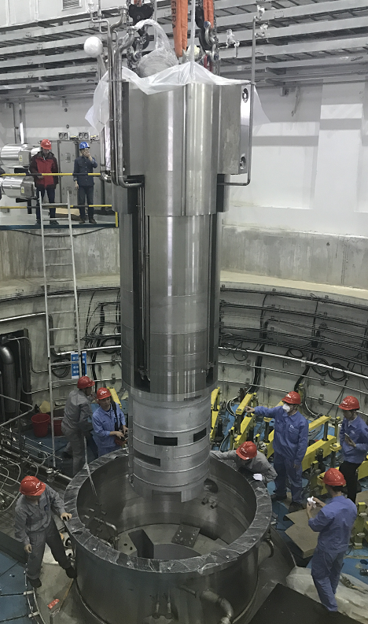
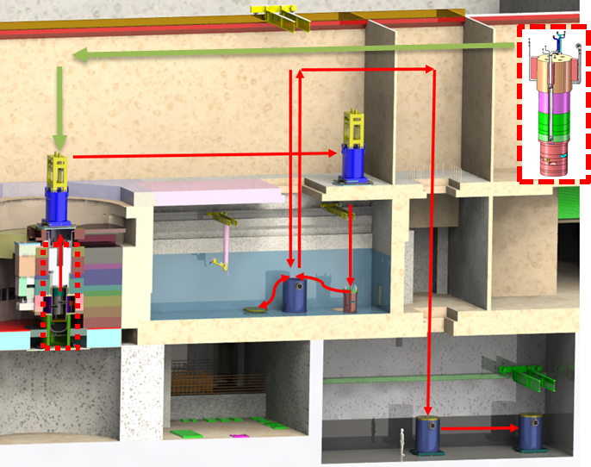
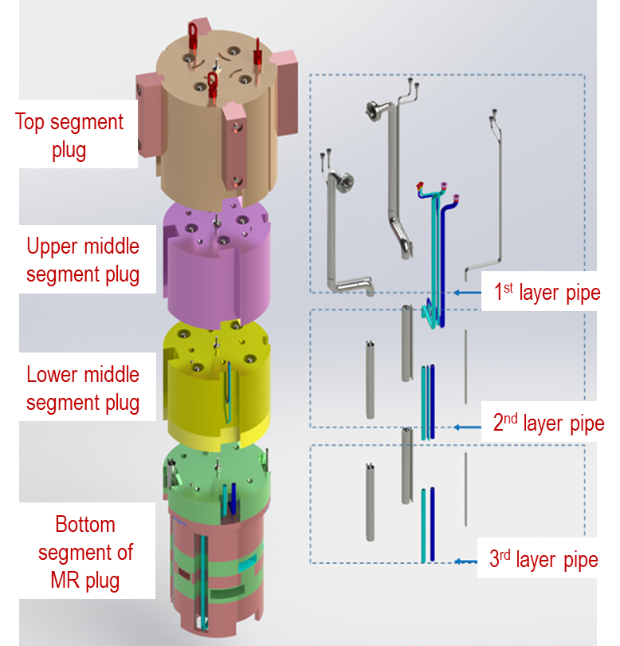
MR replacement process development
MR plug is large, complex and limited-lifetime(10y@CSNS-I, 5y@CSNS-II) key component of the target station
MR plug split into four segments and its pipeline split into three segments, each segment will be disposed separately
Use lifting and transport containers to transport plugin and pipeline to storage containers in the hot cell, and then lift them into the basement to store
High radioactive MR replacement is challenging. Replacement time: January to April 2028
MR plug@~33tons and 5.4m height

Slide 21
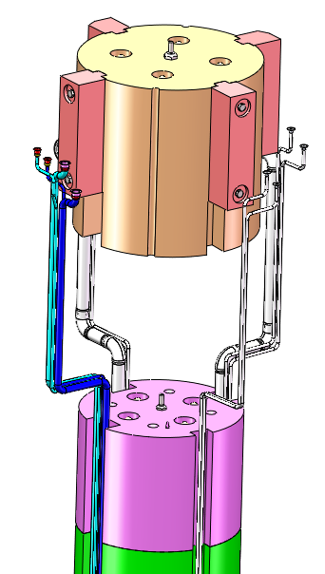
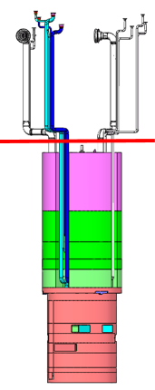
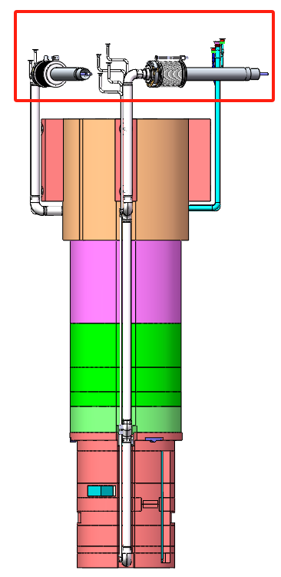
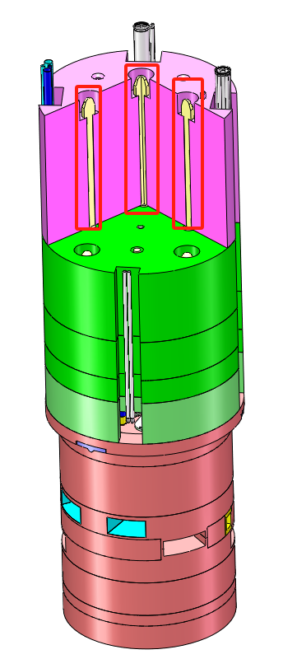
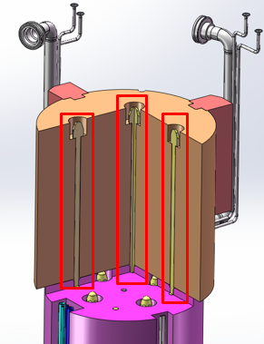
MR replacement process development
MR replacement process mainly consists of ten steps
Except for the lifting and transportation of plugins, all other steps have been tested on the testing platform
1. Disconnecting from external connecting pipelines
2. Loosening of the first plug-in connection bolt
3.Lifting of the first plug-in
4.Cutting of the first layer pipeline
5. Loosening of the second plug-in connection bolt
10.Lifting of the fourth section of the plug-in
9.Cutting of the third layer pipeline
8.Lifting of the third section of the plug-in
7.Cutting of the second layer pipeline
6.Lifting of the second section of the plug-in

Slide 22
MR replacement process development
A significant amount of testing on testing platform and target station
Bolt loosening test
Pipeline cutting test
Pipeline lifting test
Pipeline clamp out test
Pipeline shrinkage test
Ziplift lifting test
Remote camera system test

Slide 23
MR replacement process development
Lifting and transport container testing on testing platform
Preliminary design of storage container
Upper shield block in the middle section
Upper Shield Block
Lower shield block in the middle section
Lower reflector block

Slide 24
MR replacement process development
The dose of the MR plugin at the bottom is very high, close to 100Sv/h @CSNS-II, and requires sufficiently thick shielding
Main maintenance difficulties: The total weight of the plugin and shielding container is 42t(the surface dose of the shielding container is designed at 2mSv/h), but the overhead crane in the basement only 20t
Preliminary plan to use air cushion handling device for transportation

Slide 25
Upgrade of PBW Maintenance
Proton Beam Window upgrade
The flanges on both sides are designed with independent vacuum pumping pipes respectively
Optimize the interface flange and transition hose of cooling water pipeline
Mirror surface cleaning & polishing device upgrade
Complete the development of the device & cleaning test
Carry out selection of mirror surface polishing materials, development of process parameters and experimental verification as technical reserves

Slide 26
NBW replacement process development
Completed the development of a functional prototype of NBW replacement device
Material: Aluminum alloy 6061, and NBW has a long expected lifetime, then once broken, it must be able to be replaced quickly
20 NBWs in total and located at neutron beamline channels of Helium vessel
Next step will be to carry out testing and improvement work in the large component Mock up
Lifting device
Grab device
Replace device
NBW：Double metal HELICOFLEX® seal
Cleaning device
NBW replacement process

Slide 27
Basement waste room upgrade
Upgrade content: Improvement of waste maintenance and storage capabilities in TS basement
Classify and store high-level radioactive components (target, bottom segment of MR plug, PBW) at Solid Waste Room
The ion exchanger and filter are stored separately to improve the utilization of storage space
Develop a dedicated lifting system to increase lifting load and accuracy
IE/Filter replacement
lifting system design
Volume reduction

Slide 28
Muon equipment remote handling
Solution design
Remote lifting Muon target to transfer tank then storage in the pit
Solenoid and beam stop directly lift into the storage tank then transport out the muon hall
The preliminary design has been completed ,most of the maintenance tooling are akin to PBW
Muon maintenance method is similar to PBW!
Schedule
The detailed design by the end of 2026
Manufacturing will be completed in the end of 2027
After manufacturing we will do the simulation test

Slide 29
R&D on key technology/equipment
CASE#1: If the sealing surface of the target base is damaged and affects the sealing performance of cooling water
CASE#2: if the sealing bolt of the target is seized/broken or screw hole is damaged during the process for removing or installing bolts
Designed an set of integrated special machine tools to solve the above abnormal working condition problems as a key technical reserve to develop
Repair the defect damage of the sealing surface of target base
Remove the broken bolts and repair threads

Slide 30
R&D on key technology/equipment
Development of cleaning and polishing device for sealing surface of target base
Motor quick change device
Stepper motor
Sliding table
Alcohol bottle
Project Objective:
The goal is to improve the surface finish of the transition plate's sealing surface using polishing and cleaning technologies, enhancing its sealing performance against cooling media.
Key Design Features:
Automation and remote operation
Simple structure
Modular design
Current Progress: The design work is in the final stages.
Timeline:
Pneumatic grinder
Solenoid valve
Design Phase | 2024/08/01 -2024/10/31
Production Preparation Phase | 2024/11/01 -2024/11/21
Production and Process Experimentation (in parallel) | 2024/11/21 -2025/01/31
Project Completion | 2025/02/01 -2025/02/18
Industrial vacuum cleaners
Polishing sheet

Slide 31
R&D on key equipment-New Power Manipulator
Developping a new pure water hydraulic driven manipulator for emergency rescue use and improve RH capabilities
Used in Hot cell, Highbay and Basement Waste Room , etc
Complete development by the end of 2026
Lifting hole
Radiation dose resistance: ≥1.0E6Gy
Load: 300-700Kg@water hydraulic driven
Overall size after retraction <Φ1380mm
Current power manipulator
Mobile water hydraulic heavy-duty manipulator

Slide 32
R&D on key technology
Traditional remote operations in the Hot cell only relies on cameras and lead glass windows for observation, which can easily cause certain limitations, and also requires a higher level of operation for the operator
Developed a prototype system that is a vision system for remote handling based-on posture tracking and digital twin technology in Hot cell, and initially realized the basic expected functions
Providing 3D distance/position measurement and motion collision detection/alarm
Multi-angle observation(rotation, scaling & alarm prompt) in virtual & reality mapping system for assisted guiding the operation is more reliably and easier
Developed the Virtual Reality Simulation System of Hot Cell
Developing the Assisted Operating System of Hot Cell

Slide 33
R&D on key technology/equipment
Remote Operation Observation, Helium Leak Detection and Repair Welding System for Outer Reflector close to the hot cell side
Completed the development of the five-axis leak detection trolley prototype, and carried out the tests (remote operation hoisting, rail motion, leak detection test). However, durability testing still needs to be continued to ensure the reliability of actual operation
Outer reflector
welding seam area
The development of remote operation repair welding system is being carried out, and relevant key technology and process verification experiments are ongoing. This is a huge challenge work and is currently being developed as a technical reserve
Mock up

Slide 34
PIE Progress based-on Hot Cell Renovation Project
Project officially accepted in September 2024 and awaiting approval of the environmental impact assessment.
Through the full-process test for the full-scale mockup target, the feasibility of milling and wire EDM sample preparation was verified well and a lot of remote operation experience was accumulated.

Slide 35
PIE Progress based-on Hot Cell Renovation Project
Sample preparation - Transport - Mechanical properties test@50kN Universal Testing Machine with DIC
Mechanical properties test at test room ,
See Chongguang Zhao’s report for details!

Slide 36
PIE Progress-Material irradiation experiment
Using the operating target plug as a strong neutron/gamma radiation source, material irradiation experiments are being carried out >100 samples, including metal and non-metal materials.

Slide 37
PIE plan
The preparation of PBW(A5083-O) samples in hot cell will also be considered to carry out at CSNS-II
PIE for other key components will also be planned, such as Neutron Beam Window(A6061) and other key nuclear material, etc.
Upgrade plan based-on National Update & Renovation Project(by the end of 2026)
Add special testing instruments(eg. SEM-FIB) and fine sample preparation equipment, upgrade RH capabilities, and enhance PIE research & support capabilities
Expand the ability of CSNS neutron instruments to characterize irradiated samples
Sample preparation hot-cell upgrade
New PIE test lab. layout

Slide 38
Summary & Outlook
RH system maintained efficient and stable operation, successfully completed the maintenance and replacement of some key radioactive components, and accumulated valuable remote handling experience
Currently, the preliminary design of CSNS-II RH system has been completed, R&D on key technologies/equipment have been carried out, and the engineering design & construction are being accelerated progress, so as to complete the upgrading task of CSNS-II project on time and in good quality (before April 2028).
From the perspective of long-term stable operation of the target station, remote handling still faces some new challenges (M&R separate replacement, handling abnormal working conditions and potential risk/weak points)that need to be overcome. Keep improving, keep moving…
Strengthening the enhancing of RH&PIE capabilities, and promoting disciplinary development, are still on the way. International Cooperation and Exchanges are also very important for better and faster development of RH&PIE!
REMOTE HANDLING: NO BEST, JUST BETTER!

Slide 39
Thank you for your attention!

