Slide 1
Outcome of the Post-Irradiation Examination of the baseline design prototype target and Nb-cladding R&D for the Beam Dump Facility (BDF) at CERN 16th International Workshop on Spallation Materials Technology (IWSMT16) Oxfordshire, UK, 28th October – 1st November 2024
Tina Griesemer¹, Rui Franqueira Ximenes¹, Marco Calviani¹, Ana Fontenla¹, Stefano Sgobba¹, Gonzalo Izquierdo¹, Oscar Sacristan De Frutos¹, Stefan Hoell¹, Adria Terricabras¹, Ignacio Aviles Santillana¹, Giuseppe Mazzola¹, Luigi Salvatore Esposito¹, Matthew Alexander Fraser¹, Richard Jacobsson¹, Alexey Rempel², Marco Kaiser², Thomas Brehm², Roman Kuchar², William Kyffin^{3,4}, Thomas Dutilleul³, Jack Callaghan⁵, Abdullah Mamun⁵
2024/10/31
CERN, Geneva, Switzerland
Framatome, Erlangen, Germany
Nuclear AMRC, Sheffield, UK
University of Sheffield, Sheffield, UK
Bangor University, Bangor, UK

Slide 2
Content
Follow-up of IWSMT15 talk
Rui F. Ximenes - Post-Irradiation Examination of the prototype production target materials of the Beam Dump Facility (BDF)
& Beam Dump Facility production target at CERN and advanced cladding technological R&D
@ IWSMT16, is complementary to
Michael William Parkin - Alternative designs for the Beam Dump Facility (BDF) production target and in-beam test plans at CERN
.
.
.
Main difference from last year: BDF/SHiP is presently an approved experiment posed for beam commissioning in 2031 & an alternative target design is being explored
The HI-ECN3 project and BDF/SHiP
Target requirements
Baseline design
Post-Irradiation Examination of a prototype target
Nb-cladding R&D studies
Conclusions & outlook (1)

Slide 3
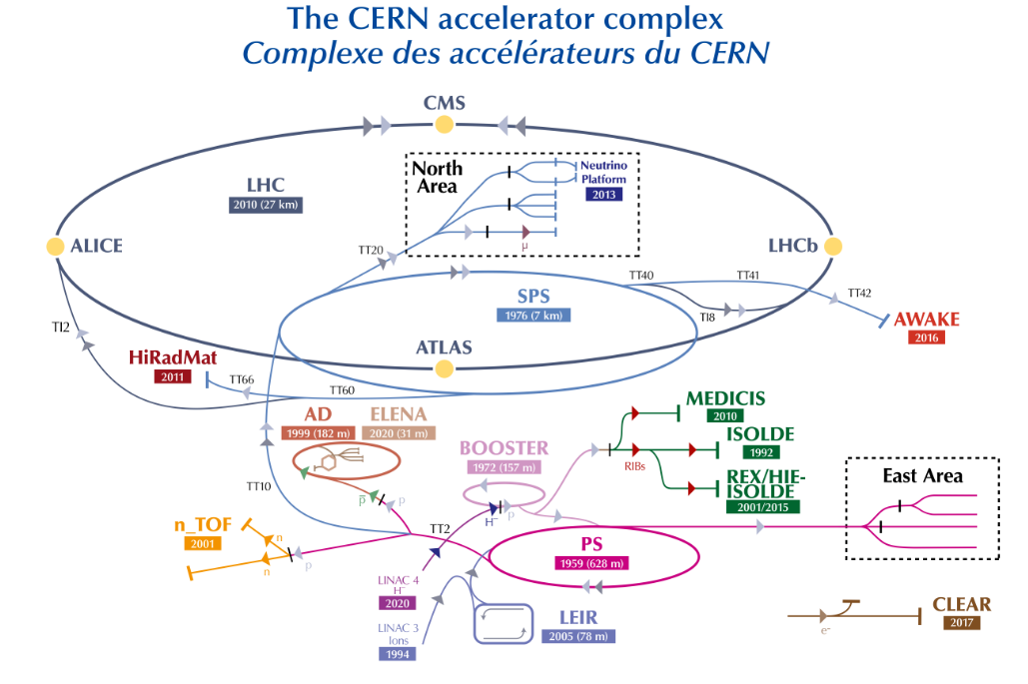
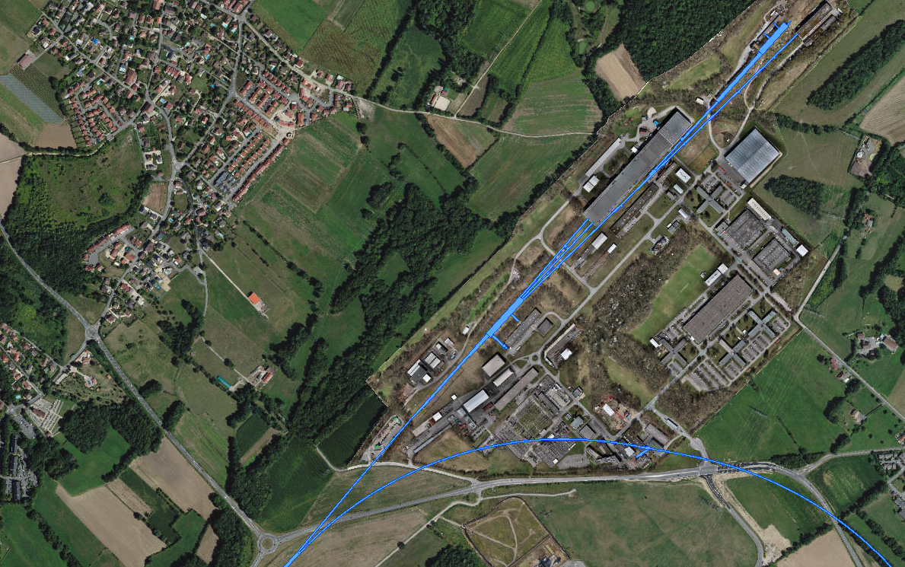
TCC8 & ECN3
ECN3
EHN2
TDC85
TT85 (P42)
EHN1
TCC8: T10 / TAX
→ K12
TT83 (P4)
TCC2:
T2 / T4 / T6 / TAX
TDC8
TDC2: TT20 splitters
P42 Beam Dump (TIDVG4)
Transfer Tunnel (TT) 20
SPS LSS2
CCC
Outcome of the PIE of the baseline design prototype target & Nb-cladding R&D for the BDF at CERN | IWSMT16

Slide 4
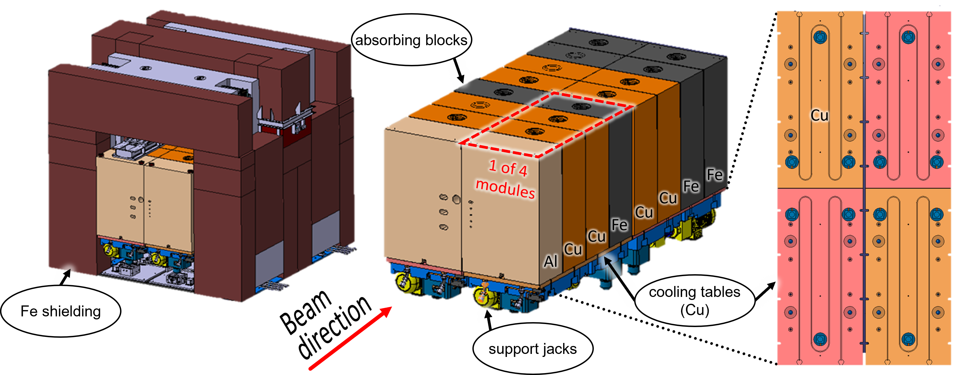
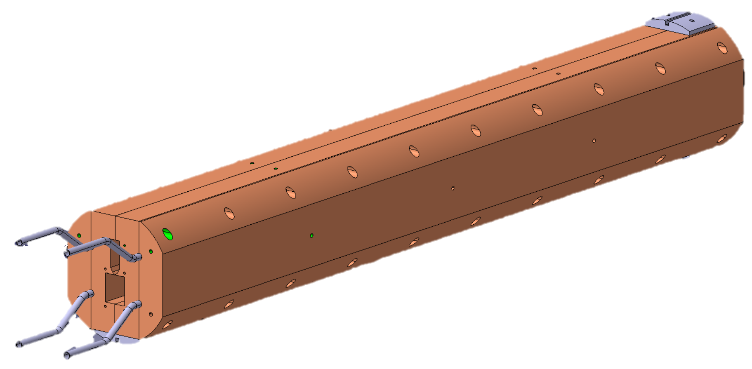
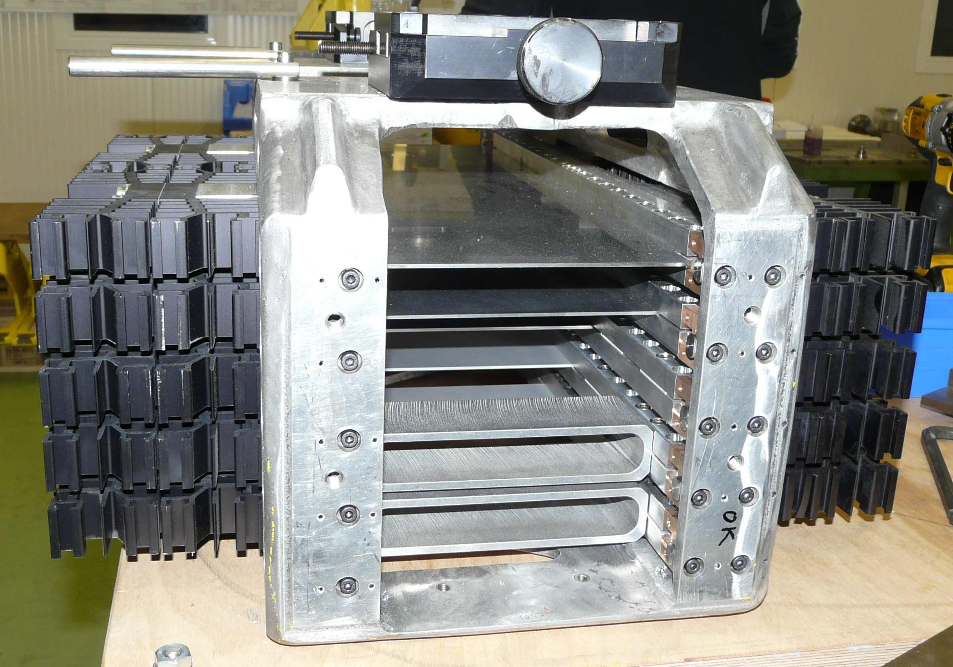
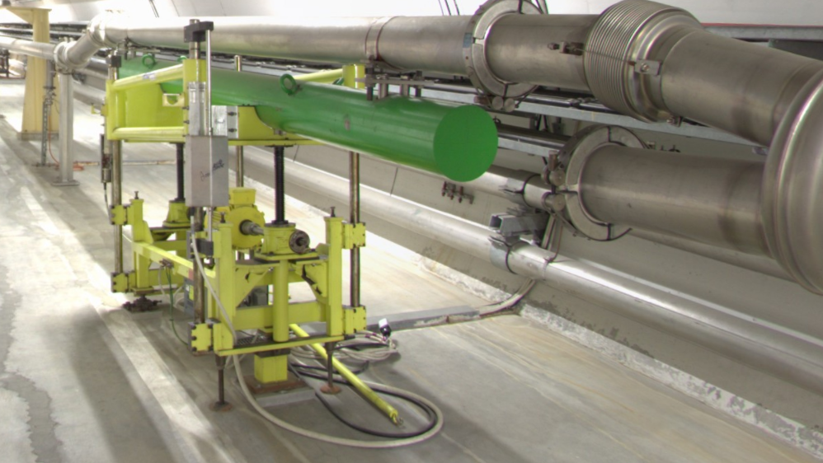
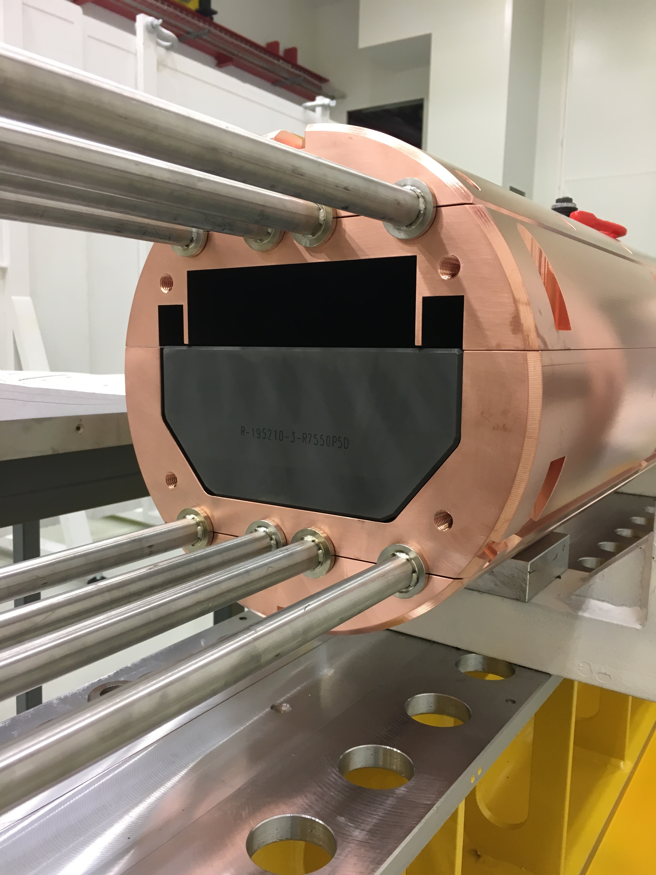
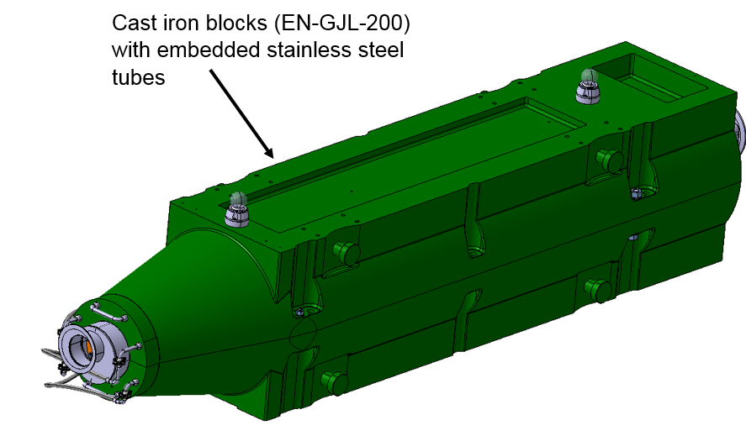
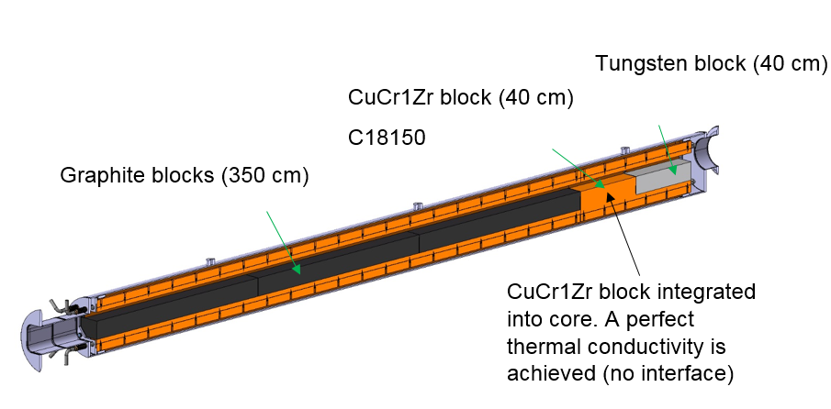
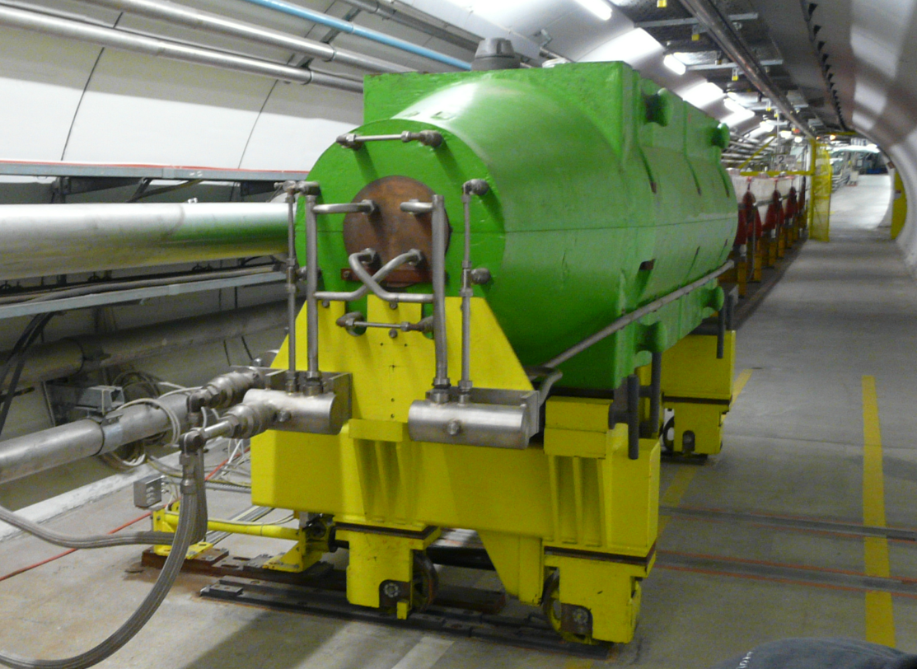
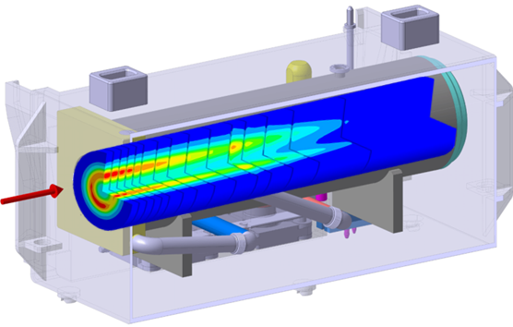
Beam Intercepting devices towards ECN3
T4 XTAX
T4 Target
TCSC
TBSE
P42 commissioning Dump (TIDVG4)
TT22
EHN1
LSS2
TT21
TT24
P4
P4:6
P42
Target + beam windows
TT20 TED
SPS
TCC8
ECN3
EHN2
NA-CONS
HI-ECN3
Other BIDS: Collimators, Masks, etc → To be defined

Slide 5
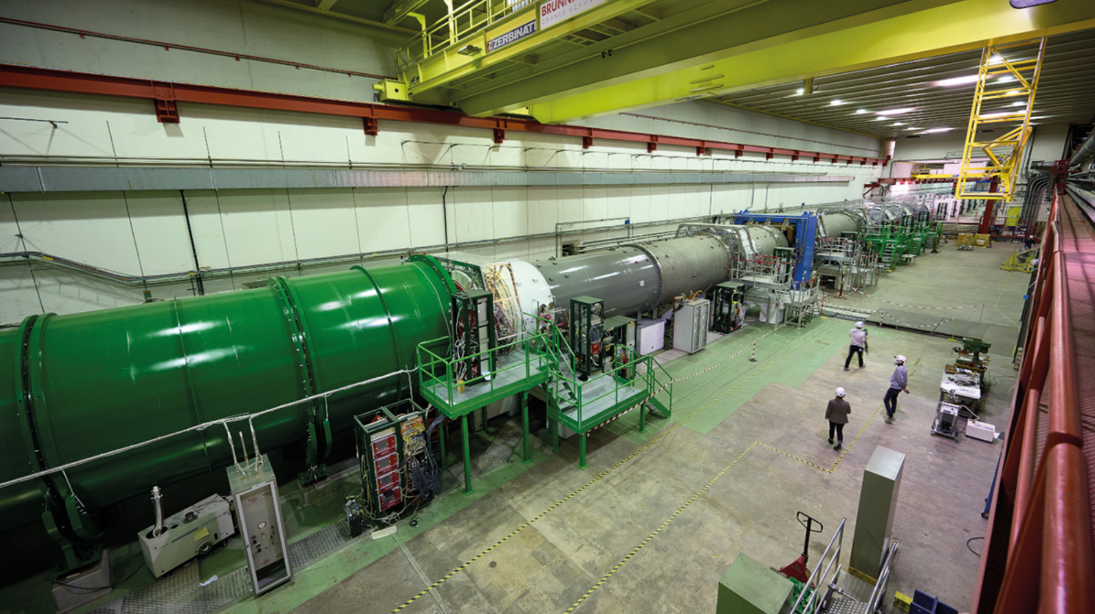

Slide 6
NA62 in ECN3 (Today)
T10 target, K12 beamline and NA62 experiment to be dismantled in LS3
T10
Target
T10
XTAX
Existing
Access Shaft
4$×$8 m²
K12 beam line
B911
B918
TCC8
ECN3
Outcome of the PIE of the baseline design prototype target & Nb-cladding R&D for the BDF at CERN | IWSMT16

Slide 7
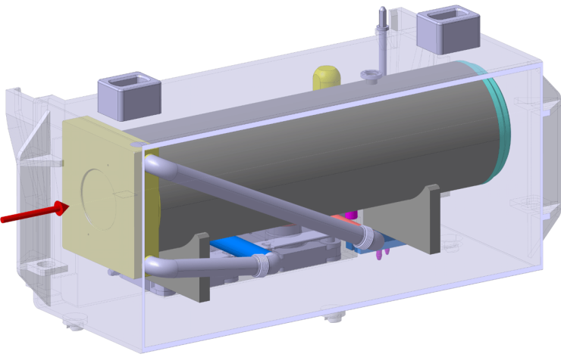
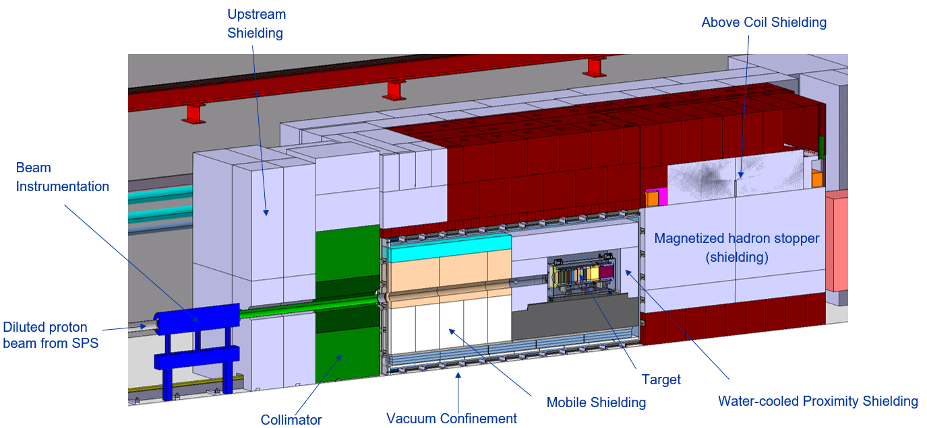
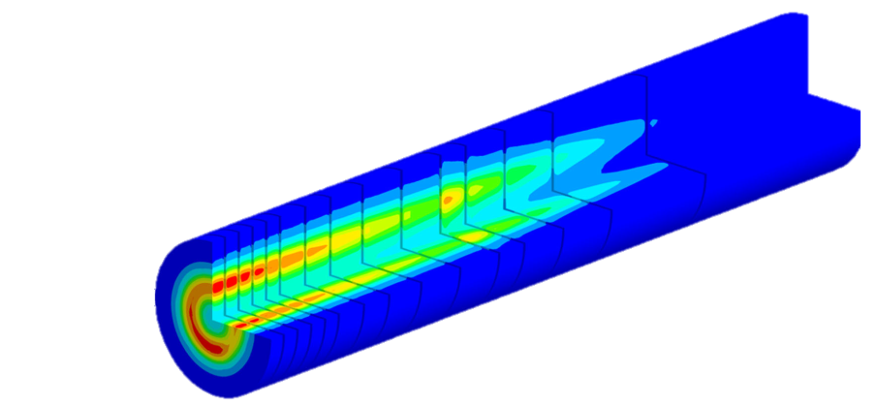
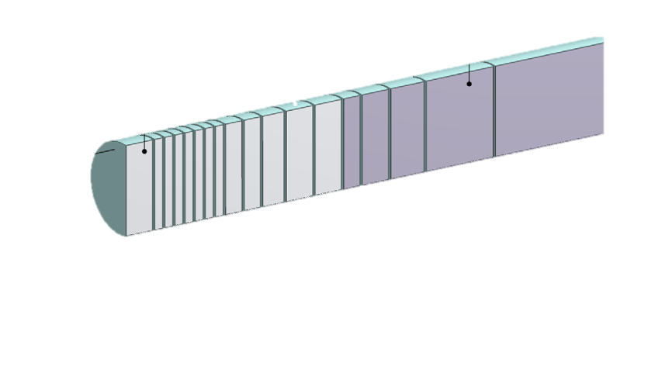
BDF/SHiP Target & Complex (Future ~ 2031)
Baseline Design → To be improved during TDR
WP4
350 kW-class Target
WP3
13 x TZM blocks (580 mm)
5x W blocks (780 mm)
New
Service Building
~ 500 – 700 m²
New
Access Shaft
(material only)
8$×$8 m²
Existing
Access Shaft
4$×$8 m²
B911
B918
Beam Dilution System
TCC8
WP2
WP4
ECN3
WP6,WP7 +al.
New Target Complex
containing the Beam Dump Target
WP5+SHiP

Slide 8
BDF/SHiP Target
Beam Dump Target / SHiP Target
Fully absorbe all p+, maximize production of charm and beauty hadrons & re-absorption of pions, muons and kaons
High energy → production of charmed and beauty mesons
High ppp & POT → overcome small prod cross-section of extra rare events of hidden particles
High ρ, Z & A → Maximize p+ interaction
Short λ → Force absorption of K & π to reduce muon & neutrino background
SPS Beam Dump Facility: Comprehensive Design Study, https://doi.org/10.23731/CYRM-2020-002
SHiP Experiment - Comprehensive Design Study report, https://cds.cern.ch/record/2704147
R. Jacobsson

Slide 9
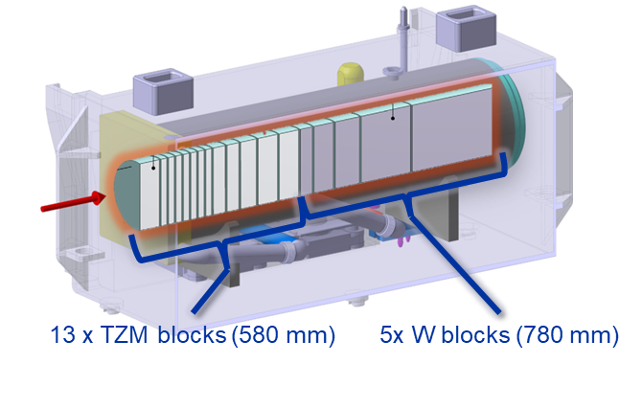
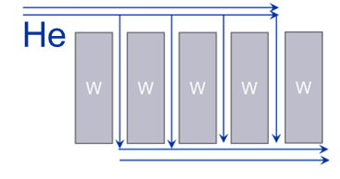
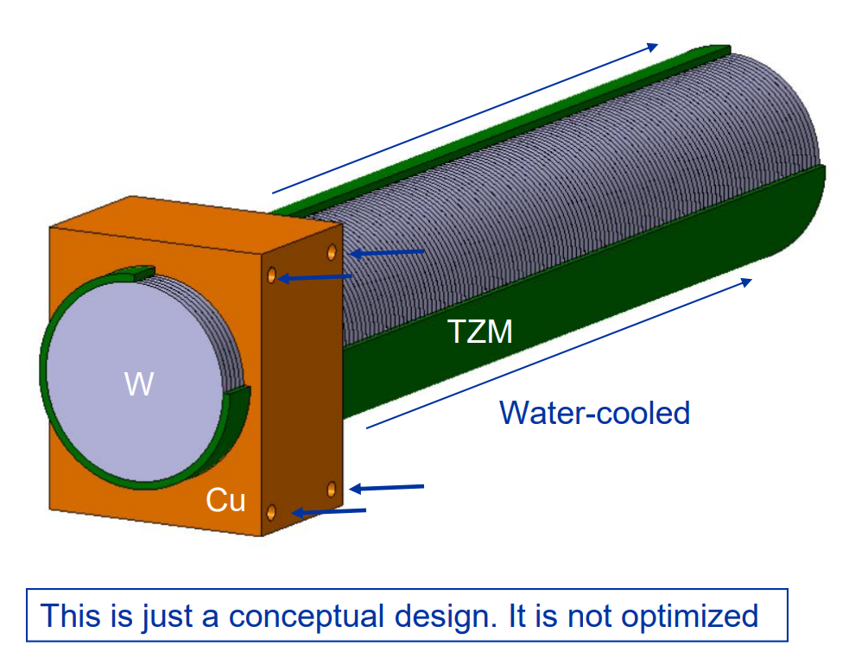
BDF Target Designs overview
BDF Baseline Target Design
Baseline Design (CDR) – Water cooled, W + TZM cladded w/ Ta2.5W .
Pursued during the conceptual design phase
Prototype + test with beam + Post irradiation examination
Still some safety aspects to be addressed
Could be further optimized for physics
https://doi.org/10.1103/PhysRevAccelBeams.22.113001
Alternative designs currently being studied in the TDR
Baseline-based concepts: with W rolled material, Nb-cladded Target, thin Ta cladding…
W Helium cooled Target
Removes water from beam
Better physics performance
Reduces decay heat & residual stresses
Conceptually different system!
Enclosed compact
Cu + W Target
Removes water from beam
Keeps physics performance
Reduces decay heat
Increases T and stress

Slide 10
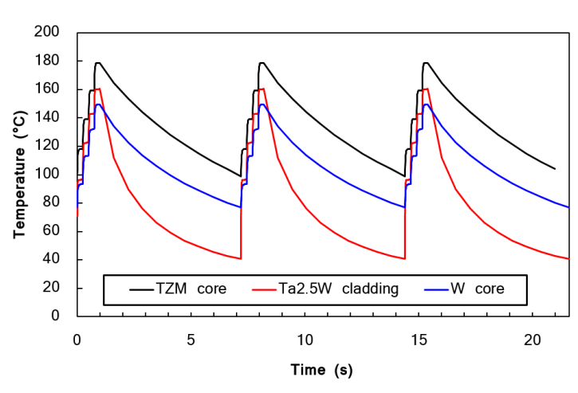
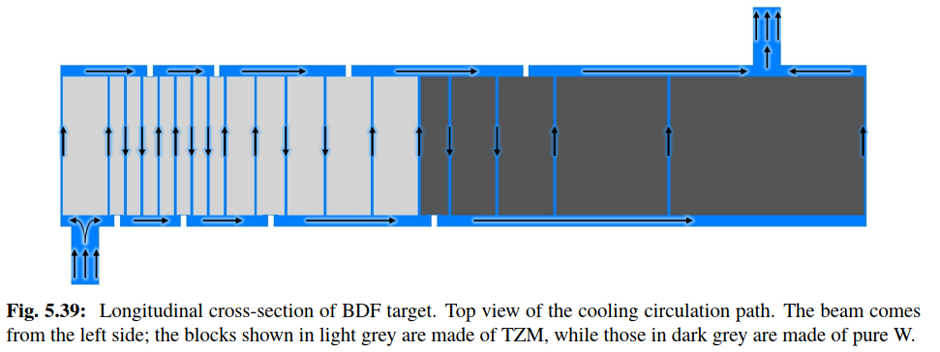
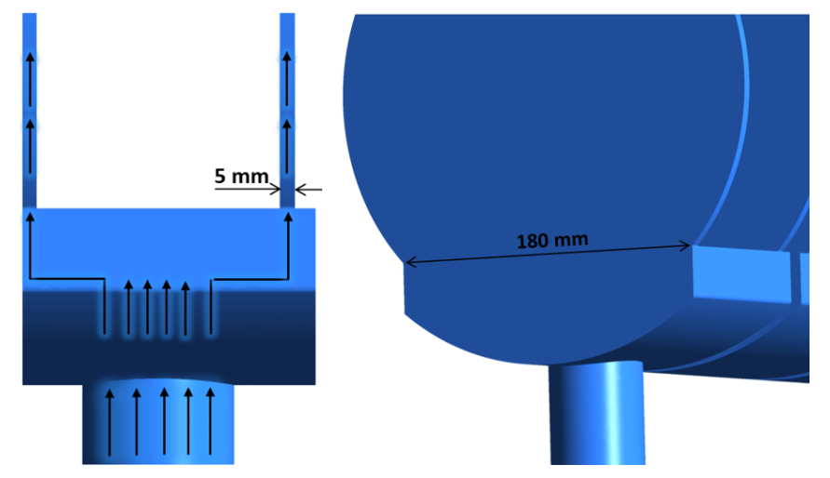
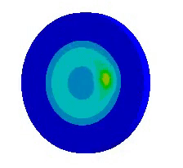
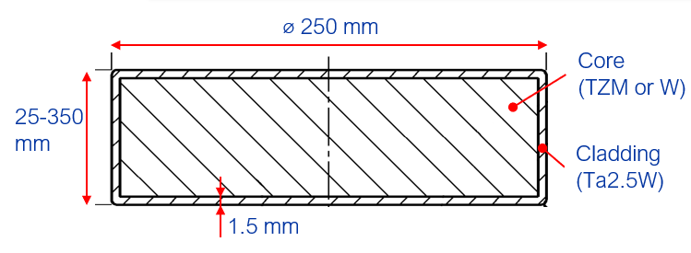
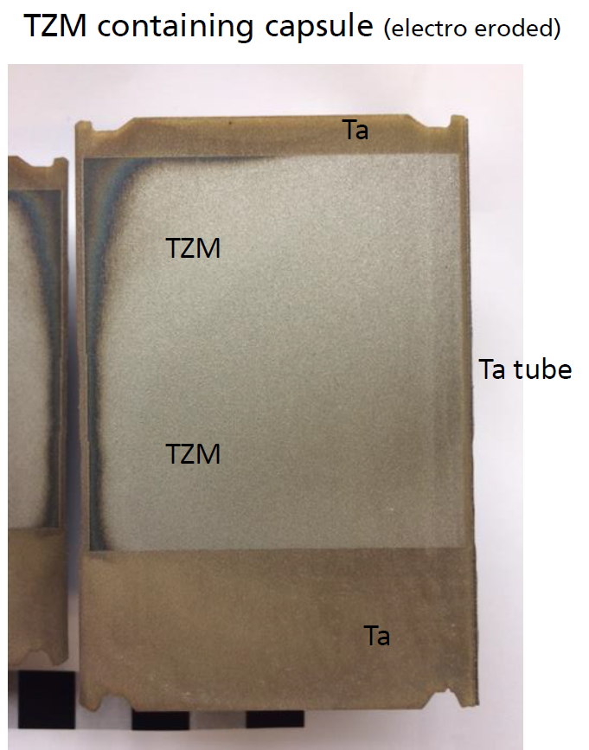
BDF Target baseline design
https://doi.org/10.1103/PhysRevAccelBeams.22.113001
BDF Baseline Target Design
Target Core with reasonable physics performance & that allows diluting (longitudinally) the energy deposition
Water-cooled, Ta-cladded TZM + W Core
TZM: Absorbs most of the power. Higher strength, better creep resistance, higher recrystallisation temp wrt Mo.
W: Good radiation damage resistance. Best for physics.
Ta2.5W: To avoid corrosion-erosion of the core materials
Cooling: 22 bar, 5 m/s, ~660l/min, ~305kW of heat.
Manufacturing
Forged TZM and sintered W (single blocks)
Diffusion bonding with cladding via Hot Isostatic Pressing
D250 mm
13 x TZM blocks (Z=42, ρ=10.2g/cm³)
(580 mm)
5x W blocks (Z=74, ρ=19.3g/cm³)
(780 mm)

Slide 11
Post-Irradiation Examination of a prototype target
Post-irradiation examination of a prototype tantalum-clad target for the Beam Dump Facility at CERN, T. Griesemer, R.F.Ximenes et al, https://doi.org/10.48550/arXiv.2410.01964 (submission to PRAB)

Slide 12
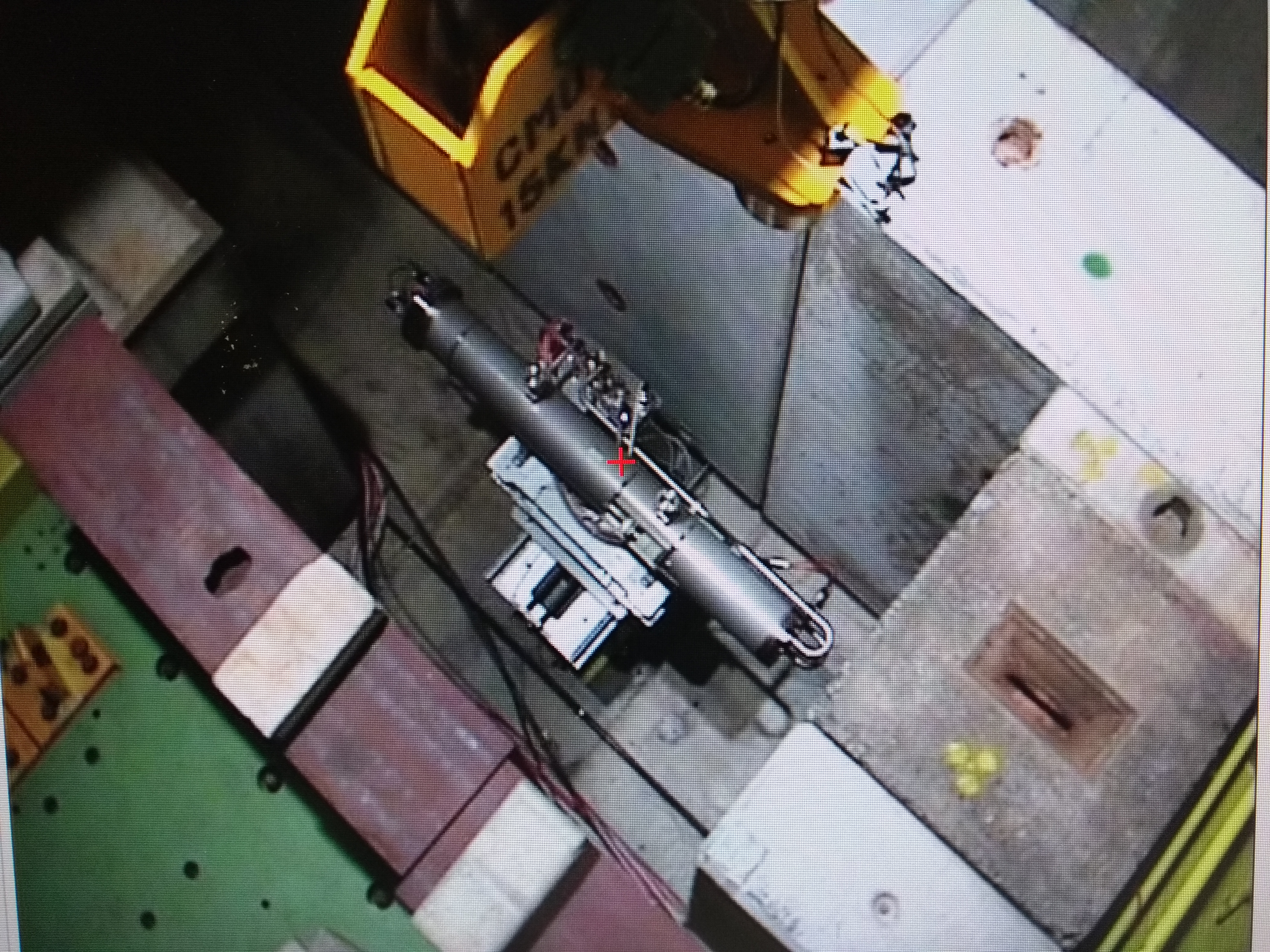
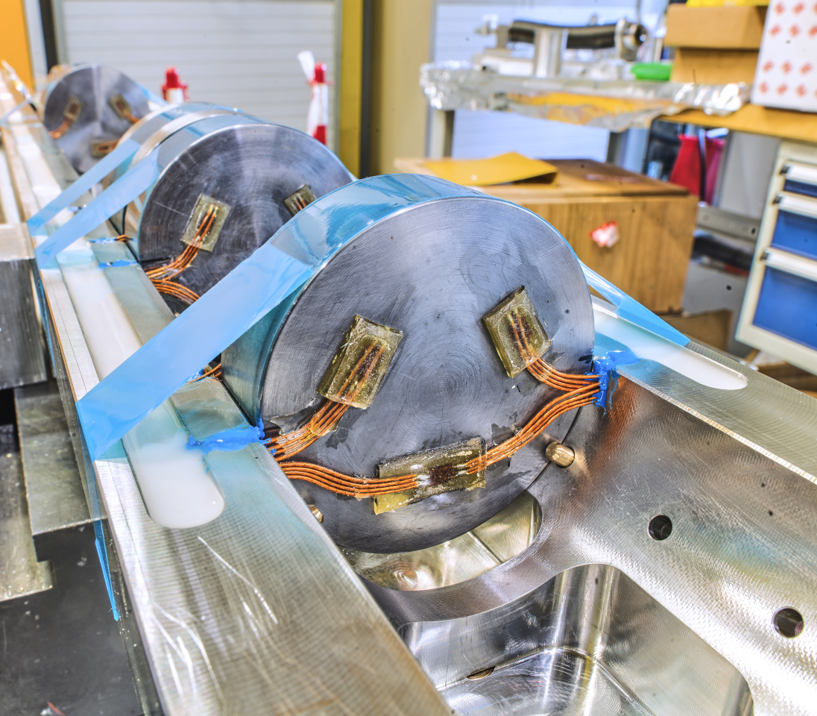
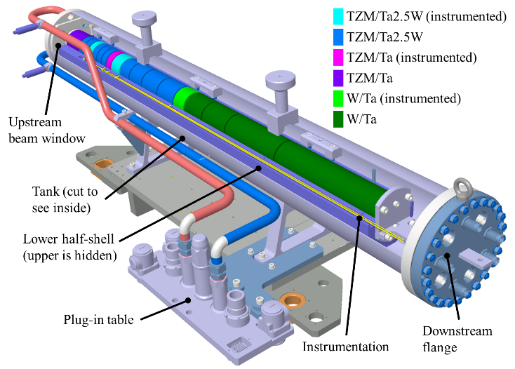
Notes:
Instrumentation (temperature and strain) of 4 most critical blocks
Total 14 hours of beam in 3 days → 2.4 × 10¹⁶ PoT

Slide 13
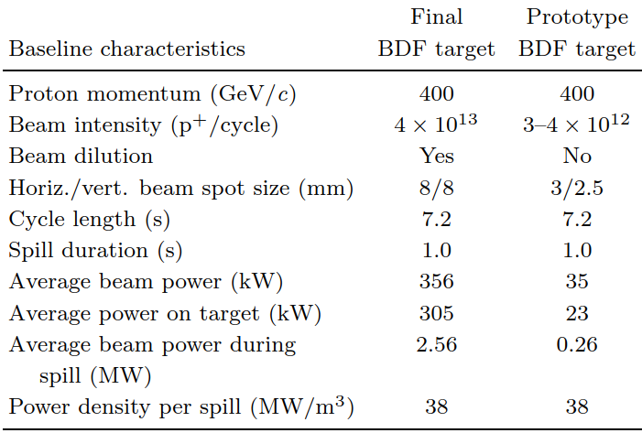
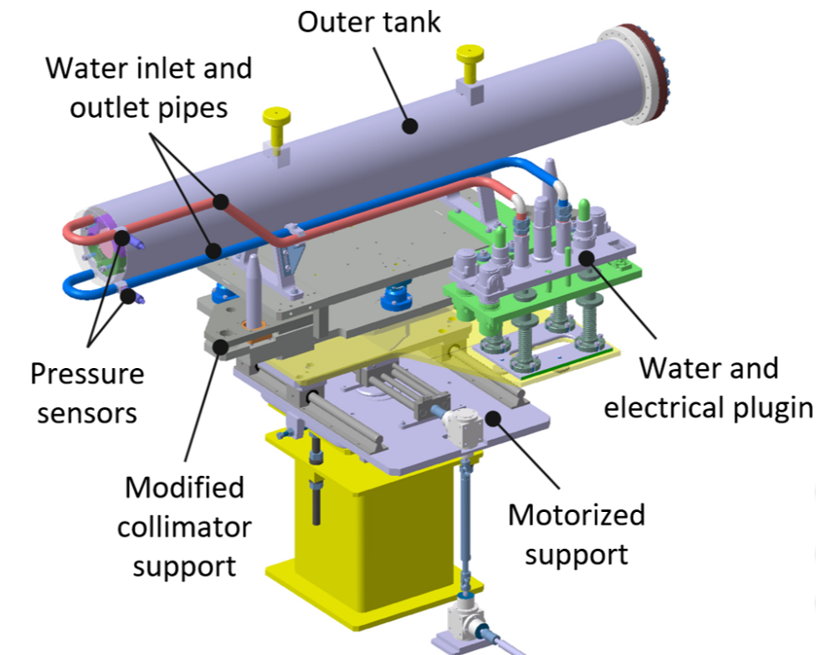
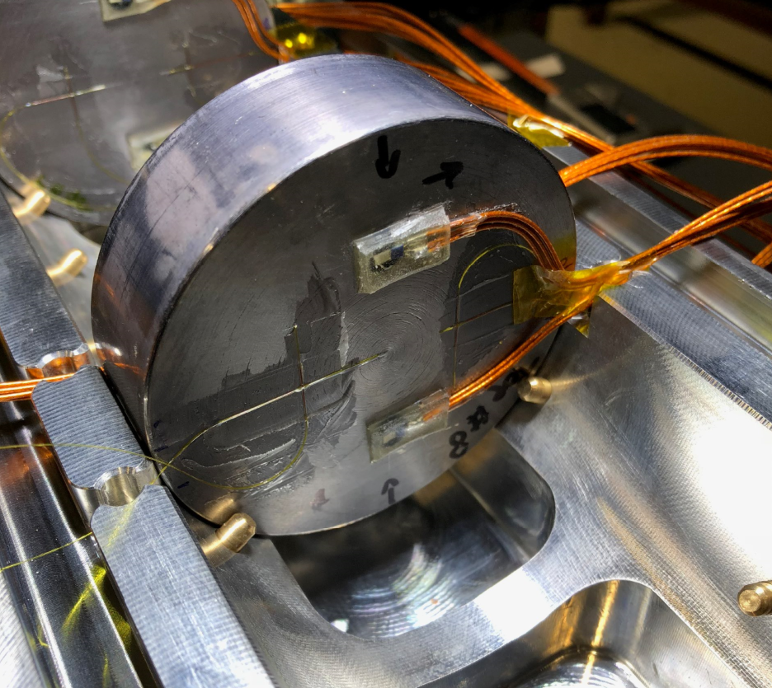
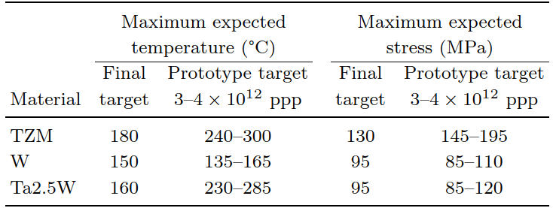
BDF Baseline Target Prototype + PIE
Beam parameters
Prototype Beam tests
Validate manufacturing and test operation at identical temperatures & mechanical stresses.
Reduced diameter (80 mm) prototype.
Tested in 2018 on a dedicated slow extraction (SX) testbench in the T6 primary beam line in TCC2 at CERN. Total of 2.4 × 10¹⁶ p⁺
Operational conditions
https://doi.org/10.1103/PhysRevAccelBeams.22.123001
Notes:
Instrumentation (temperature and strain) of 4 most critical blocks
Total 14 hours of beam in 3 days → 2.4 × 10¹⁶ PoT

Slide 14
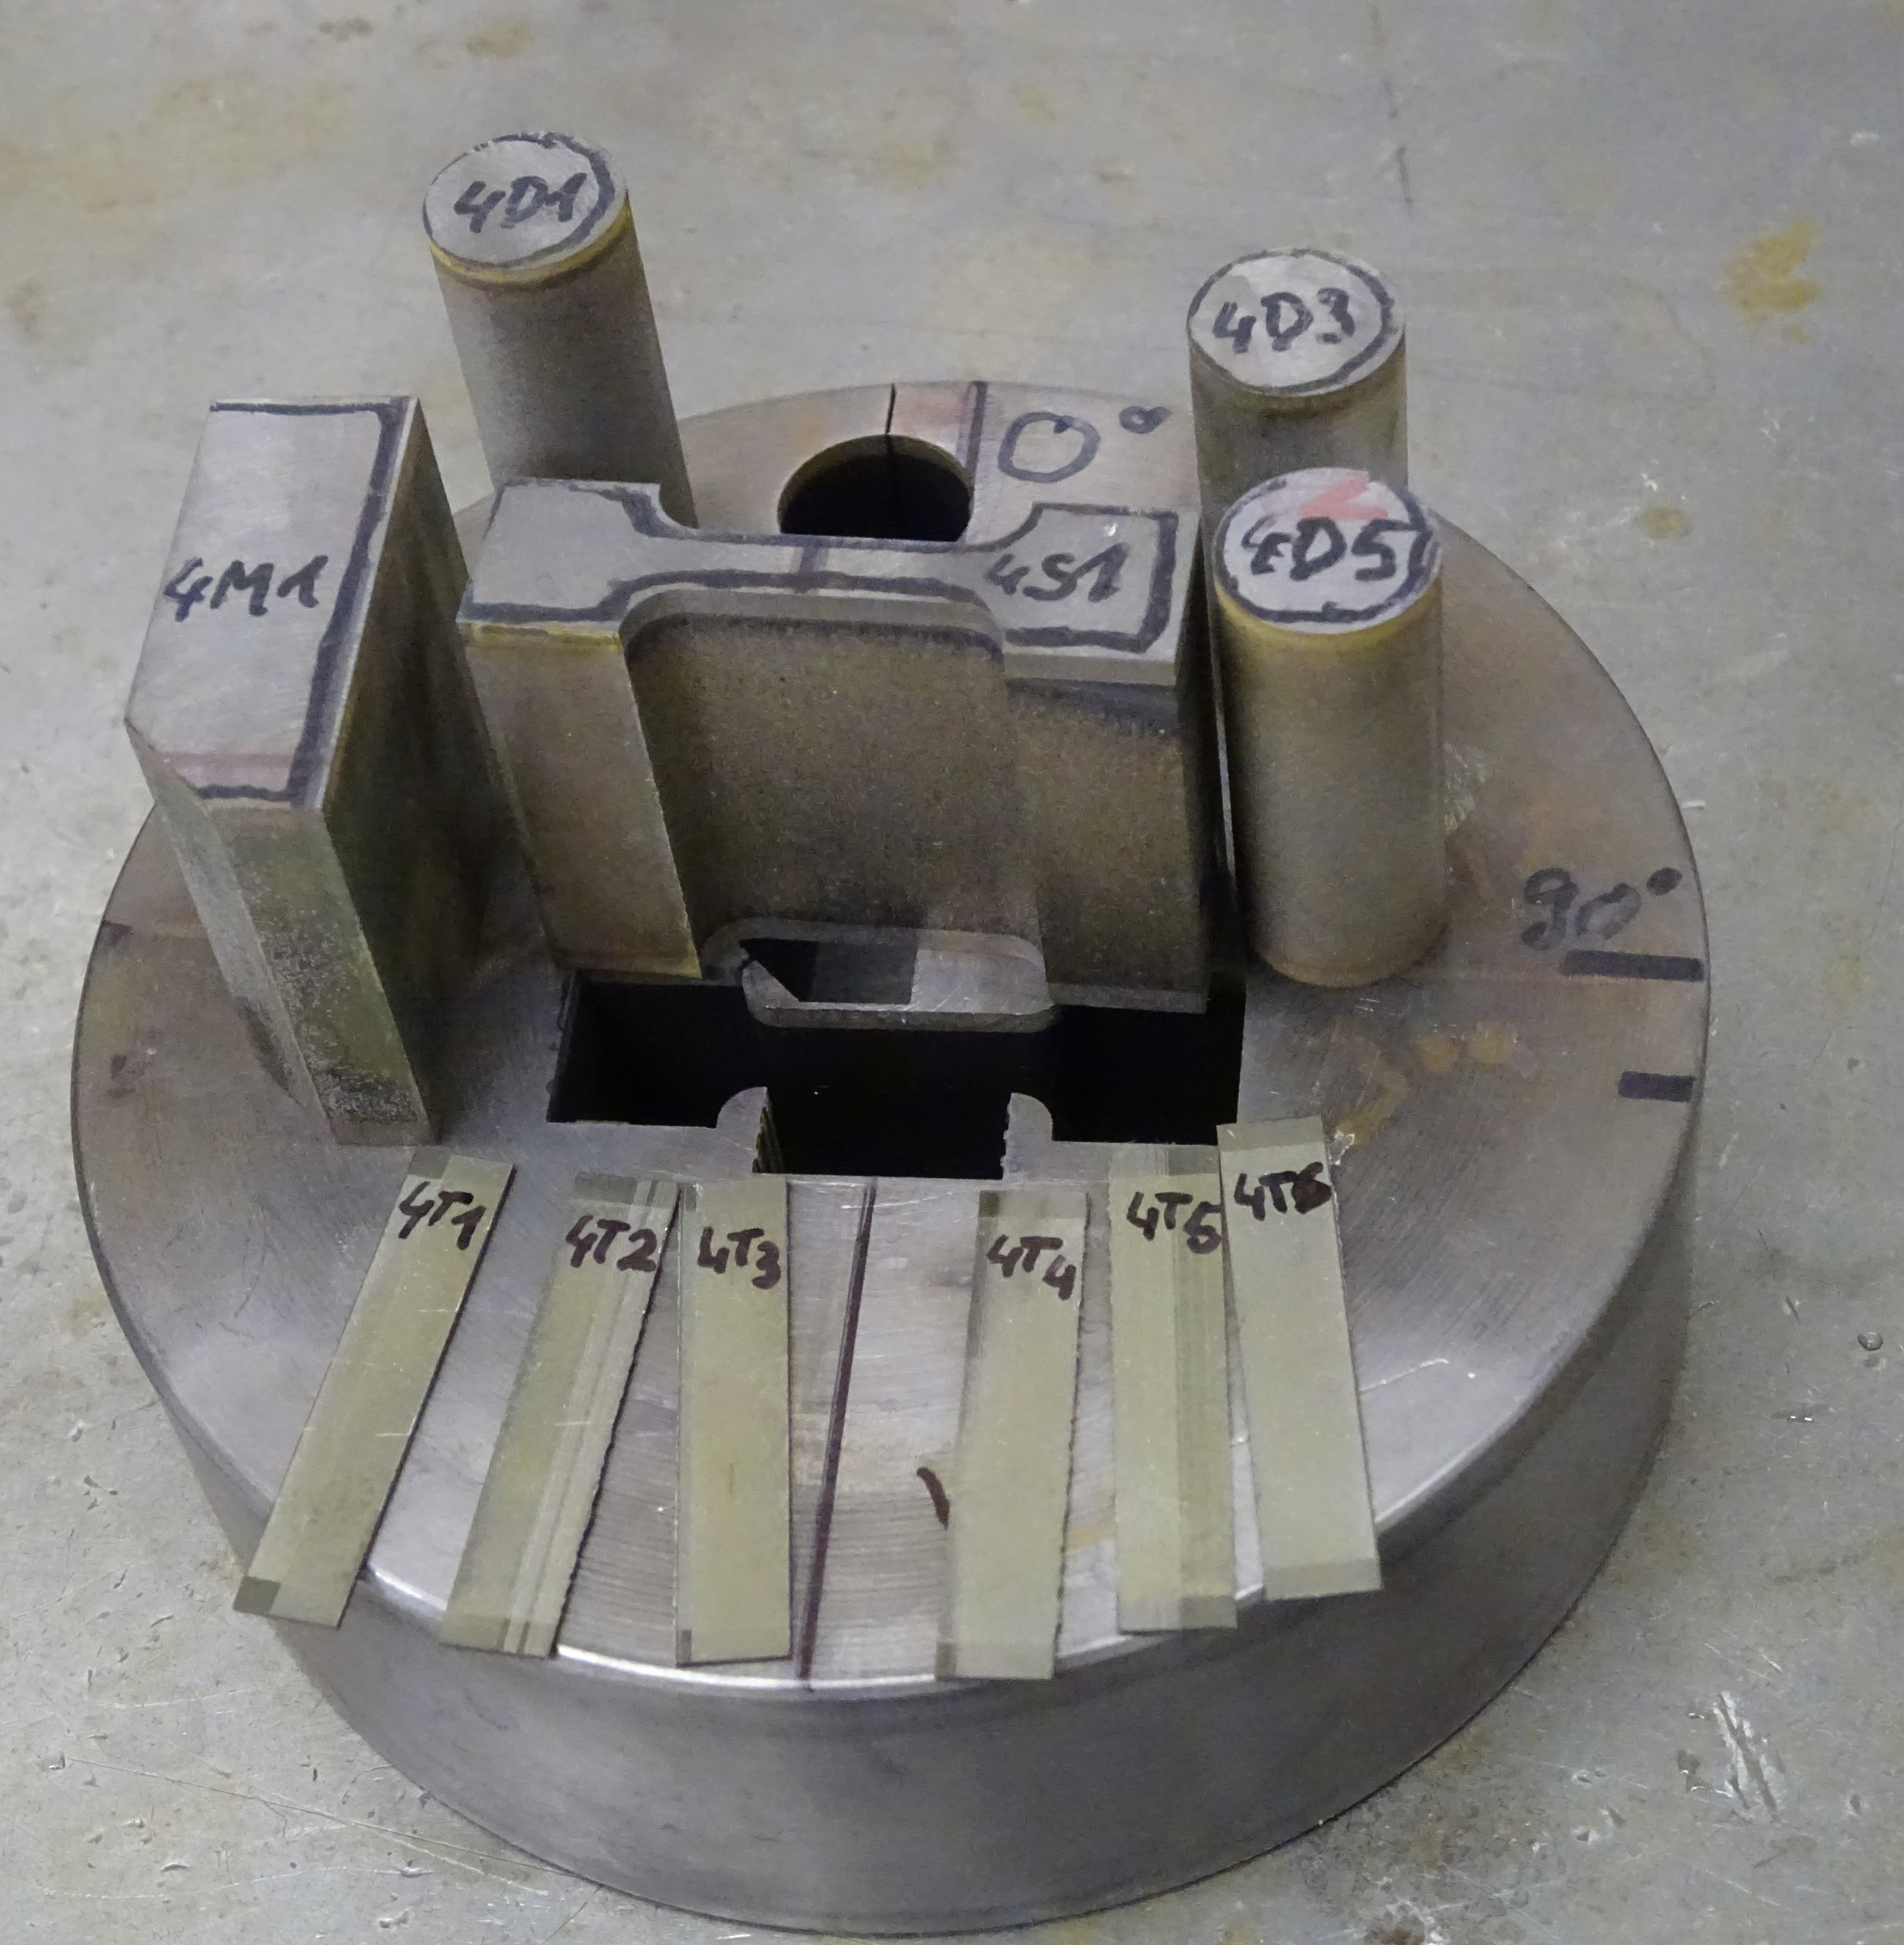
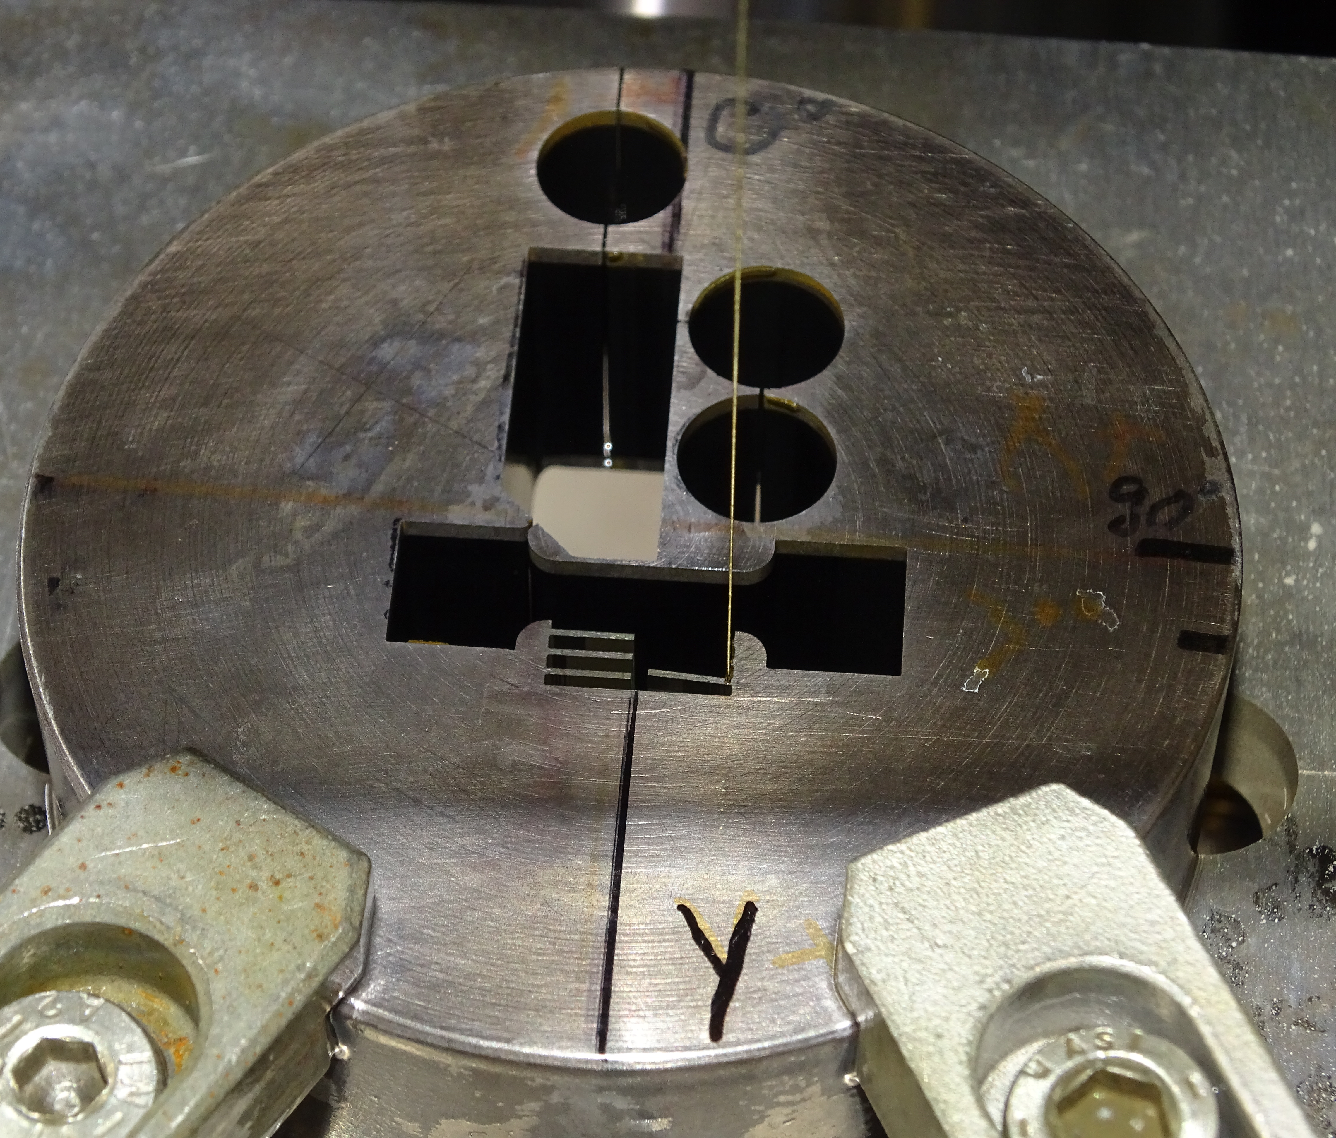
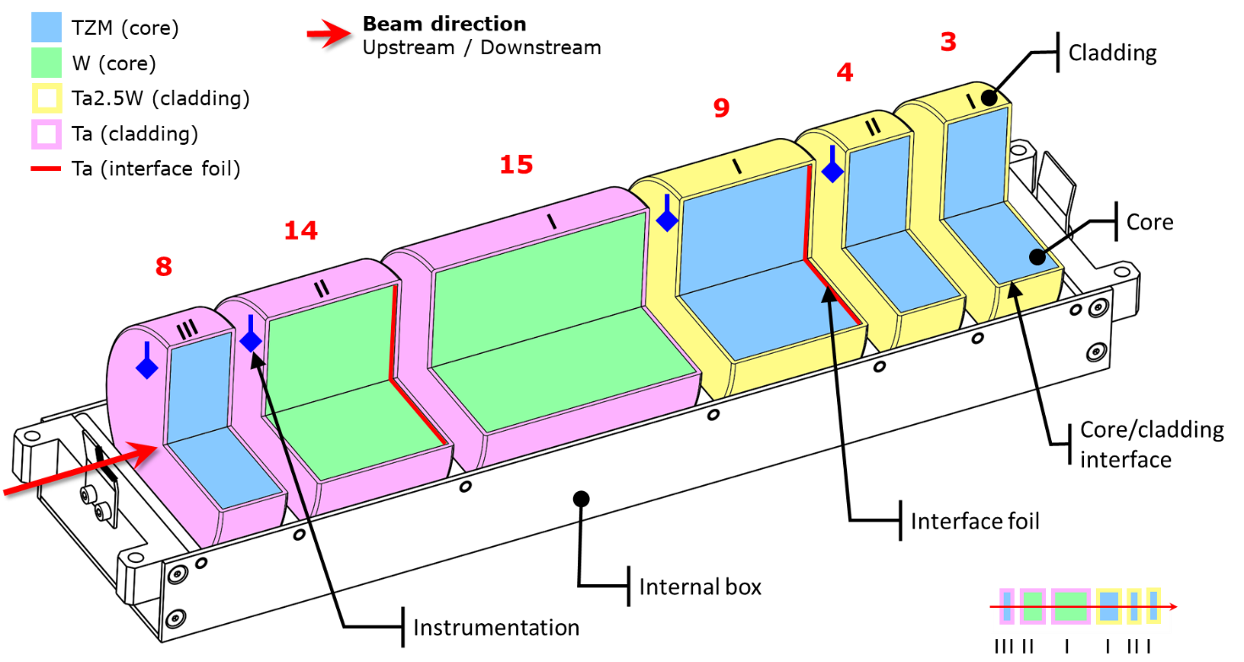
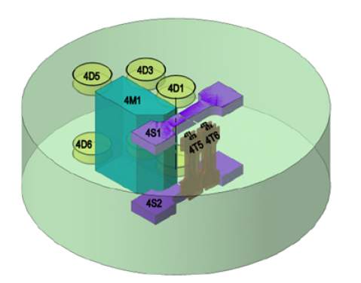
PIE activities & samples
I. Film Dosimetry
II. Metrology & Microscopy
III. Ultrasonic Testing
Non-destructive
Thermal diffusivity
Interface Shear
Bulk Tensile
IV. Specimen Extraction
V. Microstructural Characterization
VI. Mechanical Characterization
VII. Thermal Characterization
Microstructural

Slide 15
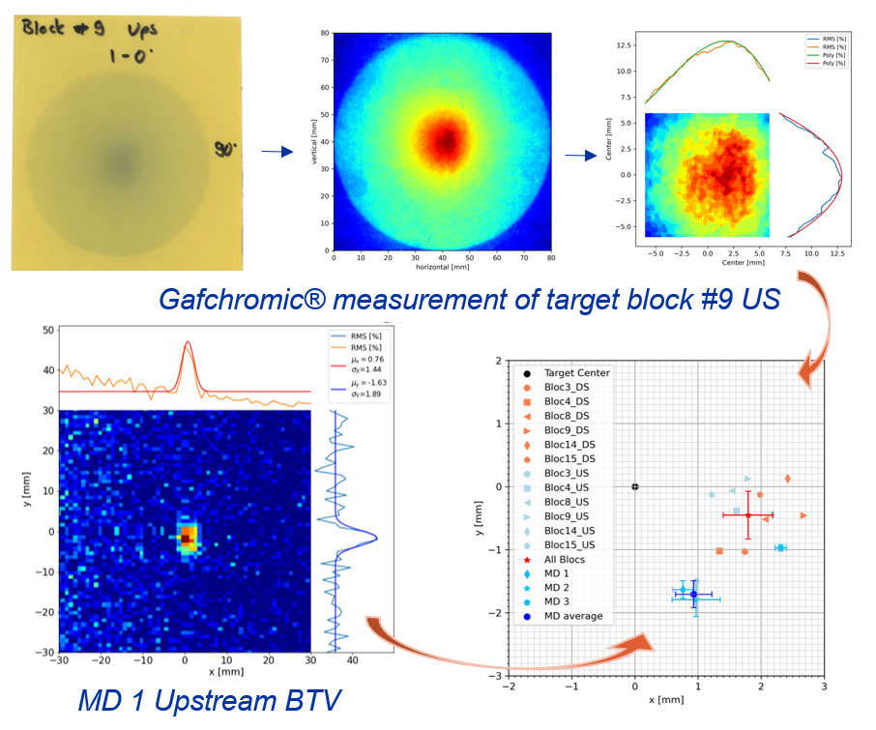
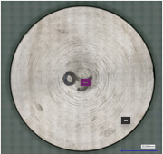
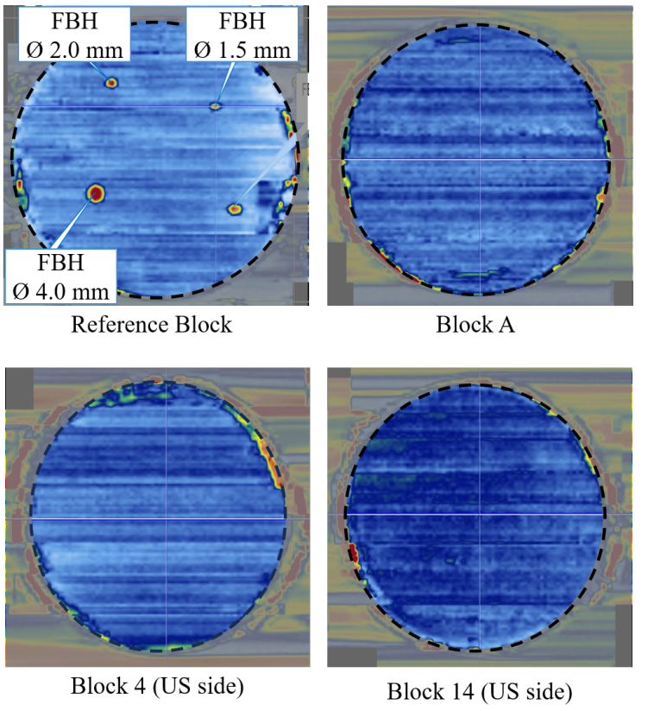
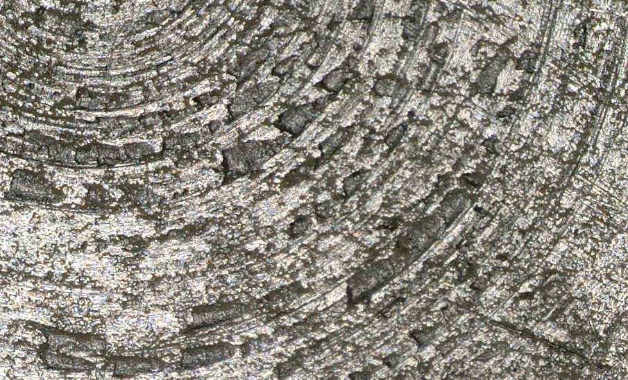
PIE – Nondestructive testing
I. Film Dosimetry
II. Metrology and Microscopy
III. Ultrasonic Tests
I. Film Dosimetry
II. Metrology and Microscopy
III. Ultrasonic Tests
→ BTV and gafchromic imaging consistent (< 1mm)
→ Blow up of the beam downstream.
→ No relevant geometrical changes nor swelling and no corrosion, cracks, or melting visible
→ No signs of damages in the bonding interface!
Better cleaning of lubricant necessary
Strong turning grooves in the centre
1 mm
1 mm

Slide 16
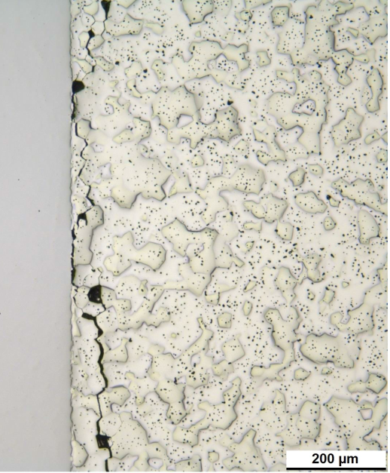
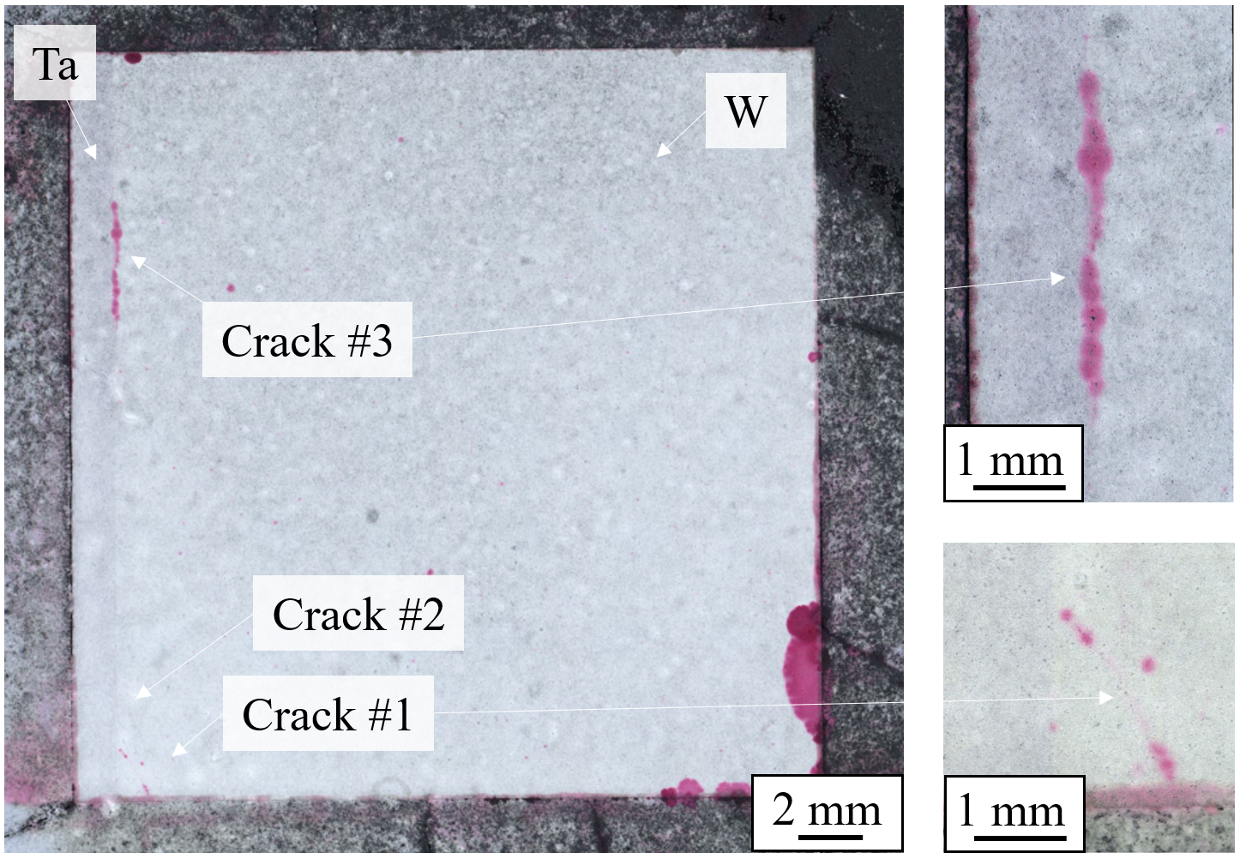
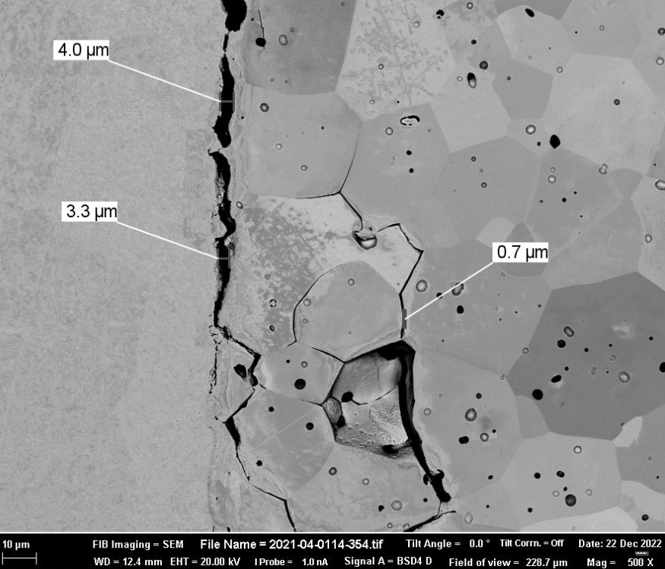
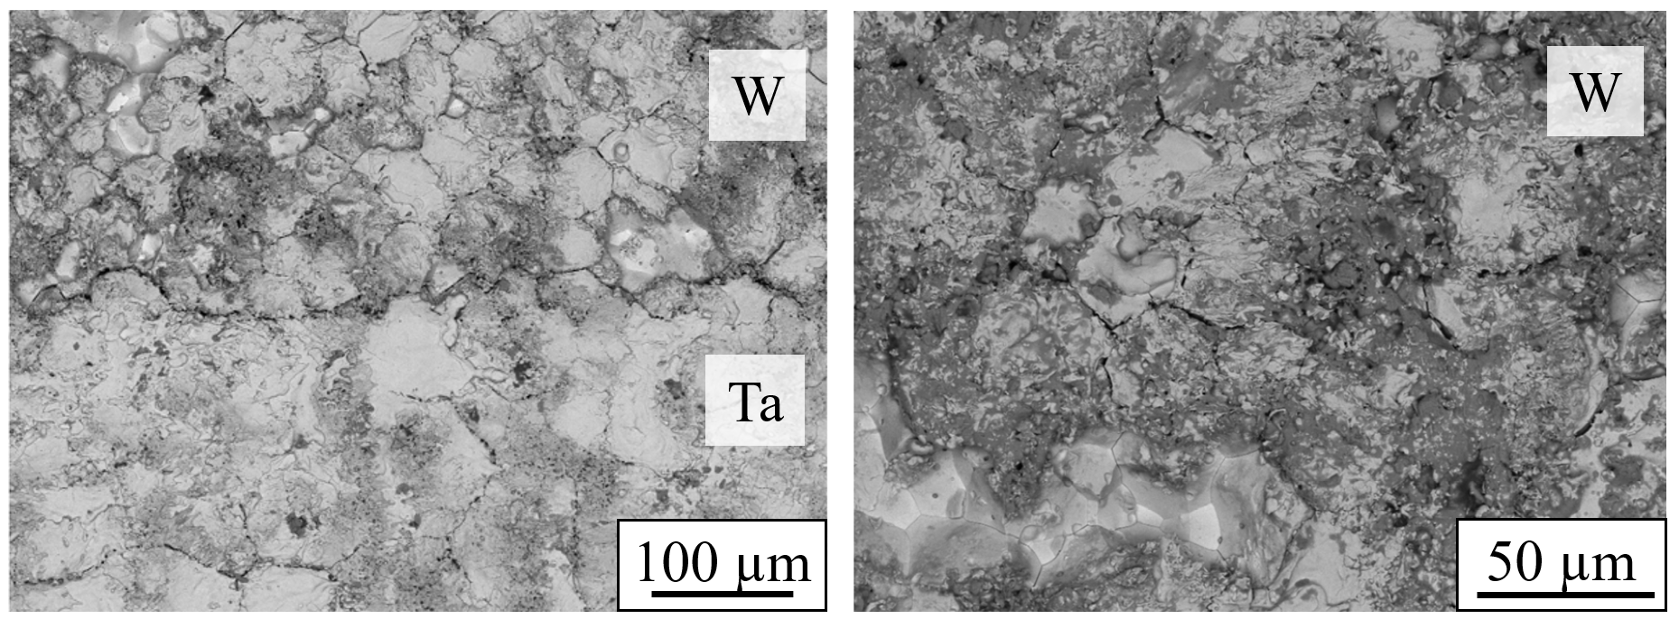
PIE – Microstructure analysis
V. Microstructural Characterization
Testing of unirradiated W Block
Cracks in irradiated W Block

Slide 17
PIE – Microstructure analysis
V. Microstructural Characterization
Cracks in irradiated W Block
Testing of unirradiated W Block
EBSD and SEM images show cracks inside W → No delamination of the interface
Dye penetrant testing (PT) show superficial cracks (1&3) and Crack 2 was not detected
PT Testing indicated cracks in unirradiated W
TZM: → Tantalum & TZM → No damages)
W: → Cracks → Beam-induced?
Cracks did not exist before EDM cutting (UT Testing)
No differences between unirradiated and irradiated microstructure
Reason: Cracks superficial, release of high residual stresses during EDM cutting, brittle W (porosity & fully recrystallized). Attributed to quality of sintered W
SEM shows similar cracks as in irradiated sample

Slide 18
PIE - Shear testing
VI. Mechanical Characterization
Shear testing
Irradiated TZM-Ta2.5W
Un-irradiated TZM-Ta

Slide 19
PIE - Shear testing
VI. Mechanical Characterization
Shear testing
Irradiated TZM-Ta2.5W
Un-irradiated TZM-Ta
Ta clad: Higher shear breaking strength than bulk Ta (150 MPa) (un-irradiated block)
Ta2.5W clad: Close to shear breaking strength of bulk Ta2.5W (215 MPa) (irradiated, w/ and wo Ta foil)
Fracture in shear neck region
1 at the interface, 3 in the Tantalum
80-750um extension (slightly higher in un-irradiated)

Slide 20
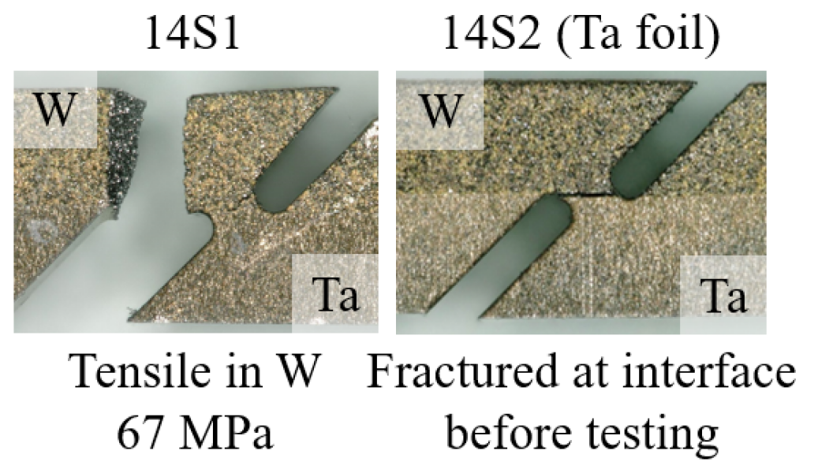
PIE - Shear testing
VI. Mechanical Characterization
Shear testing
Irradiated W-Ta
Un-irradiated W-Ta

Slide 21
PIE - Shear testing
VI. Mechanical Characterization
Shear testing
Irradiated W-Ta
Un-irradiated W-Ta
Fracture outside necking indicating very brittle W (both irradiated and un-irradiated) – weaker than interface itself
Small extension before fracture
14S2 fracture before test

Slide 22
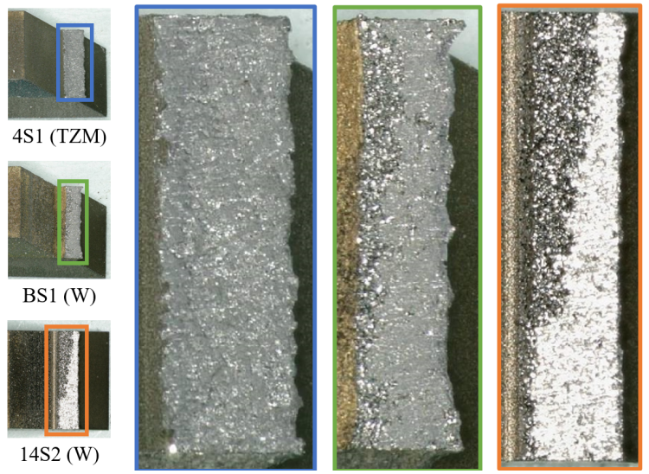
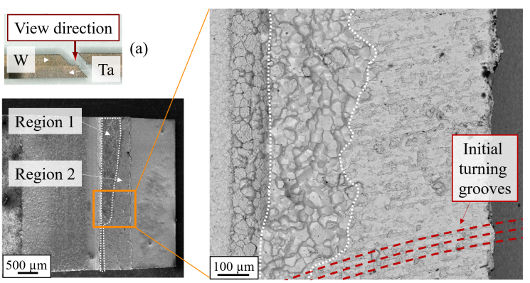
PIE - Shear testing
VI. Mechanical Characterization
Shear testing
TZM block
W block
Both Intragranular fracture & no distinct fracture on both irradiated and un-irradiated
Uniform fracture, always on Ta and Ta2.5W (with and without Ta foil)

Slide 23
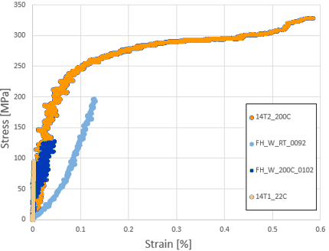
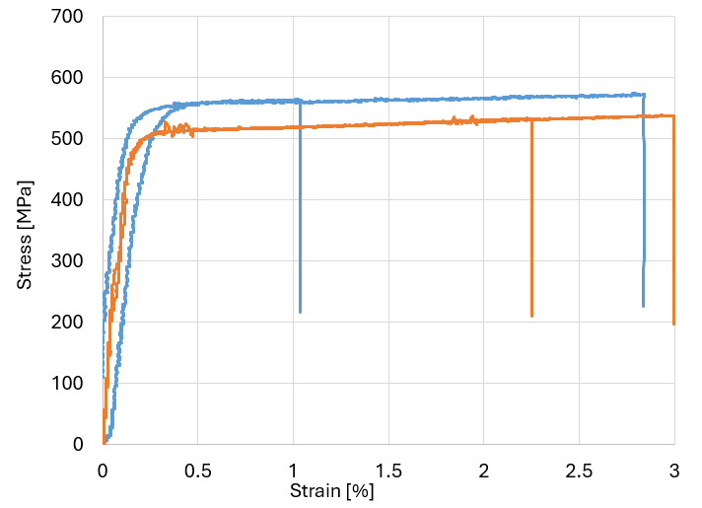
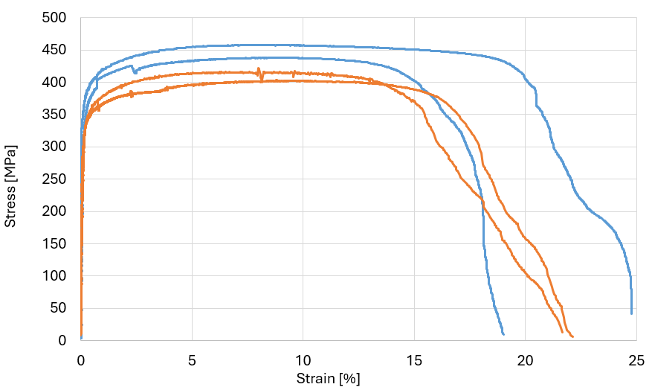
PIE: Mechanical testing
VI. Mechanical Characterization
Tensile testing
Hardness testing
Tensile Testing TZM
Tensile Testing W
Unirradiated
Unirradiated
Irradiated
200 °C
Irradiated
Irradiated
RT
200 °C
Unirradiated
RT
Unirradiated
200 °C
Irradiated
RT

Slide 24
PIE: Mechanical testing
VI. Mechanical Characterization
Tensile testing
Hardness testing
Tensile Testing
Unirradiated
Unirradiated
Vickers Hardness [HV 0.5]
Irradiated
Irradiated
TZM, Ta, Ta2.5W: as annealed materials
W as fully recrystallized
No differences unirradiated and irradiated
RT
200 °C
Thermal Testing
TZM : Lower mechanical properties of irradiated samples → low PoT → no irradiation damage
→ No differences in microstructure detected → No faults in testing set up found
Two-layered specimens of core and cladding material from irradiated Block #4 and #14
Negligible thermal contact resistance of all interfaces
No dependencies of proximity to beam impact axis or usage of Ta interlayer detected
No irradiation effects detected ( compared to prior studies)
W
Tensile specimens very error prone for brittle material such as W
→ 4-pending test better

Slide 25
Nb-cladding R&D studies
Exploring diffusion bonding of niobium and its alloys with tungsten and a molybdenum alloy for high-energy particle target applications, T. Griesemer, R.F.Ximenes et al, https://doi.org/10.48550/arXiv.2410.01988 ,
(submission to JMR&T)

Slide 26
Nb-cladding R&D
Nb-cladded baseline target
Decay heat power
Selection of Nb-alloys:
Promising LOCA improvement
Compliant with Thermo-mechanical conditions
Likely HIP “bondable”
Phase diagrams: Good solubility no critical intermetallic phases
Diffusivity: as much diffusivity into W and Mo as Ta.
Ductility: Nb identical to Ta
Temperature after LOCA
Assuming htc=1W/m2.K
*by courtesy of Bangor University

Slide 27
Nb alloy cladding R&D - Prototype capsules
I. EBW of Capsules
II. Helium Penetrant Test
III. 1st HIPing Cycle (1200 °C)
IV. 2nd HIPing Cycle (1400 °C)
V. Ultrasonic Testing
VI. Cutting & OM at interface
VII. Thermal Characterization
VIII. Mechanical Characterization
Welding lip
Successfully bonded capsule
10 mm
50 mm
30 mm
1 mm
26 mm
Capsule Geometry
1st batch after HIPing
Capsules after EB welding
HIPing Furnace at Nuclear AMRC
Single failed UT capsule fell apart when cut open
OM of Nb//W
OM to visually check the bonding interface
→ Bonding visually ok
W | TZM Nb
W | TZM Nb1Zr
W | TZM C103 (Nb10Hf1Ti)
W Ta

Slide 28
Nb-cladding R&D
Nb-cladded baseline target
However, long-lived Nb isotopes pose challenges for waste disposal
I. EBW of Capsules
II. Helium Penetrant Test
III. 1st HIPing Cycle (1200 °C)
IV. 2nd HIPing Cycle (1400 °C)
V. Ultrasonic Testing
VI. Cutting & OM at interface
VII. Thermal Characterization
VIII. Mechanical Characterization
Thermal diffusivity specimens
Excellent thermal contact has been confirmed for all Niobium alloys (Nb, Nb1Zr, C103)
Tensile specimens
Interface strength for Nb alloys higher for TZM than W
TZM core :
Ta foil + HIP: High increased the strength
C103 did not bond without the foil
W core
Higher variation, but it seems no foil increases interface strength
SEM: Increase of successful diffusion bonding / maximum stresses
*by courtesy of Bangor University

Slide 29
Conclusions & outlook

Slide 30
Conclusions & outlook
PIE of the BDF Ta-clad prototype
Manufacturing a prototype, testing it with beam and analysing it afterwards is a mandatory QA loop for high power targets like BDF.
BDF’s baseline design is sound, and the cladding technology is compliant with thermo-mechanical conditions.
The sintered tungsten is likely a bad choice. Baselining a better-quality W is mandatory.
Nb cladding R&D
On paper, Nb is a great cladding candidate for W.
HIP cladding Nb-alloys on W and TZM is possible.
For BDF, we still need to validate it with beam and address its waste disposal .
Following HI-ECN3 project approval and start of TDR phase
Sound baseline design, yet with potential for optimization and with some caveats to be addressed.
Multiple alternative designs explored in view of mitigating water radiolysis, decay heat and improve physics performance. He-cooled target most promising option. Being explored in detail.

Slide 32
WP3 – Target & BIDs: Planning (key dates)
TDR phase
Production phase
Commissioning & operation
TDR phase (main activities) – (2024-mid 2026)
Target (& BIDs) conceptual design followed by detailed design
Prototype(s) Target Design, construction and beam tests
Material studies, R&D and Procurement
Production phase – (2026 – 2030)
Detailed Design phase
Procurement & production of components and systems
Tests/dry-run, installation activities
Material tests/PIEs

Slide 33
BDF Target Prototype removal (2020)
Unplug-in  Transport to the bunker  Unscrew downstream flange  Instrumentation wire cut & flange removal  Extraction half-shells core assembly  Unscrew half-shells  Removal top half-shell & first glimpse of the target blocks
BDF target assembly

Slide 34
BDF Target Prototype removal (2020)
Identification of the blocks and angular orientation with respect to the beam with a marker  Removal of the target blocks for the post irradiation examination (PIE) campaign  Storage of the extracted blocks in a shielded container

Slide 35
Ta2.5W cladding – LOCA
Visual inspection of the samples before and after oxidation for different temperatures.
Raw sample
800 °C at 2 °C/min
800 °C at 40 °C/min
Potentially degradation of the material through oxidation with LOCA.
→ Campaign to assess the onset for extensive oxidation and formation of volatile oxides
Thermogravimetric analyses (TGA) performed for Ta2.5W, TZM and W in the range of 400-800 C under active and inert atmospheres.
Inert
Atmosphere
(argon 6.0)
Ta2.5W
400 °C
500 °C
600 °C
700 °C
TZM
Active
Atmosphere
(50% argon: 50% air)
r1 = 10
r2 = 2
r3 = 40
[°C/min]
W
r1 = 10
r2 = 2
r3 = 40
[°C/min]
400 °C at 10°C/min x 7 days
800 °C at 2°C/min
Notes:
Small mass gain for Ta2.5W at 400C with inert argon (with some impurities)
Clear oxide layer at 500 C

