Slide 1
Proton beam window replacement in CSNS
YUANGUANG XIA
Institute of High Energy Physics, Chinese Academy of Sciences (CAS)
Spallation Neutron Source Science Center

Slide 2
Contents
Brief of the proton beam window
Replacement plan and main tools
Replacement process
Improvement and upgrade
Summary

Slide 3
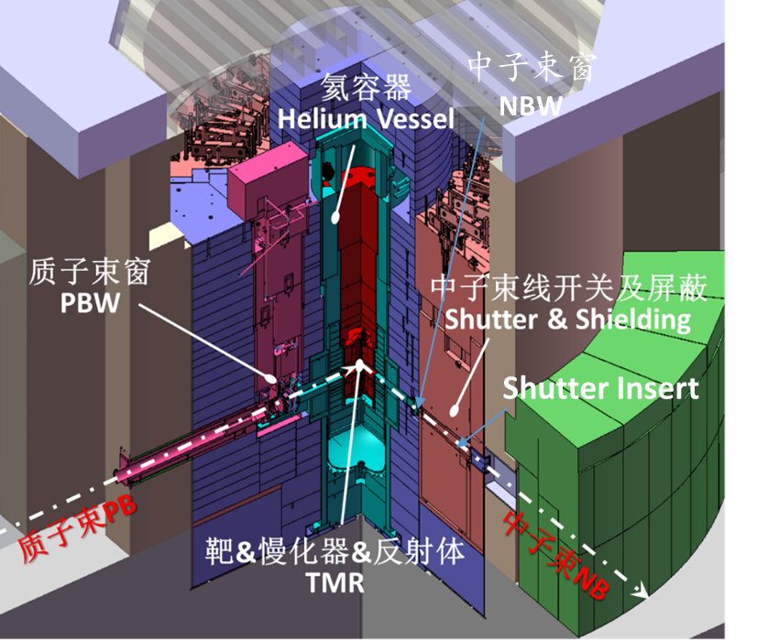
Brief of the proton beam window
The proton beam window (PBW) is located at the interface between the proton accelerator and the target station, which plays the role of isolating the high vacuum of the proton transport line chamber and the helium environment of the target station ;
The PBW1 design life greater than 3 years and it has been running stably since 2018;
We decided to replace the PBW in the 2024 is base on multifaceted considerations .

Slide 4
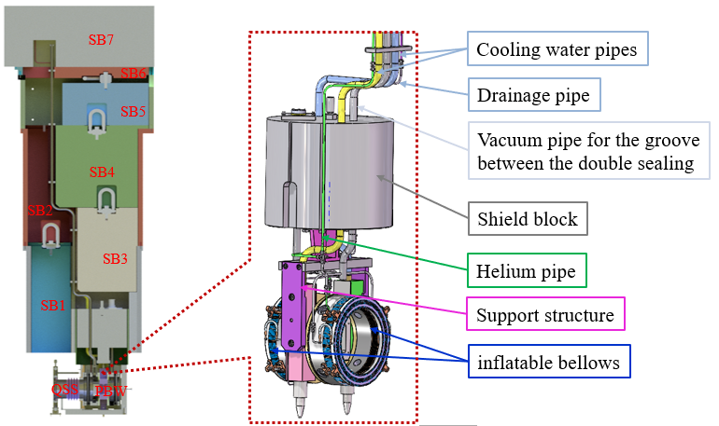
Brief of the proton beam window
The PBW mechanical structure consists of A5083-O welded aluminum window、inflatable bellows 、wire target and its cables 、cooling water pipes、vacuum pipes、shield block 、quick sealing structure and so on .

Slide 5
Contents
Brief of the proton beam window
Replacement plan and main tools
Replacement process
Improvement and upgrade
Summary

Slide 6
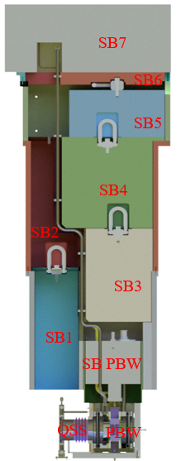
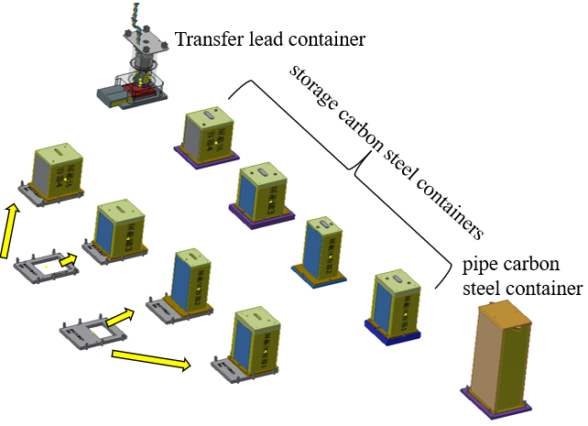
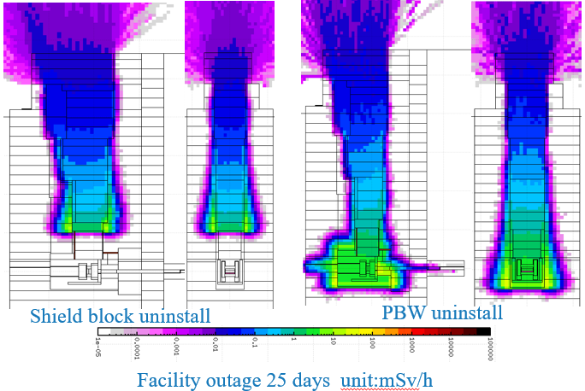
Replacement plan
The preliminary replacement plan has been considered during the PBW1# construction, and corresponding transport and storage containers have been prepared;
Based on the PBW design and the results of radiation calculations, the replacement plan has been determined.

Slide 7

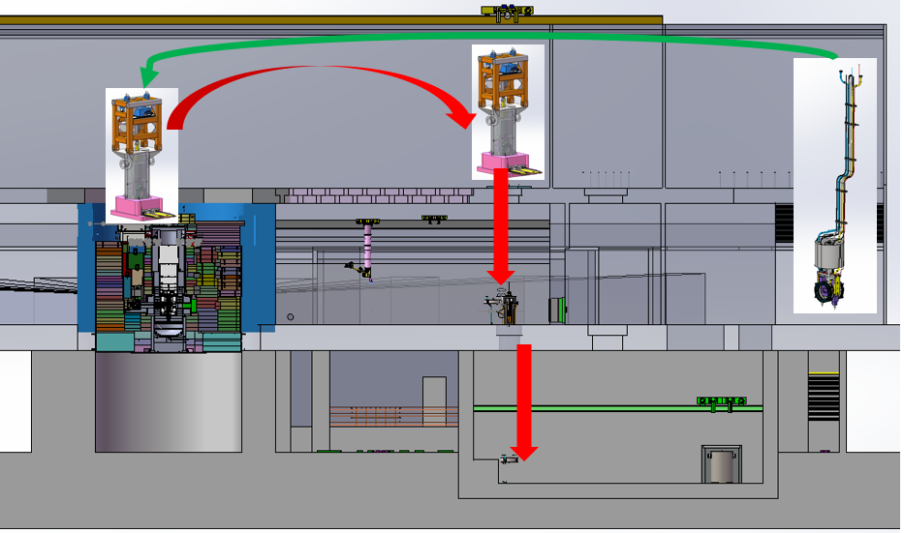
Replacement plan
Uninstall shield block;
Water pipes、vacuum pipe and cables cut;
Fastest remote install;
PBW1# lifting、transport 、observe and storage;
Sealing surface observe in tunnel;
PBW2# installation.
Direct to uninstall
Remote uninstall
Hot cell
PBW2#
Pipes and cables cut
Target station
Underground
PBW1# uninstall
PBW1 transport、observe and storage
7

Slide 8
Main tools
Hydraulic shear for water、vacuum pipes and cables cut;
Electric shear TC-1 for the helium pipe cut;
Fastest FN01 for connect the provisional vacuum pipe;
kinds of Long rod tool for PBW lift 、shield block lift 、connect shear tool and so on ;
Two-dimensional move table with 2 tons calabash for PBW1# lift ;
Bolt gripper – ZIPLIFT for remote connect the PBW;
Vacuum pump for vacuuming the inflatable bellows and chamber;
Video system for remote operation observe include camera 、cable、dispay;
Air tent for cover the top of tunnel with exhaust pipe；
Sealing surface clean and polish tool which can deal with the surface smudge and scratch in tunnel by remote operation;
Helium detector for the vacuum leak test .

Slide 9
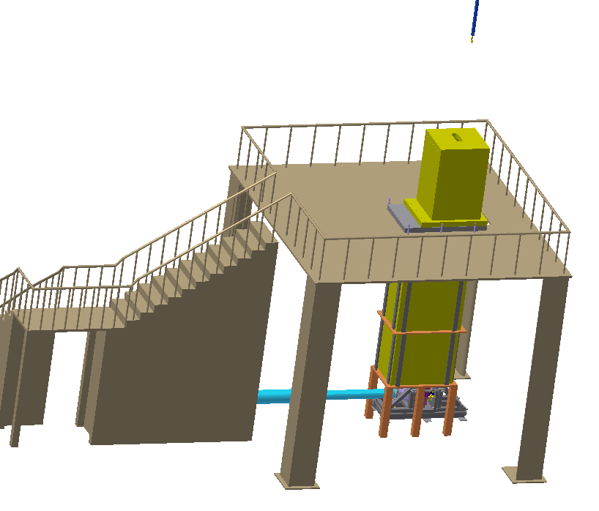
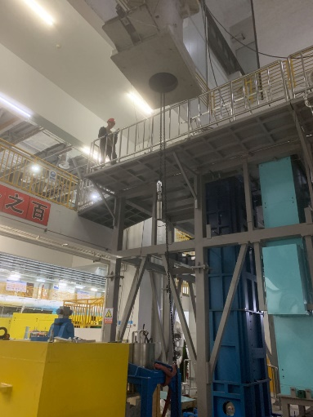
Replacement plan
Major event：
We want to replace the PBW in 2022, then start to prepare;
Formal decide to replace the PBW in 2023, design and manufacturing the tools, process tested with mock up on the test platform.
The replacement of PBW was completed during the period of CSNS shutdown in 2024.
Manpower :14 key personnel
Project team : 7 persons;
Safety management: 2 persons;
Radioactivity measurement: 2 persons;
Radioactive operator: 2 persons;
Crane operator: 1 person .
Almost tested the entire process.

Slide 10
Contents
Brief of the proton beam window
Replacement plan and main tools
Replacement process
Improvement and upgrade
Summary

Slide 11
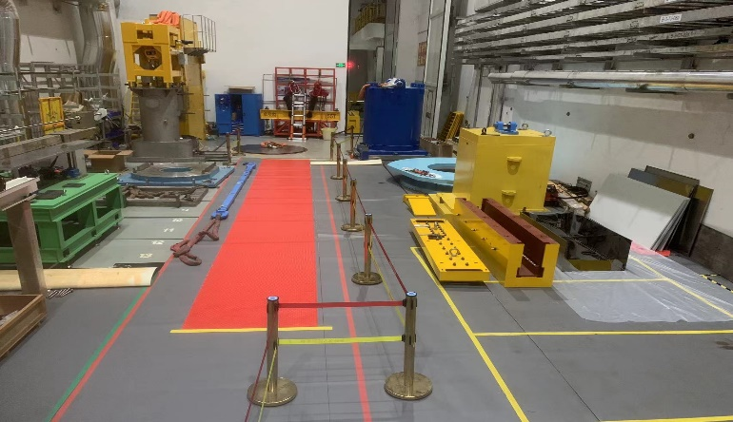
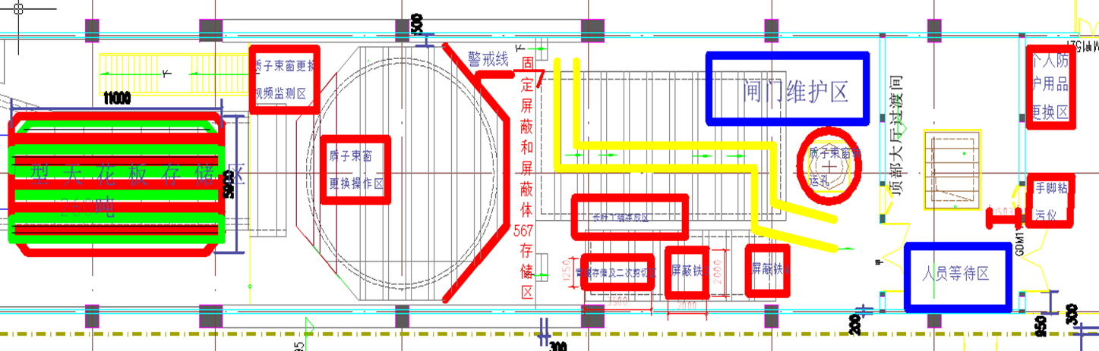
Replacement process
Preparation pre-action:
Planning the layout of maintenance area;
Transfer shielding containers, maintenance tools, and other equipment to the top hall;
Replaced the gas of helium vessel.

Slide 12
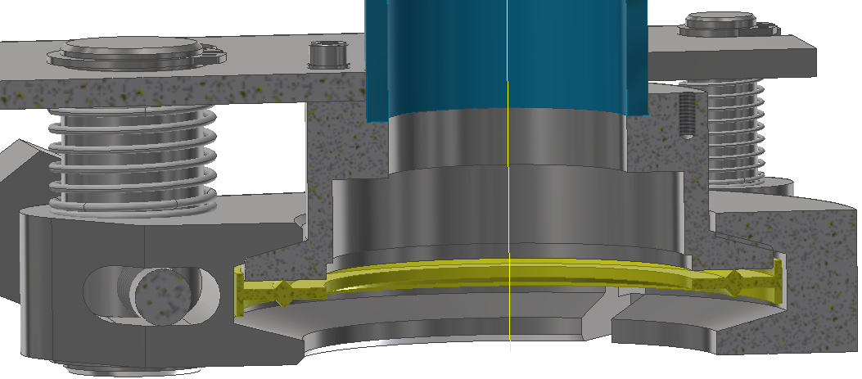
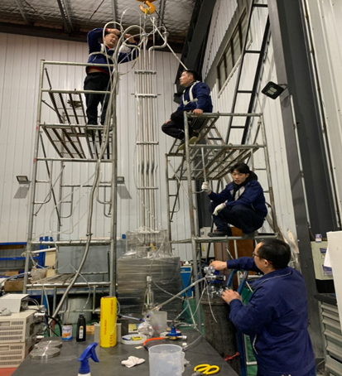
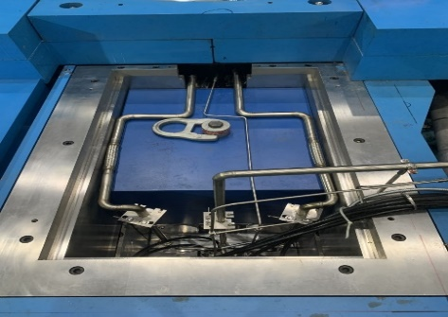
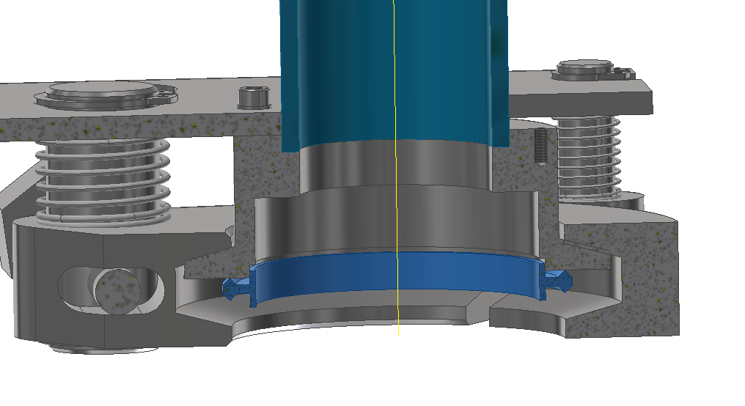
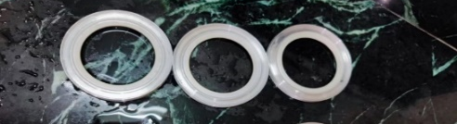
Replacement process
The pipes of transition part dismantle and reinstall:
Separate drainage test of PBW;
Purging the main pipe by nitrogen for 24 hours after draining;
Remove the transition part of the inlet and return water pipes ;
Connect provisional pipes to purge the PBW;
Final remove the drainage pipe;
Leakage test the connect flanges by helium when the pipes reinstall.
Quick-release flange;
Two types of sealing rings;
Many times to sealing .
return
inlet
Filled 10 liters then 9.8 liters come out by 0.3 MPa nitrogen purging 10 min.
drainage

Slide 13
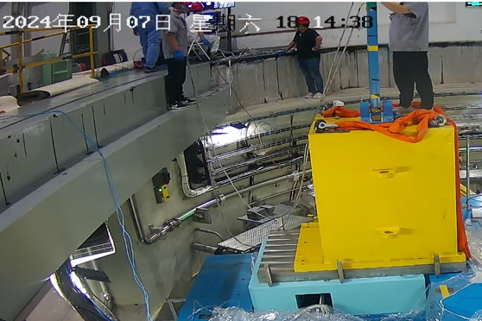
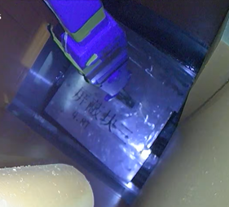
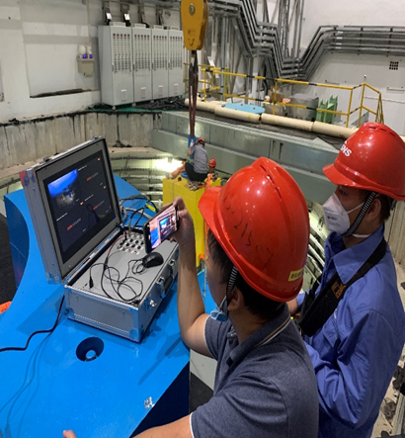
Replacement process
Remove the shield block 3 : remote operate、provisional storage 、reusable
Installation the container on the location by the pin and limit block to positioning ;
Observe the remote hook through the camera system.
Directly lift into the storage container by a long rod tool ;
We did the mockup lift test many times on the test platform at 2023.

Slide 14
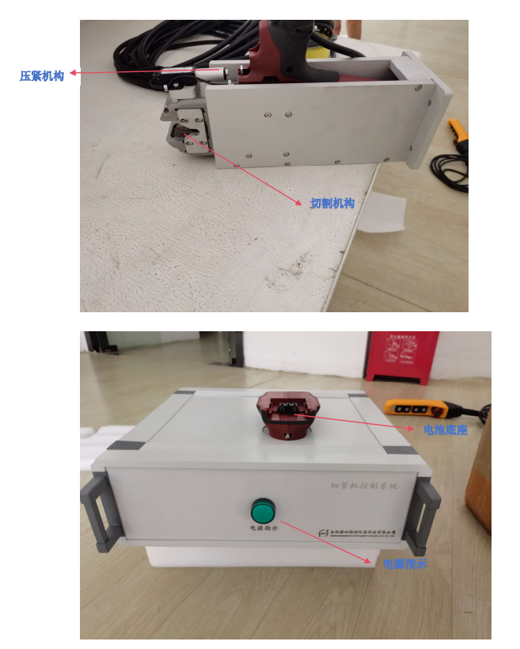
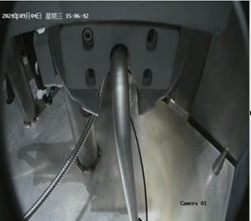
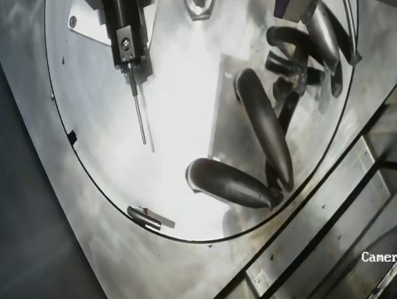
Replacement process
Helium pipe cut: keep the cylindrical shape after cutting
The shear tool is modified from a finished electric pipe cutter into a remote-controlled ;
Exhaust helium of the helium pipe, vacuum, and fill air before cut;
The overall cross-section is flat and the cylindrical shape was not changed after cut ;
There are slight debris dropped on the top surface;
Cleaning the radioactive pollutants of the tool then storage it.

Slide 15
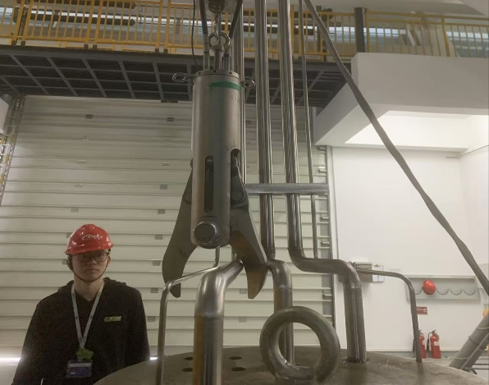
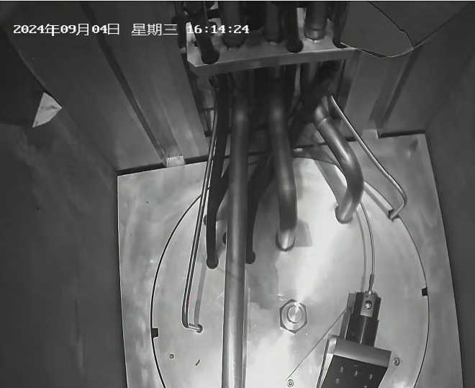
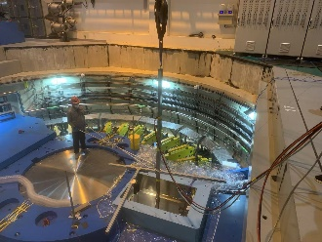
Replacement process
Cutting of the water pipes and cables: difficulty job cause the uncertain cable position
The Hydraulic shear vertical cutting pipes and cables from above;
From the installation photos, we can roughly determine the layout of the cables, they are under the pipes and close to the shield iron;
In order to ensure the completion of the task, we did lots of test and considered the emergency measures;
The crane operator aligns remotely by observing the camera and 1 person need control the direction by the long rod tool near the tunnel;
It is very lucky to have completed the cutting job in just three attempts.
cut1
cut2
blade

Slide 16
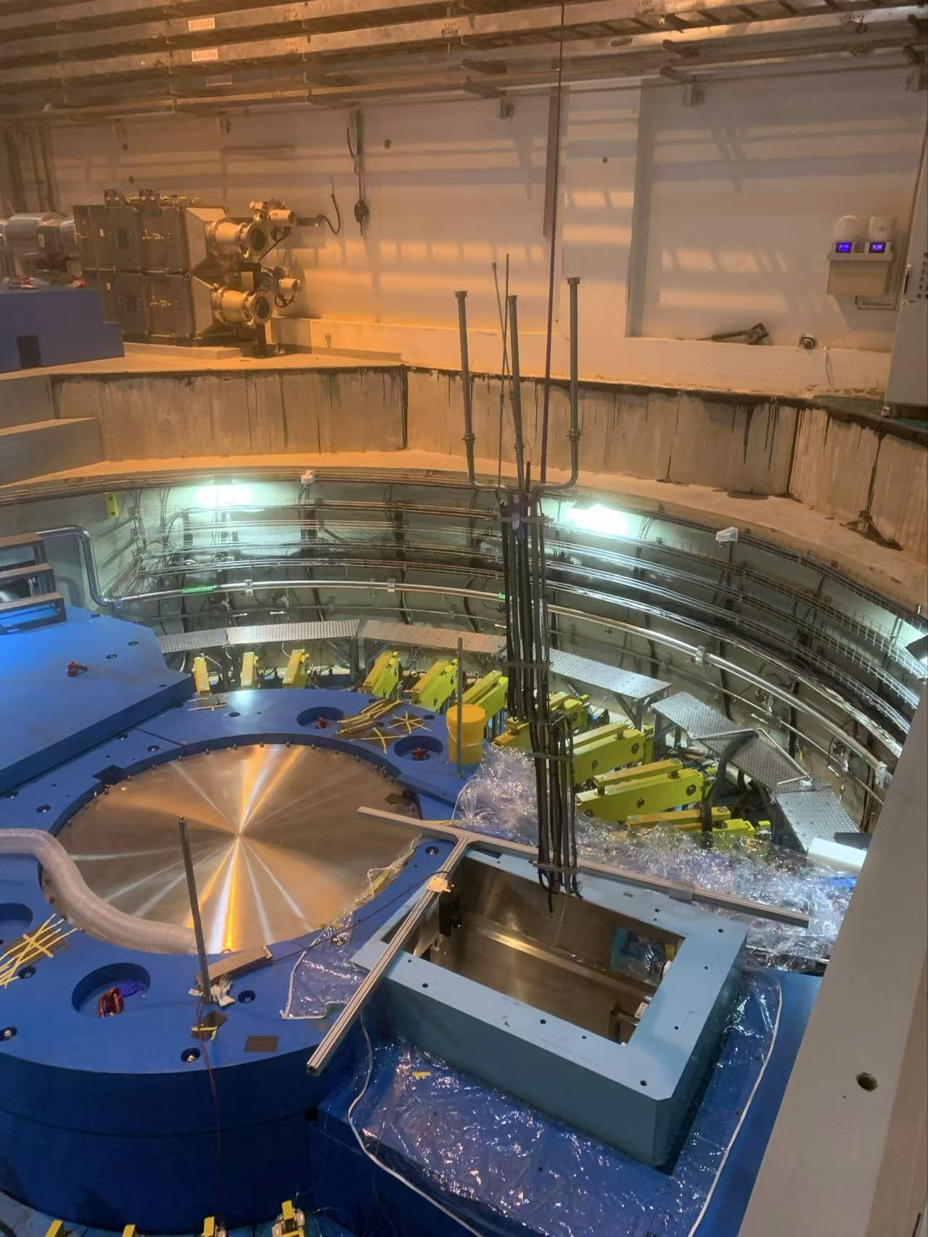
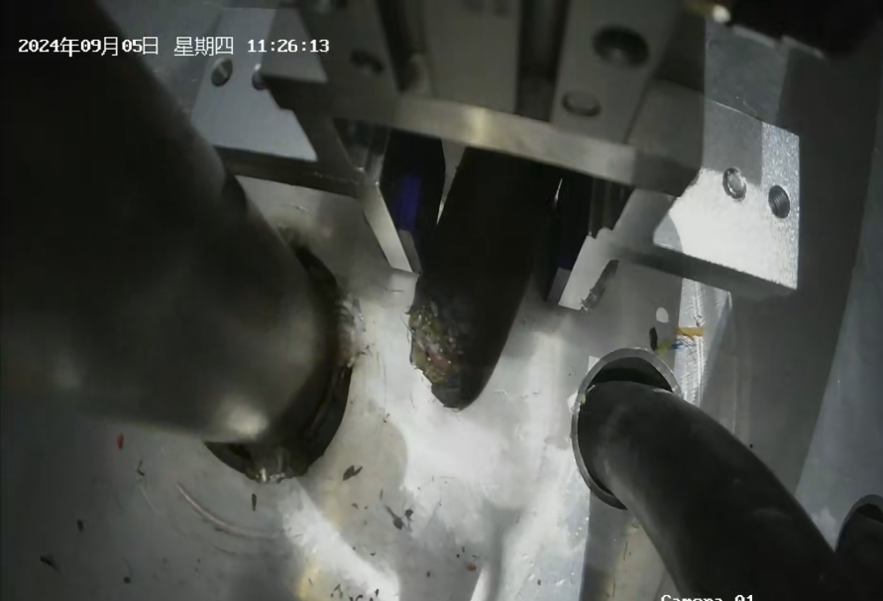
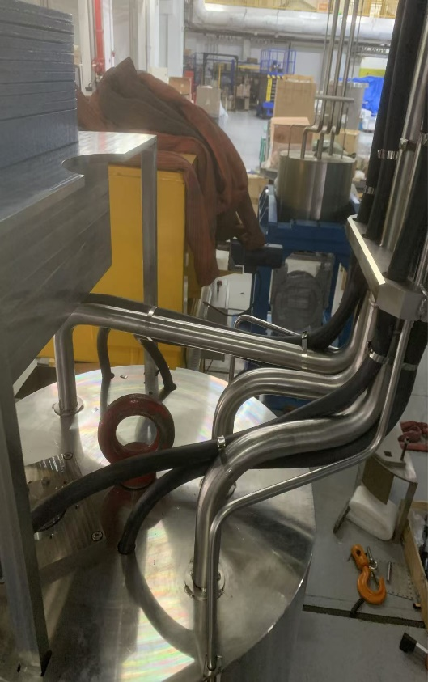
Replacement process
The pipes are remotely hoisted to the storage area for second cutting and shrinking ;
Use the pneumatic clamps to take out the short left cable due to the second cutting;
Clean up the debris generated from the cutting by a sticky roller;
The cables of PBW2# are arranged in accordance with an easy-cutting plan.

Slide 17
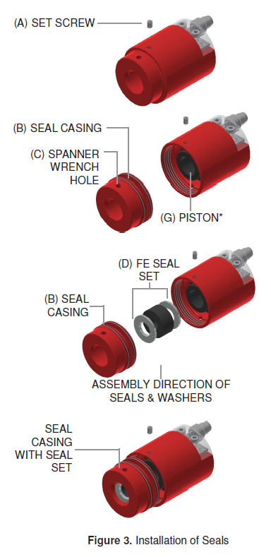
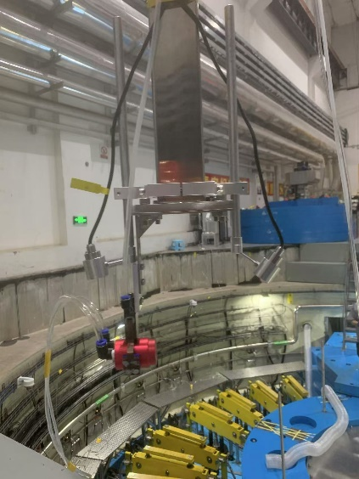
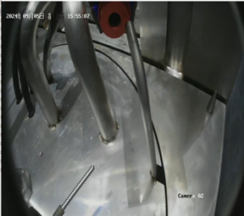
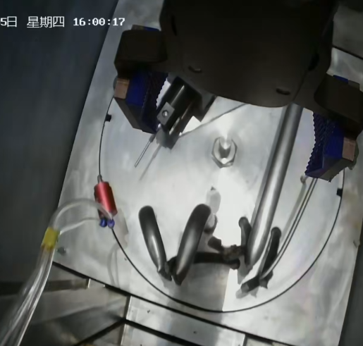
Replacement process
The Fastest connector :
The Fastest connector is held in place by a long rod tool and pneumatic clamp;
Remote operation of the connection, pressurizing with 1MPa of nitrogen gas to tighten the pipe.
Vacuum pumping to below the pressure of atmospheric ,the inflatable bellows will instantly contract.

Slide 18
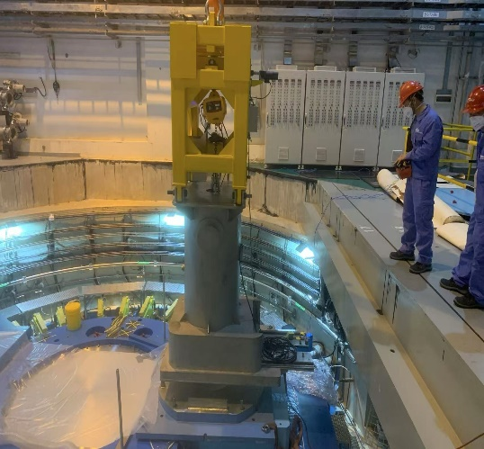
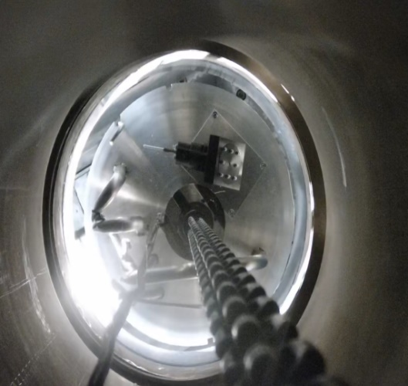
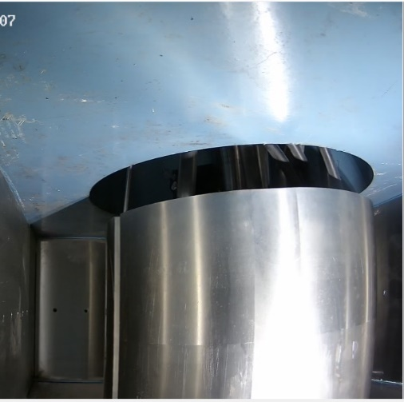
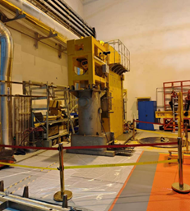
Replacement process
Hoisting the PBW1#:
Lift the transfer container and two-dimensional move table to the local area and positioning it by the pin and limit plate;
Remote operation to open the bottom shield door and lower the ZIPLIFT to grip the PBW ;
Vertically lift the PBW with speed of 1.8m/min , when reaching the bottom edge of the container should be slowly raised;
Final closed the shield door and transport them to the top of the hot cell.

Slide 19
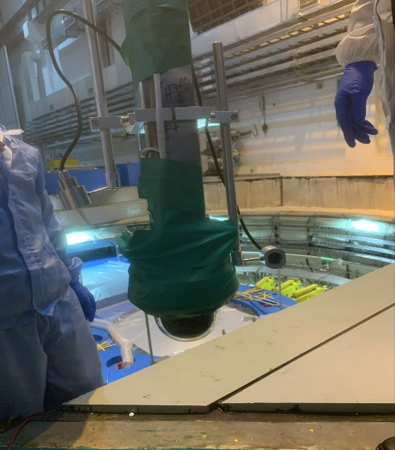
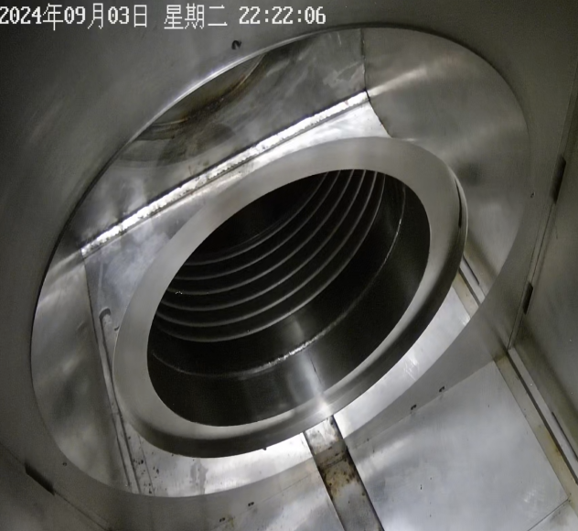
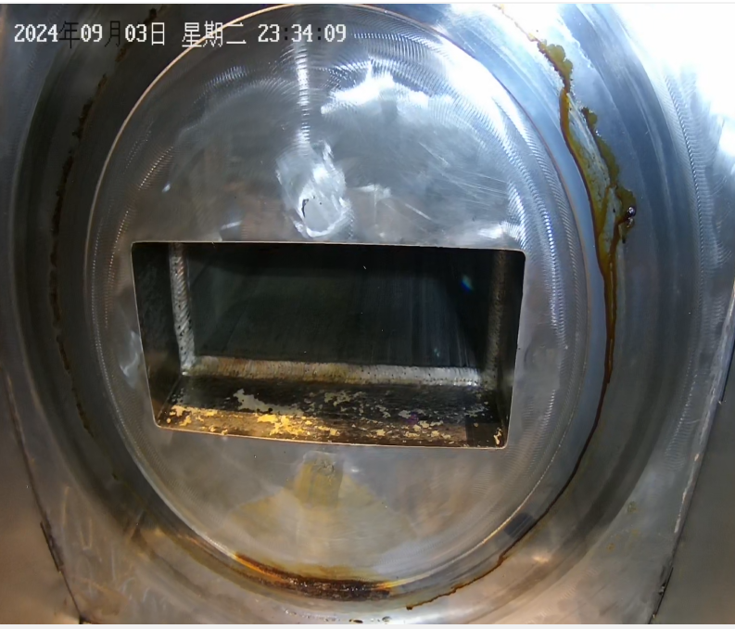
Replacement process
Observe the sealing surface in the tunnel:
The target side has obvious water stains, but no scratches, we consider that it does not affect the use and does not need to be cleaned after discussion,.
Use a 4x zoom camera and 2 Fixed focus cameras for observation;
The accelerator side mirror surface is clean, bright, and free of obvious scratches and defects;

Slide 20
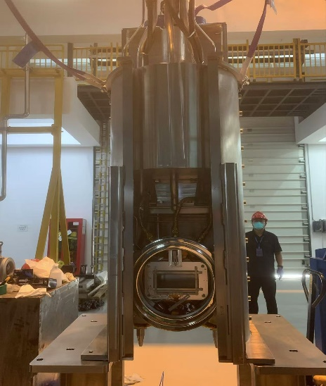
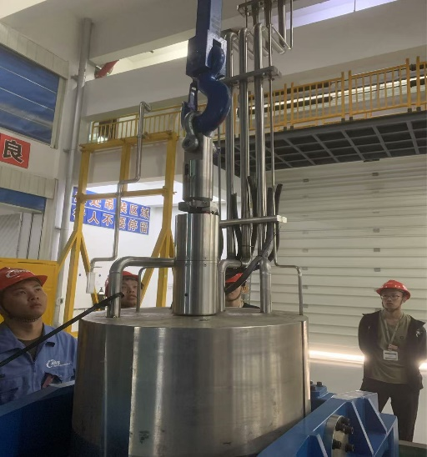
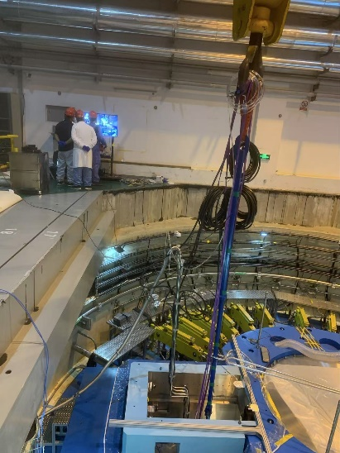
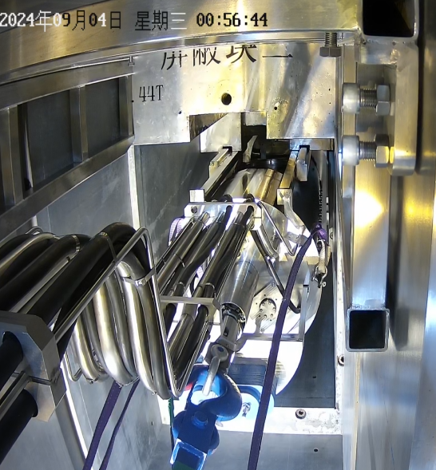
Replacement process
Hoisting with ZIPLIFT and long rod , adjust the overall level , transport to target station;
Four guide groove and two pin for the PBW positioning;
Inflate the bellows by helium to expand for sealing.
Installation of the PBW2#:
Finished the vacuum test , install the beam measure cables, vacuum pumping the helium pipe to maintain the inflatable bellows contracted;
Clean the film and install the guide sleeve;

Slide 21
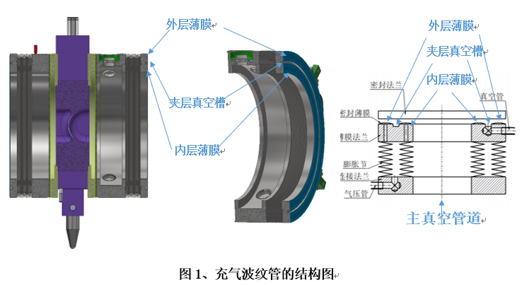
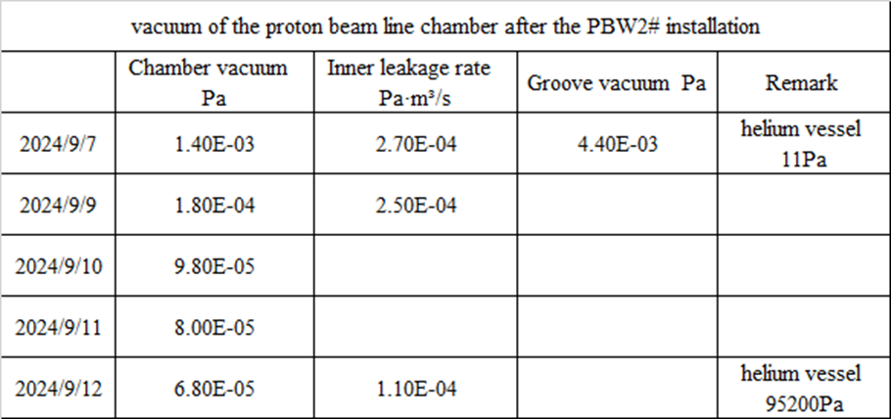
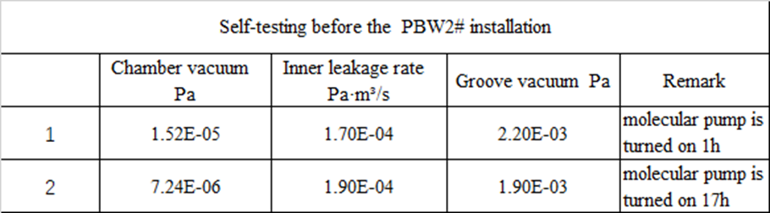
Replacement process
Vacuum : The condition of the ion pump start is the vacuum reach to E-05 Pa
We did the Vacuum test before PBW2# installation;
The vacuum level reached the operational requirements after pump on three days .
outer film
Groove
Inner film
inflatable bellows

Slide 22
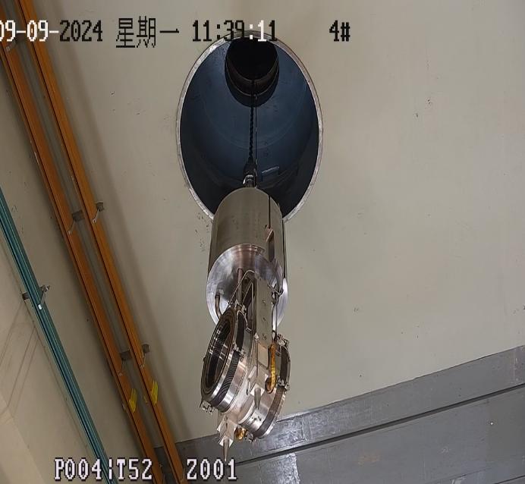
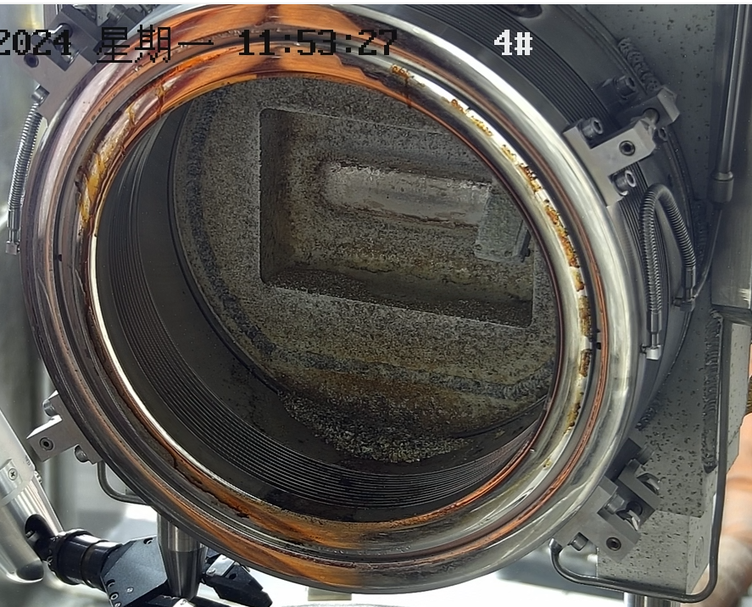
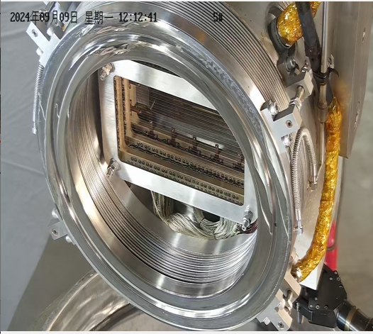
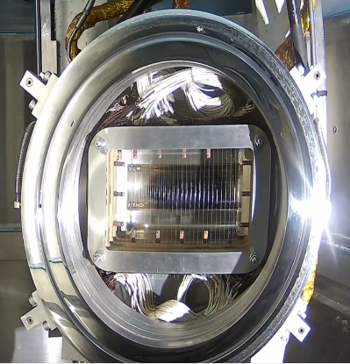
Replacement process
Observe the PBW1#:
Lower the PBW1# into the hot cell by the top transfer hole from transfer container;
There are many particles in the side window of the helium vessel and has obvious water stains on the film of the inflatable bellow;
The overall appearance is very well in the side of accelerator but the color of the window is changed;
The wire target also looks intact.

Slide 23
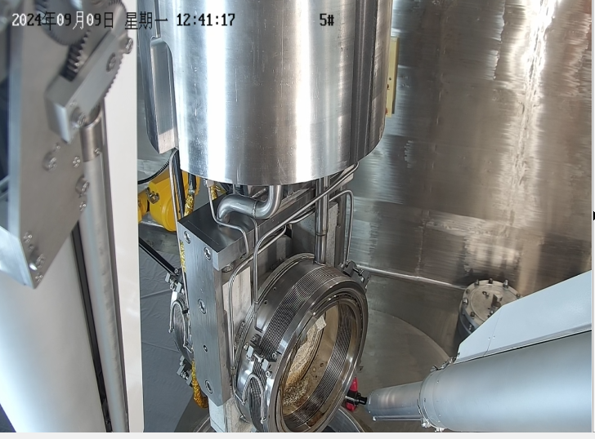


Replacement process
Storage of the PBW1#:
Lift the PBW1# into the storage container and control the direction by mechanical hand in the hot cell;
The ZIPLIFT automatically release after power on;
Cover the top cover and then transport it to the basement by the bottom transfer hole for storage.
23

Slide 24










Replacement process
Continue to measure the gamma ray in the operational area and equipment during maintenance;
The surface of the shearing equipment has very little radioactive contaminants, which is cleaned with alcohol and cleanroom cloth.
Max. pipes
2.5mSV/h
300μSv/h
8.2μSv/h
620μSv/h
6mSv/h
out1.9μSv/h
152μSv/h
10μSv/h
910mSv/h
260mSv/h

Slide 25


Replacement process
Measurement of the tritium :
Fixed at the Air tent bottom on the shielding iron and open from the top with a zipper.
The tritium is detected when the flange is disconnected between helium vessel and PBW ;
Vacuum pump exhaust port.
Tritium concentration detector
Ø10 Plastic pipe for measure
Exhaust
Replace the gas inside of the helium pipe and the helium flange transient open.
helium flange keep open.

Slide 26
Contents
Brief of the proton beam window
Replacement plan and main tools
Replacement process
Improvement and upgrade
Summary

Slide 27



Improvement and upgrade
Upgrade of the PBW:
Changed the layout of the beam measurement cables to easy cut at PBW2# ;
Modified the cooling method of the beam window for the 500KW at PBW2#;
Consider to design a separate vacuum pipe for two flange at PBW3# ;
Consider to add a limit switch to remotely determine the movement status of the inflatable bellows.

Slide 28




Improvement and upgrade
Improvement of the sealing surface clean and polish tool:
Modify the positioning method ;
Look for surface polishing materials and Explore the process.
Improvement others:
Improve the transition flange of the cooling water ；
Add a flexible section on the top of cooling water pipe of PBW.

Slide 29
Contents
Brief of the proton beam window
Replacement plan and main tools
Replacement process
Improvement and upgrade
Summary

Slide 30
Summary
The replacement start on 1st sept and finished on 14th sept (12 work days);
The remote operation maintenance tools and equipment is functioning normally ;
The radioactivity level is consistent with theoretical calculations;
The vacuum level meet the expected requirement after PBW2# installation;
The facility started operating on schedule and running smoothly;
In the future consider to research at the irradiation damage of aluminum window.
This project is an important experience accumulation for us and we need to detailed summary and modify !

Slide 31

Successfully to completed the replacement of the proton beam window for the first time in CSNS!
Thanks for your attention ！
31

