Slide 1

Conceptual development of beamstrahlung photon absorber for FCCee
R. Ximenes, R. Seidenbinder, S. Candido, A. Frasca, A. Lechner, G. Lerner, A. Perillo-Marcone, M. Widorski, M. Calviani (CERN)
C. Carrelli, M. Tarantino (ENEA)
29th October 2024

Slide 2
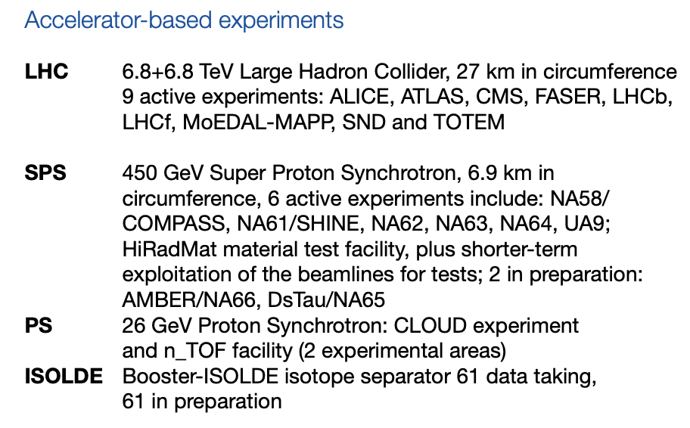
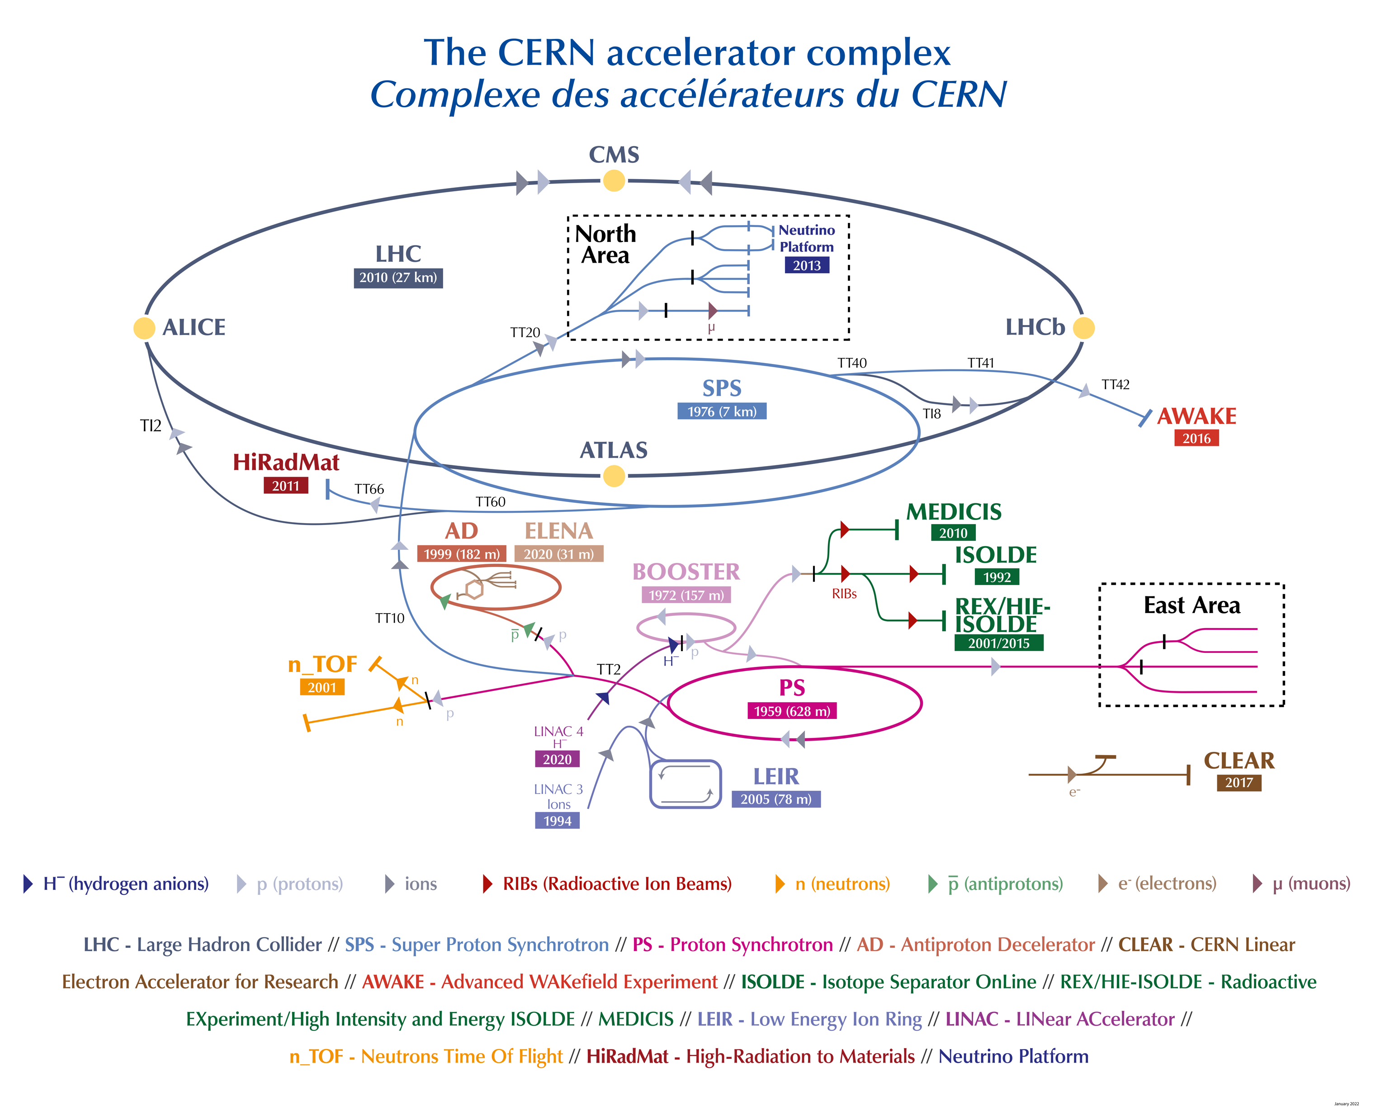

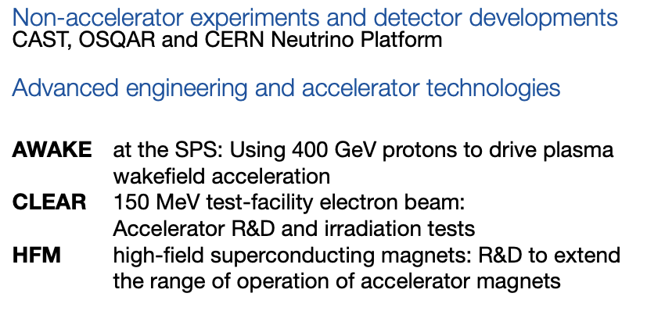

Slide 3
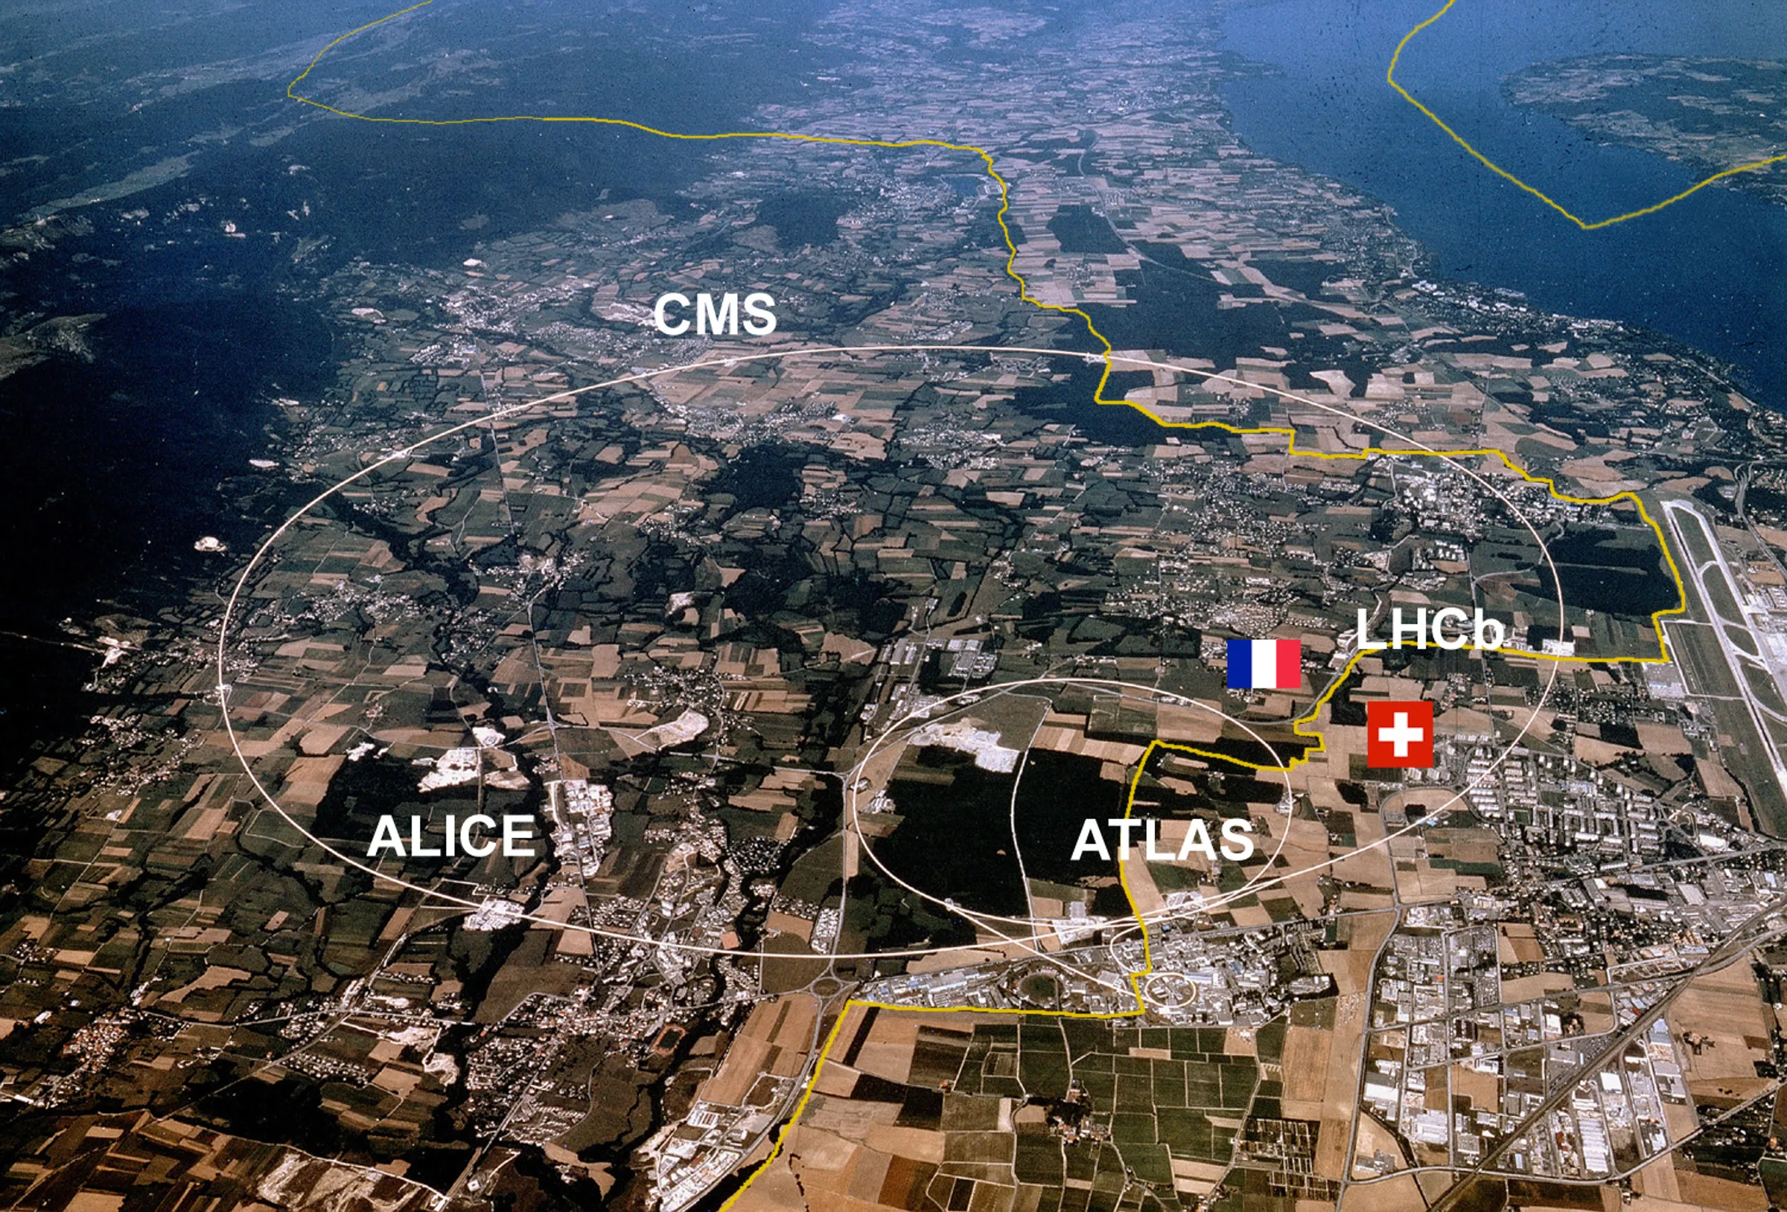

Slide 4
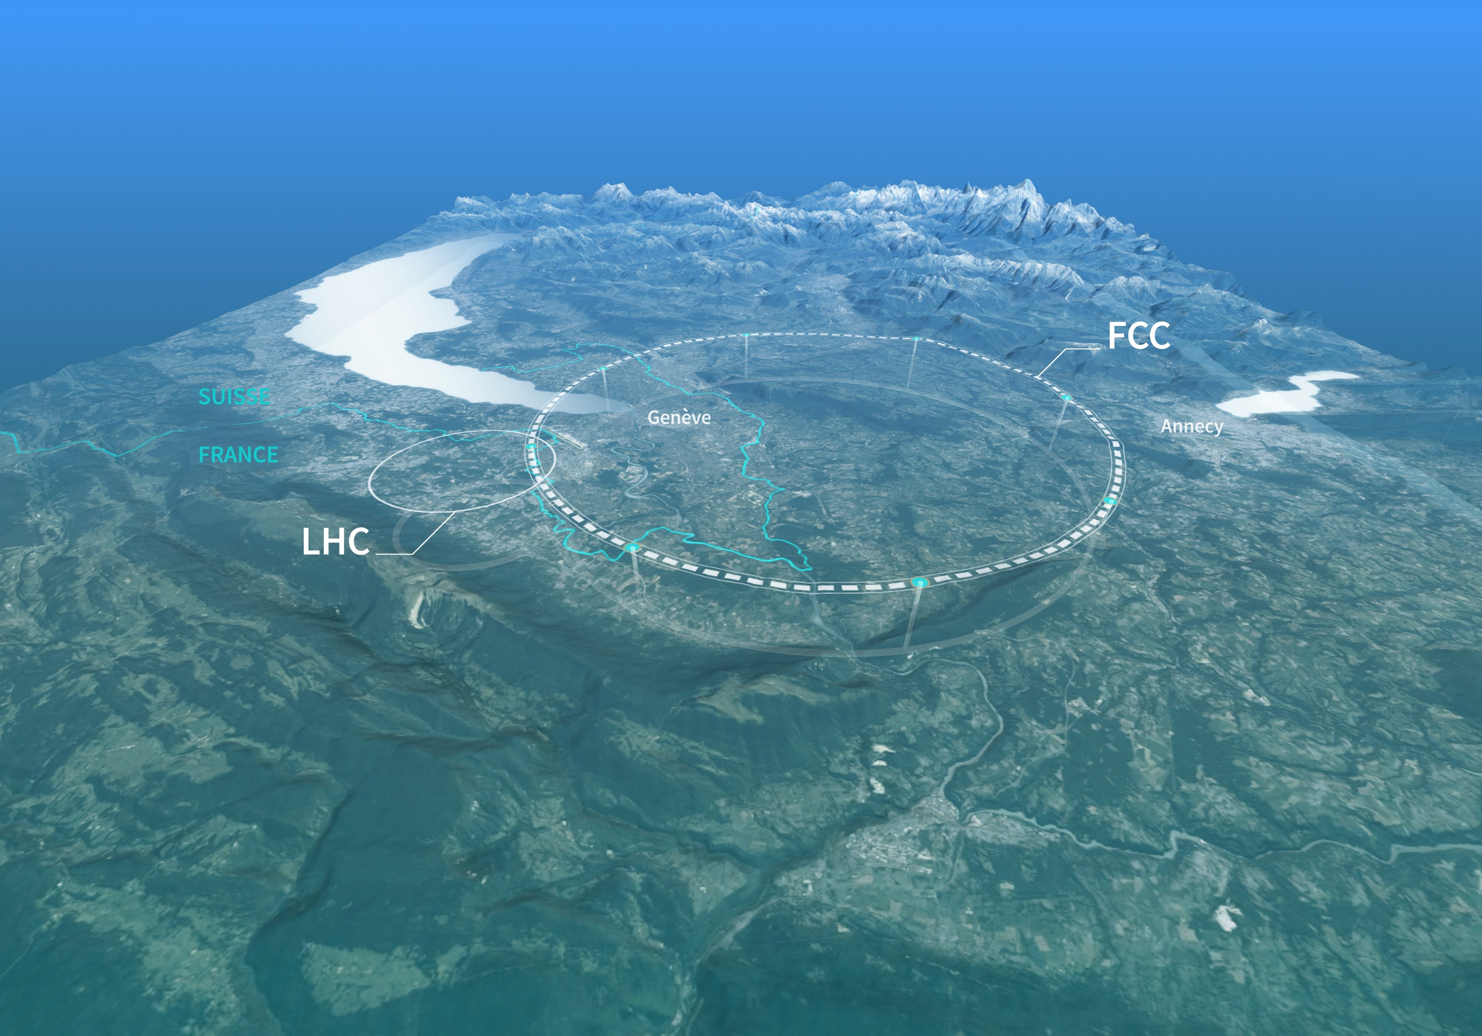
Future Circular Collider
e⁻e⁺ machine 1st stage
45 GeV → 182 GeV, up to 1.4 A current
Ceaveat: we are currently in the feasibility phase, technical choices may change
WORK IN PROGRESS

Slide 5
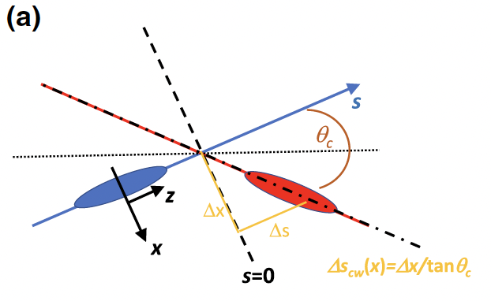
A real challenge for BIDs (and other systems)
e.g. 20 MJ with V size of ~20 nm
Up to 100+ different system will be required (e⁺ source, collimators, lepton dumps, absorbers etc.)
… and will also include non-conventional systems
Beamstrahlung radiation
emitted by an incoming electron in the opposite bunch's collective electromagnetic field at an interaction point

Slide 6
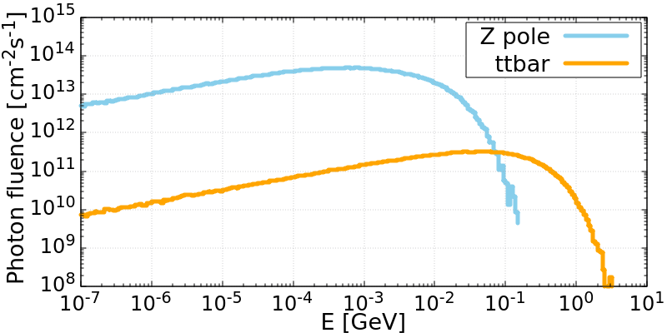
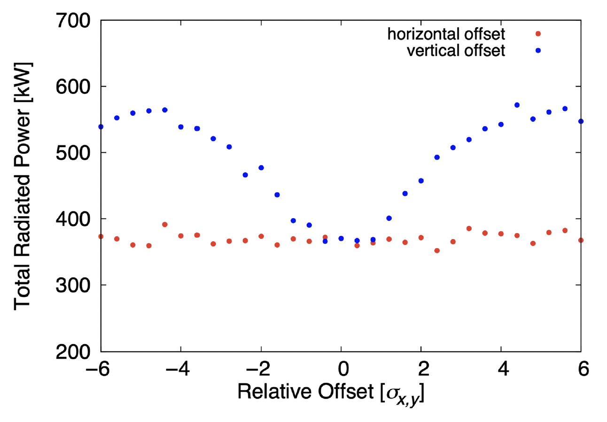
Beamstrahlung radiation source
 | Lepton energy | Beam current | Avg. γ power | Max γ energy
Z₀ mode | 45.6 GeV | 1.4 A | 370 kW | ~100 MeV
ttbar mode | 182.5 GeV | 5.4 mA | 80 kW | Few GeV
In case of vertical offsets between beams at the IP, power up to 500-600 kW
M. Boscolo, A. Ciarma, Phys. Rev. Acc. Beams 26, 111002 (2023)

Slide 7
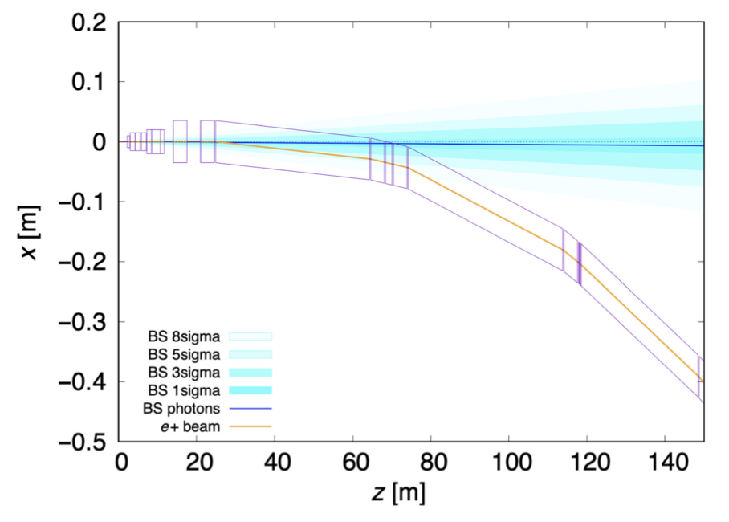
σ_{x} ~4.6 cm
σ_{y} ~2.5 cm
σ_{x} ~2.2 cm
σ_{y} ~2.5 cm
Instantaneous photon fluence exceeding ~10¹⁶ γ/cm²/s
In order to have reaosnable distance between the machine and the absorber, the latter is placed at about 500 m from the IP
Absorbers require to be relatively large in diameter (>700 mm ⌀)

Slide 8
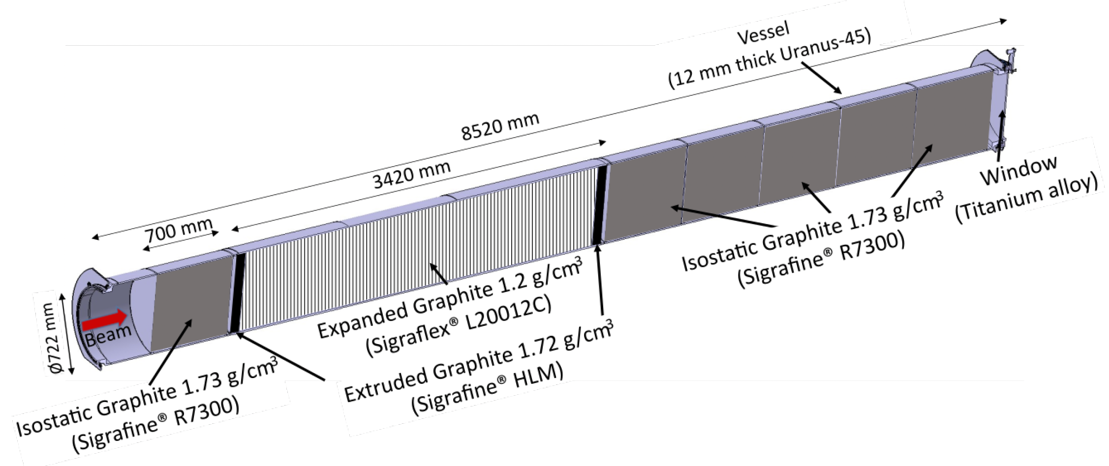
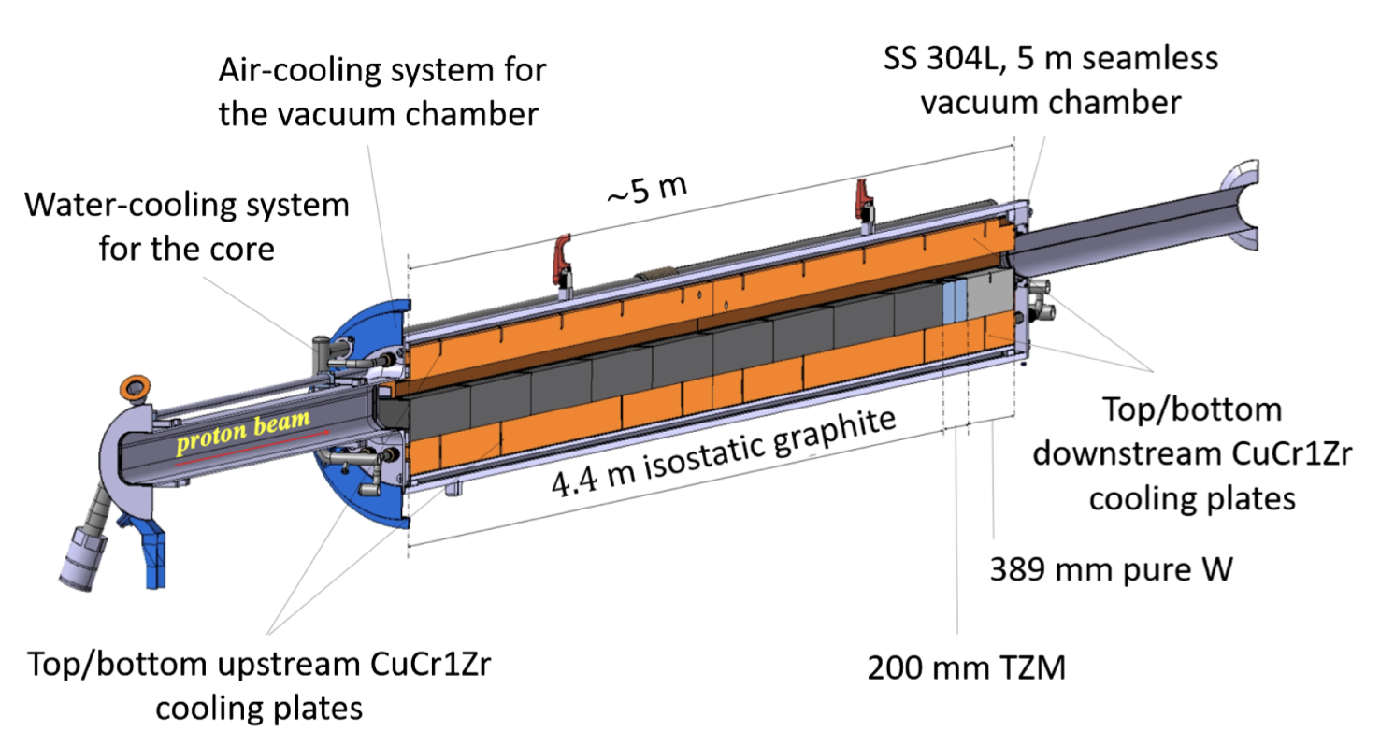
Considerations & limits of solid absorbers
As a first assumption we considered the use of graphite as absorbing material, capitalizing from the existing CERN’s experience in these types of absorbers
SPS internal beam dump
±5 MJ, O(300) kW
LHC external beam dump
500-700 MJ, O(10) kW
J. Maestre et al. 2021 JINST 16 P11019
A. Francia et al, Phys. Rev. Acc. Beams 27, 043001 (2024)

Slide 9
Considerations & limits of solid absorbers
Graphite (ρ=1.2-1.8 g/cm³) is an excellent material due to its robustness and capability for high T operation (& rather good radiation hardness)
Operation in UHV limited to O(1200) °C due to vapor pressure
Higher temperatures only possible under inert gas operation (e.g. (HL)LHC beam dump)
Unfortunately, thermal conductivity is rather poor (50-70 W/m*K), hence material not very adapted for high steady state power deposition for big volumes

Slide 10
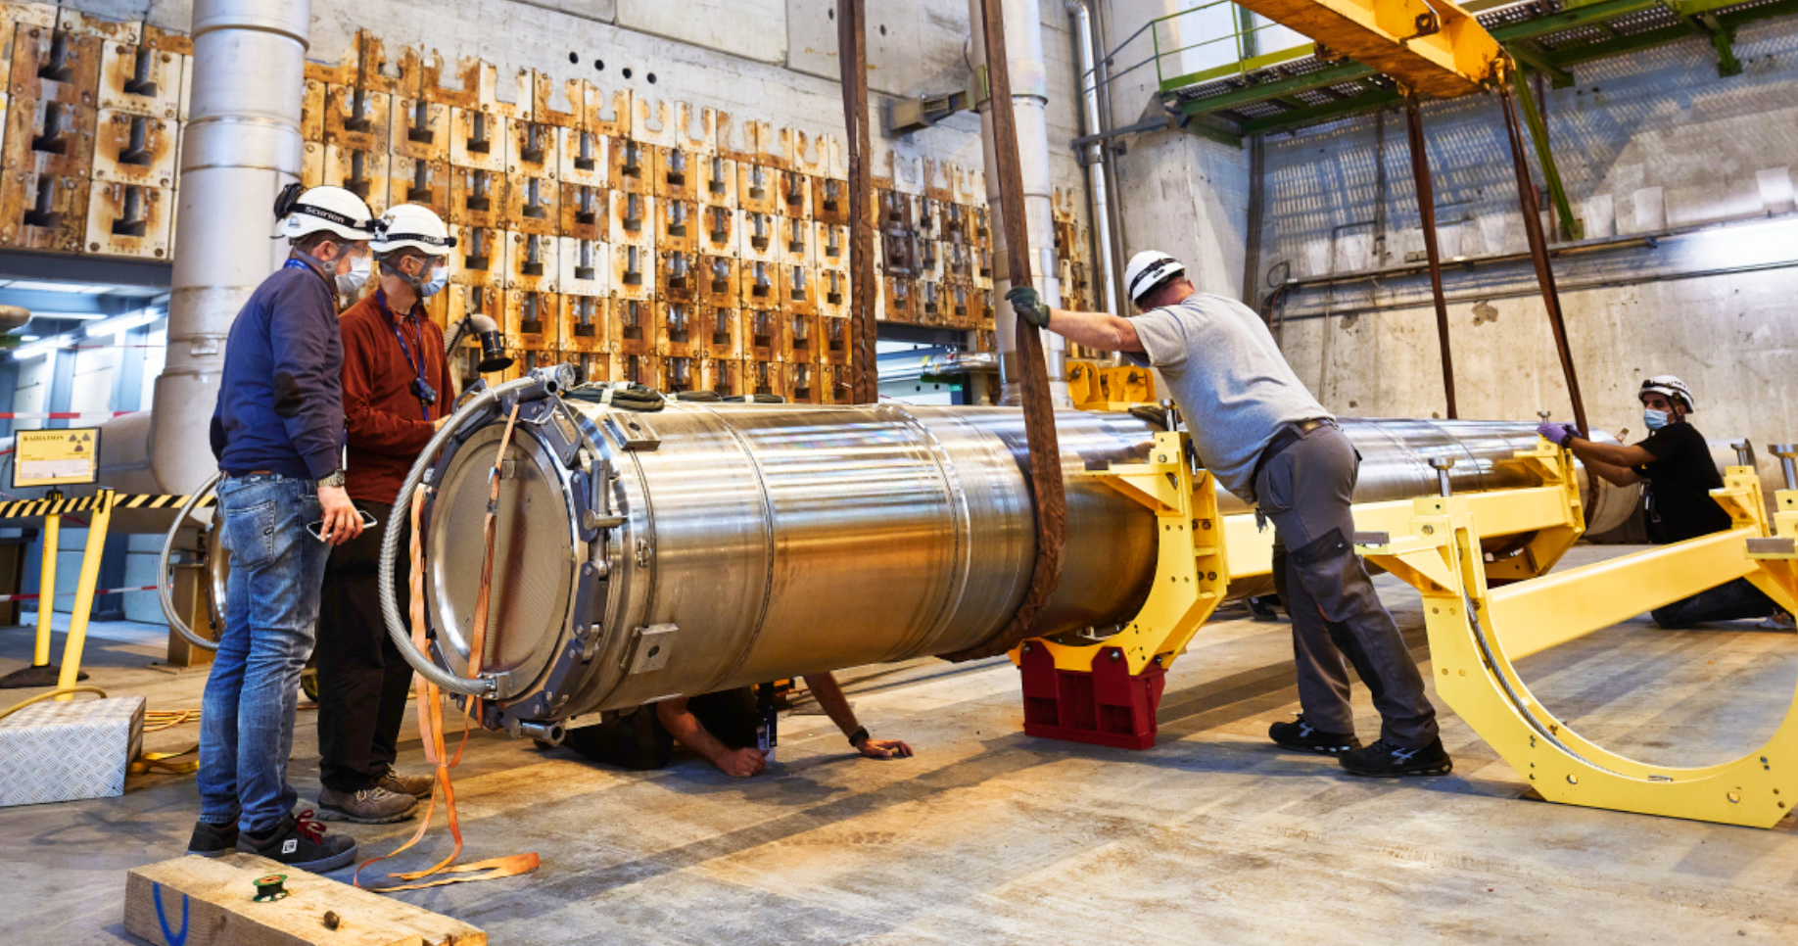
How would a LHC dump solution would perform?
Dump ±700 mm ⌀, L~300/350 cm
Assuming a peripheral cooling, >4000 °C for Z₀ operation at 500 kW
  Stresses appears beyond the limit for nominal operation
  Conditions limited by the thermal conductivity of graphitic-material, rather than on external cooling
For the time being, no-go for this option

Slide 11
What if we go liquid?
We started investigating the option of using pure liquid Pb
  Operational temperature between 400 °C and 480 °C
  Rather insensitive to total power deposited
  No Pb-Bi eutectic system to avoid complex chemistry, requirement to keep temperature under well precise control as well as due to Po production from Bi
  Synergetic with other initiatives at & with CERN
A flowing system of Pb in case of a quasi-CW energy deposition would be a good fit for the requirement of FCCee BS absorber

Slide 12
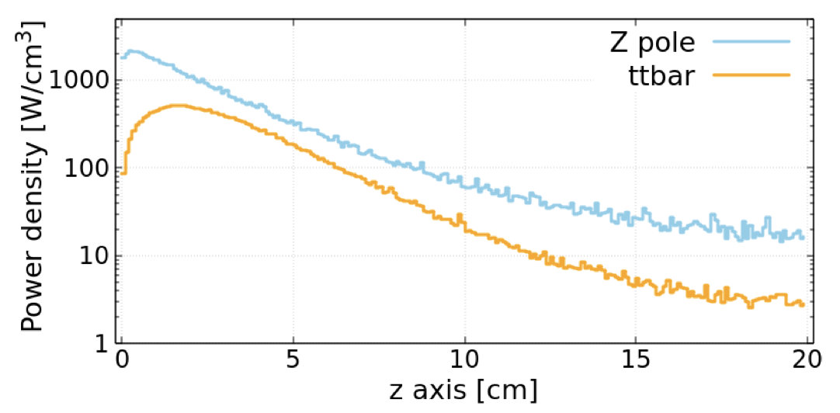
Advantages of a liquid Pb absorber (I/II)
Pb is an ”ideal” photon absorber material
Absorption and dissipation of thermal power from the beam is “trivial”
Absence of beam-induced thermo-mechanical stresses
No long-term degradation of dump materials
Dilution of radionuclide inventory within total absorber volume
Flexible waste disposal preparation

Slide 13
Advantages of a liquid Pb absorber (II/II)
Heat exchanger with coolant medium can be located away from absorber (and could be air)
Known liquid Pb thermo-hydraulics and experience building loops by collaborators
No need for vacuum vessel nor pressure vessel – operation at atmospheric pressure with cover gas
At foreseen operational temperatures, no issue with chemical compatibility, corrosion & erosion on conventional stainless steels (AISI304/316)

Slide 14
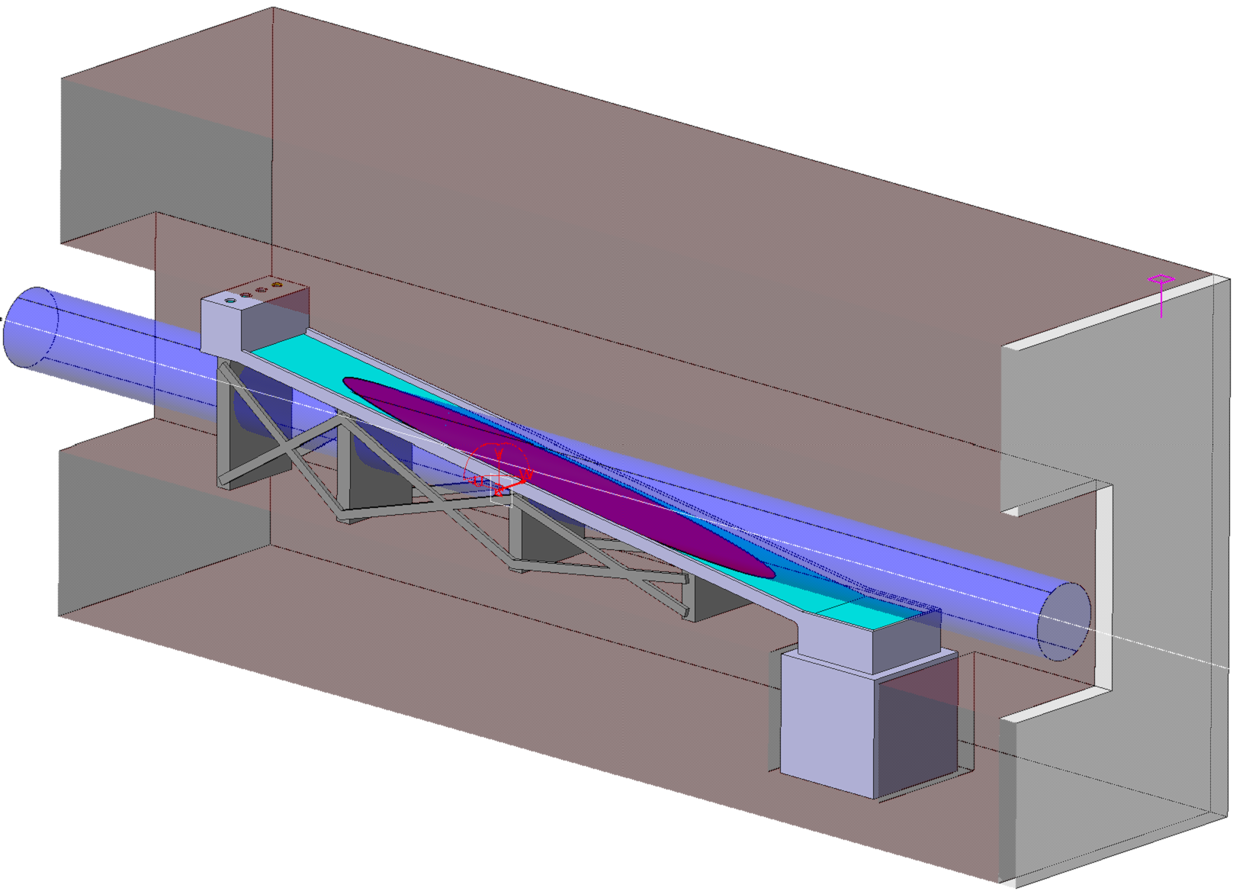
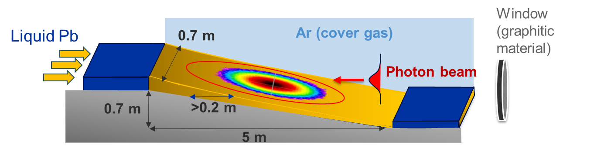
Conceptual implementation of a liquid Pb beamstrahlung absorber
Injection system
700 mm diameter footprint
S. Sorlut
Liquid Pb free surface
Slide flow oriented at ~8 degrees
Effective free surface Pb thickness of about 30-40 mm, but effective depth seen by photons of >200 mm
Shielding around the dump of 150 cm of Fe
Pb in purified Ar atmosphere at 1 bar(a)
Pb collection system

Slide 15
Cover gas & Oxygen control system
Flow rate: up to 350 kg/s
Deposited power: 500 kW
Avg. vel. (dump) : > 1 m/s
Avg. temp. : 400-420 °C (no corrosion)
Piping: DN100/DN300
Material: AISI 304/316
Vertical, mixed axial flow pump
Pressure losses: < 1.5 bar
Main systems:
  Coolant purification system (OCS)
  Cover gas system
  Air cooler
  Filling & drain system
Pump & Oxygen control system
BS dump
Fill & Drain
Air cooler
Conceptual P&ID

Slide 16
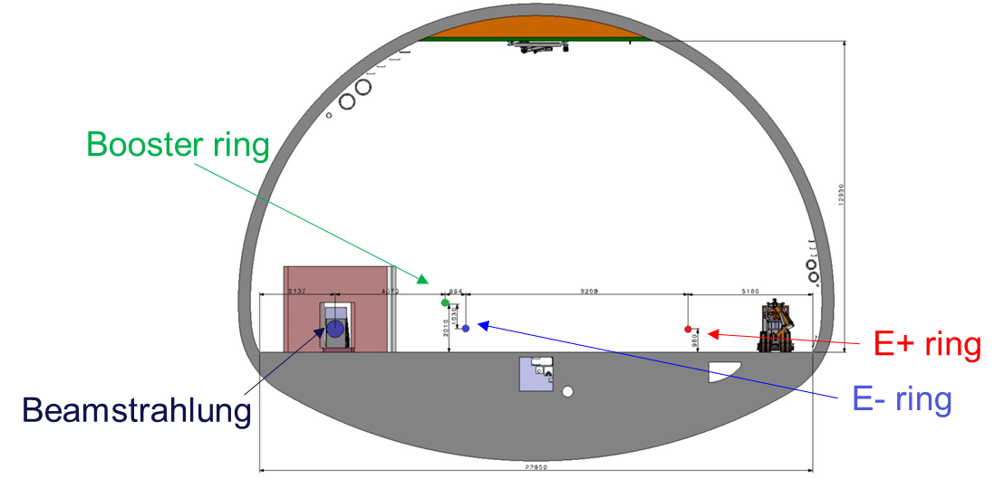
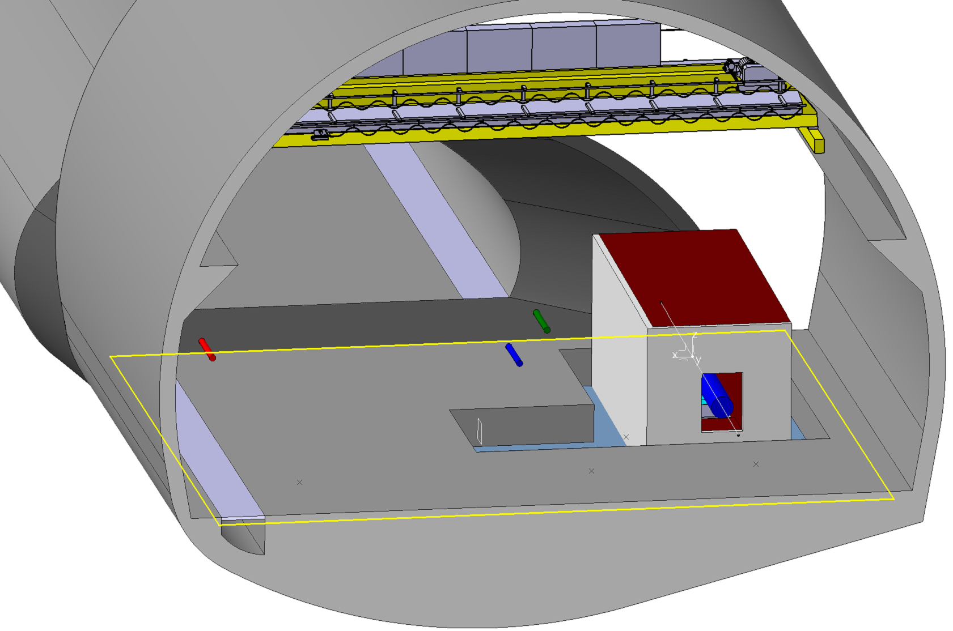
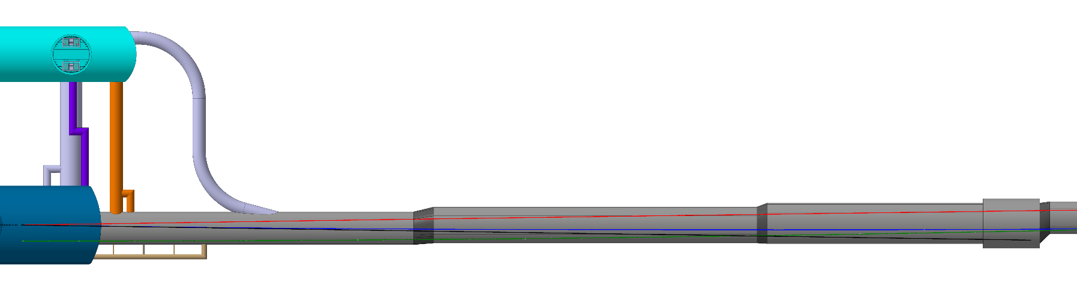
Integration in the accelerator tunnel
We assume the dump to be located at 500 m from IP, to have sufficient separation between the beamstrahlung line & booster line & as much diluted beam as possible
IP
22 m
500 m

Slide 17
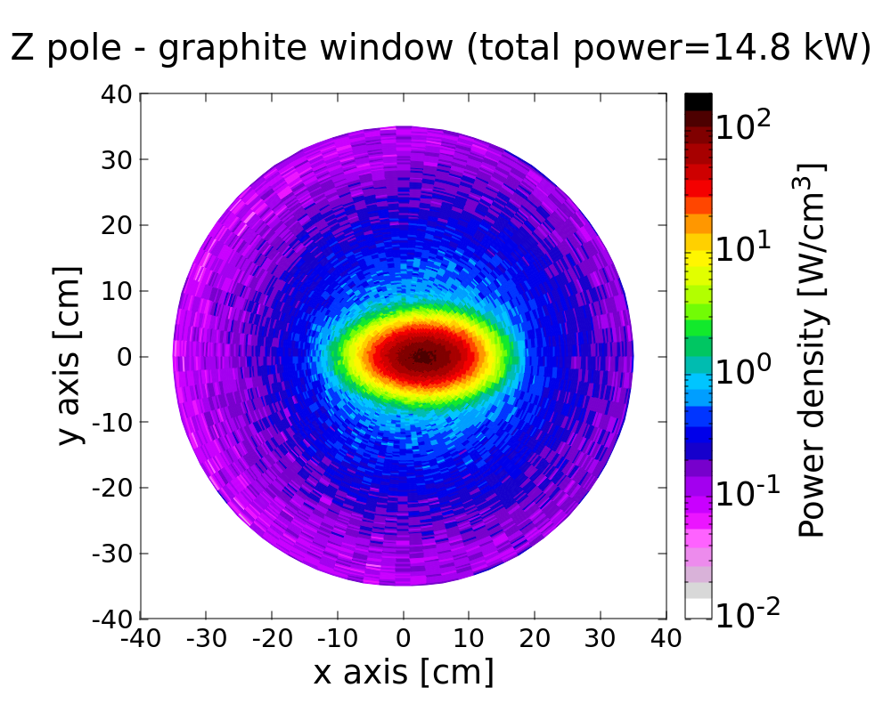
Considerations on beam windows
Windows required to separate the dumps from the UHV environment of FCCee
Very large diameter (e.g. LHC TDE) means large pressure-induced stresses → tend to favour thick windows, which in turn means high (total) power deposition
Currently favoured with is 20 mm Be for the UHV/Ar window, graphite-based window could be an option for Ar/Ar interface

Slide 18
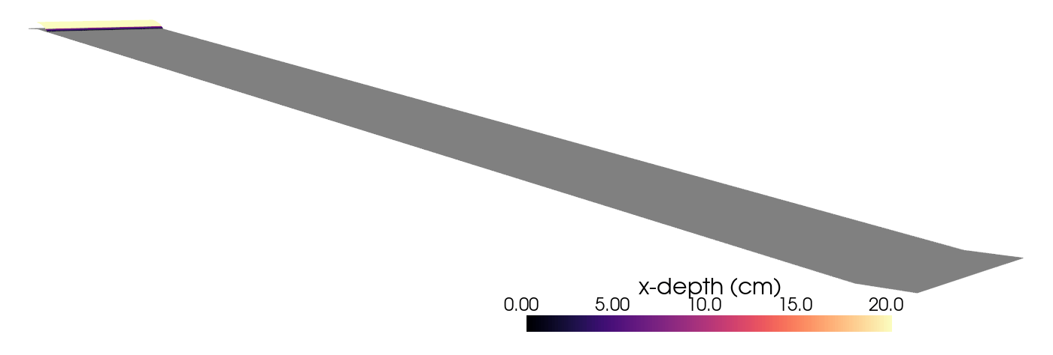
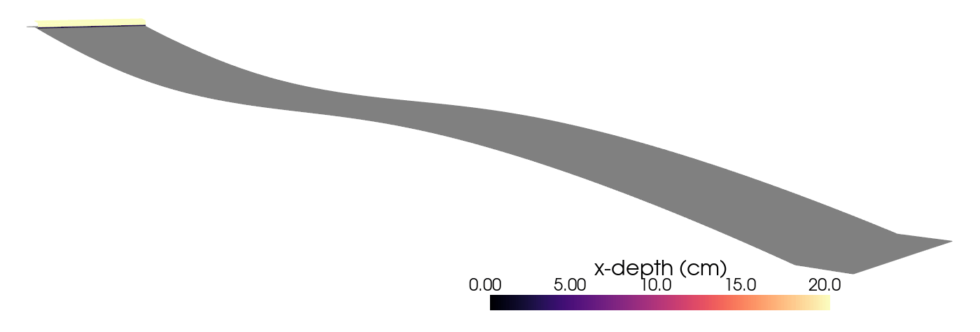
Optimization of absorber shape
Current foreseen Pb mass flow is about 300 kg/s
Considering that only the central part is impacted by the beam, further optimisation would reduce the mass flow (hence costs & total activated mass)
Basic slope
S-slope

Slide 19
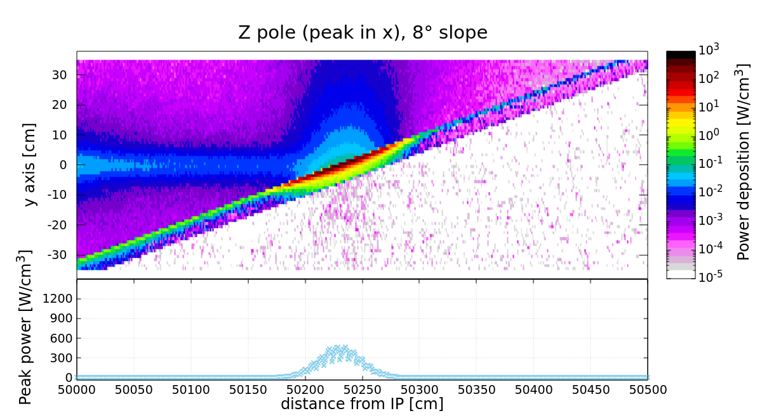
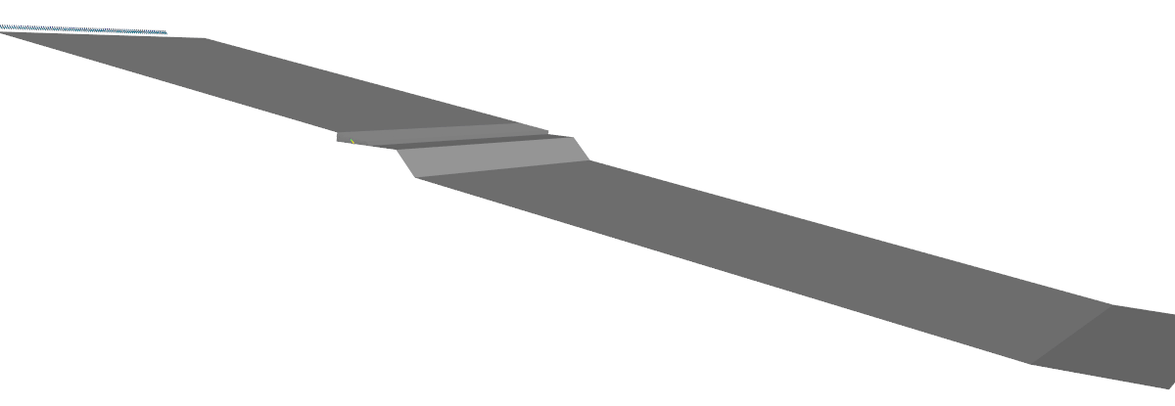
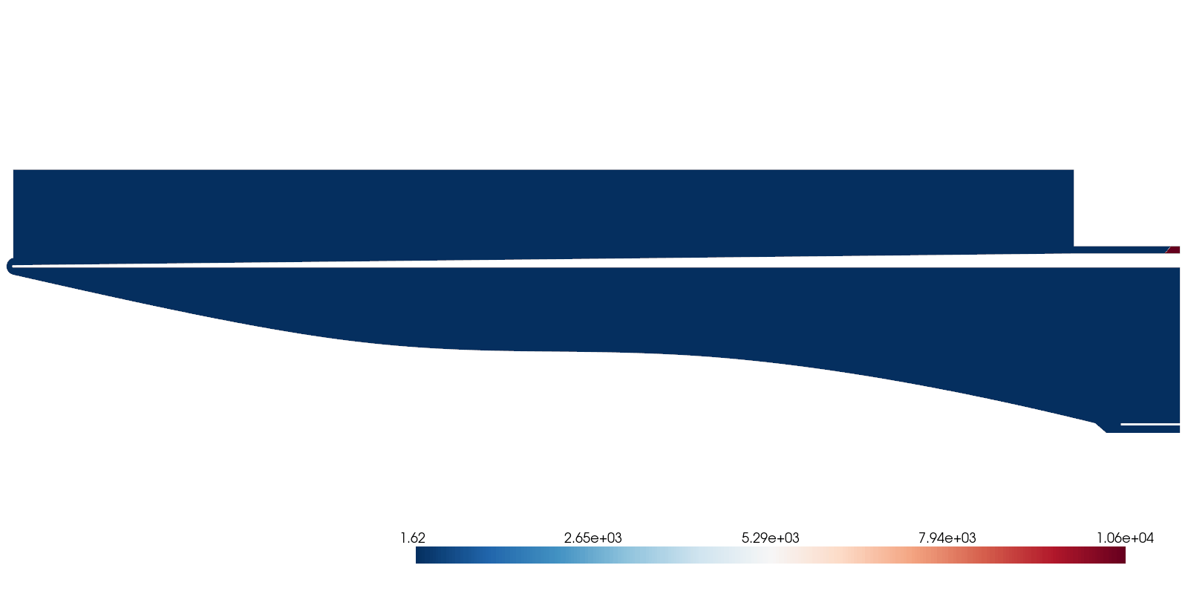
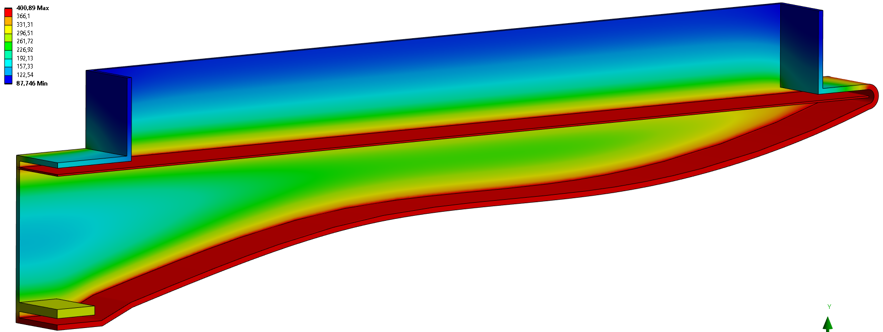
Scattered photo electrons and soft photons from the surface of liquid Pb carries a signficant fraction of beam power
Any way out?
O(100 kW) leaking
a) Double injection
b) Double slope
20% 300 kg/s
80% 300 kg/s
Options under study to contain power while keeping mass flow ~300 kg/s

Slide 20
Conclusions and perspectives
We just started an ambitious program towards the development of the FCCee machine
Beamstrahlung photons absorption is a challenging endeavour, quite new to CERN (and other similar institutions)
Work in progress for the optimization of such system
Liquid Pb is a serious candidate, and a technological development is being planned for the next 5-10 years, aimed at realizing a reduced scale test loop by 2029

