Slide 1
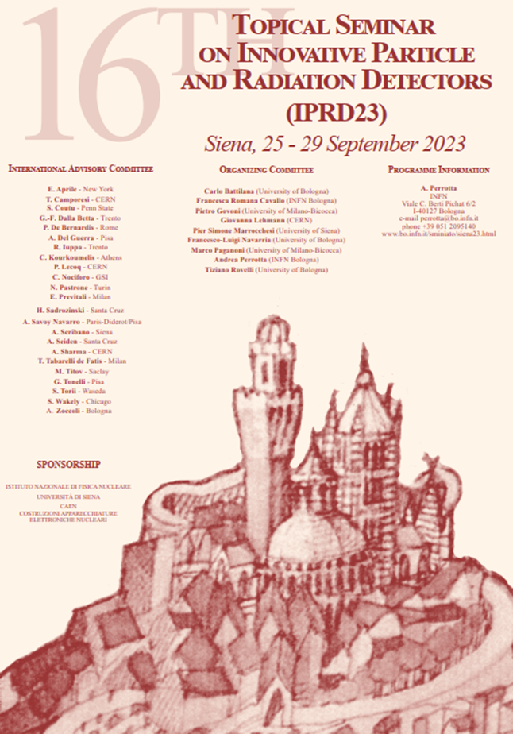
Report on
IPRD23
Siena, Italy 25-29 Sept. 2023
E. Giulio Villani

Slide 2
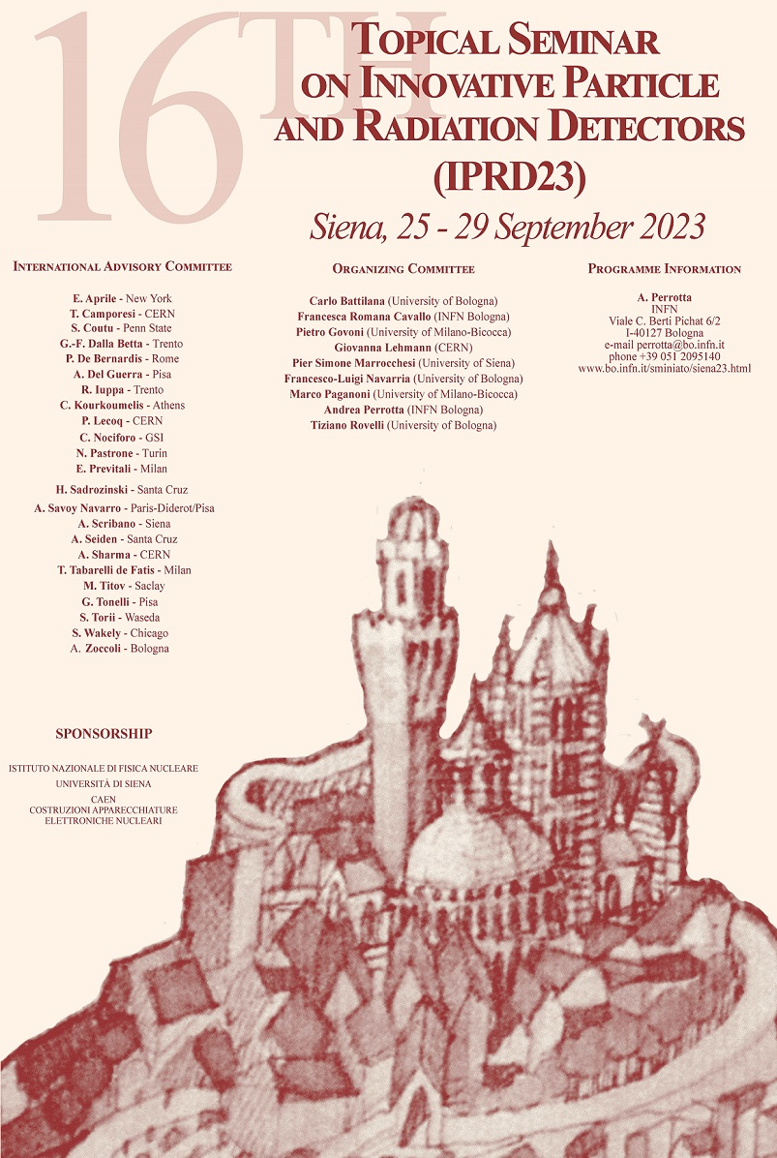
Outlook
The IPRD conference
Selected presentations
Summary & conclusions

Slide 3
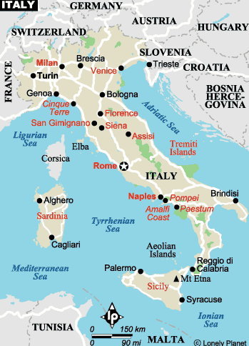
SIENA is in Tuscany about 50km south of Florence
An ancient Etruscan settlement, it became Roman colony under the name of Sena Julia
Its importance grew in Middle Ages until became a municipality in 12th century: it flourished in XIV century
Frequent confrontations with neighbouring towns, it was taken over by Florence in 16th century

Slide 4
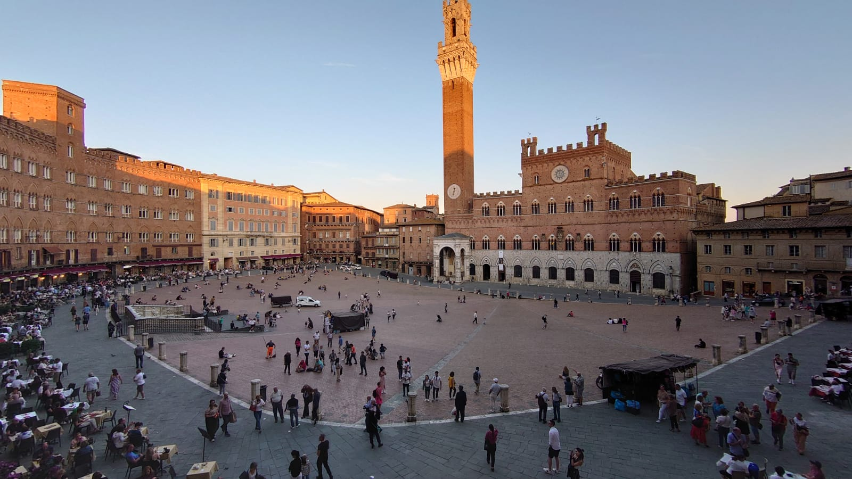
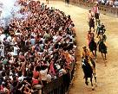
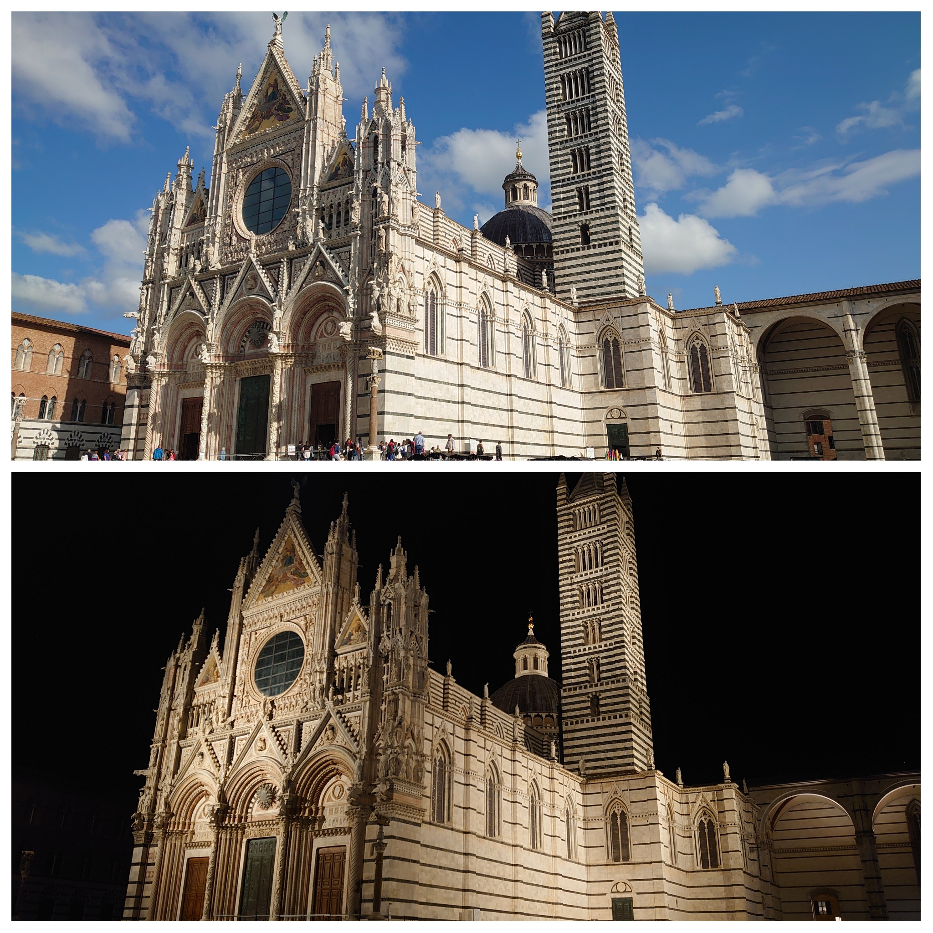
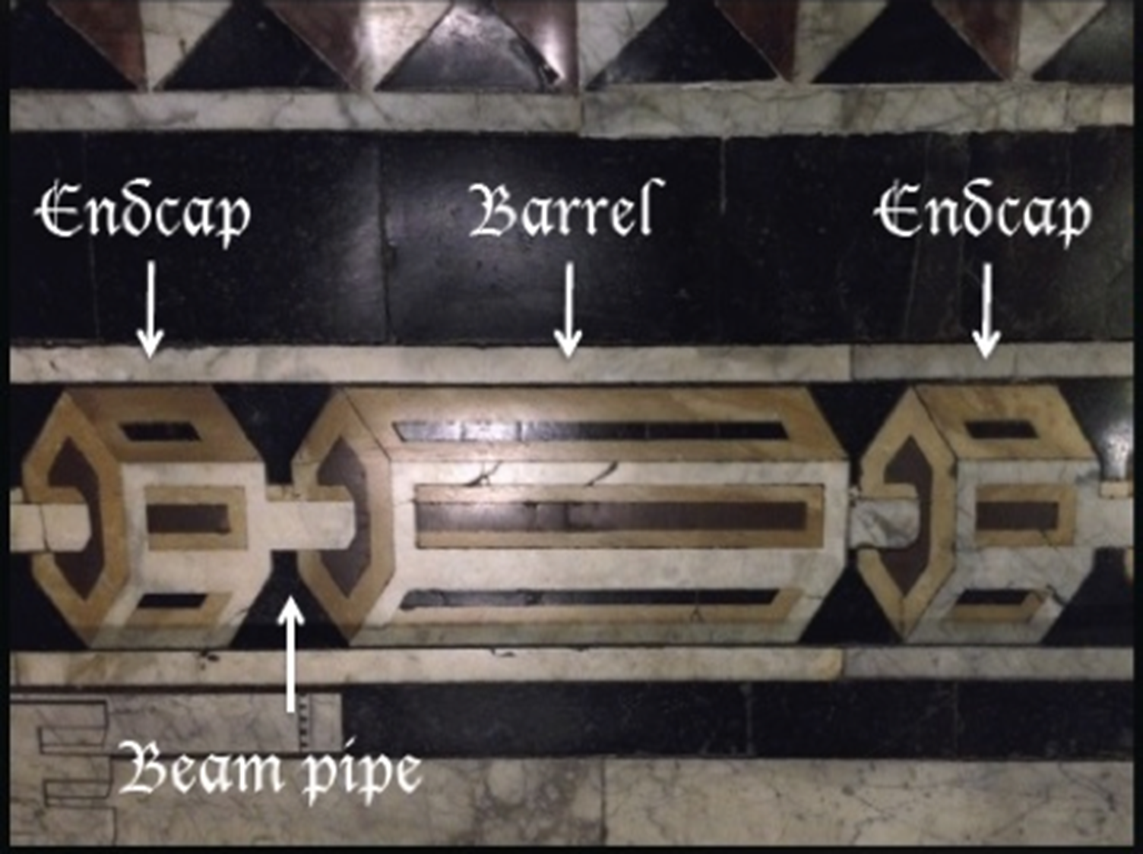
Piazza del Campo, that dates back to 14th century, is the heart of the city. The location of the ancient roman forum it boasts 14th century gothic buildings
The horse race (Palio) is held here, 2nd of July and 16th of August
The Duomo, 14th century: one of the best roman-gothic architectural examples.
It hosts works by Nicola Pisano, Donatello, Pinturicchio
An interesting innovative project in A.D. 1300 (floor panels of the Duomo)

Slide 5

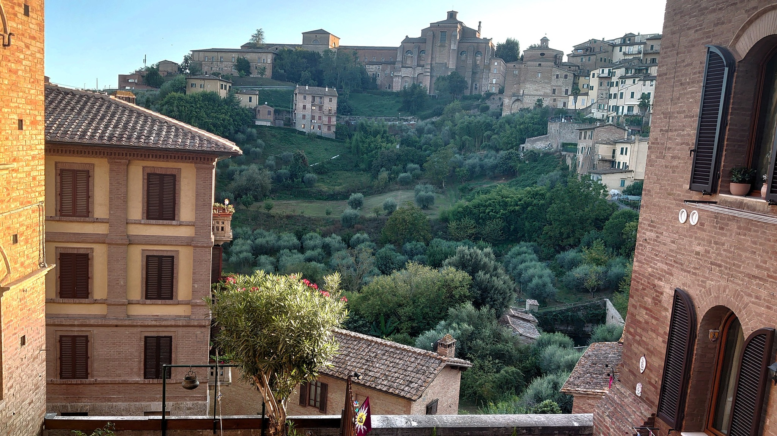
From the Basilica di San Domenico
Orto de Pecci (medieval garden)

Slide 6
16th Topical Seminar on Innovative Particle and Radiation Detectors (IPRD23)
The Seminar is the sixteenth in a series devoted, over a time span of 40 years, to detectors and experiments for high-energy particle physics and astrophysics.
The previous ones were held in San Miniato* (1984, 1986, 1988, 1990, 1993, 1996, 1998) and in Siena (2002, 2004, 2006, 2008, 2010, 2013, 2016, 2019).
The Seminar is focused on advanced technologies in particle physics at collider experiments, and in cosmic ray and astrophysics experiments, including balloon-borne, space-based and ground-based experiments.
The participation of representatives from industry will make it possible to discuss future applications of basic research.
https://web.bo.infn.it/sminiato/siena23.html
* Around 50 km NE of Siena

Slide 7
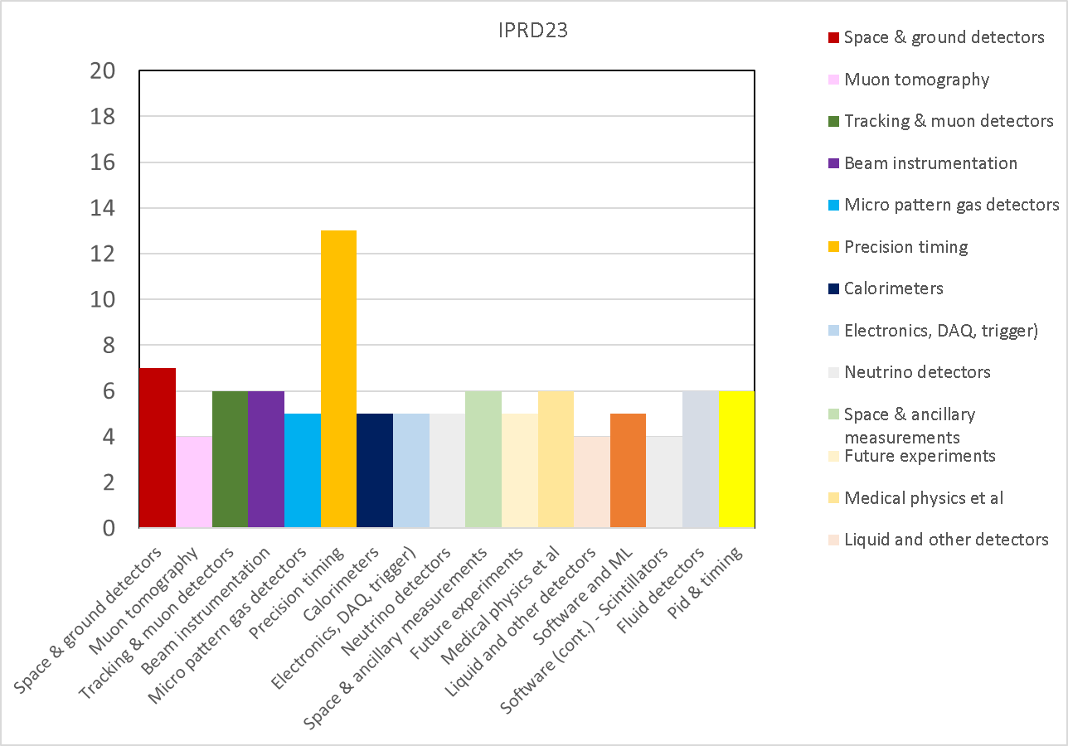
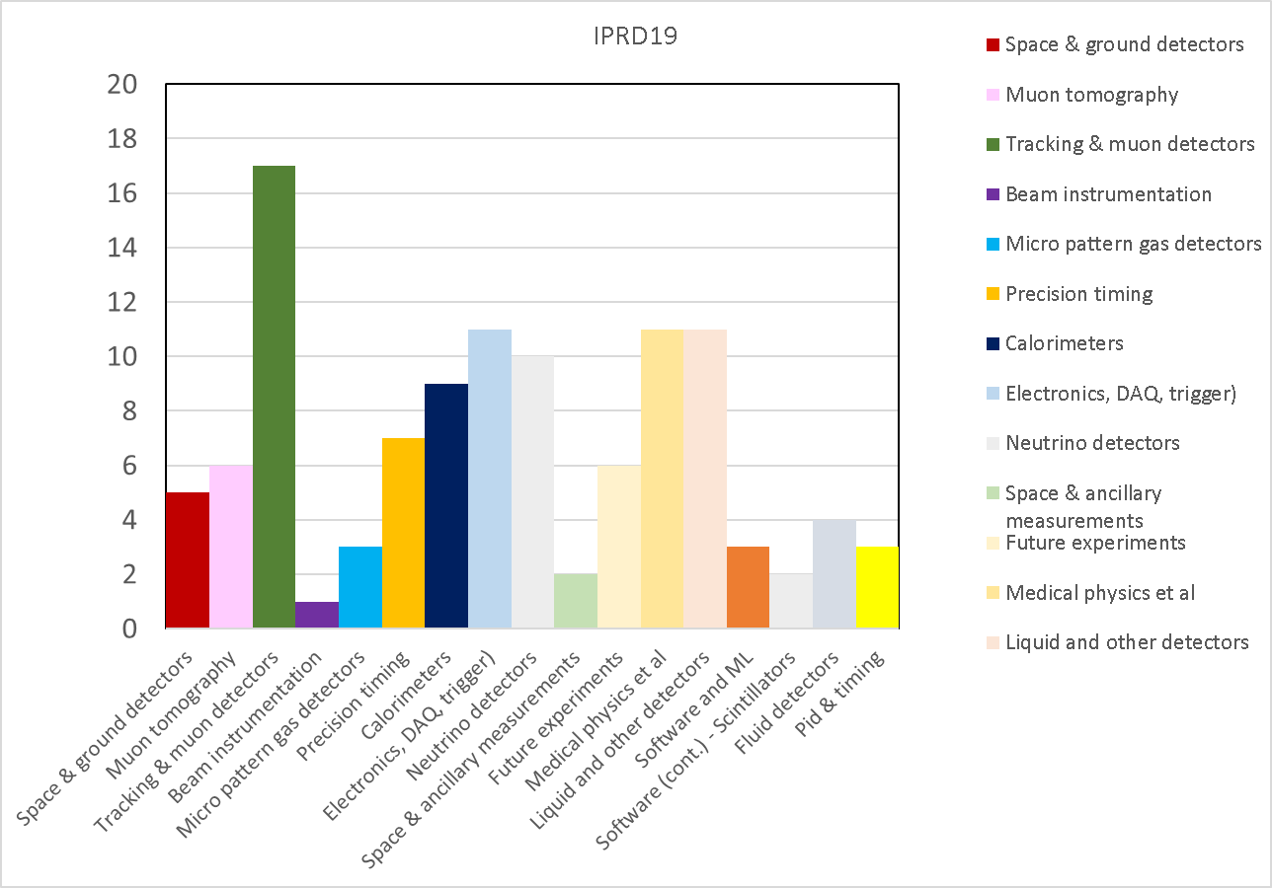
MAIN TOPICS
Tracking detectors
Calorimeters
Detectors for X and gamma ray astrophysics
Cosmic ray experiments in space, on the Earth's surface, and underground
Neutrino experiments
Radiation-hard detectors and electronics
Muon-tomography of archaeological and geophysical structures
Detectors for medicine and biology
Large X-ray and muon systems for homeland security control
Simulations and new computing methods, including machine learning techniques
Detectors for environmental controls
Outreach
​ATTENDANCE
Attendance will be limited to approximately one hundred and fifty participants.
Registered participants: 129
Talks: 98
Registered participants: 112
Talks: 111

Slide 8
Rather diversified range of topics, covering detectors for many applications
Very good technical level of talks and posters
Selected presentations:
  Fast timing , including PPD contribution
  Solar Neutrino
  Muon tomography in archaeology

Slide 9
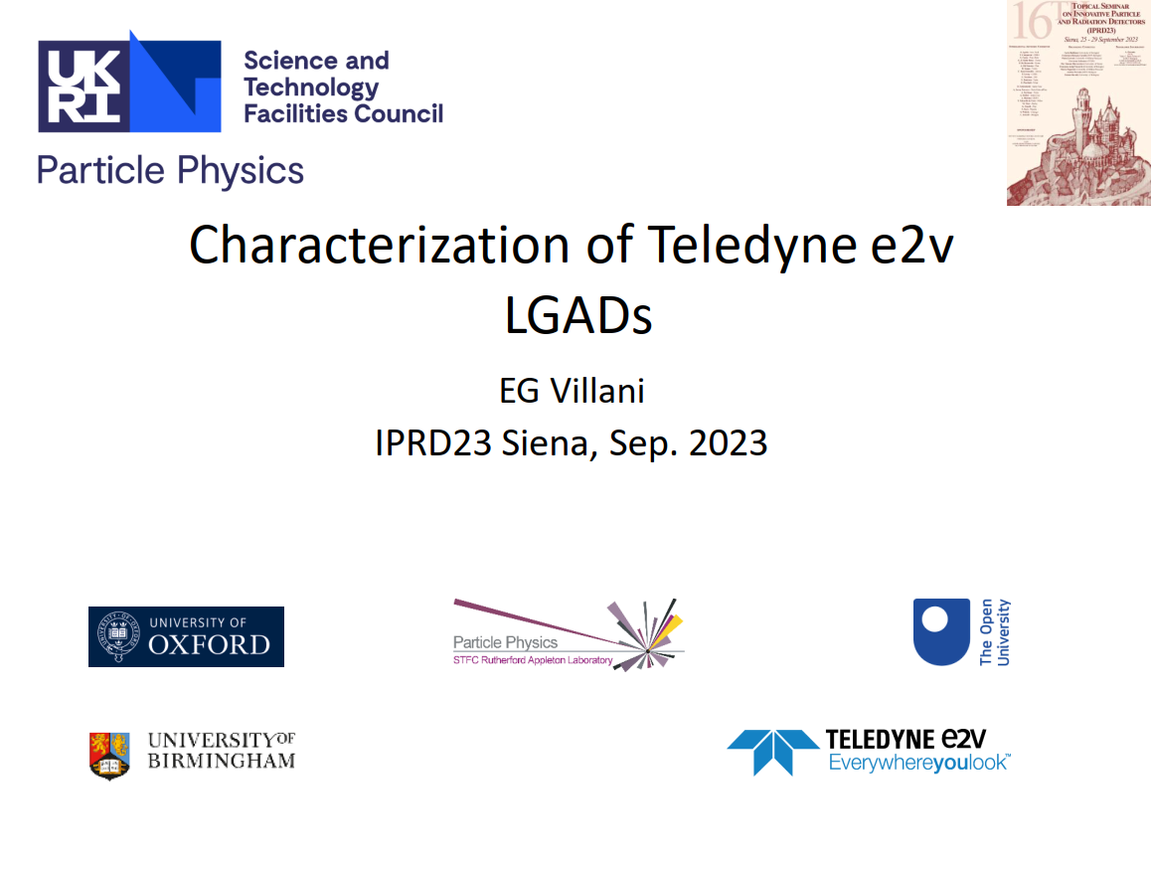
Fast timing

Slide 10
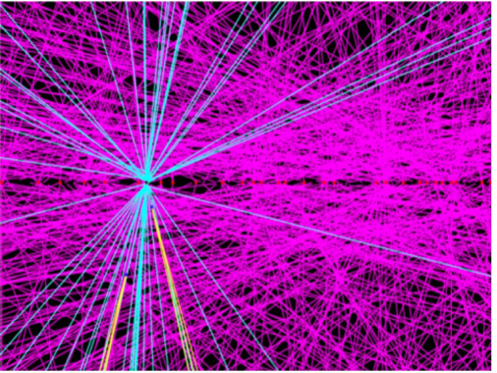
Introduction: Timing for HL-LHC
Fast timing
Interaction time of many pp vertexes happening in the same bunch crossing at LHC in the case of ≈50 overlapping events. The vertexes are spaced 10’s of ps apart
ATLAS simulation of spatial events at HL-LHC with < μ >= 140 pileup
At the nominal luminosity of the LHC the average number of pp interactions
in a single bunch crossing (pileup) is approximately 23
The planned luminosity upgrade to HL-LHC will increase this number to about 200
The increased spatial pileup line density (number of collisions / unit length along the beam
axis) will lead to misidentified tracks

Slide 11
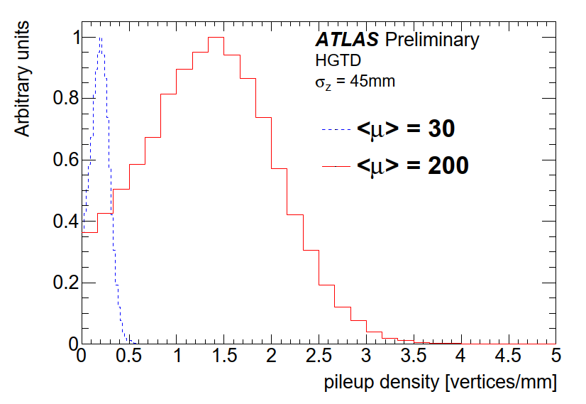
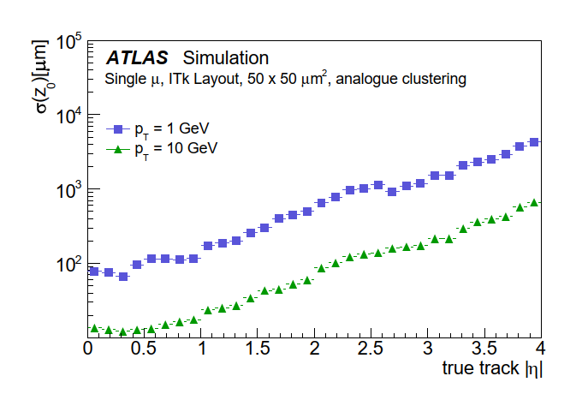
Introduction: Timing for HL-LHC
Fast timing
Simulation of HL-LHC local pileup vertex densities for two values of < μ >= 30 and < μ >= 200 ≃ 1.44 vertices/mm MPV
Resolution of the longitudinal track impact parameter, z0, as a function of η for muons of pT = 1 GeV and pT = 10 GeV using ITk alone
Track reconstruction becomes particularly critical at high η, when resolution becomes
larger than distance between vertices
One solution to suppress the detrimental effect of pileup on reconstruction is
to separate vertices in time rather than in space

Slide 12
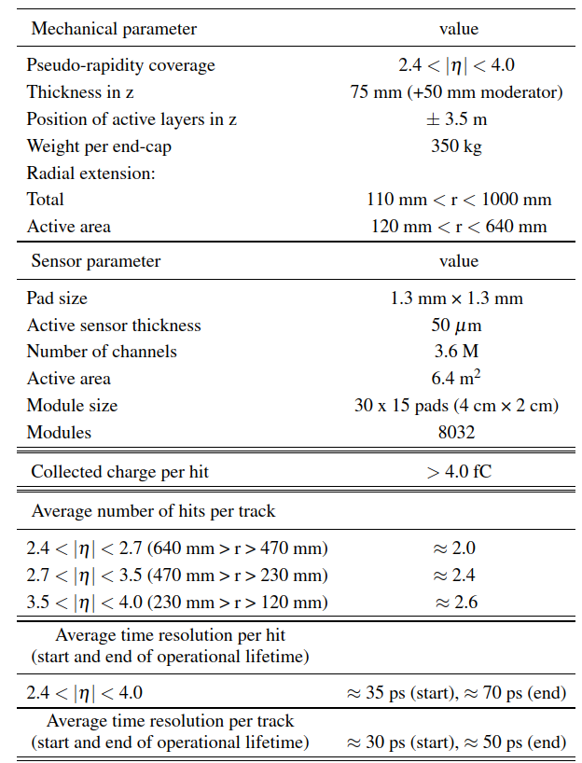
Introduction: Timing for HL-LHC
Fast timing
Position of the HGTD within the ATLAS Detector. Positioned at z = ∓ 3.5 m along the beamline, on both sides of the detector
The HGTD¹ in ATLAS will be placed the gap region between the barrel and the end-cap calorimeter. Two instrumented double-sided layers on two cooling/support disks on each end-cap.
Timing sensors used are based on Low Gain Avalanche Detector (LGAD) technology
¹ ATLAS Collaboration, Technical Design Report: A High-Granularity Timing Detector 2562 for the ATLAS Phase-II Upgrade, tech. rep. CERN-LHCC-2020-007, CERN, 2020, URL: 2563 https://cds.cern.ch/ record/2719855.

Slide 13
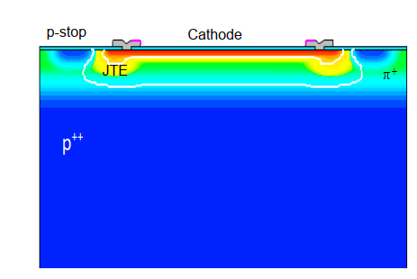
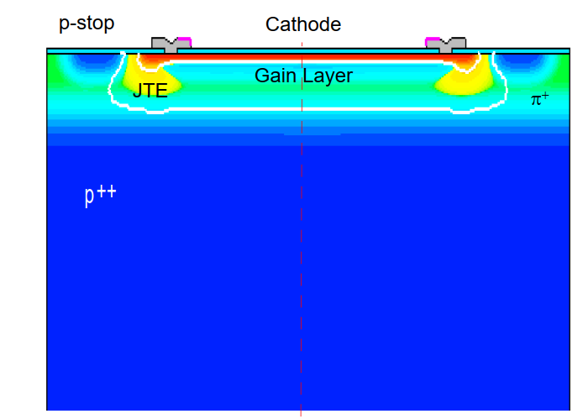
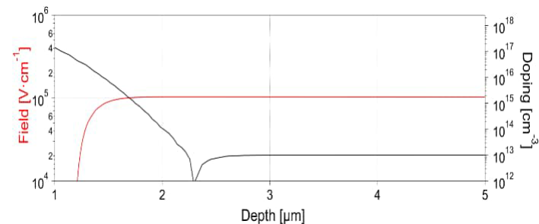
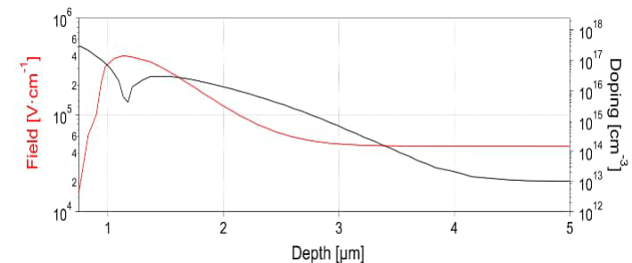
Teledyne e2v LGAD design
Fast timing
A standard PIN silicon sensor consists essentially of a pn junction. At depletion it shows an ~ uniform electric field F
In the LGAD device an additional p⁺ doped layer (gain layer or GL) is implanted near the pn junction. When depleted the GL creates an electric field high enough to start impact ionization, leading to charge multiplication by a factor G

Slide 14
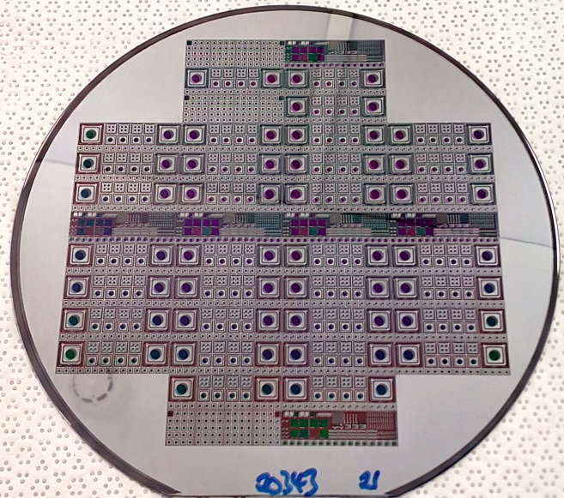
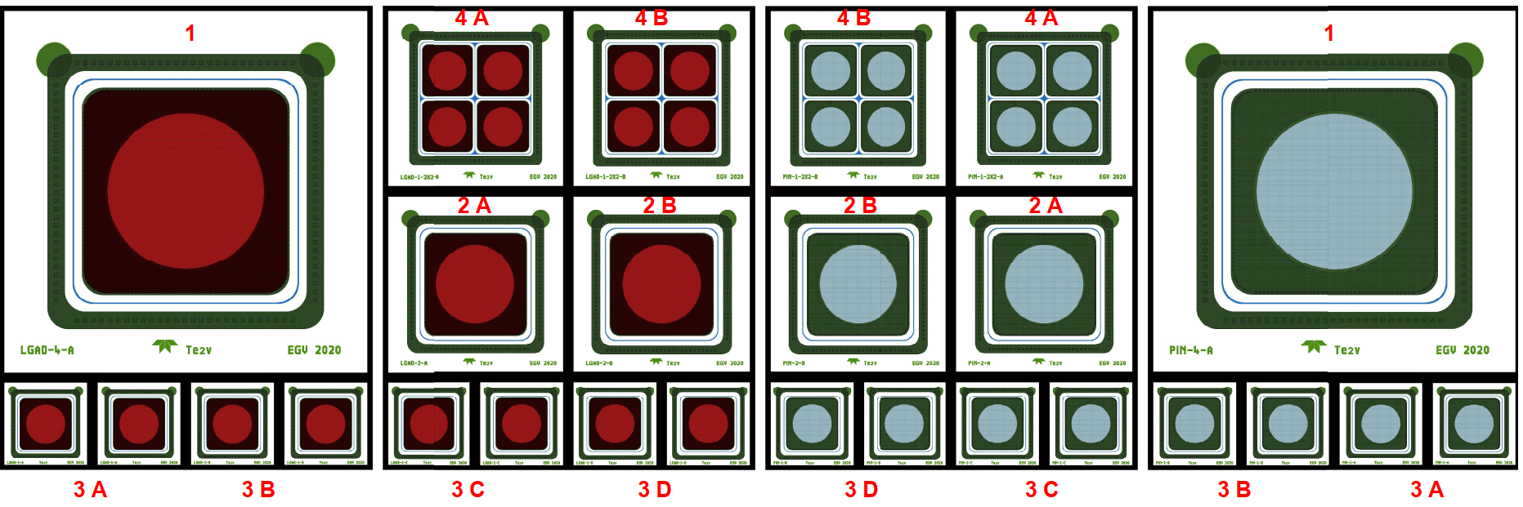
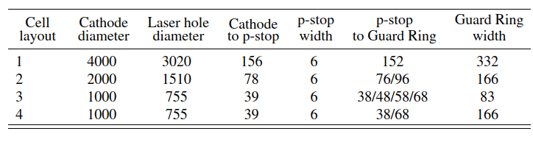
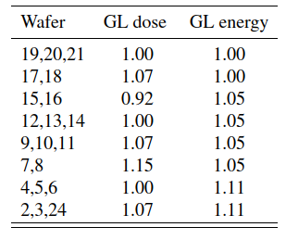
Teledyne e2v LGAD design
Fast timing
Size of Run I cells [ um]
Two runs of LGAD fabrication with Teledyne 2ev (Te2v) :
Run I included 1,2, 4 and 2x2 of 1x1 mm² cells
Normalized values of GL 11B doping

Slide 15
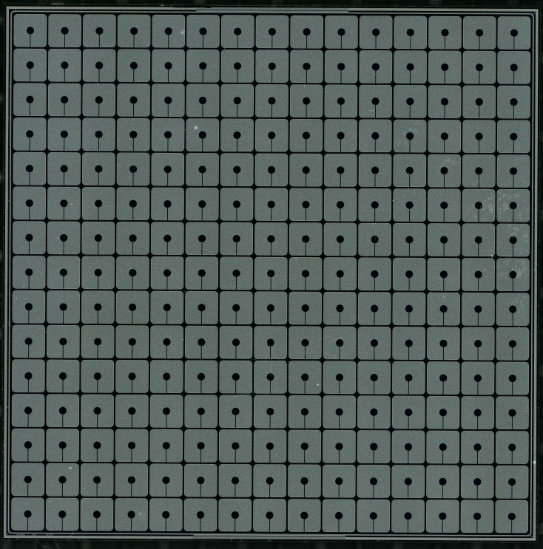
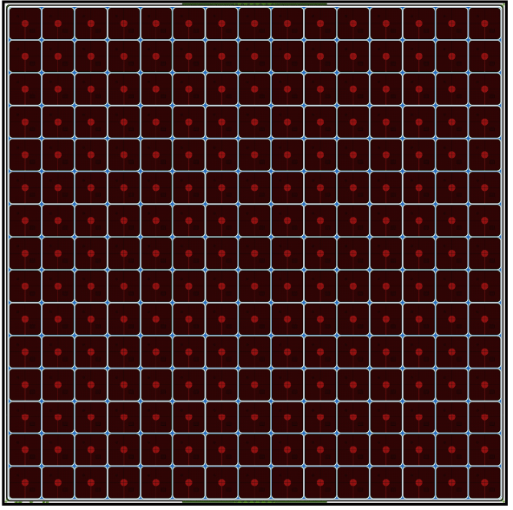
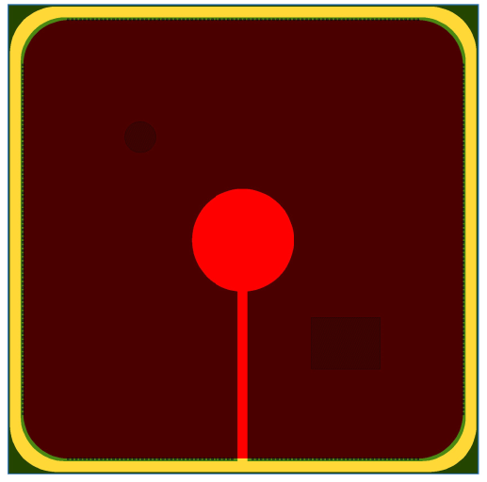
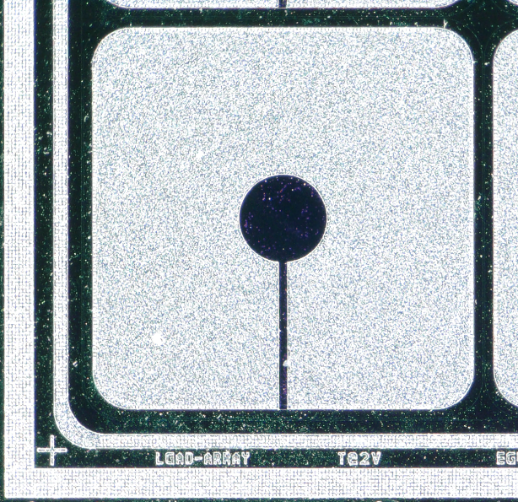
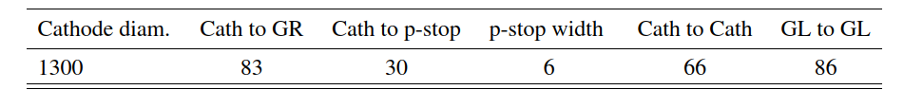
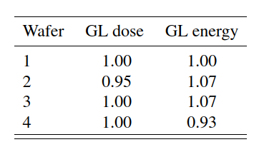
Teledyne e2v LGAD design
Fast timing
21 mm
21 mm
Size of Run II cells [ um]
Second fabrication (Run II) included array of 15 x 15 cells of 1.3 x 1.3 mm2
Normalized values of GL 11B doping

Slide 16
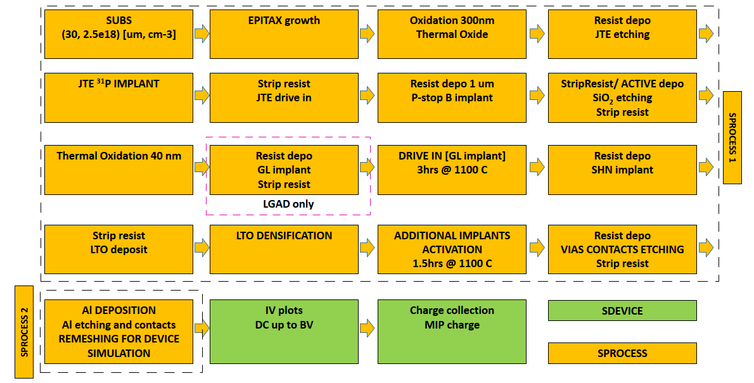
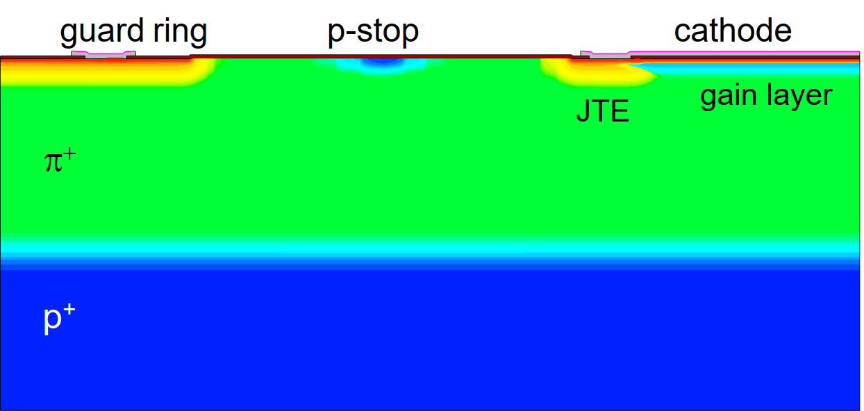
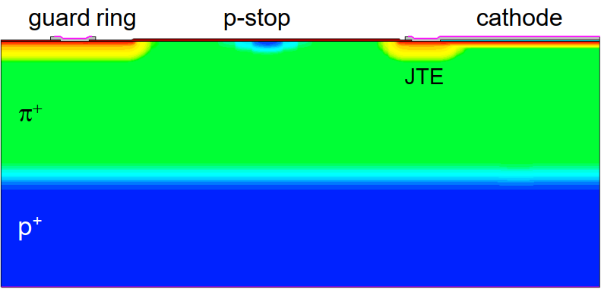
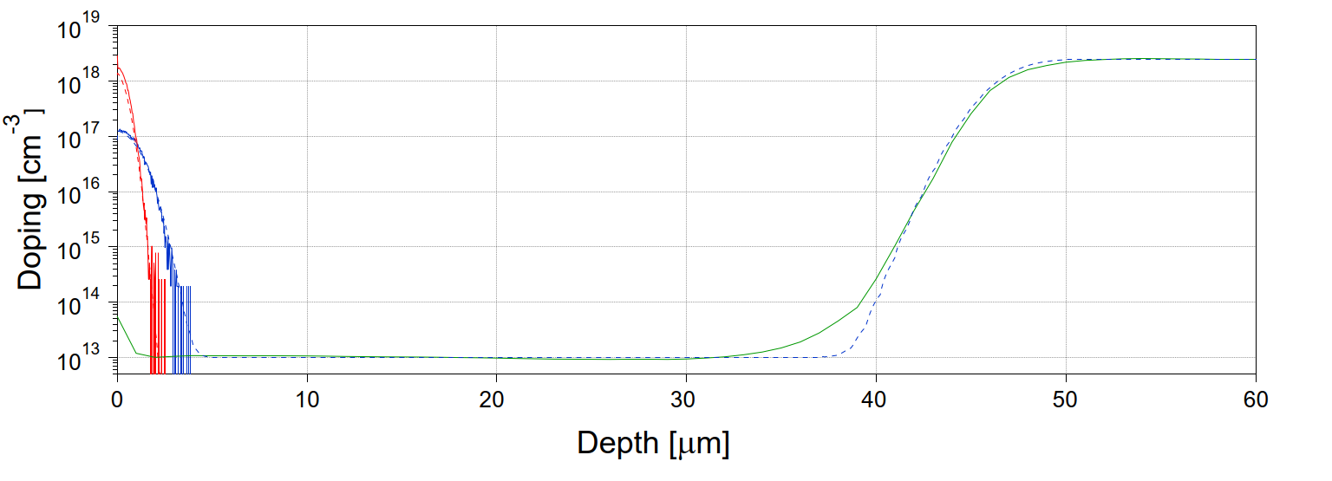
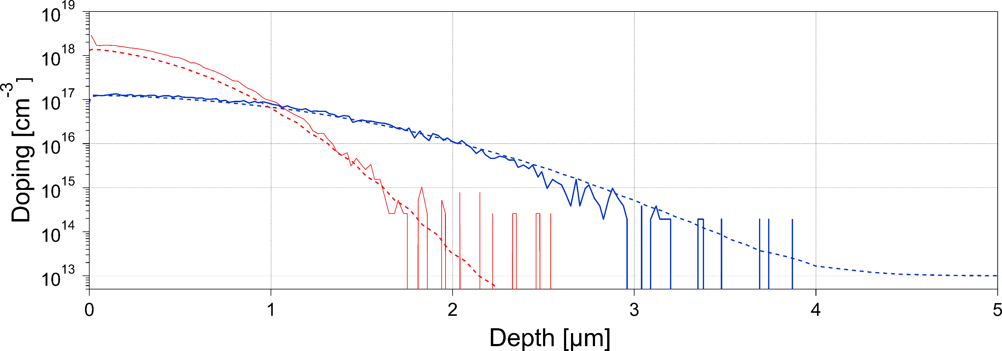
Teledyne e2v LGAD TCAD simulation fabrication process
Fast timing
Full process simulation using Synopsys TCAD to predict doping profiles compared with SIMS measurements

Slide 17
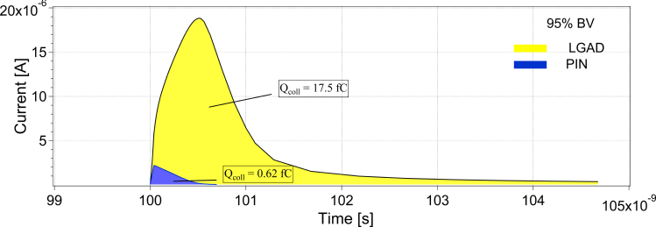
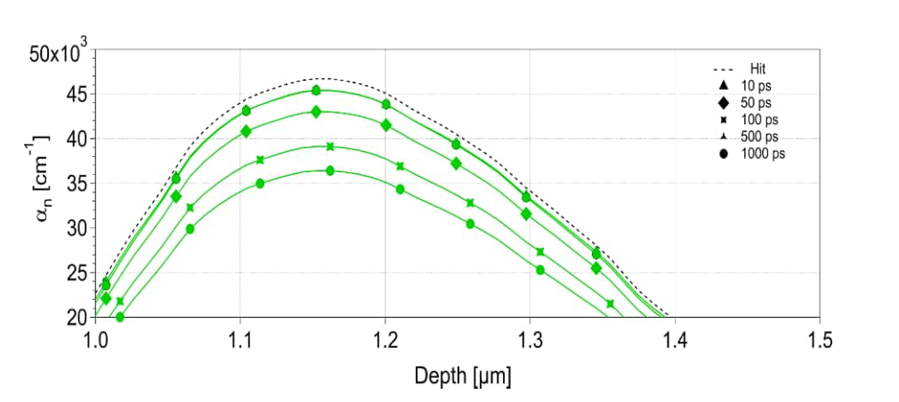
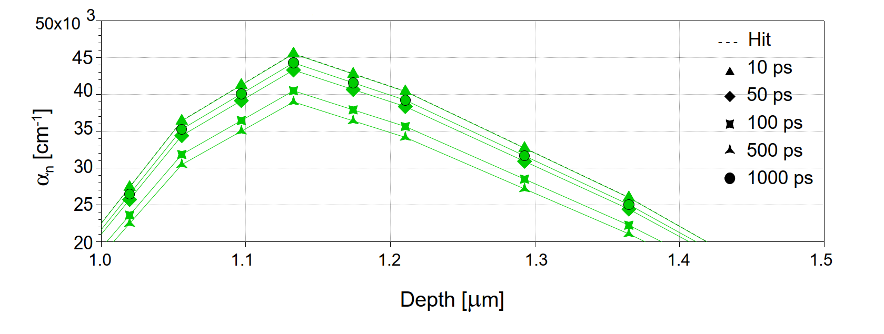
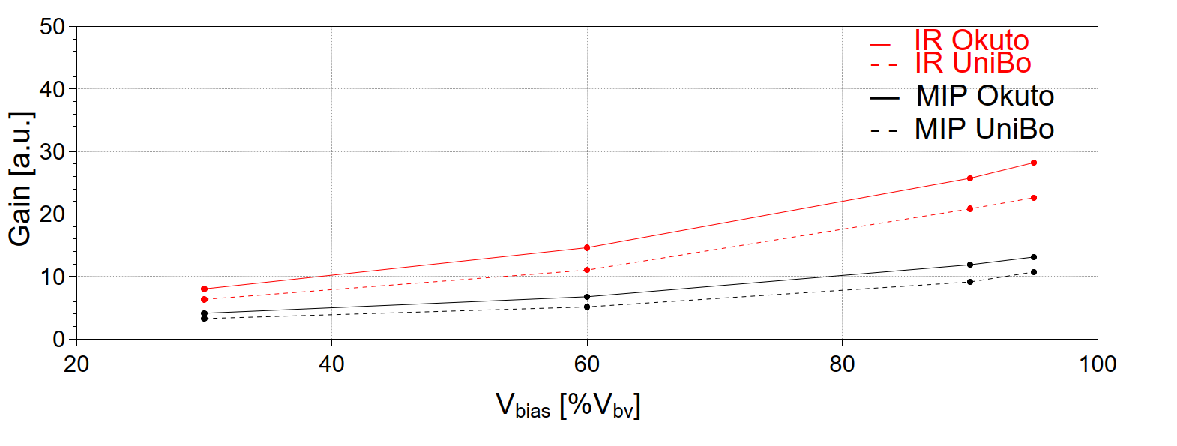


Teledyne e2v LGAD TCAD simulation
Charge collection and gain
Fast timing
$α_{n}(t)$during MIP injection
$α_{n}(t)$during Laser
injection
Transient simulation to estimate charge collection and gain performed both using Laser (1064 nm) and MIP injection
Gain obtained from ratio of collected charge by LGAD vs. bias compared to charge collected by PIN diode under same biasing conditions
Evidence of gain suppression is observed

Slide 18
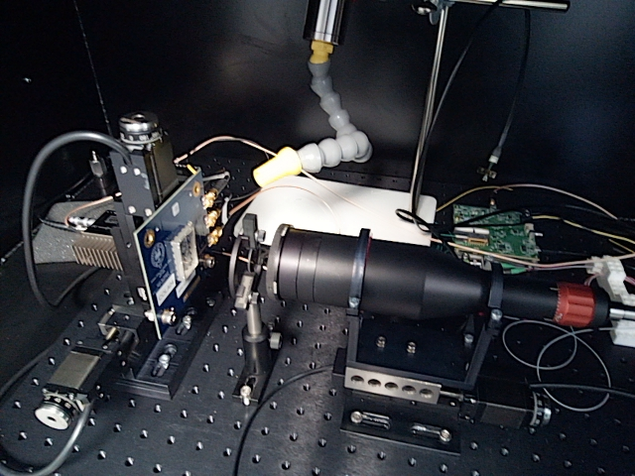
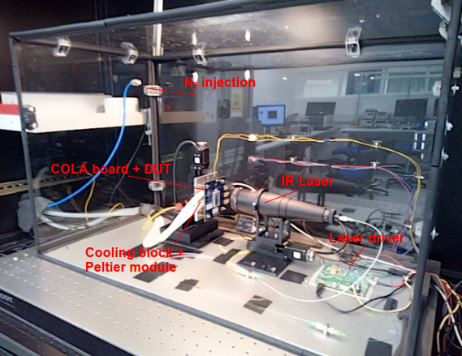
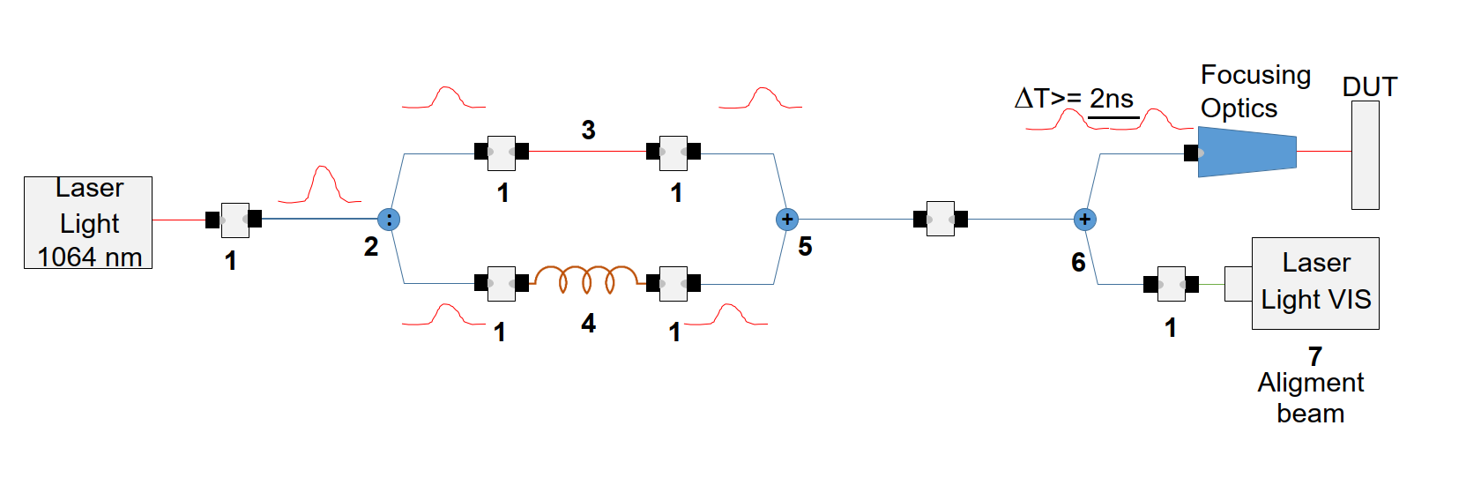
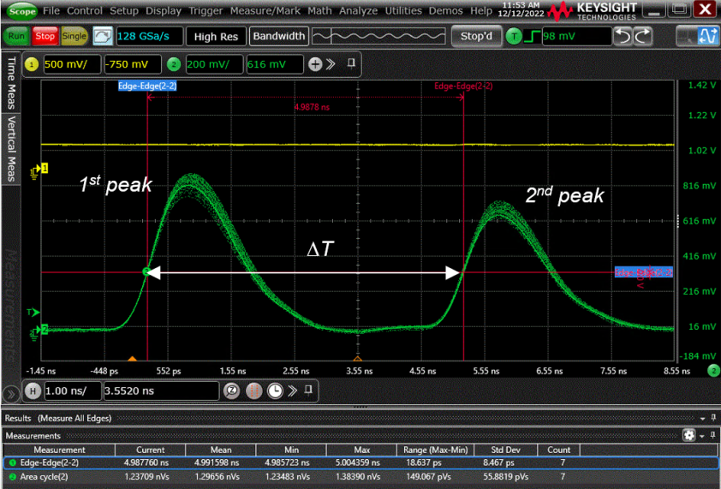
Teledyne e2v LGAD Test setup
Fast timing
Vortex cooler
COLA board + DUT
Laser drive
IR Laser
Infrared Laser (1064 nm -15 ps) charge injection
Gain measured as ratio of collected charges LGAD/PIN
Jitter measured using Split Recombine method at different CFD
Coolers to test irradiated sensors

Slide 19
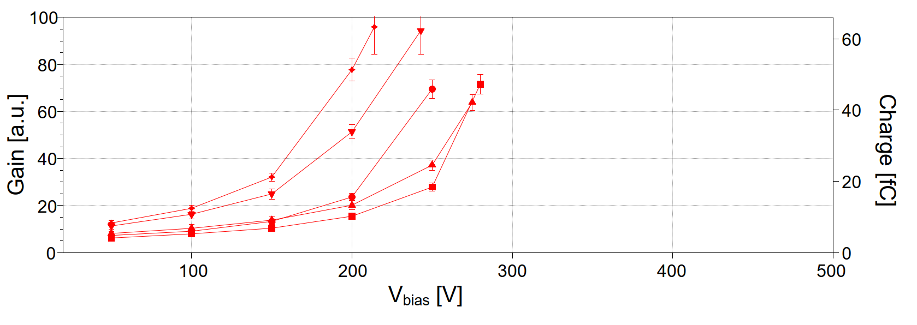
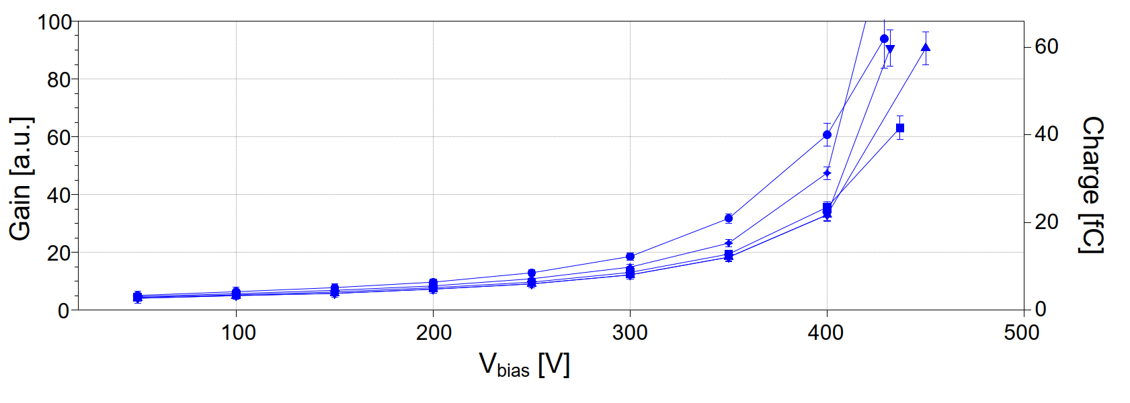
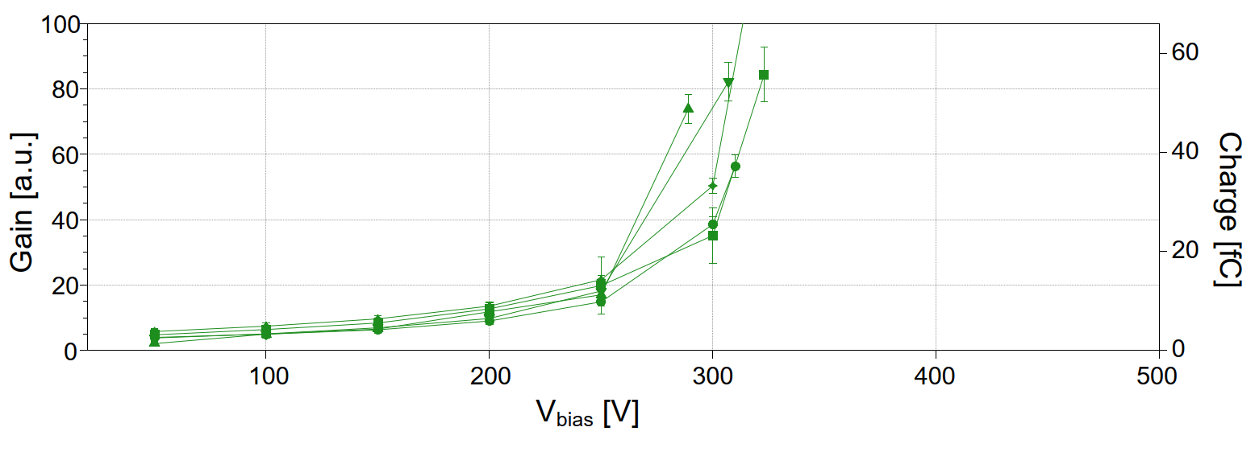
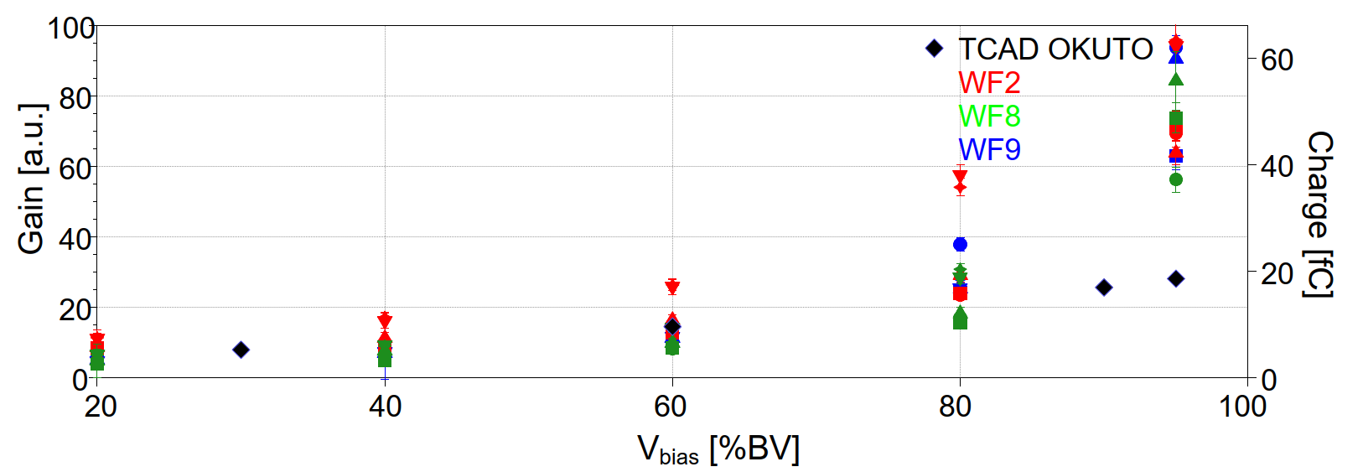
Teledyne e2v LGAD test results – Charge collection and Gain
Fast timing
WF2
WF9
WF8
T = 21 °C
Gain plots using laser injection ~ 0.7 fC
Plot of gain vs. V_{bias}/V_{bv} shows similar trend for all flavours tested
TCAD comparison shows good prediction up to ~ 80 %V_{bv}, lower predicted gain above

Slide 20
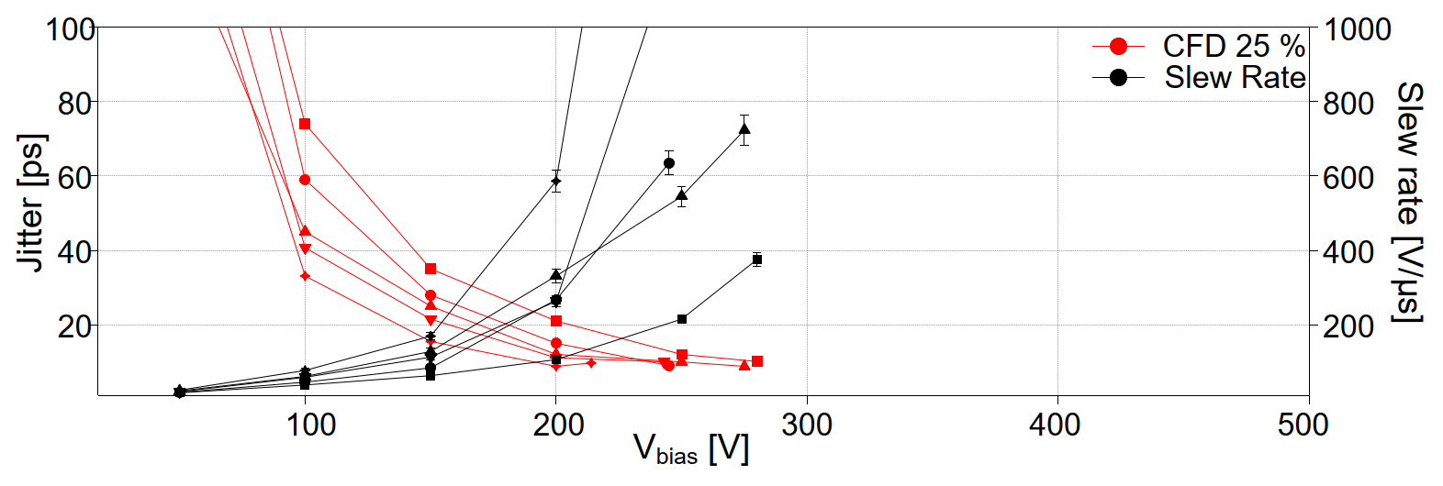
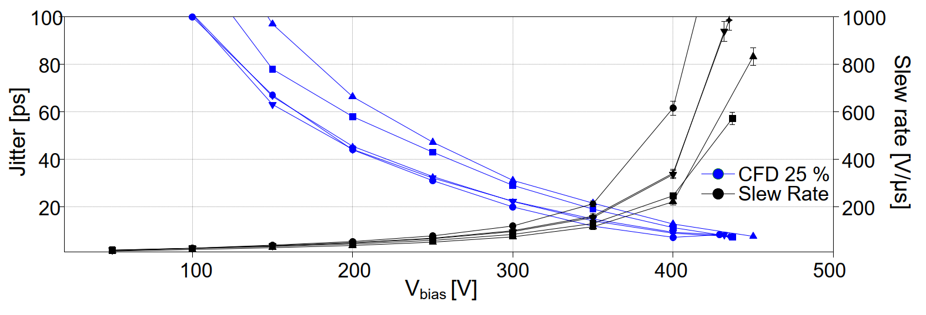
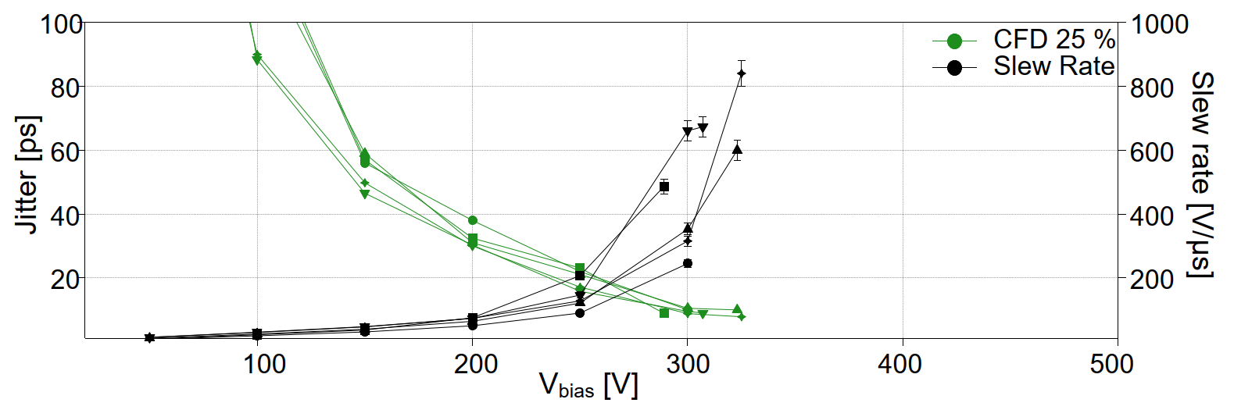
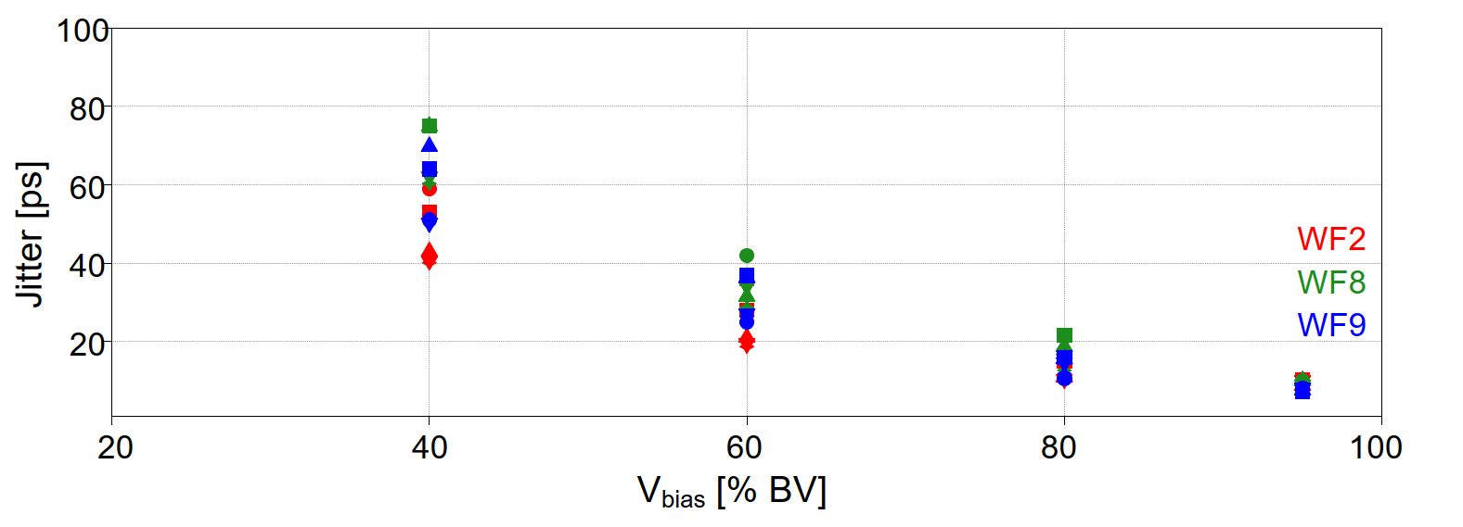
Teledyne e2v LGAD test results – timing results
Fast timing
T = 21 °C
Jitter plots using laser injection ~ 0.7 fC
Minimum jitter ~ 10 ps @ 90-95% of BV using CFD = 25 %

Slide 21


Teledyne e2v LGAD test results – timing results
Fast timing
Timing plot using 90Sr setup
For non-irradiated sensors time resolution of approximately 33 ∓ 4 ps

Slide 22

Fast timing

Slide 23

Fast timing

Slide 24


Fast timing
1

Slide 25

Fast timing

Slide 26

Fast timing

Slide 27

Fast timing

Slide 28

Fast timing

Slide 29

Fast timing

Slide 30

Fast timing

Slide 31

Fast timing

Slide 32

Fast timing

Slide 33

Fast timing

Slide 34

Fast timing

Slide 35

Neutrino det

Slide 36

Neutrino det

Slide 37



Neutrino det

Slide 38

Neutrino det

Slide 39

Neutrino det

Slide 40

Neutrino det

Slide 41

Neutrino det

Slide 42

Neutrino det

Slide 43

Neutrino det

Slide 44

Neutrino det

Slide 45

Neutrino det

Slide 46

Neutrino det

Slide 47

Neutrino det

Slide 48


Neutrino det

Slide 49

Muon tomography

Slide 50

Muon tomography
First use of muon tomography: L.W. Alvarez et al., Search for Hidden Chambers in the Pyramids, Science 167 (1970) 832.

Slide 51

Muon tomography

Slide 52

Muon tomography

Slide 53

Muon tomography

Slide 54

Muon tomography

Slide 55

Muon tomography

Slide 56

Muon tomography

Slide 57

Muon tomography

Slide 58

Muon tomography

Slide 59

Muon tomography

Slide 60

Muon tomography

Slide 61
Conclusions – IPRD23 Conference
Very good conference, with many interesting talks
Interdisciplinary approach, with detectors for different applications and useful discussions with attendants
Excellent location, with superb catering
Proceedings published in JINST
THANK YOU

