Slide 1
FETS-FFA diagnostics
10. Jan. 2024
ISIS2/LhARA FFA Project Update
E. Yamakawa*, D. PDB, T. Canfer, K. Fazlee
Diag. Dev. Sec. in Sync. Group (STFC)

Slide 2
FETS-FFA Ring Diagnostics
Commissioning phase | Required diagnostics | Required sensitivity
phase1 | Faraday Cup (FC) Wire Scanner Monitor (WSM) Phosphor Screen (PS) Beam Loss Monitor (BLM) Beam Position Monitor (BPM) | < 1% of 3E11ppp < 1mm:accuracy, <0.1mm:resolution < 1mm:accuracy, <0.1mm:resolution < 1% of 3E11ppp, τ<1us < 1mm in absolute/relative accuracy
phase2 | DC Current Transformer (DCCT) Wall Current Monitor (WCM) Beam Size Monitor (Scraper) | < 1% of 3E11 [ppp], τ~100[ms] < 1% of 3E11 [ppp], BW~0.5-500 [MHz] < 1mm
phase3 | Schottky analysis for coasting beam position | BW ~ 0.5 - 500MHz
High
Priority
Low
Large structure of diagnostics for non-destructive turn-by-turn measurements, whilst still providing required measurement sensitivity and resolutions.

Slide 3
BPM Updates

Slide 4
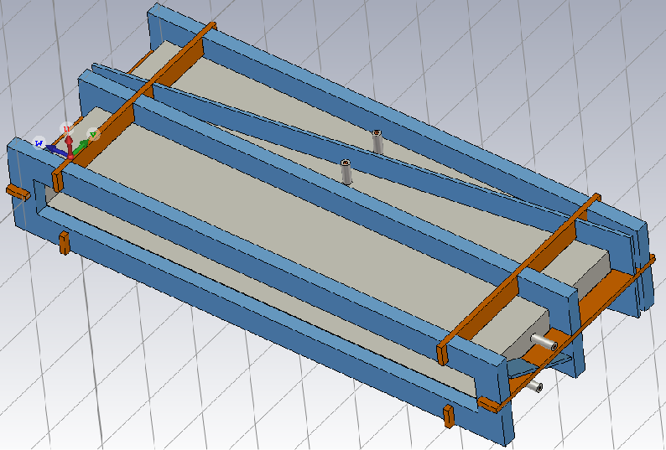
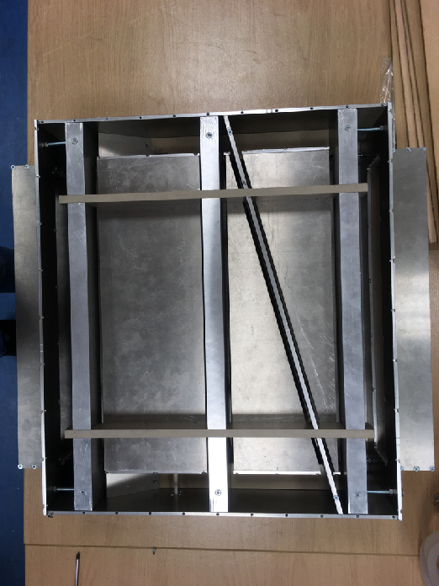
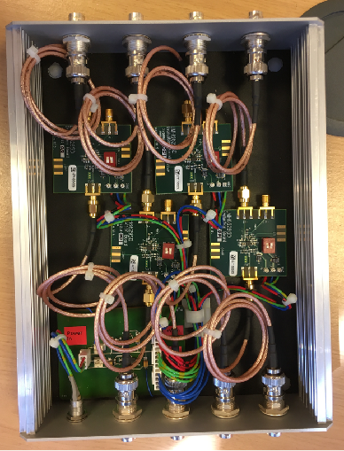
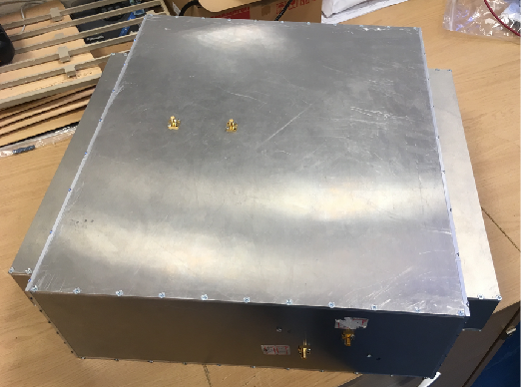
FETS-FFA BPM
A pair of electrodes (grey components in Fig.1), separated with a diagonal cut are placed along the beam direction.
Earthed rings (blue components in Fig.1) are placed between adjacent electrodes to prevent electrical coupling between electrodes, improving position sensitivity.
To demonstrate feasibility of preliminary design, half size prototype FETS-FFA BPM (Fig.2) has been manufactured and tested at ISIS Diag. Lab.
Signal amplifier has been also provided with gain of 30dB with 70MHz bandwidth (Fig.3).
778mm
317mm
Fig.1. Preliminary design of FETS-FFA BPM.
477mm
120mm
98mm
436mm
360mm
146mm
Fig.2. Half size prototype FETS-FFA BPM.
Fig.3. Signal amplifier assembly.
317mm

Slide 5
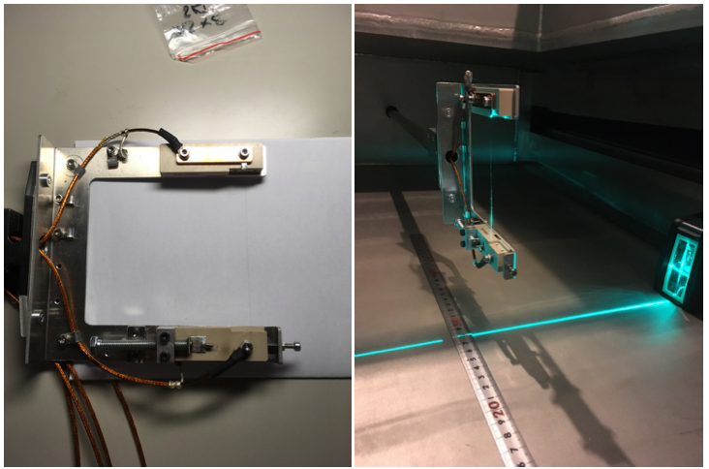
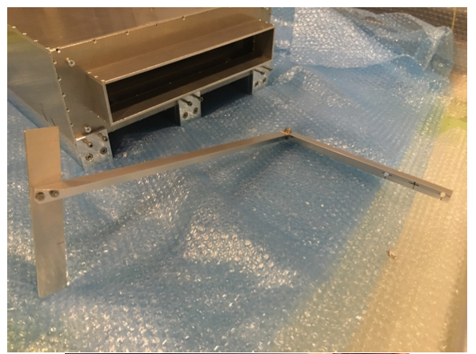
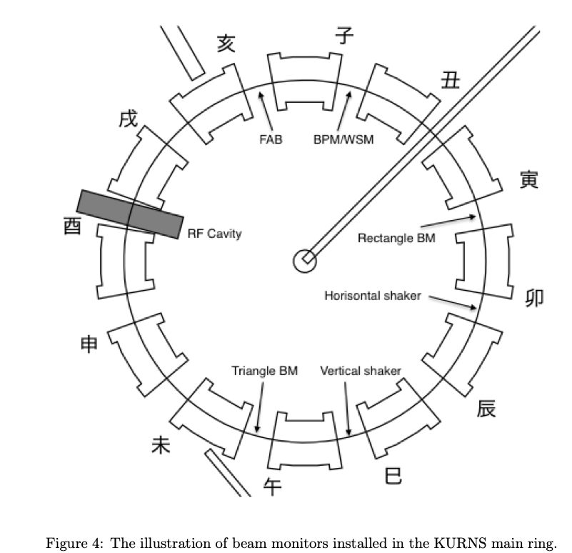
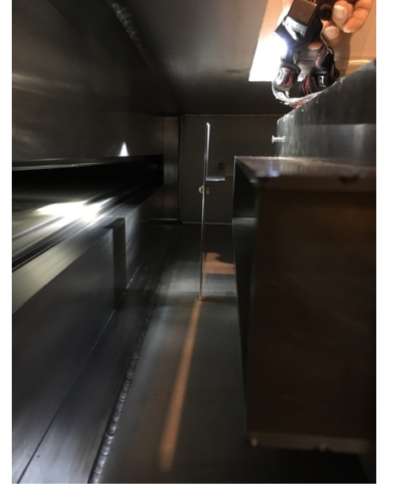
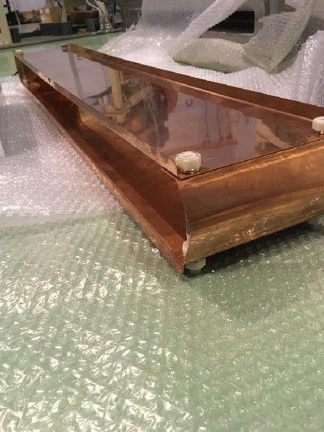
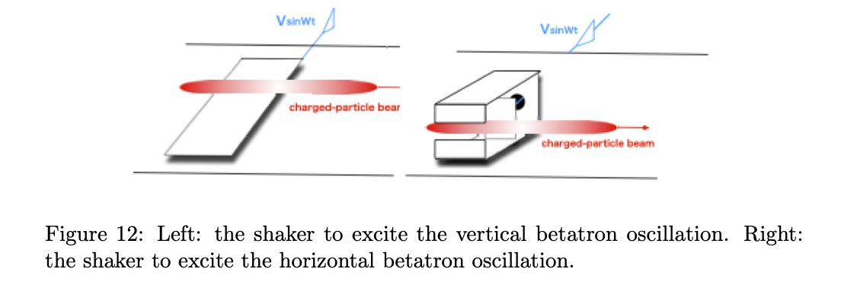
Layout at KURNS
WSM
BPM
Scraper
Beam exciter
FAB

Slide 6
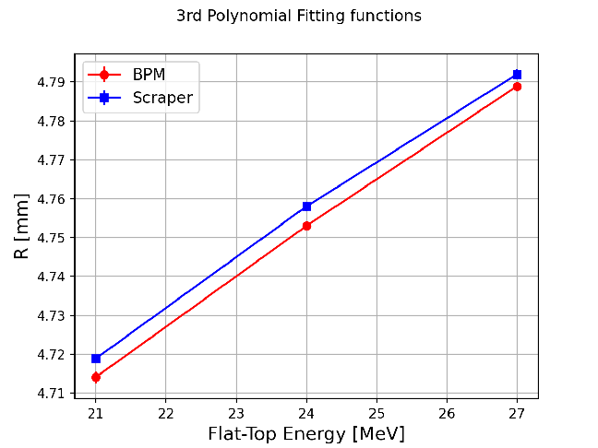
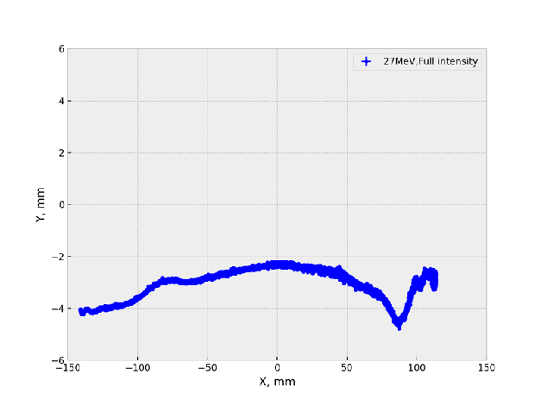
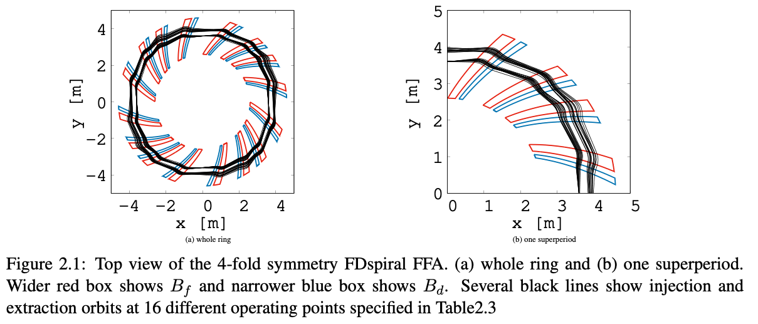
Position Accuracy
Beam positions are estimated by calibration coefficients measured at test bench at ISIS.
Within 5 mm differences in beam position measured by between BPM and scraper (destructive monitor, aluminium plate).
Reasons to make these differences are under investigation.
Different shapes of BPMs will be designed due to constraints of space availability in the test ring by 2025.
R [m]
Fig1. 2D plots of beam trajectories from 11 to 27MeV proton beams at KURNS.
Fig2. Orbits at different flat-top energies, compared by scraper measurements.

Slide 7
BLM Updates

Slide 8
Monitor Requirements
100% machine circumference (23m) should be covered uniformly.
At least a few par cell in beam direction.
BLMs on both radial sides of vacuum chamber.
 | Time resolution | Constraints/Solutions
Ionisation Chamber | A slow integrated signal over a few ms (not decided yet) for MPS. | Large structure, but easy to make. Sensitivity is unknown for low energy beam losses. To be proven by analysis and tests on FETS 3MeV H- beam.
Scintillation Monitor | To measure time structure of beam loss signals is required within 1 us. | Space would be limited between chamber and Magnets. PMT is weak at the stray magnetic fields, so use an optical fibres to guide a signal from a scintillation plate.

Slide 9
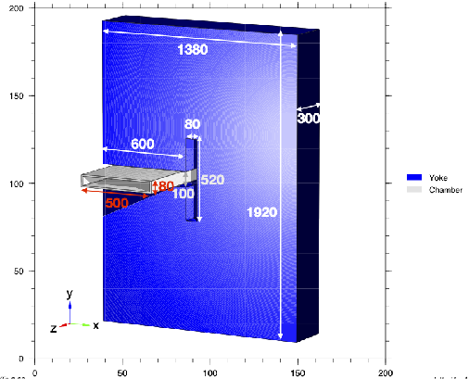
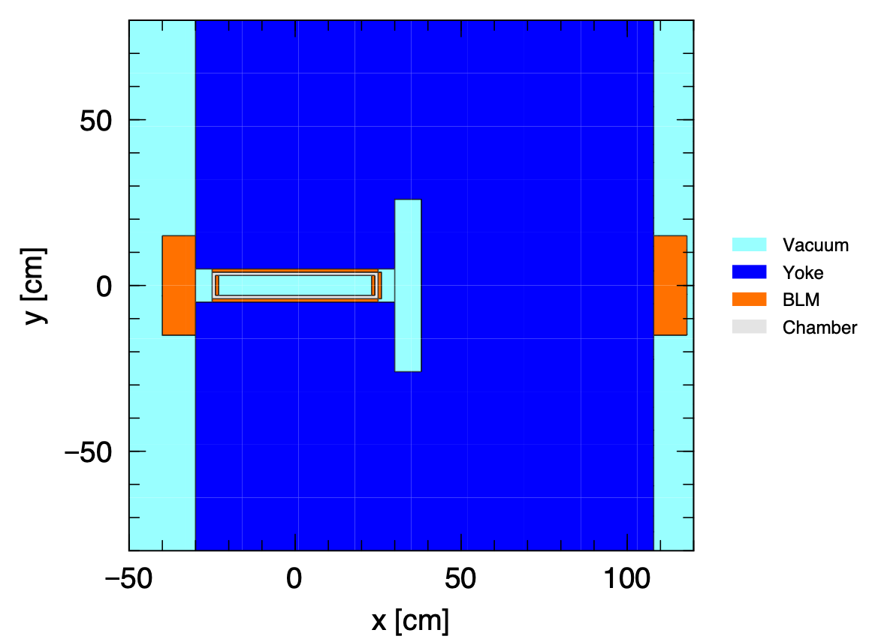
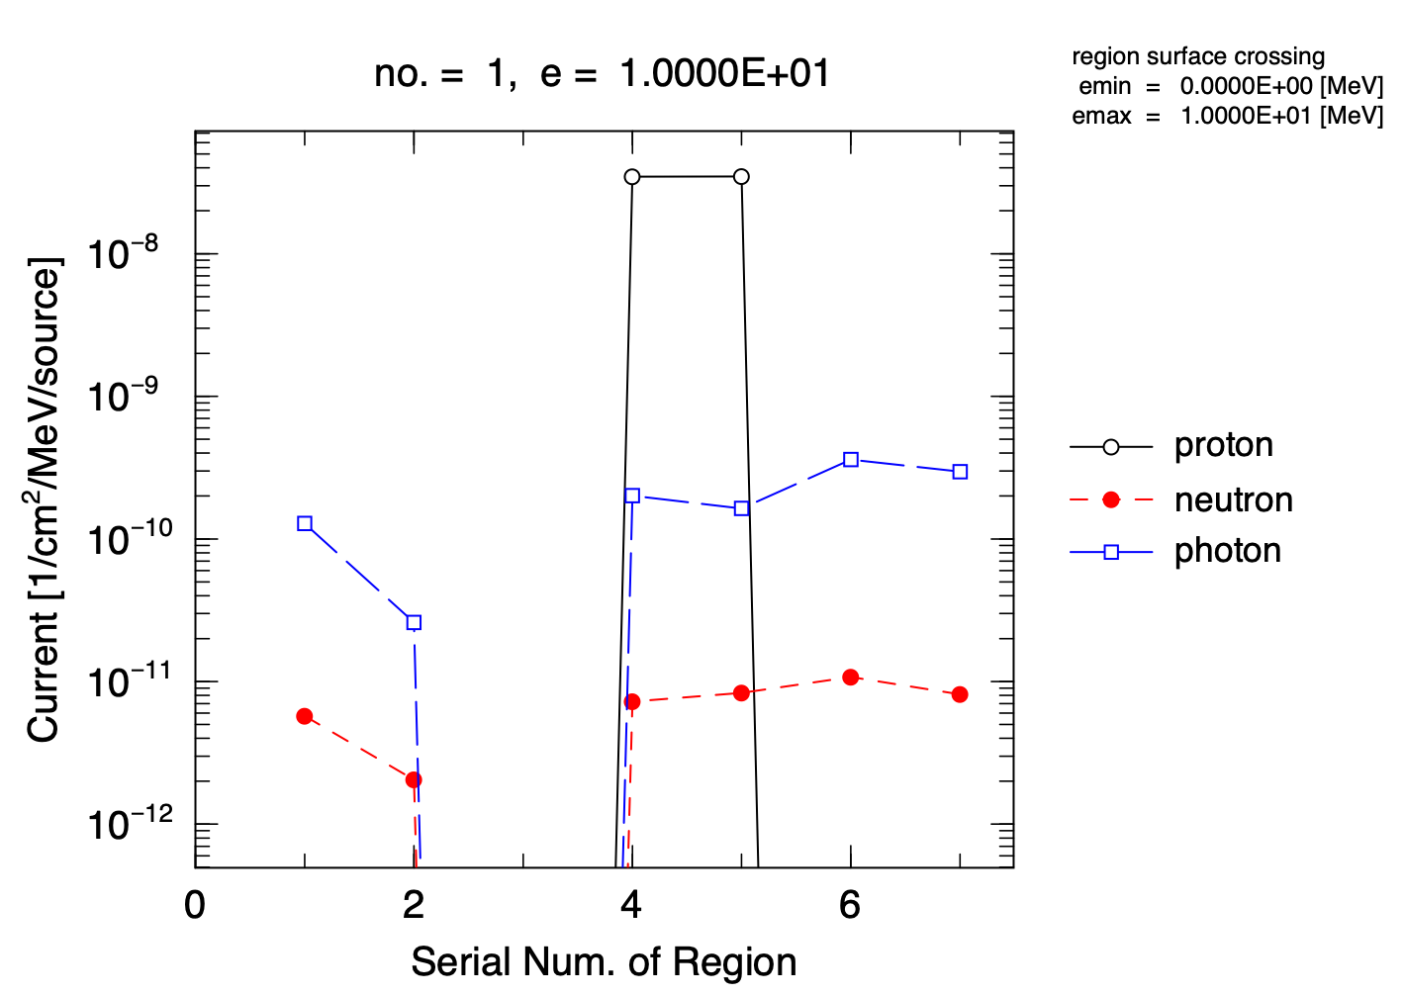
Secondary Particles
Motivation:
  Investigate an ideal monitor size to detect beam-loss signals generated by 1% of full-beam intensity (1E11 ppp).
Simulations by PHITS:
  A tilted proton (pencil beam: 3MeV) beam hits the vacuum chamber in vertical.
  SUS vacuum chamber is 10mm thick. (Not decided yet)
  Counted secondary particles in the Scintillators (BLM: void box) which are placed outside and inside chamber.
Conclusions:
  Scintillation plates/fibres will detect secondary photons at outside vacuum chamber, between York and chamber.
  Scintillation plates/fibres placed at inside(4)/outside(1) shows about 60% difference in counting rate (R) of photons (R4/R1=1.6).
  Still 40% photons can be detected at outside of chamber, and the fibres/plates will not be necessary installed in chamber.
80
600
Fig1. Diagrams of simple FFA magnets and chamber with BLM (void) boxes in PHITS.
2
5
6
4
1
3
7
1: Right side of vacuum chamber (outside)
2: Left side of York
3: Right side of York
4: Right side of vacuum chamber (inside)
5: Left side of vacuum chamber (inside)
6: Top of vacuum chamber (outside)
7: Bottom of vacuum chamber (outside)
Fig2. Secondaries coming in each BLM boxes.

Slide 10
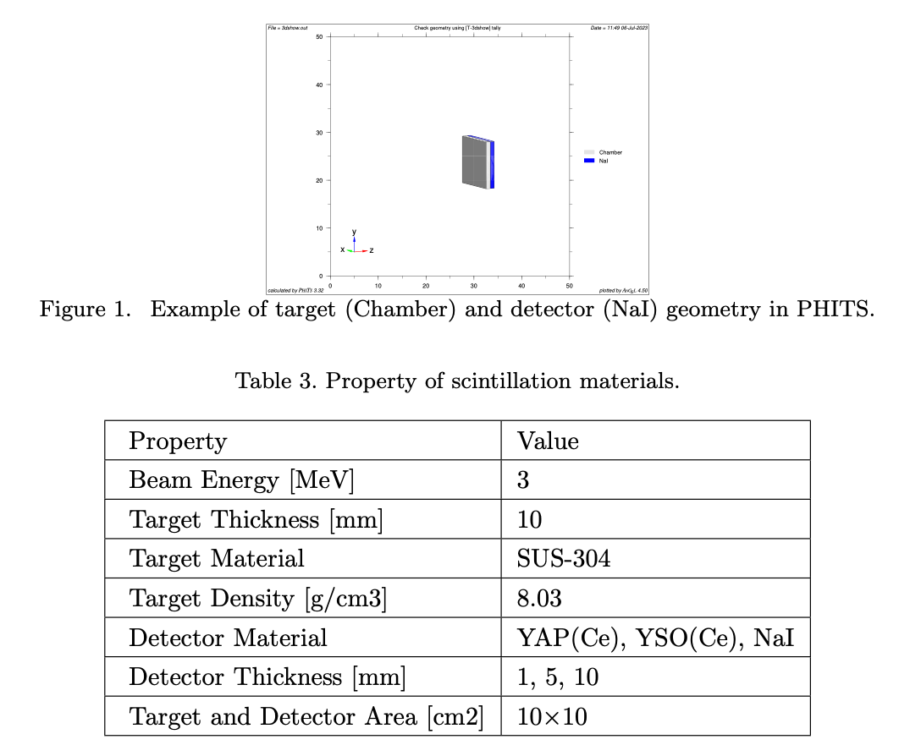
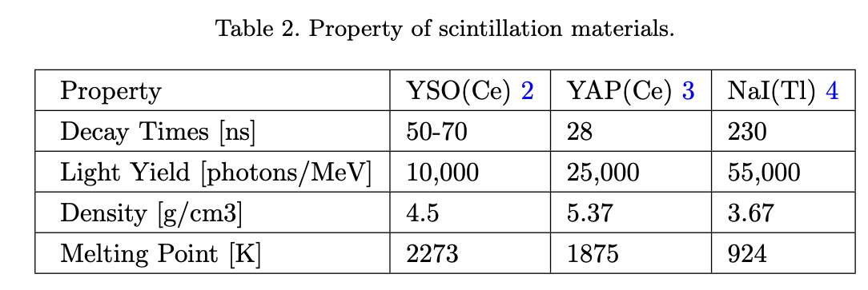
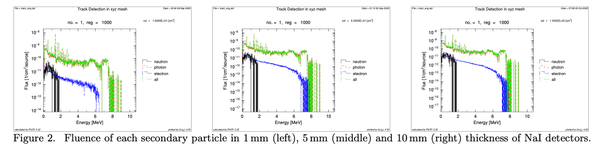
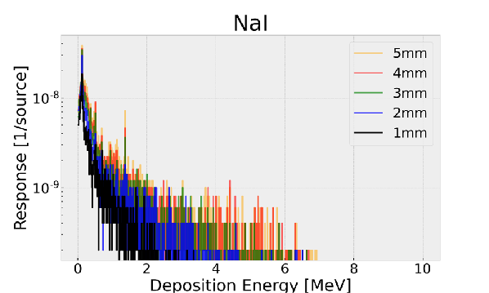
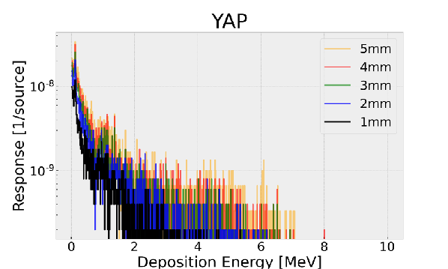
Scintillation Materials and Geometries
Suitable materials and geometries have been studied for Scintillation BLMs in the test ring:
  A few mm thick YAP,YSO will be tested on FETS with supports from Detector Group in ISIS.
Selection of optical fibres and PMT as well as electronics treatments should be performed in 2024.
Fig. 3. Response function of NaI and YAP detectors with different thicknesses.

Slide 11
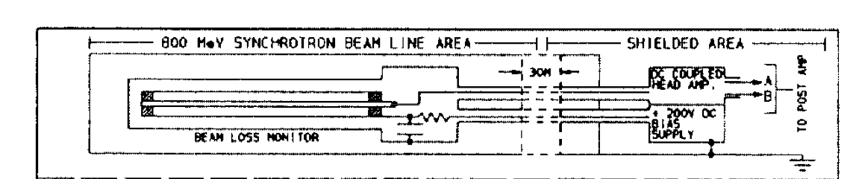
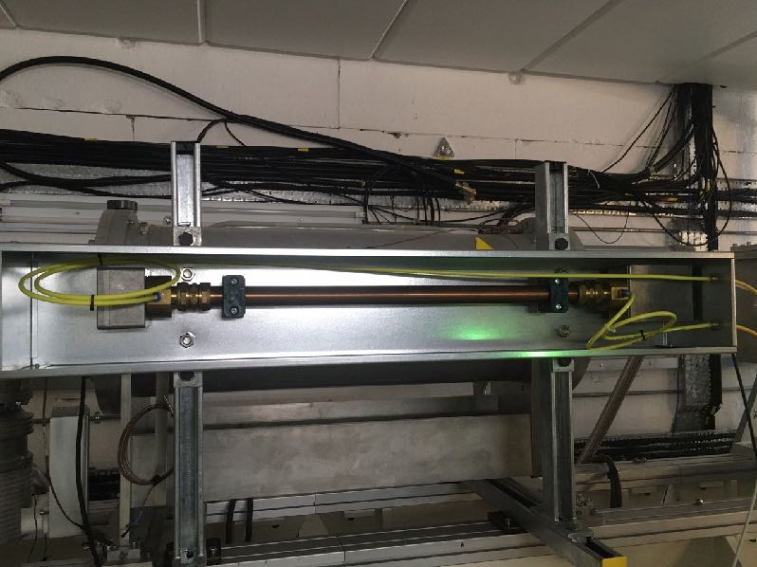
Ionisation Chamber BLM
ISIS-IC-BLMs are the model for FFA-IC-BLMs:
  Ar-gas filled in between two cylindrical tubes.
  Electron collection:
    Inner tube: grounded via downstream amplifier
    outer tube: negative voltages are applied.
Ideal geometry, types of gas, bias voltages should finished in 2024.
Fig. 1. Sketch of Ring-BLM used in ISIS [1].
Fig. 2. Test demo-BLMs on FETS beam dump.
[1] M.A. Clarke-Gayther, “Global Beam Loss Monitoring using Long Ionisation Chambers at ISIS”, Proc.C 940627 (1994)

Slide 12
Beam Intensity Monitor
Updates

Slide 13
Monitor Requirements
The intensity resolution of all Intensity Monitors is within 1% of injected beam (maximum intensity is 3E11).
  Maximum peak current for WCM: 160mA (3E11 ppp for 300ns)
  Minimum peak current for WCM: 1.6mA (3E9 ppp for 300ns)
  Coasting beam intensity can be one order higher in ideal.
WCM:
  The bunched structure with length of about 300-350 ns should be identified.
  Reading at least 100 harmonics (400-500 MHz) of frequency component is required.
DCCT:
  At least for 4 pulsed durations (80 -100 ms) should be identified.
Physical placements:
  One FC in the ring or on FETS beam line.
  One WCM at a straight in the ring.
  One DCCT at a straight in the ring.

Slide 14
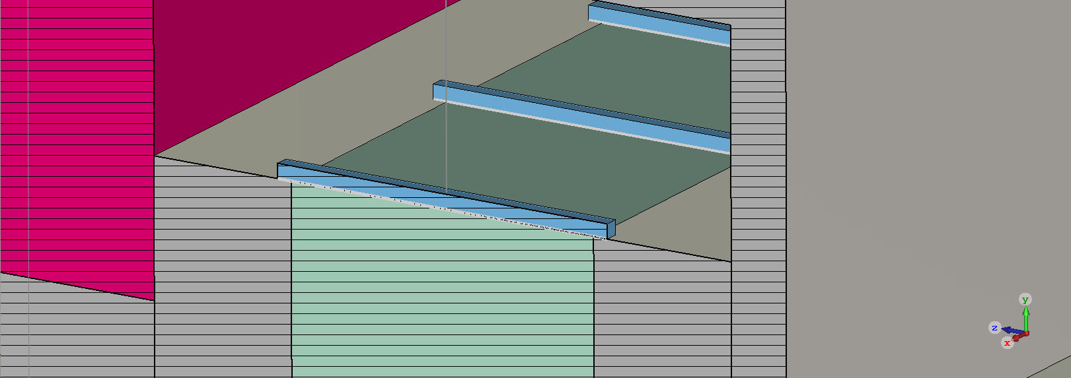
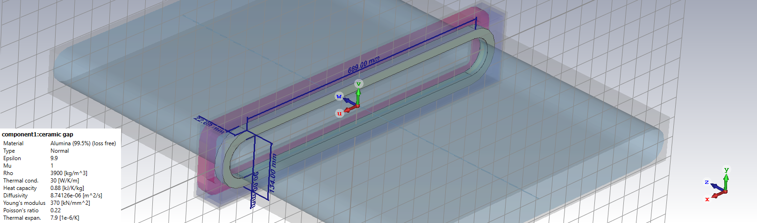
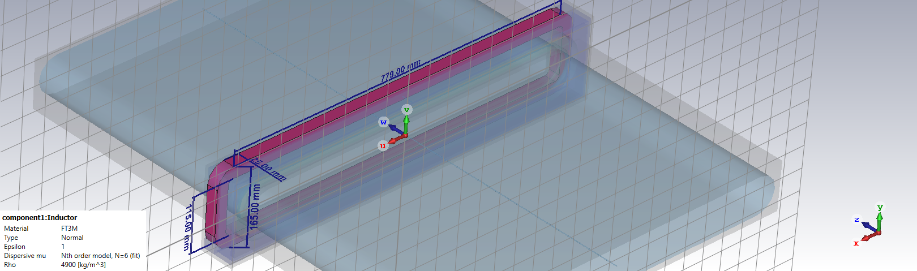
FFA-WCM model in CST
Core
Vacuum box
Ceramic
Spacer
Chamber
Lumped Element (R)

Slide 15
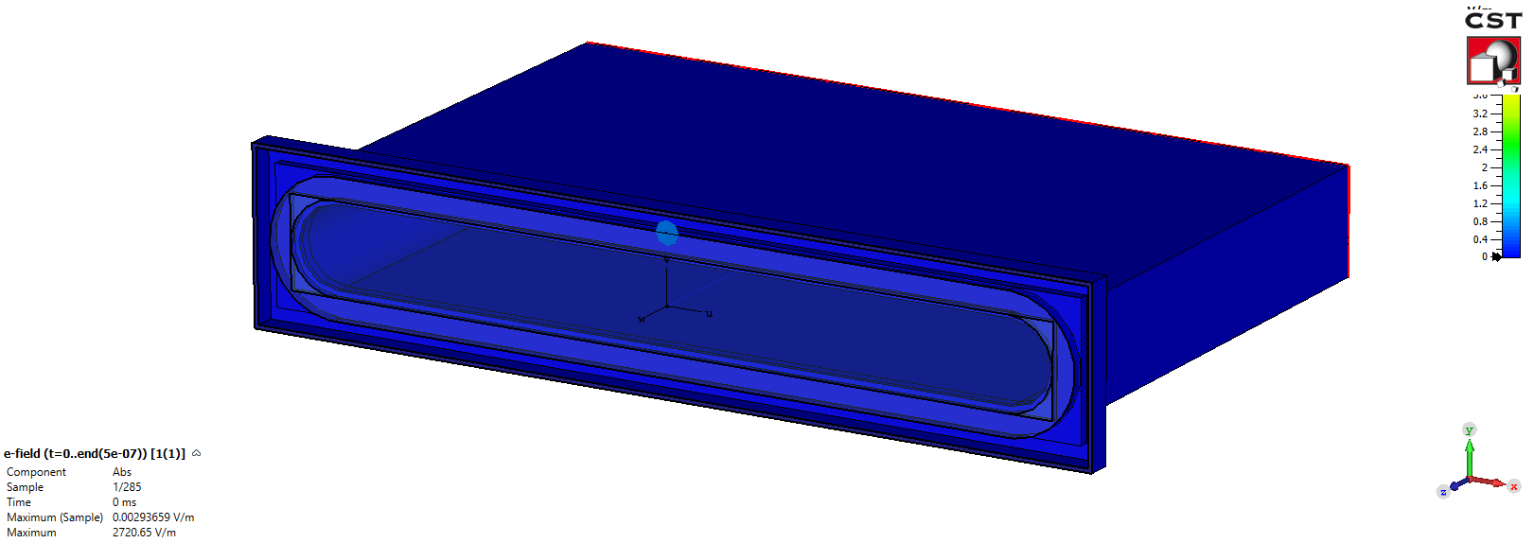
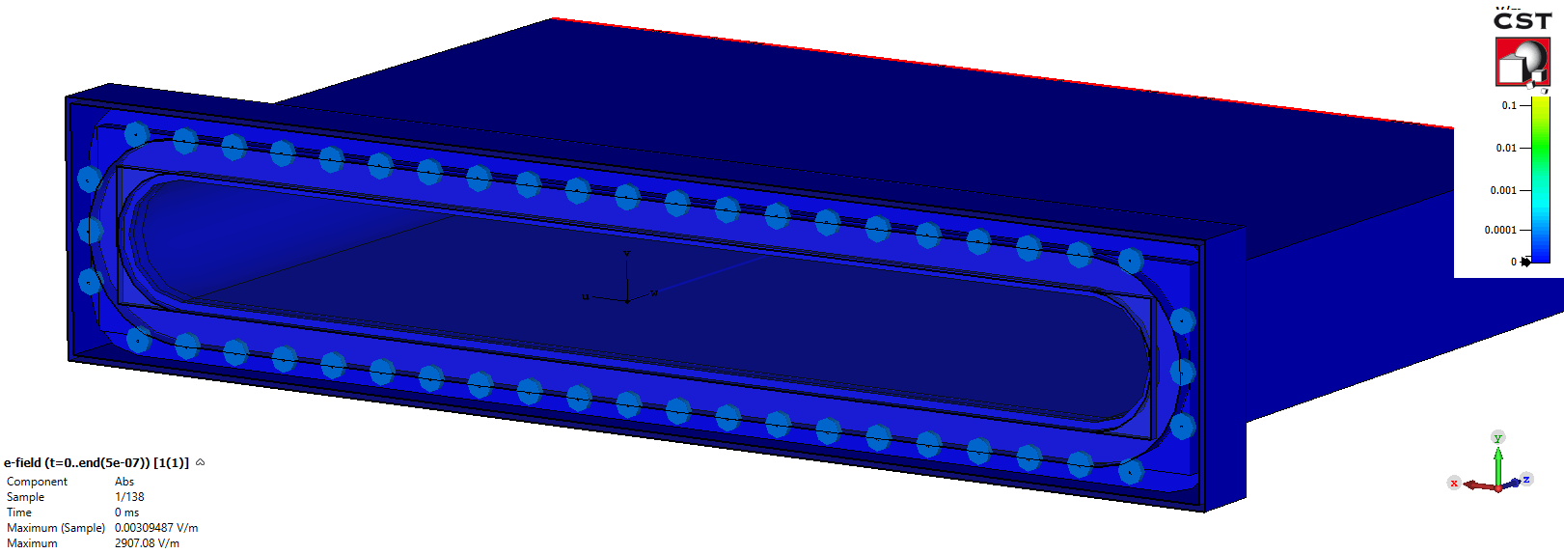

WCM: wave propagation in CST
E-fields in HF solver (time domain).
R=1.56Ω x 1, 1.56x48Ω
X=0mm, x=296.5mm
Microwave propagates in x,y,z directions.
Position of beam changes traveling time of wave in ceramic spacer and RF shield, causing a position dependency of pickup signals on resistor.
Large quantity of resistors covering ceramic spacer help to terminate microwaves at resistors.

Slide 16
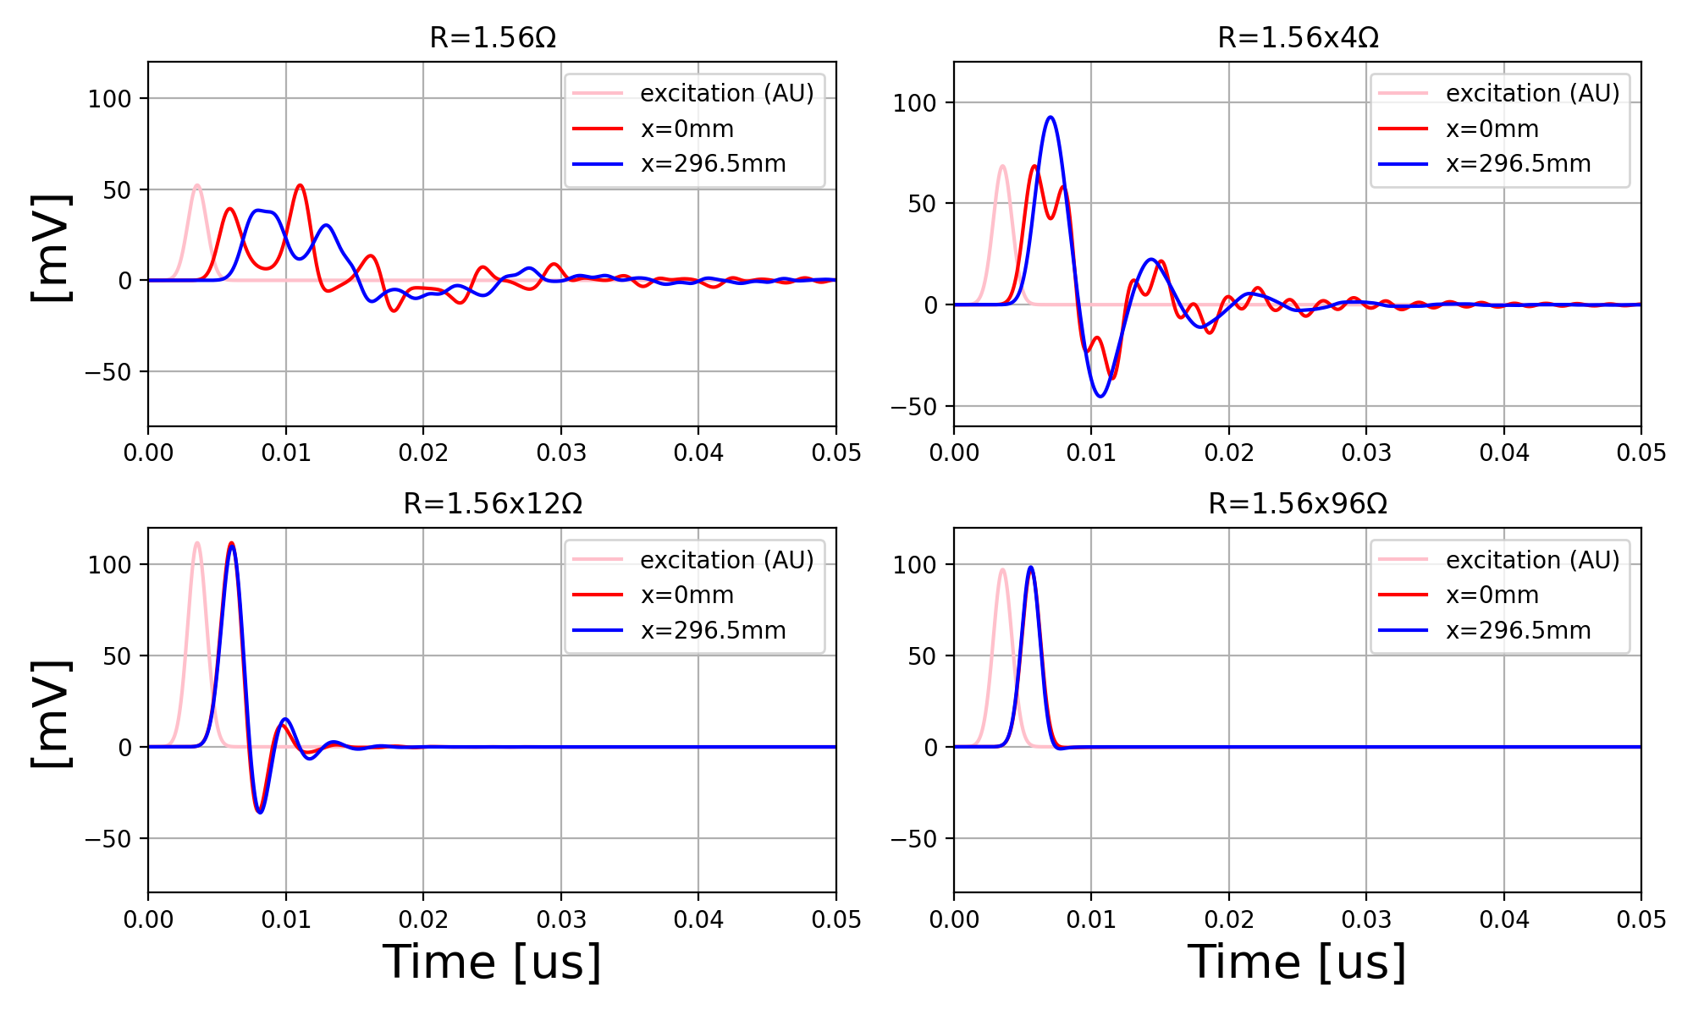
WCM: CST HF simulations
Sum signal of all Elements:FT3M
τ is consistent to analytical estimation (L/R).
Fig. 1. Time response of WCM with different numbers of resistors. Excitation frequency is DC-500MHz in this simulation.

Slide 17
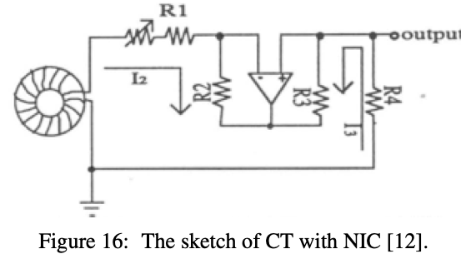
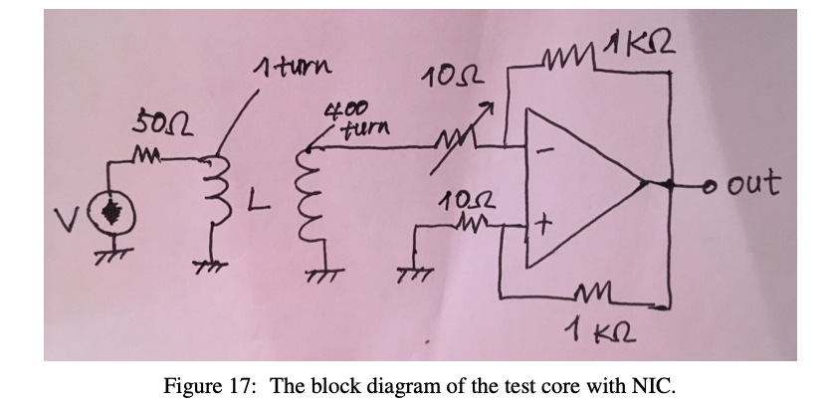
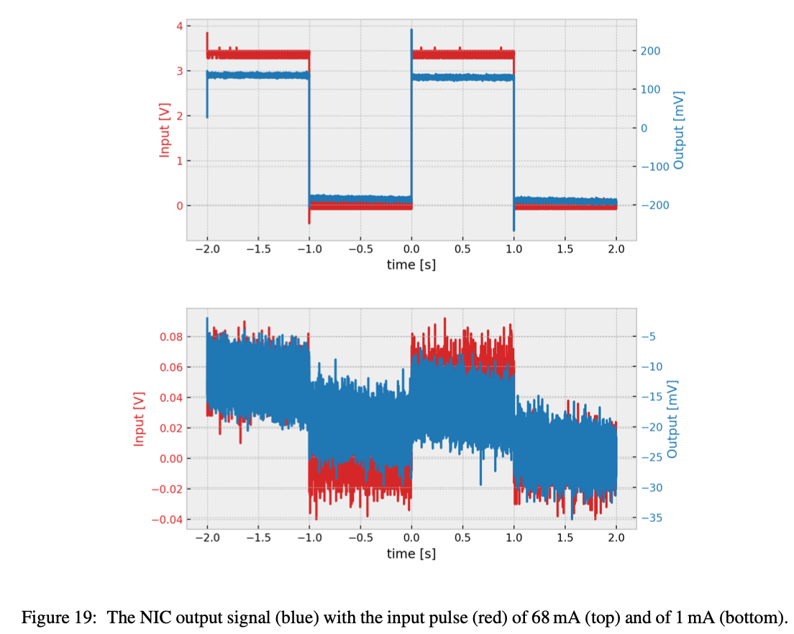
Long-Time Constant CT Monitor by
Negative Impedance Converter
Input impedance (Z) becomes close to zero by adjusting the ratio of four resistors, resulting in a large decay constant of the droop (τ = L/Z).
Turn number of the coil wire (N) should be large enough to increase L, but wire resistance is increased.
Trimmer should be placed in R1 to cancel the coil resistance and adjust the ratio between four resistors.
Test was performed in the Lab with FT3M core.
  Time constant is185 with R1=5.140 Ω (Top in Fig.19).
  Droop time is 0.53% reduction over 1 s (Top in Fig.19).
  When the input current is 1 mA, the decay constant is not consistent as the base was not stable.
  Current sensitivity of NIC is sufficient to detect the required minimum intensity of 3E9 ppp (1.6 mA with 300 ns).

Slide 18
Beam Profile Monitor
Updates

Slide 19
Commissioning Plan
In the commissioning phase 1:
  Single wire and scintillation screen are used to identify the beam position and beam profile at injection straight in the FFA ring.
  Single wire or scintillation screen will be used to identify how far the beam goes around in the ring if the BPM does not work. This includes profile/position of intermediate and final energy of beam.
  Multi-wire profile monitor will be used pulse-by-pulse measurement at injection in the ring.
In the commissioning phase 2 and 3:
  Single wire and scintillation screen are placed at extraction line (outside of ring) and measures beam position and beam profile.
  Multi-wire profile monitor will be used pulse-by-pulse measurement at extraction line.

Slide 20
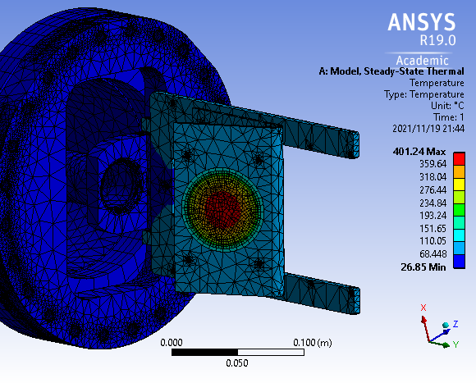
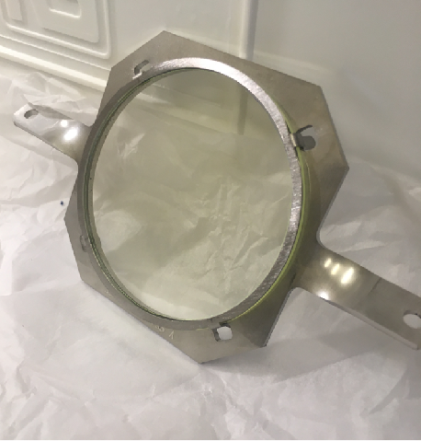
Screen Monitor: Thermal Analysis
P46 and YAG:Ce : 5um thickness
  Screen substrate is made by 2mm thickness of quartz.
  Screen holder is made by 3mm thickness of aluminium.
  Cooling: Radiation and convection.
Heat power | 18 W
Thermal conductivity of air | 10 W/K/m²
Emissivity in vacuum | 0.2
Room temperature | 300 K
Fig. 1. ANSYS steady-state thermal analysis.
To benchmark simulations, beam tests on FETS are proposed.
  YAG: crystal
  Ceramics (BeO)
  P46: Powder type
Fig. 2. YAG screen on the mounting frame.

Slide 21
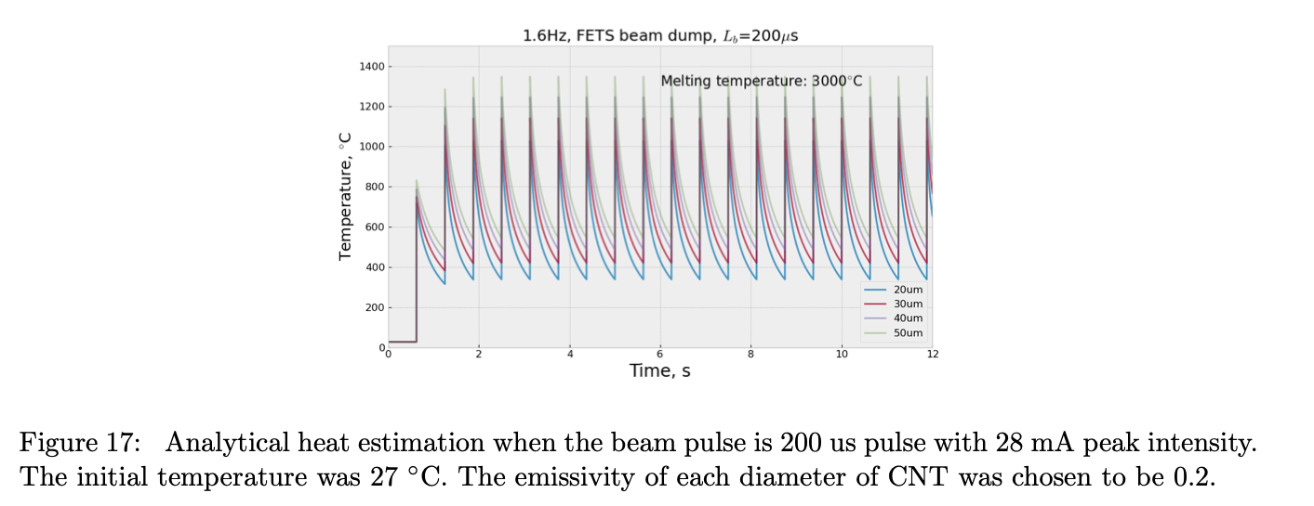
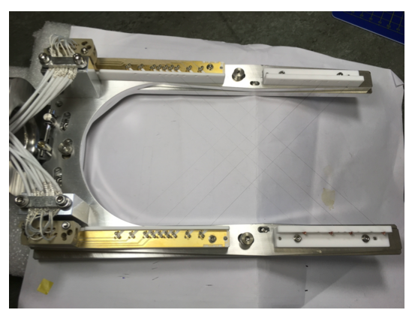
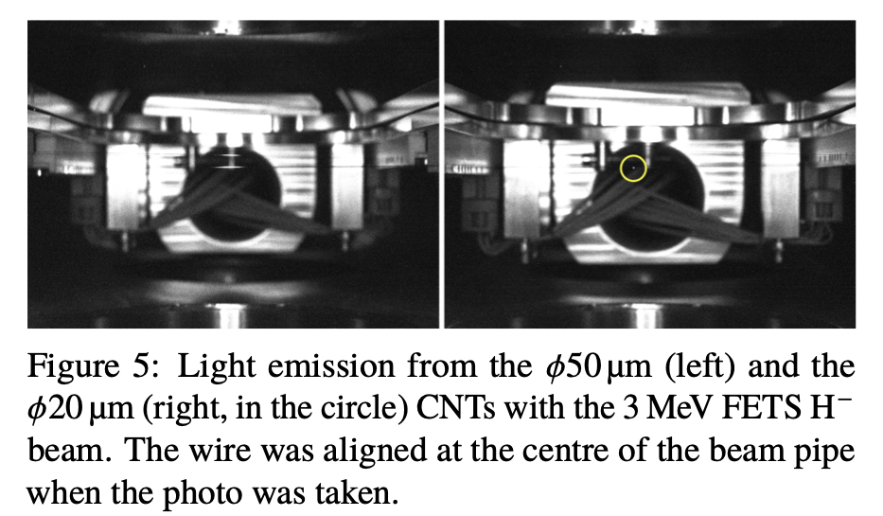
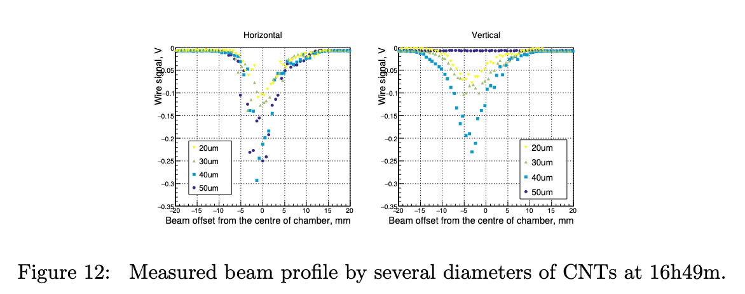
WSM:Heat Damage Test on FETS
φ20,30,40 and 50um CNTs were installed on WSM frame.
Light emission from the wires can be seen, but all wires have not been broken within 10-20 min.
As beam intensity in FETS-FFA (1E11) is 100 times smaller (1E13 in this measurement), therefore heat damage would be not a crucial issue in test ring.

Slide 22
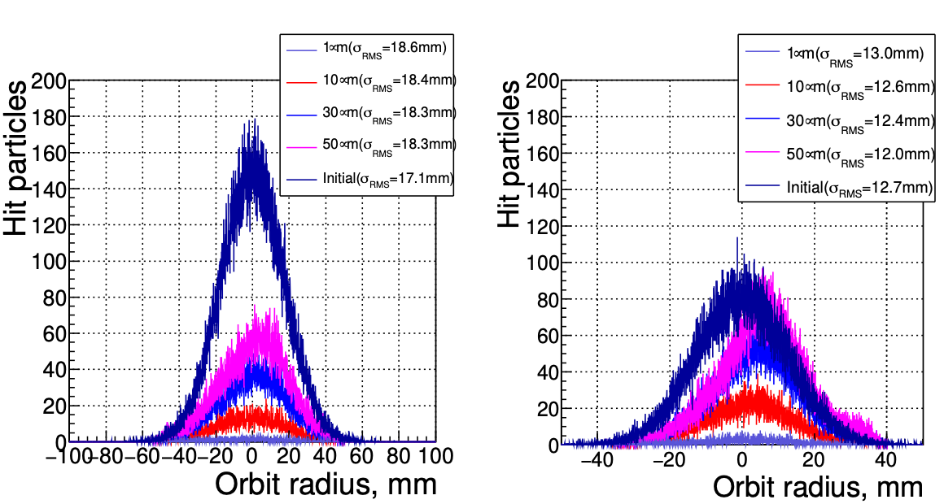
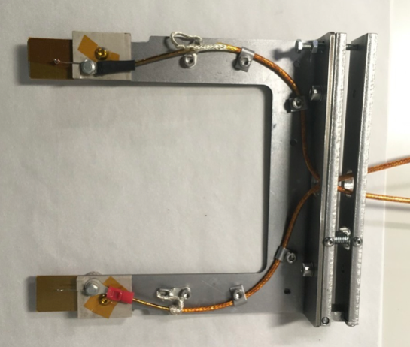
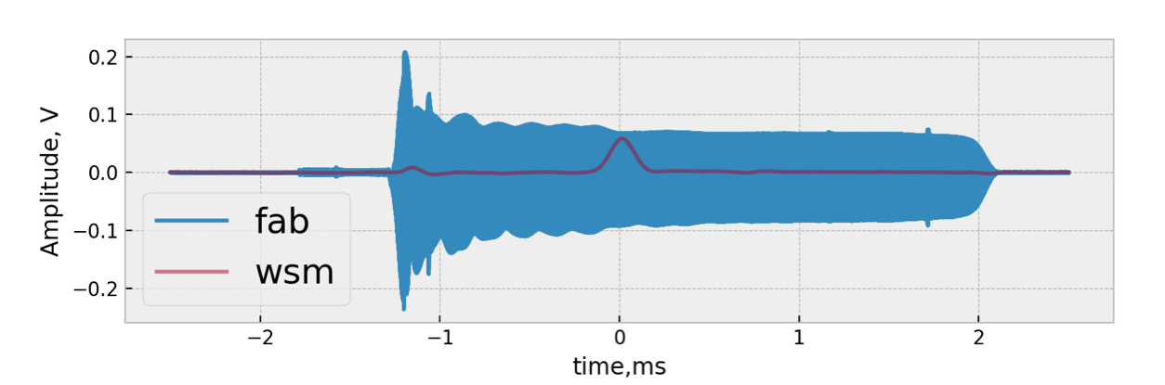
S-WSM:Demonstration at KURNS
Simulation was performed with vFFA parameters (Fig.1).
To demonstrate monitor concepts, beam tests were performed at KRNS FFA ring.
  Test probe and wire frame were designed and manufactured.
  φ10um was tested at 13.5 MeV orbit, where turn separation of about 30umm.
  Pulse signal was measured by test monitor, which is within same order of the one measured by scraper.
Fig. 1. Estimated beam profile at around 3MeV (left) and 12MeV (right) with vFFA parameters. Average turn separations are 64um for 3MeV and 25um for 12MeV. Scattering angle and energy loss of particle at wires are neglected.
When turn separations are smaller than wire thickness, the wire does not destroy whole beams and can estimate profile in the acceleration.

Slide 23
Summary and Future Plan
Variety monitors are essential to be developed for the test ring. FETS-FFA test ring is a TEST MACHINE to test diagnostics monitors as well.
Collaborations with JPARC(consultants)/PSI(exchange knowledge)/Kyoto University(Electronics development for CT monitor) have been started.
  BPMs: 50% progress
    Focus on design works.
  BLMs: 50% progress
    Design study for both BLMs finished in 2024.
    Beam tests on FETS or JPARC to benchmark design studies.
  Intensity Monitors: 30-50% progress
    WCM, NIC-CT: Design study and build test monitors at ISIS in 2024.
    Faraday cup: Design study by students in Industrial Placement Scheme in 2024-2025.
  Profile monitors: 50-70% progress
    Update mechanical designs of S-WSM and M-WSM in 2024-2025.
    Screen tests on FETS or JPARC.

Slide 24
Fin.

Slide 25
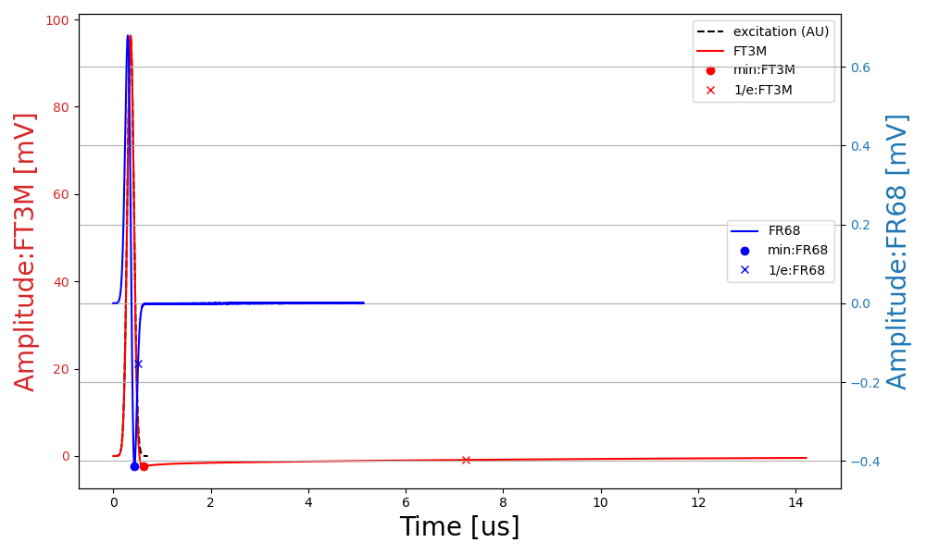
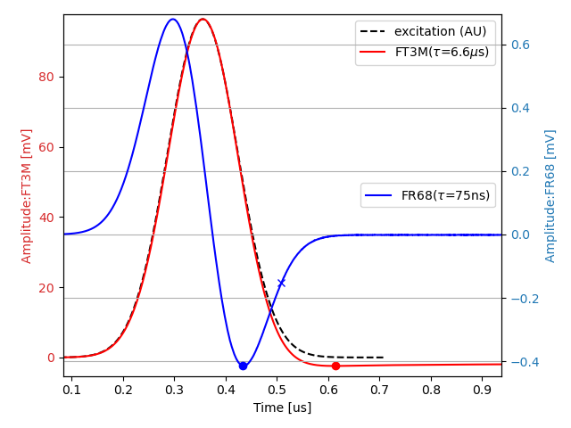
Decay Constant
Expected (ideal) time constant (τ) : FT3M: 4us , FR68: 61ns (µr~3e4 for FT3M, µr~100 for FR68).
When the frequency of excitation signal is DC - 5MHz, measured time constants in CST are good agreement with expected time constants.
CST HF solver: Exc. 0-5MHz.

