Slide 1


Plans for the LhARA RF System
ISIS2/LhARA FFA Project Update
Ajit Kurup
10th January 2024

Slide 2
Intro
LhARA FFA
Technology choices for RF
  Ferrite loaded cavity
  Magnetic alloy loaded cavity
proton RF frequency | 2.89 – 6.48 MHz
Harmonic number | 1
Bunch intensity | 10⁸ protons/bunch
Voltage per cavity | 4 kV
Cavity horizontal aperture | 65 – 85 cm
Cavity vertical aperture | Few cm?

Slide 3
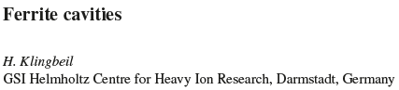
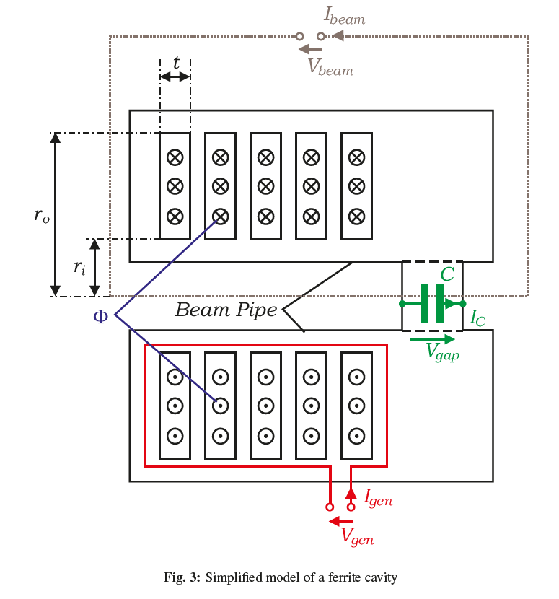
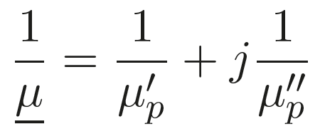
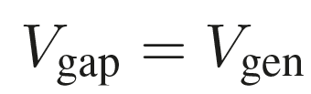
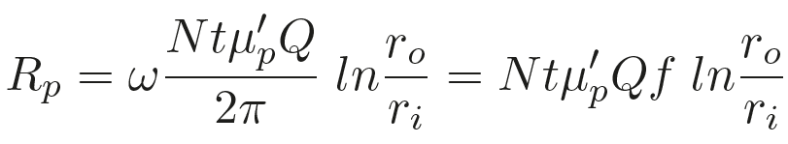
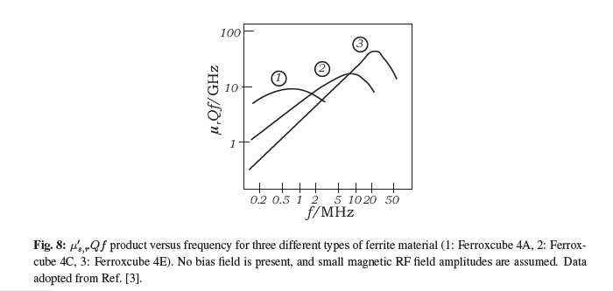
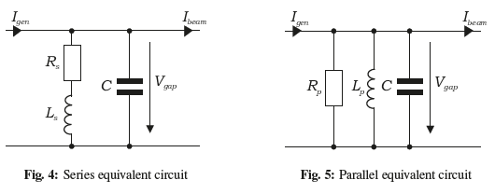
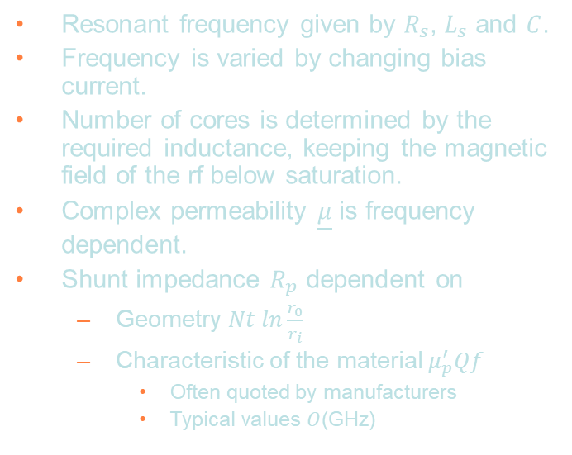
Ferrite loaded cavity design
Resonant frequency given by $R_{s}$, $L_{s}$ and $C$.
Frequency is varied by changing bias current.
Number of cores is determined by the required inductance, keeping the magnetic field of the rf below saturation.
Complex permeability $\underline{μ}$ is frequency dependent.
Shunt impedance $R_{p}$ dependent on
  Geometry $Nt ln\frac{r_{0}}{r_{i}}$
  Characteristic of the material $μ_{p}^{′}Qf$
    Often quoted by manufacturers
    Typical values $O$(GHz)

Slide 4
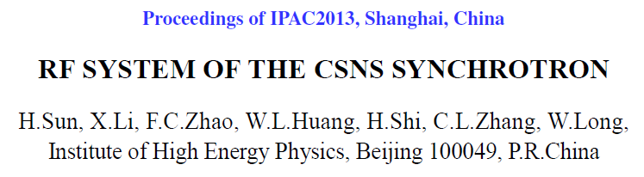
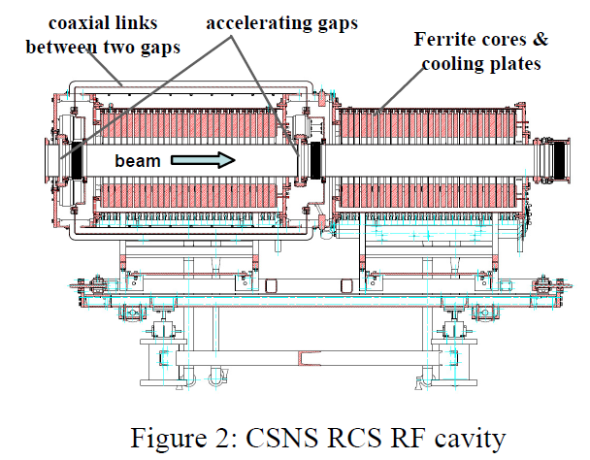
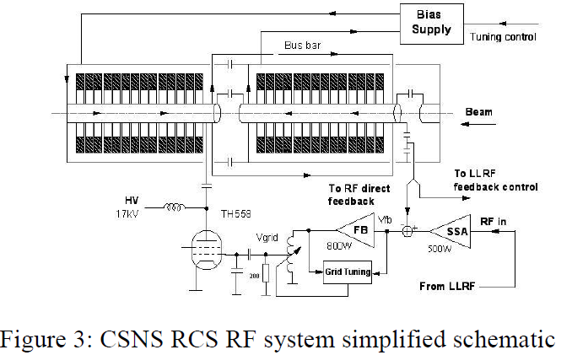
Ferrite loaded cavity
Design considerations.
  Material properties.
  Number of cores.
  Bias supply.
  Low-level control.
  RF power amplifier system.
  Cooling.
RF frequency | 1.02 – 2.44 MHz
Harmonic number | 2
Bunch intensity | 1.56E¹³ protons/bunch
Voltage per cavity | 20.6 kV
Number of cores | 56
Inner diameter | 25 cm
Outer diameter | 50 cm
Core thickness | 2.5 cm
Ferrite material | Ferroxcube 4M2
Cavity length | 2.7 m
Ferrite length | 1.4m

Slide 5
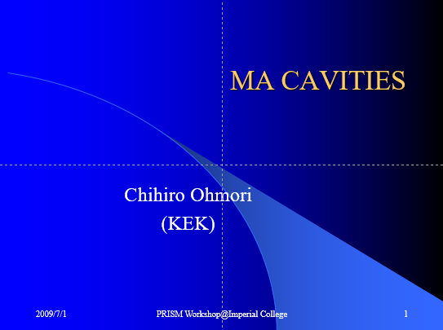
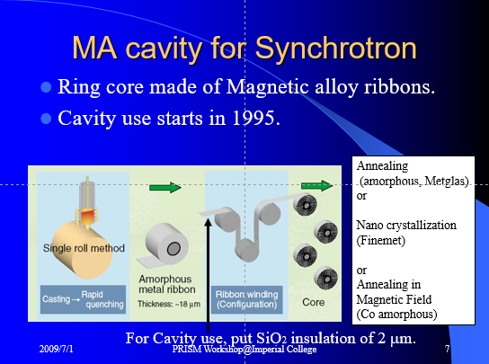
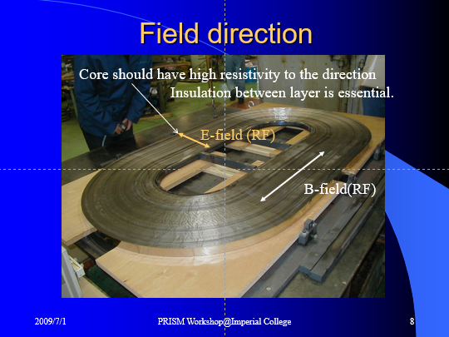
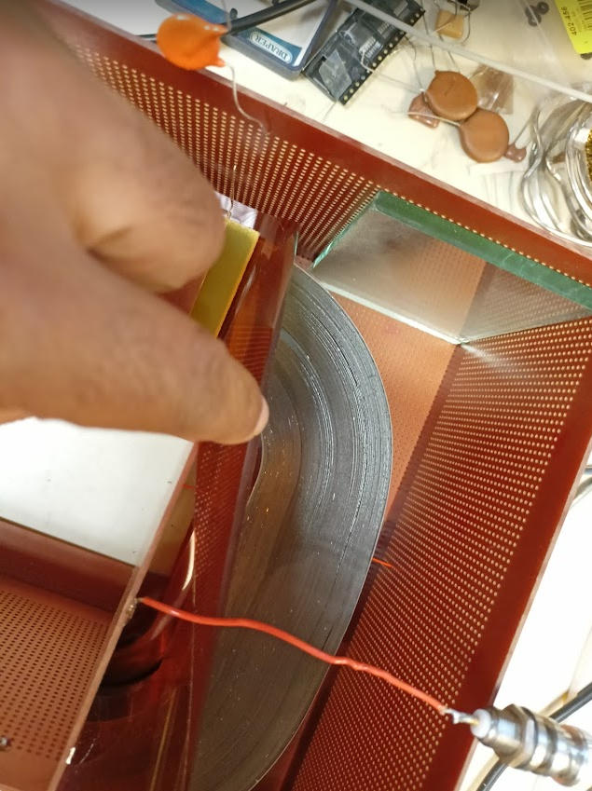
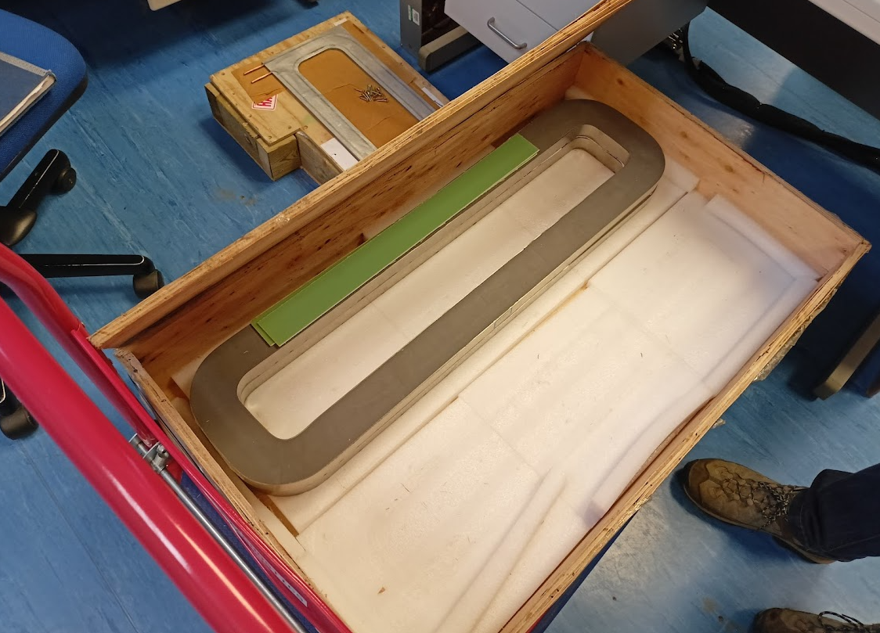
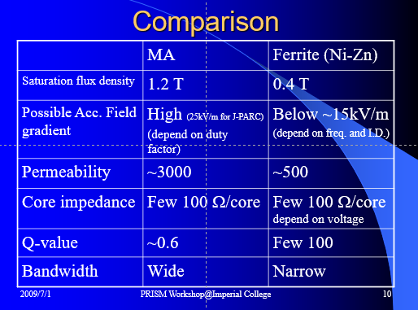
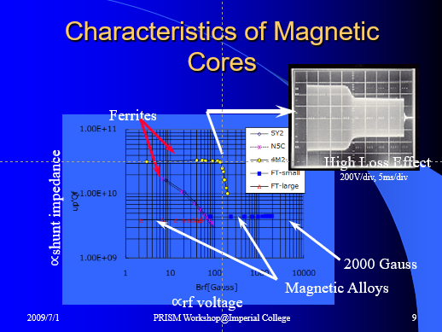
MA Cavity Design

Slide 6
MA Cavity
Design considerations
  Material
    Core manufacture is more complex.
      Need for a more complex QA procedure?
  RF power amplifier system.
    Cores are passive, i.e. no need for bias power supply.
    Simpler power amplifier chain.
    Simpler LLRF.
  Lower Q means higher power dissipation
    Requires more cooling.
    Higher running costs.

Slide 7
Steps towards selecting a cavity technology
Viability of both options needs to be demonstrated.
  Material characterisation work already being done by ISIS Synchrotron RF group.
Verify ferrite-loaded option will fit in the space available.
  Number of cores needed.
Power consumption.
  Ferrite loaded cavity will have lower losses.
  MA cut core?
Cost
  Ferrite loaded capital cost will be higher but running costs lower.

