Slide 1
Light Peer Review at IPAC’23
Nicolas DELERUE
IJCLab (CNRS and Université Paris-Saclay)
EPS-AG meeting
2nd November 2023

Slide 2
Reminder: Light Peer Review at IPAC’23
Light Peer Review (LPR) motivations:
Improve academic standing of accelerators at Universities and strengthen the position of accelerator scientists in funding discussions and project applications.
Train accelerator students and post-doc in the process of peer-reviewing publications.
Boost the impact factor of PR-AB and other.
LPR at IPAC’23:
Deadline was set 6 weeks ahead of the conference to give more time to reviewers and to the peer-review process.
Target of 250 papers.
First LPR with indico
SPMS code not available
Code rewritten in Python (>6000 lines)

Slide 3
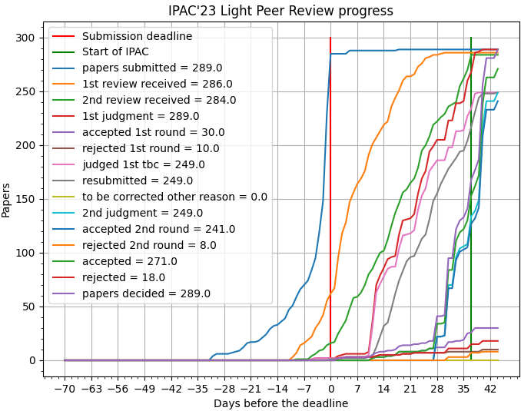
Timeline
Mid-march: submission of papers began.
[Saturday April 1st] IPAC-6 weeks: LPR Submission deadline => More than 100 papers submitted in the last 48h before the deadline.
All but 12 papers had a 1st round decision by the start of conference.
All papers decided (2nd round) one week after the conference.
Getting IoP guidance was difficult. Guidance sent to authors at the beginning of June.
All papers in IoP format collected by mid-July.
IoP submission platform is not user friendly but manageable.
Then in the middle of the summer request from IoP for an additional document (Author Declaration Form).
Collection started in September, completed end of October.
Publication expected January 2024.

Slide 4
LPR statistics
288 papers submitted by the deadline + 4 accepted after with valid reasons (several others not accepted) => 292 papers processed.
2 papers rejected on editorial grounds (non compliant and not corrected).
1 paper significantly off-topic (HEP detector).
271 papers accepted at the end of the LPR process (93%).
1 paper had failed poster police but was able to explain why and apologised (accepted).
3 papers withdrawn in the month after the conference.
1 paper withdrawn when required to submit the Author Declaration form (ethical compliance).
267 papers should be published in January 2024 in the IPAC’23 Peer-reviewed proceedings (91%).
605 reviews on 1st round (2,09/paper)
273 reviews on 2nd round (1,1/paper)

Slide 5
LPR statistics (continued)
Papers submitters:
Not in the database provided (not registered by 23rd march 2023): 82 out of 284
Student 73 out of 202 (36%)
Delegate Non-member EPS 113 (56%)
Delegate EPS Member 14 (7%)
Exhibitor extra pass 2 (1%)
Papers with student as submitter or speaker or primary author: 52%
Country of submitter: (out of 202 papers) China 18%, Germany 17%, Switzerland 15%, Japan 12%, United States 7%, Italy 9%, France 6%, Taiwan 5%; Other EMEA: 8%, Other Asia: 2%, Other America: 1%
Region of submitter: EMEA 52%, Asia 32% , Americas: 16%,

Slide 6
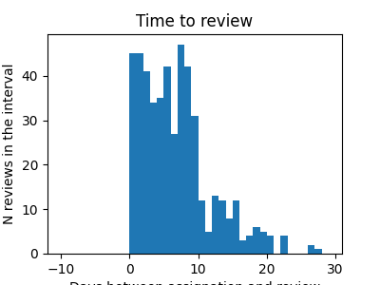
Getting more reviewers
Opt-in policy does not work:
Some reviewer who volunteered at registration never replied to request or declined all assigned papers.
Some participants who did not volunteer accepted to review and volunteered to review additional papers.
Recommendation: use an opt-out policy (all participants may be queried to review and can decline).
Review by students?
Decision by IPAC’23 SPC1 was not to ask students to review papers.
Identifying students requires access to the participants database => not data after 23rd march 2023 => participants registered after that date were not asked to review papers.
52% of the papers had a student as main contributor.
In many cases the paper was submitted by a student whose professor did not attend the conference.
One of the stated goals of the LPR is “Train accelerator students and post-doc in the process of peer-reviewing publications.”
Shall we consider allowing one of the two reviewer to be a student on a trial basis (with opt-out possibility) at a future IPAC?
Get faster reviews: 10 days to review was too much. One week is probably sufficient.
Days between paper allocation and review submission

Slide 7
LPR impact
Feedback (both by authors and by reviewers) was very positive.
Some papers were significantly improved (spelling and/or scientifically).
Several requests by students who needed to confirm the acceptance of the paper to graduate or thesis reviews.
PR-AB:
One of the stated aim of the LPR is to increase the impact factor of PR-AB and other journals in the community.
Too early to measure.
Difficult to ask reviewers to identify papers to be forwarded to PR-AB (quality vary a lot from reviewer to reviewer).

Slide 8
Recommendations for future LPRs
Bring forward past experience:
Make sure that past and future LPR chairs are in the SPB
Ensure LPR scripts are transmitted to avoid having to rewrite them each year.
Reviewers allocation:
Do not use opt-in but opt-out for reviewers (select reviewers among all conference participants, giving them the option to opt-out).
Allow one of the two reviewers to be a students?
Better sharing of the work: reviewers allocation done by several SPB members?
Be strict on deadlines for reviews!
See also slide “Some issues to be considered for Future LPR” in appendix.

Slide 9
Outlook
LPR outcome:
Increased paper quality
Increase academic standing of our community
52% of the paper had a student as main contributor.
Important for some thesis.
LPR submissions come from all regions.
Work was very intense during the 6 weeks prior to IPAC but also very interesting!

Slide 10
Thank you

Slide 11
Some issues to be considered for Future LPR
Paper submission process:
Papers using the Jacow format are significantly shorter (in pages) than those in the IoP format (typically 3 pages become 7 pages).
Impossible to fit in 3 pages on the single-column IoP format (I tried hard).
Once paper is approved, text can not be changed. Little leverage on the authors to have them try to reduce paper length.
Once paper is approved in Jacow format, ask the author to resubmit immediately in IoP format.
Add a space in indico for paper submission in IoP format and for submission of the author declaration form.
Policy:
Some papers were rejected by more than 10 reviewers.
Set a limit on the number of time a paper can be declined to be reviewed before a paper can be rejected as “off-topic/misclassified”.
Some tracks have very small communities.
Decide on a policy for papers with no reviewers available. Fetch reviewers from previous IPACs?
Late publication date has some drawbacks for students.
Consider cost benefit of publishing in January rather than July.
Number of pages for LPR papers of invited orals? 3? 5?

Slide 12
Some issues to be considered… (cont’d)
Peer review process:
Find a space in the cloud to share data on reviewers/papers matching. This would allow several persons to assign reviewers to papers.
In the review form, separate scientific comments from spelling comments (a long list of spelling mistakes does not require a review on the second round).
Indico:
Several reviewers posted comments visible by authors and some comments disclosed their identity.
Disable comments on papers
Some SPB members mistakenly validated (judged) papers without waiting for approval from the others. This created some confusion.
Create an “observer” status that can access to all reviewers comments but not “judge” the paper.
Some LOC members has large rights on indico and “judged” paper for which they were only reviewers.
No way to prevent reviewers to mark papers “to be corrected” on second round.
Limit the number of rounds in indico?
Withdrawn papers completely disappear from Indico.
Keep a record of papers even when withdrawn.

Slide 13
Some issues to be considered… (cont’d)
Jacow:
Several participants used different spelling for their name as author, as volunteer reviewer or as participants (initial, middle name,…). This create confusion!
Identify authors and conference participants by a unique id (SPMS database?).
The same affiliation appeared with different spelling (CERN, Europeean Organization for Nuclear Research, C.E.R.N.,…)
Use a unique id for institutions (SPMS databse?).
Allow queries through an API to the Jacow publication database to find someone’s field of expertise.
Scripts/code:
Ensure code is transmitted from one year to the next.
Find a space to share the scripts managing the LPR. At the moment most of the scripts (except email functions) are on gitlab at https://gitlab.in2p3.fr/delerue/ipac-lpr

Slide 14
Reviewers allocations
Final algorithm:
Search for all speakers, authors and co-authors in a given track (subMC) (including people who did not volunteer as reviewer)
Limitation to 3 papers for volunteers, 1 for non volunteer; upon review completion, ask if volunteer for more papers
If no match in the other continents, look for reviewers in the same continent but different country.
If less than 5 reviewers, look for additional reviewers in same sub-classification in other MC.
If no reviewer found, look manually in related technologies (other tracks).

Slide 15
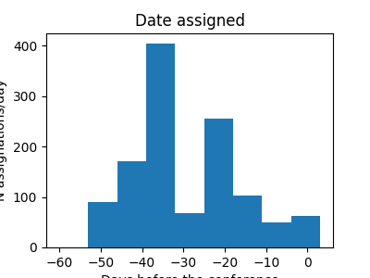
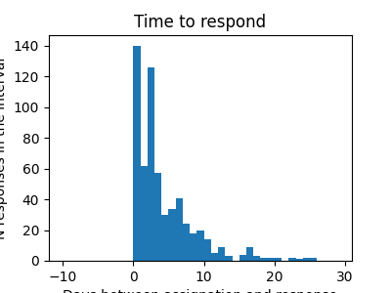
Reviewers statistics
LPR activity started around 15th March (thanks to an email from a colleague who wanted me to check that his paper had been received).
Peak activity the week after April 1st (more than 400 assignation/week).
Before 15th April, feedback: IPAC still far in the future.
After 15th April: busy preparing their own IPAC paper/poster.
Easter long week-end, easter vacation, …
Most reviewer accepted to review within a few days (week-ends not implemented in code).
Most reviews within the 10 days deadline for review.
Time allocated to review the paper should be modulated as function of time remaining to IPAC (no time to implement it in code).
Proposal: 10 days before the LPR deadline, 7 days after, -1 days each week.
Reviewers acceptance:
Some reviewer who volunteered at registration never replied to request or declined all assigned papers.
Some participants who did not volunteer accepted and volunteered to review additional papers.

Slide 16
Reminder: Peer Review General Policies for IPAC’23
Papers will be rejected if a submission or correction deadline is missed.
Papers are rejected if the review process is not completed by the end of the conference week.
Each paper shall have two (2) reviewers.
Single-blind review (where the reviewers are unknown to the authors).
A reviewer shall not know the identity of the other reviewer assigned to the paper.
A reviewer shall not contact an author directly concerning their paper.
Reviewers shall not make any personal remarks, or comments that may betray their identity, when entering the instructions for requested correction/revision of the paper.
Reviewers must not referee papers of which they are authors or co-authors.
Only a single cycle of correction(s) by the author(s) is permitted; such cycle shall include the opportunity to respond to correction requests from both reviewers.
Decisions of the SPB chief shall be final.

Slide 17
Peer Review Acceptance Criteria (from IPAC’20)
The published work must not contain clear errors or important factual mistakes.
The paper must include own work, performed by the authors and not published elsewhere.
Some aspect or part of the work must be original or demonstrate clear progress over other reports of the work.
The presentation of the results must be understandable.
The paper must be in good English.
Work and related results by others must be referenced and properly acknowledged.
The paper must include references to literature that are appropriate.
Papers are considered not-correctable and therefore rejected in following cases:
The whole Ansatz is wrong.
The work is from somebody else or claiming authorship from somebody else.
Requested changes are not implemented in time.

Slide 18
LPR organization for IPAC’23
LPR is is managed by the Scientific Publication Board (SPB)
The SPB acts much like the editorial board of a journal.
SPB membership: has changed over years:
The 16 SPC members + three regional chairs (present, past and future) [19 members] + SPC chair (new at IPAC’23)
The present chair, or chief, is from the host region.
The SPB chairs from the other two regions ensure continuity.
SPB has administrative support from a person expert in the indico peer review module – typically the scientific secretary.
In the case of disputes, the present/active SPB chair’s decision shall be final.

Slide 19
IPAC’23 SPB
Scientific Publication Board (SPB):
Previous rule for SPB membership was:
current, past and future SPB chairs
8x2 MC coordinators
19 members
SPC chair was not a member of SPB => added
No SPB chair nominated for IPAC’24
Current SPB chair is also MC8 coordinator
IPAC’23 SPB has 18 members
Chairs: Frank Zimmerman (chair ‘22), Peter McIntosh (SPC chair) and Nicolas Delerue (SPB’23)
MC1: Oliver Boine-Frankenheim, Jie Gao MC2: Sara Casalbuoni, Mark Boland
MC3: Victor Malka, Evgenya Simakov MC4: Mohammad Eshraqi, Yoichi Sato
MC5: Sven Reiche, Seunghwan Shin MC6: Adriana Rossi, Jui-Che Huang
MC7: Marie Helene Moscatello, Georg Hoffstaetter
MC8: (ND) Sandra Biedron

Slide 20
