Slide 1
European Physical Society
Accelerator Group
Board Meeting
P. McIntosh, R. Tomas
Thursday 2nd October 2023

Slide 2
Agenda for Today
Thursday 2nd November
# | Time (GMT) | Item | Who
1 | 14:00 | Agenda review and approval | P McIntosh
2 | 14:05 | EPS-AG constitution, roles and future expectations | P McIntosh
3 | 14:15 | EPS-AG finance review | N Delerue
4 | 14:25 | IPAC23 lessons learned | A Fabris
5 | 14:35 | LPR processing review | N Delerue
6 | 14:45 | IPAC26 preparations | H Franberg/P McIntosh
7 | 14:55 | Indico implementation and status | I Andrian (Video)
8 | 15:05 | Break
9 | 15:10 | EPS bylaws change implication | P McIntosh
10 | 15:15 | IPAC29 LOI hosting in Europe and timescales | P McIntosh
 |  | Task Force discussion and possible topics
11 | 15:25 | Communications: website, social media, news bulletins | P McIntosh/R Tomas
12 | 15:35 | Topical forum/workshops | P McIntosh/R Tomas
13 | 15:45 | Other ideas? | All
14 | 15:50 | Budget utilisation opportunities | All
15 | 16:00 | Meeting Close

Slide 3
EPS-AG Constitution, Roles and Future Expectations
IPAC23
IPAC24
IPAC25
IPAC26
Still to define:
Student Grant panel for IPAC24 (Nov23), grant panel and SAB for IPAC25 (Nov24) and IPAC26 (Nov25)
SPC, LPR, EO and Student Tutorial roles to be confirmed for IPAC26 (Aug24) – SPC1/OC1 expected Dec24/Jan25

Slide 4
EPS-AG Finance Review (N Delerue)

Slide 5
IPAC23 Lessons Learned (A Fabris)

Slide 6
IPAC23 LPR Processing Review (N Delerue)

Slide 7
IPAC26 Preparations (H Franberg-Delahaye)

Slide 8
Indico Implementation and Status (I Andrian)

Slide 9
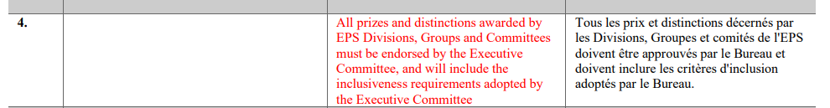
EPS Bylaws Change Implications
Meeting held with Luc Berge (EPS President) and Anne Pawsey (EPS General Secretary) on 20th Oct, with myself, Ralph Assmann and Rogelio Tomas.
Discussed implications of the proposed Rule 21.4 bylaws change:
Formal EPS bylaws change voting process on November 24th.

Slide 10
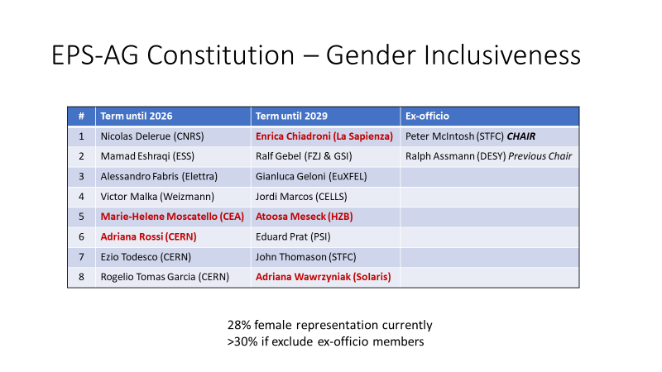
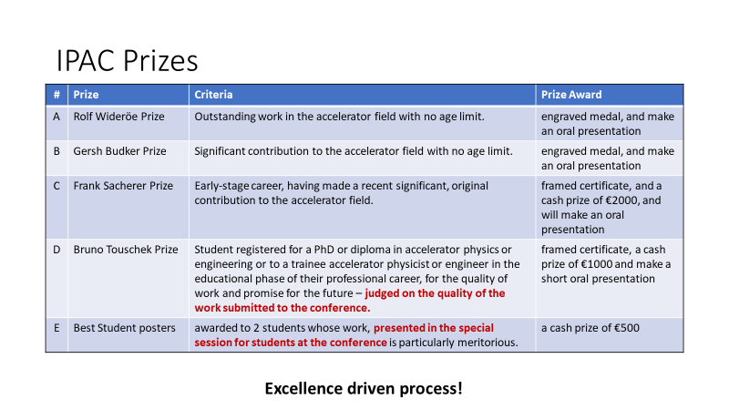
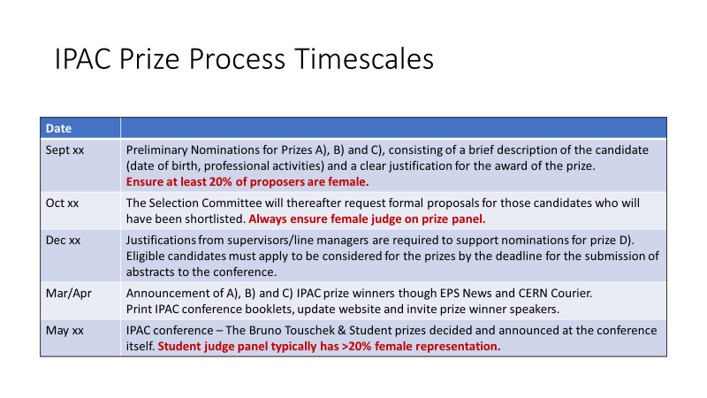
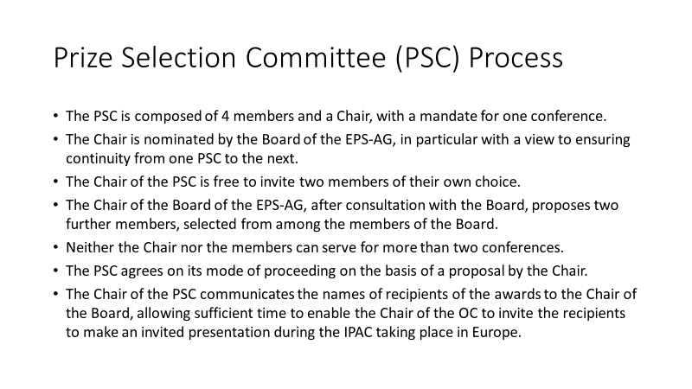
IPAC Prize Process Material Presented
1
2
3
4

Slide 11
EPS Bylaws Change Implications
IPAC has strong gender participation incorporated in its EPS-AG constitution, SAB solicitation and prize panel itself:
  The Rolf Wideroe, Gersh Budker and Frank Sacherer prizes are solicited, reviewed and decisions made 2-3 months before the conference.
  The Bruno Touschek prize is decided based of the research contributions to the conference. Decision therefore made early during the week of the conference.
  The Student Poster prizes (2 off) are reviewed by a designated prize panel, who make their decision on the Sunday before the start of the conference programme.
EPS want to ensure that there is an increased level of female prize awards being allocated across all of its Divisions and Groups – compliant with its own ED&I processes.
Our principal concerns relate to incorporating an additional stage of review by the EPS, which could compromise the timescales of the prize approval process.

Slide 12
EPS Discussion Conclusions
EPS expect their endorsement to be principally regarding the IPAC prize management process, not specifically the judging decision itself.
  Indicate that this should be happening already, but currently isn’t across many EPS Divisions/Groups.
EPS request is for IPAC prize panel to provide a short report summarising the process employed:
  Provide breakdown of solicited nomination statistics, panel constitution, any problems experienced and description of the judging mechanism itself.
EPS agreed to provide the typical template that they have used to capture such information.
EPS also agreed to provide direct connection to EPS-AG from their Equal Opportunities lead.
For the principal RW, GB, FS prizes, EPS agreed that they could provide their feedback within 1-week, which could be formally guaranteed.
For the BT and SP prizes, providing they are aware of the typical process being used, there is likely no need to interrogate anything in addition during the week of the conference.
We consequently agreed that the bylaws change could be accommodated within existing IPAC prize management processes.

Slide 13
IPAC2029 LOI Hosting in Europe and Timescales
March-April 2024:
  Prepare and agree IPAC29 specification document (have version for IPAC23).
May-June 2024:
  Call for expression of interest in ENEA region with specification document, requesting short proposal and feedback on specs, if any.
September 2024:
  Down-select 3-4 best proposals, produce final specs and invite for presentation to OC1 of IPAC26.
Dec 2024 - Jan 2025:
  Presentations of candidates and voting during IPAC26 OC1 (Deauville).
Feb 2025:
  Request commitment letter from hosting organisation(s), taking financial risks.

Slide 14
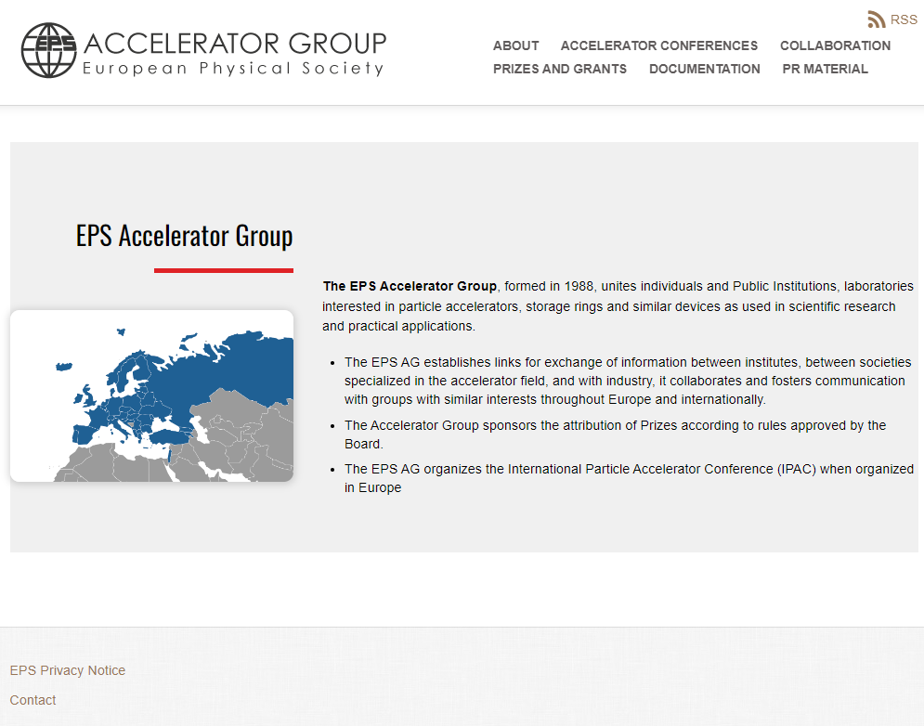
Task Force: EPS-AG Communications
Website, Social Media, Bulletins etc
Lots of potential to develop the scope and feel for the EPS-AG website.
Lots of incorrect/missing information included for current and previous board memberships.
Some inconsistent pages i.e. 2 different EPS-AG sites, with similar but different information?!?!
  https://www.eps-ag.org/
  https://www.eps.org/members/member_engagement/groups.aspx?id=85227
Note:
PR Material section …. Is empty ☹
Need to try and make pages more effective, exciting and engaging!

Slide 15
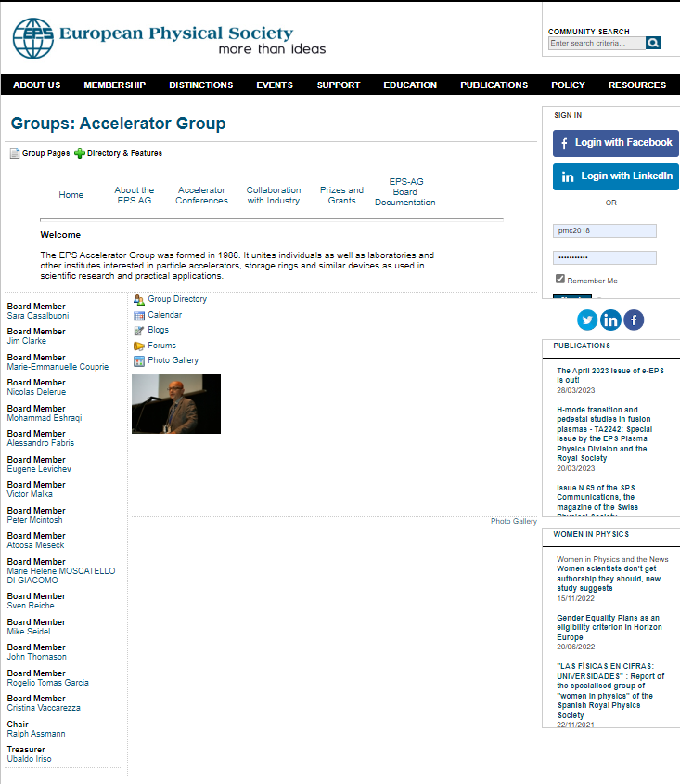
Task Force: EPS-AG Communications
Website, Social Media, Bulletins etc
No presence at all for EPS-AG on social media, but there is for EPS.
Do we need to have a dedicated presence, or otherwise post directly into EPS?
Can use to promote our EPS-AG activities more extensively:
  IPAC coordination processes.
  Showcasing student support for conference participation.
  Light Peer Review publishing benefits.
Continuous commitment and effort required to conduct effectively.
EPS specific

Slide 16
Task Force: EPS-AG Communications
Website, Social Media, Bulletins etc
Examples could include:
Online Bulletin Board:
Collaboration space to share, discuss, query research topic areas.
Newsletter:
Highlight impactful research and/or accelerator projects.
Should not replicate other existing platforms, mechanisms or publications.
Would need to be appropriately maintained and continue to be relevant and attractive.
Would such a process be useful?

Slide 17
Task Force: EPS-AG Topical Forums/Workshops
EPS-AG could coordinate and provide a series of regular topical forum meetings – stimulate communities.

Slide 18
Task Force: Other ideas?

Slide 19
Budget Utilisation Opportunities
EPS-AG website reconfiguration.
Topical workshops/forums.

Slide 20
Next EPS-AG Meetings
February 2024 – Board meeting - Remote
May 2024 – Board meeting and General Assembly – IPAC24
September 2024 – Board meeting - Remote

Slide 21

Our work has started!!
MANY THANKS

