Slide 1





Proton Computed Tomography in “High” Proton Flux Environments
By pCT standards, not LhARAs!!
Nigel Allinson Alasdair Winter Tony Price, on behalf of the OPTIma consortium
IoP: Advancing Radiobiology Technology
24/10/2023

Slide 2

Acknowledgements
University Hospitals Birmingham
Stuart Green
University of Lincoln
Nigel Allinson
Michela Esposito
Grainne Riley
Chris Waltham
Val Andrews
Bart Vorselaars
University of Birmingham
Phil Allport
John Cotterill
Tony Price
Alasdair Winter
Simon Pyatt
University of Manchester
Karen Kirkby
Michael Merchant
Hywel Owen
Mike Taylor
Carla Winterhalter
Alexander Herrod
Sam Manger
Christe PBT Centre
Adam Aitkenhead
Ran Mackay
ISDI Ltd, London and Vienna
aSpect Systems GmbH, Dresden
Hamamatsu Photonics, Shizuoka

Slide 3
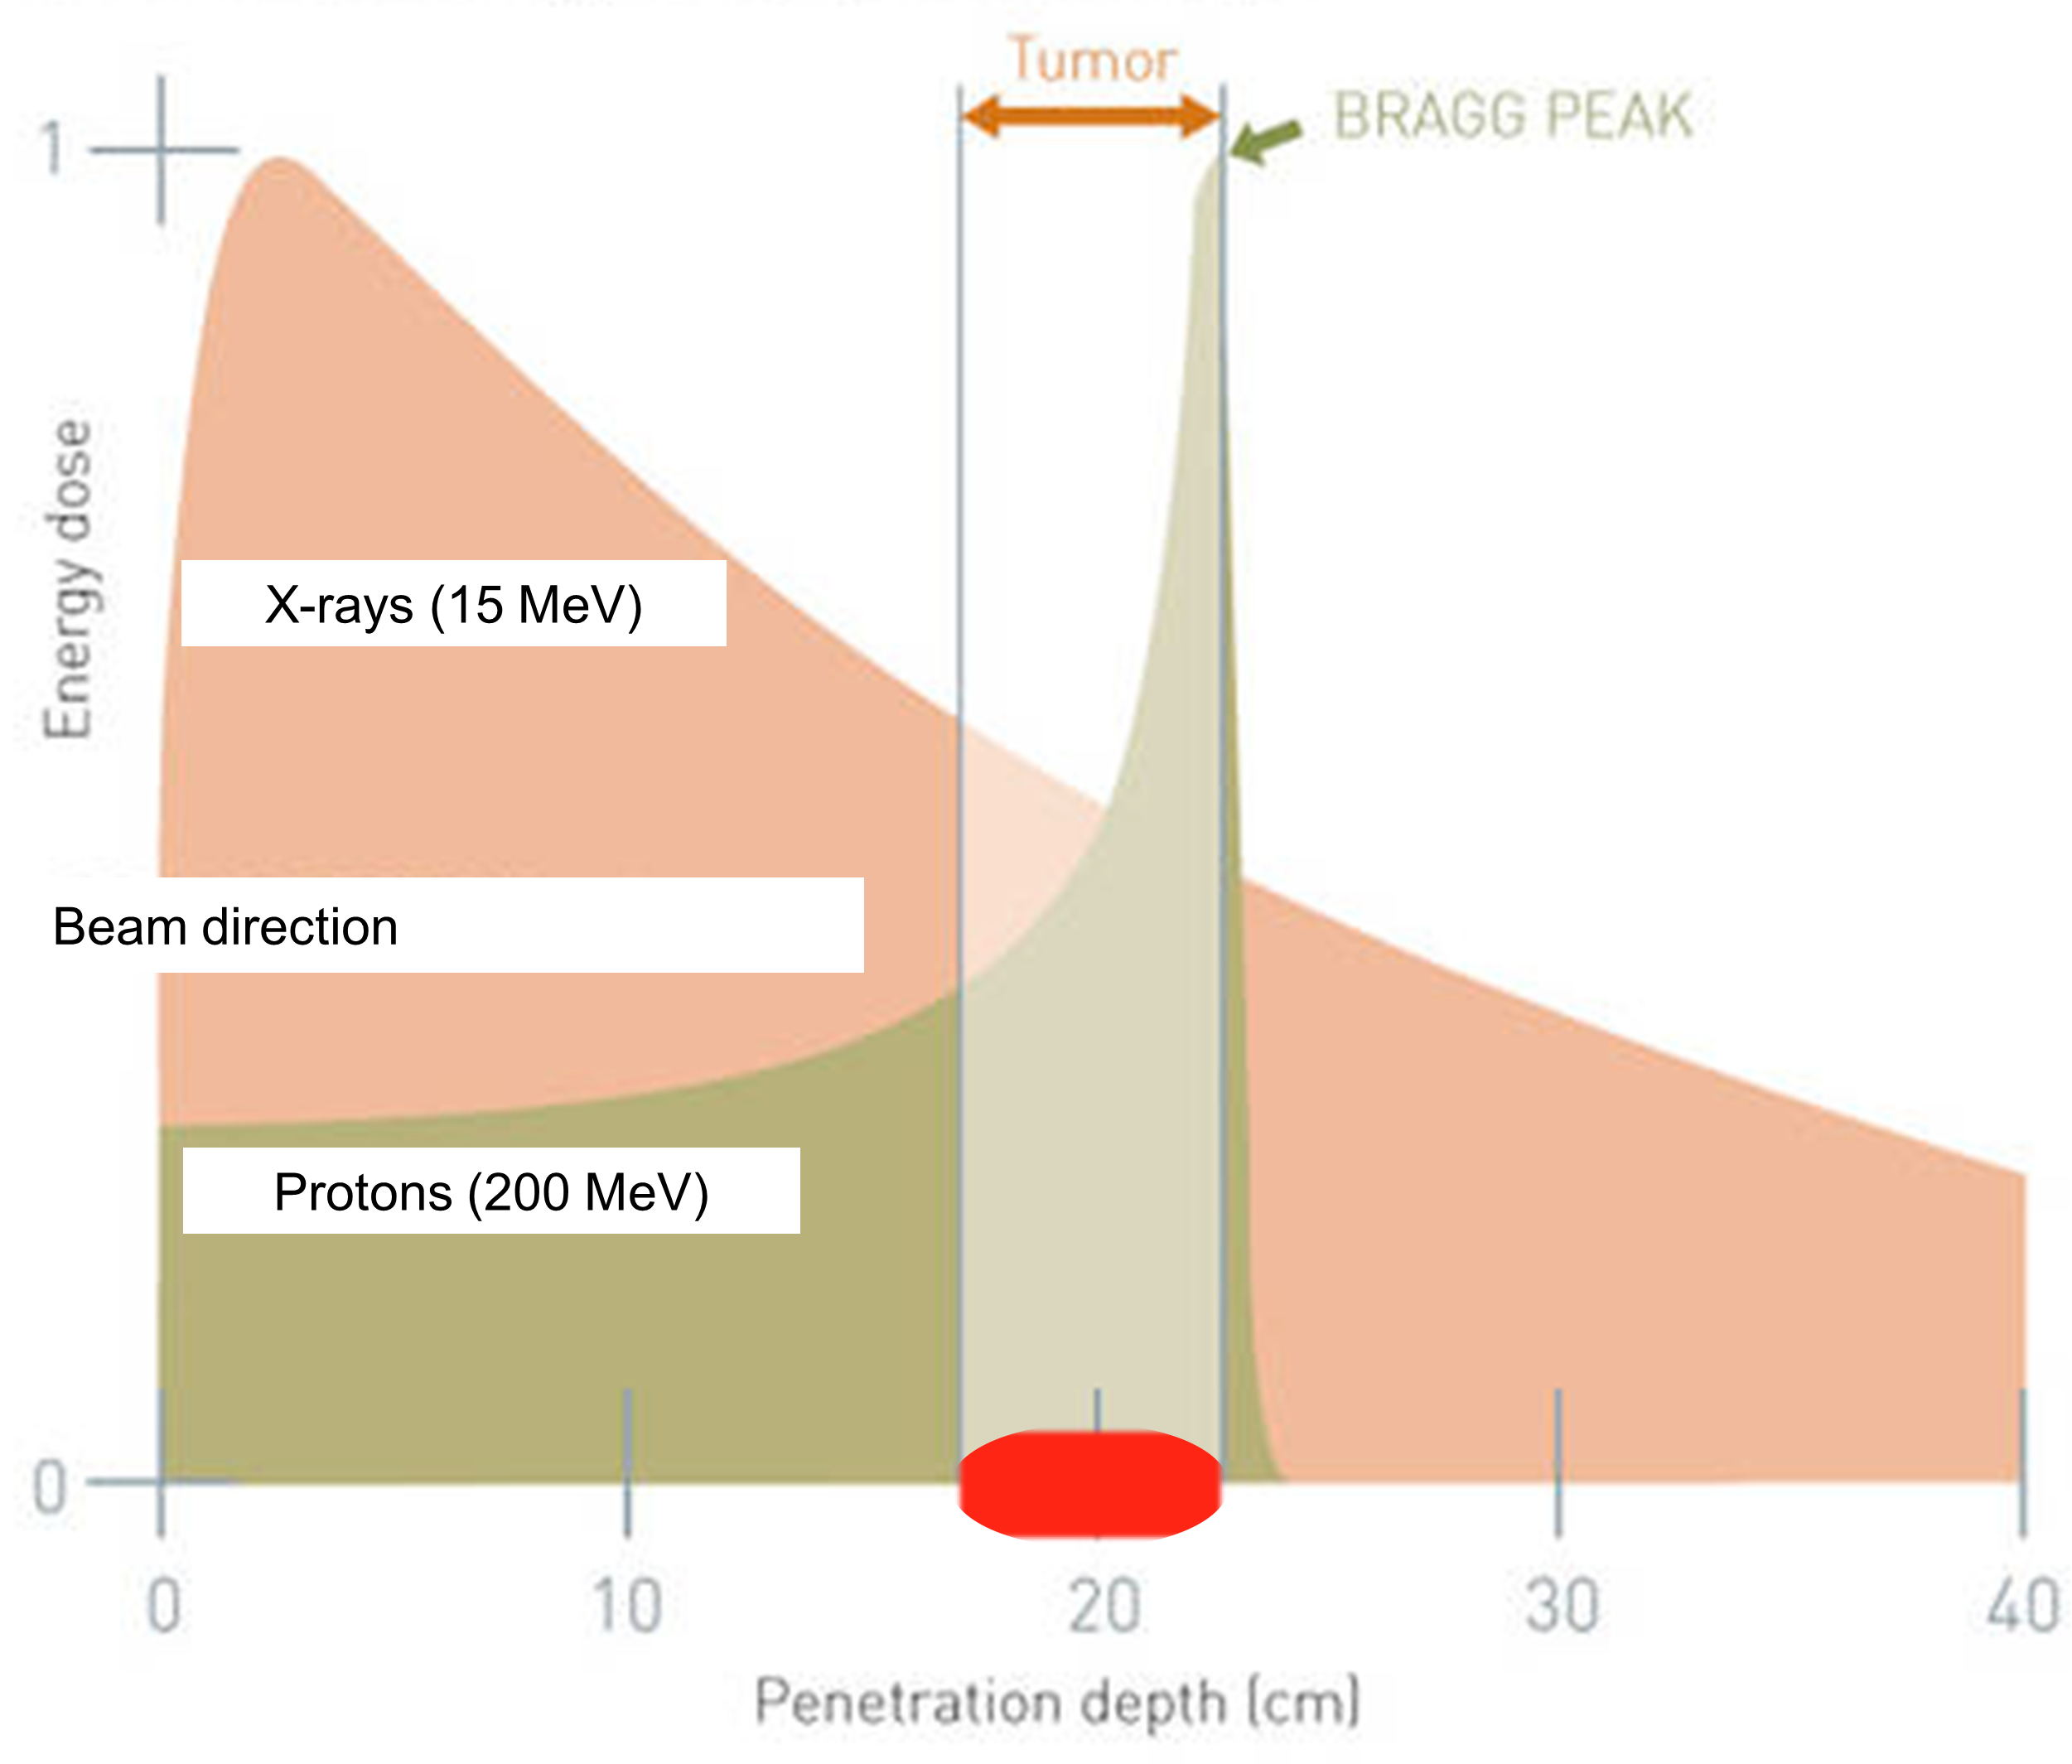

Why Proton CT?
Hadron therapy uses the Bragg peak to improve the target to healthy tissue dose ratio
But, this relies on knowing exactly where your peaks will be
  Sharp edge mean small range errors cause larger local variations in dose
Treatment planning currently based on X-ray imaging:
  DECT range uncertainties ~1-3%
  Partly limited by conversion from X-ray attenuation to proton stopping powers
  pCT avoids this limitation by imaging directly with protons

Slide 4
Basics of pCT Design
Information required from the system:
  Path taken by each proton through the patient (challenging due to MCS!)
  Energy lost by the proton along that path
Patient
Protons
Upstream Trackers
Downstream Trackers
Calorimeter
Patient is imaged with high energy protons from multiple directions
Image reconstruction produces 3D map of relative stopping power (RSP)

Slide 5
Design Considerations
Image quality
  Requires good tracking (~100 µm) and energy resolution (~1%)
  Low noise detectors
  Thin detectors to avoid disturbing the proton path
Clinical beam conditions
  Global shift from broad passively scattered beams to pencil beam scanning systems
  High currents ~200 pA and pencil beams (~10 mm)
  Bunch frequency ~100 MHz
  High flux density (not by LhARA standards!) → multiple protons per bunch (20 protons per ~10 ns)
Practicalities
  Scan time → patient can’t be expected to remain still >30min
  Needs to be mountable on a gantry
  Affordable
  Reliable → the simpler the system the better
  Radiation hard
  Highly efficient to minimise wasted dose
This is where most devices struggle!
Too many protons or very complicated systems
Arguments to be made for defocussing the beam or dialling current down, but requires operating outside vendors standard windows

Slide 6
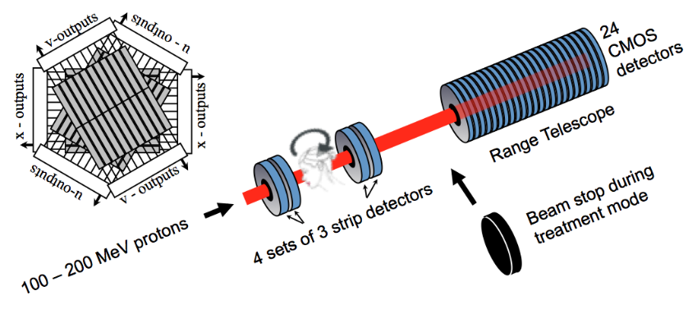
Existing Approaches
A non-exhaustive list….
Loma Linda Preclinical Head Scanner
Tracker Technology | Challenges
Silicon strips/scintillating fibres | Multiple layers required per module to resolve hit locations in bunches with more than 1 proton
CMOS pixels | Challenging to produce large area, radiation hard, fast readout sensors
Energy Measurement Technology | Challenges
Range telescope | System becomes impractically large for high energies and requires substantial instrumentation
Calorimeter | Requires fine segmentation to cope with multiple protons per bunch→ challenging readout structure
Time of flight | Promising approach but requires very fast timing sensors (ps) to achieve desired energy resolution for the flight distances available in treatment rooms
Spectroscopy | Hard to imagine mounting an appropriate magnet system on a gantry
….+ hybrids of these
PRaVDA pCT system

Slide 7
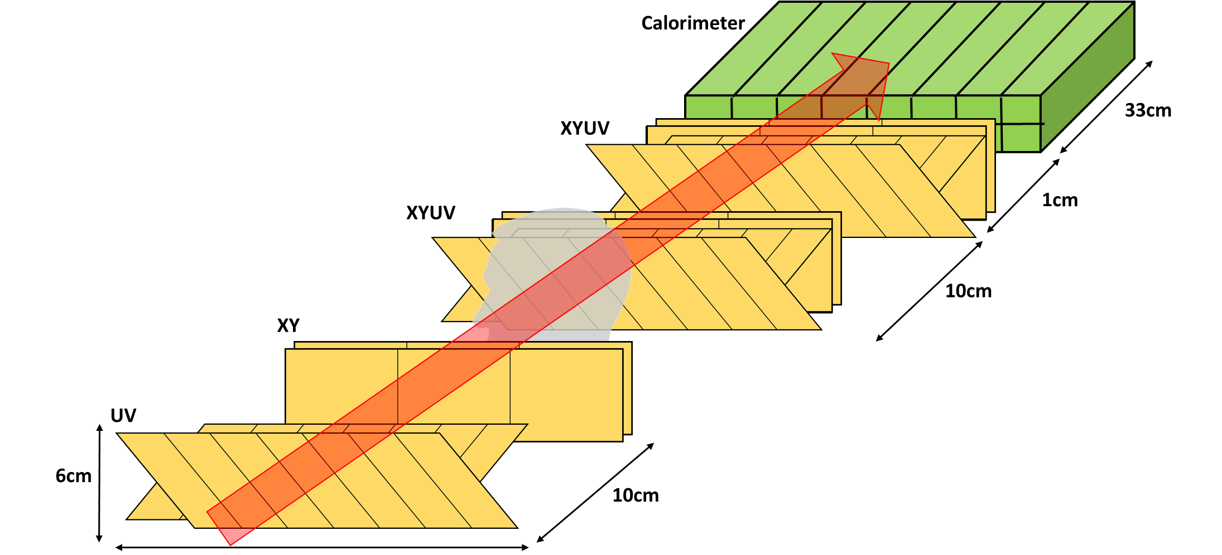
OPTIma: System Overview
Tracking: 12 layers of tiled silicon strips spread asymmetrically across four modules
Calorimeter: 8x2 array of scintillating plastic connected to 16 SiPM
Used in conjunction with motorised phantom stage to allow total imaging area of 36x36cm² with 360º coverage
Designed with The Christie beamline (Varian) in mind
36cm

Slide 8

OPTIma: Tracking
6cm
Ideally would use CMOS MAPS, but strips are a ready technology, relatively cheap, radiation hard, have good S/N, and can be easily readout at 100 MHz
Design based on 150 µm thick ATLAS ITK n-on-p silicon strips produced by Hamamatsu Photonics
Four layers required per module to handle ambiguities in hit locations for high flux densities
  Reduced to 2 layers for upstream modules where beam optics help resolve ambiguities (not possible in rear trackers due to scattering)
Two sensor types were required to provide segmentation in up to four directions
6cm
U/V
UV Sensor
120cm
6cm
X
Y
XY Sensor: right hand side uses a double metal structure to redirect signal to long edge

Slide 9
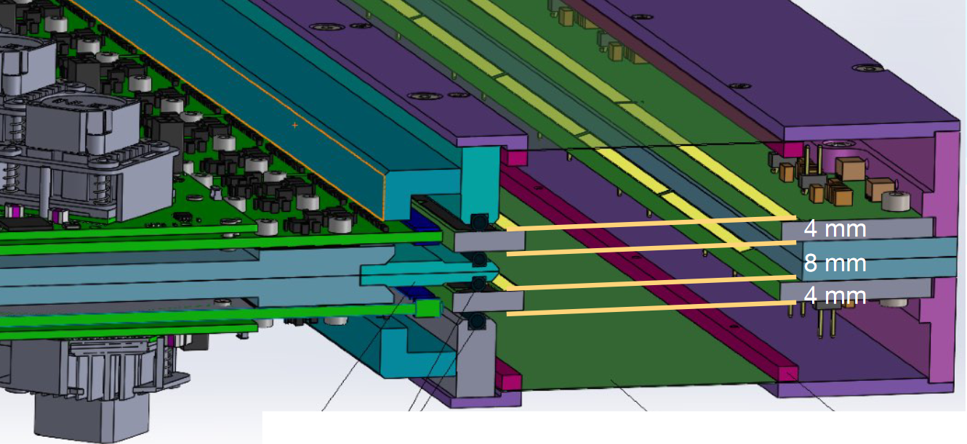
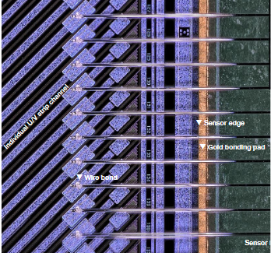
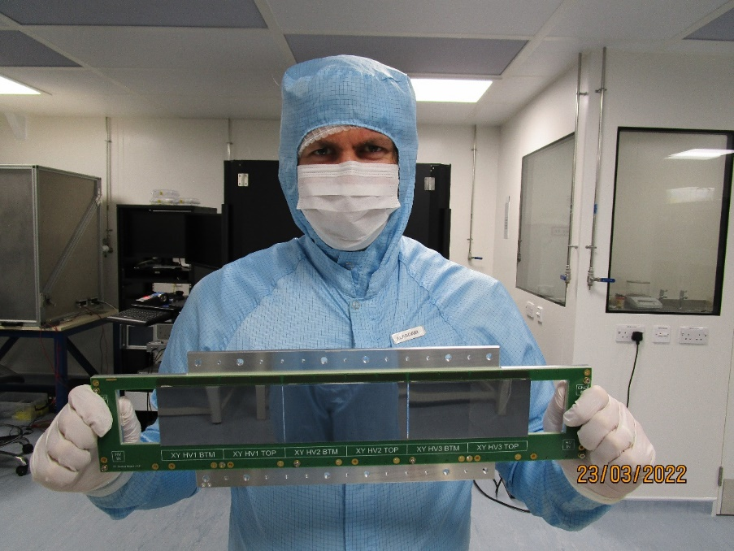
OPTIma: Tracking
Module design is focused on keeping layers as close together as possible
  Minimises uncertainty on hit location
  Achieved by using two sensor boards and gluing sensors to both sides of each board
Optima Module Layout
Sensor testing completed- no issues encountered!
Assembly underway at Birmingham, aiming to test complete system in 2024
Optima XY sensor board

Slide 10

Track Reconstruction
Three stages:
  Find hits in each module
  Form upstream tracks → can assume protons travel parallel to beam axis, no protons lost to hard interactions
  Match upstream tracks to downstream hits
Multiple approaches tried but ultimately simple cut based methods based on track straightness proved best
  Maximum allowed deviation from straight line determined from performing a calibration of scattering vs residual energy for water blocks
Pixel sensors remove step 1 but steps 2 & 3 are still necessary
Hits
Proton 1
Proton 2
Beam Axis
R
Step 1) Find combinations of strips in each module that minimise ‘R’
Step 2) Pair up hits between upstream modules to form tracks ~parallel with beam axis
Step 3) Match downstream hits to the upstream tracks. This is the hardest step due to scattering in the phantom

Slide 11
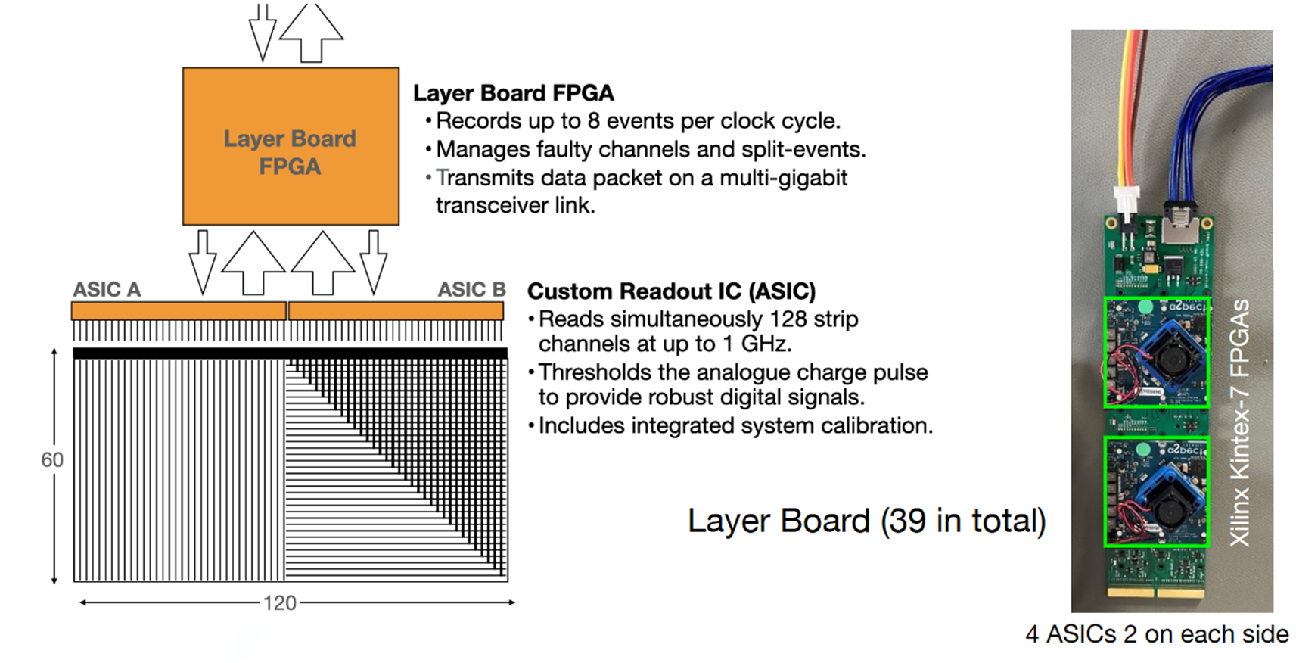
Readout
Limits system to currents of <50pA at the Christie
Requires beam collimator to reduce current by x5
Layer Board FPGA
Xilinx Kintex-7
Record maximum of 8 events per clock cycle due to bandwidth limitations
Manages faulty channels
Performs crude clustering
Transmits data packet on a multi-gigabit transceiver link
System Layout
1536 channels per tracking layer
12 tracking layers in the system
Each ASIC services 128 channels
Each layer board FPGA services 2 ASICs
Total components:
  18432 silicon strips
  144 ASICs
  72 FPGAs
  + additional FPGAs to aggregate layer data and reject cases with >8 hits in any layer

Slide 12
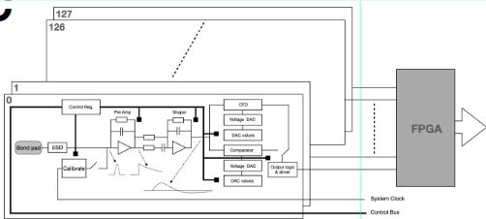
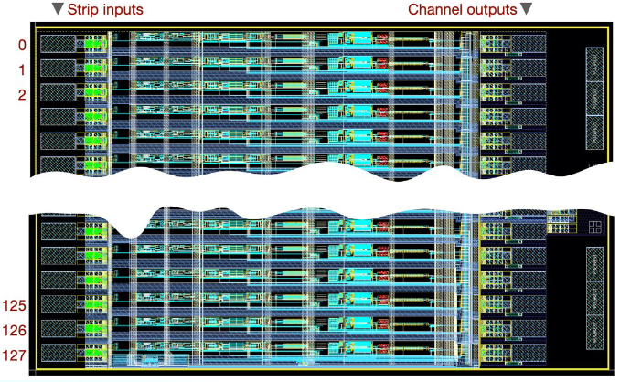
ASIC
Functionality
Converts the input charge pulse (10,000-100,000 e⁻) from 128 silicon strip channels into a reliable digital signal
The analogue chain consists of a standard preamplifier and shaper (bandpass filter)
Simple discriminator + a constant fraction discriminator convert the signal into a digital pulse with minimal time jitter
Integrated calibration circuitry included to reduce channel by channel variations
Structure
Die size: 27.22 mm x 5.00 mm
350 nm CMOS technology
128 strip channel inputs
128 digital outputs
58 additional control and power pads
Power dissipation ~0.5W

Slide 13
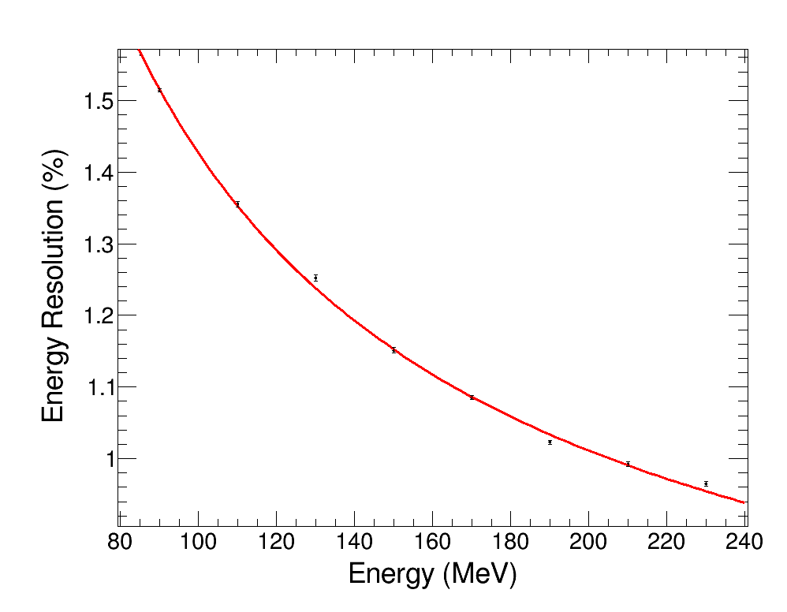
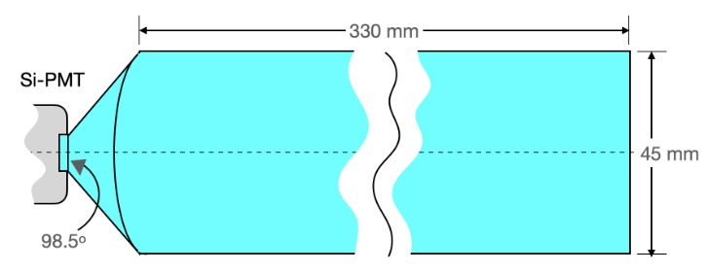
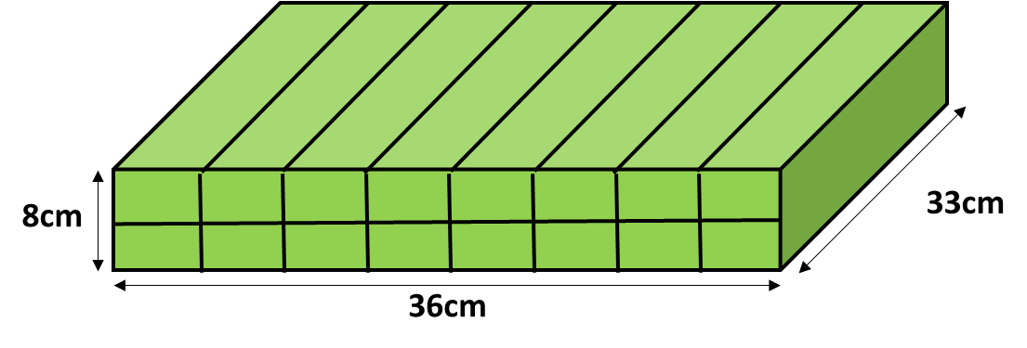
OPTIma: Calorimetry
Typically, the use of a calorimeter in a multi-proton environment requires the use of highly segmented scintillators and complex readout structures
  Here we have developed a novel approach that requires only that the calorimeter reports the total integrated light output across all channels per bunch (no spatial information!!)
  By using trajectory information from the trackers and some simple assumptions it is then possible to recover the individual proton energies
Calorimeter design is based on an 8x2 array of 45x40x330 mm³ BC408 plastic scintillators, each with a H10721 Si-PMT
  While segmentation is not needed to provide spatial information, it was found that a small amount is required to ensure suitably small path lengths for the resulting light
Array of scintillating bars
Cross section of scintillating bar
Calorimeter setup at Christie PBT research beamline
Single proton resolution

Slide 14

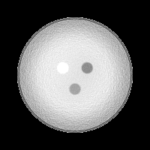
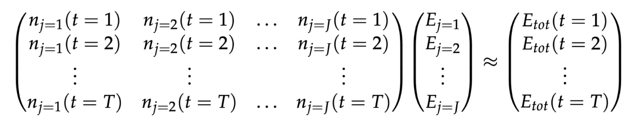

De-Averaging
Example images at 30pA for air, cortical bone and lung tissue embedded in 150 mm of Perspex
Resolving Calorimeter
If we simply used the raw output from this calorimeter and assigned each proton the average energy per bunch, the resulting image is very poor
However, if one makes the assumption that all protons that follow the same the same path should have a similar residual energy one can construct the matrix below, solve for E_{j}, and instead assign each proton an energy determined by it’s trajectory
With ideal trackers has been shown to work up to low end treatment currents of 250pA
Averaged
Energy of each trajectory
De-averaged
Measured no of protons/trajectory/pulse, n
Energy measured per pulse

Slide 15
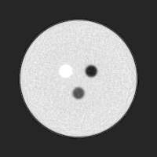
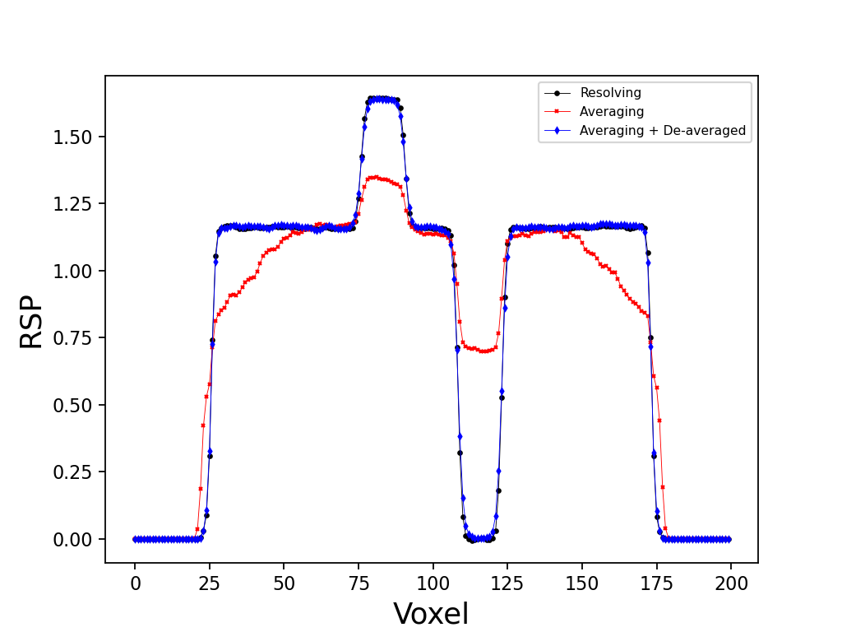
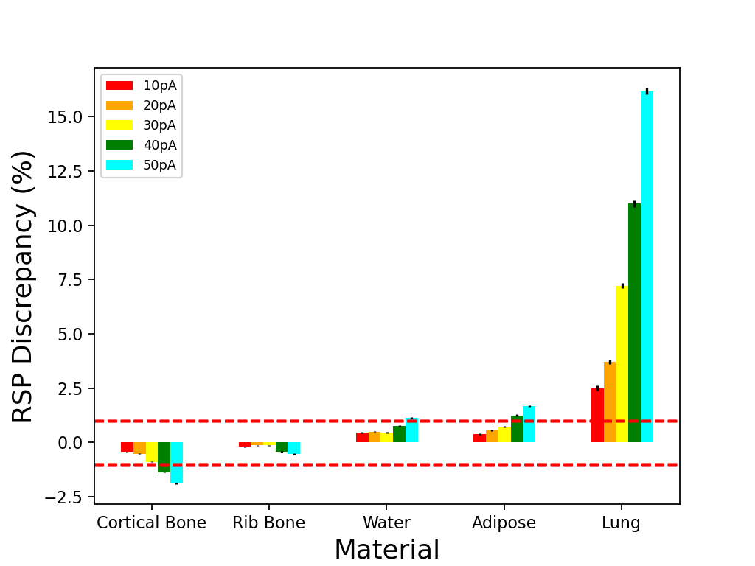
Results
Simulation studies performed using various tissues embedded in a 150mm Perspex sphere
Performance evaluated for both ideal and realistic trackers
De-averaging found to be predominantly limited by the tracking capabilities
250pA, ideal trackers
Target of <1%
Slight loss in spatial resolution
Line profiles through air and skull bone tissues for images produced with ideal tracking detectors
RSP discrepancy in central region of tissues for simulations based on realistic detectors

Slide 16
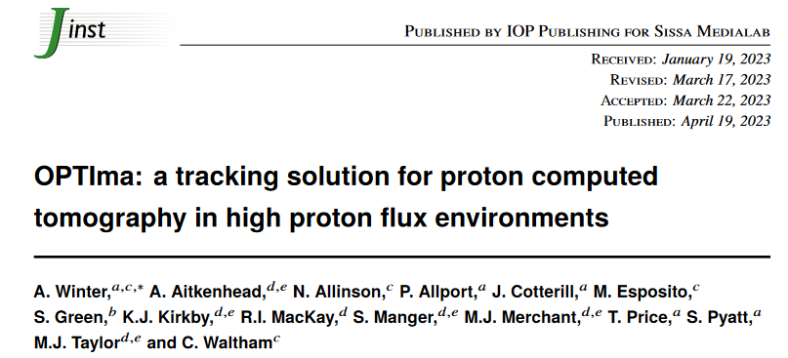
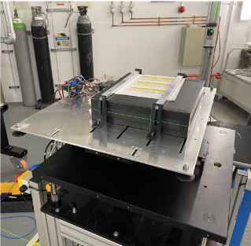
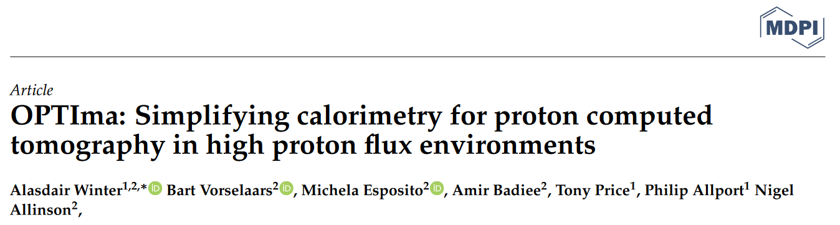
Project Status
Trackers:
  Bare sensor testing complete
  Ladder assembly underway at Birmingham
  Full details of testing and full system simulation published: DOI:10.1088/1748-0221/18/04/P04026
Calorimeter:
  Full scintillator + PMT stack assembled
  First beam test performed at Christie earlier this month
  Patent submitted
  Paper submitted, under review
DAQ:
  ASICs fabricated and readout designed
  System under test by aSpect Systems, Dresden
Full system to be completed 2024
Calorimeter setup from recent beam test at The Christie

Slide 17
Backup

Slide 18
Conclusions
Proton CT allows for reduced range uncertainties for treatment planning
Existing approaches struggle to cope with the high fluxes of modern facilities
OPTIma have developed a full pCT system that is expected to deliver RSP discrepancies of <1% at multi-proton currents
  Novel approach to energy reconstruction has greatly simplified the readout requirements for calorimeters
  Tracking currently limited to 8 protons per bunch
    Ideally would use CMOS once technology is ready for our beam conditions
All parts of the OPTIma system are under construction with first tests expected in 2024

