Slide 1
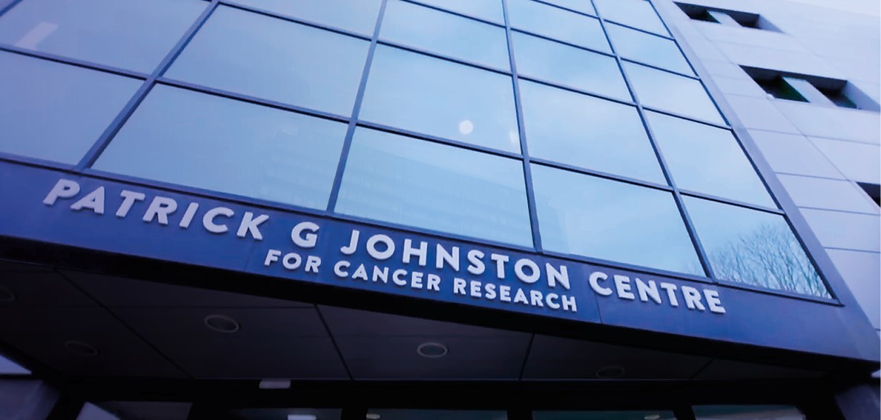
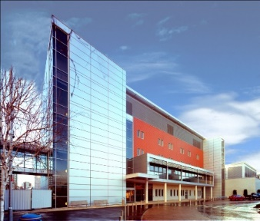

Probing extreme high dose-rate radiobiology with laser-based approaches
Kevin M. Prise
IOP- Advancing Radiobiology Technology
24th October, 2023

Slide 2
Outline
Dose-rate effects
Lasers and ion beams
Recent radiobiology
Extreme high dose-rates

Slide 3
Dose-rate effects

Slide 4
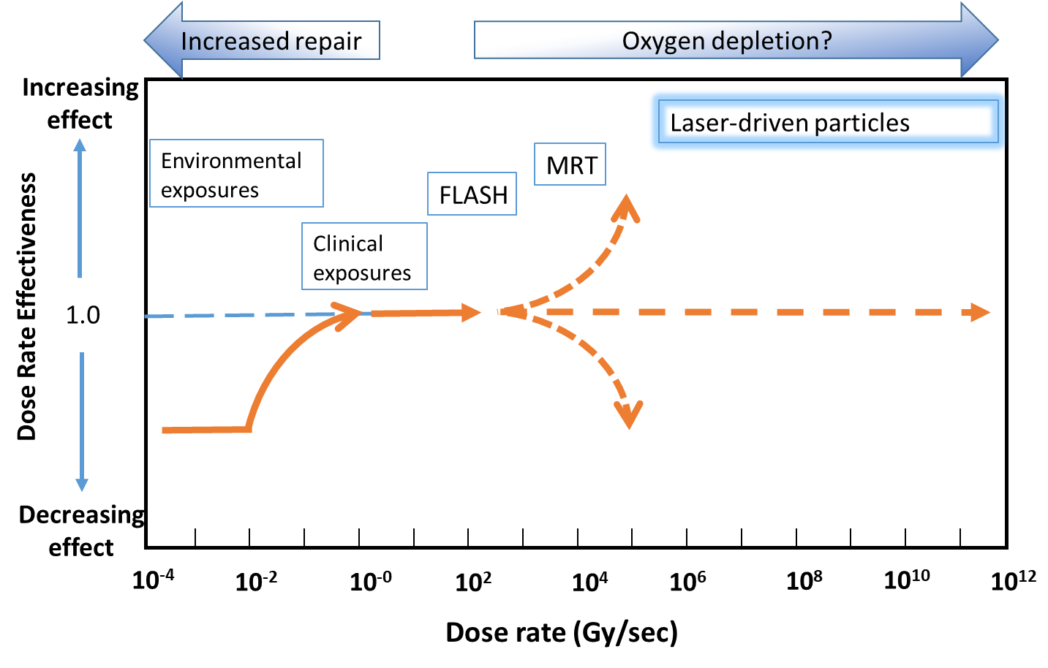
Dose-rate effects
Low dose-rate
High dose-rate
Ultra-high dose-rate
Extreme-high
dose-rate
Laser-driven beams
?
Chaudhary et al., Front Oncol, 2021

Slide 5
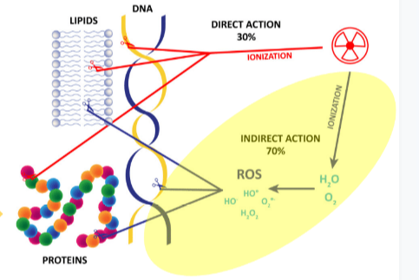
Biological mechanisms of FLASH/UHDR?
CONV
FLASH/UHDR
U
H
D
R
Direct DNA damage, standard paradigm for radiation effects
Lack of understanding of biological response at Ultra-high dose-rate
From Vozenin, Spitz, Limoli

Slide 6
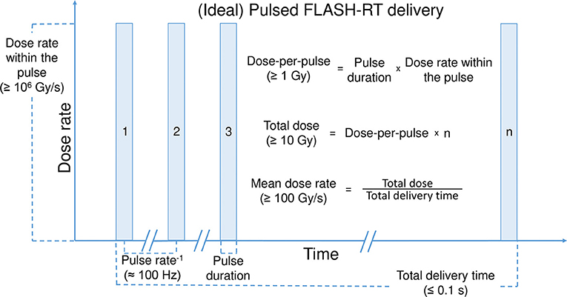
Dose-rate - Key Physical Parameters
Overall dose-rate not the only key factor
Total Dose
Dose per pulse
Frequency of pulses
Overall exposure time
Radiation type
Pulsed RT Delivery
From Wilson et al., 2017 Front Oncol, 9, 1563.

Slide 7
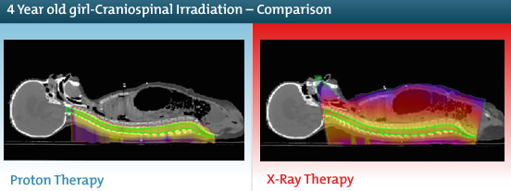

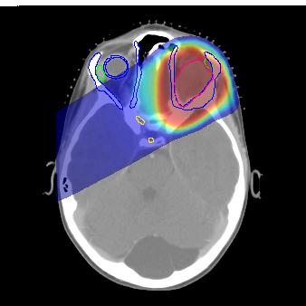
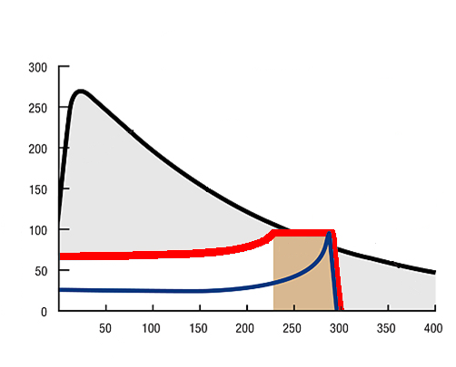
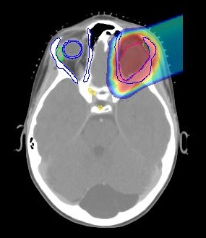
Protons versus Photons/Electrons
X-Rays
By producing a spread-out Bragg Peak (SOBP), uniform doses can be delivered at depth
CNS and paediatric tumours important
10 MeV Photons
Additional dose outside the target delivered by photons
Relative Dose / %
300 MeV
protons
SOBP
Protons
Tumour
Depth / mm

Slide 8
Role of oxygen in laser driven ion radiobiology
Cells and tissues can be up to 3 times more radioresistant to photons in the absence of oxygen
This is a major limiting factor in the treatment of solid tumour with hypoxic regions by photon radiotherapy
With increasing ionization density (LET) the modulation by oxygen (OER) decreases
This is one of the rationales for using ion beams with higher LETs for therapy
Dose-rates higher than 10⁹ Gy/s and 5 – 10 Gy deplete cellular oxygen
Jones et al., 2012, BJR, 35, e933

Slide 9
Lasers and Ion-beams

Slide 10
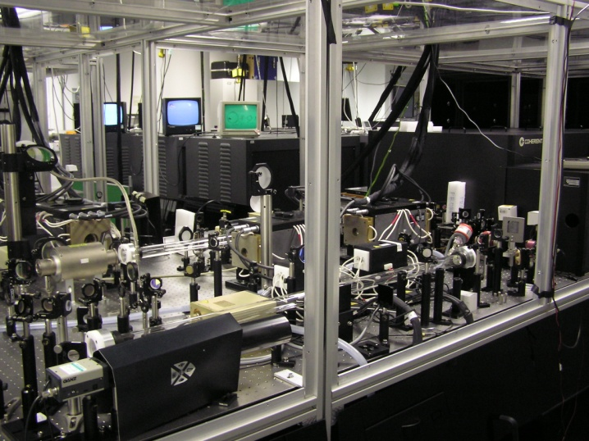
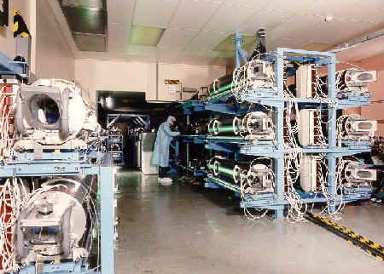
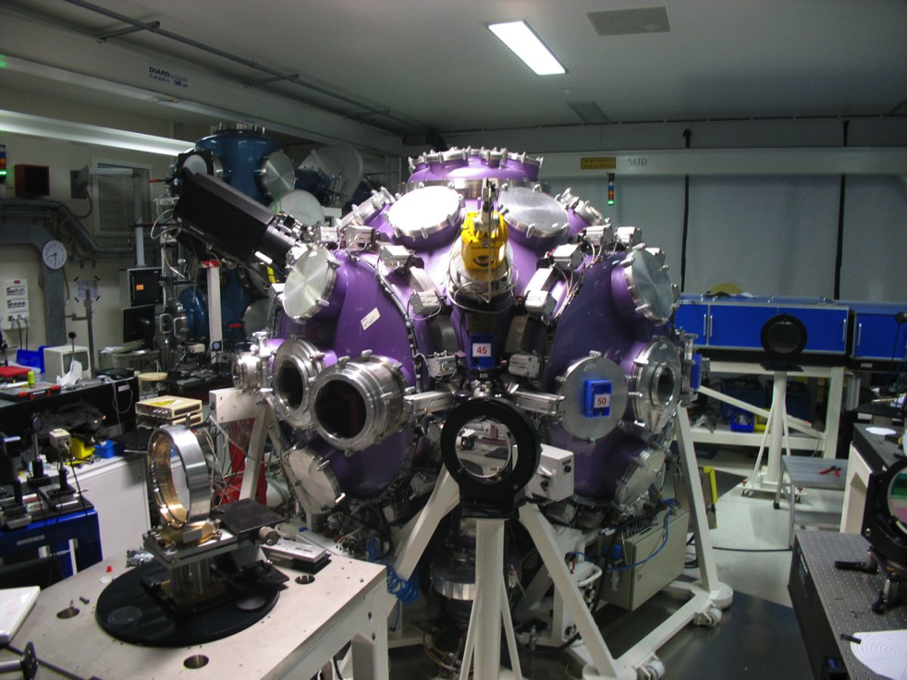
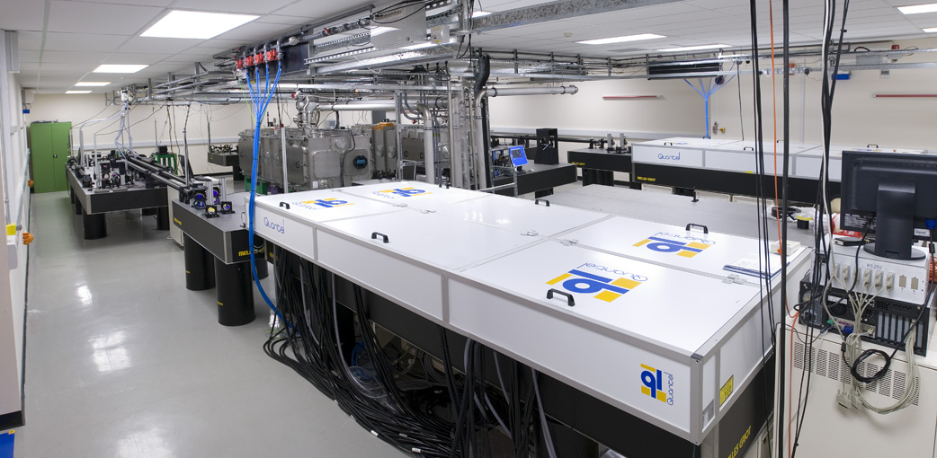
Lasers used for QUB radiobiology
2 x 10 J, 500 fs pulses,
I ~ 10¹⁹ W/cm²
VULCAN Petawatt
Pulse duration ~ 500 fs
Energy on target up to 400 J
Intensity up to 0.5 - 1.0 10²¹ W/cm²
TARANIS laser at QUB
ASTRA GEMINI
LULI
2000
Pulse duration ~ 40 fs
Energy on target up to 15 J
(2 beams @ 400 TW per beam)
I~ 0.5 - 1.0 10²¹ W/cm² (f/2 focusing)
Pulse duration ~ 1 ps
Energy ~ 100 J
Intensity ~ 5 10¹⁹ W/cm²

Slide 11
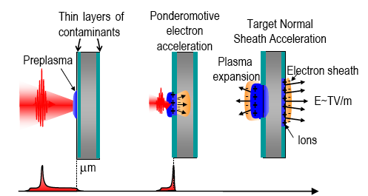
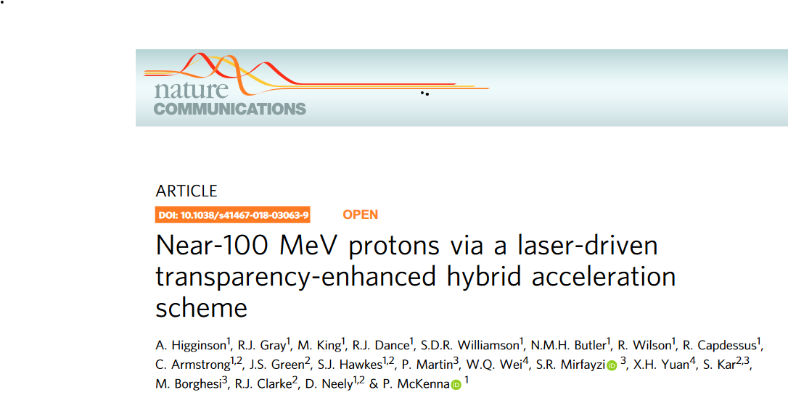
Laser induced ions: Target Normal Sheath Acceleration (TNSA)
Several mechanisms for producing laser-driven ions
Currently ~100 MeV is possible
For biology studies, pulse to pulse variations, rep rate, intensity and energy all require further developments

Slide 12
Radiobiology

Slide 13
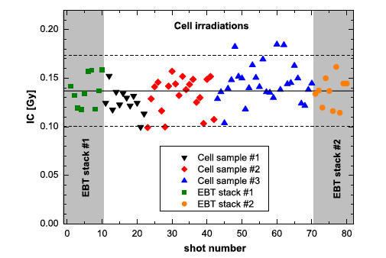
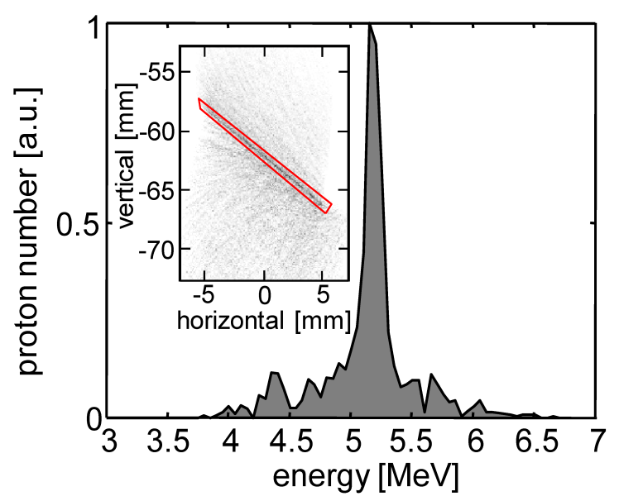
Two different approaches to laser-driven ion radiobiology
1. Multi-shot: Required dose (1 – 5 Gy) is delivered in several fractions
High-rep system
High-rep target
Typically Ti:Sa, fs systems
Dose control, transport
Average dose rate ~ Gy/min
e.g. S. Kraft et al, NJP, 12, 085003 (2010) (HZDR)
A. Yogo, et al, APL, 98, 053701 (2011) (JAEA)
2. Single shot irradiation: deliver of a single dose at Gy level in
~ 100s ps - ns pulses
Suited to low rep systems
More likely to highlight dose rate effects
Average dose rate >10⁸ Gy/min
e.g. J. Bin et al., Appl. Phys. Lett. 101, 243701 (2012) (Munich)
+ Our work…..

Slide 14
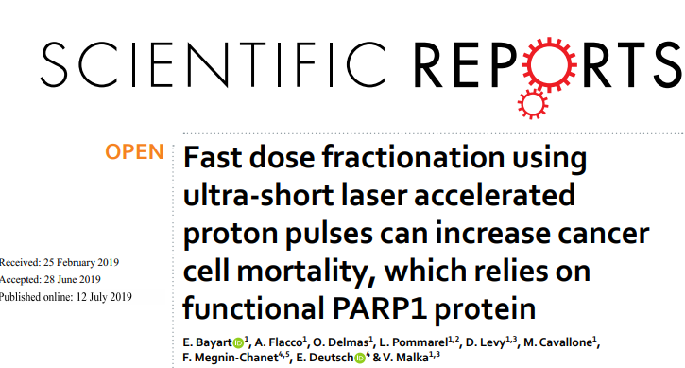
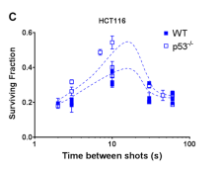
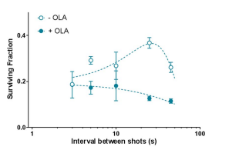
Temporal delivery of single shot laser driven ions can change the biological response of cells
LOA Group, Bayart et al, Scientific Report, 2019
Dose rate: 1.5 x 10 ⁸ Gy/sec;
Energy range: 1-6 MeV
Dose delivery mode: multiple pulses
Time interval between pulses : 3-60 seconds
Cell survival of specific cancer cell lines was found dependent on the bunch repetition rate of laser driven protons – Biology plays a role

Slide 15
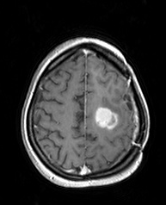
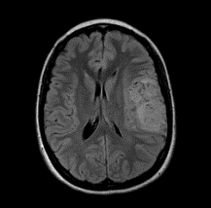
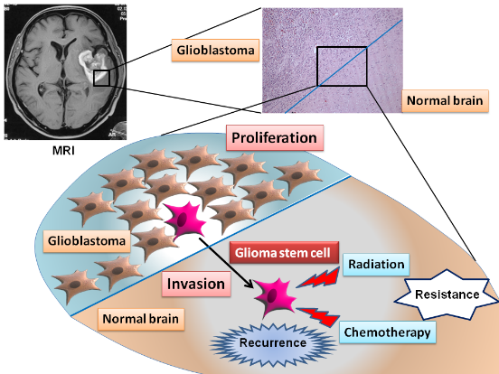
Targeting Radiation Resistance of Glioma
Initial presentation
Recurrence
Most Glioblastoma tumour recur after surgery and radiotherapy
Radiation resistance thought to be due to subpopulation of “stem-like” tumour cells which may also have enhanced invasive potential. This invasiveness and ultimate relapse may be induced by sublethal radiation and chemokine signaling processes in the tumour microenvironment.

Slide 16
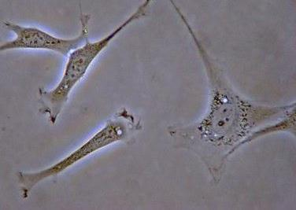
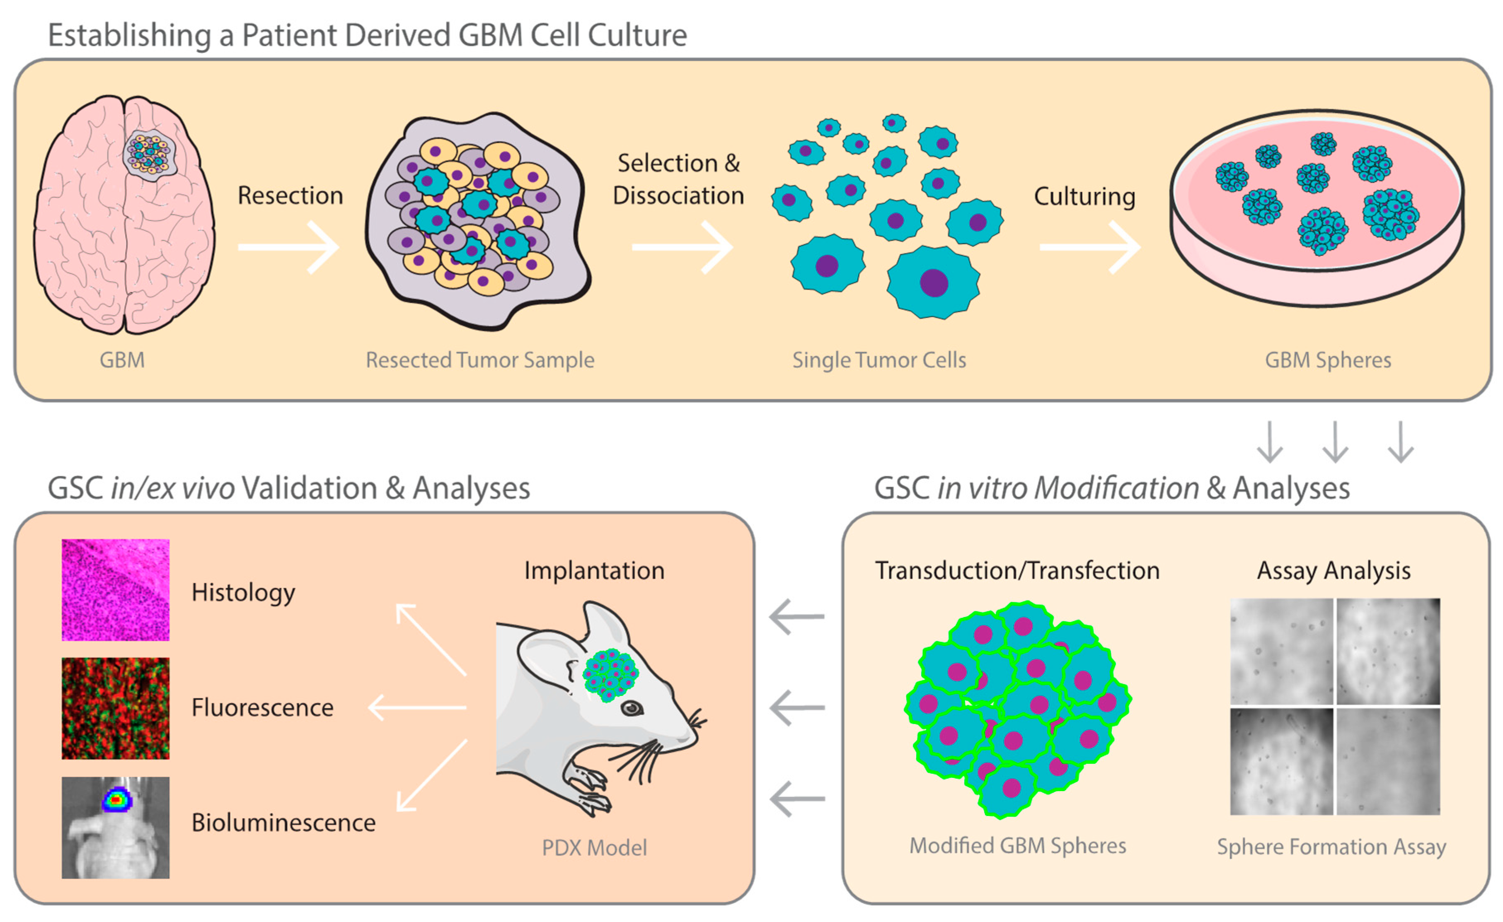
Cell Culture Models
Primary human skin fibroblasts
grown in 2D culture
Patient derived brain tumour cells
Grown as enriched stem cells
2D or 3D culture
AG01522 normal
human fibroblast
cell line
2D monolayers
E2 Glioblastoma
stem cells
3D neurospheres
200 μm
Provided by A. Chalmers, University of Glasgow

Slide 17
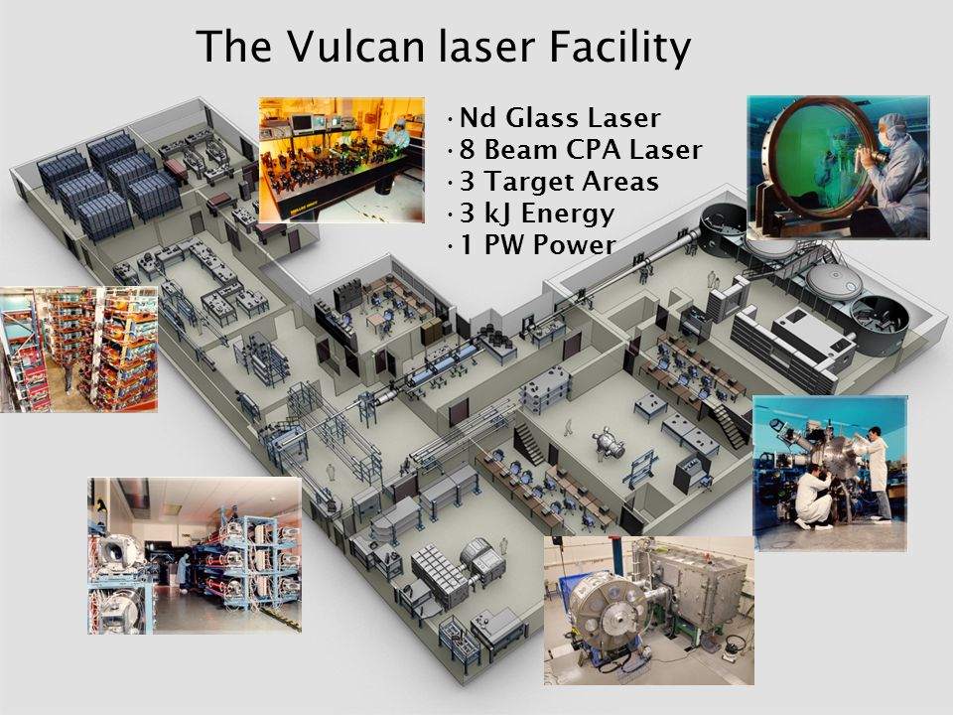
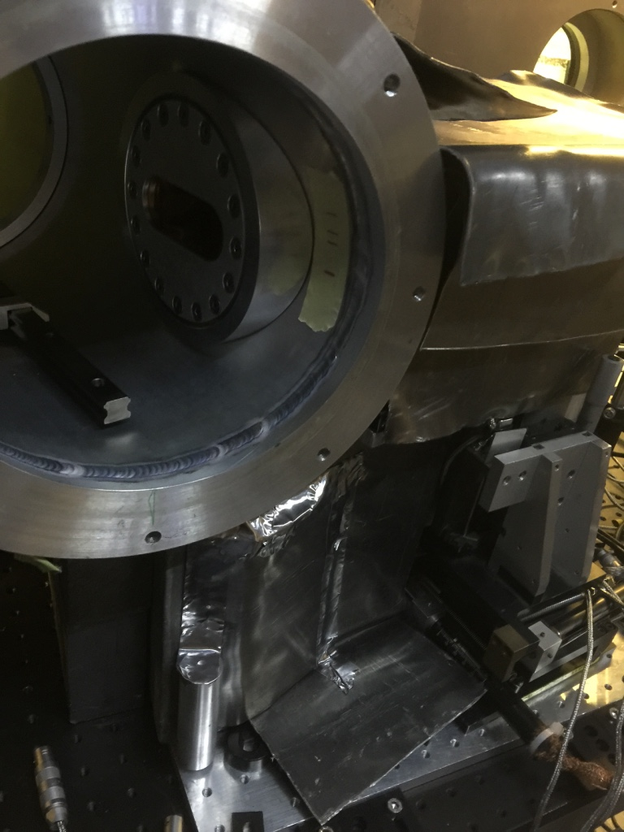
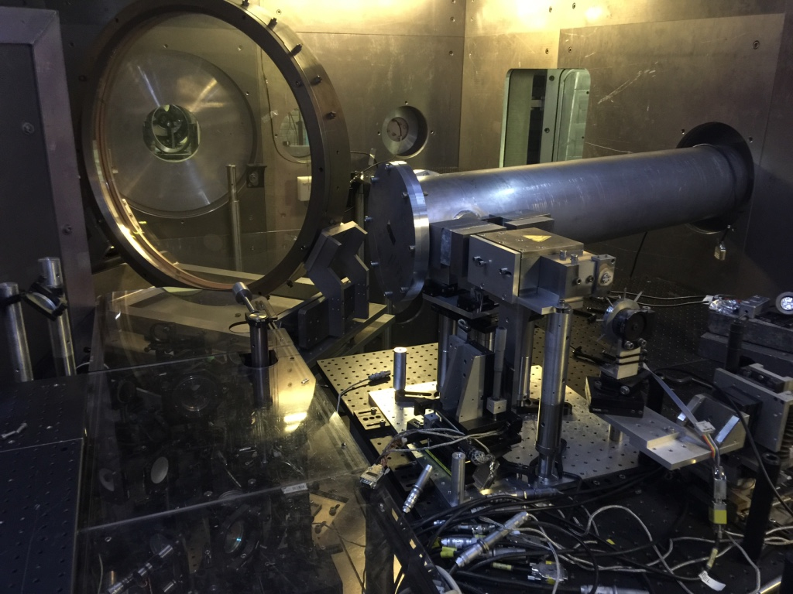
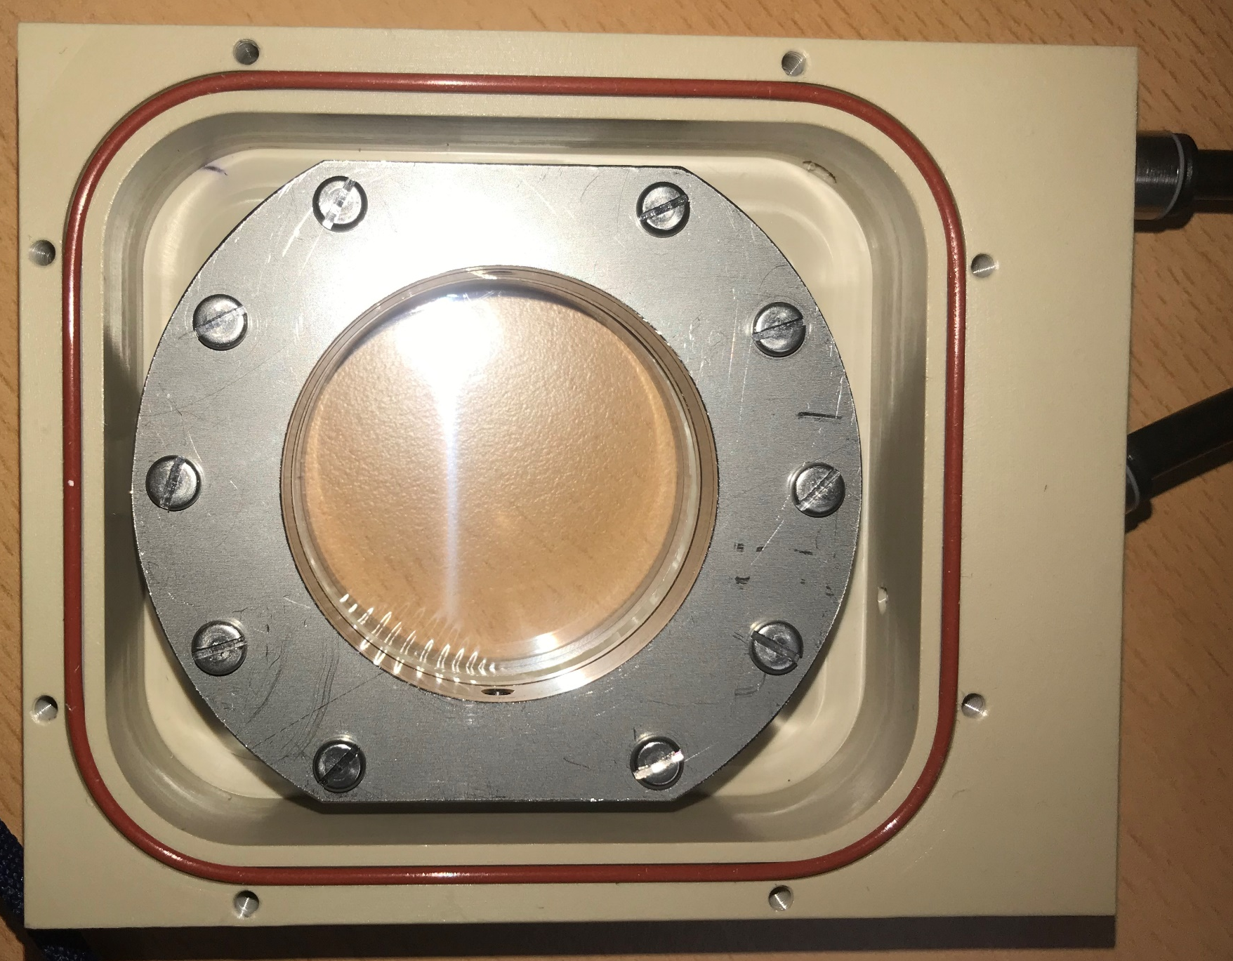
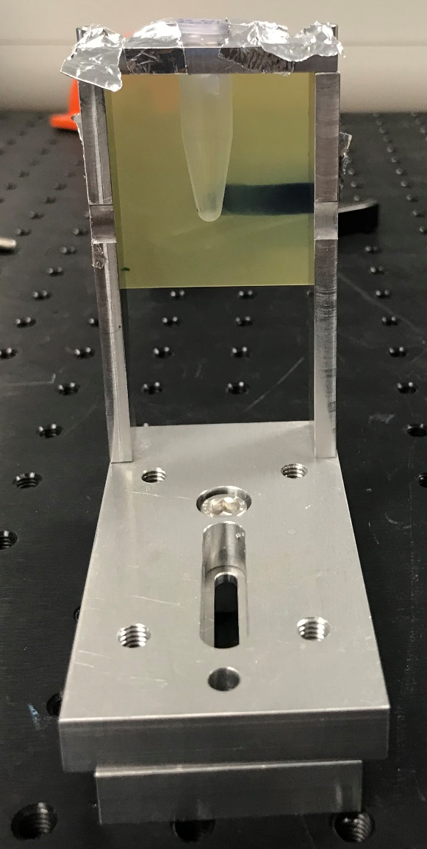
Vulcan Laser Facility
Vulcan TAP
Laser Interaction chamber
Sample
Position
Direction of the laser onto the target
2D
Cells
3D
Cells

Slide 18
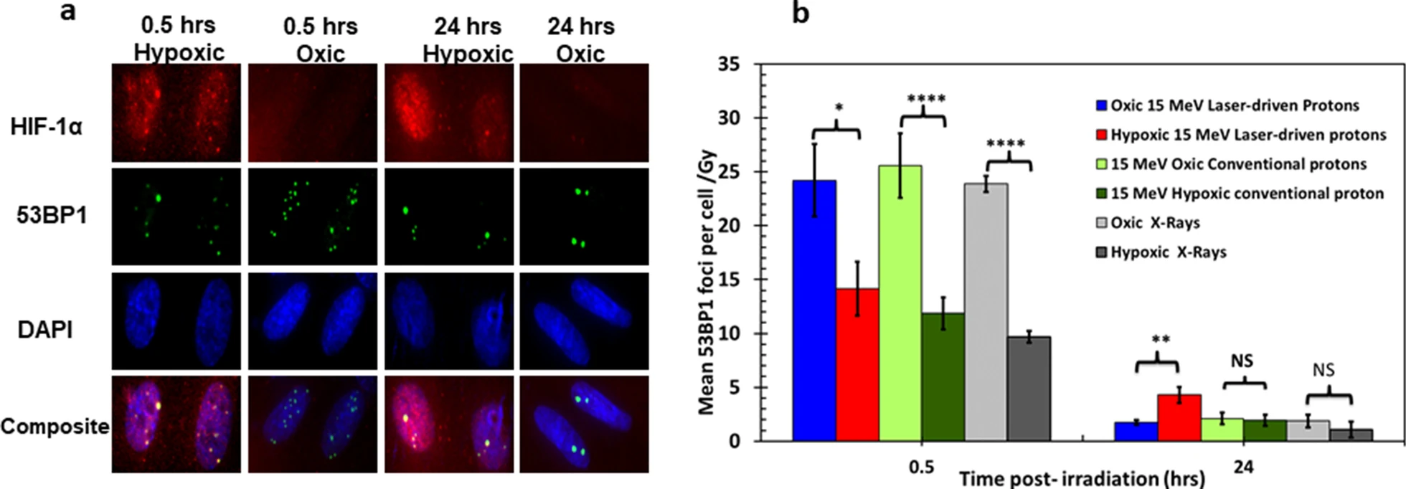
Ultra-high dose-rate - Hypoxia
Hypoxia
marker
DSB
Nucleus
Data from 15 MeV laser-driven proton irradiation of AG01522B cells
Increased residual damage with UHDR (2 x 10⁹Gy/s) but not conventional protons (4Gy/min) (2.6 keV/μm)
Chaudhary et al., 2022, Radiation Oncology, 17, 77

Slide 19
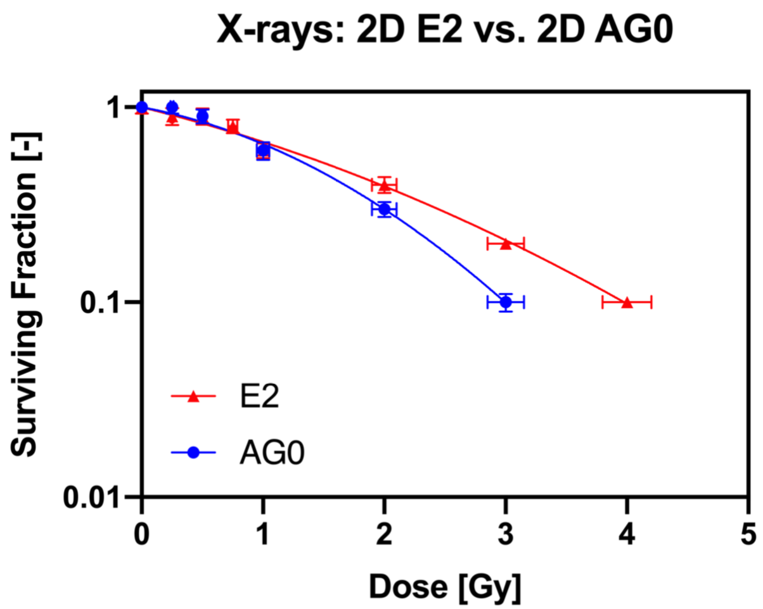
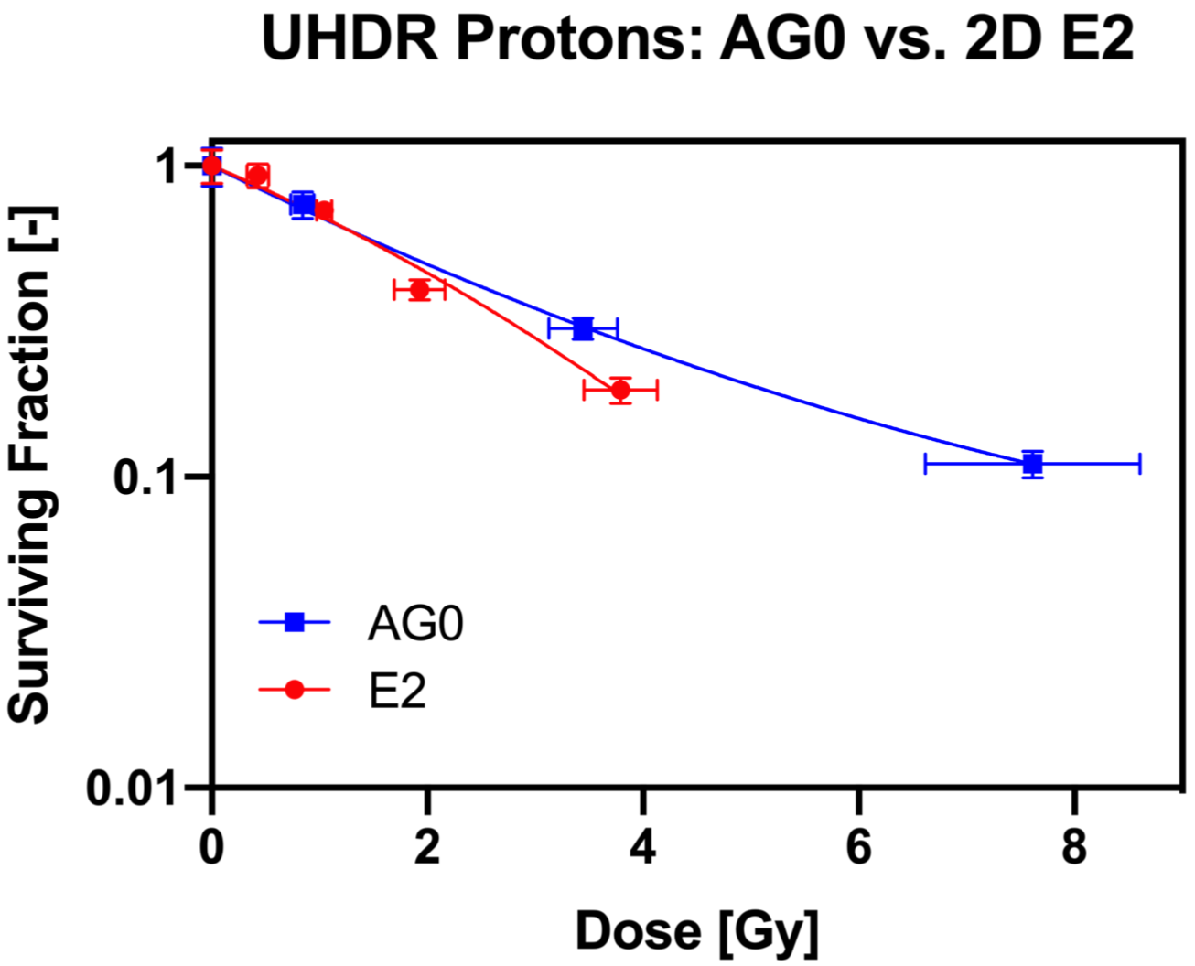
AG01522 normal cells vs. E2 GBM cancer cells
225 kVp X-rays (0.5 Gy/min) reference radiation
35 MeV protons (1.7 keV/µm) 10¹⁰Gy/s (700ps single pulse)
At ultra-high dose-rates GBM stem cells become more sensitive than normal cells
Odlozilik, Chaudhary, McMurray, Borghesi and Prise: in preparation

Slide 20
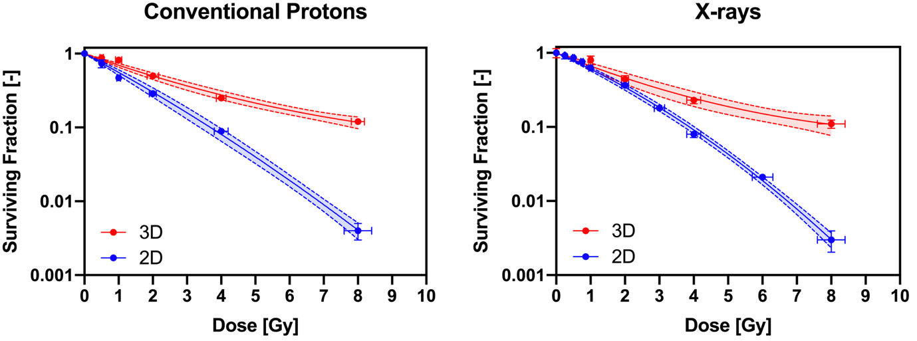
2D versus 3D GBM stem cells
3D neurospheres more radioresistant than 2D to X-rays
Similar response to conventional protons (30 MeV, 4 Gy/min)
Odlozilik, Chaudhary, McMurray, Borghesi and Prise: in preparation

Slide 21
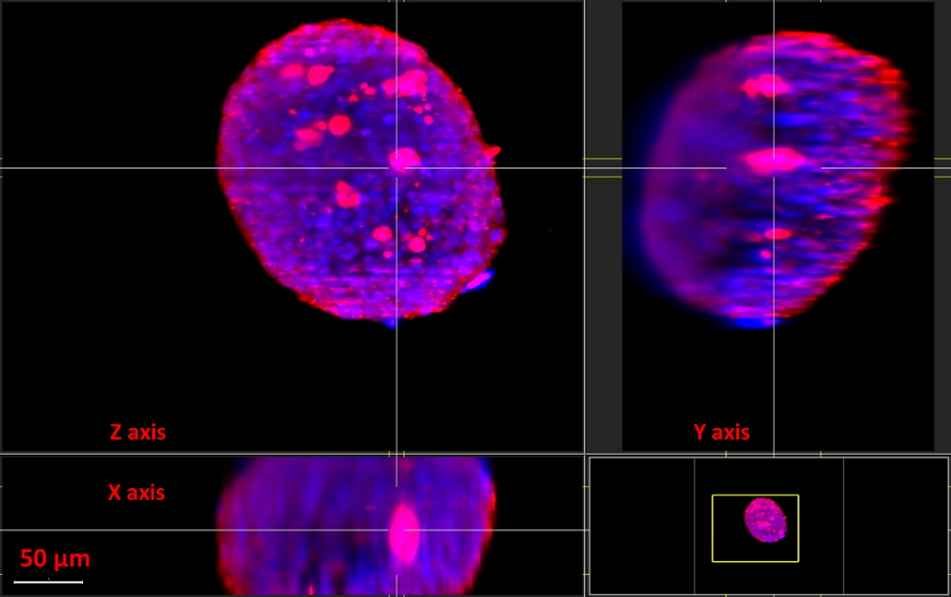
Imaging Neurospheres
Red HIF1α
Blue DAPI
GBM stem cell (E2) 3D Neurosphere 5 days old seeded at a cell density of 5000 cells per ml showing hypoxic cells (red) in control samples. Neurospheres range between 100-500 μm diameter. Image acquired using 10X objective LEICA Light Sheet System at the OCTOPUS imaging cluster facility at RCaH.
Chaudhary and Botchway
Notes:
Maximum Intensity projection image of 3D Neurosphere stained with hypoxia marker HIF-1α (red) and nuclear counterstain DAPI (blue). The neurospheres were stained for 48 hours in HIF-1 alpha primary antibody and image was captured using Light Sheet Microscope equipped with 10 X objective. The image shown here is visualized in Imaris software (Oxford instruments, Abingdon, Oxforshire, UK

Slide 22
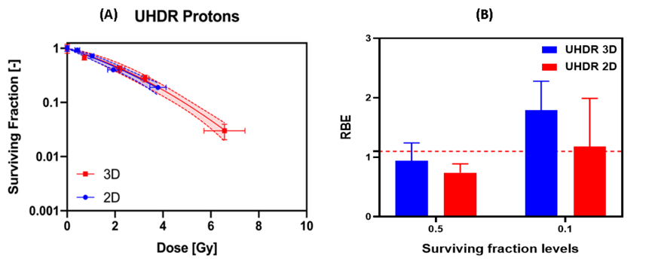
2D versus 3D UHDR protons
35 MeV laser accelerated protons at 1 x 10¹⁰ Gy/s
UHDR reduced the radioresistance of 3D neurospheres
Dose-dependent changes

Slide 23
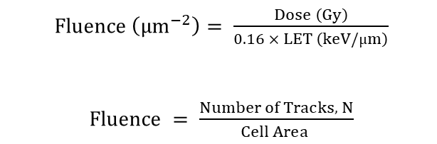
Do overlapping tracks play a role?
Monte-Carlo modelling (TOPAS-nBio) of incident protons beams
Simulation of track expansion from 10 – 100 nS
Chemistry, OH radicals, H₂O₂, E_{aq} etc included
$Fluence \left({μm}^{−2}\right)= \frac{Dose \left(Gy\right)}{0.16 × LET \left(keV/µm\right)}$
$Fluence = \frac{Number of Tracks, N}{ Cell Area }$
Thompson, McMahon et al., 2023, PMB, 68, 055006.
Notes:
Figure 1. (A) Schematic of the simulation setup of proton irradiation through the central axis of a cylindrical water phantom used to
record the position of physical and chemical species around the proton track. (B) Simulation image of fifty 100MeVprotons (blue),
showing the track expansion between the 10 and 100 ns timepoints through the simulated chemical species: solvated electron (green),
hydroxyl radical (orange), hydrogen (magenta), hydronium (sky blue), dihydrogen (purple), hydrogen peroxide (grey) and hydroxide
(yellow). Track radius, R, defined to contain 80% of chemical species is indicated through the superimposed dashed circle. (C)
Illustration of the calculation of track overlap showingNtracks on the nucleus surface and the (N+1)th incident proton track. (D)
Schematic of the simulation setup used to investigate the chemical yields within different delivery setups

Slide 24
Overlap probability
Overlap as a function of LET, diffusion time and dose
Overlap probability decreases with increasing LET for 0.5 – 100 MeV protons
23 Gy single exposure predicted for overlap probability of 1
100 MeV
10 Gy
2 Gy
Thompson, McMahon et al., 2023, PMB, 68, 055006.
Notes:
The calculated overlap probabilities (A) and the expected number of overlaps per track (B) as a function of increasing dose
for a range of proton energies. The predicted dose to give an expected number of overlaps per track of one as a function of proton
energy (C). All calculations were complete using a biologically relevant 1 ns chemical track radius, with SEM shown in the error bars
Probability of overlap with position along a 100MeVinitial energy Bragg curve (relative dose, blue dashed line). Overlap was
calculated for the biologically relevant 1 ns chemical track radius for the proton energy at individual positions along the Bragg curve
using the constant fluence required for 10 MeVto deliver 2Gy (orange triangles) and 10 Gy (green squares) in the tumour region. The
SEM of the overlap probabilities are displayed as error bars.

Slide 25
Summary - protons
Dose-rate has a significant impact on radiobiological response of 3D models
Current laser-based approaches can now deliver therapy relevant protons (~100 MeV) and at ultra-high dose-rates (>10¹⁰Gy/s)
DNA damage and survival responses are not predictable from low dose-rate exposures and are cell type dependent
Further studies are needed to fully define the impact of total dose, total exposure rate, radiation quality and ultra-high dose-rates on response

Slide 26
Carbon ions

Slide 27
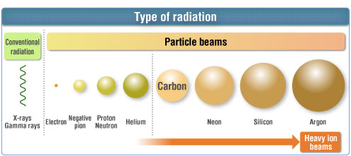
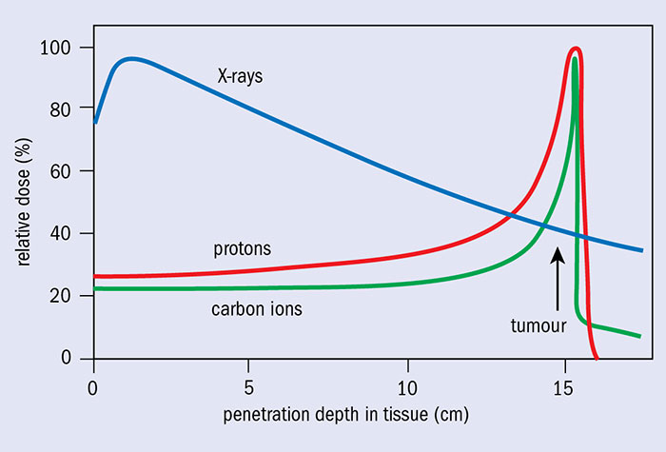
Other ions
Other ions can be used for cancer therapy
Alongside protons, helium and carbon ions are increasingly used
Advantages include lower entrance dose and increased LET (and Relative Biological Effectiveness)

Slide 28
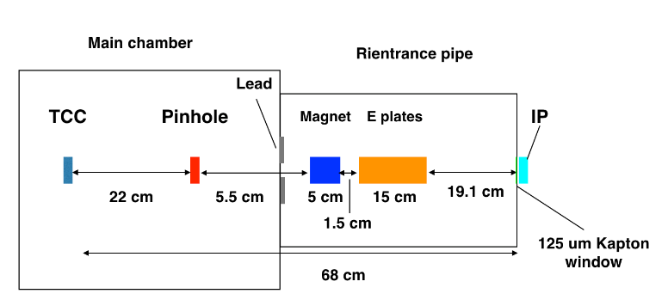
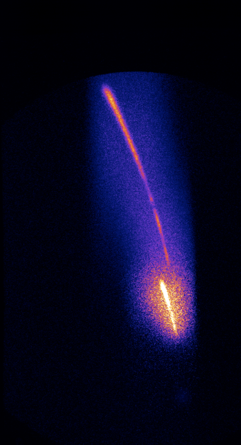
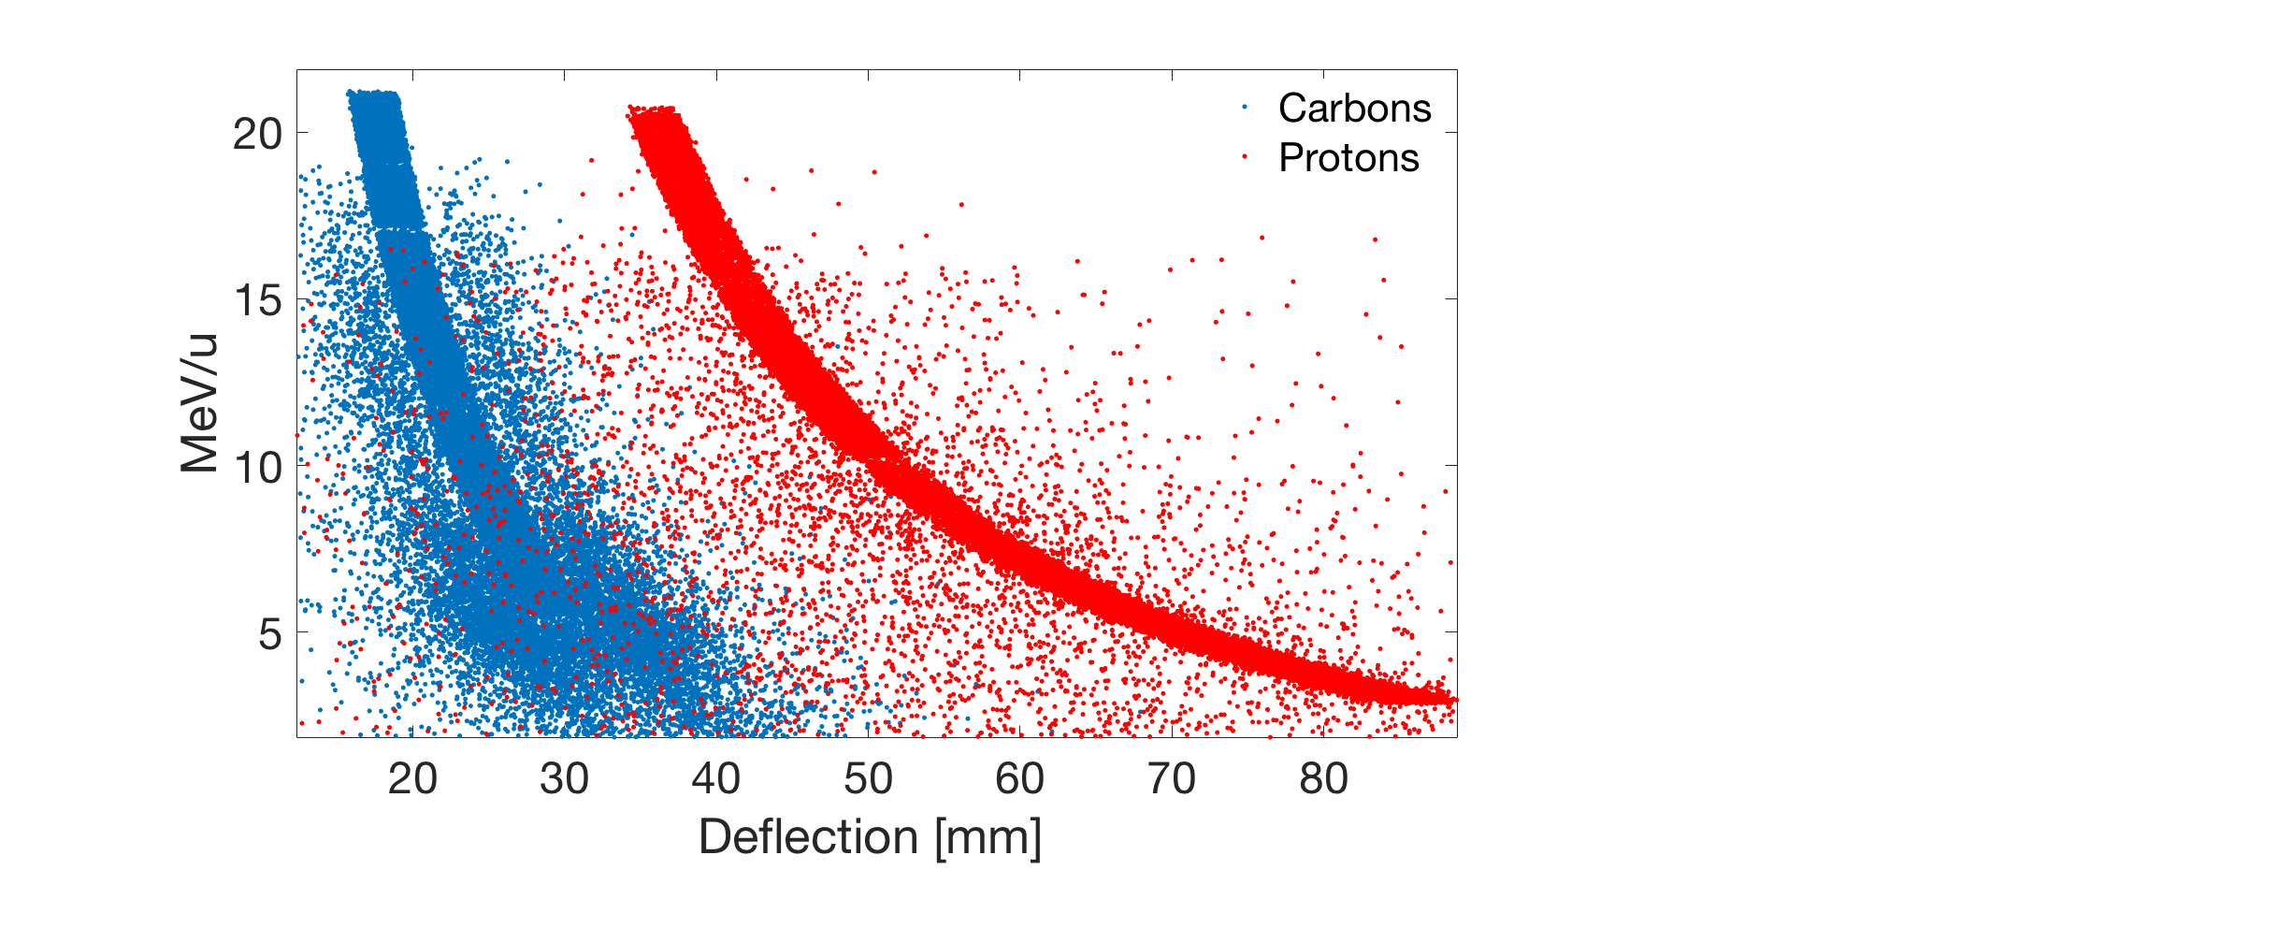
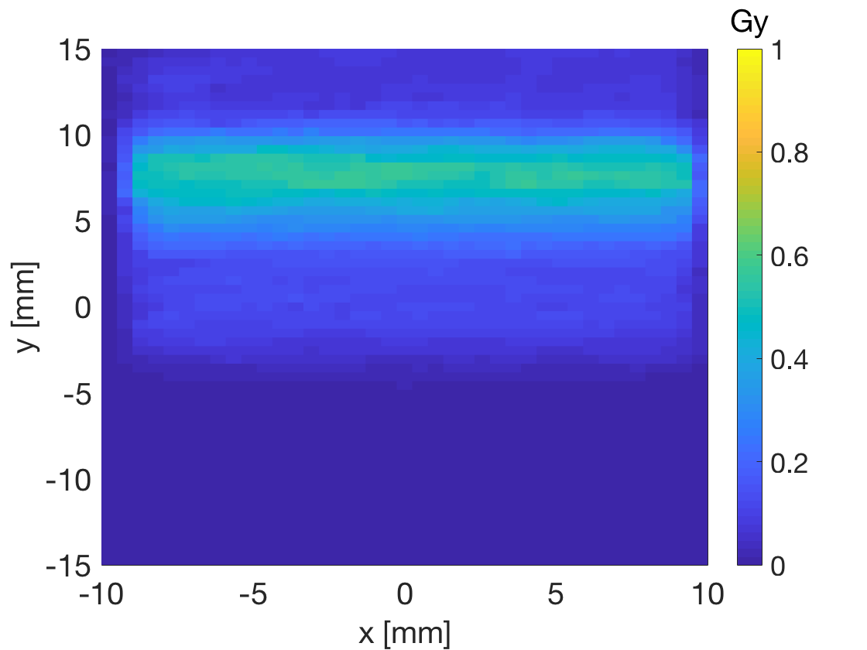
Laser-accelerated carbon ions
ASTRA Gemini Laser
p
C
McIlvenny et al., 2021 Phys Rev Lett, 127, 194801.
Milluzzo et al., 2020 J Phys Conf Ser 1596, 012038.

Slide 29
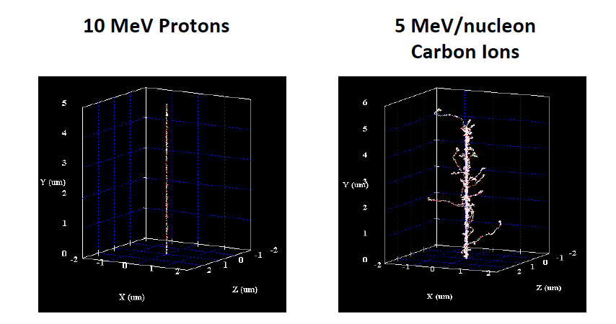
ASTRA GEMINI laser
Single ultra-short (∼400-picosecond) pulse, 2 × 10⁹ Gy s⁻¹
AG01522 human fibroblasts
Chaudhary et al.,
2023, PMB, 68, 025015
33 MeV/nucleon now possible
Notes:
DNADSB damage induced by 1 Gy of 225 kVp X-rays or 10 MeV n−1 laser-driven carbon ions and repair kinetics
studied through 53BP1 foci formation assay. 53BP1 foci are expressed as mean no. of foci per cell per Gy. (B)DNADSB repair
expressed as percentage of unrepairedDNADSB obtained by normalizing the amount of unrepairedDNADSB at different time
points, to the amount of unrepairedDNADSB observed at 30 min Error bars represent Standard deviation. The percentage repair
kinetics over time is fitted with a two-phase decay analysis function (orange line- carbon ions and green line x-rays) available in
Graph pad Prizm software version 9.v

Slide 30
Moving to extreme short pulse/high dose-rates

Slide 31
Electrons/photons
Good range of previous radiobiology studies down to sub- picosecond pulses
Photons and electrons
Chemical
stage
This work
McAnespie, Sarri et al., 2022, PMB 67, 085010

Slide 32
Picosecond electron irradiation - Setup
Taranis laser (QUB)
Hybrid Ti:Sapphire –Nd glass
7.8 J in 0.8 ps
10-20 ps pulses at sample
10¹⁰-10¹¹ Gy/s at sample
McAnsepie et al.,
IJROBP, in press

Slide 33
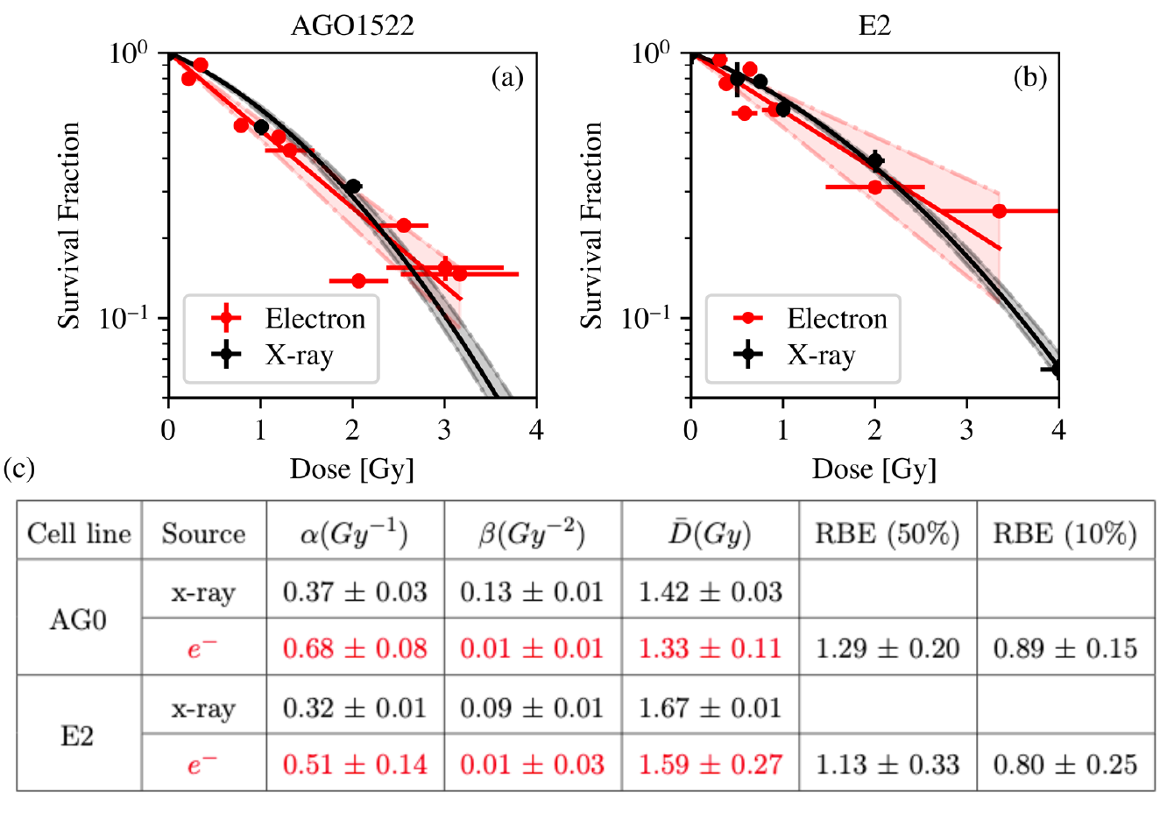
Picosecond electron irradiation
Cell survival
Doses up to 3 Gy
10-20 ps pulses
10¹⁰-10¹¹ Gy/s
Conventional X-rays (225 keV) 0.49 Gy/min
Some differences in α – initial slope
No significant difference overall
McAnsepie et al., IJROBP, in press

Slide 34
Femtosecond electron irradiation
Gemini Laser at CLF
6.7 J in 45 fs
Laser Wakefield accelerated high energy electrons
Dose-rate >10¹³ Gy/sec
McAnespie, Sarri et al., submitted

Slide 35
Biological mechanisms at extreme HDR?
eHDR
U
H
D
R
Lack of understanding of physical, chemical and biological response at ultra and extreme-high dose-rates

Slide 36
Summary
Radiobiology studies of laser driven ions and photons are:
  Validating the future applications of laser driven sources
  Testing largely unexplored regimes of extreme-high dose rates
  Validating new understanding of dose-rate effects
With the development and optimization of beam production and delivery techniques more energetic ion beams and species will be available.
A range of dose-rates are possible including well beyond the FLASH range where physical, chemical and biology knowledge is limited.
To properly understand ultra-high dose-rate radiobiology more comparisons are needed at similar energies with conventional ions and photon sources across a range of dose-rates and biological models.

Slide 37
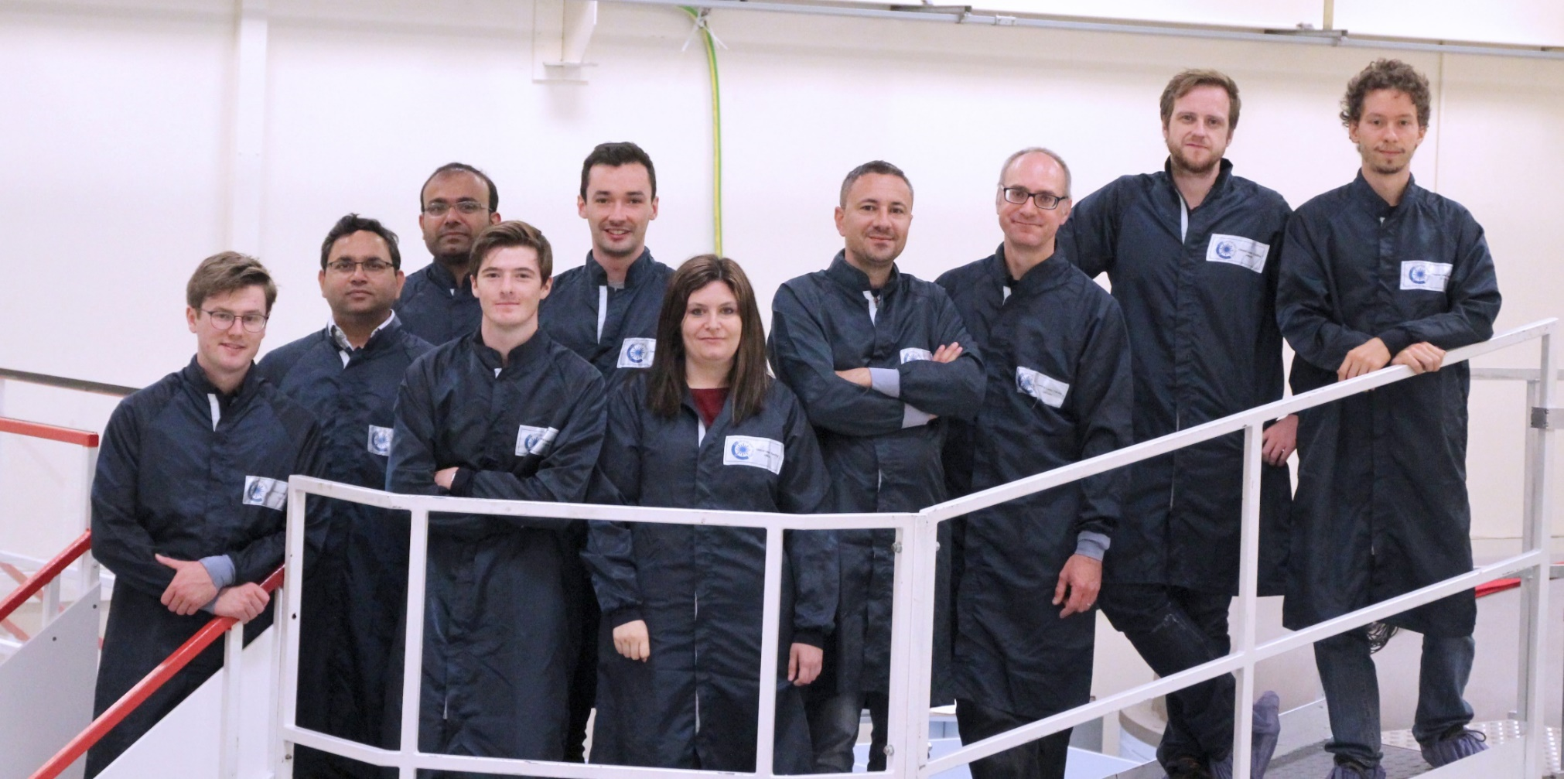
Contributors
QUB
Marco Borghesi
Gianluca Sarri
Stephen McMahon
Conor McAnespie
Boris Odlozilik
Shannon Thompson
Giuliana Milluzzo
Hamad Ahmed
Aodhán McIlvenny
Aaron McMurray
Fiona Hanton
Deborah Gwynne
Sean McCallum
Benjamin Greenwood
Vulcan Target Area Pettawatt Team
James Green , Rob Clark
David Carroll, Nicola Booth
Gemini Team
Rajeev Pattathil, Yiftach Katzir, Nicola Booth
Christopher Thornton
Dan R Symes
RCaH Team
Stanley Botchway
Alessia Condeo
CLF STFC UK
ELI NP Romania
Dr. Domenico Doria
LULI Ecole Polytechnique
France
Lorenzo Romagnani
INFN, LNS , Catania, Italy
G.A.P.Cirrone, R. Catalano, G.Petringa, F. Cammaratta
Univ. of Strathclyde
P. McKenna
NPL, London, UK
Giuseppe Schettino
Pankaj Chaudhary

Slide 38








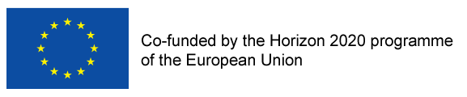

Funding and Acknowledgements
Engineering and Physical Sciences Research Council Program Advanced Strategies for Accelerating Ions with Laser (A-SAIL) grant no EP/K022415/1

Slide 39
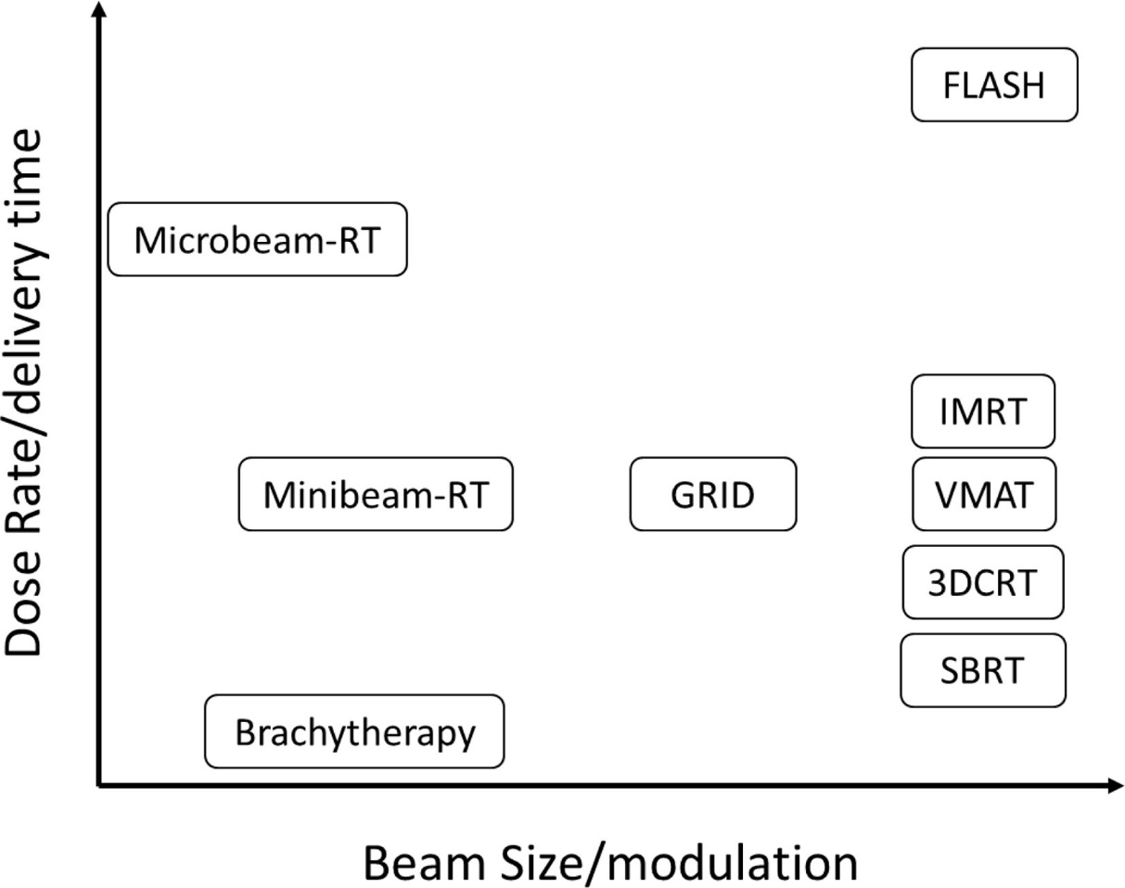
Spatial and temporal dependency of radiation action
Future radiotherapies have multiple options for spatial and temporal delivery schedules
Most offer differential protection of normal tissue
The biological rationale is not clear
The impact of increased dose-rate is unclear
Laser sources
Grid
Lattice
Griffin et al., History and current perspectives on the biological effects of high-dose spatial fractionation and high dose-rate approaches: GRID, Microbeam & FLASH radiotherapy. Br J Radiol. 2020 Sep 1;93(1113):20200217

Slide 40
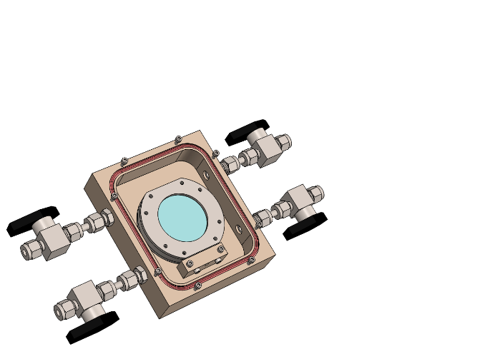
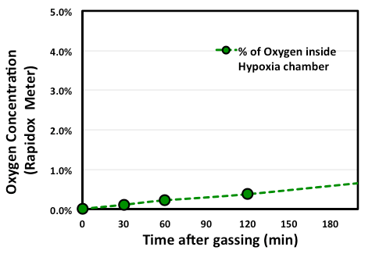


Hypoxia chamber for laser driven ion irradiations
Exposure time
Cell dish
0.4% Radiobiological hypoxia
Radiobiological hypoxia
Total Time needed for each shot after gassing is about 45 minutes maximum
Hypoxia induction with 5% CO₂, 95% N₂
Chaudhary et al., 2022, Radiation Oncology, 17, 77

